Slide 1
IR2 – Development Status
Vasiliy Morozov
on behalf of 2nd IR Design Team
IR2@EIC: Science and Instrumentation of the 2nd IR for the EIC
March 18, 2021

Slide 2
Luminosity Sharing
Conservative assumption: luminosity is shared between two detectors, different bunch pairs collide at different IPs
Luminosity in the medium range can pushed at the expense of acceptance
Annual Integrated Luminosity [fb⁻¹]
Peak Luminosity [cm⁻²s⁻¹]
10³⁴
10³³
10³²
High $L$
Baseline
Combined $L$ of both IRs
High $L$
Baseline
Fair-share $L$ per IR
$$7.9$$
$$10⋅{10}^{33}$$
$$6.1$$
100
10
1
Tomography (p/A)
$$1.54$$
Spin and Flavor Structure of
the Nucleon and Nuclei
$$0.44$$
Internal
Landscape of the Nucleus
QCD at Extreme Parton Densities-
Saturation
150
Center of Mass Energy E_{cm} [GeV]

Slide 3
Beam and Optics Parameters
Geometric emittance $ε$ is the area occupied by bunch in $(x,x′)$ phase space
$ε$ is a constant typically made as small as possible
Optics and $ε$ determine the beam parameters at the IP
rms beam size $σ^{∗}=\sqrt{εβ^{∗}}$
rms angular beam divergence $σ^{′∗}=\sqrt{\frac{ε}{β^{∗}}}$
Transverse momentum spread $σ_{pT}=p_{beam}σ^{′∗}$
Note $ε=σ^{∗}σ^{′∗}$
Maximum beam size $σ^{max}≈Lσ^{′∗}$
Have control over $β^{∗}$ through optics design
Luminosity $L∝\frac{1}{σ_{x}^{∗}σ_{y}^{∗}}∝σ_{x}^{′∗}σ_{y}^{′∗}∝σ_{pTx}σ_{pTy}∝σ_{x}^{max}σ_{y}^{max}$

Slide 4
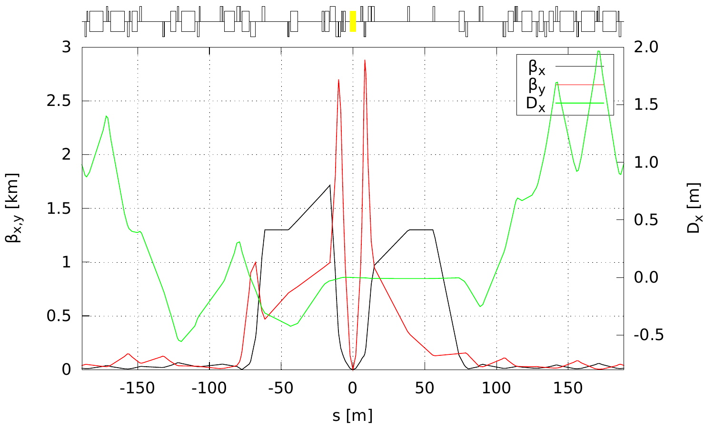
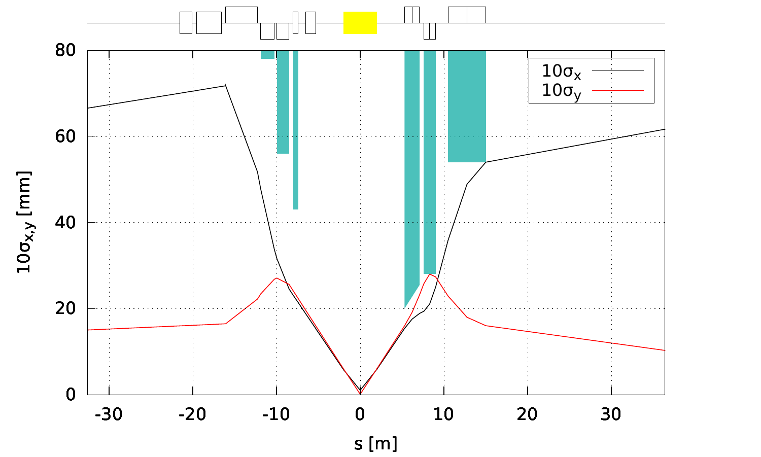
Luminosity Optimization at Low Energies
Luminosity limited by the smaller of the physical and dynamic apertures
By optimizing the final focusing quad configuration, make full use of available physical aperture
Dynamic aperture being checked
Parameter | FDF | Units
Chrom x/y | -19.55 / -74.45
β_{x/y}* | 36 / 3 | cm
σ_{x/y} at IP | 103.9 / 9 | um
σ’_{x/y} at IP | 0.289 / 0.301 | mrad
Parameter | Value | Units
Energy | 100 | GeV
Rms norm. ε_{x/y} | 3.2 / 0.29 | mm-mrad

Slide 5
Luminosity and $p_{T}$ Acceptance Trade off
Larger luminosity means smaller $p_{T}$ acceptance
Minimum $p_{T}$ acceptance is determined by the angular spread at the IP $p_{Tx/y}>p_{Tx/y}^{min}=10p_{beam}σ_{x^{′}/y^{′}}^{∗}$
Luminosity increased by stronger focusing, i.e. increase in angular divergence $L∝σ_{x^{′}}^{∗}σ_{y^{′}}^{∗}$
Table below is for the proton case
For same-rigidity nuclei, $p_{T}^{min}(Z,A)=Zp_{T}^{min}(p)$
$L$ [${10}^{33}$ cm⁻²s⁻¹]
$p_{Tx}^{min}$ / $p_{Ty}^{min}$ [MeV/c]
 | $275×18$ GeV $141$ GeV | $275×10$ GeV $105$ GeV | $100×10$ GeV $63$ GeV | $100×5$ GeV $45$ GeV | $41×5$ GeV $29$ GeV
Highest $L$ | 1.54 410 / 410 | 10 330 / 330 | 7.9 290 / 290 | 6.1 270 / 270 | 0.44 90 / 160
High divergence | 1.54 410 / 410 | 10 330 / 330 | 4.5 220 / 220 | 3.7 210 / 210 | 0.44 90 / 160
High acceptance | 0.32 180 / 180 | 3.1 180 / 180 | 3.1 180 / 180 | 2.9 180 / 180 | 0.44 90 / 160

Slide 6
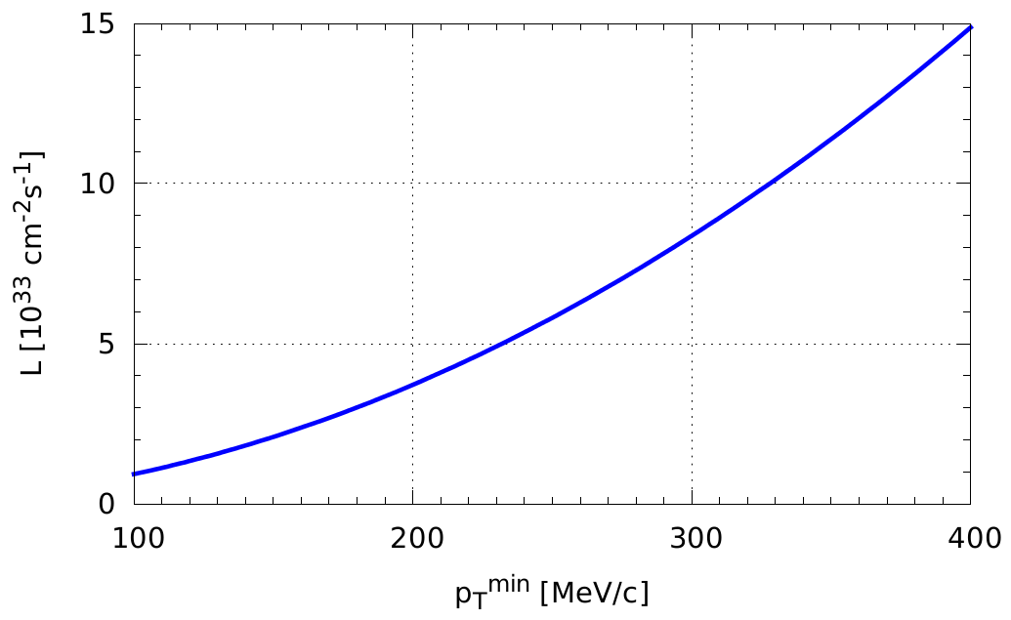
Luminosity and $p_{T}$ Acceptance Trade off
$100×10$ GeV configuration
Highest $L$
High-divergence
High-acceptance

Slide 7
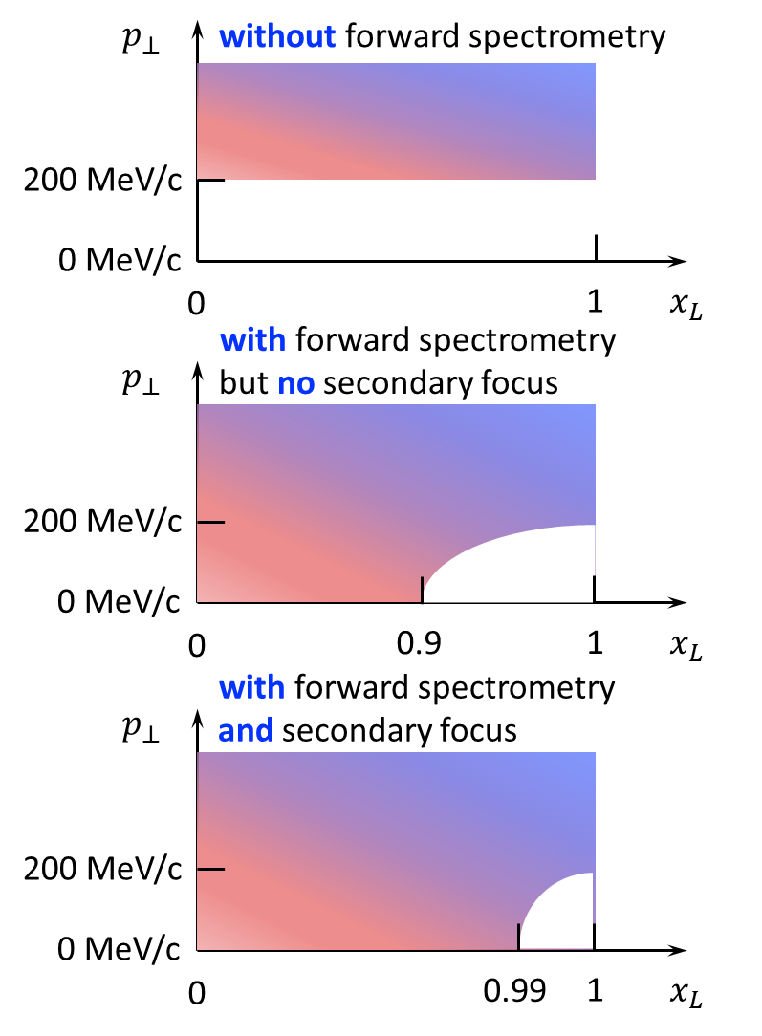
Acceptance as Function of $x_{L}$ and $p_{T}$
$p_{T}$ acceptance at $x_{L}=1$
$$p_{T}^{min}>10 p_{0} θ_{IP}=10 p_{0} \sqrt{\frac{ε}{β^{∗}}}$$
$x_{L}$ acceptance at $p_{T}=0$
Requires dispersion $D$
$$x_{L}<1−10\frac{σ_{x}}{D}=1−10\frac{\sqrt{β_{x}^{2nd}ε_{x}+D_{x}^{2}σ_{δ}^{2}}}{D}$$
$β_{x}^{2nd}∝β_{x}^{∗}$
Secondary focus allows for
$$\left|Dσ_{δ}\right|≫\sqrt{βε}$$
Therefore, one can approach the fundamental limit
$$x_{L}<1−10σ_{δ}$$
Increase of $β_{x}^{∗}$ and therefore $β_{x}^{2nd}$ may result in smaller $x_{L}$ acceptance

Slide 8
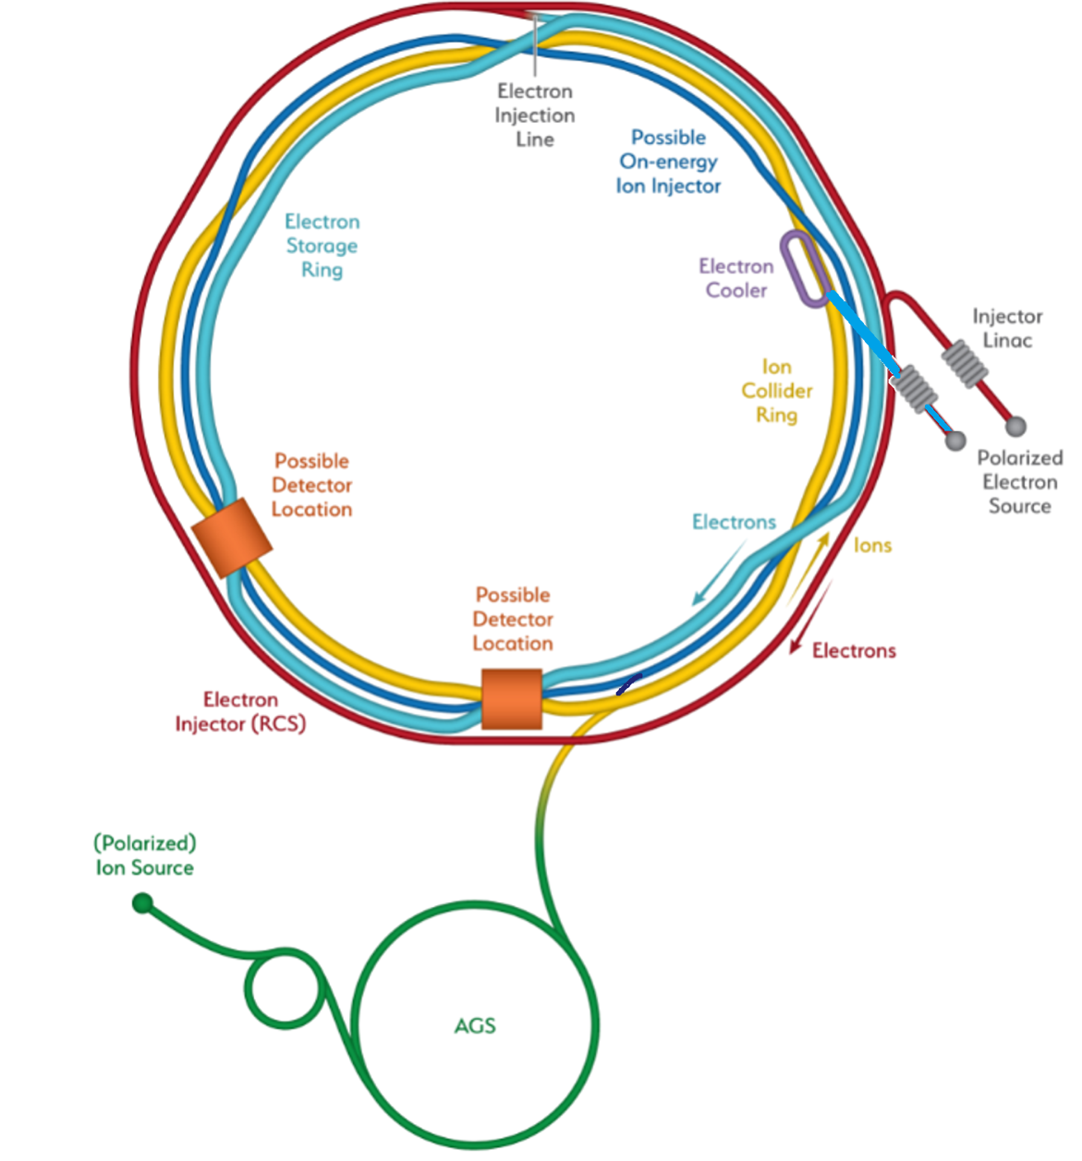
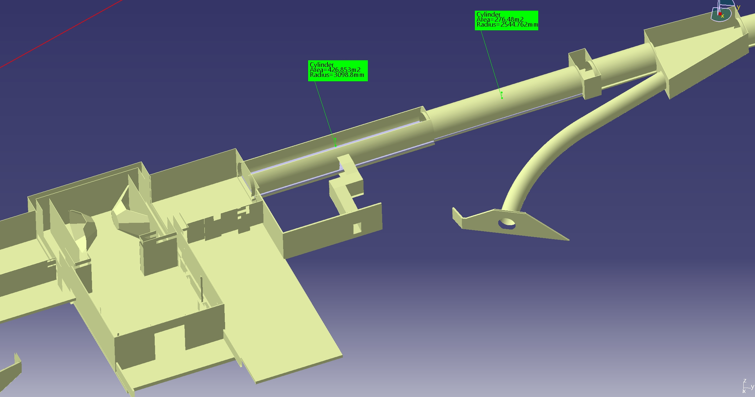
Considerations IP8
H. Witte
Going from outer arc into inner arc
IP6: from inner to outer arc
Present IR not portable to IR8
Geometric issues
60m
IR8: Tunnel dia. 6.3m to 60m (then 5.3m dia)
IR6: 7m dia. +/- 140m

Slide 9
Crossing Angle Choice
Cannot be too large, $<50$ mrad
Experimental hall geometry does not allow
IP must be shifted toward the ring center to allow RCS bypass the detector
Requires additional crabbing cavities, not only cost but additional impedance and other dynamical issues
Undesirable from acceptance point of view, e.g. with 50 mrad, acceptance limited to 3.5 in rapidity
Does not allow to move the final focusing quads closer because of detector space requirements
Unnecessarily large given that Roman pot acceptance of $±5$-$7$ mrad is sufficient; moreover, large Roman pot acceptance requires large-aperture magnets posing engineering challenge
Cannot be too small, $>25$ mrad
Hall geometry requires spectrometer dipoles to bend towards the electron beam, bending away as in IR1 is not possible because of the tunnel wall, small crossing angle would cause interference with electron beamline
Relaxes engineering requirements
Everything seems to point to an optimal crossing angle of ~35 mrad

Slide 10
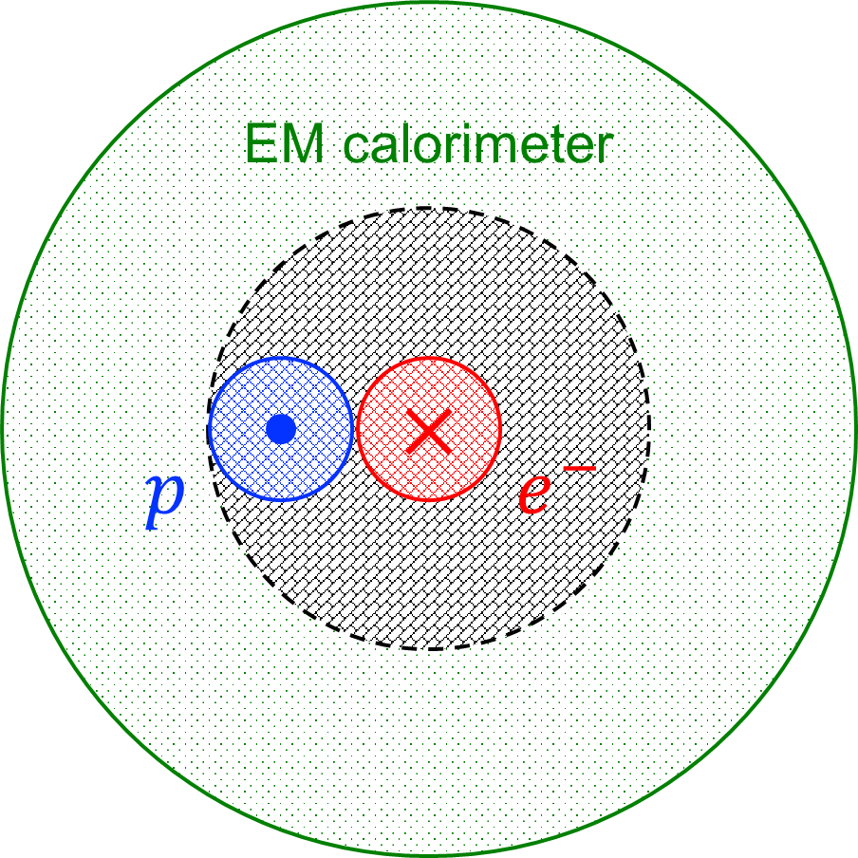
Detection Issues with Crossing Angle
Crabbing causes apparent smear of transverse beam size at the IP
Transverse vertex position can be found by
narrowing down its longitudinal position through precise timing of ~35 ps
simultaneously measuring particle’s position, angle and energy in the far-forward section
Crossing angle increases the gap in the $e^{−}$ rapidity coverage in the rear direction
Asymmetry in the forward hadron acceptance
Gap in $e^{−}$ rapidity coverage:
$p$ beam pipe solid angle (~20 mrad) + $θ_{cr}$
E.C. Aschenauer &
A. Kiselev

Slide 11
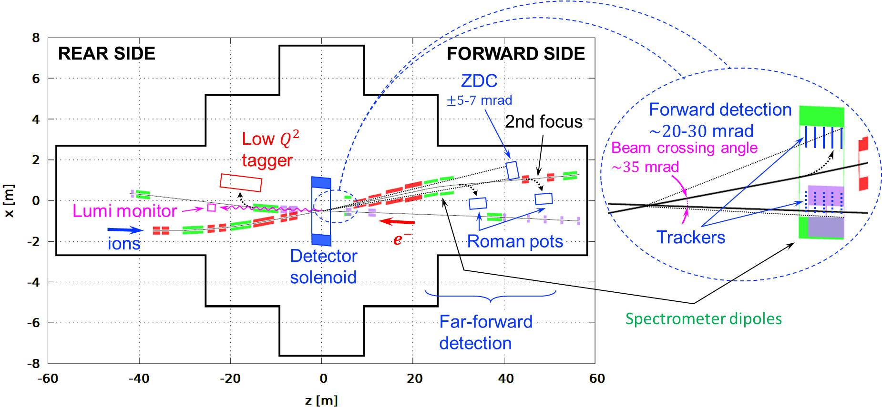
2nd IR Schematic
Forward acceptance not azimuthally symmetric because of electron dipole

Slide 12
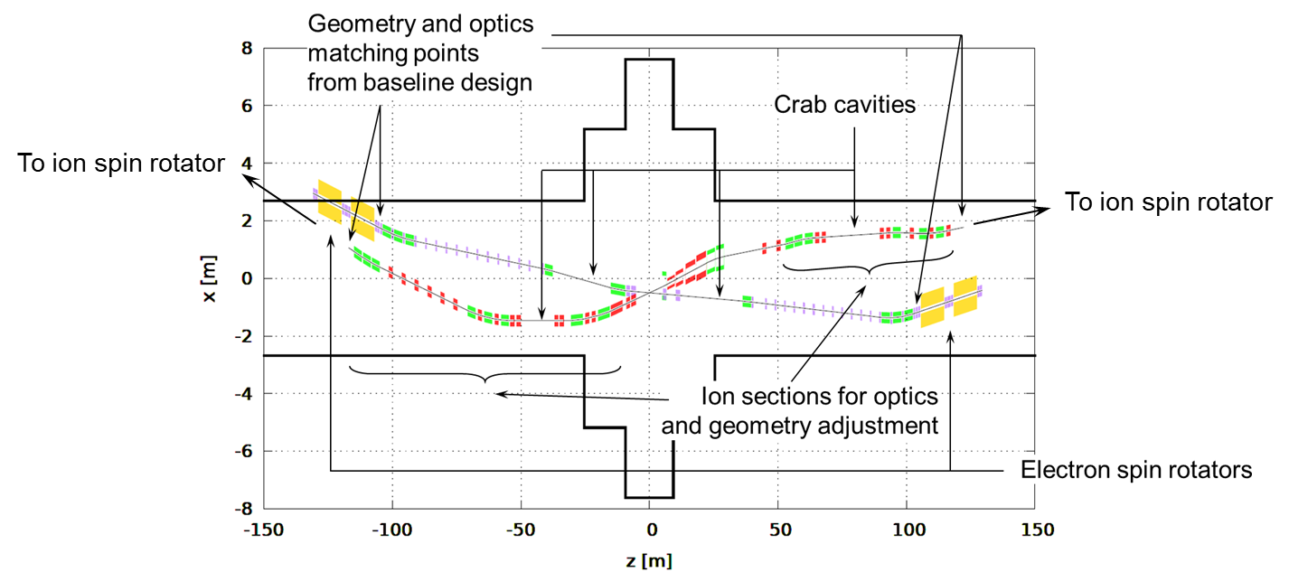
2nd IR Geometry and Optics Matching and Component Integration
Beam crossing direction flipped compared to the 1st IR
Not much flexibility in electron geometry because of electron spin rotator requirements
Electron beam line is a slightly modified baseline design
Next design iteration:
35 mrad crossing angle
~85 cm radial shift toward the ring center (modification happening in IR1 as well)

Slide 13
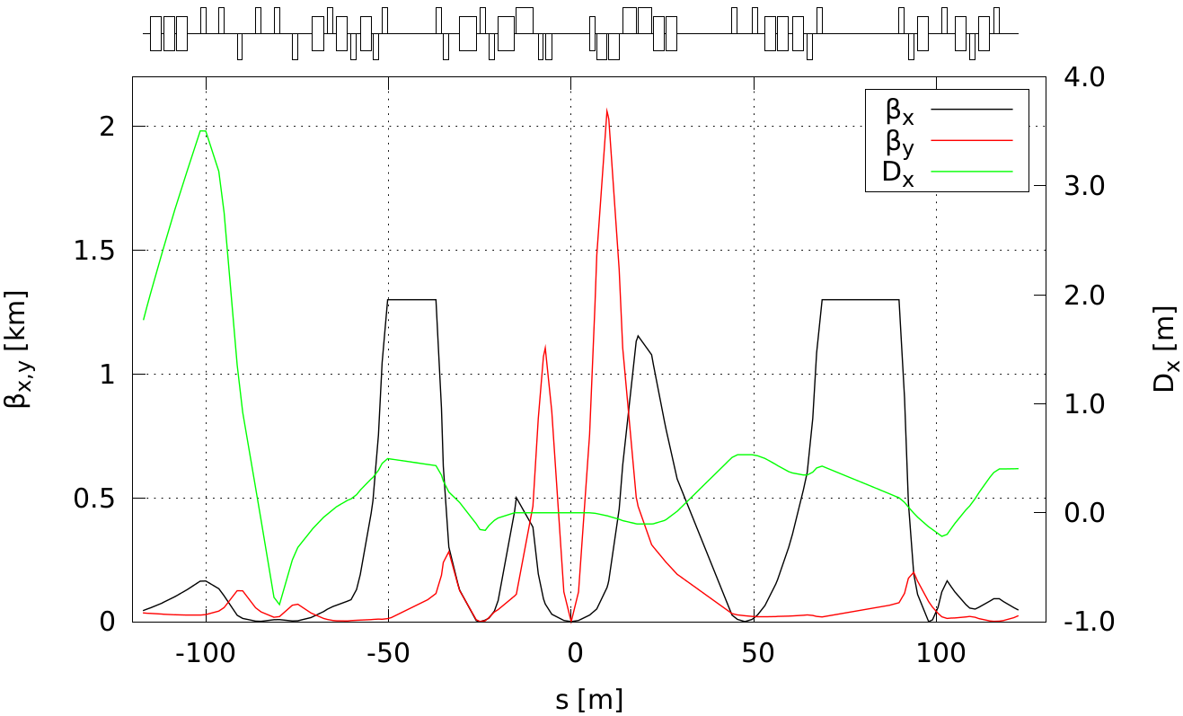
Ion 2nd IR Optics from 135 to 275 GeV
Lengths of downstream final focusing quadrupoles optimized to provide 10 mrad polar angle acceptance with aperture-edge fields below 4.6 T
Use constraints on $β_{x}^{max}=1.2$ km and $β_{y}^{max}=2$ km as in the 1st IR
Upstream section is based on the 1st IR
Doublet optics with reversible polarity of the second quad depending on the energy $β_{x/y}^{∗}=96/3.3$ cm (>135 GeV) $β_{x/y}^{∗}=37/2.5$ cm (<135 GeV)
Secondary focus with $\left(1−x_{L}\right)>7⋅{10}^{−3}$ acceptance
Same optics and geometry as in baseline
ions
IP
Roman pot
at 2nd focus

Slide 14
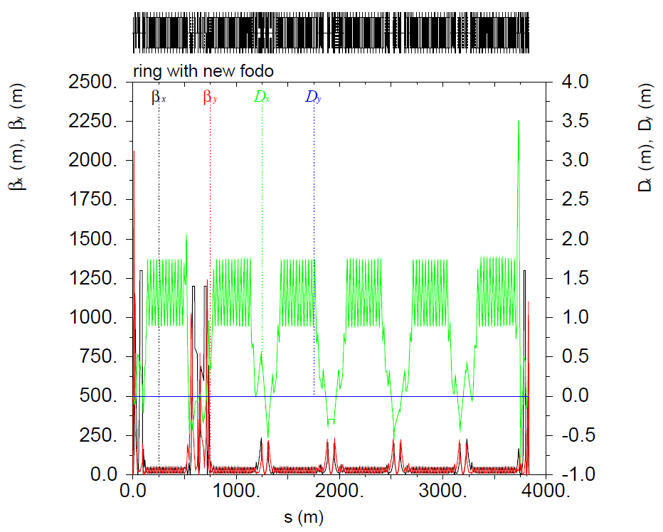
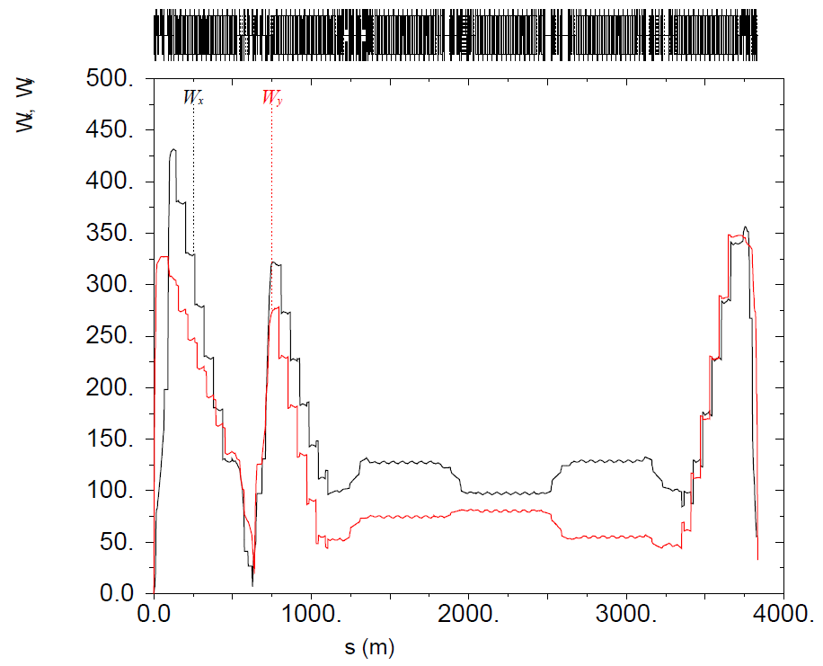
Linear Optics and Chromaticity Compensation
Greatest conceptual accelerator physics question: chromaticity compensation in the collider rings with two IRs
Making use of chromatic interference of the two IRs
No symmetry requirements to IRs
Control chromatic beam smear around the ring and compensate it at both IPs
IP8
IP8
IP6
$∝$ chromatic beam smear
IP6

Slide 15
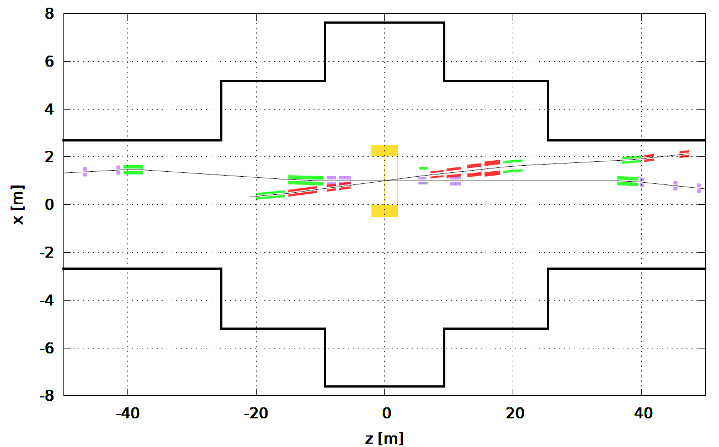
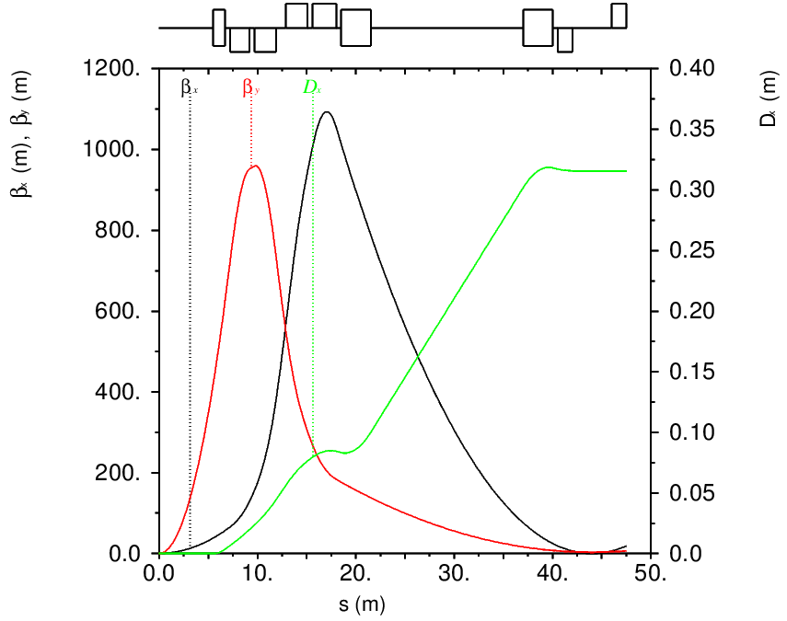
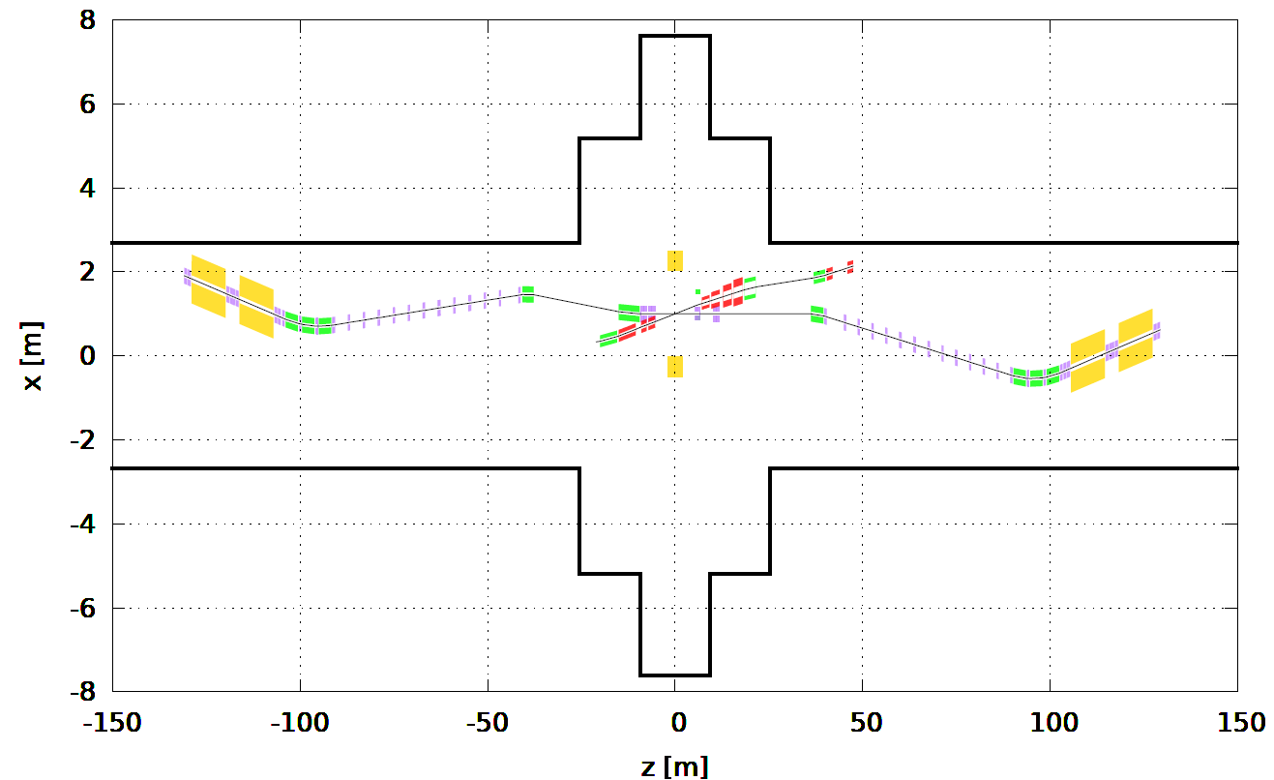
IR2 35 mrad Crossing Angle Design
Magnet parameters re-optimized for $±7$ mrad Roman pot acceptance with aperture-edge fields of $<4.6$ T
Crossing angle is 35 mrad
Forward detector space 5 m
IP shifted toward the ring center by 85 cm
Max dispersion size at 2nd focus limited by geometry but not critical if ${\left|Dσ_{δ}\right|}/{\sqrt{β_{x}^{2nd}ε}}≫1$
Radial shift
RCS
IP8
2nd focus
Roman pot
Crab cavities
2nd focus
Roman pot
RCS
Dispersion
suppressed

Slide 16
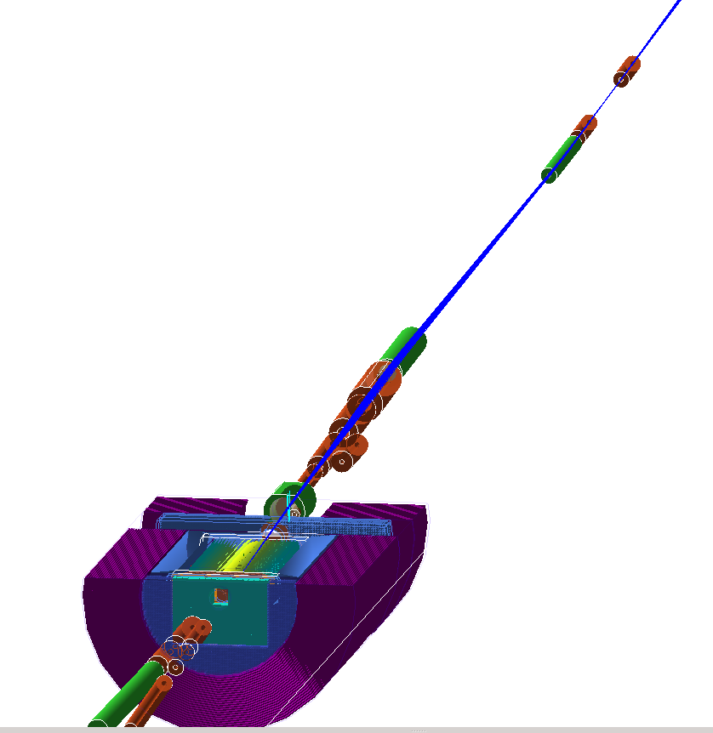
2nd IR Modeling Under Way
Framework for IR2 simulations has been setup (Yulia and Dmitriy)

Slide 17
Complementarity to 1st IR
Secondary focus with high-$x_{L}$ acceptance
Slightly larger Roman pot acceptance of $±7$ mrad vs $±5$ mrad to help cover any blind spots
Bending the ion beam by the spectrometer dipole towards the electron beam as opposed to away from the electron beam as in IR1
Different longitudinal shift of the center of the detector solenoid with respect to IP
Different crossing angle of ~35 mrad
Opposite angle of solenoid crossing by the ion beam

Slide 18
2nd IR Design Team
Jefferson Lab: V. Burkert, R. Ent, Y. Furletova, R. Gamage, D. Higinbotham, A. Hutton, C. Hyde, F. Lin, T. Michalski, V.S. Morozov, R. Rajput-Ghoshal, D. Romanov, A. Seryi, A. Sy, C. Weiss, M. Wiseman, W. Wittmer, Y. Zhang
BNL: E.-C. Aschenauer, J.S. Berg, A. Kiselev, C. Montag, R. Palmer, B. Parker, V. Ptitsyn, F. Willeke, H. Witte
Stony Brook University: P. Nadel-Turonski

Slide 19
Backup

Slide 20
Considerations IP8
H. Witte
If using IP6 forward dipole configuration (HSR bends away from ESR)
Beam is bent further inside
Can't bend back until we reach the crabs
Requires creating a roughly 2 m transverse displacement over around 50 m length; lots of extra dipoles, issues with dispersion matching
If we put ZDC on the outside, bending HSR toward the ESR
25 mrad crossing angle not possible: lines diverge slowly, crab cavity transverse size creates collision between HSR/ESR lines

Slide 21
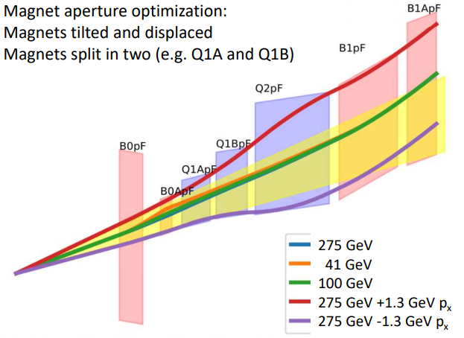
How to get more luminosity at lower E_{cm}?
F. Willeke
schematics
Doublet focusing
For hadrons, final focus lens (vertical) is split into two magnets (tapering the aperture that way).
Doublet focusing for E_{cm} ~100-140 GeV.
For low hadron beam energy
(E_{cm} =60 GeV) can rewire into triplet focusing, reduce β* ➔ Increase L by factor of 2
Triplet focusing

Slide 22
Operation with two Detectors
F. Willeke
Only one detector and one IR is in the EIC budget. The project is working on accommodating a second IR and detector. Required funding of ~500M$ is unclear at this point
The bunches cannot collide in two IRs with maximum intensity.
Simultaneous collisions of all bunches in 2 Irs most likely requires to reduce the intensities by up to a factor of 2:
L ➔ 2 x L/4
Instead, we arrange for half of the bunches collide in one IR the other half in the second IR (luminosity sharing)
L ➔ 2 x L/2
So far, we don’t have (yet) a satisfactory solution for operation with 2 IRs, too much chromaticity, to much deterioration of polarization!
What works: Run collisions in one IR at a time and alter Irs
L ➔ 2 x L/2
Nota bene: Two IRs as compared to one will most likely not increase the sum of the (integrated) luminosity

Slide 23
IR 8
F. Willeke
The first interaction region of EIC is at IR 6
Present RHIC offers IR8 as a possible second IR and detector location.
IR 8 has significantly less space than IR6.
A much larger crossing angle (35 mrad seems possible) in IR 8 compared with the present 25 mrad crossing angle in the first IR is most likely not possible without a major effort in civil construction.
The tunnel end in IR 6 is 6.9 m wide over a length of 284 m. In IR8 it is only 6.4 m wide over a length of 117 m. Further out it is only 5.27 m wide.
A detector bypass for the RCS limits the detector radius to 3.4 m
At present, we are planning the hadron and electron pathlengths in IR 8 similarly to the ones in IR6. This will constrain the differential pass length for electrons and hadrons in a later full IR8 layout, as any pathlength difference between hadron and electrons might not be able to be compensated any more by already existing accelerator arcs.
IR8 centerline needs to be moved at least 85 cm from present midline of the tunnel (outwards)
Work in progress to lay out reference design for IR with larger crossing angle and stronger emphasis on forward detection

Slide 24
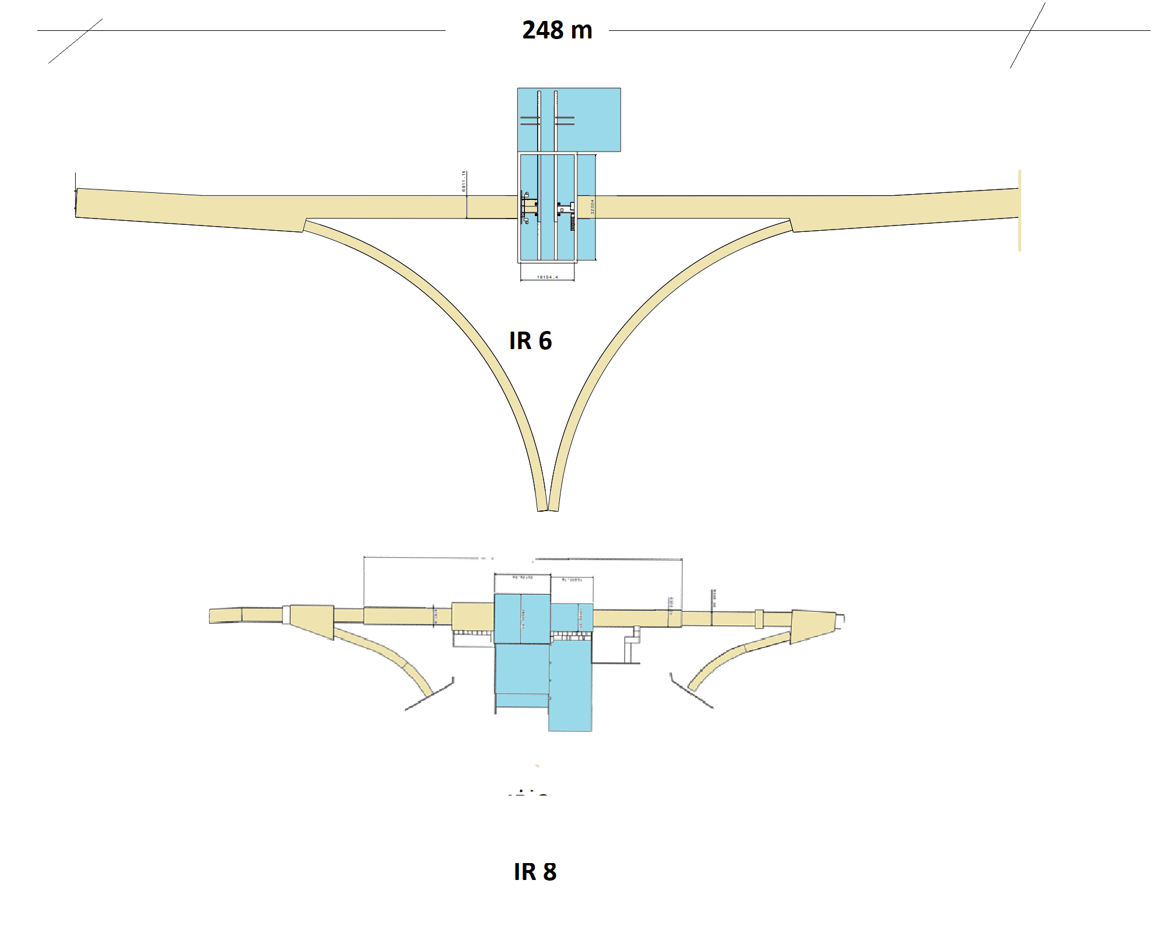
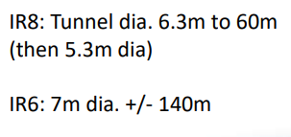
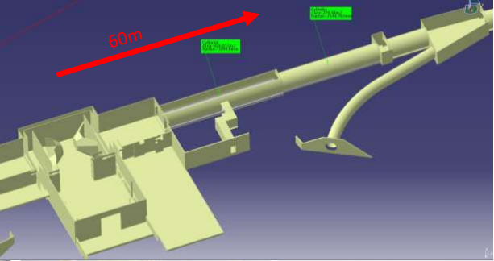
IR6 vs IR 8 geometry
F. Willeke

Slide 25
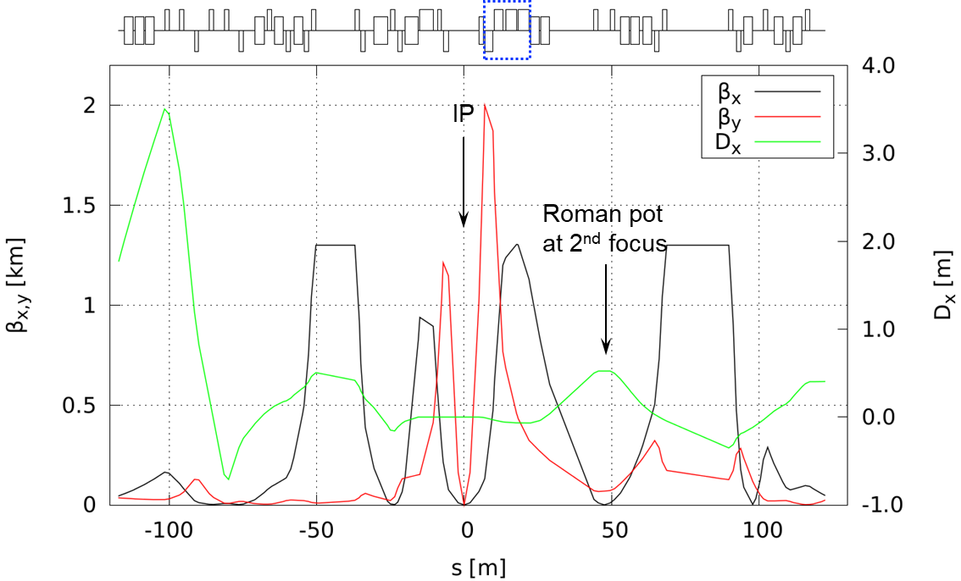
Ion 2nd IR Optics up to 135 GeV
All aperture-edge fields below 4.6 T
$β_{x/y}^{∗}=37/2.5$ cm with on $β_{x}^{max}=1.2$ km and $β_{y}^{max}=2$ km
Assuming $ε_{x/y}^{N}={3.2}/{0.29} μ$m 275 GeV: $σ_{x/y}^{∗}={102}/{5.7} μ$m, $σ_{x^{′}/y^{′}}^{∗}={107}/{173} μrad$ 100 GeV: $σ_{x/y}^{∗}={105}/{8.2} μ$m, $σ_{x^{′}/y^{′}}^{∗}={285}/{330} μrad$ $L∝$ $σ_{x^{′}}^{∗}σ_{y^{′}}^{∗}$ $p_{Tx/y}^{min}=10p_{beam}σ_{x^{′}/y^{′}}^{∗}$

Slide 26
Chromaticity Compensation
Another focus of recent effort
Strategy
Arc 9 used for semi-local compensation of the rear side of IP8
Arc 5 used for semi-local compensation of the forward side of IP6
Forward side of IP8 and rear side of IP6 partially compensate each other
Since IP8 forward and IP6 rear are different, the difference in their chromatic kicks is compensation by sextupoles in Arc 7
Exact phase advance between the IPs and sextupoles optimized slightly

