Slide 1
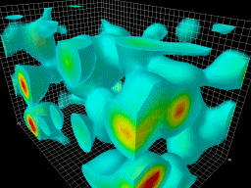
CORE: a COmpact detectoR for the EIC
Pawel Nadel-Turonski
Stony Brook University
Charles Hyde
Old Dominion University
for the CORE pre-collaboration
(open to all users)
The QCD vacuum
IR2@EIC workshop, March 17-19, 2021

Slide 2
Participating institutions
Catholic University of America
Duke University
Erlangen-Nuremberg University, Germany
GSI, Germany
Indiana University
Old Dominion University
Stony Brook University
University of Hawaii
University of South Carolina
University of York, United Kingdom

Slide 3
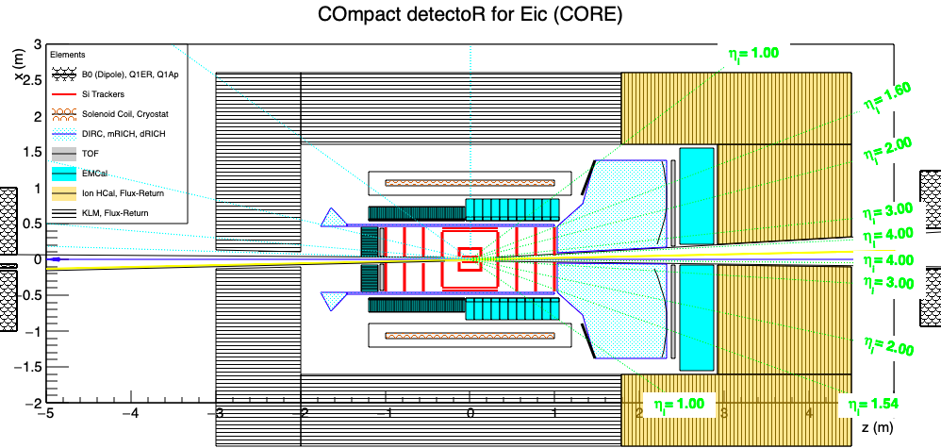
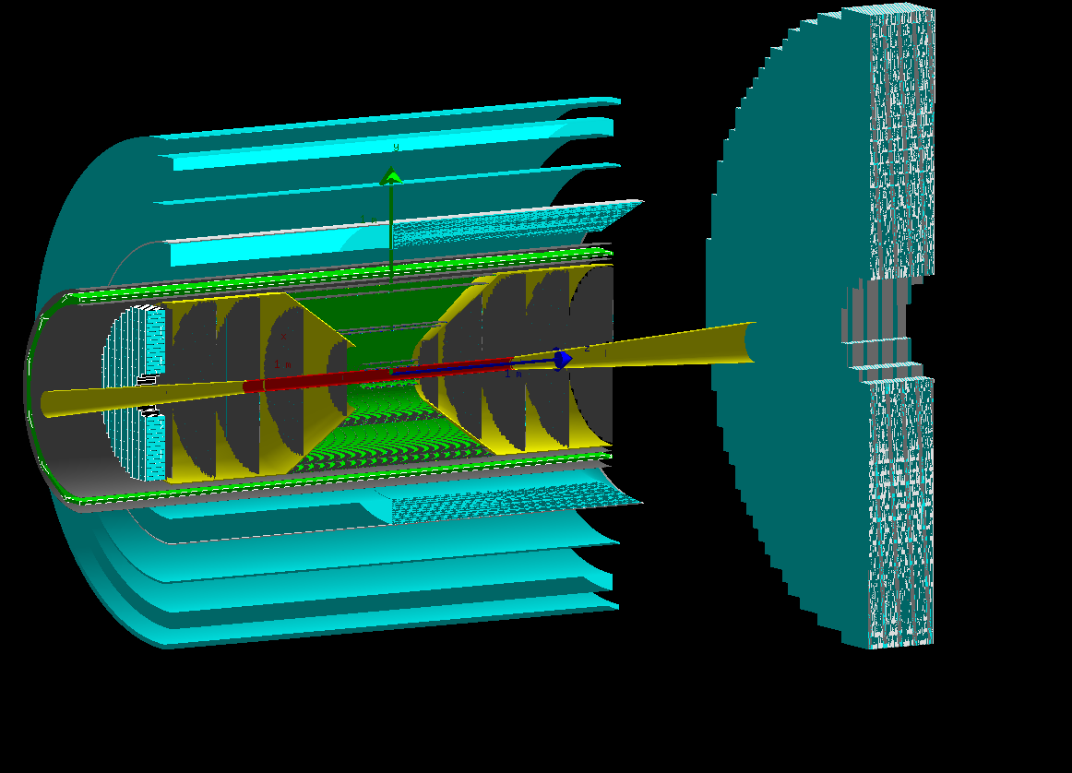
a COmpact detectoR for the Eic (CORE)
inner CORE in Geant (fun4all)
B. Schmookler
Hadron-side EMcal
A (nearly) hermetic general-purpose detector that fulfills the EIC physics requirements
A small size, in particular of the inner systems, is cost-effective and allows:
  An overall reduction in cost without performance loss
  Improved performance in critical areas without large additional cost
Risk is minimized by utilizing subsystems from the Generic EIC R&D program
Balance can be optimized depending on funding.

Slide 4
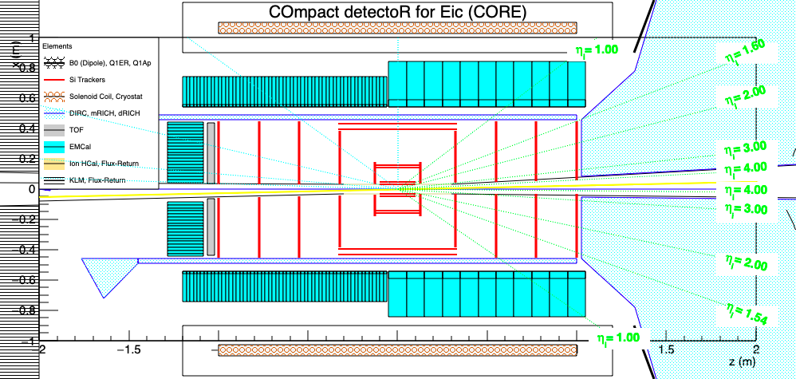
The core of CORE
inner CORE in Geant (fun4all)
dRICH photosensors
No “gap” along line-of-sight from IP
B. Schmookler
Hadron-side EMcal
Small central all-Si tracker (eRD25)
Radially compact, high-performance barrel DIRC Cherenkov (eRD14)
Dual-radiator RICH with outward-reflecting mirrors in the hadron endcap (eRD14)
Extended PWO₄ EMcal coverage (2π, η < 0) on the electron side (eRD1)
Small solenoid (2.5 m long, 0.9 m inner radius); could be new, but compatible with ZEUS

Slide 5
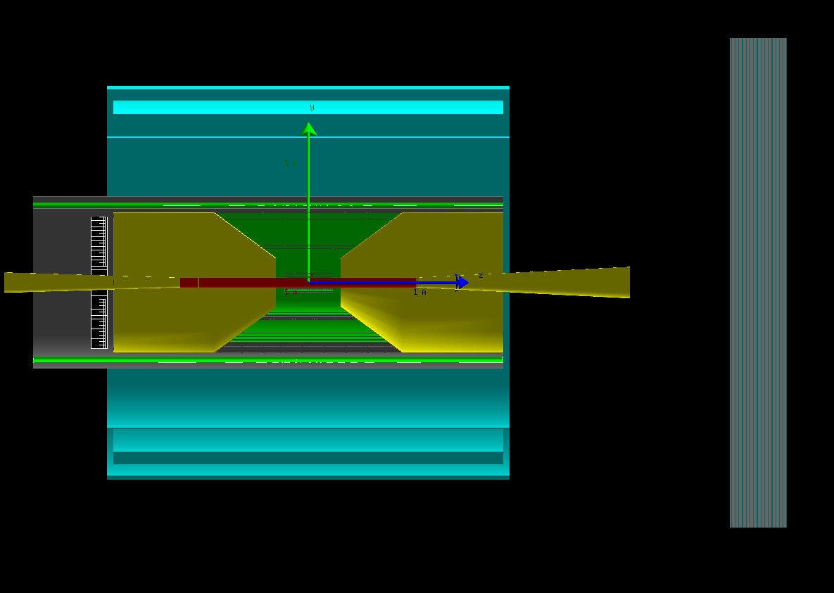
Solenoid and central Si-tracker
The CORE solenoid is identical in size to the one used by ZEUS (2.5 m long and 0.9 m inner radius)
  22% of the volume of the BaBar / sPHENIX solenoid or the proposed new large 3 T one.
With a new small solenoid, CORE could support any field in the 1.4 – 3 T range, with 2 T being the preferred value
  p_{min}, photosensors (MCP-PMTs / LAPPDs limited to 2 T)
B. Schmookler
The all-Si tracker developed by the eRD25 consortium is a good fit for CORE

Slide 6
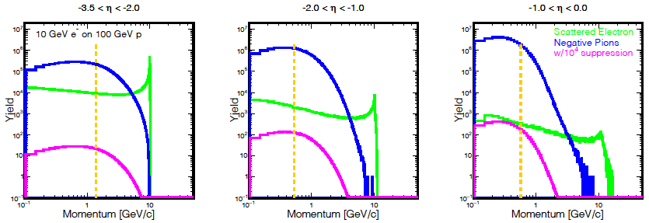
e/𝜋 identification requirements on the electron side
B. Schmookler
Q² > 1 &
y < 0.95
to the right of orange line
For the EIC, a clean identification of the scattered electron is essential.
Since the relative pion backgrounds rise with η, the most challenging region is -1 < η < 0.
The best solution is to extend the PWO₄ EMcal coverage (η < 0).
  This is only affordable in a relatively small detector
Additional e/π suppression (at least 1:10 up to 1.2 GeV) can be provided by the DIRC

Slide 7
4𝜋 EMcal
The PANDA PWO₄ EMcal covers the endcap and barrel (outside of a DIRC)
2π PWO₄ coverage
The small size of CORE makes it affordable to extend the PWO₄ coverage to η < 0
  The PWO₄ area will be half of that planned for PANDA, which is similar in size to CORE
An additional small-angle PWO₄ EMcal can be placed behind the main detector endcap
η > 0 coverage (several options – including pre-showers for γ/π⁰)
The η > 0 barrel EMcal should to be relatively compact and projective
The endcap EMcal needs to be affordable and work well with a high-resolution Hcal

Slide 8
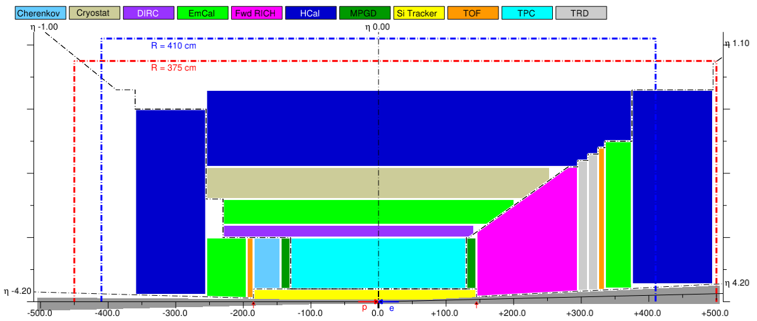
CORE 2π PWO₄ EMcal superimposed on the ”YR reference detector”
In the “reference” detector, a PWO₄ EMcal in the barrel (green) would be much larger.

Slide 9
Hcal options
The Belle II μ-K_{L} (KLM) system
The inner part of CORE is independent of the Hcal configuration.
However, an attractive option is to emphasize different capabilities in different regions of rapidity..
In the barrel and e-endcap, where jets are best reconstructed from individual tracks, one can trade energy resolution for better muon and neutral hadron ID, and lower cost (cf. Belle II KLM)
In the hadron endcap, high energy, high multiplicity jets would benefit from an advanced Hcal (e.g., as suggested by ANL, ORNL)

Slide 10
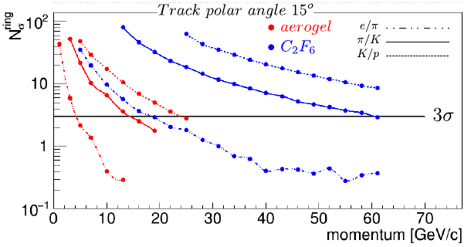
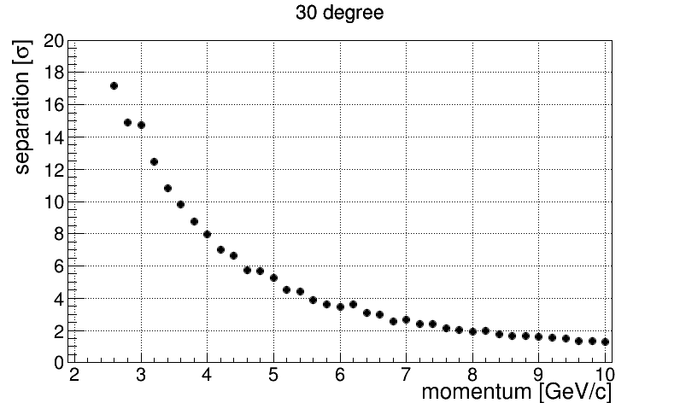
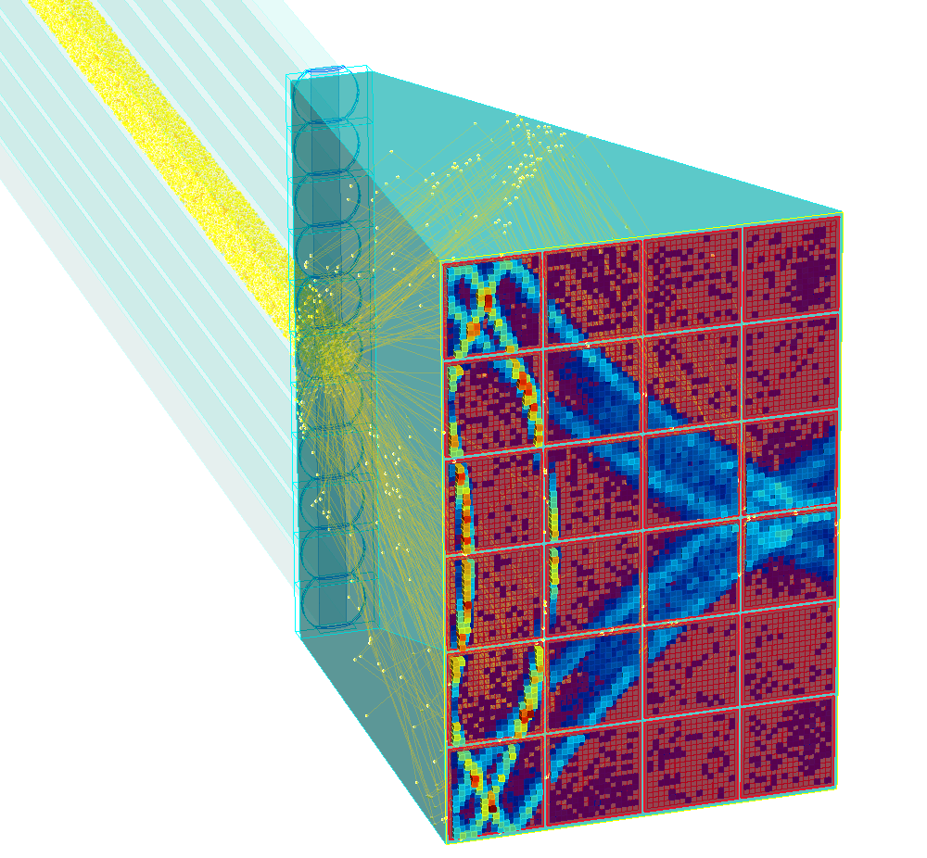
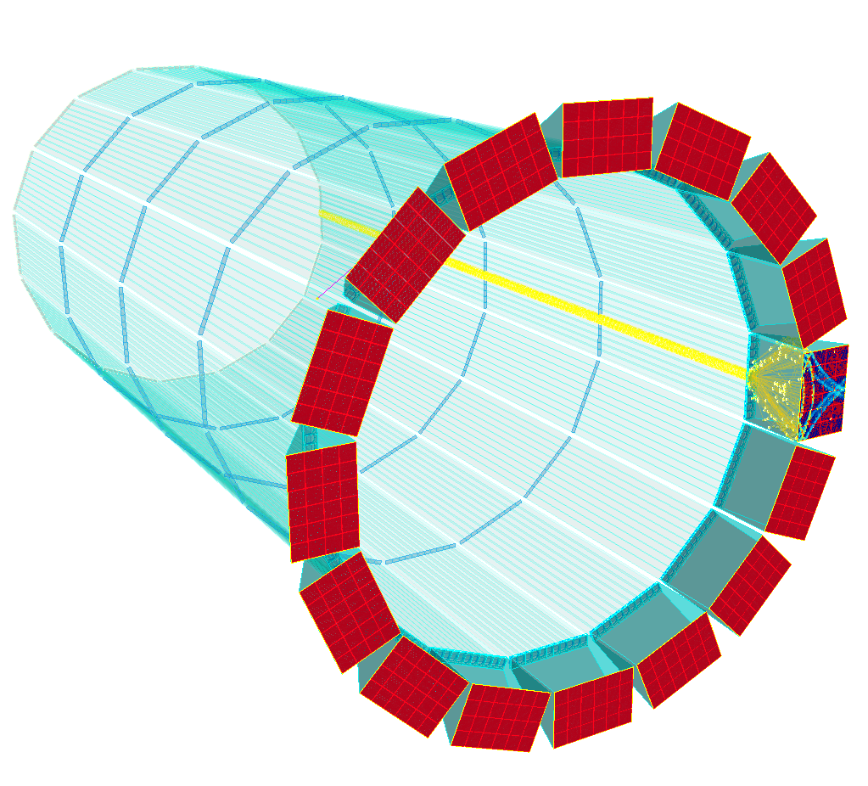
Hadron Identification in the barrel (hpDIRC) and hadron endcap (dRICH)
Using aerogel and gas radiators with a single set of photosensors the dRICH provides continuous π/K separation of >3σ up to 60 GeV and excellent e/π separation
  e/π: 10σ at 10 GeV
The hpDIRC has a π/K separation of >4σ up to 6 GeV (and 2σ at 8 GeV).
The minimum momentum for π/K ID in threshold mode is 0.2 GeV

Slide 11
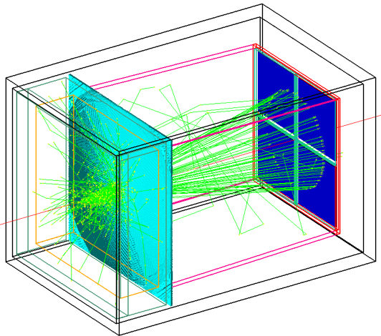
Hadron Identification in the electron endcap
High-resolution TOF is not competitive with Cherenkov detectors in the hadron endcap (large particle momenta) and central barrel (small radius), but could be a good solution for the electron endcap.
t₀ can be obtained using an electron scattered into the endcap and/or a separate ”start” layer at integrated with the Si-tracker.
A Si timing “start” layer could be added behind one disk (ANL 5D?)
The TOF installation is modest and resolution could improve through future upgrades.
High-resolution TOF using LGADs or LAPPDs (which would not work at 3 T)
However, CORE could also support an aerogel RICH (e.g., the mRICH) by extending the endcap by 30 cm, for which there is plenty of space, although this would extend the length of the PWO₄ EMcal.

Slide 12
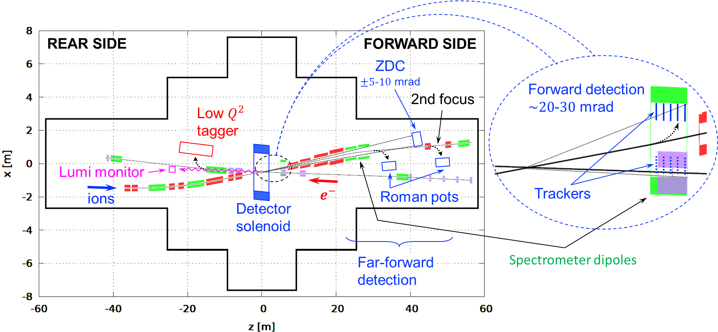
IR integration
Despite its compact size, CORE has a lot of space available for supports and services
In its nominal configuration, CORE fits into a -3 m to +4.5 m IR space.
If desired, the length on the hadron side could be reduced (or the electron side extended).
CORE is compatible any crossing angle (which only affects forward acceptance in a narrow range of phi), and can fit into into both the IP6 (STAR) and IP8 (PHENX) halls.

Slide 13
KLM: K_{L} and Muon detector subsystem at the EIC
EIC EOI #26
Will Jacobs (IU), Pawel Nadel-Turonski (SBU), Gary Varner (UH), Anselm Vossen (Duke)
High efficiency and purity μ detection and ID
  Important for di-lepton production, including J/ψ and time-like Compton scattering (TCS)
Identify K_{L} and neutrons in jets
  Focus on PID and position rather than energy, which cannot be precisely determined for a single few-GeV neutral hadron with any Hcal
The Belle II KLM provides a good starting point for developing a similar system for the EIC
  More details on the Belle II KLM can be found in the backup slides.
B⁰ J/ψ + K_{L}

Slide 14
Open collaboration kick-off meeting March 29-30
Save the date! All are welcome!
Thank you!

Slide 15
Example: upgraded Belle II detector at Super KEKB
Active readout elements interleaved with 1.5 T solenoid magnet return steel
Configuration optimized primarily for μ and K_{L} detection and ID
Relatively inexpensive, technically simple construction and robust operation
It is not a full-fledged/proper EM or Hadron calorimeter
Tracking
ECAL, iTOP, PID
KLM Backward
Endcap
Octagonal Iron yoke structures:
14 layers of ~ 47 mm thick steel plates
~ 40 mm thick air slots => 15 barrel, ~ 14 Forward , ~ 14 Back instrumented for readout
KLM Barrel
KLM Forward Endcap

Slide 16
Now: Endcap and first 2 Barrel layers are scintillator based
Scintillator strips: barrel ~ 1x2.5 cm² xsec extruded with fiber hole (endcaps ~ 0.7x4 cm² machined w/ cut)
Hamamatsu SiPM attached to fiber (mirrored at far end)
~ 1.3 x 1.3 mm2
667 pixels
1.5 T field operation
rad-hard (est. >10-year lifetime @ Belle II)
8-pixel threshold => >99% efficiency

Slide 17
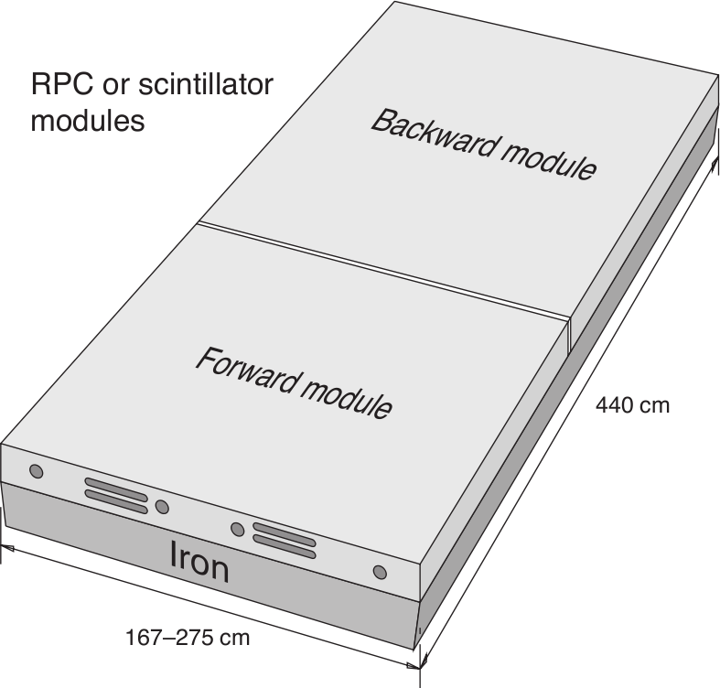
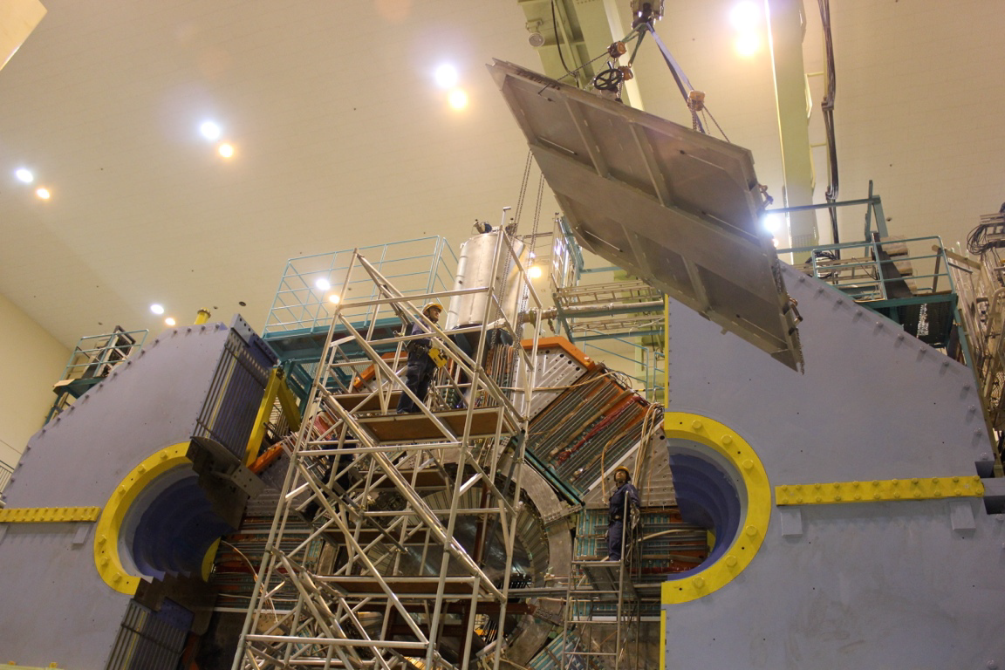
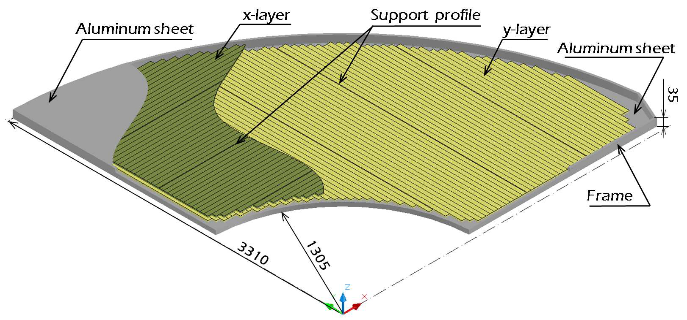
Belle II detector KLM components
Endcap
Barrel
2014
2013

Slide 18
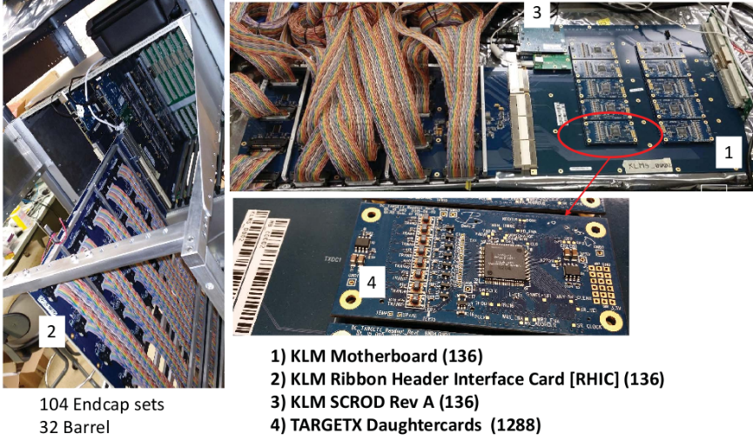

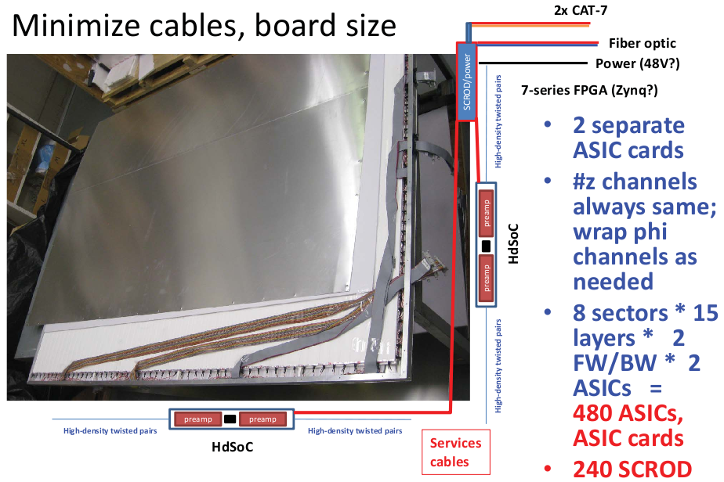
Plans (EOI to Belle II): replace 13 remaining Barrel RPC layers
Fabricate the new scintillator layers
Redesign scintillator readout for all 15 layers
Move digitizing front end electronics into detector panel
Developments: embedded ASIC; compact SCROD; 64-chn readout; several different preamp options
K_{L} time-of-flight?
Expected installation ~ 2026

