Slide 1
IR Complementarity – Introductory remarks on the “big picture as we see it”
Elke Aschenauer and Rolf Ent
Co-Associate Directors for the Experimental Program
EIC CD-1 Review
January 26-29, 2021

Slide 2
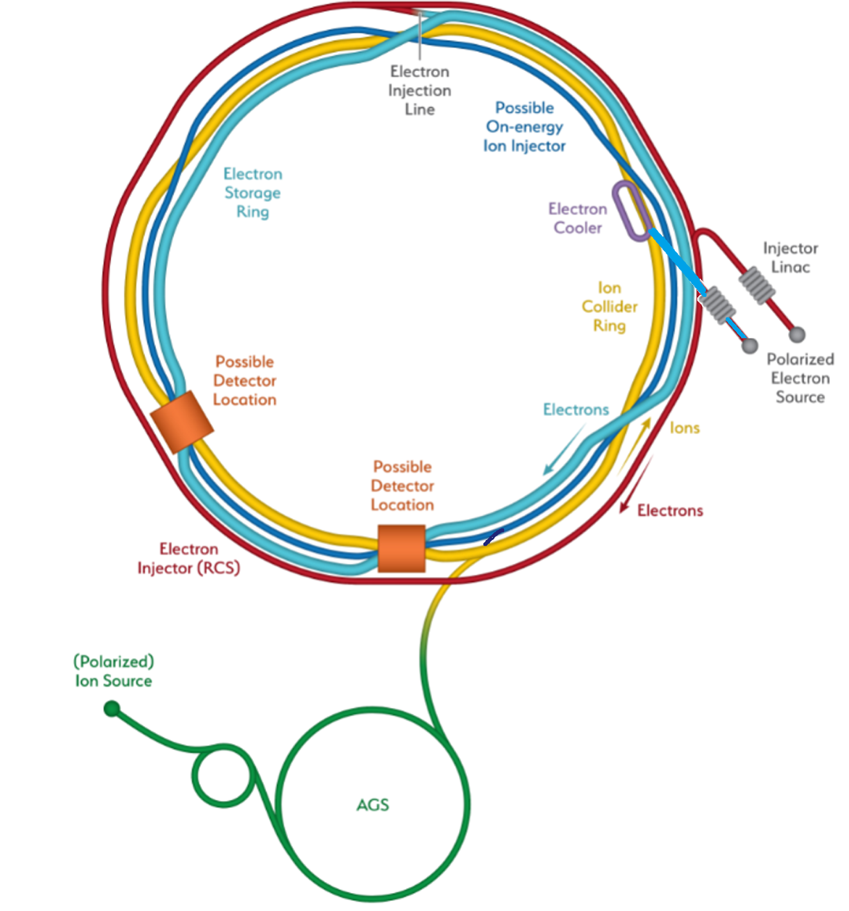
Detector – Location
Two possible locations – IP6 and IP8 – for detectors and Interaction Regions.
IP6 - planned EIC project detector location
hadrons “going from inner to outer arc”
IP8 - viable location for complementary detector/IR
hadrons “going from outer to inner arc”
→ IR designs are NOT interchangeable with each other
IP8
IP6
Hadron Storage Ring
Electron Storage Ring
Electron Injector Synchrotron
Possible on-energy Hadron
injector ring
Hadron injector complex

Slide 3
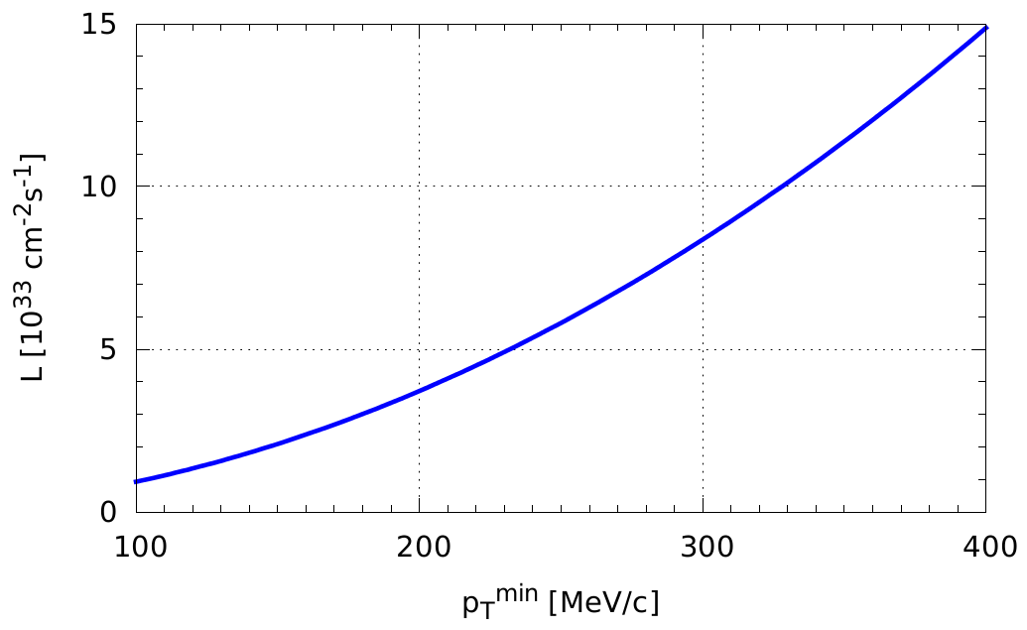
How to get more luminosity at lower E_{cm}?
F. Willeke, V. Morozov
schematics
Luminosity E_{cm} ~ 40 – 60 GeV could be increased by factor of almost 2 (work in progress!)
Applicable at both IP6 and IP8
Doublet focusing
But nothing is for free, there is a direct impact on the low p_{T} acceptance, e.g., for 100 GeV protons: p_{T}^{min} = 0.2 → 0.3 GeV
Triplet focusing
For hadrons, final focus lens is split into two.
Doublet focusing for E_{cm} ~100-140 GeV.
For low hadron beam energy (E_{cm} ~ 60 GeV) can rewire into triplet focusing, reduce β* ➔ Increase L by factor of ~2.
High-divergence
Highest $L$
High-acceptance

Slide 4
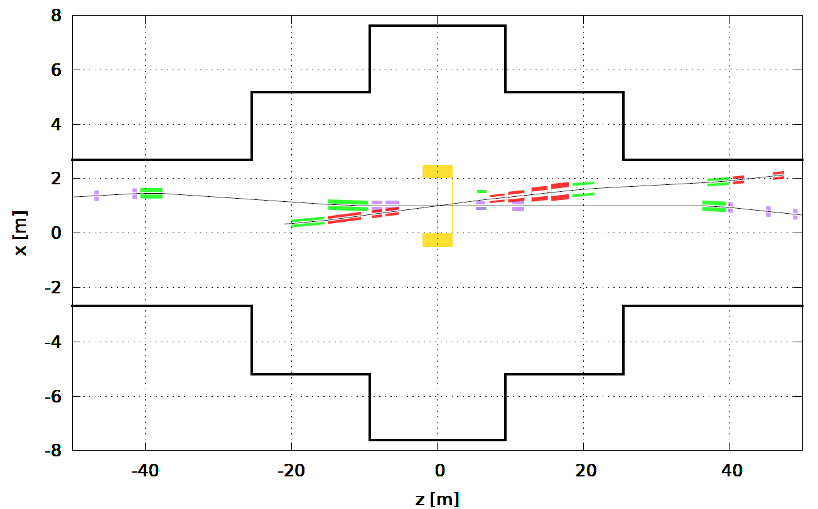
IP8 Crossing Angle Choice
Radial shift
RCS
Cannot be too large, $<50$ mrad
Experimental hall geometry does not allow it
IP must be shifted toward the ring center to allow RCS bypass the detector
Requires additional crabbing cavities, not only cost but additional impedance and other dynamical beam issues
Impact on “central” detector acceptance, e.g., with 50 mrad, acceptance limited to ~3.5 in rapidity
Cannot be too small, $>25$ mrad
Hall geometry requires spectrometer dipoles to bend towards the electron beam, bending away as in IR1 is not possible because of the tunnel wall, small crossing angle would cause interference with electron beamline
Note smaller tunnel diameter around IP8
Everything seems to point to an optimal crossing angle of ~35 mrad

Slide 5
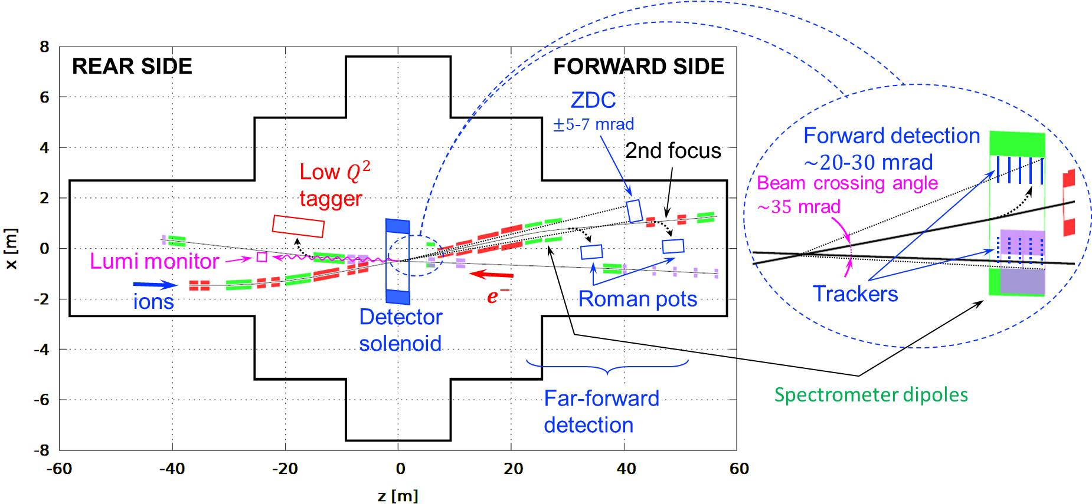
Complementary 2nd IR Schematic
Complementary science reach:
Different crossing angle
→ different holes in acceptance
Different secondary focus
→ Different forward detectors
Different magnet
Different emphasis in detector technologies
→ Different central detector

