Slide 1
Minidrift GEM detector Results Summary
EIC Tracking Workshop, Temple University
May 9, 2015
B.Azmoun, BNL

Slide 2
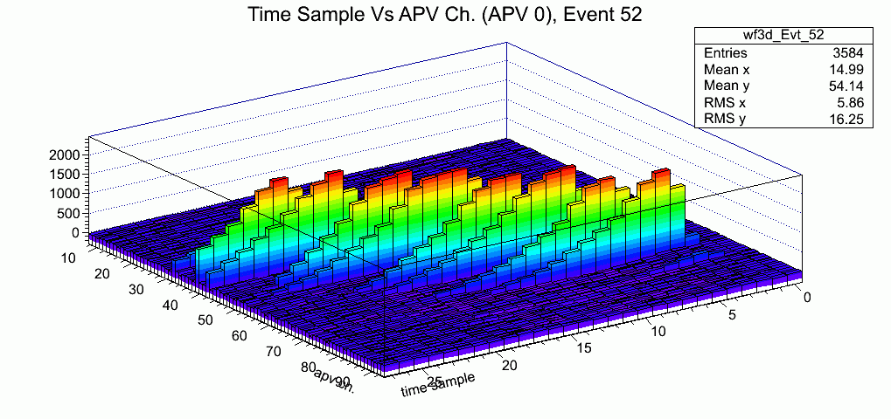
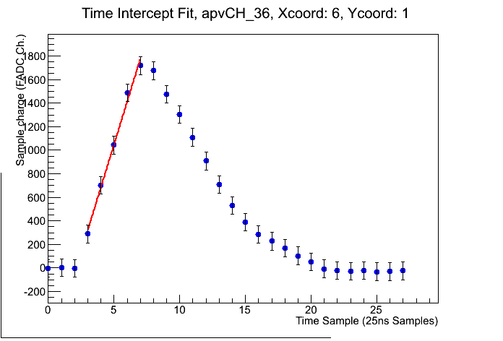
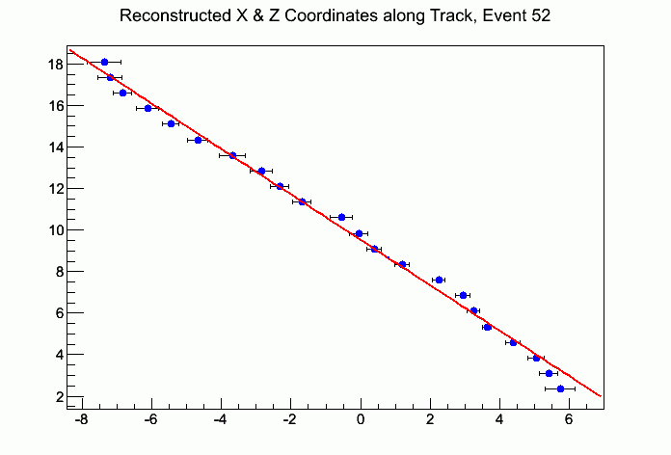
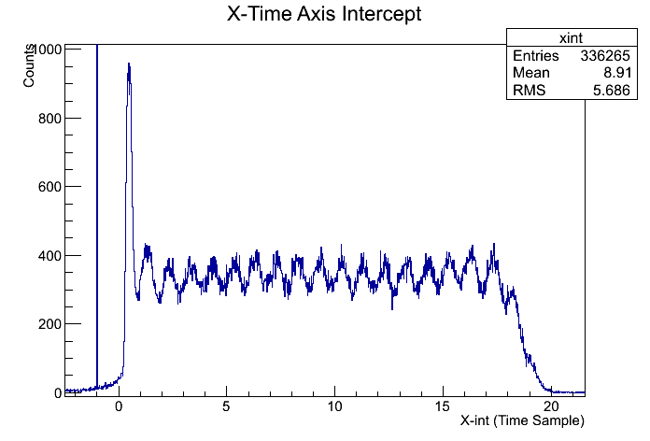
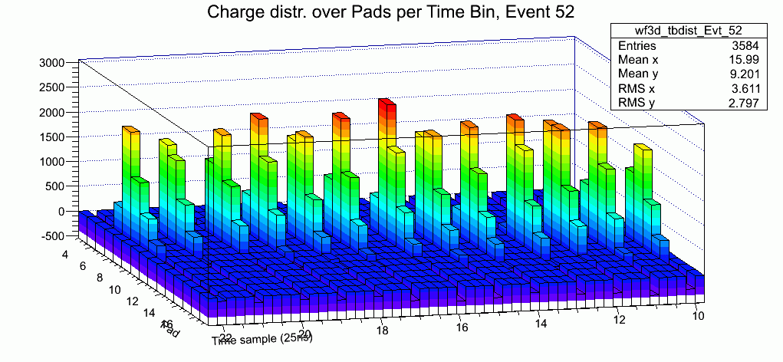
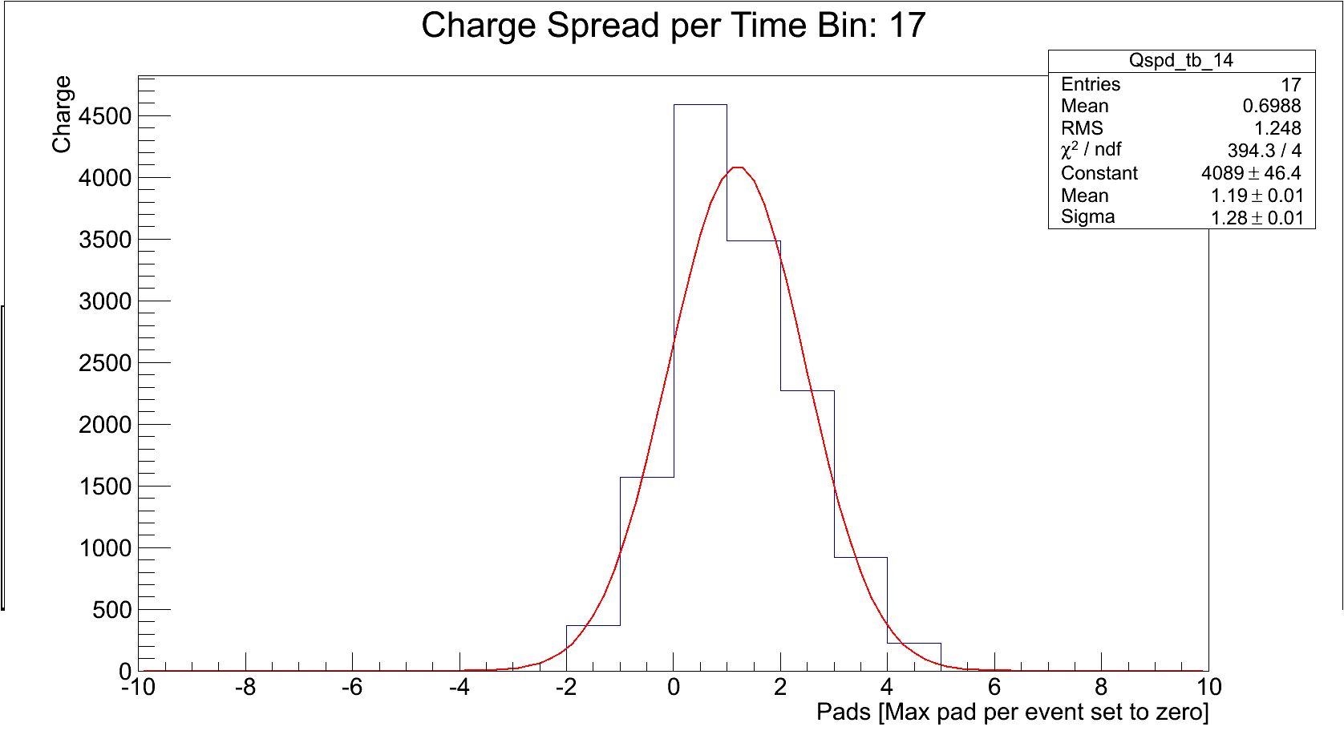
Track Reco Methods Compared
* Initially decided to determine charge arrival time (continuous variable) to determine vector z-comp., and use the pads (discrete variable) to determine the x-comp., but “rising edge method”, and others like it have modest timing resolution (~1/2 time bin). [X~1pad, Z~1/2time bin]
* Instead why not focus on improving the determination of the x-comp. In principle the charge distribution within each time slice should yield a position resolution similar to that seen for normally incident tracks (~50-60microns), which corresponds to a fraction of a pad. [X~pad fraction, Z=1 time bin]
Mesh
Primary Charge
Fluctuation
Drift Gap
17mm
GEM 1
Transfer 1
1.5mm
GEM 2
Transfer 2
1.5mm
GEM 3
Induction
2mm
X-Y Strips
Pitch: 400um
Preamp/Shaper
Rising Edge Method
Time Slice Method

Slide 3
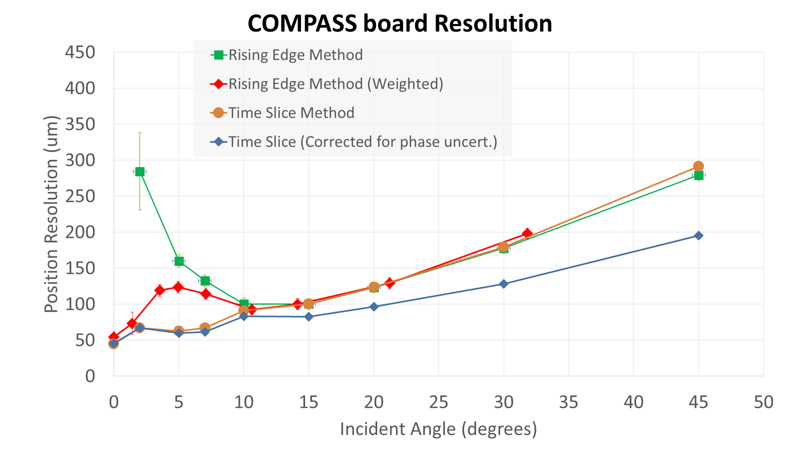
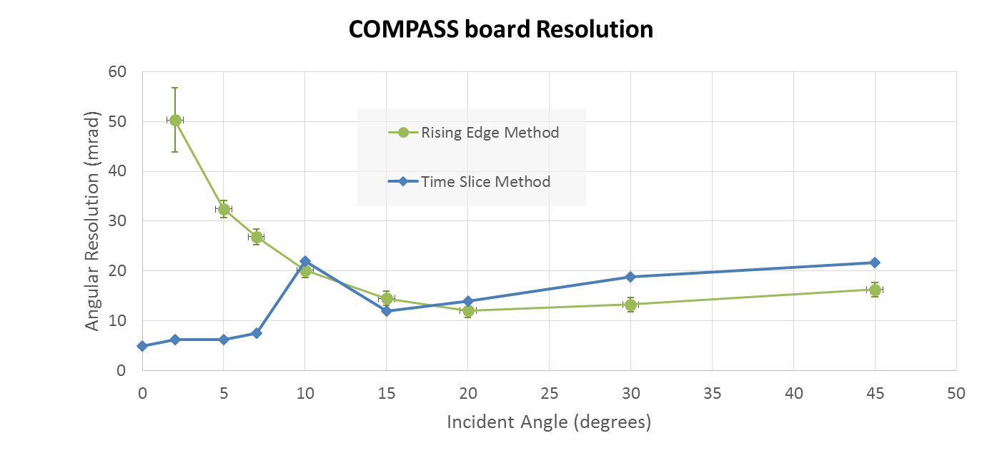
Vector Reco Methods Compared
Can unfold phase uncertainty from time slice method, NOT rising edge method
Ext. Trigger
θ
z
Δt → Δz
Incurs 25ns/sqrt(12) timing error for charge arrival as given by clock edge
40MHz Cock
APV Latency
Capture window
Phase
uncertainty
Δx=v_{d}*Δt*tanθ
x
Δx

Slide 4
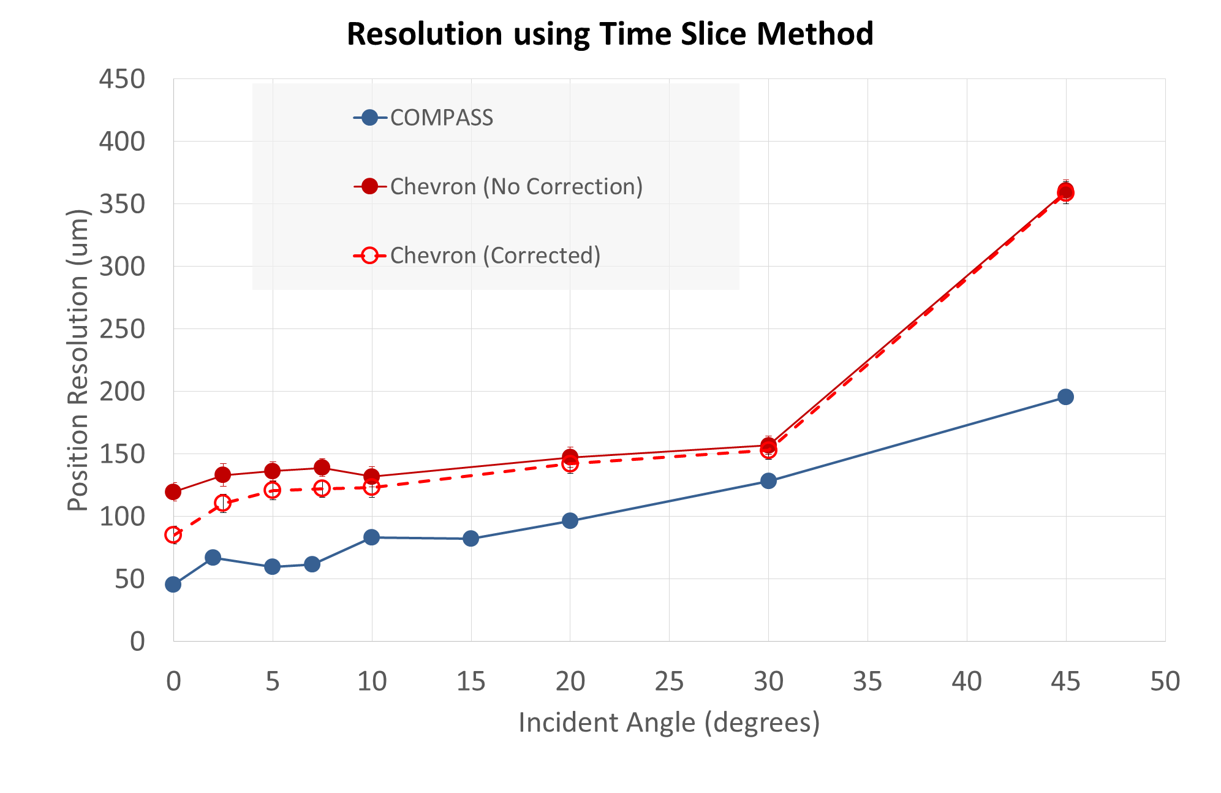
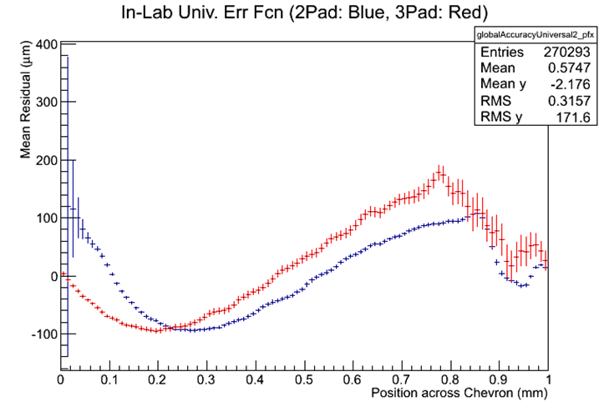
COMPASS Vs. Chevron board
Chevron Pattern --> systematic offset error can be corrected

Slide 5
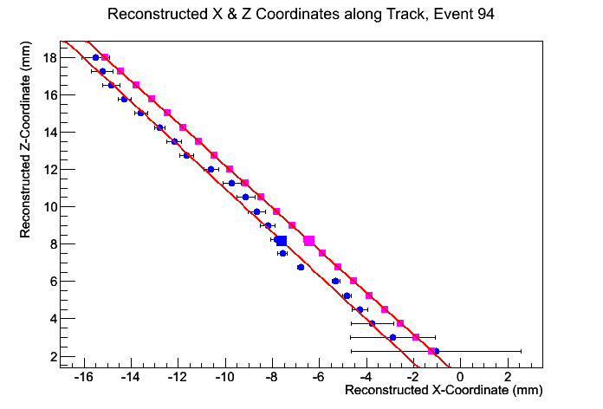
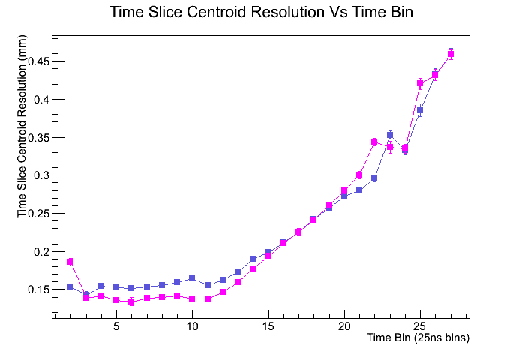
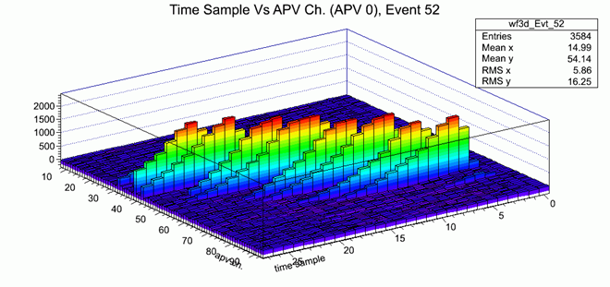
Time slice method limitations
Si Track
GEM Track
Corrected
Uncorrected
More tail overlap at later time bins deteriorates resolution

Slide 6
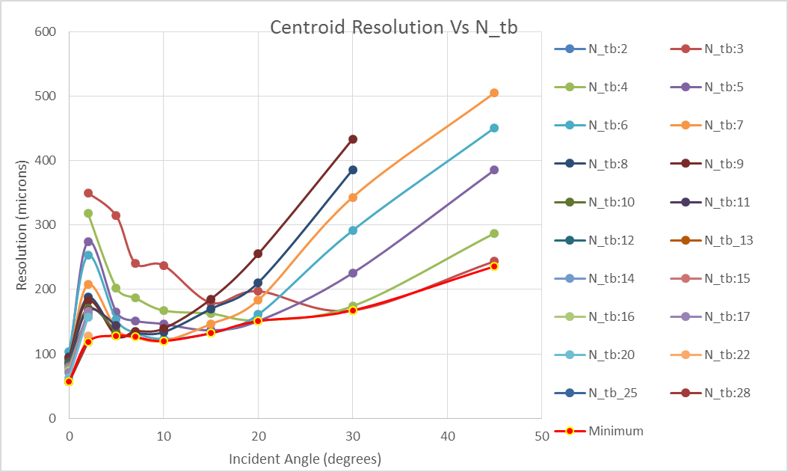
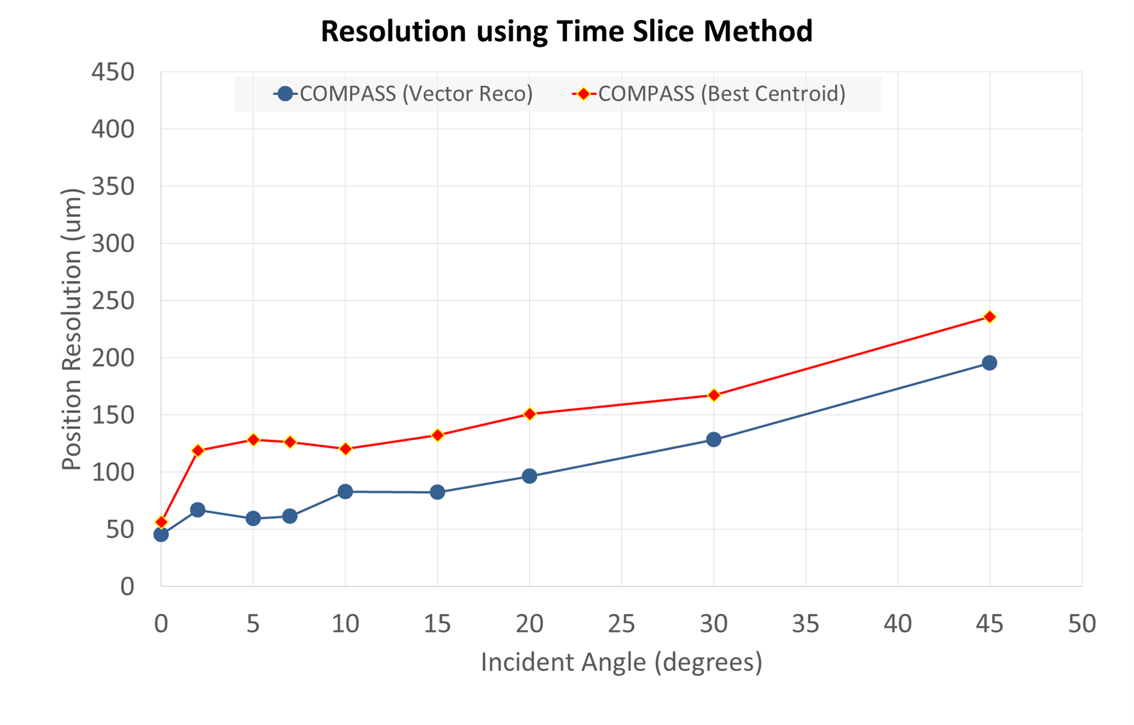
Best Centroid Vs Vector Reco
The best possible resolution as determined using the centroid alone cannot compete with vector reco.
We believe the vector reco resolution is substantially better than what is shown here!

Slide 7
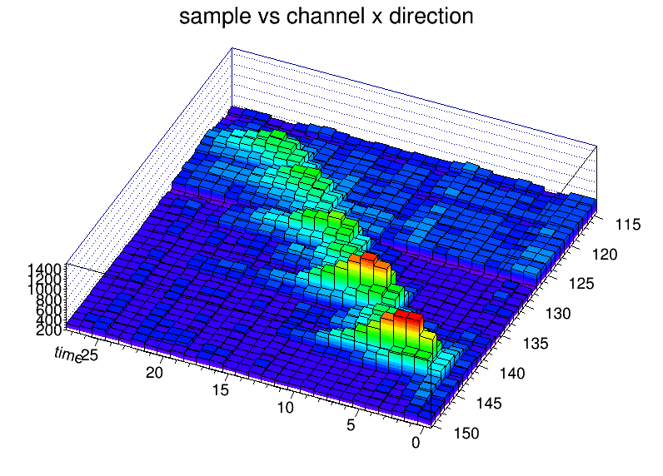
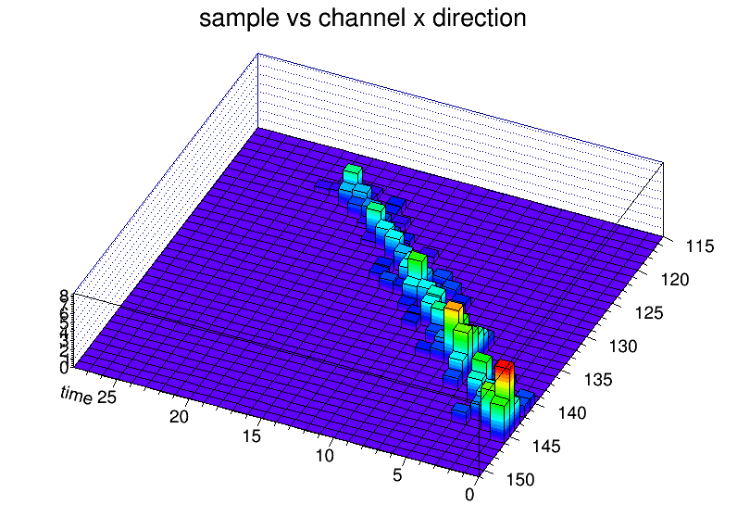
Outlook: Unfolding shaper response
A. Kiselev
Raw Waveform
Unfolded
Gain access to actual charge deposit by unfolding the nominal shaper response from the raw data
Unfolded clusters are determined with full covariance matrix
Formal Chi2 analysis shows spatial resolution <70um at 30deg. using COMPASS board.
This detector configuration has huge potential beyond what was shown on previous slides!

Slide 8
Backup

Slide 9
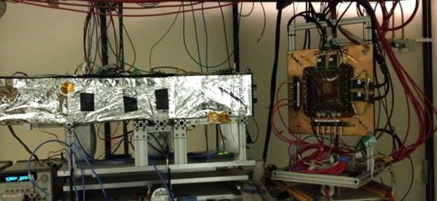
Rotate Coord. Sys. Of Si to align with GEM (GEM fixed)
GEM Coord. System orientation Parameters:
Fixed: Δx, Δy, Δφ
Measured:<θ_{x}> , <θ_{y} >, Δz (?)
Scanned: None
Si Tel. Coord. System orientation Parameters:
Fixed: Δx, Δy
Measured: <θ_{x}> , <θ_{y} >, Δz (?)
Scanned: φ, <θ_{x} > & <θ_{y} > , Δz
Si Telescope
Mini-Drift GEM
Strong Scan Parameters:
Δz & Δφ
*pulse height cut threshold for defining a hit.
Weak Scan Parameters:
<θ_{x}> , <θ_{y} > → local to measured, and Δx, Δy → local to measured
Δy
Δz
Δy
Δx
y
y
Δx
Beam
<θ_{x}>
<θ_{x}>
Δφ
z
z
x
x
<θ_{y}>
<θ_{y}>

Slide 10
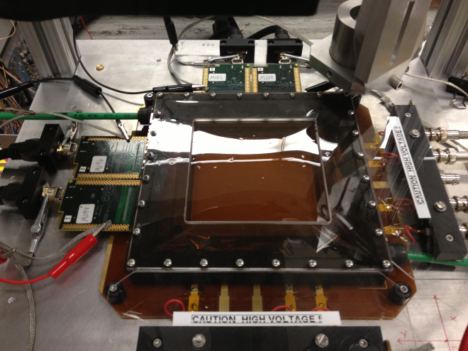
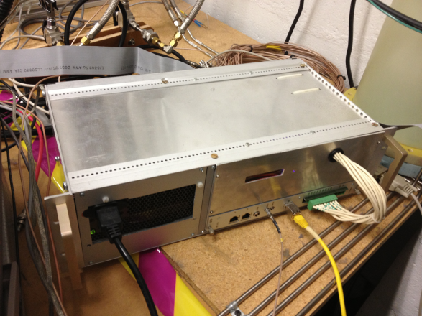
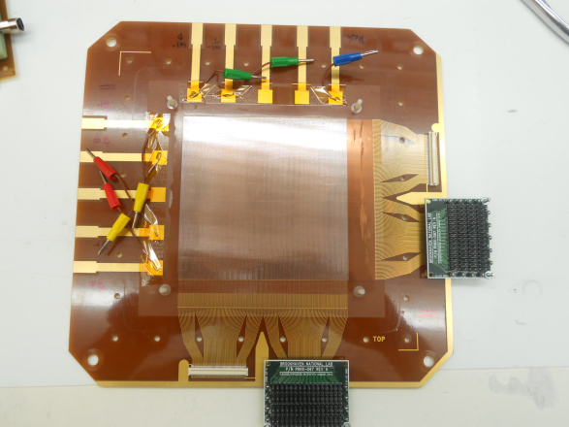
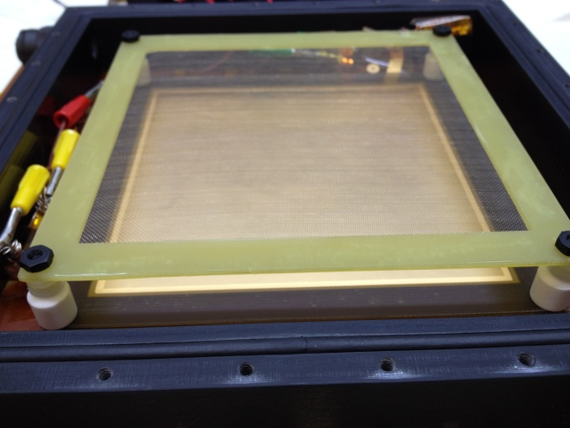
Mini-Drift GEM Det. + SRS Readout
Std. 10x10cm CERN 3-GEM Det.
ArCO2 (70/30)
Gain ~ 6500
~17mm Drift Gap
Drift Time ~600ns
SRS /512 channels APV 25
28 x 25ns Time Samples
RCDAQ
Ease of use
High flexibility
COMPASS style Readout:
256 x 256 X-Y Strips
~10cm x 400um pitch
Mesh
Primary Charge
Fluctuation
Drift Gap
17mm
GEM 1
Transfer 1
1.5mm
GEM 2
Transfer 2
1.5mm
GEM 3
X-Y Strips
Induction
2mm
Pitch: 400um
Preamp/Shaper

