Slide 1
Status of GEM R&D @ UVa
Kondo Gnanvo
University of Virginia, Charlottesville,
EIC Tracking R&D Workshop @ Temple University
05/09/2015

Slide 2
GEM Detectors @ UVa: The group members
Faculty: Nilanga Liyanage (Associate Professor)
Research Scientists: Vladimir Neliyubin, Kondo Gnanvo
Post Docs: Huong Nguyen
Graduate Students: Xinzhan Bai, Danning Di

Slide 3
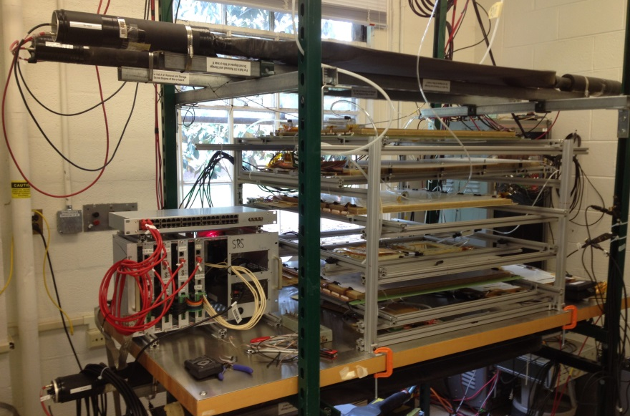
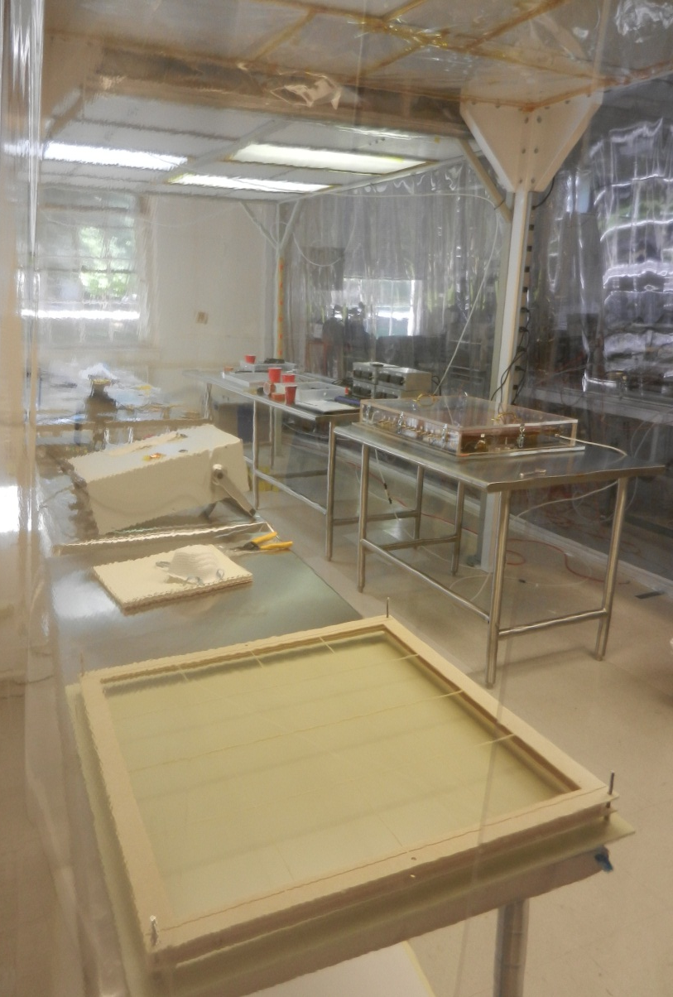
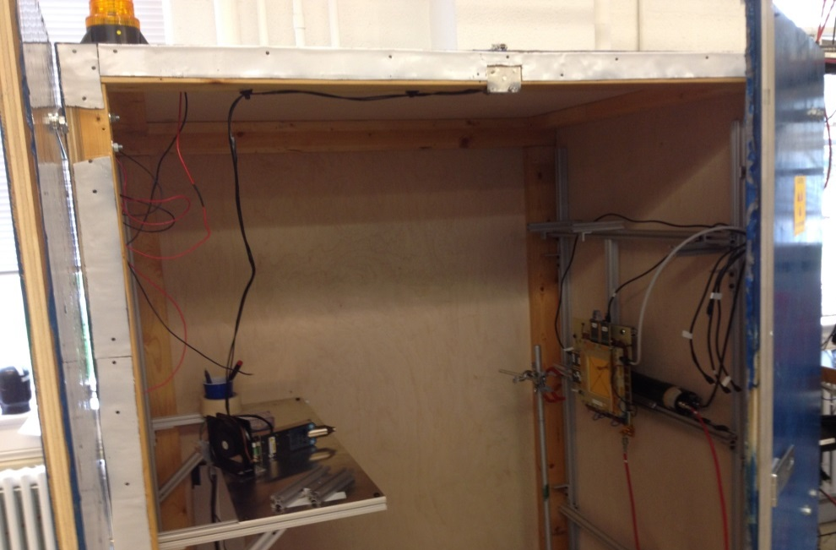
GEM Detectors @ UVa: The Lab
Clean room: 3 × 7 m² class 1000
Tests lab
SRS Readout:
12k Channels
Cosmic test setup for large GEMs
X-ray source in its lead shielding box

Slide 4
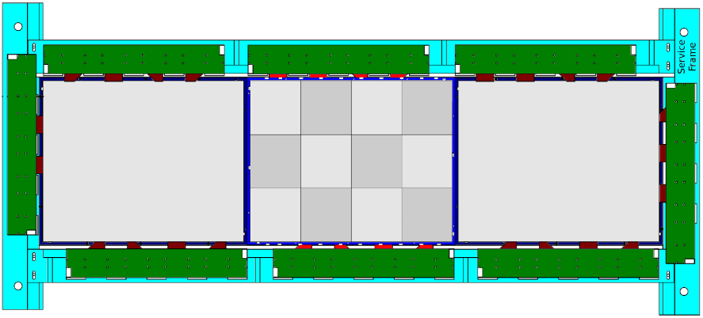
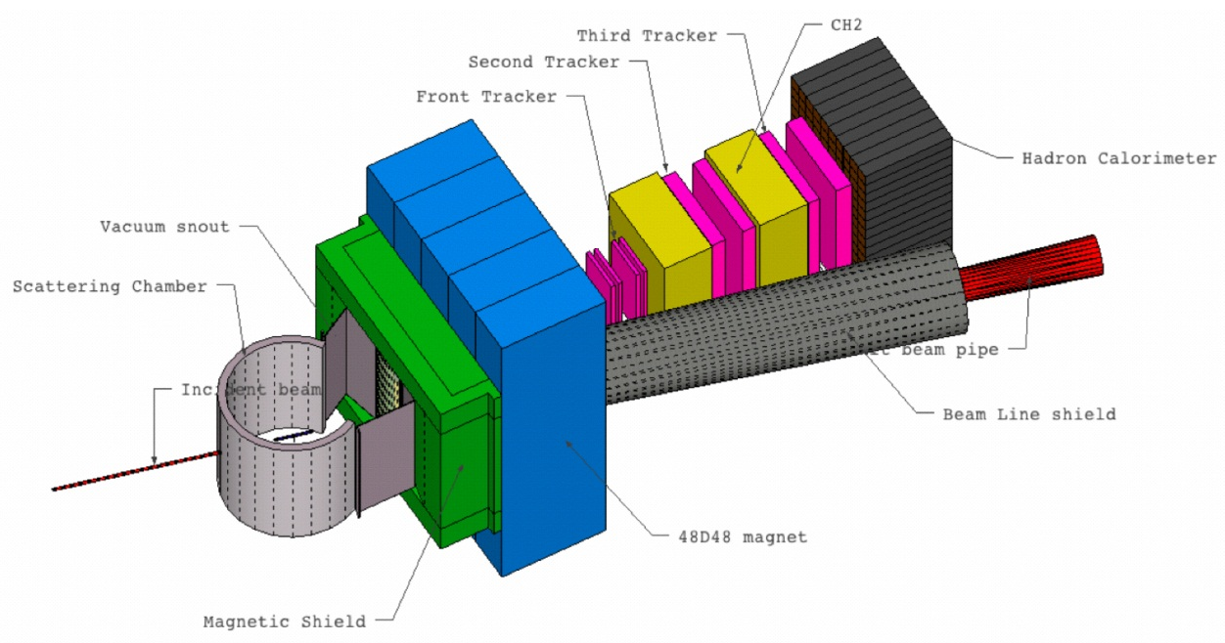
GEMs for Super Bigbite Spectrometer (SBS) in Hall A @ JLab
Front Tracker: E. Cisbani (INFN Roma, Italy)
6 GEM Layers (150 × 40 cm²)
Each layer = 3 GEM modules (50 × 40 cm²)
Back Tracker : N. Liyanage, (Uva, Virginia, USA)
10 GEM Layers (200 × 50 cm²)
Each Layer = 4 GEM modules (50 × 60 cm²)
50 cm
50 cm
60 cm
40 cm
Proton arm layout for GEp (5) experiment

Slide 5
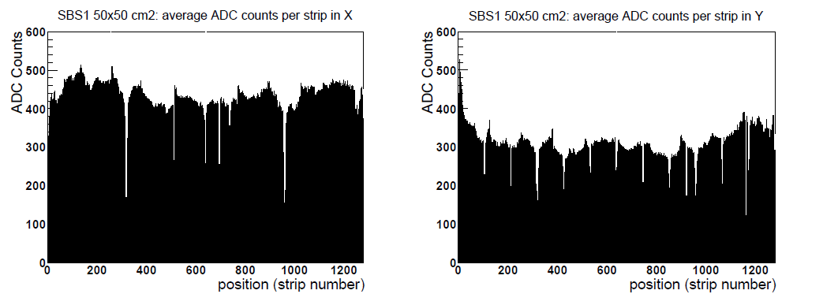
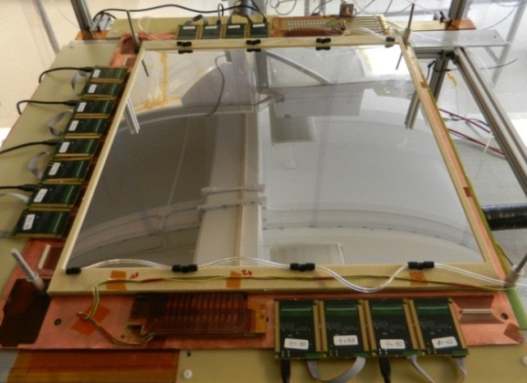
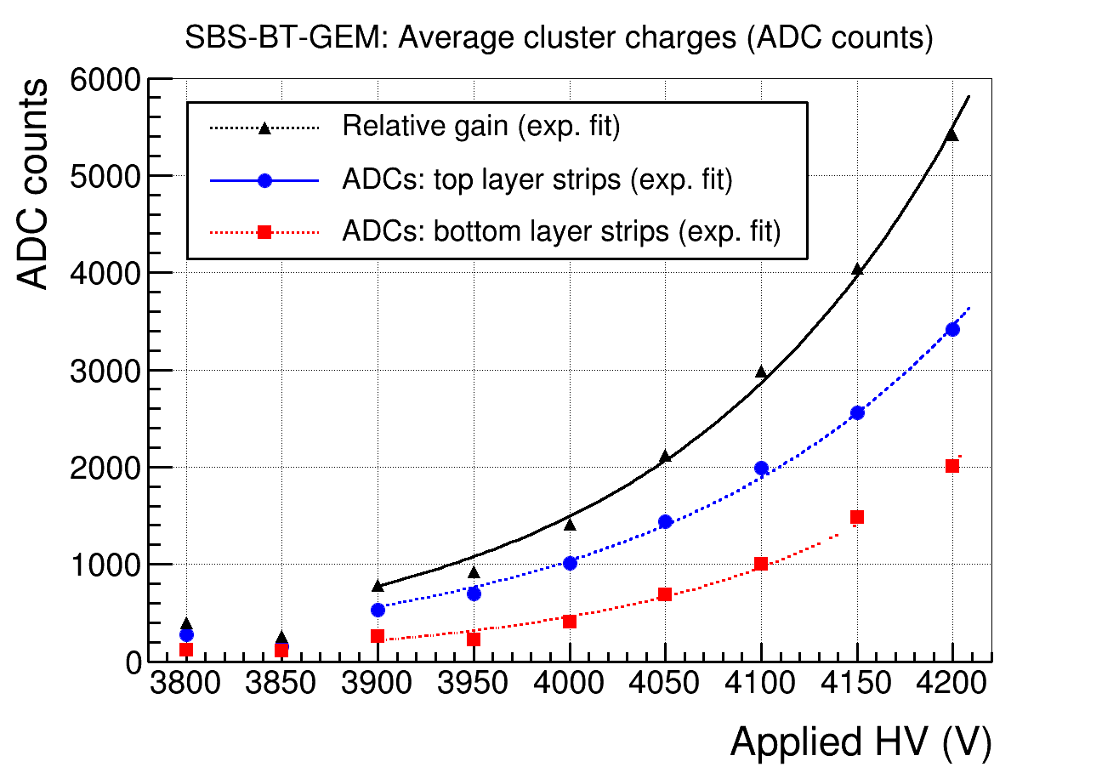
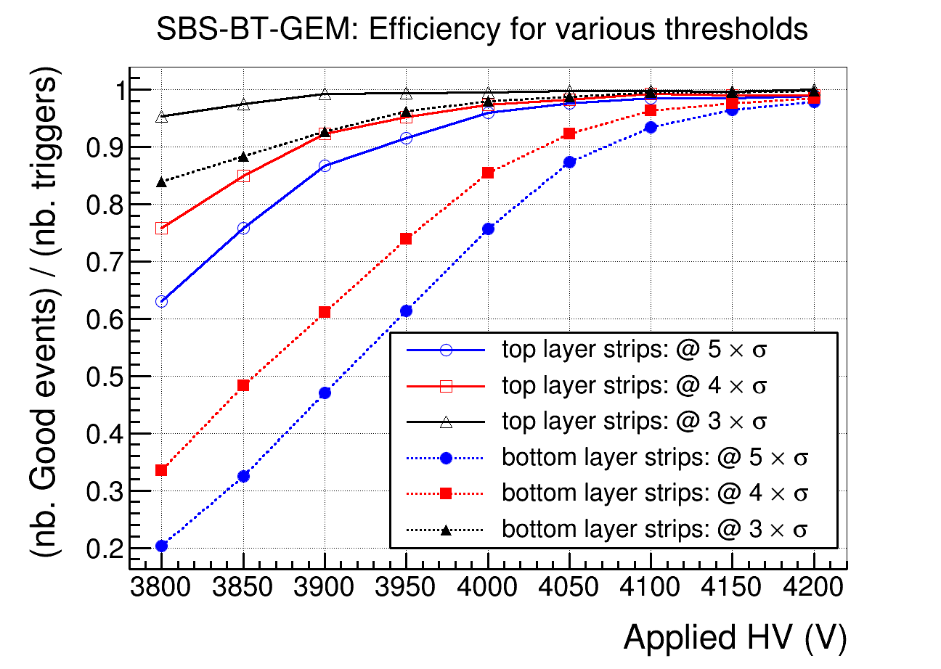
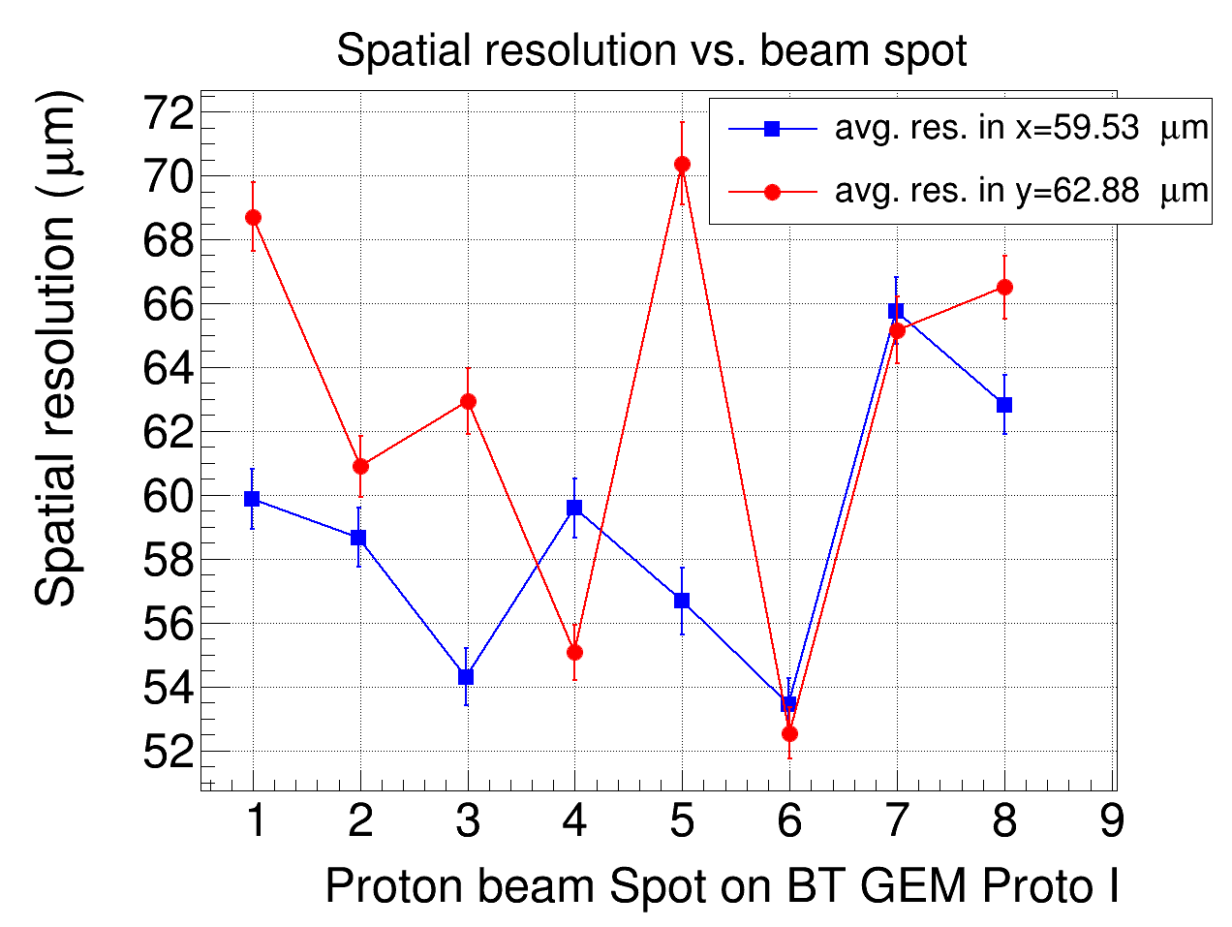
SBS-BT-GEM: R&D
K. Gnanvo et al., Nucl. Inst. and Meth. A782, 77-86 (2015), http://dx.doi.org/10.1016/j.nima.2015.02.017

Slide 6
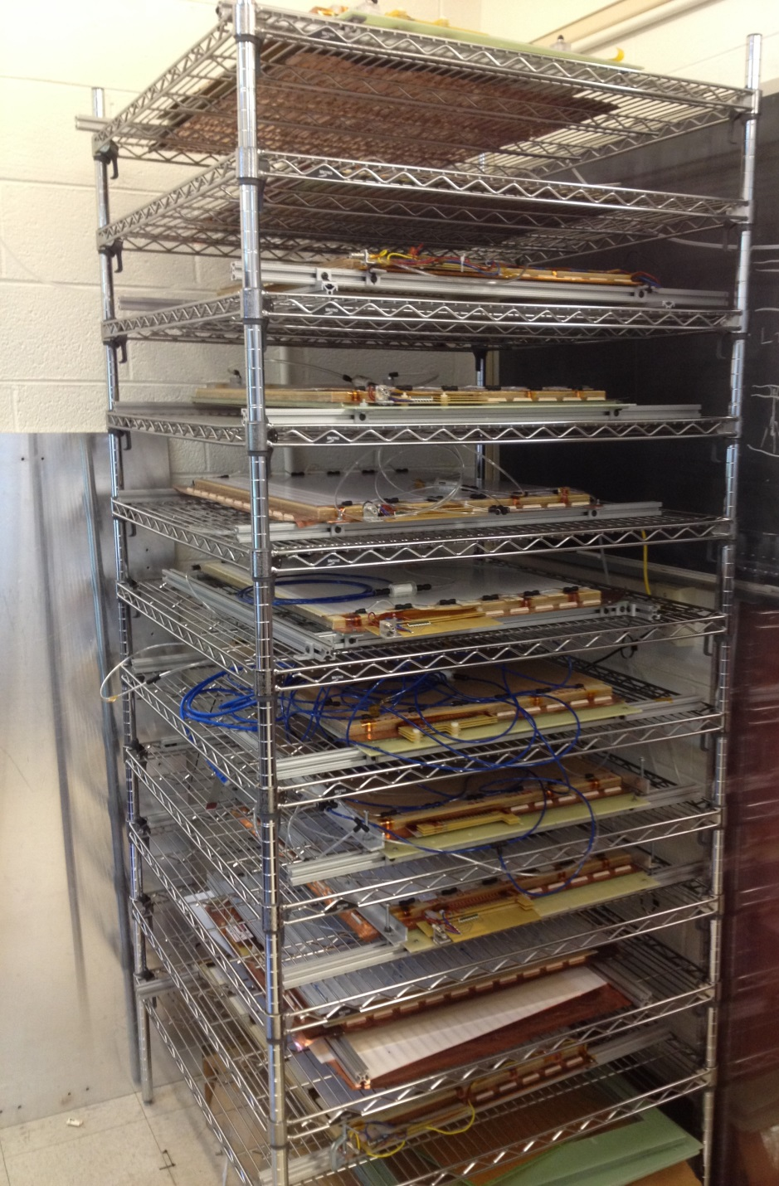
SBS-BT-GEM: Production
Production of the SBS-BT-GEM Modules
40 modules to be built by July 2017
13 modules already built as of May 09, 2015
11 successfully passes the ultimate test with cosmics
1 HV sector out of 1080 (12 × 3 × 30) was shorted and disabled
Last 2 modules just out of the clean room and will be tested in the coming days
Construction rate of 2 SBS modules / month

Slide 7
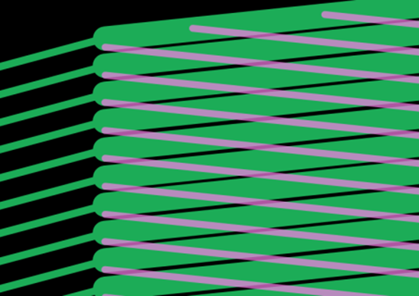
R&D for EIC Forward Tracker: Design of EIC-FT-GEM proto I
Key characteristics
Largest 2D GEM detector ever built: 100 cm × (44 cm – 22 cm)
Low mass and small dead area full disk chamber
Narrow edge GEM frame support and honeycomb for the readout
All electronics on inner and outer radius side of the chamber
Fine strips 2-d small stereo angle u/v readout on flexible board
Good position resolution and low capacitance noise
44 cm
100 cm
2D u/v readout strips
Cross section of low mass triple GEM
Pitch: 550 μm
Entrance window
Gas inlet
Bot. strips: 490 μm
22 cm
12°
Drift region
spacers
Transfer region
Top strips: 140 μm
Transfer region
Gas outlet
Induction region
2D readout board on Honeycomb support

Slide 8
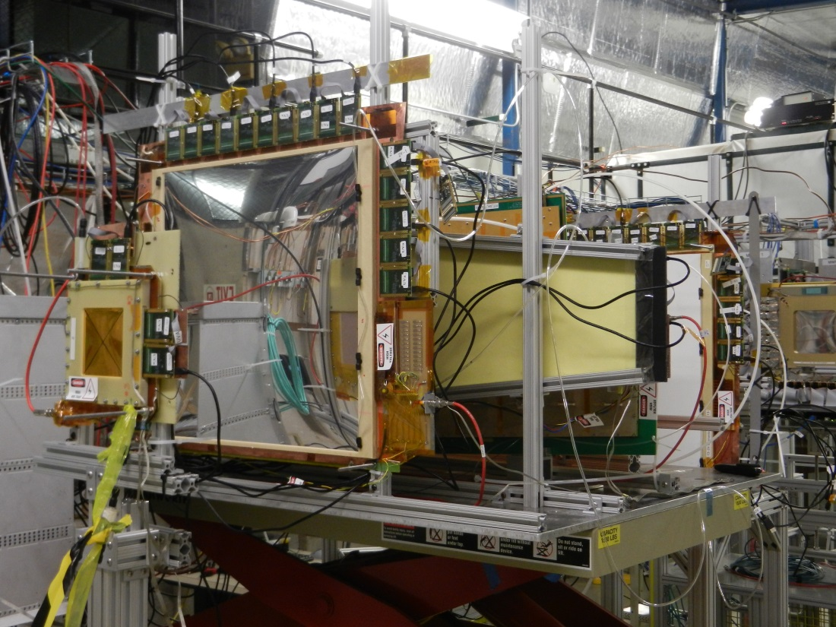
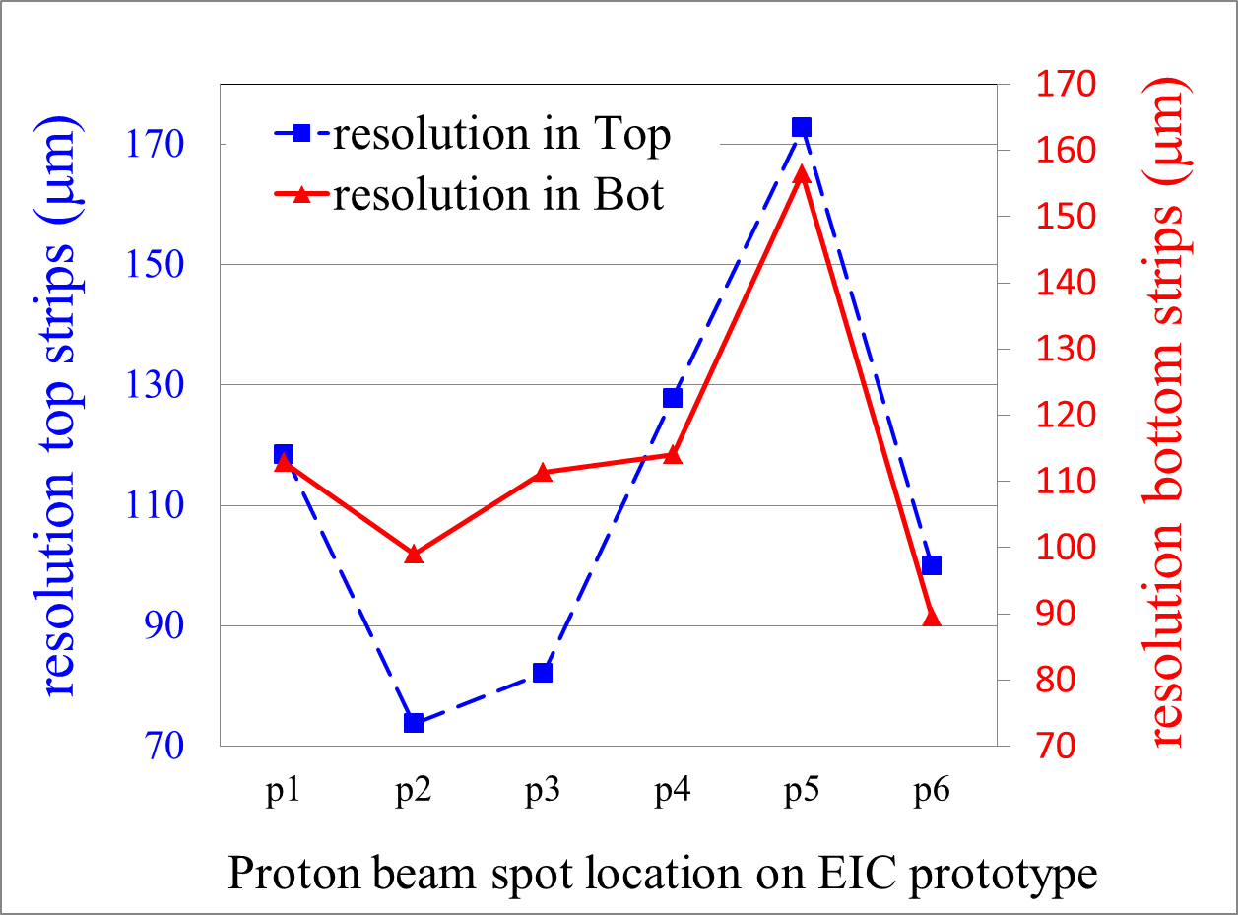
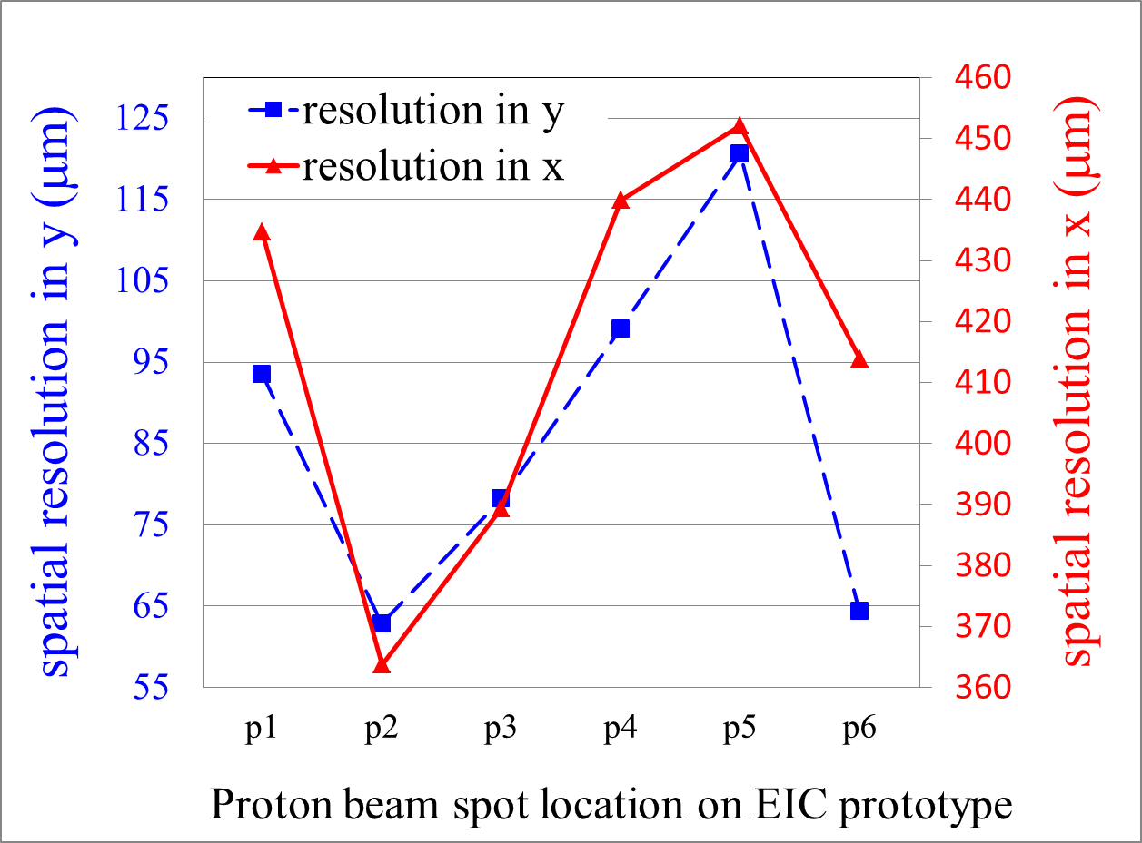
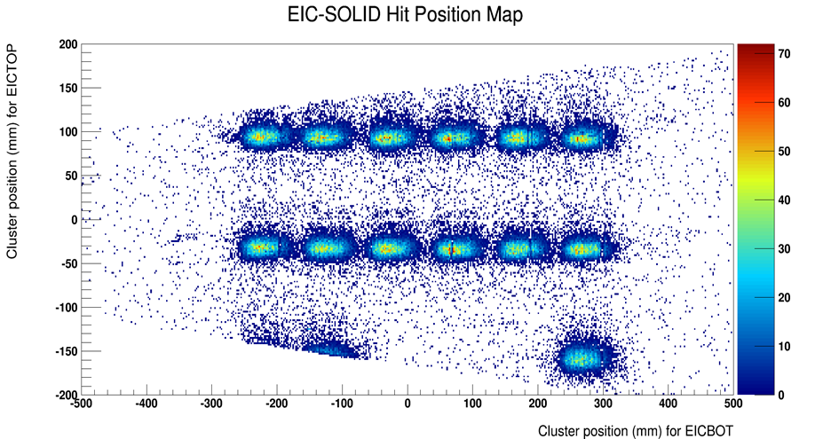
EIC-FT-GEM @ FTBF: Spatial resolution
SBS-BT-GEM
EIC-FT-GEM
Good spatial resolution
Better than 130 μm for the top and bottom strips
Better than 100 μm for y and 450 μm for x
Hadron bean reconstruction from position scan

Slide 9
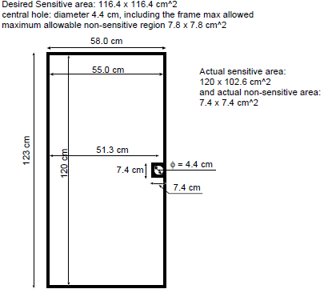
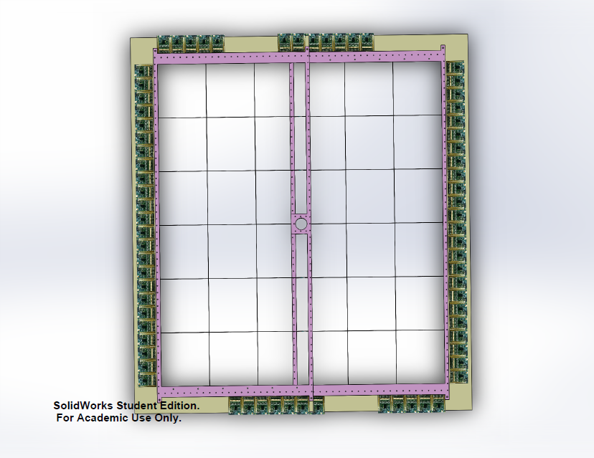
pRad GEM: Proton Radius Experiment pRad @ JLab
GEM chambers: X-Y veto counter
Slide from D. Dutta, PasSpin, Ji’nan, China, Oct. 30, 2013

Slide 10
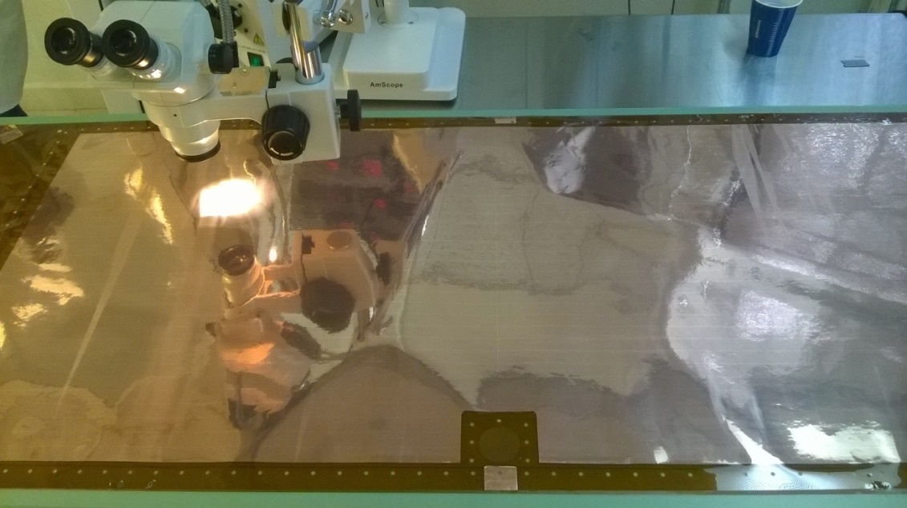
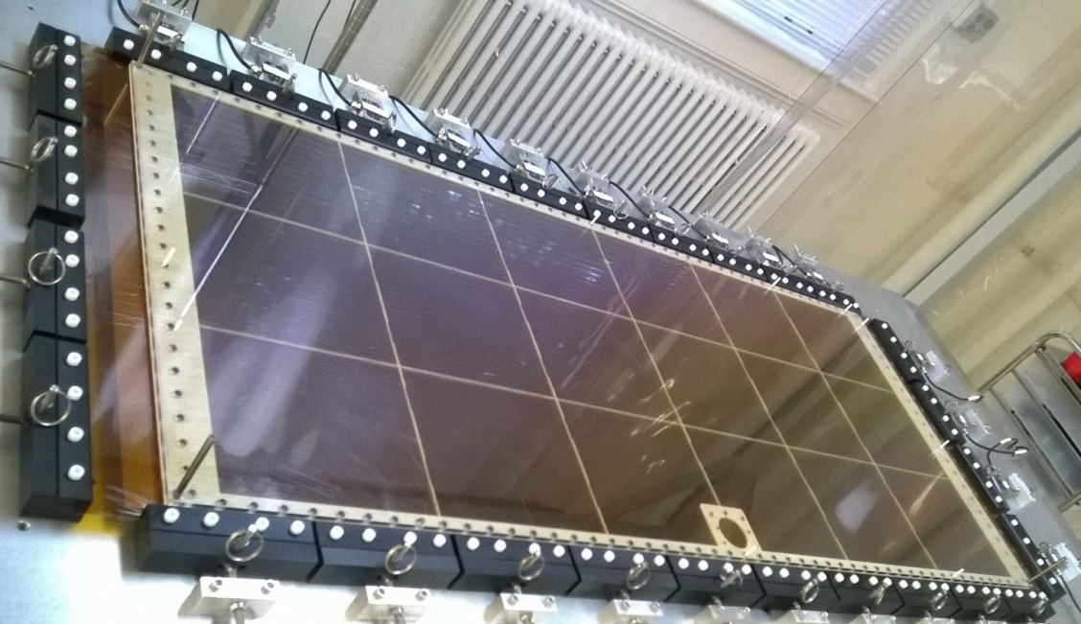
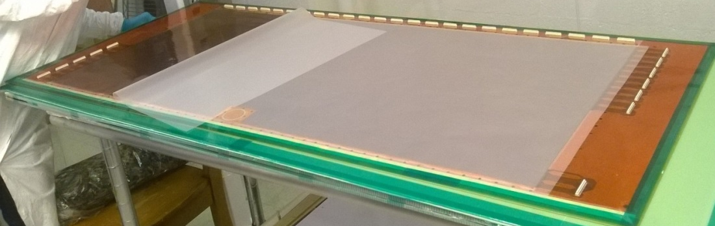
pRad GEM: Assembly of the first chamber is ongoing
New assembly technique used for pRad chambers (See next slide)
Optical inspection of pRad GEM foil
Drift cathode on the stretcher
pRad X/Y strips readout boards

Slide 11
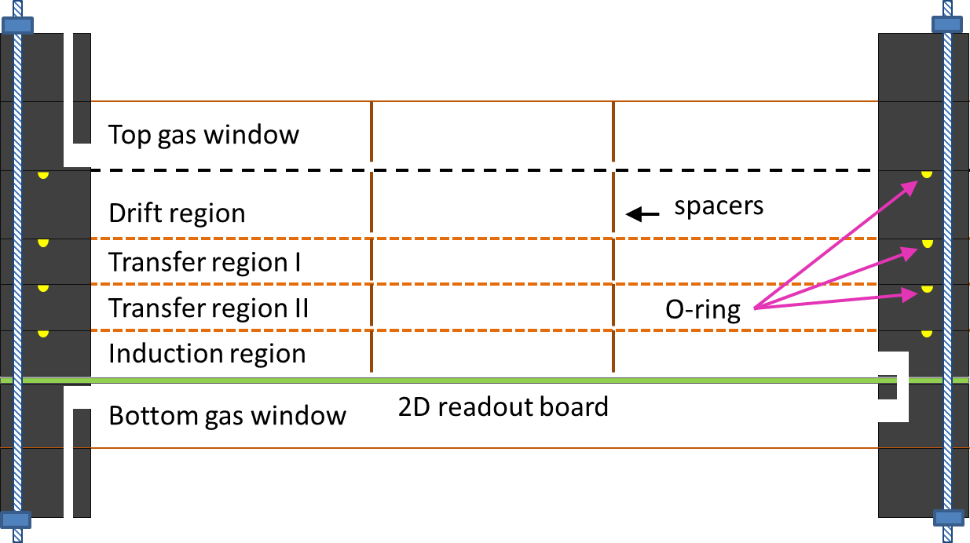
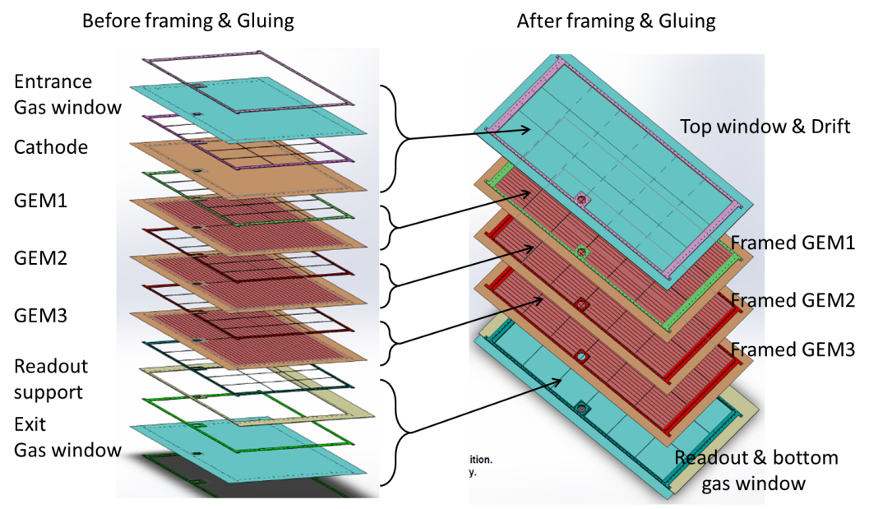
GEM R&D: New assembly technique for large GEM
Idea:
GEM foil stretched and glued to support frames
Individual framed GEM stacked together in the assembled chamber
O-ring and screws used to close the chamber and ensure the gas tighness
Pros:
Possibility of easy replacement of GEM foils or readout board after assembly
Work for light detector: plastic screw and narrow support frames, no rigid support needed
Idea already being tested on the pRad GEM chamber
Cons:
Need to evaluate gas tightness with O-ring + screw system
Would still need spacers inside the active area
Cross section of triple GEM with new assembly
Exploded view of pRad GEM: 100 cm × 55 cm

Slide 12
GEM R&D: Copper Free GEM foil
Cu-Free GEM foil
Standard GEM foil with the copper layer removed
Copper clad Kapton based material comes with 100 nm Chromium (Cr) layer between Cu and Kapton
100 nm Cr layer replace Cu as top and bottom GEM electrode
Cu-Free GEM Samples from Rui with a grid of Cu strips
Ensure electrical contact to be removed in the future
Grid copper strips
100 nm Cr
100 nm Cr
5 μm Cu
50 μm Kapton
50 μm Kapton
Cu-Free GEM foil
Standard GEM foil

Slide 13
GEM R&D: radiation length of Cu-Free GEM
Triple-GEM detector with standard GEM foil
Triple-GEM detector with Cu-Free GEM foil
Based on the data for the SBS-BT-GEM modules
The contribution of the Cr layer has not been added but is negligible to the first order
About 50% reduction in the material in a EIC-like chamber with Copperless GEM

Slide 14
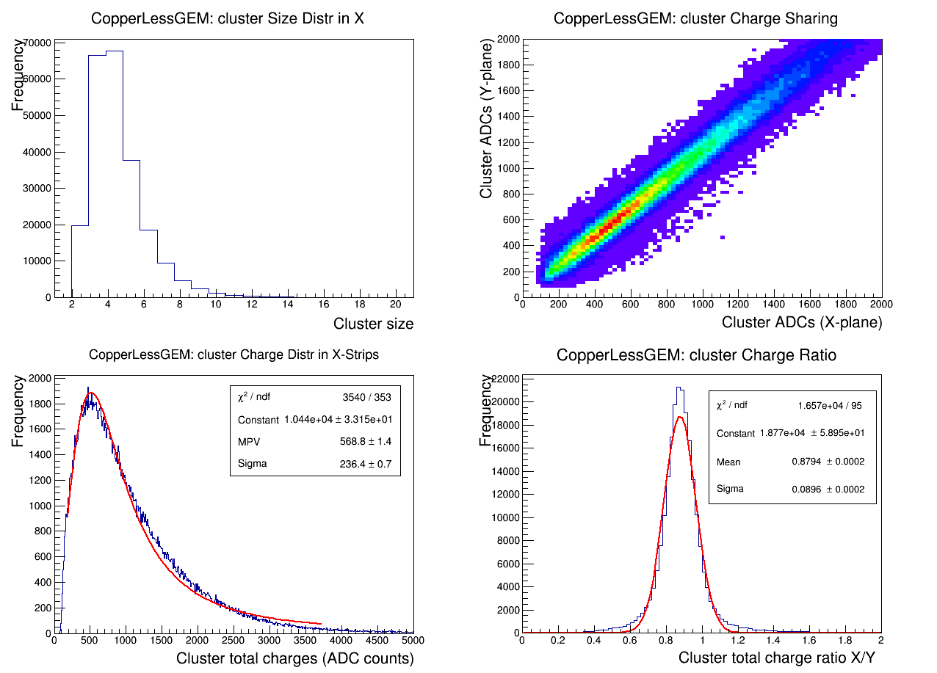
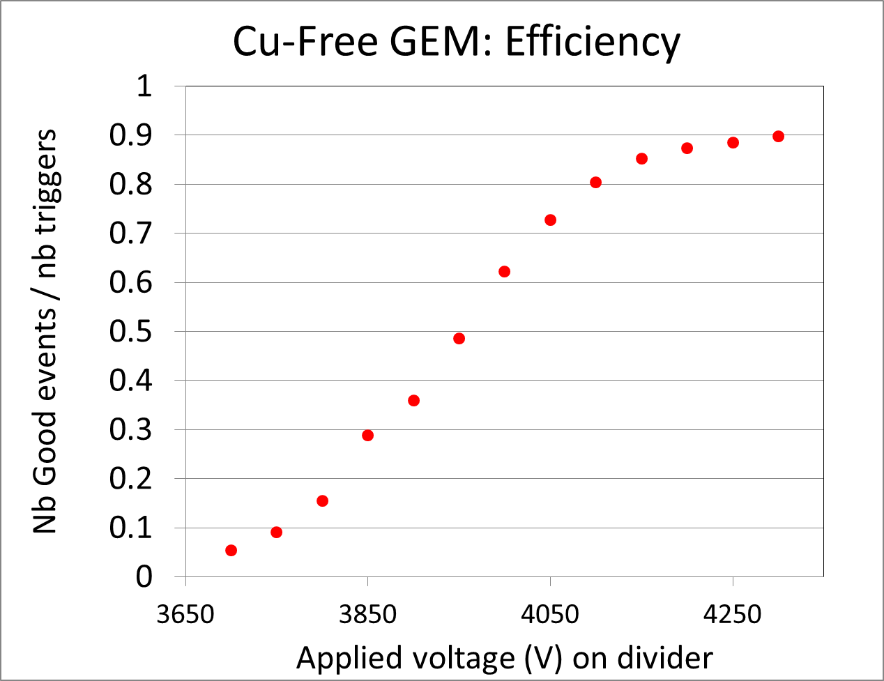
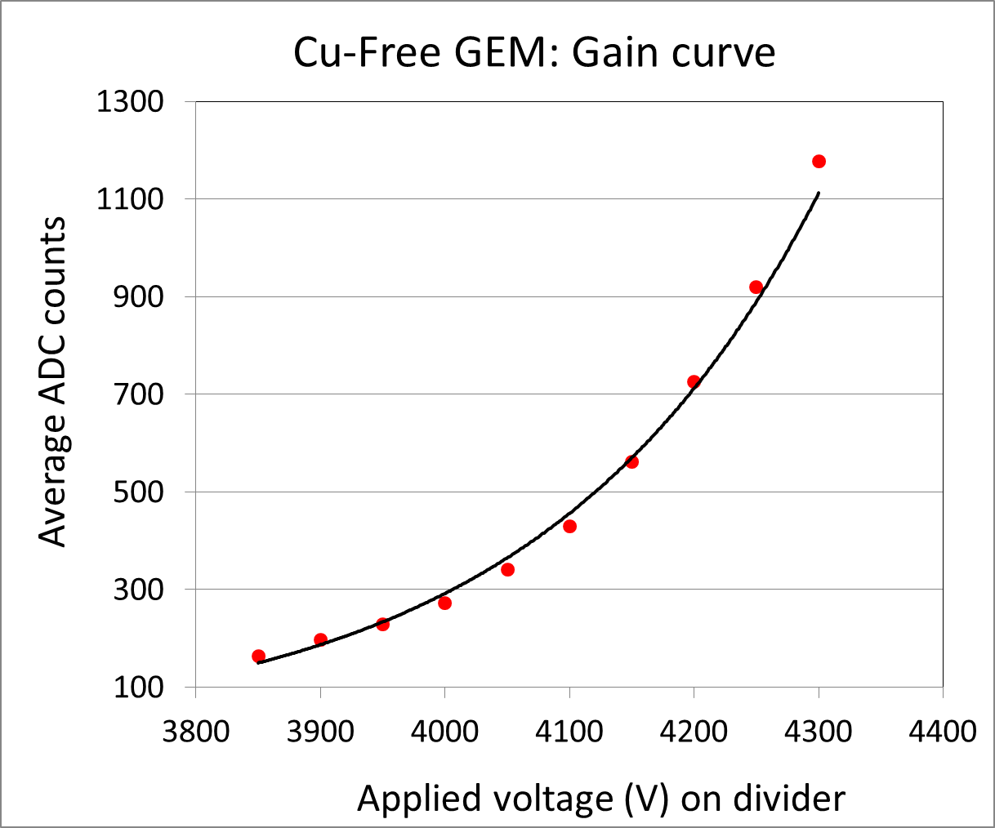
GEM R&D: Preliminary tests of Cu-Free GEM
Tests with Cosmics
HV scan with Sr90 source
Good performances of the Cu-free GEM
Need to study spark rate and ageing of the foil
High rate and long term performance study will be done with our x-ray source
Investigate Cu-less COMPASS-like readout board

Slide 15
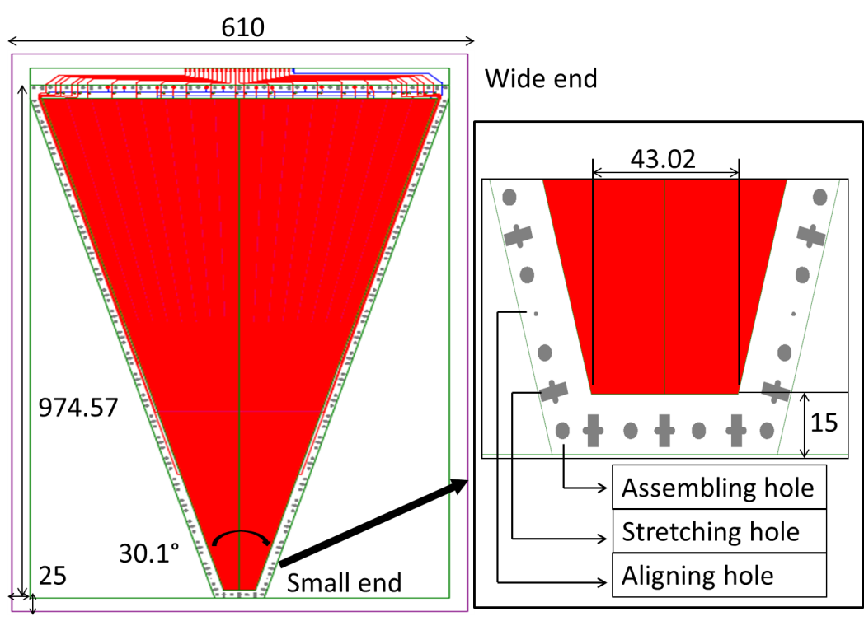
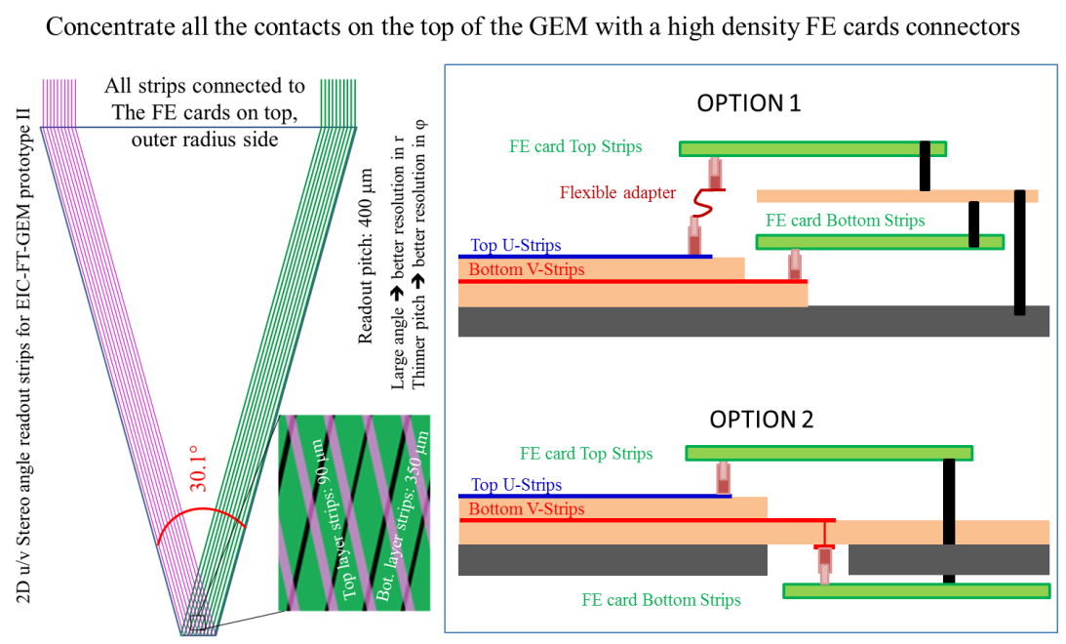
GEM R&D: EIC-FT-GEM prototype II
EIC GEM prototype II:
Common GEM foil design between UVa, Florida Tech (FIT) and Temple Univ. (TU) (Aiwu’s talk)
Satisfy the requirements and constraints from 3 different assembly assembly
Low mass and light detector
Reduce overall the material budget, Investigate copper less GEM
New detector construction technique
Possibility to re open the detector to replace parts
New u/v strips readout design
Finer pitch to improve spatial resolution, all connectors for FE electronics at the outer radius
Common GEM foil UVa, FIT and TU (Aiwu’s talk)
u/v strips readout board

Slide 16
Summary
Large GEM R&D and Production Activities at UVa
Production of the SBS Back Trackers GEM modules
First pre-R&D prototype for EIC forward tracker GEM (successfully tested @ FTBF)
Assembly of the largest GEM for pRad experiment is ongoing
New ideas for on large GEMs
New assembly technique been tested ➔ possibility to re-open large size triple-GEM chamber
Reduce overall the material budget, Investigate copper free GEM foils
EIC-FT-GEM prototype II
Common GEM foil design shared with FIT and TU
Upgrade of the U/V readout design with finer pitch to improve spatial resolution and all connectors for FE electronics at the outer radius

Slide 17
Backup

Slide 18
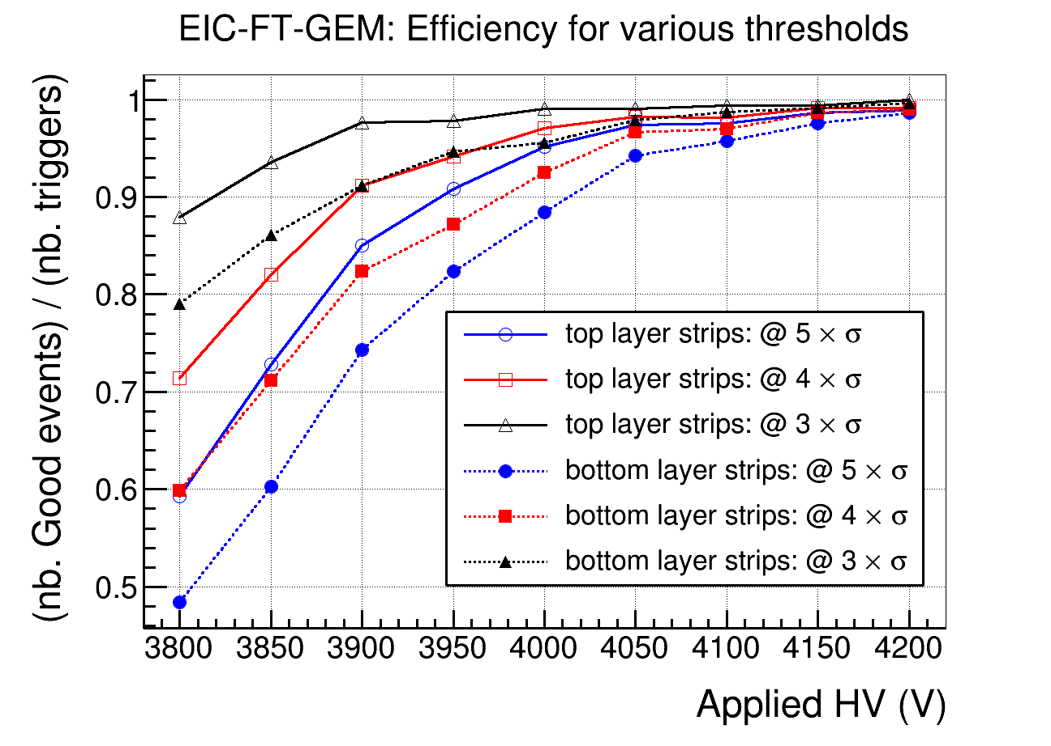
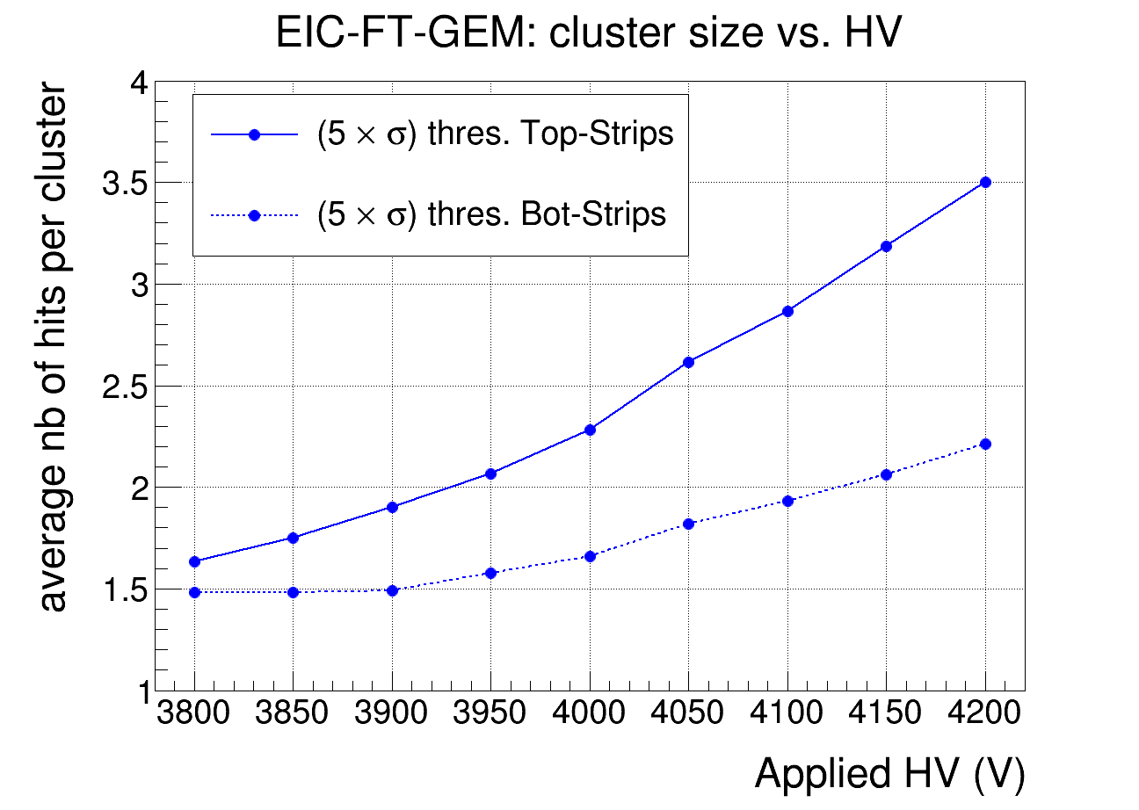
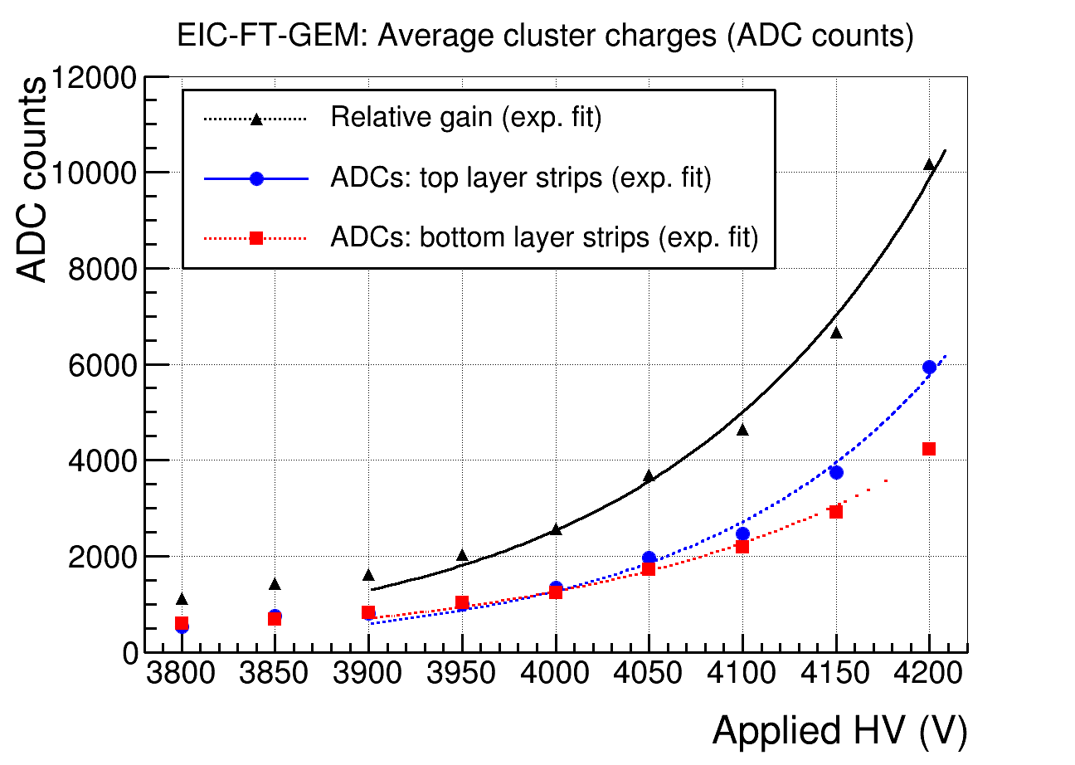
EIC-FT-GEM @ FTBF: Performances
SBS-BT-GEM
Efficiency
EIC-FT-GEM
Cluster size vs. HV
ADC vs HV

Slide 19
pRad Readout board support

Slide 20
Proton Radius Experiment pRad @ JLab
Slide from M. Kohl
EINN2013, Paphos, Cyprus 2013

Slide 21
Proton Radius Experiment pRad @ JLab
Slide from M. Kohl
EINN2013, Paphos, Cyprus 2013

