Slide 1

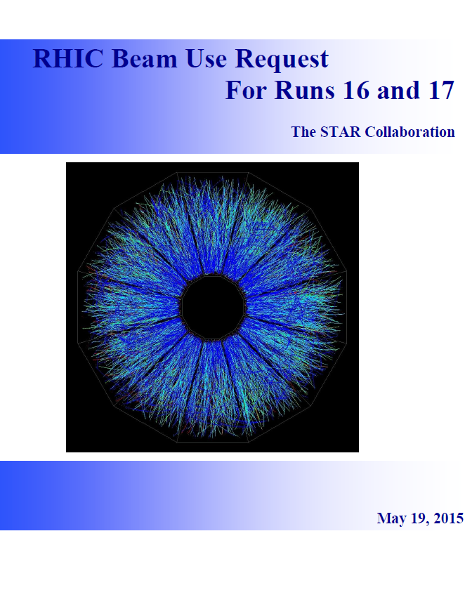

Zhangbu Xu
(Brookhaven National Lab)
Highlights
Performance in run15
BUR Heavy-Flavor Program
BUR on Spin (sign change)
BUR on Isobars (chiral effect)
BUR on Au+Au 62,
d+Au miniBES (jet quenching)
Summary
https://drupal.star.bnl.gov/STAR/starnotes/public/sn0625
https://drupal.star.bnl.gov/STAR/star-run-16-17-bur

Slide 2
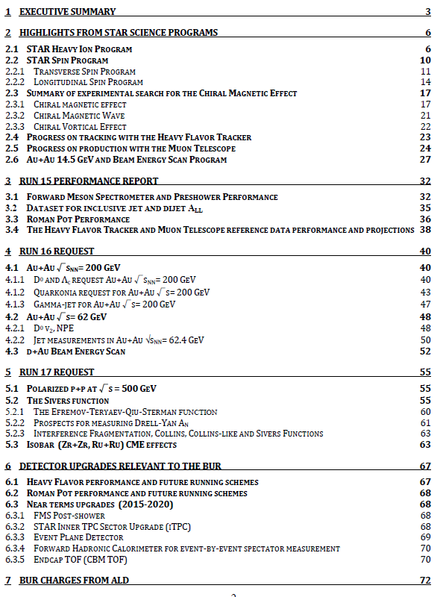
Zhangbu Xu
(Brookhaven National Lab)
https://drupal.star.bnl.gov/STAR/starnotes/public/sn0625
https://drupal.star.bnl.gov/STAR/star-run-16-17-bur

Slide 3
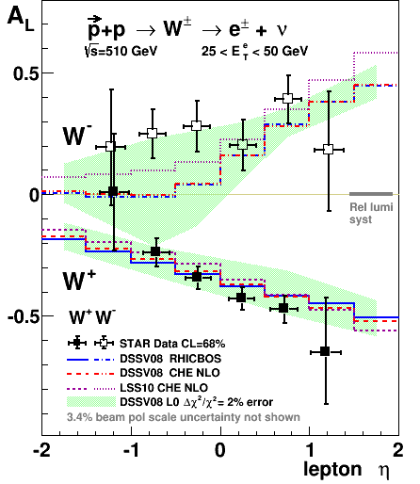
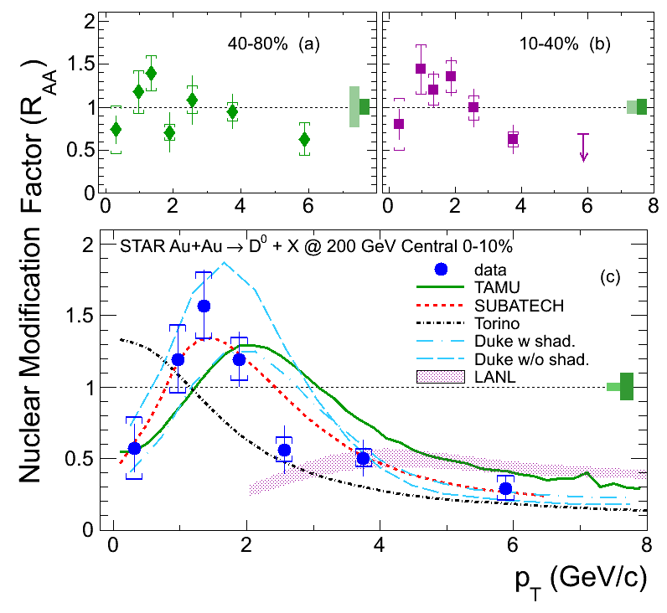
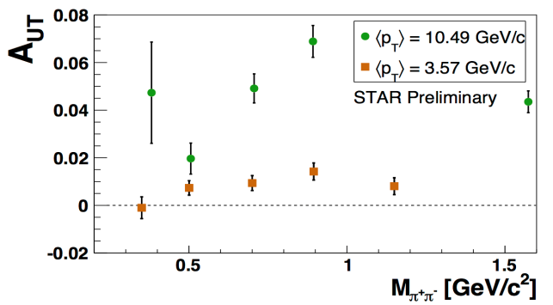
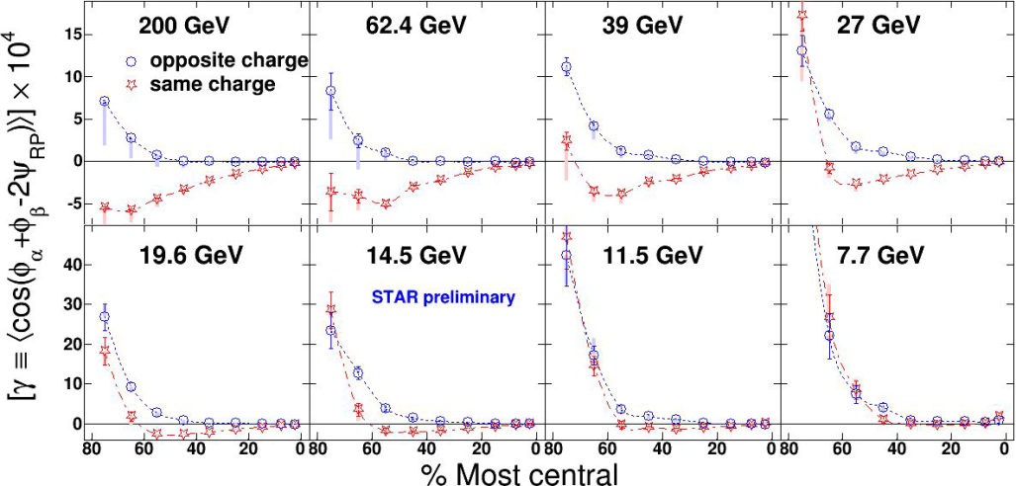
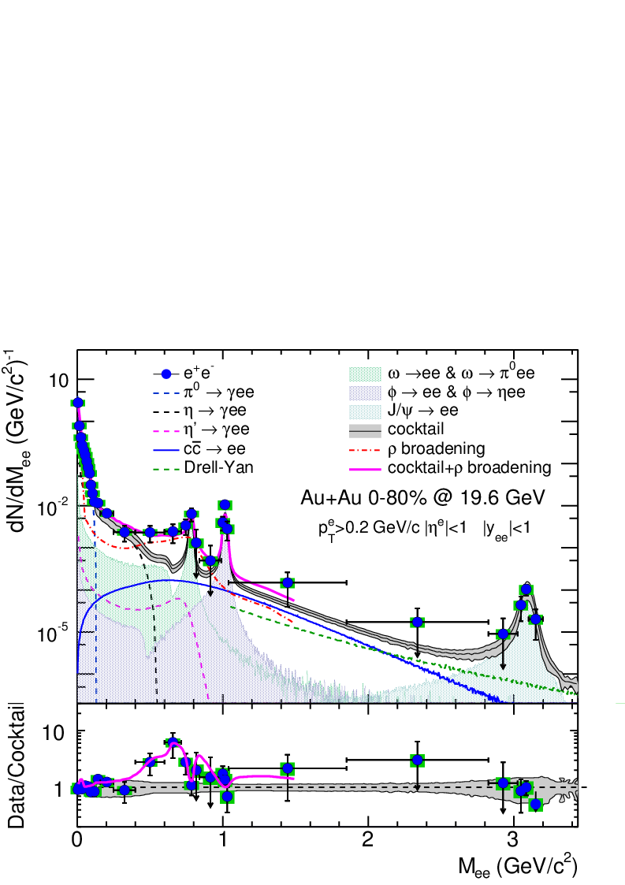
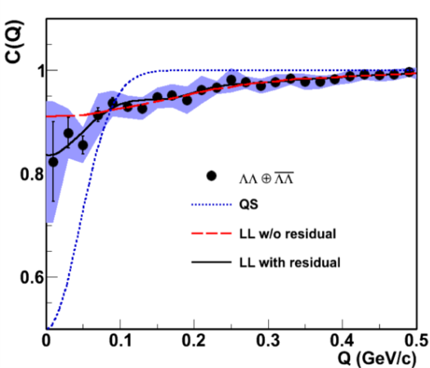
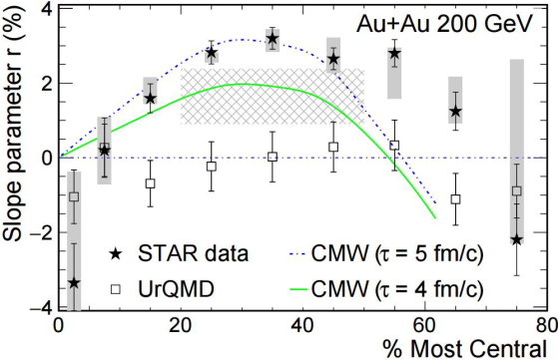
Spin Highlights:W^{+/-}, IFF
Open charm, Upsilon R_{AA}
d+Au dihadrons (2 PLB)
Three new papers on dileptons

Slide 4
BUR charges
From: Mueller, Berndt
Sent: Tuesday, March 31, 2015 9:58 PM
To: James Nagle; Morrison, David; Xu, Zhangbu; Ernst Sichtermann
Cc: Roser, Thomas; Fischer, Wolfram; Dunlop, James C
Subject: BURs for Run 16 & 17
Dear RHIC Spokespersons:
I am writing again to update my request for the beam use requests for the coming RHIC runs.
In consultation with the Office of Nuclear Physics we have decided to make a change to the future RHIC run schedule. Specifically, we now plan to run RHIC in both FY16 and FY17, followed by one year (FY18) without a RHIC run during which the low energy RHIC electron cooling (LEReC) system will be installed. The high statistics Beam Energy Scan II is then planned for the years FY19 and FY20. The modified plan will allow for a less aggressive schedule of the LEReC project. It will also relax the conflict between the heavy ion and spin physics programs of RHIC that remained unresolved at last year’s PAC meeting.
I request that you submit the annual beam use requests by May 19, 2015. The BURs should be for a 22-week RHIC run in FY16, and either a 15-week or a 22-week RHIC run in FY17.
I also ask the STAR Collaboration to present the iTPC proposal to the PAC and to provide an update on experimental efforts aimed at exploring possible phenomenological manifestations of the chiral magnetic effect.
Both collaborations should present a tentative schedule for the release of results from the data taken in runs 13 and 14 (p+p, Au+Au 15, Au+Au 200, 3He+Au).
Thanks, Berndt

Slide 5
Executive Summary Table
Run | Energy | Duration | System | Goals | priority | Sequence
16 | √s_{NN}=200 GeV √s_{NN}=62 GeV √s_{NN}=19.6 GeV | 13-wk 4-wk 1-wk | Au+Au Au+Au d+Au | Λ_{c}, D v₂, R_{AA}, ϒ R_{AA} 10nb⁻¹, 2billion MB 1.5B MB (1B w/ HFT) 100M MB | 1 4 4 | 1 2 3
17 | √s = 510 GeV √s_{NN}=19.6 GeV √s_{NN} =200 GeV √s_{NN}=200 GeV | 11 wk 1-wk 3-wk 3-wk | Transverse p+p p+p Ru+Ru Zr+Zr | A_{N} of W±, γ, Drell-Yan, L=360 pb⁻¹, 55% pol 400M MB 1.2billion MB 1.2billion MB | 2 4 3 3 | 1 2 3 4
In each scenario, the data requirements for STAR’s two top priority scientific goals will be met. In no scenario can all the data needs for all programs be met in runs 16 and 17

Slide 6


STAR Detector System
15 fully functioning detector systems
EEMCESMD
Magnet
MTD
BEMC
BSMD
TPC
TOF
BBC
FMS
FPS
RP
ZDC
HFT
X10³ increases in DAQ rate since 2000, most precise Silicon Detector (HFT)

Slide 7

2014 BUR ➔ RUN 15
Run | Energy | Duration | System | Goals | priority | sequence
15 | √s_{NN}=200GeV √s=200GeV | 5-week 12-week | Transverse p+Au 1) p+p 2) transverse 6 weeks 3) longitudinal 6 weeks | saturation physics, ridge and reference, L=300 nb⁻¹ 1) HI reference L=90 pb⁻¹, 500M MB 2) Study transversity, Sivers effects L=40 pb⁻¹, 60% pol. 3) Study Δg(x) L=50 pb⁻¹, 60% pol. | 1 2 2 | 3 2 1
16 | √s_{NN}=200GeV √s=510GeV | 10-week 7-week | Au+Au Transverse p+p | Λ_{c}, D v₂, R_{AA}, ϒ 10nb⁻¹, 2billion MB A_{N} of W±, γ, Drell-Yan, L=400 pb⁻¹ | 1 2 | 1 2
2014
BUR

Slide 8
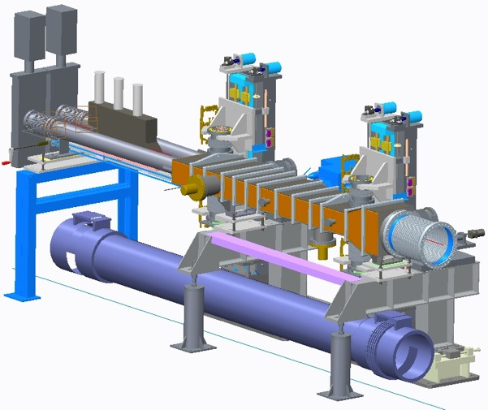
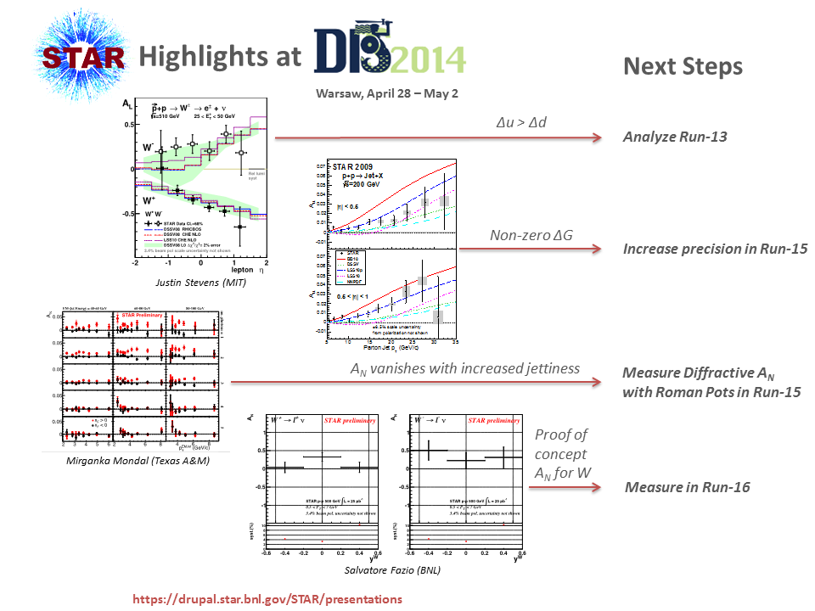
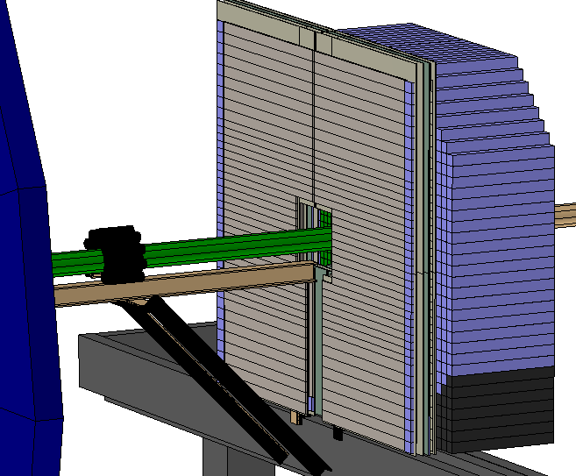
Spin Program Highlights and Upgrades
Roman Pot
FMS+preshower

Slide 9
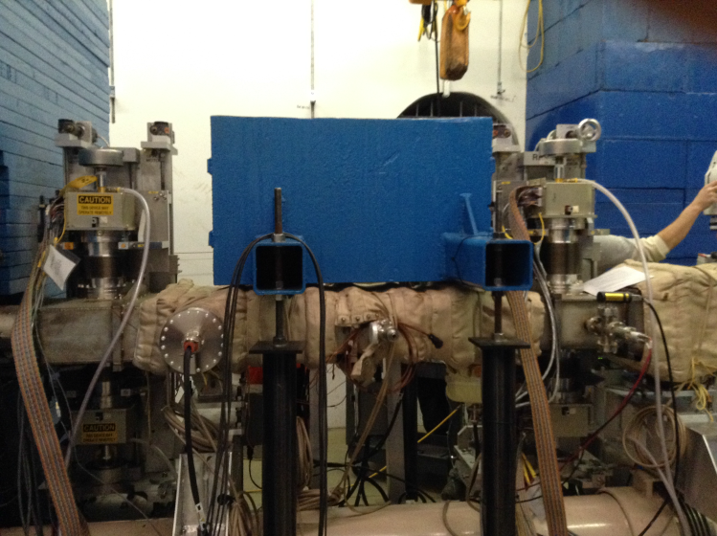
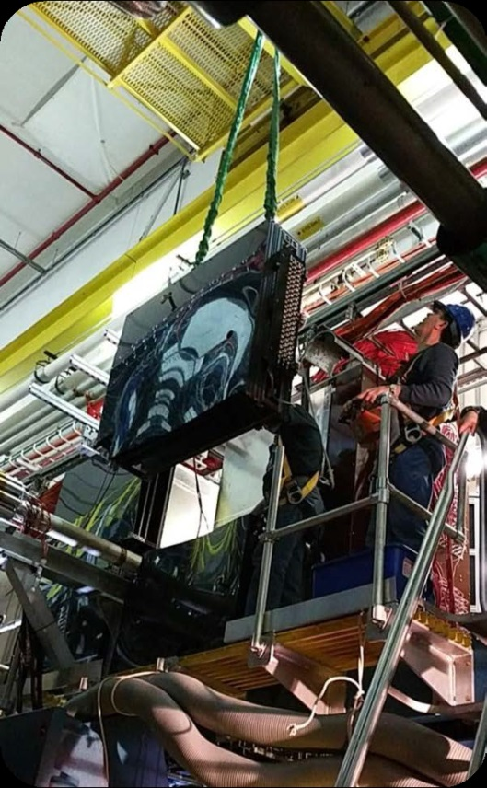
Spin Program Upgrade and Successes
Roman Pot
FMS+preshower

Slide 10
Run 15 Timeline to date
January 13th: Started two person Shifts, and started flowing flammable gases for Cosmic Ray testing and data accumulation.
January 20th: RHIC Cooldown to liquid Helium temperature starts, turned on STAR Magnet, continued Cosmic Ray commissioning and data taking.
January 25th: First overnight RHIC beams for Collider commissioning.
February 3rd: Started four person Shifts at STAR.
February 7th: First Overnight collisions for Experiment set up.
February 10th: Physics running declared by RHIC
February 12th: STAR starts “longitudinal” 200 GeV pp physics data program.
March 3rd: Problem with Spin Rotator settings for STAR resolved.
March 5th: STAR starts Transverse 200 GeV pp physics data program.
March 17th: STAR asks for a 2 wk extension to pp program to allow for coming back to pp longitudinal data. Approved on March 24th.
April 3rd: Transverse pp program ends, Longitudinal pp program begins.
~ Mid April: Short pp total & elastic cross section measurement.
April 27th: Longitudinal pp program ends. p-Au setup begins.
May 5th: STAR p-Au physics data set accumulation begins
May 20th: Fixed Target AuAu test
June 8th: p-Au run ends, p-Al setup begins (p+Au about 30% above our goals)
June 22nd: p-Al program ends. Run 15 Beam Operations end
Key: SETUP pp 200 Long pp 200 Trans p-Au p-Al

Slide 11
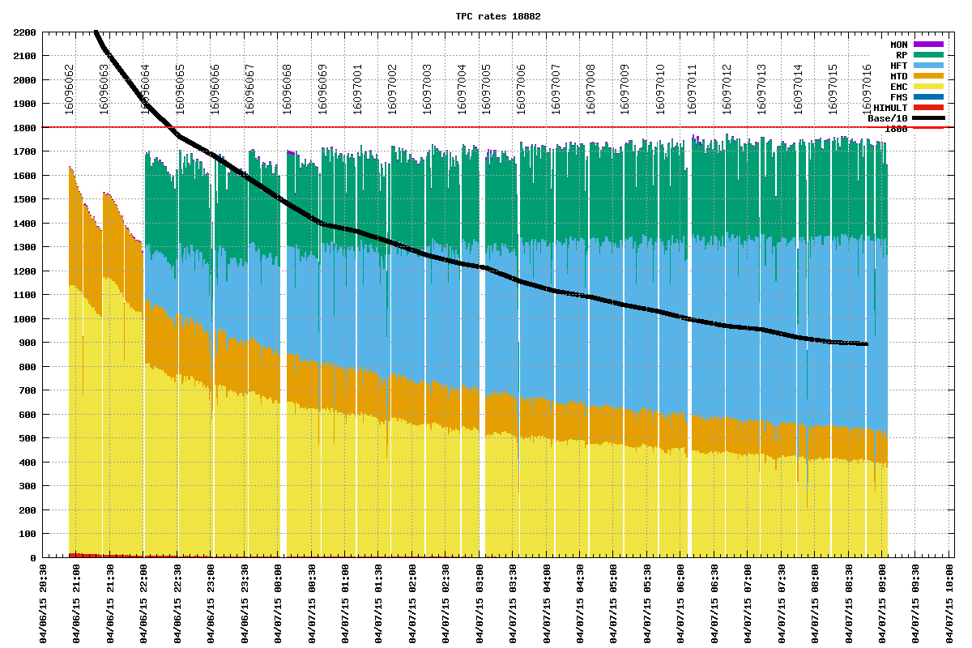
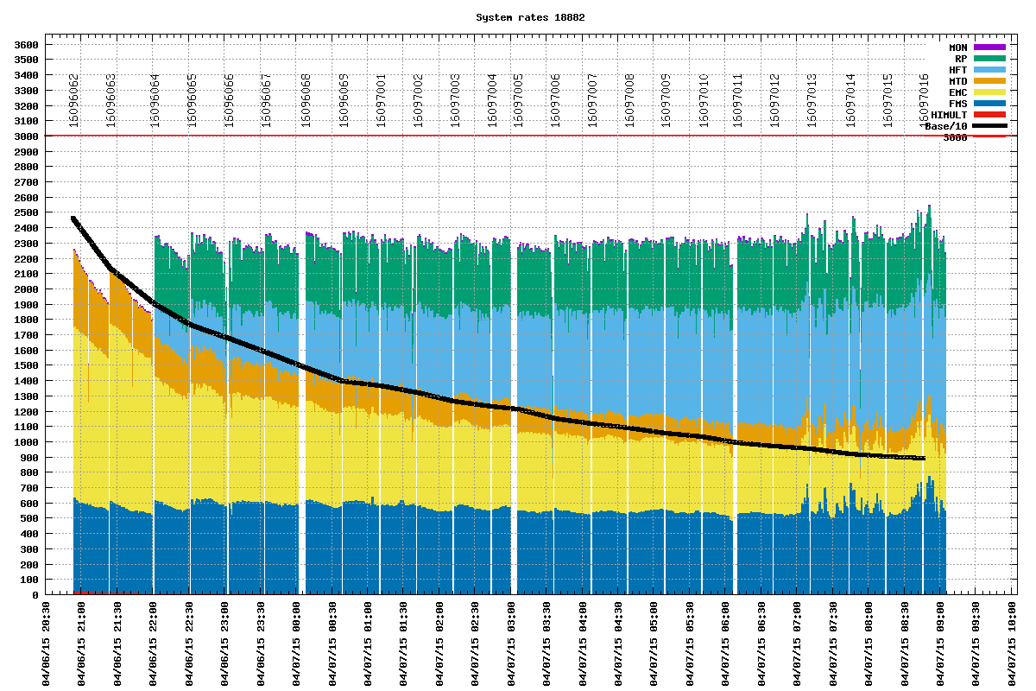
Allocate bandwidth to programs
Trigger rate with TPC
Total Trigger rate
Roman Pots
HFT
MTD
Jets&HT
FMS
pp200
Designed and implemented by Jeff Landgraf.
Linked from Trigger versioning page
http://online.star.bnl.gov/RTS/plots/storedPlots.php

Slide 12
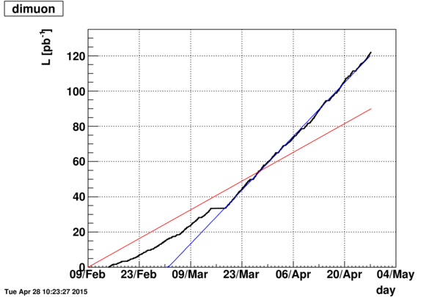
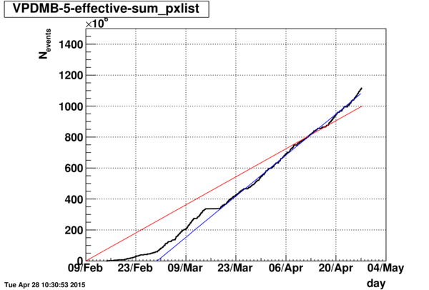
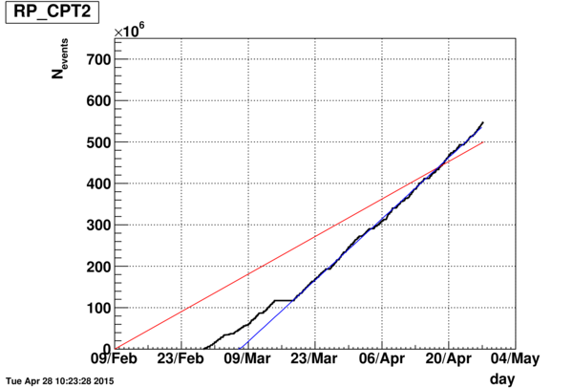
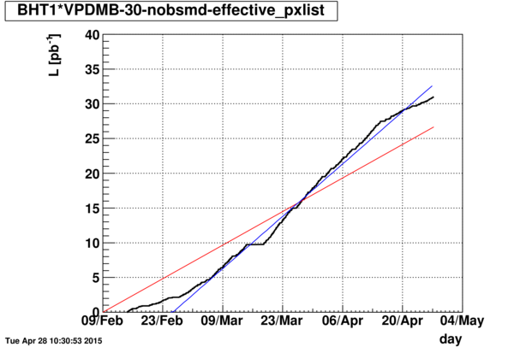
Unpolarized 200 GeV pp Goals
Di-Muons
~ 135% of Goal
HFT Min-bias
~ 115% of Goal
✓
✓
Roman Pot Central Production
~ 112% of Goal
HFT High P_{t}
~ 115% of Goal
✓
✓
All unpolarized 200 GeV pp Data Set Goals Exceeded

Slide 13
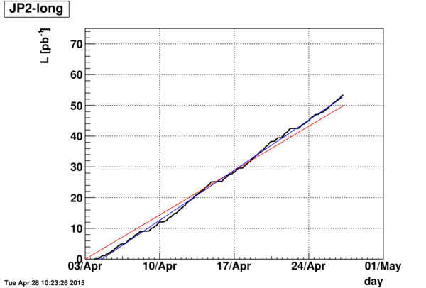
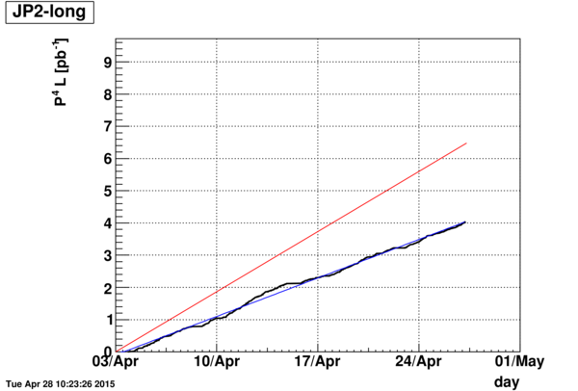
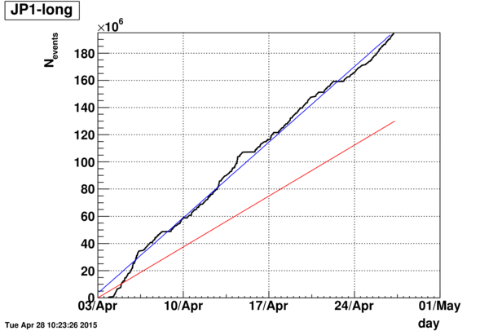
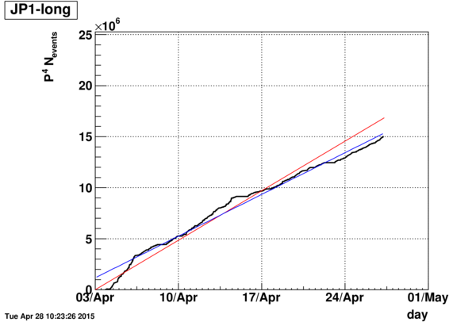
Longitudinal 200 GeV pp Goals
JP2 INT. L
~ 108% OF GOAL
JP2 FOM
~ 60% OF GOAL
JP2 Goal:
L = 50 pb⁻¹
P = 60%
P4 * L = 6.5 pb⁻¹
✓
X
UN PRESCALED
JP1 INT. L
~ 150% OF GOAL
JP1 FOM
~ 88% OF GOAL
✓
~✓
PRESCALED
THE LOWER THAN EXPECTED POLARIZATION PREVENTED REACHING THE JP2 FOM GOAL

Slide 14
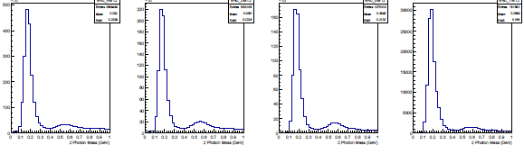
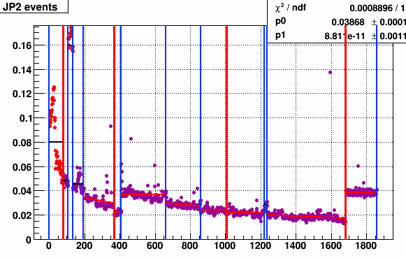
FMS Performance in Run 15
Oleg Eyser, Users’ Meeting
For the STAR Collaboration
Invariant mass distributions in 𝑝 + 𝐴u
^{𝐸}𝛾𝛾
= 40 GeV/𝑐²
Similar or better in 𝑝 + 𝑝 collisions
𝒑_{𝑻} = 𝟑. 𝟐
𝟑. 𝟖
𝟒. 𝟓
𝟓. 𝟓 GeV/𝒄
invariant mass (0 → 1 GeV/𝑐²)
Trigger performance
jet patch 2 (high-𝑝_{𝑇})
The FMS is in its best shape!
Gains balanced for 𝑝_{𝑇} triggering
Online Gain used
Signs of radiation damage
(not unexpected)
run index

Slide 15
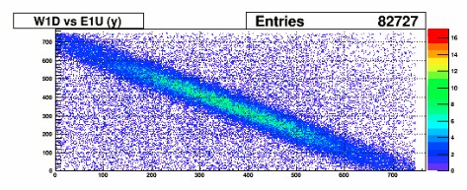
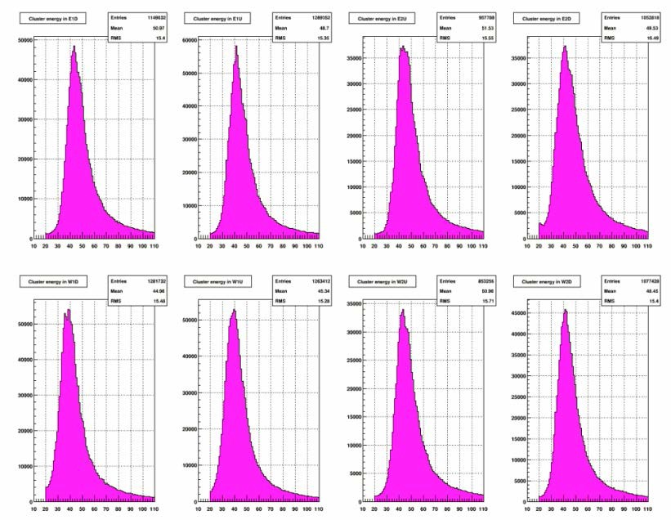
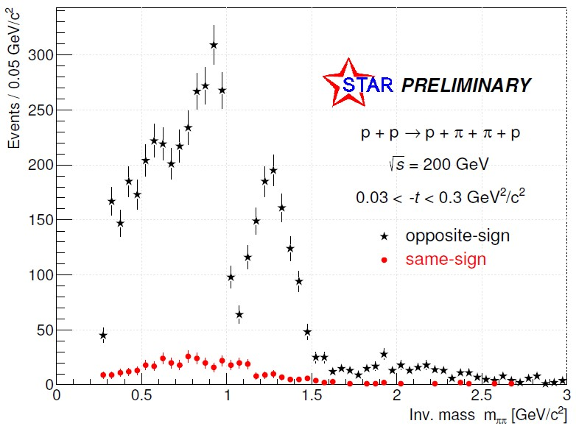
Roman Pot Performance in Run 15
Collinearity: elastic 𝑝 + 𝑝 scattering
𝑑𝐸/𝑑𝑥 in all layers
Central exclusive production
no acceptance correction, statistical uncertainties only
𝑝_{𝑇,𝑚𝑚𝑚𝑚} < 0.1 GeV/𝑐
Very successful operation
  pp2pp team & shift crew
Fast-offline alignment studies

Slide 16
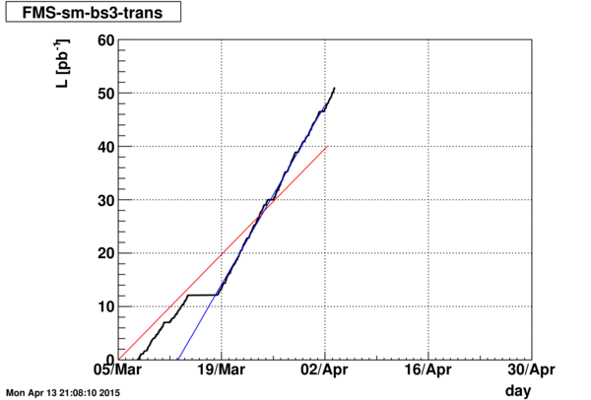
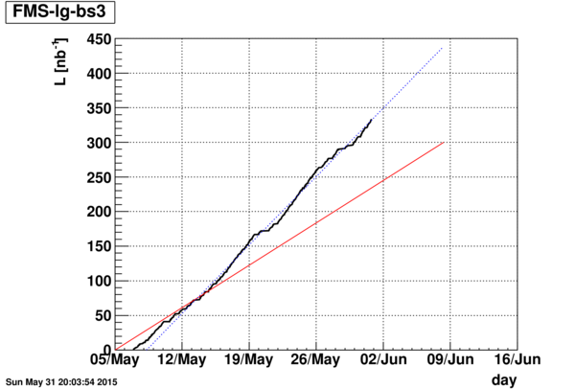
FMS Projections from offline analyses
A_{N} Errors from 2015 Transverse pp run
For collected ∫ Luminosity = 49 pb⁻¹ of p-p running
70 GeV (xF = 0.7)
60 GeV (xF = 0.6)
50 GeV (xF = 0.5)
40 GeV (xF = 0.4)
30 GeV (xF = 0.3)
20 GeV (xF = 0.2)
A_{N} Errors from 2015 Transverse p-Au run
For collected ∫ Luminosity = 0.350 pb⁻¹ of p-Au running
From analyses of >50% of the collected data,
A_{N} π⁰ projection to full dataset

Slide 17
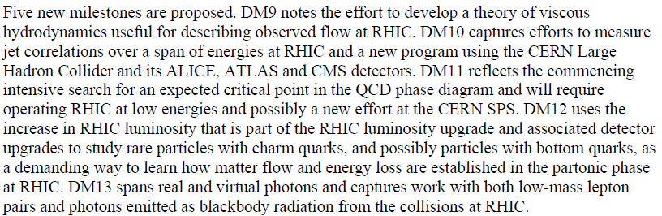
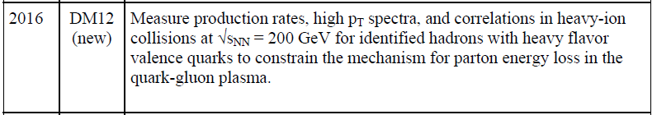
Run 16 Heavy-Flavor Program BUR and Projections

Slide 18
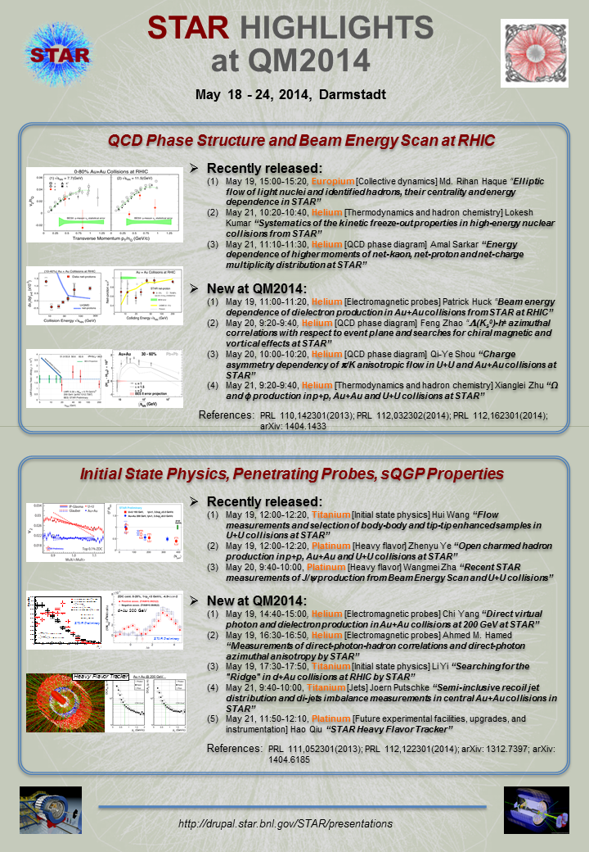
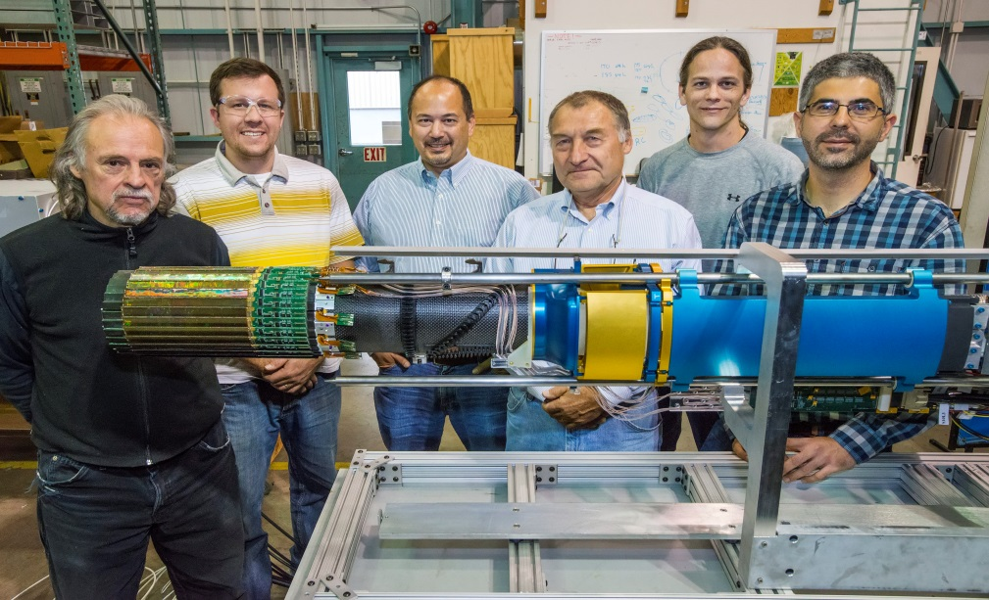
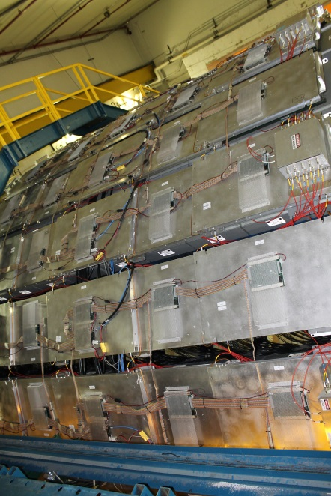
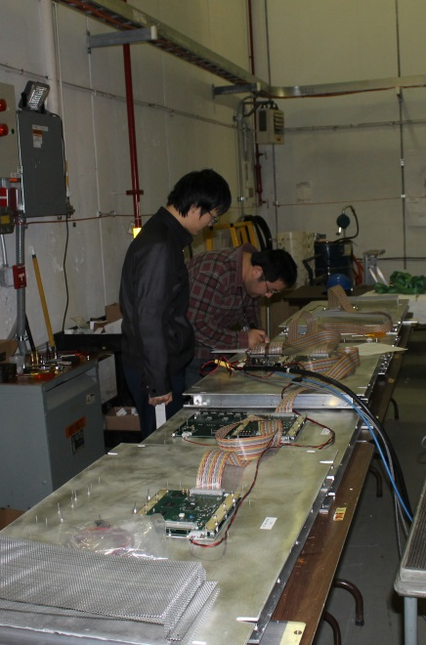
Results, technologies and
people who made it happen
https://drupal.star.bnl.gov/STAR/presentations

Slide 19
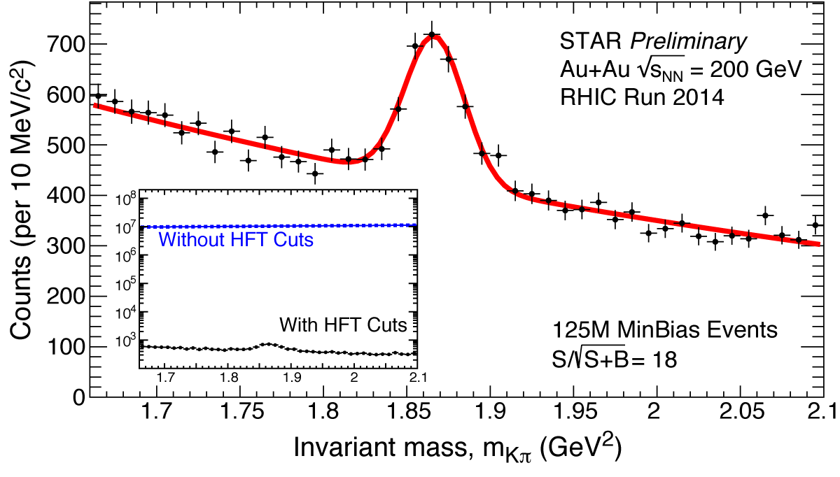
Results, technologies and
people who made it happen

Slide 20
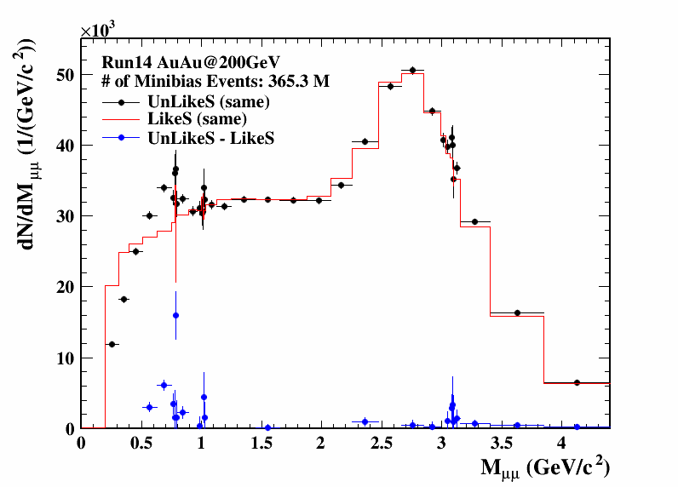
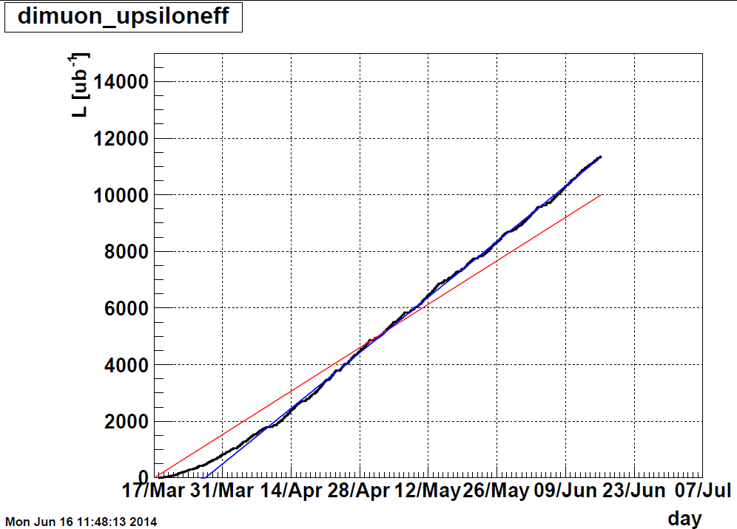
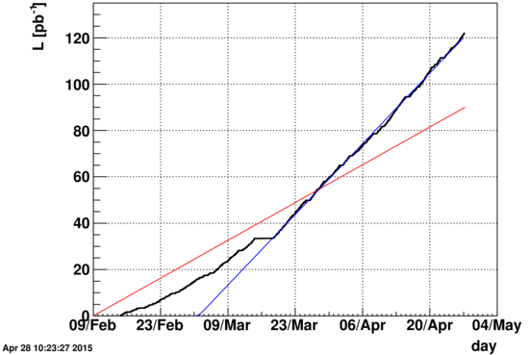
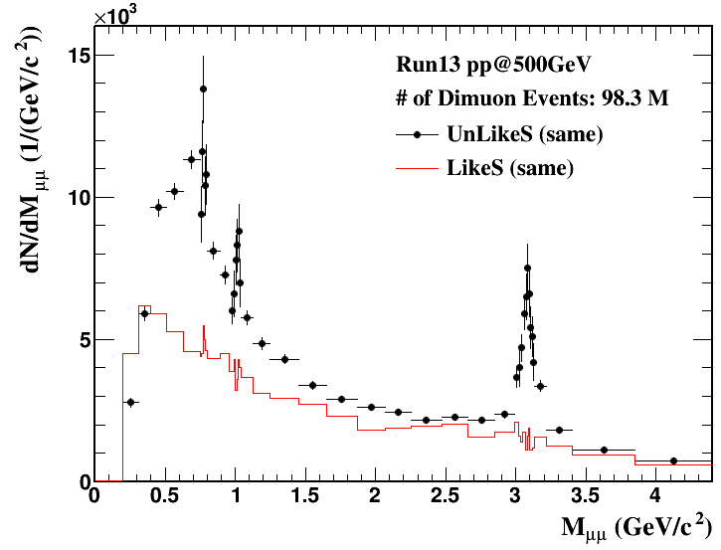
Run 13+14+15 dataset and status
Dimuons in Au+Au and p+p runs
Preview of MTD dimuon
Run14 Au+Au
STAR Preliminary
Run15 p+p
STAR Preliminary

Slide 21
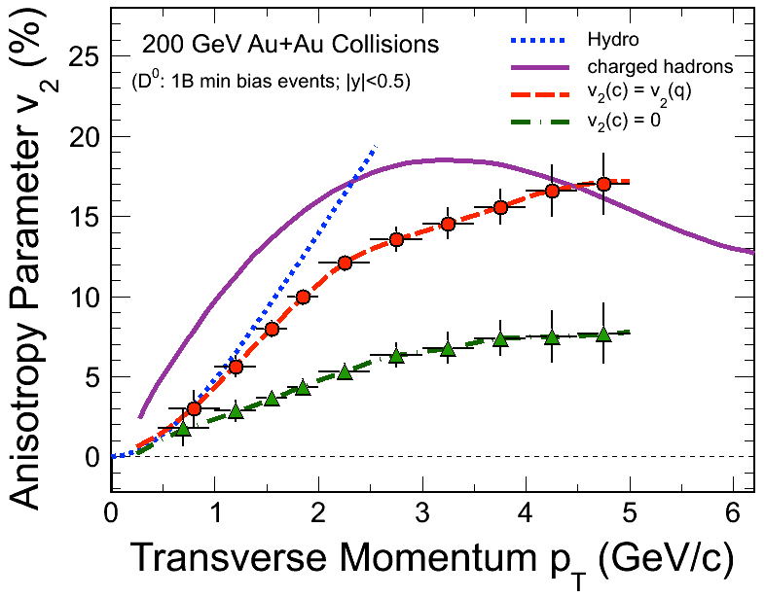
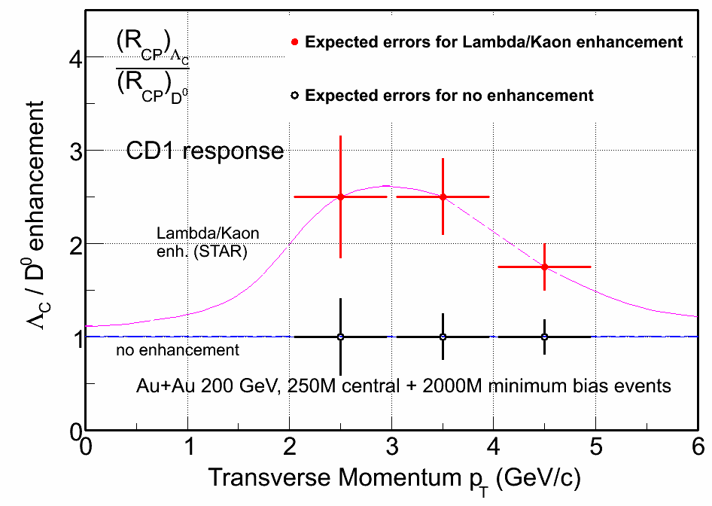
Open charm flow and coalescence
HFT Projection for Au+Au run14 + run16
Quantify charm quark flow and coalescence:
Charmed baryon enhancement?
Centrality Dependent of charm v₂

Slide 22
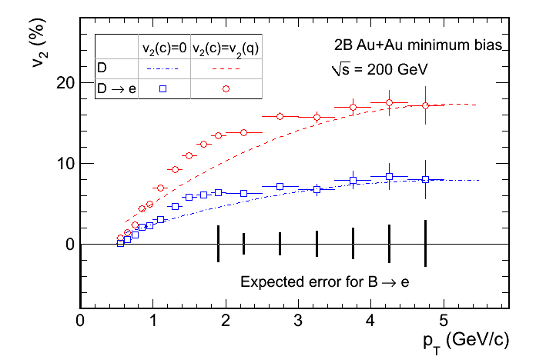
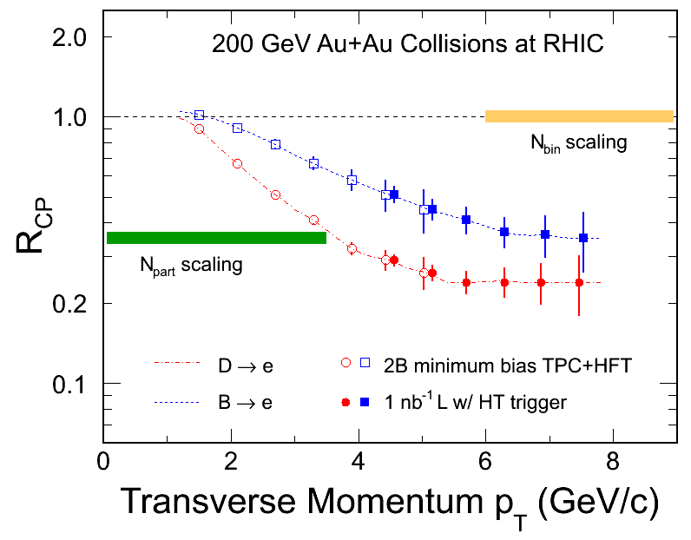
Separate charm and bottom
Use semileptonic decay of open charm and bottom

Slide 23
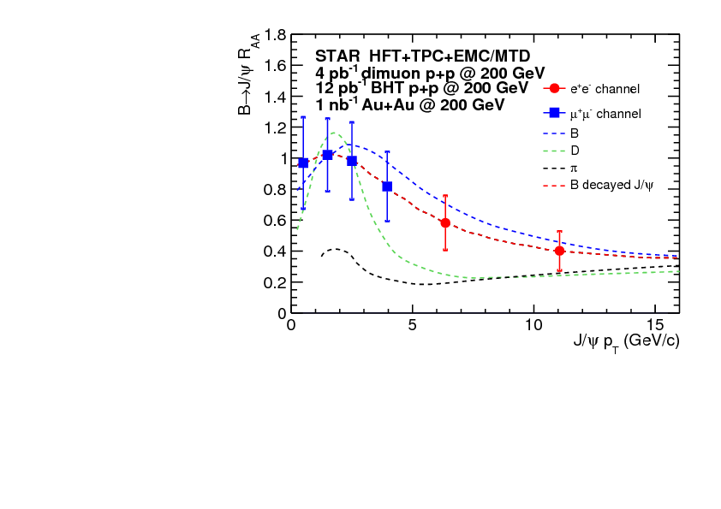
Medium Effect on Open Bottom
HFT+MTD:
B→J/ψ→μ+μ−
Exploration of Open Bottom dynamics
Decay channel with more tightly correlated kinematics
And clean separation from charm decay

Slide 24
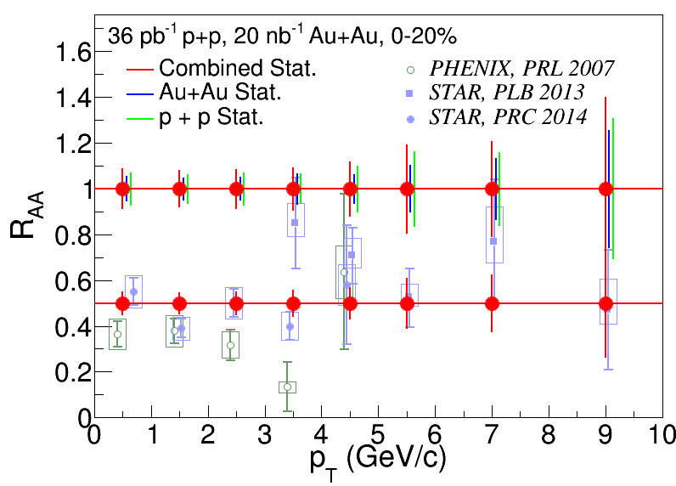
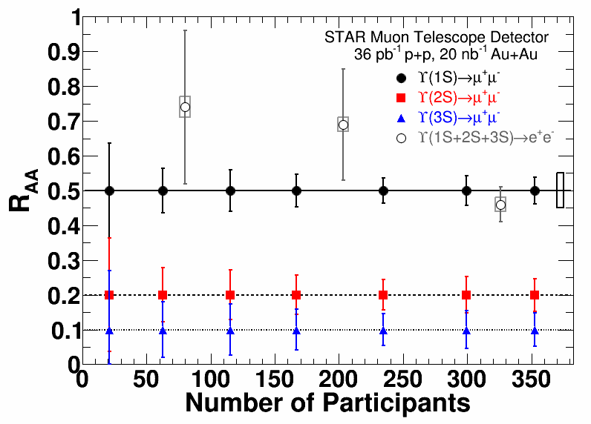
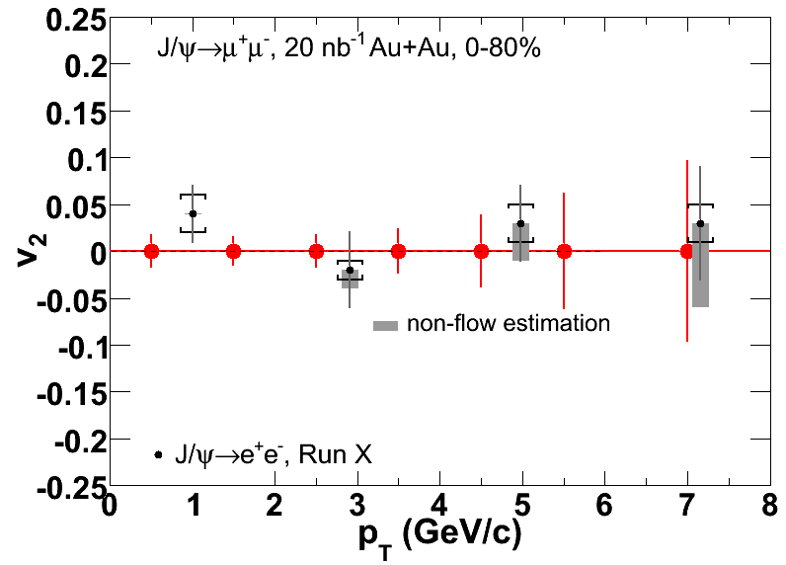
Run14+16 Quarkonium Measurements
MTD: Improves statistical uncertainty
As well as systematic uncertainty
Separate Upsilon states

Slide 25


Run16 Detector Improvements
HFT = PXL+IST+SSD
The detector installed in run14 is built with
Cu-Cable; run15-16 for all inner ladders with thin
Al cable
Online Vertex Resolution improvement with new
QT electronics
Figure of Merit x6 over run14
Run14 Au+Au

Slide 26


HFT operation mode in run16
Run16 projection
run14
Limitation of options in operation mode
<55KHz to reduce deadtime and LU rate
Store length for optimized luminosity
Perform dynamic beta* squeeze
Projection from this mode:
1.8nb⁻¹/week delivered for MTD and 2 billion MB for HFT
requires 13 weeks of operation

Slide 27
The Evolution of STAR Spin
2016-2017 STAR Beam Use Request
Run | Energy | Duration | System | Goals | priority | Sequence
16 | √s_{NN}=200 GeV √s_{NN}=62 GeV √s_{NN}=19.6 GeV | 13-wk 4-wk 1-wk | Au+Au Au+Au d+Au | Λ_{c}, D v₂, R_{AA}, ϒ R_{AA} 10nb⁻¹, 2billion MB 1.5B MB (1B w/ HFT) 100M MB | 1 4 4 | 1 2 3
17 | √s = 510 GeV √s_{NN}=19.6 GeV √s_{NN} =200 GeV √s_{NN}=200 GeV | 11 wk 1-wk 3-wk 3-wk | Transverse p+p p+p Ru+Ru Zr+Zr | A_{N} of W±, γ, Drell-Yan, L=360 pb⁻¹, 55% pol 400M MB 1.2billion MB 1.2billion MB | 2 4 3 3 | 1 2 3 4

Slide 28

NSAC Milestone (HP12)
Notes:
Here you want to show the 2009 200 GeV data which has placed the strongest constraints to date and its excellent agreement with the 2012 data which opens the door to lower x data.

Slide 29

NSAC Milestone (HP8)
First significant evidence that u and d anti-quark spin distributions are significantly different.
Notes:
By introducing the milestones first you can show that we have met them and the exceptional physics that comes out of meeting the milestones. When we get to the Sivers sign change milestone this will only add to the importance of making this measurement by putting it on the same foot as the DeltaG and W.

Slide 30


NSAC Milestone (HP13)
✓
✓
A_{N} of W±,γ, DY in pp 510 are all sensitive to the Sivers sign-change.
STAR can access all three world-class measurements in the proposed 2017 Run – Significant discovery potential before 2020!
Notes:
Not written here but you need to say verbally that one of the more interesting and important tests for these relations between single transverse spin in pp and SIDIS is sign of the Sivers function and we have access to that in A_N of W, gamma and DY.

Slide 31

SN0617 : a case for run16 pp510 (supplementary material)
January 2015
run17
2014 PAC Recommendation:
The p+p goals should address the DOE milestone HP13. The PAC encourages more interactions between theory community and experimental collaborations to address the TMD evolutions which is critical for evaluating experimental sensitivities for possible p+p run at 510 GeV in 2016.
https://drupal.star.bnl.gov/STAR/starnotes/private/psn0617

Slide 32

Why is the verification of the Sivers sign change so important?
Previous milestones concerned the gluon and antiquark helicity distributions. These are leading twist collinear PDFs.
The Sivers function encapsulates the correlation between the transverse momentum of the partons inside of the proton with the spin of the parent proton
The Sivers function is just one example of a Transverse Momentum Dependent distribution function.
Theoretical tools needed to interpret leading twist PDFs within a collinear framework are well established.
For TMDs we need to build a new framework. Tools such as factorization, evolution, universality need to be reformulated and tested.
Interest in TMD’s not isolated to just the spin community, but also in the broader QCD and LHC community.
RHIC has a unique and critical role to play in this story.
Notes:
The leading order expressions for the transverse momentum distribution of the Higgs+jet pair are provided in terms of transverse momentum dependent distributions. LHC can look at hadronic variables but RHIC is unique because it is at lower sqrt(s) and can test polarized distributions.

Slide 33

TMD Observable W⁺/W⁻ A_{N}
First measurement from limited 2011 dataset.
Fully reconstructed W using recoil jet methods.
Precision measurement proposed for Run 17
Phys.Rev.Let. 103, 172001 (2009)
PoS DIS2014 237 (2014)

Slide 34
TMD Evolution – terra Incognita
Without Evolution
One example “With” Evolution
J. Collins and T. Rogers, Phys.Rev. D91 (2015) 7, 074020
The yellow bands represent the uncertainties for the asymmetry. At negative rapidity this uncertainty is driven by the currently unconstrained sea quark Sivers functions. STAR will make the FIRST measurement of the anti-quark up and down Sivers.

Slide 35


Another TMD Observable: Drell-Yan e⁺e⁻
Propose to add post-shower to newly refurbished Pb-Glass FMS and recently commissioned scintillator pre-shower detector.
Simulate response of detector package to pions and electrons, collecting energy deposited in 3 pre-shower layers, FMS tower and post-shower layer.
Use multivariate analysis techniques to achieve hadron rejection powers of 800-14,000 for hadrons of 15 to 60 GeV while maintaining 90% electron detection efficiency.
pp510

Slide 36


Another TMD Observable: Drell-Yan e⁺e⁻
The orange square: achievable statistical precision for A_{N} DY asymmetry with 400 pb⁻¹
the theoretical prediction for the Sivers asymmetry A_{N} as a function of DY lepton-pair rapidity at √s=500 GeV, before any TMD evolution is applied.
Same evolution scheme as in W-Boson
Theoretical predictions for DY for 0 <p_{T} < 1 GeV and 4 < Q < 9 GeV after TMD evolution is applied. The yellow bands represent the uncertainties for the asymmetry.

Slide 37

Twist-3 Observable: Direct photon A_{N}
Measurements of twist-3 observables explore the consistency between TMD and Collinear Twist-3 formalism.
Statistical and systematic uncertainties for the direct photon A_{N} after background subtraction compared to theoretical predictions for √s = 500 GeV.
Notes:
Both PHENIX and STAR have installed preshowers in front of their forward electromagnetic calorimeters the MPC and the FMS. Left is for 200 GeV at PHENIX. Similar error bars will be collected at STAR.

Slide 38

Summary of Sivers Function Tests Planned for STAR
for x ~ 10⁻⁴

Slide 39
Questions we can answer with Run 17
Can the non-universality of the Sivers function between SIDIS and DY-production be experimentally verified?
Test the effects due to TMD evolution on A_{N}?
Do sea quarks have a significant sea quark Sivers function?
Can the relation between the Sivers function and the twist-3 Efremov-Teryaev-Qiu-Sterman (ETQS) distribution function be experimentally verified?
Can the evolution of the twist-3 Efremov-Teryaev-Qiu-Sterman (ETQS) distribution functions be experimentally constrained?
Notes:
I removed these questions because you didn’t talk about Collins or IFF. I think that is fine but probably shouldn’t include here and just reserve for the BUR.
How big are the factorization breaking effects in the Collins channel?
Are the Collins and IFF functions universal? How do they evolve?

Slide 40
pp510 Operation mode for W-boson
STAR TPC event pile-up affects tracking efficiency
The W-boson reconstruction efficiency
was obtained from the data measured in 2011 to 2013.
The highest FoM is reached at a ZDC rate of 300 kHz corresponding to a luminosity of 1.3 x 10³² cm⁻²s⁻¹.
Optimization of delivered luminosity with dynamic beta* squeeze.
Requires 12 weeks to reach 400pb⁻¹

Slide 41
Executive Summary Table
Run | Energy | Duration | System | Goals | priority | Sequence
16 | √s_{NN}=200 GeV √s_{NN}=62 GeV √s_{NN}=19.6 GeV | 13-wk 4-wk 1-wk | Au+Au Au+Au d+Au | L_{c}, D v₂, R_{AA}, ϒ R_{AA} 10nb⁻¹, 2billion MB 1.5B MB (1B w/ HFT) 100M MB | 1 4 4 | 1 2 3
17 | √s = 510 GeV √s_{NN}=19.6 GeV √s_{NN} =200 GeV √s_{NN}=200 GeV | 11 wk 1-wk 3-wk 3-wk | Transverse p+p p+p Ru+Ru Zr+Zr | A_{N} of W±, γ, Drell-Yan, L=360 pb⁻¹, 55% pol 400M MB 1.2billion MB 1.2billion MB | 2 4 3 3 | 1 2 3 4

Slide 42


Results from Chiral Effects
We have published a few papers on possible Chiral Magnetic Effect and potential background
U+U collisions
BES I results on CME
BES II with more statistics
Chiral Magnetic Wave
Chiral Vortical Effect
Talk by Gang Wang on Chiral Effects
PRL on possible Chiral Magnetic Wave

Slide 43
A decisive test with Isobars
CAD was not able to locate enriched Ruthenium-96 source
Run with natural abundance reduces luminosity by x400
Can reach 1Billion events within 3 weeks of operation

Slide 44
Executive Summary Table
Run | Energy | Duration | System | Goals | priority | Sequence
16 | √s_{NN}=200 GeV √s_{NN}=62 GeV √s_{NN}=19.6 GeV | 13-wk 4-wk 1-wk | Au+Au Au+Au d+Au | L_{c}, D v₂, R_{AA}, ϒ R_{AA} 10nb⁻¹, 2billion MB 1.5B MB (1B w/ HFT) 100M MB | 1 4 4 | 1 2 3
17 | √s = 510 GeV √s_{NN}=19.6 GeV √s_{NN} =200 GeV √s_{NN}=200 GeV | 11 wk 1-wk 3-wk 3-wk | Transverse p+p p+p Ru+Ru Zr+Zr | A_{N} of W±, γ, Drell-Yan, L=360 pb⁻¹, 55% pol 400M MB 1.2billion MB 1.2billion MB | 2 4 3 3 | 1 2 3 4

Slide 45


Au+Au at 62GeV
D⁰ v₂ with large statistics uncertainty
Inclusive jet measurements
The PAC considered the options of p+p 510 GeV and a combination of Au+Au and p+p at 62 GeV for the rest of the 7 weeks under a run scenario of 22 cryo-weeks to both be viable. At its 2015 meeting, the PAC will reconsider these requests without prejudice; the STAR and PHENIX collaborations are each asked to present updated physics goals for both of these scenarios.

Slide 46
What if no Isobar possible?
Run | Energy | Duration | System | Goals | priority | Sequence
16 | √s_{NN}=200 GeV √s_{NN}=62 GeV | 13-wk 5-wk | Au+Au Au+Au | L_{c}, D v₂, R_{AA}, ϒ R_{AA} 10nb⁻¹, 2billion MB 1.5B MB, HT | 1 4 | 1 2
17 | √s_{NN}=510 GeV √s_{NN} = 14.5 √s_{NN} = 19.6 √s_{NN} = 39.0 √s = 19.6 | 12-wk 1-wk 1-wk 1-wk 1-wk | Transverse p+p d+Au d+Au d+Au p+p | A_{N} of W±, γ, Drell-Yan, L=400 pb⁻¹, 55% pol 80M MB 100M MB 400M MB 400M MB | 2 4 4 4 4 | 1 5 4 3 2

Slide 47


BES Jet Quenching and dilepton baseline
STAR preliminary
arXiv:1501.05341
one week of data in 2011 at 19.6GeV
A few energy points to figure out
where the jet quenching effect sets in
A few days at each energy (100M events)
Study dilepton yields at LMR
understand reference data
Any excess beyond cocktail
small system collectivity?

Slide 48



d+Au miniBES
A few energy points to figure out
where the jet quenching effect sets in
A few days at each energy (100M events)
Study dilepton yields at LMR
understand reference data
Any excess beyond cocktail
small system collectivity?

Slide 49
What if only 15 weeks in run17?
Run | Energy | Duration | System | Goals | priority | Sequence
16 | √s_{NN}=200 GeV √s_{NN}=62 GeV √s_{NN}=19.6 GeV | 13-wk 4-wk 1-wk | Au+Au Au+Au d+Au | L_{c}, D v₂, R_{AA}, ϒ R_{AA} 10nb⁻¹, 2billion MB 1.5B MB, HT 100M MB | 1 4 4 | 1 2 3
17 | √s=510 GeV √s_{NN}=19.6 GeV | 11-wk 1-wk | Transverse p+p p+p | A_{N} of W±, γ, Drell-Yan, L=360 pb⁻¹, 55% pol 400M MB | 2 4 | 2 1

Slide 50



Detector Upgrades and Performance Improvements
Incremental upgrades/improvements, big impacts
Run15,16,17, 19, 20 (Year2015—2020)
Trigger/DAQ x2 throughput
iTPC upgrade (2018)
replace inner TPC Sectors
Extend rapidity coverage
Better particle ID; Low p_{T} coverage
Proposal: public STAR Note 0619
Roman Pots (2015)
Tag diffractive protons
FMS+FPS
HCAL
Event Plane Detector (2018):
Greatly improved Event Plane Info
Centrality definition
Better trigger
Background rejection
Forward calorimeter instrumentation (2015—2020)
FMS + pre-shower (2015), +post-shower (2017)
A_{N} photon, jets, Drell-Yan; ridge, fluctuation, spectators
refurbished HCAL (--2020, forward spectator)
CBM TOF for STAR Endcap East

Slide 51






ToF Wall proposal for STAR
Active area: 8.7 m²
MRPC: 32 x 6 cm²
MRPC: 32 x 12 cm²
Chinese glass
# RPCs: 2 x 192
# channels: 24576
Granularity and overlap may be higher than needed
3940
CBM
920
RICH TRD TOF
Ingo Deppner (Heidelberg)

Slide 52
Summary
Successful run15
(thanks CAD)
Successful operation of ALL detector upgrades
HFT, MTD, FMS+FPS, Roman Pots
Compelling Heavy-Ion Programs
for next two runs
  Completion of Heavy-Flavor program for HFT+MTD
  Decisive test of Chiral Magnetic Effect
  Jet physics at lower beam energies
Compelling Spin Program in run17
Three measurements related to TMD evolution and sign change
(A_{N} W^{+/-}, γ, DY)
Maintain track record in Results and Publications
Preparation for BES II and beyond

Slide 53

Collaboration Meeting at Stony Brook (June 1-6)

Slide 54



Slide 55


Slide 56



Data Production
Computing facilities:
  RCF
  Constant budget
  PDSF
  KISTI (end 2014)
Run14 datasets:
HFT: 650M
MTD: 150M
Run13 datasets:
pp510 done
He3+Au: 4M (test)
Schdeduled
Cu+Au: 300M before QM,
preproduction

Slide 57
RHICf collaboration in STAR:
RHICf proposal and presentation at PAC last year:
https://indico.bnl.gov/conferenceDisplay.py?confId=764
Proposal to STAR for run17 :
https://drupal.star.bnl.gov/STAR/system/files/STAR-manage_RHICf_20150529.pdf
Proposal from STAR management:
For papers relevant to RHICf, use RHICf and STAR Collaborations

