Slide 1
STAR Physics Program
STAR Beam Use Requests for Run14 and Run15
Nu Xu for the STAR Collaboration

Slide 2
Outline
STAR Physics Program & Detector System
Selected Recent Results
- Results from 200 GeV Au+Au Collisions
- Results from Beam Energy Scan (BES-I)
3) Run13 Status
4) BUR for Run 14 and 15

Slide 3
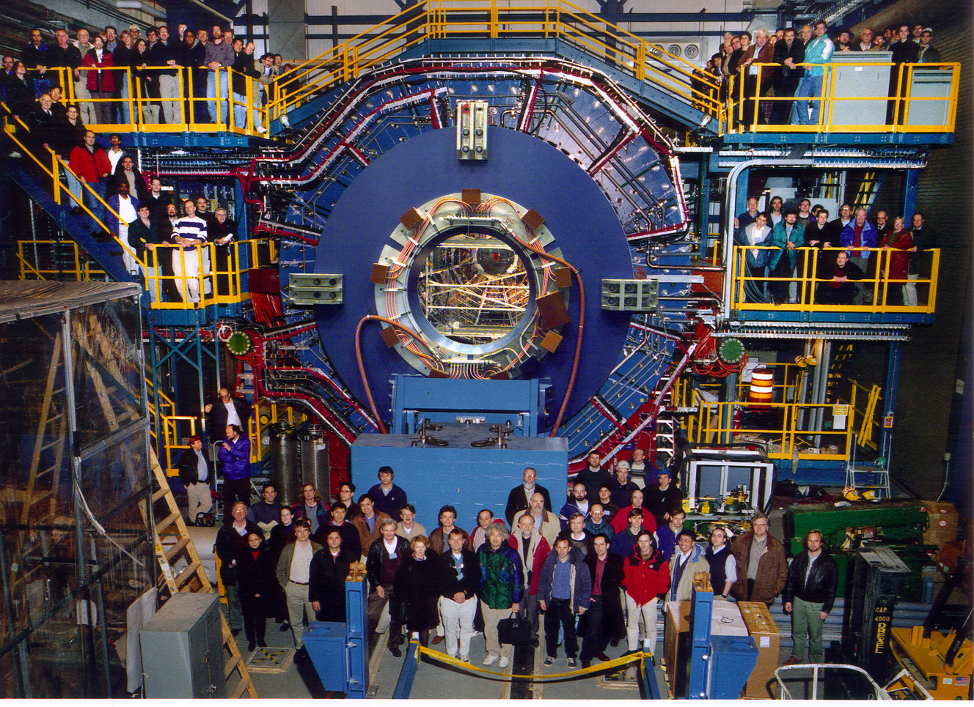
STAR Experiment
STAR Collaboration
STAR Experiment at RHIC
( http://www.star.bnl.gov/ )
Fundamental science: particle physics, nuclear
physics, astrophysics, cosmology, …
State of art technology: detector R&D, simulations,
IT, computing, mass/fast data managing, …
- 550 scientists
- 55 institutes
- 13 countries
- 154 PhD thesis completed since 2001 _{(Feb. 2013)}

Slide 4
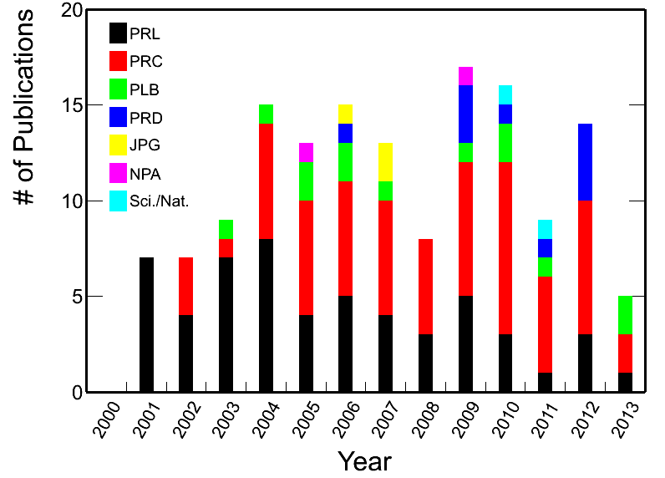
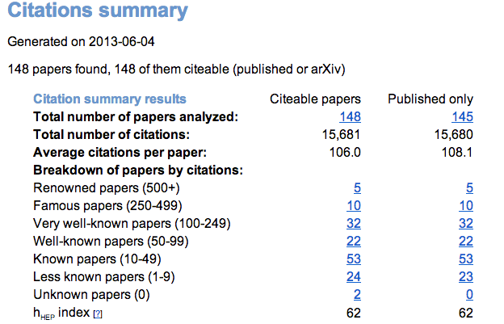
STAR Publications
2012-2013: 12 published & 7 submitted in referee process
Citations: 15681 (June 4th, 2013)
Average citation/paper: 106

Slide 5
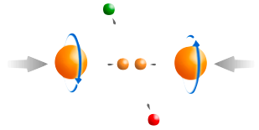
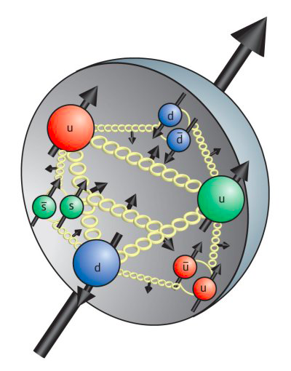

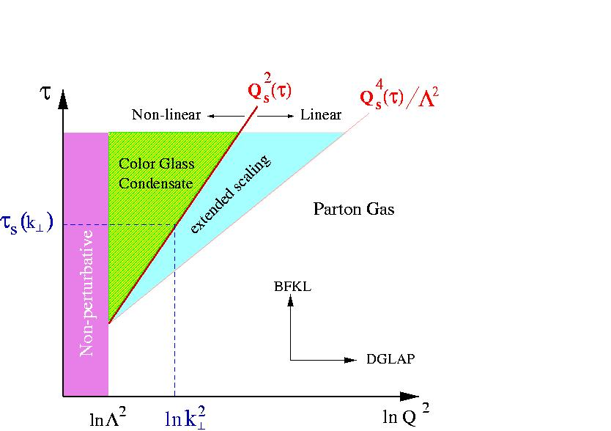
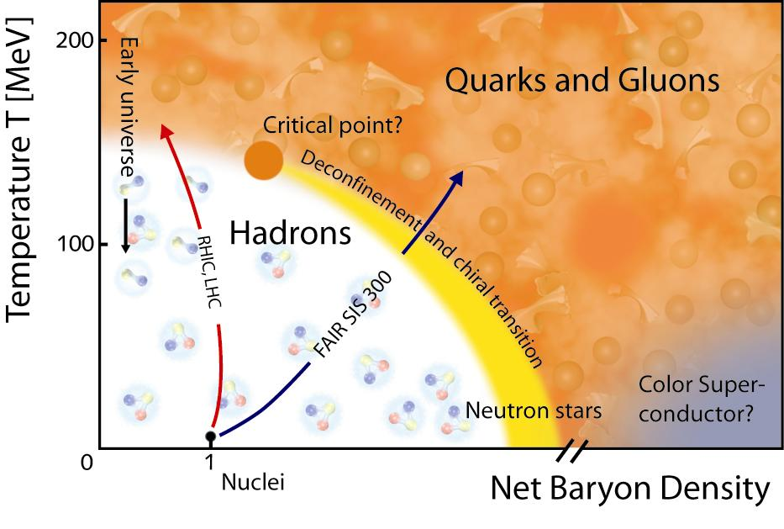
STAR Physics Focus
Polarized p+p Program
- Study proton intrinsic
properties
STAR Decadal Plan
+
eSTAR
Small-x Physics Program
- Study low-x properties, initial
condition, search for CGC
- Study elastic and inelastic
processes in pp2pp
1) At 200 GeV at RHIC
- Study medium properties, EoS
- pQCD in hot and dense medium
2) RHIC Beam Energy Scan (BES)
- Search for the QCD critical point
- Chiral symmetry restoration

Slide 6
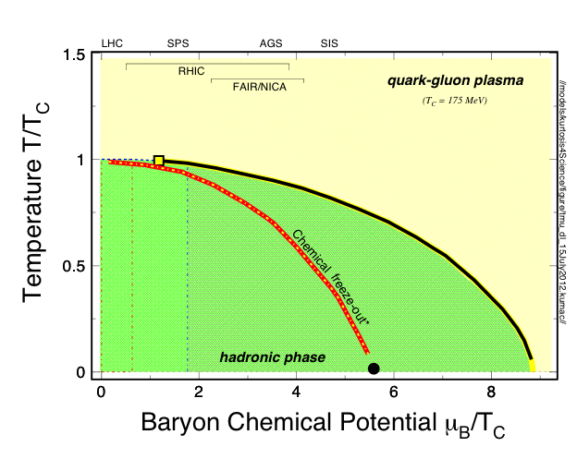
Exploring the QCD Phase Structure
1
T_{ini}, T_{C}
LHC, RHIC
2
T_{E}
RHIC, SPS
3
Large μ_{B}
NICA, FAIR
LHC+RHIC
sQGP properties
√s_{NN} ~ 0.1 - 5 TeV
Future eRHIC
Cold nuclear matter properties
e + ion collisions
1
2
3
Partonic Matter
Hadronic
Matter
RHIC BES-II
QCD phase structure and critical point
√s_{NN} ≤ 20 GeV
Emergent properties of QCD matter

Slide 7
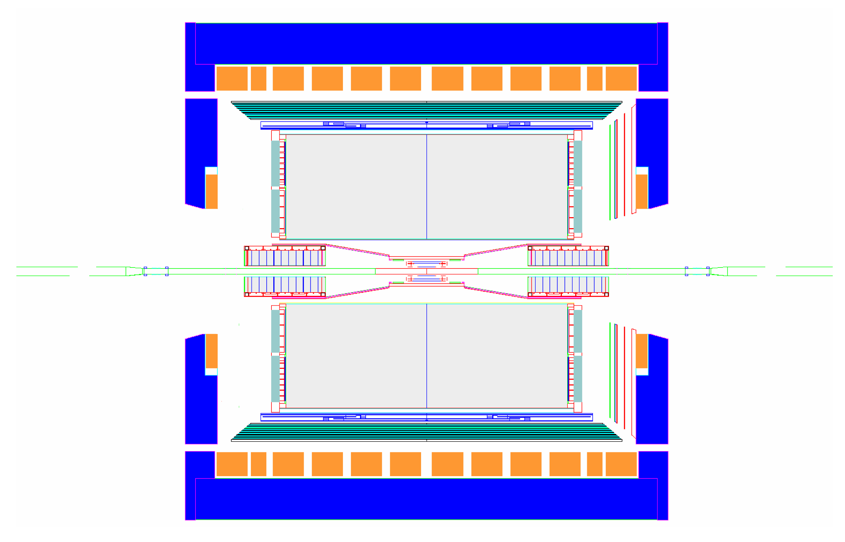
STAR Experiment
MRPC ToF Barrel
MTD
EMC Barrel
EMC End Cap
BBC
FPD
TPC
pp2pp’
pp2pp’
DAQ1000
FMS
Trigger
Computing
Complete
HLT
HFT
FGT
Ongoing
R&D

Slide 8
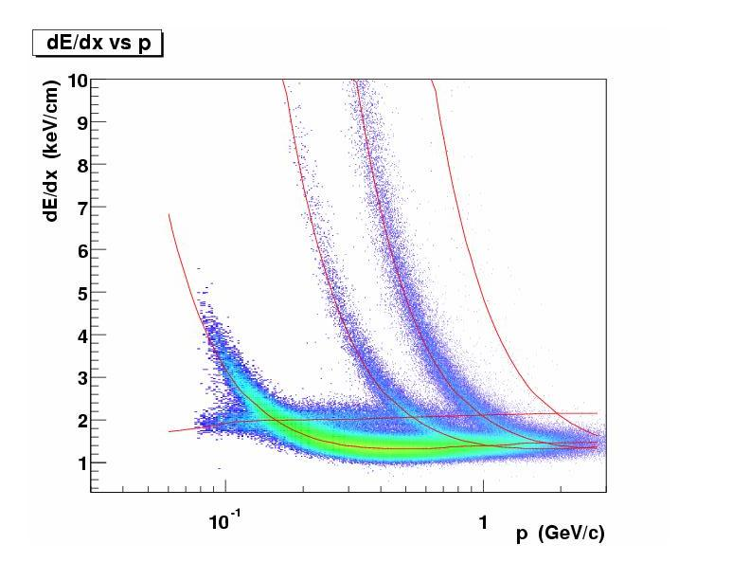
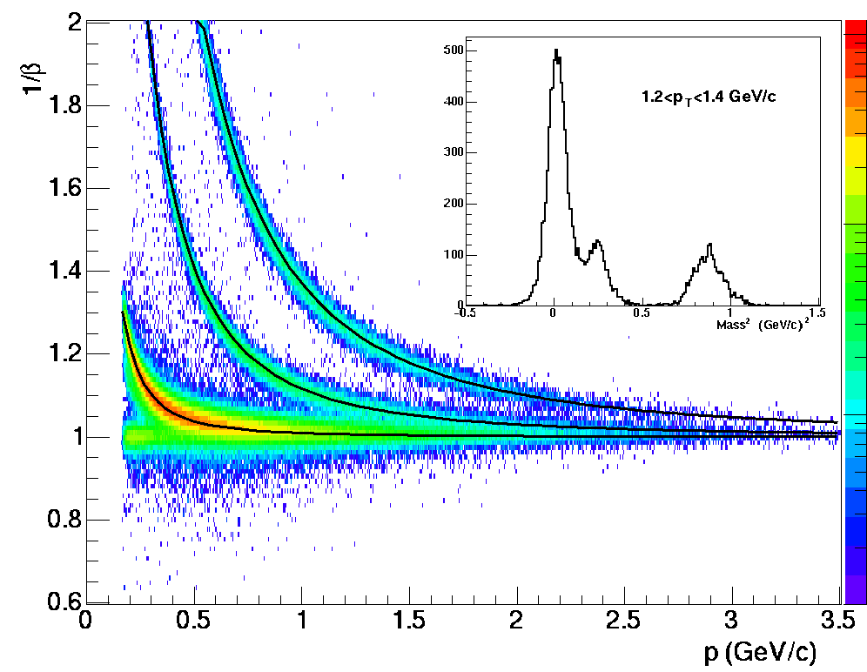
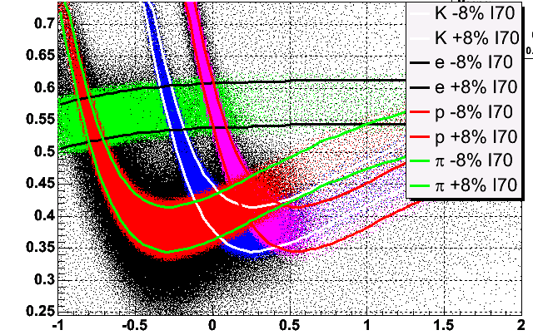
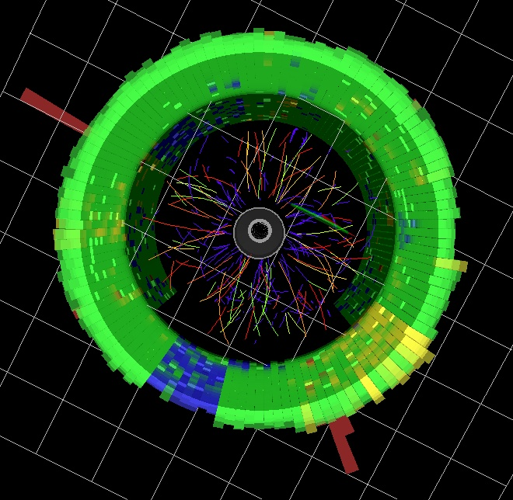
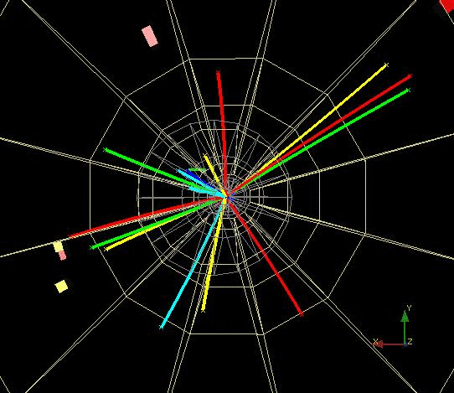
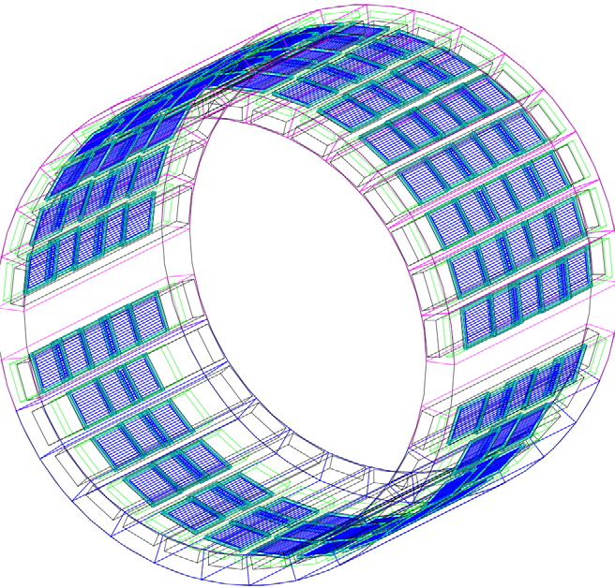
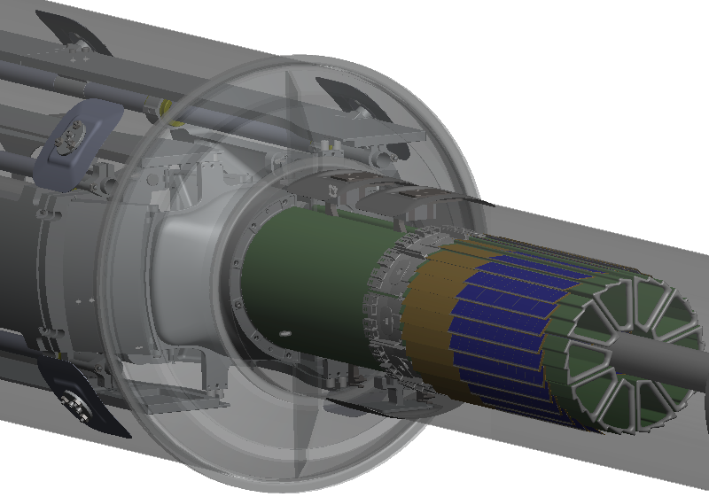
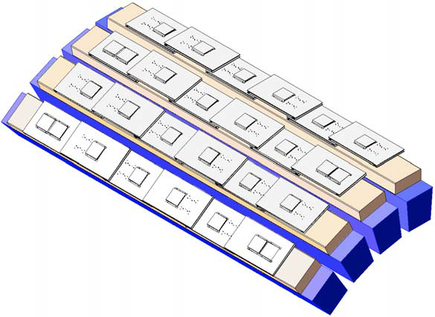
Particle Identification at STAR
TPC TOF TPC
TPC
K p d
π
e, μ
TOF
Log₁₀(p)
Charged hadrons
Hyperons & Hyper-nuclei
MTD
HFT
EMC
Jets
Neutral particles
Jets & Correlations
High p_{T} muons
Heavy-flavor hadrons
Multiple-fold correlations for the identified particles!

Slide 9
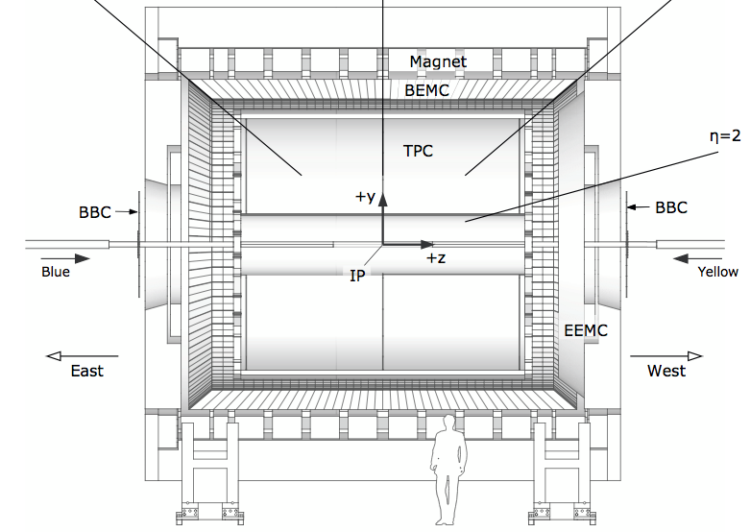
STAR Forward Upgrade Plan (2018)
MTD
BEMC
TPC
HFT
TOF
EEMC
FGT
η = -1 η = 0 η = 1
p/A
e
0
HLT
EMCal
Tracking
iTPC
Tracking
PID
EM/HCal

Slide 10
STAR Detector System
 | Period | Detectors | Physics
 | 2001-2010 | TPC | u, d, s
 | 2010 | TPC + TOF | u, d, s + dilepton
 | 2013 | TPC + TOF + MTD | u, d, s, c, b + dilepton
 | 2014 | TPC + TOF + MTD + HFT
STAR: Large coverage, excellent PID, fast DAQ
- detects nearly all particles produced at RHIC
- multiple fold correlation measurements
- Probes: bulk, penetrating, and bulk-penetrating
STAR: Perfect mid-y collider experiment
STAR: Expanding into forward rapidity regions

Slide 11
STAR: LOI for Transition to eRHIC
Membership of the committee: Elke Aschenauer, Jamie Dunlop, Renee Fatemi, Carl Gagliardi, Huan Huang, Ming Shao, Ernst Sichtermann*, Thomas Ullrich, Flemming Videbaek, Nu Xu, Zhangbu Xu*
*co-chair
Deadlines: Sept. 15: draft to the STAR Collaboration
Oct. 1: final document sent to the BNL management

Slide 12
STAR BUR for Runs 14 and 15
Run | * | Beam Energy | Time | System | Goals
14 | 2 | √s_{NN} = 15 GeV | 3-week | Au + Au | 1) 150M M.B. events for CP search 2) Fixed-target data taking⁽³⁾
 | 1 | √s_{NN} = 200 GeV | 14-week | Au + Au | HFT & MTD heavy flavor hadron measurements L=10 nb⁻¹, 1000M M.B.
15 | 1 | √s = 200 GeV | 12-week | 1) p + p 2) p↑ + p↑ (6-week) 3) p→ p→ (6-week) | 1) Heavy ion reference data L= 90 pb⁻¹ , 500M M.B. 2) A_{N}, L= 40 pb⁻¹, 60% pol. 3) Study Δg(x) L=50 pb⁻¹, 60% pol.
 | 2 | √s_{NN} = 200 GeV | 5-week | p↑ + Au | Study saturation physics, pA-ridge and heavy ion reference L=300 pb⁻¹
22 cryo-week.
15 cryo-week run, we request the top priority item for both runs.
* Physics priorities

Slide 13
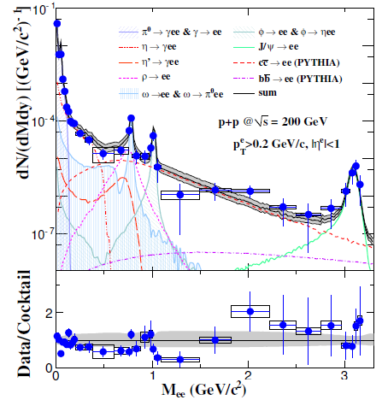
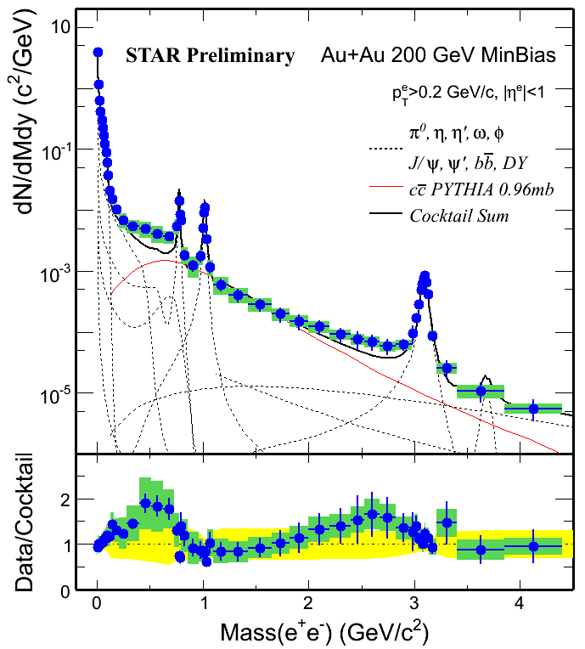
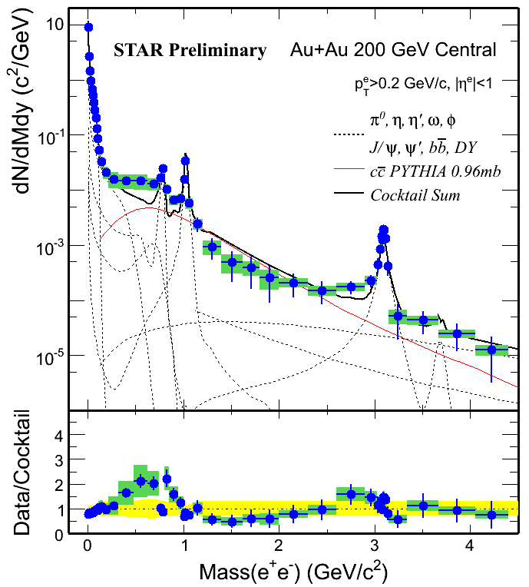
STAR Di-electron Program
√s = 200 GeV p+p Au+Au MinBias Au+Au Central
STAR: PRC86, 24906(12)
Direct radiation, penetrating-bulk probe.
Beam energy, p_{T}, centrality, mass dependence (8-10x more events):
R_{AA}, v₂, radial expansion, HBT, polarization, …
3) HFT/MTD upgrades: key for the correlated charm contributions.

Slide 14
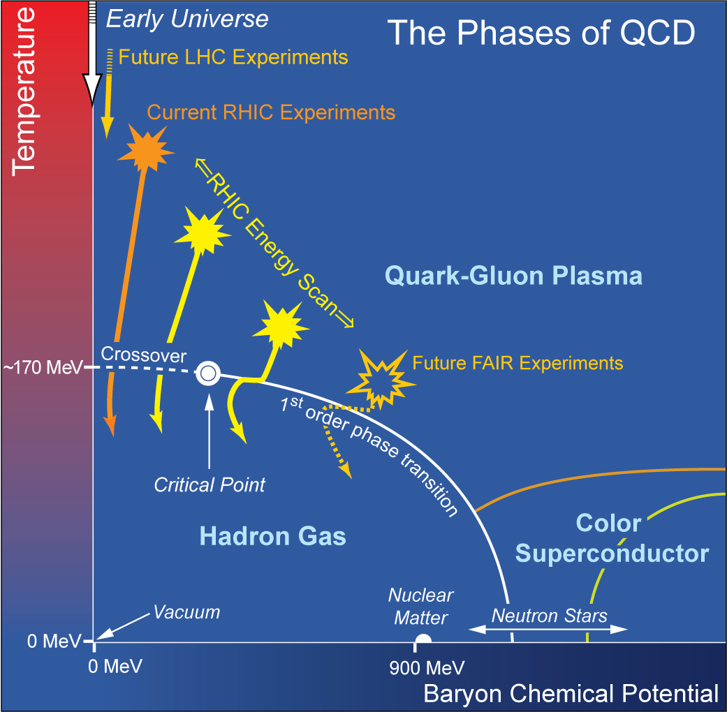
Beam Energy Scan at RHIC
Study QCD Phase Structure
- Signals of phase boundary
- Signals for critical point
Observations:
(1) Azimuthally HBT
1st order phase transition
(2) Directed flow v₁
1st order phase transition
(3) Dynamical correlations
partonic vs. hadronic dof
(4) v₂ - NCQ scaling
partonic vs. hadronic dof
(5) Fluctuations
Critical point, correl. length
Published 2 papers and 6 are coming

Slide 15
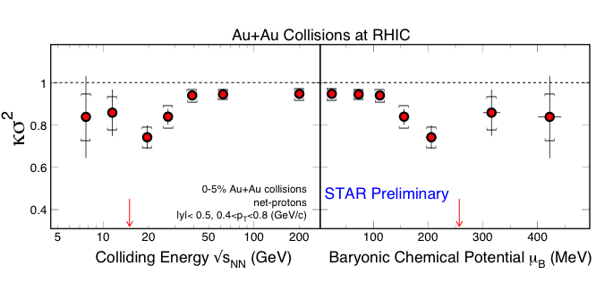
Net-proton Higher Moment
Expected statistical error from Run 14
√s_{NN} = 15GeV
The timely 15GeV AuAu data will be useful
1) physics case; 2) future BES-II efforts

Slide 16
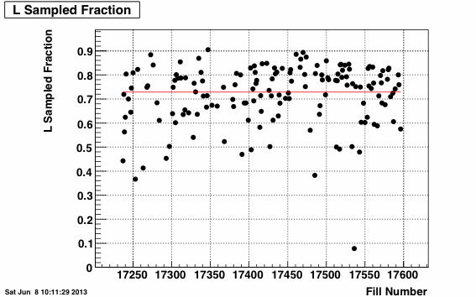
Data Taking Efficiency
pp 510GeV: ~ 73%
STAR: By continuously improving DAQ/Trigger, Automated detector configurations, and Training shifters, we effectively utilize the beams provided by RHIC

Slide 17
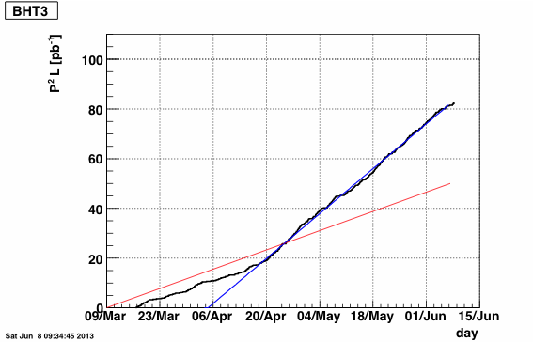
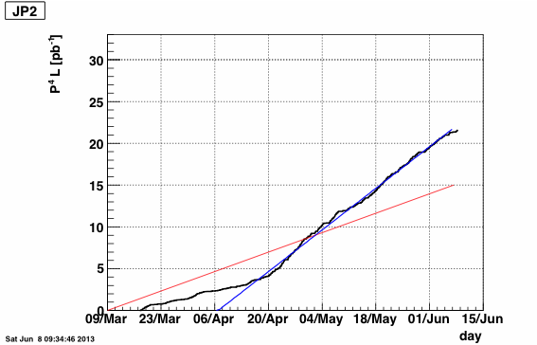
Run 13: Integrated Luminosities
510 GeV pp
A_{LL} > 22pb⁻¹
(2) 510 GeV pp
A_{L} > 80pb⁻¹
 | 2012 | 2013
P⁴L | 6 pb⁻¹ | > 22 pb⁻¹ (15 pb⁻¹ )
P²L | 23 pb⁻¹ | > 80 pb⁻¹ (50 pb⁻¹ )
STAR’s goals in Run 13

Slide 18
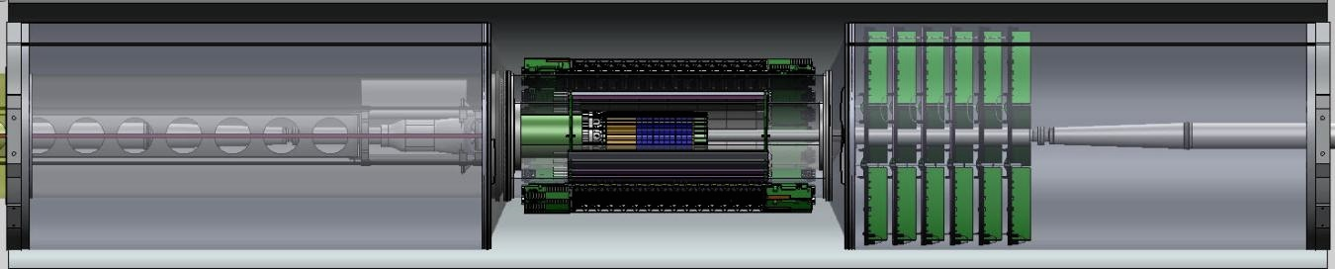
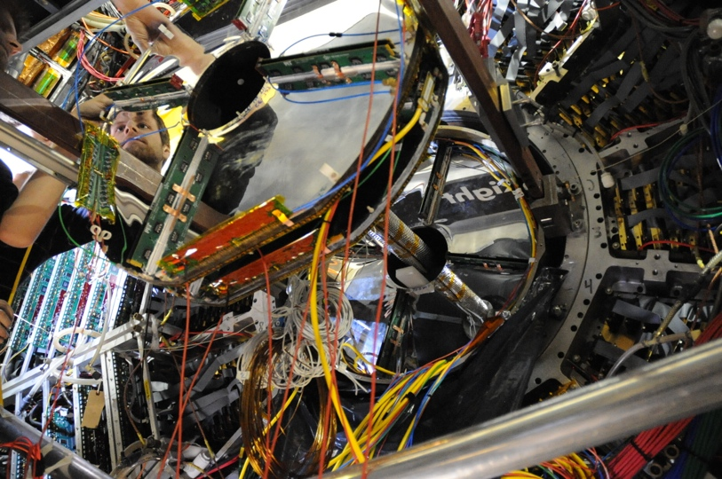
Forward GEM Tracker (FGT)
HFT
FGT
FGT: all quadrants were installed in Run 13 and their performance is under study.

Slide 19
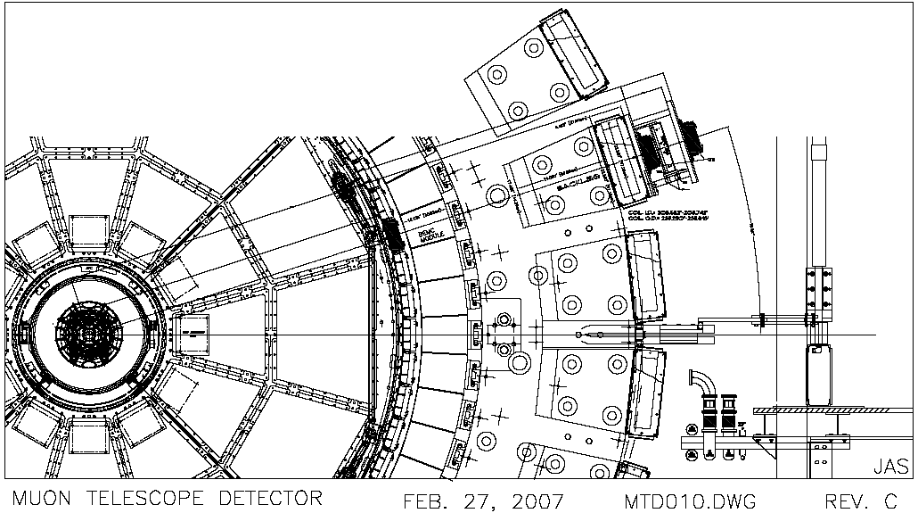
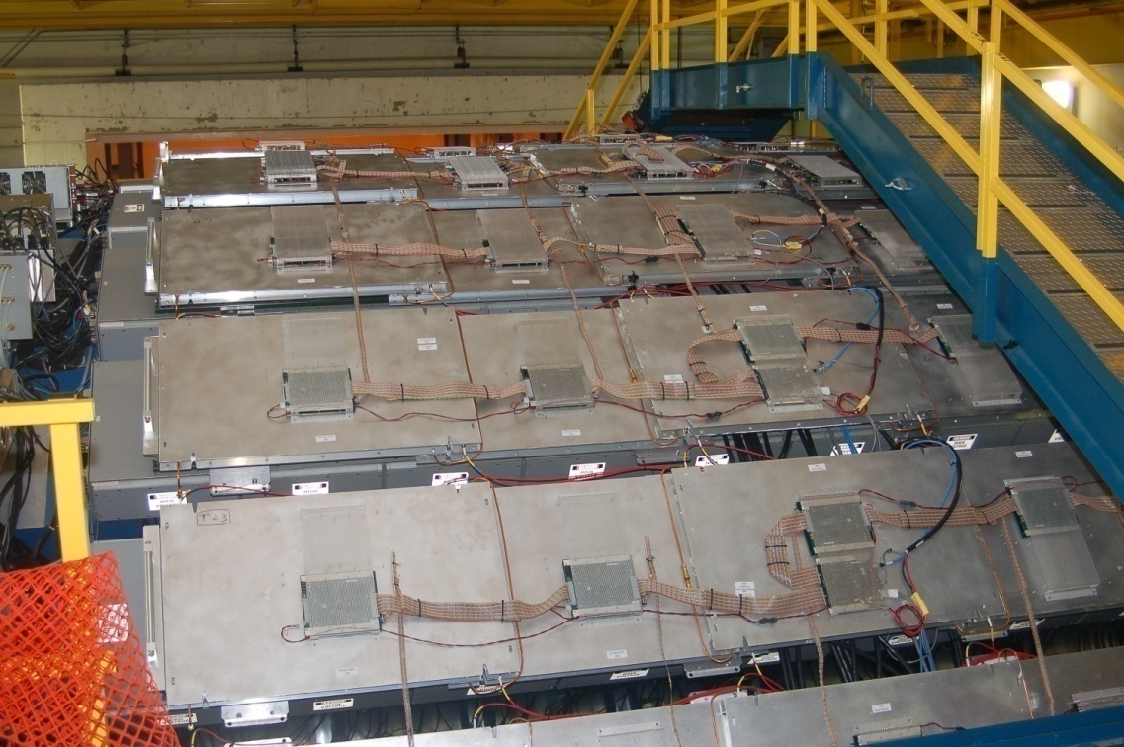
Muon Telescope Detector (MTD)
beam pipe
TPC
TOF
EMC
magnet
MTD
Muon Telescope Detector (MTD) at STAR:
MRPC technology; μ_{ε} ~ 90%; cover ~45% azimuthally and |y| < 0.5
TPC+TOF+MTD: muon/hadron enhancement factor ~ 10²⁻³
For high p_{T} muon trigger, heavy quarkonia, light vector mesons, B→J/Ψ+X
China-India-STAR collaboration
Run14: Full MTD will be ready

Slide 20
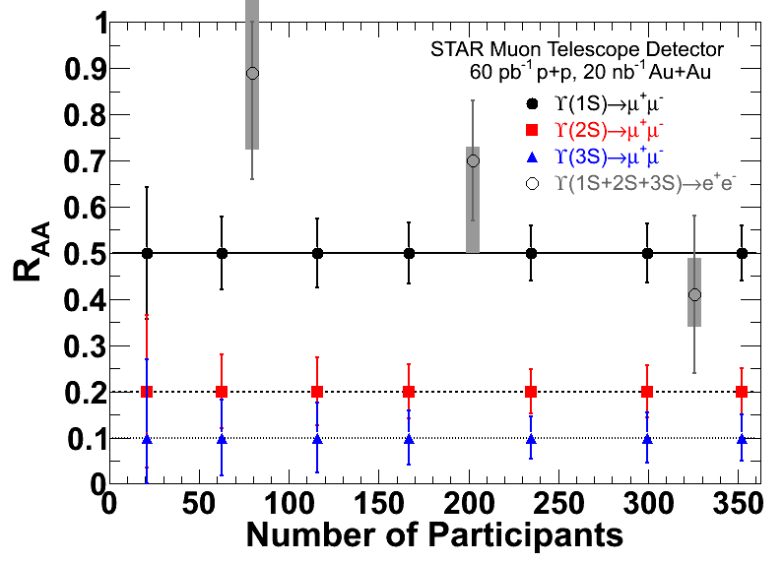
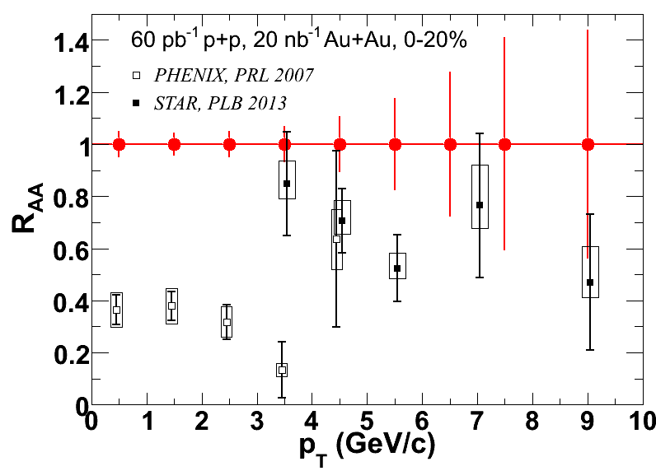
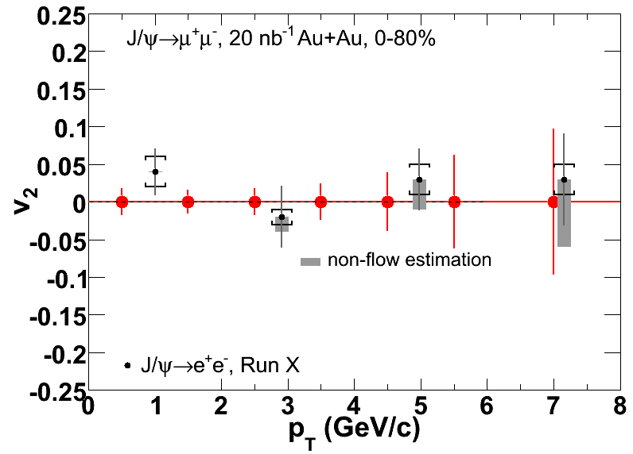
MTD: Run14 and Beyond
Υ => μμ
Upsilon at RHIC: unique, no regeneration, only initial production
MTD at STAR: Υ => μμ, no Bremsstrahlung tails, clean separation of the excited states
J/ψ
R_{AA} and v₂

Slide 21

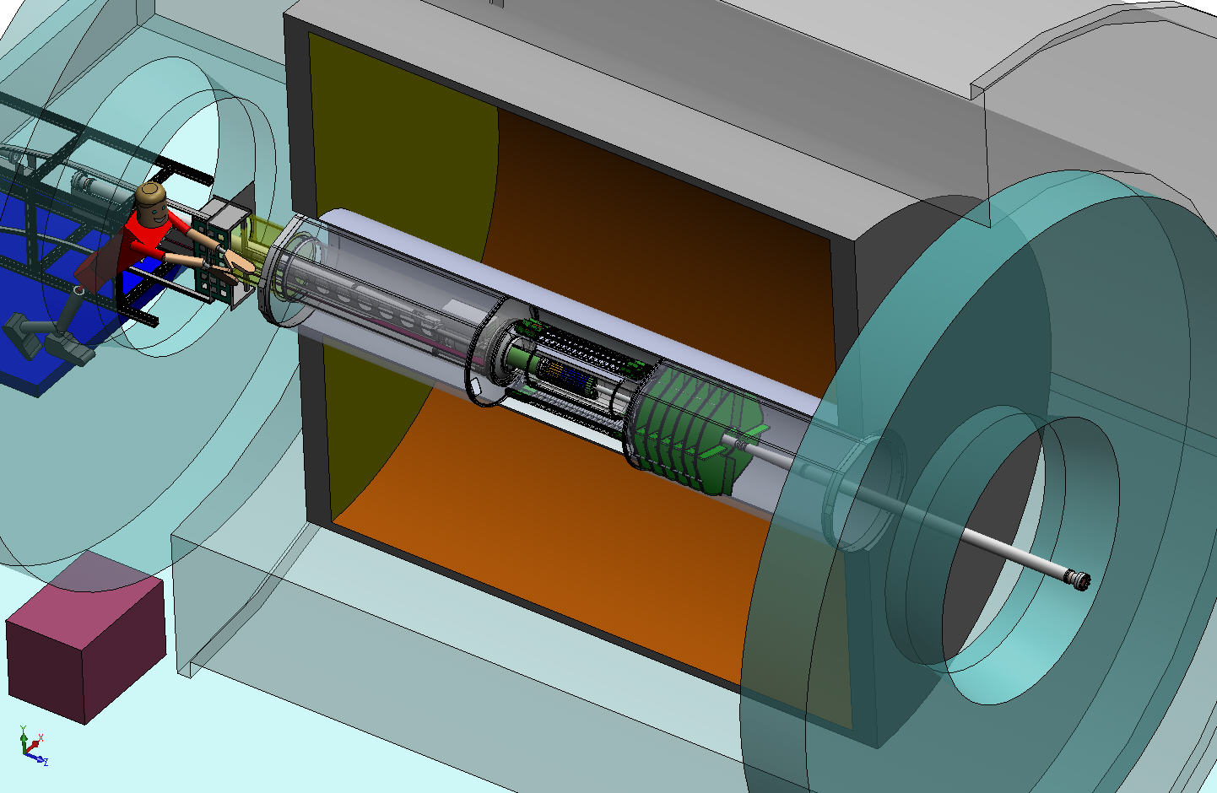
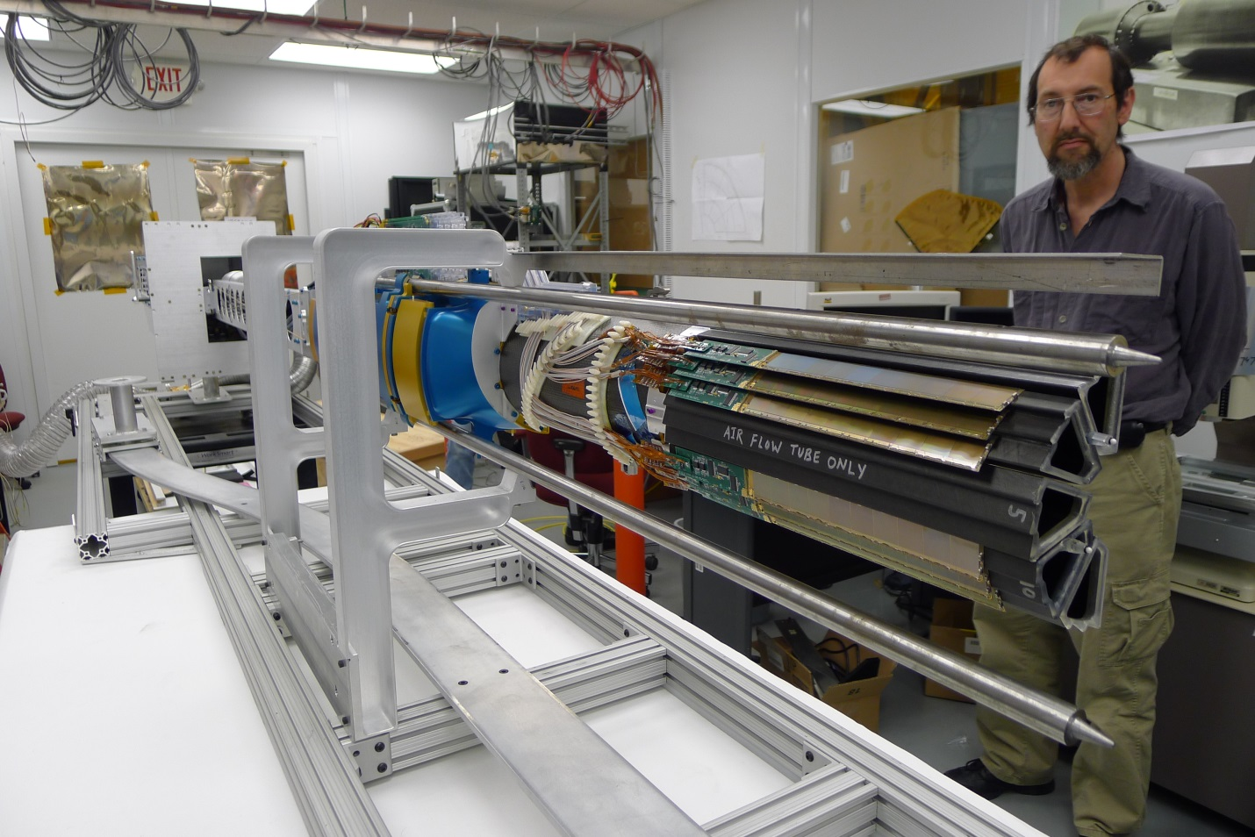
Heavy Flavor Tracker (HFT)
SSD
IST
PXL
HFT
Engineering run: 3 sectors installed on May 8, 2013
The PXL system has been integrated in STAR trigger & DAQ system
First application of MAPs technology in the collider environment

Slide 22
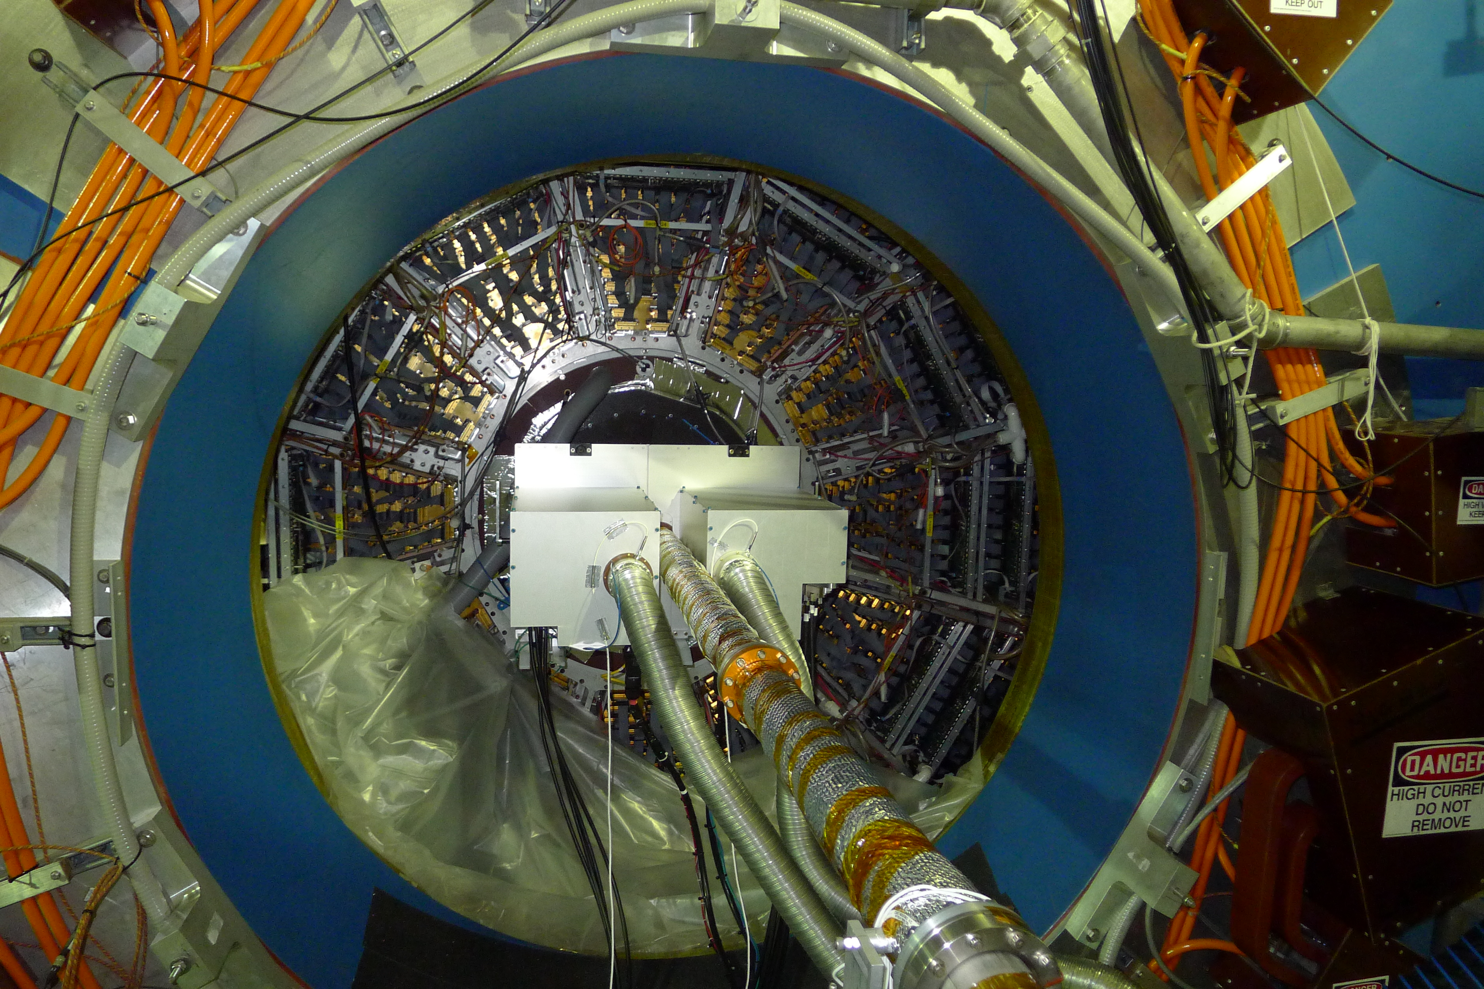
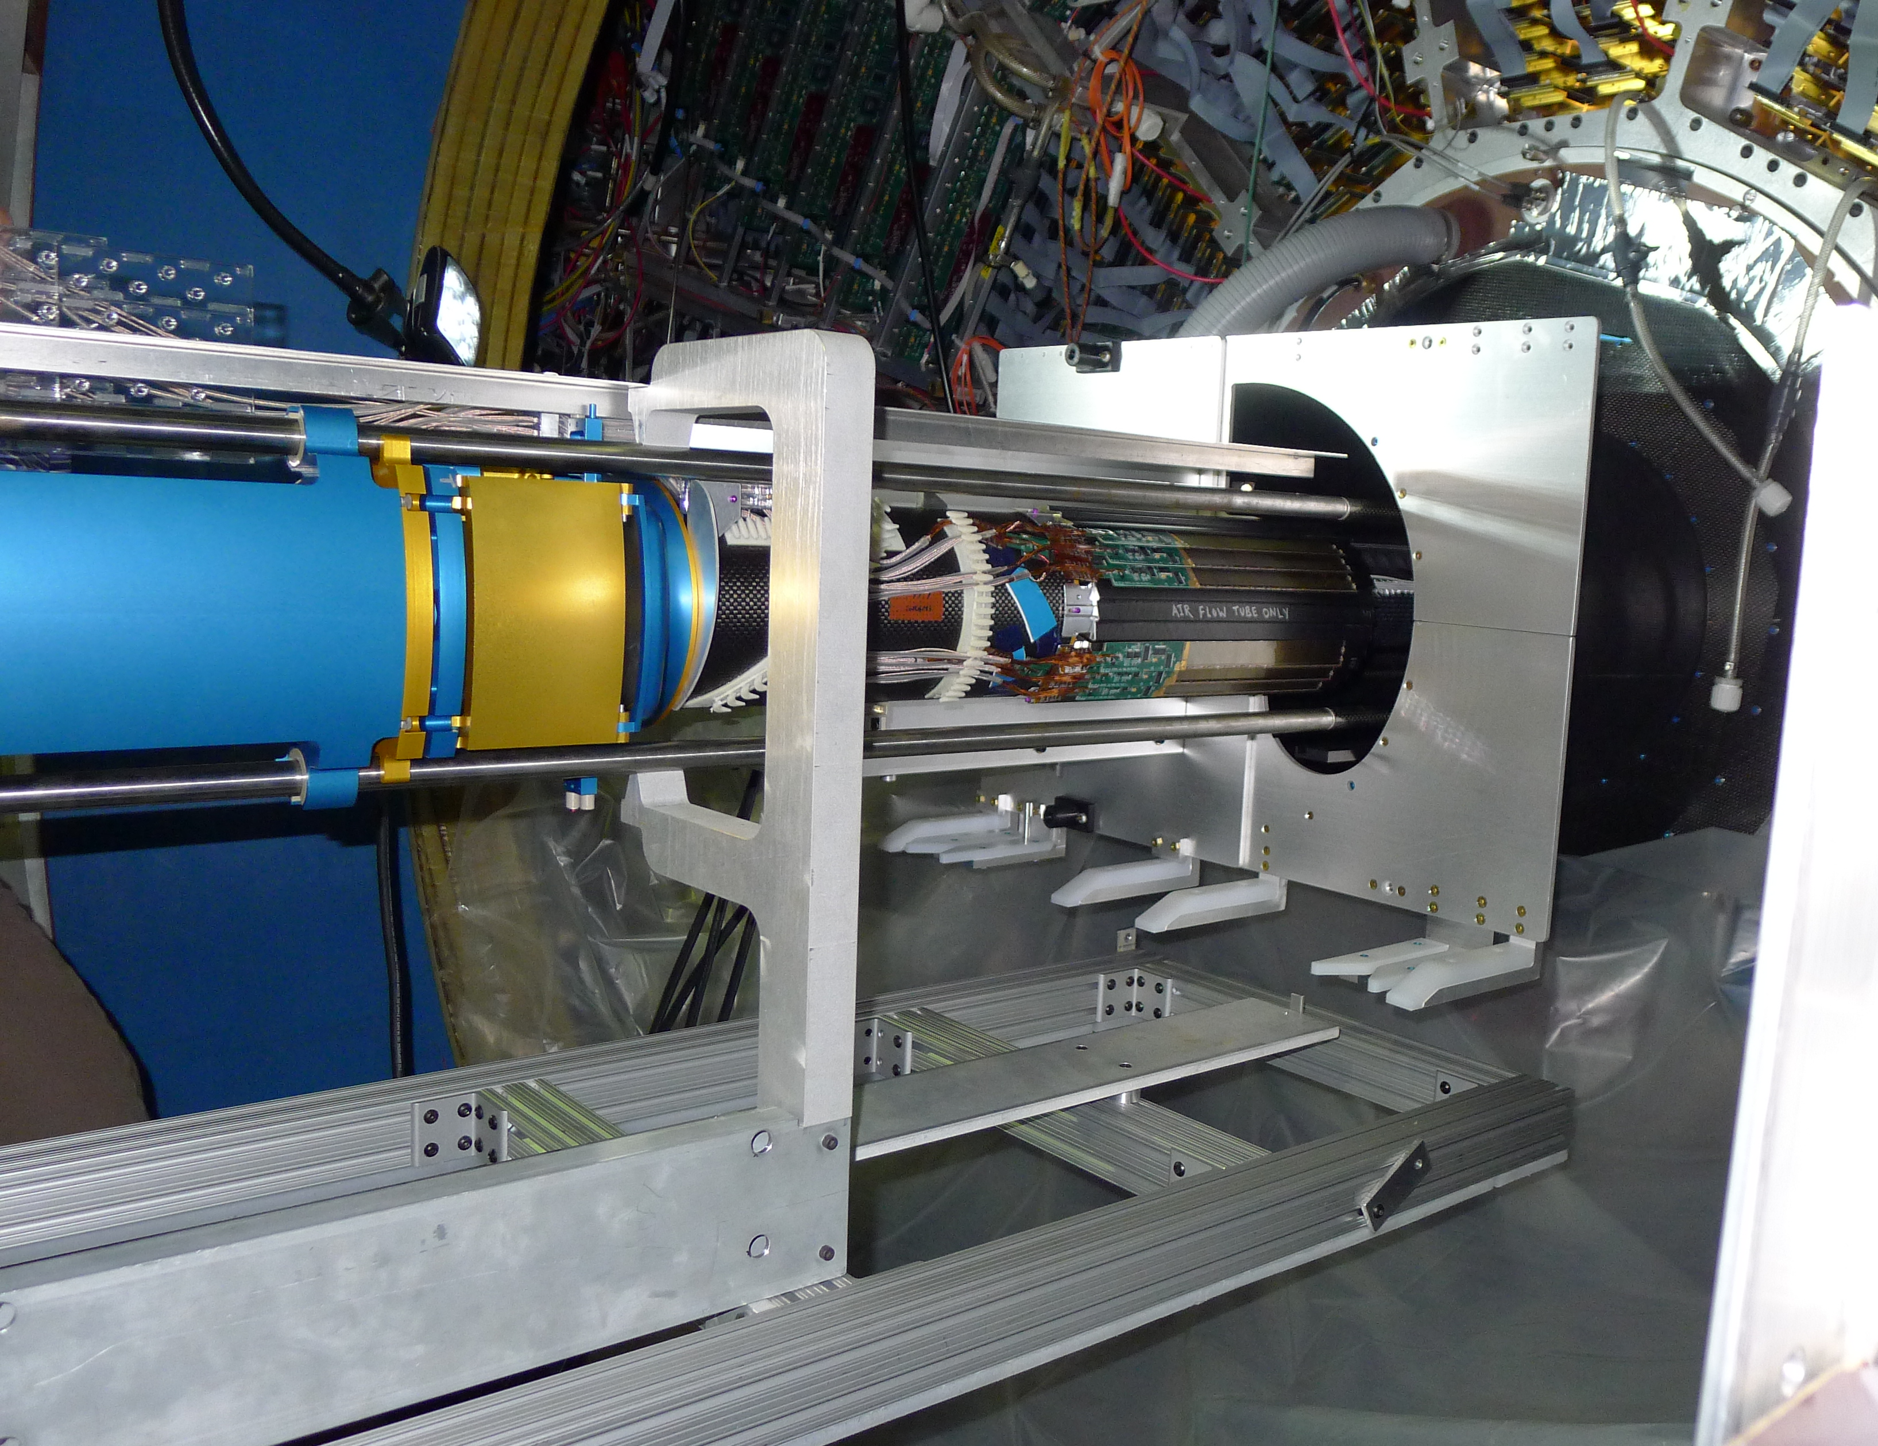
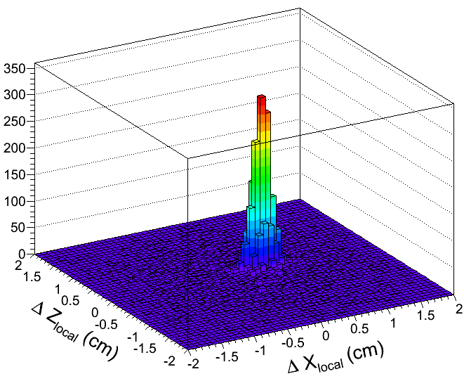
STAR HFT Commissioning
HFT designs worked
Lessons learned on mechanical, settings, latch-up and stability. Several issues have been resolved.
First tracking results: TPC-PXL correlation expected TPC resolutions (~1-2 mm)

Slide 23
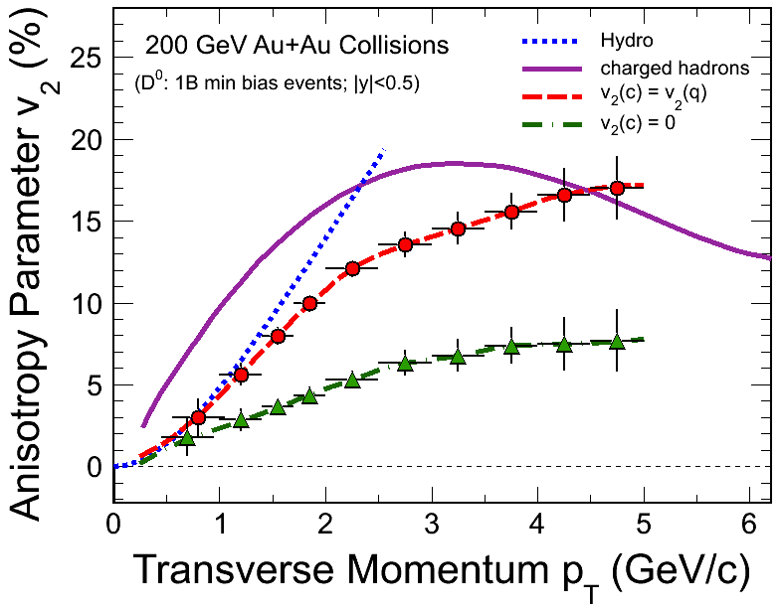
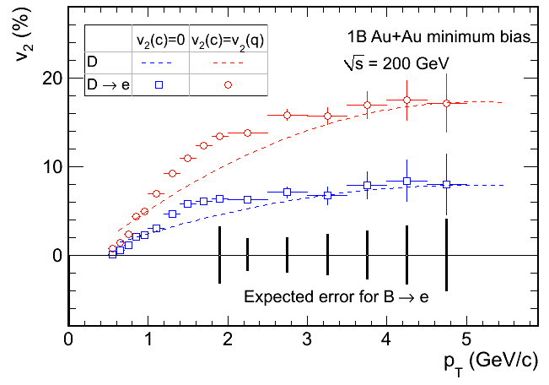
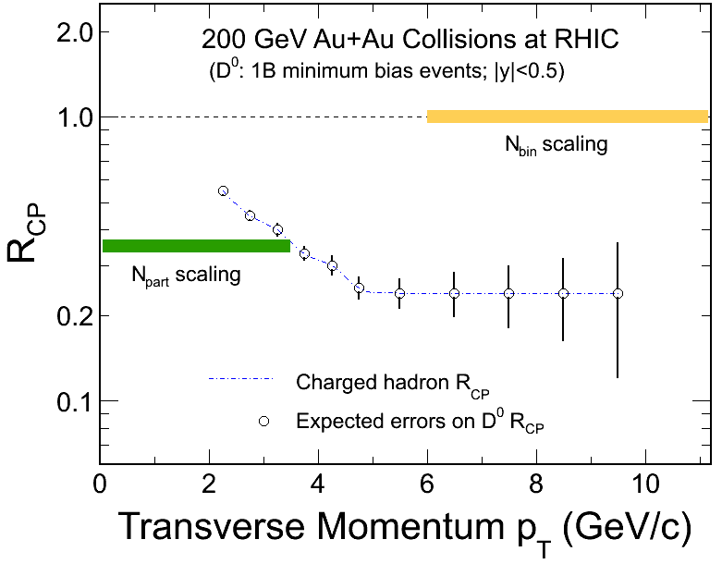
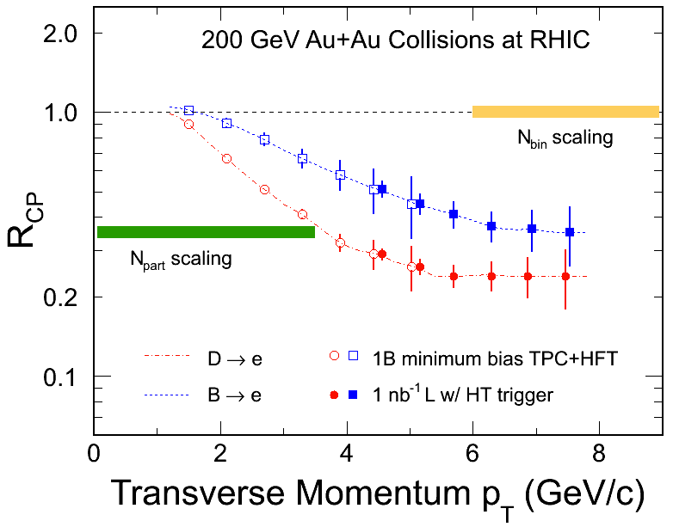
Run14: Physics Goals for HFT
D⁰ mesons
HF decayed electrons

Slide 24
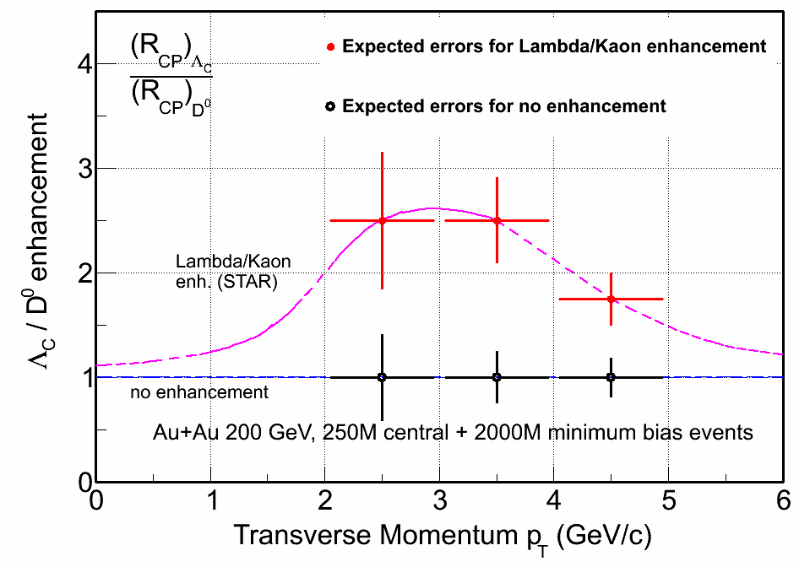
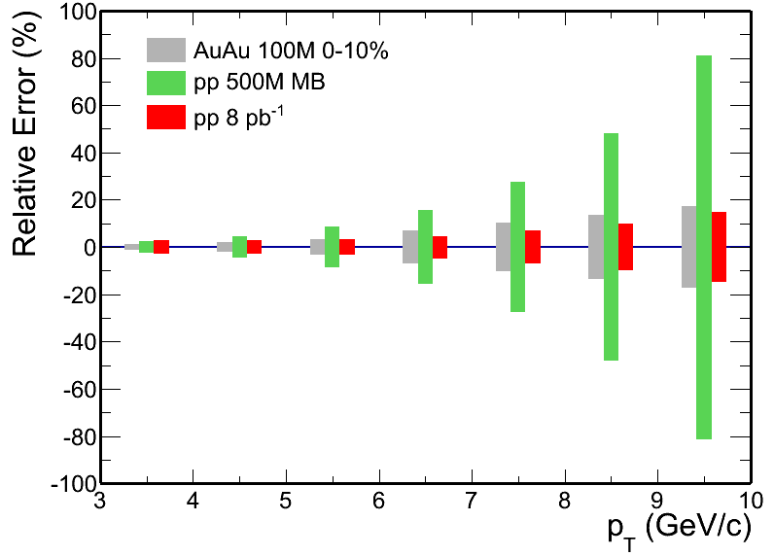
HF Physics: Beyond Run14
Λ_{C}: lowest charm baryon state,
cτ ~ 60μm
- Hadro-chemistry with charm
Meson vs. baryon effect with
charm hadrons
STAR multi-year physics program with the heavy flavor measurements requires high statistics data from both p+p and heavy ion collisions
D⁰ R_{AA}

Slide 25
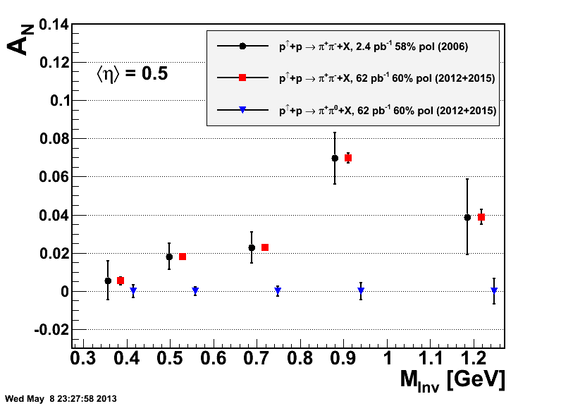
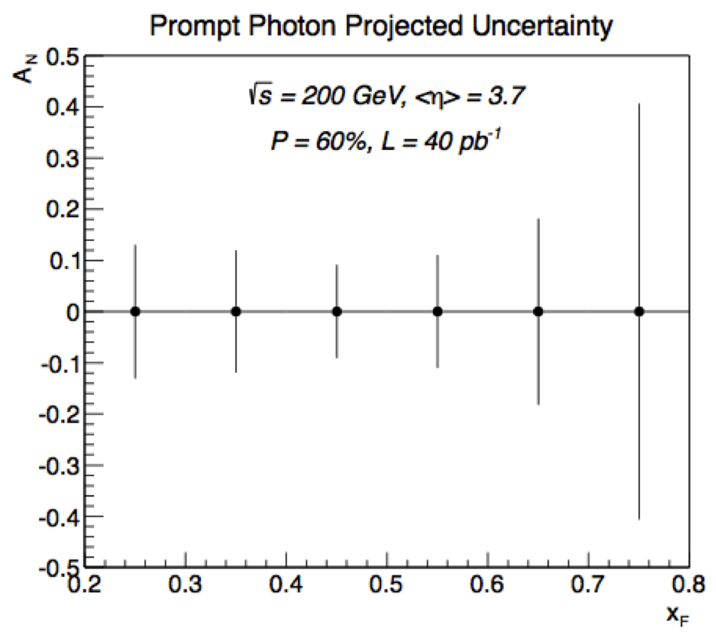
Transverse Polarized pp Collisions
Collins Mechanism Sivers/Twist-3
SSA measurements:
Mid-y: Constrain Collins function and interference fragmentation function
Forward-y: Prompt γ, require the pre-shower upgrade in front of the FMS

Slide 26
Longitudinally Polarized pp Collisions
Gluon contribution to the spin of the proton
2013 500 GeV
2015 200 GeV
2013+2015
Data ≤ 2009 yield a significant non-zero Δg(x):
Combined data of 2012+13+15 will reduce the uncertainty by a factor of 2 =>

Slide 27
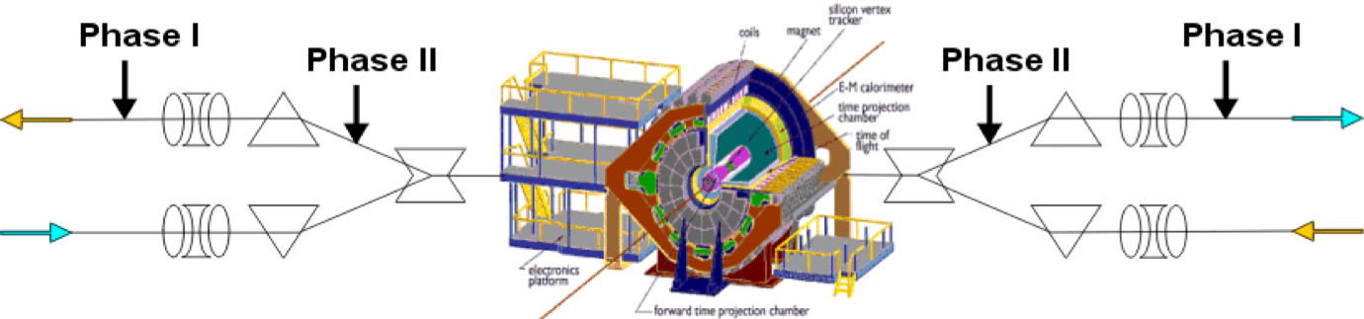
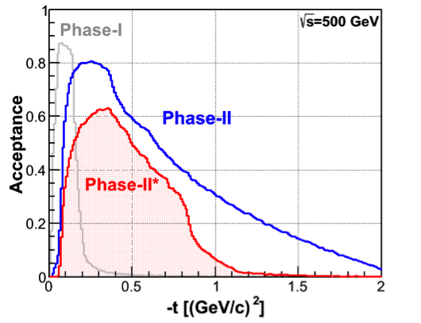
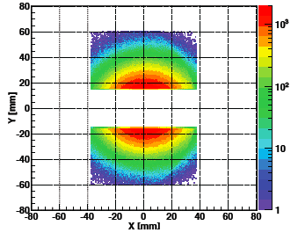
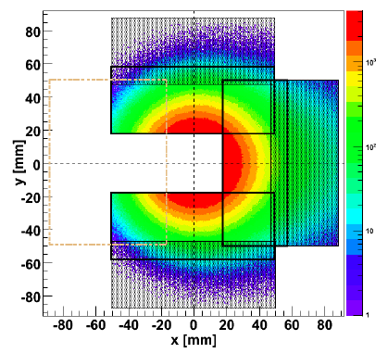
Forward Proton Tagging Upgrade
at 55-58m
at 15-17m
Phase-II: 1st step
full Phase-II
Follow PAC recommendation: data taking co-currently with other programs
Upgrade Phase-I ➔ Phase-II at a modest cost

Slide 28


p↑ + A Collisions at RHIC
Studying Saturation Through Spin
Very unique RHIC possibility p↑+A
Synergy between CGC based theory
and transverse spin physics
Suppression of A_{N} in p↑+A provides
sensitivity to Q_{s}
arXiv:1106.1375 & arXiv:1201.5890
STAR: projection for p↑A Run 15
π⁰
Curves: Solid: Q_{s}^{p} = 1 GeV; dashed: Q_{s}^{p} = 0.5 GeV

Slide 29
Summary
STAR has been very effective and productive:
TOF, HLT, DAQ1k upgrades successfully completed. FGT, MTD and HFT upgrades are all commissioned.
200 GeV Au+Au collisions:
e.g. Large acceptance di-electron analysis
3) Beam Energy Scan Phase-I (BES-I)
- Systematic analysis of Au+Au collisions at 7.7/11.5/27/19.6/39:
√s_{NN} ≥ 39 GeV: partonic // √s_{NN}≤ 11.5 GeV: hadronic dominant
4) Run13: High statistics, high quality data collected
- 510 GeV
5) Build on mid-rapidity success:
Pushing forward-upgrades for future ➔ eSTAR/eRHIC

Slide 30
STAR BUR for Runs 14 and 15
Run | * | Beam Energy | Time | System | Goals
14 | 2 | √s_{NN} = 15 GeV | 3-week | Au + Au | 1) 150M M.B. events for CP search 2) Fixed-target data taking⁽³⁾
 | 1 | √s_{NN} = 200 GeV | 14-week | Au + Au | HFT & MTD heavy flavor hadron measurements L=10 nb⁻¹, 1000M M.B.
15 | 1 | √s = 200 GeV | 12-week | 1) p + p 2) p↑ + p↑ (6-week) 3) p→ p→ (6-week) | 1) Heavy ion reference data L= 90 pb⁻¹ , 500M M.B. 2) A_{N}, L= 40 pb⁻¹, 60% pol. 3) Study Δg(x) L=50 pb⁻¹, 60% pol.
 | 2 | √s_{NN} = 200 GeV | 5-week | p↑ + Au | Study saturation physics, pA-ridge and heavy ion reference L=300 pb⁻¹
22 cryo-week.
15 cryo-week run, we request the top priority item for both runs.
* Physics priorities

Slide 31
Runs 14 & 15 Requests
Run 14: 200 GeV Au+Au collisions
- Physics run with HFT+MTD (200 GeV)
heavy flavor hadrons, quarkonia, dileptons
- 15 GeV Au+Au collisions
search for QCD critical point
2) Run 15: polarized 200 GeV p+p/p+Au collisions
- p+p: Heavy ion reference data
- p+p: Spin physics
- p↑+Au: Saturation physics

