Slide 1
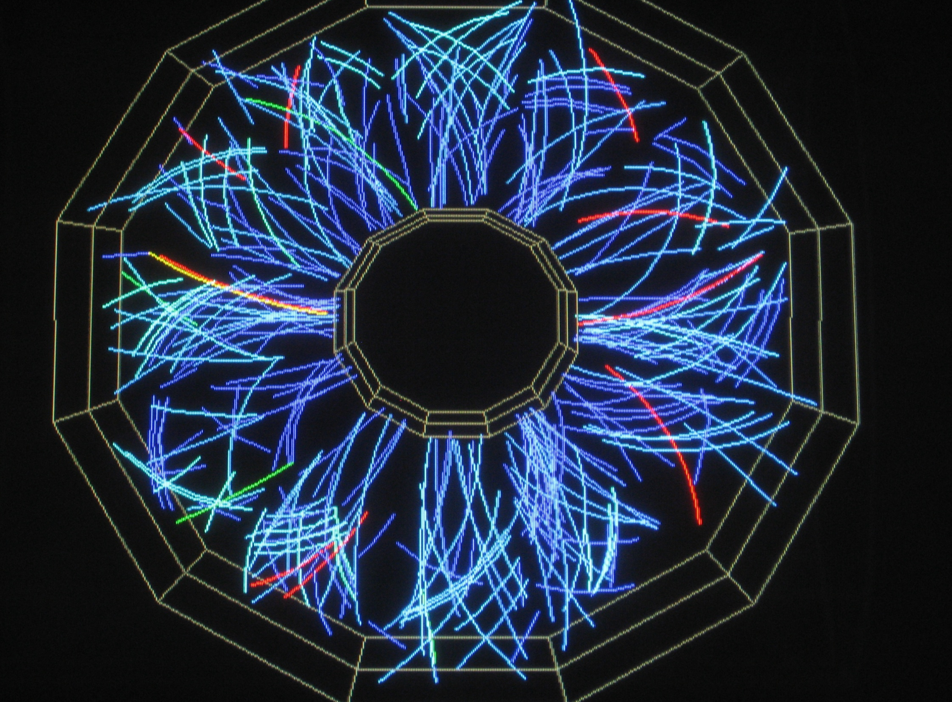
Update from the Beam Energy Scan
Daniel Cebra
For the STAR Collaboration
Daniel Cebra
June 11, 2012
RHIC/AGS Program Advisory Committee Meeting
Brookhaven National Laboratory
Slide 1 of 25

Slide 2
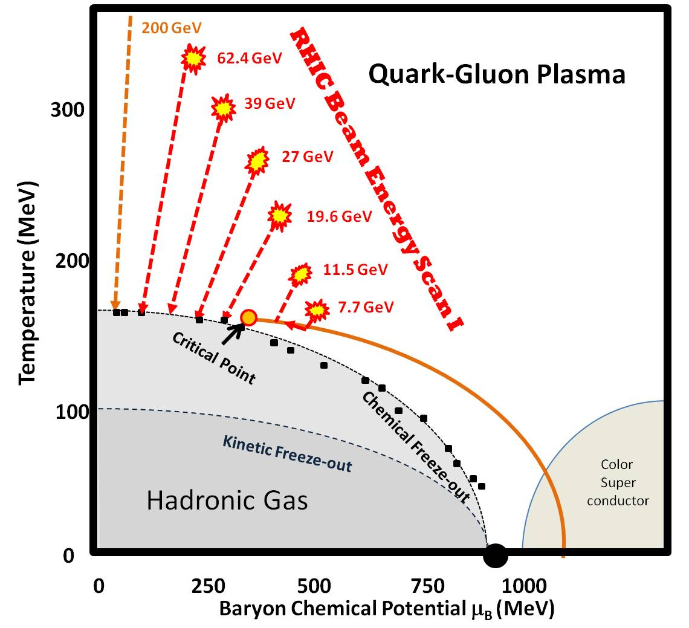
The RHIC Beam Energy Scan
Much progress has been made in understanding the phase diagram of QCD matter. We expect a cross-over at high energy. At lower energy there should be a first order transition.
Mapping the features of the QCD matter phase diagram is key to our understanding dense matter.
In 2009 the RHIC PAC approved a series of six energies to search for the turn-off of QGP signatures, the critical point, and evidence of a first order phase transition.
QGP Turn-off
First Order
Coexistence Region:
Unstable - Spinodal
Critical Point

Slide 3
Beam Energy Scan
Collision Energies (GeV) | 5 | 7.7 | 11.5 | 19.6 | 27 | 39 | 62.4
Chemical Potential (MeV) | 550 | 420 | 315 | 205 | 155 | 115 | 72
Observables | Millions of Events Needed
n_{cq} scaling π/K/p/Λ | 8.5 | 6 | 5 | 5 | 4.5 | 4.5
R_{CP} up to p_{T} ~4.5, 5.5, 6.0 |  |  |  | 15 | 33 | 24
Local Parity Violation |  | 4 | 4 | 4 | 4 | 4
v₂ (up to ~1.5 GeV/c) | 0.3 | 0.2 | 0.1 | 0.1 | 0.1 | 0.1
v₁ | 0.5 | 0.5 | 0.5 | 0.5 | 0.5 | 0.5
Azimuthally sensitive HBT | 4 | 4 | 3.5 | 3.5 | 3 | 3
PID fluctuations (K/π) | 1 | 1 | 1 | 1 | 1 | 1
net-proton kurtosis | 5 | 5 | 5 | 5 | 5 | 5
Total Number of Good Events Taken (Millions) | 0 | 4.3 | 11.7 | 36 | 70 | 130 | 67
QGP
1st Order
C.P.

Slide 4
Setting the Scene

Slide 5
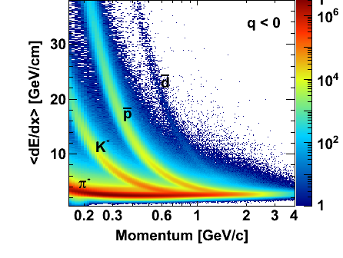
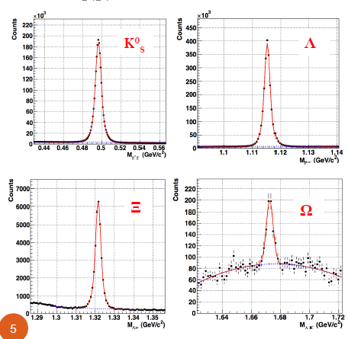
Particle Identification
dE/dx
TOF
Invariant Mass

Slide 6
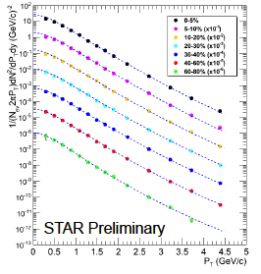
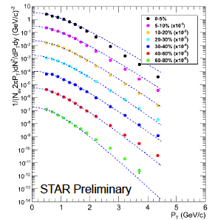
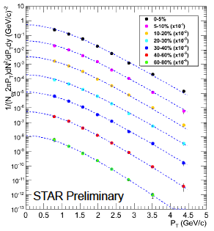
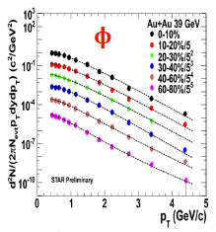
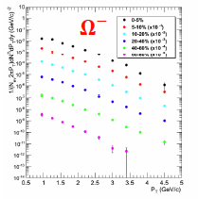
Hadron Spectra
π⁺
Λ
K⁰_{s}
STAR Preliminary
Κ⁺
STAR Preliminary
Ξ⁻
φ
p
φ, K⁰_{s} : Levy function fits
Λ, Ξ: Boltzmann fits
Λ: feed‐down corrected
STAR Preliminary
Ω⁻
STAR Preliminary

Slide 7
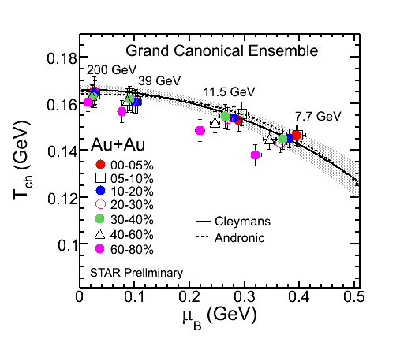
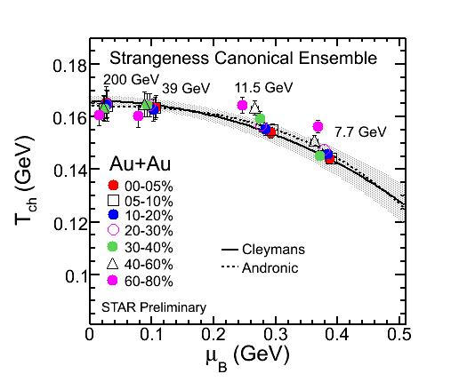
Chemical Equilibrium
Adding the strange particle ratios to the π, K, and p and using different ensembles in the thermal model, we can study the centrality and energy dependence of T and μ_{B}

Slide 8
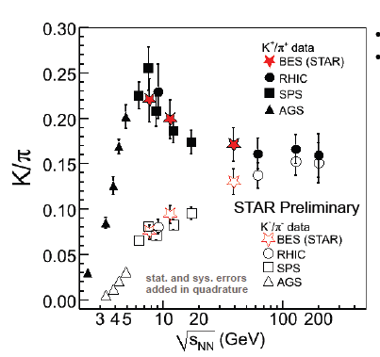
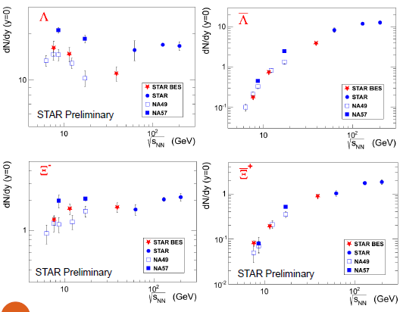
The Horn and Other Yields
STAR Preliminary
The STAR BES data are consistent with the NA49 results
NA49, PRC78,034918.
NA57, PLB595,68; JPG32, 427
STAR, PRL86,89,92,98;PRC83

Slide 9
Turn-off of QGP Signatures

Slide 10
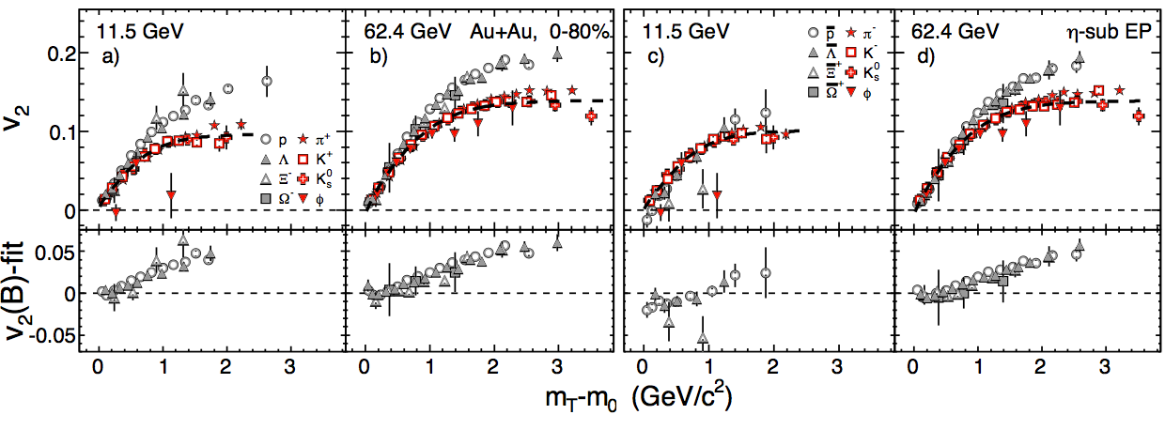
Constituent Quark Scaling – BES Results
NCQ scaling of elliptic flow – BES
scaling by the number of quarks ➔ partonic collectivity➔deconfinement
Baryon/meson and high m_{t}-m₀ indicates NCQ scaling
Particles
Anti-particles
Phys. Rev. Lett. 110 (2013) 142301
Particles:
Baryon/Meson splitting at 11.5 GeV
No baryon/meson splitting at 7.7 GeV
QGP Signature turned off
Anti-Particles:
No baryon/meson splitting at 11.5 GeV
QGP Signature turned off

Slide 11
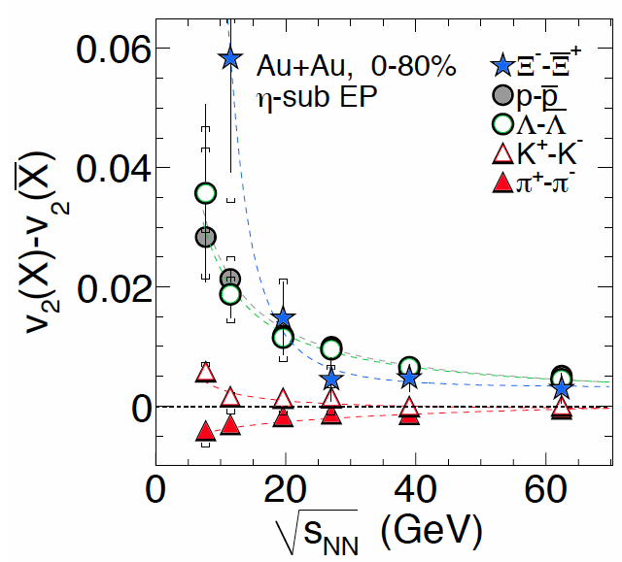
Constituent Quark Scaling – BES Results
Particle-anti-particle elliptic flow; Energy Scan
There is a remarkable difference between particles and their anti-particles, especially for the lowest energies in the range.
Difference between particles and their anti-particle decreases with increasing beam energy.
Most significant below 19.6 GeV
Possible explanation
Baryon transport to mid-rapidity [J. Dunlop et al., PRC 84, 044914 (2011)]
Hadronic potential [J. Xu et al., PRC 85, 041901 (2012)]
Phys. Rev. Lett. 110 (2013) 142301
NCQ scaling seen at 200 GeV breaks down at lower energies

Slide 12
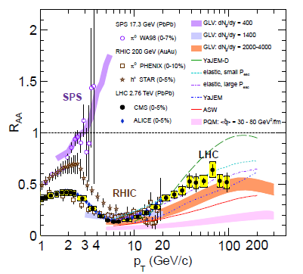
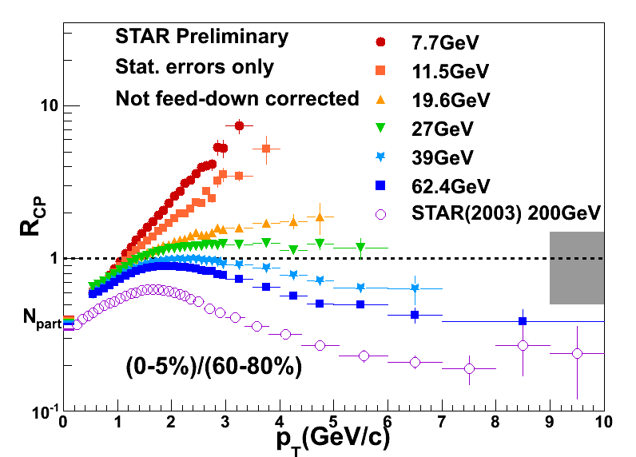
Turn-off of QGP Signatures
High p_{T} suppression has been seen as a clear manifestation of energy loss by color objects (quarks) in a color medium (QGP)
R_{cp} suppression NOT seen at lower energies!
➔The QGP signature is turned off.
Is QGP turned off?
Need p+A in this energy range.
Eur.Phys.J. C72 (2012) 1945
Thermal emission from a radial expanding source or Cronin Effect
Perturbative QCD and parton energy loss

Slide 13
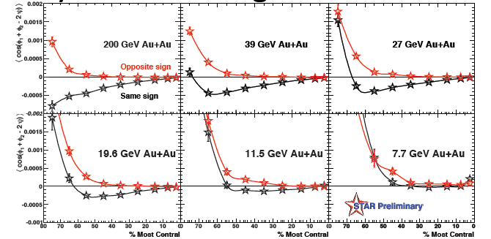
Local Parity Violation – BES Results
The anisotropy attributed to the Chiral Magnetic Effect is gone at 7.7 GeV

Slide 14
Search for 1st Order PhaseTransition

Slide 15
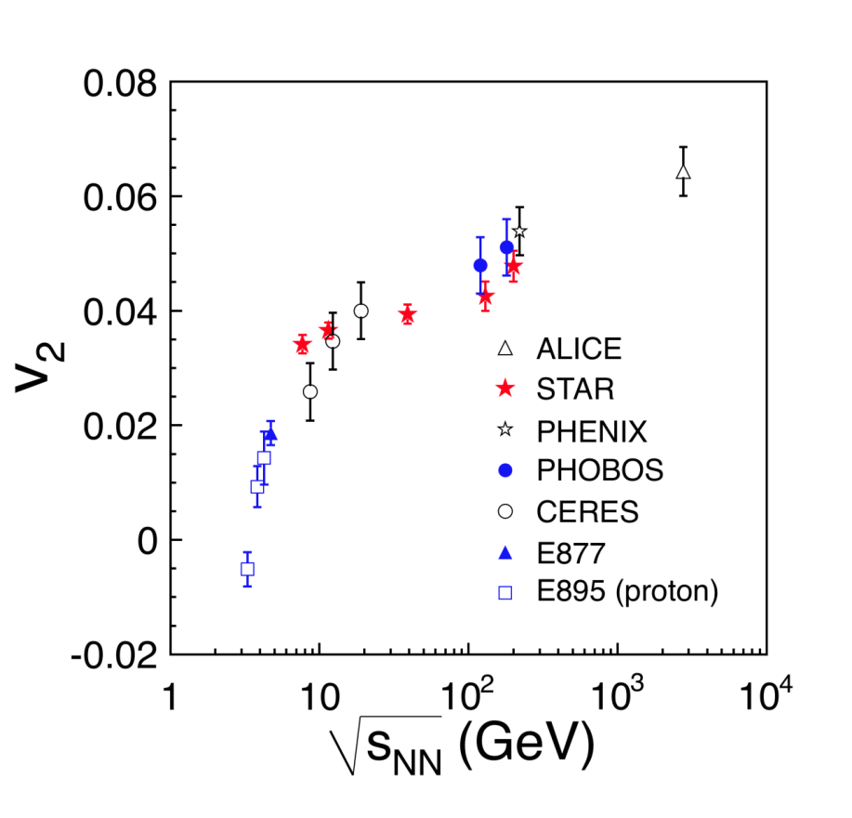
Elliptic Flow – BES Results
A reduction in flow or in the rate of increase in flow could indicate a softening of the equation of state.
Many caveats with this comparison:
We need v₂ of indentified particles
We need consistent analysis methods between energy ranges
Such detailed analyses are not available in the previous published results
➔ This rough comparison highlights the need for STAR data below 7.7 GeV
STAR PRELIMINARY
Elliptic Flow is rising rapidly with beam energy at AGS energies
The rate of increase is reduced above 7.7 GeV for BES energies

Slide 16
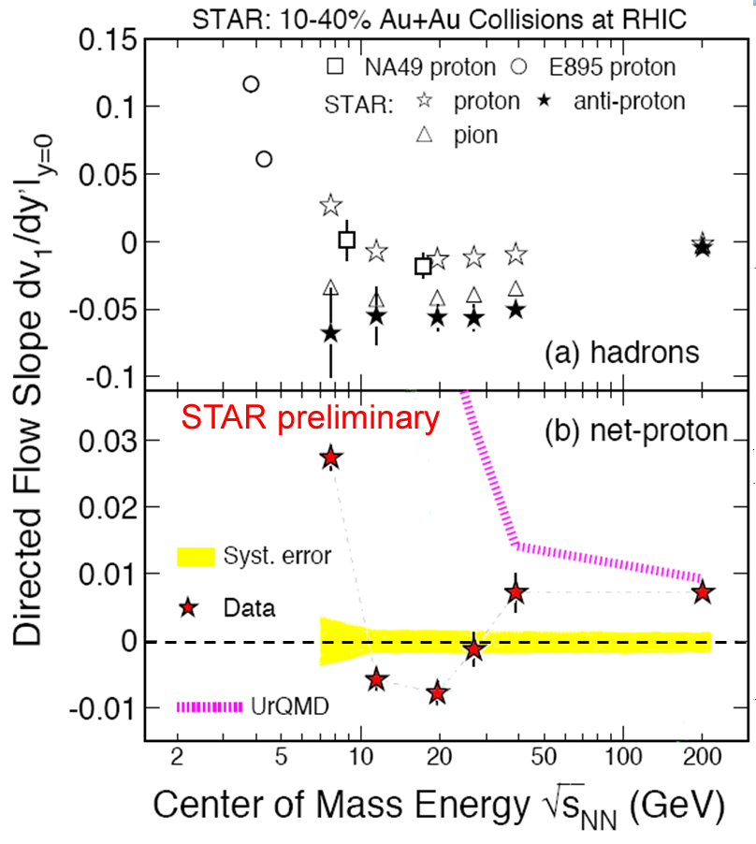
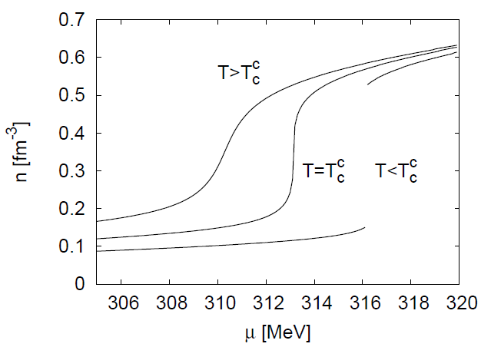
Directed Flow -- BES
B. Schaefer and J. Wambach Phys.Rev. D75 (2007) 085015
Lattice QCD calculations predict a first order phase transition seen, as a discontinuity in the density.
First order phase transition is characterized by unstable coexistence region. This spinodal region will have the lowest compressibility
v₁ is a manifestation of early pressure in the system
We see a minimum of the v₁ signal between 11.5 and 19.6 GeV ➔ New data are needed at 15 GeV

Slide 17
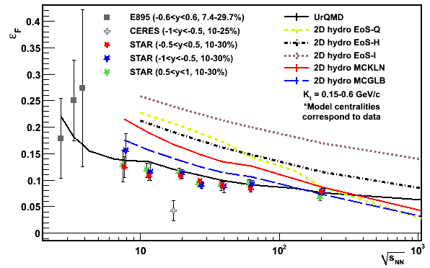
Azimuthally Sensitive HBT - BES Results
Initial eccentricity defined by overlap.
A softening of the equation of state would change the spatial expansion of the system.
This would be seen in ε_{F}.
Final Coordinate Space Eccentricity
Checked suggestive CERES result
The expansion (reduction of ε_{F}) slows above 7.7 GeV.
No minimum in ε_{F} is observed.
STAR PRELIMINARY
The E895 data are inconclusive
➔ STAR data below 7.7 GeV are needed

Slide 18
Search for 1st Order P.T. below 7.7 GeV
➔ Fixed-Target

Slide 19
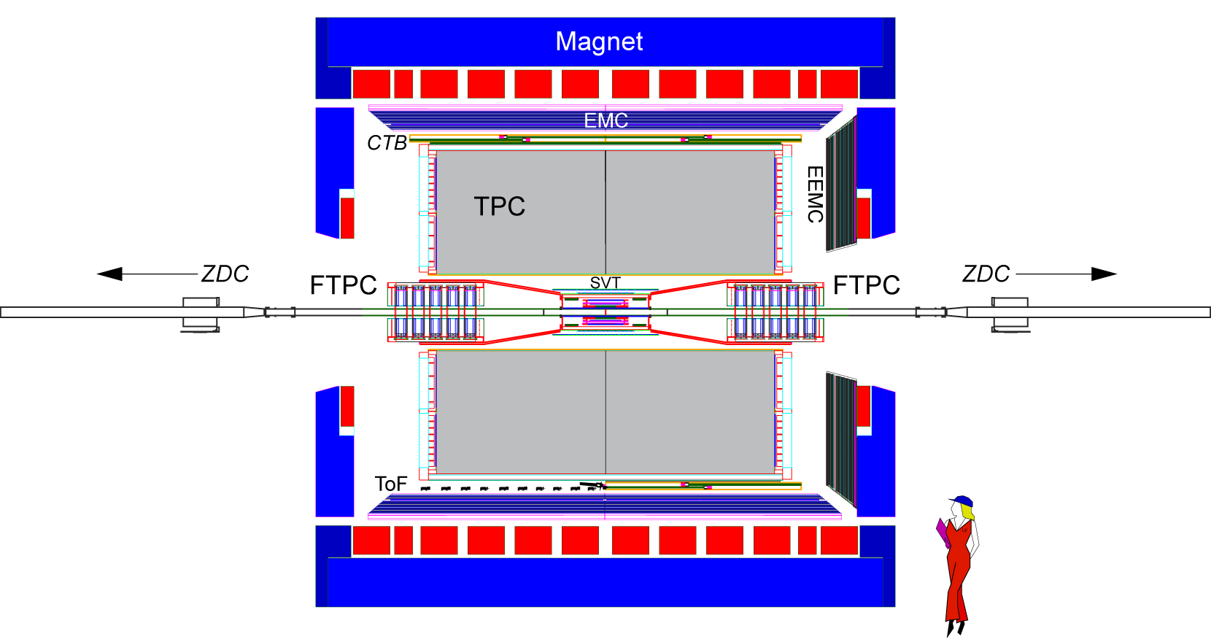
Outlook – Fixed Target
STAR Fixed-Target Run14 Set-up
Fixed-Target Trigger:
BBC-East
Not-BBC-West
TOFmult >70
top 30% centrality Au+Au
10⁶ Au+Al rejection
Tof
Place fixed target here (z ~ 2.0 m)
η = 1.0
η = 0.5
η = 0
η=1.5 Mid-rapidity for 4.5 GeV
BBC-East
η = 2.0
BBC-West
Yellow
Beam
Al Beam Pipe
4.0 cm diameter Be Beam Pipe
Al Beam Pipe
VPD-East
Beam pipe and Target Schematic
Energies for Run14
Collider mode Energies (GeV) | 5 | 7.7 | 11.5 | 15 | 19.6
Fixed Target √s_{NN} (GeV) | 2.5 | 3.0 | 3.5 | 4.0 | 4.5
Fixed Target μ_{B} (MeV) | 775 | 720 | 670 | 625 | 585
Fixed Target y_{CM} | 0.82 | 1.05 | 1.25 | 1.39 | 1.52
Gold Segment
30 mil thick

Slide 20
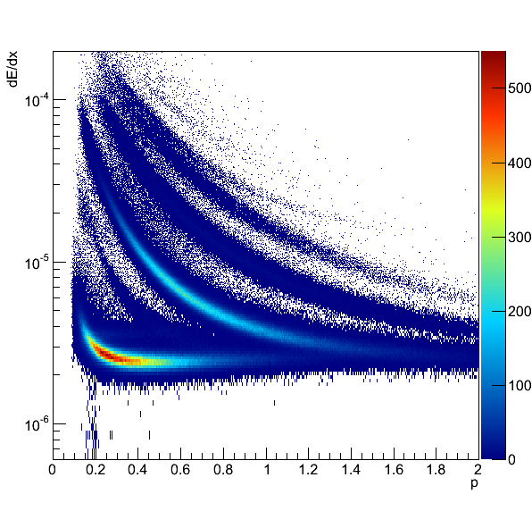
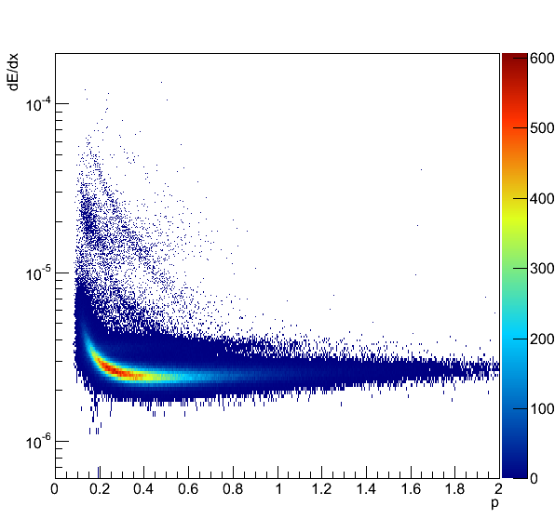
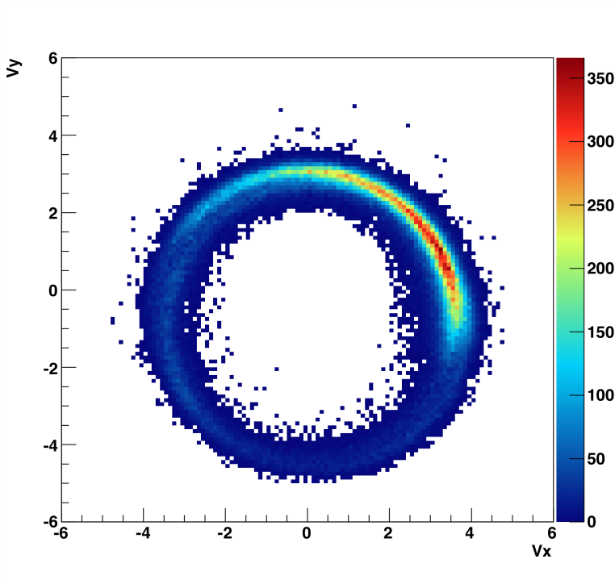
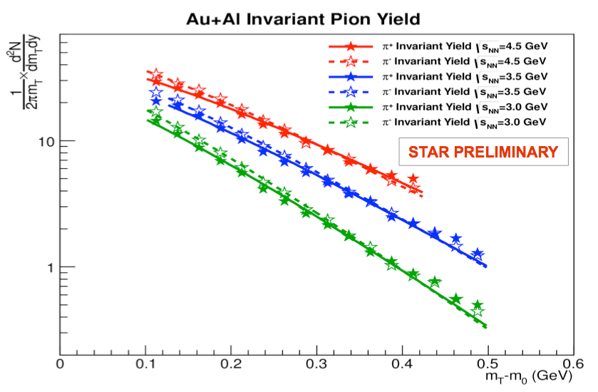
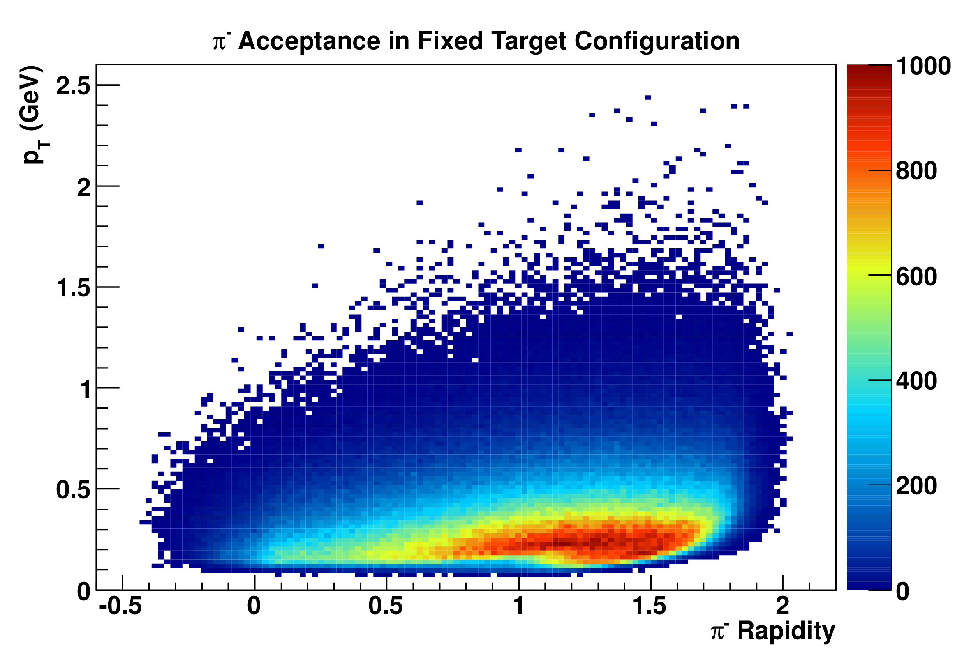
Pion Fixed-Target PID, Acceptance, Spectra
Proven capabilities with Beam Halo + Beam Pipe background events, Au_{Like}+Al at √s_{NN} = 4.5 GeV
XY Vertex
Positive Particles
Negative Particles
Pion Acceptances
y_{cm} = 0
4.0 GeV
y_{cm} = 0
4.5 GeV
Mid-rapidity pion spectra

Slide 21
STAR Fixed-Target Run14 Goals
All Au_{Like}+Al data taken during BES were pile-up background events
We need to develop a dedicated fixed-target trigger, however the test run request becomes irrelevant if RHIC runs 15GeV Au+Au before running 200 GeV Au+Au.
It is likely/possible that in the beam halo events studied in the BES data sets the projectile nucleus is a heavy projectile fragment from an upstream beam-gas nuclear interaction
We request a test to intentionally steer the beams to graze the target to create known Au+Au events.
➔ We will need the target to be designed, fabricated, and installed during this summer shutdown.
Physics goals for Run14 Au+Au at 4.0 GeV:
Elliptic flow of identified π⁺, π⁻, and p
Directed flow of protons
Azimuthally sensitive HBT of pions
These are out key 1st Order Phase Transition signatures

Slide 22
Search for the Critical Point

Slide 23
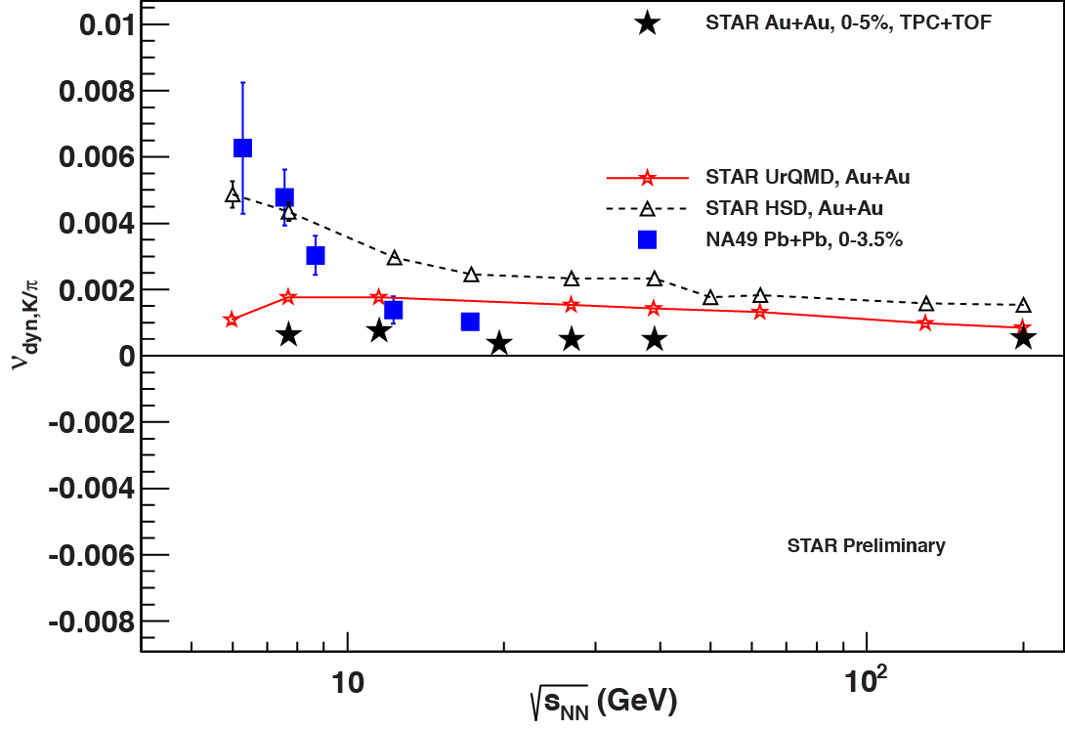
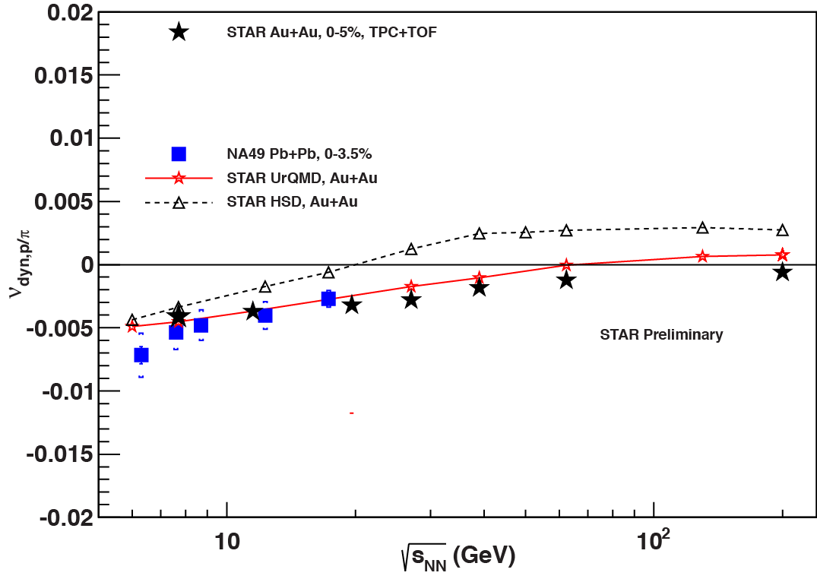
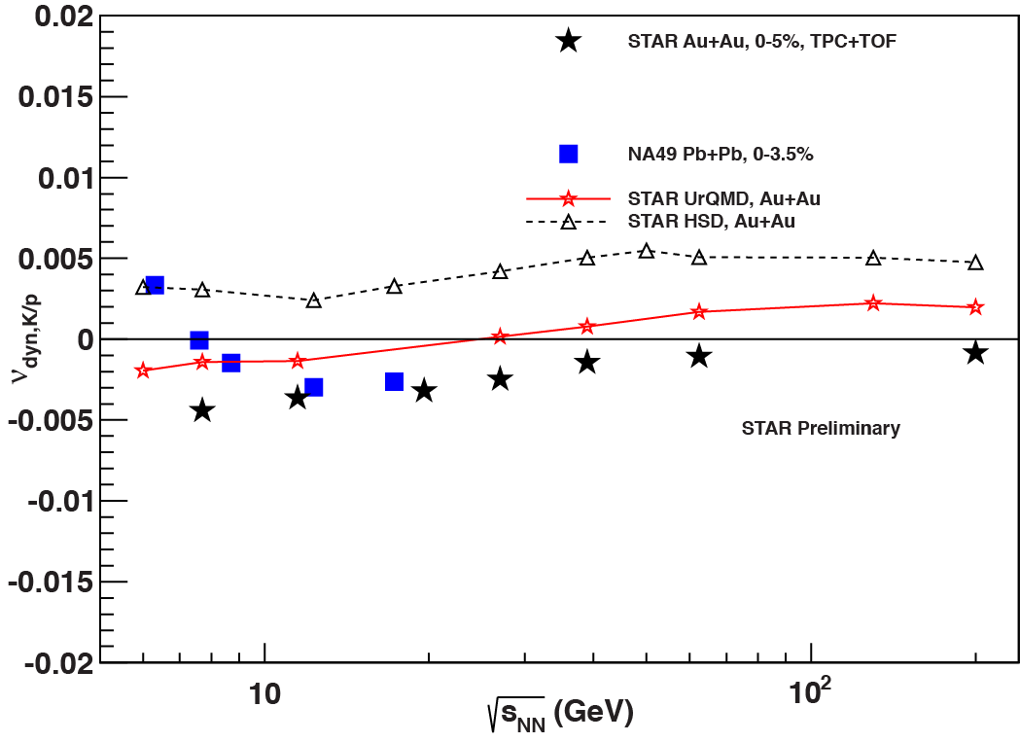
Ratio Fluctuations – BES Result
K/π
p/π
• Naively, fluctuations are expected at the critical point
STAR data show no significant energy dependence for K/π fluctuations
• Smooth evolution with energy for p/π and K/p fluctuations
• No non‐monotonic behavior is observed
➔ We need a more sensitive observable
K/p

Slide 24
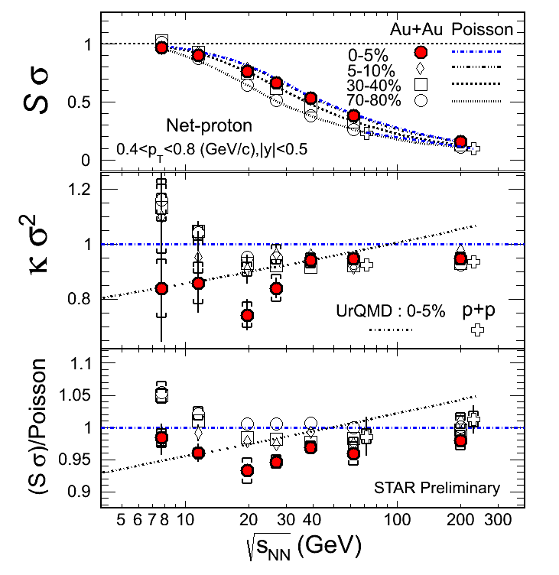
Higher Moments – Net Proton Skew/Kurtosis - BES
Third (Skew) and Fourth (Kurtosis) moments are increasingly sensitive to fluctuations expected at a critical point.
Ratios of cumulants allow volume terms to cancel
STAR data are similar to Poisson baseline at energies above 27 GeV.
Deviations are seen at low energies.
Signal size will be affected by finite size
The gap between 11.5 and 19.6 is large, might miss the critical point
➔ Need data at 15 GeV
Additionally
➔ Need detailed theory with finite systems
➔ More data are needed ➔ BESII
STAR PRELIMINARY

Slide 25
Conclusions
Turn-off of QGP signatures:
NCQ scaling breaks down below 19.6 GeV
High p_{t} suppression not seen below 19.6 GeV
LPV effect not seen below 11.5 GeV
➔ The onset of deconfinement is below 11.5 Gev
Evidence of the first order phase transition.
Inflection in v₂ at 7.7 GeV
v₁ slope (dv₁/dy) double sign change, minimum near 15 GeV
Azimuthal HBT interpretation is challenging
➔ Need more data near 15 GeV and below 7.7 GeV
Search for the critical point.
Measurements of K/π, K/p, or p/π fluctuations
Measurements of Higher moments of the net-proton and charge
➔ An Beam Energy Scan survey point is needed at 15 GeV
➔ These are challenging analyses, more data/theory ➔ BESII

Slide 26
Backup

Slide 27
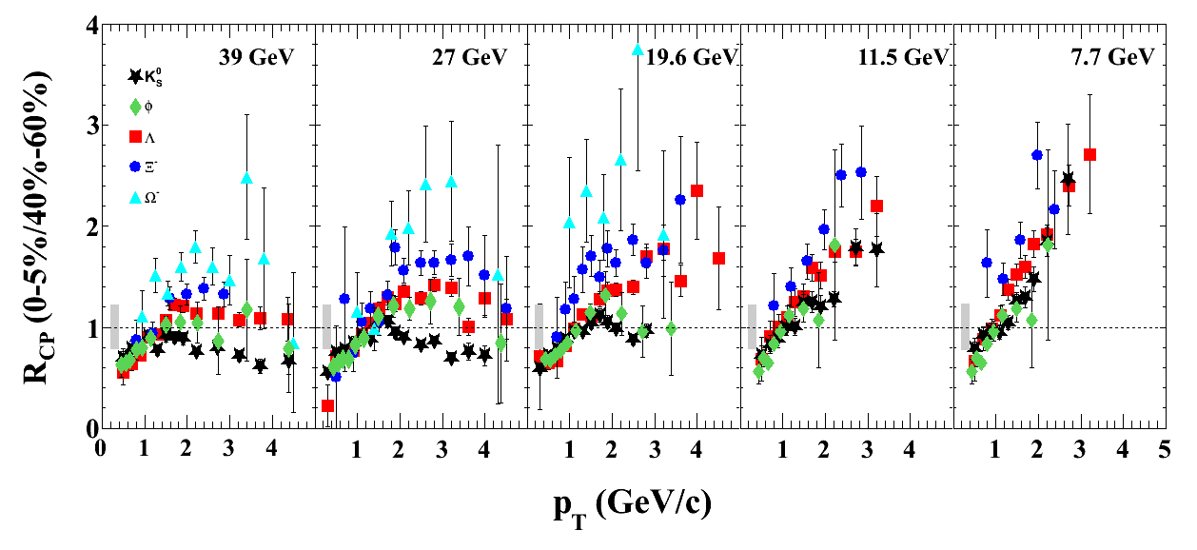
High p_{T} Suppression: BES Results
STAR Preliminary
R_{CP} of strange particles at 39 and 27 GeV show a similar trend as that in higher energies.
19.6 shows intermediate behavior
At 11.5 and 7.7 GeV, all particles R_{CP} are larger than 1 at intermediate p_{T}.

Slide 28
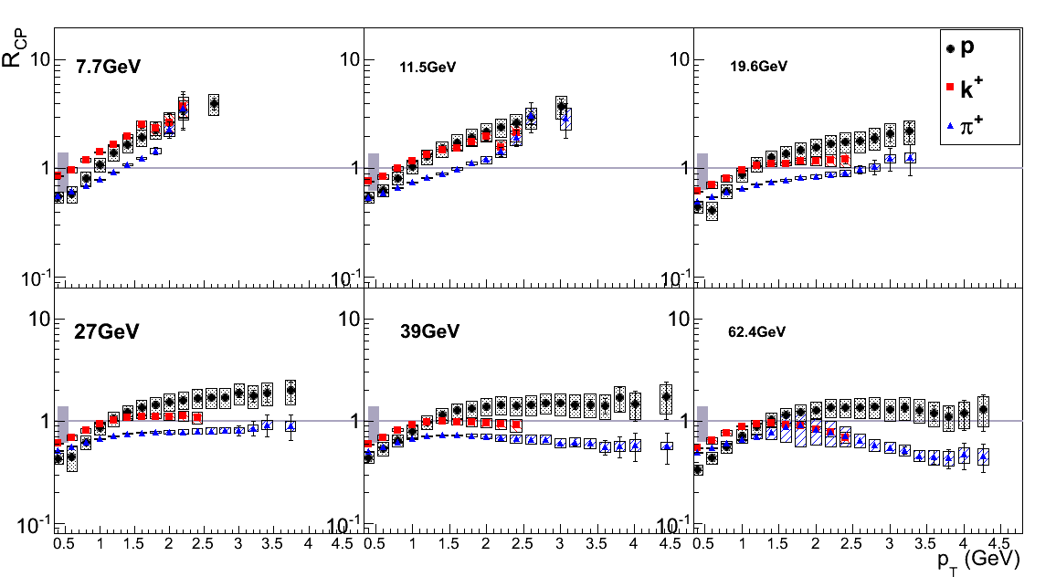
High p_{T} Suppression: BES Results
0-5% / 60-80%
STAR Preliminary
High p_{T} suppression seen at 27 GeV and above
19.6 shows intermediate behavior
At 11.5 and 7.7 GeV, all particles R_{CP} are larger than 1 at intermediate p_{T}.
E. Sangaline QM2012

Slide 29
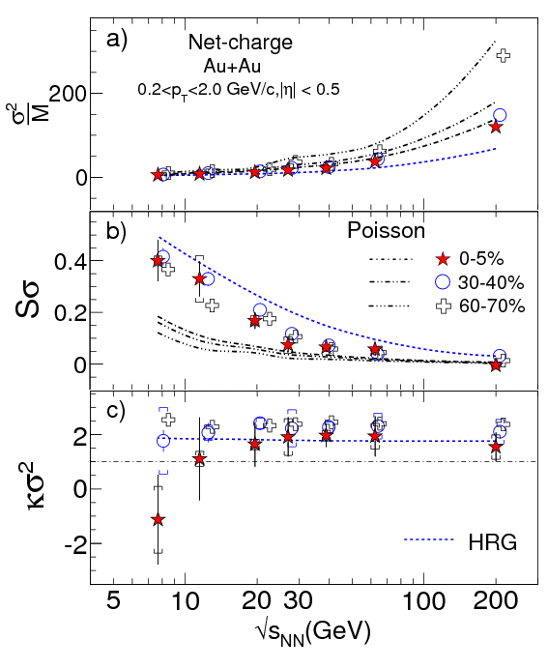
Higher Moments – Net Charge Skew/Kurtosis - BES
Data are consistent Poisson baseline at highest energy.
Deviations from Poisson at low energy.
➔ More theory is needed
➔ More data are needed
Draft paper in God Parent Committee

