Slide 1
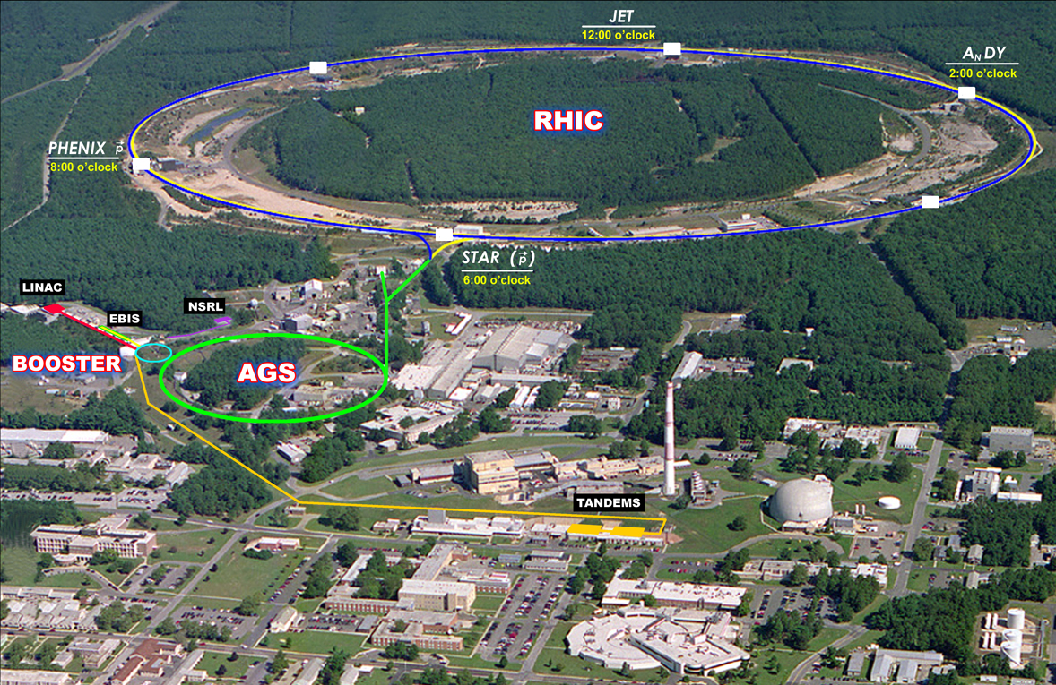

RHIC performance and projections
Wolfram Fischer
11 June 2013
BNL NPP PAC
Notes:
11 June 2013, 09:00, 30 min total => 25 slides

Slide 2
Relativistic Heavy Ion Collider
1 of 2 ion colliders (other is LHC), only polarized p-p collider
2 superconducting 3.8 km rings
2 large experiments
100 GeV/nucleon ions up to U
255 GeV polarized protons
Performance defined by
1. Luminosity L
2. Proton polarization P
3. Versatility (species, E)

Slide 3
Content
Run-13 overview
Polarized protons √s = 510 GeV OPPIS, e-lenses
Tests: He-3 in AGS, loss control of STAR fixed targets,
p in RHIC with same (Bρ) as Au-Au at √s_{NN} = 5 GeV
Preparation for Run-14 and Run-15
Au+Au operation √s_{NN} = 15, 200 GeV 3D cooling, 56 MHz SRF
p⬆+p⬆ operation √s = 200 GeV e-lenses
Asymmetric operation (p⬆-Au, d-Au, h-Au, p⬆-Al(Si), p⬆-Cu) DX move
Further running modes/upgrades
Electron cooling for Au-Au √s_{NN} = 7.7−20 GeV
Source upgrades: polarized He-3, Laser Ion Source
Comments on LHCf@RHIC LoI

Slide 4
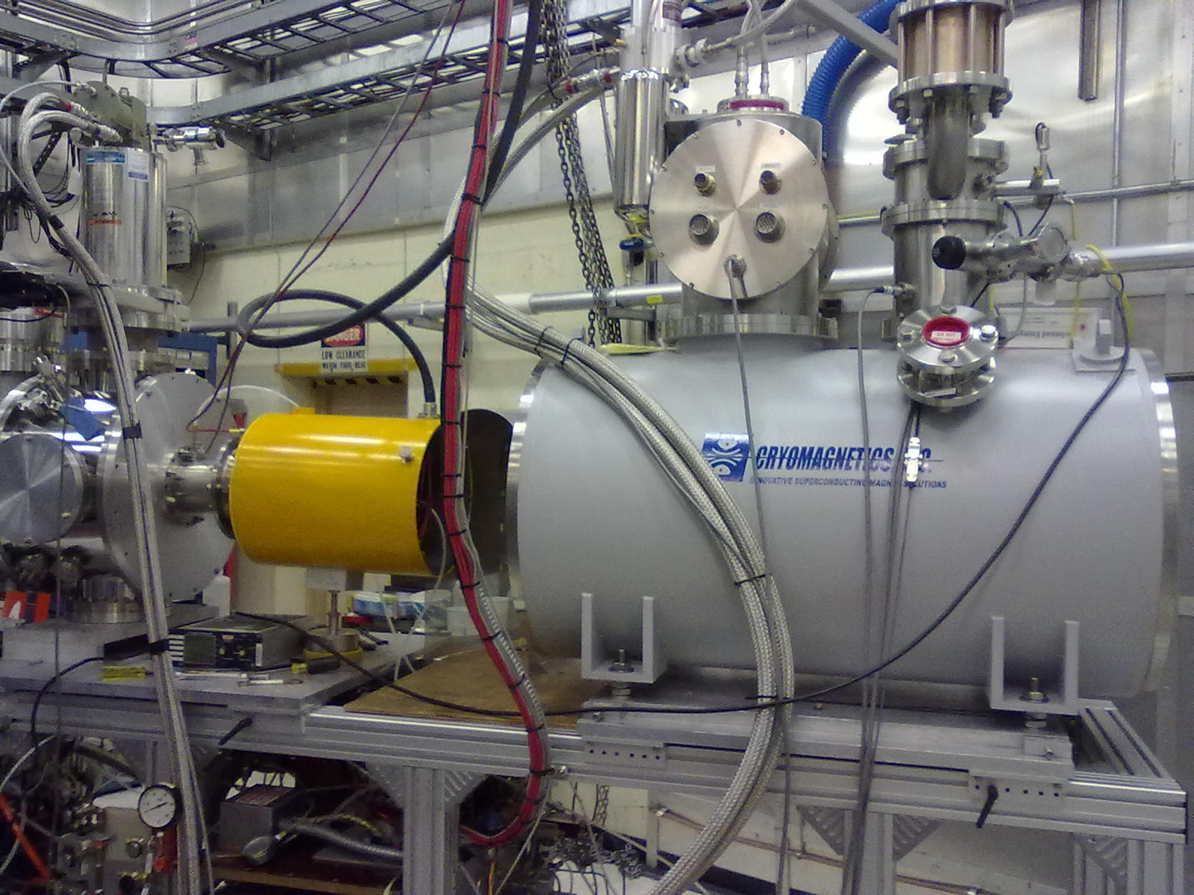
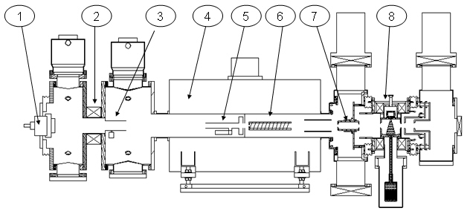
Optically Pumped Polarized H– source (OPPIS) – A. Zelenski
Upgraded OPPIS (2013)
Goals:
1. H⁻ beam current increase to 10mA (order of magnitude)
2. Polarization to 85-90% (~5% increase)
Upgrade components:
1. Atomic hydrogen injector (collaboration
with BINP Novosibirsk)
2. Superconducting solenoid (3 T)
3. Beam diagnostics
and polarimetry
Setup on 10 May 2012
Source Neutralizer Ionizer Rb-cell Sona Na-jet
(H⁺) (H⁰) (H⁺) (H⁰) (H⁻)
New Atomic
Beam Source
(ABS)
New superconducting
solenoid
sc solenoid
Notes:
UPDATE

Slide 5
Optically Pumped Polarized H– source (OPPIS) – A. Zelenski
Commissioning before/during Run-13
First year with new OPPIS, reliable operation
Maintenance time is significantly reduced
The source intensity is about 5-10 mA (10x more than old source).
Strong space-charge limits transport through RFQ and Linac, losses can be reduced.
Performance increase to date
Maximum Booster intensity: 2x higher than Run-12
Polarization: 83%, 3-4% higher than Run-12 (at nominal intensity 5x10¹¹)
Expect further intensity and polarization increases
Will be primarily used to increase brightness
Polarization at store can be reduced by accelerating smaller beams

Slide 6
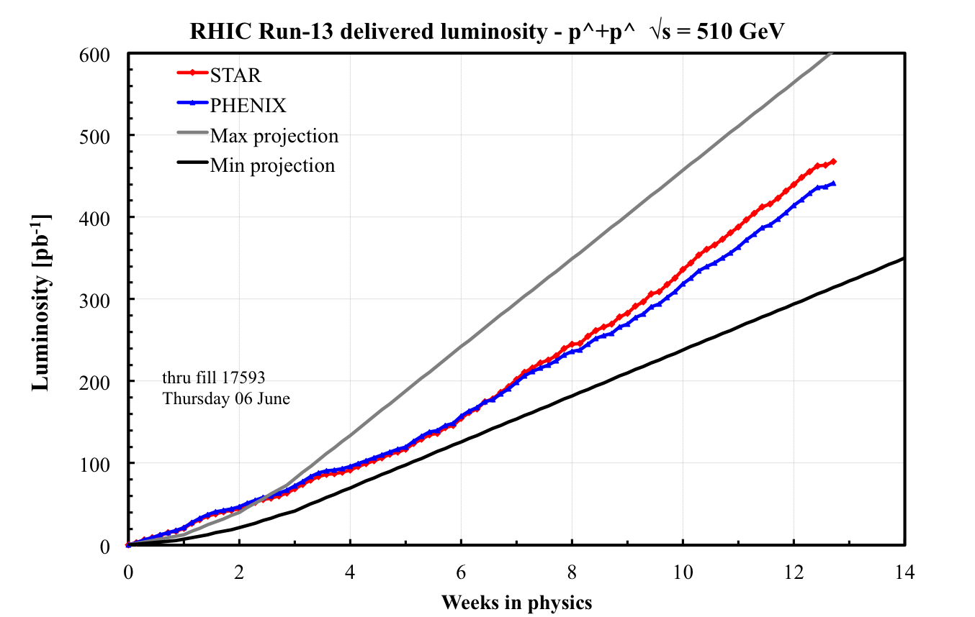
Run-13 luminosity
Best weeks
(50 pb⁻¹/week)
close to max
projected
(56 pb⁻¹/week)
New: OPPIS, AGS survey, upgrade 9 MHz, upgrade pC, new STAR Be pipe,
e-lens lattice tested, e-lens hardware commissioning, longitudinal damper
injection and ramp, …

Slide 7
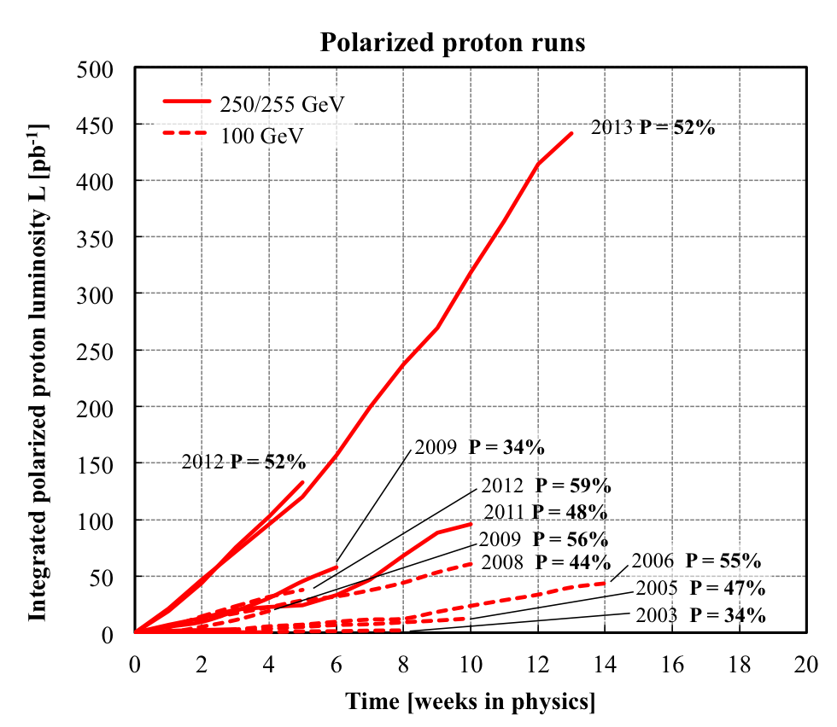
RHIC polarized protons – luminosity and polarization
At 255 GeV in 2013
L_{avg} = 132x10³⁰cm⁻²s⁻¹
P_{avg} = 52%
L_{avg} +26% relative to 2012
P_{avg} same as 2012
FOM = LP²
(single spin experiments)
FOM = LP⁴
(double spin experiments)

Slide 8
Run-13 polarization (preliminary)
Transverse emittance reduction
after optimization of AGS
transition crossing
50%
H-jet measured polarization
(average over intensity, time, run)
H-jet measures intensity-averaged P
LP² and LP⁴ are luminosity-averaged
Luminosity-averaged values are higher
than intensity-averaged values
 | Run-12 | Run-13
Blue | 50.3% | 49.8%
Yellow | 53.5% | 53.2%

Slide 9
Run-13 calendar time in store
------------- 250/255 GeV pp runs ----------
Time in store (54%) same as Run-12
Problems early in the run – e.g.
  Lab closed for 4 days after Blizzard Nemo on 02/18/13
  lost 8 stores (~ ½ week recovery time) due to power fluctuations after
  LIPA switching capacitors around 6 am

Slide 10
Luminosity limit reached due to beam-beam tune spread
border for
polarization loss
tune distributions without collisions
Verified both limits in Run-13
with collisions
border for fast beam
size growth

Slide 11
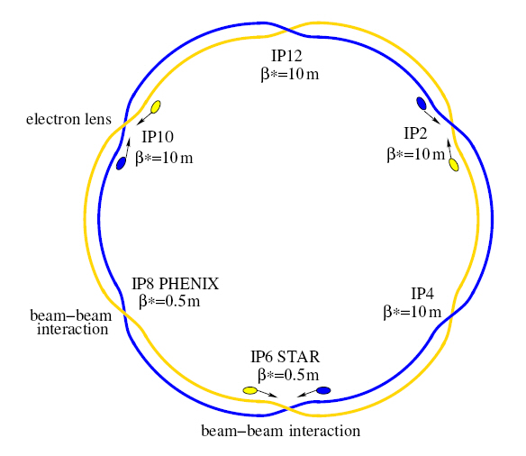
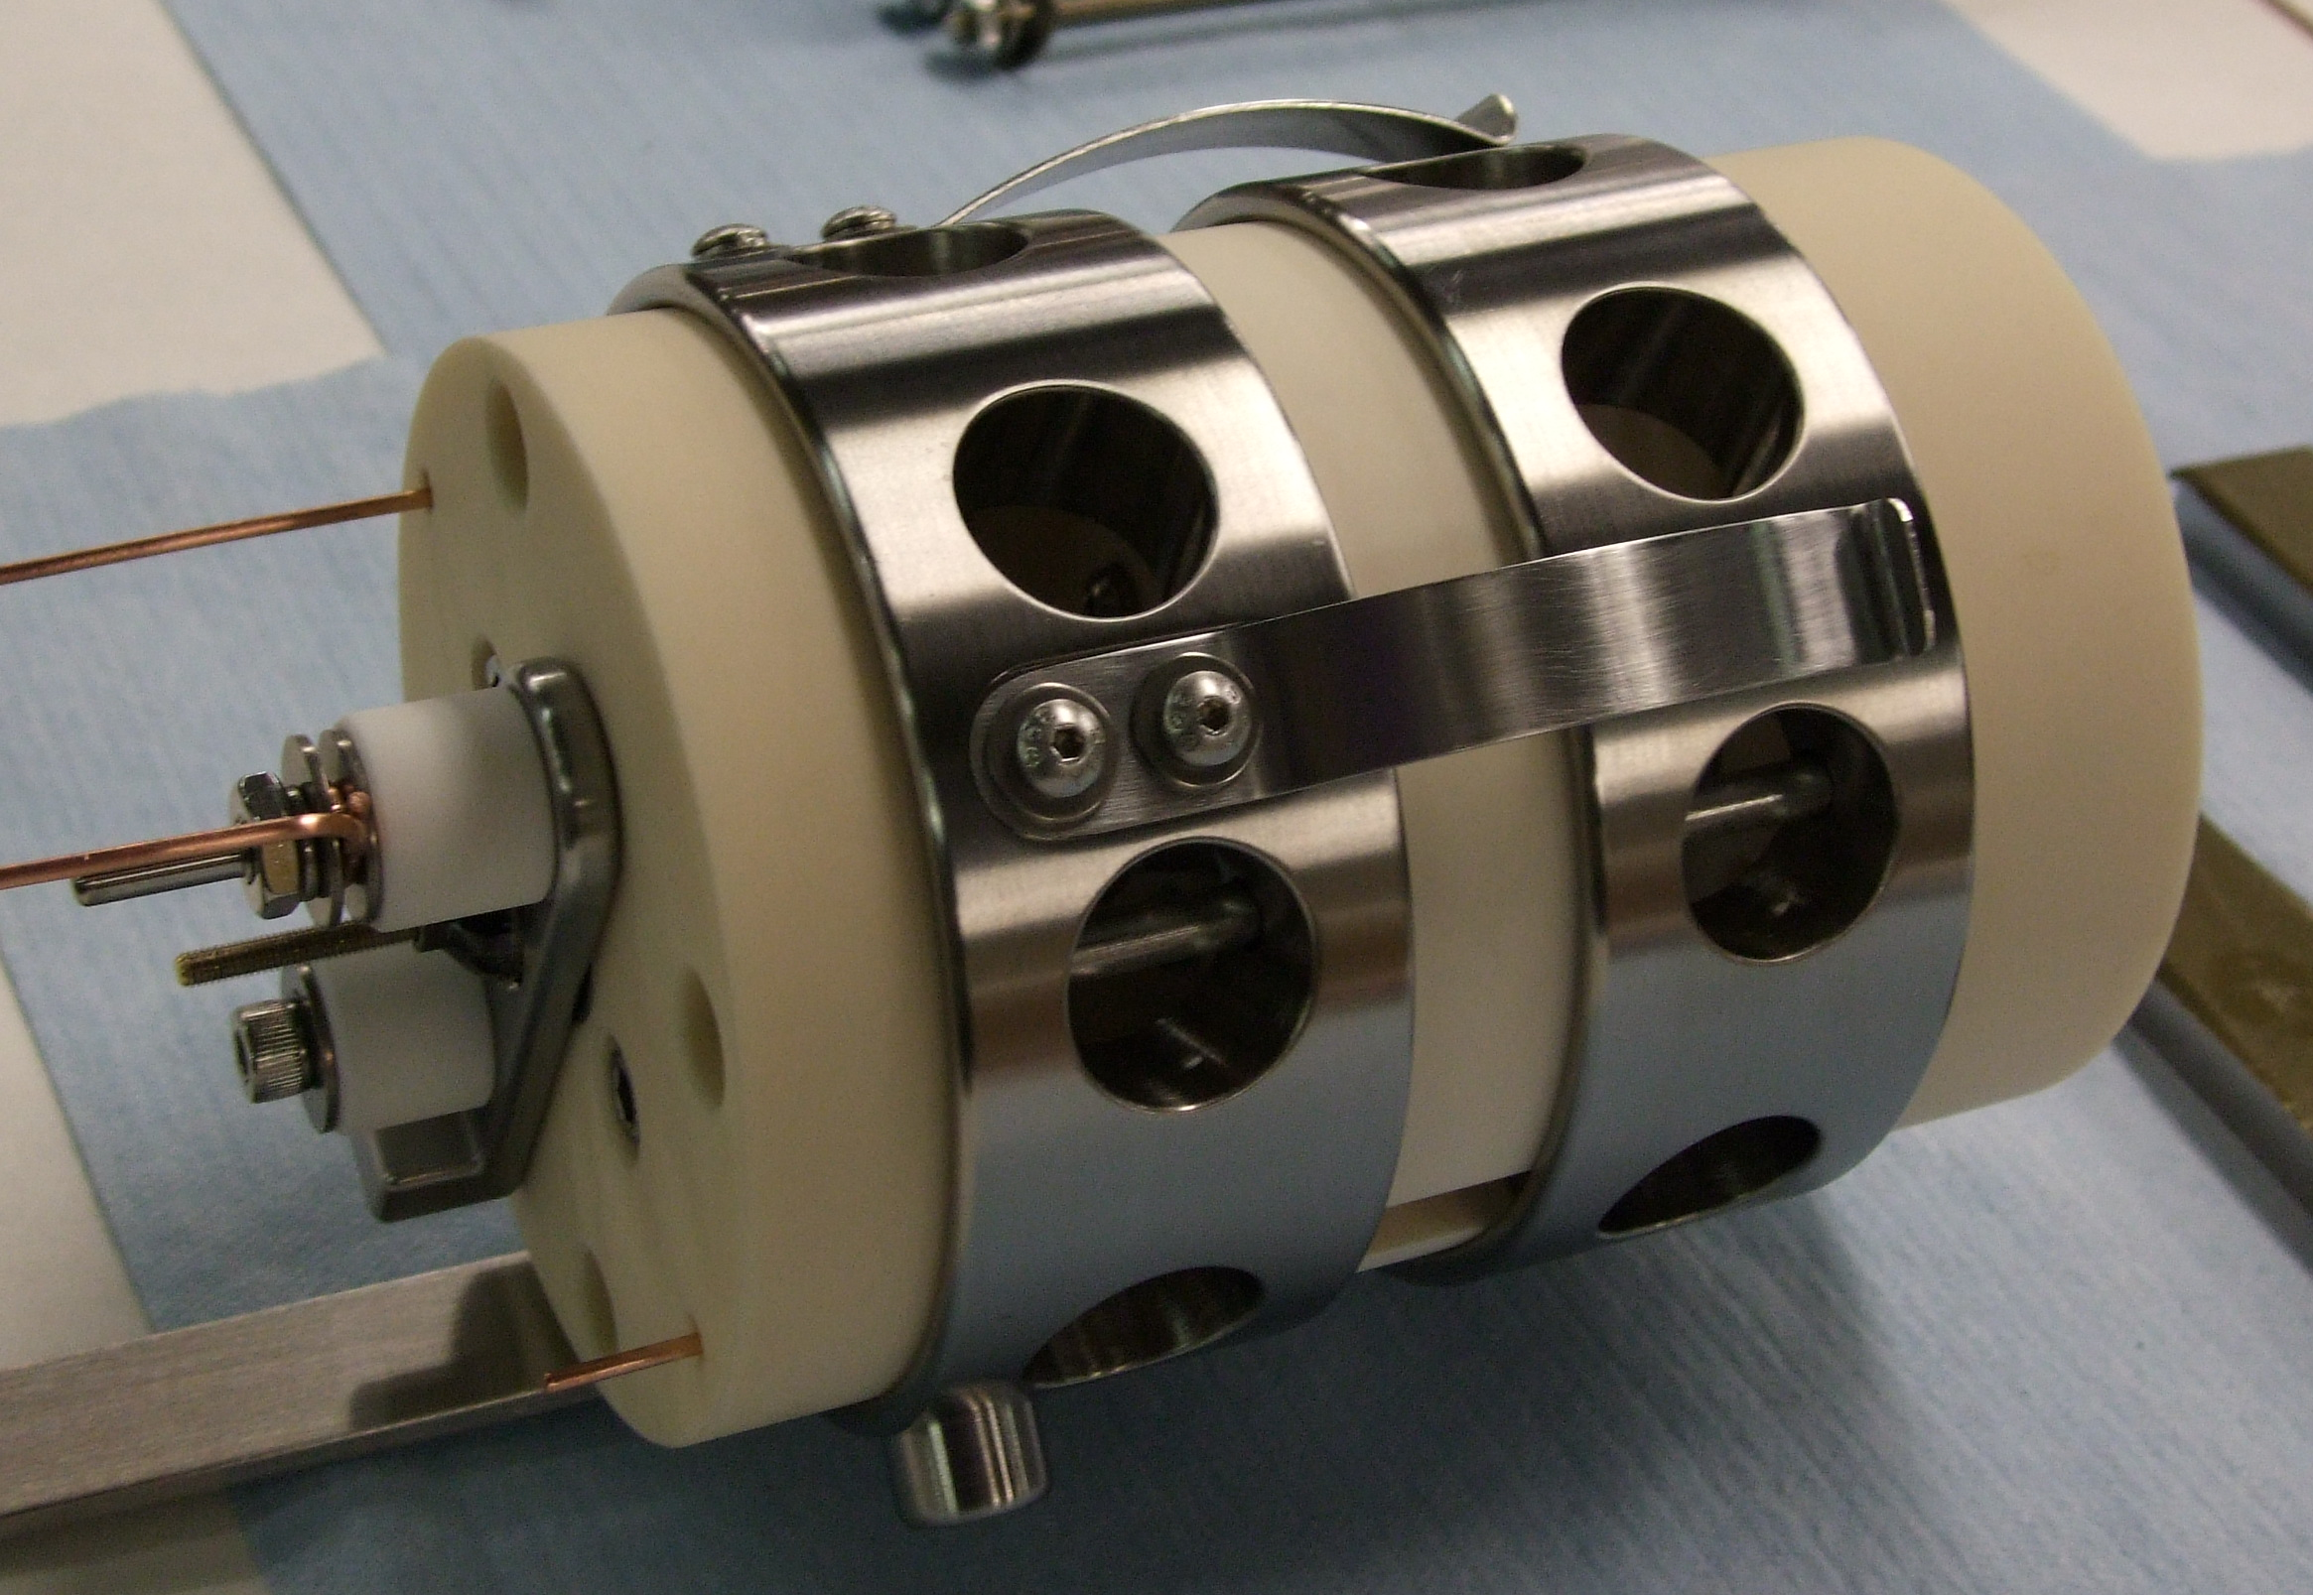
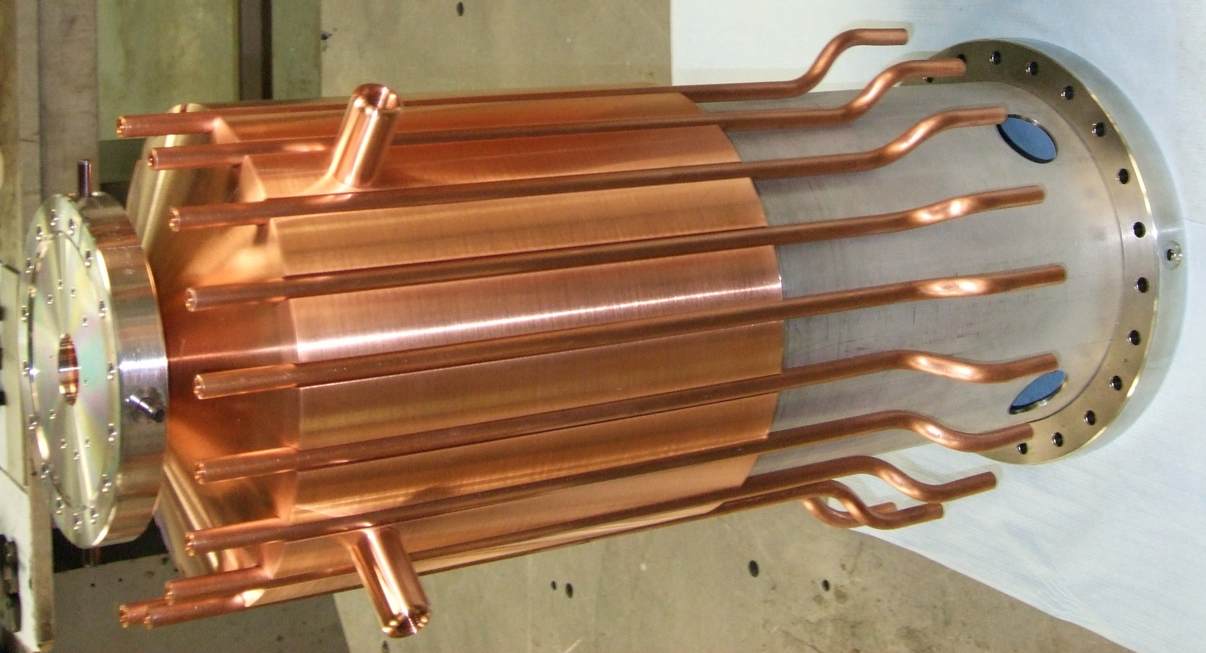
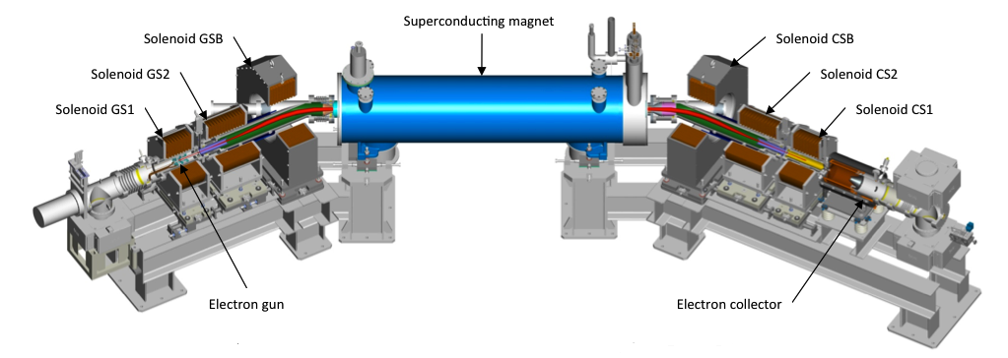
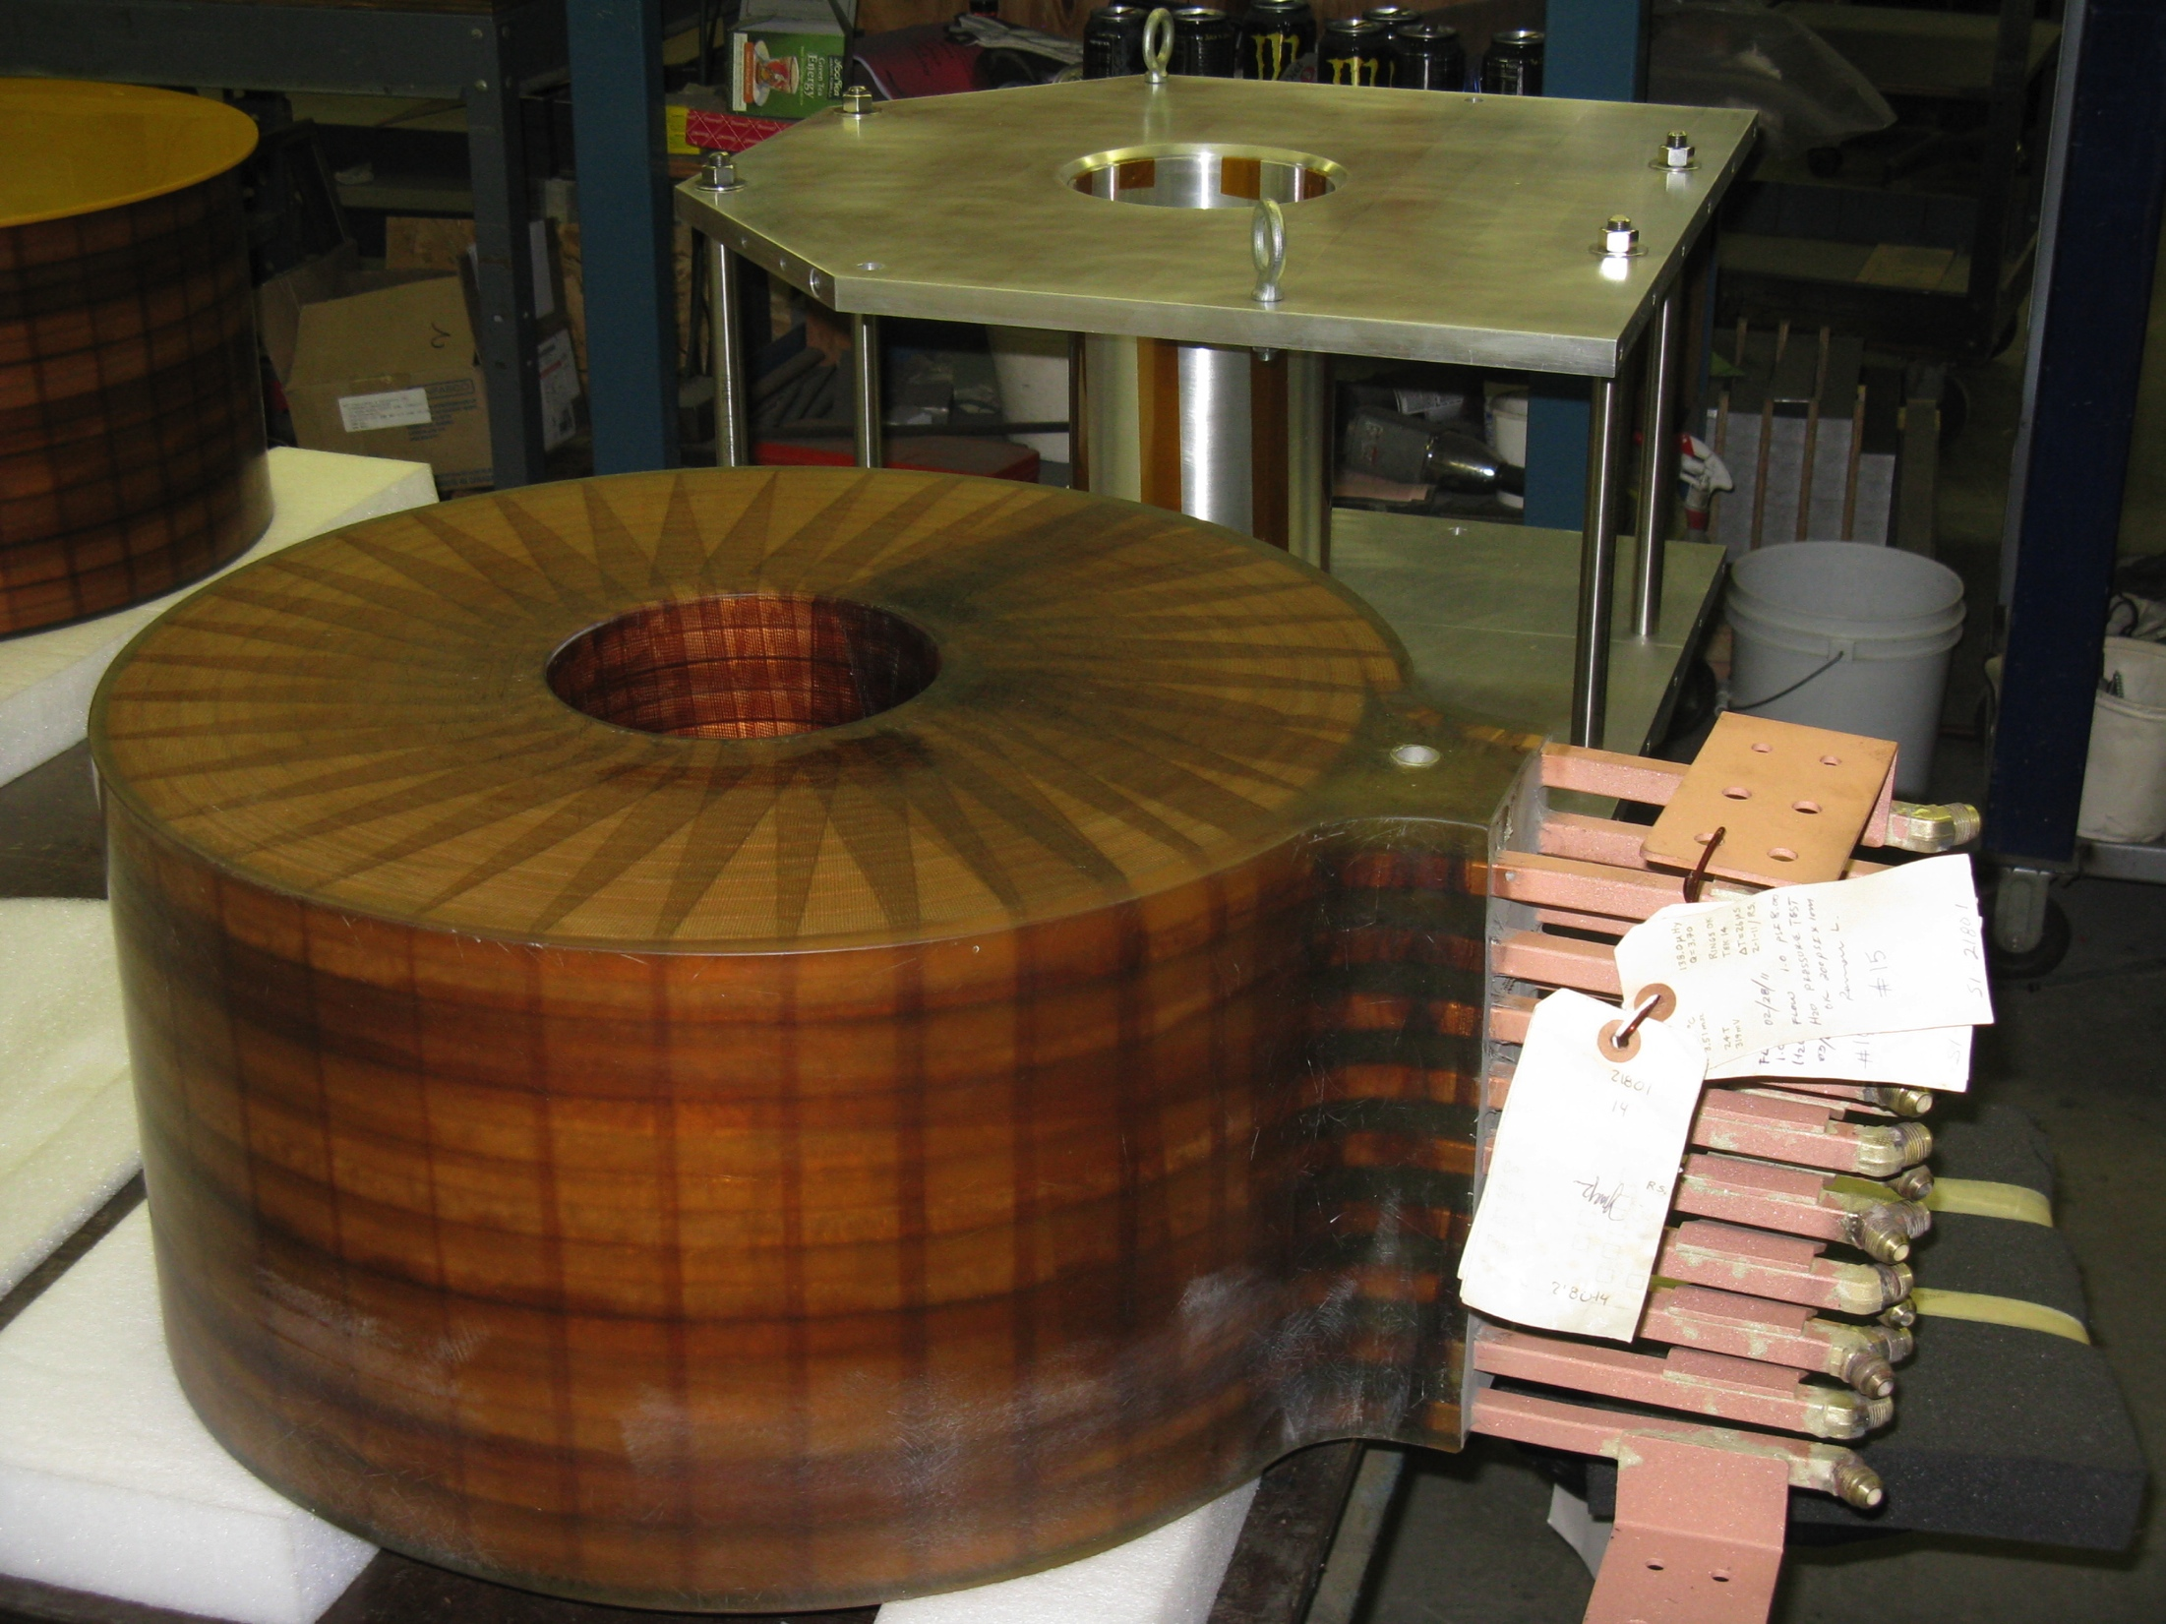
Electron lenses – partial head-on beam-beam compensation
Basic idea:
2 beam-beam collisions with positively charged beam
Add collision with a negatively charged beam – with matched intensity and same amplitude dependence
Compensation of nonlinear effects:
e-beam current and shape
=> reduces tune spread
Δψ_{x,y} = kπ between p-p and p-e collision
=> reduces resonance driving terms
Hardware commissioning in Run-13
Beam commissioning in Run-14
Expect up to 2x more luminosity
e-gun
e-collector
main solenoid
manufacturing in SMD
GS1 manufacturing
in industry

Slide 12
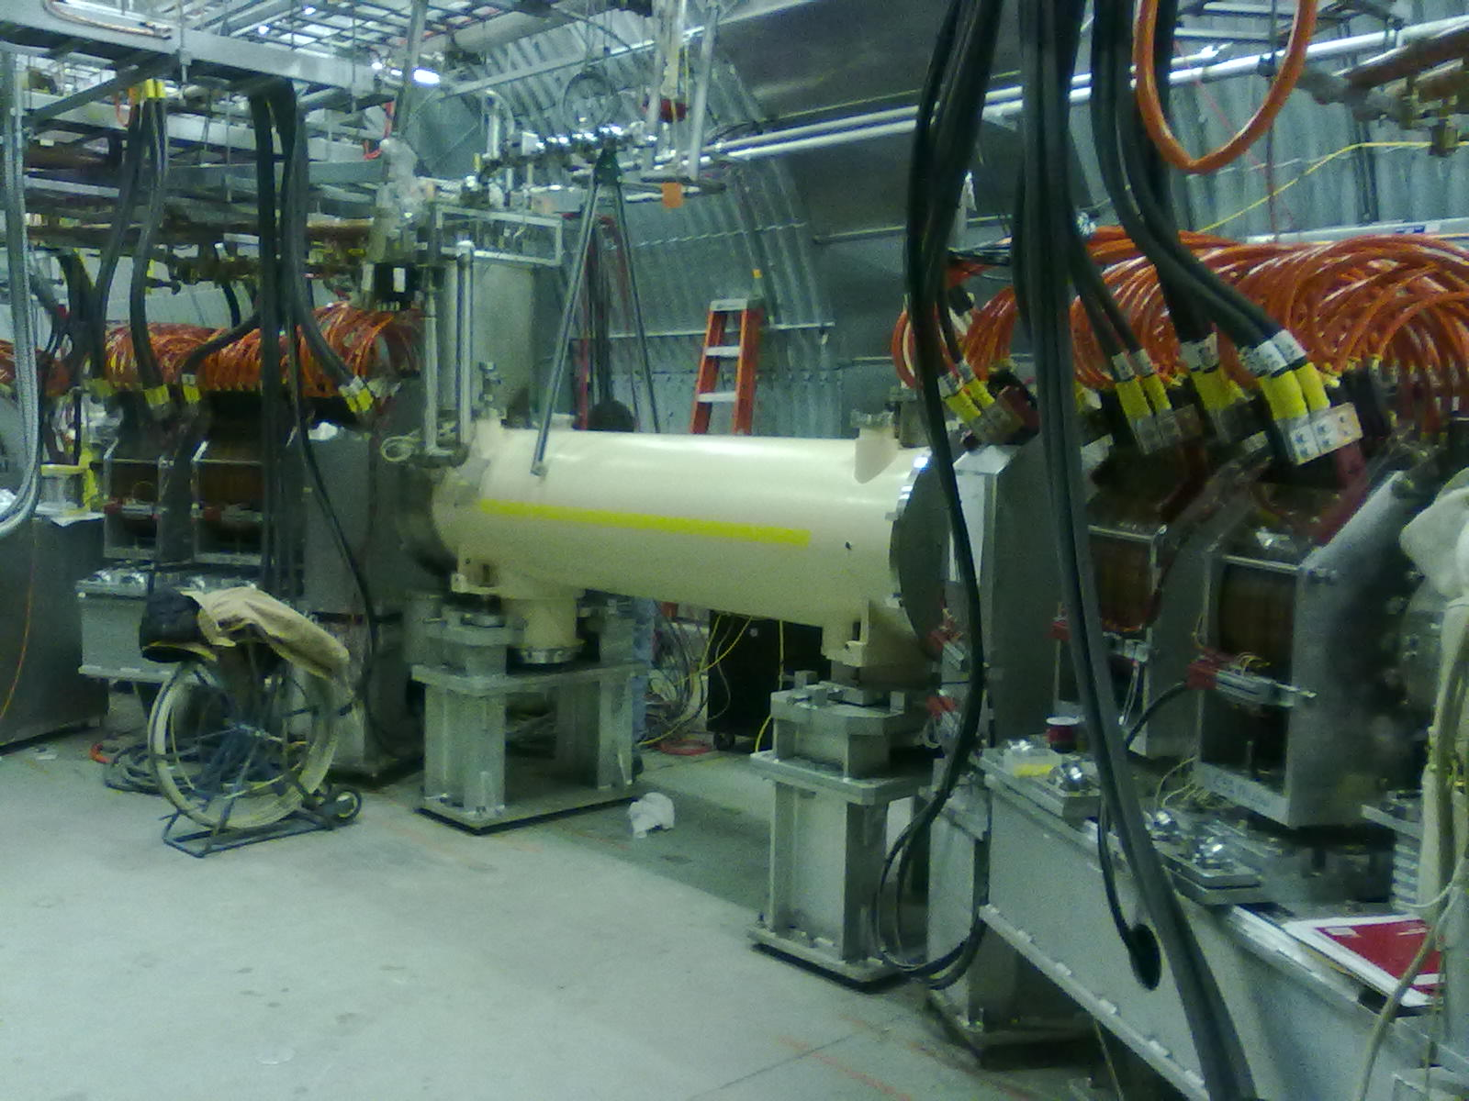
Electron lenses commissioning
2 lenses partially installed
– Blue lens with EBIS spare solenoid – allows for e-beam transport
– Yellow lens with superconducting solenoid – magnet commissioning
Tested new lattices with Δψ = kπ between PHENIX and e-lenses (needs modification), and new bunch-by-bunch diagnostics
Commissioned hardware: both sc solenoids cold and powered
(not yet full current), all warm solenoids ready, Blue gun and collector ready
Will complete installation in summer 2013, measure and correct
field straightness of superconducting magnets
Beam commissioning in Run-14 (any ion beam ok for beam commissioning, need protons for compensation)
Notes:
Have background picture of RHIC electron lens – in contrast to DCI picture

Slide 13
Run-13 test: fixed Au target in STAR
C. Montag et al.
Control of loss rate at vertical target (collimator) via tune
0.71
horizontal tune
Tune
vertical tune
0.67
=> Loss rate variations ~2x, no spikes
400
loss rate at collimator (measured with PIN diodes)
Rate
0

Slide 14
Run-13 test: study for 2.5 GeV/nucleon Au operation
C. Montag et al.
2012: 2.5 GeV/nucleon Au
1x10⁹
Intensity
2x10¹¹
Bunched beam intensity
2013: p with same rigidity
(beam is smaller, same field errors)
Intensity
Conclusion:
Bam lifetime at 2.5 GeV/nucleon limited by beam size/aperture.
Brighter Au beams may allow operation with 2.5 GeV/nucleon.

Slide 15
Run-13 test: He-3 acceleration in AGS
H. Huang et al.
Polarized He-3 source under development at MIT,
accelerated unpolarized He-3 nuclei (helions) in AGS:
3.3x more intensity at AGS extraction than 2012
4x10¹⁰/bunch in reach at AGS extraction
Details:
EBIS intensity increase from 3.4 to 3.9x10¹⁰
2 bunch merges in Booster, can do 2 more merges in AGS
(needs to be demonstrated in AGS)
Better Booster injection field regulation
For polarization preservation have demonstrated
  Vertical tune at Booster injection of 4.09
  AGS tune of 8.97

Slide 16
RHIC luminosity and polarization goals
parameter |  | unit | achieved |  | goals
Au-Au operation |  |  | 2011 |  | ≥ 2014 3D stochastic cooling + 56 MHz SRF
energy | GeV/nucleon |  | 100 |  | 100
no colliding bunches | … |  | 111 |  | 111
bunch intensity | 10⁹ |  | 1.3 |  | ≥ 1.1
avg. luminosity | 10²⁶ cm⁻²s⁻¹ |  | 30 |  | 40
p↑-p↑ operation |  |  | 2013 |  | ≥ 2014 source + e-lenses
energy | GeV |  | 100 | 255 | 100 | 255
no colliding bunches | … |  | 107 | 111 | – 107 –
bunch intensity | 10¹¹ |  | 1.6 | 1.85 | 1.8 | 2.5
avg. luminosity | 10³⁰ cm⁻²s⁻¹ |  | 33 | 135 | 60 | 300
avg. polarization* | % |  | 59 | 53 | 62 | 56
*Intensity and time-averaged polarization as measured by the H-jet. Luminosity-averaged polarizations, relevant in single-spin
colliding beam experiments, are higher. For example, for intensity-averaged P = 48% and R_{x} = R_{y} = 0.2 (255 GeV, 2013), the
luminosity-averaged polarization is P = 53%.

Slide 17
Preparation for Run-14
Stochastic cooling
First 100 GeV/nucleon Au-Au run with full 3D cooling
New longitudinal pick-ups – better signals
New longitudinal kickers – better mechanics, wave guides and
vacuum performance (one kicker became stuck in Run-10)
56 MHz SRF
Plan installation and commissioning of 56 MHz cavity
Schedule pressure due to vendor failure on HOM damper fabrication
Due to commissioning will only have modest contribution
to Run-14 total luminosity
Expect 30-50% luminosity increase after full commissioning

Slide 18
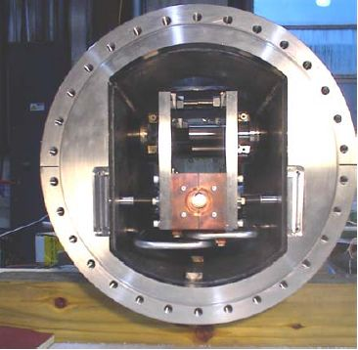
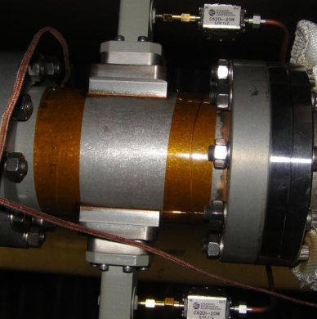
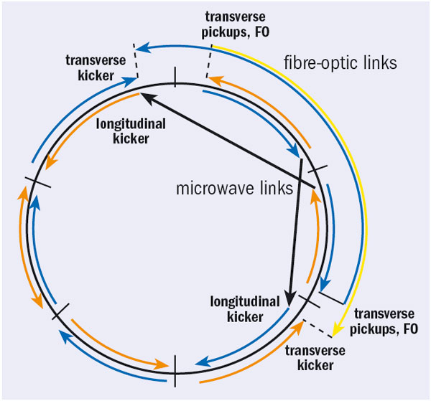
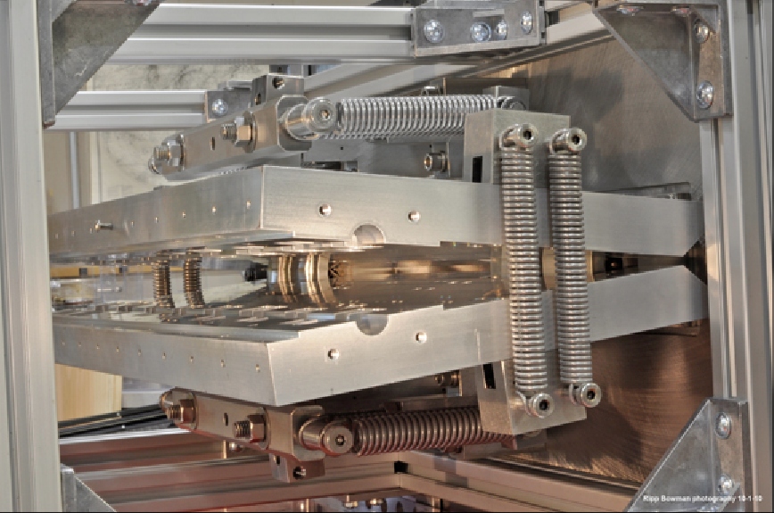
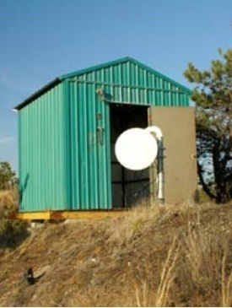
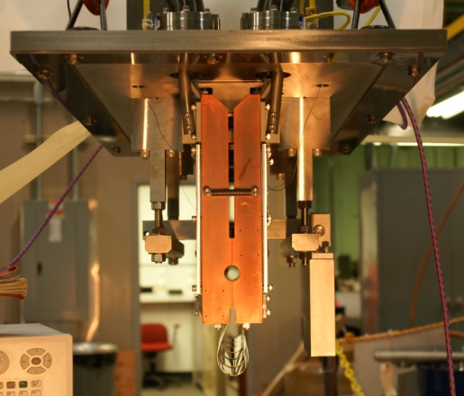
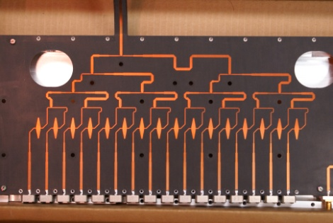
Existing 3D stochastic cooling for heavy ions
longitudinal pickup
longitudinal
kicker
(closed)
horizontal kicker
(open)
horizontal and
vertical pickups
vertical
kicker
(closed)
5-9 GHz, cooling times ~1 h
M. Brennan, M. Blaskiewicz, F. Severino, PRL 100 174803 (2008); PRSTAB, PAC, EPAC
Notes:
Frequency range: 5-8 GHz transverse, 6-9 GHz longitudinal

Slide 19
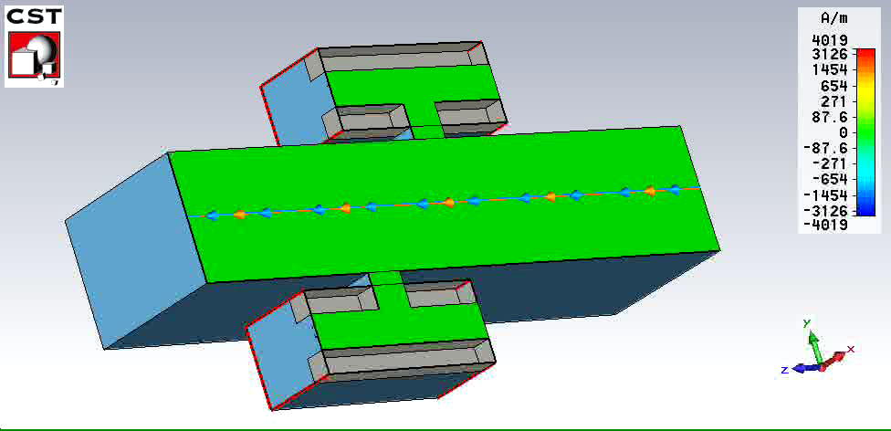
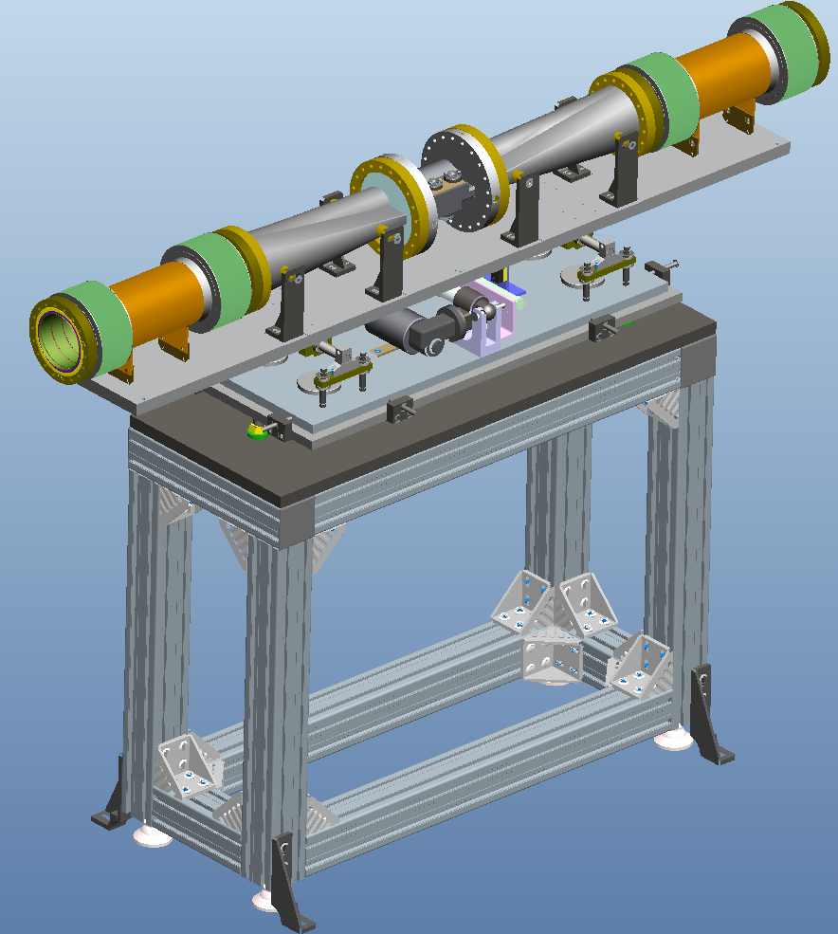
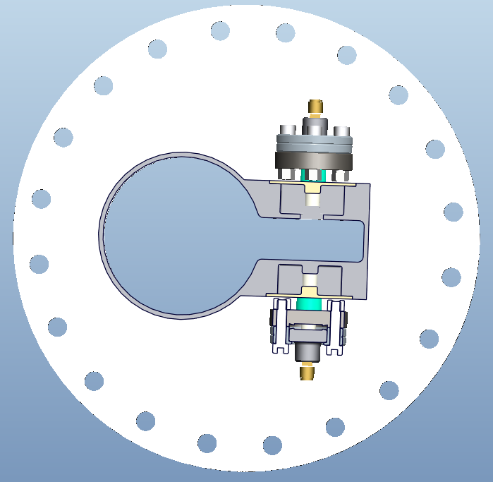
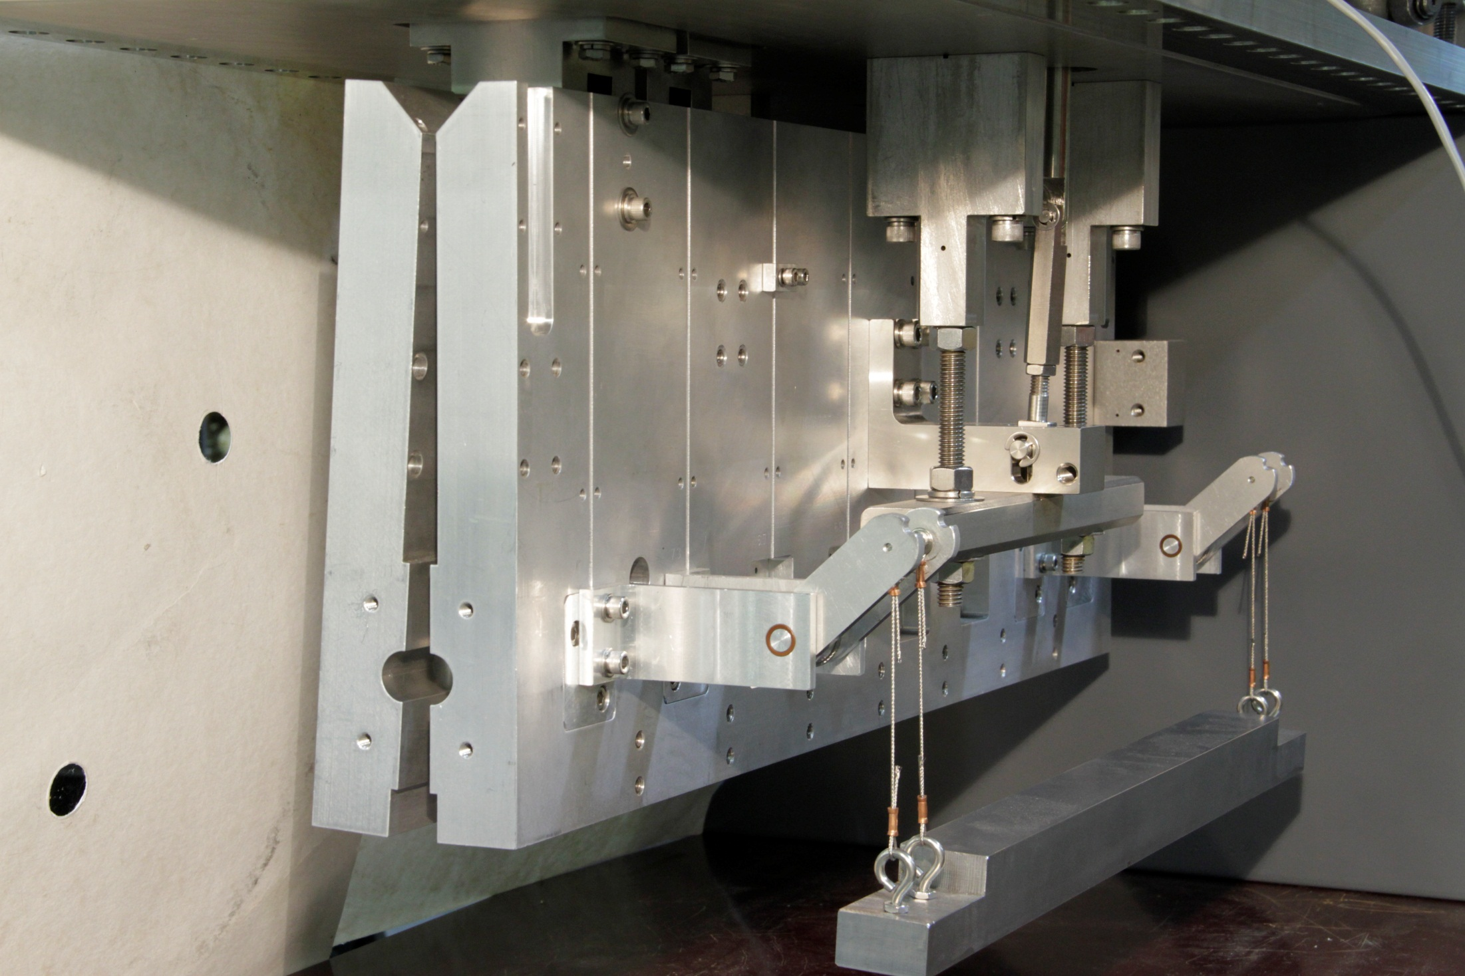
Stochastic cooling upgrades for Run-14
M. Brennan, M. Blaskiewicz, K. Mernick, et al.
New longitudinal pickups – better signals
Shape transition
Bellows
New longitudinal kickers – better mechanics
and
wave guides
old longitudinal kicker

Slide 20
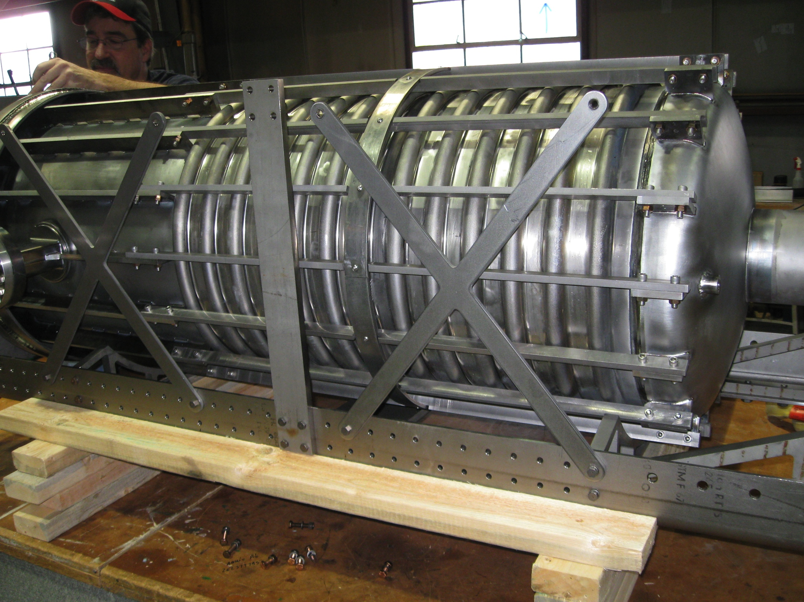
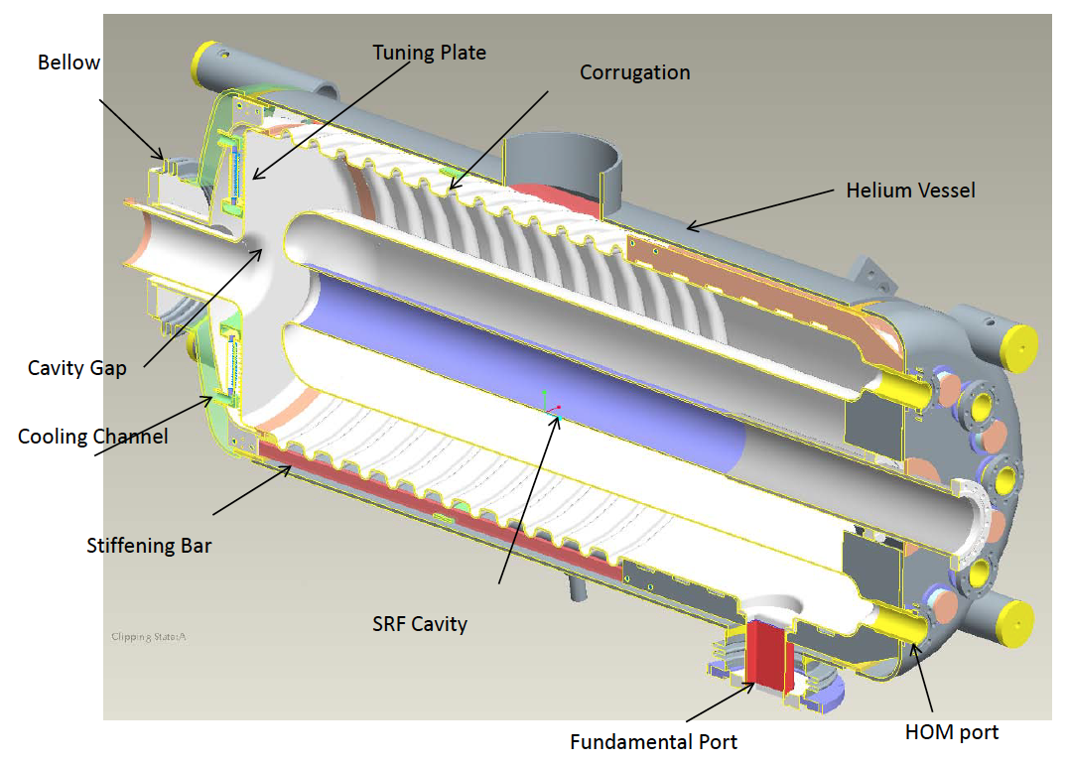
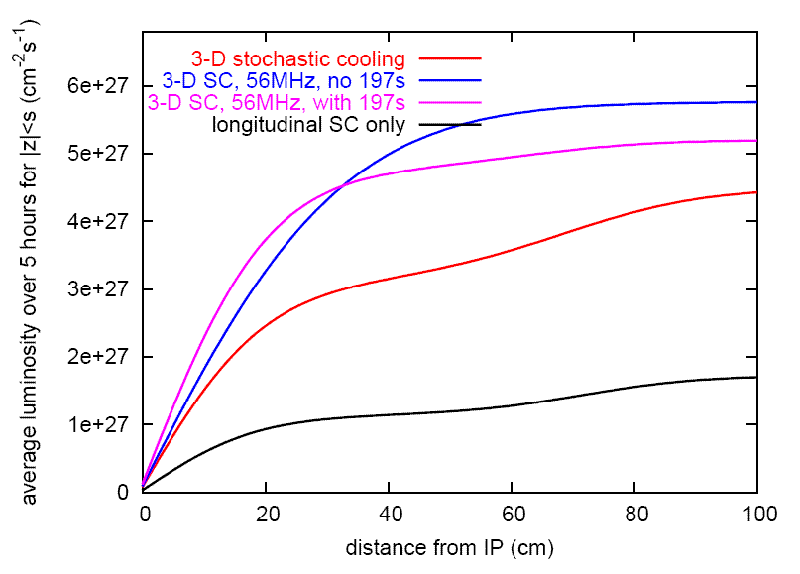
56 MHz SRF for heavy ions – under construction (I. Ben-Zvi et al.)
Longitudinal profile at end of store
even with cooling ions migrate
into neighboring buckets
can be reduced with increased
longitudinal focusing
Commissioning
planned for 2014
40ns
40 ns
Average luminosity vs. vertex size
+ 56 MHz SRF
full 3D cooling
λ/4 Ni resonator
common to both
beams
beam driven
56 MHz, 2 MV
demonstrated 2011
long. + ver. cooling
Calculations Calculation by M. Blaskiewicz
Notes:
Longitudinal profile: 11676 Blue

Slide 21
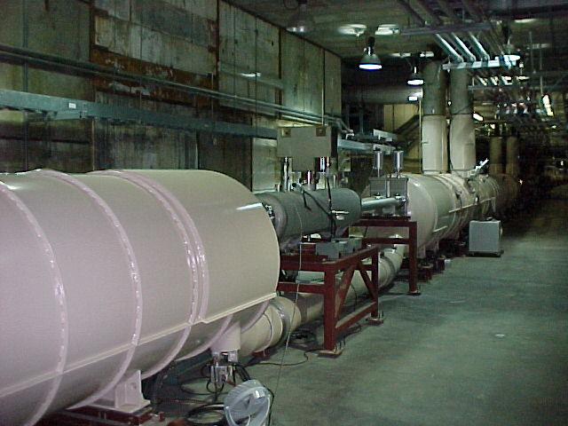
Preparation for Run-15: asymmetric p-Au operation
IR design with beam splitting DX dipoles first
DX dipoles
L_{mag} = 3.7 m, B_{max} = 4.3 T
large aperture
(18 cm coil ID)
only magnets that
need training
(~5 for IR6/8 only)
D0,Q1—Q3
DX dipole
Notes:
MAKE REAL CALCULATION FOR DX MOVE

Slide 22
Preparation for Run-15: asymmetric p-Au operation
maintains same f_{rev} for both beams
Lorentz
factor γ
collision p+Au
107.4
injection p⬆
store Au (close to γ_{tr})
acceleration p, Au
injection Au
25.4
10.5
acceleration Au (cross transition)
time
Note: now tolerate ion beam instabilities at transition to obtain higher intensity
(can be cooled down again), not possible with p+Au since have smaller
aperture available

Slide 23
Preparation for Run-15: asymmetric p-Au operation
p-Au is possible in Run-15
max energy 100 GeV/nucleon for both beams
lower energies possible, need same Lorentz γ for both beams
Stochastic cooling for ion beams helps:
DX move only in IR6 & IR8, no Au beam growth
DX move in ~1 shifts
possible upgrade for pp2pp in IR6 requires change of DX bellows
will reduce flexibility, cannot move DX magnets during run
New injection/acceleration scheme
store Au beam above transition for ~15 min
Luminosity estimate based on available p⬆ and Au beam
  L = 75 – 160 nb⁻¹/week
Will modify shielding in IR6 and IR8 (partially), vacuum stands to allow for test move at the end of Run-14

Slide 24
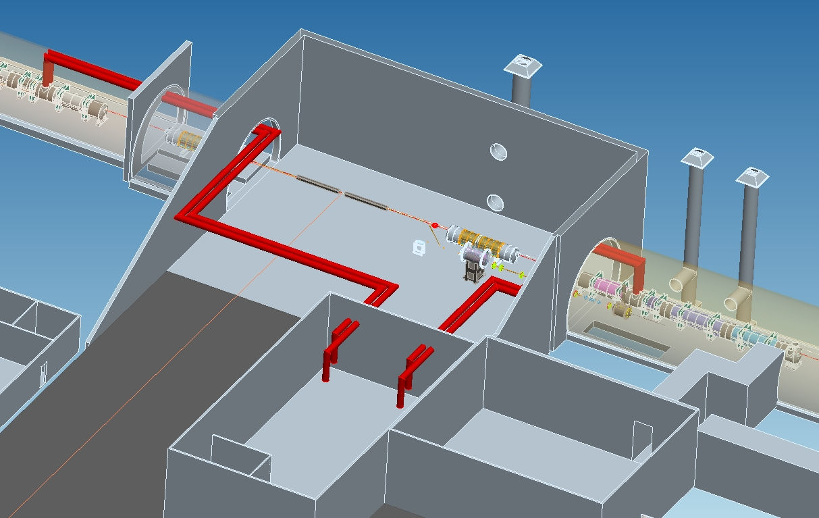
Further upgrades: e-cooling for Au-Au √s_{NN} = 7.7 − 20 GeV
V. Litvinenko, A. Fedotov et al.
Based on bunched electron beams (new), SC e-gun and SC booster cavity
102.74 MHz SRF gun with maximum energy of 2-2.5 MV
2.5 MV booster 102.74 MHz SRF cavity in the same cryostat with the gun
Transport form IR2 section to the cooling section in warm sector 2.
Cooling sections 20 m long, 10-15 cm correction solenoids (10 mT) located every 1(2) m, free space covered by μ-metal to shield magnetic field or Helmholtz coils for active correction.
U-turn between cooling
section in Blue and Yellow
Rings
LEReC injector
(close to cryo and cooling sections)
gun solenoid booster
IR2

Slide 25
LEReC: luminosity projection
A. Fedotov, V. Litvinenko et al.
L_{avg} with new
4.5 MHz RF system
(further upgrade)
L_{avg} with present
28 MHz RF system
(base line)
Luminosity [cm⁻²s⁻¹]
L_{peak} and L_{avg} in Run-10
LEReC luminosity gain: 3x (low energy) to 10x (high energy)

Slide 26
Further upgrades: e-cooling for Au-Au √s_{NN} = 7.7 − 20 GeV
A. Fedotov, V. Litvinenko et al.
Major design choices made
Accelerator Physics Design review: 13-14 August 2013
Largest performance upgrade in near-future $8M
Needs 70% of all expected Accelerator Improvement Project (AIP) funds from FY2013 to FY2017
No FY2013 budget
yet, no AIPs started
in FY2013
Start commissioning
in Run-18 earliest
LEReC injector
(close to cryo and cooling sections)
IR2

Slide 27
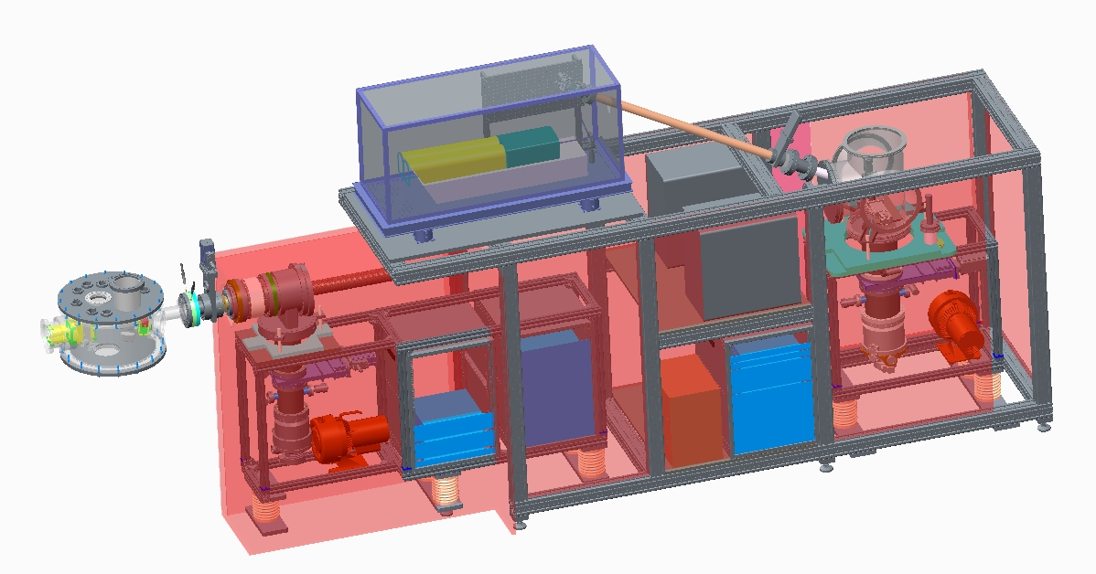
Source developments: Laser Ion Source
M. Okamura et al.
More than ten species can be provided.
Al, Ti, Cr, Mn, Fe, Cu, Ta, Au on test stand
Switching species is in a few seconds.
Status:
Physics design completed
Most parts ordered
Plan to commission
in September 2013
1+ ions into EBIS
N+ ions out of EBIS

Slide 28
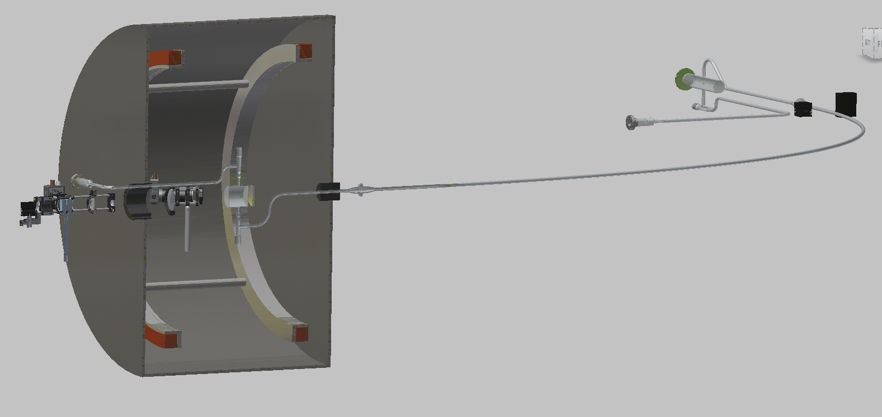
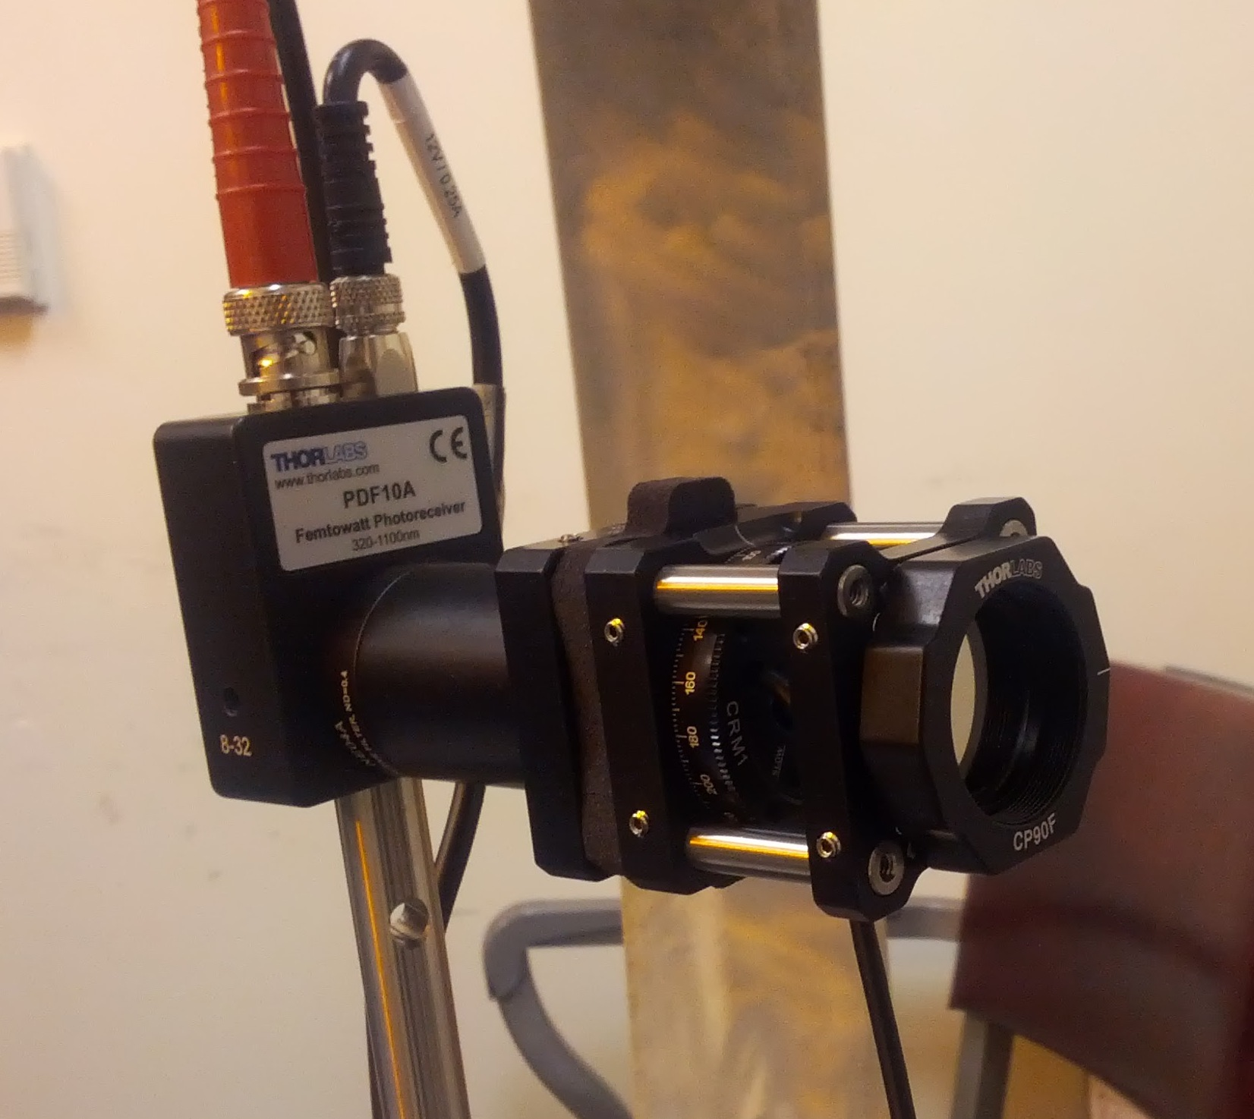
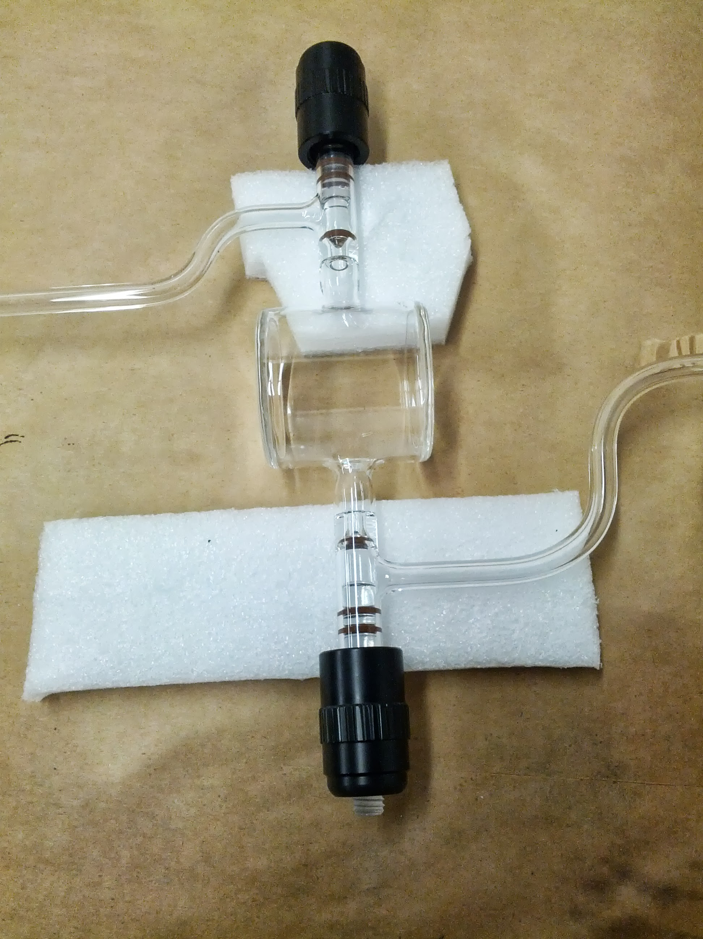
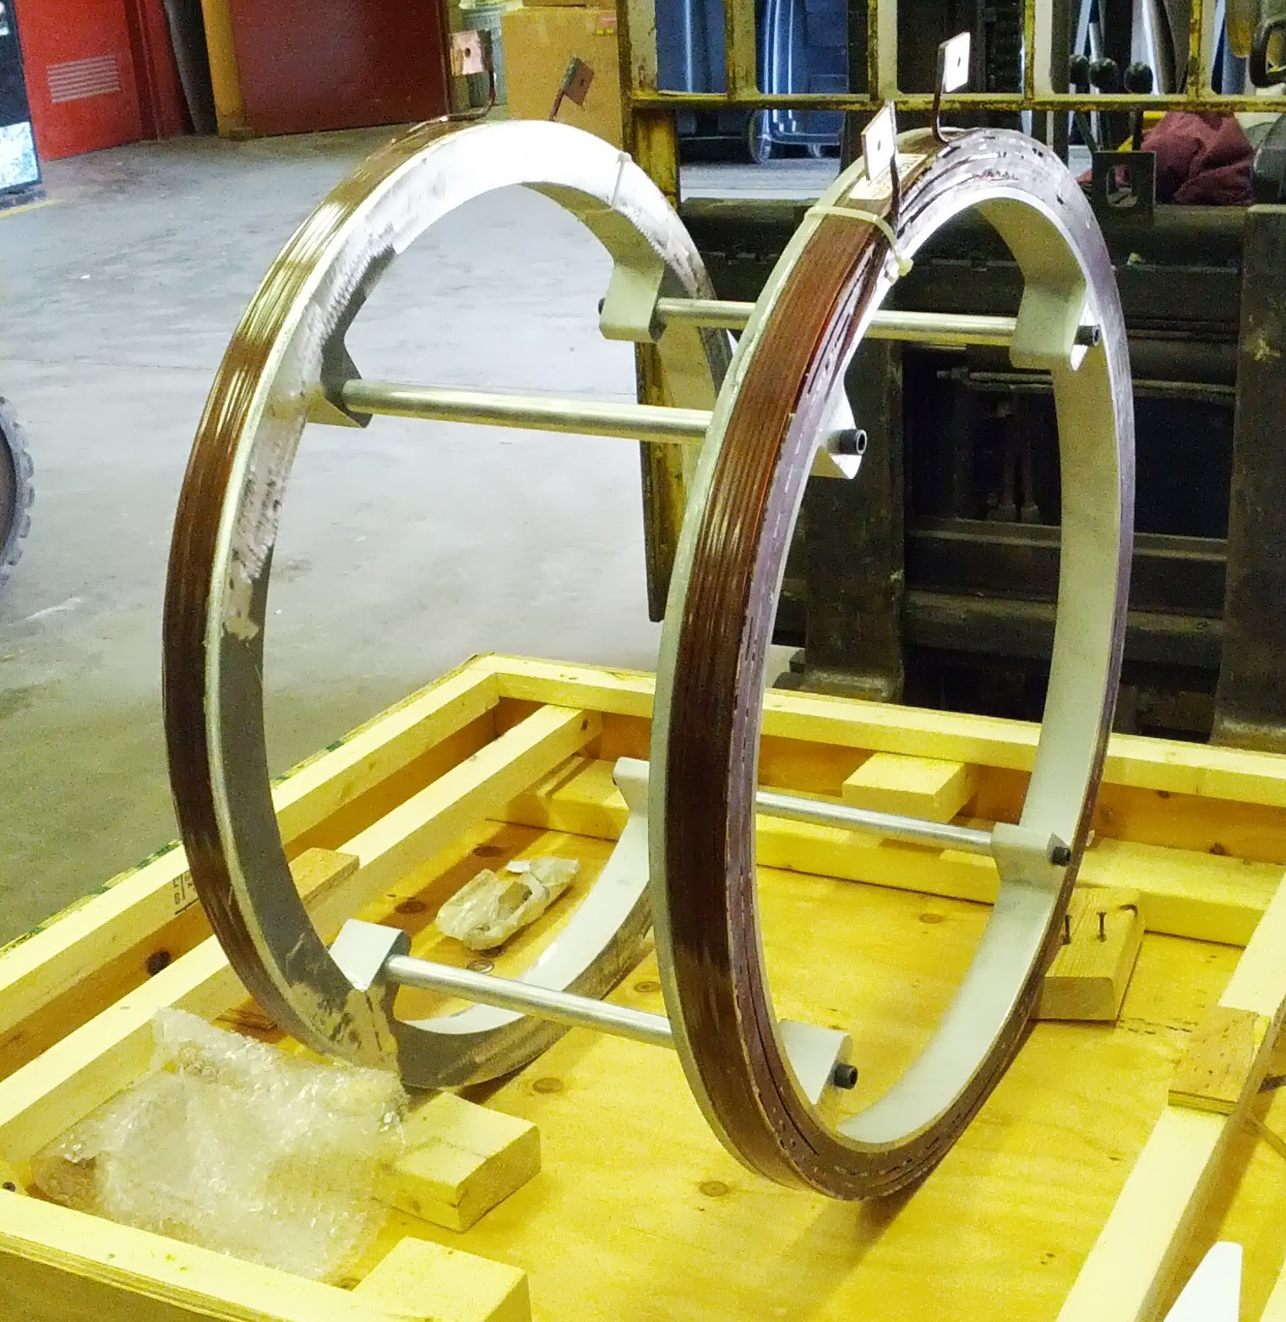
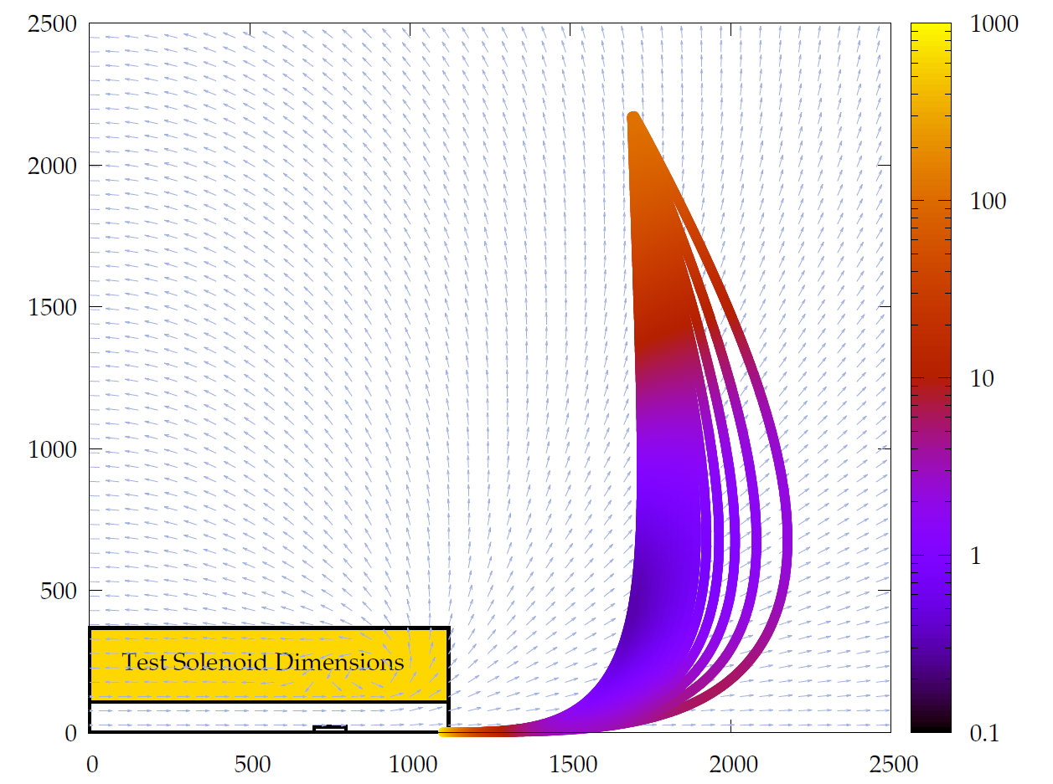
Source developments: polarized ³He source with EBIS
R. Milner, J. Maxwell, C. Epstein; MIT
Metastability exchange optical pumping for neutron polarization at 1 torr in shielded 30 G magnet
Transfer into EBIS at 10⁻⁷ torr and 5 T
Doubly ionize ³He²⁺ ~100% in EBIS
Primary source of depolarization is field gradient in transfer from polarizer to EBIS
Test of transfer depolarization with EBIS test solenoid planned in 2013
Currently assembling new components at MIT for first run
Testing with sealed cells at MIT, new discharge polarimeter developed
CAD of new polarizer and test transfer line
New polarimeter
New glass cells
New Helmholtz pair
Transfer path simulation

Slide 29
RHIC luminosity and polarization goals
parameter |  | unit | achieved |  | goals
Au-Au operation |  |  | 2011 |  | ≥ 2014 3D stochastic cooling + 56 MHz SRF
energy | GeV/nucleon |  | 100 |  | 100
no colliding bunches | … |  | 111 |  | 111
bunch intensity | 10⁹ |  | 1.3 |  | ≥ 1.1
avg. luminosity | 10²⁶ cm⁻²s⁻¹ |  | 30 |  | 40
p↑-p↑ operation |  |  | 2013 |  | ≥ 2014 source + e-lenses
energy | GeV |  | 100 | 255 | 100 | 255
no colliding bunches | … |  | 107 | 111 | – 107 –
bunch intensity | 10¹¹ |  | 1.6 | 1.85 | 1.8 | 2.5
avg. luminosity | 10³⁰ cm⁻²s⁻¹ |  | 33 | 135 | 60 | 300
avg. polarization* | % |  | 59 | 53 | 62 | 56
*Intensity and time-averaged polarization as measured by the H-jet. Luminosity-averaged polarizations, relevant in single-spin
colliding beam experiments, are higher. For example, for intensity-averaged P = 48% and R_{x} = R_{y} = 0.2 (255 GeV, 2013), the
luminosity-averaged polarization is P = 53%.

Slide 30
Possible running modes Run-13 and Run-14 (BUPs)
Run-14
200 GeV Au-Au (STAR, PHENIX) 12-14 weeks
15 GeV Au-Au (STAR) 3 weeks
200 GeV p-p (PHENIX) 6.5 weeks
Run-15
200 GeV p-Au (STAR, PHENIX) 4-5 weeks
200 GeV p-p (STAR) 12 weeks
200 GeV d-Au, h-Au, p-Al, p-Cu (PHENIX) 4 weeks
Luminosity expectations ok, except:
Cannot quantify if only min bias events are stated.
PHENIX Run-15 p-Al and p-Cu probably too optimistic by 2x (only 1 week)

Slide 31
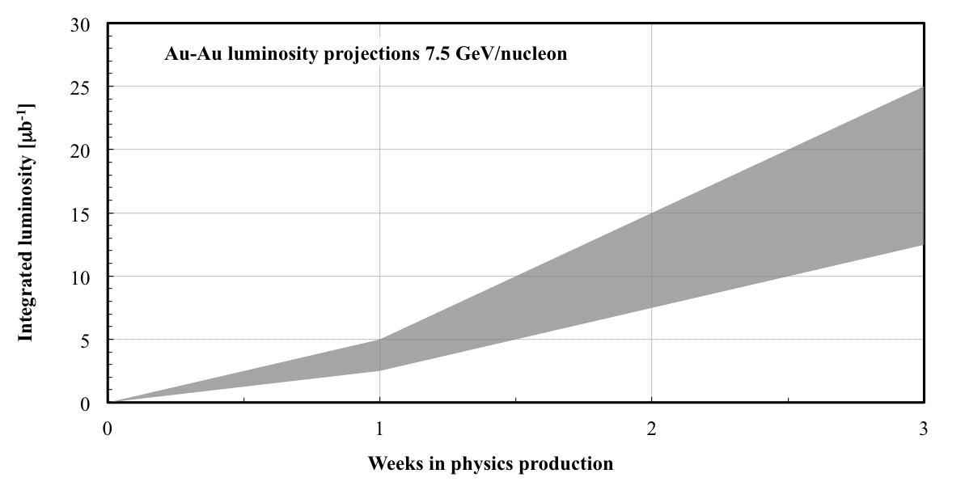
7.5 GeV/nucleon Au-Au projection for Run-14
Scaled from operation at 5.75 GeV/nucleon (Run-10) and
9.8 GeV/nucleon (Run-11)

Slide 32
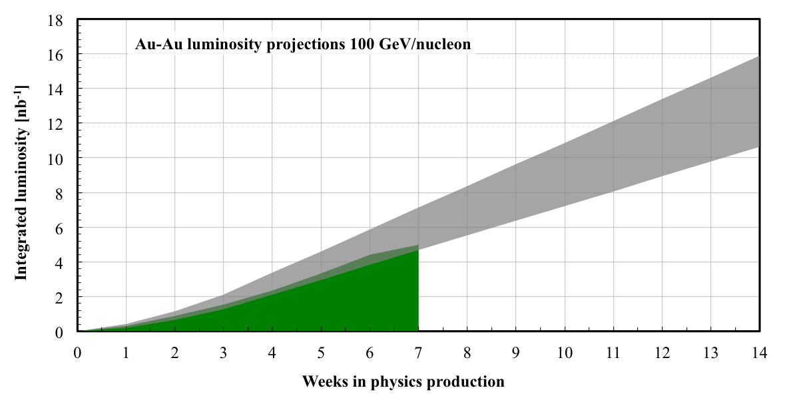
100 GeV/nucleon Au-Au projection for Run-14
Run-11
Improvements compared to Run-11: 3D cooling, new longitudinal pick-up
and kicker for stochastic cooling, higher bunch intensity
(56 MHz SRF commissioning)

Slide 33
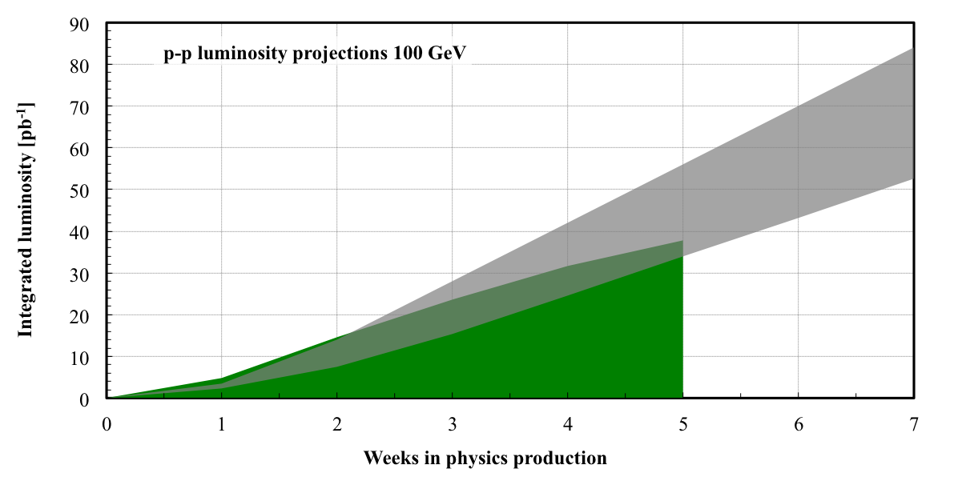
100 GeV p⬆-p⬆ projection for Run-14
Run-11
Improvements compared to Run-11: OPPIS upgrade, e-lenses

Slide 34
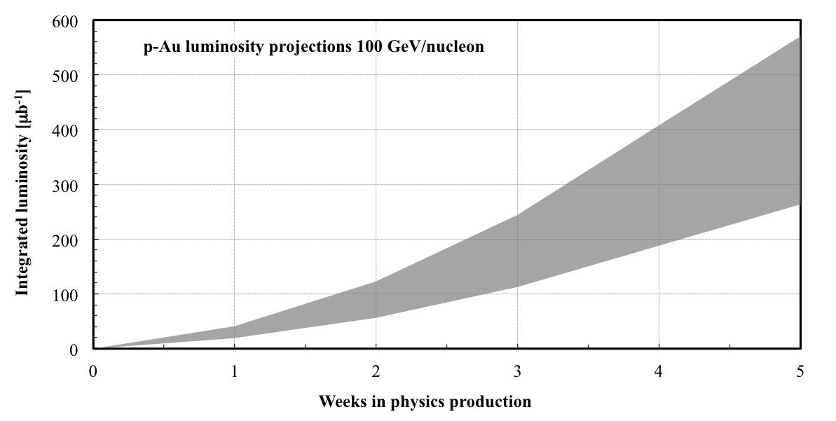
100 GeV/nucleon p-Au projection for Run-15
DX (beam splitting dipoles next to experiments) and ZDC move needed

Slide 35
Comments on LHCf@RHIC LoI
Requested running modes
p+p √s = 510 GeV
L = 6×10²⁹ cm⁻²s⁻¹ for several hours, β* = 10 m
p+p √s = 200 GeV
L = 4×10³¹ cm⁻²s⁻¹ for several hours, β* = 10 m
➔ too optimistic: need 3x10¹¹ p/bunch for L = 2.5×10³¹ cm⁻²s⁻¹
(assume e-lenses and single IP, N_{b} > 3x10¹¹ p challenging)
p+N √s = 200 GeV
L = 7×10³⁰ cm⁻²s⁻¹ for several hours, β* = 10 m
➔ also too optimistic
p⬆+p⬆ √s = 510 GeV
L = 2.5×10³⁰ cm⁻²s⁻¹ for 11 hours, β* = 10 m
also horizontal polarization
Detector fit under investigation, plan to begin operation in 2016
All modes possible, some luminosity expectations optimistic
Notes:
Need to check numbers

Slide 36
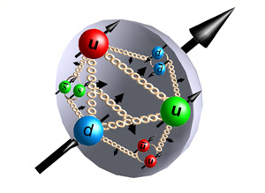
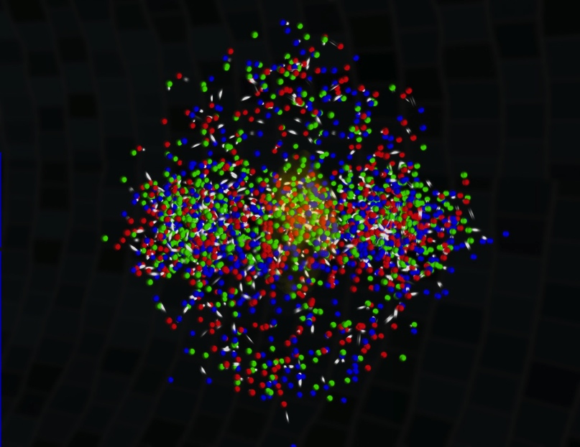
RHIC status and upgrades
Run-13
Polarized protons at √s = 510 GeV
new source commissioned, 2x intensity & P +3-5%
new records for L_{peak}, L_{avg} – at limit before e-lenses
Run-14 upgrades
Stochastic cooling new longitudinal pick-ups and kickers
56 MHz SRF commissioning
A-A L +30-50% after commissioning
Electron lenses beam commissioning
p-p L +100% after commissioning
Run-15 upgrades
p-Au
Further performance upgrades
Low-energy cooling for Au-Au
New sources: polarized He-3, Laser Ion Source
Au-Au collision
Notes:
Polarized proton picture: http://www.physastro.iastate.edu/research/highlights/view.php?id=15
Uranium nucleus picture: http://paomura.wordpress.com/2012/04/19/nuclear-physics-nuclear-weapons/

