Slide 1
eRHIC: the MACHINE to imagE quarks and gluons
arXiv: 1212.1701 & 1108.1713

Slide 2
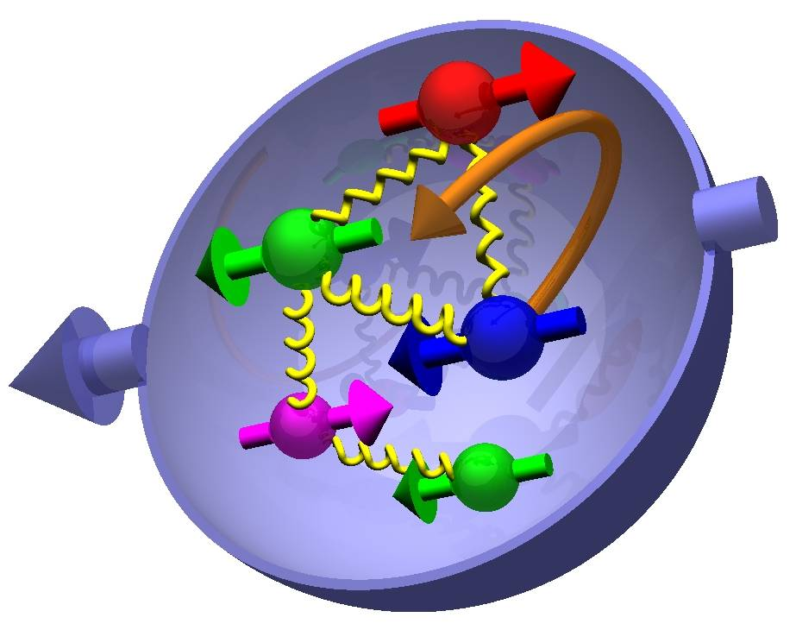

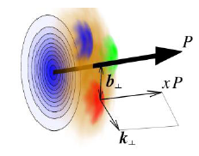

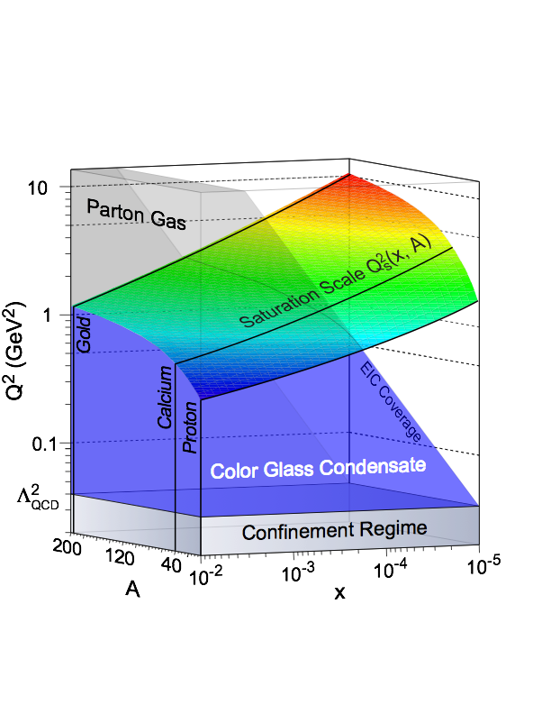
Most Compelling SCIENCE Questions
How are sea quarks and gluons and their spin distributed
in space and momentum inside the nucleon?
How are these quark and gluon distributions correlated with the
over all nucleon properties, such as spin direction?
What is the role of the motion of sea quarks and gluons
in building the nucleon spin?
only at
eRHIC
How does the nuclear environment affect the distribution
of quarks and gluons and their interaction in nuclei?
only at
eRHIC
How does the transverse spatial distribution of gluons compare to that in the nucleon?
How does matter respond to fast moving color charge passing through it?
Is this response different for light and heavy quarks?
γ*
h
e’
q
e
Where does the saturation of gluon densities set in?
only in
eA/ep
Is there a simple boundary that separates the region from the more dilute quark gluon matter? If so how do the distributions
of quarks and gluons change as one crosses the boundary?
Does this saturation produce matter of universal properties in
the nucleon and all nuclei viewed at nearly the speed of light?

Slide 3
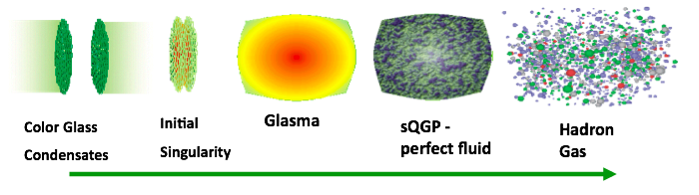

The eA Physics program
time
The Initial Conditions
Hard Processes
(pQCD)
FF/coal.
CGC
JIMWLK/BK
I
Hadron
Transport
Hydro (EoS)
Our understanding of some fundamental
properties of the Glasma, sQGP and
Hadron Gas depend strongly on our
knowledge of the initial state!
Advantage over p(d)A:
  eA experimentally much cleaner
      no “spectator” background to subtract
    Access to the parton kinematics through scattered lepton (x, Q²)
    initial and final state effects can be disentangled cleanly
    Saturation:
      no alternative explanations, i.e. no hydro in eA
3 conundrums of the initial state:
What is the spatial transverse distributions
of nucleons and gluons?
2. How much does the spatial distribution
fluctuate? Lumpiness, hot-spots etc.
3. How saturated is the initial state of the
nucleus?
→ unambiguously see saturation

Slide 4
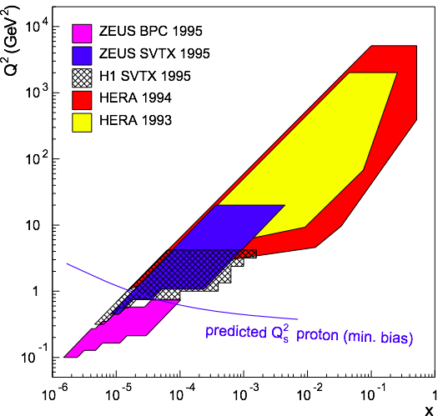
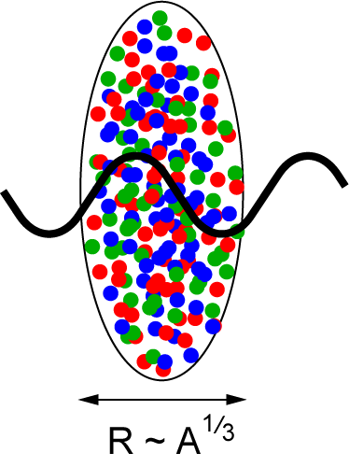
eRHIC: Reaching the Saturation Region
eRHIC (eA):
HERA (ep):
Despite high energy range:
F2, Gp(x, Q²) outside the saturation regime
Need also Q² lever arm!
Only way in ep is to increase √s
Would require an ep collider at
√s ~ 1-2 TeV → LHeC
L ~ (2m_{N} x)⁻¹ > 2 R_{A} ~ A^{1/3}
Probe interacts
coherently with all nucleons
Gold: 197 times smaller effective x !

Slide 5
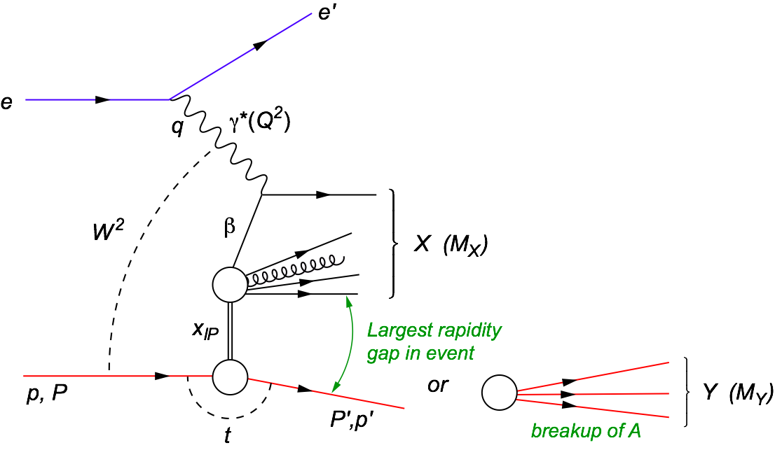
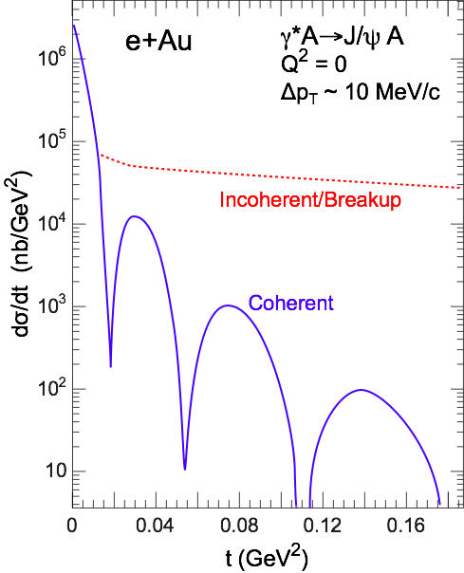
Saturation: The golden Channel
Hard diffraction in DIS at small x
Why is diffraction so important
Sensitive to spatial gluon distribution
  Hot topic:
    Lumpiness?
    Just Wood-Saxon+nucleon g(b)
  Incoherent case:
  measure fluctuations/lumpiness in g_{A}(b)
VM: Sensitive to gluon momentum distributions
  σ ~ g(x,Q²)²
Diffraction in e+A:
  coherent diffraction
  (nuclei intact)
  breakup into nucleons
  (nucleons intact)
  incoherent diffraction
  Predictions: σdiff/σtot in e+A ~25-40%
  HERA: 15% of all events are hard diffractive

Slide 6
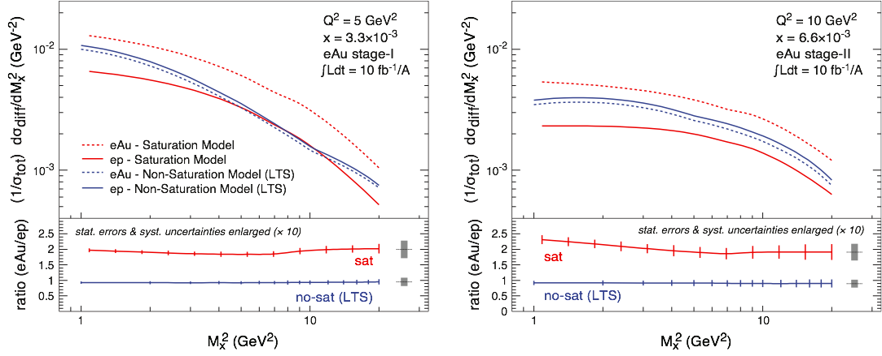
Ratio of Diffractive to Total Cross-Section
Black disc limit characterized by σdiff/σtot = 1/2 (Hera sees 1/7)
Large fraction of diffractive event is unambiguous signature for reaching the saturated limit
Fraction of low-mass coherent diffraction in ep and eA at eRHIC:
Find:
w/o non-linear effects eA/ep ratio stays roughly one
Day-1 signature for Saturation
non-linear effects enhance σdiff in eA scattering

Slide 7
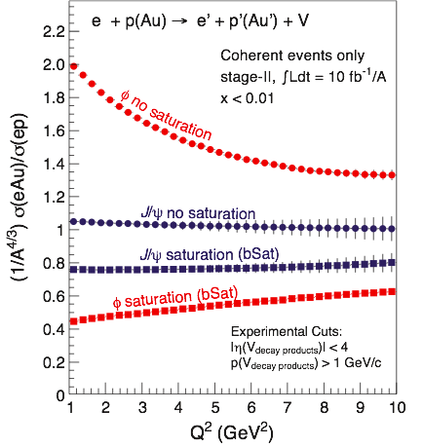
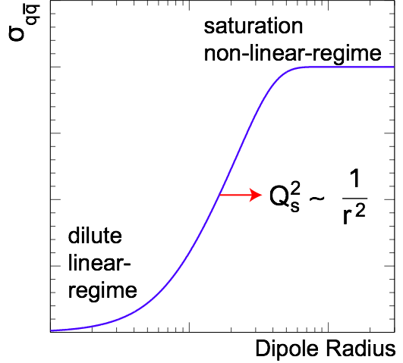
Exclusive Vector Meson Production
  Unique probe - allows to measure momentum transfer t in eA diffraction
  → in general, one cannot detect the outgoing nucleus and its momentum
Dipole Cross-Section:
small size (J/Ψ): cuts off saturation region
large size (φ,ρ, ...): “sees more of dipole amplitude” → more sensitive to saturation
J/ψ
ϕ

Slide 8
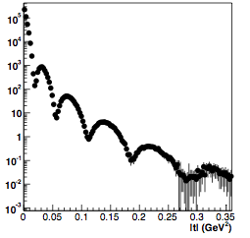
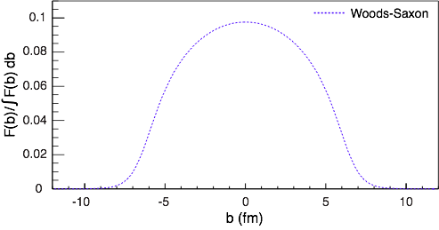
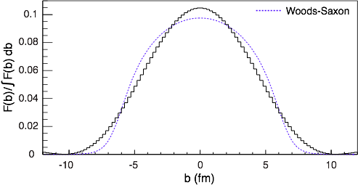
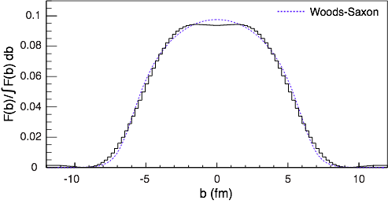
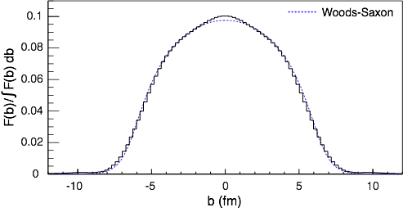
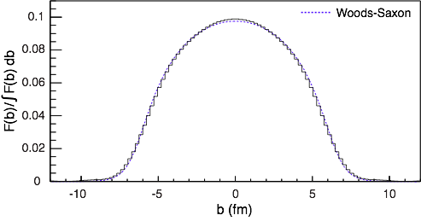

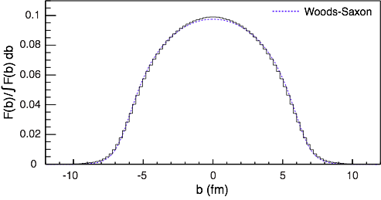

Spatial Gluon Distribution Through Diffraction
  Idea: momentum transfer t conjugate to transverse position (b_{T})
    coherent part probes “shape of black disc”
    incoherent part (dominant at large t) sensitive to “lumpiness” of the source (fluctuations, hot spots, ...)
Spatial source distribution:
t = Δ²/(1-x) ≈ Δ² (for small x)
ϕ, nosat
Golden eA measurement for eRHIC

Slide 9

What composes the Spin of the Proton
L_{g}
Σ_{q}Δq
Σ_{q}L_{q}
δq
The Holy Grail
ΔG
The Spin Sum Rule
“Helicity sum rule”
gluon
spin
Can an eRHIC give the
final answer?
angular
momentum
Contribution to proton spin to date:
Gluon: 20% (RHIC)
Quarks: 30% (DIS)
MISS 50% → low x
total u+d+s
quark spin

Slide 10
present vs eRHIC kinematic coverage
RHIC pp data
constraining Δg(x)
in approx. 0.05 < x <0.2
data plotted at x_{T}=2p_{T}/√S
likewise for Q²
5 x 100 GeV eRHIC stage-1
20 x 250 GeV eRHIC
eRHIC extends x coverage
by up to 2 decades
(at Q²=1 GeV²)
lowest x so far 4.6 x10⁻³ COMPASS

Slide 11
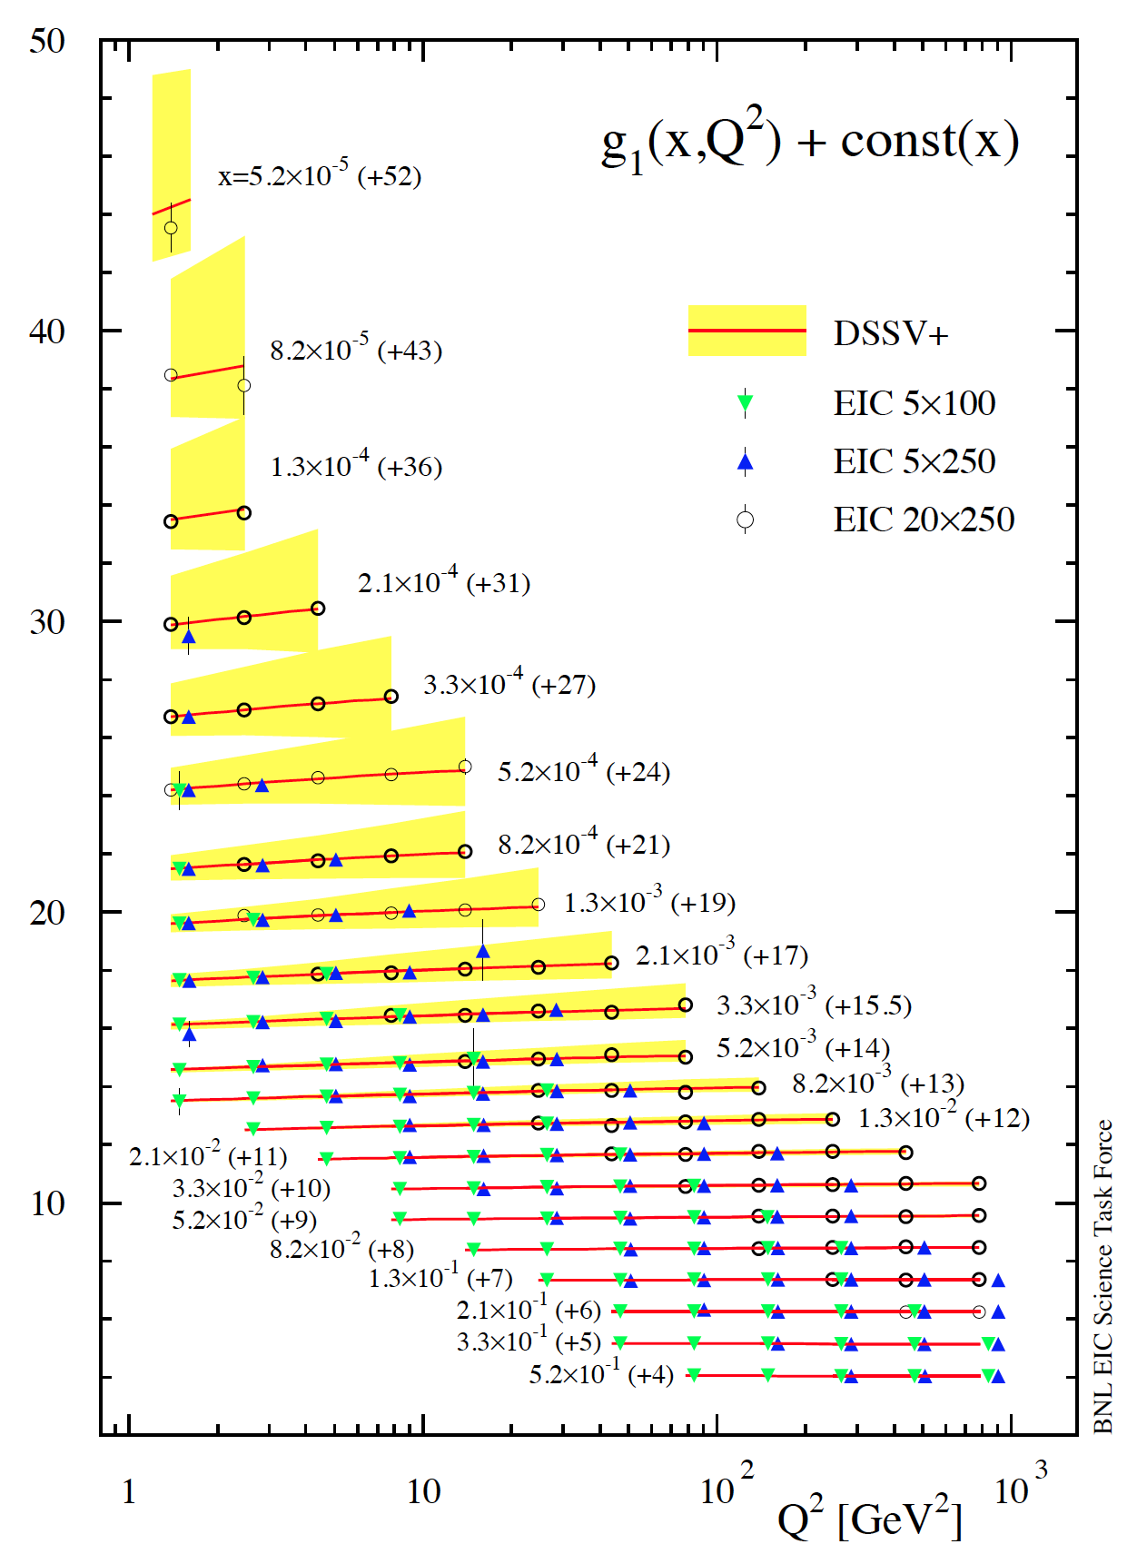
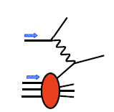
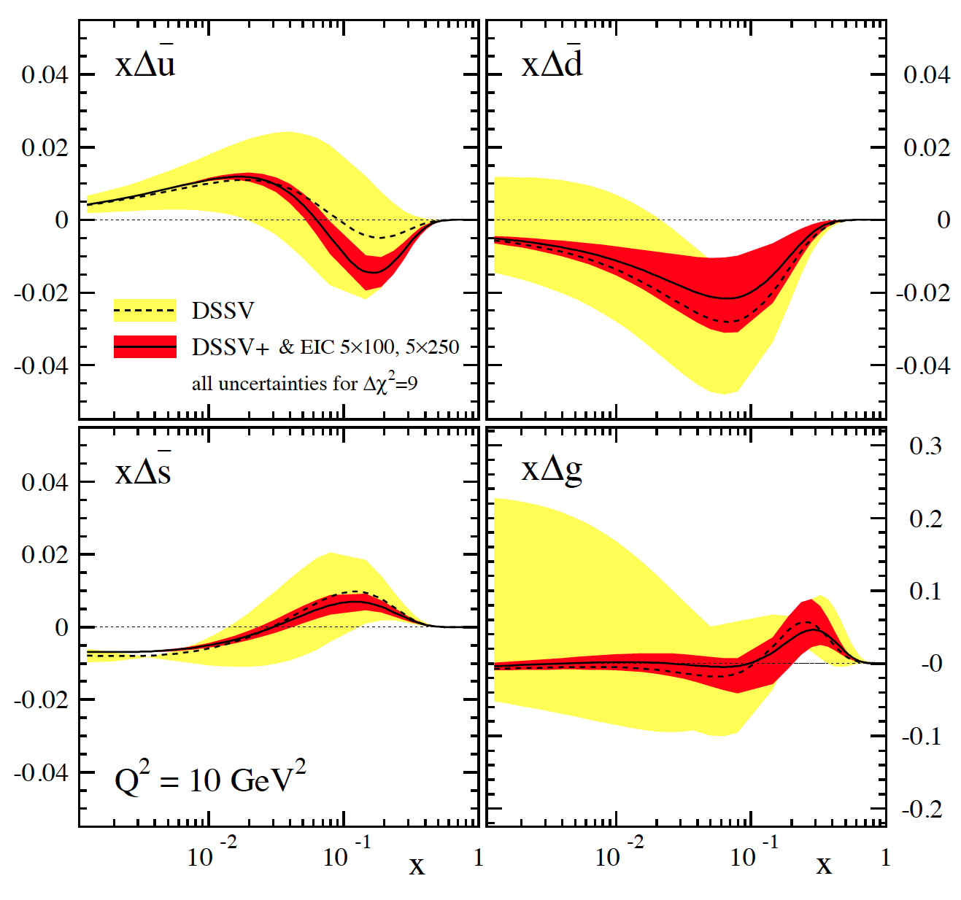
g₁^{p} the way to find the Spin
hep-ph:1206.6014
cross section:
pQCD scaling violations
5 x 250 starts here
5 x 100 starts here
dramatic reduction
of uncertainties:
world data
now
eRHIC 5x100/250 GeV

Slide 12
Can we solve the spin sum rule ?
gluon
spin Δg
✔
total quark
spin ΔΣ
✔
what about the
orbital angular
momentum?
current data
w/ eRHIC data
can expect approx. 5-10%
uncertainties on ΔΣ and Δg
but need to control systematics

Slide 13

Generalized Parton Distributions
the way to 3d imaging of the proton and the orbital angular momentum L_{q} & L_{g}
Measure them through exclusive reactions
golden channel: DVCS
e’
γ
e
γ_{L}*
(Q²)
x+ξ
x-ξ
~
~
p
H, H, E, E (x,ξ,t)
p’
t
Spin-Sum-Rule in PRF:
from g₁
GPDs:
Correlated quark momentum
and helicity distributions in
transverse space
responsible for orbital angular momentum

Slide 14
The DVCS Phase Space
HERA results on GPDs
very much limited by
lack of statistics
imaging in
valence region
but limited t-range
X
quantum numbers of final state → selects different GPD
DVCS: wide range of observables (σ, A_{UT}, A_{LU}, A_{UL}, A_{C}) to disentangle GPDs

Slide 15




DVCS at eRHIC
e’
γ
e
γ_{L}*
(Q²)
x+ξ
x-ξ
~
~
p
H, H, E, E (x,ξ,t)
p’
t
transverse
plane
DVCS data at end of HERA
Fourier
Transform
large t
small t
D. Mueller, K. Kumericki
S. Fazio, and ECA
arXiv:1304.0077

Slide 16
GPD H^{g}: J/ψ
M. Diehl & ECA
To improve imaging on gluons
add J/ψ observables
cross section
A_{UT}
…..
Fourier
Transform
eRHIC will constrain GPDs
GPDs will tell us the orbital angular momenta of quarks and gluons

Slide 17
Where do we stand to realize EIC@RHIC
eRHIC
Latest Review:
NSAC 2013 Subcommittee Report on Scientific Facilities:
“The Subcommittee ranks an EIC as Absolutely Central in its ability to contribute to world-leading science in the next decade.”
“There are outstanding R&D issues that remain to be addressed in order to achieve performance metrics. Staging approaches to the EIC are also being explored by [BNL and JLab]. Both laboratories are actively addressing R&D issues and are making good progress.”

Slide 18
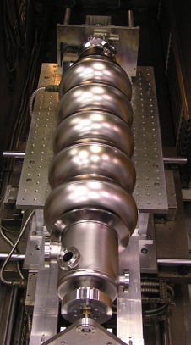
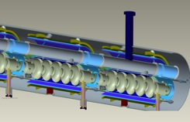


Electron beam evolution in eRHIC’s ERL
0.60 GeV
0.6 GeV
Polarized
e-gun
0.6 GeV
Beam
dump
27.55 GeV
E/Eo
0.0200
0.1017
0.1833
0.2650
0.3467
0.4283
0.5100
0.5917
0.6733
0.7550
0.8367
0.9183
1.0000
New
detector
Linac 2.45 GeV
Coherent e-cooler
0.1017 GeV E₀
Linac 2.45 GeV
0.1833 GeV Eo
0.2650 GeV E₀
0.3467 GeV E₀
0.4283 GeV E₀
0.5100 GeV E₀
0.5917 GeV E₀
0.6733 GeV E₀
0.7550 GeV E₀
0.8367 GeV E₀
0.9183 GeV E₀
30 GeV
1.0000 GeV E₀
Staging:
All lepton beam energies scale proportionally by adding SRF cavities to the injector
E_{o}=5, 10, 20, 30 GeV
ePHENIX
All magnets would be installed from the day one and we would be cranking power supplies up as energy is increasing
100 m
ERL:
energy recovery linac
eSTAR
30 GeV
Animation is by N. Tsoupas

Slide 19
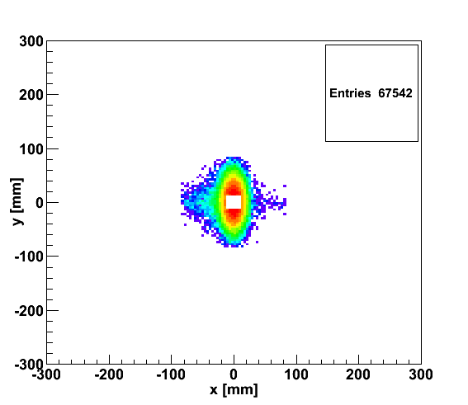
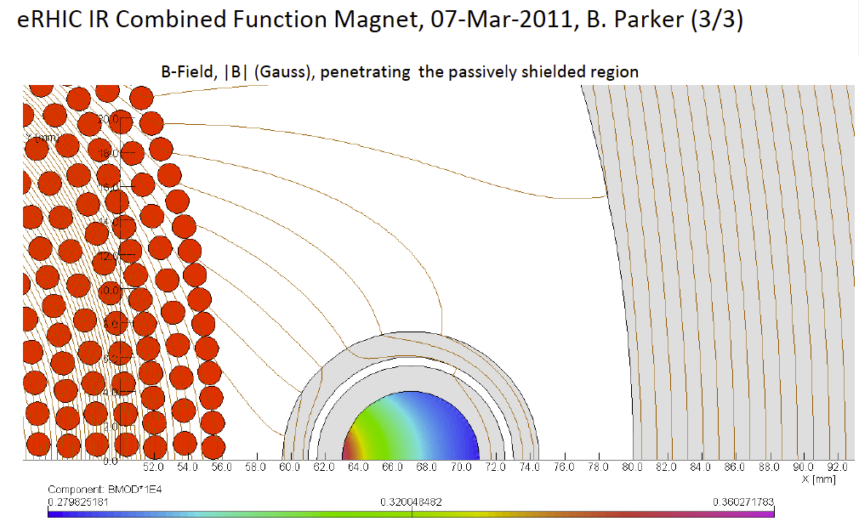
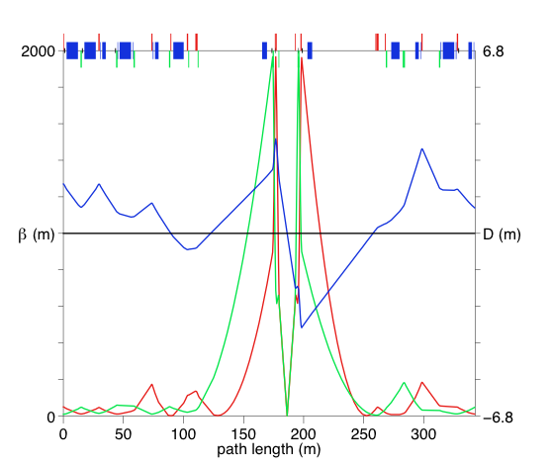
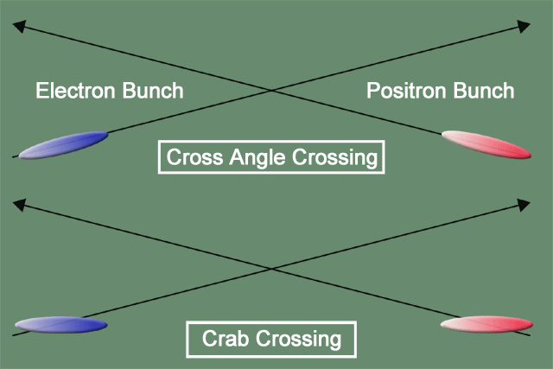
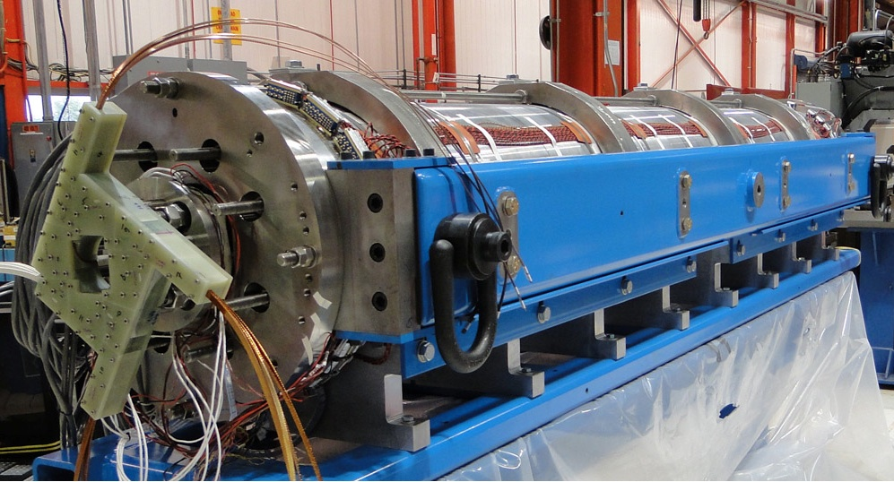
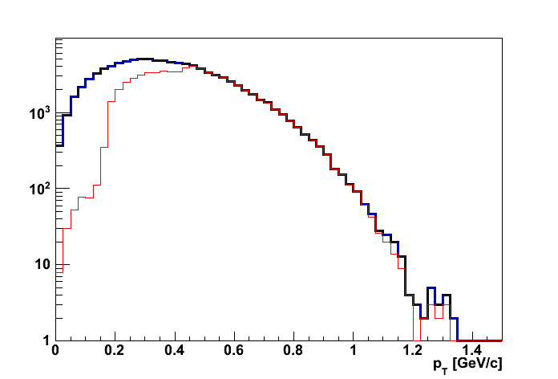
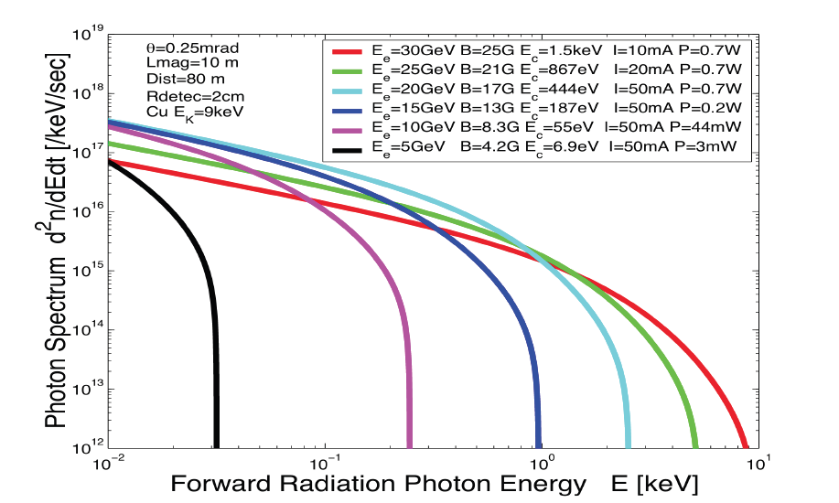
eRHIC: high-luminosity IR
20x250
p
Proton beam lattice
G.Ambrosio et al., IPAC’10
e
Nb₃Sn
20x250
200 T/m
eRHIC - Geometry high-lumi IR with β*=5 cm, l*=4.5 m
and 10 mrad crossing angle → 10³⁴ cm⁻² s⁻¹
Generated
Quad aperture limited
RP (at 20m) accepted
10 mrad crossing angle and crab-crossing
High gradient (200 T/m) large aperture Nb₃Sn focusing magnets
Arranged free-field electron pass through the hadron triplet magnets
Integration with the detector: efficient separation and registration of low angle collision products
Gentle bending of the electrons to avoid SR impact in the detector

Slide 20
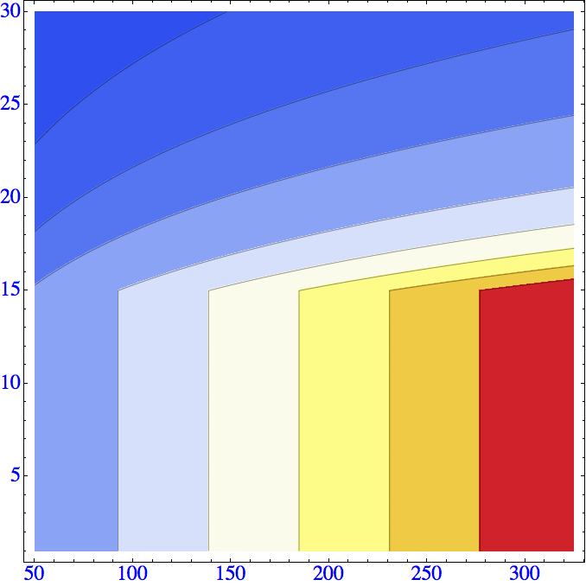

eRHIC R&D highlights and Luminosity
Challenge | Increase/reduction beyond the state of the art
Polarized electron gun | 10 x increase
Coherent Electron Cooling | New concept
Multi-pass SRF ERL | 5 x increase in current 30 x increase in energy
Crab crossing | New for hadron colliders
Understanding beam-beam effects | New type of collider
β*=5 cm | 5x reduction
Multi-pass SRF ERL | 2-3 x in # of passes
Feedback for kink instability suppression | Novel concept
Space charge effect compensation | Novel concept
E_{e} (GeV)
L.(cm⁻² sec⁻¹)
>3.10³⁴
0.1.10³⁴
3.10³⁴
0.25.10³⁴
2.5.10³⁴
0.5.10³⁴
2.10³⁴
1.5.10³⁴
1.10³⁴
1.10³⁴
1.5.10³⁴
2.10³⁴
2.5.10³⁴
3.10³⁴
0.5.10³⁴
0.25.10³⁴
0.1.10³⁴
E_{p} (GeV)
Hourglass the pinch effects are included. Space charge effects are compensated.
Energy of electrons can be selected at any desirable value at or below 30 GeV
The luminosity does not depend on the electron beam energy below or at 20 GeV
The luminosity falls as E_{e}⁻⁴ at energies above 20 GeV
The luminosity is proportional to the hadron beam energy: L ~ E_{h}/E_{top}

Slide 21
Can we do with less ?
Challenge | Increase/reduction beyond the state of the art
Polarized electron gun | 10 x increase
Coherent Electron Cooling | New concept
Multi-pass SRF ERL | 5 x increase in current 30 x increase in energy
Crab crossing | New for hadron colliders
Understanding beam-beam effects | New type of collider
β*=5 cm | 5x reduction
Multi-pass SRF ERL | 2-3 x in # of passes
Feedback for kink instability suppression | Novel concept
Space charge effect compensation | Novel concept
no cooling not
possible lose all
exclusive physics
more conventional
cooling
reduced lumi 10^³³
need to remove
crossing angle and go
to head on collisions
beams get
separated by
dipoles close to IR
impact on
synchrotron rad.
Currently investigate machine and IR design with a less ambiguous R&D
to reach 10³³ cm⁻²s⁻¹ with 10 GeV initial beam energy

Slide 22


What needs to be covered BY THE DETECTOR
e’
γ, π,J/Ψ
e
γ_{L}*
(Q²)
x+ξ
x-ξ
~
~
H, H, E, E (x,ξ,t)
p
p’
Inclusive Reactions in ep/eA:
Physics: Structure Fcts.: g₁, F₂, F_{L}
Very good electron id → find scattered lepton
Momentum/energy and angular resolution of e’ critical
scattered lepton → kinematics
t
Semi-inclusive Reactions in ep/eA:
Physics: TMDs, Helicity PDFs → flavor separation, dihadron-corr.,…
→ Kaon asymmetries, cross sections
Excellent particle ID: π±,K±,p± separation over a wide range in η
full Φ-coverage around γ*
Excellent vertex resolution → Charm, Bottom identification
Exclusive Reactions in ep/eA:
Physics: GPDs, proton/nucleus imaging, DVCS, excl. VM/PS prod.
Exclusivity → large rapidity coverage → rapidity gap events
↘ reconstruction of all particles in event
high resolution in t → Roman pots

Slide 23
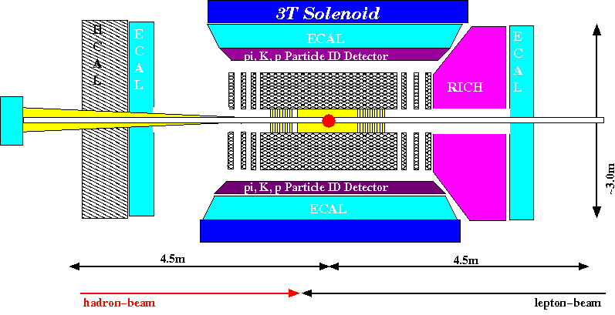
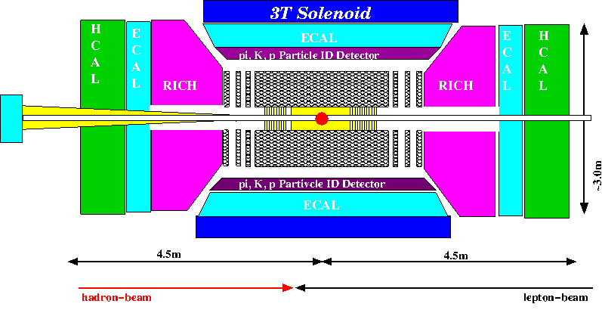
The eRHIC Detector CONCEPT
Extremely wide physics program puts stringent requirements on detector performance
high acceptance -5 < η < 5
good PID (π,K,p and lepton) and vertex resolution
same rapidity coverage for tracking and calorimeter
  → good momentum resolution, lepton PID
low material density because of low scattered lepton p
  → minimal multiple scattering and brems-strahlung
very forward electron and proton/neutron detection
Fully integrated in machine IR design
Summary:
Full Geant Model based on Generic EIC R&D detector concepts
https://wiki.bnl.gov/eic/index.php/DIS:_What_is_important
https://wiki.bnl.gov/eic/index.php/ERHIC_Dedicated_Detector_Design
Phase-I (5 – 10 GeV):
Phase-II (>10 GeV):

Slide 24
tracking elements
barrel silicon tracker:
MAPS technology; ~20x20mm² chips, ~20 μm 2D pixels
6 layers at [30..160] mm radius
0.37% X₀ in acceptance per layer simulated precisely;
digitization: single discrete pixels, one-to-one from MC points
forward/backward silicon trackers:
2x7 disks with up to 280 mm radius
N sectors per disk; 200 μm silicon-equivalent thickness
digitization: discrete ~20x20 μm² pixels
TPC:
~2m long; gas volume radius [300..800] mm
1.2% X₀ IFC, 4.0% X₀ OFC; 15.0% X₀ aluminum endcaps
digitization: idealized, assume 1x5 mm GEM pads
GEM trackers:
3 disks behind the TPC endcap
STAR FGT design
digitization: 100 mm resolution in X&Y; gaussian smearing

Slide 25
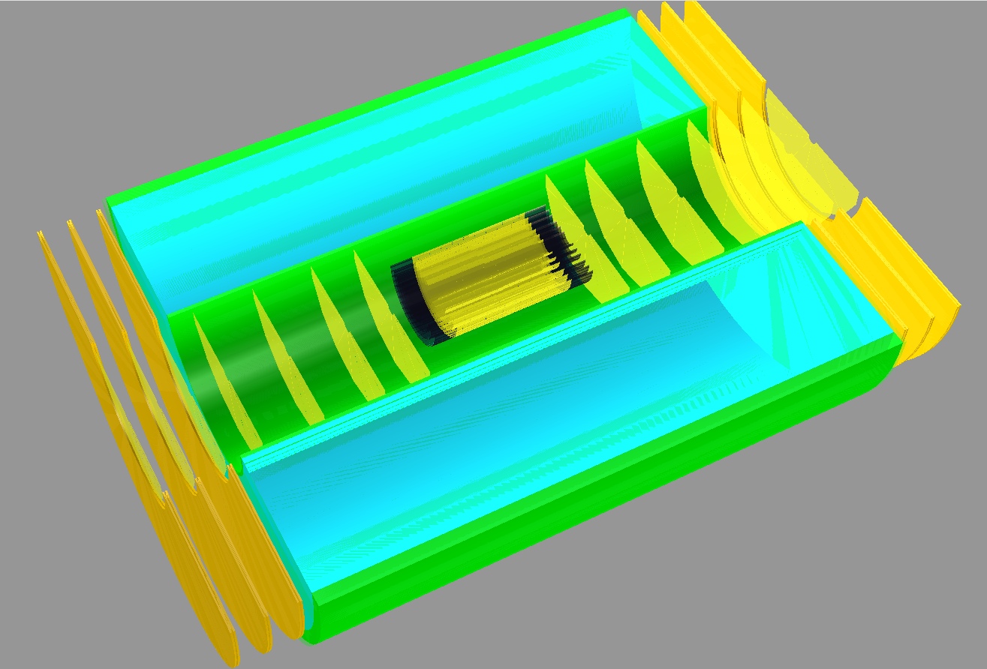
Tracker zoomed view
FGT
FST
VST
BST
TPC
BGT

Slide 26
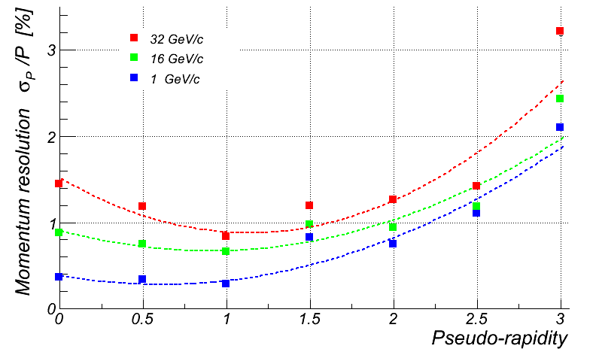
Momentum resolution study (1)
π⁺ track momentum resolution vs. pseudo-rapidity
-> expect 2% or better momentum resolution in the whole kinematic range

Slide 27
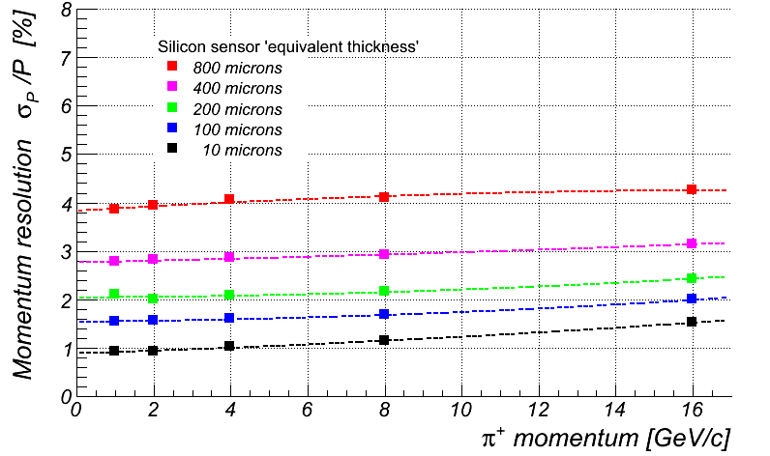
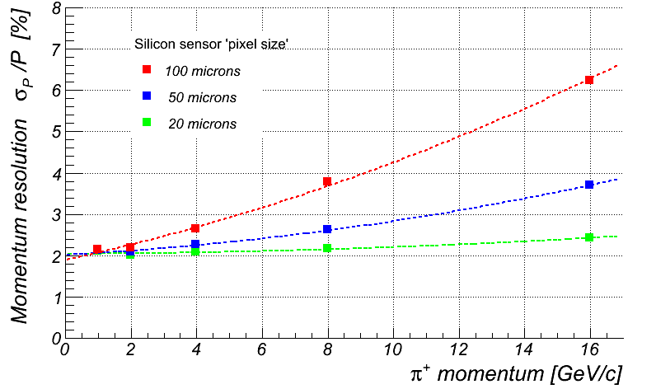
Momentum resolution study (2)
π⁺ track momentum resolution at η = 3.0 vs. Silicon thickness
-> ~flat over inspected momentum range
because of very small Si pixel size
π⁺ track momentum resolution at η = 3.0 vs. Silicon pixel size
-> 20 micron pixel size is essential to
maintain good momentum resolution

Slide 28
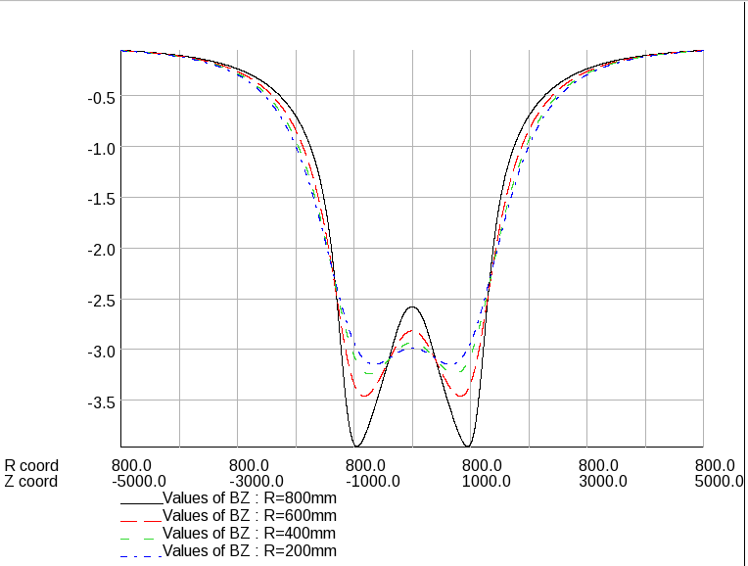
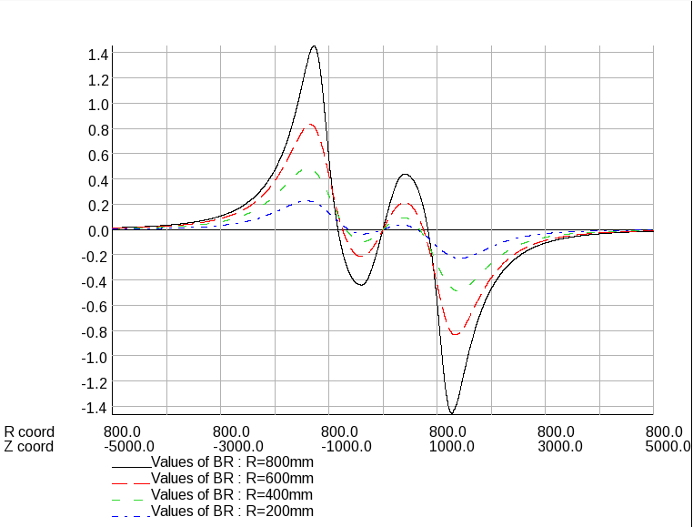
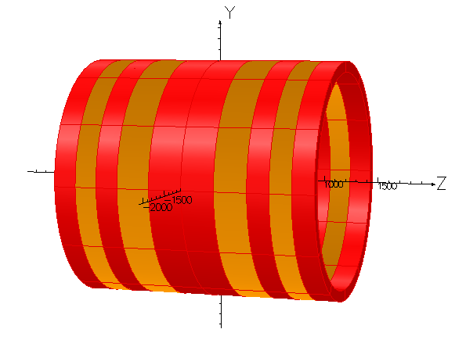
EIC solenoid modeling
main requirements:
Yield large enough bending for charged tracks at large η
Keep field inside TPC volume as homogeneous as possible
Keep magnetic field inside RICH volume(s) small
-> use OPERA-3D/2D
software
Presently used design: MRS-B1

Slide 29
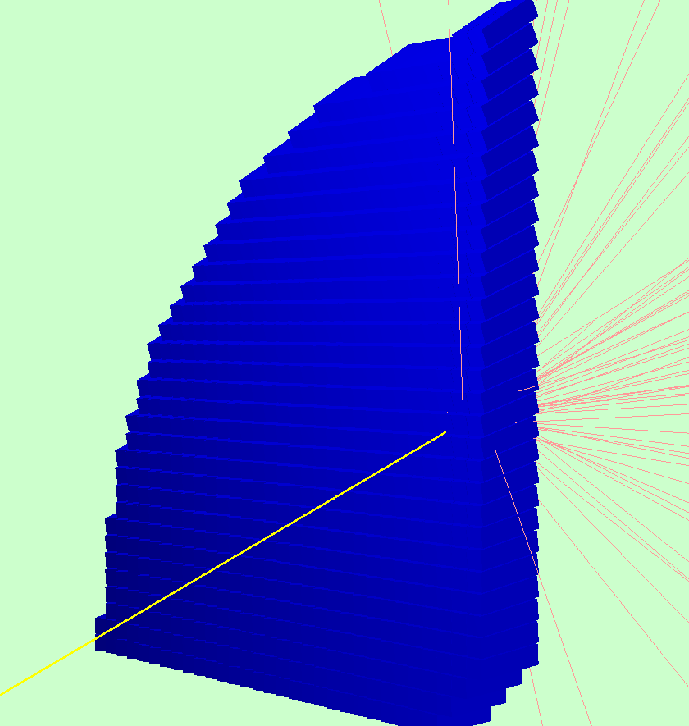
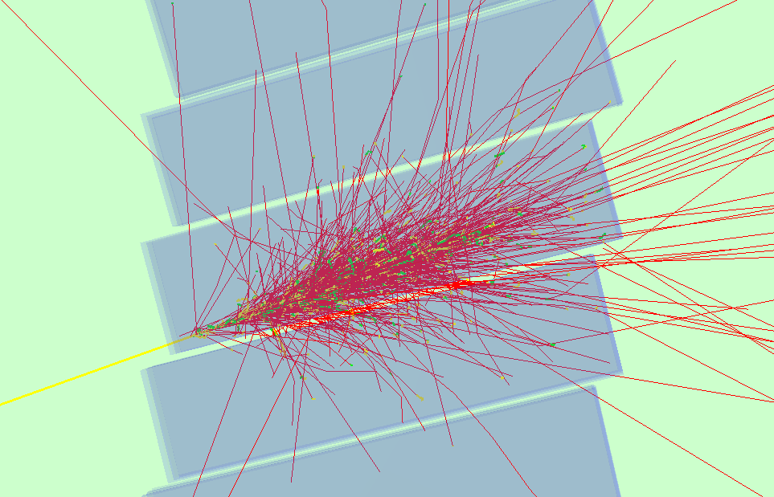
Backward EM Calorimeter (BEMC)
PWO-II, layout a la CMS & PANDA
-2500mm from the IP
both projective and non-projective geometry implemented
digitization based on PANDA R&D
10 GeV/c electron hitting one
of the four BEMC quadrants
Same event (details of shower development)

Slide 30
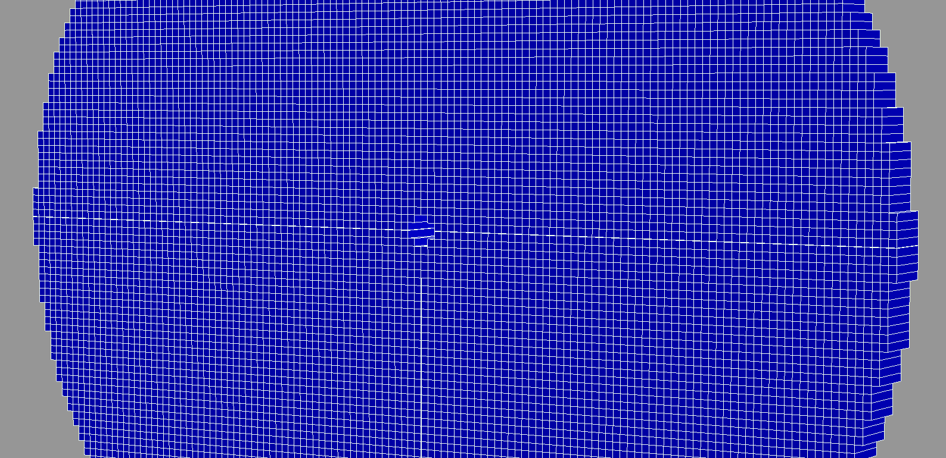
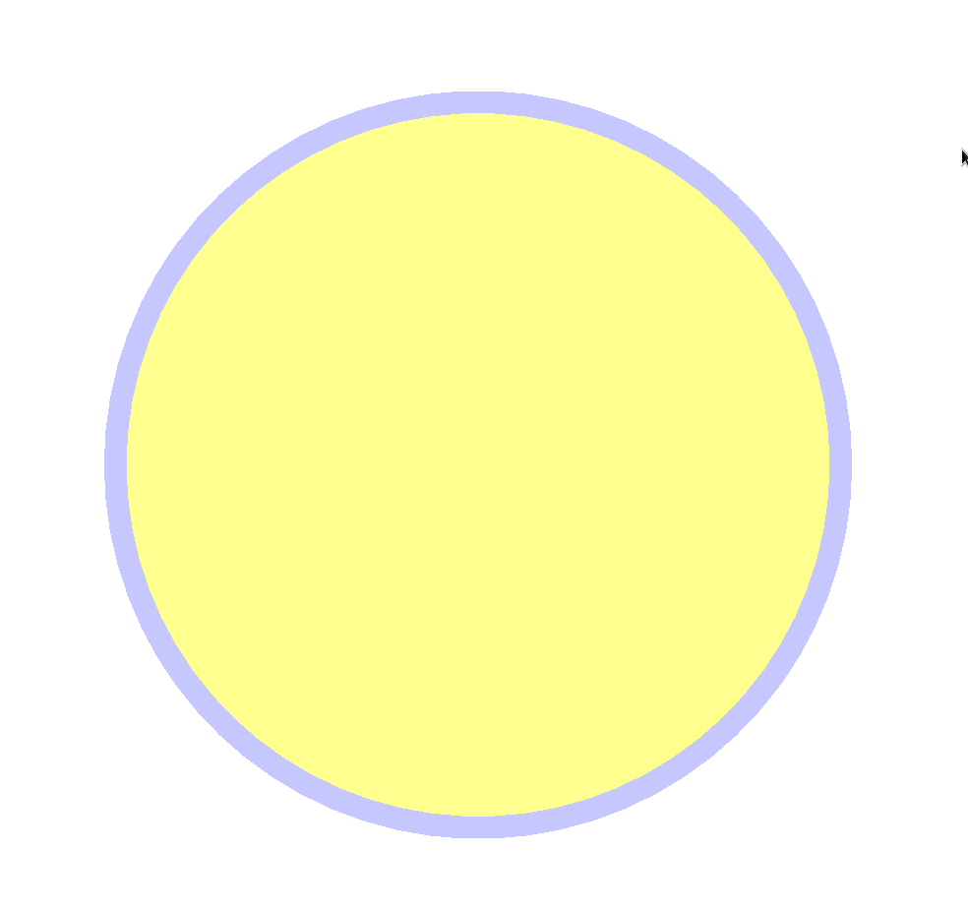
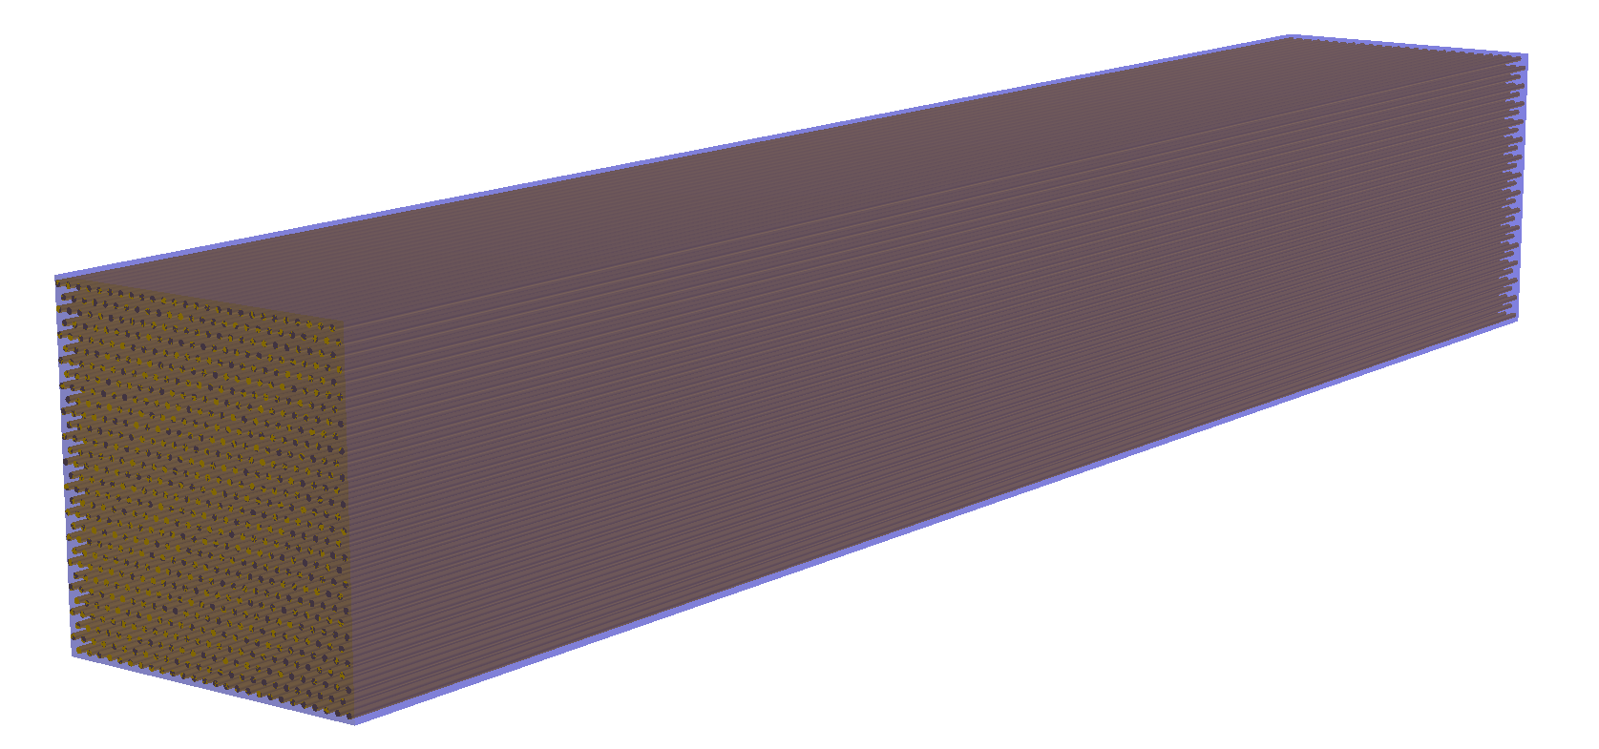
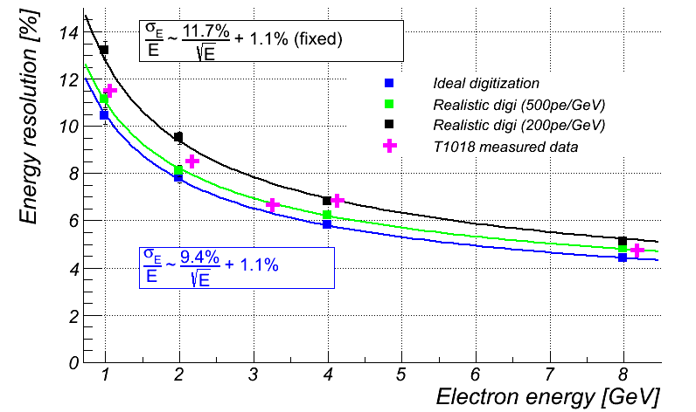
Forward EM Calorimeter (FEMC)
tower (and fiber) geometry
described precisely
tungsten powder scintillating fiber sampling calorimeter
technology
+2500mm from the IP; non-projective geometry
sampling fraction for e/m showers ~2.6%
“medium speed” simulation (up to energy deposit in
fiber cores)
reasonably detailed digitization; “ideal” clustering code
“Realistic” digitization: 40MHz SiPM noise in 50ns gate;
4m attenuation length; 5 pixel single tower threshold;
70% light reflection on upstream fiber end;
-> good agreement with original MC studies
and measured data
3 degree track-to-tower-axis incident angle

Slide 31
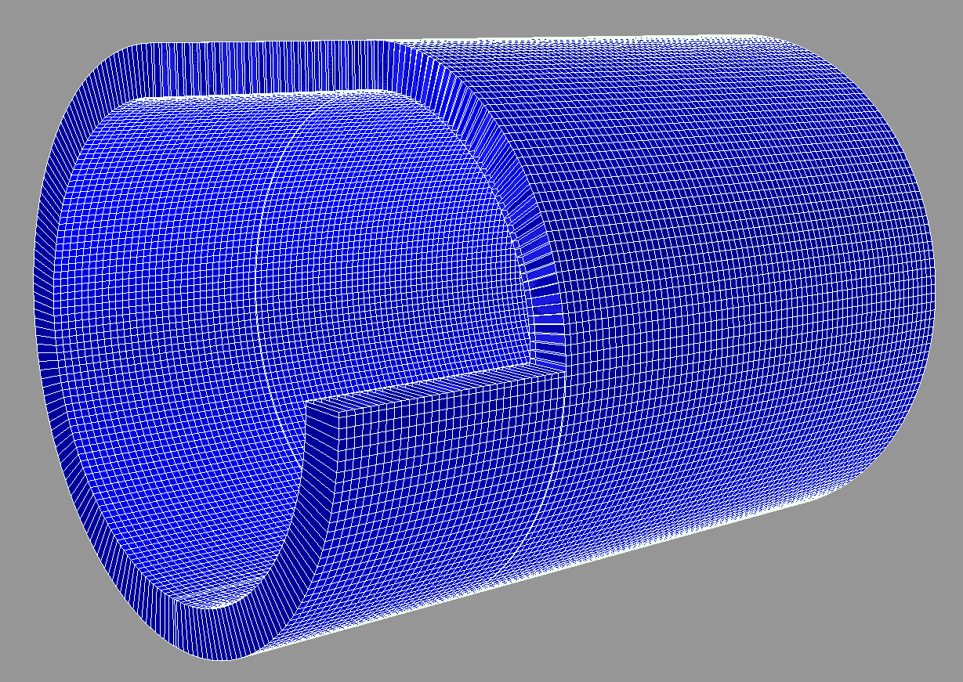
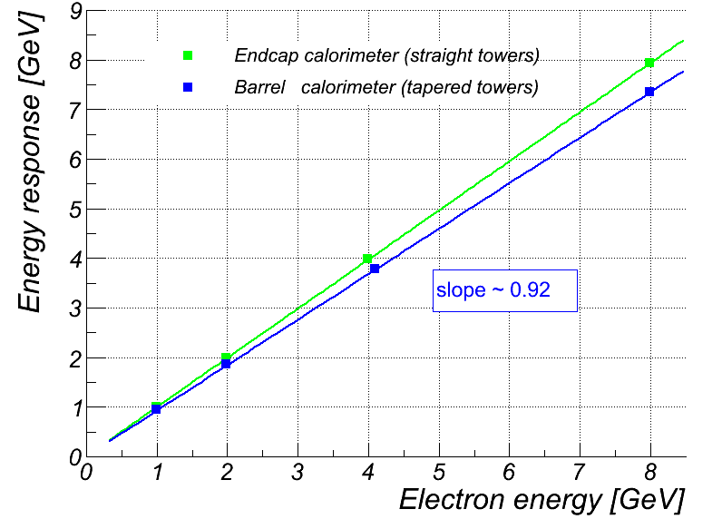
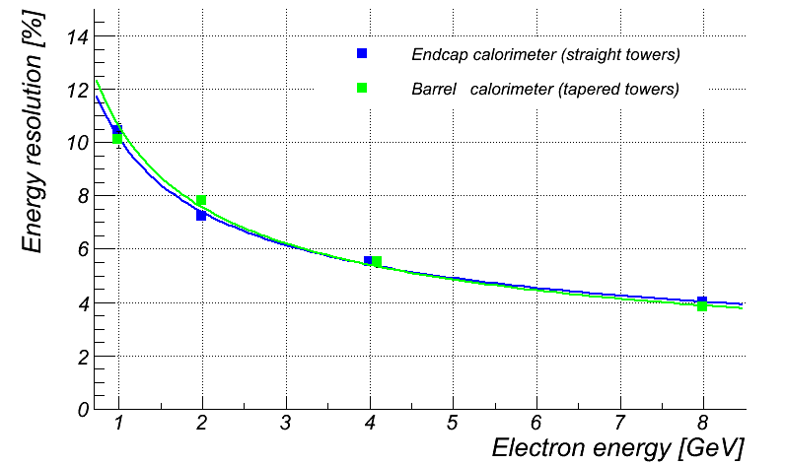
Barrel EM Calorimeter (CEMC)
same tungsten powder + fibers technology as FEMC, …
… but towers are tapered
non-projective
-> barrel calorimeter collects less light,
but response (at a fixed 3º angle) is
perfectly linear
-> simulation does not show any noticeable
difference in energy resolution between
straight and tapered tower calorimeters
3 degree track-to-tower-axis incident angle

Slide 32
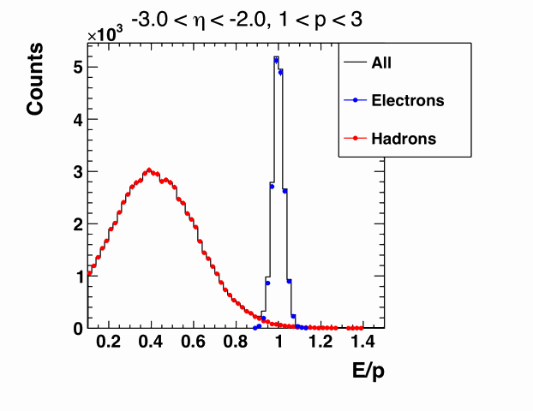




Lepton-hadron separation via E/p
all plots: 10GeV x 100GeV beams
Hadron identification with RICH
consider hadrons in
pseudo-rapidity range
~[1.0 .. 3.0]
-> pion/kaon/proton identification should be possible up to momenta ~40 GeV/c

Slide 33

Migration in (x,Q²) bins
10 GeV x 100 GeV beams
high y limited by
radiative corrections
can be suppressed by
requiring hadronic
activity
dedicated detector fully tuned to do
EIC physics program as in WP
detector designed based on already achieved performance
HERA:
y>0.005
low y-coverage:
limited by E’_{e} resolution
hadron method
or change beam energy
-> “survival probability” is above ~80% in the region,
where tracking has superior resolution

Slide 34
From RHIC to eRHIC
2013/14: Develop physics case and preliminary design for eRHIC.
Run RHIC annually until 2016; thereafter every other year.
Use reduced RHIC running to complete accelerator and detector R&D, detailed design and prototyping for eRHIC.
Construct sPHENIX.
2017: Install electron cooling
2018/19: Perform beam energy scan II.
2020/21: Perform high luminosity jet measurements.
2022-24: RHIC shutdown and conversion into eRHIC (10 GeV e-beam); upgrade of STAR/sPHENIX to eRHIC detectors.
2024: Commission eRHIC.
of course all subject to
funding by DOE

Slide 35

Take Away Message
The eRHIC will profoundly impact
our understanding of QCD
with its high energy, high luminosity
eA and polarized ep collisions
a dedicated eRHIC detector is
essential
to do the physics program as
envisioned by the community
and it will be critical to form a
eRHIC community beyond RHIC
eRHIC machine design ambitious,
but will push collider technologies
in several regions
ACHIEVED
if
eRHIC is built
entire science program uniquely tied to a
future high energy polarized electron ion collider
never been measured before & never without

Slide 36
BACKUP

Slide 37

International context
Electron-“Ion” colliders in the past and future:

Slide 38

Possible Schedule To Realize eRHIC

Slide 39
Lepton Kinematics
Increasing Lepton Beam Energy:
5 GeV: Q² ~ 1 GeV → η ~ -2
10 GeV: Q² ~ 1 GeV → η ~ -4
highest E’_{e} at most negative rapidities
independent of E_{h}
low Q² coverage
critical for
saturation physics
√s

Slide 40
Scattered Lepton Kinematics
CUTS: Q²>0.1GeV² && 0.01<y<0.95
higher √s:
scattered lepton has
small scattering angle
→ negative rapidities

Slide 41
Pion Kinematics
Cuts: Q²>1 GeV, 0.01<y<0.95, z>0.1
√s
Increasing Hadron Beam Energy: influences max. hadron energy at fixed η
Increasing 30 GeV < √s < 170 GeV
hadrons are boosted from forward rapidities to negative rapidities
no difference between π±, K±, p±

Slide 42
Hadron, lepton, Photon Separation
5 GeVx50 GeV
hadron
photon
electron
no cuts applied
hadron/photon suppression factor
needed for p_{e’}>1GeV:
-3<η<-2: ~10
-2<η<-1: > 100
-1<η<0: ~1000
p_{max} hadron for PID:
-5<η<-1: < 10 GeV
-1<η<-1: < 5 GeV
1<η<5: < 50 GeV

Slide 43
Lepton Identification
20 GeVx250 GeV
hadron
photon
electron
no cuts applied
hadron/photon suppression factor
needed for p_{e’}>1GeV:
-4<η<-3: >100
-3<η<-2: ~1000
-2<η<-1: > 10⁴
p_{max} hadron for PID:
-5<η<-1: < 30 GeV
-1<η<-1: < 10 GeV
1<η<5: < 100 GeV

Slide 44


What do we know
Gluon density dominates at x<0.1
small x
Gluon density dominates at x<0.1
x=10⁻⁵
QCD
FIT
large x
x=1
Rapid rise in gluons described naturally by linear pQCD evolution equations
This rise cannot increase forever - limits on the cross-section
  → non-linear pQCD evolution equations provide a natural way to tame this growth and lead to a saturation of gluons, characterised by the saturation scale Q²_{s}(x)
Notes:
Counter-intuitively the best way is through an EM process: DIS
y = inelasticity = fraction of the incoming electron energy carried by photon in the rest frame of the nucleon
The structure function F2 is sensitive to the sum of quark and anti-quark momentum distribution in the nucleon.
The apparent scaling of the data with Q2 at large x in early DIS data from SLAC was termed “Bjorken scaling” and motivated the parton model.
In the parton model, FL = 0, while in QCD, it is directly proportional to the gluon structure function, FL(x,Q2) ~ aS xG(x,Q2), at low x.
DGLAP: fixed x -> evolution along Q2
sigma (gamma N) = sig_T + sig_L
sig_L ~ FL
sig_tot ~ F2/Q^2
\frac{d^2 \sigma^{ep \rightarrow eX}}{dx dQ^2} = \frac{4 \pi \alpha^2_{e.m.}}{xQ^4} \left[ \left(1-y+\frac{y^2}{2} \right ) F_2(x,Q^2) - \frac{y^2}{2} F_L(x,Q^2) \right]

Slide 45

What Do We Know About xG in Nuclei?
99% of all h± have p_{t} < 2 GeV/c
“Bulk Matter” → x < 0.01
Other than in p:
G(x,Q²) for nuclei is little known
Key: F_{L} (x,Q²) ~ xG(x,Q²)

Slide 46

Inclusive DIS in eA: Nuclear PDFs
quark+anti-quark
gluon
  Expect strong non-linear effects in FL
Relative contributions of higher twist
effects to FL amplified in eA
Dipole model (J. Bartels et al.)
Notes:
\frac{d^2 \sigma^{eA\rightarrow eX}}{dx dQ^2} = \frac{4 \pi \alpha^2}{x Q^4} \left[ \left(1-y+\frac{y^2}{2}\right) {\color{blue}F_2(x, Q^2)} - \frac{y^2}{2} {\color{red}F_L(x, Q^2)}\right]

Slide 47

Inclusive DIS in eA: Nuclear PDFs
  measurement of FL requires running at different √s
  F2, FL: negligible stat. error, systematics dominated
  A dependence helps to discriminate between linear and non-linear (saturation) models
  Precision nPDF: Huge impact on pA, AA programs

Slide 48

Spatial Gluon Distribution Through Diffraction
  Goal: going after the source distribution of gluons through Fourier transform of dσ/dt
  Find: Typical diffractive pattern for coherent (non-breakup) part
  As expected: J/Ψ less sensitive to saturation effects than larger Φ-meson

Slide 49






di-hadron correlations in dA
comparisons between d+Au → h₁ h₂ X
(or p+Au → h₁ h₂ X ) and p+p → h₁ h₂ X
At y=0, suppression of away-side
jet is observed in A+A collisions
No suppression in p+p or d+A
  → x~10⁻²
∼π
However, at forward
rapidities (y ~ 3.1), an away-
side suppression is observed
in dAu
Away-side peak also much
wider in d+Au compared to pp
→ x ~ 10⁻³

Slide 50
eA Dihadron Correlations Studies
Exp: Saturation versus
“conventional” scenario
Theory: Saturation
Dominguez, Xiao, Yuan, Lee, Zheng ‘11/12
J.H. Lee, L. Zheng (CCNU) ‘11/12
eA-MC: Pythia6.4 + nPDF (EPS09) + nuclear geometry from DPMJetIII without PS
Here for 10 fb⁻¹/A (~ 20 weeks), std. experimental cuts
Clear signal, pronounced differences between sat and no-sat

Slide 51

Deep Inelastic Scattering - Vacuum
h
e’
γ*
q
e
What happens if we add a nuclear medium
Observables:
Broadening:
Attenuation:
Δp_{t}² linked directly with saturation scale
ratio of hadron production in A to d
modifications of nPDF cancel out
Notes:
Example here is DIS in vacuum
Propagating quark is colored, thus emits gluons. “Free.” “Lifetime of deconfined quark.” Universal for light quarks?
Dipole is a color singlet object, thus no gluon emission. “Prehadron.” Formation time depends on hadron formed.
Heuristic arguments and models: Formation time is longer, ~ 1 order of magnitude for pions.
One of the goals of the studies I will be describing is to directly measure these two time parameters. Another is to understand the detailed mechanisms of how the hadron gets formed. The method of determining these quantities consists of studying this process embedded in a nuclear medium of well-known properties such as size and density.
Make point here - whole process is hadronization? or make that point later?

Slide 52
What do we know and what can EIC do
Hermes:
E_{e} = 27 GeV → √s = 7.2 GeV
E_{h} = 2-15 GeV
Unprecedented precision to distinguish between different models
large ν range
hadronization in and out of nucleus
first time for charm
EIC:

Slide 53


What Do we know now on Δg(x)
Scaling violations of g₁
(Q²-dependence) give indirect access to the gluon distribution via DGLAP evolution.
RHIC polarized pp collisions at midrapidity direct access to gluons (gg,qg)
Rules out large ΔG for 0.05 < x < 0.2
Integral in RHIC x-range:
Contribution to proton spin to date:
Gluon: 20% Quarks: 30%

Slide 54

g₁^{p} the way to find the Spin
hep-ph:1206.6014
cross section:
pQCD scaling violations
5 x 250 starts here
5 x 100 starts here
world data

Slide 55
impact of eRHIC data on helicity PDFs
DIS scaling violations mainly determine Δg at small x
in addition, SIDIS data provide detailed flavor separation of quark sea
yet, small x behavior completely
unconstrained
→ determines x-integral,
which enters proton spin sum
includes only “stage-1 data”
can be pushed to x=10⁻⁴ with
20 x 250 GeV data
dramatic reduction
of uncertainties:
“issues”:
(SI)DIS @ eRHIC limited by
systematic uncertainties
need to control rel. lumi,
polarimetry, detector performance,
… very well

Slide 56
What will we learn about 2d+1 structure of the proton
GPD H and E as function of t, x and Q²
GPD H and E 1d+1
A global fit over all pseudo data was done, based on the GPDs-based model:
[K. Kumerički, D Müller, K. Passek-Kumerički 2007]
Known values q(x), g(x) are assumed for H^{q}, H^{g} (at ξ=0, t=0 forward limits E^{q}, E^{g} are unknown)
Excellent reconstruction of H^{sea}, H^{sea} and good reconstruction of H^{g} (from dσ/dt)
GPD H and E 2d+1 structure for sea-quarks and gluons

Slide 57
an Electron Ion Collider in the US
Requirements:
High Luminosity > 10³³ cm⁻²s⁻¹
Flexible center of mass energies
Electrons and protons/light nuclei polarised
Wide range of nuclear beams
a wide acceptance detector with good PID (e/h and π, K, p)
wide acceptance for protons from elastic reactions and
neutrons from nuclear breakup

Slide 58

What is eRHIC
RHIC
Existing = $2B
Electron accelerator
to be build
p
Polarized protons
50-250 GeV
Unpolarized and
polarized leptons
5-20 (30) GeV
e⁻
Light ions (d,Si,Cu)
Heavy ions (Au,U)
50-100 GeV/u
e⁻
e⁺
70% e⁻ beam polarization goal
polarized positrons?
Polarized light ions He³ 166 GeV/u
Center mass energy range: √s=30-200 GeV; L~100-1000xHera
longitudinal and transverse polarization for p/He³ possible
protons
electrons

Slide 59
eRHIC: design luminosity
 | e | p | ²He³ | ⁷⁹Au¹⁹⁷ | ⁹²U²³⁸
Energy, GeV | 20 | 250 | 167 | 100 | 100
CM energy, GeV |  | 100 | 82 | 63 | 63
Number of bunches/distance between bunches | 107 nsec | 111 | 111 | 111 | 111
Bunch intensity (nucleons) ,10¹¹ | 0.36 | 4 | 6 | 6 | 6
Bunch charge, nC | 5.8 | 64 | 60 | 39 | 40
Beam current, mA | 50 | 556 | 556 | 335 | 338
Normalized emittance of hadrons , 95% , mm mrad |  | 1.2 | 1.2 | 1.2 | 1.2
Normalized emittance of electrons, rms, mm mrad |  | 16 | 24 | 40 | 40
Polarization, % | 80 | 70 | 70 | none | none
rms bunch length, cm | 0.2 | 5 | 5 | 5 | 5
β*, cm | 5 | 5 | 5 | 5 | 5
Luminosity per nucleon, x 10³⁴ cm⁻²s⁻¹ |  | 2.7 | 2.7 | 1.6 | 1.7
Hourglass the pinch effects are included. Space charge effects are compensated.
Energy of electrons can be selected at any desirable value at or below 30 GeV
The luminosity does not depend on the electron beam energy below or at 20 GeV
The luminosity falls as E_{e}⁻⁴ at energies above 20 GeV
The luminosity is proportional to the hadron beam energy: L ~ E_{h}/E_{top}

Slide 60
BNL: 1st Detector Design Concept
ECAL W-Scintillator
Upstream
low Q²
tagger
ECAL PWO
ECAL WScin
To
Roman Pots
HCAL
RICH
RICH
HCAL
DIRC/proximity RICH
−η
η
PID:
-1<η<1: DIRC or proximity focusing Aerogel-RICH
1<|η|<3: RICH
Lepton-ID:
-3 <η< 3: e/p
1<|η|<3: in addition Hcal response & γ suppression via tracking
|η|>3: ECal+Hcal response & γ suppression via tracking
-5<η<5: Tracking (TPC+GEM+MAPS)

Slide 61






Vibrant Detector R&D Program
Calorimetry
  W-Scintillator & W-Si
    compact and high resolution
  Crystal calorimeters PbW & BGO
BNL, Indiana University, Penn State Univ., UCLA, USTC, TAMU
Pre-Shower
  W-Si
  LYSO pixel array with
  readout via X-Y WLS fibers
Univ. Tecnica Valparaiso
More Info on EIC-Detector R&D:
https://wiki.bnl.gov/conferences/index.php/EIC_R%25D
“Cartesian PreShower”
PID via Cerenkov
  DIRC and timing info
  Catholic Univ. of America, Old Dominion, South Carolina, JLab, GSI
  RICH based on GEM readout
  e-PID: GEM based TRD → eSTAR
BNL, Indiana Univ., USTC, VECC, ANL
Tracking
BNL, Florida Inst. Of Technology, Iowa State, LBNL, MIT, Stony Brook, Temple, Jlab, Virginia, Yale
  μ-Vertex: central and forward based on MAPS
  Central: TPC/HBD provides low mass,
  good momentum, dE/dx, eID
  Fast Layer: μ-Megas or PImMS
  Forward: Planar GEM detectors

Slide 62





Modeling the Detector in Geant
μ-vertex detector:
6 layers with [30..160] mm radius
0.37% X₀ in acceptance per layer simulated precisely;
digitization: single discrete pixels, one-to-one from MC points
Forward/backward μ-vertex detector:
3+5+3 silicon disks with up to 280 mm radius
N sectors per disk; 200 μm silicon-equivalent thickness
digitization: discrete ~20x20 μm² pixels
TPC
~2m long; gas volume radius [300..800] mm
1.2% X₀ IFC, 4.0% X₀ OFC; 15.0% X₀ aluminum endcap
digitization: assume known (gaussian) resolutions in “rφ” and “Z” and 1x5 mm GEM pads (up to 100 points per track)
Forward tracking:
3 disks behind the TPC endcap
rather precise START FGT design implemented
digitization: 100 μm resolution in X&Y; gaussian smearing

Slide 63



Kinematics of Breakup Neutrons
Results from GEMINI++ for 50 GeV Au
Results:
With an aperture of ±3 mrad we are in relative good shape
• enough “detection” power for t > 0.025 GeV²
• below t ~ 0.02 GeV² we have to look into photon detection
‣ Is it needed?
Question:
For some physics rejection power for incoherent is needed ~10⁴
→ How efficient can the ZDCs be made?
by Thomas Ullrich
+/-5mrad acceptance seems sufficient

Slide 64


Diffractive Physics: p’ kinematics
Diffraction:
t=(p4-p2)² = 2[(mp^{in}.mp^{out})-(E^{in}E^{out} - pz^{in}pz^{out})]
→ “ Roman Pots” acceptance studies see later
?
5x50
p’
5x100
5x250
Simulations by J.H Lee

Slide 65




proton distribution in y vs x at s=20 m
without quadrupole aperture limit
20x250
5x50
with quadrupole aperture limit
20x250
5x50

Slide 66


Accepted in“Roman Pot”(example) at s=20m
25x250
5x50
25x250
5x50
Generated
Quad aperture limited
RP (at 20m) accepted

Slide 67

The Pillars of the eRHIC Physics program
Electro Weak
physics of
strong color
fields
spin Physics
2D+1 Imiging
Hadronisation
Wide physics program with high requirements on detector and machine performance

Slide 68





the path to imaging quarks and gluons
PDFs do not resolve transverse momenta or positions in the nucleon
transverse
plane
fast moving nucleon turns into a `pizza’ but transverse size remains about 1 fm
compelling questions
how are quarks and gluons spatially distributed
how do they move in the transverse plane
do they orbit and do we have access to spin-orbit correlations
→ required set of measurements & theoretical concepts
1-D
form factor
parton densities
not related by
Fourier transf.
2+1-D
transv. mom. dep. PDF
impact par. dep. PDF
generalized PDF
semi-inclusive DIS
exclusive processes
Wigner function
high-level connection
4+1-D
measurable ?
important in other branches of Physics

Slide 69



The Hadronic Mass Puzzle
are
C.D. Roberts, Prog. Part. Nucl. Phys. 61 (2008) 50
M. Bhagwat & P.C. Tandy, AIP Conf.Proc. 842 (2006) 225-227
In QCD, all “constants” of quantum mechanics are actually strongly momentum dependent: couplings, number density, mass, etc.
So, a quark’s mass depends on its momentum.
Mass function can calculated and is depicted here.
in agreement: the vast bulk of the light-quark mass comes from a cloud of gluons, dragged along by the quark as it propagates.
Continuum- and Lattice-QCD
Running gluon mass
  Gluon is massless in UV, in agreement with pQCD
  Massive in infrared
    m_{G}(0) = 0.67-0.81 GeV
    m_{G}(m_{G}²) = 0.53-0.64 GeV
DSE prediction confirmed by numerical simulations of lattice-regularised QCD
Mass from nothing!
m_{G}²(k²) ≈ m_{G}⁴/(k²+m_{G}²)
Qin et al., Phys. Rev. C 84 042202 (Rapid Comm.)

Slide 70

How many gluons have space in A proton?
at small x linear evolution gives strongly
rising g(x)
  cannot go on forever
BK/JIMWLK non-linear evolution includes
recombination effects → saturation
  Dynamically generated scale
  Saturation Scale: Q²_{s}(x)
    Increases with energy or decreasing x
  Scale with Q²/Q²_{s}(x) instead of x and Q²
small x / higher energy
x = P_{parton}/P_{nucleon}
Terra Incognita
Bremsstrahlung
~ α_{s}ln(1/x)
Recombination
~ α_{s}ρ
Saturation must set in at
low x → high occupancy
α_{s}~1 α_{s} << 1

Slide 71

Dihadron Correlations in eA at EIC
EIC:
  Extract the spatial multi-gluon correlations and study their non-linear evolution
    essential for understanding the transition from a deconfined into a confined state.
Advantage over p(d)A:
  eA experimentally much cleaner
    no “spectator” background to subtract
    Access to the exact kinematics of the DIS process (x, Q²)
Perfect saturation signature:
Either jets or use leading hadrons from jets (dihadrons)
Notes:
Raju: Di-hadron correlations are a test of universality because the same measurement in p+A and e+A is sensitive to "dipole" and "quadrupole" operators which are the same for both processes.

Slide 72






Deep Inelastic Scattering
Kinematics:
Measure of resolution power
Measure of inelasticity
Measure of momentum fraction of struck quark
Gluon splits
into quarks
Quark splits
into gluon
splits
into quarks …
10⁻¹⁶m
10⁻¹⁹m
higher √s
increases resolution

Slide 73





helicity structure - open questions
significant experimental and theoretical progress in past 25+ years, yet many unknows …
Δg(x,Q²)
found to be small at 0.05 < x < 0.2 [RHIC, COMPASS, HERMES]
RHIC can slightly extend x range & reduce uncertainties
[500 GeV running & particle correlations]
can hide one
unit of here
yet, full 1st moment [proton spin sum]
will remain to have significant uncertainties
from unmeasured small x region
DIS
&
pp
RHIC
pp
Δq’s (x,Q²)
x
known: quarks contribute much less to proton spin
than expected from quark models
large uncertainties in ΔΣ from unmeasured small x
surprisingly small/positive Δs from SIDIS: large SU(3)
breaking?
_
_
flavor separation not well known, e.g., Δu - Δd

Slide 74


scaling violations at small x
rough small-x approximation to Q²-evolution:
spread in Δg(x,Q²) translates into
spread of scaling violations for g₁(x,Q²)
need x-bins with a least two Q² values to compute derivative (limits x reach somewhat)
smallest x bins require 20 x 250 GeV
5 x 250 starts here
error bars for moderate 10fb⁻¹ per c.m.s. energy; bands parameterize current DSSV+ uncertainties

Slide 75

Constrain J_{q} via GPD E
observables sensitive to E:
(J_{q} input parameter in ansatz for E)
DVCS A_{UT} : HERMES
nDVCS A_{LU} : Hall A
Hermes DVCS-TTSA [arXiv: 0802.2499]:
VGG
eRHIC:
HERMES like A_{UT}
20 GeV x 250 GeV
Lumi: 2x50fb⁻¹
Notes:
AHLT: Ahmad, Honkanen, Liuti, Taneja PRD75(2007)

Slide 76
Different DVCS Asymmetries
arXiv:1304.0077

Slide 77
BH Fraction
5 GeV x 100 GeV
BH subtraction will be relevant in stage 1, at large y, depending on the x-Q² bin
BUT…
5 GeV x 100 GeV
and
5 GeV x 250 GeV
are overlapping:
x-sec. measurements at 5x250 at low-y can
crosscheck the BH
subtrac. made for 5x100
20 GeV x 250 GeV
BH subtraction will be not an issue for y<0.6

Slide 78



Hard Diffraction in DIS at Small x
e+p
t = (p-p’)²
β is the momentum fraction of the struck parton w.r.t. the Pomeron
xIP = x/β: momentum fraction of the exchanged object (Pomeron) w.r.t. the hadron
Diffraction Analogy: plane monochromatic wave incident on a circular screen of radius R
  Diffraction in e+p:
    coherent ⇔ p intact
    incoherent ⇔ breakup of p
    HERA: 15% of all events are hard diffractive
Diffraction in e+A:
  coherent diffraction (nuclei intact)
  breakup into nucleons (nucleons intact)
  incoherent diffraction
  Predictions: σdiff/σtot in e+A ~25-40%

Slide 79
Hard Diffraction in DIS at Small x
e+p
t = (p-p’)²
β is the momentum fraction of the struck parton w.r.t. the Pomeron
x_{IP} = x/β: momentum fraction of the exchanged object (Pomeron) w.r.t. the hadron
  Diffraction in e+p:
    coherent ⇔ p intact
    incoherent ⇔ breakup of p
    HERA: 15% of all events are hard diffractive
Diffraction in e+A:
  coherent diffraction (nuclei intact)
  breakup into nucleons (nucleons intact)
  incoherent diffraction
  Predictions: σdiff/σtot in e+A ~25-40%

Slide 80


Large Rapidity Gap Method (LRG)
  Identify Most Forward Going
  Particle (MFP)
    Works at HERA but at higher √s
    EIC smaller beam rapidities
Diffractive ρ⁰ production at EIC:
η of MFP
M. Lamont ’10
DIS
Hermeticity requirement:
needs just to detector presence
does not need momentum or PID
simulations: √s not a show stopper for EIC
(can achieve 1% contamination, 80% efficiency)
Diffractive

Slide 81
Best Knowledge of QS in eA
Model-I: IPSat dipole model
Model-II: BK + higher order corr.
Enhancement of Q_{S} with A
⇒ saturation regime reached at significantly lower energy in nuclei

Slide 82

h-h Forward Correlation in p(d)A at RHIC
side-view
beam-view
large-x1 (q dominated)
p
p
A
π
low-x2 (g dominated)
Low gluon density (pp):
pQCD predicts 2→2 process ⇒ back-to-back di-jet
High gluon density (pA):
2 → many process
⇒ expect broadening of away-side
  Small-x evolution ↔ multiple emissions
  Multiple emissions → broadening
  Back-to-back jets (here leading hadrons) may get broadening in pT with a spread of the order of QS
First prediction by: C. Marquet (’07)
Latest review: Stasto, Xiao, Yuan arXiv:1109.1817 (Sep. ’11)
Notes:
Raju: Di-hadron correlations are a test of universality because the same measurement in p+A and e+A is sensitive to "dipole" and "quadrupole" operators which are the same for both processes.

Slide 83




Forward Correlations in dA at RHIC
1 question, 2 answers
Initial state saturation model
“Non-initial state” shadowing model
Away side parton randomized
by strong color field
Albacete, Marquet
+offset
+offset
Kang, Vitev, Xing arXiv:1112.6021v1
B. Xiao et al. 2012
How saturated is the initial state?

Slide 84
Why is DiFfraction So Important
Sensitive to spatial gluon distribution
  Hot topic:
    Lumpiness?
    Just Wood-Saxon+nucleon g(b)
  Incoherent case: measure fluctuations/lumpiness
  in g_{A}(b)
Sensitive to gluon momentum distributions
  σ ~ g(x,Q²)²

Slide 85

Measuring FL with the EIC (I)
quark+anti-quark
momentum distributions
gluon momentum distribution
In practice use reduced cross-section:
How to extract F_{L}
  Need different values of y²/Y⁺
  FL slope of σr vs y²/Y⁺
  F2 intercept of σr vs y²/Y⁺ with y-axis
  σr
  y²/Y⁺
0
Notes:
\begin{eqnarray*}\sigma_r = \left( \frac{d^2 \sigma}{dx dQ^2}\right)\ \frac{x Q^4}{2 \pi \alpha^2 [1 + (1-y)^2]}
&=& F_2(x, Q^2) - \frac{y^2}{\color{red}{1+(1-y)^2}} F_L(x, Q^2) \\
{} &=& F_2(x, Q^2) - \frac{y^2}{{\color{red}Y^+}} \ F_L(x, Q^2) \\\end{eqnarray*}

Slide 86



Measuring FL with the EIC (II)
In order to extract F_{L} one needs at least two measurements of the inclusive cross section with “wide” span in inelasticity parameter y (Q² = sxy)
F_{L} requires runs at various √s ⇒ longer program
Need sufficient lever arm in y²/Y⁺
Limits on y²/Y⁺:
At small y:
detector resolution for e’
At large y:
radiative corrections and charge symmetric background
EIC studies:
Statistical error is negligible
in essentially whole range
Systematical Error
Calibration
Normalization
Experiment
Radiative Corrections
Notes:
Lowest value of x and Q2 :
y y2/Y+ proton p
0.7 0.44 100
0.54 0.24 130
0.28 0.28 250

Slide 87


preparation of DIS and SIDIS mock data
PEPSI MC to generate σ⁺⁺ and σ⁺⁻ with LO GRSV PDFs
DIS
SIDIS
inclusive final-state
identified charged pions and kaons
assume modest 10 fb⁻¹ for each energy, 70% beam polarizations
Q² > 1 GeV² , 0.01 < y < 0.95 , invariant mass W² > 10 GeV²
depolarization factor of virtual photon D(y,Q²) > 0.1 (cuts on small y)
scattered lepton: 1º < θ_{elec} < 179º and p_{elec} > 0.5 GeV
hadron: p_{hadr} > 1 GeV, 0.2 < z < 0.9,
1⁰ < θ_{hadr} < 179º
use rel. uncertainties of data to generate mock data by randomizing around
DSSV+ by 1-σ
SIDIS: incl. typical 5% (10%) uncertainty for pion (kaon) frag. fcts (from DSS analysis)

Slide 88

DVCS ASYMMETRIES
→ different charges: e⁺ e⁻:
~
Δσ_{C} ~ cosφ ∙Re{ H + ξH +… }
H
→ polarization observables:
~
Δσ_{LU} ~ sinφ∙Im{H + ξH + kE}
H
Δσ_{UT}
~
~
Δσ_{UL} ~ sinφ∙Im{H + ξH + …}
H
beam target
Δσ_{UT} ~ sinφ∙Im{k(H - E) + … }
H, E
ξ = x_{B}/(2-x_{B} ) k = t/4M²
kinematically suppressed

