Slide 1

Probing Nucleon Structure at an
Electron Ion Collider
Zein-Eddine Meziani
Temple University
Long Range Plan Joint Town Meeting on QCD
Temple University, Philadelphia
September 14, 2014
Thanks to everyone who contributed to the EIC White Paper effort
and particularly to my co-Editors Abhay Deshpande and Jianwei Qiu
“It is difficult and often impossible to judge the value of a problem correctly in advance; for the final award depends upon the gain which science obtains from the problem.”
David Hilbert, 1900 Paris

Slide 2
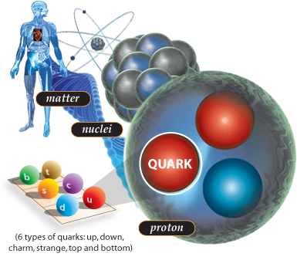
Nuclear Science and QCD
Nuclear Science
    To discover, explore and understand all forms of nuclear matter
Nuclear Matter
    Quarks + Gluons + Interactions →Nucleons →Nuclei
    At the heart of the visible universe, accounting
    for essentially all its mass
Experimental Tools:
    Giant electron microscopes opened the gateway to nucleon structure at Stanford and at SLAC using electron proton scattering.
    Modern microscopes are pushing the frontiers of resolution, brightness and polarization combined.
Theory Tools: Quantum Chromodynamics (QCD)
    A fundamental theory of quarks and gluons
    Describes the formation of all forms of nuclear matter
Understanding of QCD is a fundamental and compelling goal of Nuclear Science

Slide 3


The Science Problem ?
The structure of all nuclear matter in Quantum Chromodynamics (QCD) and ultimately confinement
What do we know?
QCD successes in the perturbative regime are impressive, many experimental tests led to this conclusion
But
Many non-perturbative aspects of QCD including confinement are still puzzling. Confinement has been identified as one of the top millenium problems in Physics! (Gross, Witten,.…) Many conferences have been devoted to this problem
Present theoretical tools:
Models, AdS/CFT…
Q²
0
1
10
∞
Lattice QCD
pQCD

Slide 4
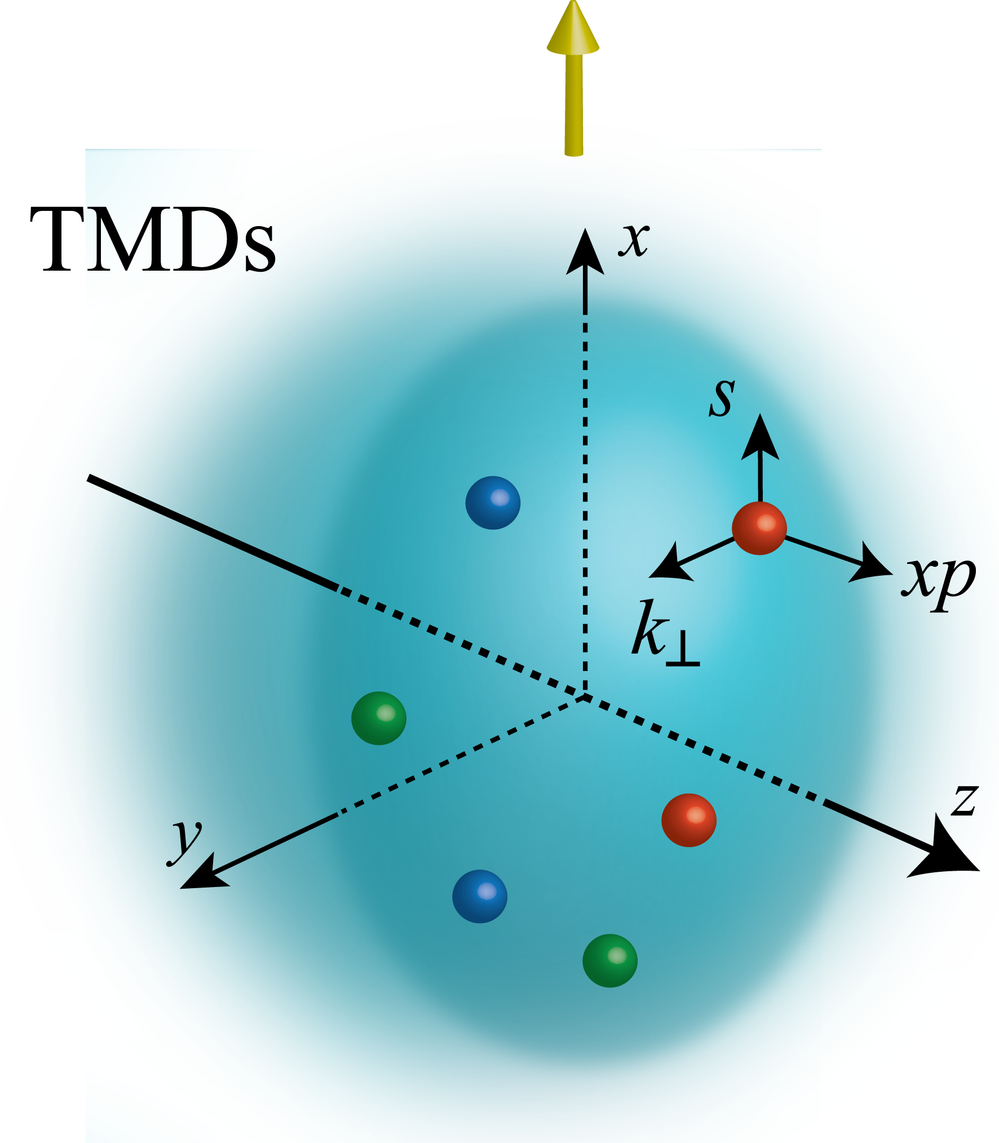
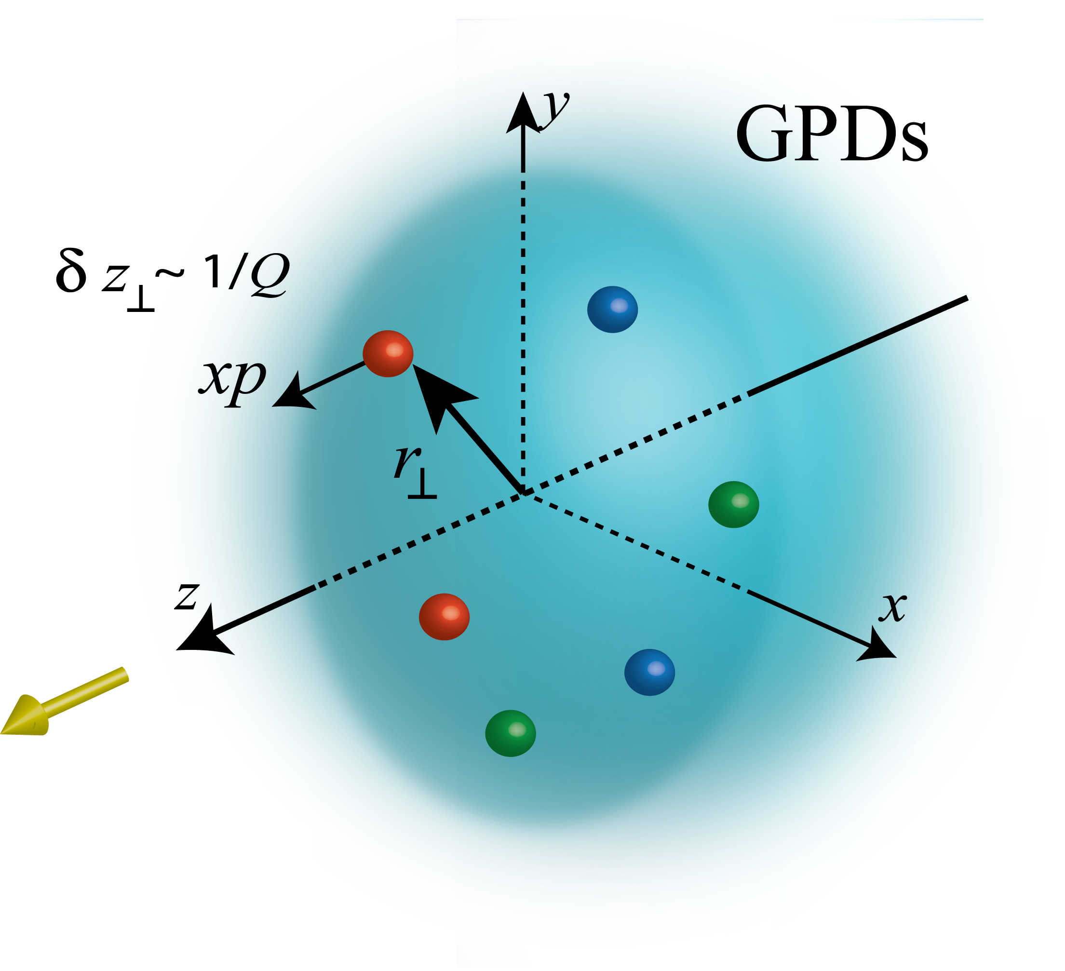
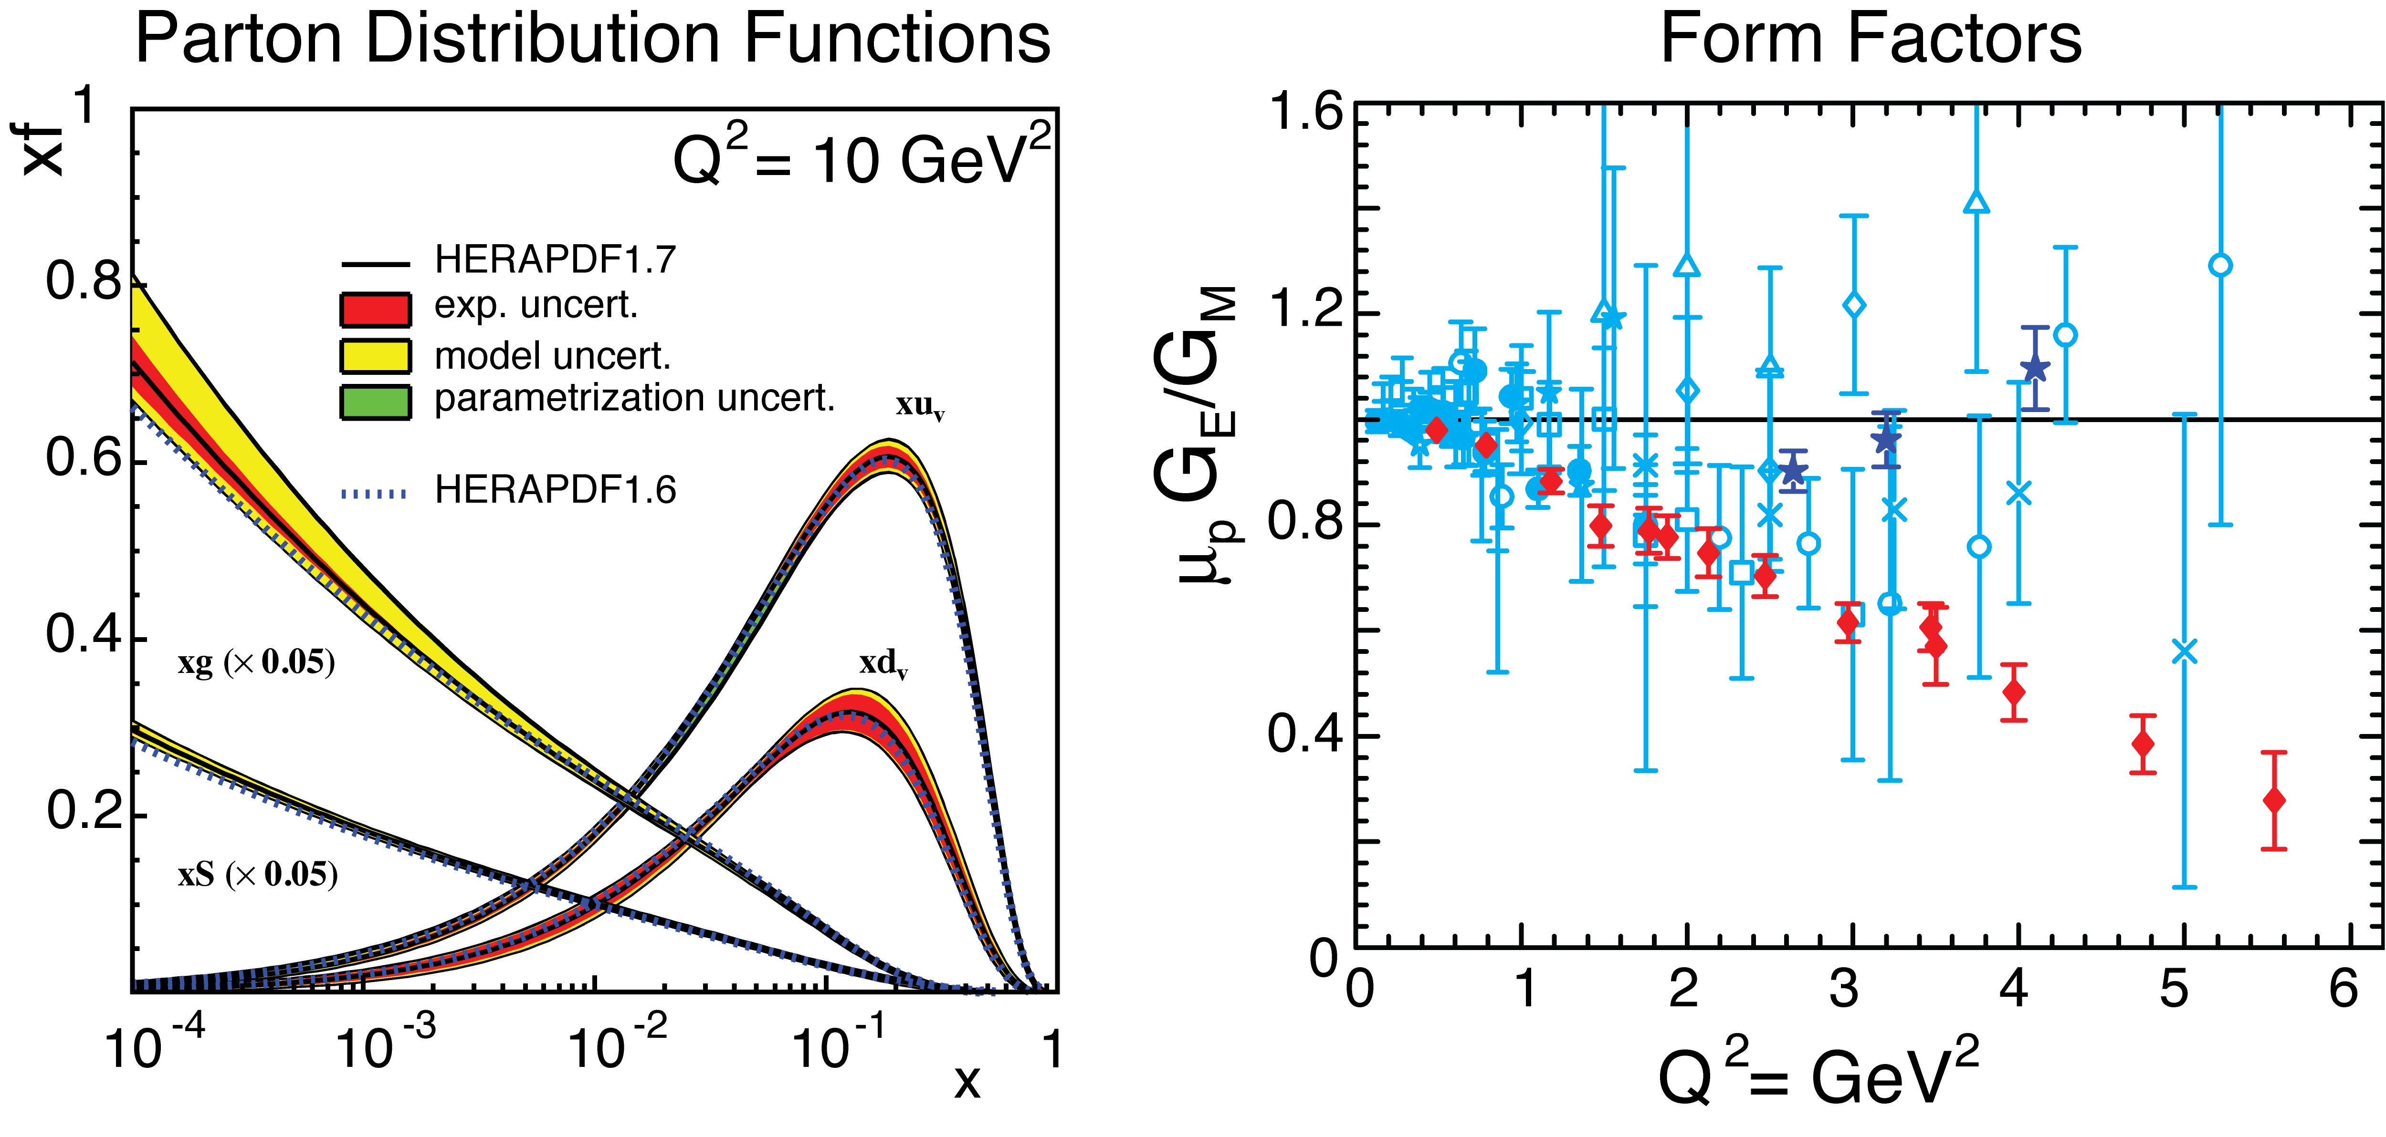
Unified View of Nucleon Structure
W_{p}^{u}(x,k_{T},r_{T} ) Wigner distributions
5D Dist.
Transverse Momentum Dist.
Generalized Parton Dist.
dr_{T}
d²k_{T}
TMD f₁^{u}(x,k_{T}), h₁^{u}(x,k_{T})‏
GPD
“3D” imaging
d²k_{T}
dx &Fourier Transformation
d²r_{T}
PDFs
f₁^{u}(x), .. h₁^{u}(x)‏
Form Factors
G_{E}(Q²),
G_{M}(Q²)‏
1D

Slide 5
Experimental Tools: Scattering
Inclusive reactions
Semi-Inclusive reactions
Exclusive reactions
Deep Inelastic Scattering
(DIS)
Meson
Elastic
Scattering
Deep Virtual
Compton Scattering

Slide 6
The many fronts of experimental studies in an EIC
Since 1998
Inclusive
Parton distributions
Sum rules and polarizabilities
Since 2002
Generalized Parton Distributions
(GPDs)
Transverse Momentum Distributions
(TMDs)
Exclusive reactions
In nucleons and nuclei
Elastic form factors
Deep Virtual Compton Scattering
Deep Virtual Meson Production
Semi-Inclusive DIS
In nucleons and nuclei
Distributions and
Fragmentation functions
QCD
Electroweak
probe to hadronic systems

Slide 7
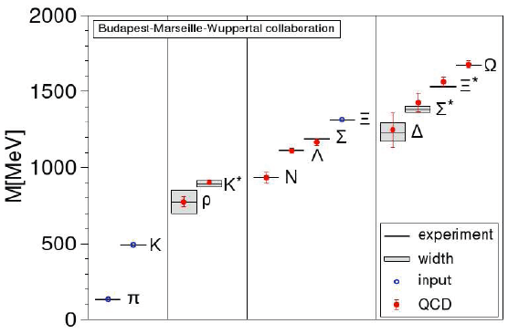
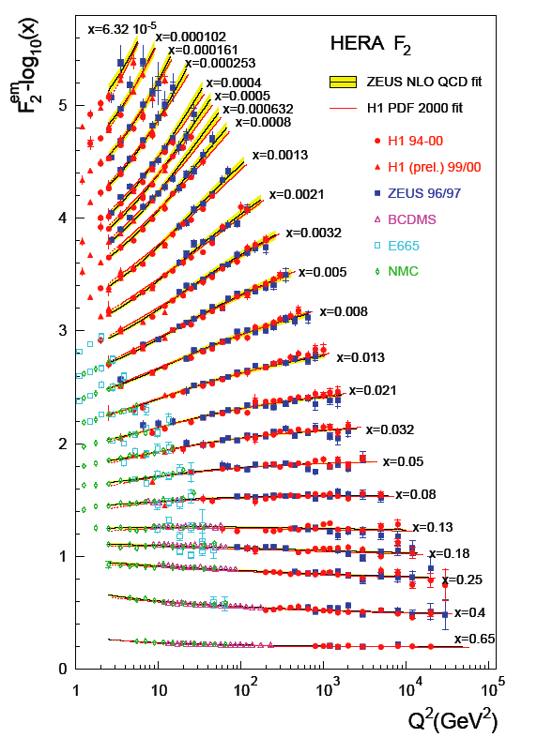
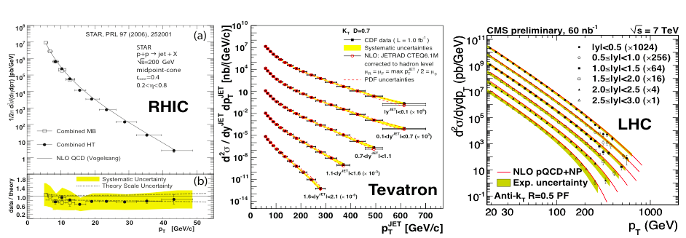
Successes of QCD
  At low Energy: Hadron Mass Spectrum from Lattice
  At high Energy: Asymptotic freedom + perturbative QCD
Measure e-p at 0.3 TeV (Hera)
Predict p-p and p-pbar at 0.2, 1.96 and 7 TeV

Slide 8

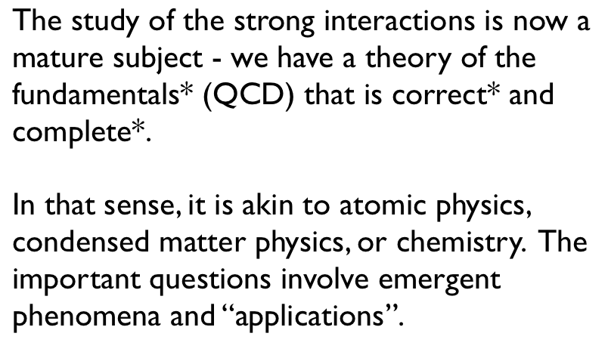
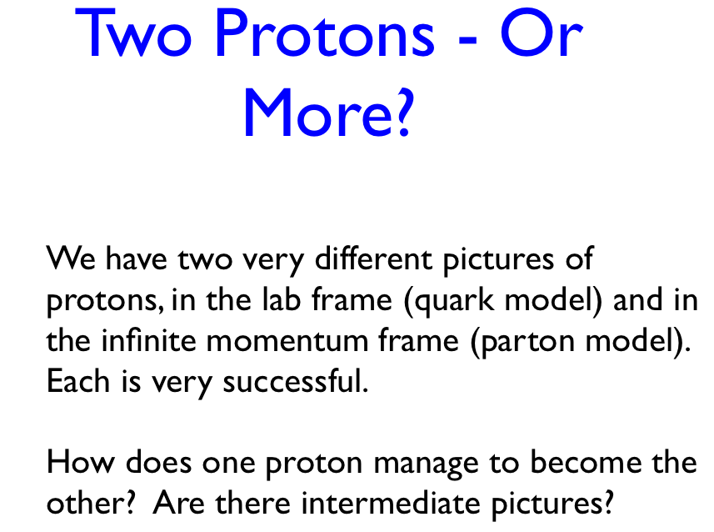
Quoting from F. Wilczek (XXIV Quark Matter 2014)
Emergent Phenomena

Slide 9
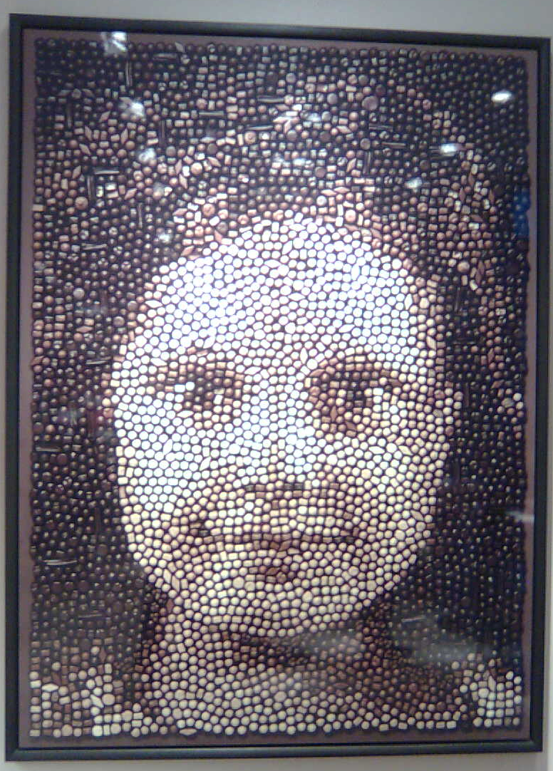
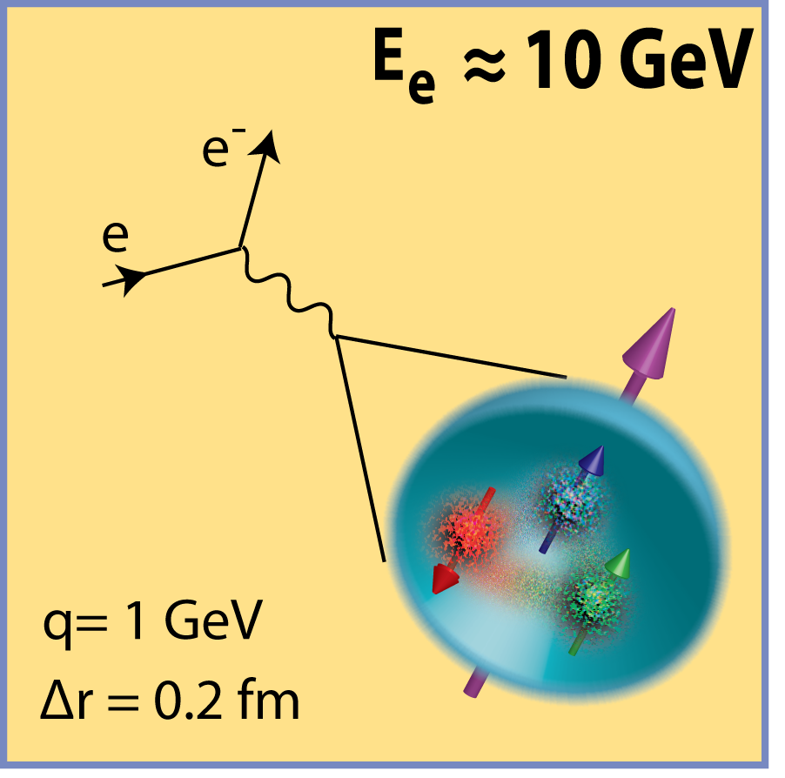
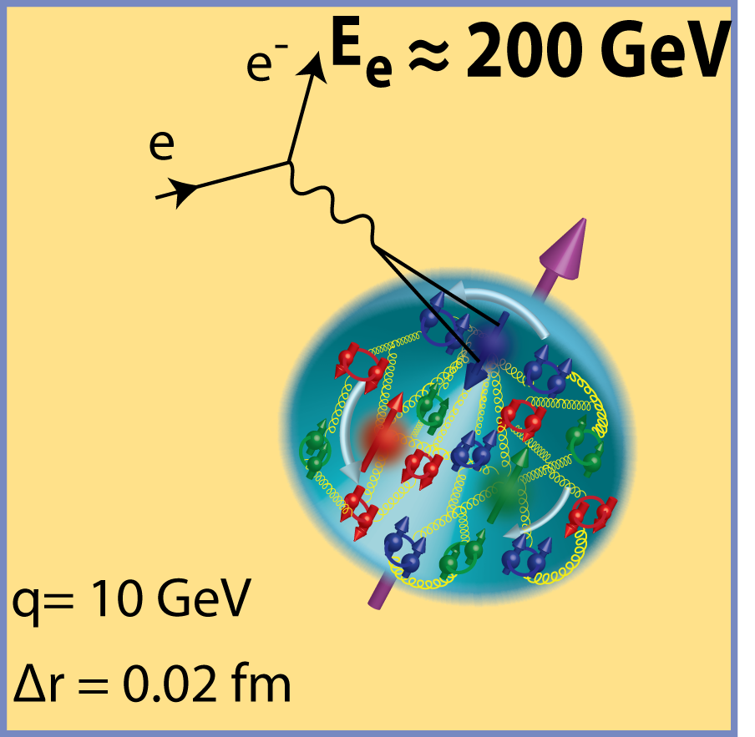

Nucleon
Probing deeper for the fundamental degrees of freedom, quarks and gluons
Quarks & Gluons
Emergent Phenomenon
9

Slide 10
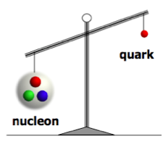
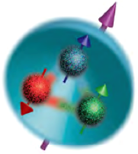

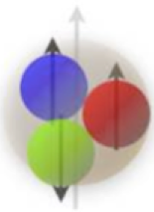
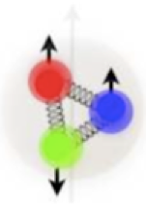
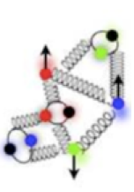
Puzzles and Challenges
m_{q} ~ 10 MeV
m_{N} ~ 1000 MeV
Proton mass “puzzle”:
Quarks carry
of proton’s mass
How does glue dynamics generate the energy for nucleon mass?
Proton spin “puzzle”:
Quarks carry
of proton’s spin
How does quark and gluon dynamics generate the rest of the proton spin?
3D structure of nucleon: (2D space +1 in momentum) or 3D in momentum
Color Confinement
Asymptotic freedom
200 MeV (1 fm)
2 GeV (1/10) fm)
Probing
momentum
How does the glue bind quarks and itself into a proton and nuclei?
Can we scan the nucleon to reveal its 3D structure?

Slide 11

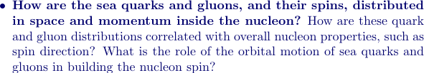
Fundamental QCD Question
How do quarks and gluons confine themselves into a proton?
The color confinement
“Hints” from knowing hadron structure
Hadron structure:
Proton spin:
If we do not understand proton spin from QCD, we do not understand QCD!
It is more than the number ½! It is the interplay between
the intrinsic properties and interactions of quarks and gluons
Need a polarized proton beam!

Slide 12
Electron-Ion Collider
An ultimate machine to provide answers to QCD questions
A collider to provide kinematic reach well into the gluon-dominated regime
An electron beam to bring to bear the unmatched precision of the electromagnetic interaction as a probe
Polarized nucleon beams to determine the distributions and correlations of sea quark and gluon distributions with the nucleon spin
A machine at the frontier of polarized luminosity, combined with versatile kinematics and beam species
Answers all above QCD questions at a single facility

Slide 13
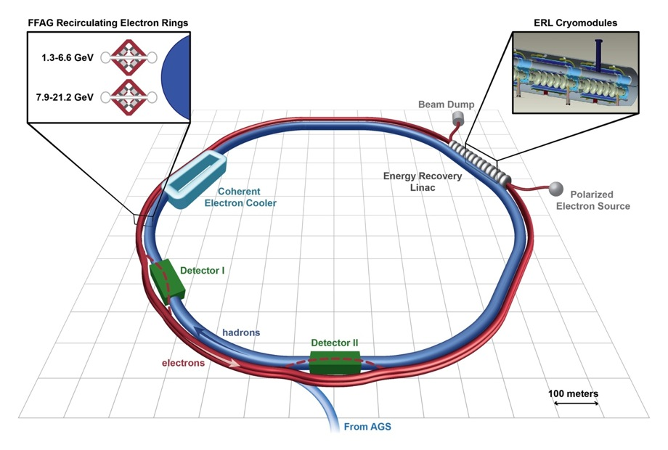
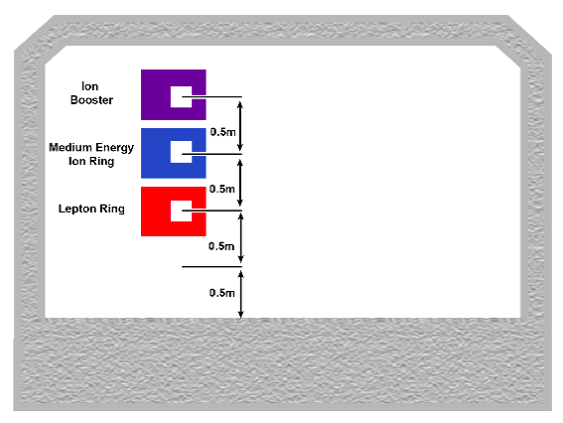
U.S.-based EICs – the Machines
MEIC (JLab)
eRHIC (BNL)
Pre-booster
Ion Source
Linac
MEIC collider rings
IP
IP
Full Energy EIC Collider rings
12 GeV
12 GeV CEBAF
AGS
11 GeV
First polarized electron-proton/light ions collider in the world
First electron-nucleus (various species) collider in the world
Both cases make use of existing facilities

Slide 14
Kinematics and machine properties for e-N collisions
First polarized e-p collider
Polarized beams: e, p, d/³He
Variable center of mass energy
Luminosity L_{ep} ~ 10³³⁻³⁴ cm⁻²s⁻¹, HERA luminosity ~ 5x10³¹ cm⁻² s⁻¹

Slide 15
EIC: Goals and deliverables
The key measurements
Why is it a unique facility with capabilities unmatched by existing and planned
facilities?

Slide 16
Proton spin and hadron structure?
Beyond a one dimensional view
Proton – composite particle of quarks and gluons:
Mass = intrinsic (quark masses) + quarks motion (kinetic + potential)
+ gluon motion (kinetic + potential) + trace anomaly
Spin = intrinsic (partons spin) + motion (orbital angular momentum)
Over 20 years effort (following EMC discovery)
Quark (valence + sea) helicity: of proton spin
Gluon helicity: positive with large uncertainty from limited x range
How to explore the “full” gluon and sea quark contribution?
How to quantify the role of orbital motion?

Slide 17
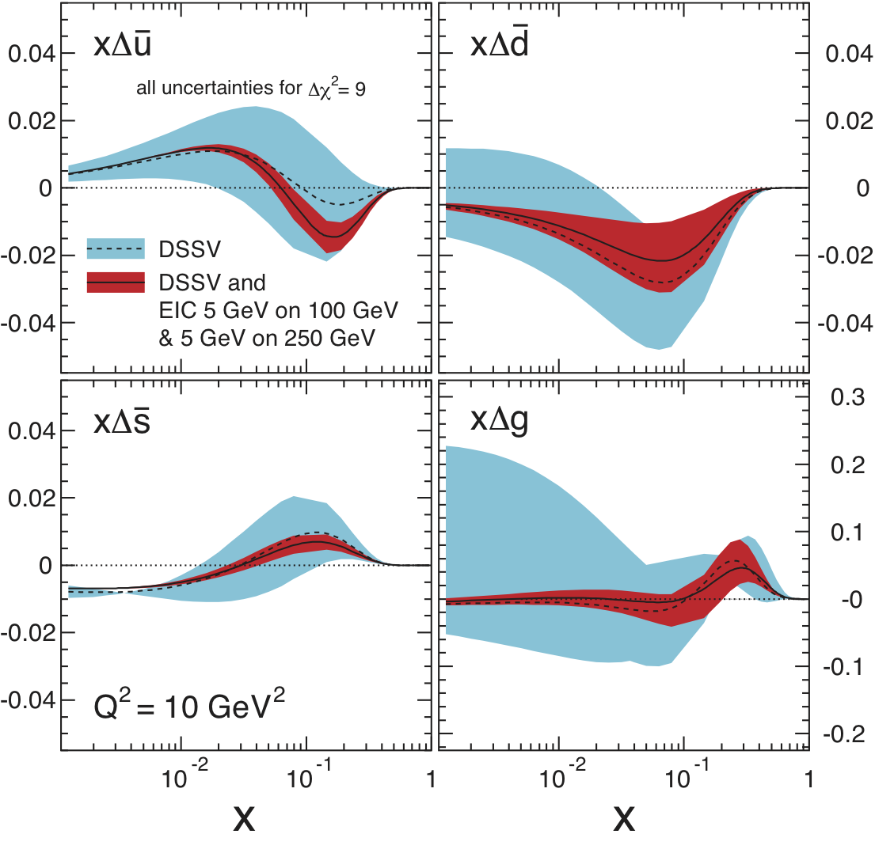
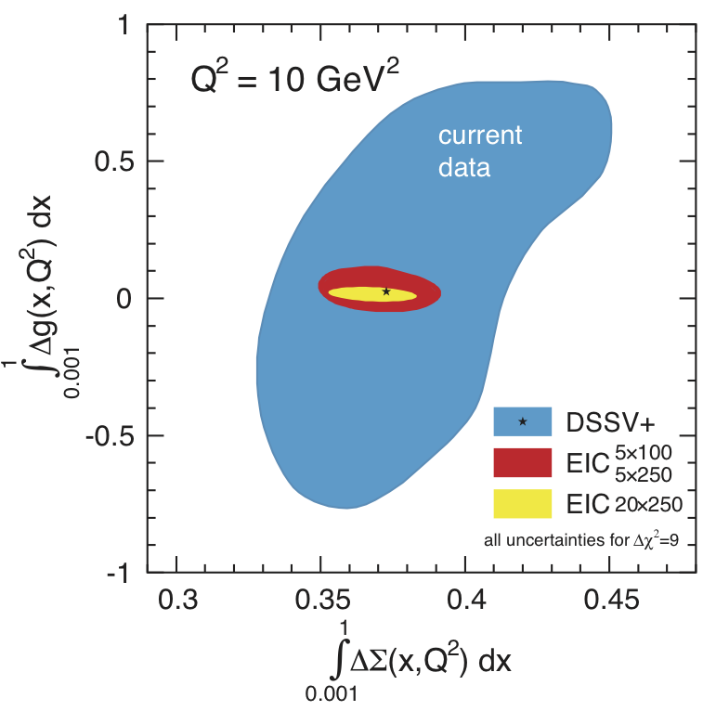
Proton spin and hadron structure?
The EIC – the decisive measurement (1st year of running):
(Wide Q², x including low x range at EIC)
w/EIC data
Before/after
No other machine in the world can achieve this!
Solution to the proton spin puzzle:
Precision measurement of ΔG – extends to smaller x regime
Orbital angular momentum – motion transverse to proton’s momentum

Slide 18
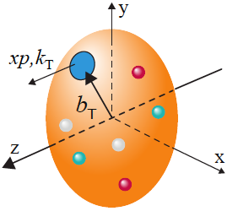
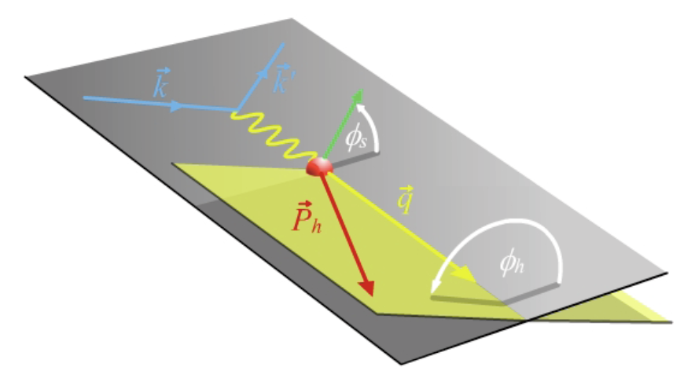
EIC is the best for probing TMDs
TMDs - rich quantum correlations:
Naturally, two scales and two planes:
Two scales (theory-QCD TMD factorization):
high Q - localized probe
Low p_{T} - sensitive to confining scale
Two planes:
angular modulation to separate TMDs
Hard to separate TMDs in hadronic collisions
Notes:
Change arrows on the picture.

Slide 19
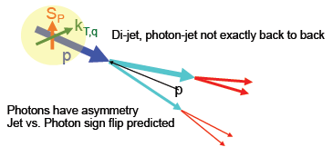
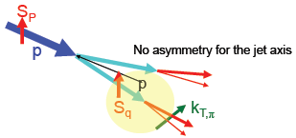
Confined motion in a polarized nucleon
Quantum correlation between hadron spin and parton motion:
Observed
particle
Sivers effect – Sivers function
o
Hadron spin influences
parton’s transverse motion
Quantum correlation between parton spin and hadronization:
Transversity
Collins effect – Collins function
Observed
particle
Parton’s transverse spin
influence its hadronization
JLab12 and COMPASS for valence, EIC covers the sea and gluon!

Slide 20
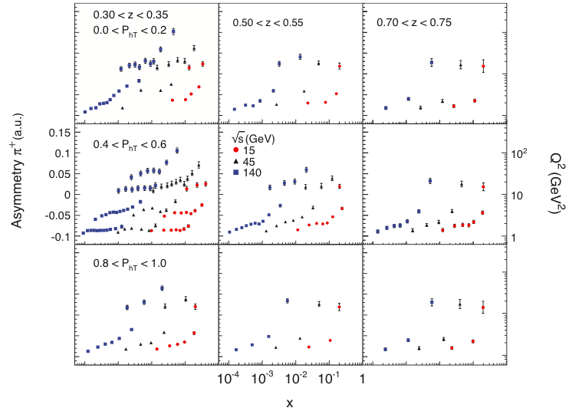
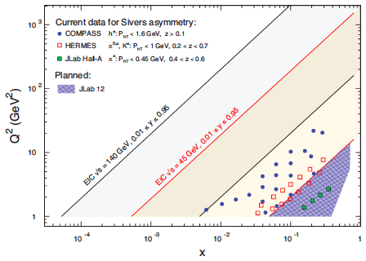
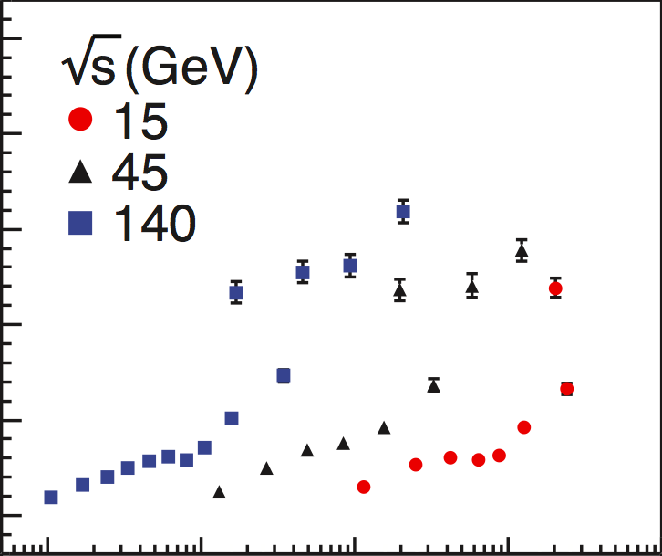
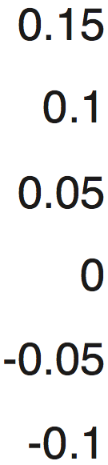






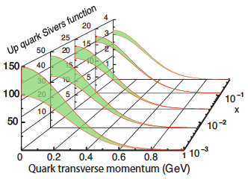
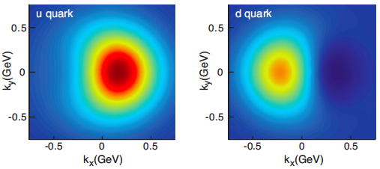
What can EIC do for the Sivers function?
Coverage and Simulation:
10 fb⁻¹
Unpolarized quark inside a transversely polarized proton:
JLab12
For
Large-x
x=0.1
No other machine in the world can do this!

Slide 21
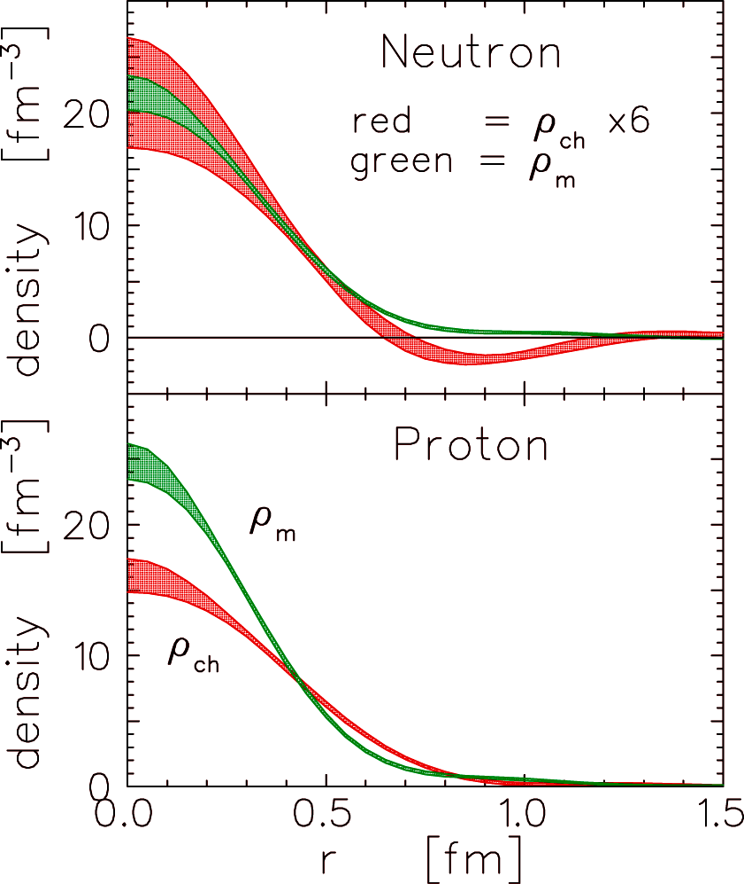
How is color distributed inside the proton?
Electric charge distribution:
Elastic electric form factor
Charge distributions
empirical quark transverse densities in Neutron
ρ_{T}
ρ₀
densities : Miller (2007); Carlson, Vanderhaeghen 2007)
induced EDM : d_{y} = F_{2n} (0) . e / (2 M_{N})

Slide 22
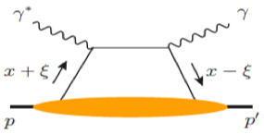
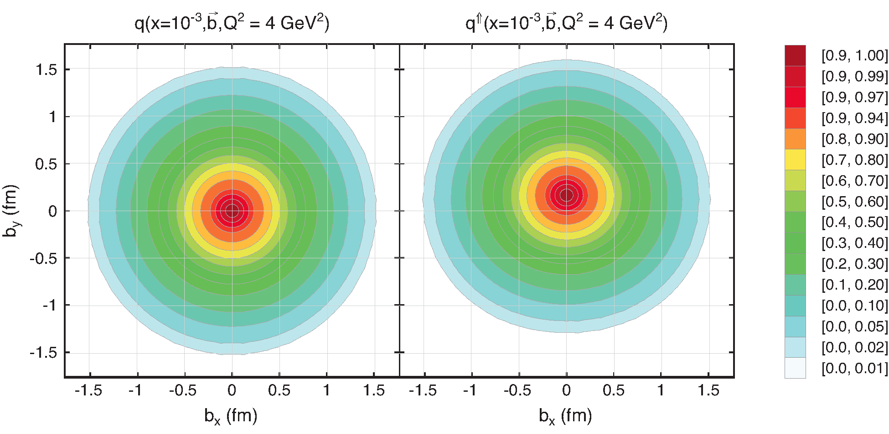
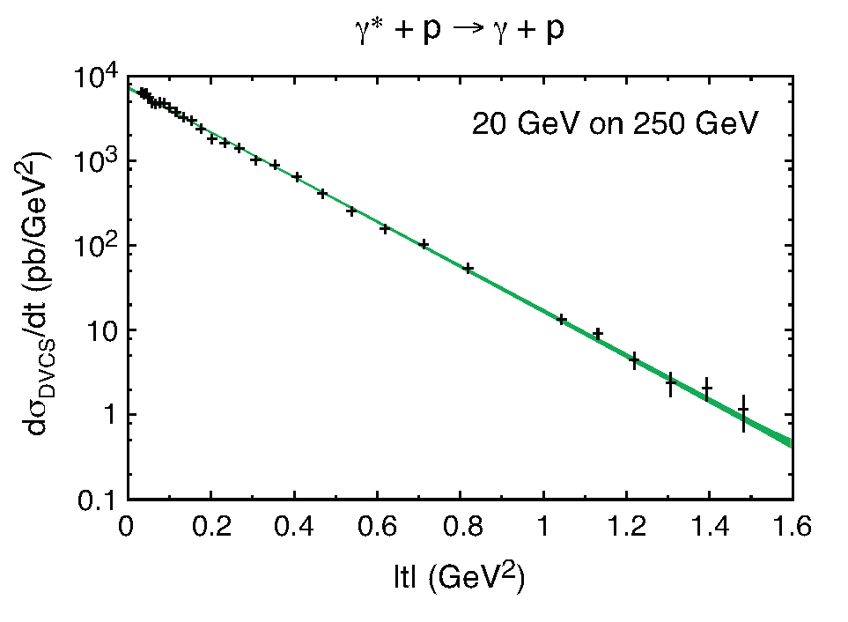
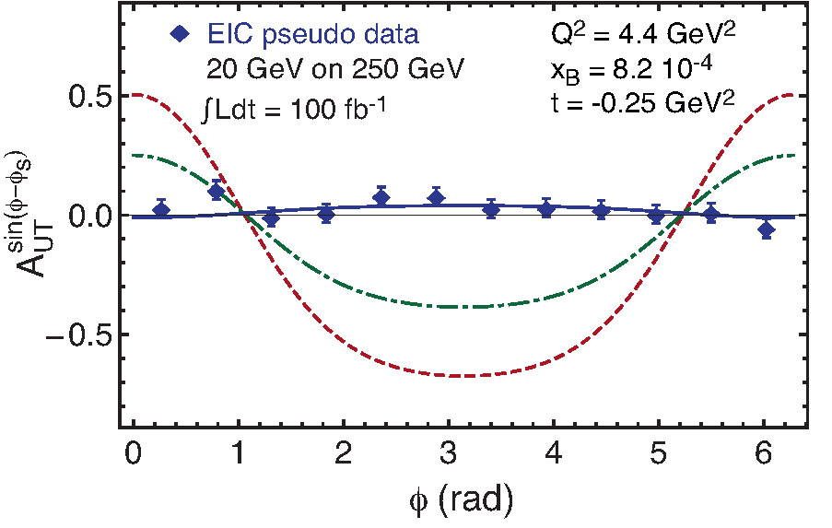
Spatial imaging of sea quarks
EIC: Sea quarks
Exclusive processes - DVCS:
CFFs→GPDs
F.T. of t-dep
Spatial distributions
t-dep
JLab 12: Valence quarks
EIC: Sea quarks
How about the glue?

Slide 23
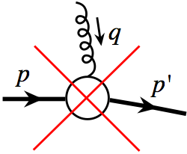
A big question!
How is color distributed inside a hadron? (clue for color confinement?)
Unfortunately NO color elastic nucleon form factor!
Hadron is colorless and gluon carries color
What to do?

Slide 24
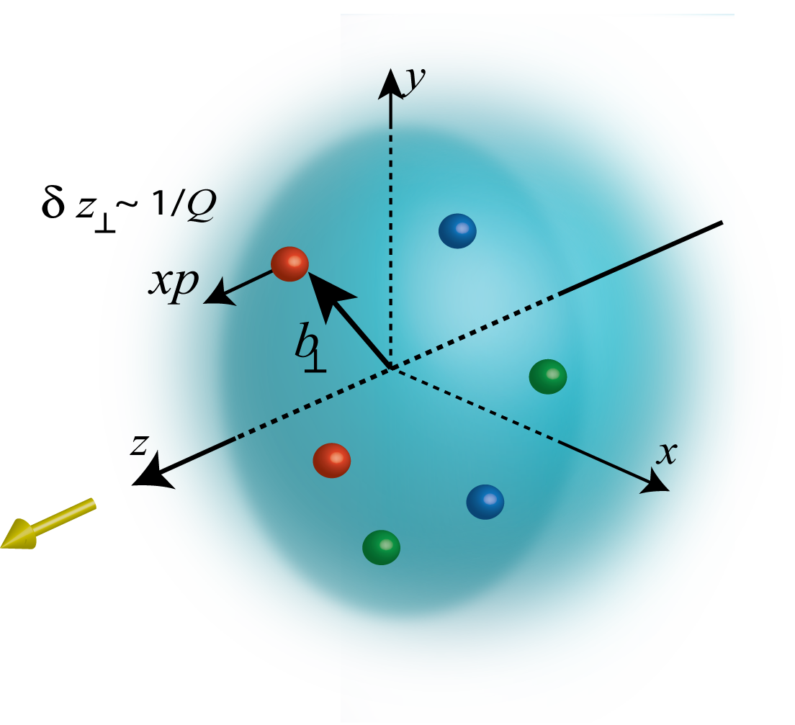
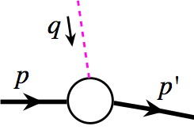
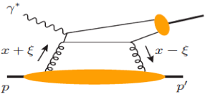
Spatial imaging of gluons
Need Form Factor of density operator:
Exchange of a colorless “object”
“Localized” probe
Control of exchanged momentum
Exclusive vector meson production:
Q
J/Ψ, Φ, …
Fourier transform of the t-dep
Spatial imaging of glue density
Resolution ~ 1/Q or 1/M_{Q}
t-dep

Slide 25
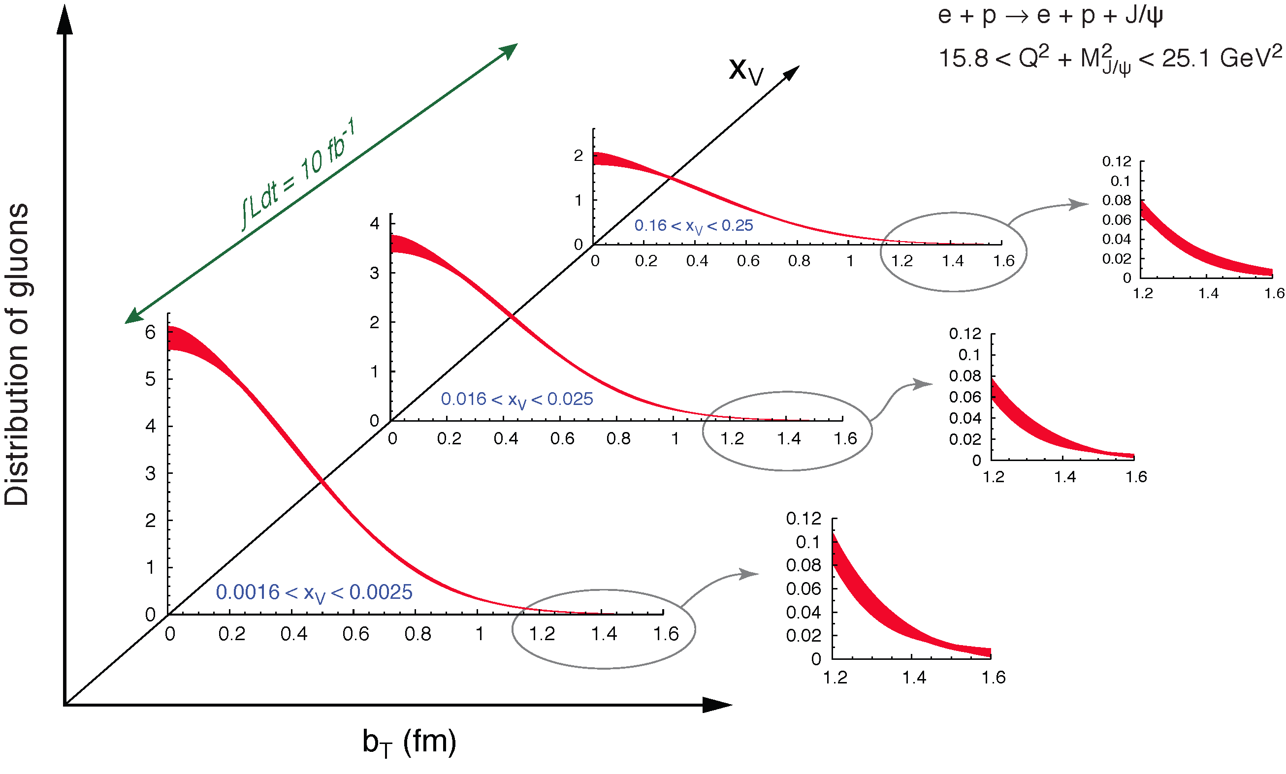

Spatial imaging of gluon density
Gluon imaging from simulation:
Images of gluons
from exclusive
J/ψ production
Only possible at the EIC: From the valence quark region
deep into the sea quark region

Slide 26
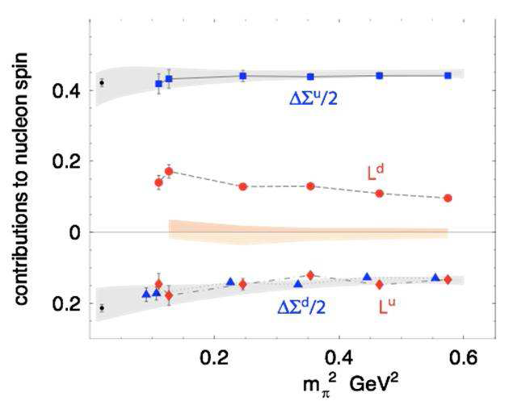
A direct consequence!
Quark GPDs and its orbital contribution to the proton spin:
The first meaningful constraint on quark orbital contribution to proton spin
by combining the sea from the EIC and valence region from JLab 12
This can be checked by Lattice QCD.
L_{u}+L_{d}~0
Rapid developments on ideas
of calculating parton distribution functions on Lattice:
X. Ji et al. arXiv 1310.4263; 1310.7471; 1402.1462
& Y.-Q. Ma, J.-W. Qiu 1404.6860

Slide 27
Physics opportunities at EIC
Machine parameters
Collision energy:
Luminosity:
Polarized proton and various nuclei
Upgradable to
10³³⁻³⁴ cm⁻² s⁻¹ (compare to HERA luminosity ~ 5x10³¹ cm⁻² s⁻¹ )
Key Deliverables
Deliverables | Observables | What we learn
Sea/gluon x~10⁻² -10⁻⁴ S.F. | Inclusive DIS at low-x, in e-p | Sea/gluon contrib. to proton spin, flavor separation
Polarized and unpolarized TMDs | SIDIS e-p, single hadron, Dihadron and heavy flavors | 3D momentum images of quarks and gluons
Sea quarks and gluon GPDs | DVCS, Exclusive J/Ψ, ρ,φ production | Spatial images of sea and gluon, angular mom. J_{q} , J_{g}
Weak mixing angle | PV asymmetries in DIS | EW symmetry breaking, BSM

Slide 28
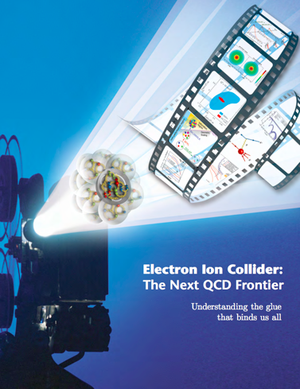
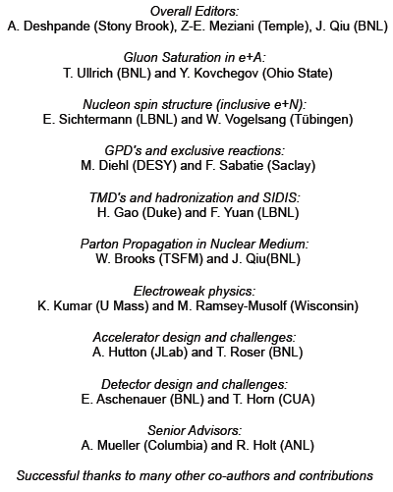
U.S.-based EICs – the White Paper
arXiv:1212.1701
Appointed by
S. Vigdor (BNL) and
R. McKeown (Jlab)

Slide 29
Summary
EIC is “the” machine to understand the glue that bind us all
It is “the” brightest sub-femtometer scope to ANSWER fundamental questions in QCD in ways that no other facility in the world can
Extends the QCD programs developed at BNL and JLab in dramatic and fundamentally important ways
EIC would benefit fundamental nuclear science and accelerator / detector technology
“It is by the solution of problems that the investigator tests the temper of
his steel; he finds new methods and new outlooks, and gains a wider and freer
horizon.”
D. Hilbert Paris, 1900

