Slide 1
RHIC and LHC Overview:
Where are we? Where are we going?
QCD Town Meeting
September 12th, 2014
W.A. Zajc
Columbia University

Slide 2
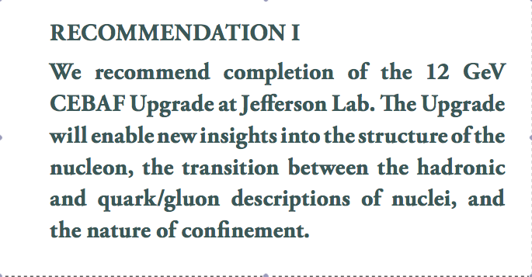
2007 Long Range Plan Recommendations
Ongoing

Slide 3

2007 Long Range Plan Recommendations
Ongoing

Slide 4
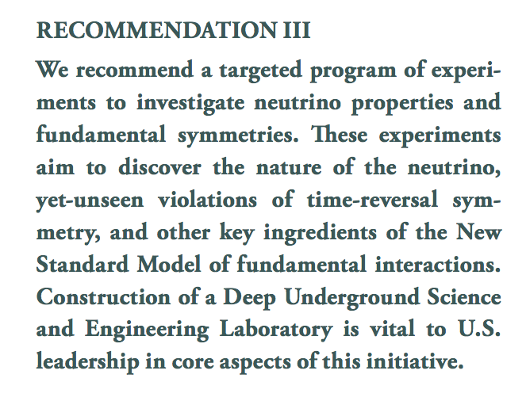
2007 Long Range Plan Recommendations
A complicated story…

Slide 5
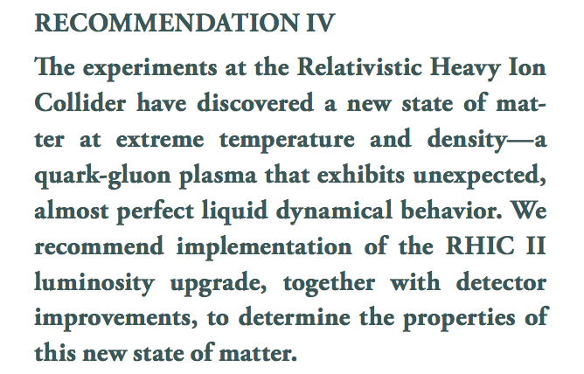
2007 Long Range Plan Recommendations
DONE!

Slide 6
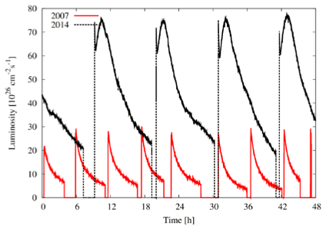
To Be Completely Clear :
RHIC II Luminosity Upgrade
“determine the properties of the matter”
Most importantly:
DONE!
RHIC II Luminosity
Design Luminosity
Underway
DONE! ≠ Finished!

Slide 7
Where Are We?

Slide 8
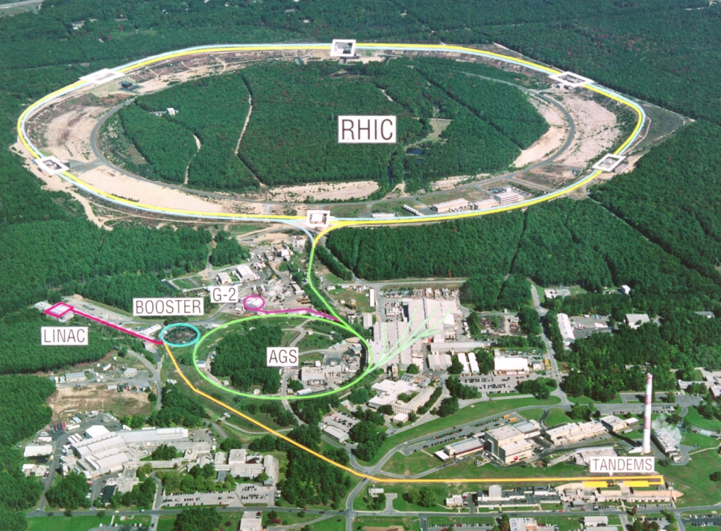
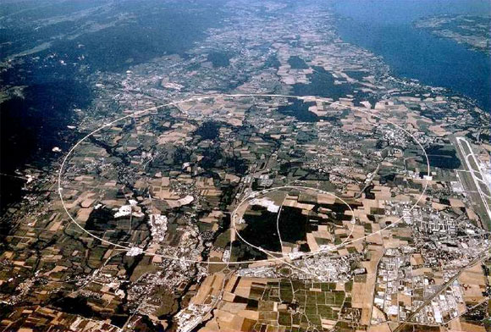
Opened New Energy and Intensity Frontiers
RHIC → RHIC II
LHC
First collisions 2000
p+p, d+Au, Cu+Cu,
Cu+Au, Au+Au, U+U
√s_{NN} ~ 7 – 200 GeV
Polarized protons
First collisions 2010
p+p, Pb+Pb, p+Pb
√s_{NN} =2.76 TeV
(5.5 TeV in 2015-16)

Slide 9
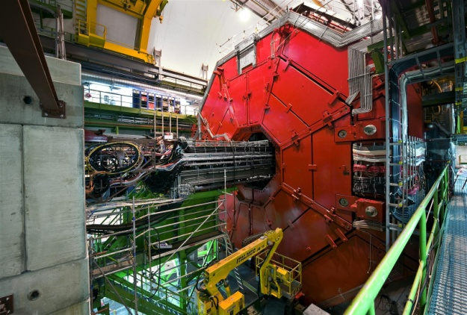
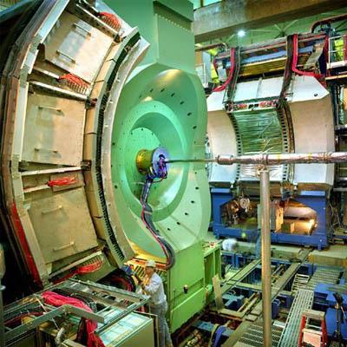
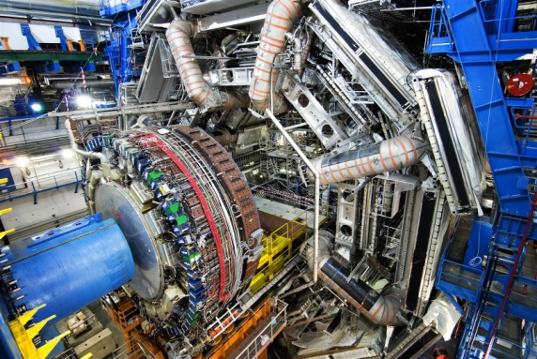
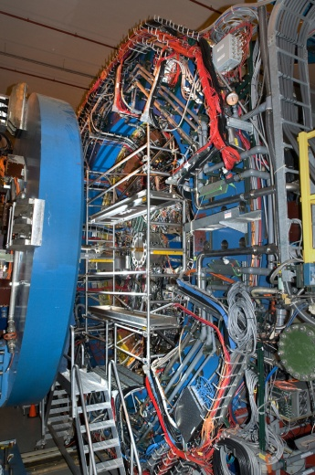

Five Experiments
RHIC
LHC
PHENIX
STAR
ALICE
ATLAS
CMS

Slide 10
The First LHC Heavy Ion Discovery
The matter produced in LHC collisions exhibits the same qualitative features discovered at RHIC:
  Strong
  hydrodynamic flow
  Strong
  quenching of high momentum particles

Slide 11
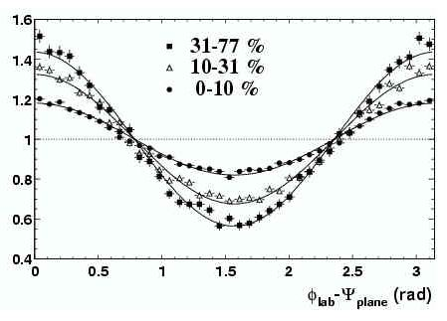
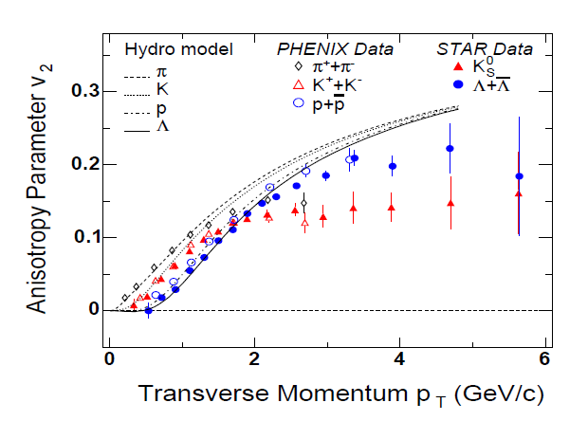

An Aside on Nomenclature
φ
RHIC discovery
  The initial state azimuthal asymmetry
  produces a strong signal in the
  final state
  particle
  emission
  pattern dn/dφ ~ 1 + 2 v₂(p_{T}) cos (2 φ) + ...
y
z
x
2v₂
φ

Slide 12
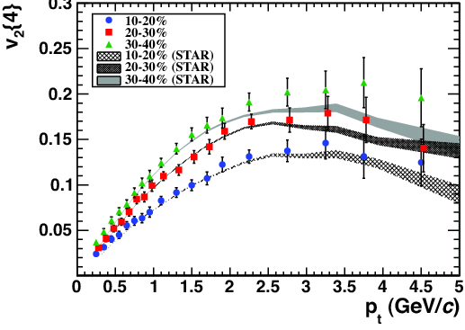
The First LHC Heavy Ion Discovery
The matter produced in LHC collisions exhibits the same qualitative features discovered at RHIC:
  Strong
  hydrodynamic flow
  RHIC and LHC
  data
  well-described
  by relativistic
  viscous
  hydrodynamics
CMS, Phys. Rev. C87, 014902 (2013)

Slide 13
Theoretical Discovery 2003-4
An estimate (bound?) on viscosity appeared from string theory’s AdS/CFT correspondence:
  A Viscosity Bound Conjecture,
  P. Kovtun, D.T. Son, A.O. Starinets,
  hep-th/0405231 (1300+ citations!)
Fundamental measure of strong coupling
Cleanest result from gauge/gravity duality
A measure of “quantum liquidity”

Slide 14
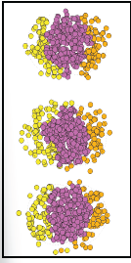
2010: The Noise Is The Signal
Importance of higher harmonics
dn/dφ ~ 1 + 2 v₂(p_{T}) cos (2 φ) + ...
B. Alver and G. Roland, Phys. Rev. C81, 054905 (2010)

Slide 15
2010: The Noise Is The Signal
Importance of higher harmonics
dn/dφ ~ 1 + 2 v₂(p_{T}) cos (2 φ)
+ 2 v₃(p_{T}) cos (3 φ)
+ 2 v₄(p_{T}) cos (4 φ) + …
Fluctuations critical for determining
allowed range of η/s .
Persistence of “bumps”➔small η/s !
B. Alver and G. Roland, Phys. Rev. C81, 054905 (2010)

Slide 16
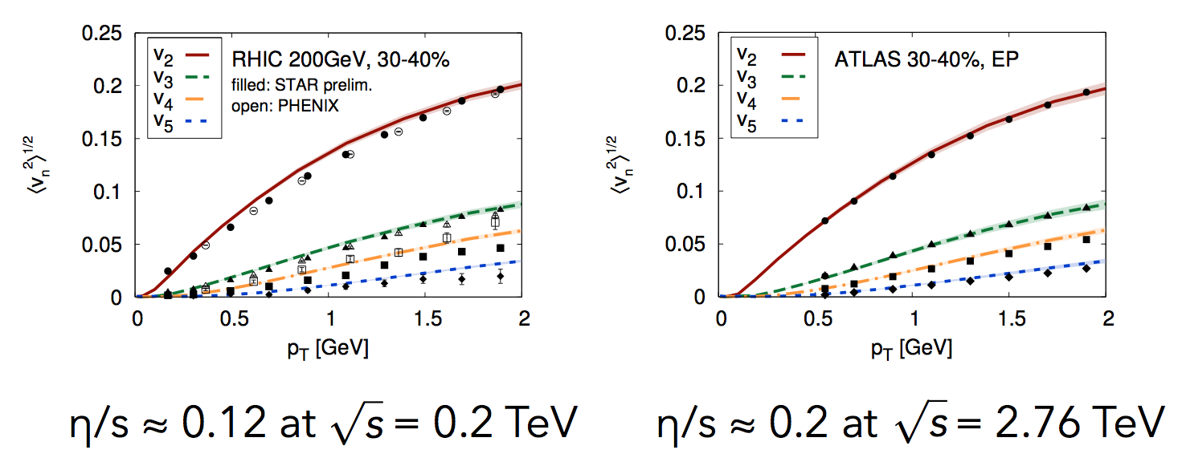
Higher Harmonics Used to Determine η/s
The fundamental matter formed at RHIC and the LHC is within a factor of 3 of KSS bound(!)
≈ 1.5 x KSS Bound
≈ 2.5 x KSS Bound
C. Gale, S. Jeon, B. Schenke, P. Tribedy, R. Venugopalan, Phys. Rev. Lett. 110, 012302 (2013)

Slide 17
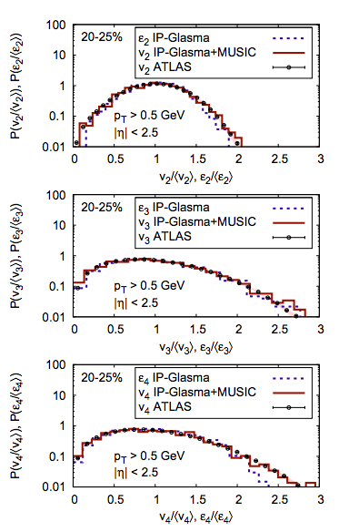
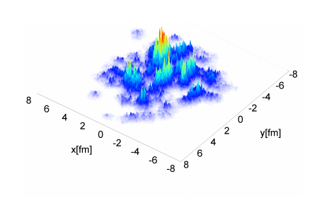
Measuring and Predicting the Fluctuation Spectrum
C. Gale et al., Phys. Rev. Lett. 110, 012302 (2013)
B. Schenke, P. Tribedy and R. Venugopalan, Phys. Rev. Lett. 108, 252301 (2012)

Slide 18
Power of Hydrodynamics
“Fine structure” (mass ordering) in hydrodynamic response predicted for π, K, p, Ξ, Ω :

Slide 19
An Ahistorical Motivation
Small value of η/s:
  Persistence of v_{n} up to n ~ 4-5
  Each 1/n-th part of the initial state flows
  Test this by studying small systems
Ahistorical: in reality flow in small systems
was discovered by experimentalists at the LHC

Slide 20
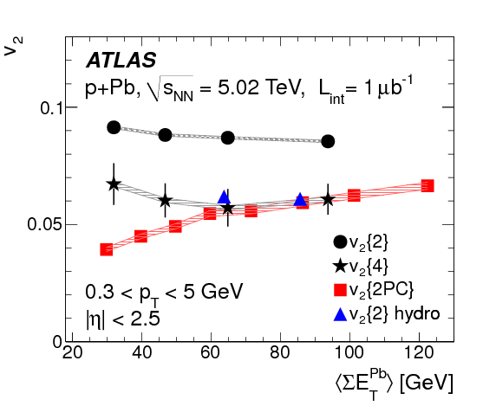
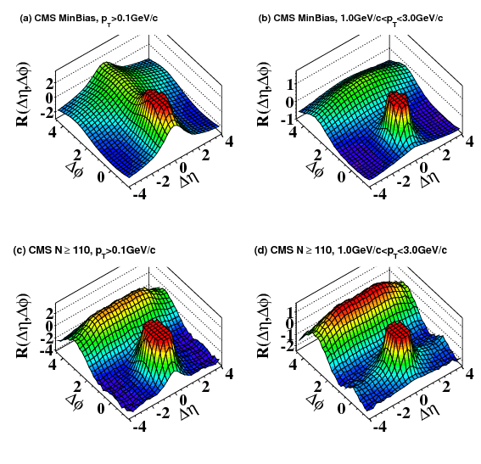
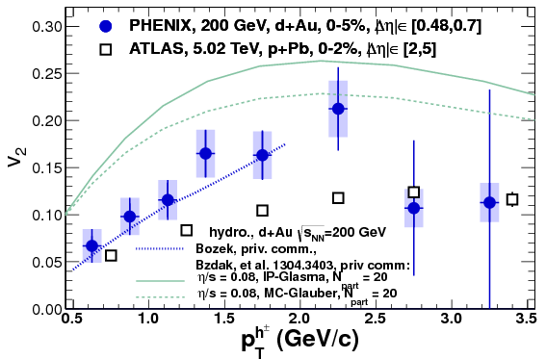
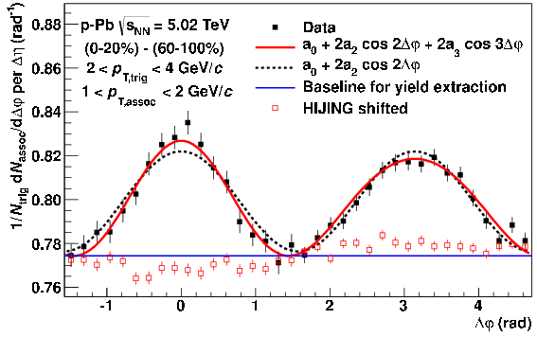
Discovery: Hydrodynamic Ubiquity
Flow signatures
observed
in smallest
flecks of matter!
Collisions of:
  p+p
  p+Pb,
  d+Au
CMS, JHEP 1009, 091 (2010)
ATLAS, Phys. Lett. B725, 60 (2013)
PHENIX, Phys. Rev. Lett. 111, 21 (2013)
ALICE, Phys. Lett. B719, 29 (2013)

Slide 21
The First LHC Heavy Ion Discovery
The matter produced in LHC collisions exhibits the same qualitative features discovered at RHIC:
  Strong
  hydrodynamic flow
  Strong
  quenching
  of high momentum
  particles

Slide 22
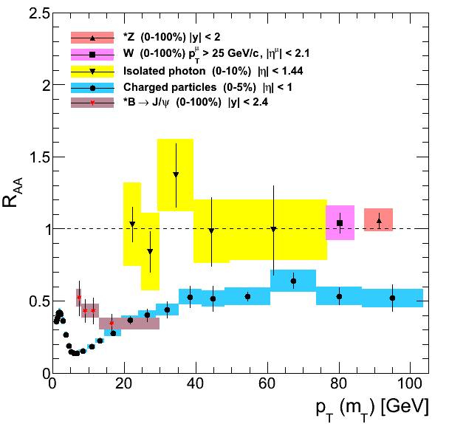
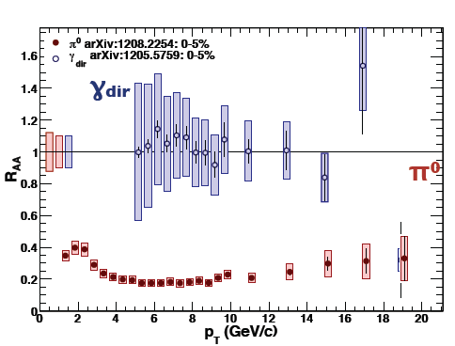
More Nomenclature
0-th order observable :
for high pT diagnostics:
1st, 2nd, 3rd order:
  Differential studies versus: impact parameter, reaction plane, away-side partner;
  flavor tagging, tagged photons, complete jet reconstruction…
Enhanced
Suppressed

Slide 23
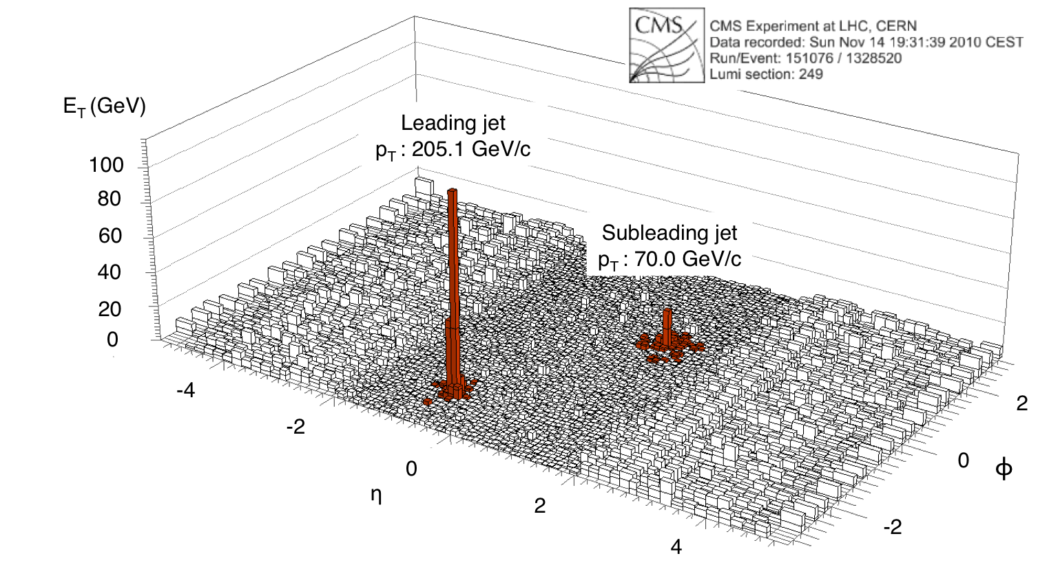
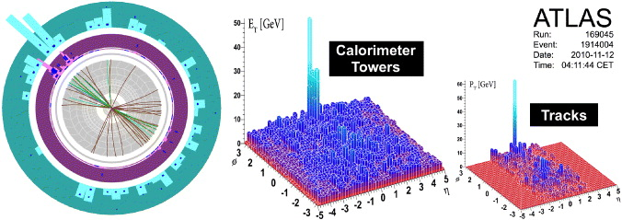
New Heavy Ion Physics at the LHC
Huge
(and hugely visible)
modifications to jets
in Pb+Pb collisions

Slide 24
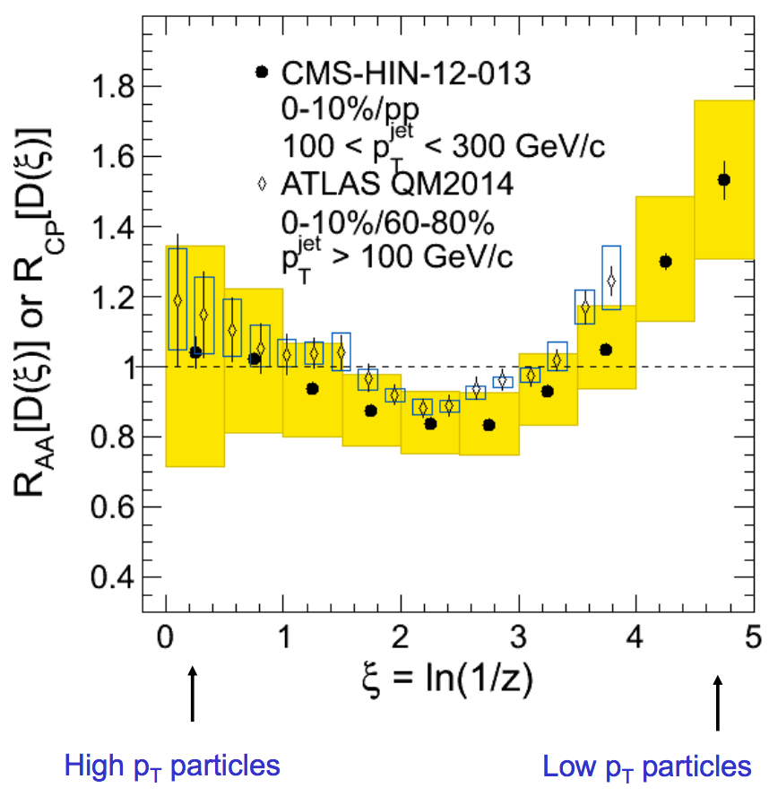
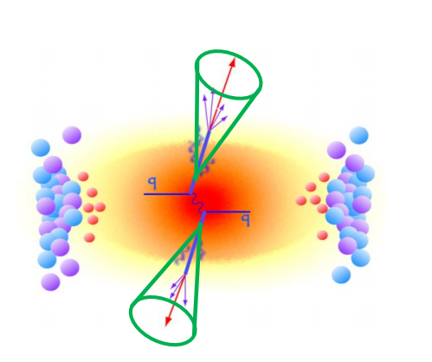
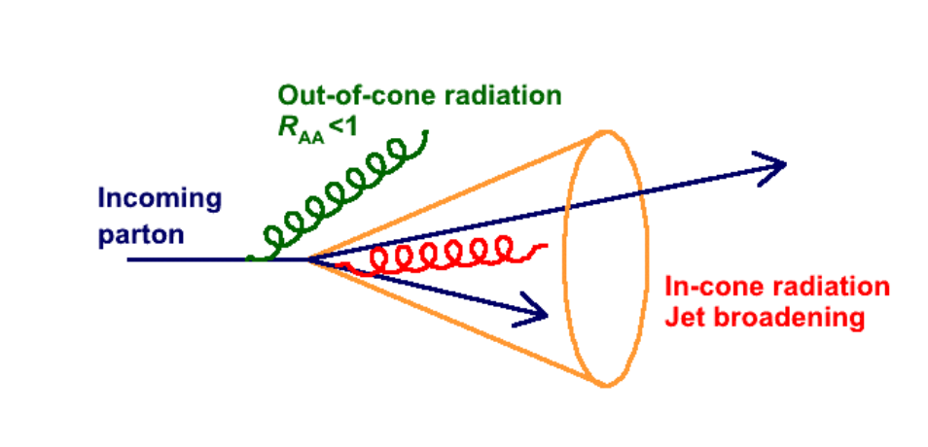
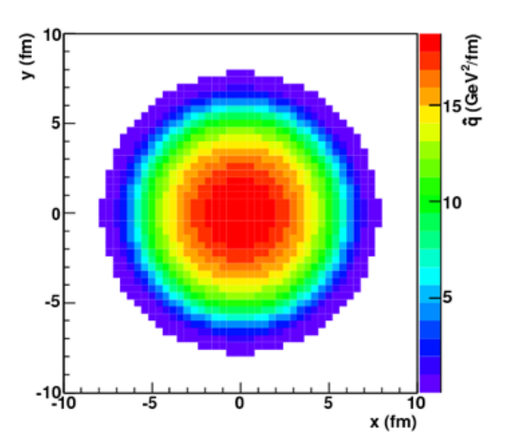
Modifications to Jet Fragmentation
Yen-Jie Lee, QM14
Extensive world data on
fragmentation functions
D(z) in vacuo
Complete
jet reconstruction
in heavy ion collisions
→ in medium D(z)
Compelling need for
precision study versus
  System size, √s, orientation,
  with photon-jet, b-tagging, …
  To understand jet-medium coupling → degrees of freedom in the medium

Slide 25
Surrounded By New Frontiers
Heavy ion collisions at the LHC opened a fascinating new energy frontier in the field
  Push towards temperatures and densities
  even closer to the early universe
  than 200 GeV RHIC collisions
  (Even smaller values of μ_{B}/T )
There is an equally compelling frontier at
lower energies
  Deliberately increase the value of μ_{B}/T
  Search for a fundamental feature of thermal QCD:
  The critical end point and change to 1st order phase transition

Slide 26
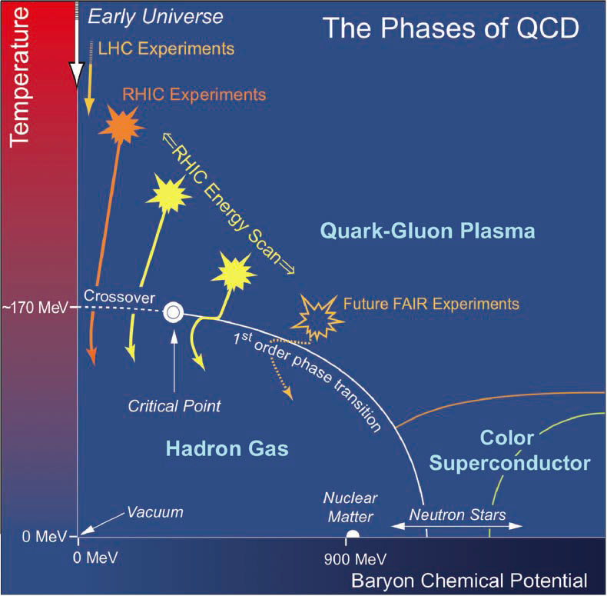
√s Varies a True Control Parameter: μ_{B}
Emphasis
in first part
of this talk:
  “Recreating
  conditions
  in the early
  universe”
  with μ_{b}/T <<1
  A subset of
  “exploring
  the QCD
  phase diagram”

Slide 27
√s Varies a True Control Parameter: μ_{B}
Emphasis
in first part
of this talk:
  “Recreating
  conditions
  in the early
  universe”
  with μ_{b}/T <<1
  A subset of
  “exploring
  the QCD
  phase diagram”

Slide 28
√s Varies a True Control Parameter: μ_{B}
Beam Energy
Scan at RHIC
  Only at RHIC !
    Note:
    COLLIDER →
    complete control of
    systematics vs. √s
  Range explored
  to date
    Note:
    horizontal position
    accurate;
    vertical position
    schematic
  “Exploring
  the QCD
  phase diagram”
  in search of the
  critical point
200
39
27
19.6
11.5
7.7

Slide 29
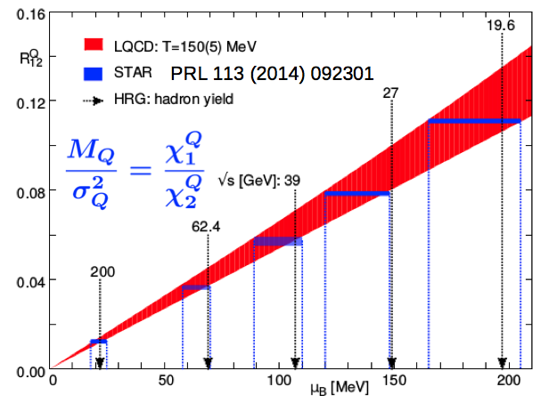
Our GPS on the Phase Diagram
Translate √s to μ_{B} by:
  Standard approach (to date):
    Model observed particle abundances
    using known states and assuming
    thermal equilibrium to
    determine T, μ_{B} and μ_{S}.
    Vertical black lines on plot
  21st century approach:
    Use LQCD results compared
    to experimental observable
    (scaled charge fluctuations)
    to translate observable to μ_{B}.
  Impressive agreement
BNL-Bielefeld: Phys. Rev. Lett. 109, 192302 (2012)

Slide 30
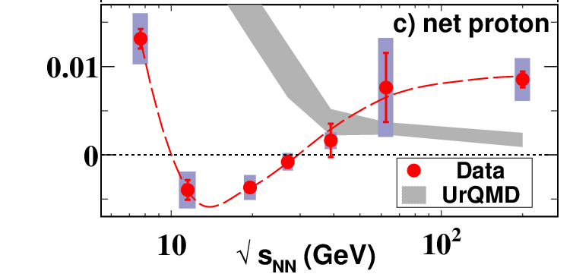
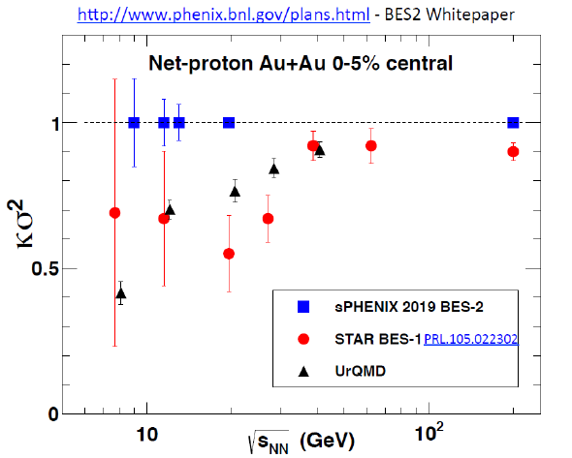
Results from Beam Energy Scan I
Systematic study of
various quantities
as function of √s:
  Source radii
  Directed flow v₁
  Scaled kurtosis
  (baryon fluctuations)
Suggestive non-monotonic
behavior at a ~common √s
Compelling need for
RHIC Beam Energy Scan II
  Greatly increase statistical precision
  Additional √s points
dv₁/dy|_{y=0}

Slide 31
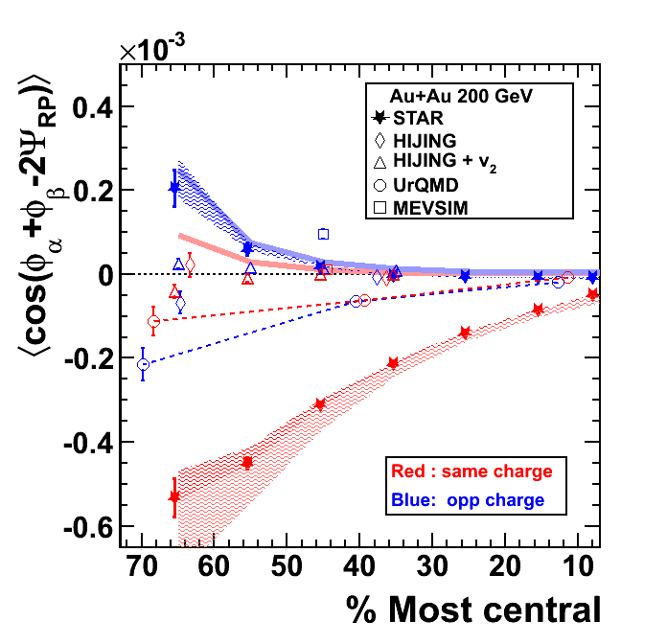
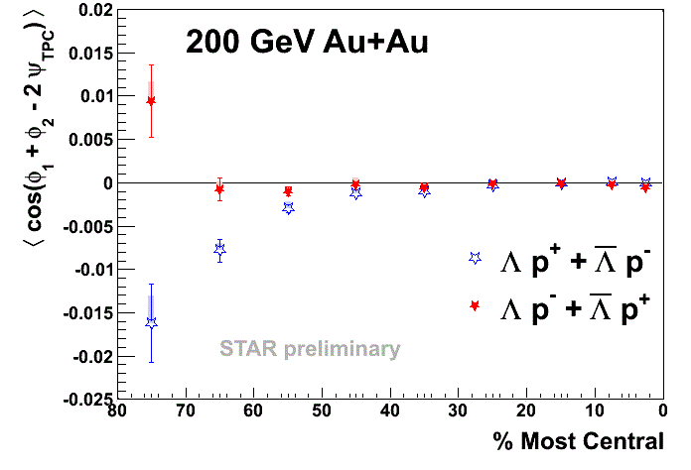
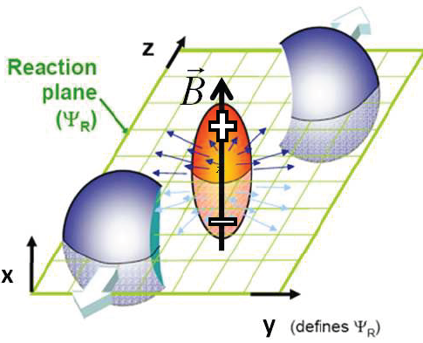
Search For QCD Anomalies
Possible formation of parity-odd domains…
Coupled with
  Strong B-field → Charge separation
  (Chiral Magnetic Effect)
  Fluid vorticity → Baryon # separation
  (Chiral Vortical Effect)
Direct contact with topologically
non-trivial phases in
condensed matter physics
  Simons Center: Quantum Anomalies, Topology and Hydrodynamics

Slide 32
Summary: Where Are We?
Since the last Long Range Plan, we have
  Opened a new energy frontier – the LHC
  Begun exploration of QCD phase diagram - RHIC
  Developed sophisticated multi-scale models
  Discovered hydrodynamic flow in small systems
  Discovered the critical role of fluctuations
  Extended connections to other fields
Where are we?
  We are in the midst of a paradigm shift in our quantitative understanding of thermal QCD

Slide 33
Where Are We Going?

Slide 34
Why “Done!” ≠ “Finished!”
To date:
  Data from RHIC and LHC
  together with
  Mature and sophisticated theoretical modeling…
Tell us what the QGP does.
Yet we have only very limited insight into
How the QGP does it.
  Creates near-perfect fluidity
  Approaches first order phase transition
  Modifies jet fragmentation
  Many other observed signals…

Slide 35
Key Science Drivers For The Next Decade
How does the perfect liquid behavior emerge from the short-distance degrees of freedom?
What conditions produce the most nearly perfect liquid behavior?
Is there a critical end point and change to a
1st order phase transition in the QCD phase diagram?
Which mechanisms or conditions drive
early thermalization in nuclear collisions?
Can the effects of quantum anomalies be detected in the final state?

Slide 36
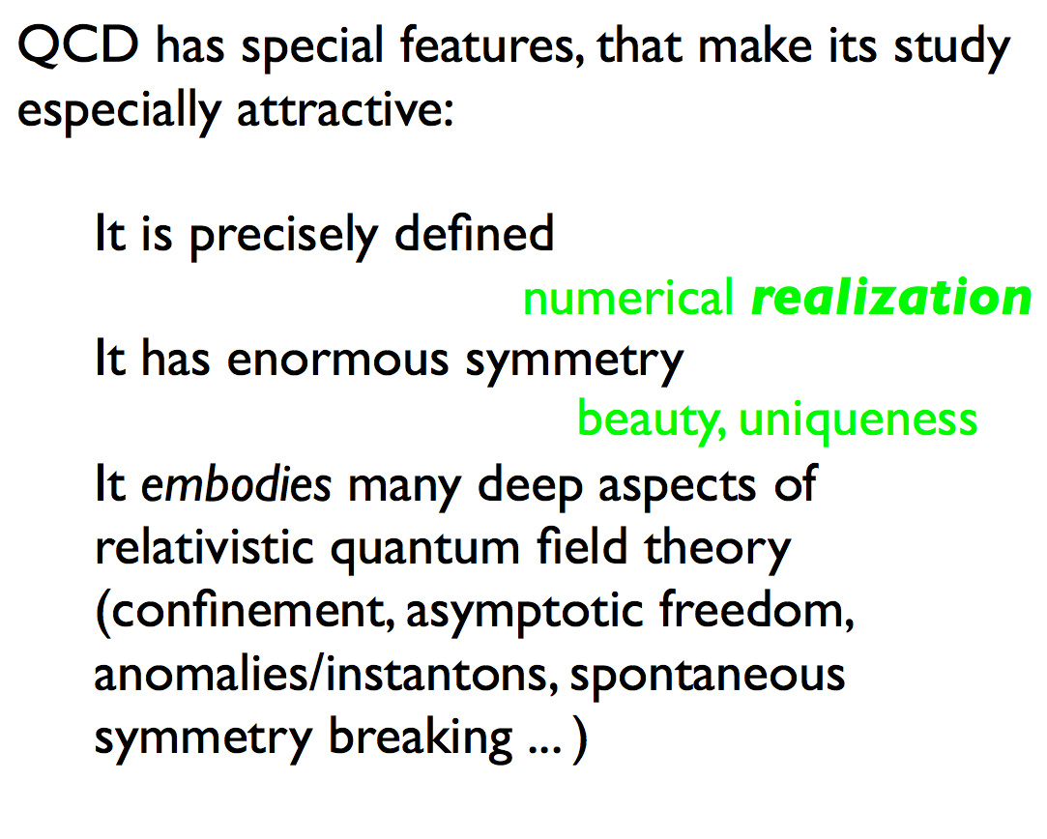
Wilczek, 2014
Quarks (and Glue) at the Frontiers of Knowledge

Slide 37
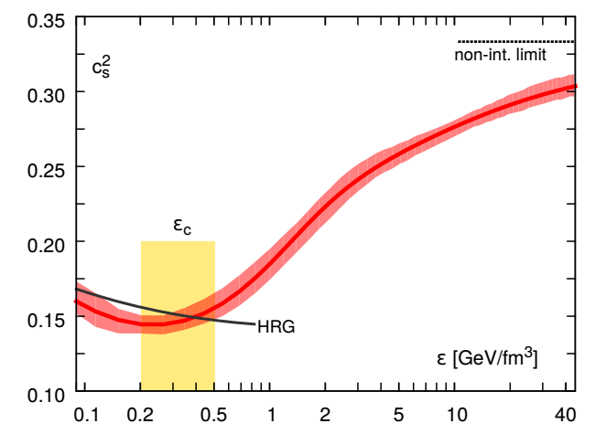
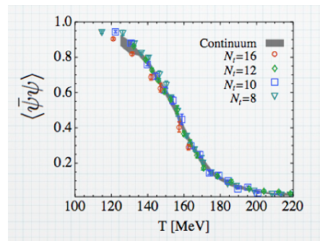
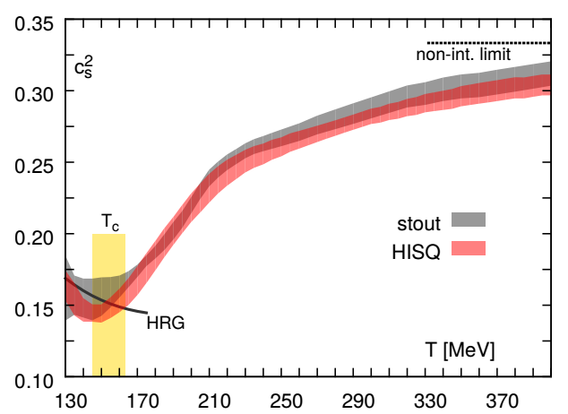
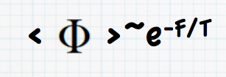
Latest Lattice Gauge Results
Now a reliable guide (calculation) of many (static) medium properties:
  Chiral symmetry restoration Equation of State
HotQCD, arXiv:1407.6387

Slide 38
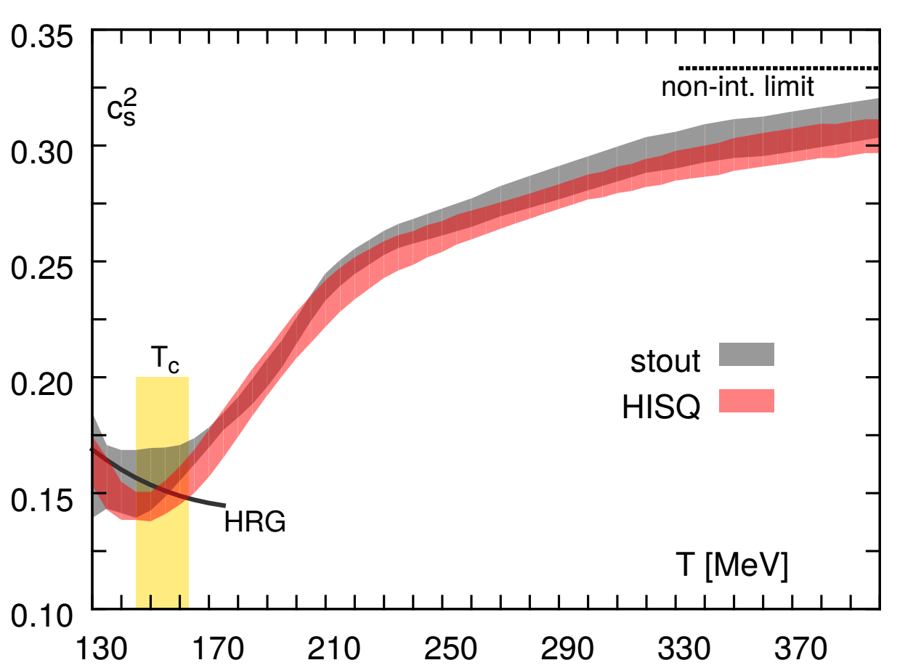
Cross Fertilization (1)
Model Emulations
  Parameterize dependence of model outputs on input parameters via “Gaussian Process emulators”.
Determining Fundamental Properties of Matter Created in Ultrarelativistic Heavy-Ion Collisions, J. Novak et al., arXiv:1303:5769

Slide 39
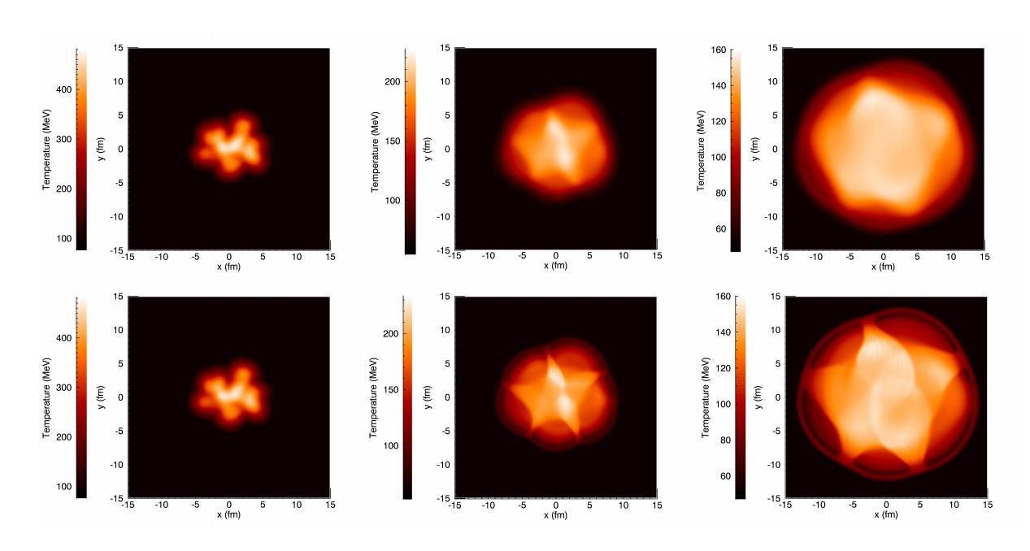
Cross Fertilization (2)
ECHO-QGP: Based on existing astrophysics code ECHO:
  Eulerian Conservative High Order scheme for relativistic magnetohydrodynamics in arbitrary GR background
Del Zanna et al. Astron.Astrophys., 473:11–30, 2007
Dell Zanna et al., Eur.Phys.J.,C73:2524, 2013

Slide 40
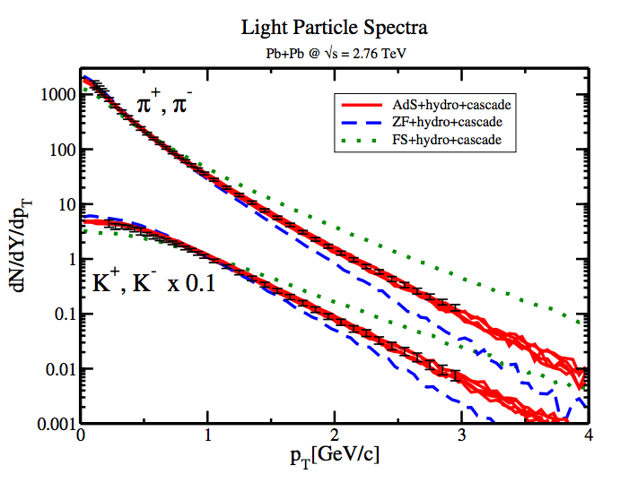
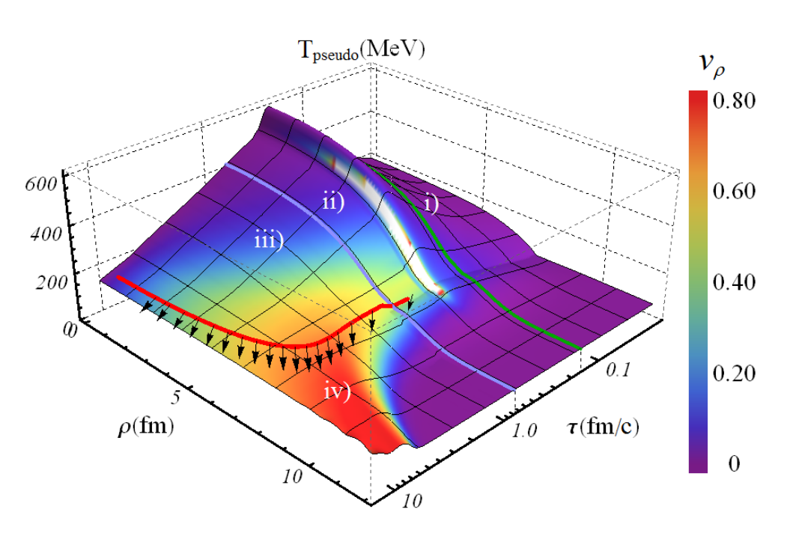
Cross Fertilization (3)
Numerical relativity
  Hybrid model with
    Pre-equilibrium: numerical relativity in Anti de Sitter space
    Mid-stage: Viscous hydrodynamics
    Final stage: Kinetic theory transport
A fully dynamical simulation of central nuclear collisions, W. van der Schee, P. Romatschke and S. Pratt, arXiv:1307.2539

Slide 41
Wise Advice
“QCD is an especially difficult theory in which to investigate this issue, and were it not for the data we would have no good intuition for the physics.”
The Pomeron and Gauge/String Duality, R. Brower, J. Polchinski, M. Strassler and C.I. Tan, hep-th/0603115

Slide 42
RHIC / LHC Timeline
1 Month Ion Running
11/2015, 11/2016, 6/2018
1 Month Ion Running
11/2020, 11/2021, 12/2022
LHC
End of
Long Shutdown 1
Long Shutdown 2 7/18-12/19
2015
2020
>2025
eCooling
LS2
sPHENIX
Installation
Shutdown 2017
Installation
Shutdown 2020
Electron-Ion Collider
RHIC
2014-2016
Heavy Flavor Probes of QGP
2018-2019
Beam Energy Scan II
2021-2022
Precision jets
and quarkonia

Slide 43
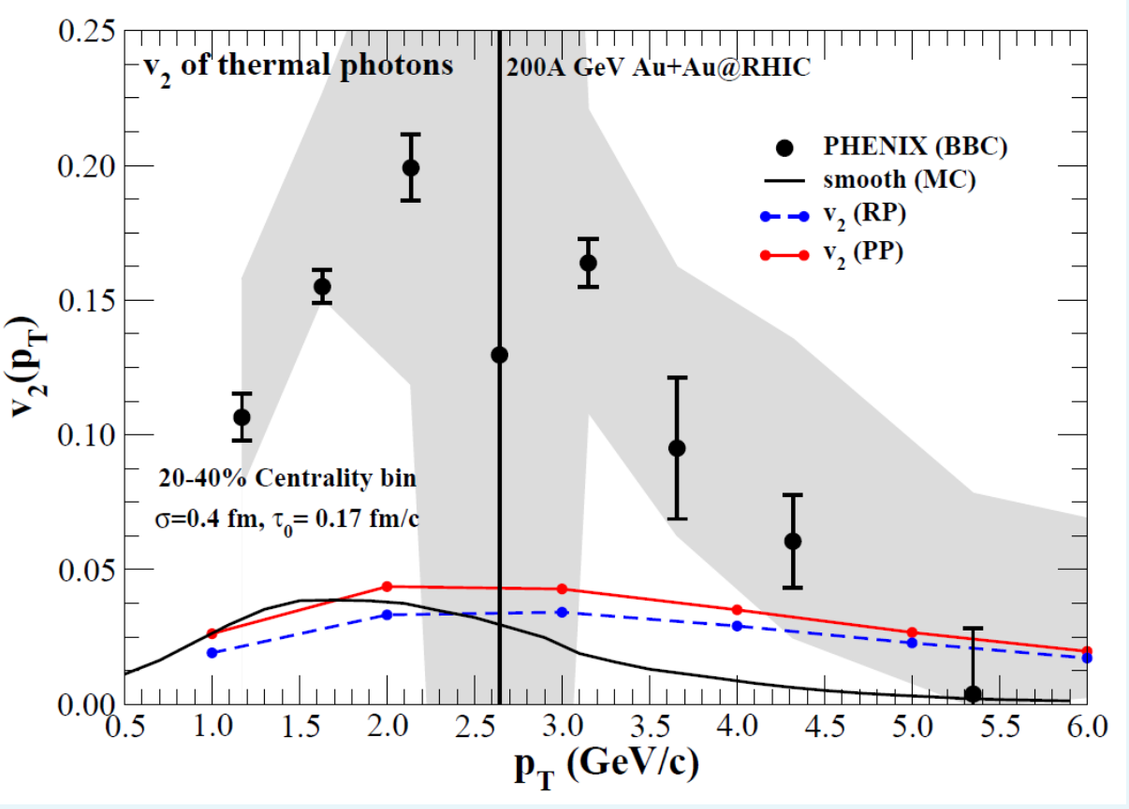
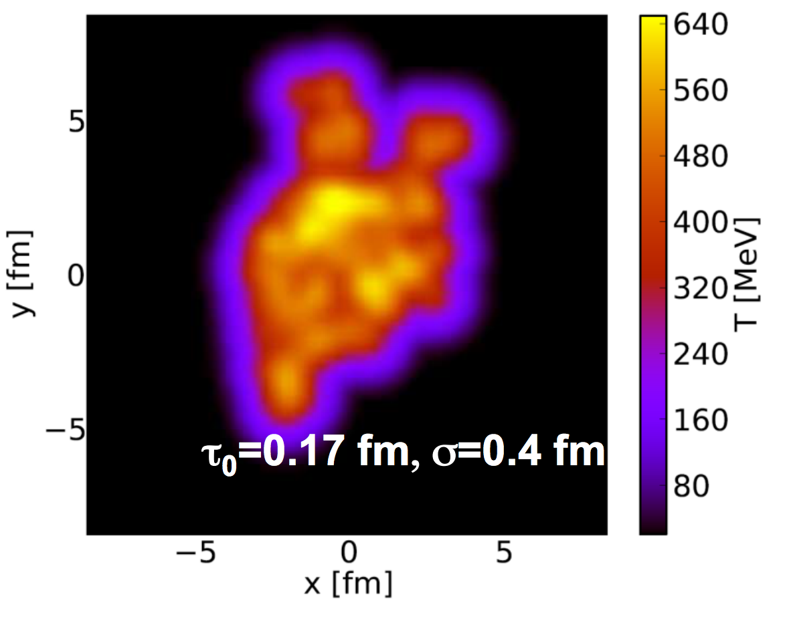
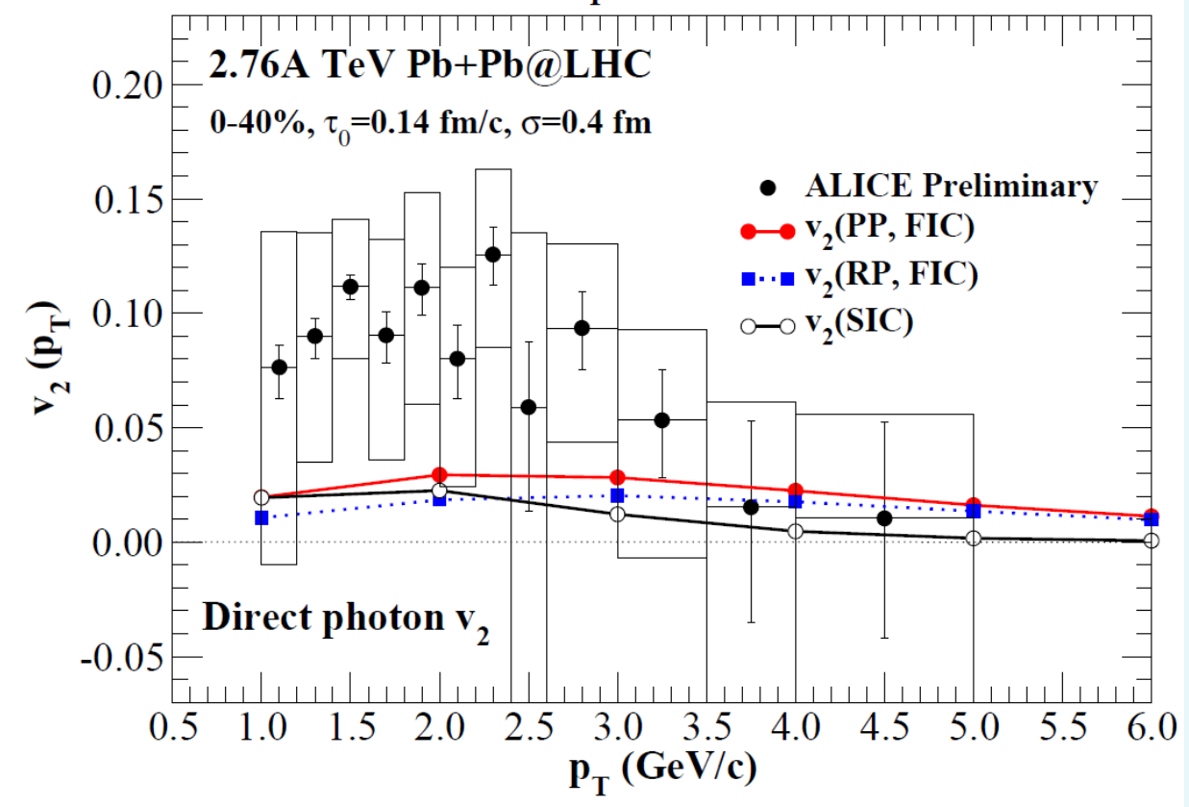
A (Deep) Puzzle to Solve: Photon Flow Signal
Photons show no
energy loss but have
a strong flow signal
Luminosity-hungry measurements
are needed to resolve this
challenge to our “standard model”
R. Chatterjee et al., Phys. Rev. C88, 034901 (2013)

Slide 44
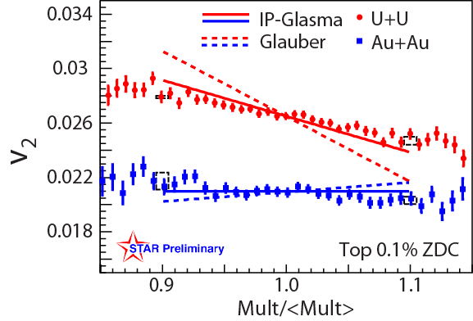


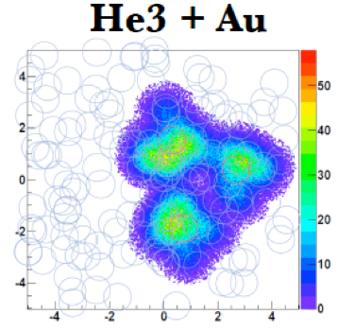

Tools and Techniques
Deliberate distortion
of initial state
  U+U collisions
Deliberate injection
of granularity
  ³He+Au collisions

Slide 45
Plasma Diagnostics
Needed: Tools to interrogate QGP at small distances
Intrinsic scales of the QGP:
  T ~ 200 MeV
  gT ~ 500 MeV ~ gluon effective mass
Hard processes provide a wide variety of
perturbative scales:
  M_{c} ~ 1.3 GeV
  M_{b} ~ 4.2 GeV
  M_{W} ~ 80 GeV
  M_{Z} ~ 90 GeV
  Q ~ 10-300 GeV
}

Slide 46
Completing RHIC’s Mission
Goal: to fully understand thermal QCD matter
Organized as 3 campaigns:
  2014-16: Heavy flavor probes of the QGP
  2017: Install low energy e-cooling
  2. 2018-2019: Precision scan of QCD phase diagram
  2020: Install sPHENIX upgrade
  3. 2021-2022: Precision measurements of jets and quarkonia
  In parallel with sustained theoretical studies, modeling and phenomenology

Slide 47



Where Is η/s Minimal ?
What conditions produce the most nearly perfect liquid behavior?
  We know (only) two points in √s :
RHIC
R. Lacey et al., Phys. Rev. Lett. 112, 082302 (2014)

Slide 48

STAR Upgrades for Beam Energy Scan II
Major improvements for BES-II
EPD Upgrade:
Allows a better and independent reaction plane measurement critical to BES physics
iTPC Upgrade:
Rebuilds the inner sectors of the TPC
EndCap TOF Upgrade:
Rapidity coverage is critical for several proposed BES Phase II measurements

Slide 49


sPHENIX Upgrade
Proposed sPHENIX:
  EM+hadronic calorimetry
  over |η| < 1.1
  Re-use existing
  BaBar 1.5T solenoid
  Silicon tracking
  DAQ rate ~ 10 kHz
Will provide full suite of jet and quarkonia data
Maximal overlap with LHC measurements

Slide 50




A Calibrated Length Scale in the Plasma
Wide range of Bohr radii of quarkonium states:
  Ψ’ 0.88 fm → Υ(1s) 0.23 fm
Should lead to sequential melting
(from Debye screening)
2s
1s
3s
arXiv:1404.2246

Slide 51


A Calibrated Length Scale in the Plasma
Wide range of Bohr radii of quarkonium states:
  Ψ’ 0.88 fm → Υ(1s) 0.23 fm
Should lead to sequential melting
(from Debye screening)
sPHENIX
arXiv:1404.2246
Current data

Slide 52

Wilczek, 2014
Quarks (and Glue) at the Frontiers of Knowledge
RHIC
Beam Energy Scan
Precision jet and quarkonia data from RHIC & LHC

Slide 53

Wilczek, 2014
Quarks (and Glue) at the Frontiers of Knowledge
From the suite of RHIC and LHC measurements from strong to weak coupling,
in concert with continued theoretical effort.

Slide 54
Where Are We Going?
Forward in a rich science program designed to answer fundamental questions about the nature of thermal QCD matter.

