Slide 1

Theoretical Issues in Nucleon Structure
Xiangdong Ji
University of Maryland
QCD Town Meeting，
Philadelphia, Sept 15, 2014

Slide 2
Outline
Why is nucleon structure an important scientific problem?
Recent achievements: some examples
Outstanding questions
Looking to the future

Slide 3

Why important

Slide 4
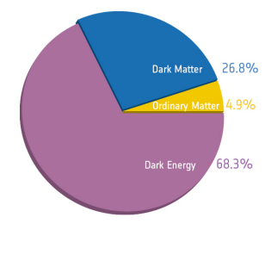
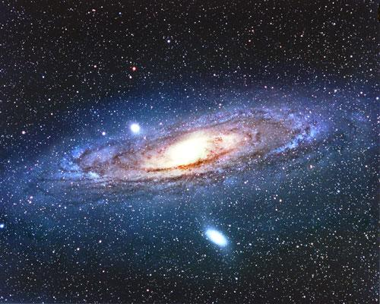
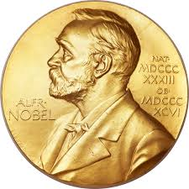
Fundamental building blocks
Protons and neutrons are the fundamental building block of the matter universe.
There have been three Nobel Prizes in physics awarded directly to the discovery of structure of the nucleon!

Slide 5
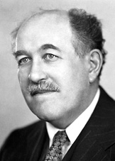
Nobel Prize in Physics 1943
Proton’s magnetic moment
The Nobel Prize in Physics 1943 was
awarded to Otto Stern "for his contribution
to the development of the molecular ray method and his discovery of the magnetic moment of the proton".

Slide 6
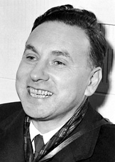
Nobel Prize in Physics 1961
Nucleon EM form factors
and charge radius
The Nobel Prize in Physics 1961 was awarded
to Robert Hofstadter "for his pioneering studies
of electron scattering in atomic nuclei
and for his thereby achieved discoveries concerning
the structure of the nucleons”

Slide 7
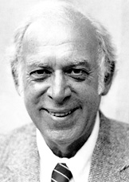
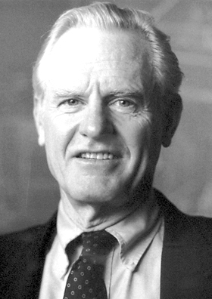
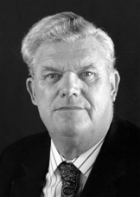
Nobel Prize in Physics 1990
Partonic structure
The Nobel Prize in Physics 1990 was awarded jointly to Jerome I. Friedman, Henry W. Kendall and Richard E. Taylor "for their pioneering investigations concerning deep inelastic scattering of electrons on protons and bound neutrons, which have been of essential importance for the development of the quark model in particle physics".

Slide 8
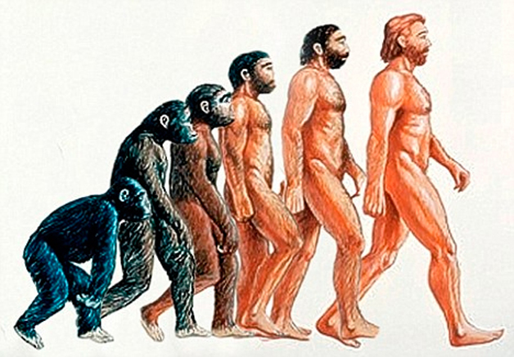

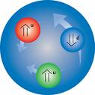
Evolution in Understanding the nucleon
Piont-like particle
Quark model
QCD!

Slide 9
We still don’t understand much about…
How does the nucleon mass emerge from the light quarks dynamically?
Why quarks and gluons are confined inside the nucleon?
How do the fundamental nuclear forces arise from QCD?
We don’t have a comprehensive picture of the nucleon structure as we don’t have an approximate QCD nucleon wave function.
…

Slide 10
Recent progress: some examples

Slide 11
Much has been learnt since 1970’s
Partonic structure of the nucleon and its spin
  DIS and hadron scattering have evolved into a standard tool for exploring the parton structure of the nucleon
Importance of meson D.O.F.
  Through quark sea structure, chiral structure and nuclear effective theory, one has learnt that the mesons play an important role
Rapid theoretical progress in non-perturbative QCD
  Lattice QCD

Slide 12
Feynman’s parton language
If a composite particle is involved in high-energy scattering, the physics simplifies considerably in the infinite momentum frame.
The scattering can be decomposed into a convolution of parton scattering and parton density (distribution), or wave function or correlations.
  QCD Factorization!
There is no complication of the vacuum in quantum field theory!

Slide 13
Parton picture of the nucleon
Beside valence quarks, there are sea and gluons.
Sea quarks have complicated spin and flavor structure.
Sea quarks and gluons playing important role in the mass and spin of the nucleon.
Partons have orbital angular momentum.

Slide 14
Partons: advantage and disadvantage
Advantage: constructing the bound state properties in terms of those of the individual particles, such as the momentum, part of the spin.
Disadvantage:
  Not all quantities can be done this way
  Mass, contains twist-2, 3 and 4 components
  No Lorentz symmetric physical picture, transverse polarization, longitudinal polarization, different components of a four vector, etc.

Slide 15
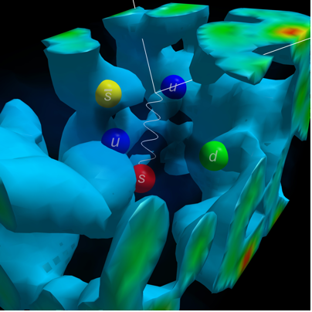
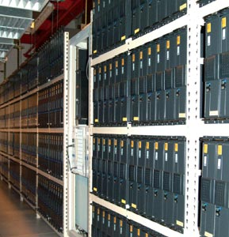
Theoretical progress：Lattice QCD
The only known rigorous framework for ab-initio calculation of the structure of protons and neutrons with controllable errors.
After decades of effort, one can finally calculate nucleon properties with dynamical fermions at physical pion mass!

Slide 16
State-of-art lattice QCD calculations
Achieving systematic controls over
Quark masses: nearly physical
Excited states: different source-sink separations
Finite volume: different volumes
Finite temperature: different time extents
Discretization: different lattice actions and lattice spacings

Slide 17

Iso-vector anomalous magnetic moment
J. R. Green et al, BMW colver-improved Wilson action and lowest $m_{π}=149MeV$

Slide 18
First moment of parton distribution

Slide 19
Outstanding issues

Slide 20
Nature of QCD bound states
The nucleon is a strongly interacting, relativistic bound states.
Understanding such a system theoretically is presently beyond the capability of the best minds in the world.
It posts a great intellectual challenge to the QCD community (theorists and experimentalists).

Slide 21
Outstanding questions
Haven’t you understand the proton spin already?
What does the nucleon look like in 3D?
What are the gluons doing inside the nucleon?
What is the role of QCD theory?
…

Slide 22
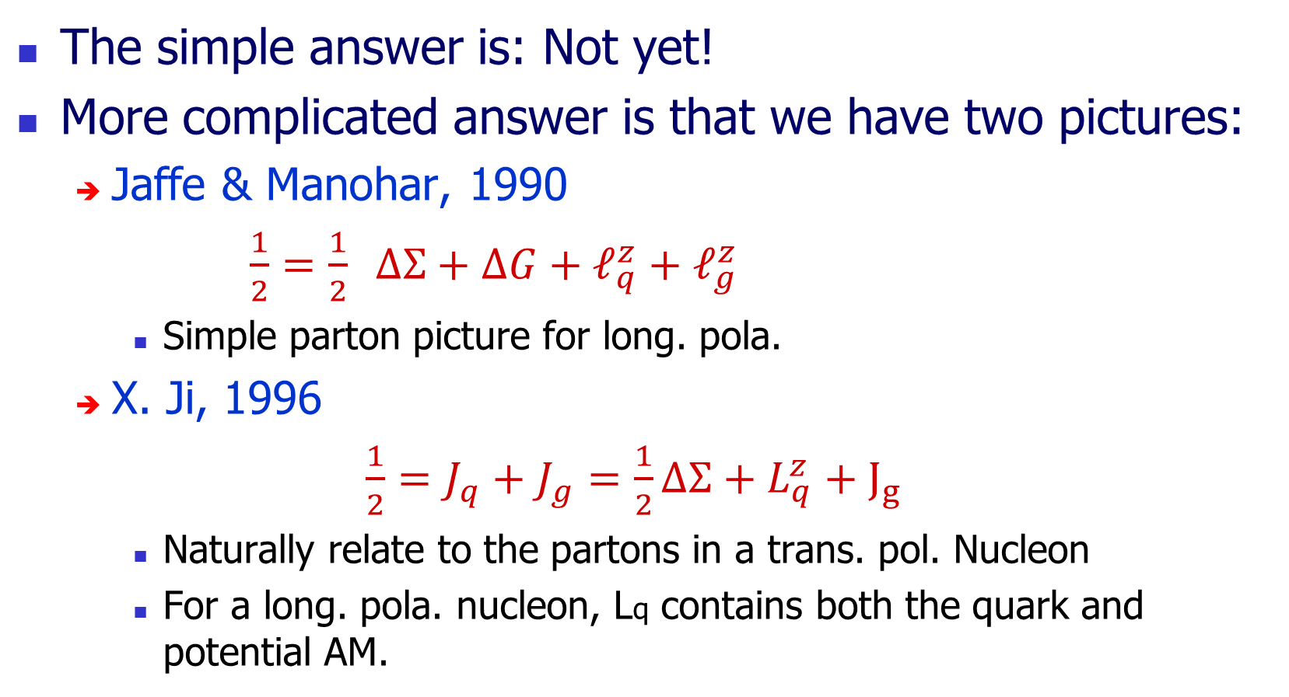
Haven’t you understand the proton spin?
The simple answer is: Not yet!
More complicated answer is that we have two pictures:
  Jaffe & Manohar, 1990
  $\frac{1}{2}=\frac{1}{2} ΔΣ+ΔG+ℓ_{q}^{z}+ℓ_{g}^{z}$
    Simple parton picture for long. pola.
  X. Ji, 1996
  $\frac{1}{2}=J_{q}+J_{g}=\frac{1}{2}ΔΣ+L_{q}^{z}+J_{g}$
    Naturally relate to the partons in a trans. pol. Nucleon
    For a long. pola. nucleon, Lq contains both the quark and potential AM.

Slide 23
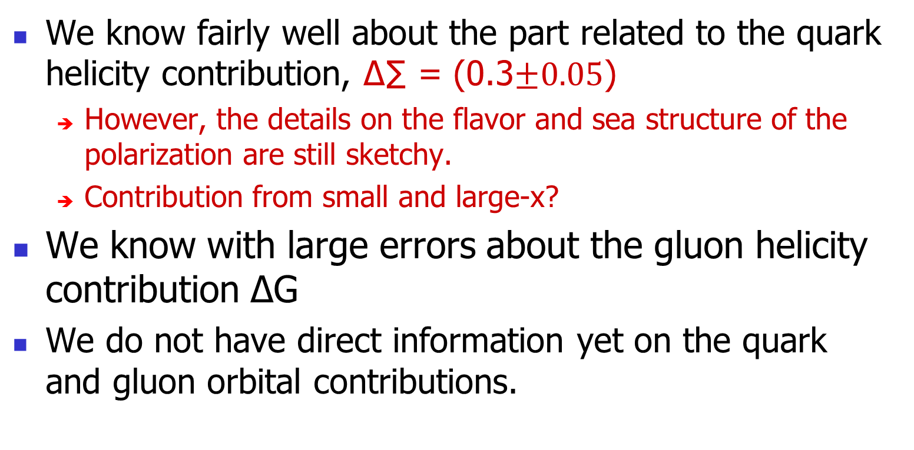
What do we know and don’t know?
  We know fairly well about the part related to the quark helicity contribution, ∆∑ = (0.3$±0.05$)
  However, the details on the flavor and sea structure of the polarization are still sketchy.
  Contribution from small and large-x?
We know with large errors about the gluon helicity contribution ∆G
  We do not have direct information yet on the quark and gluon orbital contributions.

Slide 24
The orbital motion:
Orbital motion of quarks and gluons must be significant inside the nucleons!
  This is in contrast to the naive non-relativistic quark model, which was the motivation to introduce the color quantum number!
The orbital motion shall generate direct orbital AM which must contribute to the spin of the proton.
However, orbital motion can also give rise to a range of interesting physical effects (Sivers, Collins, etc.

Slide 25
New ways to look at partons
We not only need to know that partons have long. momentum, but must have transverse degrees of freedom as well.
Partons in transverse coordinate space?
  Generalized parton distributions (GPDs)
Partons in transverse momentum space?
  Transverse-momentum dependent parton distribution (TMDs)
Both? Wigner distributions!

Slide 26
What does a nucleon look like in 3D?
This is a great question that is hard to answer.
Does it look like a sphere? like a small basket ball?
  Quantum mechanical uncertainty principle?
  What do you plot?
Let the nucleon move with a large momentum, then its relativistic mass is large, the transverse coordinates can be well-defined!
  It is better to picture the nucleon in an infinite momentum frame → partons!

Slide 27
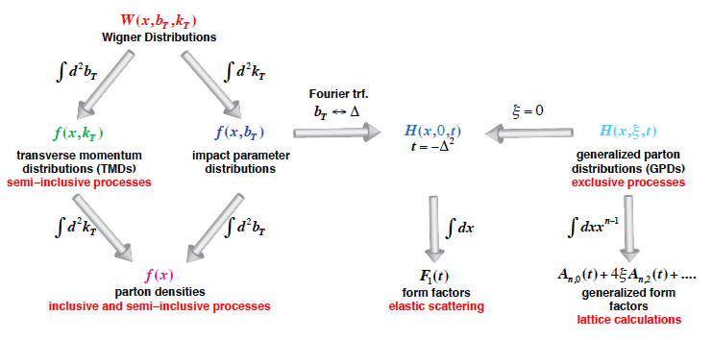
Unified view of the Nucleon
Wigner distributions (Belitsky, Ji, Yuan)
5D
(X. Ji, D. Mueller, A. Radyushkin)
3D
1D

Slide 28
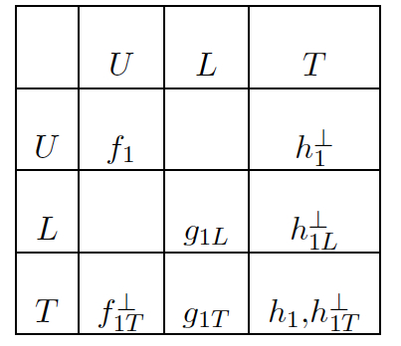
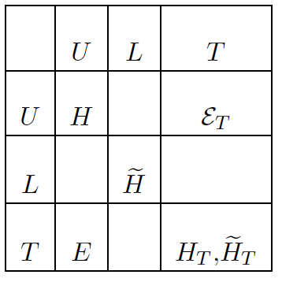
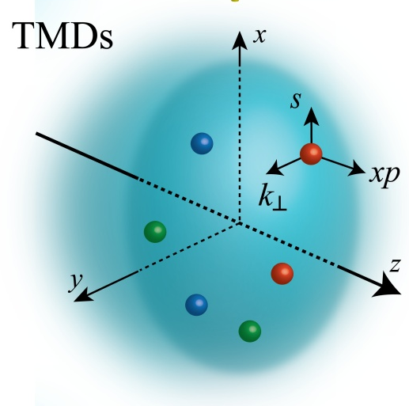
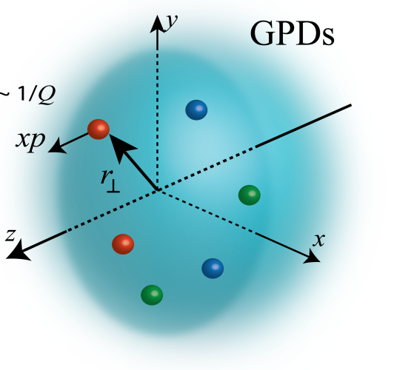
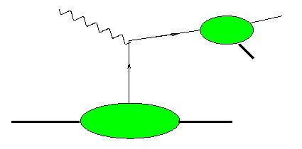
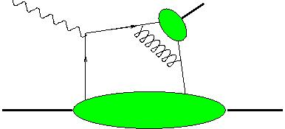
Zoo of TMDs & GPDs
k
k
k
γ,h
h
TMDs
GPDs
NOT directly accessible
Their extractions require measurements of x-sections and asymmetries in a large kinematic domain of x_{B}, t, Q² (GPD) and x_{B}, P_{T}, Q² , z (TMD)
Notes:
To understand better the dynamics we need
Study orbital motion, move from 1D to 3D,
Study interactions and correlations of spin, longitudinal and transverse degrees of freedom
Here is what we understand under the 3D structure of the nucleon. It is basicaly encoded in this two tables of functions describing transverse momentum and space distributions of quark with different polarizations in proton with different polarizations..

Slide 29
Orbital motion
To answer the spin question, one needs to know the orbital angular momentum and hence the transverse coordinate distribution→ GPDs
TMDs give rise to interesting spin-dependent phenomena (Sivers, Collins etc.), but are not directly related to parton orbital AM.
To get the parton orbital angular momentum a la Jaffe-Manohar, one needs to have twist-3 GPDs (Hatta, Yuan et al)

Slide 30
What are the gluons doing in the nucleon?
Due to the strong coupling of QCD, the gauge particles play a much more important role in the nucleon structure than the photons in the hydrogen atom.
Gluon is known to play an important role in the the momentum of the nucleon, similar to neutrons in a large nucleus.
It also has the key role in the nucleon mass

Slide 31




The nucleon mass
One can calculate the proton mass through the expectation value of the QCD hamiltonian,
Quark energy
Quark mass
Gluon energy
Trace anomaly:
Sets the scale for the
Hadron mass!

Slide 32
Other gluonic effects
The gluon is also expected to play a significant role in the spin structure through ΔG and orbital motion.
Probing the gluon orbital motion is a fascinating goal.
Small x: gluon saturation (CGC)-> TMD with a saturated transverse-momentum distribution.
Can one calculate the gluons in the nucleon like in a hot pure-glue plasma? Large Nc approximation?

Slide 33
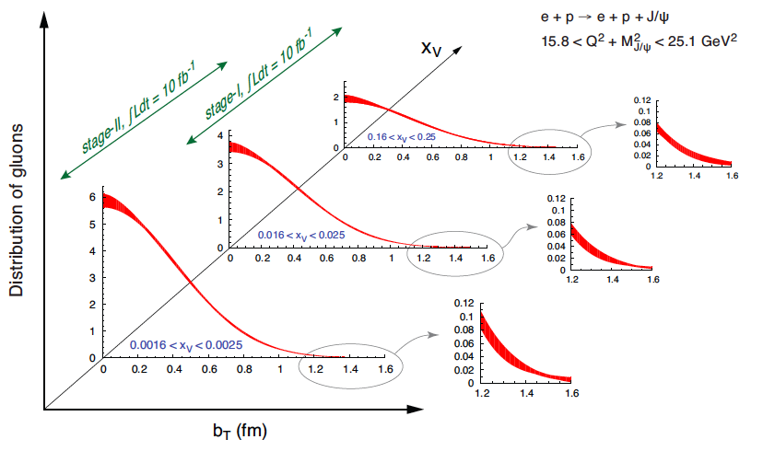
Gluon tomography at small x (GPDs)

Slide 34
What is the role of theory?
The fundamental QCD lagrangian is known.
Now it is time to produce the most reliable predictions from the fundamental theory!
Models:
NR quarks
Bags
Chiral quarks
Approximate QCD
QCD sum rules
Schwinger-Dyson
Lattice QCD

Slide 35
To be a lattice QCD theorist is hard!
Two opposite views:
Lattice QCD is just doing number crunching, even we get the answer right, we still don’t have a picture of the nucleon.
Since Lattice QCD is doing such a good job, why do we need to build an expensive machine, let us just buy some big computers.

Slide 36
Complementary principle
Good physics is learnt when experiments produce good data, and reliable theory either reproduces or predicts the results or finds a discrepancy.
A good investment in EIC must be accompanied by a good investment in theory, particularly lattice QCD!

Slide 37
Looking to the future

Slide 38
What an EIC can do?
Studying partonic content of a QCD bound state (nucleon and nucleus)
The probe is hard and relativistic, the nucleon is measured in the infinite momentum frame (light-cone correlations)
Note that the wave function is frame-dependent, the DIS naturally selects the IMF.

Slide 39
Theoretical Issues
New structure, new dynamics and new phenomena!
  Structure and probe physics separation or factorization
  New processes to measure novel observables
  Models needed for parton fragmentations and justifications of experiments
  Study partons directly on lattice

Slide 40
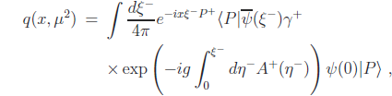
Parton physics on lattice
Parton physics involves intrinsically light-cone correlations, i.e. the real time separations
On lattice, one cannot handle directly the time-dependent observables.
However, one can form can calculate moments of parton distributions: such as <x>, <x²> etc, as matrix elements of local operators
𝜉⁻
𝜉⁰
𝜉⁺
𝜉³

Slide 41
Solution of the problem?
Step 1: Light-cone correlations can be approximated by “off but near” light-cone “space-like” correlations
Step 2: Any space-like separation can be made simultaneous by suitably choosing the Lorentz frame.
t
𝜉⁻
𝜉⁺
Step1
Step2
x

Slide 42

A Euclidean quasi-distribution
Consider space correlation in a large momentum P in the z-direction.
  Quark fields separated along the z-direction
  The gauge-link along the z-direction
  The matrix element depends on the 3-momentum P.
  This distribution can be calculated using standard lattice method.
𝜉⁰
⁰
^{Z}
𝜉³

Slide 43
Power of the approach
Gluon helicity distribution and total gluon spin
GPDs
TMDs
Light-cone wave functions
Higher twist observables
Etc.

Slide 44
Support theory, please!

