Slide 1

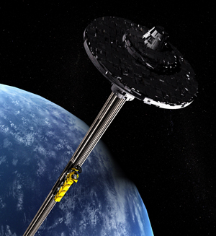
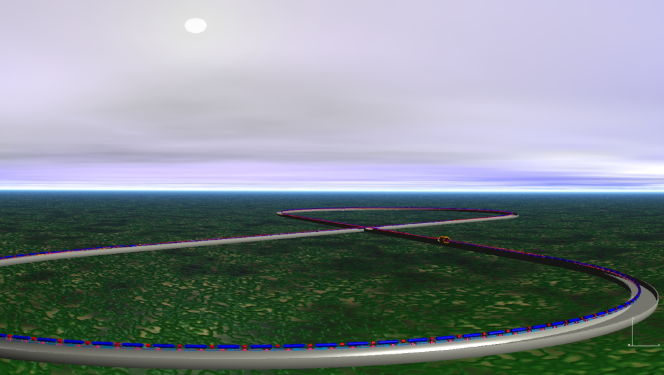
Why we need an EIC:
the view from 10,000 meters
R. D. McKeown
Jefferson Lab
QCD Town Meeting
Sept. 13, 2014

Slide 2
Why We Need EIC
HERA discovered a very large abundance of soft gluons inside the proton. However, the role of gluons in nucleon structure and dynamics is still unclear.
The origin of nucleon spin and the distributions of quarks and gluons in nuclei remain mysteries after decades of study.
We have new phenomenology to explore nucleon structure: Generalized Parton Distributions (GPDs) and Transverse Momentum Dependent (TMDs) distributions that provide powerful “imaging” of quarks and gluons and access to orbital angular momentum. These studies will require high luminosity and polarized beams.
A new facility, EIC, with a versatile range of kinematics, beam polarizations, and beam species, is required to precisely image the sea quarks and gluons in nucleons and nuclei, to explore the new QCD frontier of strong color fields in nuclei, and to resolve outstanding issues in understanding nucleons and nuclei in terms of QCD.

Slide 3
Science Questions
What is the transverse spatial and momentum structure of the gluons and sea quarks? Are there non-perturbative structures and can one image them?
How much do the gluons contribute to the nucleon spin? Is there significant orbital angular momentum?
How is the gluon distribution in nuclei different than in the nucleon? How does this relate to nuclear binding or short range nucleon-nucleon correlations?
Can one find evidence for saturation of the gluon density?
How do quarks and gluons propagate in nuclear matter and join together to form hadrons?

Slide 4
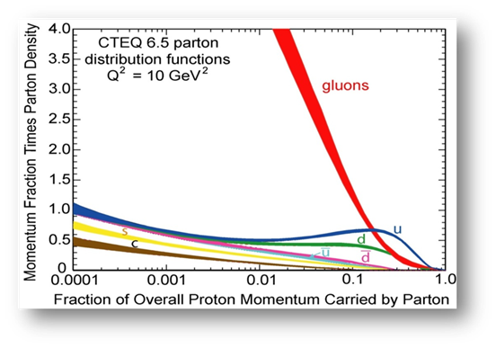


Present Knowledge
Dramatic rise in gluon distribution discovered at HERA in 1990’s.
Gluon splitting drives the dynamics at x<0.1
Otherwise the low x region is essentially unexplored.
Generally expect saturation at lower x where high gluon density drives recombination – but where?
+
?

Slide 5

New Paradigm for Nucleon Structure
JLab12
3D imaging of valence quarks
EIC
3D imaging of sea and gluons
TMDs
– Confined motion in a nucleon
(semi-inclusive DIS)
GPDs
– Spatial imaging
(exclusive DIS)

Slide 6
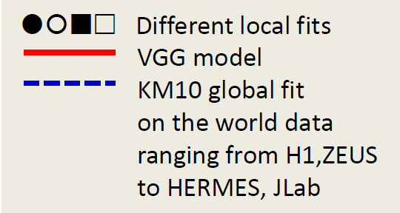
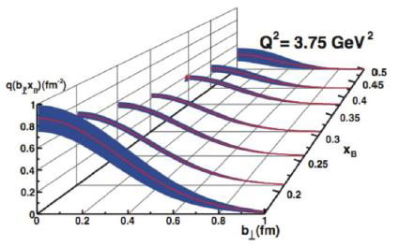
The First Crude Images
the GPD H in Im DVCS
Projection for JLab 12 GeV

Slide 7

EIC:
The New QCD Frontier
High Luminosity
◻ 10³⁴ cm⁻²s⁻¹
Low x regime
x ◻ 0.0001
High Polarization
◻ 70%
JLab
12
EIC
Discovery
Potential!
EMC
HERMES

Slide 8
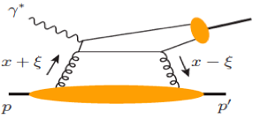
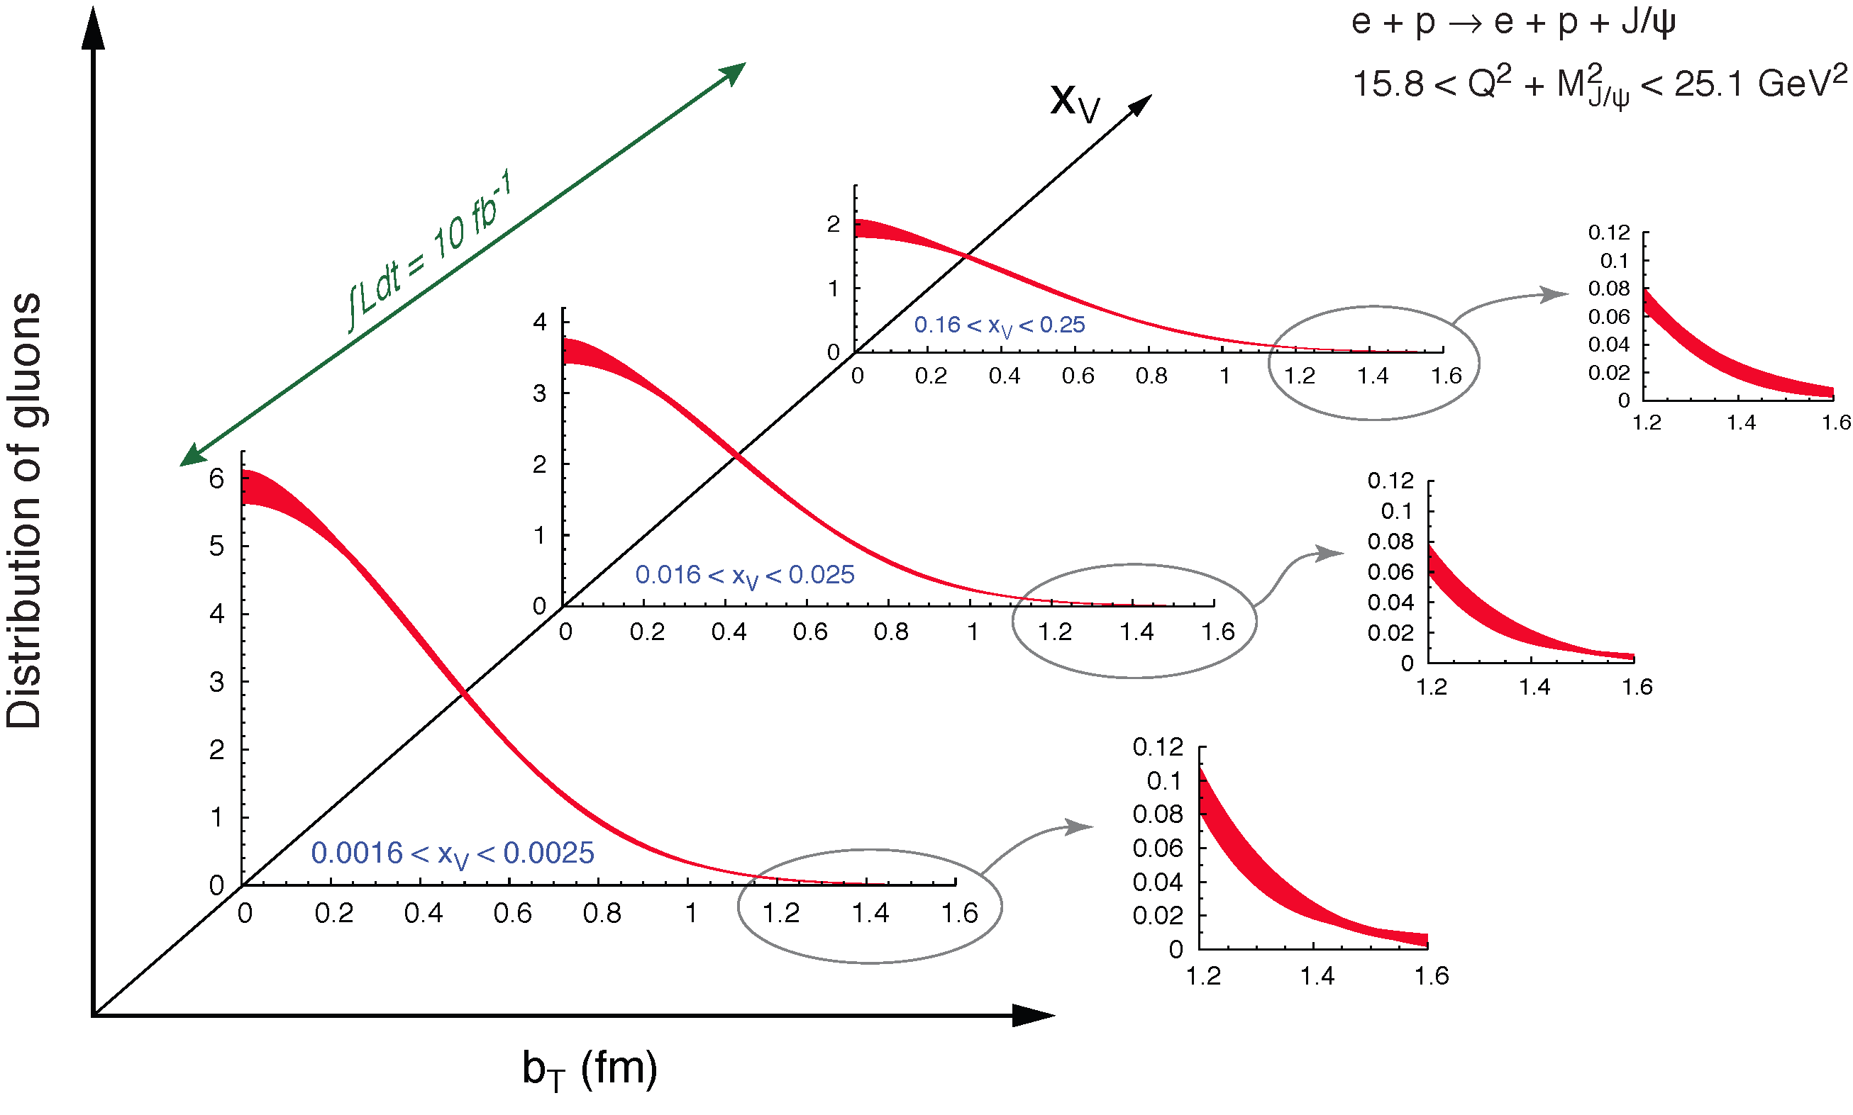
Spatial Imaging of Gluon Density at EIC
Exclusive vector meson production:
Q
J/Ψ, Φ, …
Fourier transform of the t-dep
Spatial imaging of glue density
t-dep
Resolution ~ 1/Q or 1/M_{Q}
Gluon imaging from simulation:
_
Images of gluons
from exclusive
J/ψ production

Slide 9
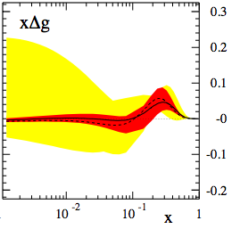

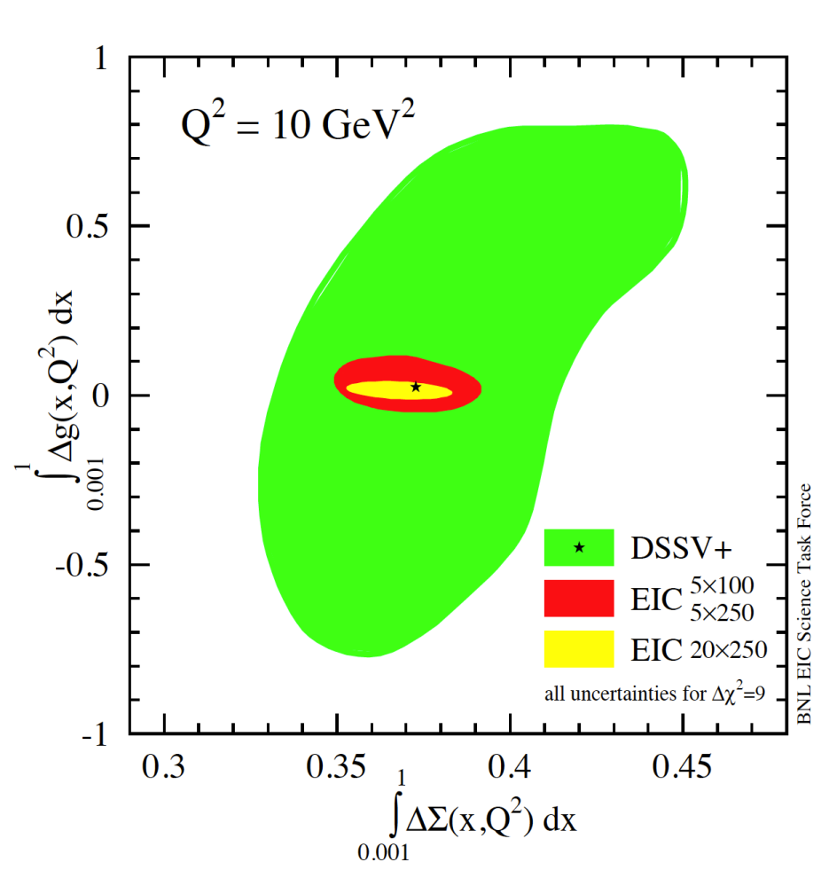
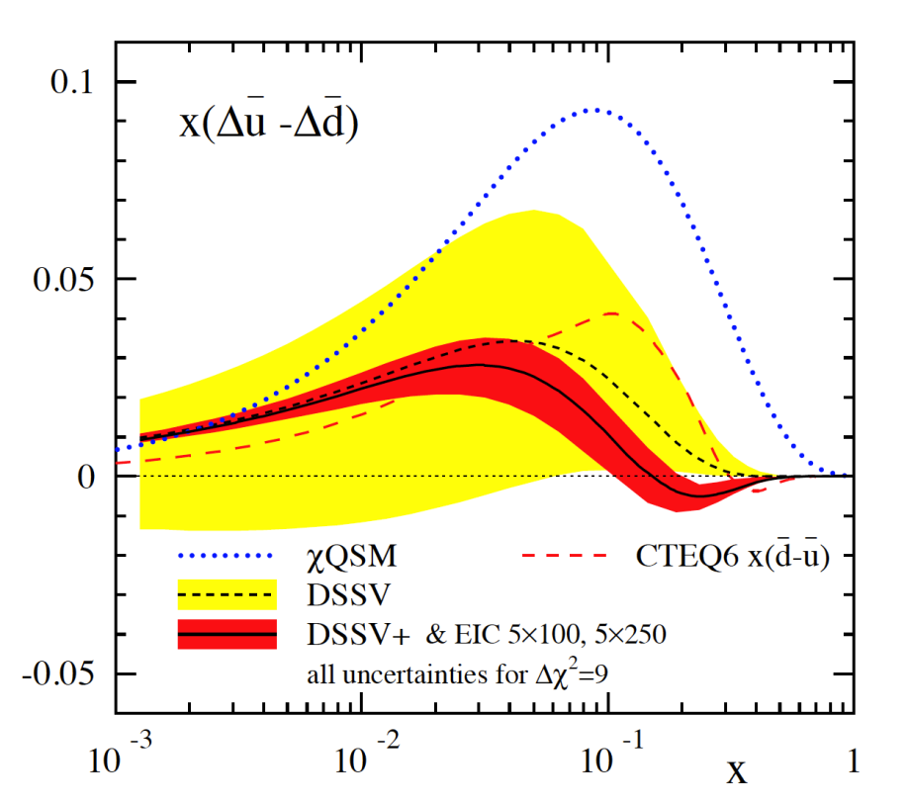
Helicity PDFs at an EIC
Q² = 10 GeV²
A Polarized EIC:
Tremendous improvement on ΔG
Good improvement in ΔΣ
Spin Flavor decomposition of the Light Quark Sea
current data
ΔG
w/ EIC data
ΔΣ

Slide 10
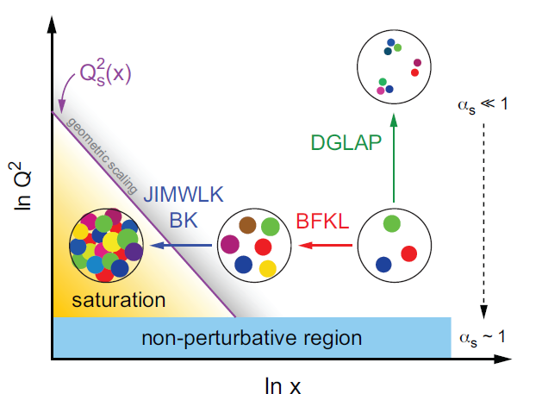
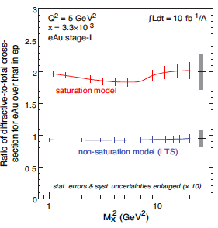
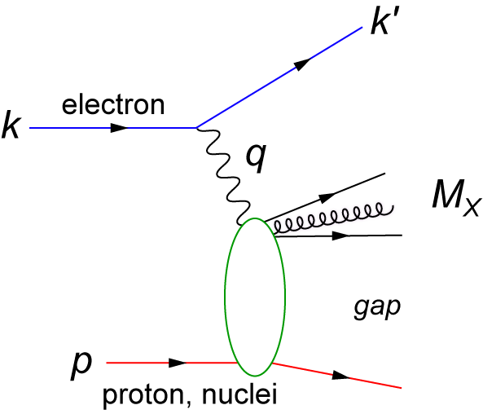
Gluon Saturation at EIC
Radiation
Recombination
Diffractive event

Slide 11

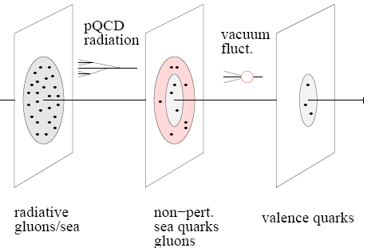
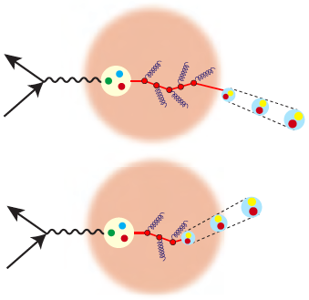
Electron Ion Collider: A QCD Laboratory
Understanding the “99%”, the glue that binds us
  Tomography of the nucleus
  Gluon and sea quarks
  spin
  orbital angular momentum
  QCD at high gluon density
  Propagation of color in nuclei, formation of hadrons

Slide 12
EIC Properties
Access to low values of x~0.0001 (not available at JLab12), which requires collisions of high energy electrons with high energy nucleons and nuclei.
Highly polarized beams of nucleons and light ions (not available at HERA), and polarized electrons to access the spin and orbital motion of the partons.
High luminosity to enable 3D tomography of the distributions of partons (not available at HERA).
Collisions of electrons with atomic nuclei (not available at HERA), up to the heaviest available, to provide information on the effect of the nuclear medium on the parton distributions as well as the properties of partons traversing the nuclear medium.

Slide 13

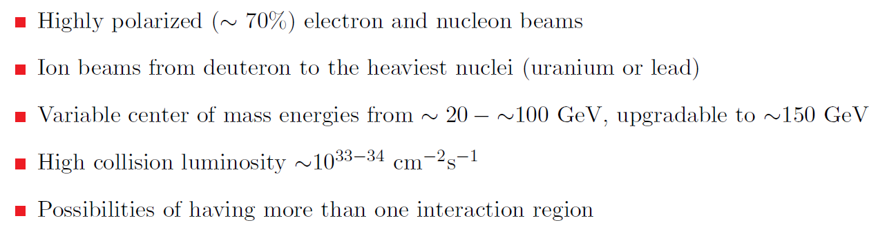
EIC Requirements
From the 2013 EIC White Paper:

Slide 14

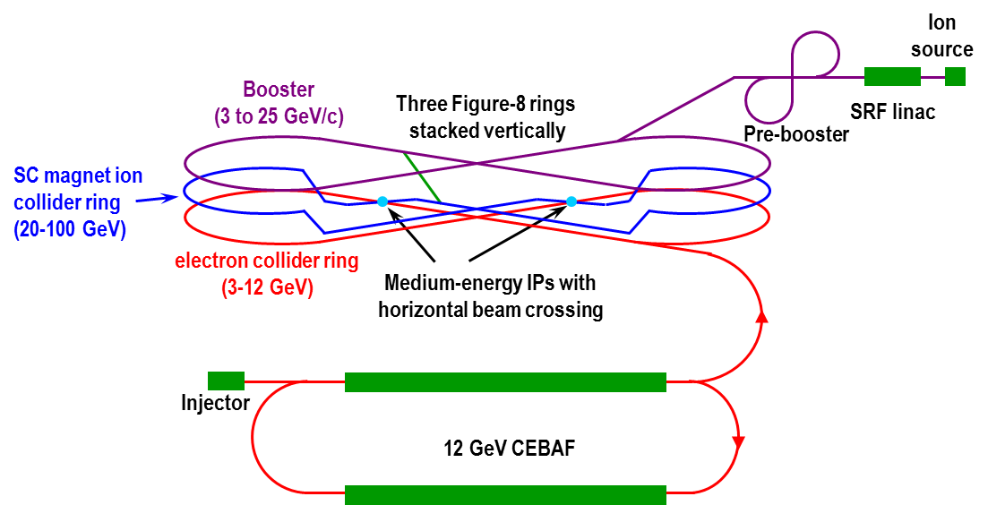

Medium Energy EIC@JLab
JLab Concept
Initial configuration (MEIC):
  3-12 GeV on 20-100 GeV ep/eA collider
  Fully-polarized, longitudinal and transverse
  Luminosity:
  up to few x 10³⁴ e-nucleons cm⁻² s⁻¹
    Upgradable to higher energies
    250 GeV protons + 20 GeV electrons

Slide 15
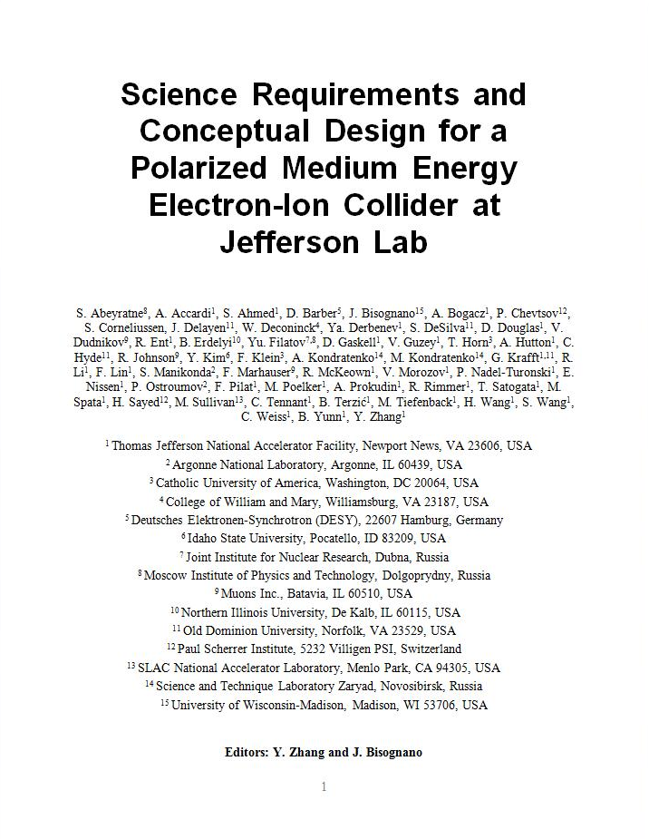
MEIC Design Goals
Energy
  Full coverage of √s from 15 to 70 GeV
  Electrons 3-12 GeV, protons 20-100 GeV, ions 12-40 GeV/u
Ion species
  Polarized light ions: p, d, ³He, and possibly Li
  Un-polarized light to heavy ions up to A above 200 (Au, Pb)
At least 2 detectors
Full acceptance is critical for the primary detector
Luminosity
  Above 10³³ cm⁻²s⁻¹ per IP in a broad CM energy range
  Maximum luminosity >10³⁴ optimized to be around √s=45 GeV
Polarization
  At IP: longitudinal for both beams, transverse for ions only
  All polarizations >70%
Upgrade to higher energies and luminosity possible
  20 GeV electron, 250 GeV proton, and 100 GeV/u ion
  Design goals consistent with the White Paper requirements

Slide 16
EIC Realization Imagined
Activity Name | 2010 | 2011 | 2012 | 2013 | 2014 | 2015 | 2016 | 2017 | 2018 | 2019 | 2020 | 2021 | 2022 | 2023 | 2024 | 2025
12 GeV Upgrade
FRIB
EIC Physics Case
NSAC LRP
EIC CD0
EIC Machine Design/R&D
EIC CD1/Downsel
EIC CD2/CD3
EIC Construction
Assumes endorsement for an EIC at the next NSAC Long Range Plan
Assumes relevant accelerator R&D for down-select process done around 2016

Slide 17
Summary & Outlook
Science case is much advanced  white paper
Common set of facility requirements – 2 viable facility designs are emerging
Support of Hot and Cold QCD communities is essential
Must articulate the science case for NP community and also broader audience
  US leadership in nuclear science
  US leadership in accelerator science and technology
NSAC LRP Recommendation  CD-0

Slide 18


