Slide 1
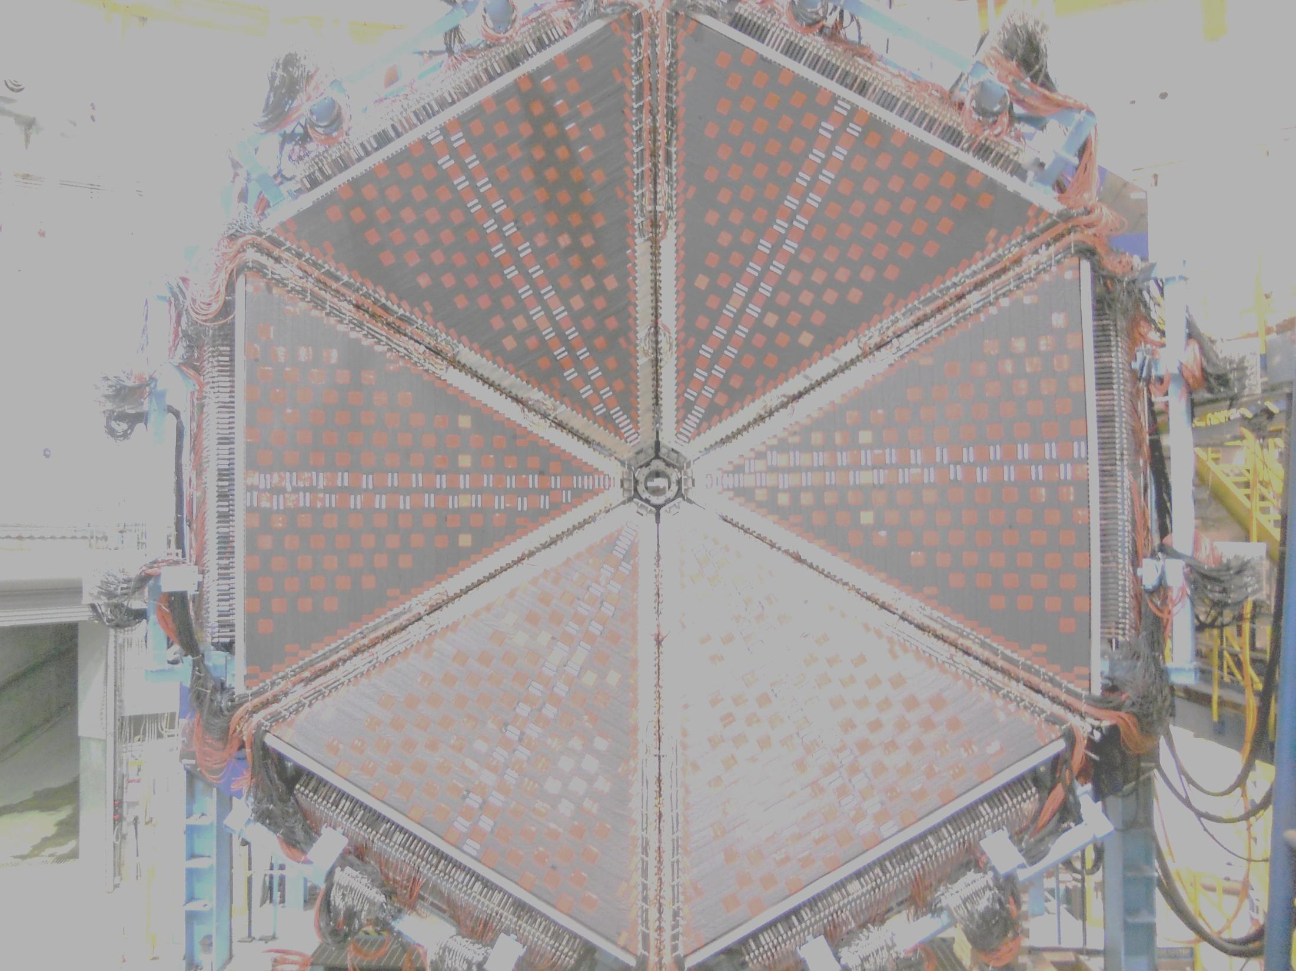



Experimental Overview on Baryon Spectroscopy: Current and Future
Ralf W. Gothe
APS Division of Nuclear Physics: 2014 Long-Range Plan
Joint Town Meetings on QCD, Temple University
September 13-15, 2014, Philadelphia, PA
γNN* Vertexcouplings: A unique window into baryon and quark structure?
Analysis and new Results: Phenomenological but consistent.
QCD based Theory: Can we solve non-perturbative QCD and confinement?
Outlook: New experiments with extended scope and kinematics.
This work is in parts supported by the US National Science Foundation under the Grant PHY-1205782

Slide 2
Spectroscopy
Notes:
EBAC: dynamical coupled channel analysis is based on the world data set on piN. gammaN, and gamma*N and constrained by unitarity. (to Npi, Neta, N2pi)
This allows the extraction of the meson-baryon contributions under minimal model assumptions

Slide 3
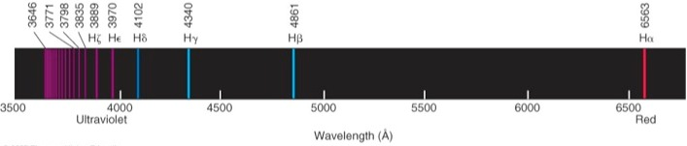
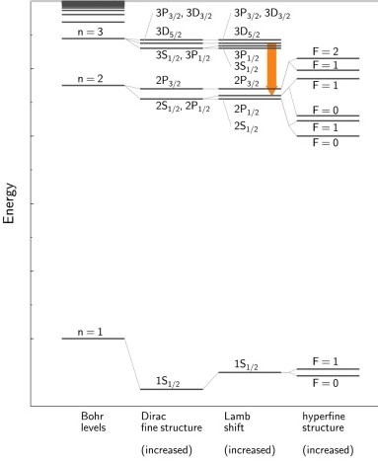
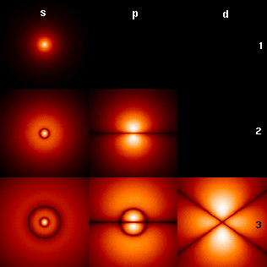
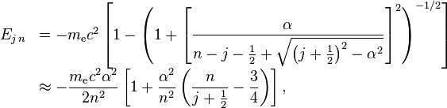

Hydrogen Spectroscopy and QED
Q
E
D
Proton Radius Puzzle
Notes:
EBAC: dynamical coupled channel analysis is based on the world data set on piN. gammaN, and gamma*N and constrained by unitarity. (to Npi, Neta, N2pi)
This allows the extraction of the meson-baryon contributions under minimal model assumptions

Slide 4
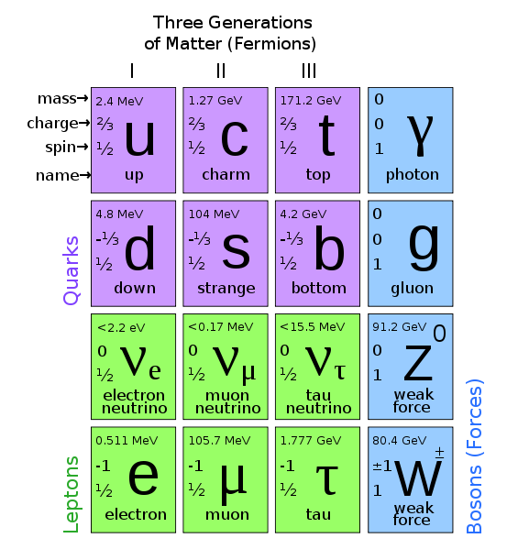
Hadron Spectroscopy: Meson, Baryons, …
Q
C
D

Slide 5
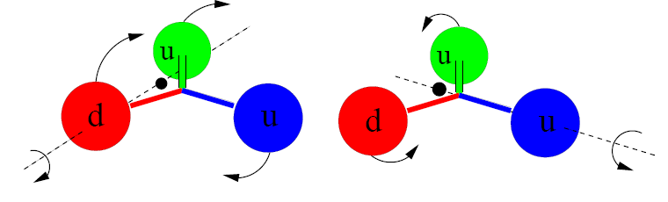
N and Δ Excited Baryon States …
Simon Capstick
Orbital excitations
(two distinct kinds in contrast to mesons)
Radial excitations
(also two kinds in contrast to mesons)

Slide 6
Quark Model Classification of N*
Dietmar Menze
D₁₃(1520)
S₁₁(1535)
+ q³g
+ q³qq
+ N-Meson
+ …
Δ(1232)
Roper P₁₁(1440)
- q²q
- …
1135 MeV 1545 MeV 1839MeV 2130 MeV Mass
Notes:
SU(6) spin(2)-flavor(3)symmetry combined with the O(3) group for radial and rotational excitations
leads to the SU(6) L-P (number of states angular momentum parity) supermultiplets
Lambda(1405) N-K molecule, Roper N-gluon excitation, di-quark pointlike in contrast to DSE dynamic and non-pointlike

Slide 7
Quark Model Classification of N*
BnGa energy-dependent coupled-channel PWA of CLAS K⁺Λ and other data
Dietmar Menze
2012
2010
q²q
1135 MeV 1545 MeV 1839MeV 2130 MeV Mass
Notes:
SU(6) spin(2)-flavor(3)symmetry combined with the O(3) group for radial and rotational excitations
leads to the SU(6) L-P (number of states angular momentum parity) supermultiplets
Lambda(1405) N-K molecule, Roper N-gluon excitation, di-quark pointlike in contrast to DSE dynamic and non-pointlike

Slide 8
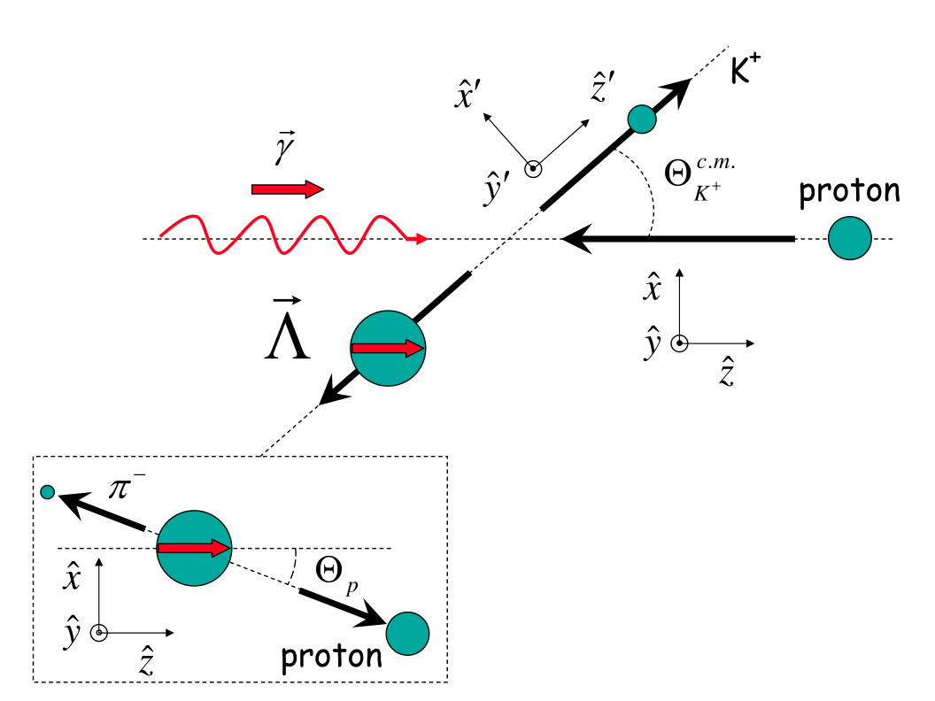
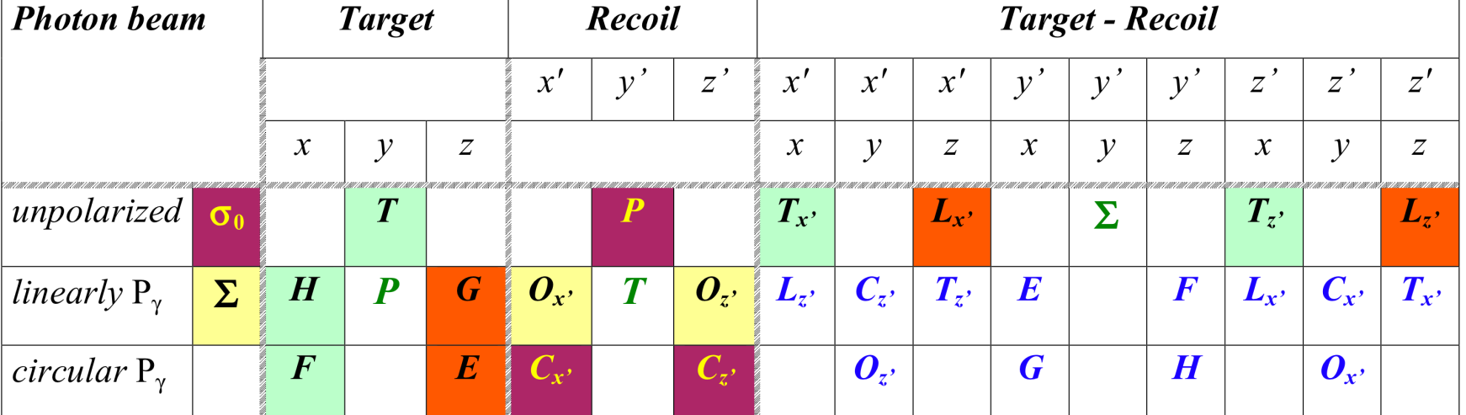
γp→K⁺Λ
FROST/HD γN πN, ηN, KΛ, KΣ, Nππ, Νω, ...
Single pseudo-scalar meson production process is described by 4 complex, parity conserving amplitudes.
8 well-chosen measurements are needed to determine all amplitudes.
For hyperon finals state 16 observables are measured in CLAS ➠ large redundancy in determining the photoproduction amplitudes ➠ allows for many cross checks and increased accuracy.
8 observables measured in reactions without recoil polarization.
weak decay has
large analyzing power
Notes:
Photo: 4 complex, 7 independent plus unknown common phase, 16 total
Electro: 6complex, 11 independent, 36 total
The K-Lambda channel is ideal for complete measurement as the Lambda decays weakly to pi- p with large analyzing power.
8

Slide 9
CLAS Results on γp K⁺Λ K⁺pπ
Bonn-Gatchina Coupled Channel Analysis, A.V. Anisovich et al., EPJ A48, 15 (2012)

Slide 10
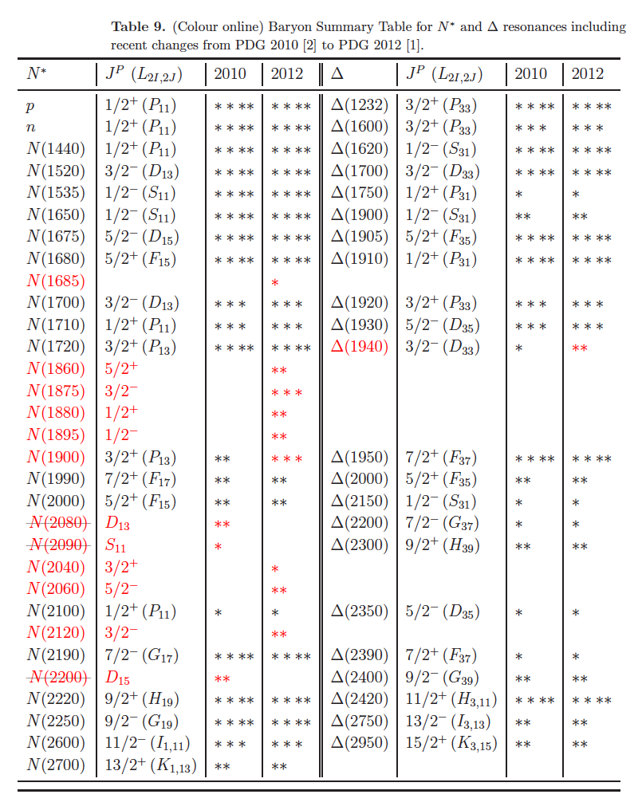
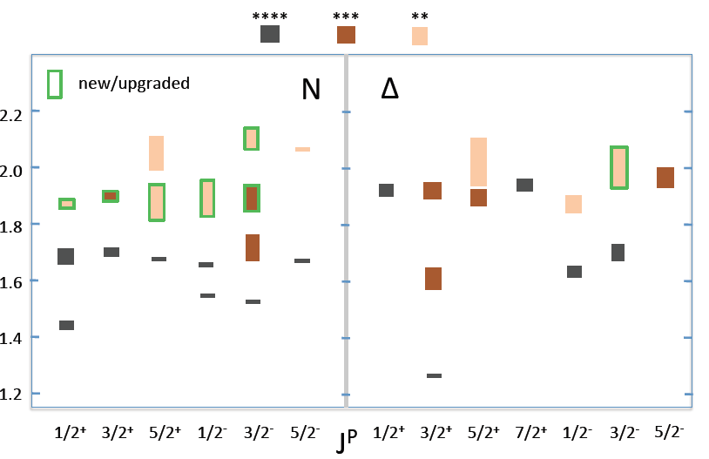
N/Δ Spectrum in RPP 2012
High-statistics and high-precision photoproduction data from
JLAB, MAMI, ELSA, GRAAL
Are we observing parity doublets with the new states?
V. Crede & W. Roberts, Rep. Prog. Phys. 76 (2013)

Slide 11
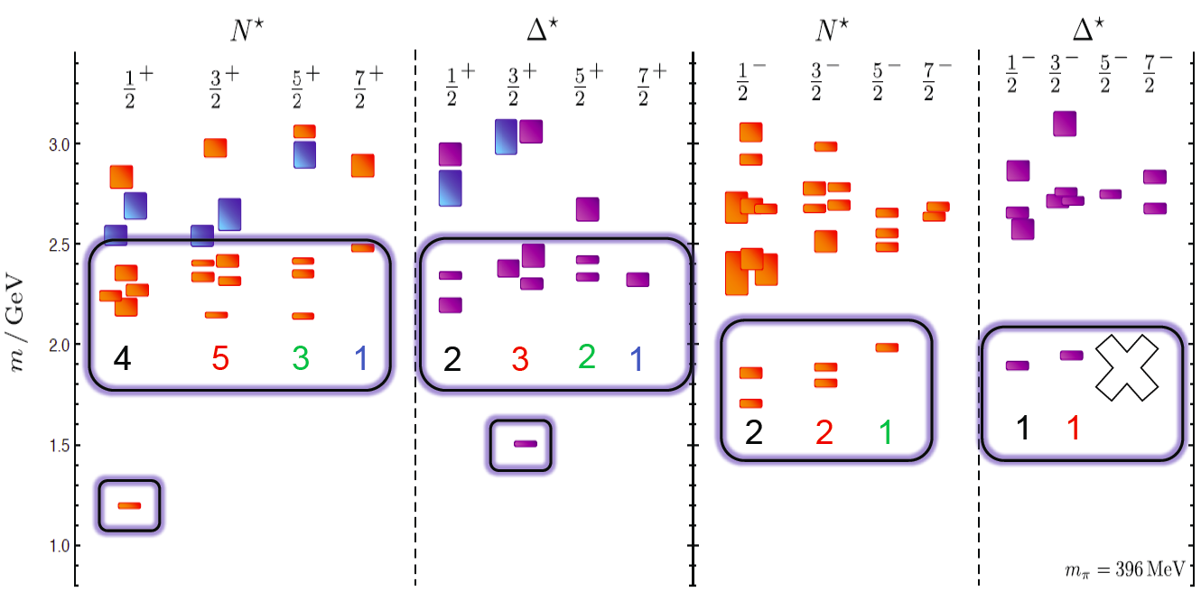
N* Spectrum in LQCD
The strong interaction physics is encoded in the nucleon excitation spectrum that spans the degrees of freedom from meson-baryon and dressed quarks to elementary quarks and gluons.
LQCD predicts states with the same quantum numbers as
CQMs with underlying SU(6)xO(3) symmetry.
R. Edwards et al. arXiv:1104.5152, 1201.2349
Notes:
SU(3) and SU(2) multiplets combine into SU(6) supermultiplets

Slide 12
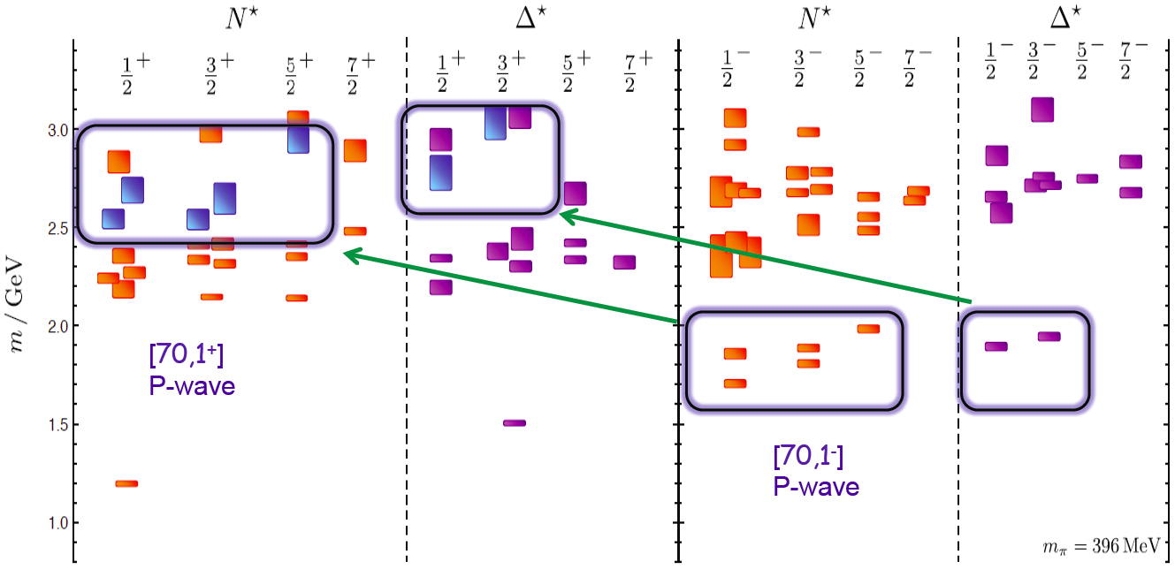
N* Spectrum in LQCD
The strong interaction physics is encoded in the nucleon excitation spectrum that spans the degrees of freedom from meson-baryon and dressed quarks to elementary quarks and gluons.
LQCD predicts hybrid baryon states replicating the negative parity multiplet structure.

Slide 13
Transition Form Factors and QCD Models
Roper resonance P₁₁(1440)
PDG 2013 update
nrQM
+ q³g
+ q³qq
+ N-Meson
+ …
LC QM
q³+Nσ
- q²q
- …
or
q³G
… all have distinctively different
Q² dependencies
A_{1/2} has zero-crossing near Q²=0.5 and becomes dominant amplitude at high Q².
Eliminates gluonic excitation (q³G) as a dominant contribution.
Consistent with radial excitation at high Q² and large meson-baryon coupling at small Q².
Notes:
http://pdg.lbl.gov/2013/reviews/rpp2013-rev-n-delta-resonances.pdf
S. Capstick and B. Keister, Phys. Rev. D51, 3598 (1995)
I.G. Aznauryan, Phys.Rev.C76, 025212 (2007)
L.T. Obukhovsky et al., Phys.Rev. D84, 014004 (2011)

Slide 14
Transition
Form Factors
Notes:
EBAC: dynamical coupled channel analysis is based on the world data set on piN. gammaN, and gamma*N and constrained by unitarity. (to Npi, Neta, N2pi)
This allows the extraction of the meson-baryon contributions under minimal model assumptions

Slide 15
Hadron Structure with Electromagnetic Probes
Q²
Study the structure of the nucleon spectrum in the domain where dressed quarks are the major active degree of freedom.
Explore the formation of excited nucleon states in interactions of dressed quarks and their emergence from QCD.
π,ρ,ω…
low
N,N*,Δ,Δ*…
k
3q-core+MB-cloud
K_{2μ}
N
P_{2μ}
*
3q-core
²
Q² = −K_{μ}
K_{1μ}
N
P_{1μ}
pQCD
high
Notes:
15
Why do we use electromagnetic probes to study hadron structure? I think the answer is that the e.m. probe allows us to efficiently address the central question of hadron physics: What are the relevant degrees of freedom at varying distance scales? To simply illustrate this I show here the quark propagator mass calculated in LQCD, Dyson Schwinger, and other approaches as a function of the momentum transfer. In the em probe we can vary the resolution and momentum transfer. In doing so, we probe the effective degrees of freedom in the nucleon from meson-nucleon, to constituent quarks, to elementary partons. The study of nucleon resonance transitions provides a testing ground for our understanding of these effective degrees of freedom.

Slide 16
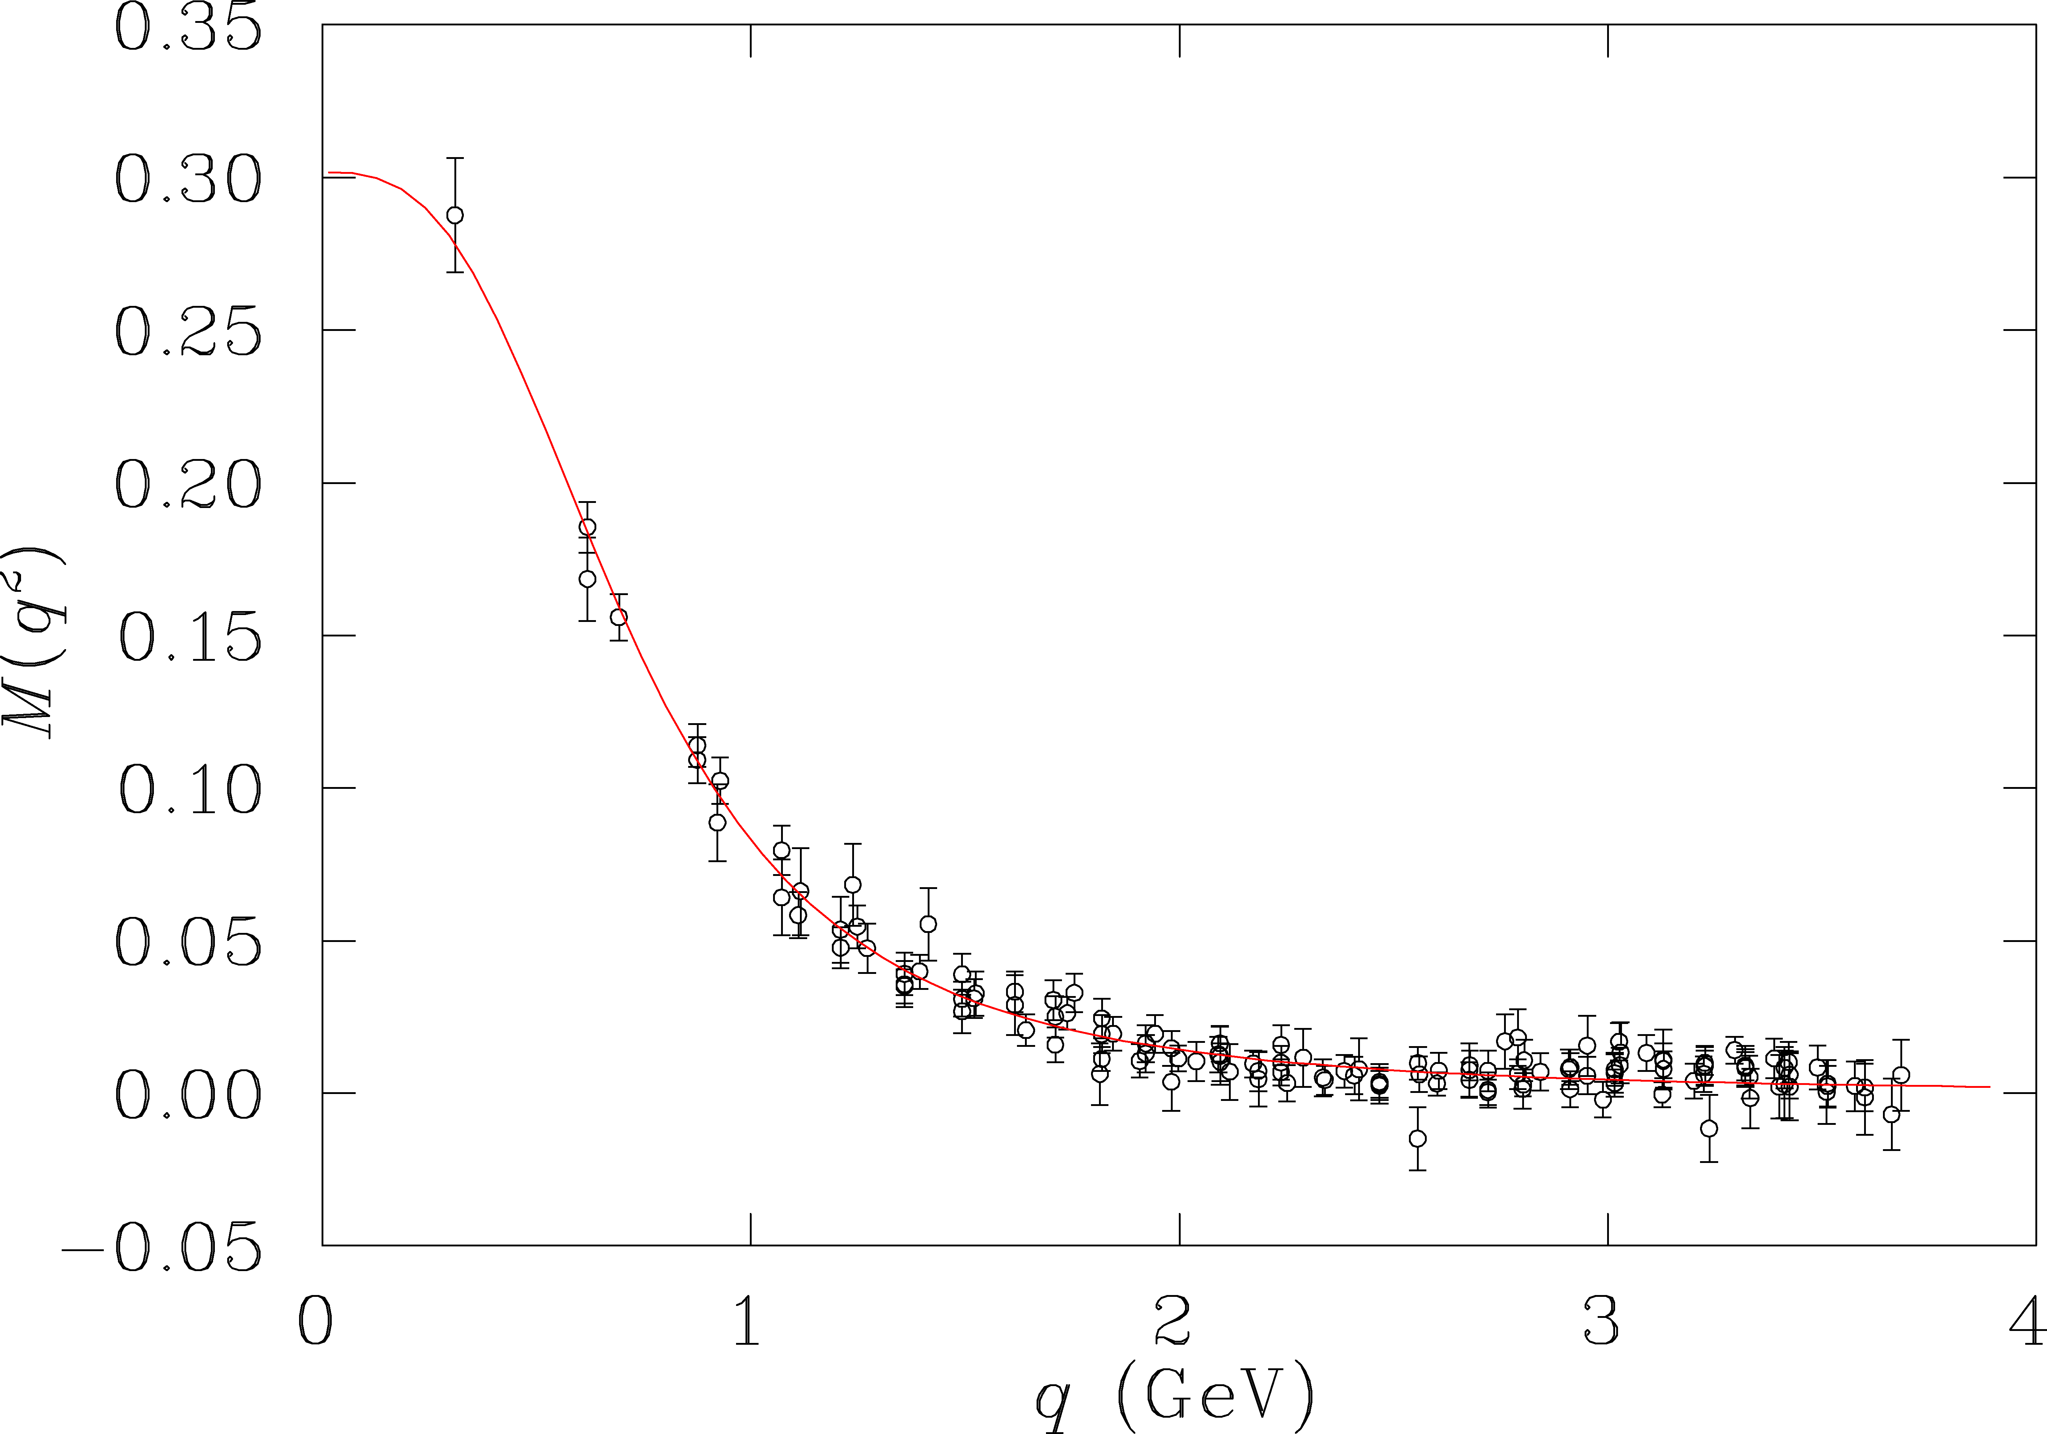
Hadron Structure with Electromagnetic Probes
Study the structure of the nucleon spectrum in the domain where dressed quarks are the major active degree of freedom.
Explore the formation of excited nucleon states in interactions of dressed quarks and their emergence from QCD.
π,ρ,ω…
Q²
Quark mass extrapolated to the chiral limit, where q is the momentum variable of the tree-level quark propagator using the Asqtad action.
low
N,N*,Δ,Δ*…
q
meson dressed quark
LQCD, DSE and …
3q-core+MB-cloud
confinement
quark mass (GeV)
3q-core
current quark
e.m. probe
pQCD
high
Notes:
16
LQCD, DSE, or Gribov-Zwinziger, Kugo-Ojima (all in Landau gauge)
Why do we use electromagnetic probes to study hadron structure? I think the answer is that the e.m. probe allows us to efficiently address the central question of hadron physics: What are the relevant degrees of freedom at varying distance scales? To simply illustrate this I show here the quark propagator mass calculated in LQCD, Dyson Schwinger, and other approaches as a function of the momentum transfer. In the em probe we can vary the resolution and momentum transfer. In doing so, we probe the effective degrees of freedom in the nucleon from meson-nucleon, to constituent quarks, to elementary partons. The study of nucleon resonance transitions provides a testing ground for our understanding of these effective degrees of freedom.

Slide 17
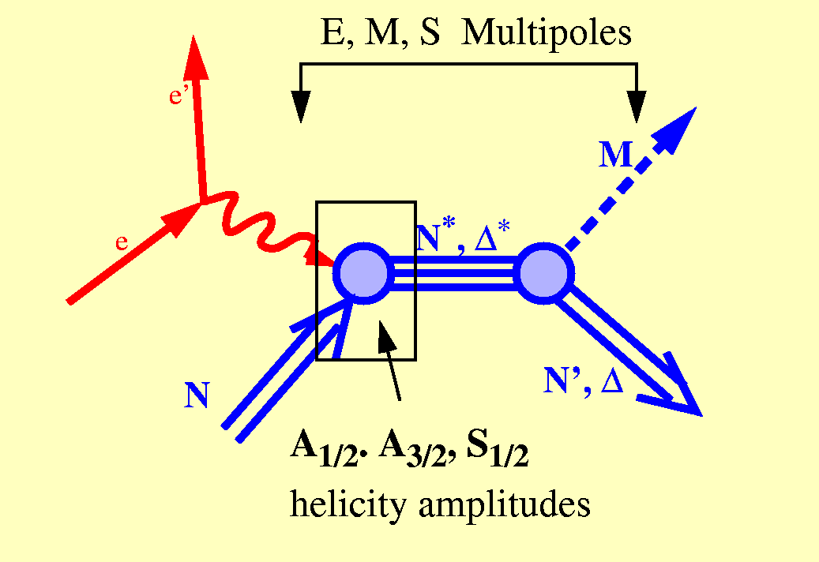
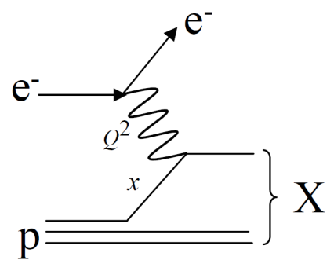
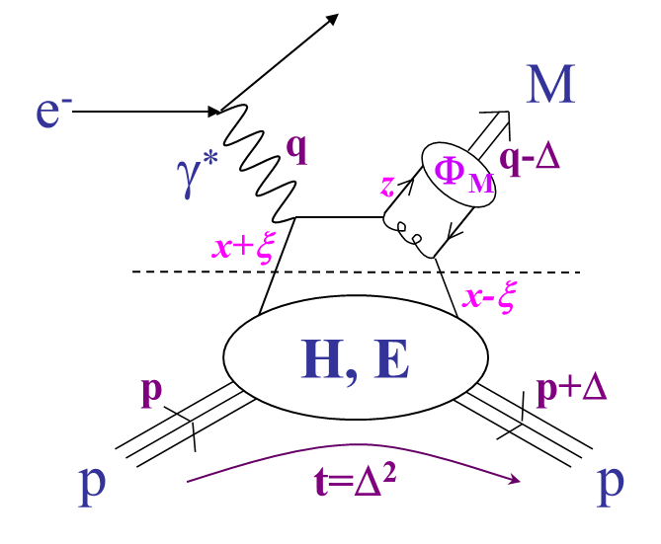
Baryon Excitations and Quasi-Elastic Scattering
hard and
confined
Elastic Form Factors
Transition Form Factors
quasi-elastic
hard
soft
Deep Inelastic Scattering
S. Stein et al., PR D22 (1975) 1884

Slide 18
Data-Driven Data Analyses
Consistent Results
QCD
LQCD
N*, Δ*
DSE
Single meson production:
Unitary Isobar Model (UIM)
Fixed-t Dispersion Relations (DR)
Double pion production:
Unitarized Isobar Model (JM)
Coupled-Channel Approach:
EBAC ⇒ Argonne-Osaka
JAW ⇒ Jülich-Athens-Washington
BoGa ⇒ Bonn-Gatchina
Reaction
Models
Amplitude
analysis
Data
Hadronic
production
Electromagnetic
production
Int. J. Mod. Phys. E, Vol. 22, 1330015 (2013) 1-99
Notes:
EBAC: dynamical coupled channel analysis is based on the world data set on piN. gammaN, and gamma*N and constrained by unitarity. (to Npi, Neta, N2pi)
This allows the extraction of the meson-baryon contributions under minimal model assumptions

Slide 19
Electrocouplings of N(1440)P₁₁ from CLAS Data
S_{1/2}
A_{1/2}
PDG
Nπ (UIM, DR)
Nππ (JM) 2012
Nππ (JM) preliminary
Consistent results obtained in the low-lying resonance region by independent analyses in the exclusive Nπ and pπ⁺π⁻ final-state channels – that have fundamentally different mechanisms for the nonresonant background – underscore the capability of the reaction models to extract reliable resonance electrocouplings.
Phys. Rev. C 80, 055203 (2009) 1-22 and Phys. Rev. C 86, 035203 (2012) 1-22
Notes:
Allows to determine systematic model uncertainties. This consistency check will also be applied at high Q^2.

Slide 20
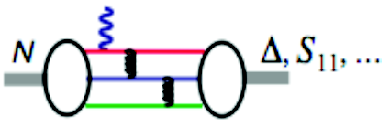
Evidence for the Onset of Scaling?
Phys. Rev. C80, 055203 (2009)
S₁₁ Q³A_{1/2}
F₁₅ Q⁵A_{3/2}
P₁₁ Q³A_{1/2}
D₁₃ Q⁵A_{3/2}
A_{1/2} α 1/Q³
A_{3/2} α 1/Q⁵
F₁₅ Q³A_{1/2}
G_{M} α 1/Q⁴
*
D₁₃ Q³A_{1/2}
q²q

Slide 21
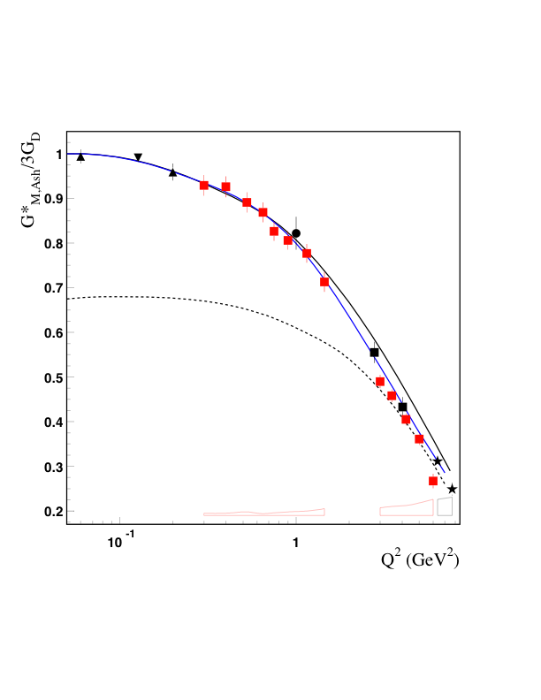
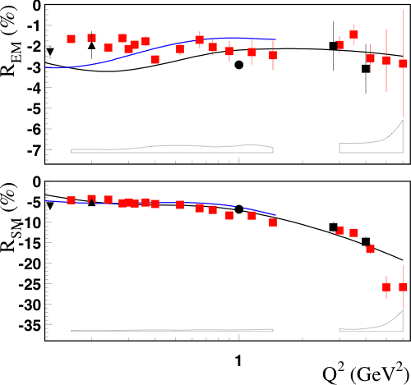
N → Δ Multipole Ratios R_{EM} , R_{SM}
CLAS
Hall A
Hall C
MAMI
Bates
Phys. Rev. Lett. 97, 112003 (2006)
Meson
Cloud
Effect
Pascalutsa
Vanderhaeghen
Sato-Lee
New trend towards pQCD behavior does not show up
CLAS12 can measure G_{M} , R_{EM} , and R_{SM} up to Q²~12 GeV²
R_{EM} +1 R_{SM} const
G_{M,J.-S.} 1/Q⁴ G_{M,Ash} 1/Q⁵
*
*
*
Notes:
I.G. Aznauryan et al. (2009) Phys. Rev. C 80, 055203, arXiv:0909.2349 [nucl-ex]
M. Ungaro et al. (2006) Phys. Rev. Lett. 97, 112003, arxiv.org/abs/hep-ex/0606042
Pascalutsa large N_c relations link the N to Delta transition to in terms of the electromagnetic properties of the nucleon: GM can be expressed as a function of the nucleon form factors! And so are REM and RSM, Phys. Rev. D 76, 111501(R) (2007)
Helicity conservation, A(3/2)<<A(1/2), REM->+1 derived in pQCD and AdS/QCD, M. Ungaro et al., http://arxiv.org/abs/hep-ex/0606042, triangle down Bates

Slide 22
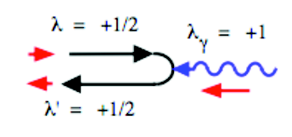
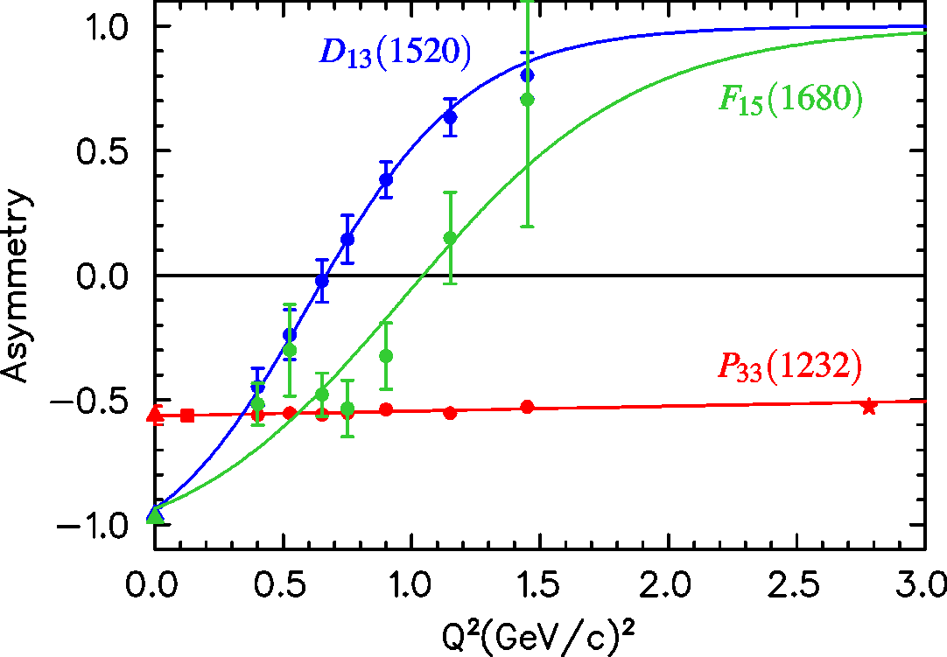
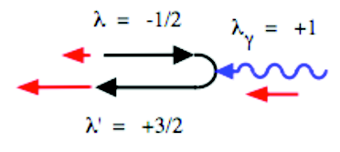
N(1520)D₁₃ Helicity Asymmetry
A_{1/2}² – A_{3/2}²
10⁻³ GeV^{-1/2}
A_{hel} =
A_{1/2}² + A_{3/2}²
A_{1/2}
L. Tiator
A_{3/2}
world data
PDG estimation
Nπ (UIM, DR)
Nπ, Nππ combined analysis
Nππ (JM)
Notes:
N(1720)P13 Ahel (Q2): 0.74 (0), 0 (0.7), 0.88 (1.3)

Slide 23
QCD-Based
Models and Theory

Slide 24
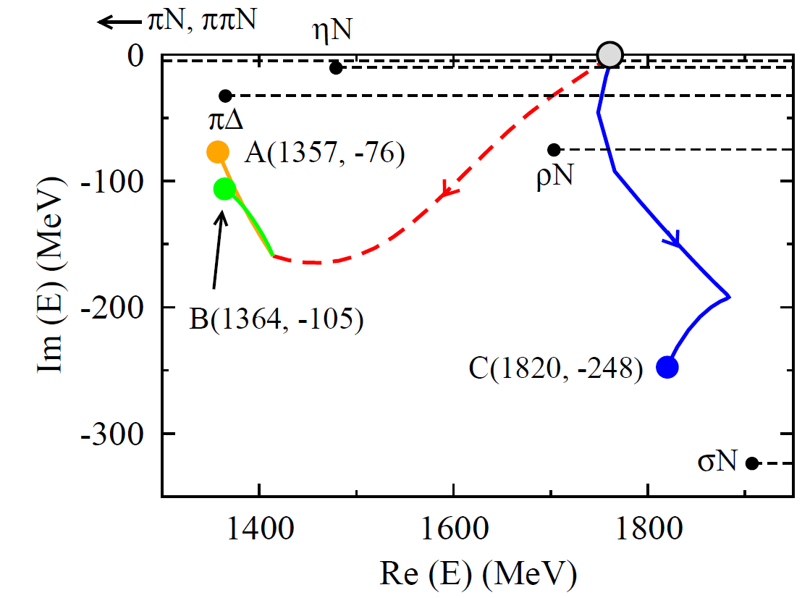
DSE and EBAC/ANL-Osaka Approaches
Location of the first 3-dressed-quark core
radial excitation predicted by DSE
Two poles associated with the Roper resonance and
one with the next higher P₁₁ resonance are all
seeded by the same bare 3-dressed-quark state
Int. J. Mod. Phys. E, Vol. 22, 1330015 (2013)
Notes:
DSE and LQCD are both fundamental approaches to calculate electrocouplings from basic QCD.

Slide 25
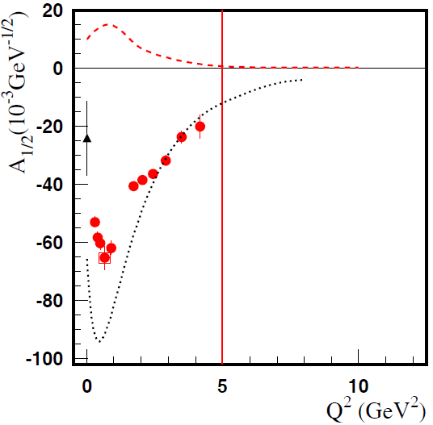
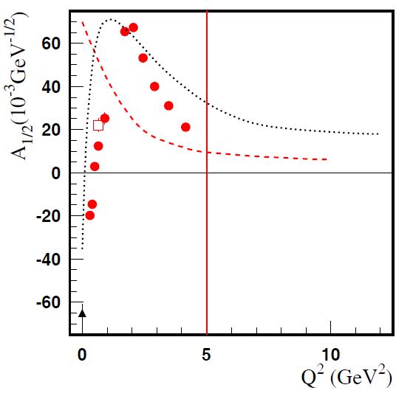
Progress in Experiment and Phenomenology
Meson-Baryon Dressing
D₁₃(1520)
P₁₁(1440)
absolute meson-baryon cloud amplitudes
(EBAC now ANL-Osaka)
quark core contributions (constituent quark models)
CLAS: Nπ and Nπ/Nππ combined (Phys. Rev. C80, 055203, 2009)
Resonance structures can be described in terms of an internal quark core and a surrounding meson-baryon cloud whose relative contribution decreases with increasing Q².
Data on γ_{v}NN* electrocouplings from exclusive meson electroproduction experiments at Q² > 5 GeV² will afford first direct access to the non-perturbative strong interaction among dressed quarks, their emergence from QCD, and the subsequent N* formation.
Notes:
Open box: combined, but double pion is only based on four not nine observables
25

Slide 26
Electrocouplings of N(1520)D₁₃
Electrocouplings of N(1520)D₁₃ and N(1535)S₁₁
A_{3/2}
A_{1/2}
10⁻³ GeV^{-1/2}
10⁻³ GeV^{-1/2}
10⁻³ GeV^{-1/2}
10⁻³ GeV^{-1/2}
A_{1/2}
S_{1/2}
Argonne Osaka / EBAC DCC MB dressing (absolute values)
π⁺π⁻p
2012
π⁺π⁻p
2010
Nπ
2009
E. Santopinto, M. Giannini, hCQM
PRC 86, 065202 (2012)
S. Capstick, B.D. Keister (rCQM)
PRD51, 3598 (1995)
ηp
CLAS/Hall-C
Notes:
Analysis of pη channel assumes S1/2=0
Branching ratios: βNpi = βNeta = 0.45

Slide 27
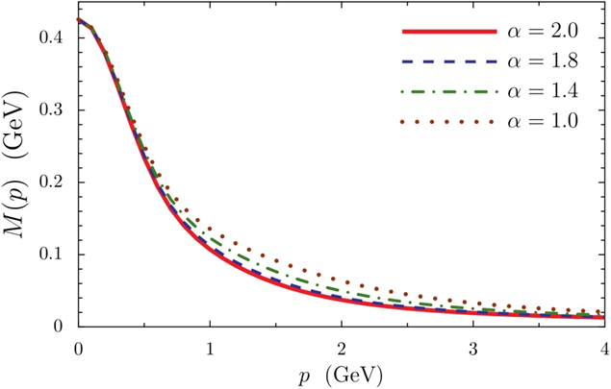
Dyson-Schwinger Equation (DSE) Approach
DSE approaches provide links between dressed quark propagators, form factors, scattering amplitudes, and QCD.
CLAS
CLAS12
EIC
N* electrocouplings can be determined by applying Bethe-Salpeter / Faddeev equations to
3 dressed quarks while the properties and interactions are derived from QCD.
Impact of a modified momentum dependence of the dressed-quark propagator.
Data Fit
Q² = 2.75 GeV² 12 GeV²
I.C. Cloet et al., arXiv:1304.0855[nucl-th]
DSE electrocouplings of several excited nucleon states will become available as part of the commitment of the Argonne NL.
Int. J. Mod. Phys. E, Vol. 22, 1330015 (2013) 1-99

Slide 28
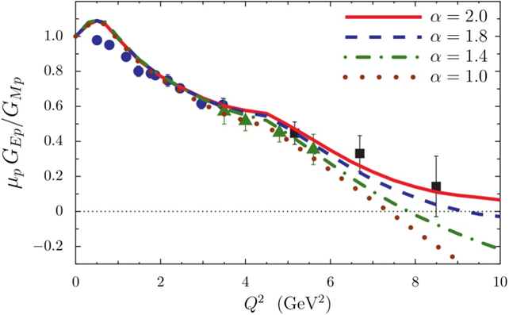
Dyson-Schwinger Equation (DSE) Approach
DSE approaches provide links between dressed quark propagators, form factors, scattering amplitudes, and QCD.
CLAS
CLAS12
N* electrocouplings can be determined by applying Bethe-Salpeter / Faddeev equations to
3 dressed quarks while the properties and interactions are derived from QCD.
DSE calculations of elastic and transition form factors are very sensitive to the momentum dependence of the dressed-quark propagator.
Data Fit
I.C. Cloet et al., arXiv:1304.0855[nucl-th]
DSE electrocouplings of several excited nucleon states will become available as part of the commitment of the Argonne NL.
Int. J. Mod. Phys. E, Vol. 22, 1330015 (2013) 1-99

Slide 29
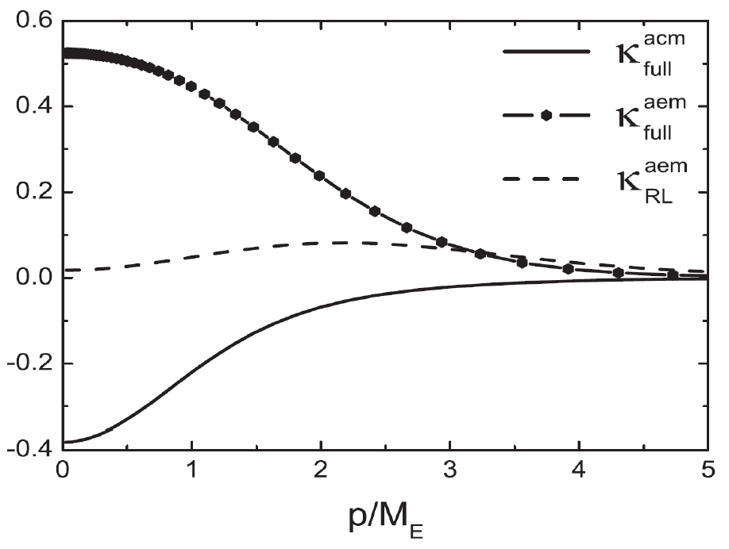
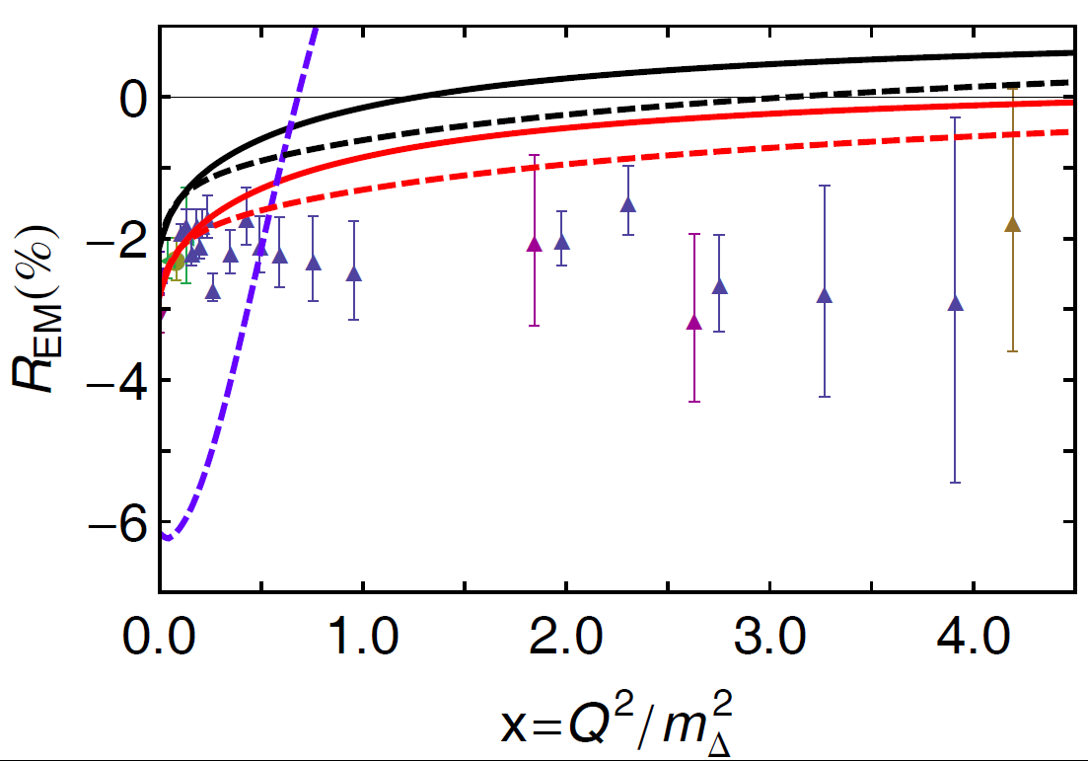
Anomalous Magnetic Moment in DSE Approach
J. Segovia
contact interaction
sophisticated interaction
with momentum dependent κ
renormalized at real photon point
L. Chang et al., PRL 106 (2011) 072001
The DSE calculation of R_{EM} zero crossing is sensitive to the momentum dependent anomalous magnetic moment of the dressed-quark.
Notes:
Contact Interaction (CI): mq=const (old amm=0 and new amm=const)
Sofisticated Interaction (SI): m momentum dependent, amm=const, full Poincare treatment of meson and Fadeev amplitudes, exchange and seagull diagrams
SI (newest): also amm momentum dependent

Slide 30
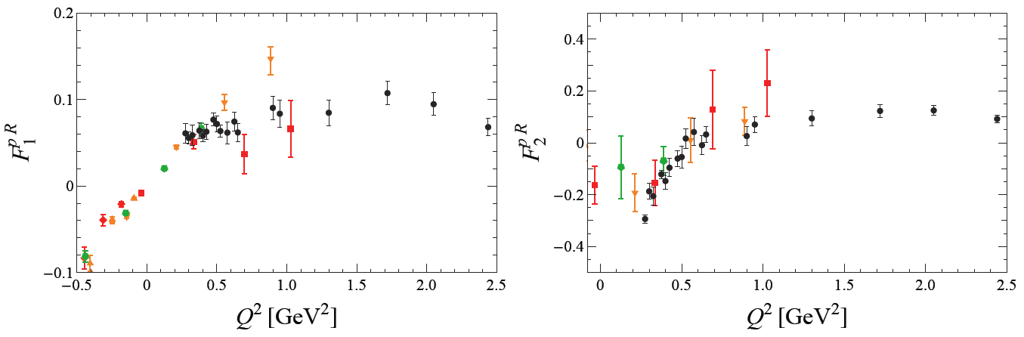
Roper Transition Form Factors in LQCD
p(1440)P₁₁
Huey-Wen Lin and S.D. Cohen
CLAS Data
CLAS Data
Lattice QCD calculations of the p(1440)P₁₁ transition form factors have been carried out with various pion masses, m_{π}= 390, 450, and 875 MeV. Particularly remarkable is the zero crossing in F₂ that appears at the current statistics in the unquenched but not in the quenched calculations. This suggests that at low Q² the pion-cloud dynamics are significant in full QCD.
LQCD calculations of N* electrocouplings will be extended to Q² = 10 GeV² near the physical π-mass as part of the commitment of the JLab LQCD and EBAC groups in support of this proposal.
Int. J. Mod. Phys. E, Vol. 22, 1330015 (2013) 1-99
Notes:
m_{πι}= 390, 450, and 875 MeV with volumia 3, 2.5, 2.5 fm, green, red, orange
LQCD offers a straight forward way to relate N* electrocouplings to QCD. Recent LQCD results are just the first step.
High Q^2 LQCD calculations allow us to relate dressed quark interactions to QCD.
Upto now lower Q^2 involves meson baryon contributions and is thus much more complicated.
the so-called quenched approximation can be used, in which the quark fields are treated as non-dynamic "frozen" variables. While this was common in early lattice QCD calculations, "dynamical" fermions are now standard

Slide 31
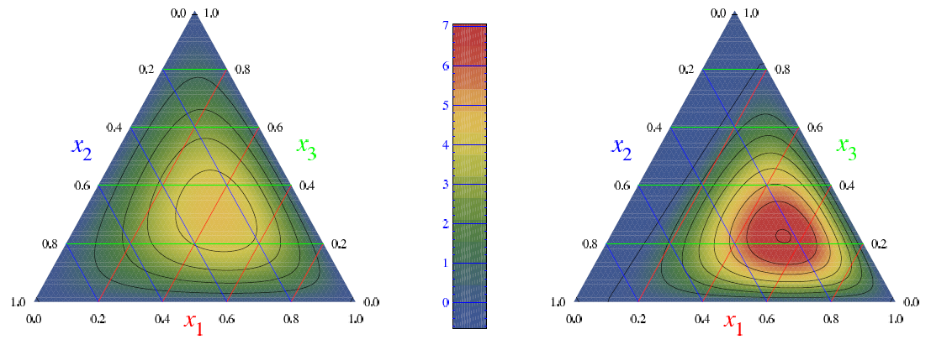
LQCD & Light Cone Sum Rule (LCSR) Approach
N(1535)S₁₁
N
S₁₁
LQCD is used to determine the moments of N* distribution amplitudes (DA) and the N* electrocouplings are determined from the respective DAs within the LCSR framework.
Calculations of N(1535)S₁₁ electrocouplings at Q² up to 12 GeV² are already available and shown by shadowed bands on the plot.
LQCD & LCSR electrocouplings of others N* resonances will be evaluated as part of the commitment of the University of Regensburg group.
Int. J. Mod. Phys. E, Vol. 22, 1330015 (2013) 1-99
Notes:
Analysis of pη channel assumes S1/2=0
Branching ratios: βNpi = βNeta = 0.45

Slide 32
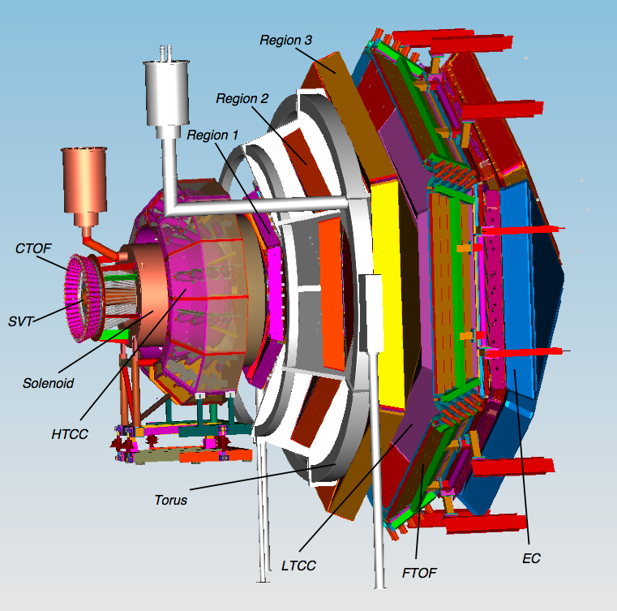
CLAS12
CLAS12
Forward
Detector
Luminosity > 10³⁵ cm⁻²s⁻¹
Hermeticity
Polarization
Baryon Spectroscopy
Elastic Form Factors
N to N* Form Factors
GPDs and TMDs
DIS and SIDIS
Nucleon Spin Structure
Color Transparency
…
Central
Detector
1m

Slide 33
Anticipated N* Electrocouplings from Combined Analyses of Nπ/Nππ
P₁₁(1440)
D₁₃(1520)
S₁₁(1535)
CLAS
Hall C
CLAS
CLAS
Open circles represent projections and all other markers the available results with the 6-GeV electron beam
Examples of published and projected results obtained within 60d for three prominent excited proton states from analyses of Nπ and Nππ electroproduction channels. Similar results are expected for many other resonances at higher masses, e.g. S₁₁(1650), F₁₅(1685), D₃₃(1700), P₁₃(1720), …
The approved CLAS12 experiments E12-09-003 (NM, Nππ) and E12-06-108A (KY) are currently the only experiments that can provide data on γ_{v}NN* electrocouplings for almost all well established excited proton states at the highest photon virtualities ever achieved in N* studies up to Q² of 12 GeV², see https://userweb.jlab.org/~carman/ky12/temple-final.pdf .
Notes:
Errors: projections and D13 data stat^2+syst^2, P11 and S11 data only stat
Blue overlap with and red limit of current data

Slide 34
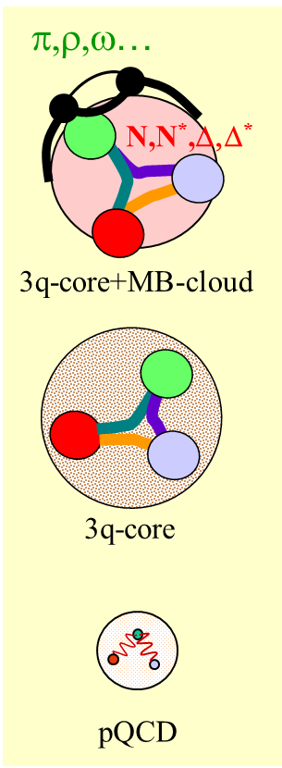
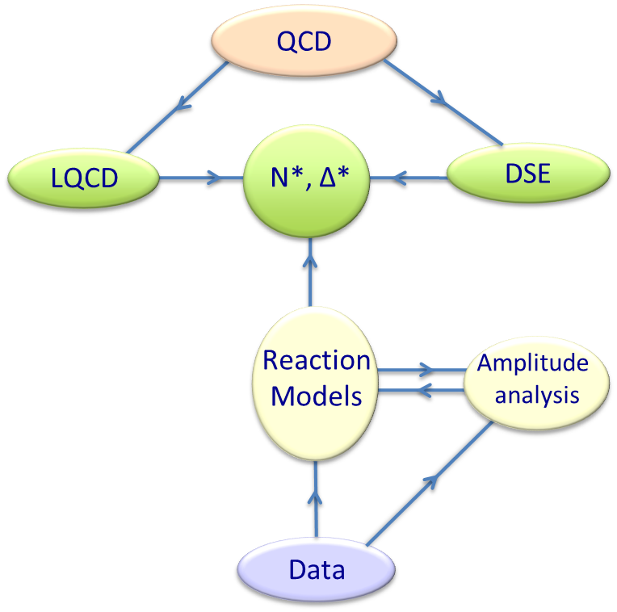
Summary
Personal Summary
First high precision photo- and electroproduction data have become available and led to a new wave of significant developments in reaction and QCD-based theories.
New high precision hadro-, photo-, and electroproduction data off the proton and the neutron will stabilize coupled channel analyses and expand the validity of reaction models, allowing us to
  investigate and search for baryon hybrids,
  establish a repertoire of high precision spectroscopy parameters, and
  measure light-quark-flavor separated electrocouplings over an extended Q²-range for a wide variety of N* states.
Support This!
Comparing these results with DSE, LQCD, LCSR, and rCQM will build insights into
  the strong interaction of dressed quarks and their confinement,
  the emergence of bare quark dressing and dressed quark
  interactions from QCD, and
  the QCD β-function and the origin of 98% of nucleon mass.
A tight collaboration of experimentalists and theorists has formed and is needed to push these goals, see Review Article Int. J. Mod. Phys. E, Vol. 22, 1330015 (2013) 1-99, that shall lead to a QCD theory that describes the strong interaction from current quarks to nuclei.
Notes:
34
3 channles times 4 structure functions (12) plus 9 single diff cross sec => 21 observables
60 days, lattice, GPDs, easier to study, different branching ratios, combined analysis, transition towards partonic degrees of freedom

