Slide 1

The p+A Programs at RHIC and the LHC
John Lajoie
Iowa State University
Many thanks to Ernst Sichtermann, Tony Frawley, Elke Aschenauer, Brian Cole, Hannu Paukkunen, Anne Sickles, Marco Stratmann, Julia Velkovska, …

Slide 2
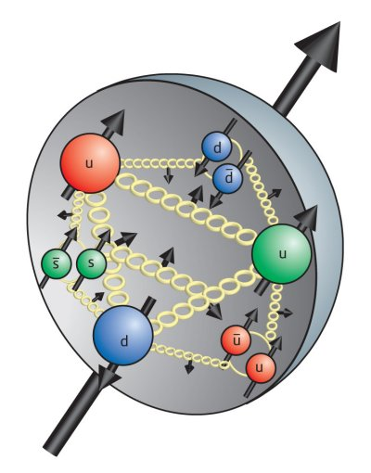
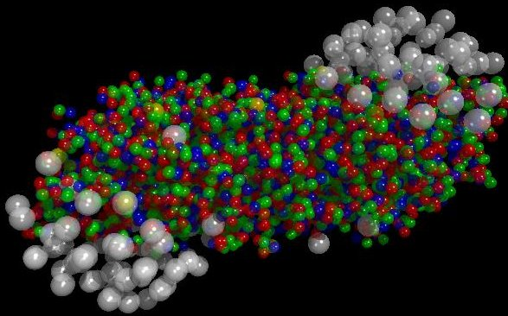
The Big Picture At RHIC and the LHC
How do collective, many-body phenomena arise from first-principles QCD?
Quark-Gluon Plasma
Polarized Protons
Gluons in Nuclei

Slide 3
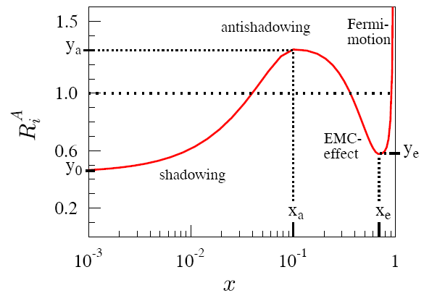
Gluons in Nuclei
gluons
shadowing/saturation in nuclei
Fit data on nuclei:
SLAC, NMC, EMC
DIS+DY+PHENIX
midrapidty π⁰
Lack of data
⇨large uncertainly
in gluon pdf
at low-x
Large uncertainty
at low-x
Paukkunen DIS 2014
Large uncertainties in the nuclear gluon PDF at low-x: many important effects to disentangle – shadowing, antishadowing, nonlinear QCD, saturation, etc.
Important for fundamental understand of partonic processes in nuclei, as well as for the initial conditions at RHIC and the LHC.

Slide 4
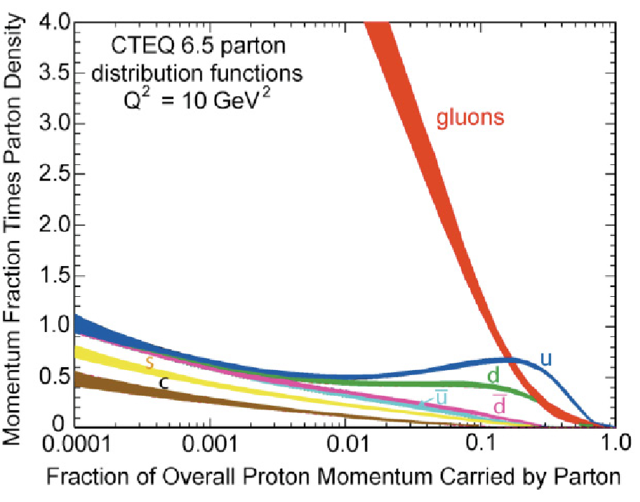
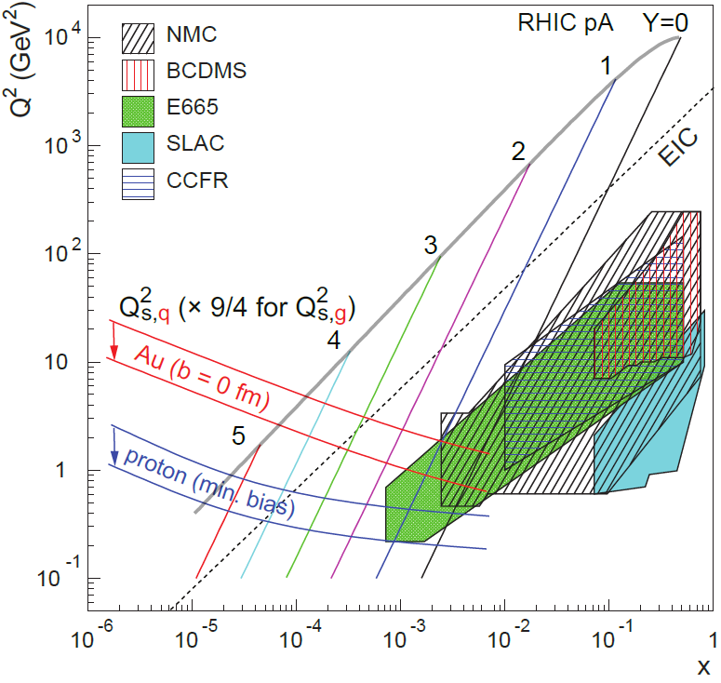
Saturation
The gluon density grows to the point where recombination tames the growth of the gluon distribution at small x.
(x)
The nucleus is an amplifier of high gluon densities.
gluons

Slide 5
The Big Questions
What is the gluon density in heavy nuclei? How is it modified in the nuclear environment?
What role does saturation play in determining this gluon density?
What is the saturation scale Q_{s}, and how does it depend on A and x?

Slide 6
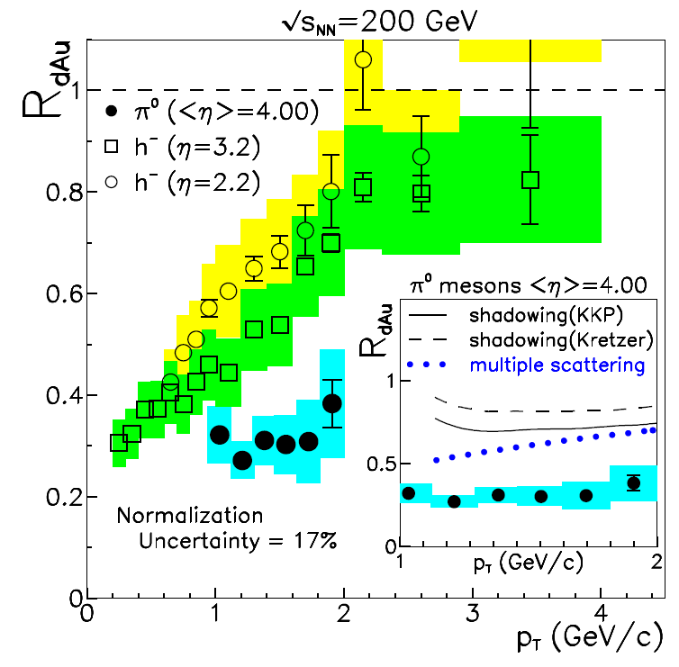
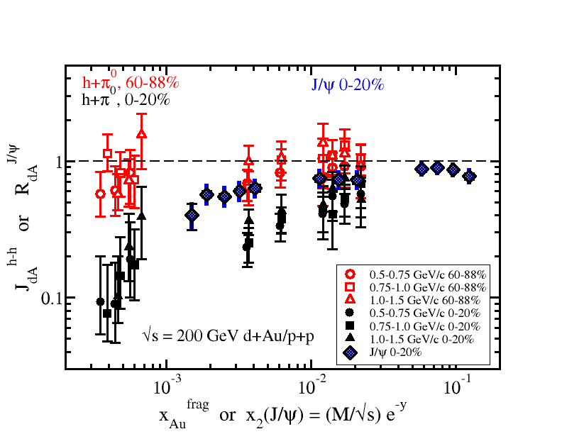
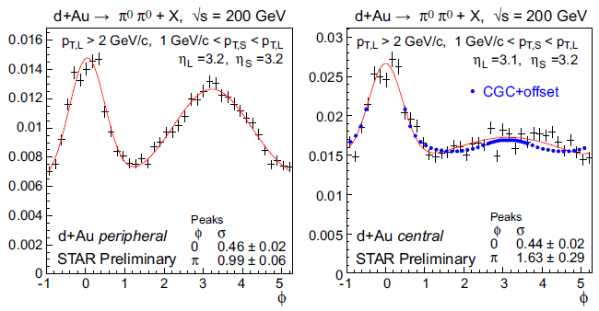
What do we know from d+Au at RHIC?
PHENIX/BRAHMS/STAR R_{dAu}
Forward R_{dAu} shows higher suppression
PHENIX/STAR forward π⁰ correlations and J/Ψ suppressed
6

Slide 7
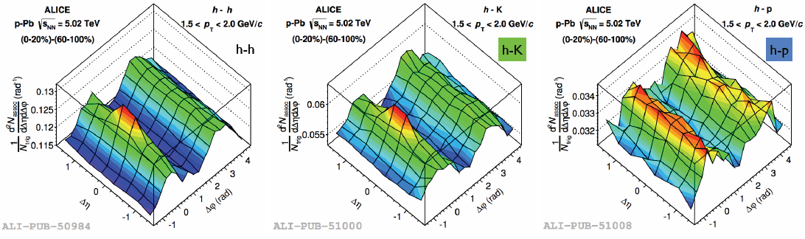
What do we know from p+Pb at the LHC?
“Collective” behavior observed in high multiplicity p+p/p+Pb collisions!
Similar behavior observed in RHIC d+Au…
What is the origin of this behavior?
Jet-medium/multi-parton interactions
(arXiv 1203.2048)
CGC (PRD 87 094304)
Hydrodynamics from small dense system
(arXiv 1211.0845)
STAR Preliminary
CMS: Phys. Lett. B718 (2013) 795
ATLAS: Phys. Rev. Lett. 110 (2013) 182302
ALICE: Phys. Lett. B719 (2013) 29-41
Y. Li QM2014
Phys. Rev. Lett. 111 (2013) 112301

Slide 8
The Near Future

Slide 9

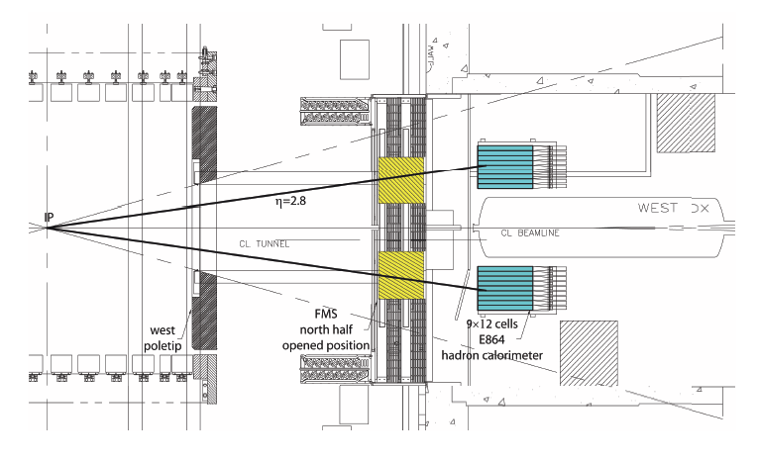
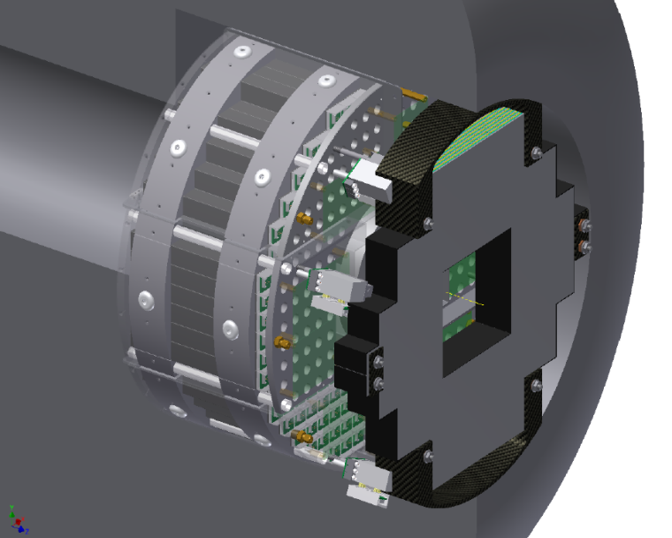

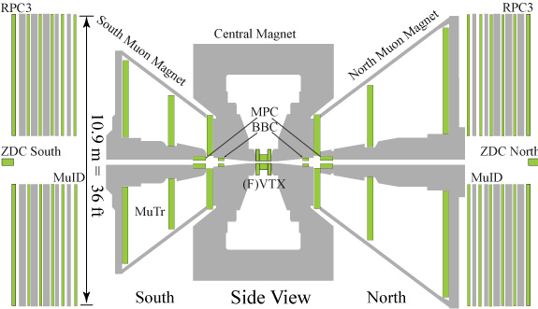
RHIC Near Term Upgrades
STAR FPS Preshower Array
PHENIX MPC-EX Preshower

Slide 10
nPDF Limits from Photons @ RHIC
No CNM final state effects!
90% C.L.
Example using MPC-EX pseudodata to constrain EPS09 family of curves.
Prompt photons in p+Au -> Precise Measurement of Gluons at Low-x

Slide 11
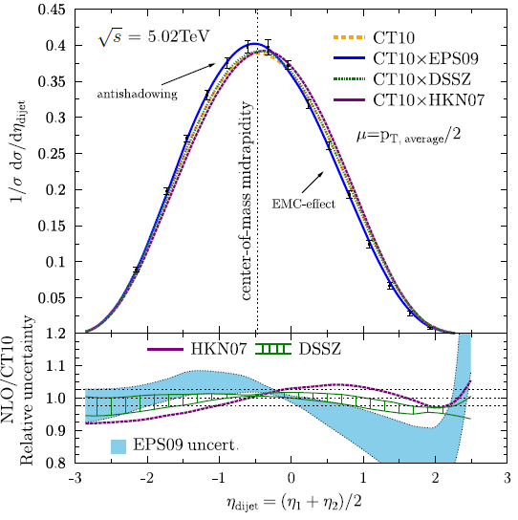
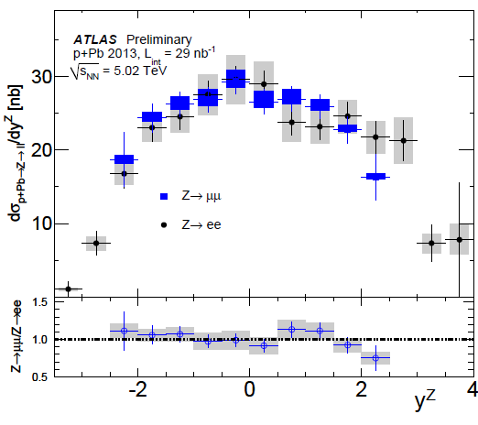
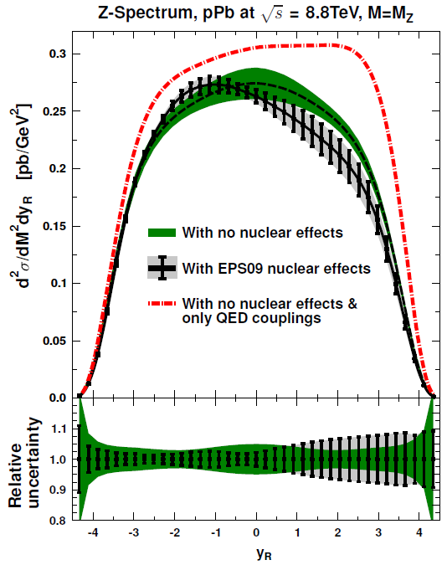
Constraints on nPDFs from the LHC
Existing CMS p+Pb dijet measurements can discriminate between different nPDFs.
Future results for photons, W^{+/-}, and Z bosons in p+Pb collisions will constrain nPDFs at a large scale.
ATLAS-CONF-2014-20
JHEP 1103 (2011) 071
JHEP 1310 (2013) 213
A combination of the RHIC and LHC data will provide significant new constraints on nPDFs.
CMS PAS HIN-13-007

Slide 12
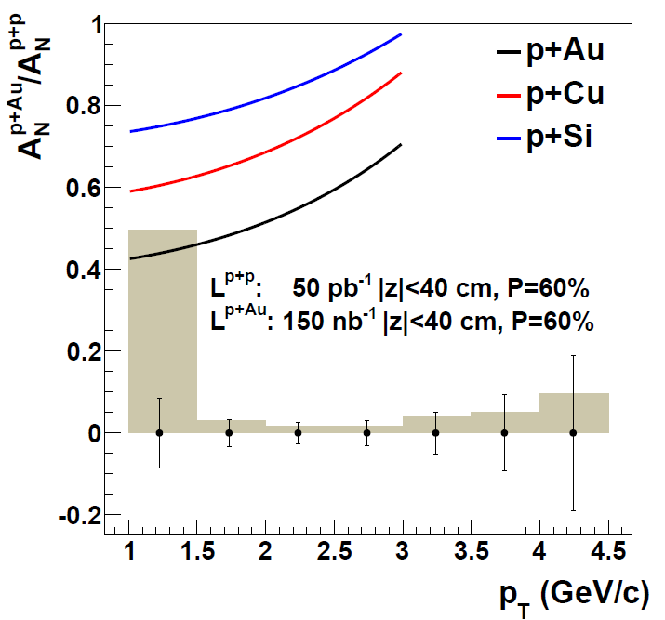
Polarized p+A Collisions at RHIC
Y. Kovchegov & M.D. Sievert: PRD 86, 034028 (2012)
Kang, Yuan: PRD 84, 034019 (2011)
Left
Q_{sp}² = (1.0 GeV)²
Q_{sA}² = (2.5 GeV)²
δ = 0.16 GeV
Right
Single spin asymmetries can act as a probe of the saturation scale – the p+p reference will also be better understood with new instruments.
Dependence of Q_{sA} on A
Combined with other measurements this can estimate Q_{sp}
A unique capability of RHIC!

Slide 13
The Future p+A Program

Slide 14
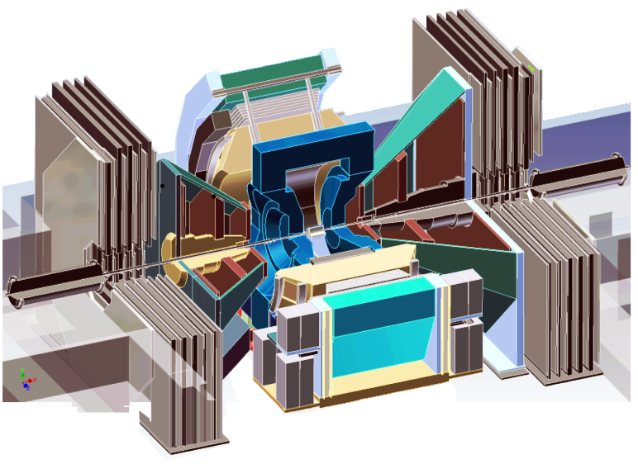
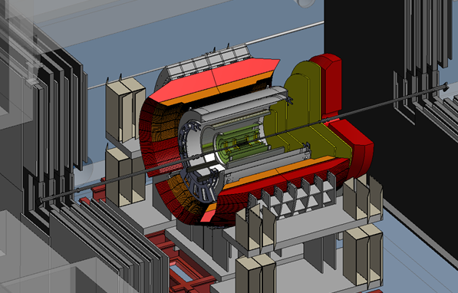
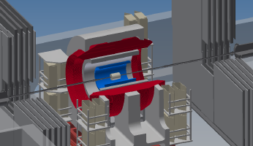
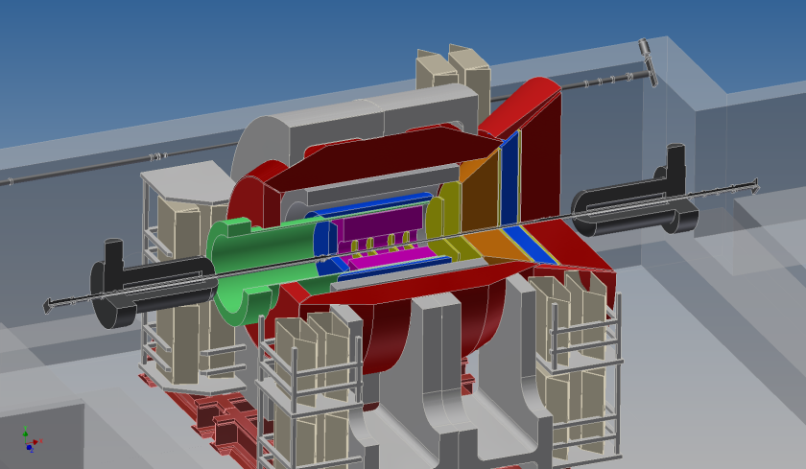
The PHENIX Detector Evolution
PHENIX
sPHENIX + fsPHENIX
sPHENIX
2021-22
Evolve sPHENIX (HI detector) with forward instrumentation for p+p/p+A physics:
GEM tracking chambers
Hadronic Calorimetry
Reconfigure existing FVTX and MuID
fsPHENIX forward instrumentation in common with evolution of sPHENIX into an EIC (eRHIC) detector.
~2025
EIC Detector
14

Slide 15
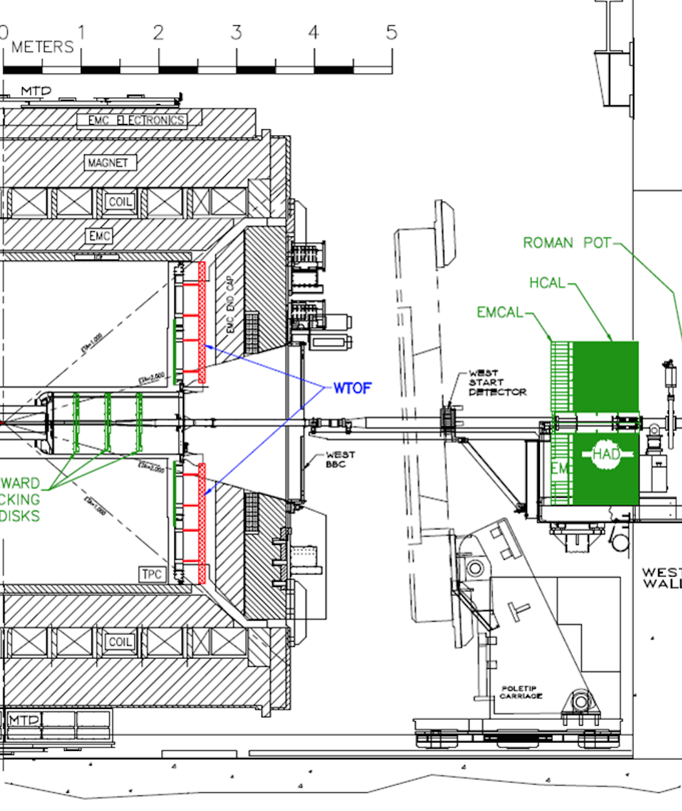
STAR Forward Upgrades for 2021+
Forward Upgrades:
ECal:
Tungsten-Powder-Scintillating-fiber
2.3 cm Moliere Radius, Tower-size: 2.5x2.5x17 cm³, 23 X_{o}
HCal:
Lead and Scintillator tiles, Tower size of 10x10x81 cm³
4 interaction length
Tracking:
Silicon mini-strip detector 3-4 disks at z ~70 to 140 cm
Each disk has wedges covering full 2π range in ϕ
and 2.5-4 in η (other options still under study)
STAR is also pursuing a coordinated upgrade path that can lead to an EIC detector.
Roman Pots Phase-II :

Slide 16
Future p+A Measurements @ RHIC
Correlations:
  h-h and π⁰-π⁰ are straightforward experimentally
  γ-h and γ-π⁰ are easier to interpret
  jet-jet, γ-jet gives access to complete kinematics at LO
Ultra-Peripheral Collisions:
  Access to g(x,Q²,b)
Drell-Yan:
  Access q_{bar}(x,Q₂)
  Complete kinematics: x₁, x₂, Q²
  True 2->1 process yields access to x<0.001

Slide 17
A p+A Timeline for the LHC and RHIC
ATLAS:
Trigger Upgrades
Inner Tracker
CMS:
L1 Trigger
HCAL Upgrade
ALICE:
ITS Upgrade
Trigger and DAQ
Future ion running at LHC to be split between p+Pb and Pb+Pb…
1 Month Ion Running 11/2015, 11/2016, 6/2018
1 Month Ion Running 11/2020, 11/2021, 12/2022
LHC
End of LS1
LS2 7/18-12/19
2015
2021-2023
>2025
STAR Upgrades:
FMS-Preshower, Roman Pots-II*
PHENIX Upgrade:
MPC-EX Preshower
Run:
p+p 200 GeV
p↑+Au 200 GeV
transverse
Goals:
nPDF: g(x,Q²)
Saturation
Energy loss in CNM
STAR Upgrades:
Forward tracker, Ecal+Hcal, Roman Pots-II
PHENIX Upgrades:
f/sPHENIX barrel + forward
Run:
p+p 200 GeV
p↑+A (Au, Cu, C…) 200 GeV
transverse
Goals:
nPDF: g(x,Q²), q(x,Q²)
Saturation
Energy loss in CNM
Electron-Ion Collider
RHIC

Slide 18
Why RHIC and the LHC?
RHIC:
  RHIC “straddles” Q_{sA}
    RHIC can make measurements both above and below the saturation scale (rapidity and centrality)
  RHIC can explore the dependence of the saturation scale on nuclear size
    Flexibility of RHIC collider to run p+A with multiple A species
  Polarized p↑+A collisions offer a unique, fundamentally new observable
LHC:
  The LHC measurements provide a large lever arm in Q².
  Higher energy at the LHC makes available new probes (W^{+/-}, Z)
Measurements at RHIC and the LHC and complementary!

Slide 19
Why p+A and e+A?
p+A:
  Initial kinematics undetermined – a given measurement averages over a range in x
  Essential for comparison with e+A to separate
  universal physics from process
  dependence.
e+A:
  Initial kinematics determined
  event-by-event
  Large range in x,Q²

Slide 20
Summary
The study of p+A collisions offers a window into the structure of matter:
  Important to understand partonic processes on nuclei
  Sets the initial conditions for HI collisions
  Tantalizing hints of saturation in current RHIC data
  Exciting evidence of collective behavior
Near-term detector upgrades at RHIC and analysis of existing LHC data will continue the success and open new approaches:
  Prompt photons in the PHENIX MPC-EX and STAR FMS
  New nPDF constraints from RHIC + LHC data
  Polarized p+A collisions a unique scientific opportunity!
PHENIX/STAR forward upgrades will enable critical new observables on the road to the EIC
  Extend observables to include jets, DY
Measurements in e+A at the EIC will enable a complete, systematic study of the behavior of low-x gluons in nuclei.

Slide 21
BACKUP

Slide 22
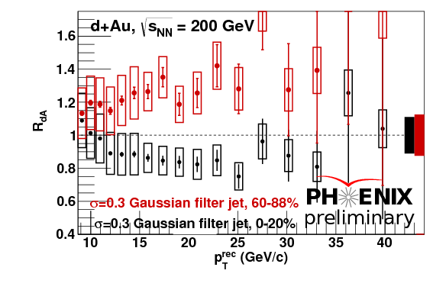
An Intriguing Idea…
Jet R_{pPb} at LHC and R_{dAu} at RHIC show a surprising
pattern – suppression in central events,
enhancement for peripheral!
Seems to be an initial state effect associated with the x
of the parton from the proton!
minbias
Pb
high-x parton
ATLAS-CONF-2014-24
Pb
Fluctuations in proton size correlate with centrality!?
hep-ph/1307.5911
ATLAS-CONF-2014-24

Slide 23
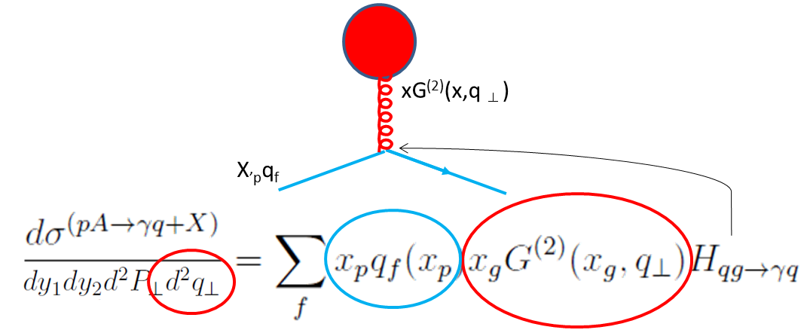
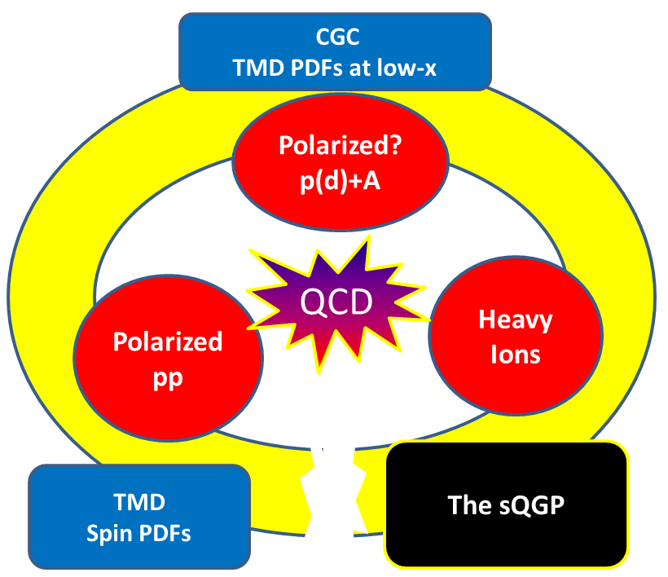
Connection to EIC : TMD Gluon PDFs
Dominguez, Marquet, Xiao, Yuan: Phys Rev. D 83: 105005 (2011)
Transverse Momentum Dependent (TMD) factorization is recovered in low-x limit in p+A, consequence is two gluon distributions!
TMD PDF’s at low-x are equivalent to those obtained in the Color Glass Condensate framework!
The TMD framework is important in attempts to understand single-spin asymmetries!
Strong synergies between RHIC programs!

Slide 24
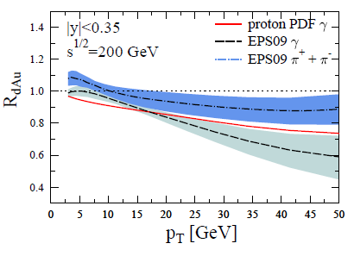
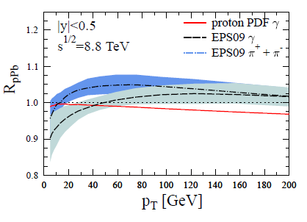
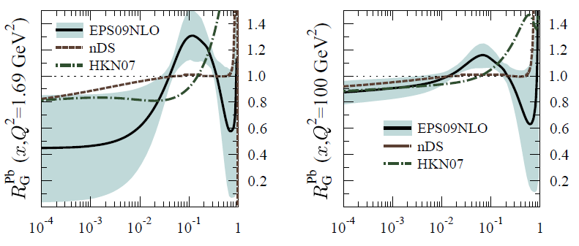
Prompt Photon Predictions
arXiv:1103.1471v2
RHIC
LHC

Slide 25
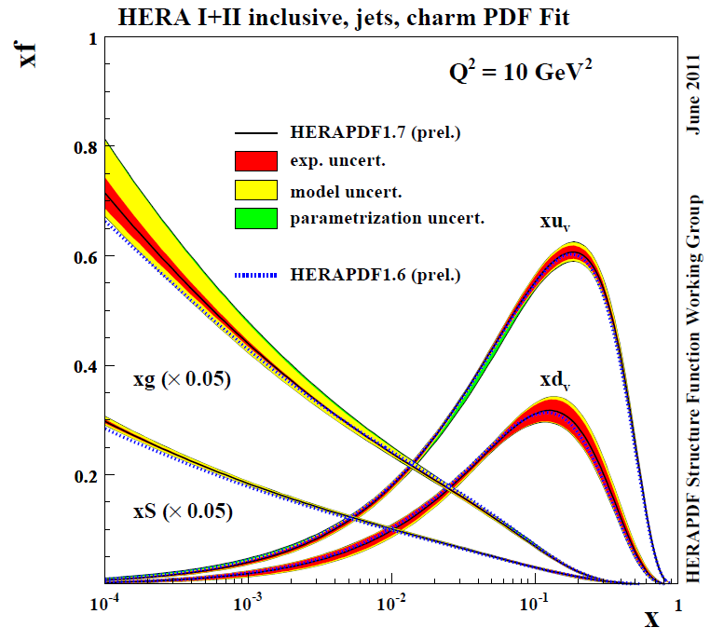
PDF’s

Slide 26
nPDF Constraints from the LHC
arXiv:1408.4563v1

Slide 27
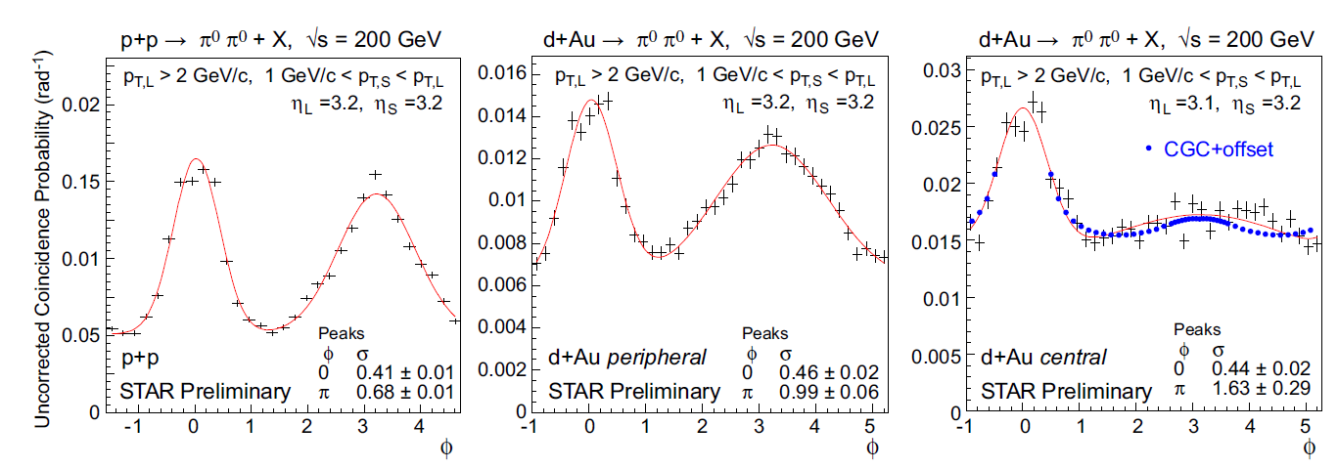
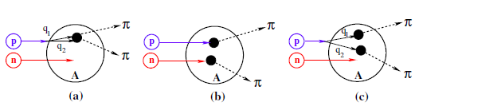
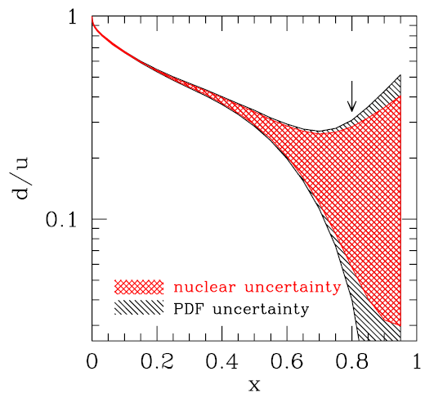
Why p+A instead of d+A?
Multi-parton interactions can contribute to the suppression of the away-side correlation strength.
Phys. Rev. D 84 014008 (2011)
Forward rapidity corresponds to high-x in the projectile nucleon (d or p). Nuclear corrections at high-x are large for the deuteron, which may necessitate d+p running for proper comparison.
…and you can’t polarize the deuteron at RHIC…

