Slide 1
QCD &
Hadron Physics
APS Division of Nuclear Physics:
2014 Long-range plan
Joint Town Meetings on QCD
Temple University, September 13-15, 2014

Slide 2
Background
LRP Charge delivered at 24 April NSAC Meeting
26 May 2014
Haiyan and I were nominated by the DNP Executive Committee to be the conveners for the Hadron QCD town meeting.
We accepted; and have been working with Ulrich Heinz and Paul Sorenson to arrange the programmes for these joint meetings
LRP Working Group was finalised by early in June
DNP town meetings in August/September
That’s why we’re here now
End-January 2015: White papers, summarising the Town Meetings
Late March – early April 2015, resolution meeting of Long Range Plan Working Group
LRP: Final report is anticipate by October 2015

Slide 3
Local Organising Committee
Jim Napolitano (Co-Chair) (Temple University)
Bernd Surrow (Co-Chair) (Temple University)
Jeff Martoff (Temple University)
Andreas Metz (Temple University)
Zein-Eddine Meziani (Temple University)
Nikos Spaveris (Temple University)
Invaluable … in securing meeting and accommodation space, constructing and maintaining meeting website … Indeed, making it possible for these community-wide discussions to take place.

Slide 4
Programme Committee
Stan Brodsky (SLAC National Accelerator Laboratory)
Abhay Deshpande (Stony Brook University)
Bob McKeown (Jefferson Laboratory)
Curtis Meyer (Carnegie Mellon University)
Dave Richards (Jefferson Laboratory)
Feng Yuan (Lawrence Berkeley National Laboratory)
Haiyan and I consulted these people extensively in preparing the programme.

Slide 5
Charge to the Speakers
The goal of these Town Meetings is to gather forceful arguments in support of our field of research that can be included in the Long Range Plan and thereby used to define and secure the future of Nuclear Physics in the USA.
We expect that all plenary presentations describe selected highlights of the past seven years but also identify the key questions and plausible paths to solutions that should define our next decade.
Presentations of this nature will document seven years of success and describe a vision for our future that will enable our Committees to write the White Papers from which the Long Range Plan will be fashioned.

Slide 6
Structure of the Town Meetings
Two days running in parallel, Cold- and Hot-QCD in tandem
One day of joint presentations
Day 1 – today – is LONG
Begins with sessions running in parallel, until 4pm
First joint session begins at 4pm today, with closing at 8pm
Joint session continues on Sunday, until 4pm
Revert to parallel running at 4:30pm Sunday
QCD and Hadron Physics closing discussion 2-4pm on Monday
Discussion of recommendations in the White Paper
Writing assignments

Slide 7
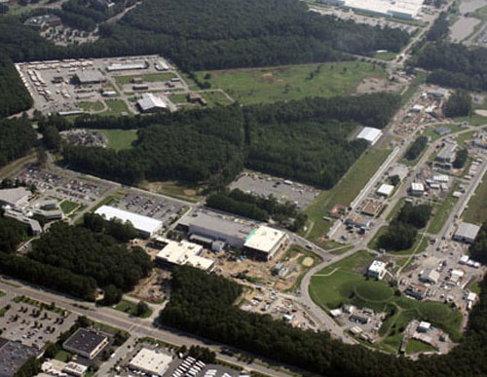
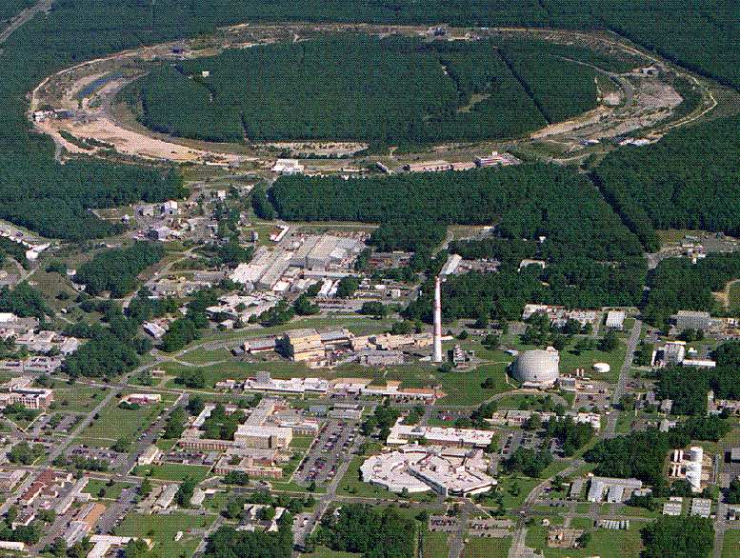
Major Sponsors
JLab
RHIC

Slide 8
Major Sponsors
DNP

Slide 9
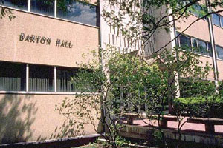
Major Sponsors
Temple Department of Physics
Temple College of Science & Technology.
Both have provided enormous help with staff and also server support for the web page and internet services.

Slide 10
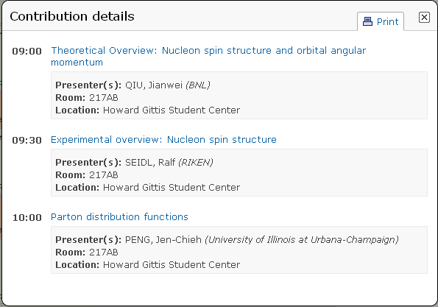
Opening Session
Hadron Structure at Short Distance I:
Chair: Sebastian Kuhn

