Slide 1
2020 Update
European Strategy for Particle Physics
Joachim Mnich
CERN
XXVIII International Workshop on Deep-Inelastic Scattering and Related Subjects
Virtual Event @ Stony Brook University, April 12-16, 2021

Slide 2

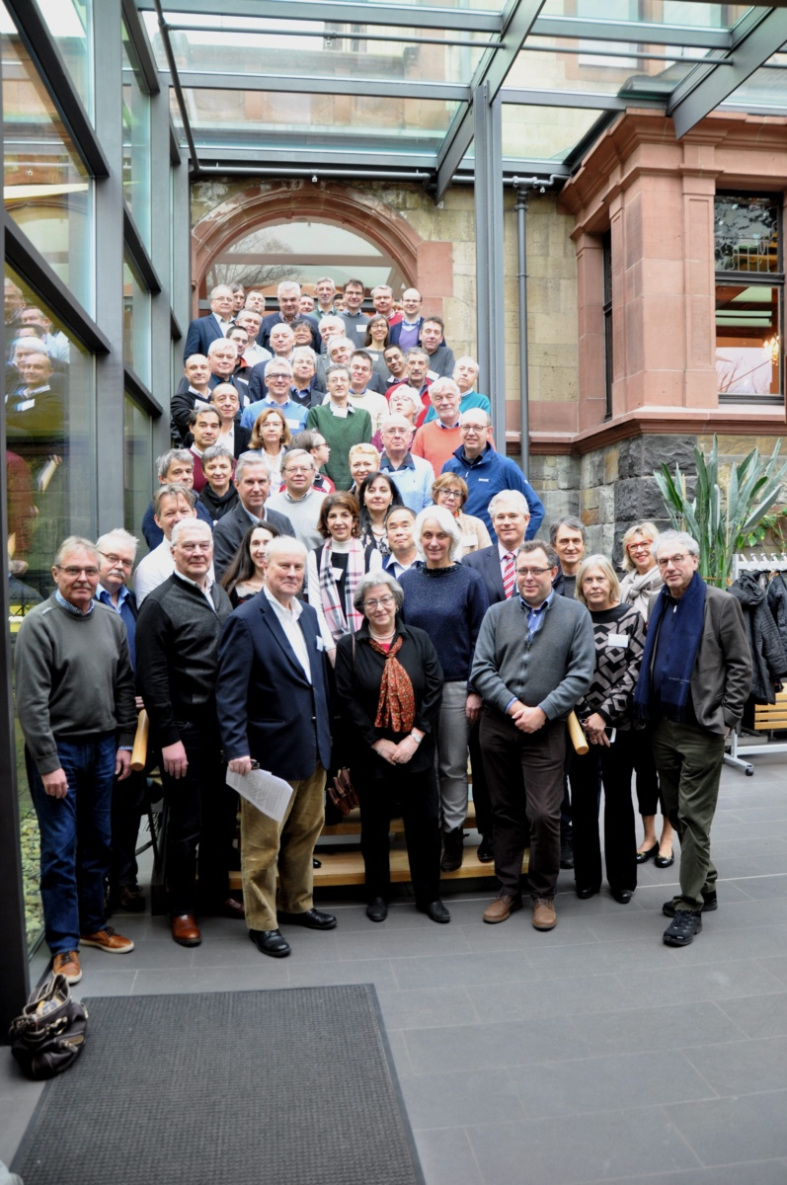
The Strategy Process
Initiated by CERN Council in 2017
a process spanning over several years
Open Symposium
May 2019
Strategy Group at
the drafting session
January 2020

Slide 3
The Strategy Process
CERN Council updated the Eureopean Strategy for Particle Physics in June 2020
Document contains 20 statements on
Major developments
General considerations
High-priority future projects
Other essential activities for particle physics
Organisational issues
Environmental and societal impact
Here: focus on a few selected statements and the developments since June 2020

Slide 4
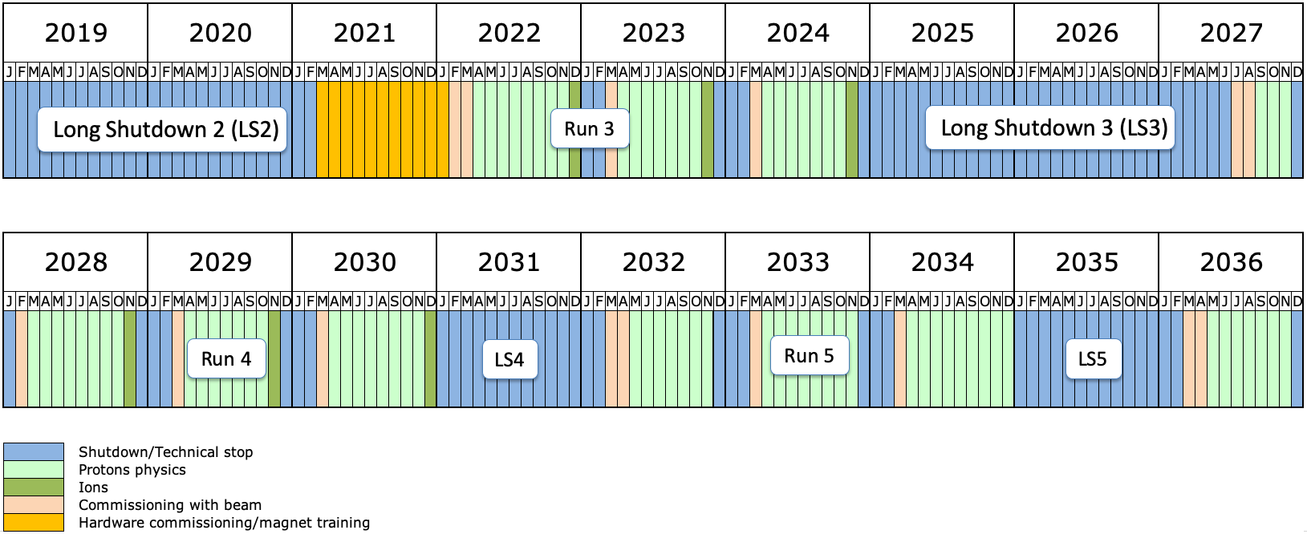
LHC
The successful completion of the high luminosity upgrade of the machine and detectors should remain the focal point of European particle physics, …
Phase I upgrade
ALICE, ATLAS, CMS, LHCb
Phase II upgrade
ATLAS, CMS
High-lumi LHC
Plans for upgrades ALICE; LHCb
Final goal
3000 - 4000 fb⁻¹

Slide 5
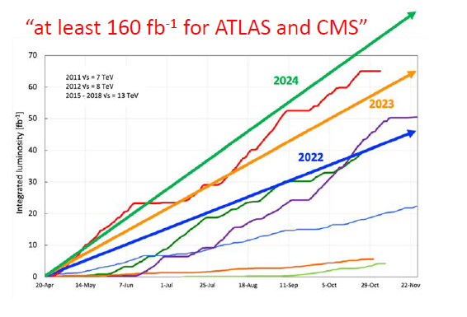
LS2 and Preparation for Run 3
Closure of caverns February 2022
pilot run end September 2021
training campaign started to
reach 14 TeV
Run 3 expected luminosity ≥160 fb⁻¹
≈ doubling the ATLAS/CMS
data set of Run 1 + 2

Slide 6
Status LHC
Sector by sector, 154 dipoles in series
LHC Injectors Upgrade (LIU)
increase beam intensity and brightness to meet HL-LHC demands
work sucessfully completed end 2020
goal 2021: re-establish pre-LS2 parameters
then ramp up to full LIU specs
Dipole training campaign started in several sectors
goal is to re-establish B-field required for
7 TeV proton beam energy
(attained by all dipoles before installation)
Notes:
Factor 2 in intensity, factor 2.5 in brightness

Slide 7
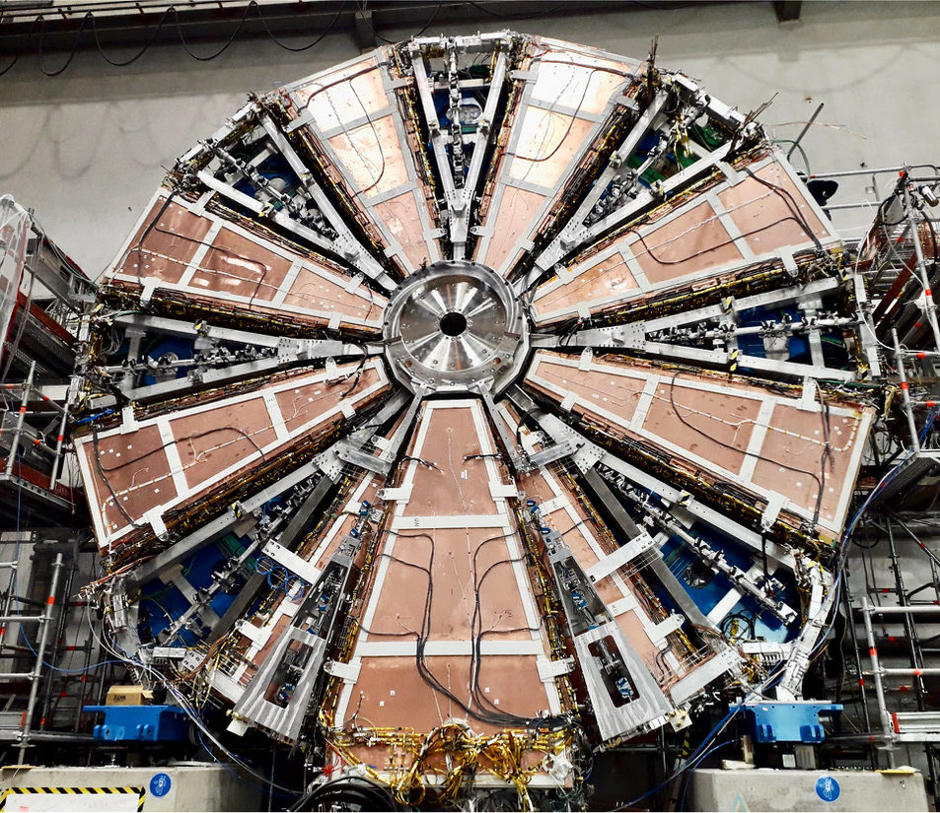
Status Experiments
Upgrades of the experiments impacted by the pandemic
closure of universities, labs, …
travel restrictions
But also a lot of progress
experiments are working hard to keep the schedule
ATLAS New Small Wheel A, status March 2021

Slide 8
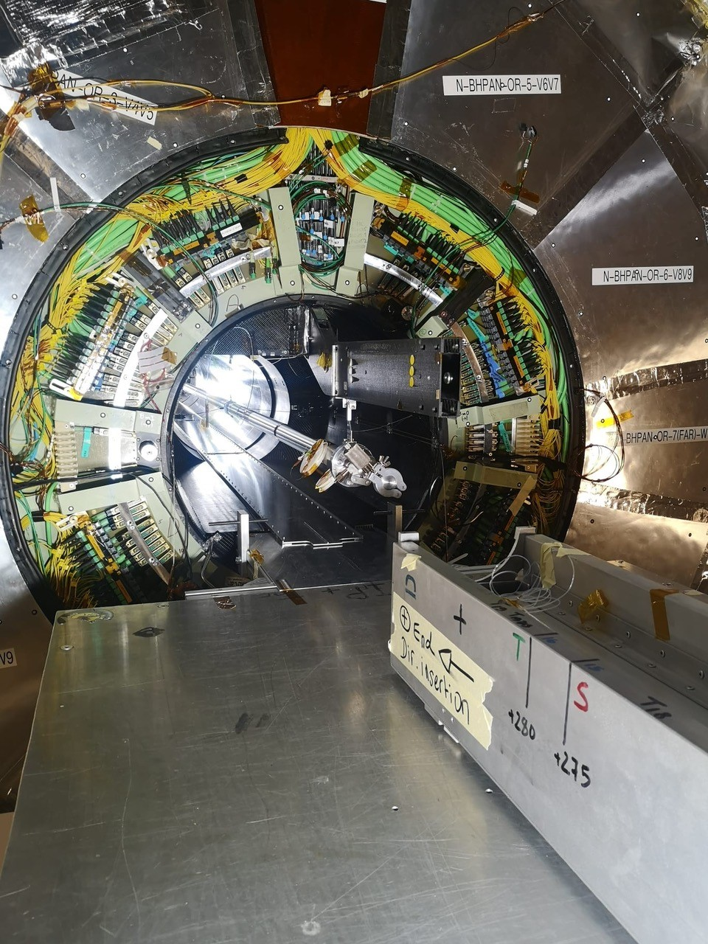
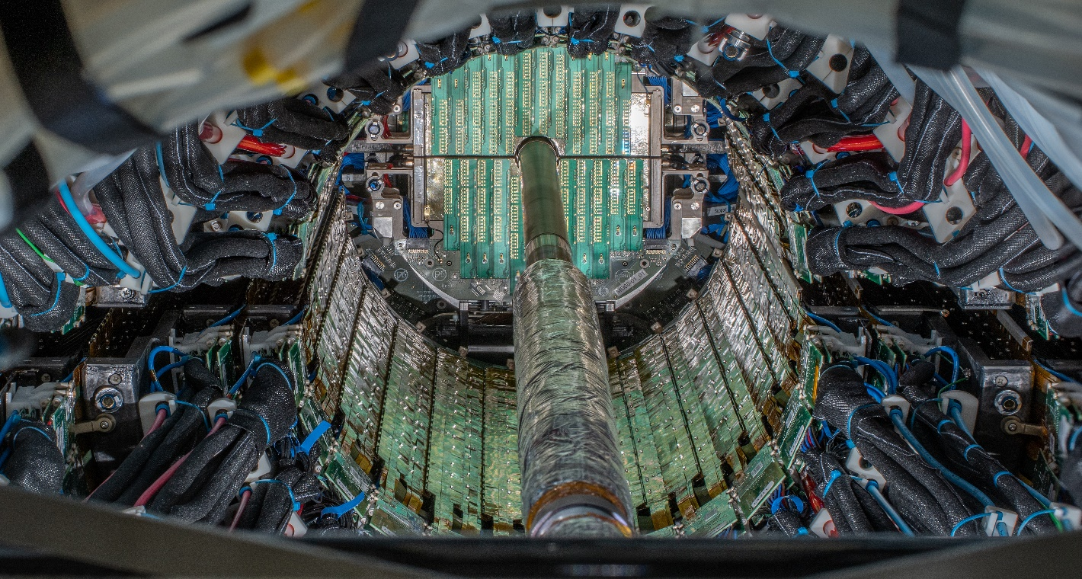
Status Experiments
Examples on LS2 progress
ALICE inner tracking system:
The whole ITS Outer Barrel installed in its final position
CMS central beam pipe in place

Slide 9
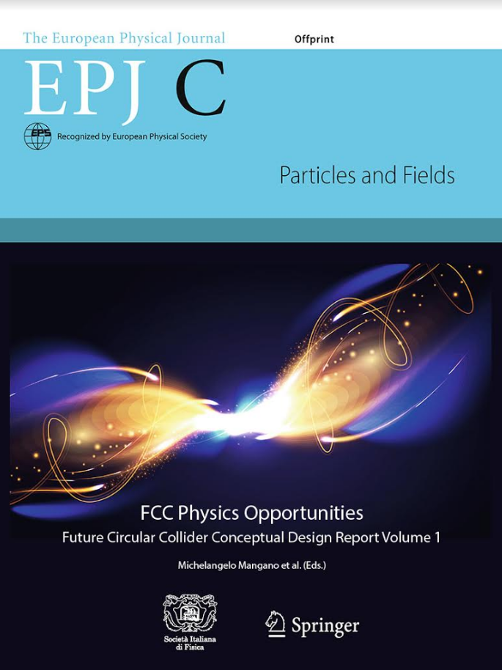
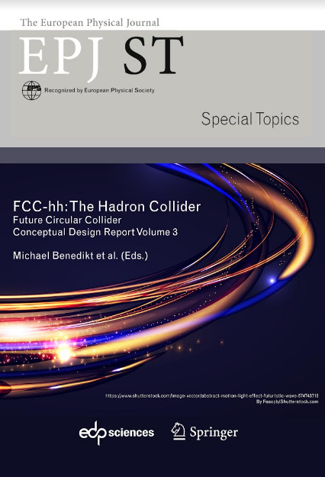
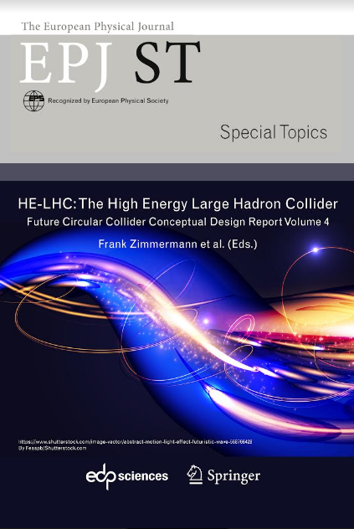
High-Priority Future Initiatives
An electron-positron Higgs factory is the highest-priority next collider. For the longer term, the European particle physics community has the ambition to operate a proton-proton collider at the highest achievable energy.
>1350 contributors from > 350 institutes,
a truly global effort as suggested by EPPSU 2013
Following the 2013 strategy update a study for a Future Circular Collider (FCC) at CERN was launched
1st phase of FCC design study completed
conceptual design report in 2019
European Physical Journal C (Vol 1) and ST (Vol 2 – 4)
baseline machine designs, performance matching
physics requirements
was input to the 2020 strategy update

Slide 10
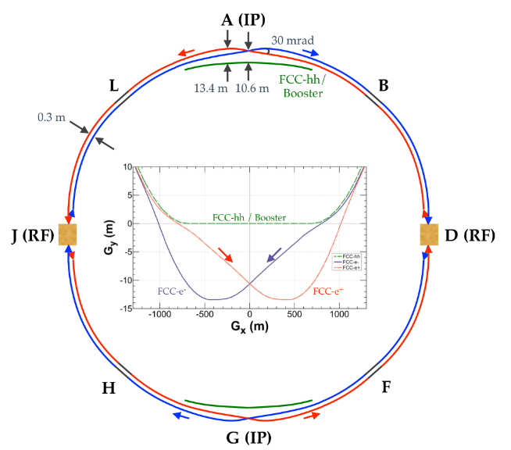
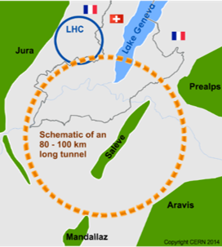
FCC Feasibility Study
CERN is now launching a FCC feasibility study
investigation of the technical and financial feasibility of a future ≥ 100 TeV hadron collider at CERN
  with e⁺e⁻ Higgs and electroweak factory as possible first stage
to be completed by the next Strategy Update (≈ 2026)
Enable a project decision:
feasibility study of the 100 km tunnel
geological aspects and optimisation
host-state related processes
CDR+ for colliders and injectors
high Field Magnetintermediate milestones
…
FCC-ee
FCC-hh

Slide 11
Alternative e⁺e⁻ Higgs Factory
The timely realisation of the electron-positron International Linear Collider (ILC) in Japan would be compatible with this strategy and, in that case, the European particle physics community would wish to collaborate.
In February 2020 the ICFA set up the
ILC International Development Team (IDT)
to prepare for an ILC pre-lab in Japan
Chair: Tatsuya Nakada
with participation from all regions
Note: CLIC@CERN is still retained as a possible future option

Slide 13
Accelerator and Detector R&D
The European particle physics community must intensify accelerator R&D and sustain it with adequate resources. A roadmap should prioritise the technology, taking into account synergies with international partners and other communities..
Accelerator Road Accelerator R&D has been identified as key element for all future (collider) projects
High field magnets
High-gradient acc. structures (PWA, SCRF)
µ-collider
Energy recovery linac
Likewise detectors
International collaboration beyond Europe is encouraged
Example:
CERN is discussing collaboration with EIC
  on accelerator (FCC-ee)
  and detectors (e.g. ALICE 3 for LS4)
Detector R&D programmes and associated infrastructures should be supported at CERN, national institutes, laboratories and universities… The community should define a global detector R&D roadmap that should be used to support proposals at the European and national levels.

Slide 14
Accelerator Roadmap
CERN and the national laboratories in Europe (LDG) are charged by CERN Council to define a Roadmap for Accelerator R&D
Topics:
High-field magnets
High-gradient accelerations
(plasma, SCRF)
Muon beams/collider
Energy recovery linacs
Education and training
 | High Field Magnets Low Temp & HTS | High Gradient Acceleration (plasma) | Muon Collider | ERL | High Gradient Accelerating Structures (sc & nc)
chair | Pierre Vedrine, IRFU | Ralph Assmann, DESY & INFN | Daniel Schulte, CERN | Max Klein, Liverpool | Sebastien Bousson, IJCLab
co-chair | Luis Garcia-Tabares Rodriguez, CIEMAT | Edda Gschwendtner, CERN | Nadia Pastrone, INFN | Andrew Hutton, JLAB | Hans Weise, DESY
Goal: viable options which deserve to be pursued can be identified by the next strategy update

Slide 15
ECFA Detector R&D Roadmap Panel
CERN Council has charged European Committee for Future Accelerators (ECFA) to define a detector R&D Roadmap

Slide 16
Higgs Factory
ECFA initiated also a study on Physics, Experiment & Detector Studies Towards a Higgs Factory
Goal: bring the entire e+e- Higgs factory effort together, foster cooperation across various projects, collaborative research programs are to emerge
Should lead to a ECFA report /Yellow report
à la Aachen for LHC, Aix-les-Bains for phase II LHC detectors
International Advisory Committee set up to define work programme and convenors
• International Advisory Committee
o ECFA-chair would act as chair: Karl Jakobs
o From RECFA: Jean-Claude Brient, Tadeusz Lesiak, Chiara Meroni
o With (HL-)LHC experience: Jorgen D’Hondt, Max Klein, Aleandro Nisati, Roberto Tenchini
o For theory: Christophe Grojean, Andrea Wulzer
o For Linear Colliders: Steinar Stapnes, Juan Fuster, Frank Simon, Aidan Robson
o For Circular Colliders: Alain Blondel, Mogens Dam, Patrick Janot, Guy Wilkinson
o For CERN: Joachim Mnich

Slide 17

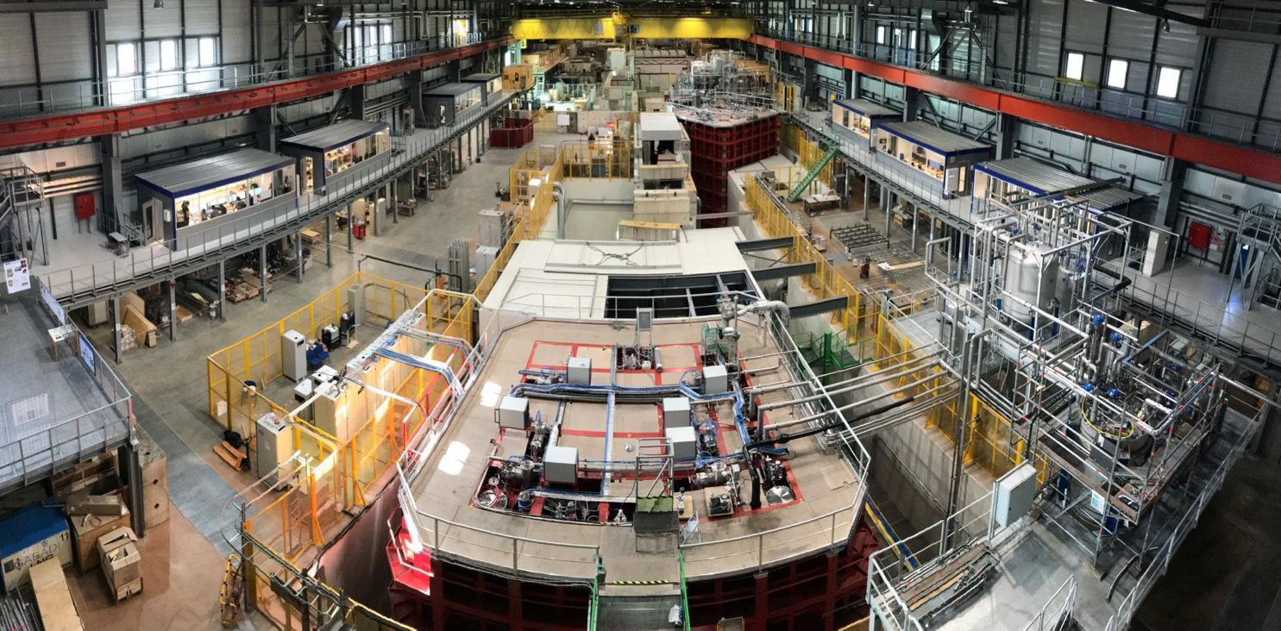
Neutrino Physics
Europe, and CERN through the Neutrino Platform, should continue to support long baseline experiments in Japan and the United States.
NP02: double phase TPC
Following the 2013 strategy update CERN operates the Neutrino Platform (NP) to support European researchers participating in long-baseline neutrino experiments elsewhere
Examples:
development of LAr TPC for DUNE (ProtoDUNE)
in 2 cryostats 1:20 scale croystats
  single phase
  dual phase → new vertical drift concept
New:
strengthening of the NP
provision of an additional, second cryostat as European contribution to the LBNF/DUNE infrastructure
NP04: single phase TPC
Several R&D projects also for T2K and HyperK at NP

Slide 18
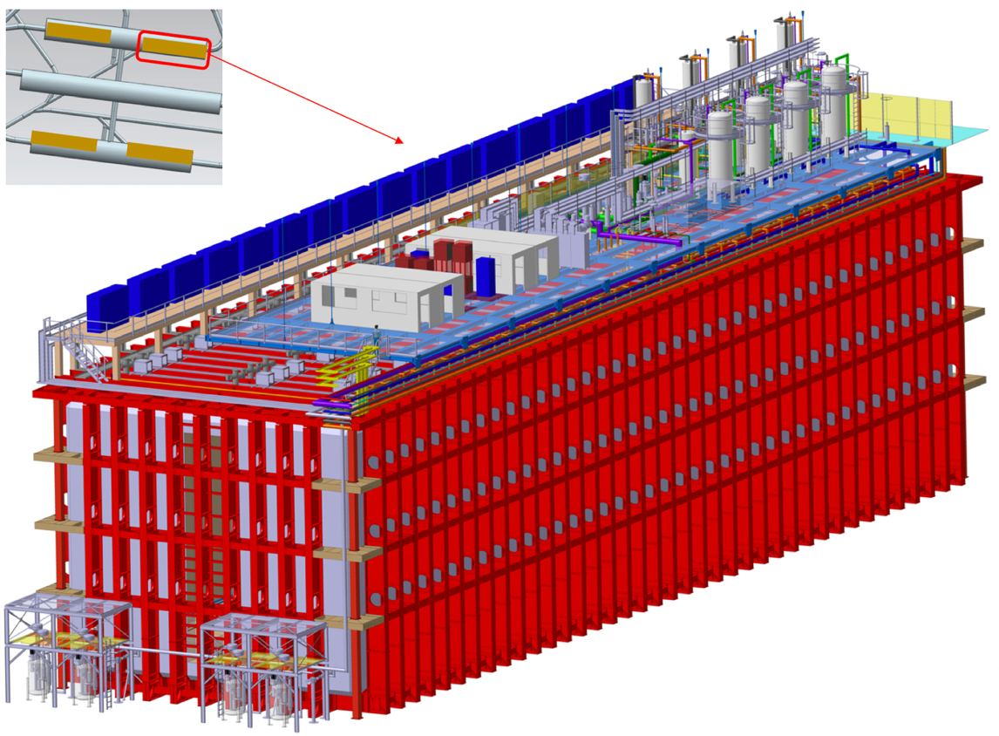
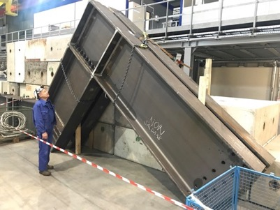
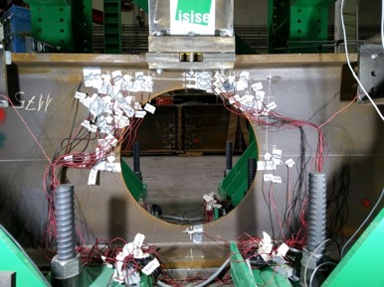
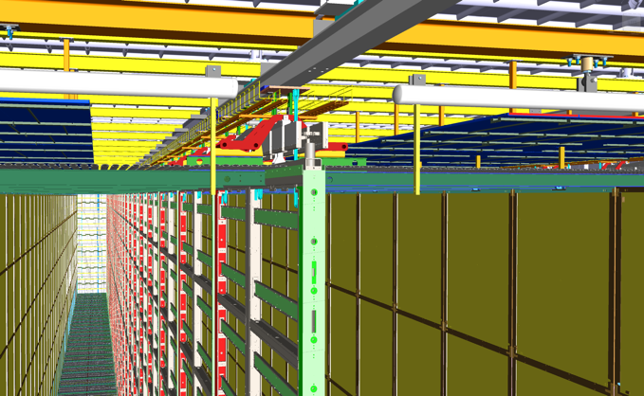
LBNF/DUNE cryostats
All engineering work done (design and calculations) based on the LNG membrane technology
1:1 scale components prototyped and tested
66 m x 19 m x 18 m (L x W x H)
next step: formal CERN technical final review
then procurement and installation phase can start
cavern will be available in Spring 2024 at the SURF Laboratory, 1.5 km underground
DUNE HD detector

Slide 19
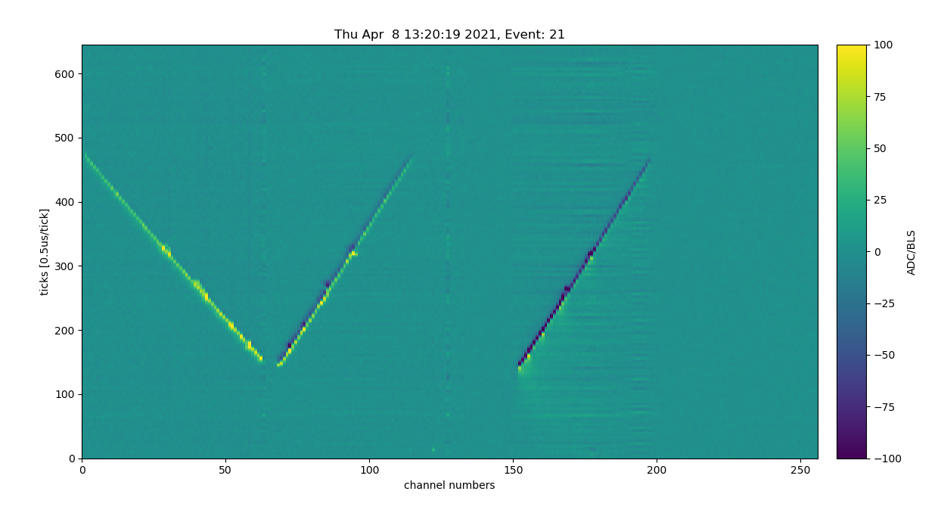
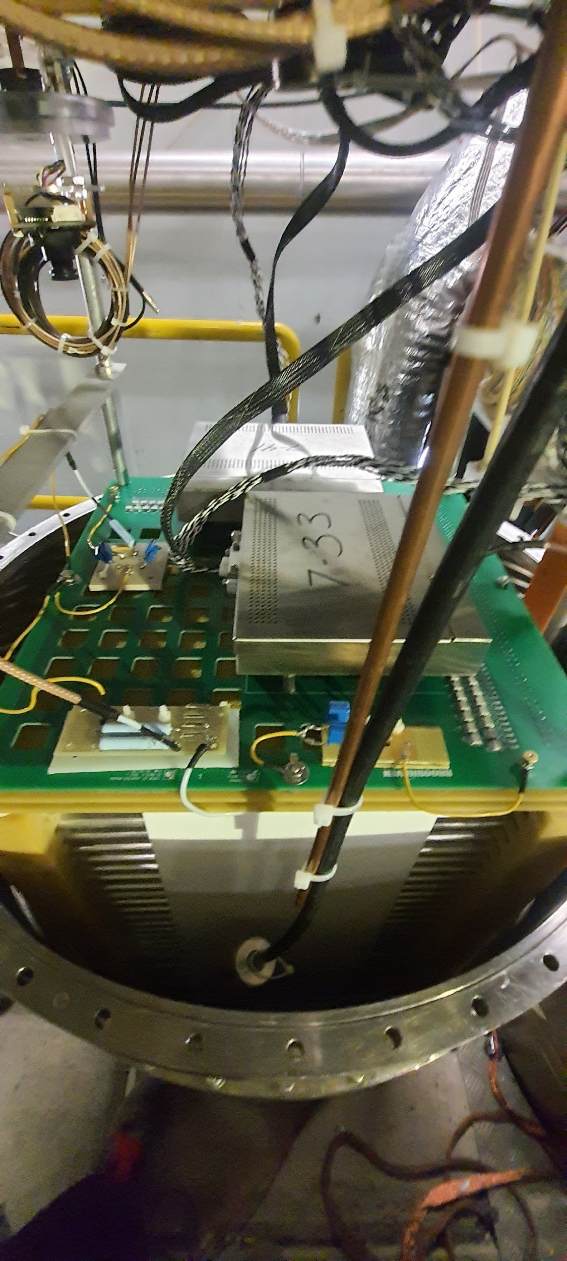
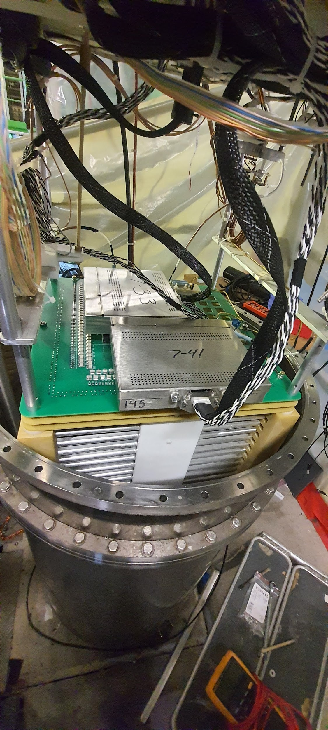
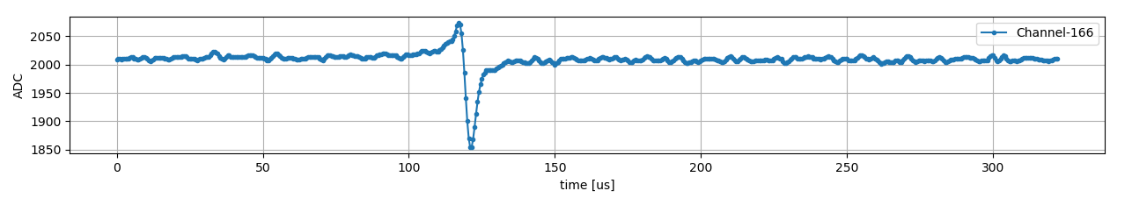
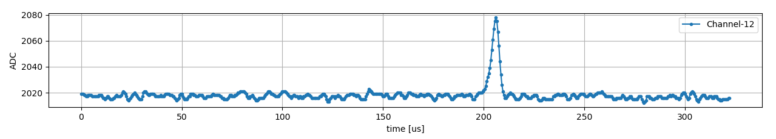
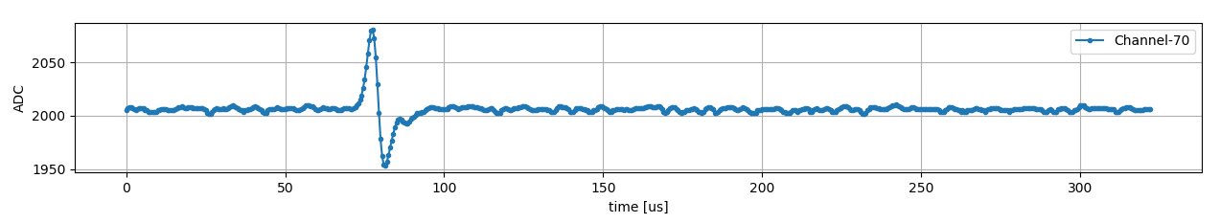
Status Neutrino Platform
Test of 3-view anode PCB for DUNE LAr TPC
in 50 l cryostat @ NP
Cosmic ray event
collection
induction-2
induction-1
Collection
Induction-2
Induction-1
induction-1
collection
induction-2
4/16/2021
J. Mnich | News from the Experiments

Slide 20
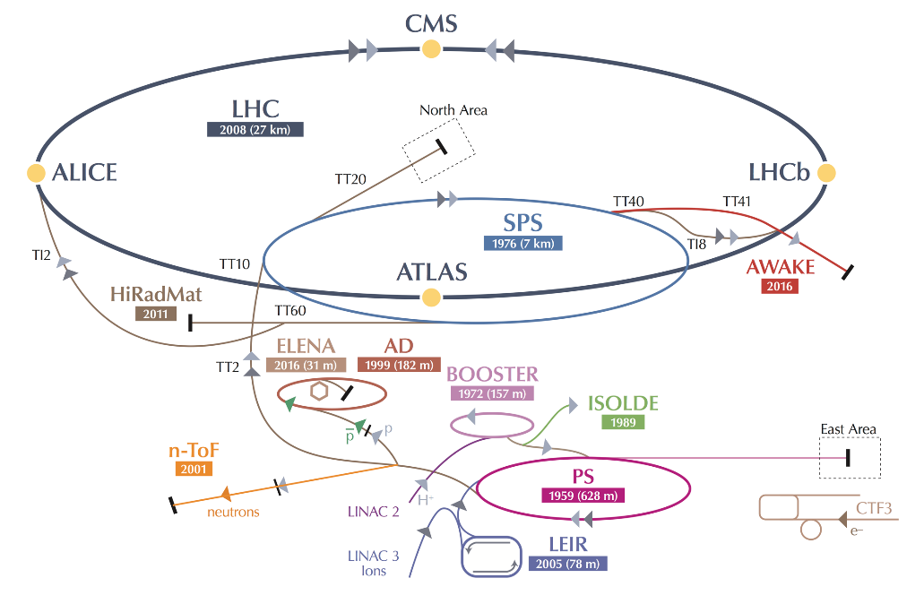
Scientific Diversity
A diverse programme that is complementary to the energy frontier is an essential part of the European particle physics Strategy. Experiments in such diverse areas that offer potential high-impact particle physics programmes at laboratories in Europe should be supported, as well as participation in such experiments in other regions of the world.
2021 Injectors schedule:
21 June: ISOLDE
12 July: SPS North area (fixed target with protons)
23 August: antiproton physics AD-ELENA
27 September: n_TOF
18 October: PS East area (fixed target with protons)
Physics Beyond Collider study continues

Slide 21
Other Priority Items
Europe should continue to vigorously support a broad programme of theoretical research covering the full spectrum of particle physics from abstract to phenomenological topics.
Acknowledge the essential role of theory
Support for computing and software infrastructure
Exploit synergies with neighboring field, in particular nuclear and astroparticle physics
Mitigate environmental impact of particle physics
Invest in next generation of researchers
Support knowledge and technology transfer
Cultural heritage: public engagement, education and communication
The community must vigorously pursue common, coordinated R&D efforts in collaboration with other fields of science and industry to develop software and computing infrastructures that exploit recent advances in information technology and data science.
Europe should maintain its capability to perform innovative experiments at the boundary between particle and nuclear physics, and CERN should continue to coordinate with NuPECC on topics of mutual interest.
Synergies between particle and astroparticle physics should be strengthened through scientific exchanges and technological cooperation in areas of common interest and mutual benefit.
The environmental impact of particle physics activities should continue to be carefully studied and minimised.
Particle physics research centres should promote knowledge and technology transfer and support their researchers in enabling it.
Public engagement, education and communication in particle physics should continue to be recognised as important
components of the scientific activity and receive adequate support.

Slide 22
Summary
Steps to implement the strategy are taken at CERN and elsewhere
Some key objectives for the next update 2026
Successful operation of the LHC and experiments
Construction of the HL-LHC and ATLAS and CMS Phase II upgrades
Start of installation of the first DUNE detector
Completion of the FCC fesibility study
Accelerator R&D on high-field magnets, PWA, muon collider ,…
to prepare decicisions on the way forward
The 2020 update of the European Strategy is visionary and ambitious, but also realistic and prudent. It lays the foundation for a bright future for particle physics in Europe, within the global context of the field.
(CERN DG)

Slide 23
Backup

