Slide 1
The Electron-Ion Collider
DIS 2021
April 16, 2021

Slide 2
Overview
The EIC is a DOE project to build the most advanced particle collider of its kind in the world, with capabilities that are state-of-the-art and beyond.
When completed, the EIC will be the only collider in the U.S.. It will serve as a primary focus for frontier accelerator physics for a very long time.
A primary science goal of the EIC is to understand the properties of the nucleon are dynamically generated by the quark – gluon fields including how mass is produced from energy in the interior of the proton.
The EIC will be sited at Brookhaven National Lab (BNL). It will be implemented by BNL in partnership with Thomas Jefferson National Accelerator Facility (TJNAF).
Many countries as well as CERN have expressed interest in participating, collaborating, and contributing.
The EIC project has CD-0 (Approve Mission Need) and has completed steps necessary for CD-1 (Approve Alternatives Selection and Cost Range).

Slide 3
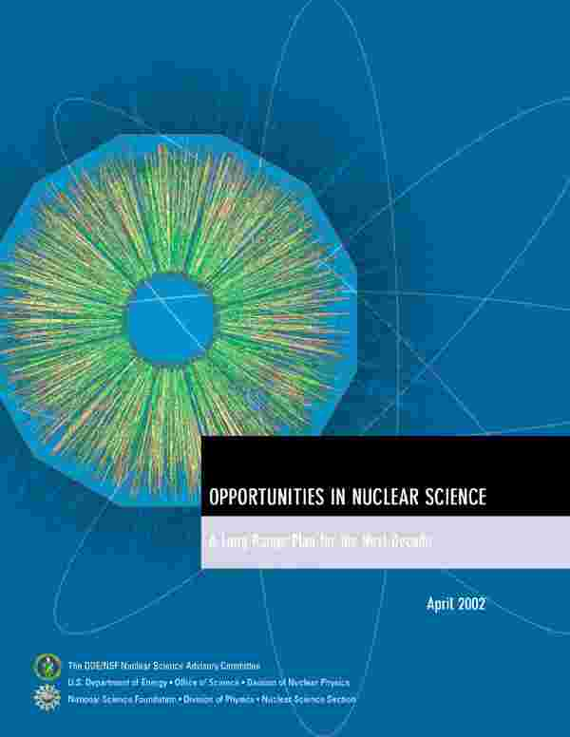
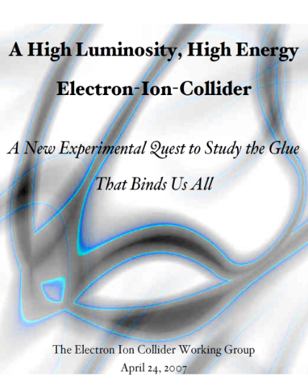


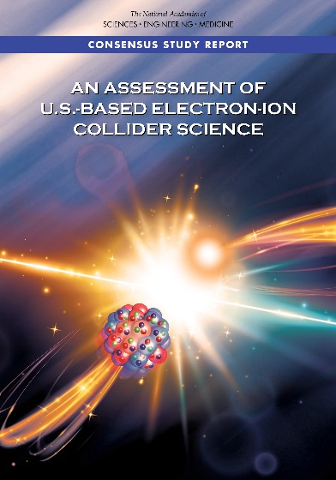
A Brief Background: Developing the Science Case
2002
A strong community emphasis on the urgent need for a machine to illuminate the dynamical basis of hadron structure in terms of the fundamental quark and gluon fields has been a persistent message for almost two decades
2007
2009
2010
Gluons and the Quark Sea at High Energies
2012
“a high-energy high-luminosity polarized EIC [is] the highest priority for new facility construction following the completion of FRIB.”
2013
Major Nuclear Physics Facilities for the Next Decade
2015
NSAC
“…essential accelerator and detector R&D [for EIC] should be given very high priority
in the short term.”
“We recommend the allocation of resources …to lay the foundation for a polarized Electron-Ion Collider…”
“..a new dedicated facility will be essential for answering some of the most central questions.”
March 14, 2013
2018
“The quantitative study of matter in this new regime [where abundant gluons dominate] requires a new experimental facility: an Electron Ion Collider.”
Electron-Ion Collider absolutely central to the nuclear science program of the next decade.

Slide 4

The 2015 Long Range Plan for Nuclear Science
Recommendations:
Capitalize on investments made to maintain U.S. leadership in nuclear science.
Develop and deploy a U.S.-led ton-scale neutrino-less double beta decay experiment.
Construct a high-energy high-luminosity polarized electron-ion collider (EIC) as the highest priority for new construction following the completion of FRIB.
Increase investment in small-scale and mid-scale projects and initiatives that enable forefront research at universities and laboratories.
The EIC is a key element of the 2015 LRP Vision

Slide 5
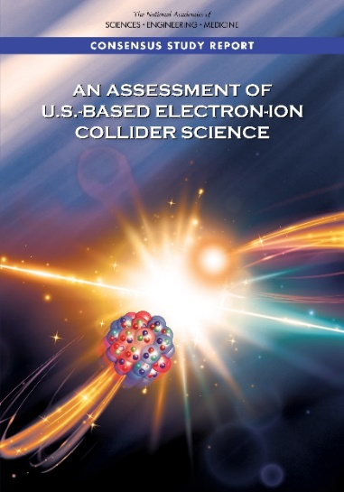
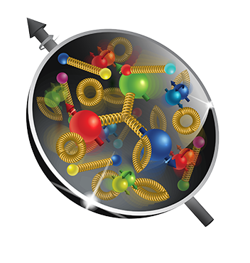
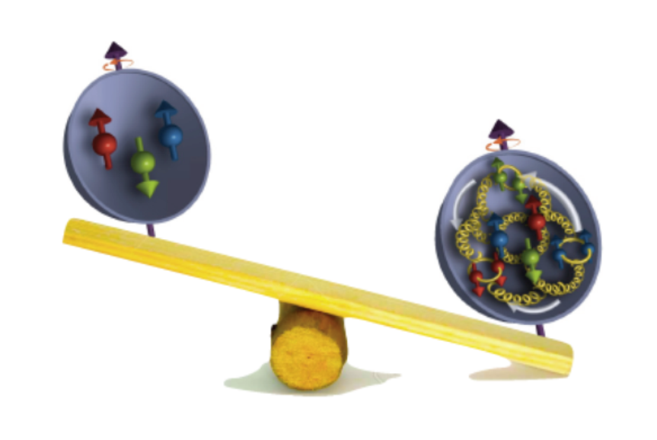
The Next Super High Power, High Energy Microscope:
The Electron-Ion Collider
National Academy of Science Report: AN ASSESSMENT OF U.S.-BASED ELECTRON-ION COLLIDER SCIENCE
“An EIC can uniquely address three profound questions
About nucleons—neutrons and protons—and how they
are assembled to form the nuclei of atoms:
• How does the mass of the nucleon arise?
• How does the spin of the nucleon arise?
• What are the emergent properties of dense systems of gluons?”
The EIC would be a unique facility & maintain leadership in nuclear science
The EIC would maintain leadership in the accelerator science and technology of colliders

Slide 6



EIC CD-0, Site Selection, Project Start & Dedication in FY20
The EIC will be located at BNL and with TJNAF as a major partner. The realization of the EIC will be accomplished over the next decade at an estimated cost between $1.7 and $2.8 billion.
Utilize existing operational hadron collider; add electron storage ring, cooling in existing RHIC tunnel and electron injector.
EIC scope includes the machine upgrade to RHIC asset and two interactions regions with one of the interaction regions outfitted with a major detector. Working towards CD-1 in Q3 FY 2021
EIC Dedication September 18, 2020
The EIC will be a game-changing resource for the international nuclear physics community. DOE looks forward to engaging with the international community and the international funding agencies about potential collaborations and contributions to the EIC effort, in nuclear, accelerator and computer science.

Slide 7


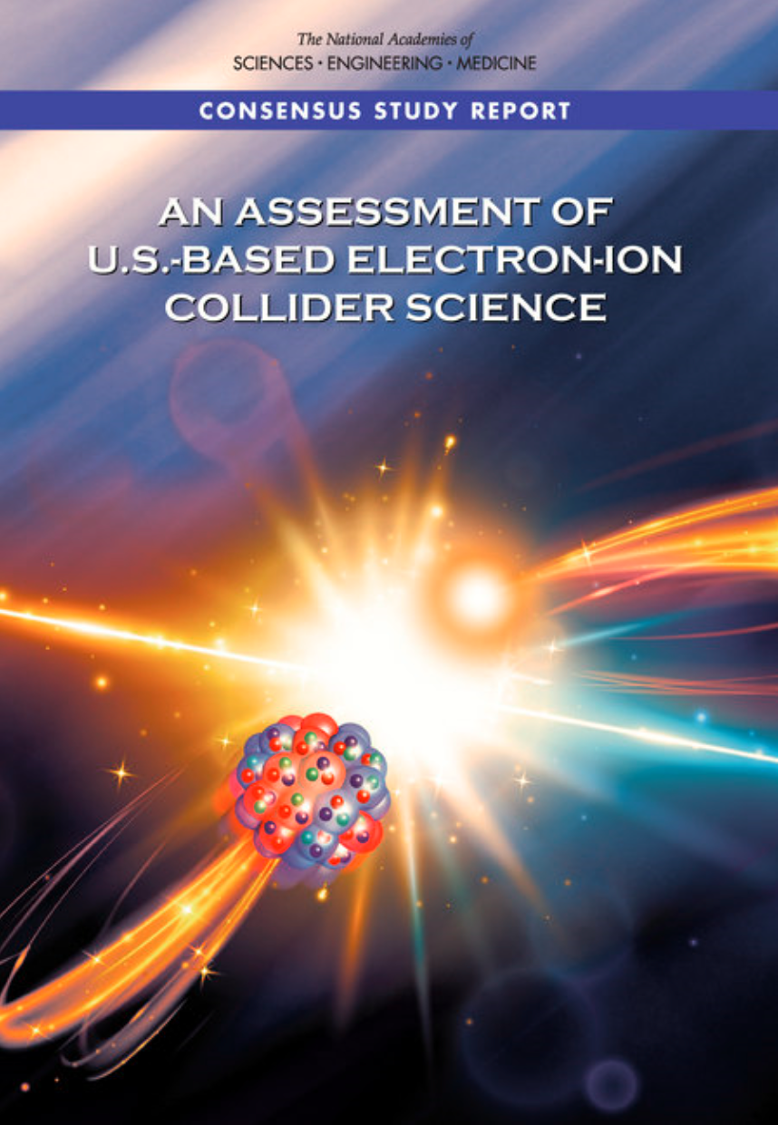
Science-Driven Project Requirements
Project Design Goals
High Luminosity: L= 10³³ – 10³⁴cm⁻²sec⁻¹, 10 – 100 fb⁻¹/year
Highly Polarized Beams: 70%
Large Center of Mass Energy Range: E_{cm} = 20 – 140 GeV
Large Ion Species Range: protons – Uranium
Large Detector Acceptance and
Good Background Conditions
Accommodate a Second Interaction Region (IR)
Conceptual design scope and expected performance meets or exceed NSAC Long Range Plan (2015) and the EIC White Paper requirements endorsed by NAS (2018)
These challenging performance goals require a machine that is state-of-the-art

Slide 8
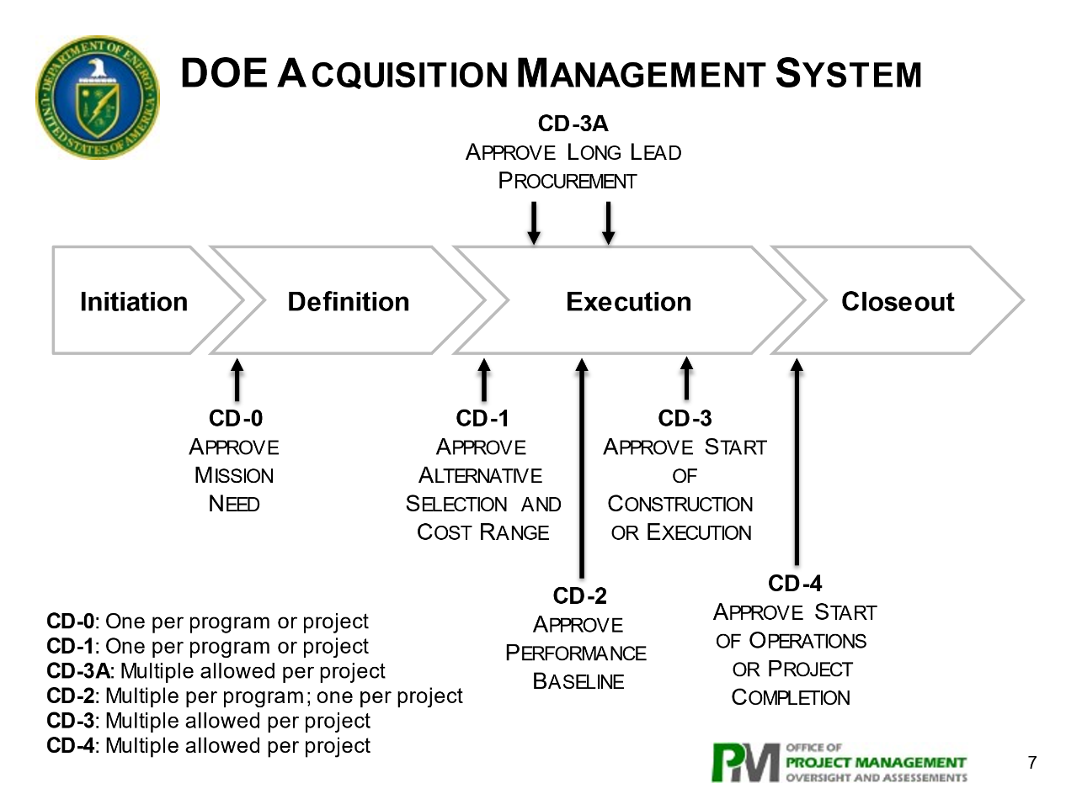
DOE Critical Decision “State-Gate” Reviews
At each stage, gate passage approval is determined by an Energy System Acquisition Advisory Board (ESAAB), which for a project of this cost is also preceded by a meeting of the Project Management Risk Committee (PMRC)

Slide 9
EIC Recent History
Event | Date
DOE Mission Need Statement Approved | January 22, 2019
DOE Independent Cost Review | July 2019
DOE Electron Ion Collider Site Assessment | October 2019
Critical Decision – 0 (CD-0) Approved | December 19, 2019
DOE Site Selection Announced | January 9, 2020
BNL TJNAF Partnership Agreement | May 7, 2020
DOE Office of Science Status Review | September 9-11, 2020
Independent EIC Conceptual Design Review | November 16-18, 2020
DOE Office of Science CD-1 Review | January 26-29, 2021
DOE Independent Cost Review | January - February 2021
CD-1 Approval Target Date | April/May 2021

Slide 10
CD-1 Reviews
CD-1 Preparation Reviews
  Independent Design Review – November 2020
  Director’s Review – December 2020
DOE CD-1 Reviews
  DOE Office of Science, Office of Project Assessment
  CD-1 Readiness Review – January 26-29, 2021
  DOE Office of Project Management Independent Cost Review – January/February 2020
DOE reviews recommend proceeding with CD-1!

Slide 11
Post CD-1 Timeline
Accelerator Technical Reviews | Spring/Summer 2021
Call for Detector Proposals | March 2021
Start Preliminary Design | April 2021
Detector Proposals Submitted | December 2021
Selection of Project Detector | March 2022
Start Earned Value Tracking | Summer 2022
In-kind Deliverables - Agreements | Summer/Fall 2022
Goal for CD-2 Approval | Q1FY2023
Goal for CD-3 Approval | Q4FY2023

Slide 12

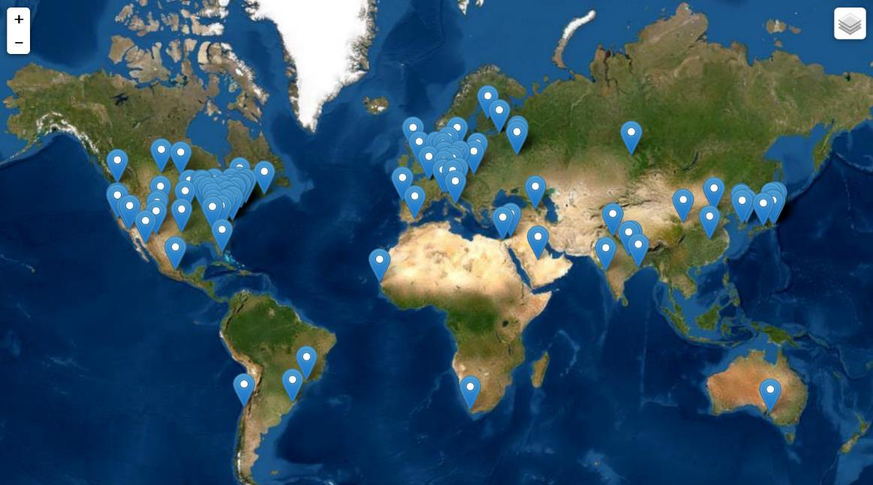
EIC User Community
EIC Users Group Formed in 2016
EICUG.ORG
Status February 2021:
Collaborators 1259
Institutions 252
Countries 34
Annual EICUG meeting
2016 UC Berkeley, CA
2016 Argonne, IL
2017 Trieste, Italy
2018 Washington, DC
2019 Paris, France
2020 Miami, FL
2021 Warsaw, Poland

Slide 13
EIC Partnership Plans
Bi-lateral meetings with potential partners are underway to discuss opportunities in the accelerator and experimental areas.
Accelerator Partnership Activities
  In-kind contributions to accelerator design and hardware expected
  Workshop hosted by UK Cockcroft Institute in October 2020 Promoting Collaboration on the Electron-Ion Collider
Detector Partnership Activities
  Expressions of Interest submitted in November 2020
  Call for proposals for detectors issued in March 2021
Regular meetings among the international funding agencies organized by DOE Office of Nuclear Physics.
New York State is a partner in the EIC infrastructure ($100M in-kind).

Slide 14
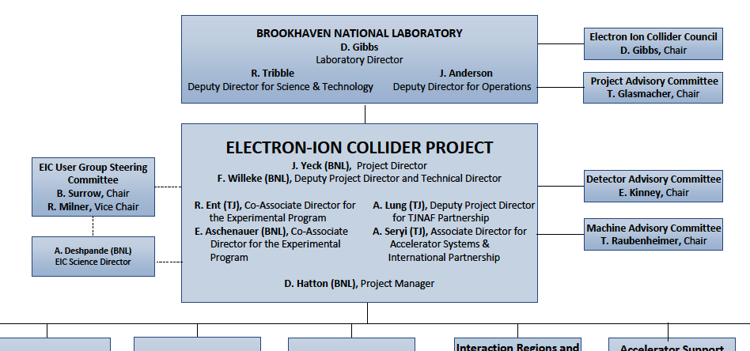
Project Organization

Slide 15
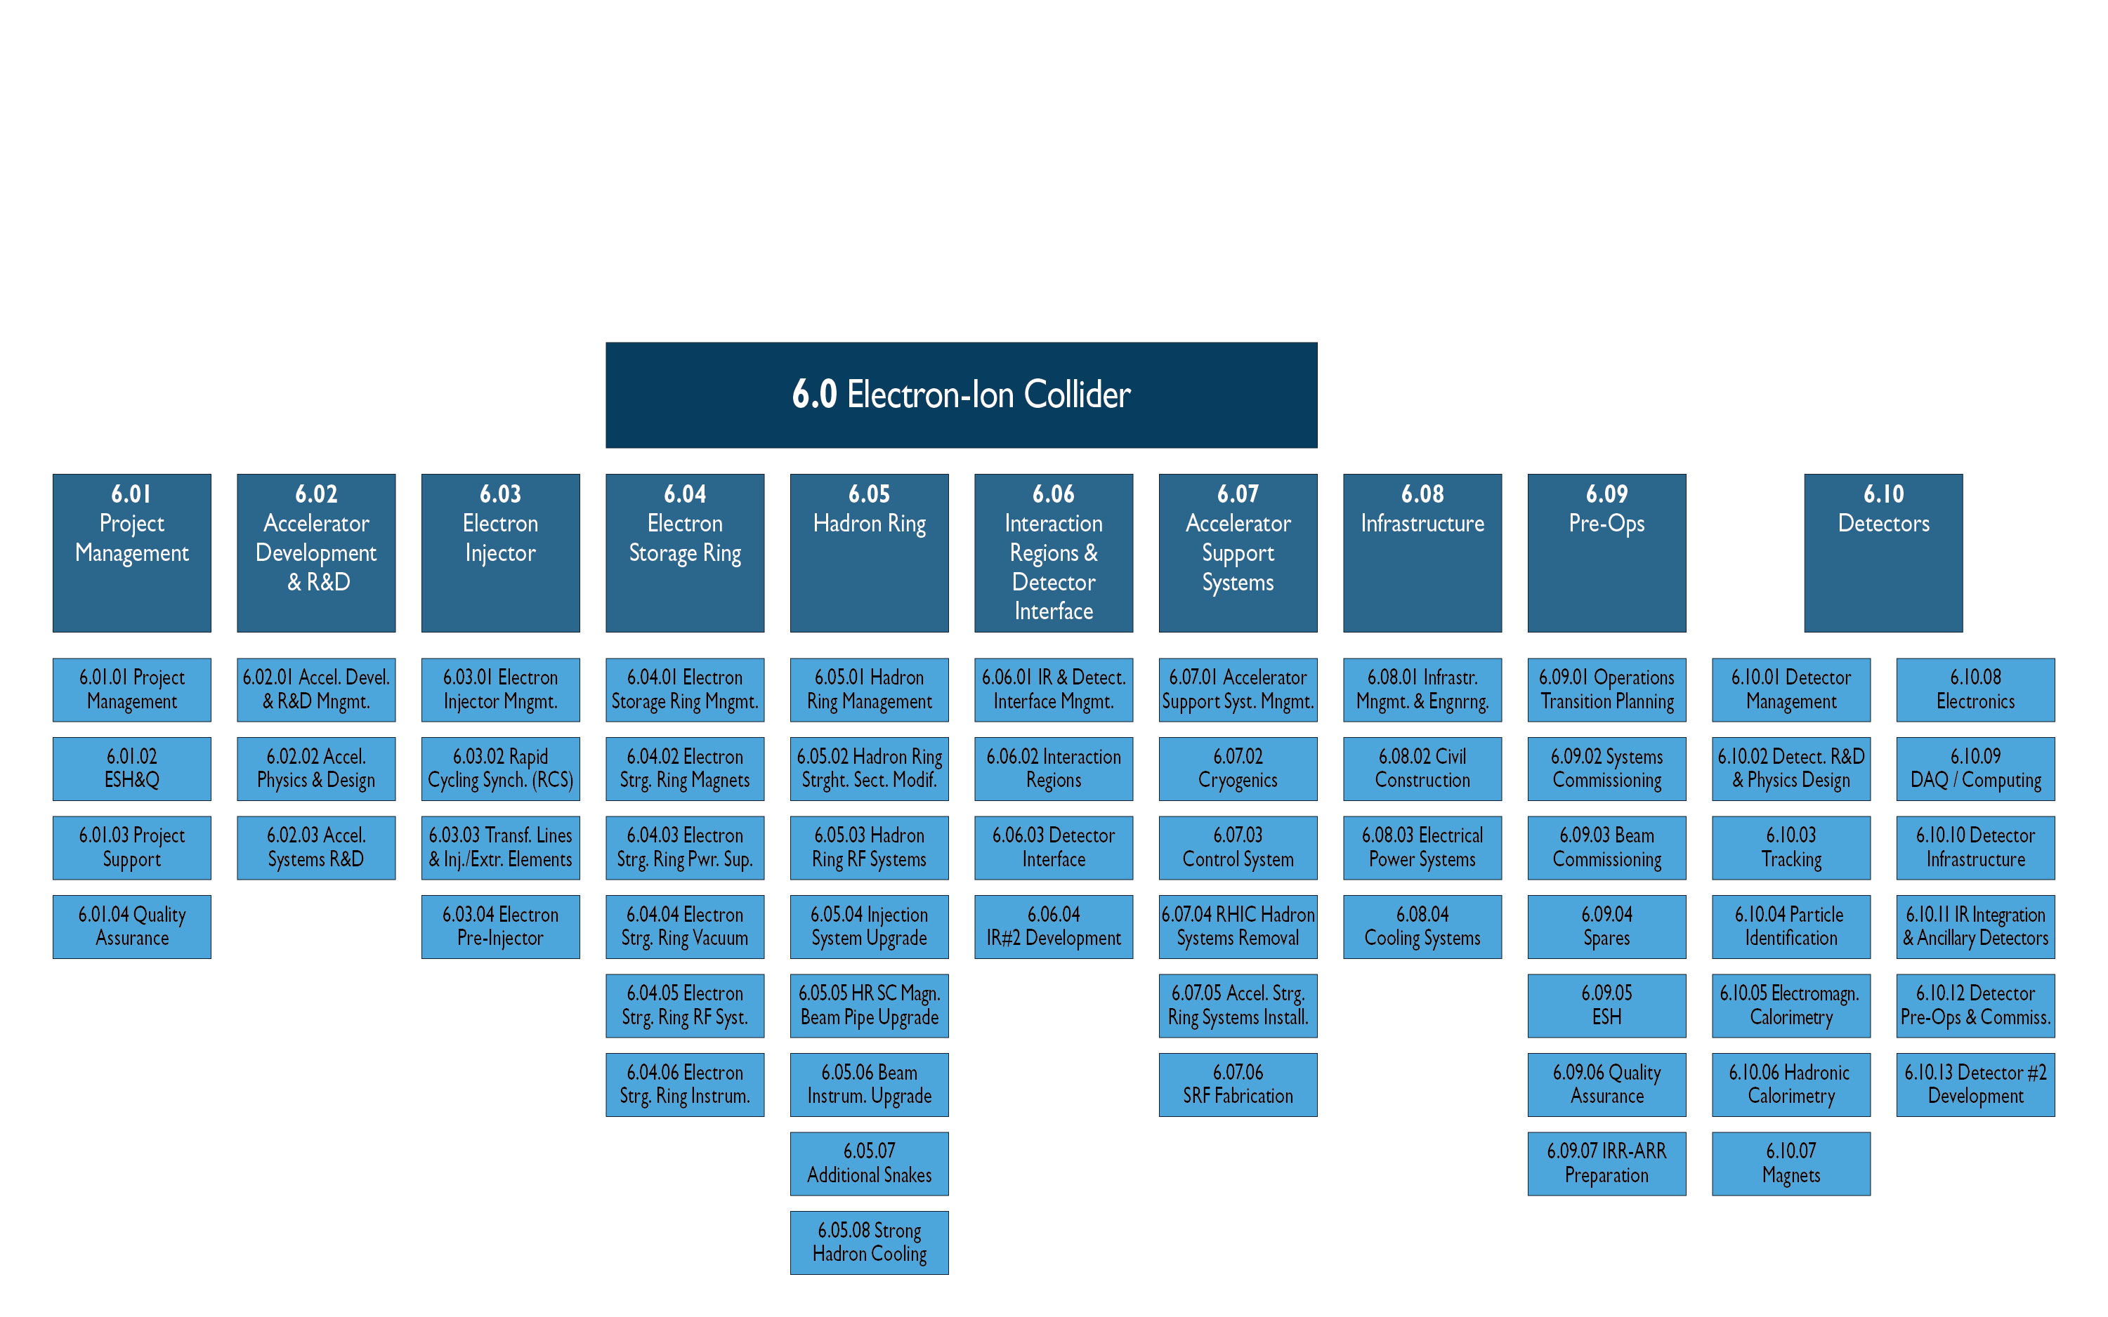
Project Organization

Slide 16
Project Organization
BNL/TJNAF Partnership
  BNL and TJNAF partnering agreement signed in May 2020.
  Executive Management Team established that integrates BNL and TJNAF into project leadership roles.
  EIC Council, chaired by BNL Director, established in June 2020. TJNAF Director is a founding member. Major international partners will also join the Council.
Established standing advisory committees with international membership
  Machine Advisory Committee: Meeting Aug 26, 2020
  Project Advisory Committee: Meetings - Aug 27, Dec 1, 2020
  Detector Advisory Committee: Meetings - Sep 28-29, Dec 18, 2020

Slide 17
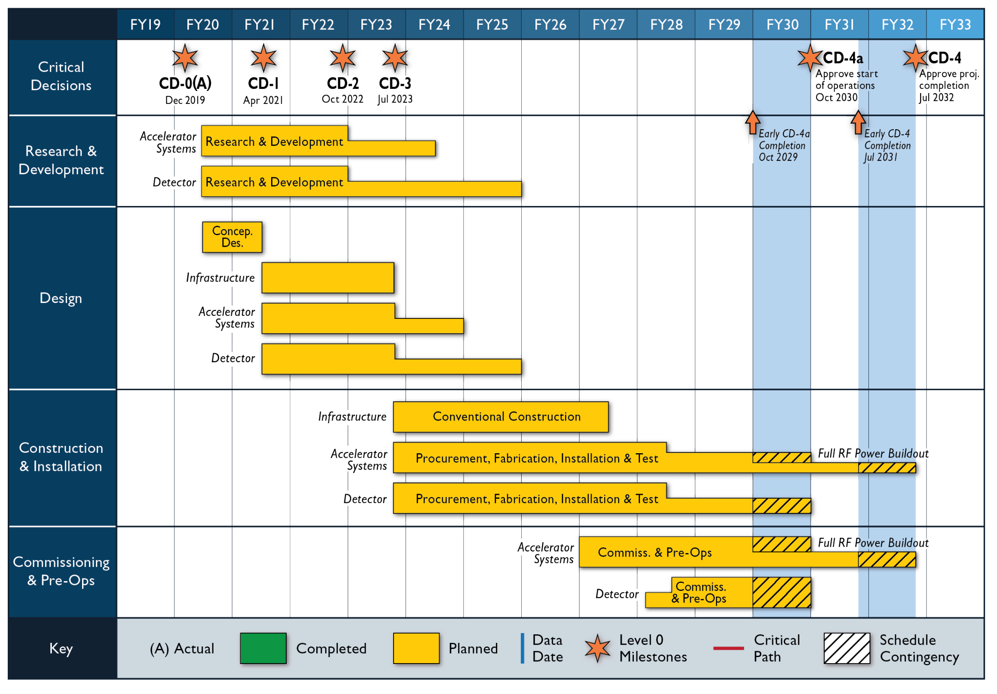
Proposed Reference Schedule

Slide 18
EIC Challenges and Opportunities
Affordability – EIC is very large project for DOE Office of Nuclear Physics (NP) and Office of Science (SC)
  Requires reprioritization of RHIC operations funding to EIC and new funding
  Significant ramp up of project funding is required to maintain timeline for DOE Critical Decisions
  Most cost-effective project follows closely to a technically driven schedule
Partner Engagement – Expectations and Implementation
  International engagement is highly desirable and widely expected
  In-kind contributions to the accelerator and detector are being pursued
  Partners must engage now given the EIC technically driven schedule

Slide 19
Complementary Contemporary Opportunities

Slide 20
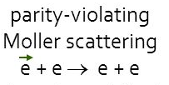
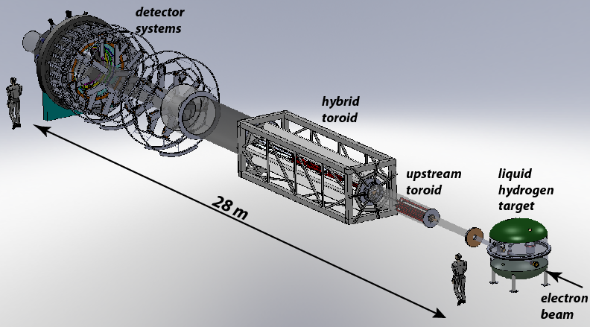
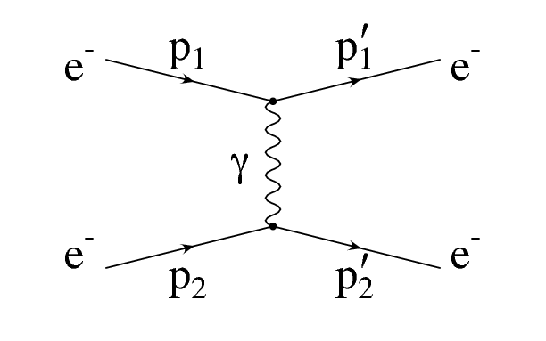
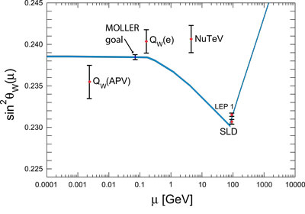
MOLLER: a “Must Do” Experiment To Point the Way to New Science
The scientific world rather desperately needs additional markers due to the consistency thus far of LHC data with Standard Model Predictions. Due to the technical challenge of constructing a next generation accelerator with very high accelerating gradients, those markers will have to come from “indirect” discovery experiments like MOLLER.
Z
In MOLLER, polarized electrons are scattered of unpolarized electrons. The amount of parity violation due to interference of the two possible exchange mechanisms (γ or Z) is precisely predictable in QED. (No messy quarks or color charge, or QCD to worry about, only quantum electrodynamics). The theory is so “clean” that like the g-2 approach, If the level of parity violation is greater than expected, a new particle must be the source of the discrepancy.
Projected sensitivity to Standard Model prediction
FY 2020 Enacted: $2M

Slide 21
Anticipating SoLID
Pre-Conceptual Design Submitted to DOE February 2020
SoLID Science Review March 8-10, 2021
Possibility for Scientific Complementarity with EIC is Striking

Slide 22
PAC Approved SoLID Research (Wiki)
SoLID (Solenoidal Large Intensity Device) will be used in Hall A 12GeV era. The approved experiments and their allocated beam time are the following:
PVDIS(E12-10-007)
  Submission at PAC 34, Update at PAC 35, Update at PAC 37, requested 180 days deuterium target, 90 days hydrogen target, plus commissioning, total 338 days; approved 169 days (half of requested), rated A
SIDIS
  SIDIS with Transversely Polarized 3He(E12-10-006)Submission at PAC 34, Update at PAC 35, Update at PAC 38, approved 90 days, rated A
  SIDIS with Longitudinally Polarized 3He(E12-11-007)Submission at PAC 37, Update at PAC 38, approved 35 days, rated A
  SIDIS with Transversely Polarized Proton (E12-11-108)Submission at PAC 38, Update at PAC 39, approved 120 days, rated A
  SIDIS Dihadron with Transversely Polarized 3He (E12-10-006A) Submission at SoLID TAC and PAC 42,2014, approved as run group with E12-10-006
  SIDIS in Kaon Production with Plarized Proton and 3He (E12-11-108B/E12-10-006D) Submission to SoLID TAC and PAC46, conditionally approved as a run group experiment
J/Psi (E12-12-006)
  Near Threshold Electroproduction of J/Psi at 11 GeV Submission at PAC 39,2012, approved 60 days, rated A-

Slide 23
PAC Approved SoLID Research (Continued)
Ay (E12-11-108A/E12-10-006A)
  Target Single Spin Asymmetry Measurements in the Inclusive Deep-Inelastic Reaction on Transversely Polarized Proton and Neutron (3He) Targets using the SoLID Spectrometer Submission at SoLID TAC and PAC 42,2014,approved as run group with E12-10-006 and E12-11-108
Deep Exclusive Meson Production (E12-10-006B) (DEMP)
  Measurement of Deep Exclusive Pi- Production using a Transversely Polarized He3 Target and the SoLID Spectrometer,Submission at SoLID TAC and PAC 45, 2017, approved as run group with E12-10-006.
Timelike Compton Scattering (E12-12-006A)
  TCS with circular polarized beam and unpolarized LH2 target,Submission at SoLID TAC and PAC 43, 2015, approved as run group with J/Psi(E12-12-006)
Deeply Virtual Compton Scattering (DVCS)
  Polarized target DVCS (ideas)
Double Deeply Virtual Compton Scattering (DDVCS)
  DDVCS on proton (LOI12-12-005) LOI to PAC 43, 2015, first as run group with J/Psi(E12-12-006) and then as a dedicated run

Slide 24
Summary
The EIC is off to a good start, and is moving out “smartly”
The science of the EIC is compelling, and the opportunities for tech development in a number of areas are quite exciting
The EIC team is actively pursuing international collaboration and partnership in the EIC to enable intellectual contributions to the project.
The EIC Team is promoting possibilities for in-kind contributions to the accelerator and detector.
International participation is expected in the governance of the EIC expected, e.g., Council, Advisory Committees, Collaborations,…
The EIC Project is ready for CD-1, DOE approval expect in April/May 2021.
The EIC team is preparing for CD-2, Approve Performance Baseline, in ~ two-years. Need definition of partner scope, in-kind contributions, and agreements.

Slide 25
Additional Information

Slide 26

NSAC 2015 LRP Performance Parameters
NSAC Performance Parameters:
A - Polarized e, p, light nuclei
B - Ion beam from deuterons to the heaviest table nuclei
C - Center of Mass energy 20-100 GeV
D - Capable of future Center of Mass upgrade to 140 GeV
E - High collision luminosity ~10³³-10³⁴ cm⁻² S⁻¹
F - More than one Interaction Region
Community and NSAC defined the parameters of machine needed to address the science.
These challenging performance goals require a machine that is state-of-the-art

