Slide 1
Summary of IAC meeting
Aharon Levy
Tel Aviv University
DIS2021, Virtual Event @ Stony Brook, April 16, 2021
XXVIII International Workshop on
Deep-Inelastic Scattering and
Related Subjects (DIS 2021)

Slide 2
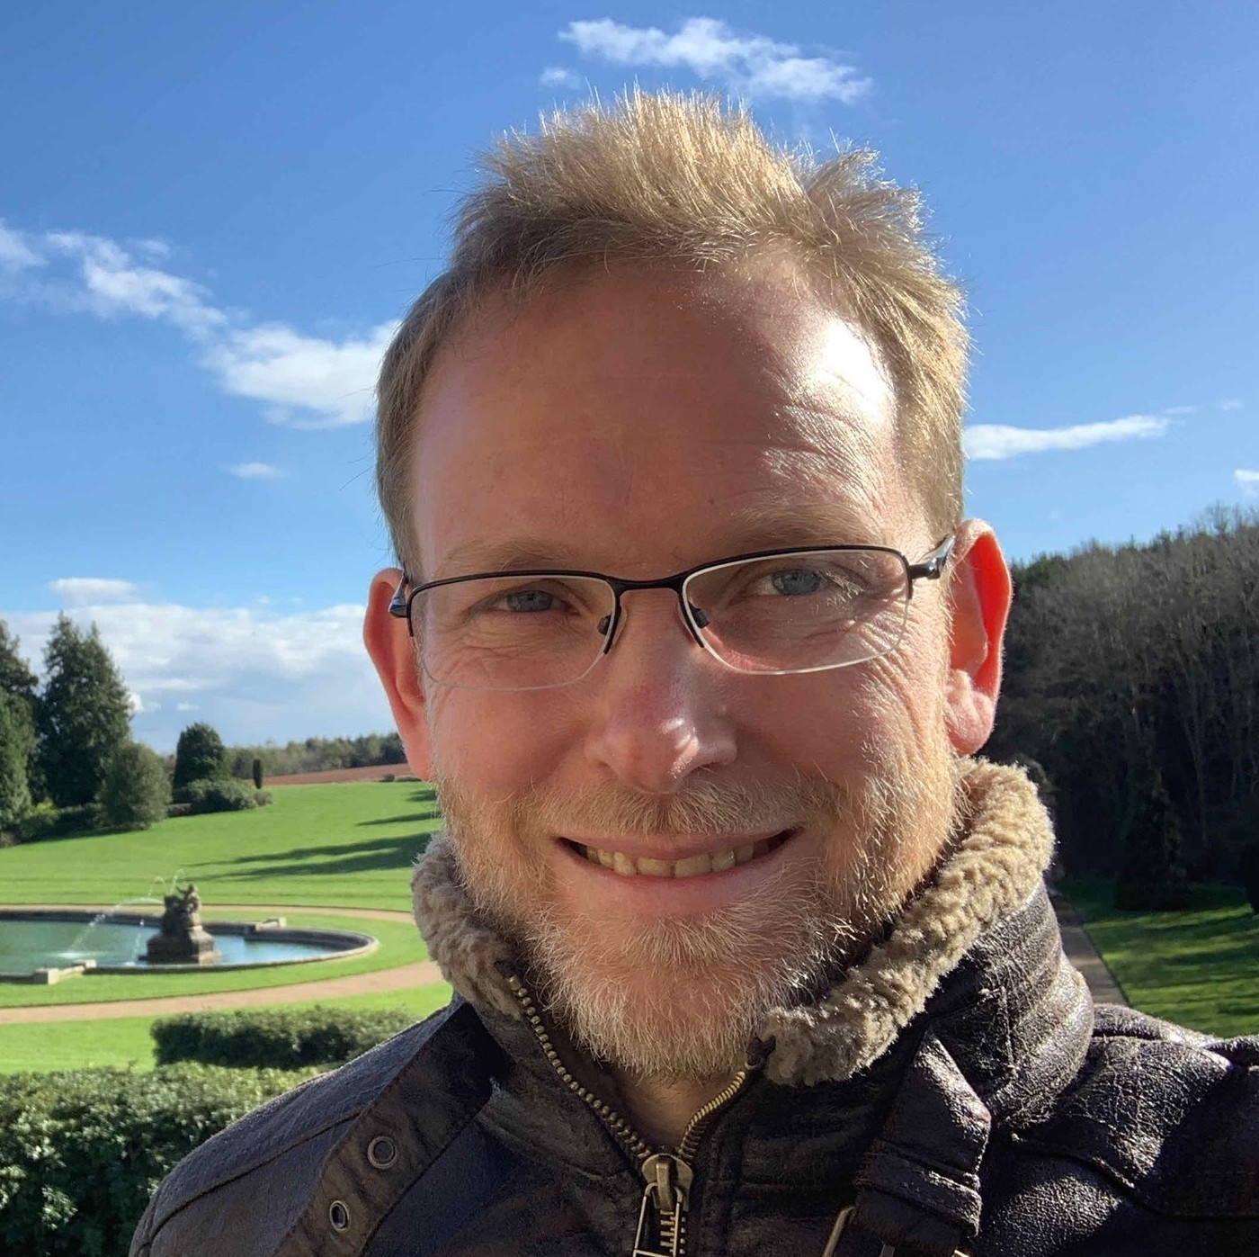
IAC co-Chair
Paul Newman, co-Chair IAC

Slide 3
N(DIS) as function of time
DIS 19, Torino
313 participants
(participants from 28 countries,
21% from Italy)
DIS 21, ‘SBU’ virtual
748 participants
(participants from 37 countries, 7 world regions)
Attandence: between 200 to 280, both for plenary and parallel.

Slide 4
Countries
Countries (37)
Armenia, Australia, Belgium, Brazil, Canada, Chile, China, Croatia, Czechia, Egypt, Finland, France, Germany, India, Iran, Israel, Italy, Japan, Mexico, Morocco, Netherland, Nigeria, Poland, Portugal, Romania, Russia, Saudi Arabia, Spain, Sri Lanka, South Africa, South Korea, Switzerland, Taiwan, Turkey, Ukraine , UK, USA.

Slide 5
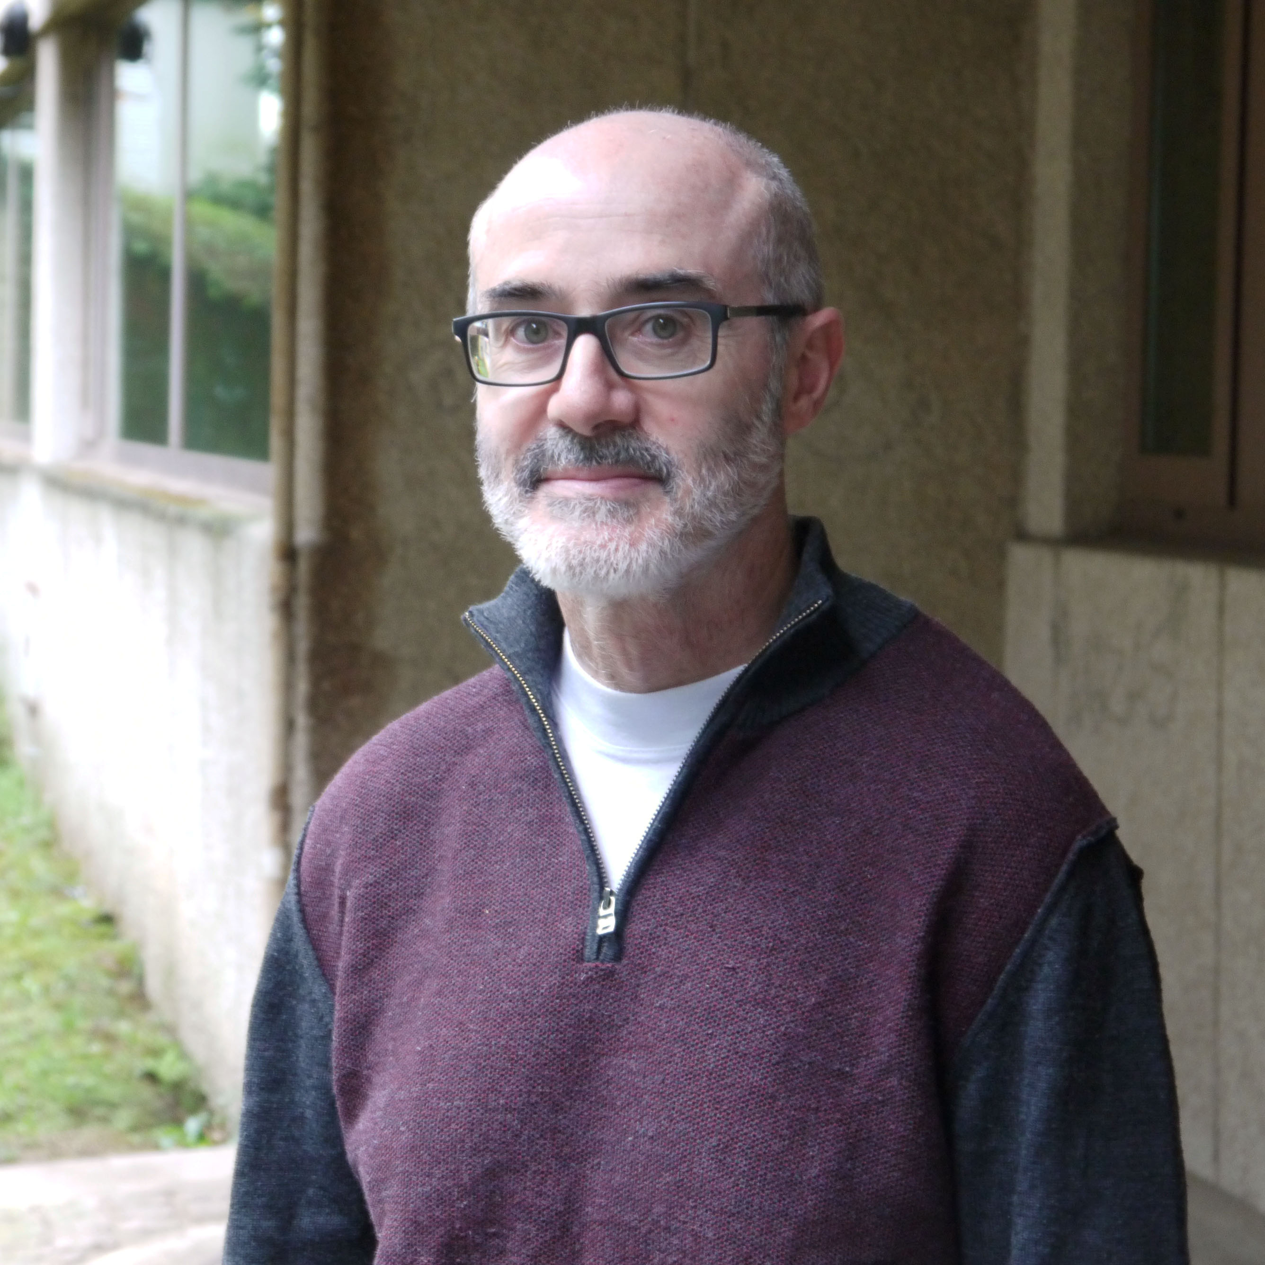
IAC meeting
The IAC chose Santiago de Compostela
as the venue for DIS2021.
Nestor Armesto

Slide 6
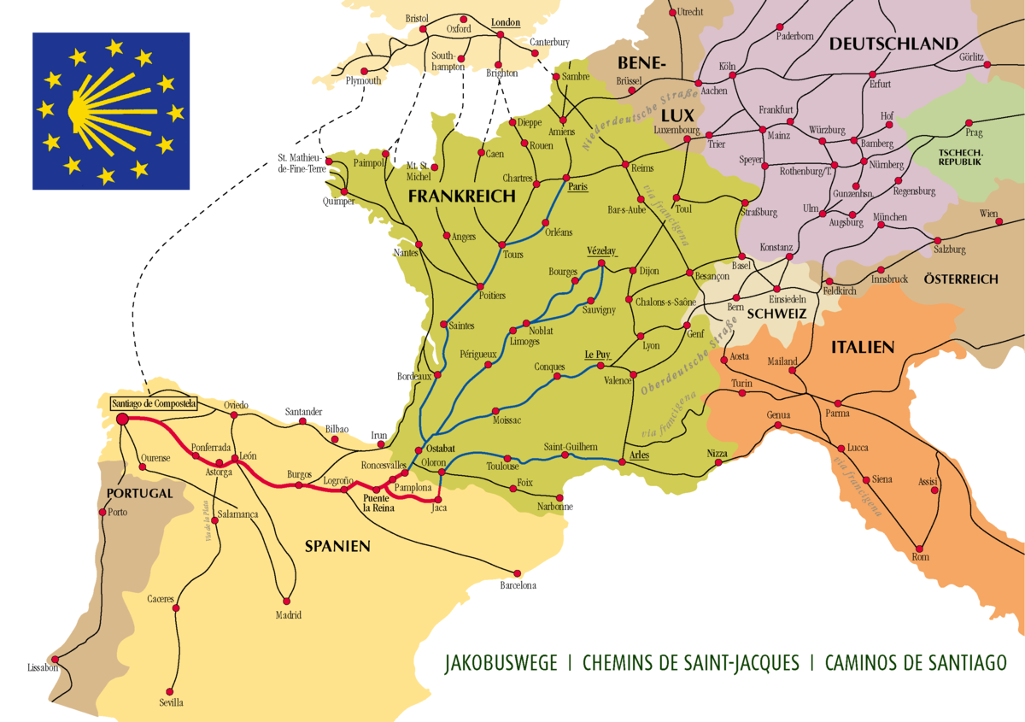
● Santiago de Compostela: touristic town (2.6 million visitors in 2017). The old town is World Heritage since 1985, end of Pilgrims’ Way, 2022 has been declared Holy Year.
● In 2019 (pre-COVID):
➜ 177 hotels for ~ 7700 guests;
May is not the highest season.
➜ Santiago airport (SCQ) had direct flights to Frankfurt, Milano, London, Rome, Brussels, Paris, Amsterdam, Munich, Geneva, Basel, Zurich and Dublin, as well as connections with 11 Spanish airports, etc.
➜ Nearby airports (within 100 Km) in A Coruña (LCG) and Vigo (VGO) also had additional direct flights to Bologna, Edinburg and Lisbon.
● COVID-19 situation has reduced the hotel and flight offer. If the situation substantially improves something like the 2019 situation should be that in May 2022.

Slide 7
Local and program committee
● Logistic organised through the university-related agency (web page cared by them; CERN indico for the program by the LPC).
● Local and program committee (it will evolve if needed):
- Local people: NA, Elena G. Ferreiro, Abraham Gallas (LHCb), Pier Paolo Giardino (SMEFT, Higgs), Carlos Salgado, Bin Wu.
- Non local people: Tolga Altinoluk (NCBJ, small x), Patricia Conde (LIP, ATLAS), Leticia Cunqueiro (ORNL→École Polytechnique, jets, H1, ALICE→CMS), Pasquale Di Nezza (Frascati, LHCb), Claire Gwenlan (Oxford, ATLAS), Guilherme Milhano (LIP, small x and jets), Hannu Paukkunen (Jyväskylä, nPDFs), Christian Schwanenberger (DESY, CMS).
● Logistic organised through the university-related agency (web page cared by them; CERN indico for the program by the LPC).
● Local and program committee (it will evolve if needed):
- Local people: NA, Elena G. Ferreiro, Abraham Gallas (LHCb), Pier Paolo Giardino (SMEFT, Higgs), Carlos Salgado, Bin Wu.
- Non local people: Tolga Altinoluk (NCBJ, small x), Patricia Conde (LIP, ATLAS), Leticia Cunqueiro (ORNL→École Polytechnique, jets, H1, ALICE→CMS), Pasquale Di Nezza (Frascati, LHCb), Claire Gwenlan (Oxford, ATLAS), Guilherme Milhano (LIP, small x and jets), Hannu Paukkunen (Jyväskylä, nPDFs), Christian Schwanenberger (DESY, CMS).
Logistic organised through the university-related agency (web page cared by them; CERN indico for the program by the LPC).
● Local and program committee (it will evolve if needed):
- Local people: NA, Elena G. Ferreiro, Abraham Gallas (LHCb), Pier Paolo Giardino (SMEFT, Higgs), Carlos Salgado, Bin Wu.
- Non local people: Tolga Altinoluk (NCBJ, small x), Patricia Conde (LIP, ATLAS), Leticia Cunqueiro (ORNL→École Polytechnique, jets, H1, ALICE→CMS), Pasquale Di Nezza (Frascati, LHCb), Claire Gwenlan (Oxford, ATLAS), Guilherme Milhano (LIP, small x and jets), Hannu Paukkunen (Jyväskylä, nPDFs), Christian Schwanenberger (DESY, CMS).

Slide 8
Venue:
Requirements: one room for 300+ people for plenaries for two days, plus 3 rooms for ~100 people and 3 rooms for ~ 50 people (assuming 6 WGs in parallel) for 2.5 days, plus poster session.
Several options under consideration: USC installations (Faculty of Medicine, 400 people in the main auditorium), ABANCA auditorium (600 people), Congress Palace (up to 2000 people). They can be combined.
Waking distances from the cathedral indicated
Congress Palace, 40’
Fac. Medicine, 2’
ABANCA, 4’
● COVID-19 situation implies that we have to wait for a couple of months for the availability in the university installations.

Slide 9
Tentative date
Beginning of May - TBD

Slide 10
COVID
● We expect an in-person conference!
● If not possible, we will go online (help with tools from, e.g., CERN will be required). A decision should be taken ~ end of the year.
● If done with a few months, no cancellation fees would apply for any of the sites.
● Hotel prices are not expected to increase more than a few % from 2019 fares.

Slide 12
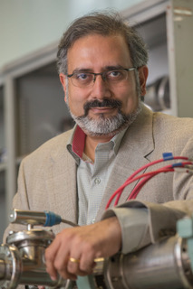
Thank you, Abhay !!!
Thank you, LOC !!

Slide 13
Thank you DIS2021 !
See you at DIS2022 !!

