Slide 1
Studies performed for the EHN2 Beamline at CERN for next generation muon beam experiments
D. Banerjee
CERN BE-EA-LE

Slide 2
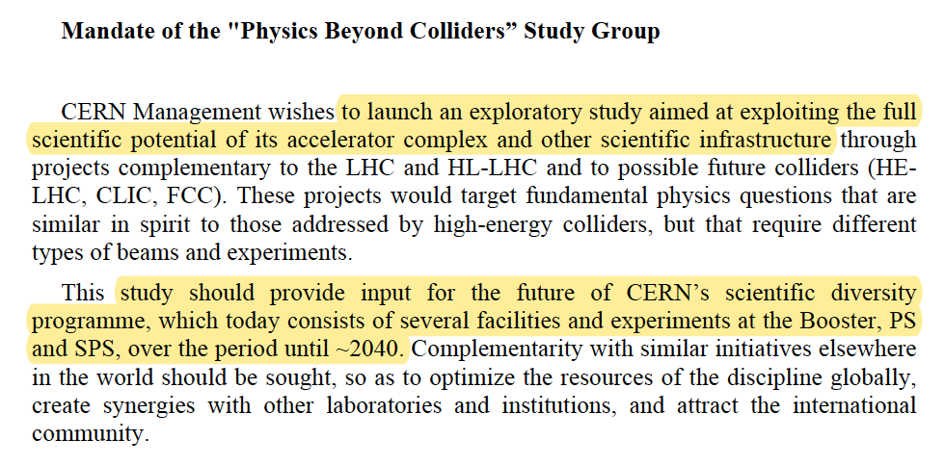
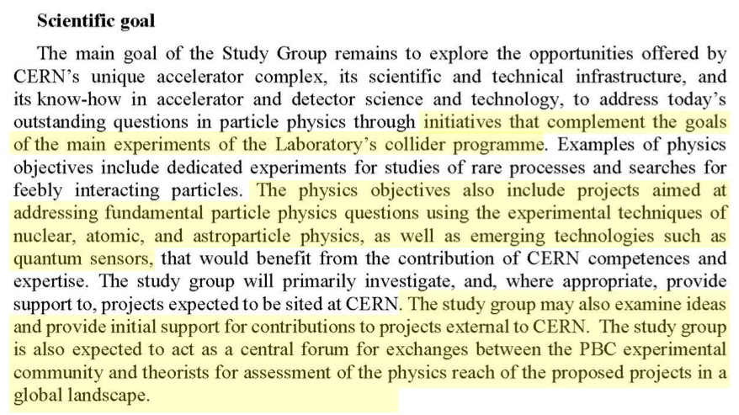
Physics Beyond Colliders Study
PBC Kickoff workshop launched in 2016
Updated PBC Mandate 2021
The Conventional Beams Working Group (CBWG) was formed as part of the Accelerators and Facilities Committee within the framework of the Physics Beyond Colliders study.
A large number of fixed target proposals were presented for the CERN North Area.
A number of studies were launched to allow the working groups to make progress with their evaluation.
A follow-up program has now also been approved by CERN.
The updated mandate was presented during the 2021 PBC workshop.
http://pbc.web.cern.ch/

Slide 3
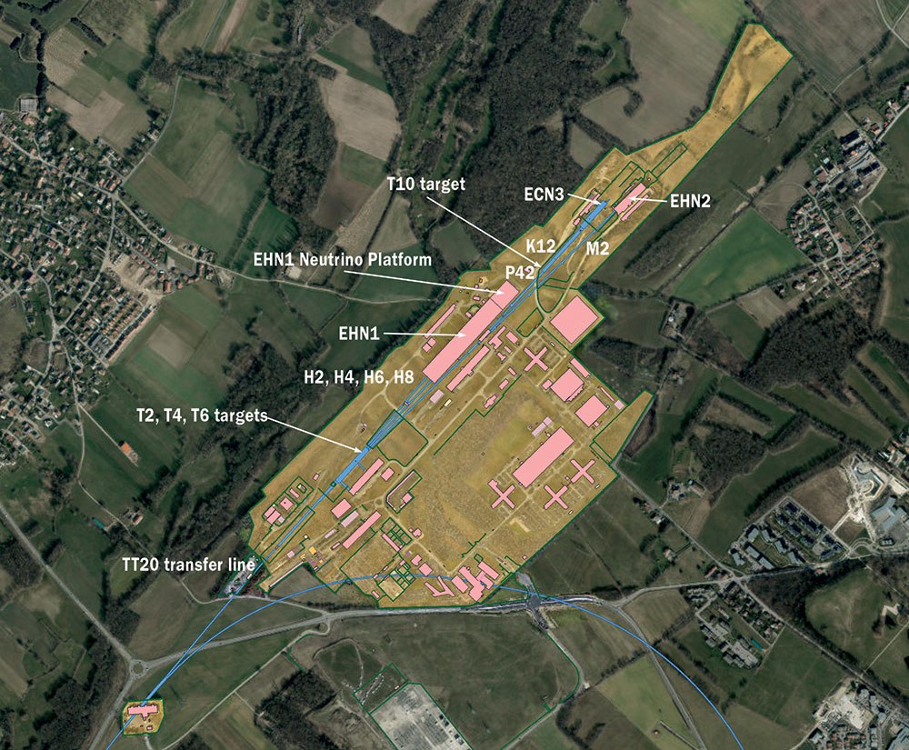
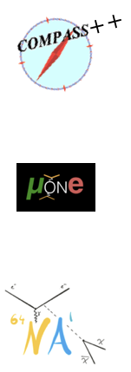
PBC Proposals for the EHN2 Beamline
Several projects for the ENH2 beamline in the CERN North Area have been proposed in context of PBC:
AMBER

Slide 4
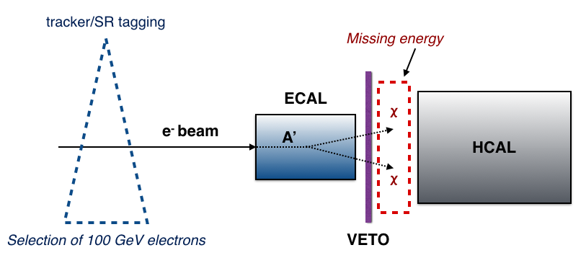
PBC Proposals for the EHN2 Beamline
Several projects for the ENH2 beamline in the CERN North Area have been proposed in context of PBC:
  NA64 - NA64 is an active beam dump dark matter experiment looking for sub-GeV dark photons at the CERN EHN1 H4 beamline with 100 GeV/c electron beams.
  NA64µ is the muon program looking for a new massive gauge boson, Z_{µ}, that couples predominantly to the 2nd and 3rd lepton generations.
Dark Sector
Zµ
SM
tracking
tracking
10⁻⁶ < 𝜖 < 10⁻³
> 50 GeV
Missing mom > 80 GeV/c
NA64µ
at M2
ECAL
NA64
at H4
µ beam
Z_{µ}
HCAL
Out µ
100 GeV
ECALE< 50 GeV
VETO
Selection of 160 Gev/c muons
Out µ < 80 GeV/c

Slide 5
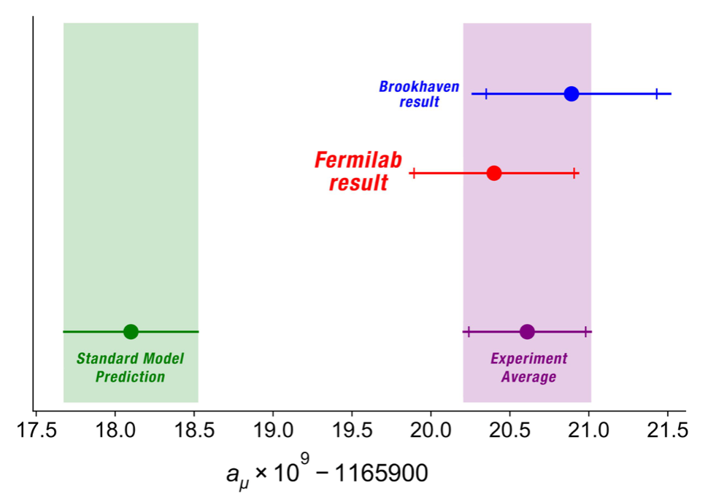
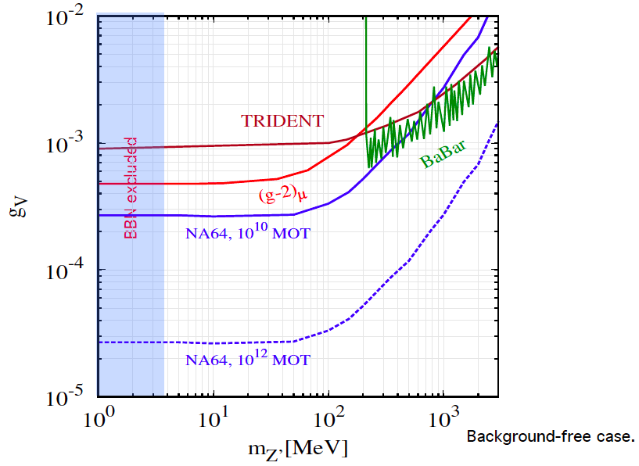
PBC Proposals for the EHN2 Beamline
Several projects for the ENH2 beamline in the CERN North Area have been proposed in context of PBC:
  Additional motivation: (g-2)_{µ} anomaly → Recent results from Fermilab confirm the previous BNL result on the (g-2)_{µ} anomaly showing a 4.2σ deviation for a_{µ} compared to the theoretical value.
  The most motivated explanation of this discrepancy is related to the BSM physics with either light (<<) or heavy (>>) particles compared to the EW scale ( ~ 100 GeV). NA64µ is designed to decisively probe the former scenario with a light Z_{µ}. The negative results are also important for further clarification of (g-2)_{µ}.
Preliminary feasibility study:
SG, Krasnikov, Matveev PRD(2015)
Background-free case.
Possible to cover (g-2)µ favored parameter space with ~ 10¹⁰ MOT
With the high intensity µ beam at CERN: Possible in a month running time.
https://news.fnal.gov/2021/04/first-results-from-fermilabs-muon-g-2-experiment-strengthen-evidence-of-new-physics/

Slide 6
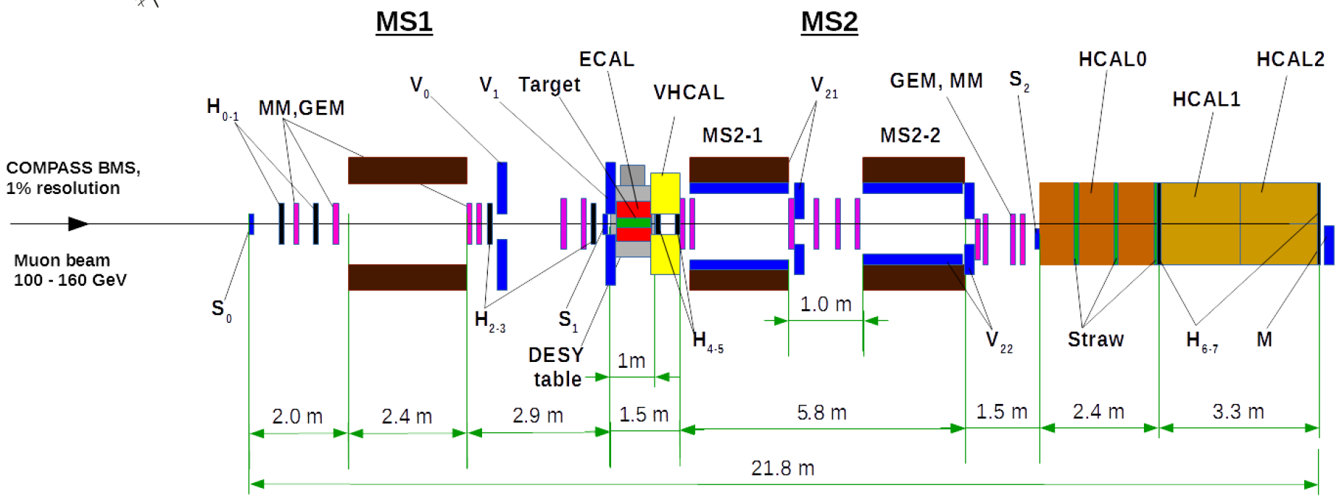
PBC Proposals for the EHN2 Beamline
Several projects for the ENH2 beamline in the CERN North Area have been proposed in context of PBC:
  NA64µ - Requirements:
    Requires medium to high intensity focussed 160 GeV/c muon beam.
    Setup ~ 15 - 25 m long and about 120 cm x 60 cm transversely.
    In 2021 they aim to do a test run with a minimal setup of 13 m.
2022-2024
2021
Test Run
Phase 1

Slide 7
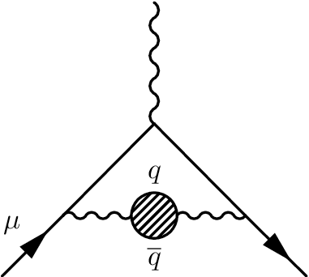
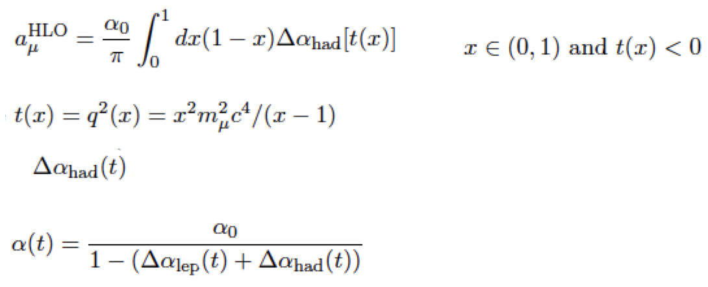
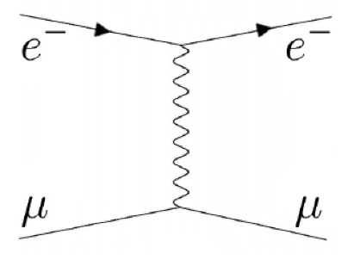
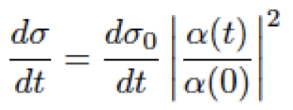
PBC Proposals for the EHN2 Beamline
Several projects for the ENH2 beamline in the CERN North Area have been proposed in context of PBC:
  MUonE - aims to investigate the hadronic contribution to the vacuum polarisation in context of (g-2)_{µ}.
    Following the recent Fermilab results their final aim is a 5σ deviation from the SM for (g-2)_{µ.}
    The uncertainty on the theoretical prediction of the hadronic contributions to a_{µ} (=(g-2)_{µ}/2) will be the main limitation when the future experiments reach their precision.
    MuOnE aims to determine a_{µ}^{HLO} from scattering data.
  Δ⍺_{lep}(t) - leptonic contribution well known from perturbative calculations ( P. Achard et al. Measurement of the running of the electromagnetic coupling at large momentum-transfer at LEP. Physics Letters B 623, 26–36 (2005).)
  Therefore determination of a_{µ}^{HLO} reduces to determination of ⍺(t).
Hadronic contribution to the running ⍺(t)

Slide 8
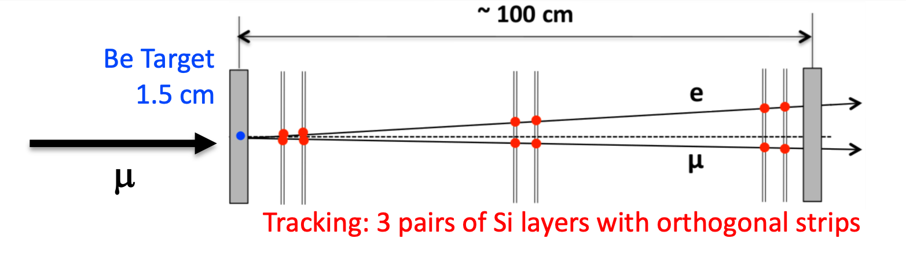
PBC Proposals for the EHN2 Beamline
Several projects for the ENH2 beamline in the CERN North Area have been proposed in context of PBC:
  MUonE – determine ⍺(t) from the differential cross-section of the elastic scattering of high energy muons on the atomic electrons in a low-Z target.
  Final goal of MUonE is to determine the differential cross-section with ~ 10 ppm systematic uncertainty at the peak of the integrand —> 0.3% statistical error on a_{µ}^{HLO} MUonE talk at PBC Workshop
  Letter of Intent presented with estimated performance from simulations. CERN-SPSC-2019-026 / SPSC-I-252

Slide 9
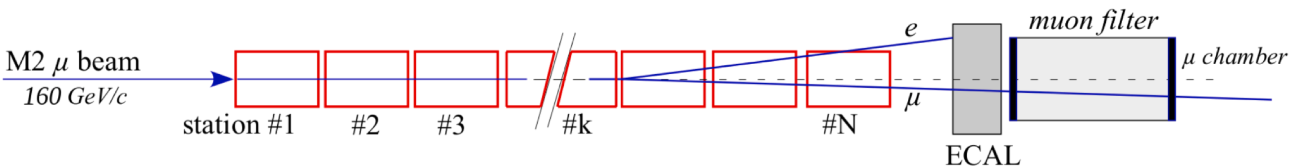
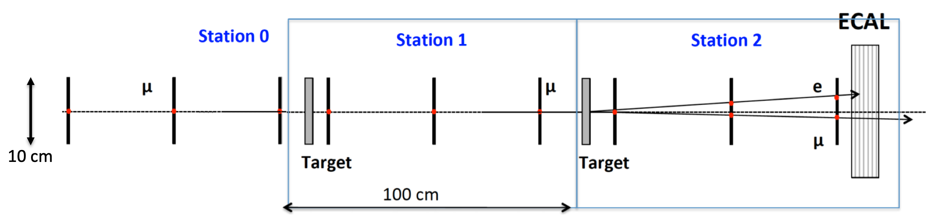
PBC Proposals for the EHN2 Beamline
Several projects for the ENH2 beamline in the CERN North Area have been proposed in context of PBC:
  MUonE – Requirements:
    Requires high intensity 160 GeV/c, low divergence muon beam.
    Full setup ~ 40 m long.
    In 2021 they aim to do a pilot run with up to three stations and the ECAL requiring a space of 7 m
Full setup
For further updates see :
“Status of the MUonE experiment”, proceedings of the 40th International Conference on High Energy Physics, PoS(ICHEP2020)223
MUonE Test Beam 2018
Pilot Run 2021

Slide 10
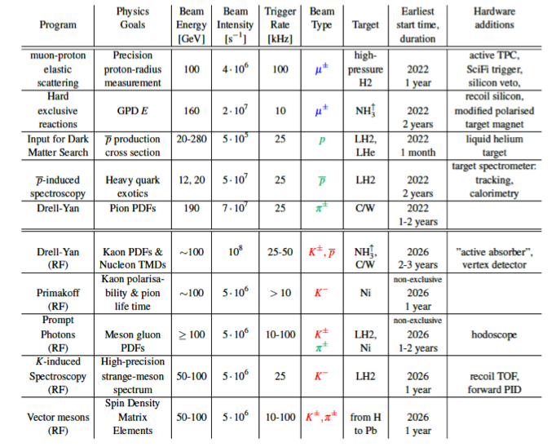
PBC Proposals for the EHN2 Beamline
AMBER
Several projects for the ENH2 beamline in the CERN North Area have been proposed in context of PBC :
  Successor to the COMPASS experiment - A QCD Facility (AMBER)
Very rich QCD physics program.
Aims to address fundamental issues of strong interactions in the medium and long-term future.
Proposed measurements cover a wide range of Q² and will firstly concentrate on:
  Measurement of the proton charge radius through elastic muon-proton scattering to address the proton radius puzzle.
  Study of the pion structure via the Drell-Yan process to address the emergence of the proton mass with the massless-ness of the pion in the chiral limit.
  Measurement of proton induced anti-proton production cross-section which is crucial for the indirect dark matter detection experiments.

Slide 11
PBC Proposals for the EHN2 Beamline
AMBER
Several projects for the ENH2 beamline in the CERN North Area have been proposed in context of PBC :
  Successor to the COMPASS experiment - A QCD Facility (AMBER)
Phase 1:
Requires conventional muon and hadron beams. 2022-2025
https://cds.cern.ch/record/2676885/files/SPSC-P-360.pdf
Phase 2 :
Requires conventional and RF separated hadron and muon beams. 2026 and beyond
The RF separated option is currently under study at the CERN BE-EA group.
A higher intensity hadron beam option is also being studied in collaboration with the CERN RP department for the Drell Yan runs.
This talk will focus on the measurements requiring µ beam.

Slide 12
PBC Proposals for the EHN2 Beamline
AMBER
Several projects for the ENH2 beamline in the CERN North Area have been proposed in context of PBC :
  Successor to the COMPASS experiment - A QCD Facility (AMBER)
Phase 1:
Requires conventional muon and hadron beams. 2022-2025
https://cds.cern.ch/record/2676885/files/SPSC-P-360.pdf
Phase 2 :
Requires conventional and RF separated hadron and muon beams. 2026 and beyond
AMBER Phase 1 has been approved by the Research Board
Actual Beamtimes are subject to separate approval
The RF separated option is currently under study at the CERN BE-EA group.
A higher intensity hadron beam option is also being studied in collaboration with the CERN RP department for the Drell Yan runs.
This talk will focus on the measurements requiring µ beam.

Slide 13
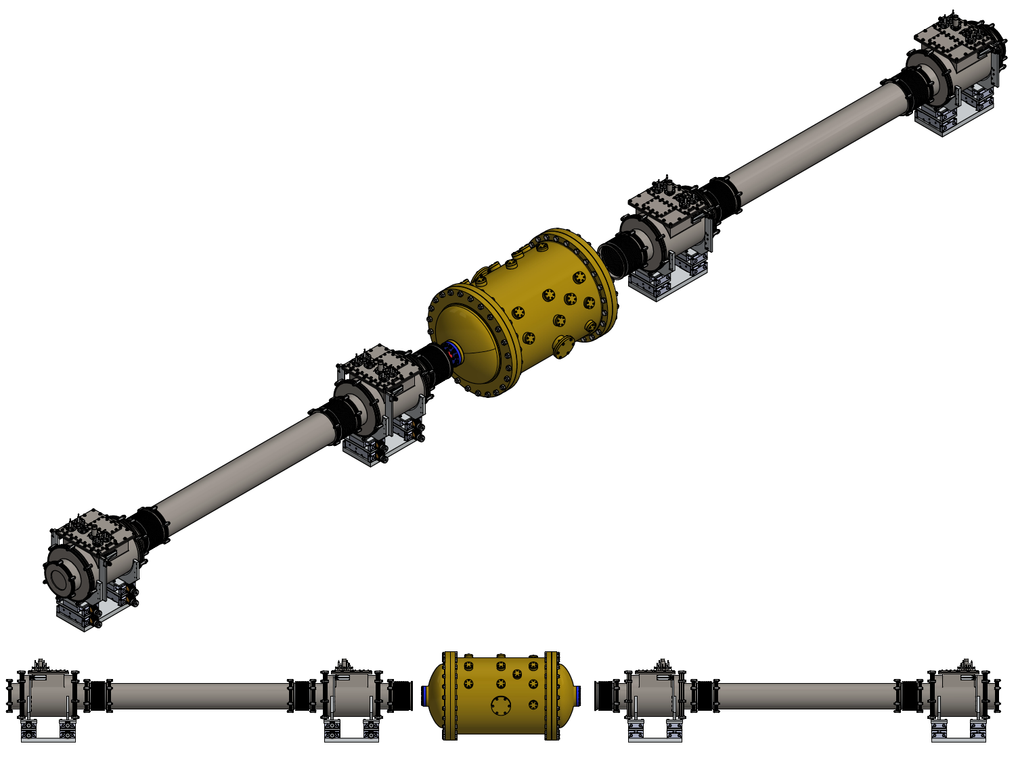
PBC Proposals for the EHN2 Beamline
Several projects for the ENH2 beamline in the CERN North Area have been proposed in context of PBC :
  AMBER Proton radius measurement – Requirements :
    COMPASS currently occupies the EHN2 hall with a 55 m long setup.
    In 2021 they aim to do a test run for their proton radius measurement with the TPC and 160 GeV/c µ beam requiring a space of about 9 m.
AMBER
9 m
PRM-TPC
3 m
2.2 m
3 m

Slide 14
Studies and Challenges
Most important challenge: Will we be able to run MUonE or NA64µ together with COMPASS/AMBER?
Main questions
  Is there enough space?
  Are the physics requirements feasible (e.g. beam size, momentum)?
  Is parallel running feasible ?
Studies were launched by the EHN2 sub-working Group of the Conventional Beams Working Group to address all these questions.

Slide 15
Studies and Challenges
Most important challenge: Will we be able to run MUonE or NA64µ together with COMPASS/AMBER?
Main questions
  Is there enough space?
  Are the physics requirements feasible (e.g. beam size, momentum)?
  Is parallel running feasible ?
Studies were launched by the EHN2 sub-working Group of the Conventional Beams Working Group to address all these questions.

Slide 16
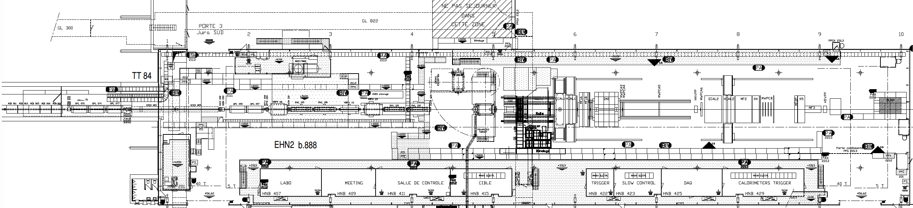
Space required for the installation
Currently COMPASS occupies the 55 m long EHN2 hall to be used for the approved AMBER Drell Yan runs in 2022 and beyond.
Upstream of the COMPASS setup 2 CEDAR detectors are located which will not be used during the 2021 COMPASS transversity run.
This 13 m available space was deemed feasible for all three 2021 test runs without any modification to the beamline.
COMPASS
M2 beamline

Slide 17
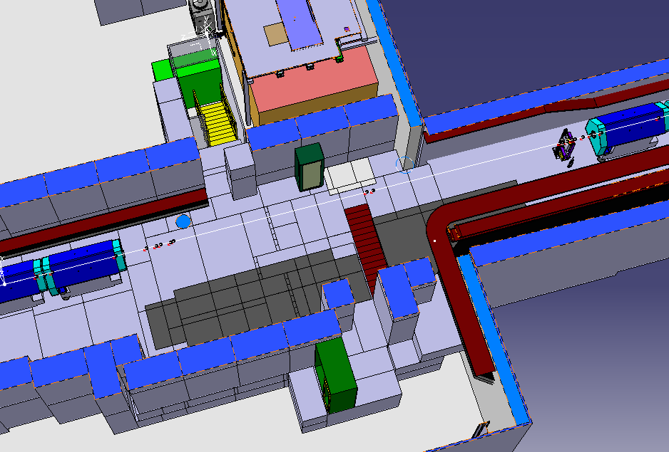
Space required for the installation
Currently COMPASS occupies the 55 m long EHN2 hall to be used for the approved AMBER Drell Yan runs in 2022 and beyond.
Upstream of the COMPASS setup 2 CEDAR detectors are located which will not be used during the 2021 COMPASS transversity run.
This 13 m available space was deemed feasible for all three 2021 test runs without any modification to the beamline.
13 m
COMPASS
M2 beamline
µ

Slide 18
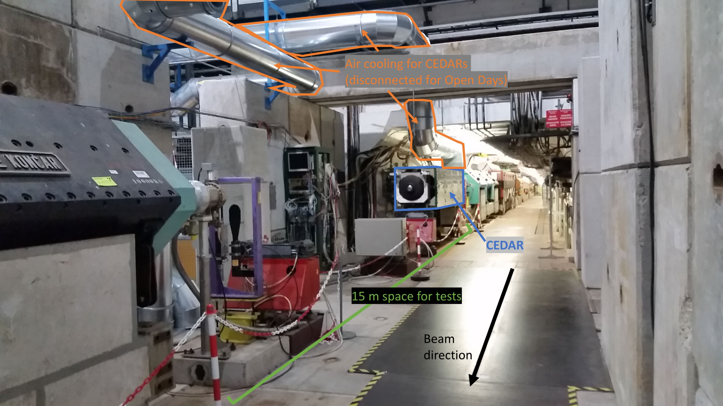
Space required for the installation

Slide 19
Space required for the installation
Following the 2021 runs NA64µ would require a space of 25 m, MUonE would require a space of 40 m for their full setup and AMBER will require their 55 m long spectrometer.
To accommodate NA64µ and MUonE the beamline elements downstream of the current CEDARs will be removed.
A rail system will be installed and the magnets and detector components will be installed on it to reduce the change-over time.
All integration studies for the 2021 runs as well as the rail design have been completed.
COMPASS
M2 beamline
~ 42 m

Slide 20
Studies and Challenges
Most important challenge: Will we be able to run MUonE or NA64µ together with COMPASS/AMBER?
Main questions
  Is there enough space?
  Are the physics requirements feasible (e.g. beam size, momentum)?
  Is parallel running feasible ?
Studies were launched by the EHN2 sub-working Group of the Conventional Beams Working Group to address all these questions.

Slide 21
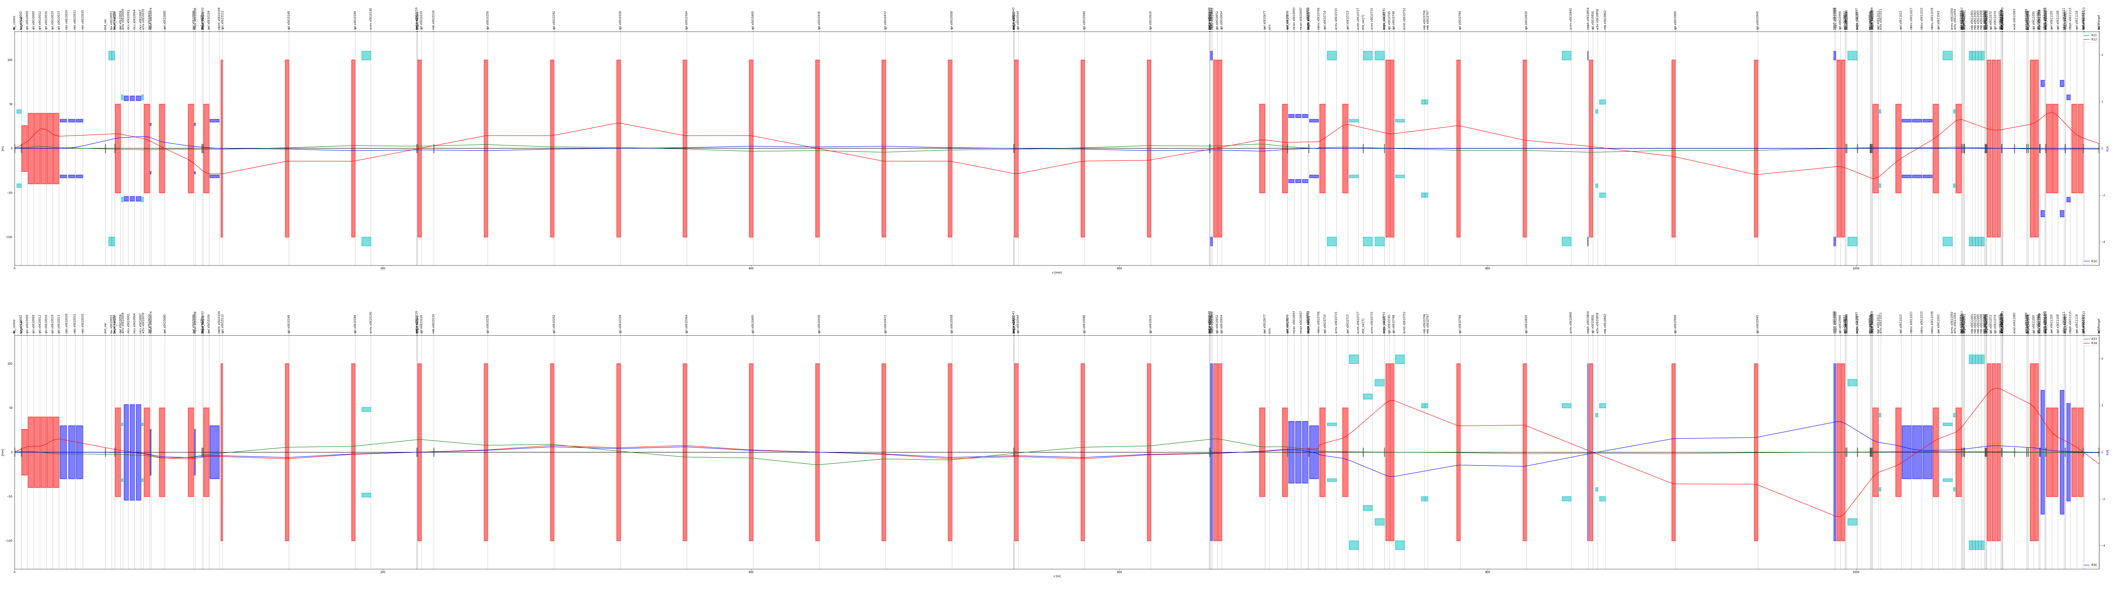
Optics studies
The M2 beamline is ~ 1.1 km long transporting secondary particles from the target to the EHN2 hall.
It has a 700 m long hadron section to allow hadron decays to muons followed by 9.9 m Be in a bend to absorb the hadrons with the muons passing through. A 400 m long muon section selects the final muon momentum and cleans the muon beam halo.
For the AMBER runs in the current COMPASS location the conventional muon beam optics fits the requirements.
However, currently the beam parameters in the upstream location does not fit the test run requirements.
Two optics settings were studied – 1) focussed beam (AMBER test run / NA64µ) 2) low divergence beam (MUonE)
HADRON SECTION
MUON SECTION
COMPASS
13 m Upstream location

Slide 22
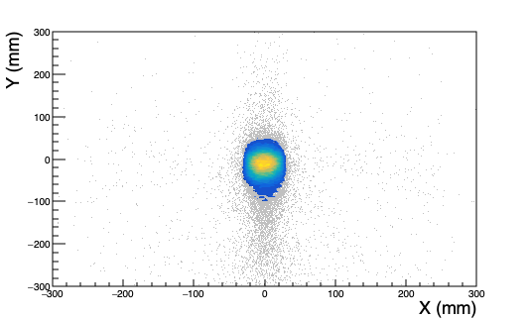
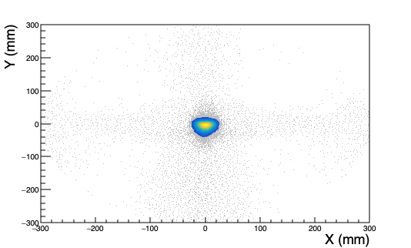
Upstream Location - Two Optics options
Parallel beam Focussed beam
𝜎_{x} = 13 mm
𝜎_{y} = 22 mm
𝜎_{x} = 9.99 mm
𝜎_{y} = 11.8 mm
𝜎_{x’} = 0.23 mrad
𝜎_{y’} = 0.24 mrad
𝜎_{x’} = 0.47 mrad
𝜎_{y’} = 1.3 mrad
𝜎_{p} = 6 GeV/c
𝜎_{p} = 6 GeV/c

Slide 23
Upstream Location - Two Optics options
Parallel beam Focussed beam
𝜎_{x} = 13 mm
𝜎_{y} = 22 mm
𝜎_{x} = 9.99 mm
𝜎_{y} = 11.8 mm
𝜎_{x’} = 0.23 mrad
𝜎_{y’} = 0.24 mrad
𝜎_{x’} = 0.47 mrad
𝜎_{y’} = 1.3 mrad
Fits the experiment requirements
𝜎_{p} = 6 GeV/c
𝜎_{p} = 6 GeV/c

Slide 24
Studies and Challenges
Most important challenge: Will we be able to run MUonE or NA64µ together with COMPASS/AMBER?
Main questions
  Is there enough space?
  Are the physics requirements feasible (e.g. beam size, momentum)?
  Is parallel running feasible ?
Studies were launched by the EHN2 sub-working Group of the Conventional Beams Working Group to address all these questions.

Slide 25
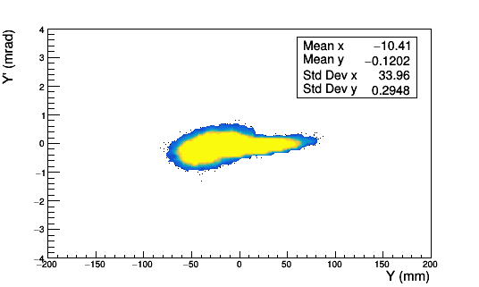
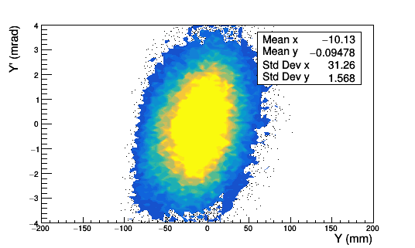
NA64µ and MuOnE setups
Both NA64µ and MuOnE have considerable material (HCAL / µ-filter) which blows up the beam for AMBER downstream.
MUonE
NA64µ
2021
Test Run
2022-2024
Phase space in Y
Pilot Run
Phase 1
Effect of the material
Entrance of MUonE setup
Exit of MUonE setup

Slide 26
NA64µ and MuOnE setups
Both NA64µ and MuOnE have considerable material (HCAL / µ-filter) which blows up the beam for AMBER downstream.
MUonE
NA64µ
2021
Test Run
2022-2024
Phase space in Y
Pilot Run
Phase 1
Effect of the material
In order to re-focus the beam for AMBER we would need the downstream quadrupoles after the NA64µ/MuOnE setups → not possible given the space available and the requirements.
Parallel running was therefore excluded.
Entrance of MUonE setup
Exit of MUonE setup

Slide 27
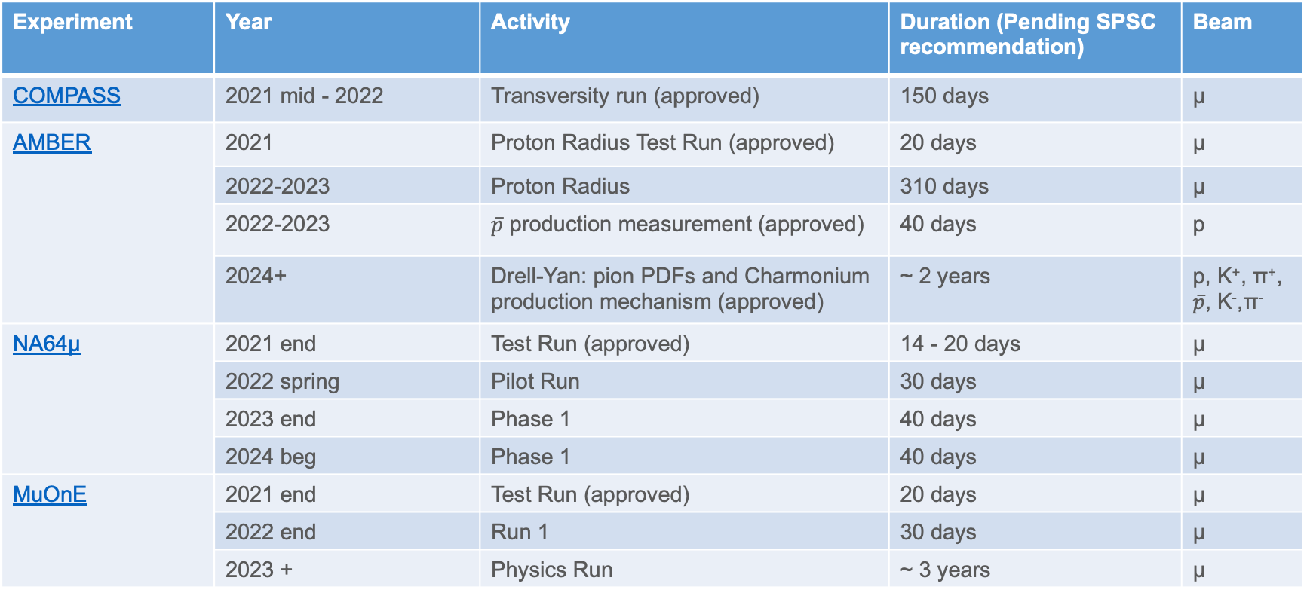
Tentative Beam Times up to LS3
Experiment | Year | Activity | Duration (Pending SPSC recommendation) | Beam
COMPASS | 2021 mid - 2022 | Transversity run (approved) | 150 days | µ
AMBER | 2021 | Proton Radius Test Run (approved) | 20 days | µ
 | 2022-2023 | Proton Radius | 310 days | µ
 | 2022-2023 | $\overline{p}$ production measurement (approved) | 40 days | p
 | 2024+ | Drell-Yan: pion PDFs and Charmonium production mechanism (approved) | ~ 2 years | p, K⁺, π⁺, $\overline{p}$, K⁻,π⁻
NA64µ | 2021 end | Test Run (approved) | 14 - 20 days | µ
 | 2022 spring | Pilot Run | 30 days | µ
 | 2023 end | Phase 1 | 40 days | µ
 | 2024 beg | Phase 1 | 40 days | µ
MuOnE | 2021 end | Test Run (approved) | 20 days | µ
 | 2022 end | Run 1 | 30 days | µ
 | 2023 + | Physics Run | ~ 3 years | µ

Slide 28
Conclusion
Three new projects have been proposed for the EHN2 beamline in context of the PBC studies – AMBER, MUonE and NA64µ.
Test runs for all three experiments have been approved and they will be running this year.
Feasibility studies in terms of space, beam parameters and parallel running performed by the Conventional Beams Working Group.
Space for all three test runs as well as optics options have been finalised.
Parallel running is excluded from the results of the studies.
Integration of a rail system is foreseen to reduce change over time.
Preparation for the 2021 test runs are ongoing – no showstoppers.
Future studies include higher intensities for Drell Yan, an RF separated option for AMBER, integration of the final MUonE and NA64µ setup.

Slide 29
Thank you for your attention!

