Slide 1
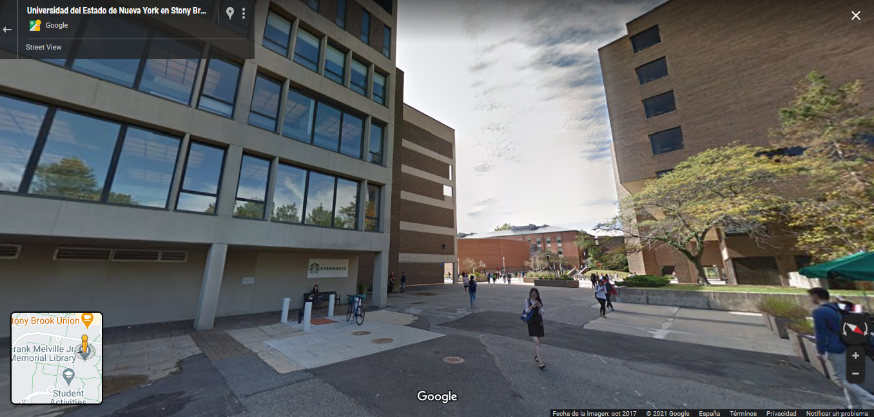

Physics of LHCb Upgrade(s)
Diego Martínez Santos
Axencia Galega de Innovacion
(On behalf of the LHCb Collaboration)

Slide 2



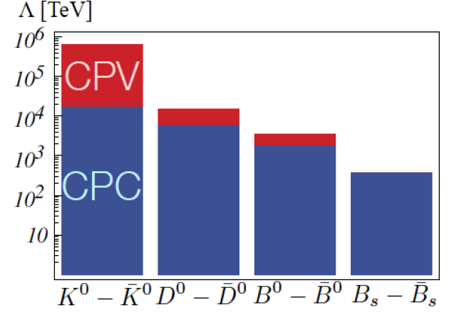
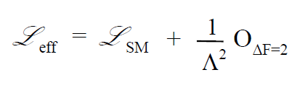
Introduction
Flavour Physics is a powerful tool to access NP beyond the reach of direct production at accelerators
Most notably in searches for sources of FV/CPV other than CKM
(G. Isidori, KAON’16)

Slide 3
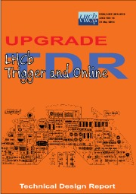
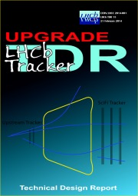
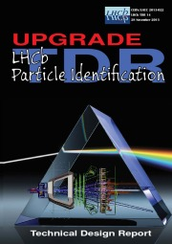

Introduction
Flavour Physics is a powerful tool to access NP beyond the reach of direct production at accelerators
Most notably in searches for sources of FV/CPV other than CKM
LHCb will upgrade to continue improving our knowledge of Flavour Physics
We speak about two upgrade phases:
  Phase-I (2022-2030): Approved, TDR’s ready, data taking next year
(G. Isidori, KAON’16)
CERN-LHCC-2014-016
CERN-LHCC-2014-001
CERN-LHCC-2013-022
CERN-LHCC-2013-021

Slide 4

Introduction
Flavour Physics is a powerful tool to access NP beyond the reach of direct production at accelerators
Most notably in searches for sources of FV/CPV other than CKM
LHCb will upgrade to continue improving our knowledge of Flavour Physics
We speak about two upgrade phases:
  Phase-I (2022-2030): Approved, TDR’s ready, data taking next year
  Phase-II (2031->2035): Expression of Interest published. Framework TDR expected for September 2021
(G. Isidori, KAON’16)

Slide 5
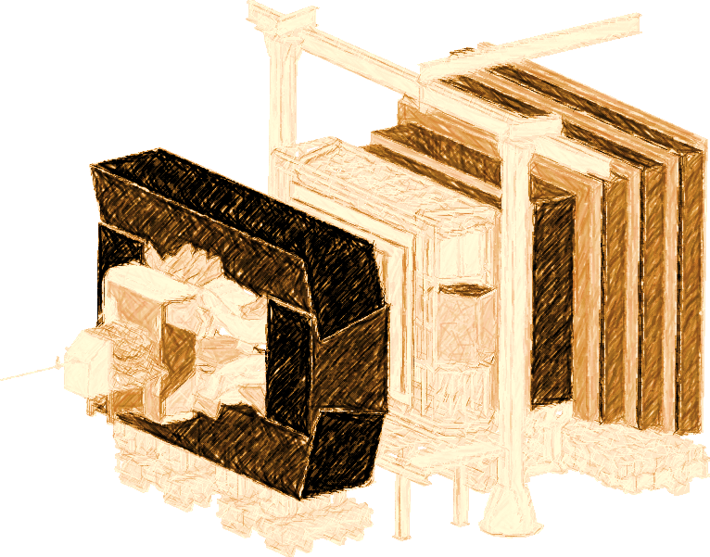
Outline
Timescale for Phase-I and Phase-II
Detector:
  Phase-I upgrade detector
  Phase-I upgrade trigger
  Phase-II upgrade detector
Sensitivity:
  b→sll transitions
  LFV
  B mixing
  Οther CPV
  Semitauonic B decays
  s→dll transitions

Slide 6






Timescale
Run from 2010 to 2018
L_{peak} 4x10³²cm⁻²s⁻¹
Accumulated ~9 fb⁻¹
Phase-I
19 | 20 | 21 | 22 | 23 | 24 | 25 | 26 | 27 | 28 | 29 | 30
LS2 |  |  | Run 3 |  |  | LS3 |  |  | Run 4
 |  |  | L_{peak} 2x10³³cm⁻²s⁻¹ |  |  |  |  |  | L_{peak} 2x10³³
 |  |  |  |  |  |  |  |  | L_{int} 50 fb⁻¹
(Note: This logo may not be official)
31 | 32 | 33 | 34 | 35 | 36 | 37 | 39
LS4 | Run 5 |  |  | LS5 | Run 6
 | L_{peak} 2x10³⁴cm⁻²s⁻¹ |  |  |  | L_{peak} 2x10³⁴
 |  |  |  |  | L_{int} ~300 fb⁻¹
. . .
Phase-II

Slide 7
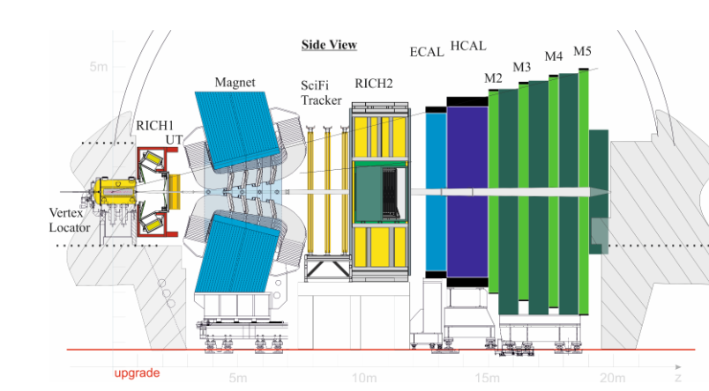
LHCb Upgrade detector (Phase-I)
CERN-LHCC-2014-016
CERN-LHCC-2014-001
CERN-LHCC-2013-022
CERN-LHCC-2013-021
Main Phase-I upgrades

Slide 8
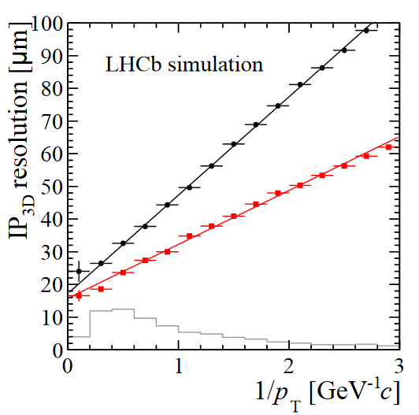
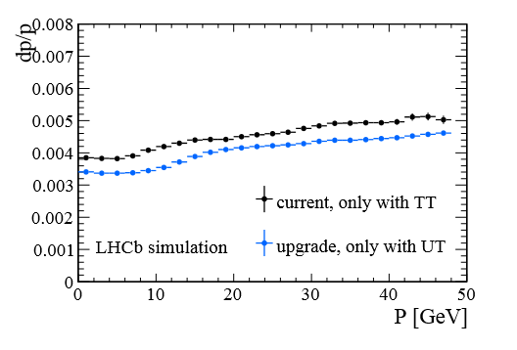
LHCb Upgrade detector (Phase-I)
CERN-LHCC-2014-001
CERN-LHCC-2013-021
CERN-LHCC-2014-001
LHCb
LHCb UPG
CERN-LHCC-2013-021
Upgraded detector has to cope with higher multiplicity
But it also has an improved performance

Slide 9
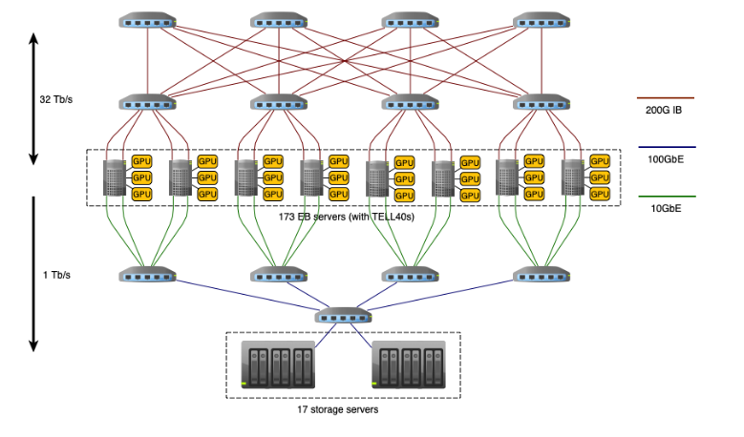

LHCb Upgrade trigger
LHCB-TDR-021
First stage of software trigger is done in GPU’s
The GPU’s replace the event building units, and run the first stage of the trigger (40 MHz -> ~0.5-1MHz)
CPU farm processes the second stage of the trigger (few kHz)

Slide 10
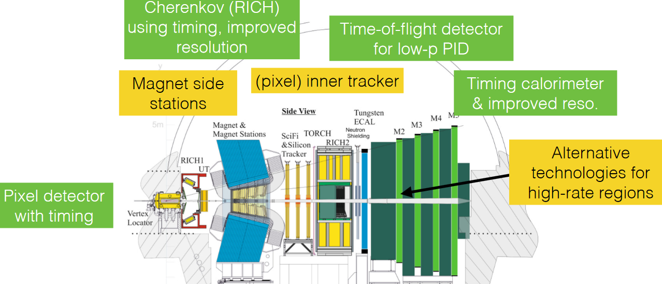
LHCb Phase-II Upgrade detector
CERN-LHCC-2017-003

Slide 11
Experiment sensitivity

Slide 12

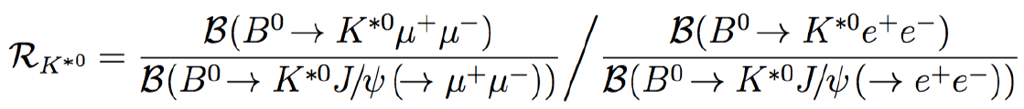

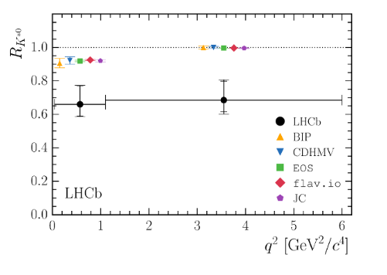
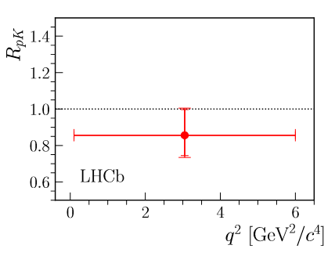

Lepton Universality Violation in b→sll
LHCb observes some interesting deviations in the ratios
Full LHCb dataset, arxiv:2103.11769
JHEP08(2017)055
JHEP05(2020)040

Slide 13
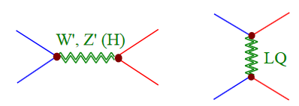
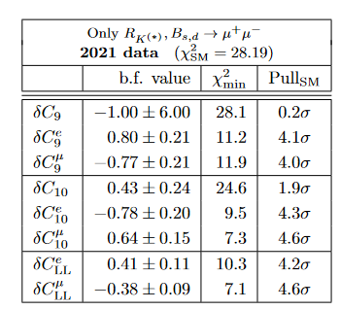
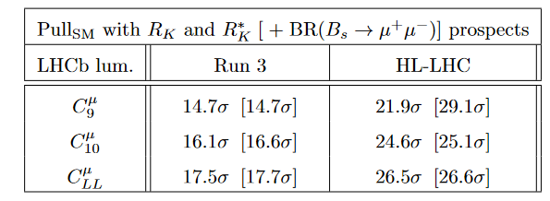
Lepton Universality Violation in b→sll
Main BSM interpretations: Z’ and LQ
μ
Ultimate precision by LHCb Upgrade with 300 fb⁻¹ is expected to be ~ 1%
b
b
μ
s
μ
s
μ
One operator fits
T. Hurth et al., in preparation

Slide 14
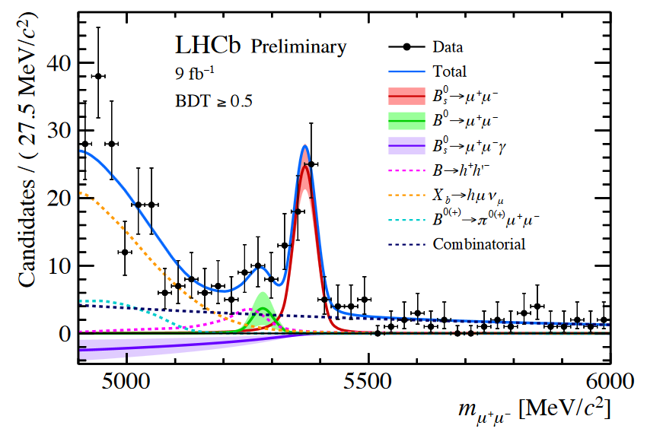



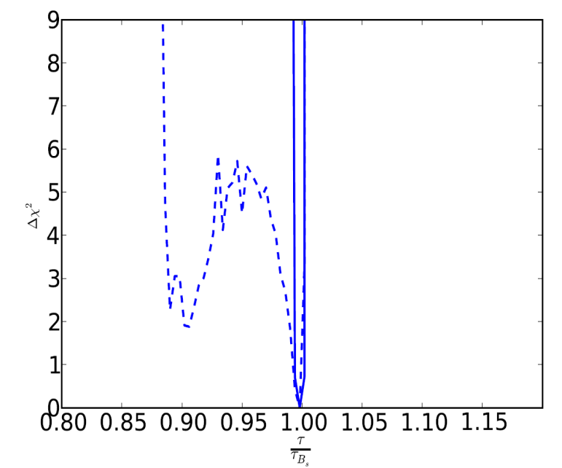

B_{s}→μμ
B_{s}→ μμ are golden modes in NP searches
  w/a average deviates about 2σ from SM, (in line w/ expectations from R_{K}, R_{K*})
  Expected precision
The effective B_{s} lifetime in B_{s}→ μμ is also sensitive to NP for precisions of percent
LHCB-PAPER-2021-007
JHEP 10 (2019) 232
  σ(ΒR(B_{s}→μμ)), 50 fb⁻¹ ~ 3.0x10⁻¹⁰
  σ(ΒR(B_{s}→μμ)), 300 fb⁻¹ ~ 1.6x10⁻¹⁰
LHC + LEP + g-2 + Ωh2 +…
Δχ2
50 fb⁻¹
300 fb⁻¹
σ(τ), 50 fb⁻¹ ~ 5%
σ(τ), 300 fb⁻¹ ~ 2%
E. Bagnaschi et al.
arXiv:1612.05210
M. Lucio

Slide 15
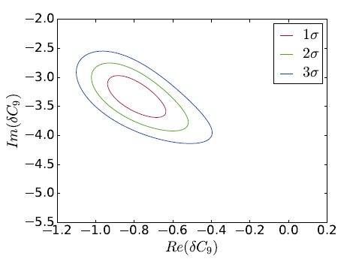
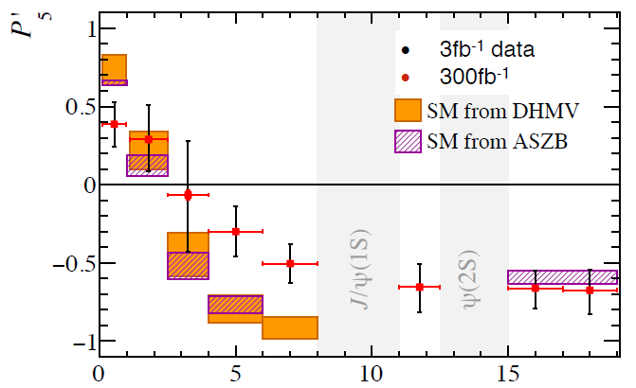
B_{d}→K*μμ angular observables
T. Blake
Example
~300 fb⁻¹
V. Chobanova et al.
arXiv:1702.02234
q²
(yes, the red points have error bars)
Moreover, the q² dependence will be known with high precision → very valuable input to the discussion on NP vs hadronic power corrections to SM

Slide 16
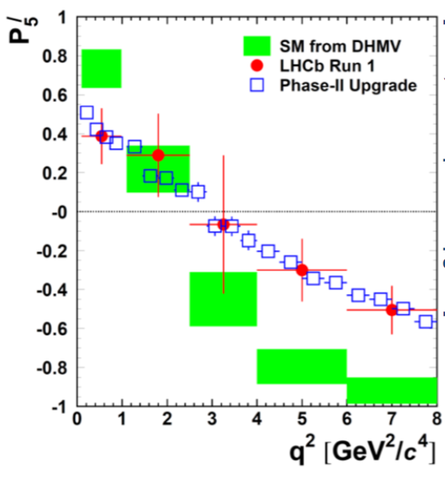
B_{d}→K*μμ angular observables
T. Blake
CERN-LHCC-2017-003
q²
(yes, the red points have error bars)
Moreover, the q² dependence will be known with high precision → very valuable input to the discussion on NP vs hadronic power corrections to SM
… and larger datasets would allow to make finer q² binning

Slide 17
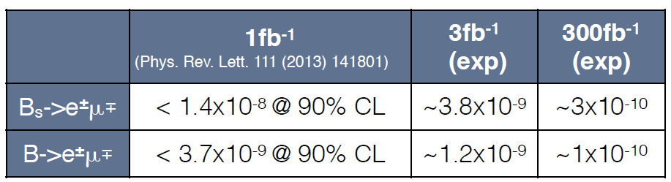
Lepton Flavour Violation
LFV forbidden in SM, but allowed in BSM →positive signal is compelling NP discovery
LHCb searches for LFV
  Several world best results in hadron decays
  Competitive in τ → 3μ (and LHCb upgrade expect to go down to O(10⁻⁹), competitive w/ Belle –II)
Other searches in future
B→Keμ → expected O(10⁻⁹) for Phase – II
K_{S}→μe, K⁺→πμe

Slide 18
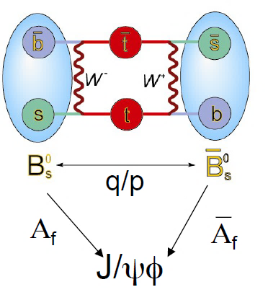
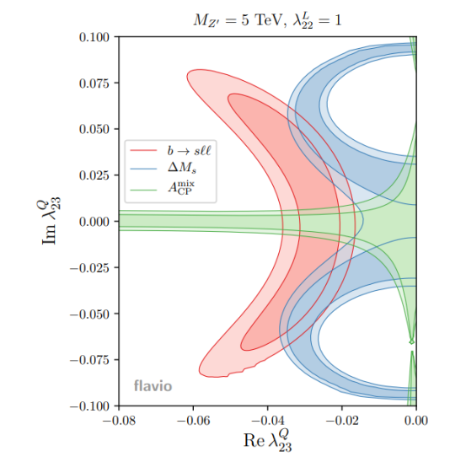
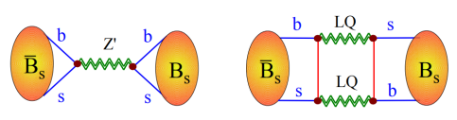

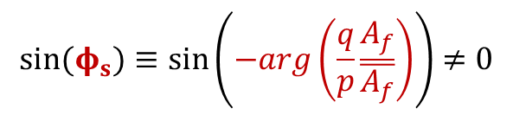
B_{s} mixing phase, Φ_{s}
CPV in interference mixing-decay:
$$sin⁡(φ_{s})≡sin⁡\left(−arg\left(\frac{q}{p}\frac{A_{f}}{\overline{A_{f}}}\right)\right)≠0$$
Which in b→cc decays corresponds to the phase of the B_{s} mixing. In SM, neglecting penguin pollution:
$$φ_{s}$$
B_{s} mixing in models for b→sll anomalies (from G. Isidori, FPCP 2020)
L. Di Luzio,M. Kirk, A. Lenz
arXiv:1811.12884

Slide 19
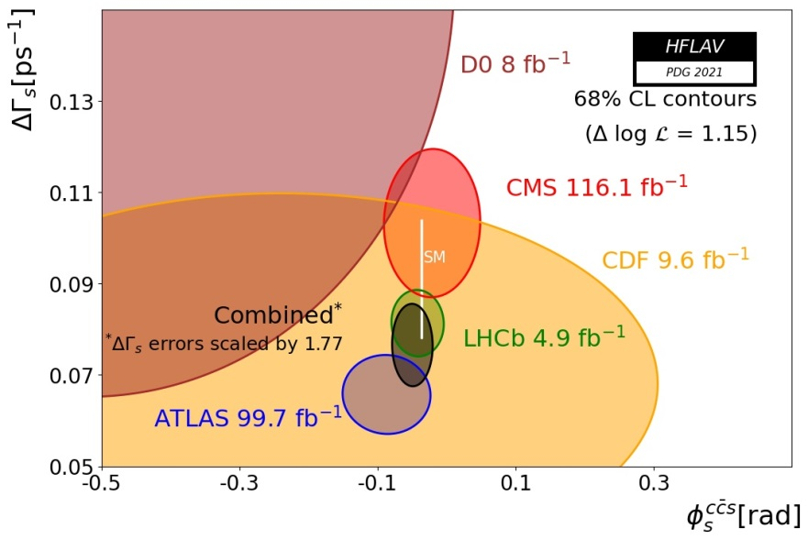
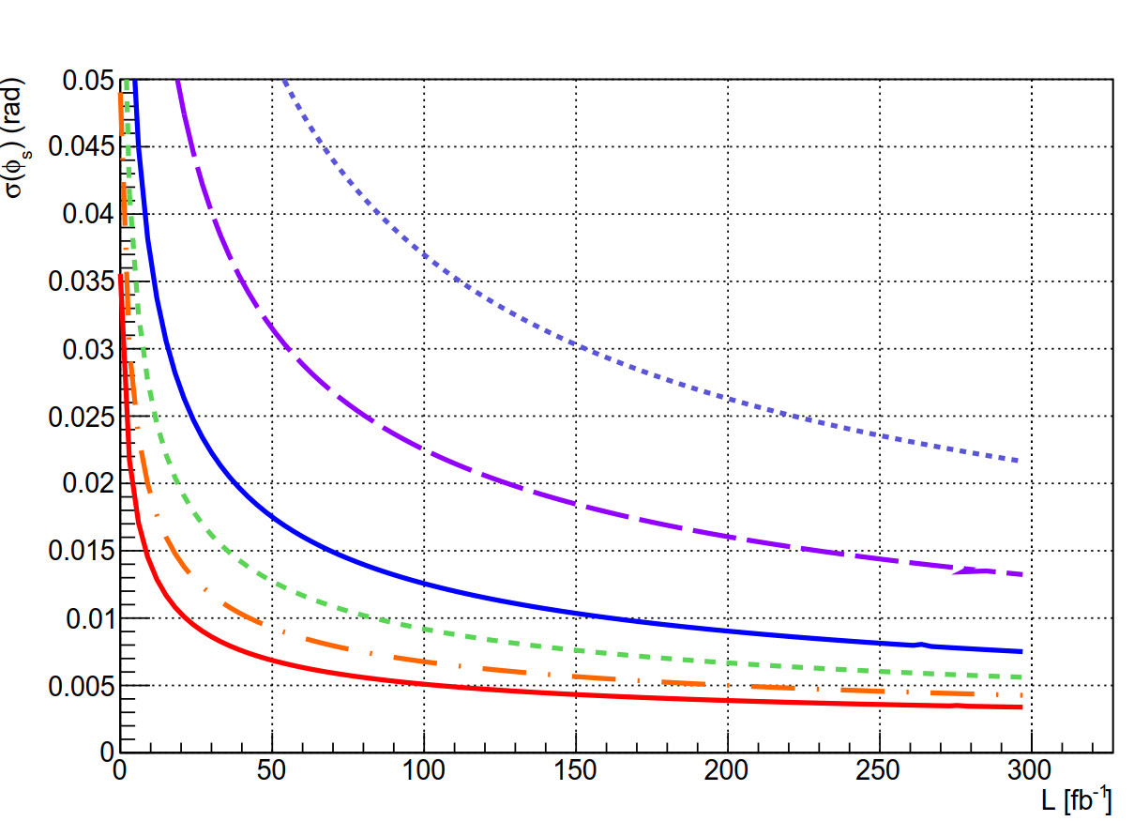
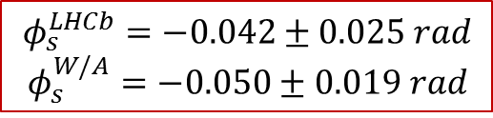
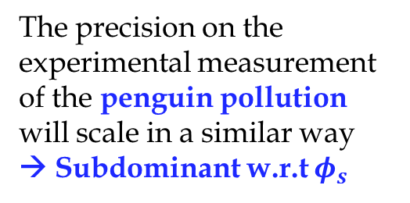
B_{s} mixing phase, Φ_{s}
$$φ_{s}^{LHCb}=−0.042±0.025 rad$$
$$φ_{s}^{W/A}=−0.050±0.019 rad$$
(HFLAV 4 PDG 2021)
The precision on the experimental measurement of the penguin pollution will scale in a similar way
→ Subdominant w.r.t $φ_{s}^{}$
Phase I upgrade,
50 fb⁻¹
V. Chobanova
DsDs
J/ψππ
Ψ(2S)KK
J/ψΚΚ (high mass)
Phase II upgrade,
300 fb⁻¹
J/ψKK(low mass)
< 0.005 rad
@ 300 fb⁻¹
COMBINED

Slide 20
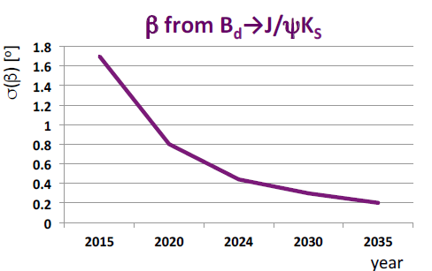
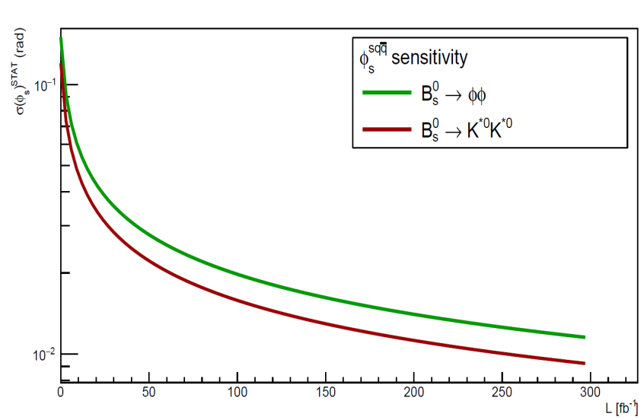
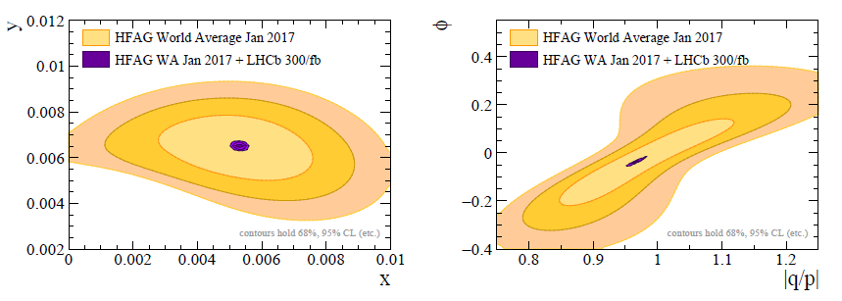
Other CPV measurements
D. Johnson
B_{d} Mixing phase β in B_{d}→J/ψK_{S}.
Electroweak phase in penguin modes like B_{s}→ΦΦ and K*K* (not to be confused with Φ_{s} of the B_{s}→J/ψΧ modes)
CKM angle γ
  50 fb⁻¹ : ~1º
  300 fb⁻¹ : ~0.4º
CPV in charm:
V. Chobanova
CERN-LHCC-2017-003
CERN-LHCC-2017-003
(HFAG = HFLAV)

Slide 21
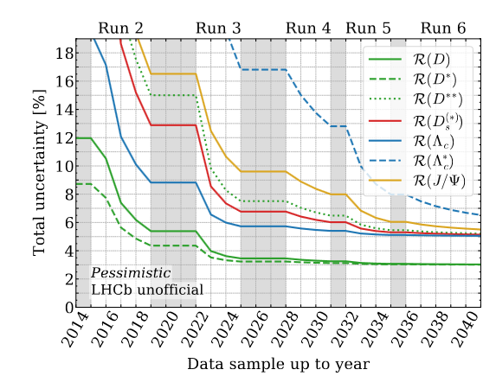
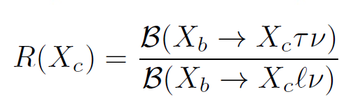
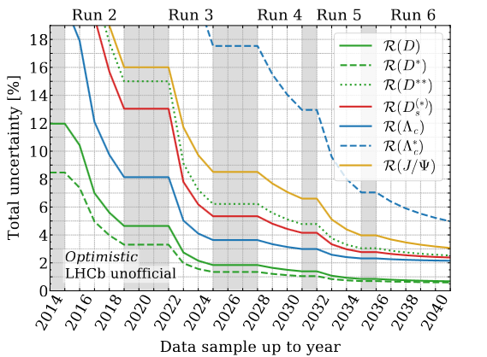
Semitauonic B decays
arXiv:2101.08326
Bernlochner, Franco, Robinson & Wormser
LHCb and B-factories show an interesting 4σ deviation w.r.t SM prediction
Can be accommodated in NP correlated with b→sll^{(*)}
LHCb upgrade(s) can shed more light with several additional modes
arXiv:2101.08326
Bernlochner, Franco, Robinson & Wormser
(*) see eg:
https://arxiv.org/abs/1506.01705
https://arxiv.org/abs/1512.01560
https://arxiv.org/abs/1702.07238

Slide 22
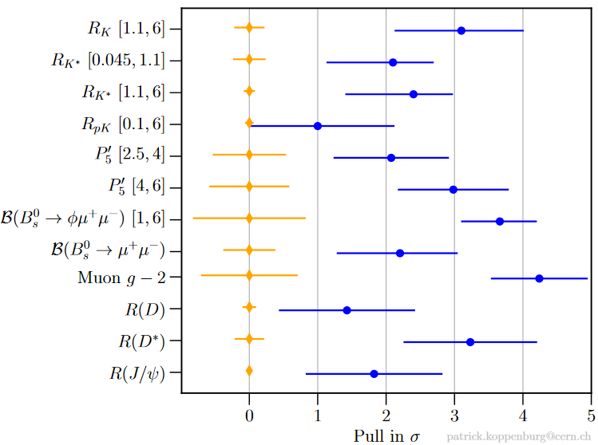

SM
EXP
b→sμμ anomalies
μ
SL anomalies
P. Koppenburg

Slide 23
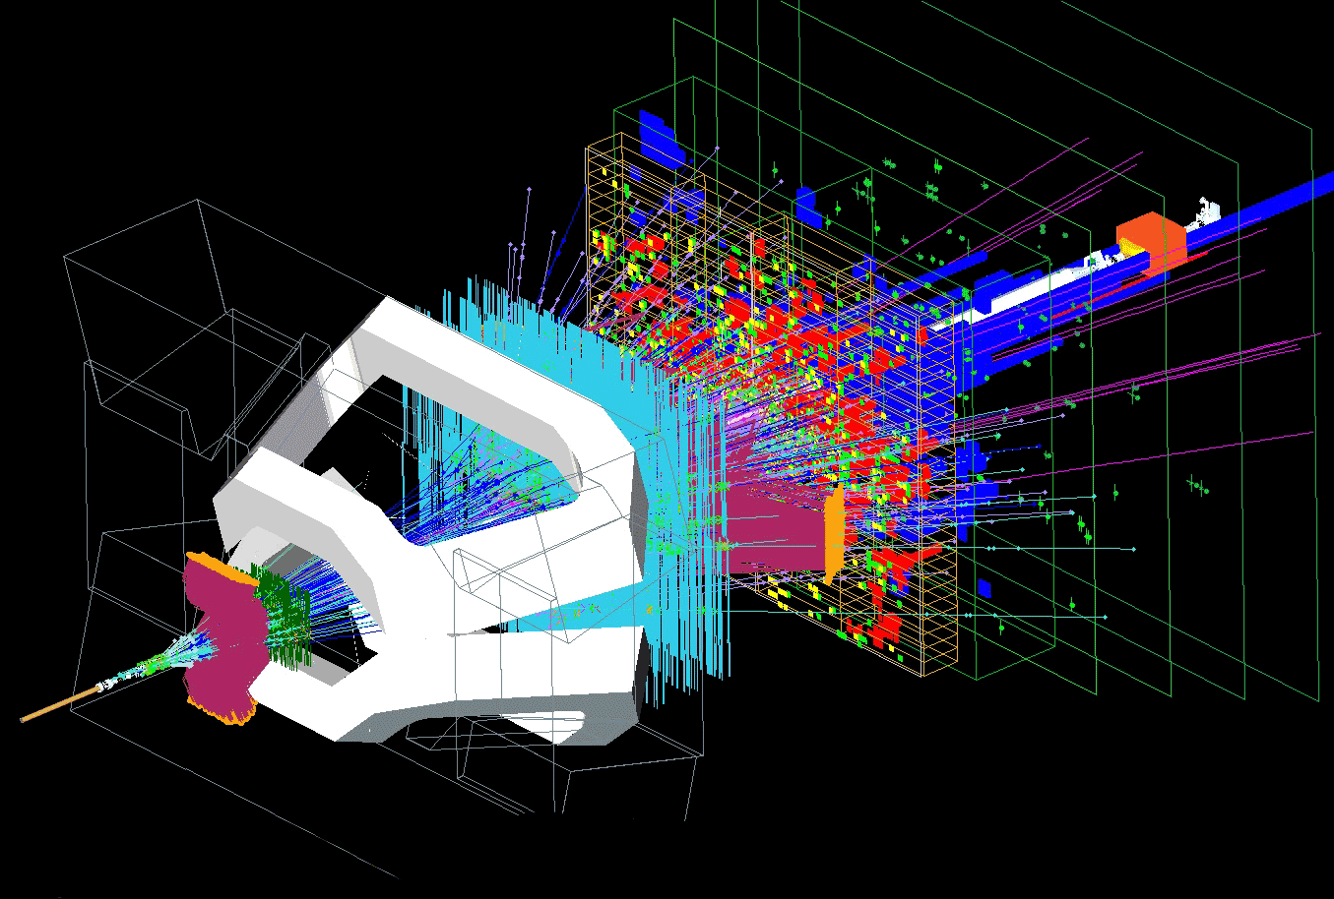
SM
EXP
b→sμμ anomalies
μ
SL anomalies
P. Koppenburg

Slide 24
s→dμμ
s→d transitions very interesting in the search for new sources of FV (they have smallest SM bkg of all quark transitions)
LHCb has already good results in K_{S}→μμ (world best limit) and Σ→pμμ (HyperCP anomaly not seen)
Very low trigger efficiency in Run-I
LHCb upgrade will have full software trigger
Expect a trigger efficiency of ~100%
Simulation studies show that trigger output rate and timingcan be controlled
→ For Strange decays, the LHCb upgrade is much more than “just” a luminosity gain
PERIOD | Efficiency (s→dμμ)
2011 | ~ 1%
2012 | ~2%
Run-II | ~18 %
Upgrade | ~100%
Trigger efficiencies are normalized to events that would have been selected offline

Slide 25
s→dμμ
K_{S} → μμ: sensitive to NP scalars, complementary to other P→μμ
  Run-II: approach the TH interesting region
  50 fb⁻¹ → BR < 10⁻¹⁰ region
  300 fb⁻¹ → go further, down to near SM
Κ_{S}→π⁰μμ:
  Κ_{L}→π⁰μμ is an important mode in several NP scenarios (eg, ED)
  SM precision dominated by EXP uncertainty on Κ_{S}→π⁰μμ (NA48)
  LHCb upgrade can improve it
  Dimuon spectum and LFV also interesting
Several other Kaon and hyperon measurements
V. Chobanova et al.
CERN-LHCb-PUB-2016-017

Slide 26
Conclusions
LHCb Upgrade has a far reaching Flavour Physics program (b, c, s, τ ...)
Is μ the long-awaited vaccine for the exhausting SM pandemic?
  b→sμμ will provide a very precise picture of this
  Interplay w/ B mixing, LFV, etc…
The flexible trigger foreseen allows overtaking the difficulties that a hardware trigger would imply for hadronic and electronic decays
Also to better access the very low transverse momentum of strangeness decays
The Phase-II upgrade would collect a thirty times bigger data sample than LHCb currently has

Slide 27
B_{s}→μμ/ B_{d}→μμ
The ratio of BR’s B_{d}/B_{s} is considered a golden mode for testing new sources of flavour violation
LHCb upgrade can reach <30% precision (stat. limited)
Phase-II could achieve ~10% (…and still stat limited)

Slide 28
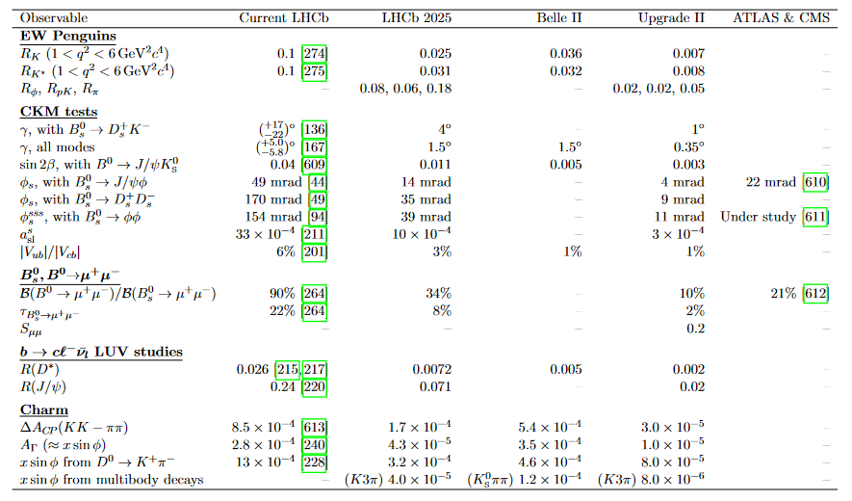

Slide 29
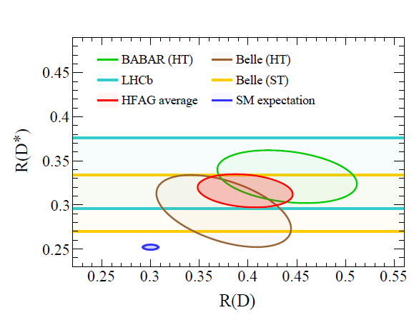

Slide 30
