Slide 1
Ab Initio Coupling of Jets to Collective Flow
in the Opacity Expansion Approach
Andrey Sadofyev
IGFAE (USC) and ITEP
in collaboration with M. Sievert and I. Vitev

Slide 2
Jet Tomography
Jets are main available probes of the matter in HIC and they are going to be important in DIS at EIC;
The hot nuclear matter in HIC undergoes multi-phase evolution and its details are hard to access through the soft sector;
In turn, jets see the matter at multiple scales, and essentially X-ray it;
However, most approaches to the jet-medium interaction are either empirical or based on multiple simplifying assumptions – static matter, no fluctuations, etc;
In what follows I will highlight our progress on the medium motion effects in the QCD calculations for jet broadening and gluon emission;
The developed formalism can be also applied to include orbital motion of nucleons and some of in-medium fluctuations (e.g. spatial inhomogeneities) in the DIS context;

Slide 3
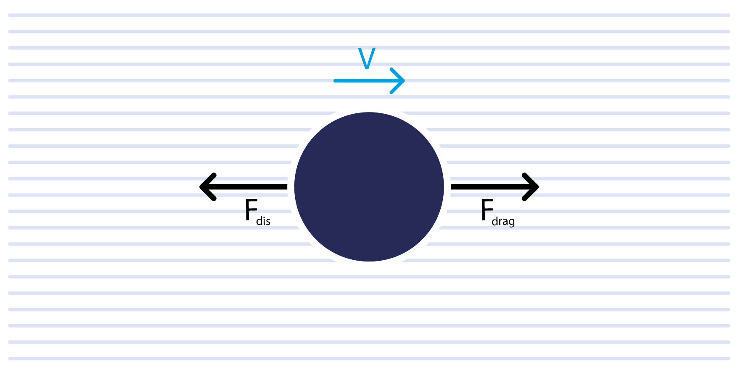
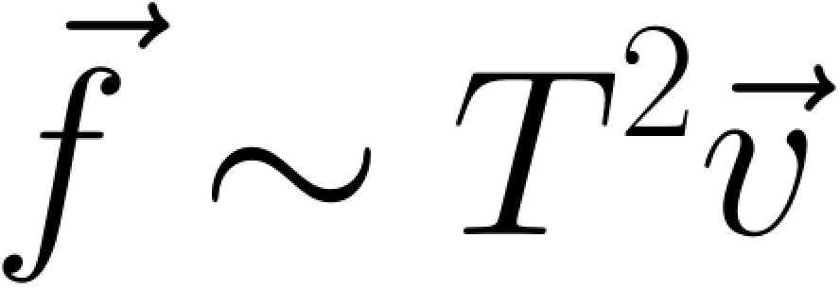
Drag Force

Slide 4
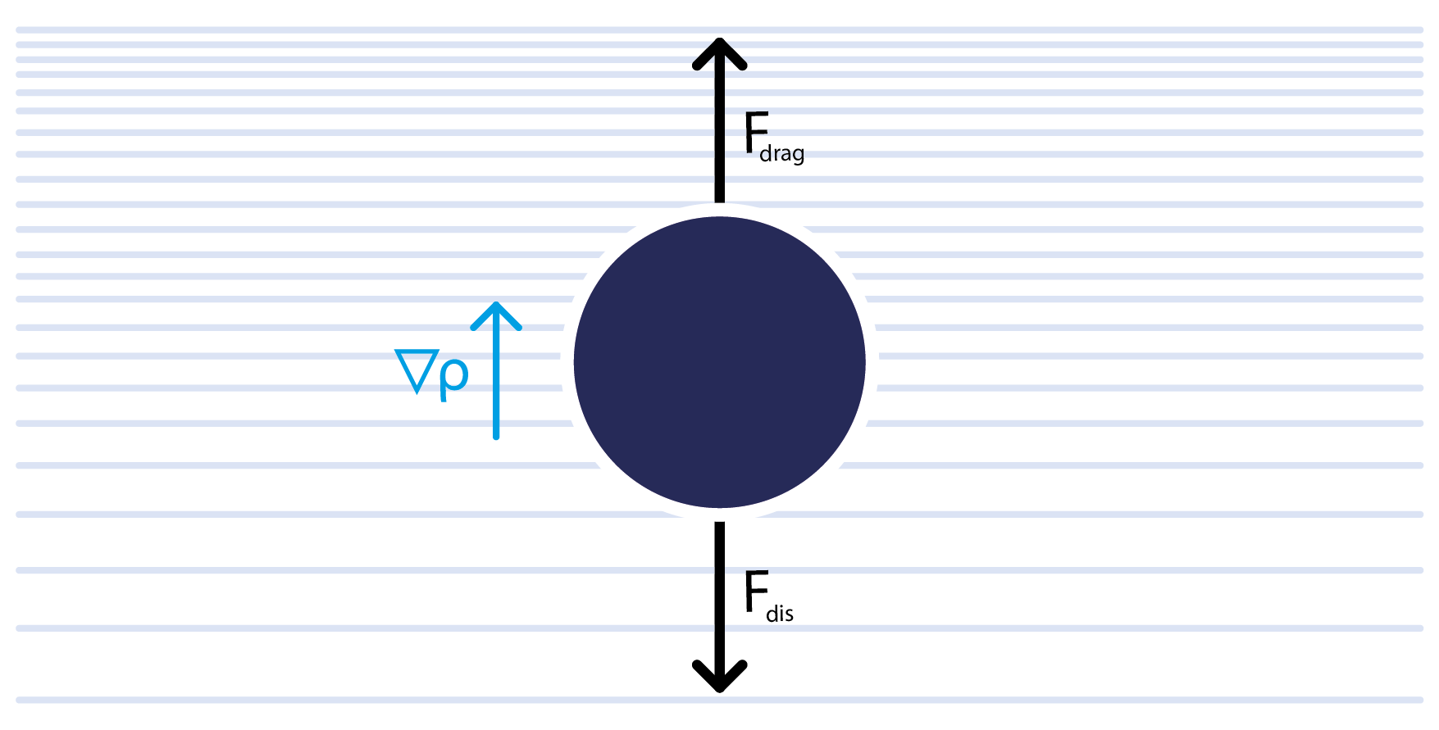

M. Lekaveckas, K. Rajagopal, JHEP, 2014
K. Rajagopal, AS, JHEP, 2017
J. Reiten, AS, JHEP, 2020
Drag Force

Slide 5
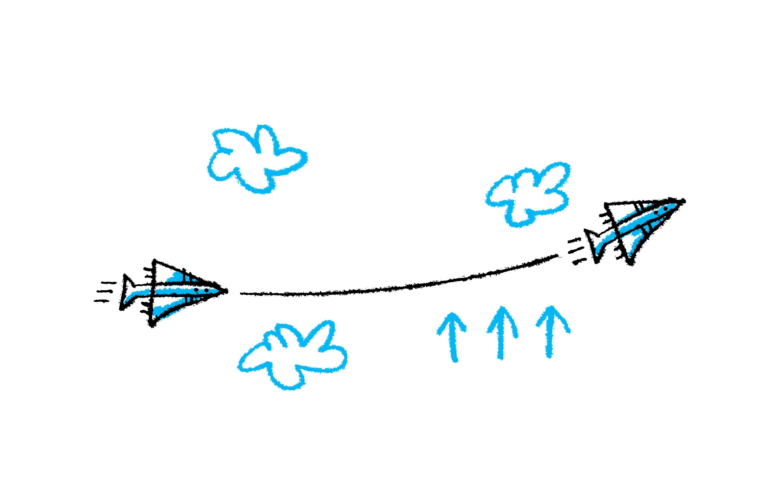
Jets
Does a jet feel the flow?

Slide 6
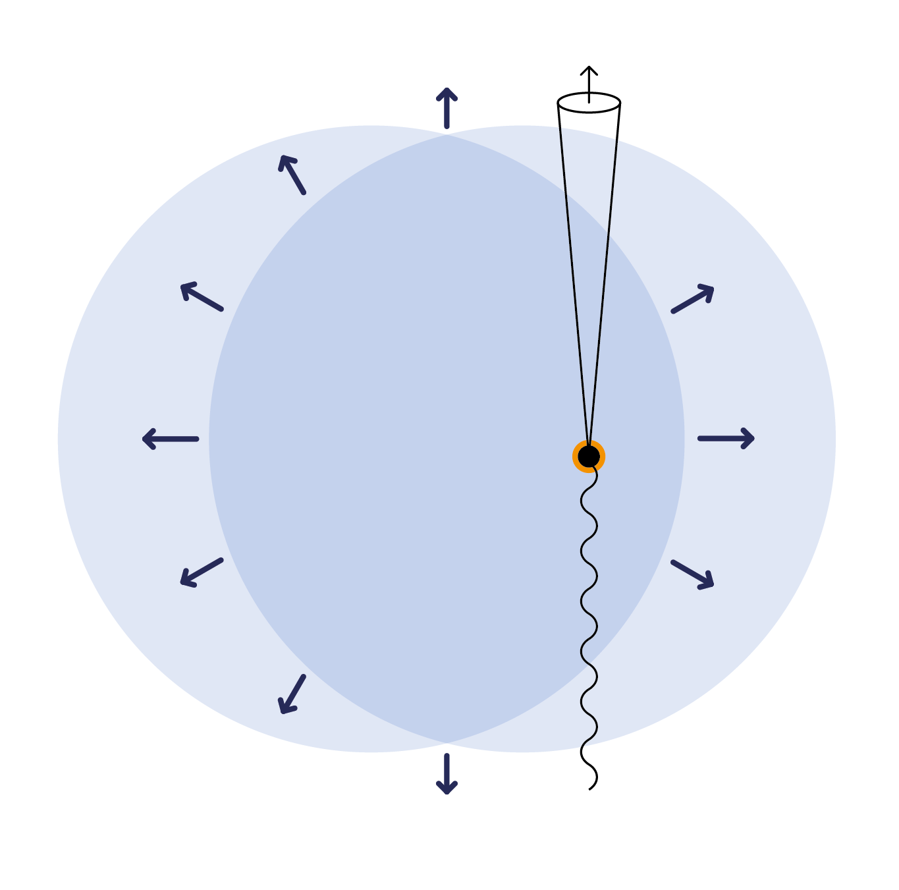

Slide 7
R. Baier et al, NPB, 1997
B. G. Zakharov, JETP, 1997
R. Baier et al, NPB, 1998
M. Gyulassy et al, NPB, 2000
M. Gyulassy et al, NPB, 2001
…
Jets
QCD broadening and gluon emission
(GLV/BDMPS-Z) with flow

Slide 8
R.B. Neufeld et al, PRC, 2011
R.B. Neufeld, I. Vitev, PRL, 2012
Y.T. Chien, I. Vitev, JHEP, 2016
Y.T. Chien, I. Vitev, PRL, 2017
Z.B. Kang et al, JHEP, 2017
Z.B. Kang et al, PLB, 2017
…
Jets
QCD broadening and gluon emission
(GLV/BDMPS-Z) with flow
M. Sievert, I.Vitev, PRD, 2018

Slide 9
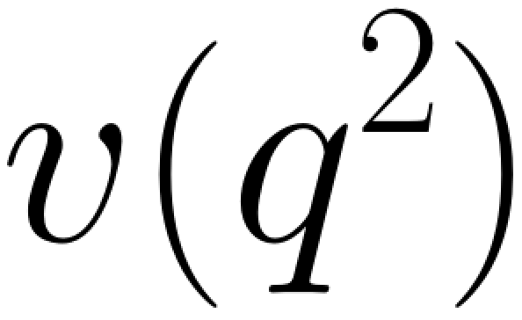
Color Potential
-- the Gyulassy-Wang potential

Slide 10
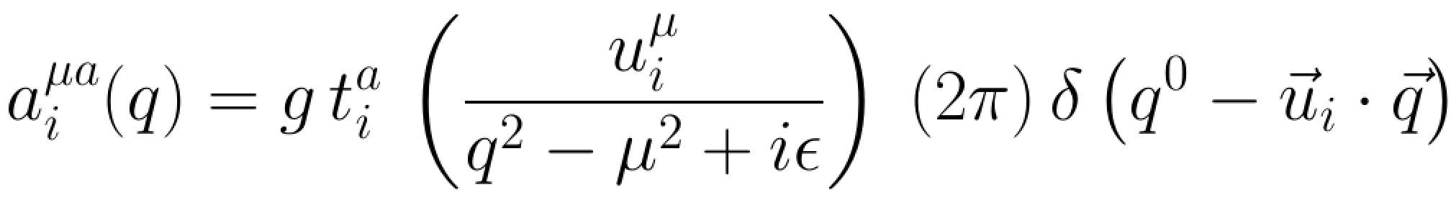
Color Potential
the four-vector of the fluid non-relativistic velocity
finite energy transfer!!!

Slide 11
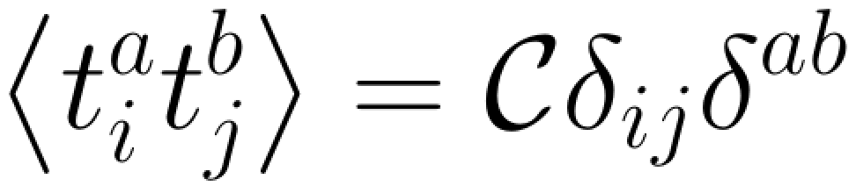
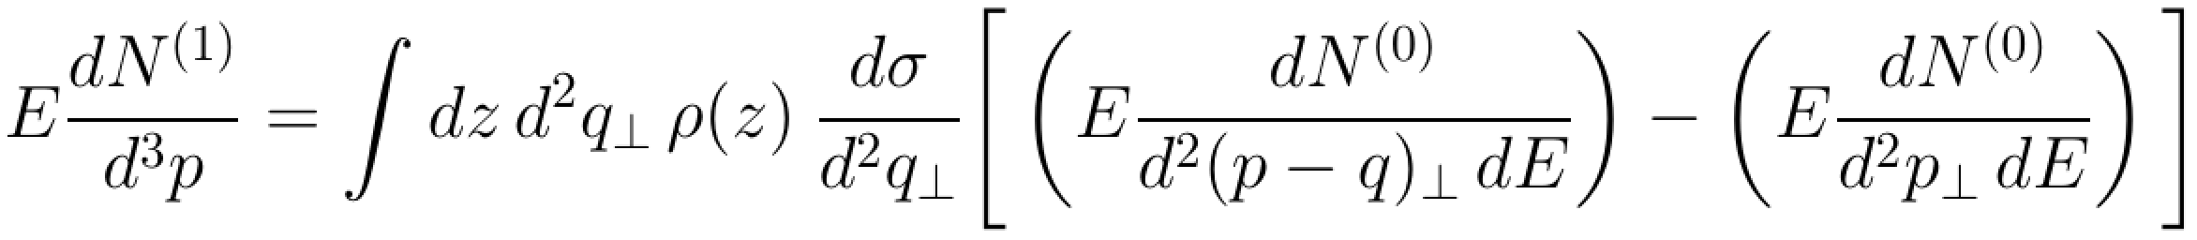
Jet Broadening
color neutrality
the static case:
the 1st order in opacity
elastic scattering cross section

Slide 12
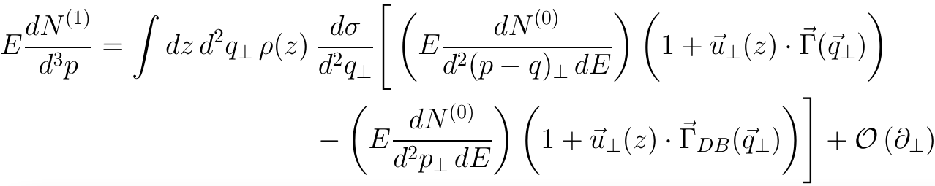
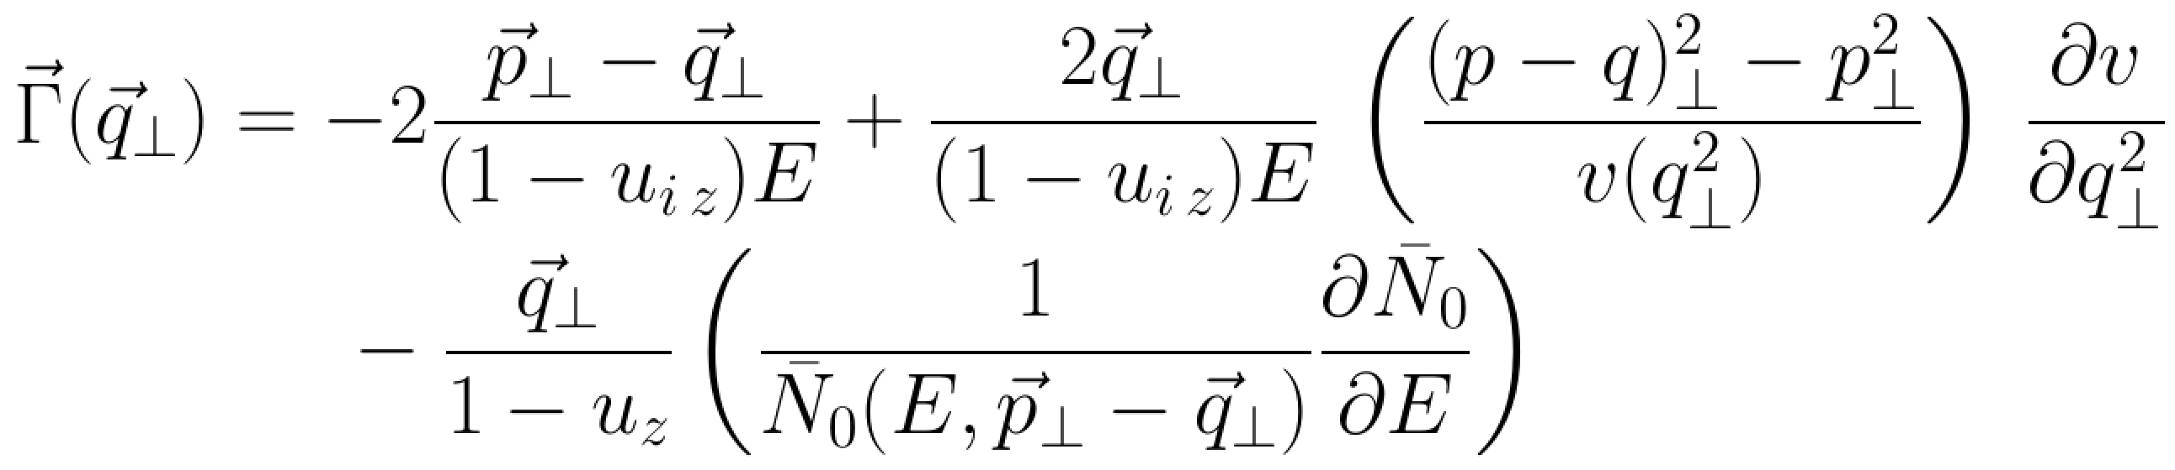
Jet Broadening
with flow:

Slide 13

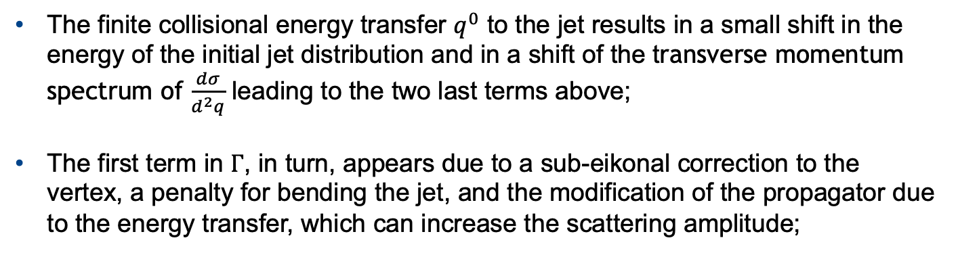
Jet Broadening
with flow:
The finite collisional energy transfer $q^{0}$ to the jet results in a small shift in the energy of the initial jet distribution and in a shift of the transverse momentum spectrum of $\frac{dσ}{d^{2}q}$ leading to the two last terms above;
The first term in $Γ$, in turn, appears due to a sub-eikonal correction to the vertex, a penalty for bending the jet, and the modification of the propagator due to the energy transfer, which can increase the scattering amplitude;

Slide 14
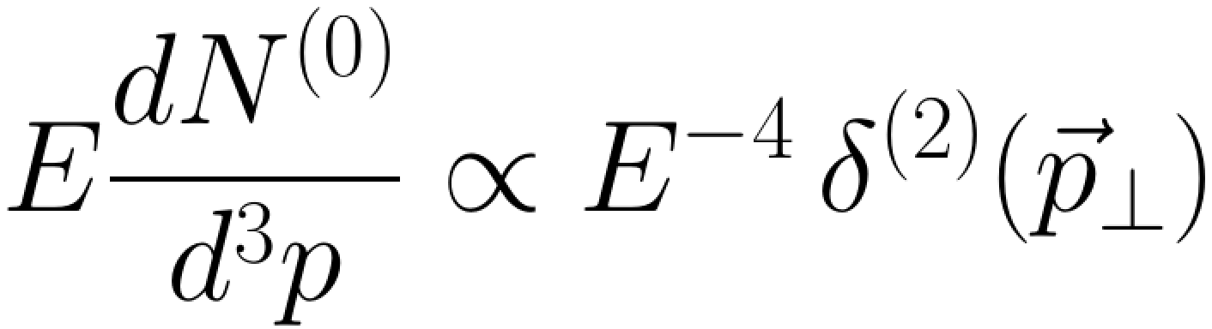
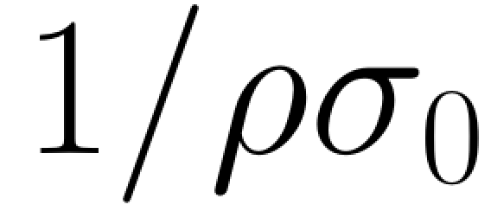
Jet Broadening
An illustration:
assuming a model source
and ignoring z-dependence, we find
the distribution in energies
the mean free path
while even moments are unmodified
A family of velocity-sensitive observables!

Slide 15
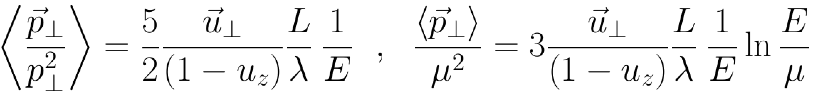
Jet Broadening
An illustration:
assuming a model source
and ignoring z-dependence, we find
while even moments are unmodified
A family of velocity-sensitive observables!

Slide 16
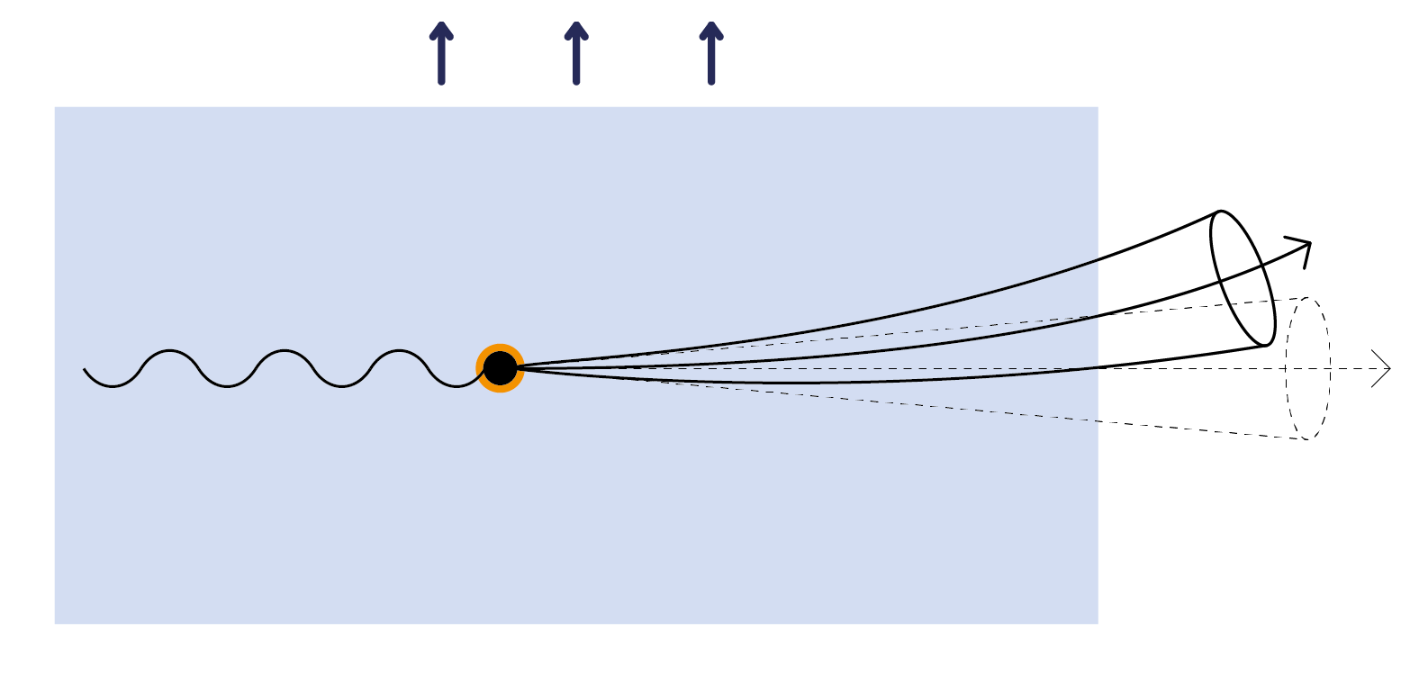

Slide 17
M. Lekaveckas, K. Rajagopal, JHEP, 2014
K. Rajagopal, AS, JHEP, 2017
J. Reiten, AS, JHEP, 2020
Drag Force

Slide 18
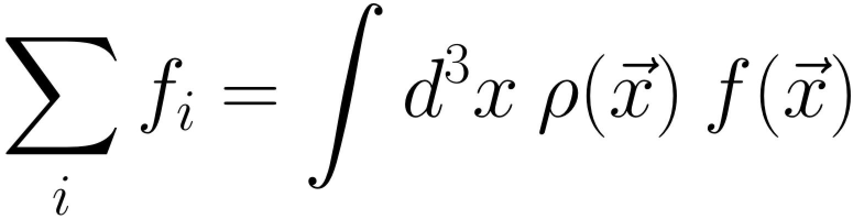
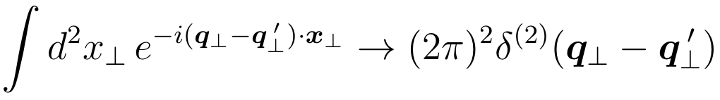
Jet Broadening
inhomogeneous matter
The amplitude squared should be averaged over the sources and their colors:
-- color neutrality
-- source average
and in static GLV calculation

Slide 19
Jet Broadening
inhomogeneous matter
The amplitude squared should be averaged over the sources and their colors:
-- color neutrality
-- source average
but if the sources are different in their properties,
then the final result is more involved.

Slide 20
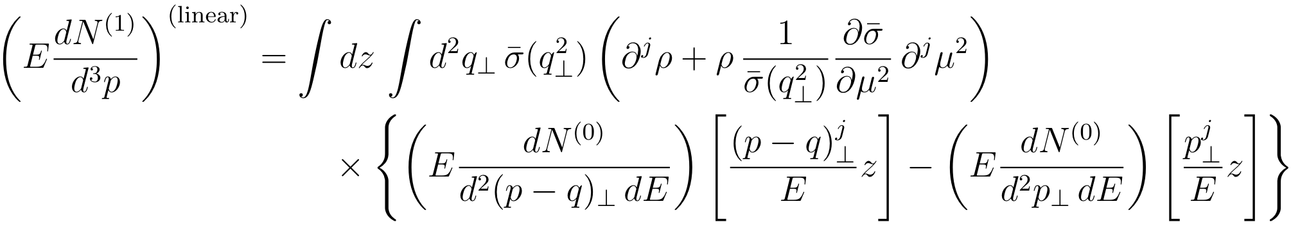
Jet Broadening
gradient expansion
the leading gradient correction at the first order in opacity

Slide 21
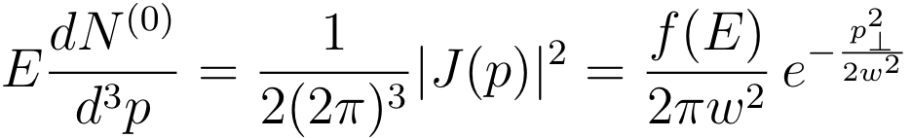
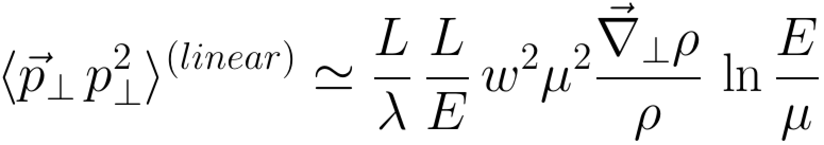
Jet Broadening
gradient expansion
the leading gradient correction at the first order in opacity

Slide 22
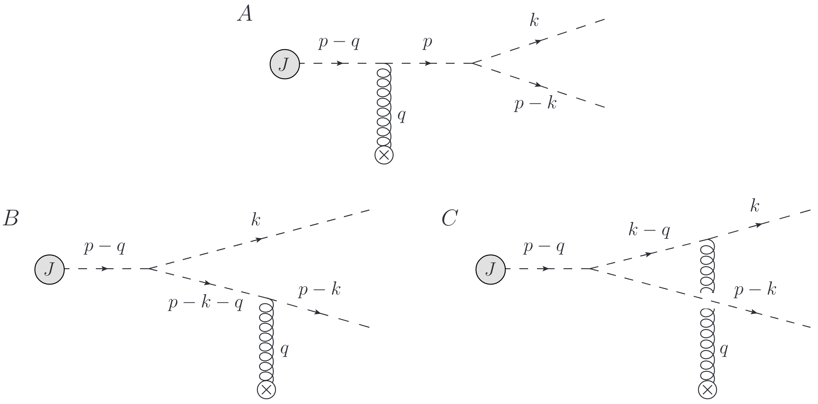
“Gluon” Emission

Slide 23
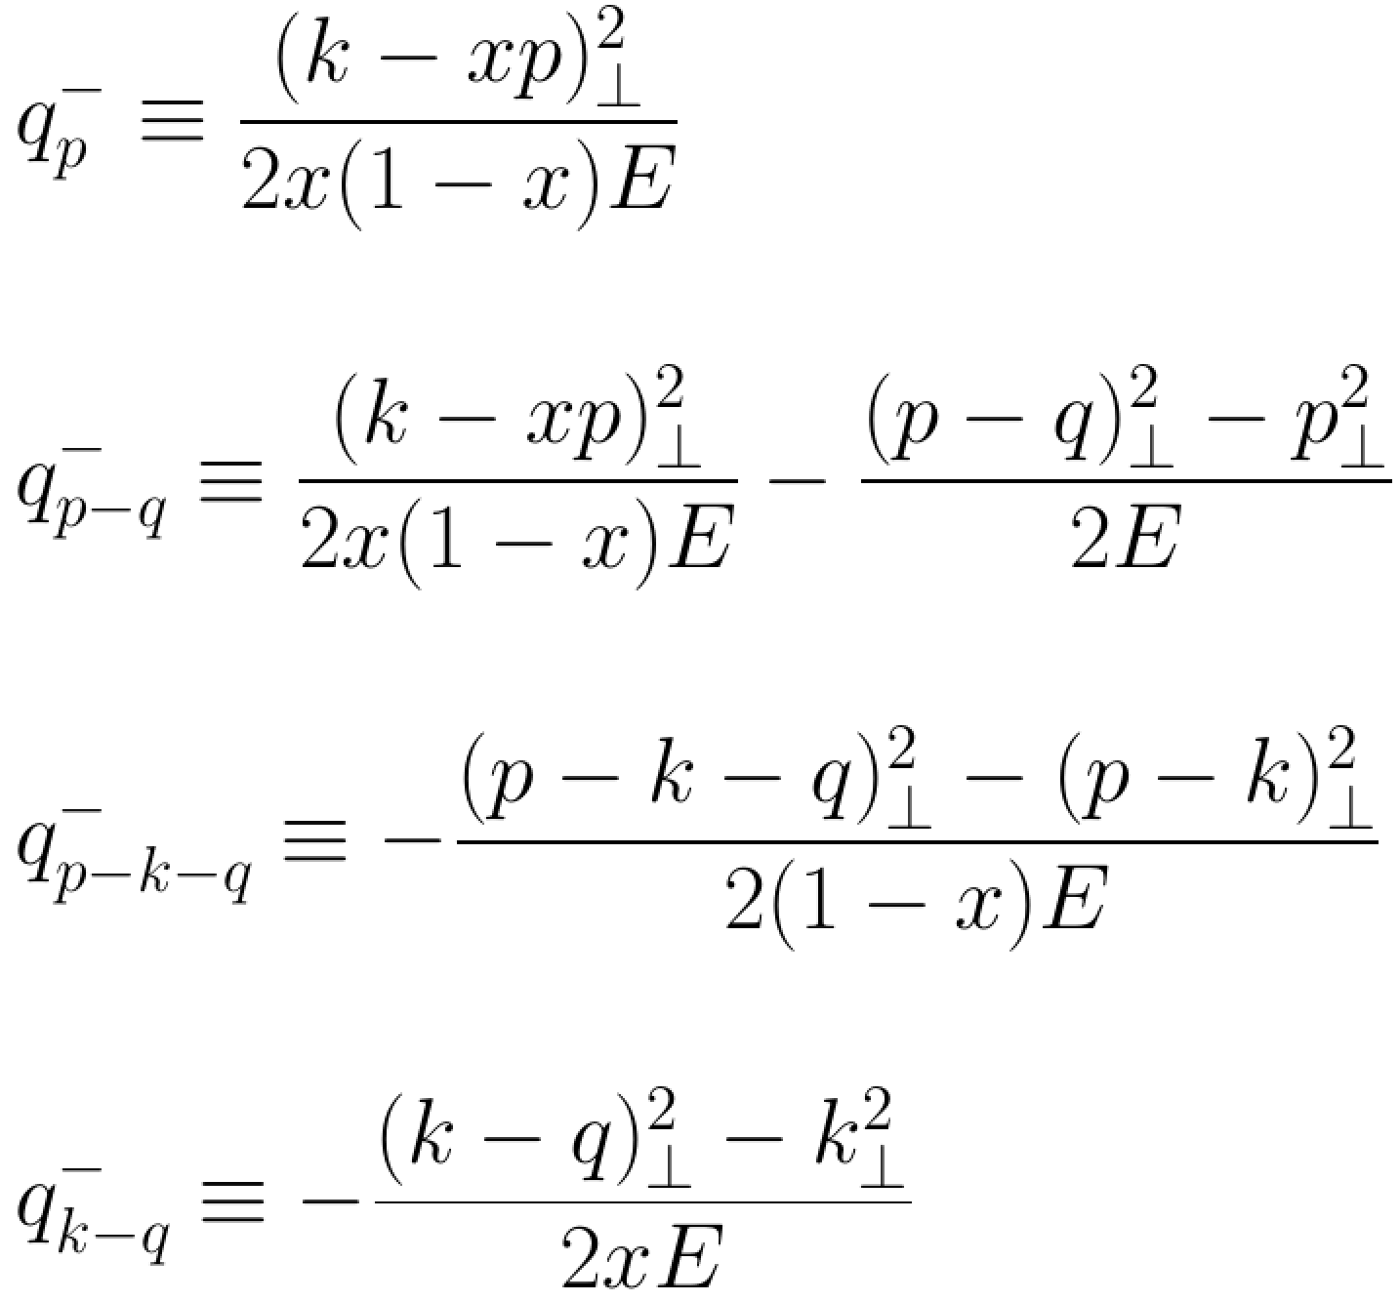
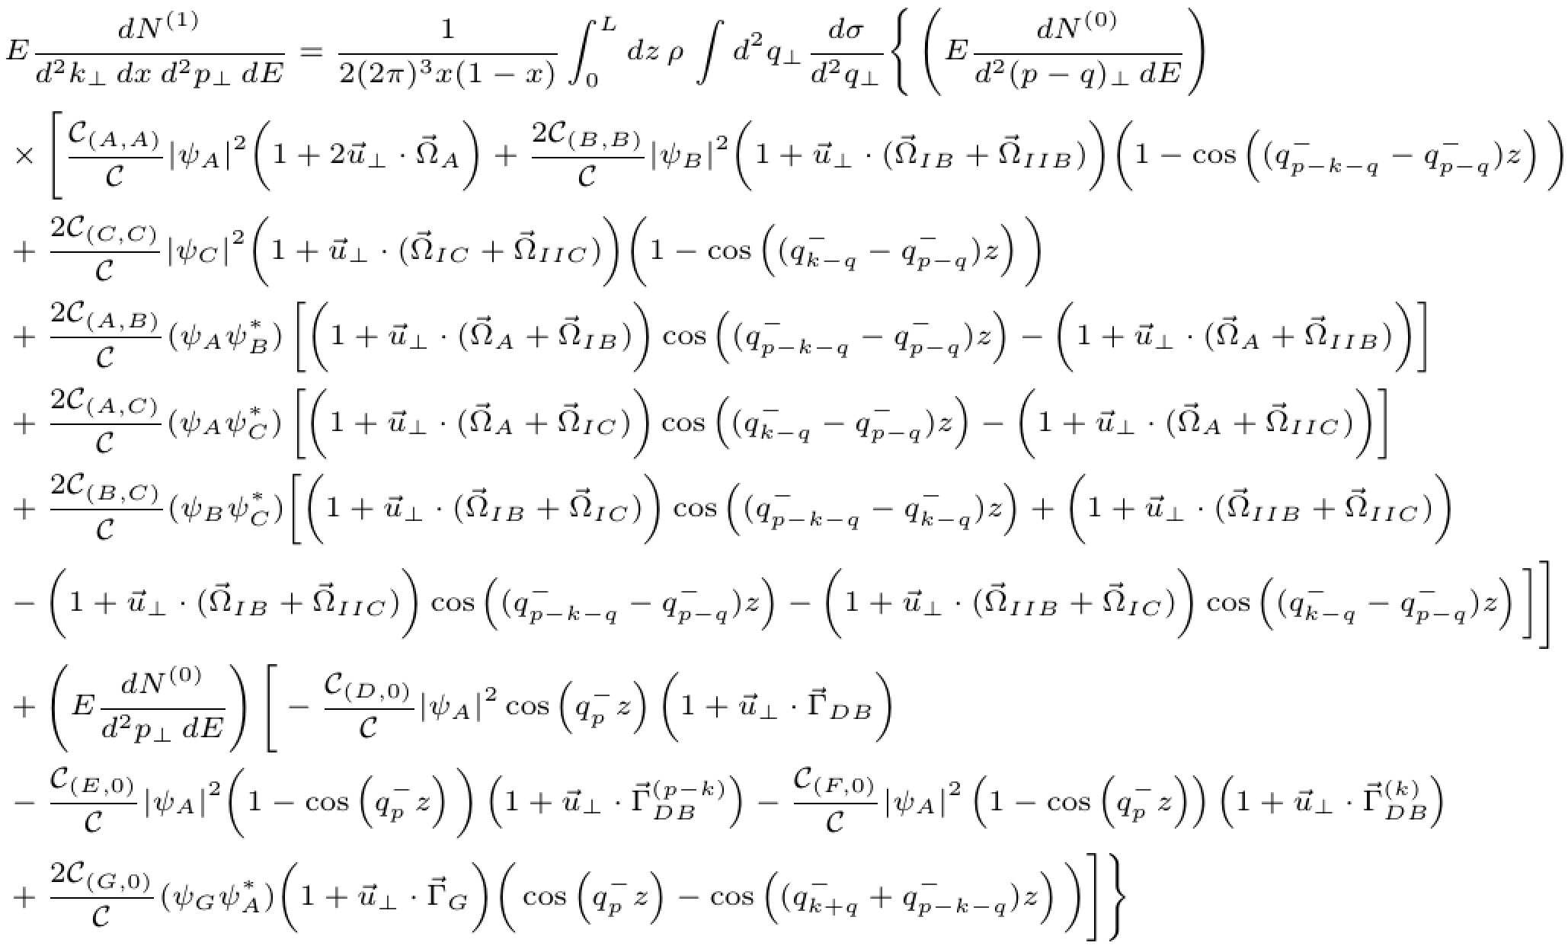
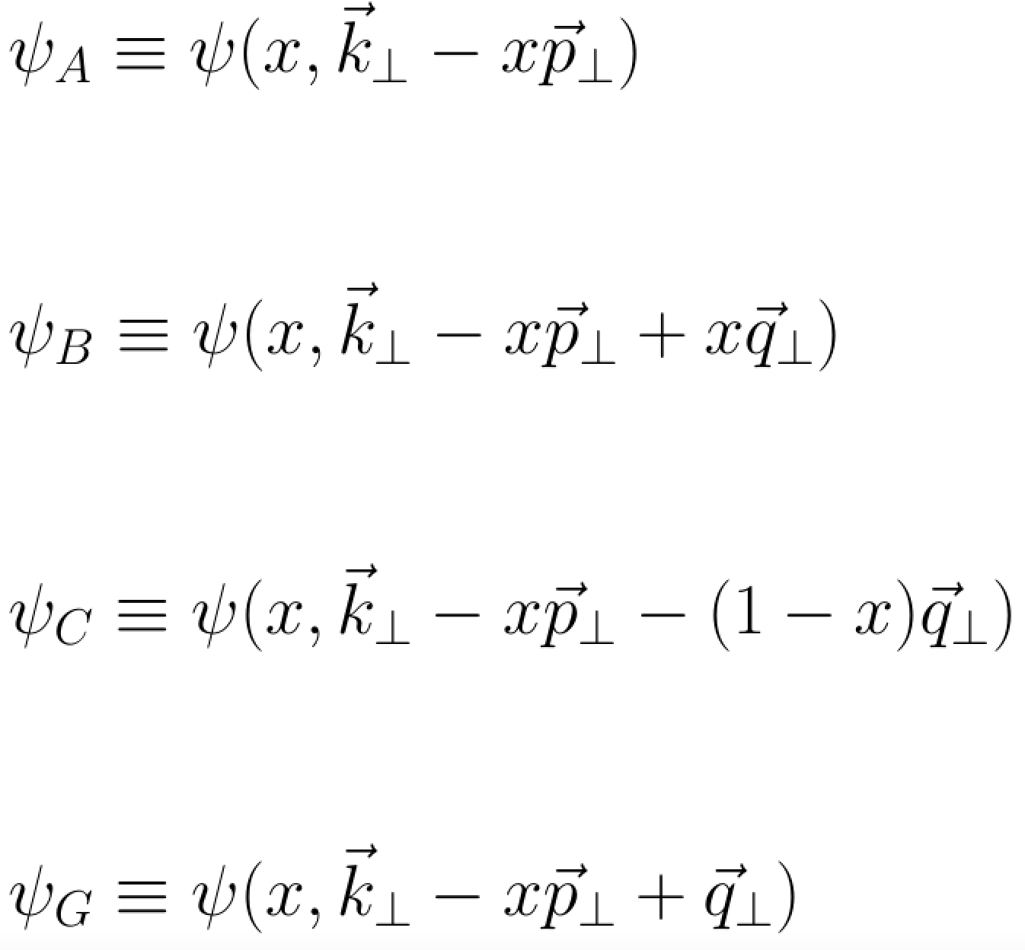

Slide 24
Summary
We have constructed a generalization of the GLV approach which includes the medium motion effects. With this tool one can study general flow, temperature, and source density profiles in the context of HIC;
It is shown that the odd moments of the jet momentum are modified by the medium motion, and the jet is bended by the flow and gradients;
We have derived the “gluon” emission spectrum in the case of uniformly flowing matter. The resulting answer, while obtained for scalar interactions, can be compared to the QCD results when written in the terms of LFWFs;
In the context of DIS our formalism can be used to study nucleon orbital motion and spatial inhomogeneities in the system (a relation to GPDs and TMDs?);
These results open multiple opportunities to include the medium motion and in-medium fluctuation effects into studies of other hard probes of nuclear matter;

