Slide 1


Measurements of inclusive cross-sections and azimuthal asymmetries of light charged hadrons at Belle
15+3
Anselm Vossen
Based on
Phys.Rev.D 101 (2020) 9, 092004
Phys.Rev.D 99 (2019) 11, 112006
Phys.Rev.D 100 (2019) 9, 092008
Research supported by the

Slide 2


Access of FFs for light mesons in e⁺e⁻
(spin averaged case)
hadronic jet
Cleanest process→testbed for QCD calculations
Limited access to flavor
  (Use different couplings to γ* and Z⁰)
  (Use polarization (SLD) and parity violating coupling)
  Use back-to-back correlations for different flavor combinations
Limited access to gluon FF
  From evolution
  From three jet events (but theory treatment not clear)
e⁻
q
γ*
e⁺
q
Hadron

Slide 3

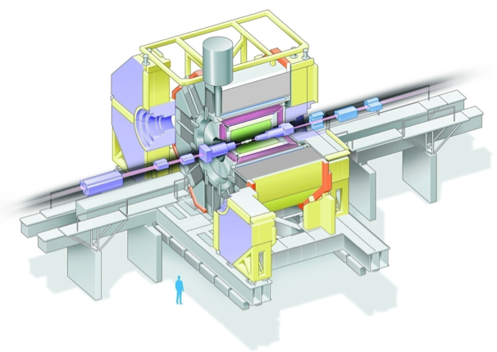
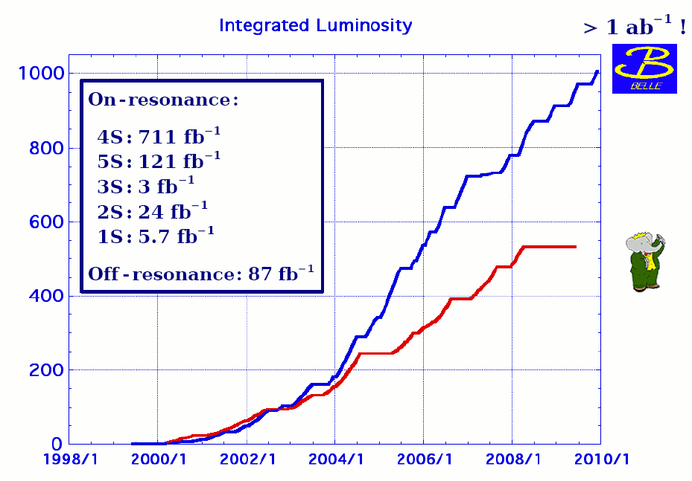
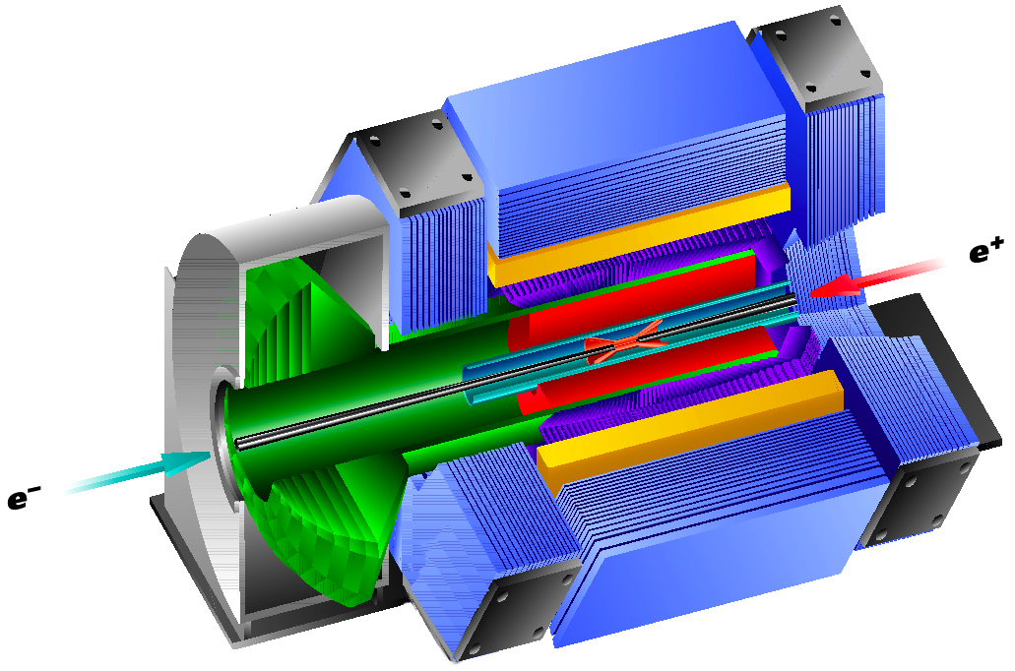
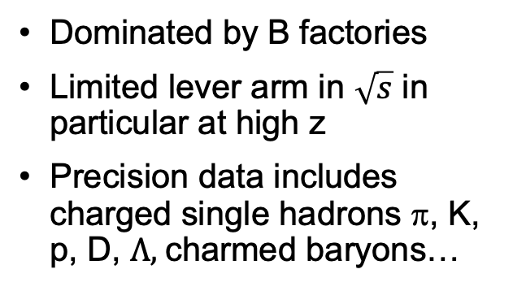
B-factories provide the necessary statistics…
Asymmetric-energy e⁺e⁻ collider
√s ∿ 10.6 GeV (ϒ(4S))
βγ=0.425
L ∿ 1 ab⁻¹
NIMA729,615(2013)
Phys.Rev.Lett. 111 (2013) 062002 (Belle)
Phys.Rev. D88 (2013) 032011 (BaBar)
NIMA479,117(2002)
Dominated by B factories
Limited lever arm in $\sqrt{s}$ in particular at high z
Precision data includes charged single hadrons π, K, p, D, $Λ,$charmed baryons…
Asymmetric-energy e⁺e⁻ collider
√s ∿ 10.6 GeV (ϒ(4S))
βγ=0.65
L ∿ 500 fb⁻¹

Slide 4
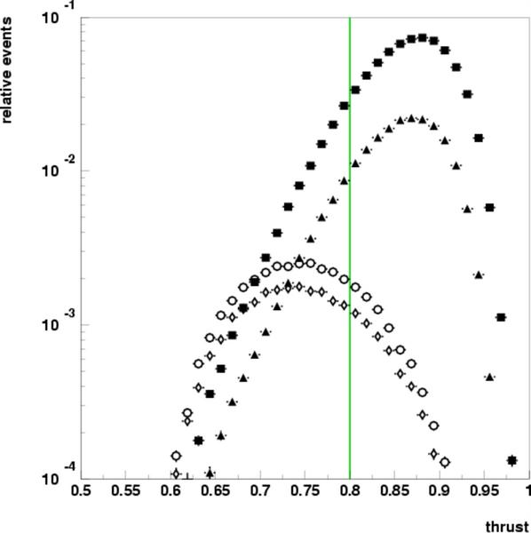
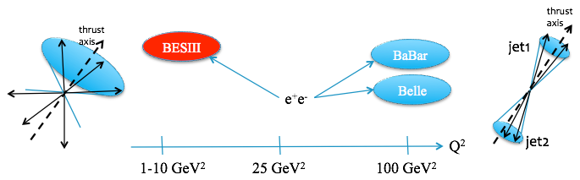
Lots of data off resonance, easy to remove resonance background
e⁺e⁻→qq̅, q∈uds
4s
“off”
e⁺e⁻→cc̅
small B contribution (<1%) in high thrust sample
>75% of X-section continuum under
ϒ (4S) resonance
~100 fb⁻¹ ➔ ~1000 fb⁻¹
0.5 0.8 1.0
T∼0.5
T∼1
Notes:
4
4

Slide 5
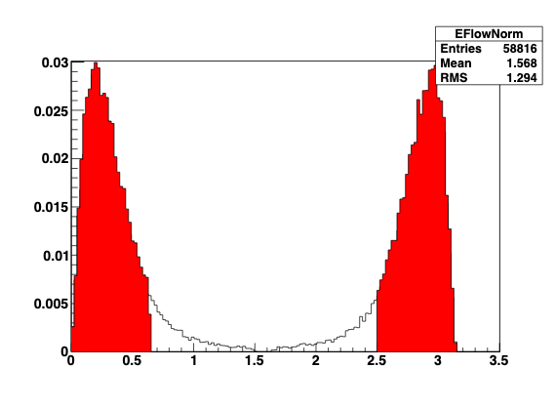
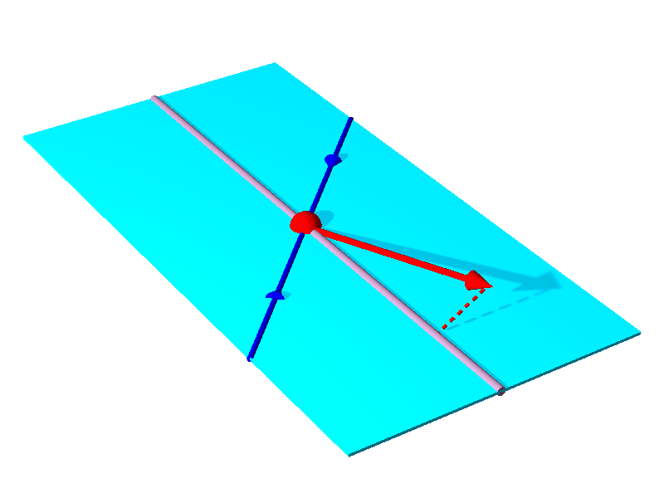
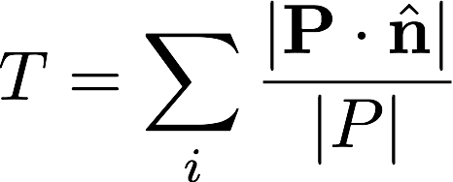







Use thrust as proxy to $q\overline{q}$ axis
No phase space for >2 jet events
Transverse momentum measured with respect to thrust axis
$$e^{+}$$
Energy flow
T>0.8
$$Thrust axis$$
$$P_{h}$$
$$P_{hT}$$
$$e^{−}$$
$$θ_{CMS}$$
T∼0.5
T∼1
0.5≤T≤1

Slide 6
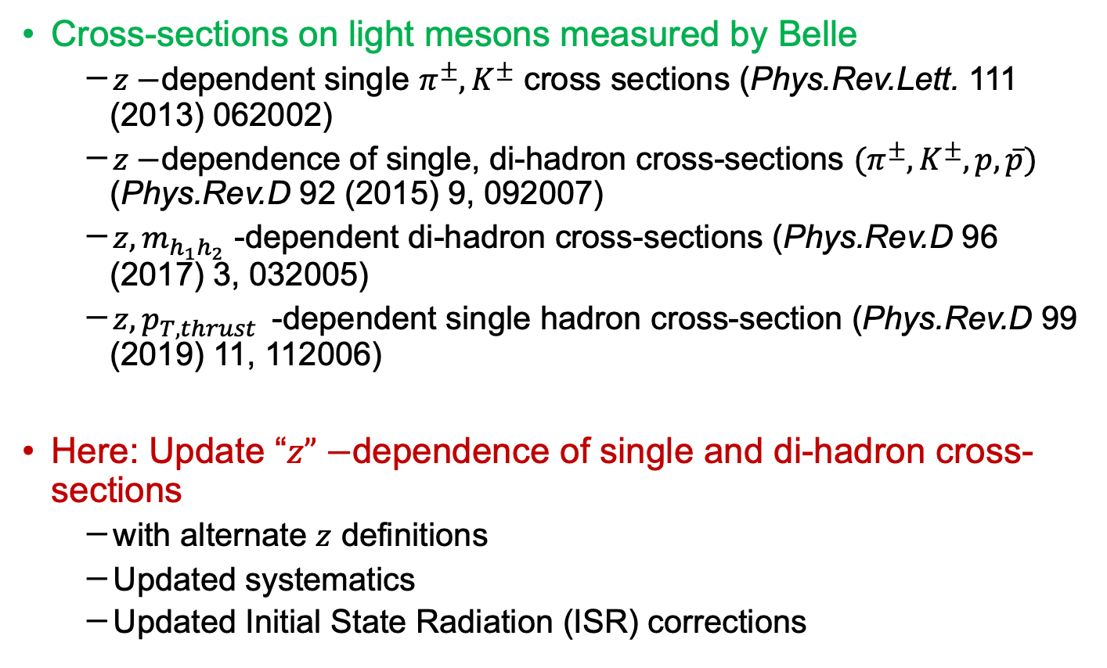
Previous measurement of light meson (pair) cross sections
Cross-sections on light mesons measured by Belle
  $z−$dependent single $π^{±}, K^{±}$ cross sections (Phys.Rev.Lett. 111 (2013) 062002)
  $z−$dependence of single, di-hadron cross-sections ${(π}^{±}, K^{±},p,\overline{p})$ (Phys.Rev.D 92 (2015) 9, 092007)
  $z,m_{h_{1}h_{2}}$ -dependent di-hadron cross-sections (Phys.Rev.D 96 (2017) 3, 032005)
  $z,p_{T,thrust }$ -dependent single hadron cross-section (Phys.Rev.D 99 (2019) 11, 112006)
Here: Update “$z”−$dependence of single and di-hadron cross-sections
  with alternate $z$ definitions
  Updated systematics
  Updated Initial State Radiation (ISR) corrections

Slide 7
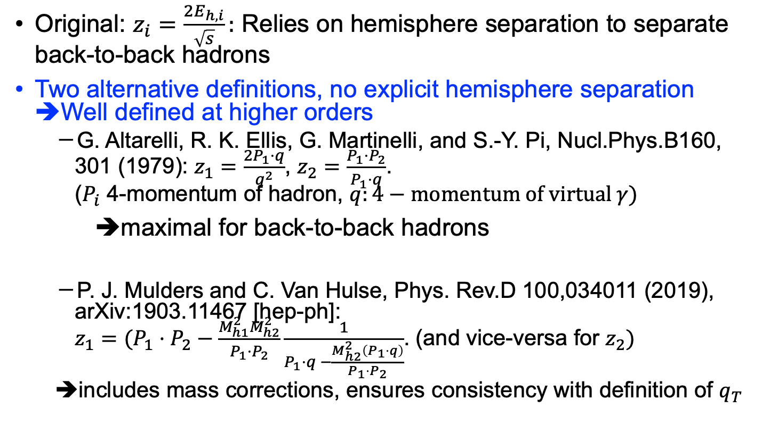

Definition of the scaling variable $z$
Original: $z_{i}=\frac{2E_{h,i}}{\sqrt{s}}:$ Relies on hemisphere separation to separate back-to-back hadrons
Two alternative definitions, no explicit hemisphere separation ➔Well defined at higher orders
  G. Altarelli, R. K. Ellis, G. Martinelli, and S.-Y. Pi, Nucl.Phys.B160, 301 (1979): $z_{1}=\frac{2P_{1}⋅q}{q^{2}}$, $z_{2}=\frac{P_{1}⋅P_{2}}{P_{1}⋅q}$.
  ($P_{i}$ 4-momentum of hadron, $q:4−momentum of virtual γ)$
➔maximal for back-to-back hadrons
  P. J. Mulders and C. Van Hulse, Phys. Rev.D 100,034011 (2019), arXiv:1903.11467 [hep-ph]:
  $z_{1}=(P_{1}⋅P_{2}−\frac{M_{h1}^{2}M_{h2}^{2}}{P_{1}⋅P_{2}}\frac{1}{P_{1}⋅q −\frac{M_{h2}^{2}\left(P_{1}⋅q\right)}{P_{1}⋅P_{2}}}$. (and vice-versa for $z_{2})$
  ➔includes mass corrections, ensures consistency with definition of $q_{T}$

Slide 8

Updated cross-sections for light mesons
Results with conventional $z$-definition, no hemisphere or thrust selection

Slide 9

New ISR Correction
Previously: remove events where more than $0.5 \%$ of the energy was lost ➔only $≈60\%$ of events kept
Now: Ratio between ISR/no ISR ➔correction factors close to unity→reported cross-sections higher

Slide 10
New reporting of correlated/uncorrelated systematics
Correlated systematics from variations of MC tunes to determine ISR, acceptance, weak decay corrections
Uncorrelated from MC statistics

Slide 11
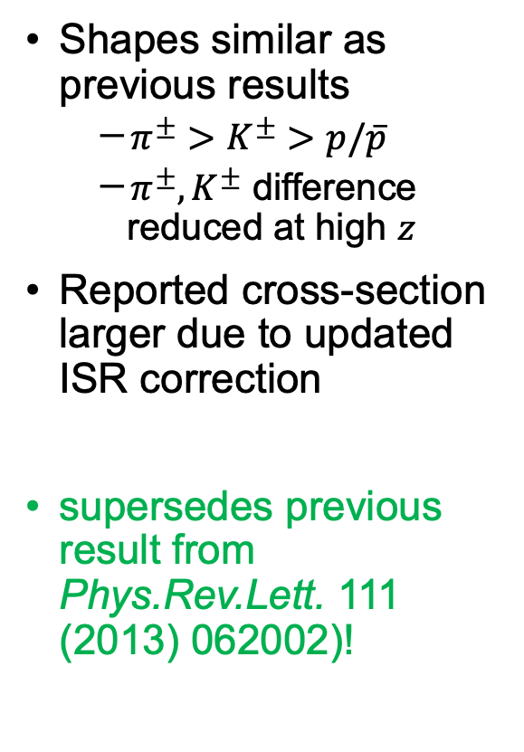
Update single hadron cross-section
Shapes similar as previous results
  $π^{±}>K^{±}>p/\overline{p}$
  $π^{±}, K^{±}$ difference reduced at high $z$
Reported cross-section larger due to updated ISR correction
supersedes previous result from Phys.Rev.Lett. 111 (2013) 062002)!

Slide 12

Comparison of different $z$ definitions, inclusive $π^{+}π^{−}$ cross section

Slide 13
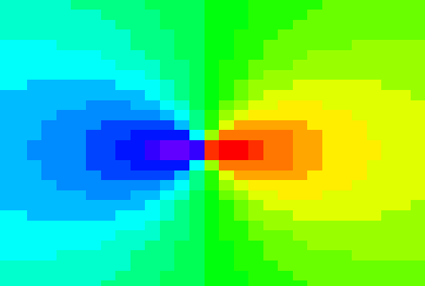
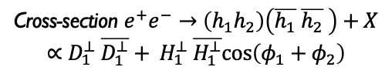
Collins FFs IN $e^{+}e^{−}$
Access spin dependence and p_{T} dependence (convolution or in jet) without PDF complication
Made possible by B-factory luminosities
First non-zero independent measurement of the Collins effect for pion pairs in e⁺e⁻ annihilation by Belle Collaboration @ √s ∼ 10.6 GeV (PRL 111,062002(2008), PRD 88,032011(2013)) leads to first extraction of transversity (Phys.Rev. D75 (2007) 054032 ) from SIDIS and e+e-
  Confirmed by BaBar @ √s ∼ 10.6 GeV (PRD 90,052003 (2014); PRD 92,111101(R)(2015) for KK and Kπ)
  Measured at BESIII @ √s = 3.65 GeV (PRL 116,42001(2016))
ϕ₂
π⁺
z₂
q₂
π⁻
ϕ₁
q₁
quark-2
spin
quark-1
spin
z₁
z_{1,2} relative pion pair
momenta
Cross-section $e^{+}e^{−}→\left(h_{1}h_{2}\right)\left(\overline{h_{1}} \overline{h_{2}} \right)+X$
$$∝D_{1}^{⊥} \overline{D_{1}^{⊥}}+ H_{1}^{⊥} \overline{H_{1}^{⊥}}cos\left(φ_{1}+φ_{2}\right)$$

Slide 14
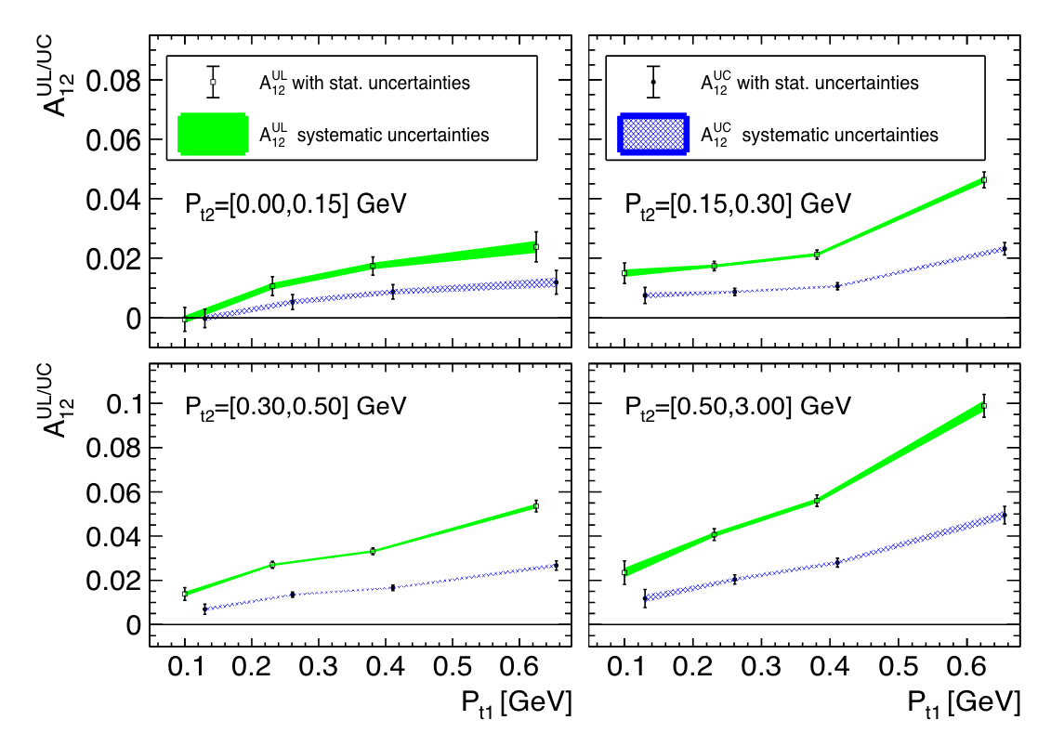
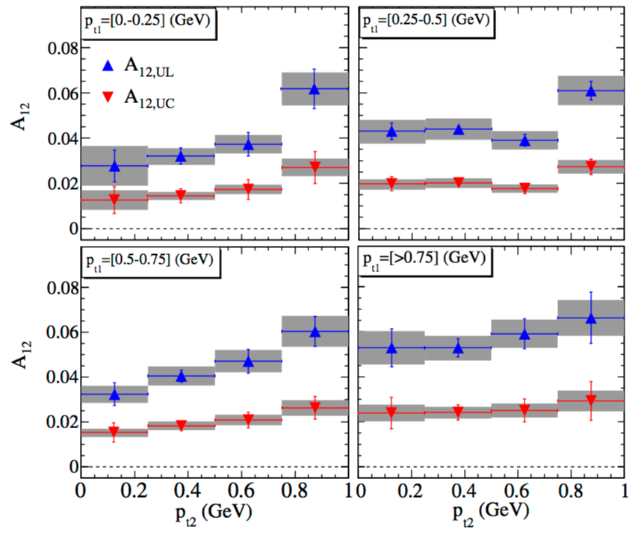

New Pt dependence from Belle
Trend consistent with BaBar
Direct comparison difficult due to different correction schemes (thrust vs $q\overline{q}−$axis)
BaBar
Unlike/Likesign
Ratios to cancel
acceptance effects
Unlike:
fav*fav+dis*dis
Like:
fav*dis
Preliminary
This and following Belle results from Phys.Rev.D 100 (2019) 9, 092008

Slide 15
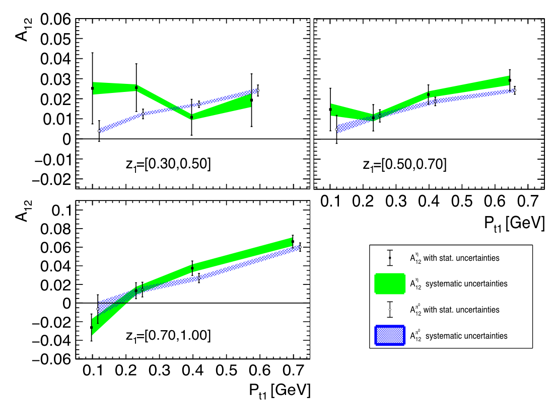



New $π^{0}/η$ from Belle
Rise with $z_{1,2}$, similar to charged pions
$η$ almost flat except large z

Slide 16
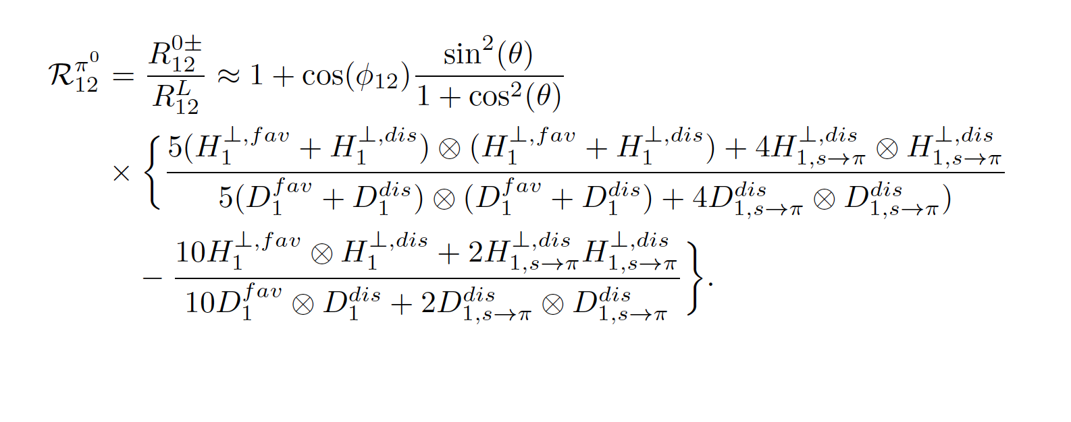

Consistency between Neutral and charged pions
=$A_{12}^{UL}−A_{12}^{UC} (Isospin)$

Slide 17
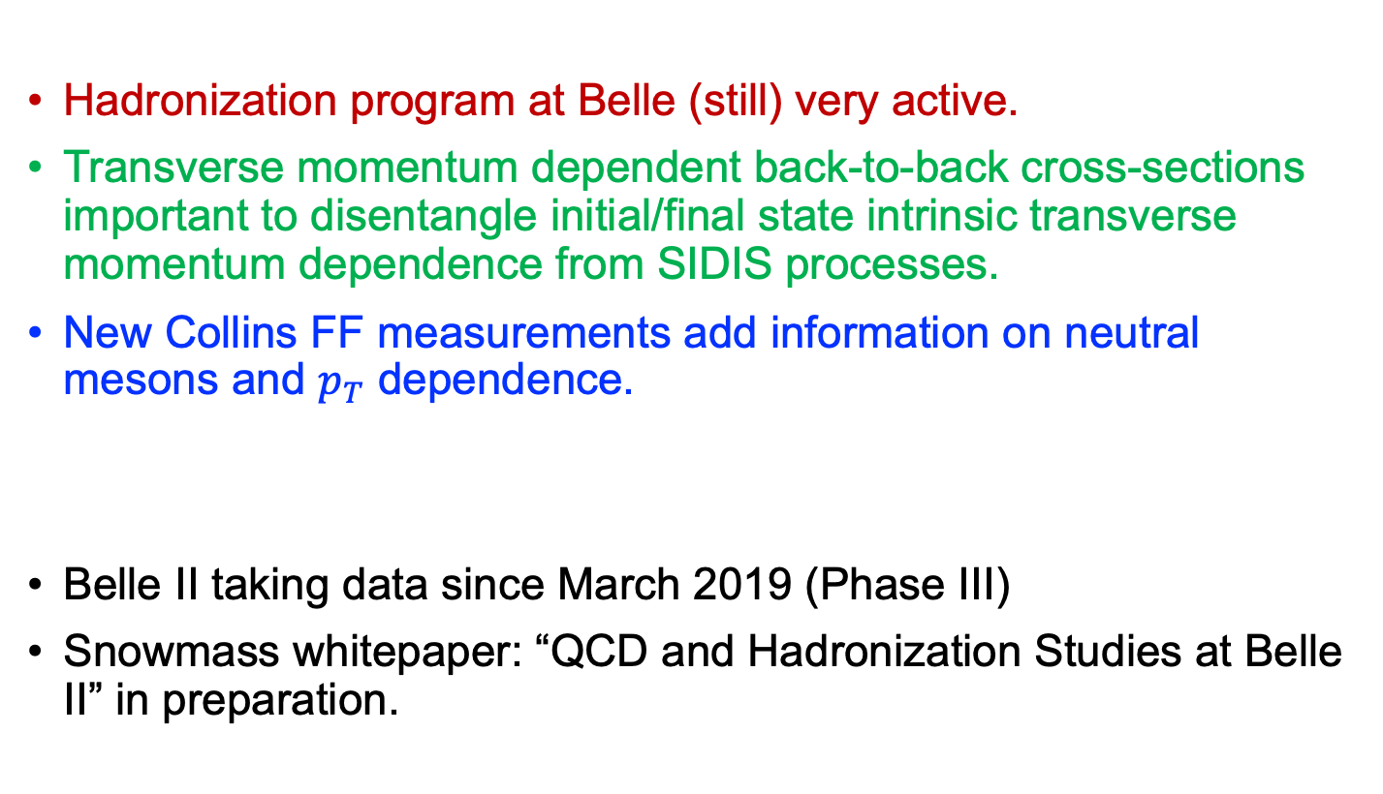
Summary
Hadronization program at Belle (still) very active.
Transverse momentum dependent back-to-back cross-sections important to disentangle initial/final state intrinsic transverse momentum dependence from SIDIS processes.
New Collins FF measurements add information on neutral mesons and $p_{T}$ dependence.
Belle II taking data since March 2019 (Phase III)
Snowmass whitepaper: “QCD and Hadronization Studies at Belle II” in preparation.

Slide 19

Transverse momentum distributions
0.85< Thrust T < 0.9
  Transverse momenta mostly Gaussian
  Possible deviations for large $P_{hT}$ tails, but also large uncertainties
Phys.Rev.D 99 (2019) 11, 112006
See also Phys.Rev.D 101 (2020) 9, 092004 →includes updates systematics and results with
modiefied scaling variable definition.

Slide 20

Transverse Momentum: Gaussian widths
0.85 < T < 0.9
  Fit Gauss to low $P_{hT}$ data
  Mostly well described with possible exception at high z
  Deviation from Gauss at large $P_{hT}$
  Clear increase in width with z for low values of z

Slide 21
Gaussian Width as a function of z and T
General increase with z with turnover at larger
values of z for mesons
Protons with smaller width and more linear rise with z
General increase with z with turnover at larger
values of z for mesons
Clear decrease of widths with increase of T
  Particles more and more collimated

Slide 22
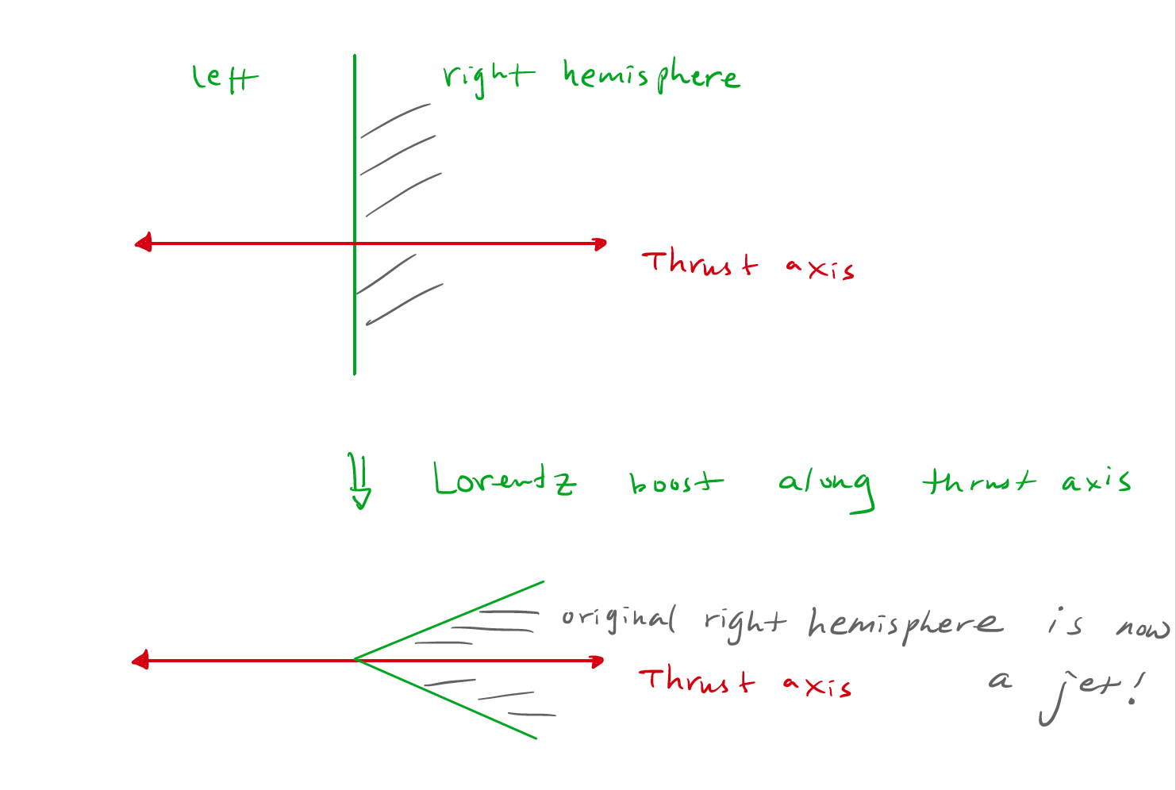
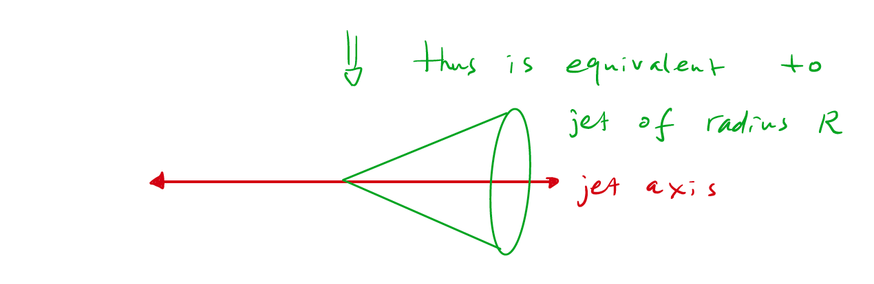
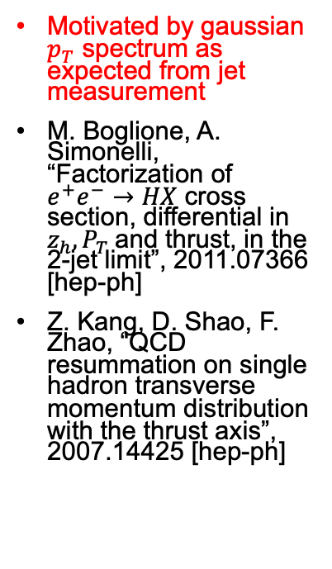
New theoretical insights: Thrust and Jet measurements are closely related
Motivated by gaussian $p_{T}$ spectrum as expected from jet measurement
M. Boglione, A. Simonelli, “Factorization of $e^{+}e^{−}→HX$ cross section, differential in $z_{h}, P_{T}$and thrust, in the 2-jet limit”, 2011.07366 [hep-ph]
Z. Kang, D. Shao, F. Zhao, “QCD resummation on single hadron transverse momentum distribution with the thrust axis”, 2007.14425 [hep-ph]
Drawing by Zhong-Bo Kang

Slide 23
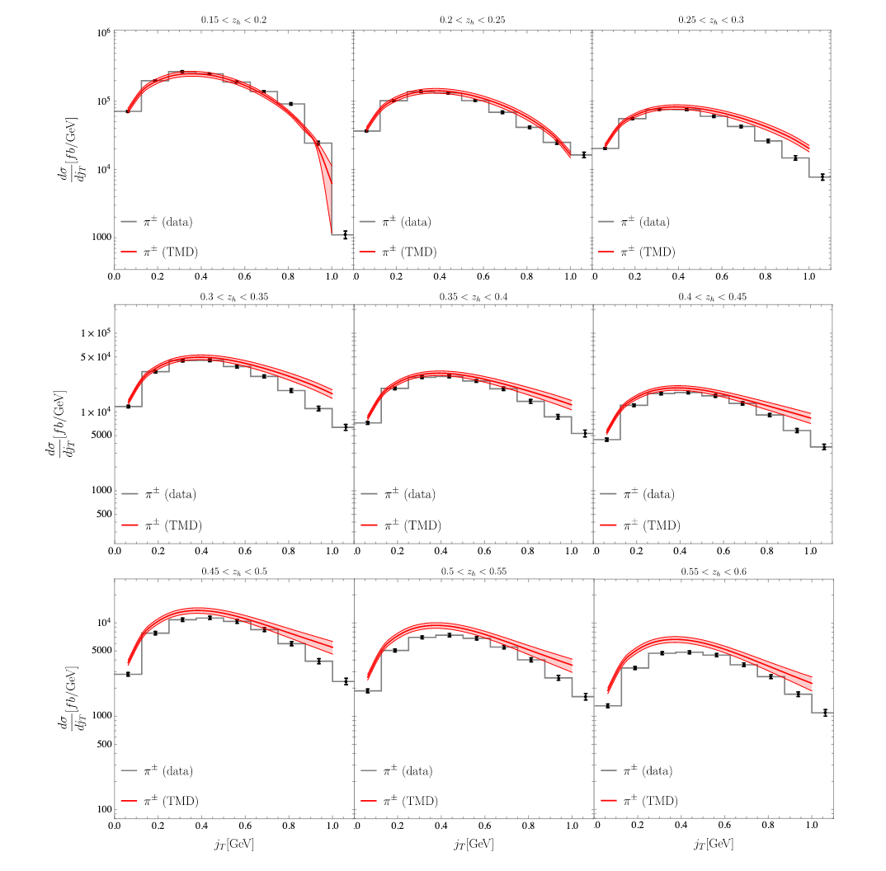
Z. Kang, D. Shao, F. Zhao, “QCD resummation on single hadron transverse momentum distribution with the thrust axis”, 2007.14425 [hep-ph]

Slide 24
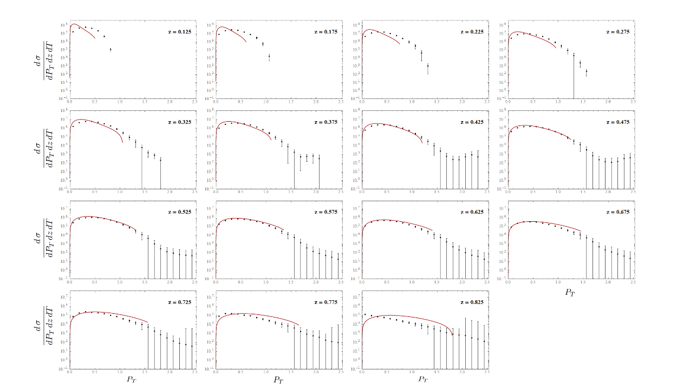
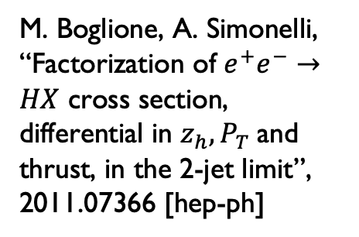
M. Boglione, A. Simonelli, “Factorization of $e^{+}e^{−}→HX$ cross section, differential in $z_{h}, P_{T}$and thrust, in the 2-jet limit”, 2011.07366 [hep-ph]

Slide 25

Use thrust as proxy to $q\overline{q}$ axis
No phase space for >2 jet events
Transverse momentum measured with respect to thrust axis
$$e^{+}$$
$$Thrust axis$$
$$P_{h}$$
$$e^{−}$$
$$P_{hT}$$
T∼0.5
T∼1
0.5≤T≤1
Energy flow
T>0.8

Slide 26
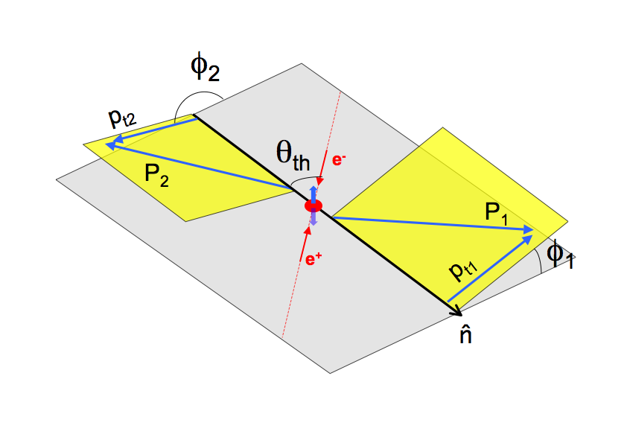
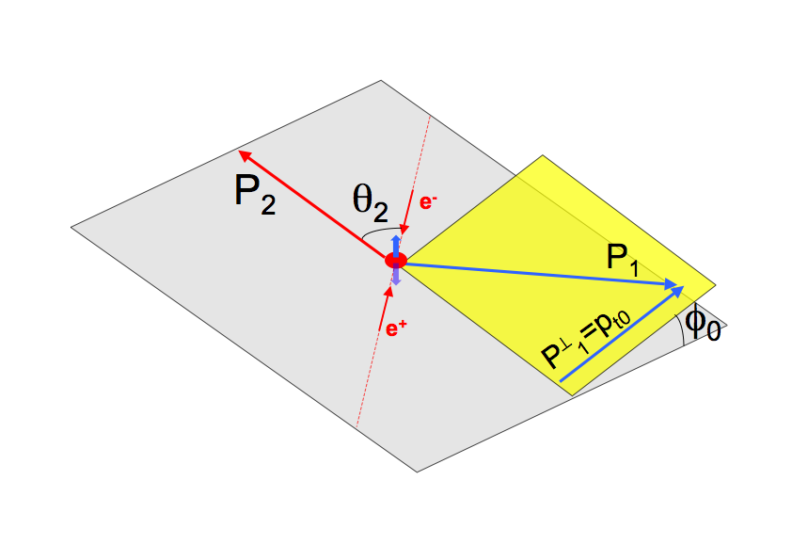
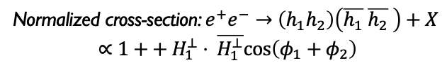
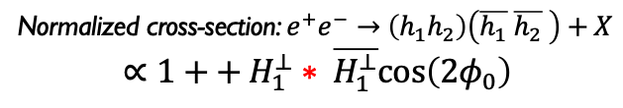
Collins Effect
RF12 or Thrust RF
RF0 or Second hadron momentum RF
All quantities in e⁺e⁻ c.m.
All quantities in e⁺e⁻ c.m.
BaBar
Belle
BESIII
BaBar
Belle
BESIII
Thrust axis to estimate the qq̅ direction
φ_{1,2} defined using thrust-beam plane
Use one track in a pair
Very clean experimentally (no thrust axis)
Normalized cross-section: $e^{+}e^{−}→\left(h_{1}h_{2}\right)\left(\overline{h_{1}} \overline{h_{2}} \right)+X$
$$∝1++ H_{1}^{⊥}⋅ \overline{H_{1}^{⊥}}cos\left(φ_{1}+φ_{2}\right)$$
Normalized cross-section: $e^{+}e^{−}→\left(h_{1}h_{2}\right)\left(\overline{h_{1}} \overline{h_{2}} \right)+X$
$$∝1++ H_{1}^{⊥}∗ \overline{H_{1}^{⊥}}cos\left({2φ}_{0}\right)$$

Slide 27
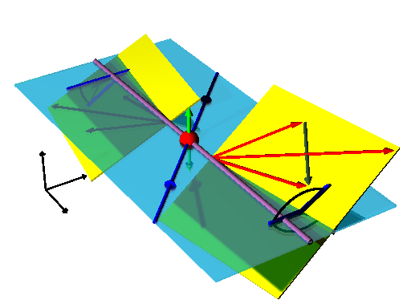
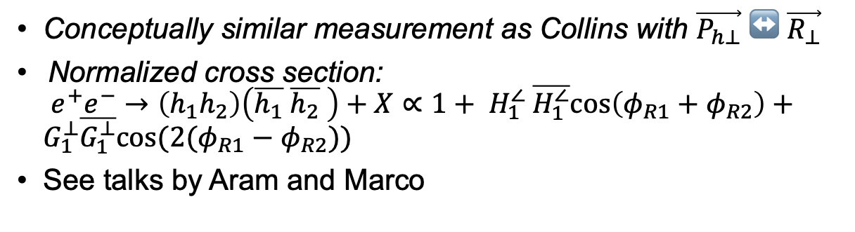
Di-hadron asymmetries
ϕ_{R2}−π
π−ϕ_{R1}
Conceptually similar measurement as Collins with $\vec{P_{h⊥}}↔\vec{R_{⊥}}$
Normalized cross section:
$e^{+}e^{−}→\left(h_{1}h_{2}\right)\left(\overline{h_{1}} \overline{h_{2}} \right)+X∝1+ H_{1}^{∠} \overline{H_{1}^{∠}}cos\left(φ_{R1}+φ_{R2}\right)+G_{1}^{⊥}\overline{G_{1}^{⊥}}cos({2(φ}_{R1}−φ_{R2}))$
See talks by Aram and Marco

Slide 28
Comparison of different $z$ definitions, inclusive $π^{+}π^{−}$ cross section

Slide 29
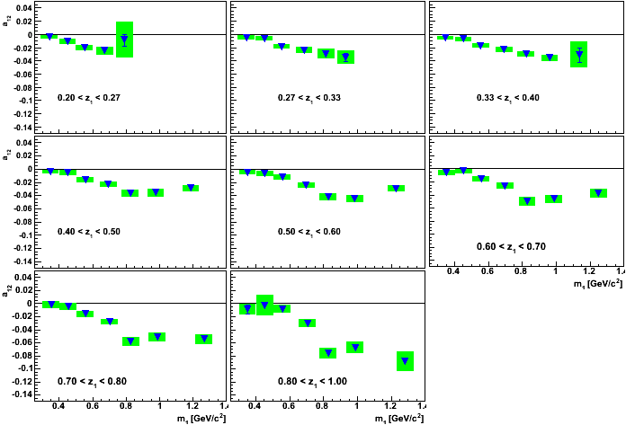

Extraction of $cos⁡(φ_{R_{1}}+φ_{R_{2}})$
First measurement of Interference Fragmentation Function
See Marco’s talk about
Transversity extraction
From di-hadrons
AV et. al, PRL 107, 072004(2011)
a₁₂∝H₁<•H₁<

Slide 30
Backup

Slide 31
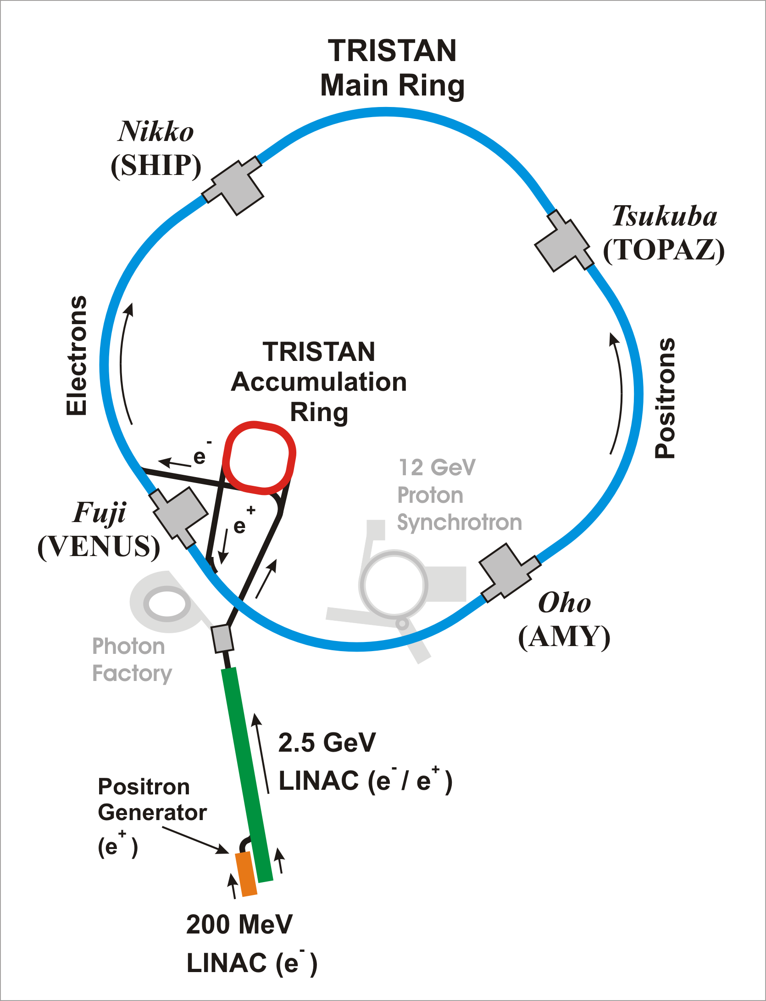
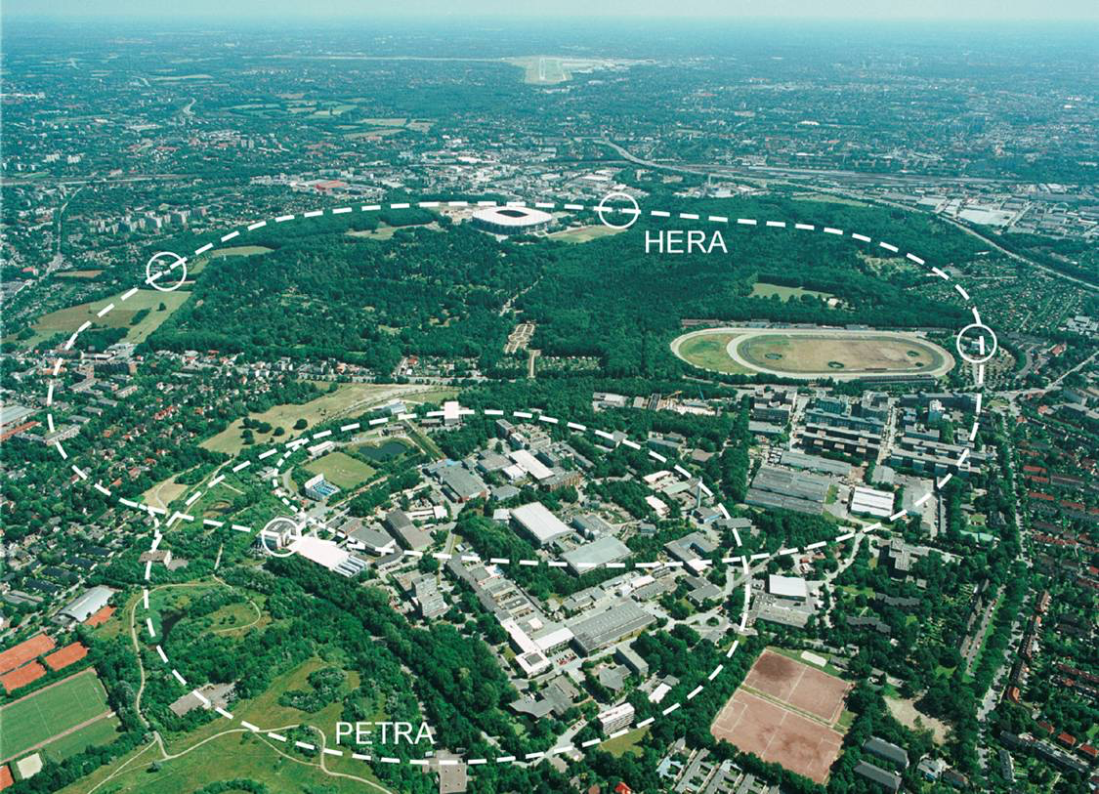
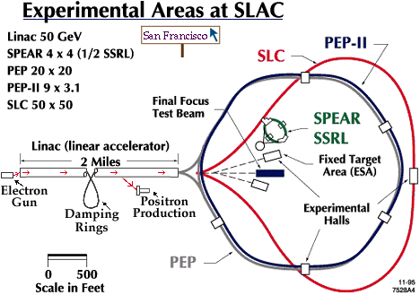
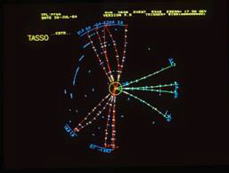
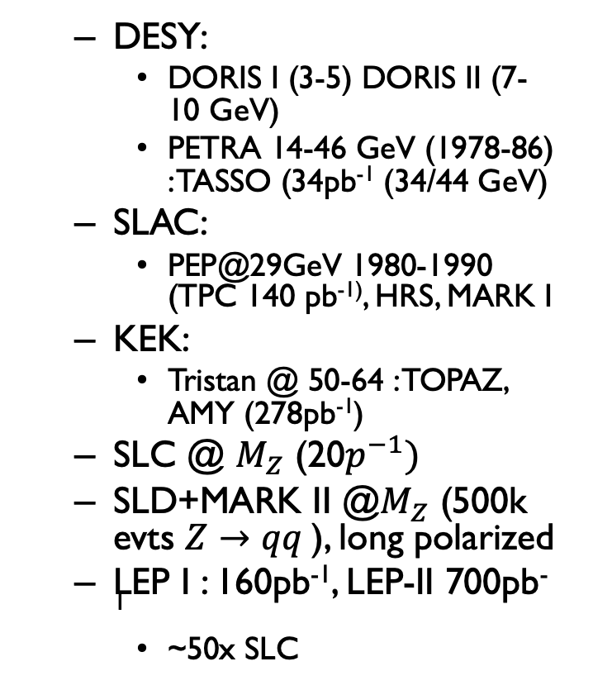
Long history of e+e- colliders: First generation for FF measurements
  DESY:
    DORIS I (3-5) DORIS II (7-10 GeV)
    PETRA 14-46 GeV (1978-86) : TASSO (34pb⁻¹ (34/44 GeV)
  SLAC:
    PEP@29GeV 1980-1990 (TPC 140 pb⁻¹⁾, HRS, MARK I
  KEK:
    Tristan @ 50-64 : TOPAZ, AMY (278pb⁻¹)
  SLC @ $M_{Z}$ (20$p^{−1})$
  SLD+MARK II @$M_{Z}$ (500k evts $Z→qq$), long polarized
  LEP I : 160pb⁻¹, LEP-II 700pb⁻¹
    ~50x SLC

Slide 32
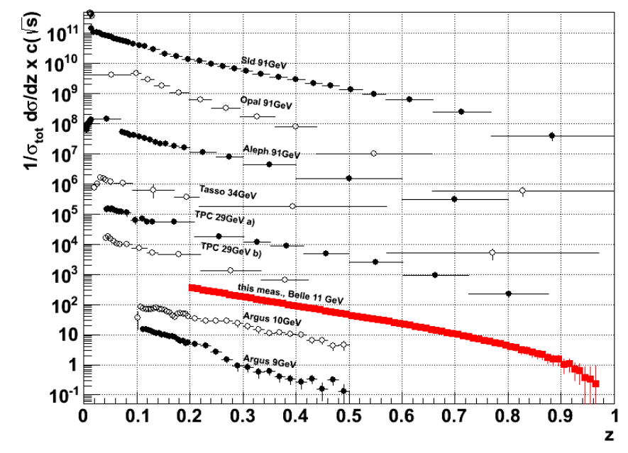
Where to Study?
e⁺e⁻ cleanest way to access FFs
B factories
  close in energy to SIDIS (100 GeV² vs 2-3 GeV²)
  Large integrated lumi!, high z reach
π
hadronic jet
e⁻
γ*
q
e⁺
q
Hadron
h
h

Slide 33
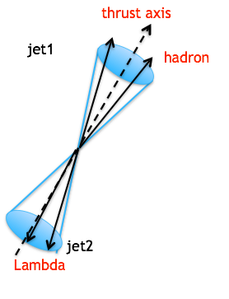
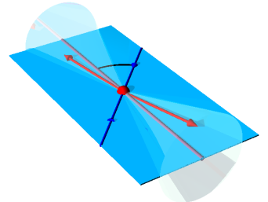
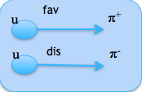
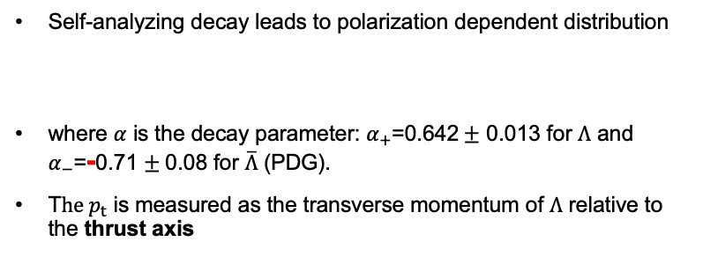



Observables in Λ Restframe
$\hat{n}$ is perpendicular to the $Λ$ production plane.
$Λ$ production plane
thrust axis
$Λ$(uds); $π^{+}$(u$\overline{d}$); $K^{+}$(u$\overline{s}$)
Self-analyzing decay leads to polarization dependent distribution
where $α$ is the decay parameter: $α_{+}$=0.642$±$ 0.013 for $Λ$ and
$α_{−}$=-0.71 $±$0.08 for $\overline{Λ}$ (PDG).
T$he p_{t}$ is measured as the transverse momentum of $Λ$ relative to the thrust axis

Slide 34
Long history of e+e- colliders: First generation for FF measurements
  X-section below M_{Z0}
  DESY:
    DORIS I (3-5) DORIS II (7-10 GeV)
    PETRA 14-46 GeV (1978-86) : TASSO (34pb⁻¹ (34/44 GeV)
  SLAC:
    PEP@29GeV 1980-1990 (TPC 140 pb⁻¹⁾, HRS, MARK I
  KEK:
    Tristan @ 50-64 : TOPAZ, AMY (278pb⁻¹)

Slide 35
Outlook to Belle II

Slide 36
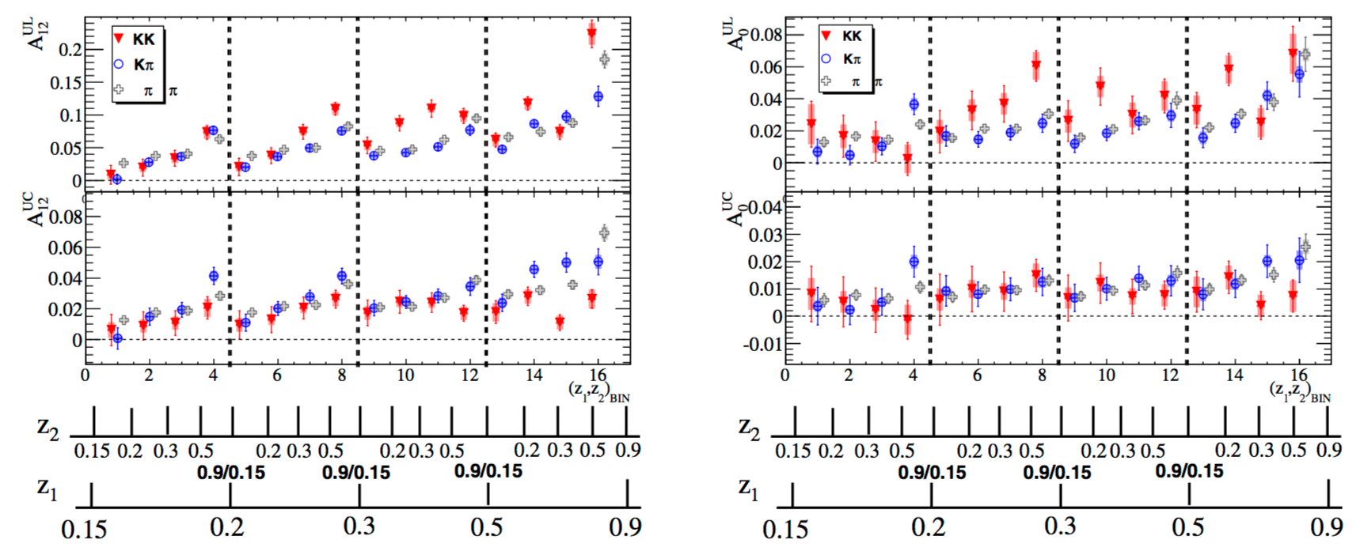
Collins effect for kaon/pion pairs
Simultaneous measurement of KK, Kπ and ππ Collins asymmetries from BaBar data
PRD 92,111101(R)(2015)
Rising of the asymmetry as a function of z:
  more pronounced for U/L
A^{UL} KK asymmetry slightly higher than pion asymmetry for high z
KK asymmetry consistent with zero at lower z
ππ asymmetries consistent with previous measurements (PRD90, 052003)

