Slide 1
SDCC Website Update
Status Update and Next Steps

Slide 2
Public-Facing Website
Resource for Liaisons and Users
One repository for documentation to avoid information divergence & drift
Users can submit and edit content to site, reducing need to repeat content on other sites
Updated content for today’s applications
Rethinking IA and content organization for better usability and discoverability
Clean, modern design

Slide 3
Action Plan
Working on site architecture and content strategy in tandem
Identify content owners and interested parties
Work with them to adapt and update existing content on current site
Content Migration should begin in earnest December, site widely available some time January

Slide 4
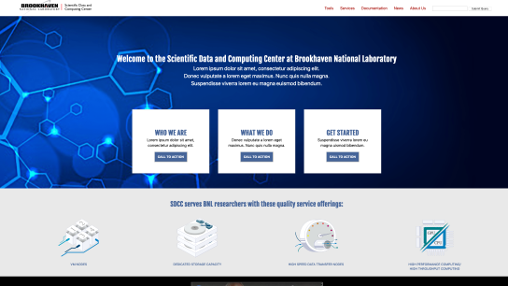
Public-Facing Website
Design Concept
Provides a cleaner, more modern organization that will improve discoverability and serve our users and the wider community.
Work to adapt design concept to Drupal theme is under way
Prototype at https://webtest.sdcc.bnl.gov/

Slide 5
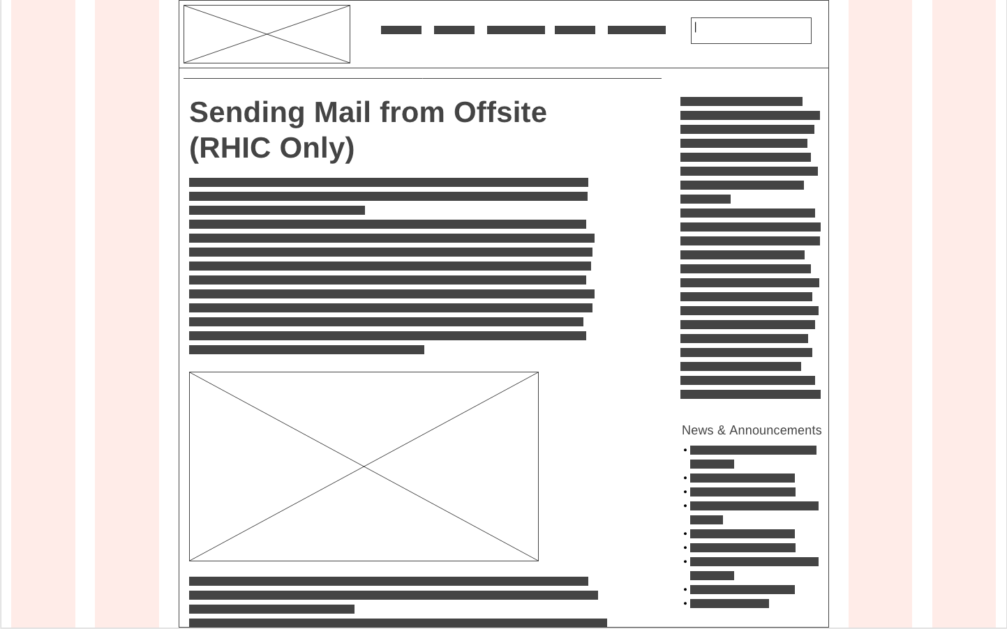
Updated Page Templates

Slide 6
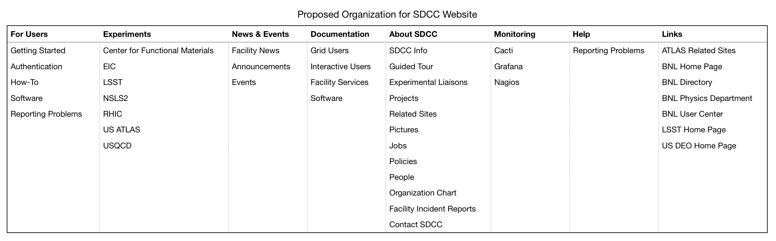
Updated Information Architecture

Slide 7
What We Need
We need your feedback! clepore@bnl.gov or lpelosi@bnl.gov
  Services to highlight
  Features that would be useful to the community (calendaring, web forms, email lists, etc.)
  Design preferences/UX concerns
Once site is stood up, we will need service providers and users to help us with content creation and migration

Slide 8
Questions?

