Slide 1




The FLUKA (re)interaction models
An introduction to FLUKA nuclear interaction models
Workshop: Open Questions in Photon-Induced Interactions-from
Relativistic Nuclear collisions to the Future Electron-Ion Collider
Stony Brook 26-28 April 2021
Alfredo Ferrari,
(alfredo.ferrari@mi.infn.it)
for the FLUKA Collaboration
Universitätsklinikum Heidelberg
INFN, Milan, Italy
Gangneung-Wonju National University, South Korea

Slide 2
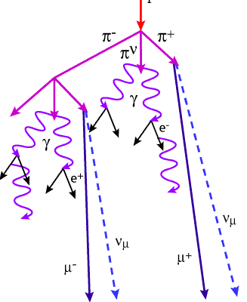
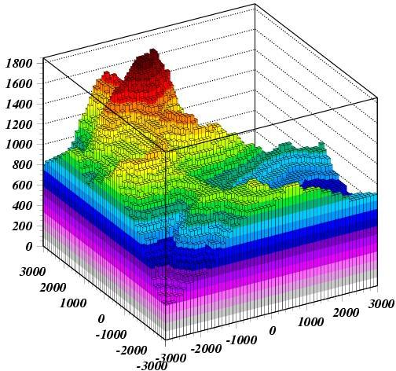
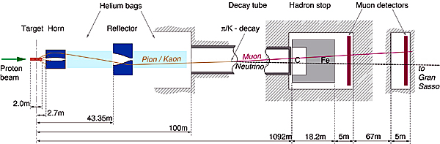
FLUKA Applications:
FLUKA (A.Fasso`,A.Ferrari,J.Ranft,P.R.Sala):
FLUKA is a general purpose tool for calculations of particle transport and interactions with matter
Cosmic ray physics
Neutrino physics
Accelerator design (→ n_ToF, CNGS, LHC systems, μCollider)
Particle physics: calorimetry, tracking and detector simulation etc.
(→ ALICE, ICARUS, ...)
ADS systems, waste transmutation, (→”Energy amplifier”, FEAT, TARC,…)
Shielding design
Dosimetry and radioprotection
Radiation damage
Space radiation
Hadron therapy
Neutronics
http://www.fluka.org ~14000 registered users worldwide

Slide 3
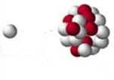
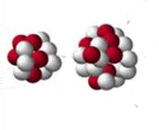
Fluka hA/AA models:
PEANUT
2⋅10⁴ > E > ~0.01 GeV
Photonuclear interactions
ElectroMagneticDissociation
Leptonuclear interactions
DPMJET-3
10⁸ > E > 2⋅10⁴ GeV
10⁸ > E/n > 5-10 GeV
Extended rQMD
5-10 > E/n > 0.1-0.15 GeV
BME
100-150 > E/n > ~5 MeV

Slide 4
Hadron Nucleon interactions in FLUKA (threshold ~ few TeV lab)

Slide 5
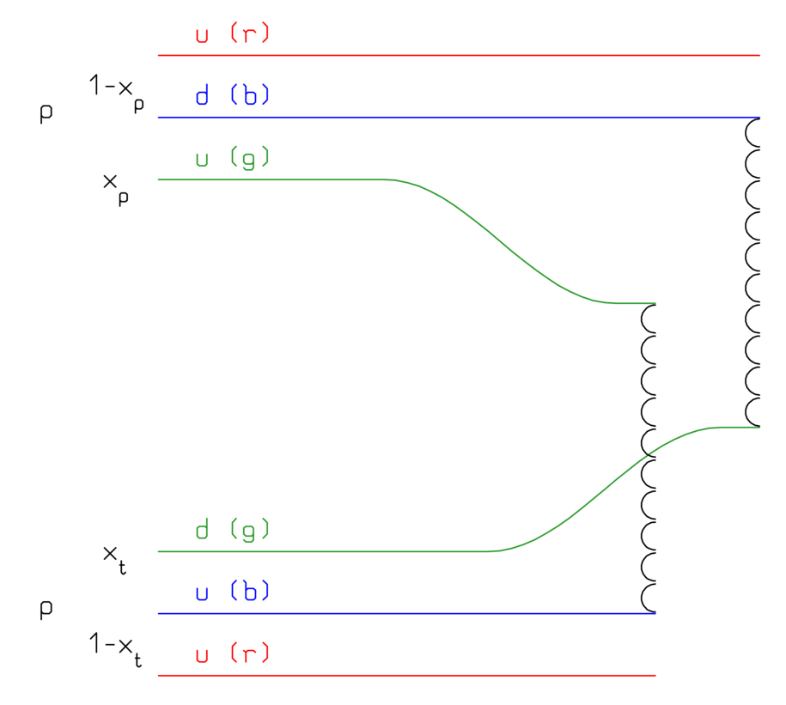
Nonelastic hN interactions: (very) short summary
Up to a few GeV’s:
Dominance of the Δ and of the N∗, ρ… resonances
→ isobar model
→ all reactions proceed through an intermediate state containing at least one resonance
N₁ + N₂ → N”₁ + Δ(1232) → N₁’ + N₂’ + π
π + N → Δ(1600) → π’+ Δ(1232) → π’ + π“+ N’
N_{’1}+ N₂ → Δ₁(1232) + Δ₂(1232) → N₁’ + π₁ + N’₂ + π₂
FLUKA: ≈ 60 resonances, and ≈ 100 channels
At energies above a few GeV’s:
Interacting strings (quarks held together by gluons into the form of a string)
Interactions treated in the Reggeon-Pomeron framework (Dual Parton Model, DPM)
Each hadron splits into 2 colored partons
  → combination into 2 colourless chains
  → 2 back-to-back jets
each jet is then hadronized into physical hadrons
Fluka contains its own hadronization model
pp: 1 cut pomeron

Slide 6
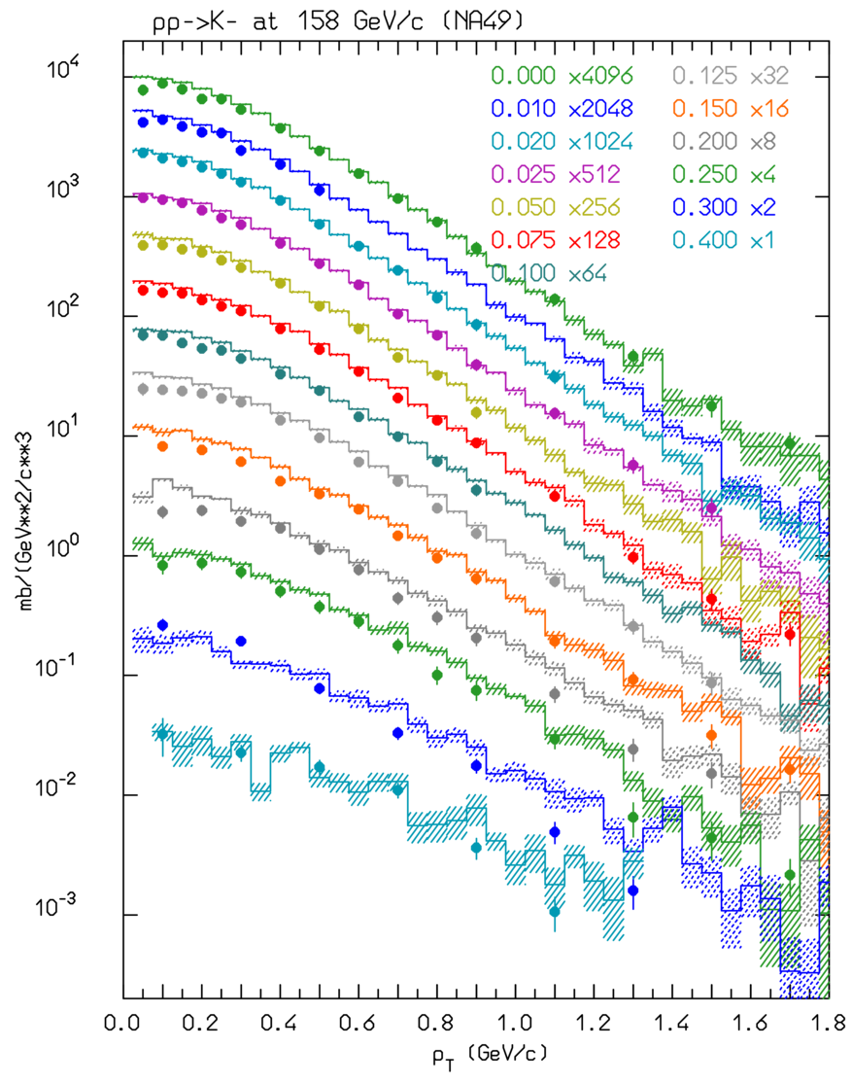
Pion/Kaon production in p-p collisions:
K⁻ yield as a function of p_{T} for different X_{F} bins, for 158 GeV/c protons on hydrogen
Inclusive cross section for the production of π⁰ (blue), π+ (red), and π⁻ (green) in p-p collisions as a function of the proton kinetic energy. Lines: simulations, symbols exp. Data.
(figure from AstrPhys81, 21 (2016))
pp @ 158 GeV/c → K⁻
Histos: FLUKA
Symbols: NA49

Slide 7
(γ,μ,ν,e^{+/-}) and hadron Nucleus interactions in PEANUT

Slide 8
FLUKA (PEANUT) modeling of nuclear interactions
Target nucleus description (density, Fermi motion, etc)
t (s)
10⁻²³
10⁻²²
10⁻²⁰
10⁻¹⁶
Glauber-Gribov cascade with formation zone
(Generalized) IntraNuclear cascade
Preequilibrium stage with current exciton configuration and excitation energy
(all non-nucleons emitted/decayed + all nucleons below 30-100 MeV)
Evaporation/Fragmentation/Fission model
γ deexcitation

Slide 9
(Generalized) IntraNuclear Cascade in PEANUT
Primary and secondary particles moving in the nuclear medium
Target nucleons motion and nuclear well according to the Fermi gas model
Interaction probability
σ_{free} + Fermi motion × ρ(r) + exceptions (ex. π)
Glauber cascade at higher energies
Classical trajectories (+) nuclear mean potential (resonant for π)
Curvature from nuclear potential → refraction and reflection throughout the nucleus
Interactions in projectile-target nucleon CMS → Lorentz boosts
Multibody absorption for π, μ⁻, K⁻
Quantum effects (Pauli, formation zone, coherence length, correlations…)
Energetic light ion production by coalescence
Together with the preequilibrium and evaporation steps → exact conservation of energy, momenta and all additive quantum numbers, including nuclear recoil

Slide 10
Glauber-Gribov cascade, formation zone* (→ classical INC will never work)
At energies below a few GeV: hA interactions → single primary collision hN, followed by re-interaction of secondary particles (INC).
Projectile
frame
At higher energies, Glauber calculus: multiple primary collisions
Laboratory frame
Formation time/zone: naively “materialization" time. Qualitative estimate:
* J.Ranft applied the concept, originally proposed by Stodolski, to hA and AA nuclear interactions
In the frame where p|| =0
Going from the produced hadron
p|| =0 frame to the nucleus system
Due to the relativistic length contraction and the uncertainty principle, at high energy most of the newly produced particles escape the nucleus without further re-interaction

Slide 11
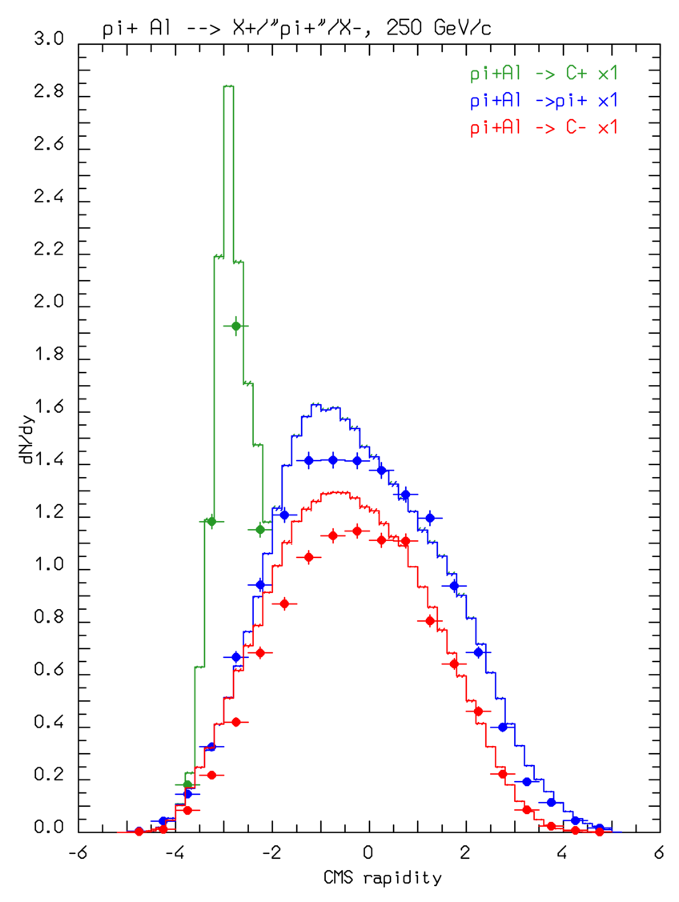
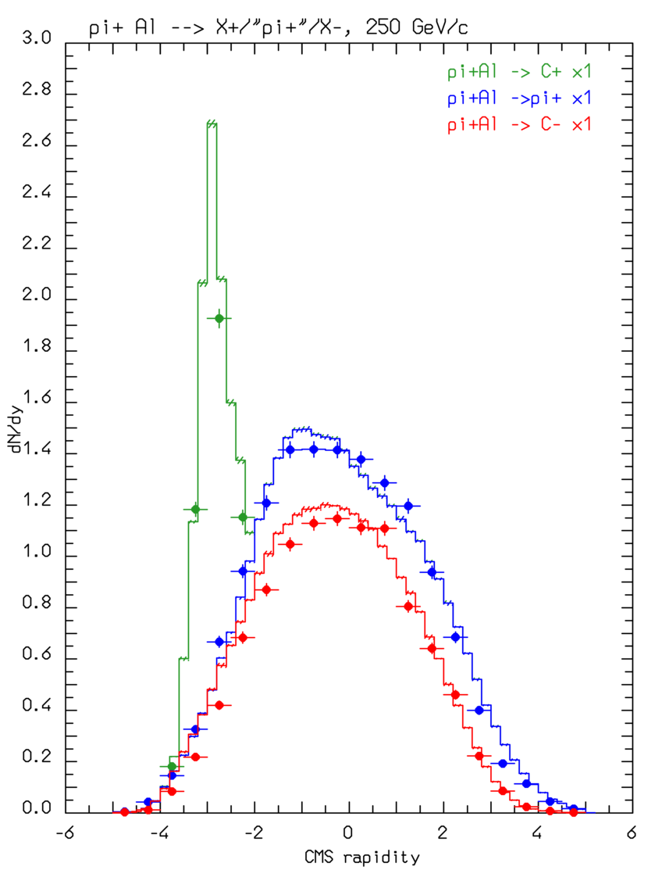
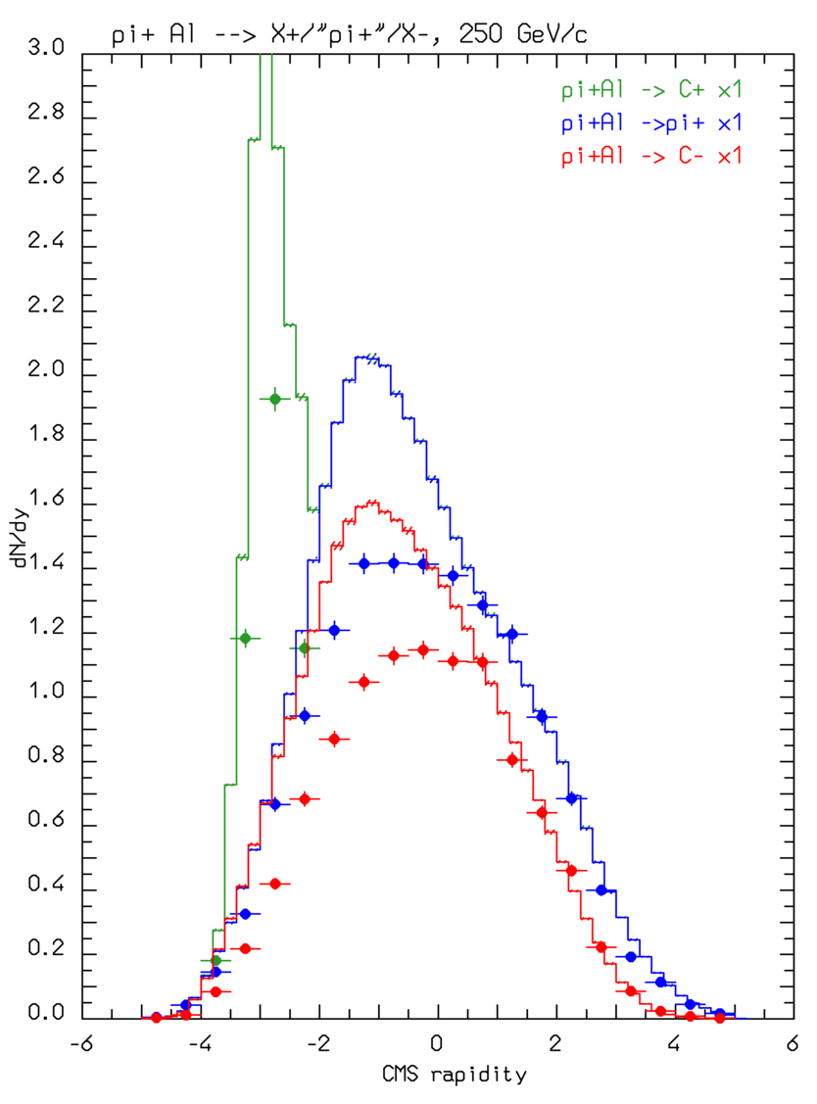
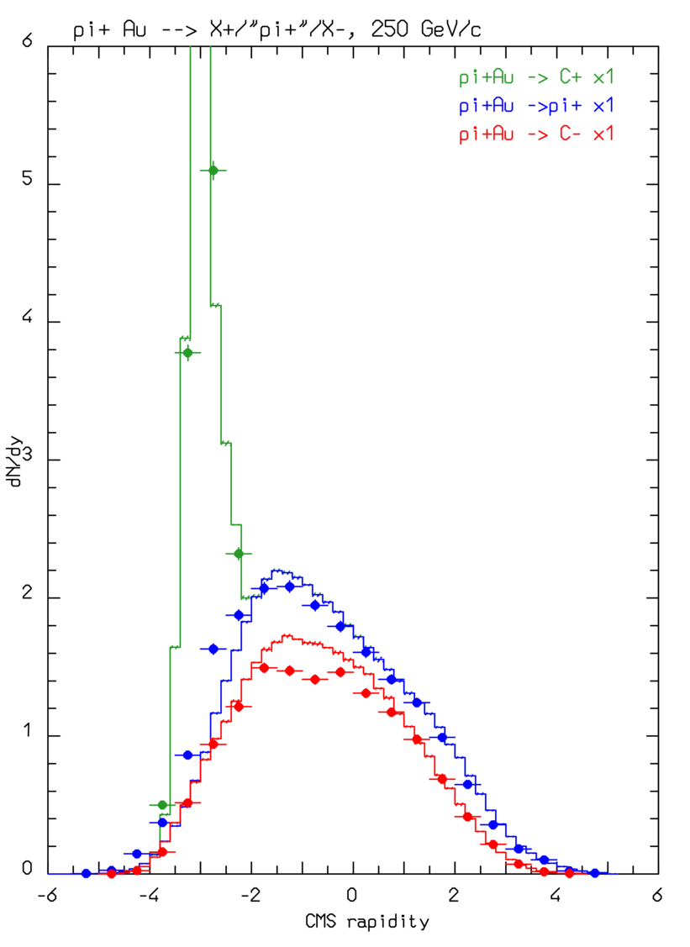
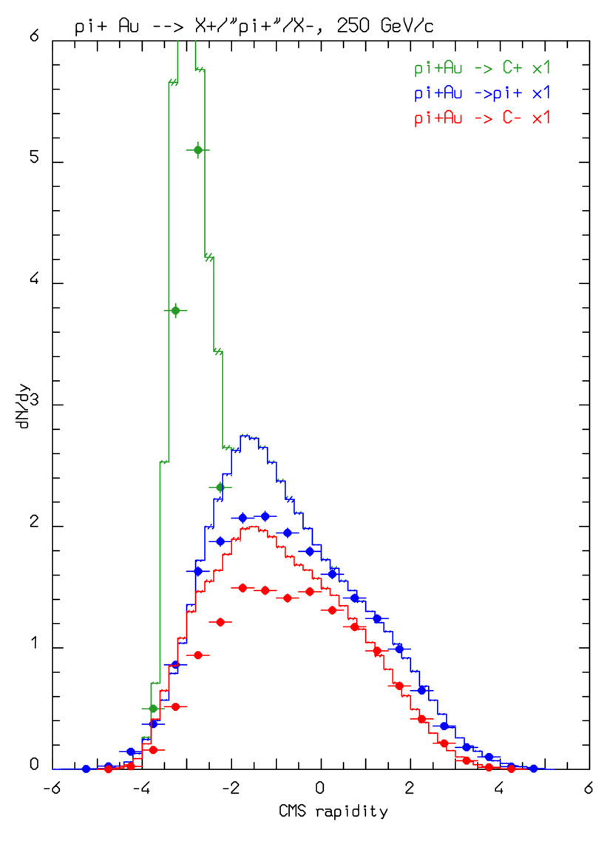
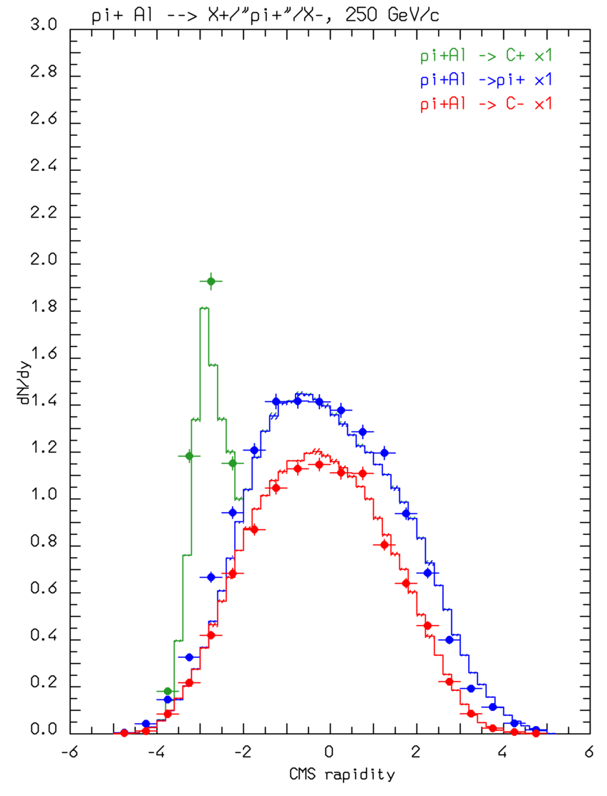
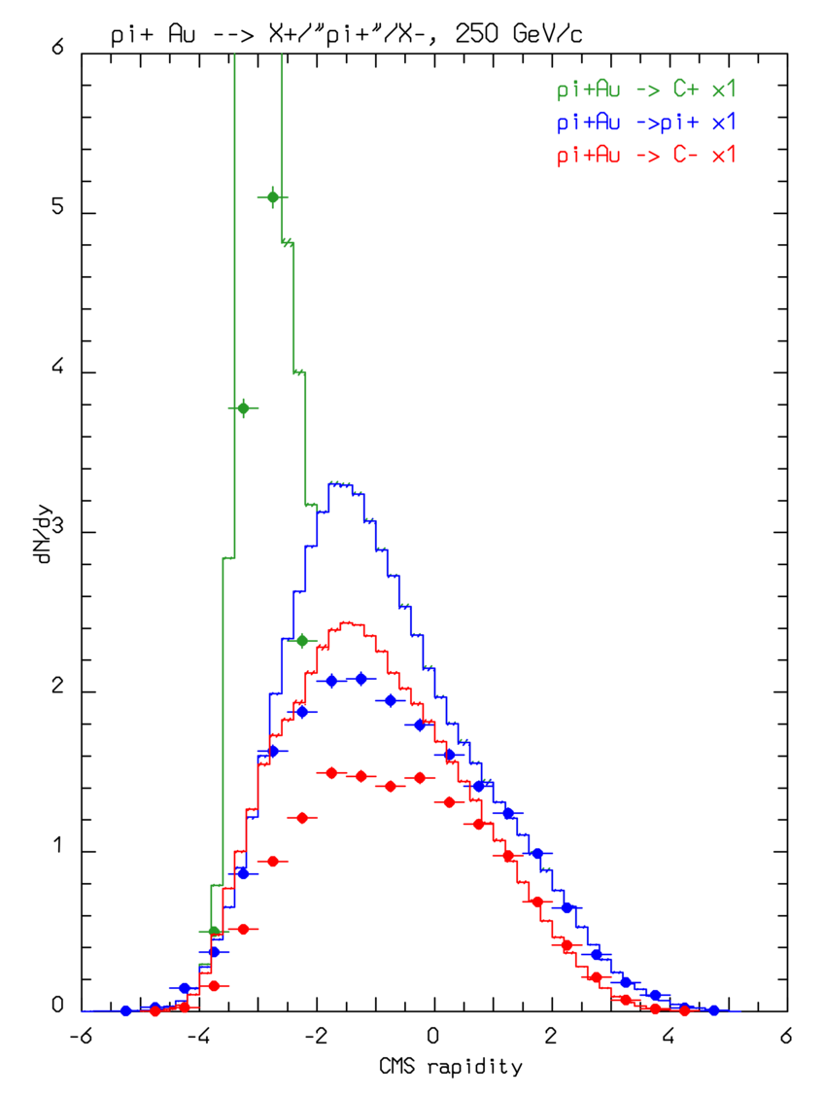
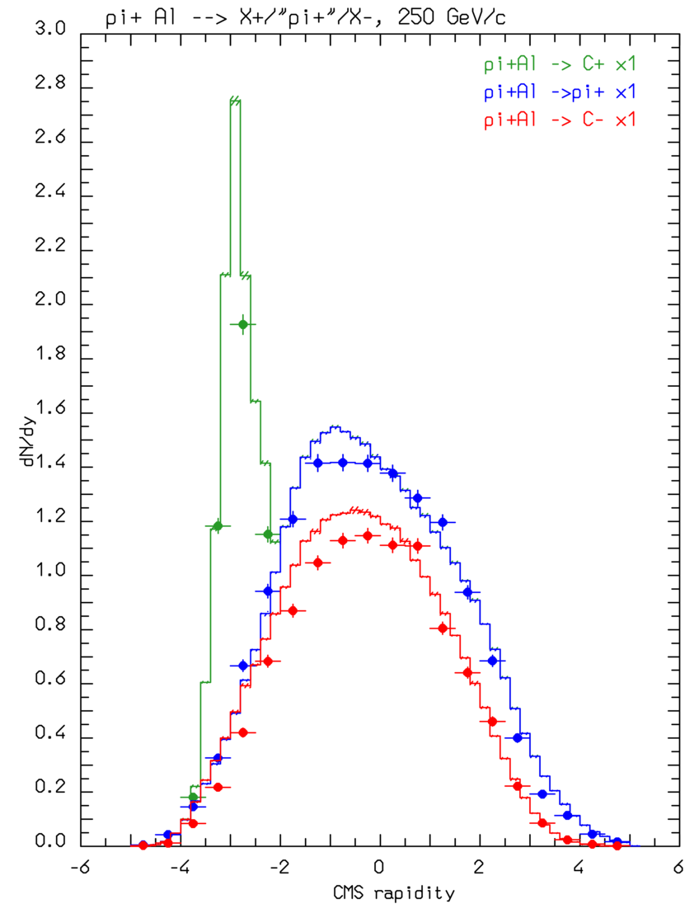
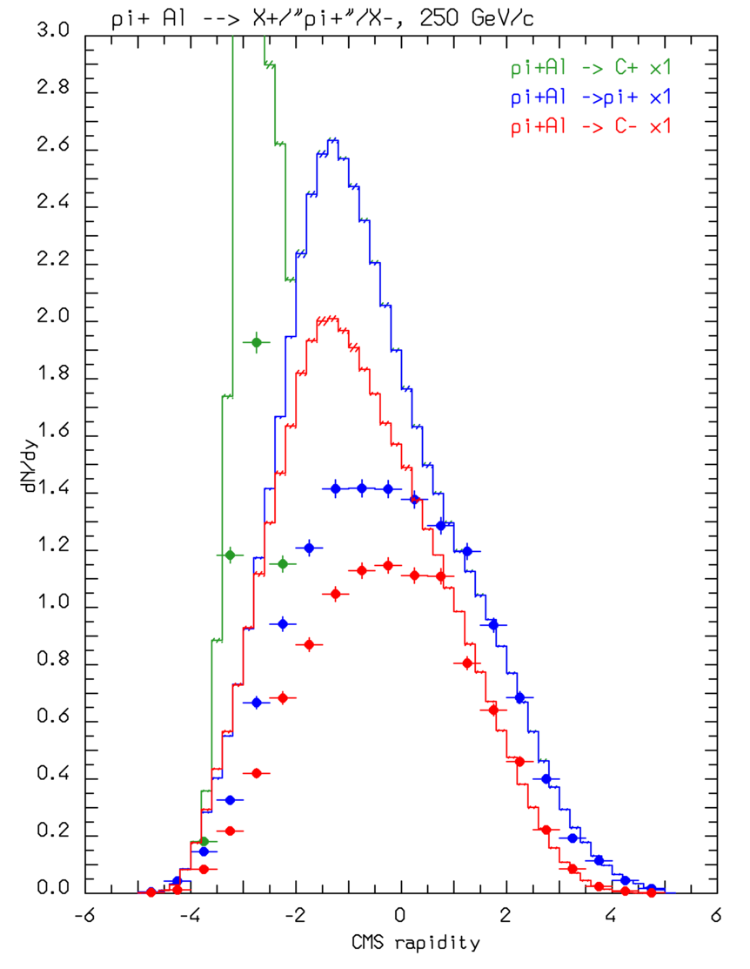
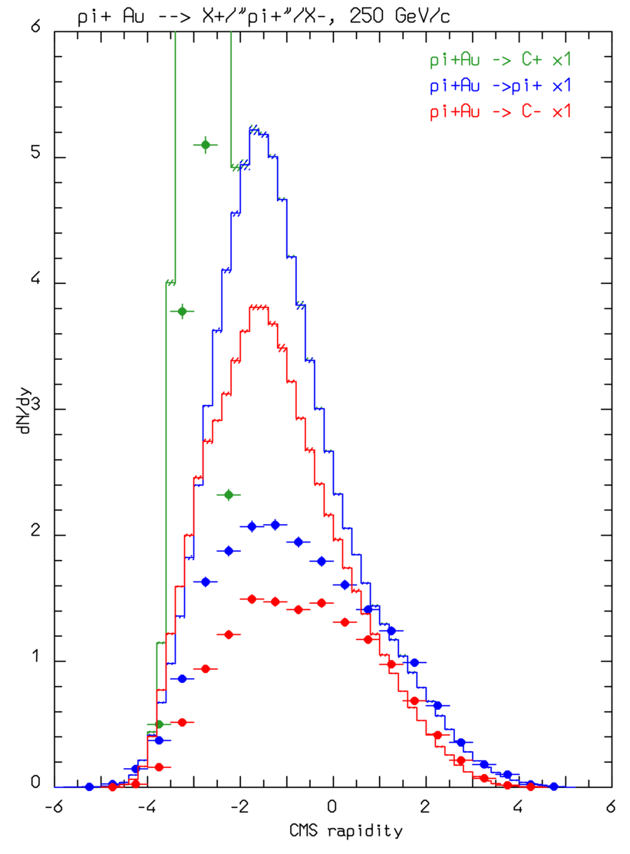
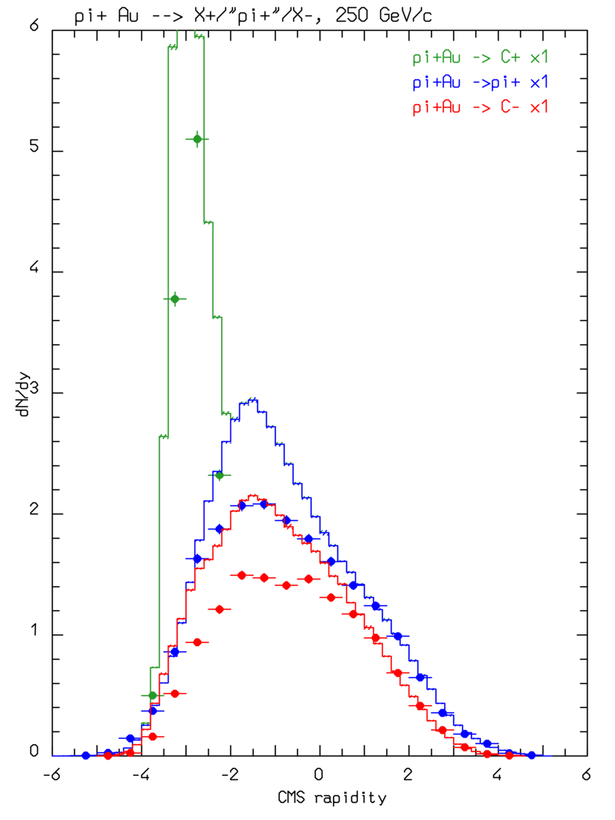
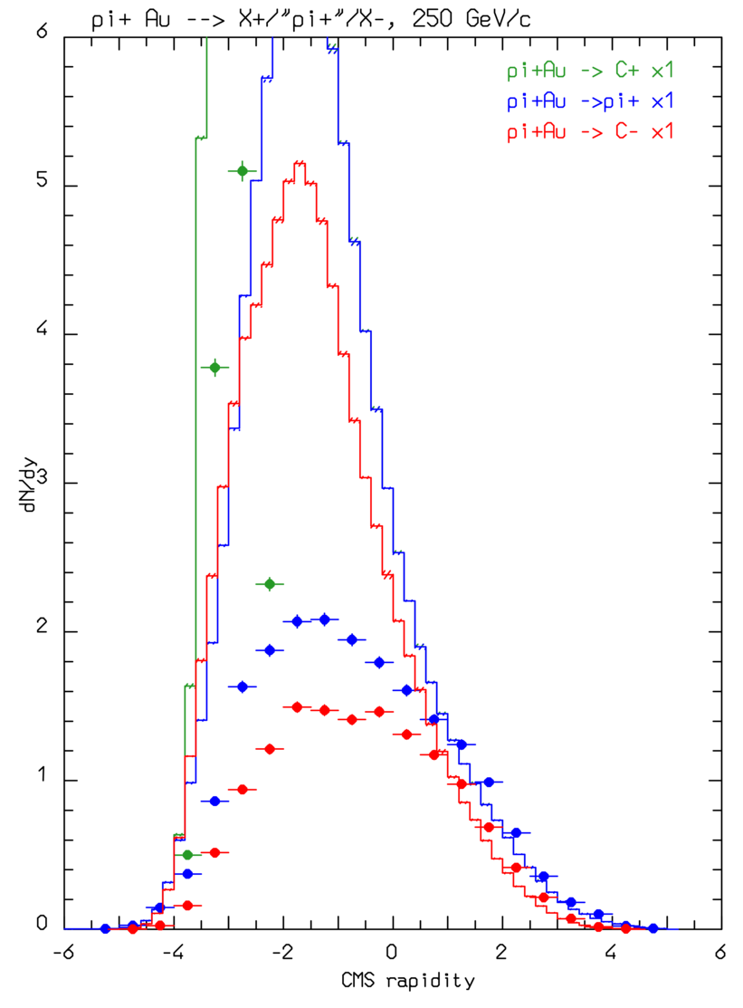
Are hA multi-GeV data compatible with a (lab) linearly increasing σ?
π⁺ @ 250 GeV/c on Al and Au: FLUKA with formation zone
Standard
Fluka with formation zone:
Rapidity distribution of charged particles 250 GeV π⁺ on Aluminum (left) and Gold (right)
Histos: FLUKA
Points: exp. Data
Positive
Negative
“π⁺”
It has been proposed (previous workshop on Target Fragmentation Physics with EIC, September 2020) that σ’s of produced particles should increase linearly from 0 to the nominal one over a given distance in the laboratory frame
We have tested this hypothesis substituting the standard Fluka formation zone with a linearly increasing σ over X fm, X ranging from 5 to 100 fm for 250 GeV π⁺ collisions on Aluminum (left) and Gold (right).
In all next plots rapidity distributions are shown for positive, negative, and “π^{+”} particles, with histos for FLUKA and symbols for exp.data (ZPC50, 361)
σ linearly increasing over 10 fm (lab)
σ linearly increasing over 5 fm (lab)
σ linearly increasing over 30 fm (lab)
σ linearly increasing over 50 fm (lab)
σ linearly increasing over 100 fm (lab)

Slide 12
Cross section fluctuations in high energy hA collisions
(Color transparency)

Slide 13
Glauber … what is the problem? Cross section fluctuations!
Glauber Particle production (absorption) cross section
Absorption probability over a given b and nucleon configuration
Indeed the observed σ_{hN} is just the average of the cross sections corresponding to all possible (quark) configurations of the incoming hadron
Considering the incoming hadron as a color dipole (q-qbar for mesons, q-qq for baryons, …) and with some hypothesis on the distribution of spatial configurations, P(ρ²), with the constraint ∫dρ²ρ²P(ρ²)=σ_{hN} , a fluctuating σ can be used inside the Glauber formalism
Technically it is rather complex, since the configuration changes over a timescale of ~1 fm proper time, so up to 10-20 GeV, for heavy nuclei, σ can change within the width of the target nucleus. The work is pretty recent, some initial results in the next slide(s)

Slide 14
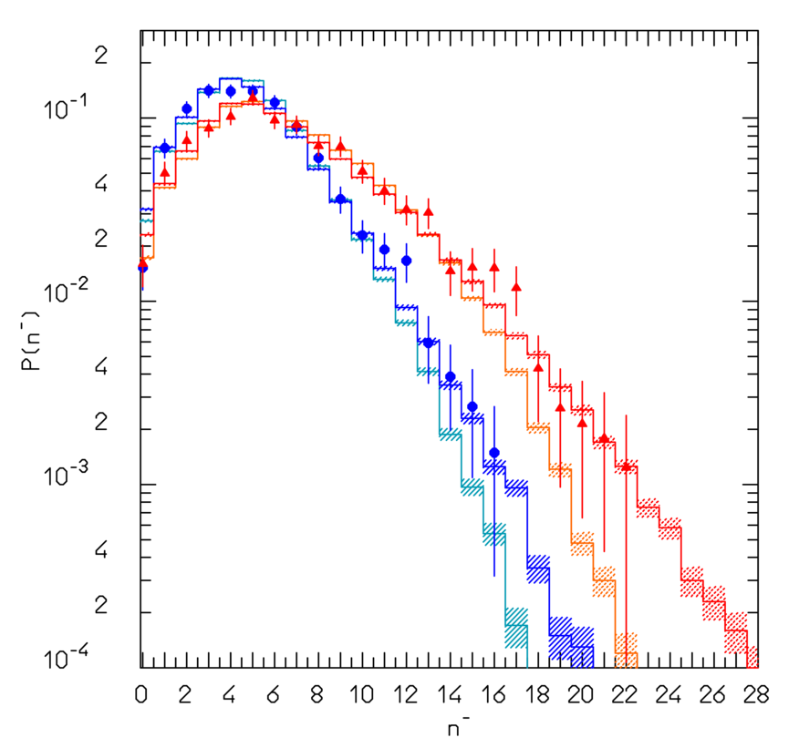
K⁺Al/K⁺Au → X⁻ @ 250 GeV/c: mult. distribution
Multiplicity distributions of negative particles for 250 GeV/c K⁺ on Al and Au:
K⁺ Al:
  Blue symbols with error bars: exp. data (NA22 experiment)
  Blue histo: Fluka simulation with cross section fluctuations
  Cyan histo: Fluka simulation without cross section fluctuations
K⁺ Au:
  Red symbols with error bars: exp. data (NA22 experiment)
  Red histo: Fluka simulation with cross section fluctuations
  Orange histo: Fluka simulation without cross section fluctuations
Preliminary
Work in progress
Please note that the average multiplicities are ~equal with and without cross section fluctuations

Slide 15
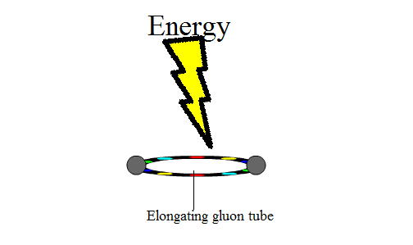
Summary about formation zone/color transparency
Two aspects of the same physics phenomenology:
Hadrons are composite objects…
…their σ_{hN} fluctuates depending on the configuration, with <σ_{hN}>=σ_{hN measured} …
… secondary hadrons are naturally produced from strings in their minimum cross section configuration…
… configuration re-arrangements occur on the space-time scale of the hadron rms, ~ 1 fm in the (projectile or produced) particle rest frame
(incoming projectile) cross section fluctuations
Formation zone
Picture
From Wikipedia

Slide 16
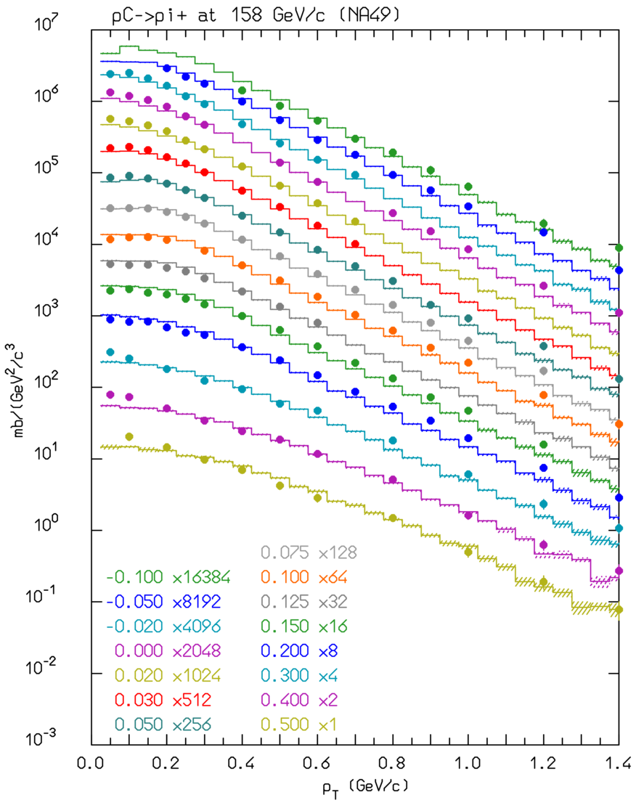
Pion and Kaon production data (ν beams…)
π⁺ (left) yield as a function of p_{T} for different X_{F} bins for 158 GeV/c p on C
pC @ 158 GeV/c → π⁺
Histos: FLUKA
Symbols: NA49
Phase space of interest for CENF
Angle integrated distributions are the most relevant for judging the reliability of ν predictions, at least for the bulk of the spectrum.
The p_{T} integrated distributions for pC→π⁺, π⁻ and pp→K⁺, K⁻ are shown in the right Figure as a function of Feynman X_{F} (dots exp. data, NA49, lines FLUKA predictions), together with the “focused” zones for CNGS and CENF
Phase space of interest for CNGS

Slide 17
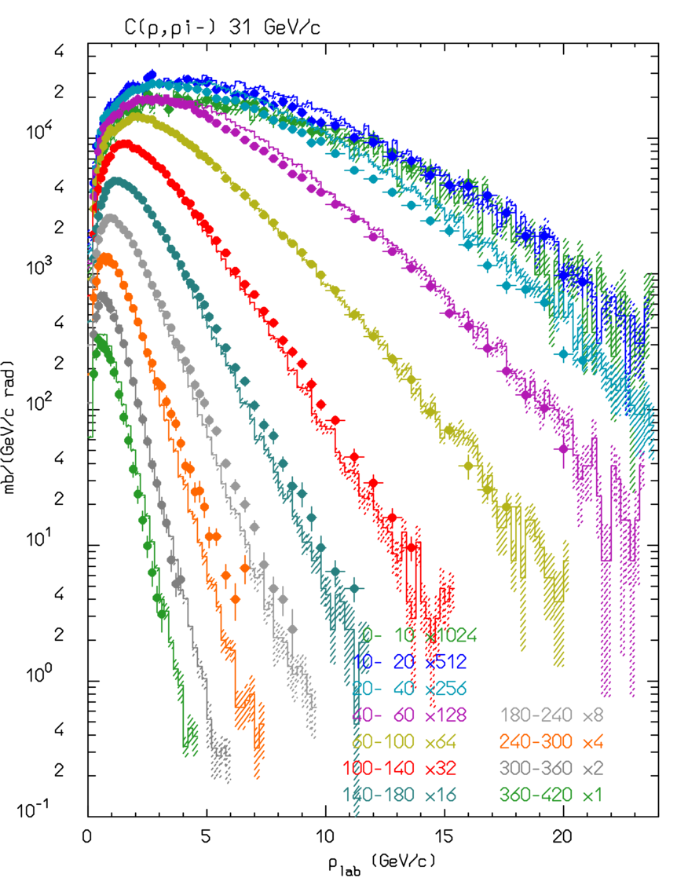
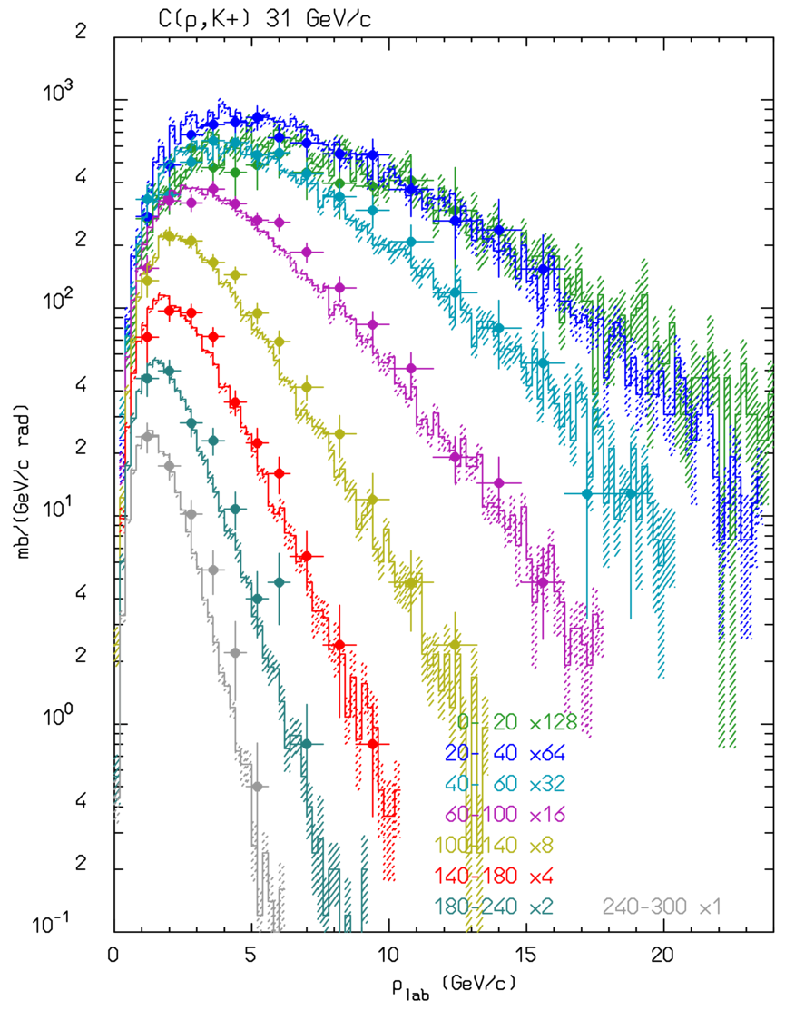
pC @ 31 GeV/c: π⁻ and K⁺
π⁻
K⁺
π⁻(left) and K⁺(right) momentum spectra for various angular bins (from 0-10 to 360-420 mrad for π⁻ and 0-20 to 240-300 for K+) for pC @ 31 GeV/c (left)
Symbols: exp. Data
(NA61 EPJC85, 84)
Histos: FLUKA

Slide 18
Pions in FLUKA: nuclear medium effects
Free π N interactions ⇒ | ⇒ | Non resonant channel
 | ⇒ | P-wave resonant Δ production
π + N → Δ in nuclear medium | ⇒ | decay | ⇒ elastic scattering, charge exchange
 | ⇒ | reinteraction | ⇒ Multibody pion absorption
Assuming for the free resonant σ a Breit-Wigner form with width Γ_{F}
An “in medium” resonant σ (σ^{A}_{res}) can be obtained adding to Γ_{F} the imaginary part of the (extra) width arising from nuclear medium
(Oset et al., NPA 468, 631)
quasielastic scattering, two and three body absorption
The in-nucleus σ_{t}^{A} takes also into account a two-body s-wave absorption σ_{s}^{A} derived from the optical model

Slide 19
Pion absorption:
Emitted proton spectra at different angles , 160 MeV π⁺ on Ni
Phys. Rev. C41,2215 (1990), Phys. Rev. C24,211 (1981)
Proton spectra extend up to 300 MeV!!
Pion absorption cross section on Gold and Bismuth in the Δ resonance region (Black dots: exp data, colored ones: model)
Symbols: exp. Data
Histos: model

Slide 20
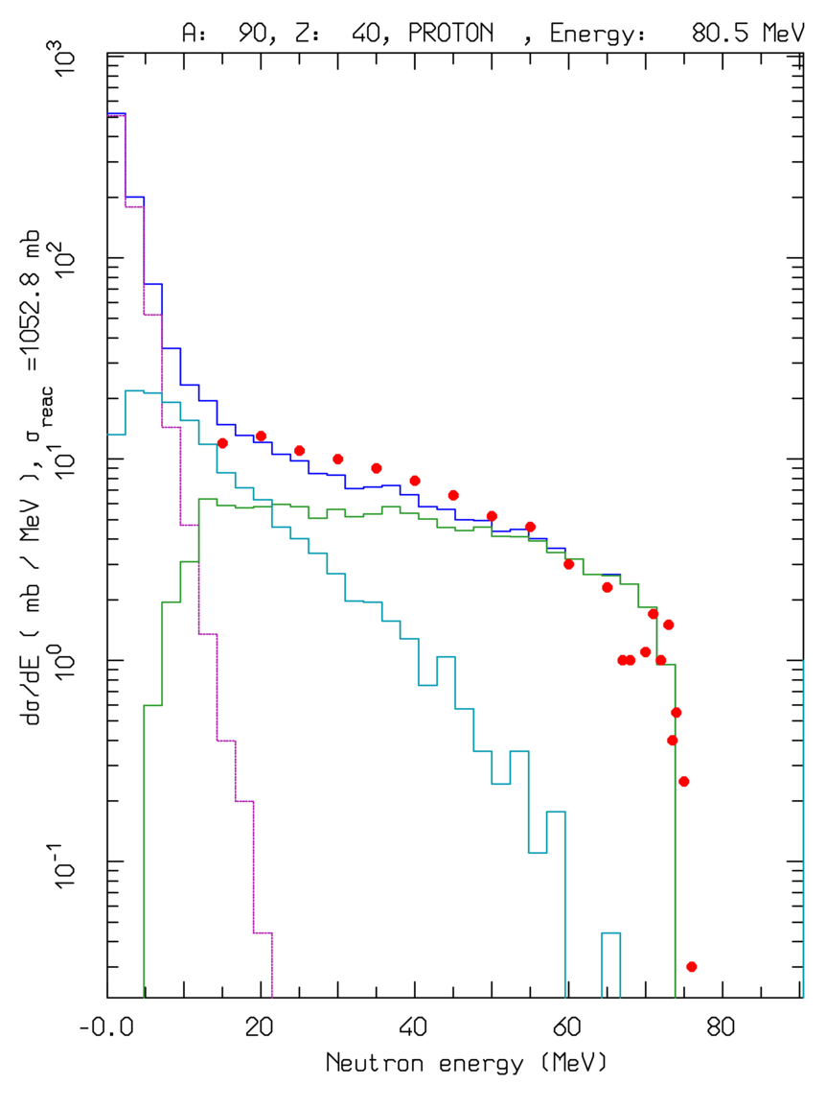
Preequilibrium/Evaporation/γ de-exc.:
dσ/dE ⁹⁰Zr(p,xn) at 80.5 MeV
Lines: total, INC, preequilibrium, evaporation contributions
Data • :from Phys. Rev. C39, 452
For E > π prod. threshold → only (G)INC models. At lower energies INC becomes increasingly inapplicable → preequilibrium models == share the excitation energy among many nucleons/holes. FLUKA: directly for p/n induced reactions below 30-100 MeV, or all remaining nucleons/clusters below 30-100 MeV/n.
When the system is fully equilibrated, particle emission through evaporation, fission and nuclear break-up. In FLUKA: ~600 possible emitted particles/states (A<25) with an extended (heavy) evaporation/ fission/ fragmentation formalism.
For light nuclei (A<17): enhanced Fermi break up
When particle emission is no longer possible → γ de-excitation. In Fluka: at high excitation: continuous level density and statistical emission (Z. Phys C 71, 75), At low excitation: discrete levels, either tabulated exp. levels (RIPL-3b library from IAEA) and branchings, or rotational approximation outside tabulations

Slide 21
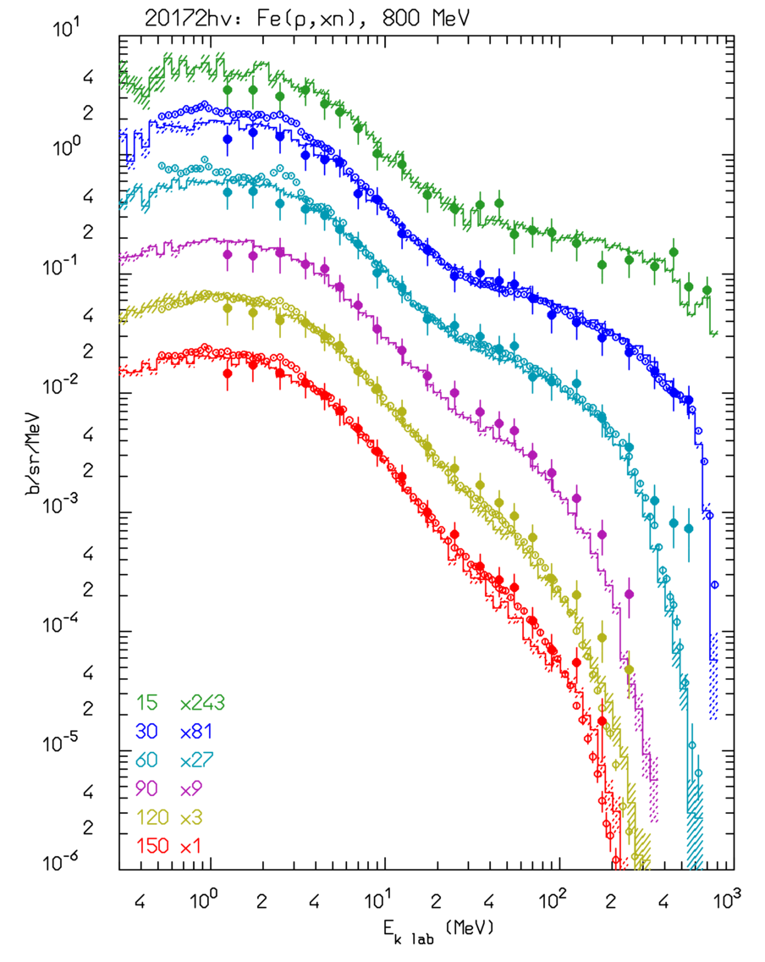
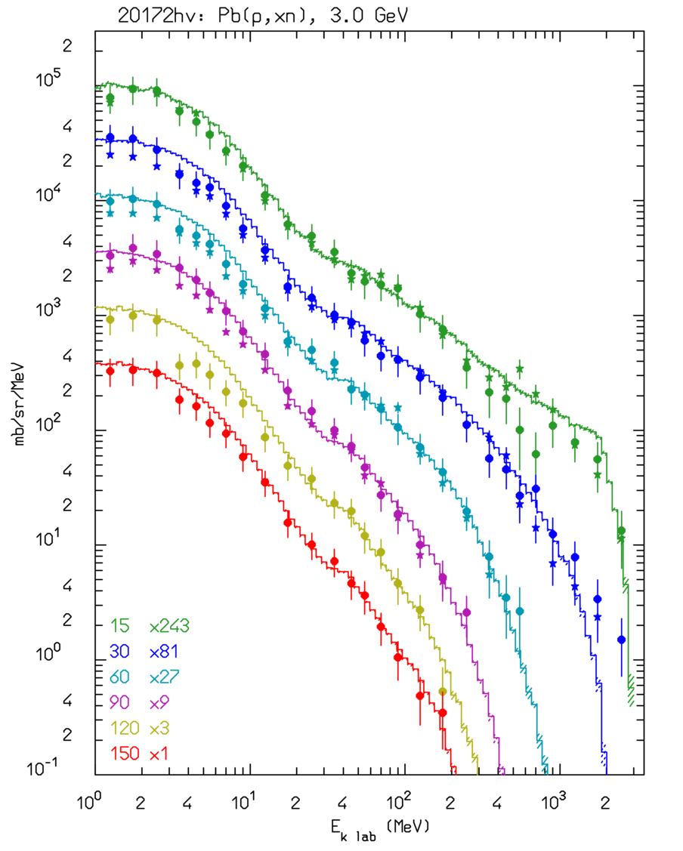
Thin target examples: neutrons
Double differential ← cross section d²σ/dEdΩ for Fe(p,xn) @ 800 MeV, thin target
Data: NSE112, 78 (1992), NST34, 529 (1997)
Cascade, preequilibrium neutrons
Evaporation
neutrons
Double differential cross section d²σ/dEdΩ for Pb(p,xn) @ 3 GeV → thin target
Data: NST32, 827 (1995)

Slide 22
Example of fission/evaporation
1 A GeV ²⁰⁸Pb + p reactions Nucl. Phys. A 686 (2001) 481-524
Data
Fluka
Fluka after cascade
Fluka after preeq
Quasi-elastic
Spallation
Evaporation
Fission
Deep spallation
Fragmentation

Slide 23
Real and Virtual Photonuclear Interactions
Photonuclear reactions
Giant Dipole Resonance interaction (special database)
Quasi-Deuteron effect
Delta Resonance energy region
Vector Meson Dominance at high energies
INC, preequilibrium and evaporation via the PEANUT model
Virtual photon reactions
Muon photonuclear interactions
Electronuclear interactions
Electromagnetic dissociation
Real and virtual photons
Electro(Positro)Fission on ²³⁸U
Lines:FLUKA (E1+E2)
Symbols.: exp. data
With help from P.Degtiarenko and G.Kharashvili
Notes:
In not many other existing transport codes photonuclear reactions are simulated over the whole energy range

Slide 24
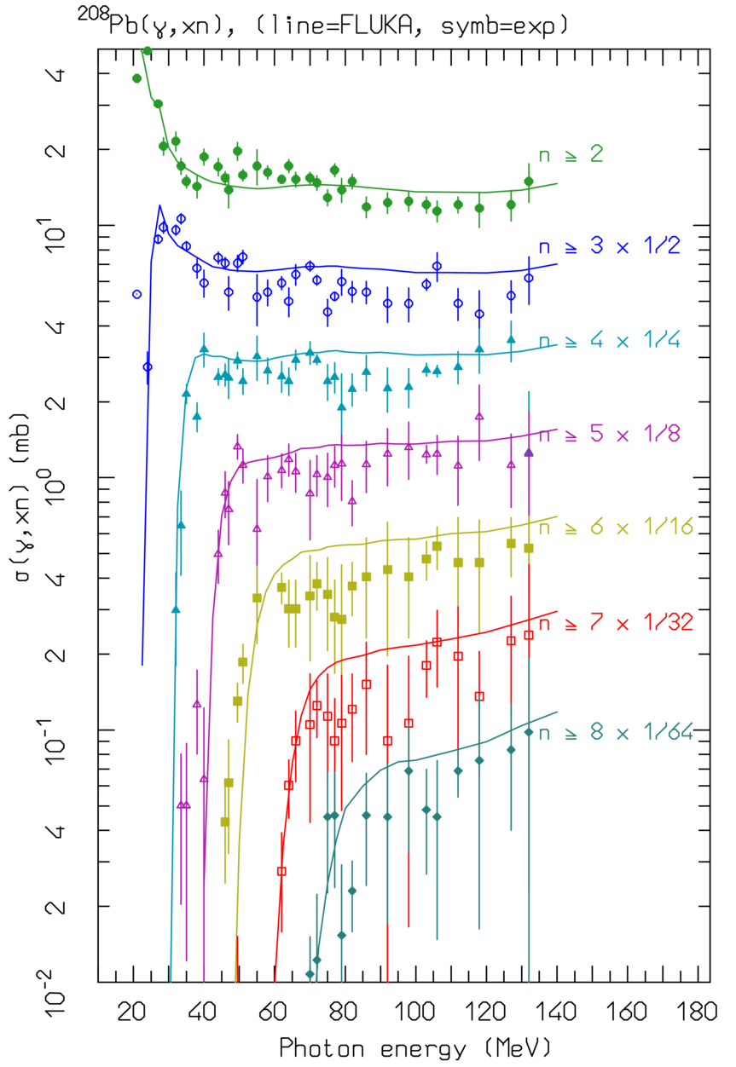
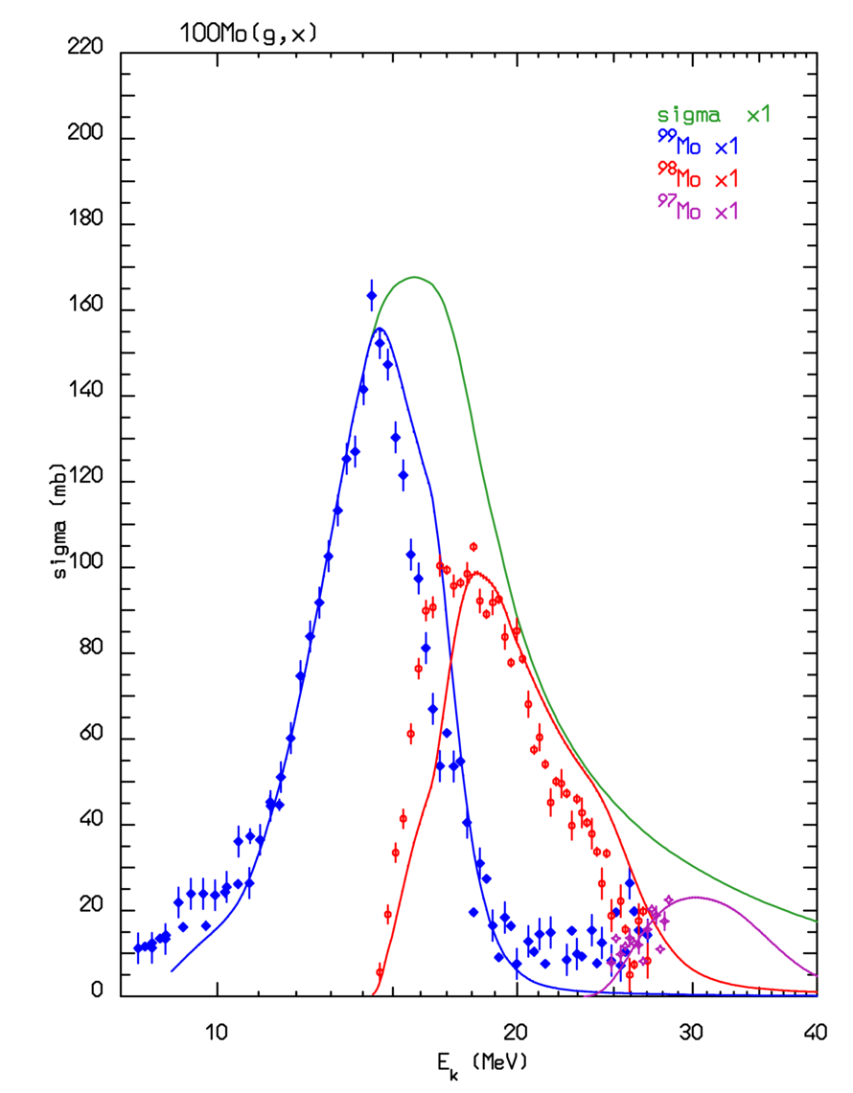
Photonuclear interactions:
Photonuclear production of ⁹⁹Mo through ¹⁰⁰Mo(γ,n) (lines Fluka, symbols exp.data from Exfor)
Reaction: ²⁰⁸Pb(γ,xn) →
20≤Eγ ≤140 MeV
σ for multiple neutron emission as a function of γ energy
Different colors refer to neutron multiplicity ≥ n , with 2≤n≤8
Symbols: exp data
(NPA367, 237 (1981) ;
NPA390, 221 (1982) )
Lines: FLUKA

Slide 25
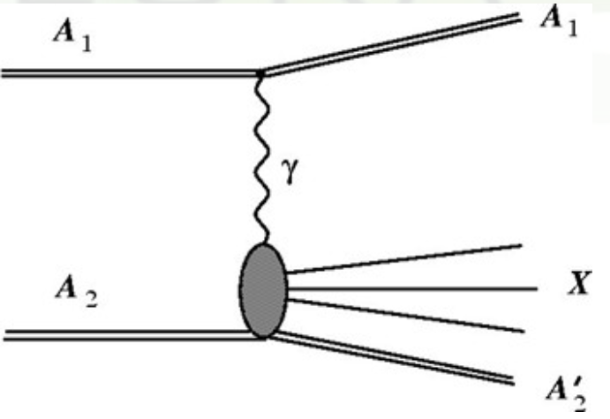
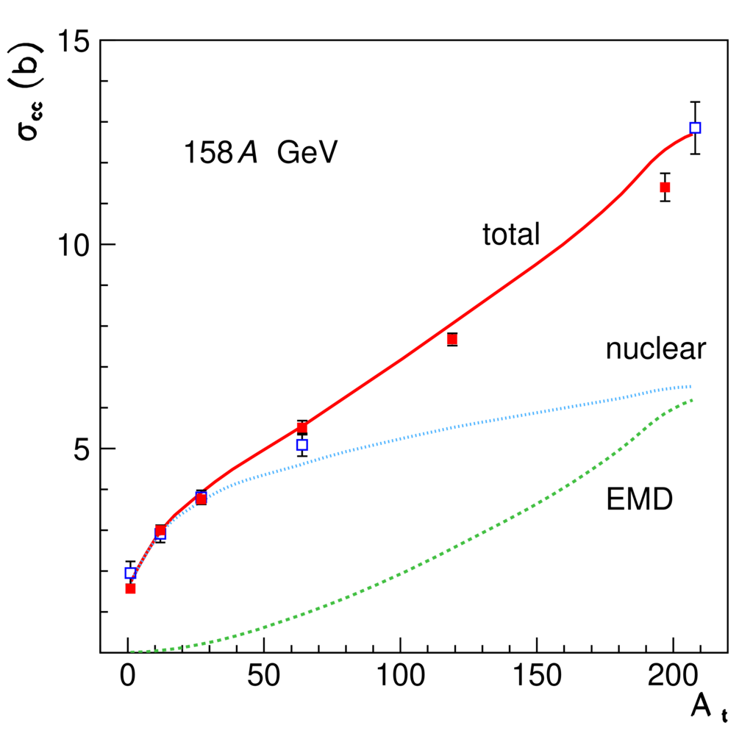
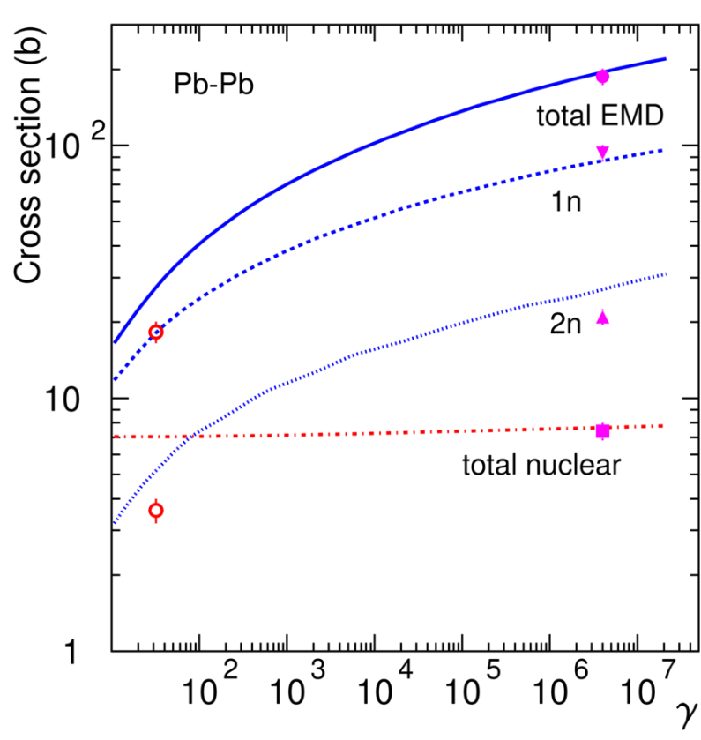
Electromagnetic dissociation*
Very peripheral collisions
Break-up of one of the colliding nuclei in the electromagnetic field of the other nucleus
… nuclear and, mostly, ElectroMagneticDissociation collisions on LHC machine elements or at IP’s produce a variety of (excited), possibly radioactive, fragments in flight
Pb ions on various targets
Alice:
√s_{nn}=2.8 TeV
Symbols: exp. data
Lines: Fluka*
*PRSTAB17 021006
Total charge changing cross section as a function of atomic mass
Total EMD, 1 n, 2 n, and nuclear cross sections as a function of the effective γ factor

Slide 26
(Anti)Neutrinos in FLUKA:
Acta Phys.Polon. B40 (2009) 2491-2505
CERN-Proceedings-2010-001 pp.387-394.
νN QuasiElastic (from ~0.1 GeV upward):
  Following Llewellyn Smith formulation
  Lepton masses accounted for
νN Resonance production
  From Rein-Sehgal formulation
  Keep only Δ production
  Non-resonant background term from DIS
μ
±
ν
ν
k’
μ
μ
k
2
2
Q = -q
±
q=k-k’
W
q
Z
0
p=xP
q
g
W
νN Deep Inelastic Scattering
  NunDIS model (developed ad hoc for FLUKA)
  Chains from νN DIS: → FLUKA hadronization
νN interactions embedded in PEANUT for νA (Initial State and Final State effects)
q
N
q
q
P
Hadronization

Slide 27
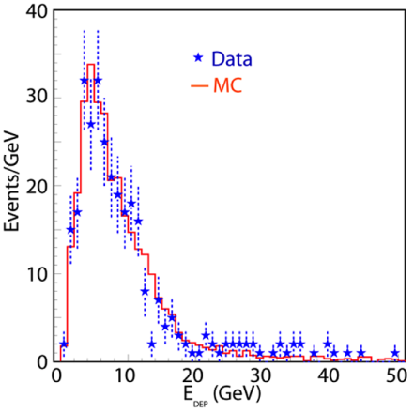
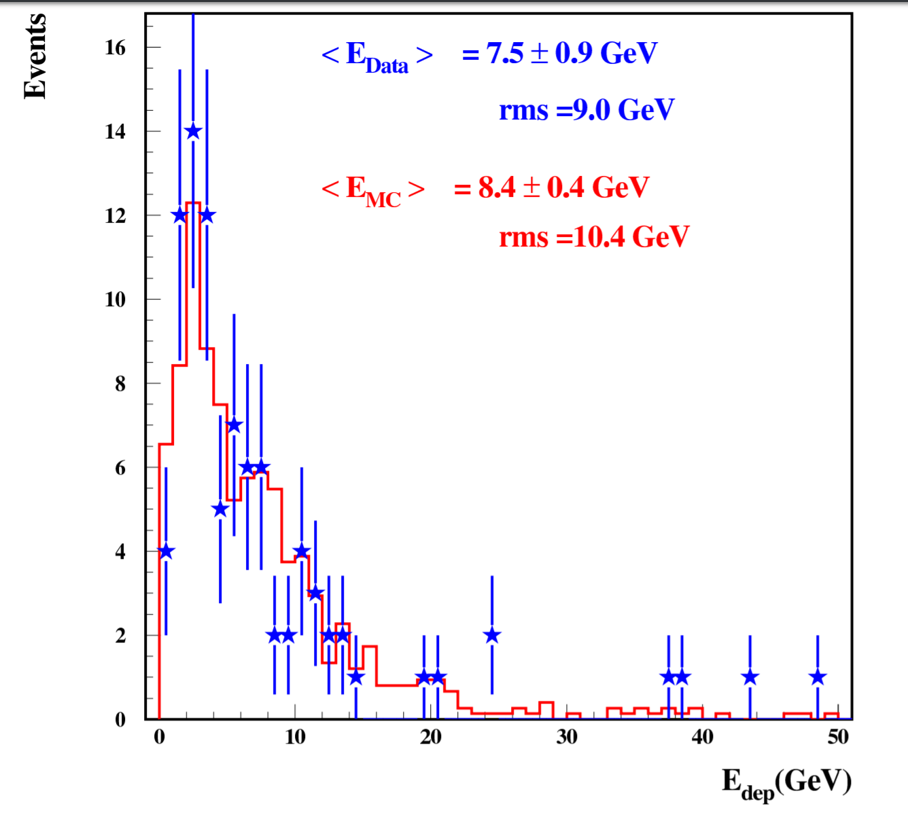
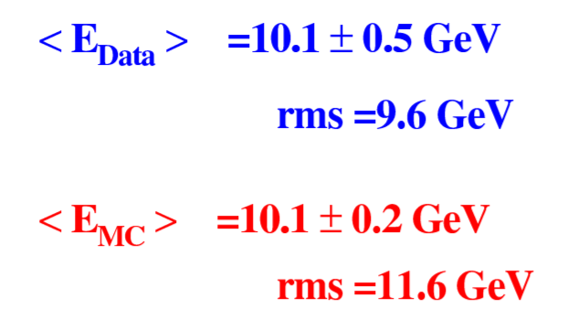
Reaction products: CNGS data (≈20 GeV <E_{ν}>)
Distribution of total deposited energy in the T600 (Icarus) detector
← Left:
ν_{µ} CC events
Right:→
ν NC events
Same reconstruction in MC and Data
Neutrino fluxes from FLUKA CNGS simulations
Absolute agreement on neutrino rates within 6%
Eur. Phys. J. C (2013) 73:2345
Phys. Lett. B (2014)

Slide 28
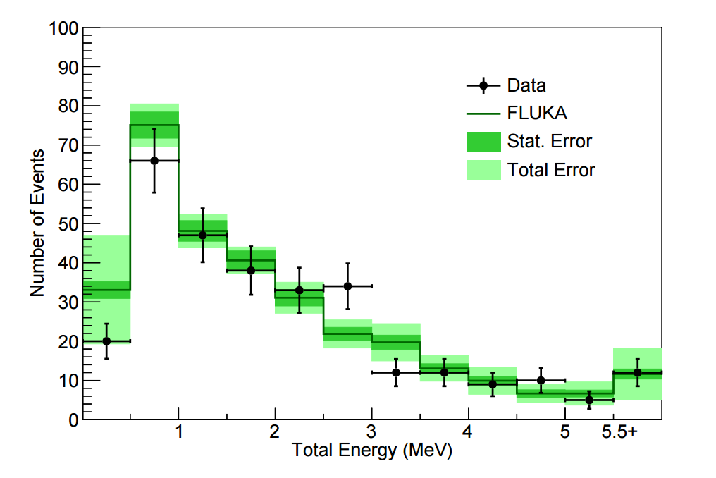
γ de-excitation application: neutrinos+neutrons
Detector: ARGONEUT operated in the NuMi beam, in front of the Minos near detector. Small LAr chamber
One of the measurements: de-excitation gamma-rays from neutrino interactions
Background to this search: mainly photons from unseen neutrons generated in the neutrino interaction
Simulations with FLUKA, internal neutrino generator + fully correlated pointwise low-energy neutron σ’s for Ar
Total reconstructed γ energy in an event for neutrino data and FLUKA MC events. Events with no reconstructed energy are not included
Phys. Rev. D 99, 012002 – Published 7 January 2019

Slide 29
Questions from past workshops:
How can we help in general?
Would a Peanut interface to a eN generator (similar to the built-in one for Nundis) be of help?
… if so, it would require implementing two handles as per νN interactions:
  one for getting the σ for a given eN √s…
  … another for filling arrays with secondary id’s (PDG coded) and 4-vectors
  Peanut would then do the reinteraction etc business…

Slide 30
Thanks for your attention

