Slide 1

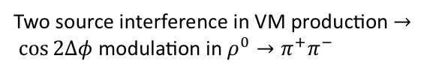
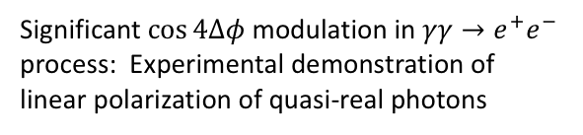
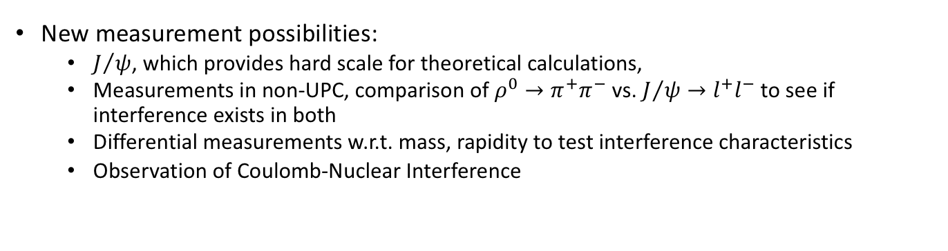
Highlights I : Polarized Photon-Gluon Collisions
Significant $\cos{4Δφ}$ modulation in $γγ→e^{+}e^{−}$ process: Experimental demonstration of linear polarization of quasi-real photons
Two source interference in VM production $→ \cos{2Δφ}$ modulation in $ρ^{0}→π^{+}π^{−}$
Interference shows rich structure vs. $P_{T}$
New Interference pattern observed in diffractive photo-nuclear interactions
Experimental demonstration of sensitivity to gluon distribution and that incoherent does not contribute to interference pattern
Coulomb-Nuclear Interference
New measurement possibilities:
  $J/ψ$, which provides hard scale for theoretical calculations,
  Measurements in non-UPC, comparison of $ρ^{0}→π^{+}π^{−}$ vs. $J/ψ→l^{+}l^{−}$ to see if interference exists in both
  Differential measurements w.r.t. mass, rapidity to test interference characteristics
  Observation of Coulomb-Nuclear Interference

Slide 2
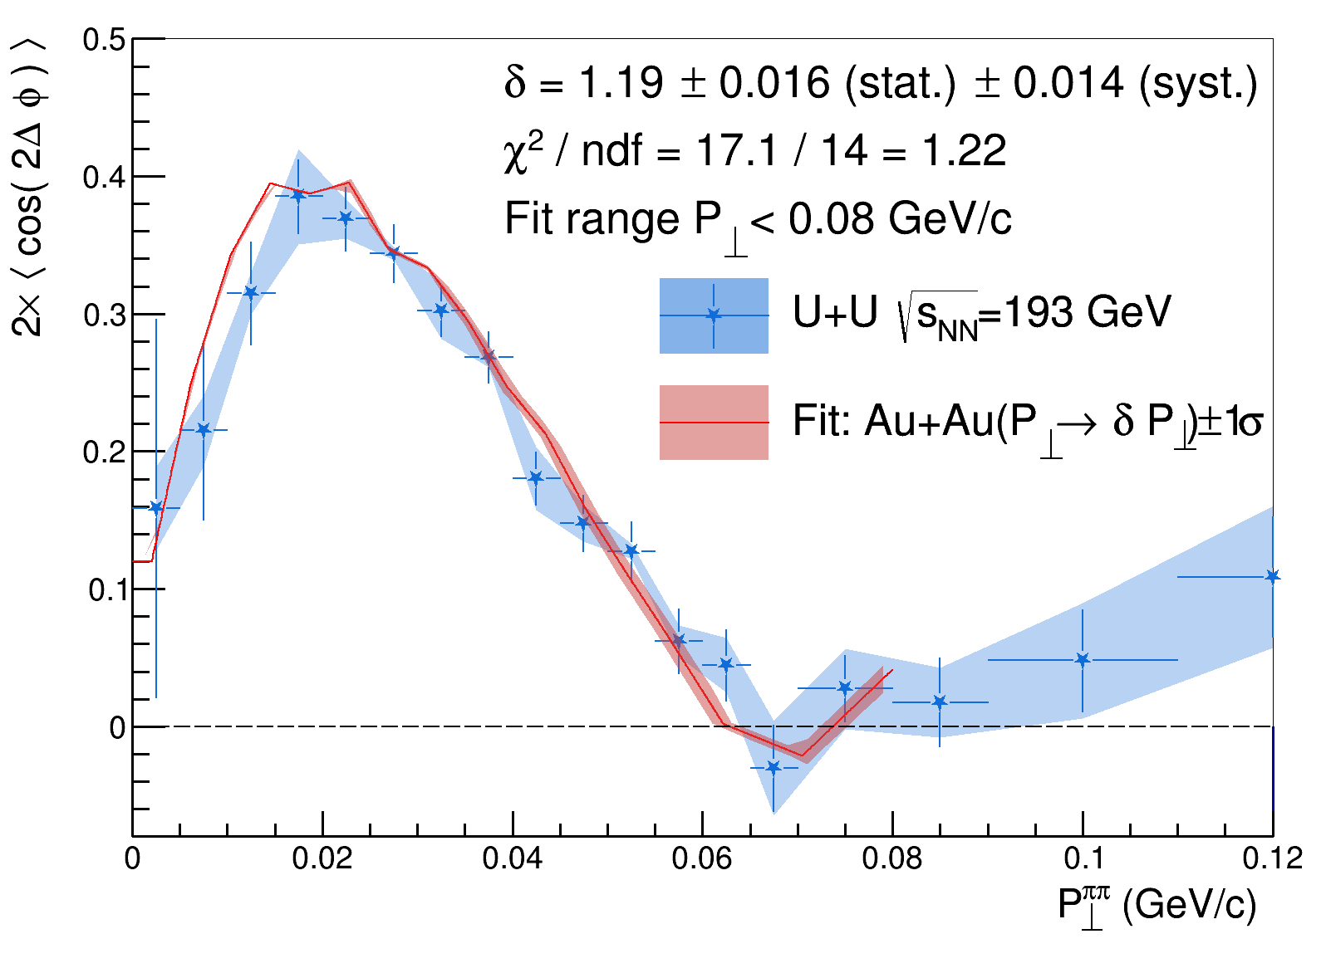
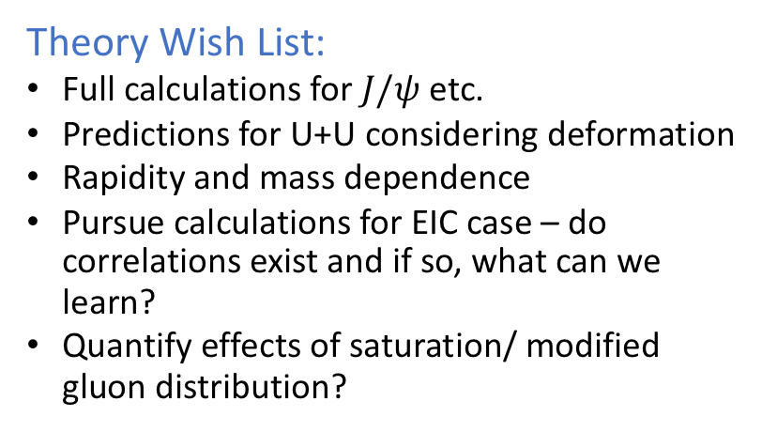
Highlights II : Theory Questions and EIC
Separation of coherent vs. incoherent is the essential experimental challenge for EIC measurements
Gain a deeper understanding of what ‘coherent’ means
Theory Wish List:
Full calculations for $J/ψ$ etc.
Predictions for U+U considering deformation
Rapidity and mass dependence
Pursue calculations for EIC case – do correlations exist and if so, what can we learn?
Quantify effects of saturation/ modified gluon distribution?
Continue to pursue theory – gain quantitative agreement
Why are we sensitive primarily to the ‘long’-axis

