Slide 1
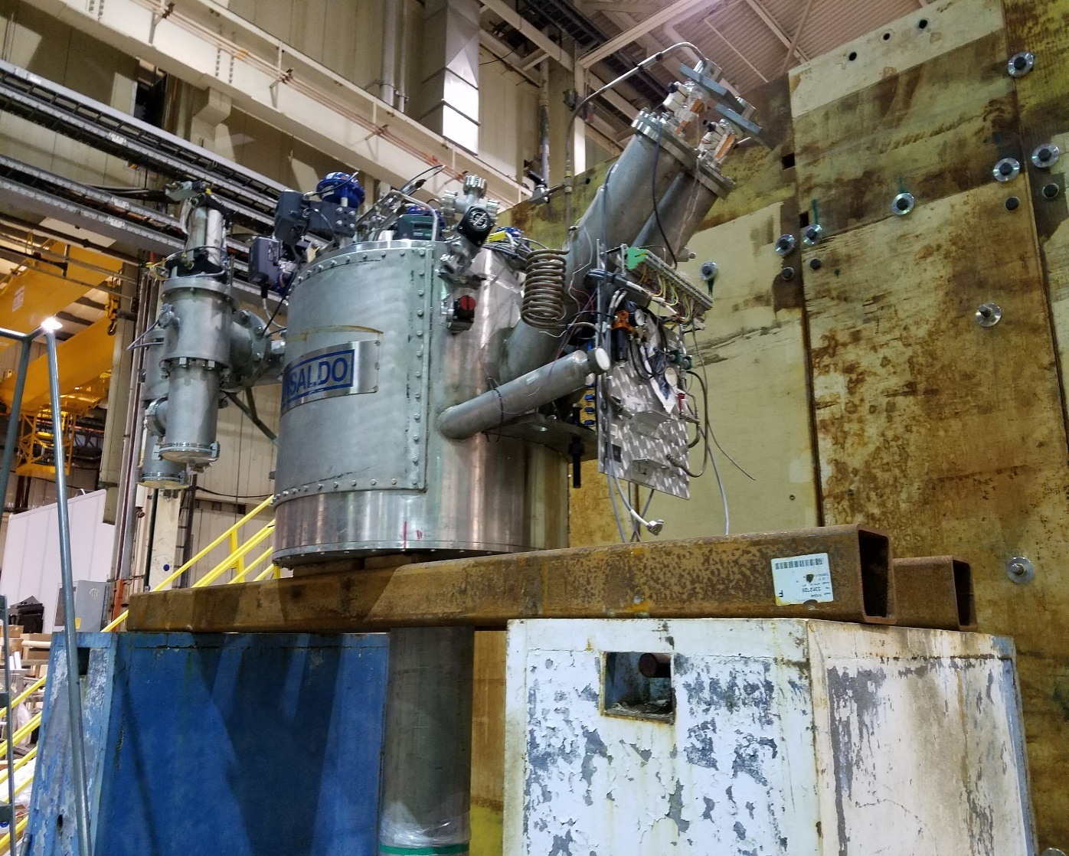

Meeting page: https://indico.bnl.gov/event/10194/
Agenda :
Cryo group’s plan to access the Valvebox to the internal piping to change the coax helium line into 2 separate lines for supply and return.
  Mike’s concern about making the vacuum leak worse etc.
  When will we need Ray Ceruti &“new crew” to come to help open up … and close afterwards ? How long each occasion will be ?
    T. Tallerico has agreed to
    help record the process with
    video/pictures. Thanks, Tom !
AOB

