Slide 1
Yellow Report Ch 8 Status
Brian Page
JHF Weekly Meeting
December 7th, 2020

Slide 2
Major edits to chapters 7 and 8 due by December 13th (PWG conveners edit to 22nd, then rounds of community / outside review)
Have received some comments on Ch 8 from PWG conveners – mostly plotsmanship issues and references
Will add some discussion on effects of new detector matrix parameters on Jet energy scale / resolution
Please let me know if anyone else has / is planning on doing further studies with the new parameters
After the 13th, major edits will become much harder to implement – please speak up now if you have comments on Ch 8!

Slide 3
Tracking Parameters: 3T vs 1.5T
Eta Range | 3T Mom Res | 1.5T Mom Res | 3T Min pT | 1.5T Min pT
-3.5 to -3.0 | 0.1%*P + 2% | 0.2%*P + 5% | 150 MeV | 100 MeV
-3.0 to -2.5 | “ | “ | 150 MeV | 100 MeV
-2.5 to -2.0 | 0.02%*P + 1% | 0.04%*P + 2% | 220 MeV | 130 MeV
-2.0 to -1.5 | “ | “ | 160 MeV | 70 MeV
-1.5 to -1.0 | “ | “ | 300 MeV | 150 MeV
-1.0 to -0.5 | 0.02%*P + 0.5% | 0.04%*P + 1% | 400 MeV | 200 MeV
-0.5 to 0.0 | “ | “ | 400 MeV | 200 MeV

Slide 4
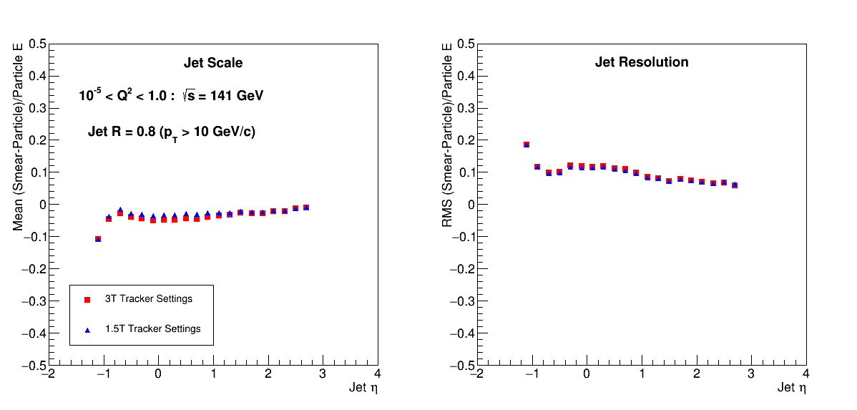
Jet Response: 3T vs 1.5T

Slide 5
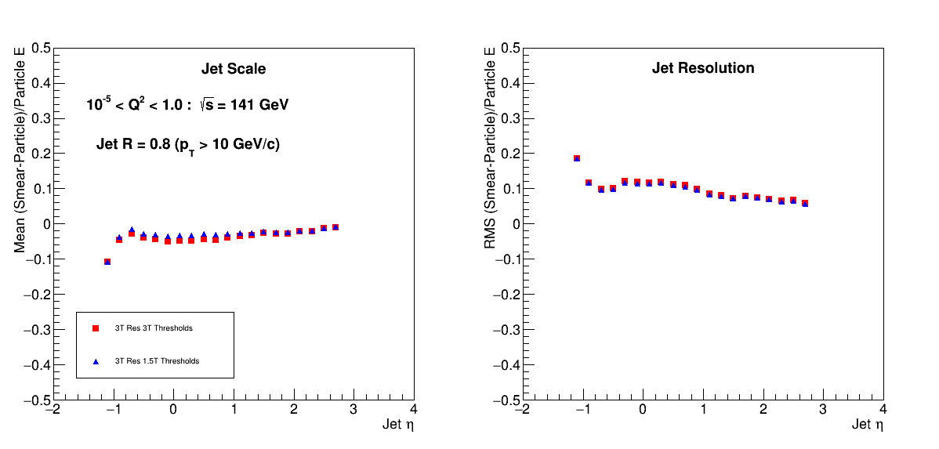
Jet Response: 3T vs 1.5T Thresholds

Slide 6
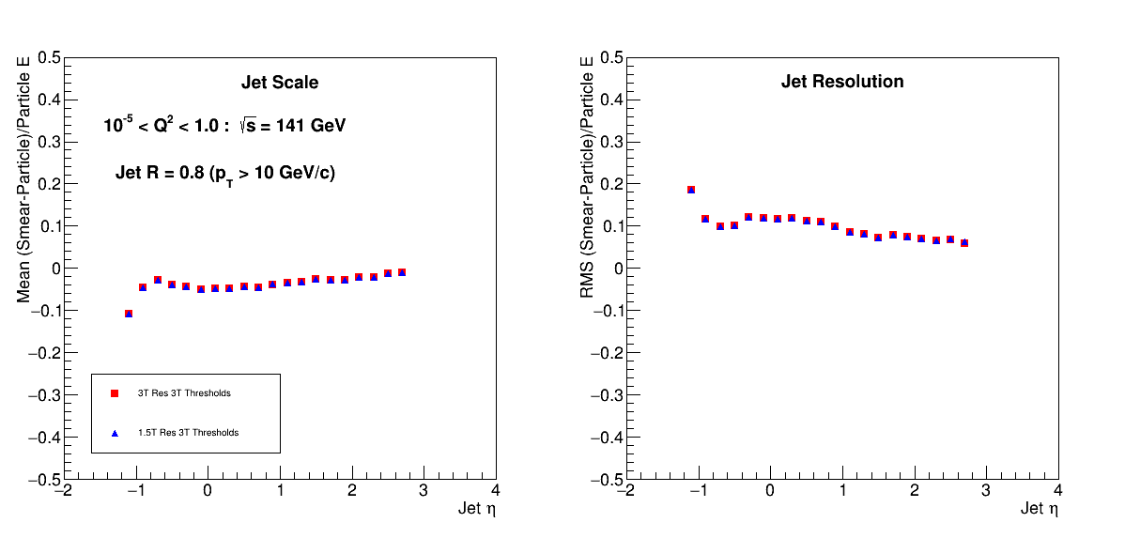
Jet Response: 3T vs 1.5T Fields

Slide 7
