Slide 1
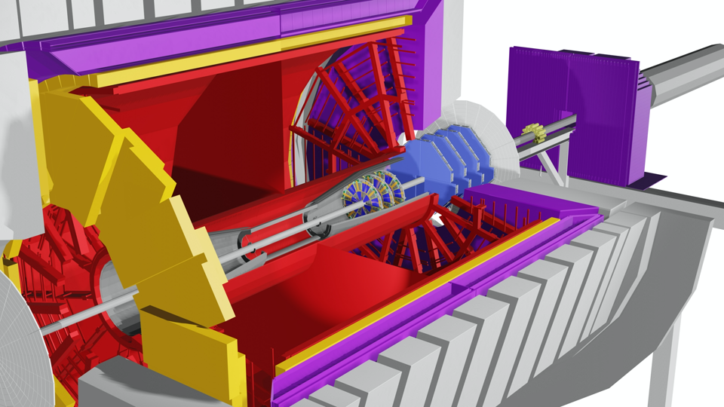


STAR Forward sTGC Tracker
Integration
Rahul Sharma
August 27, 2020

Slide 2
Outline
Integration Scope
Integration Interfaces
Design
  Single Pentagon
  Single Plane
  Multiplane Assembly
  Cooling Manifold Design
  Cart Design for Transportation
  Final Installation
Schedule and Milestones
Safety
Conclusion

Slide 3
Integration Scope
Integration group is responsible for designing, analyzing, testing and building:
The support structure of individual detector modules (Also referred as Pentagons) into a plane
Assembly 4 detector plane assemblies to form complete detector assembly
Cooling Manifolds and ducting for FEB boards
Cable paths and cable supports (cable trays, clips etc.) to route the cables to the desired locations. Also, identifying right cable lengths for the detectors.

Slide 4
Workforce
STSG Group:
Rahul Sharma – Chief Mechanical Engineer
Mechanical Designers – Felix Archampong
Mechanical Technicians – Robert Soja, William Struble
Other Resources:
CAD Technicians (Will be used for help during installation activities)
CAD ESRC : For reviewing and approvals related to Engineered Lift

Slide 5
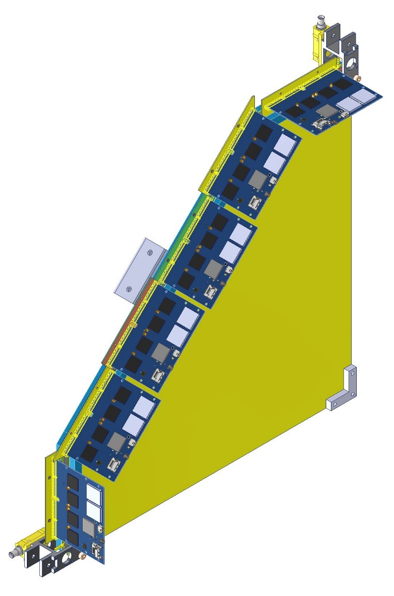
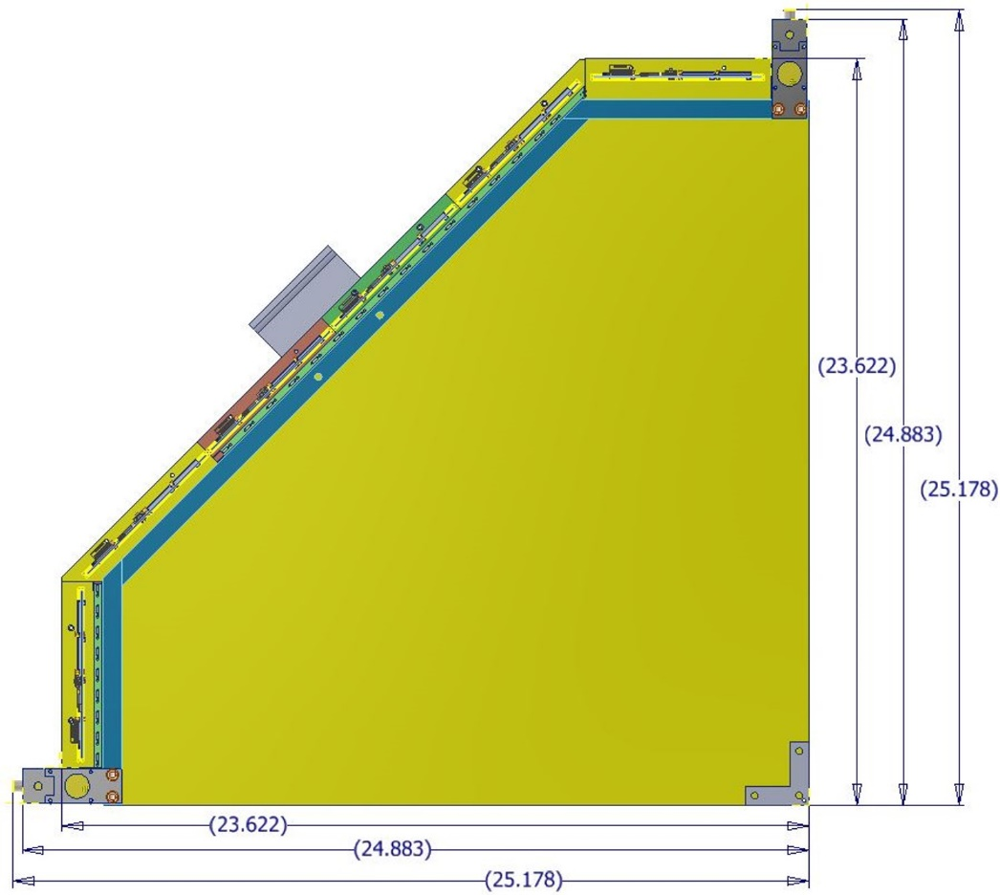
Design (Single Pentagon)
sTGC detector modules (that are shaped like irregular pentagons) also referred to as Pentagons will be delivered to BNL from SDU, China

Slide 6
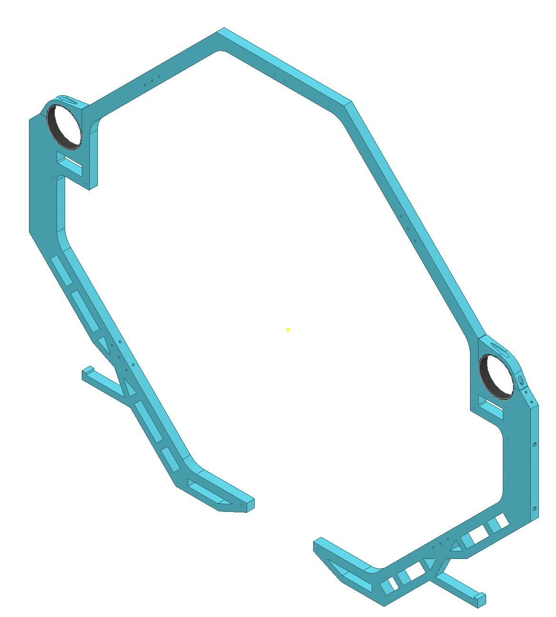
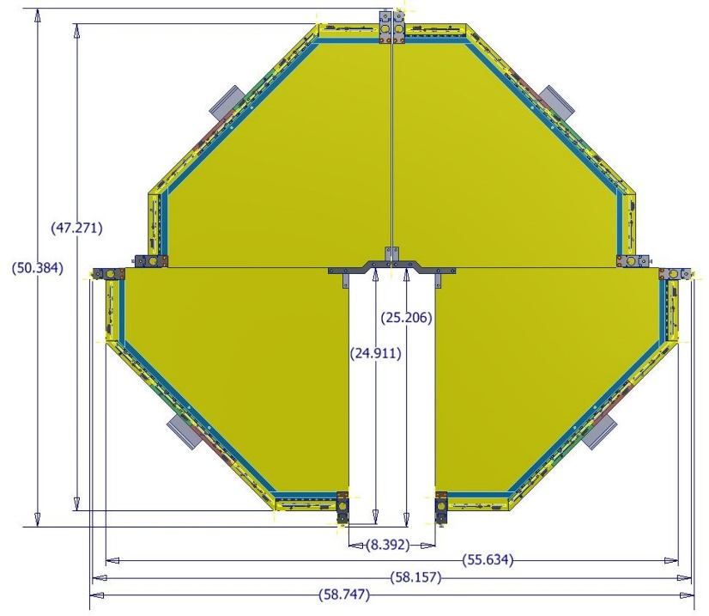
Plane Frame and Single Plane Assembly

Slide 7
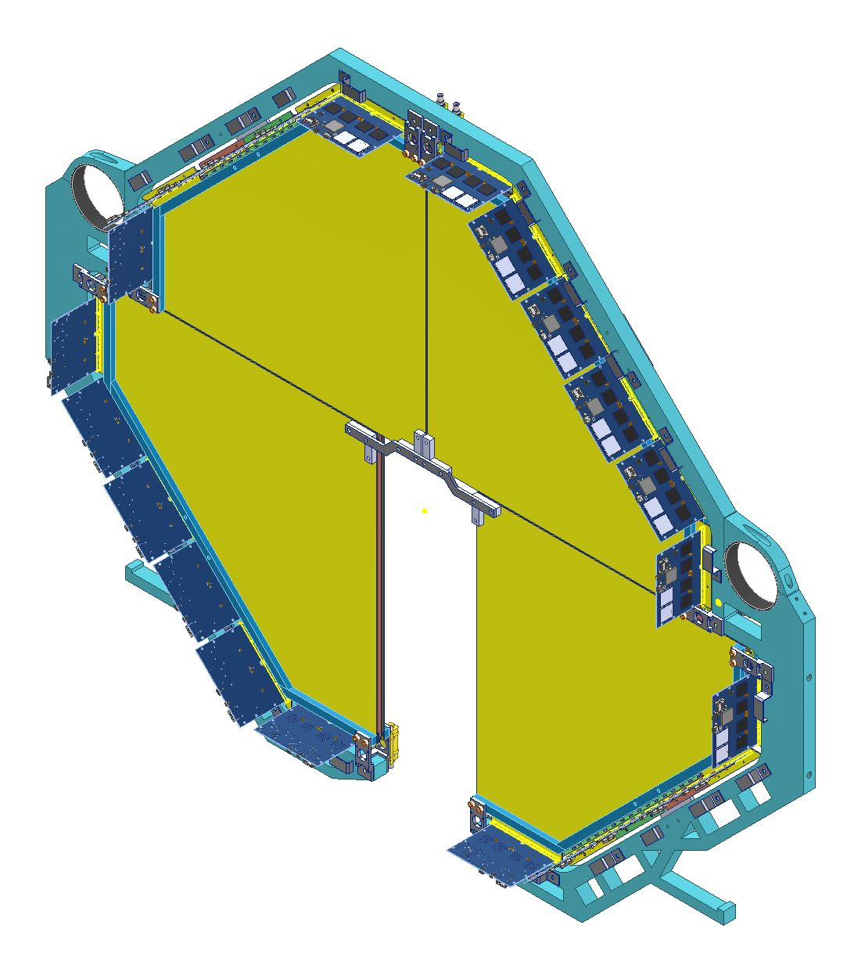
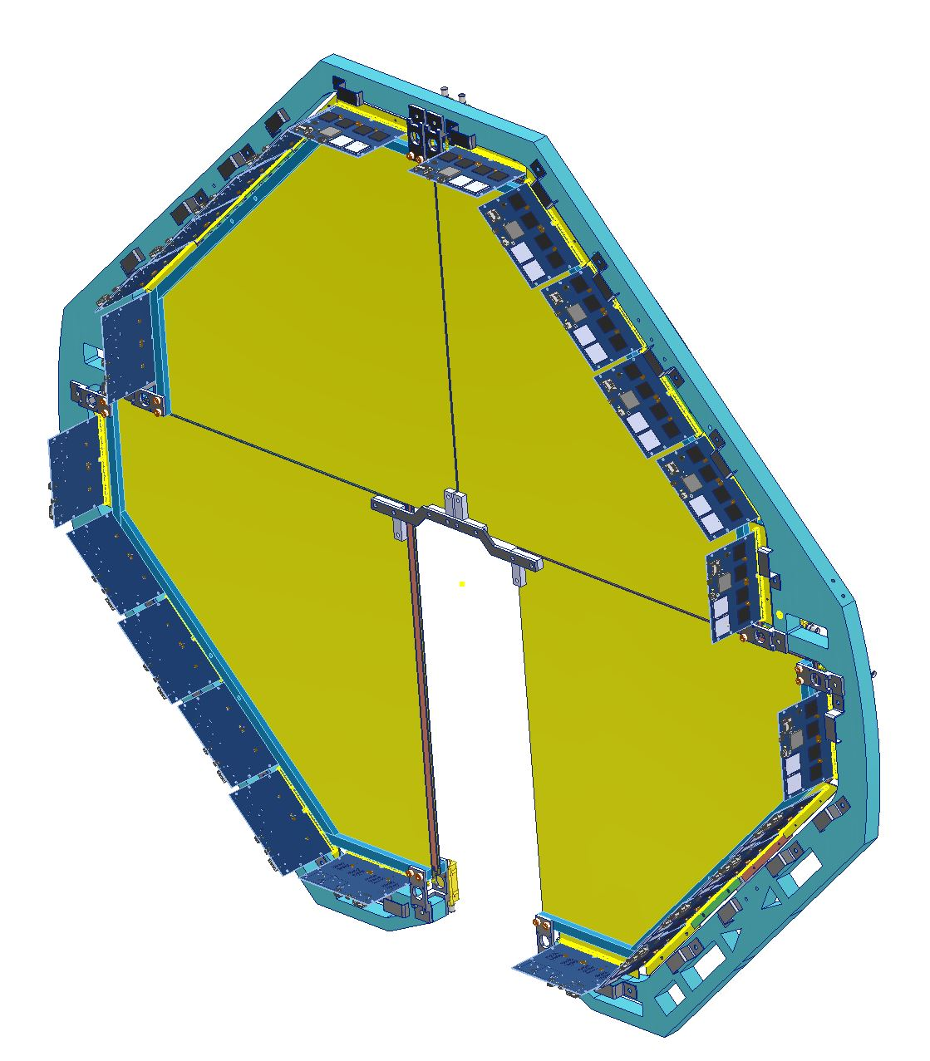
Plane Frame and Single Plane Assembly

Slide 8
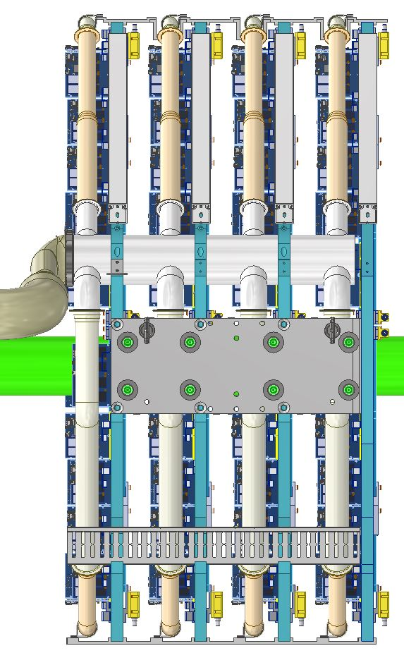
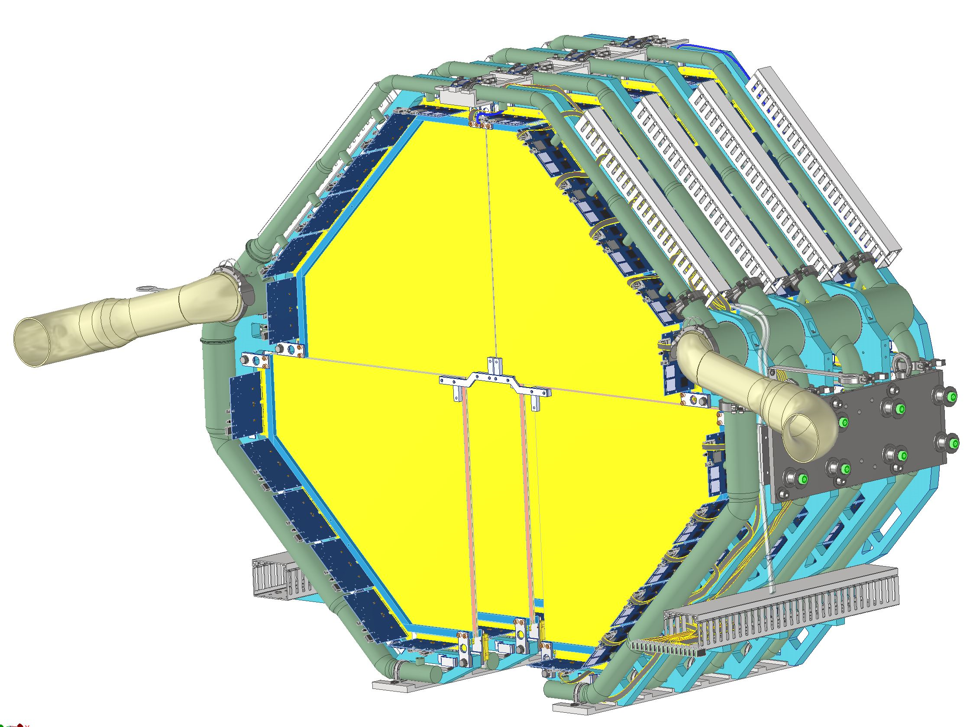
Multiplane Assembly (Cooling Manifolds, Ducting and Cable Trays)

Slide 9
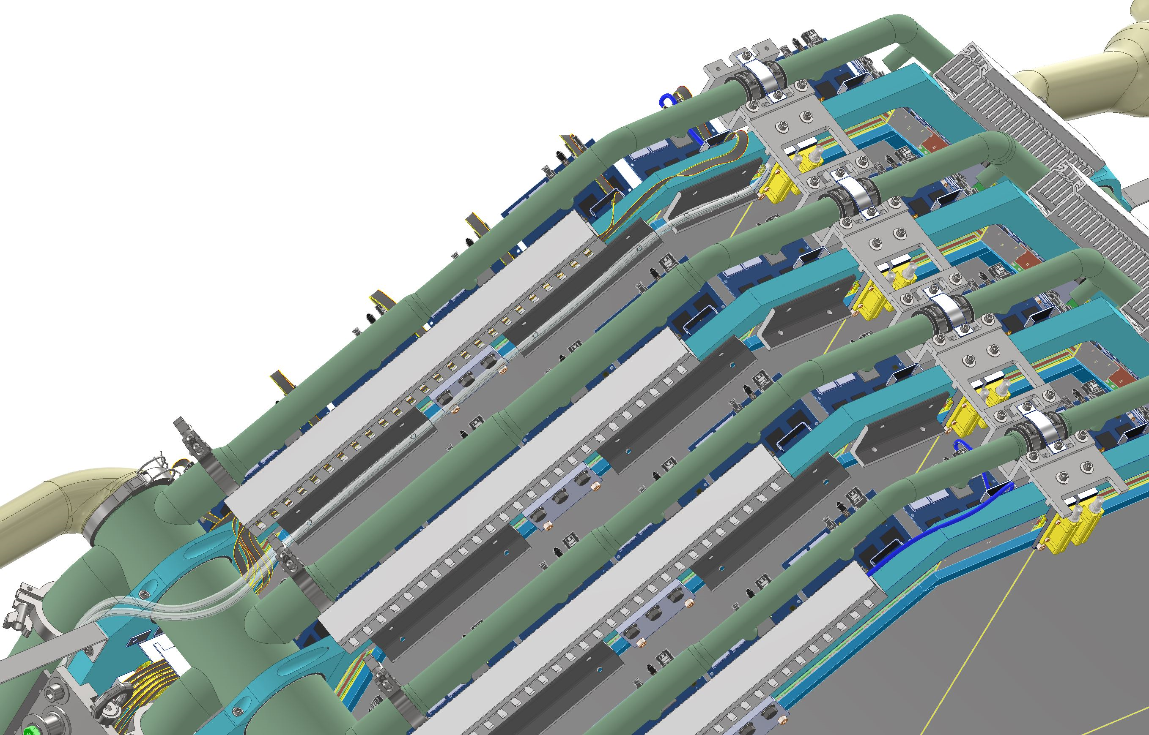
Multiplane Assembly (With Cooling Manifolds and Ducting)

Slide 10
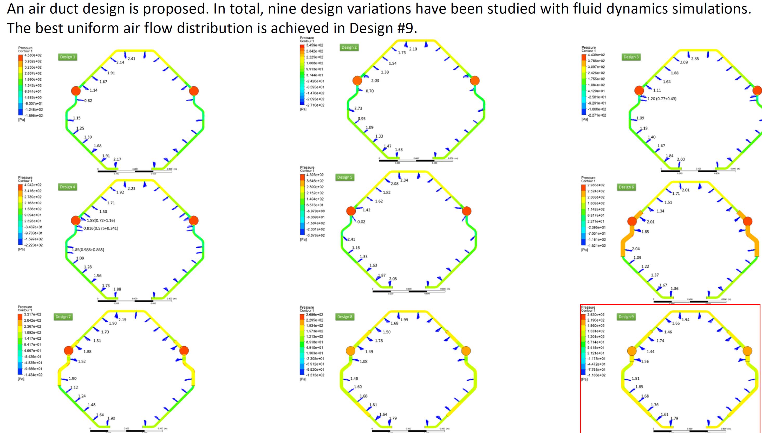
Cooling Manifold and Ducting Design
Objective: Design and optimize air ducts to deliver air flow to all PCBs in STAR-sTGC individually and as evenly as possible.
Existing moving cool unit will be used to cool the detector electronics (FEB Boards). The flow rate delivered to the detector will be 300CFM.

Slide 11
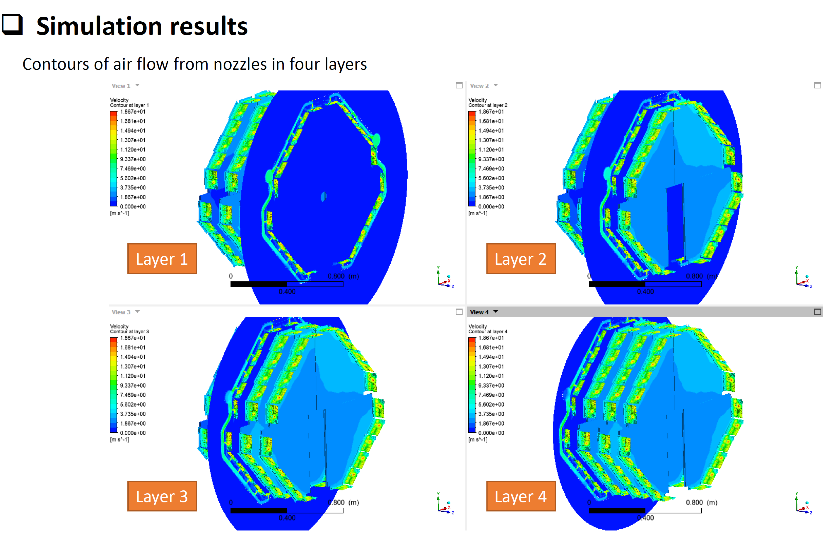
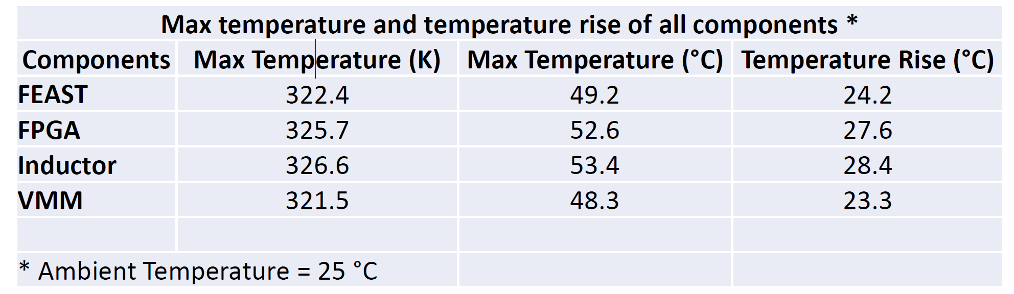
Cooling Manifold and Ducting Design

Slide 12
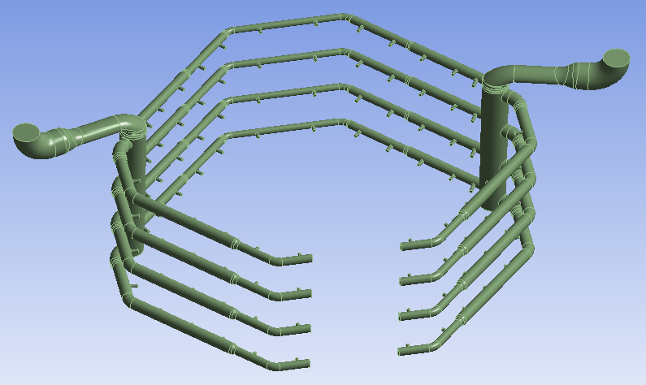
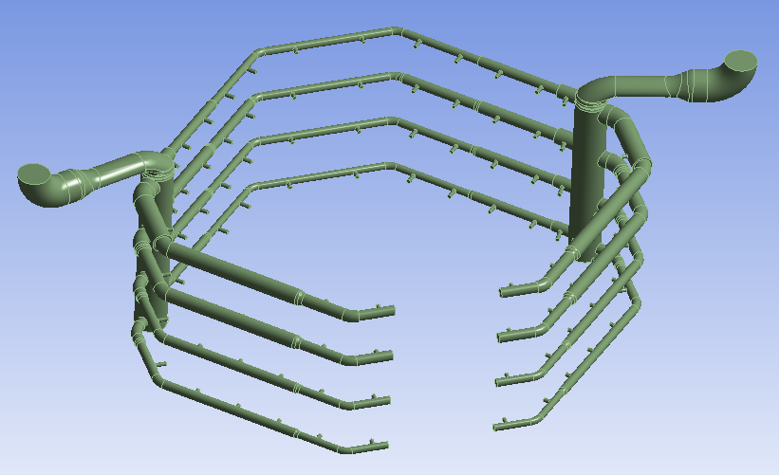
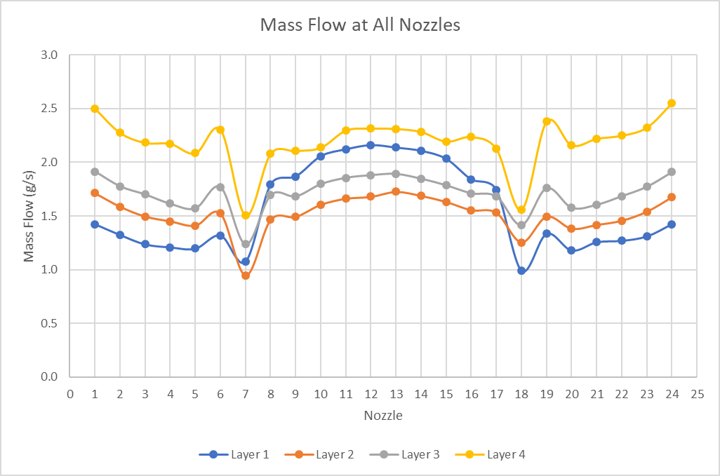
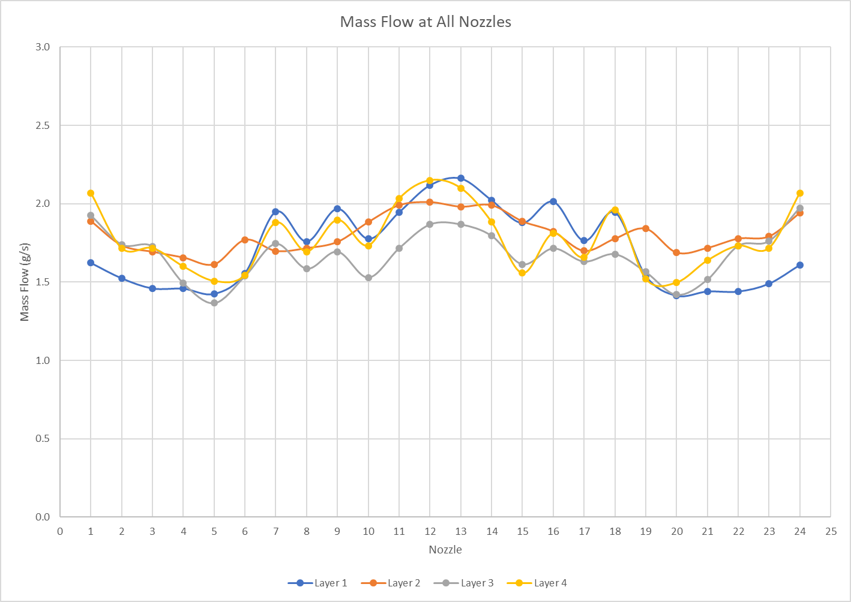
Original 4in air duct
Optimized 4in air duct

Slide 13
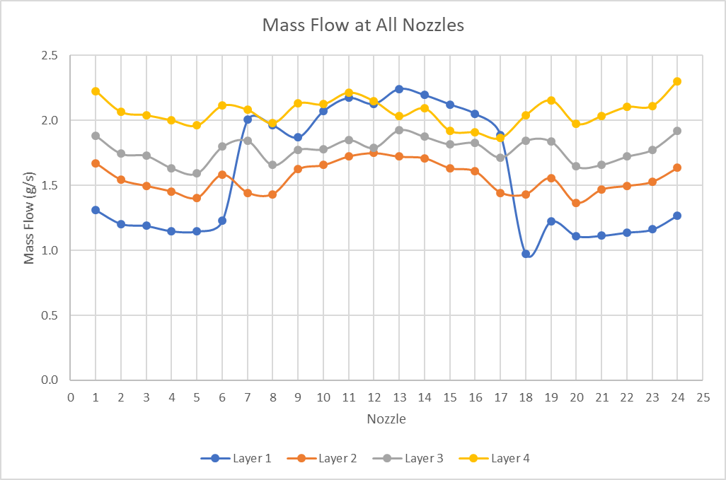
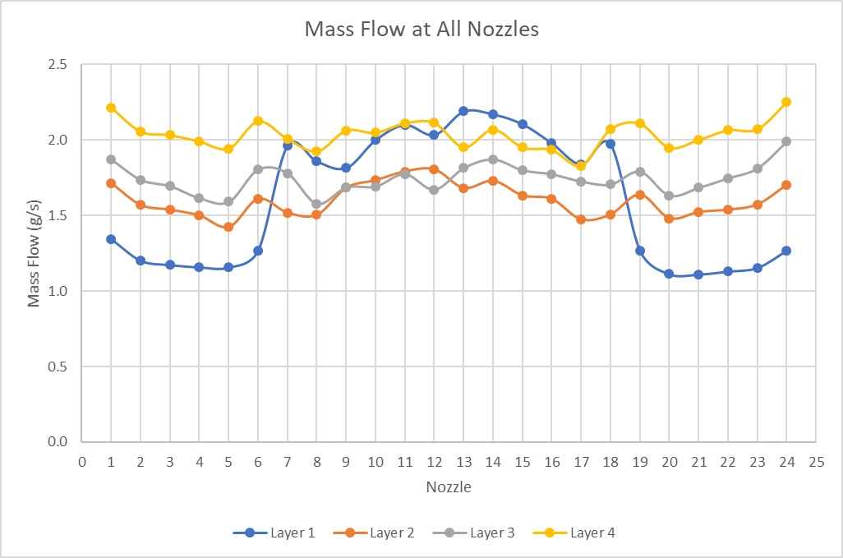
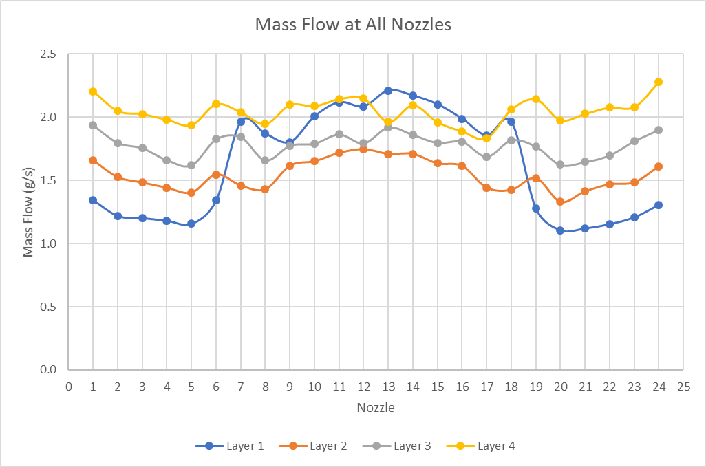
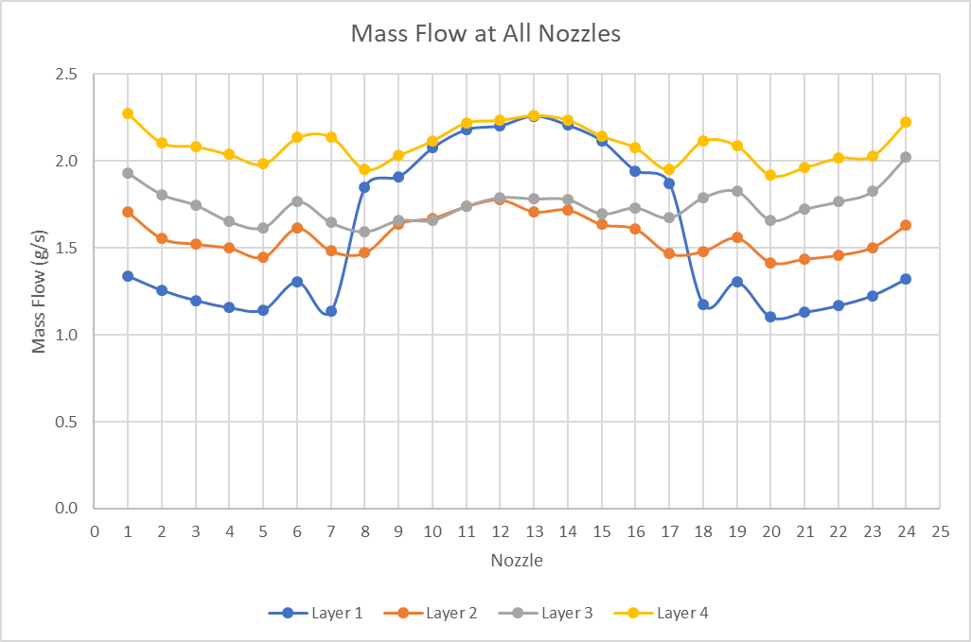
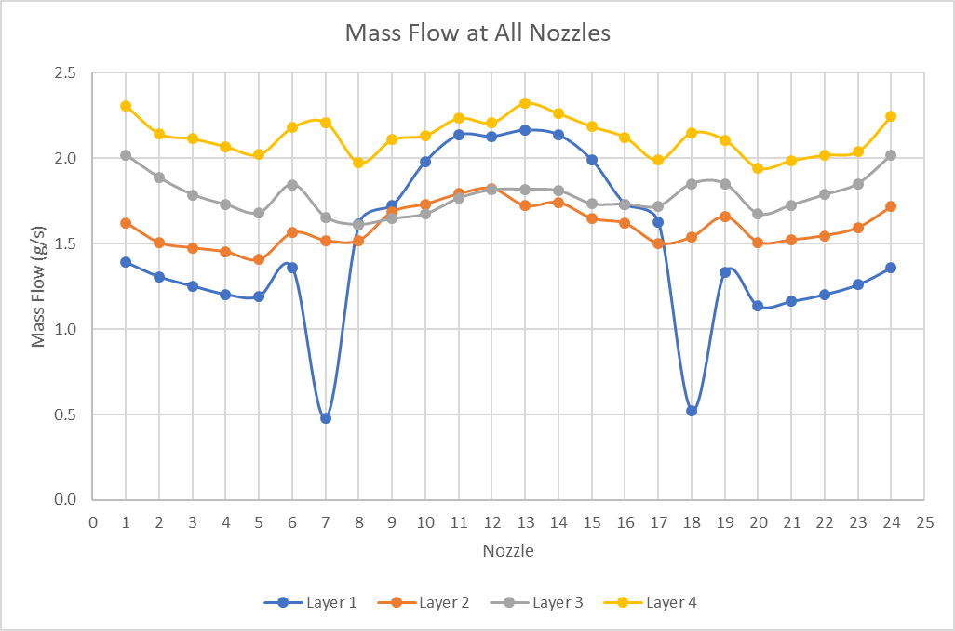
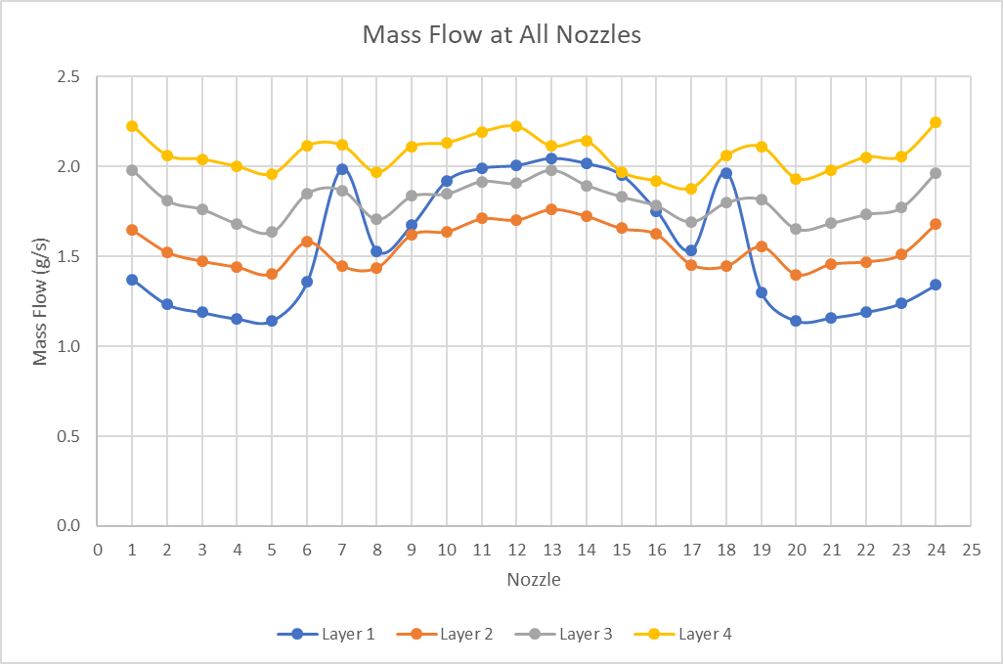
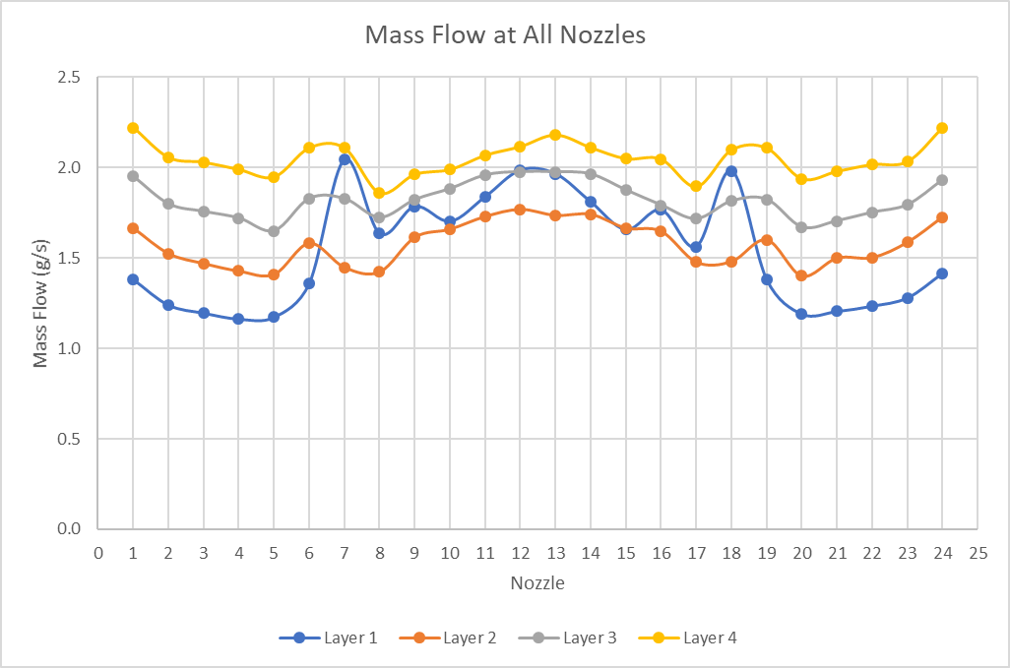
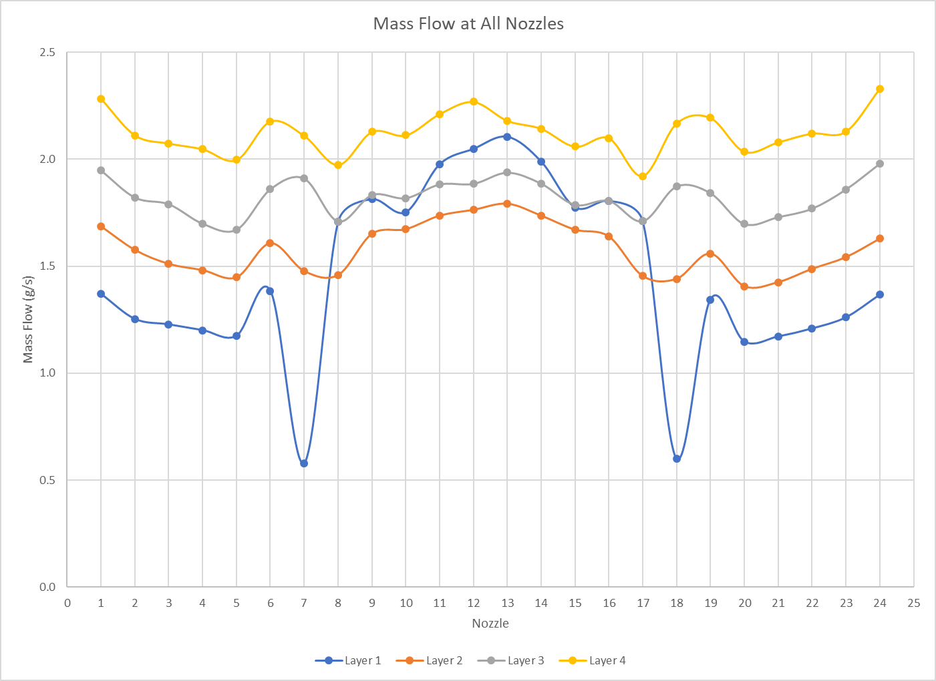
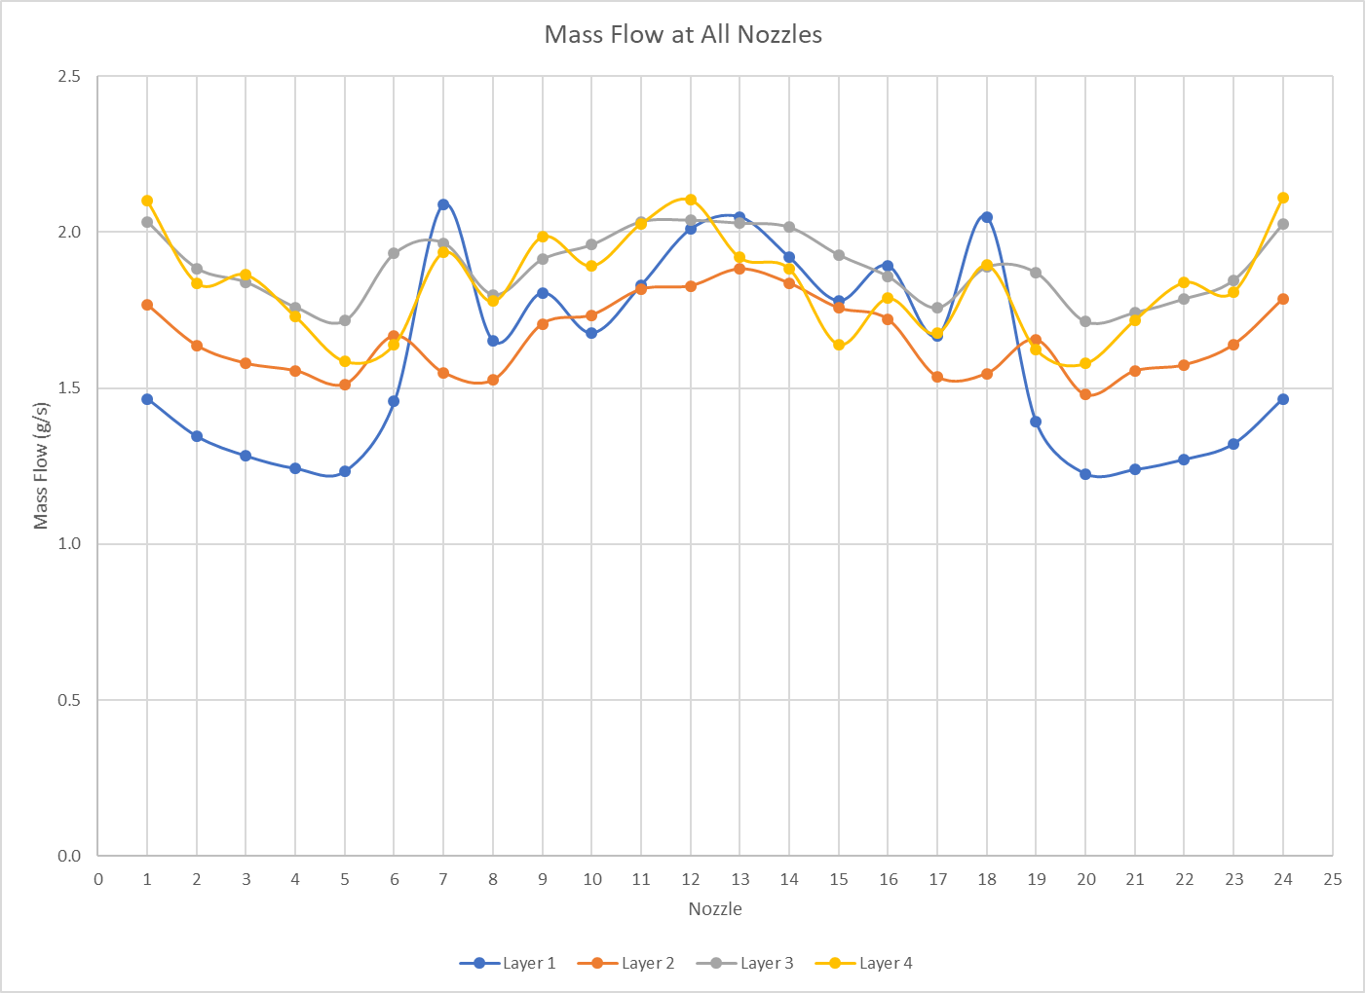
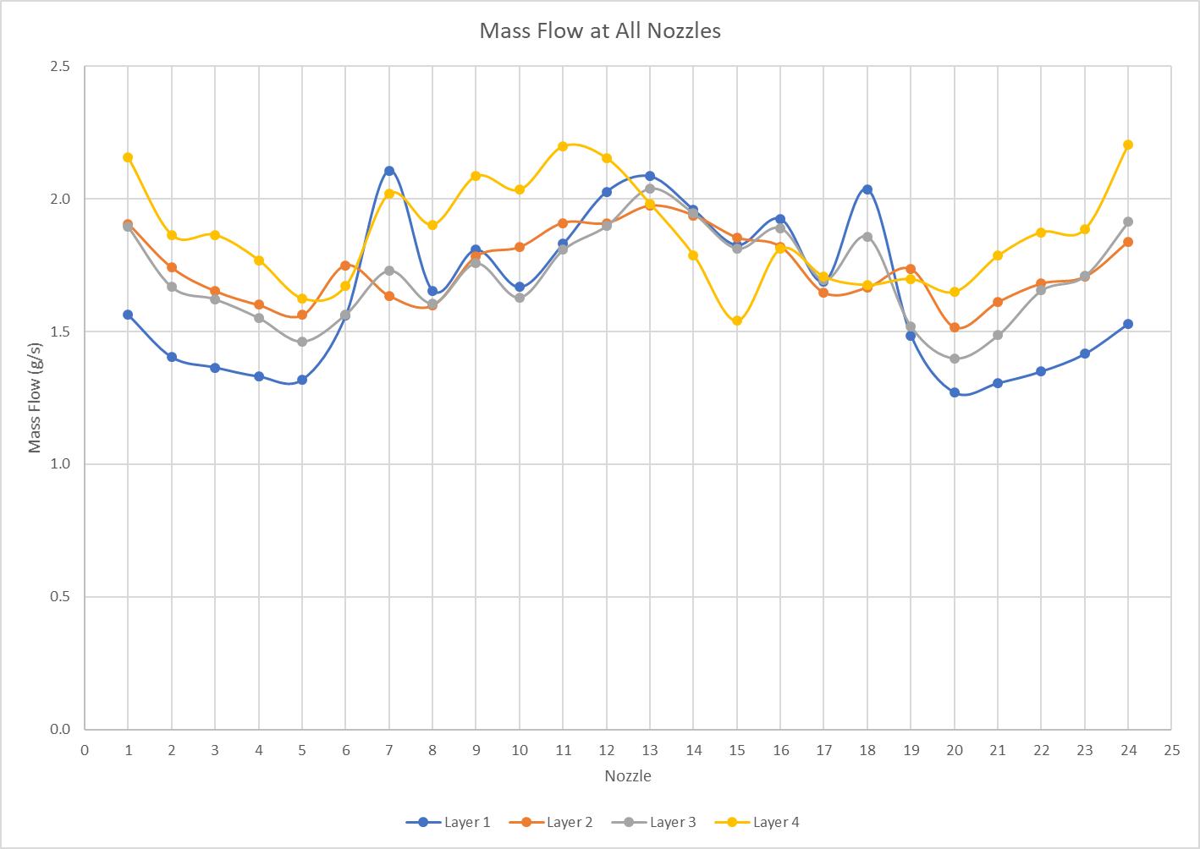
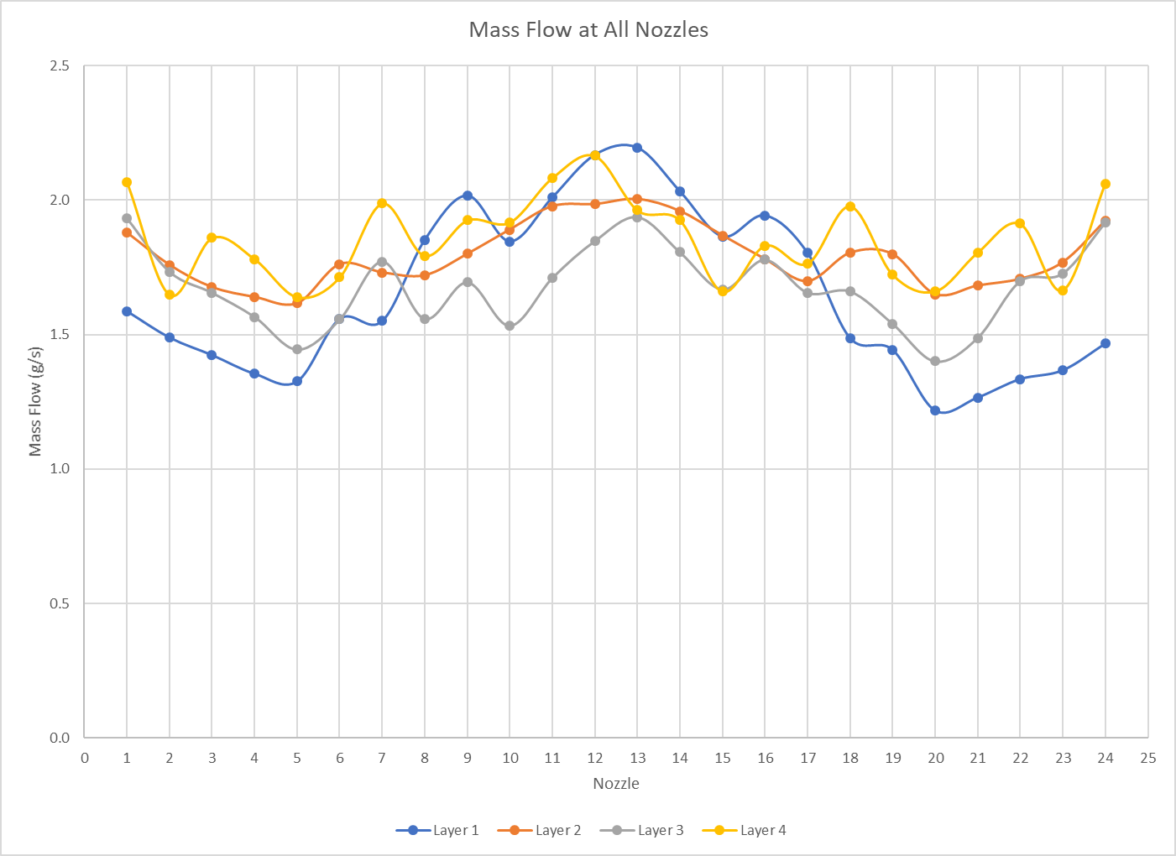
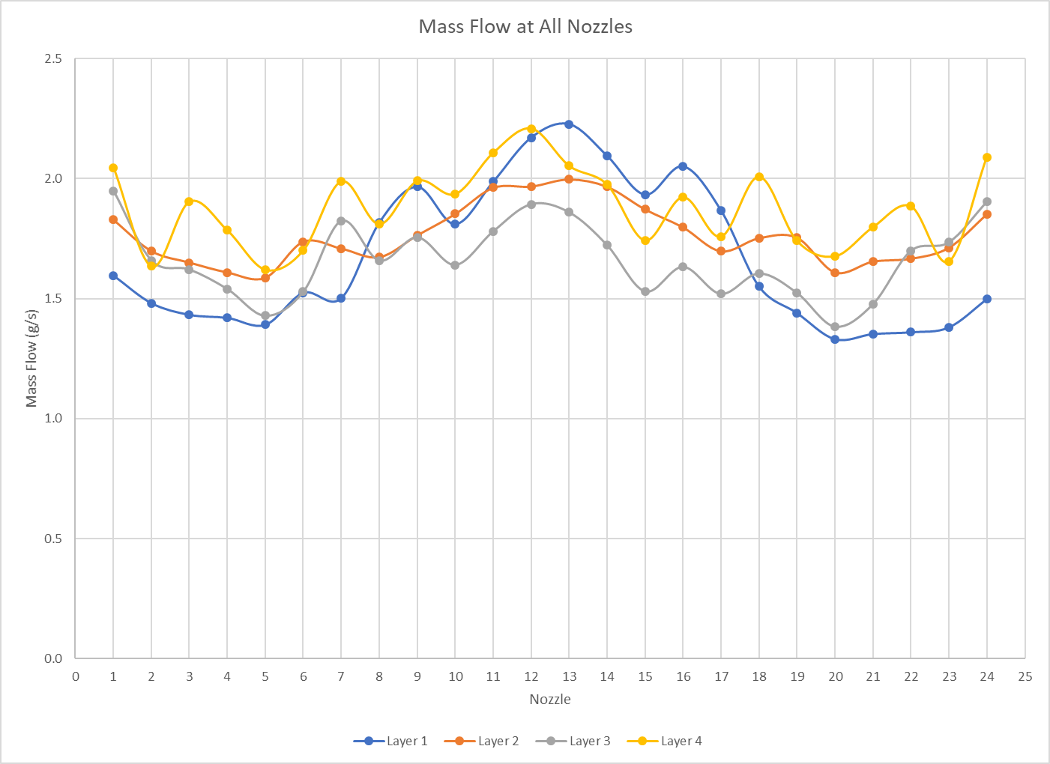
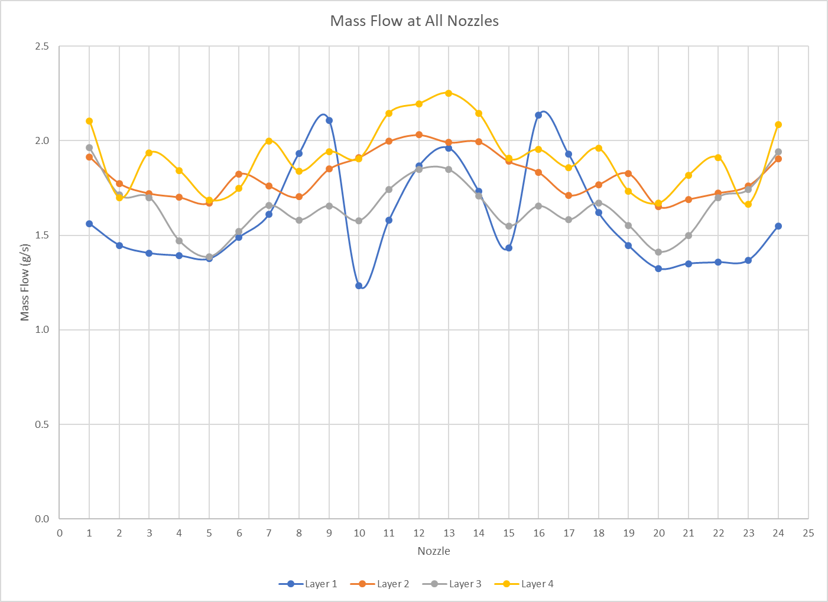
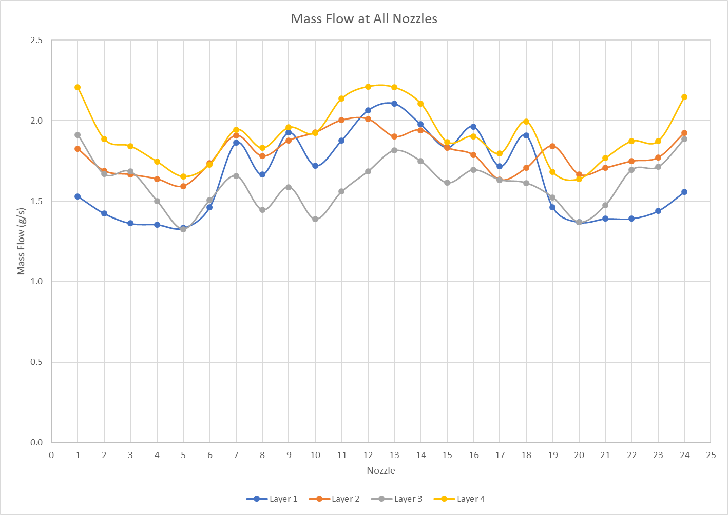
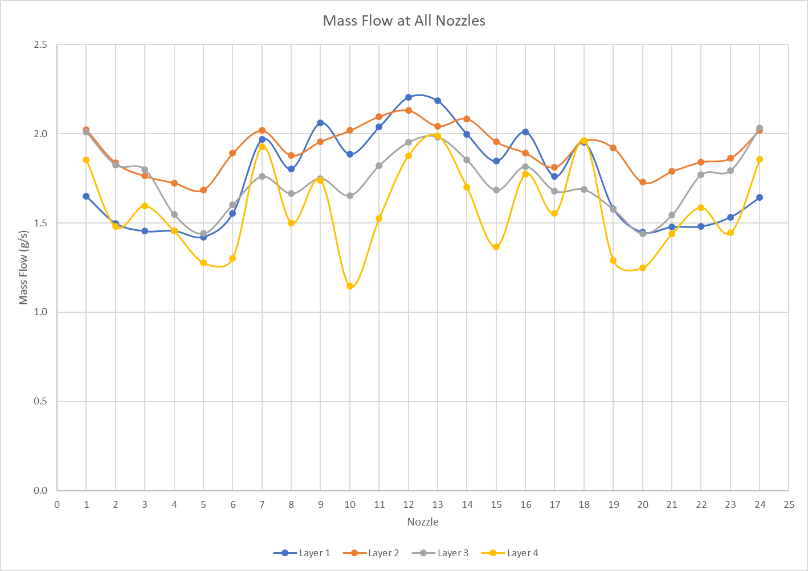
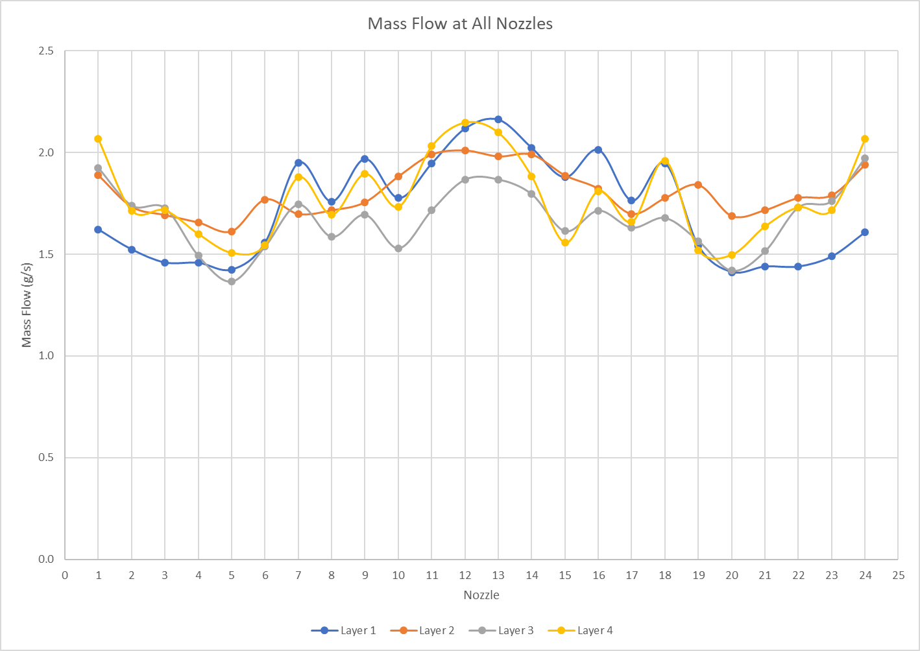
More than 25 modified designs are simulated for optimization.

Slide 14
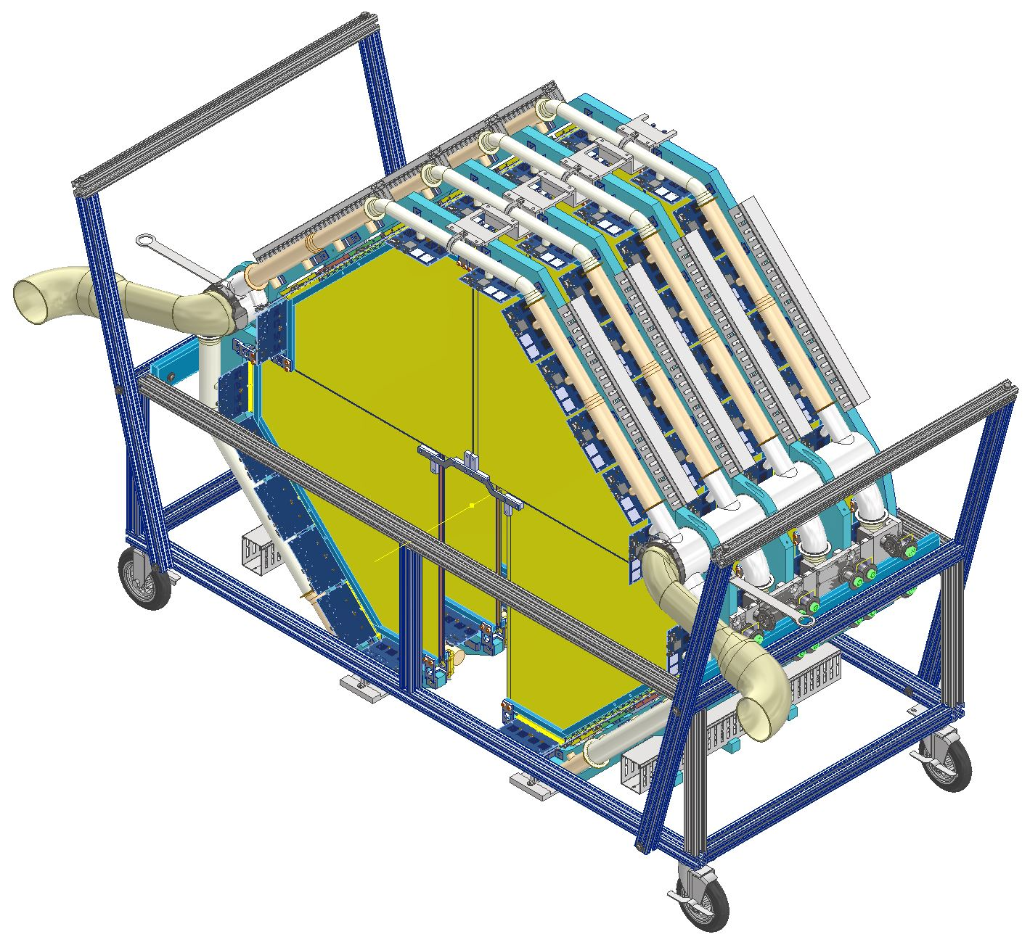
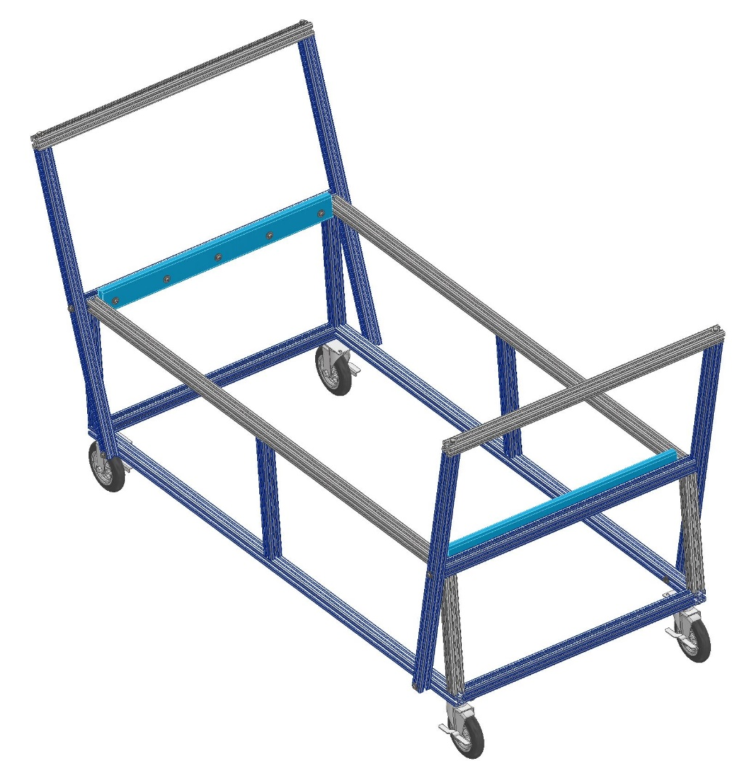
Transportation Cart

Slide 15
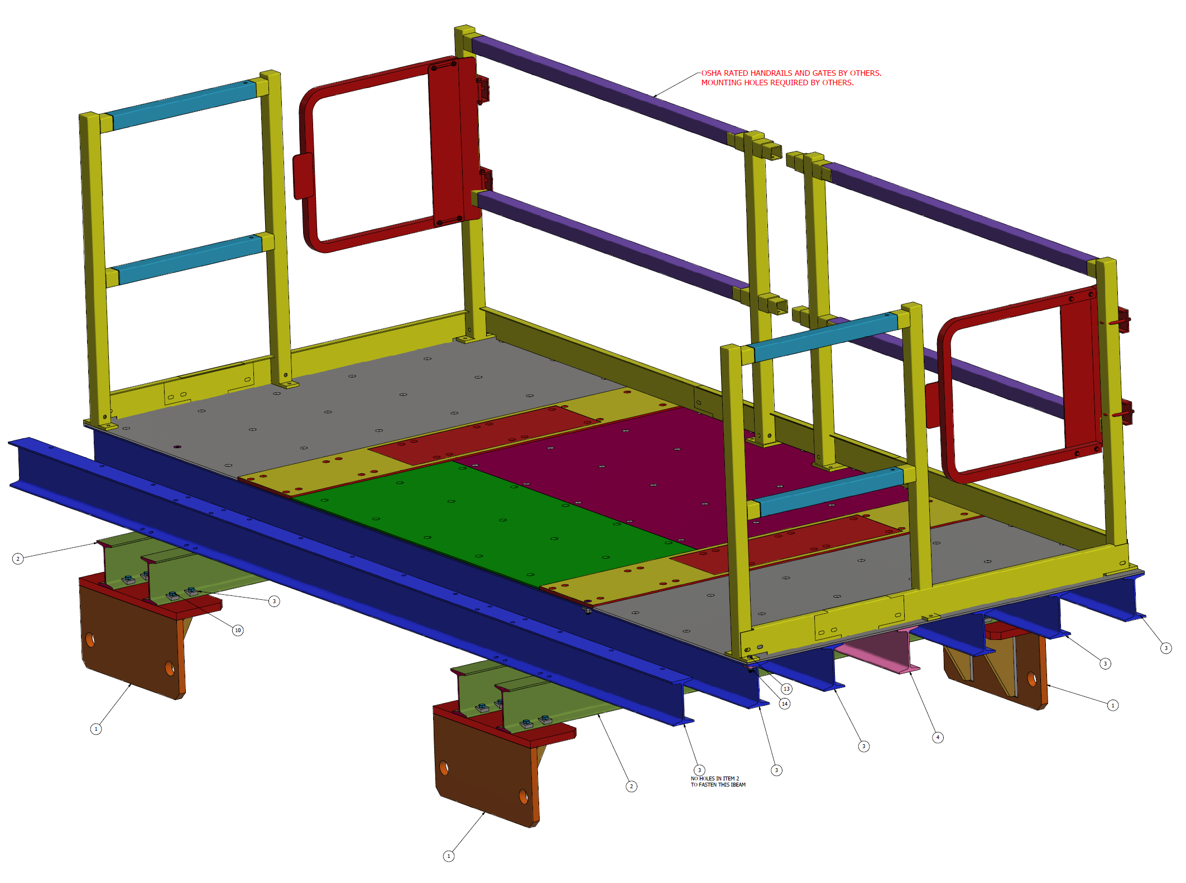
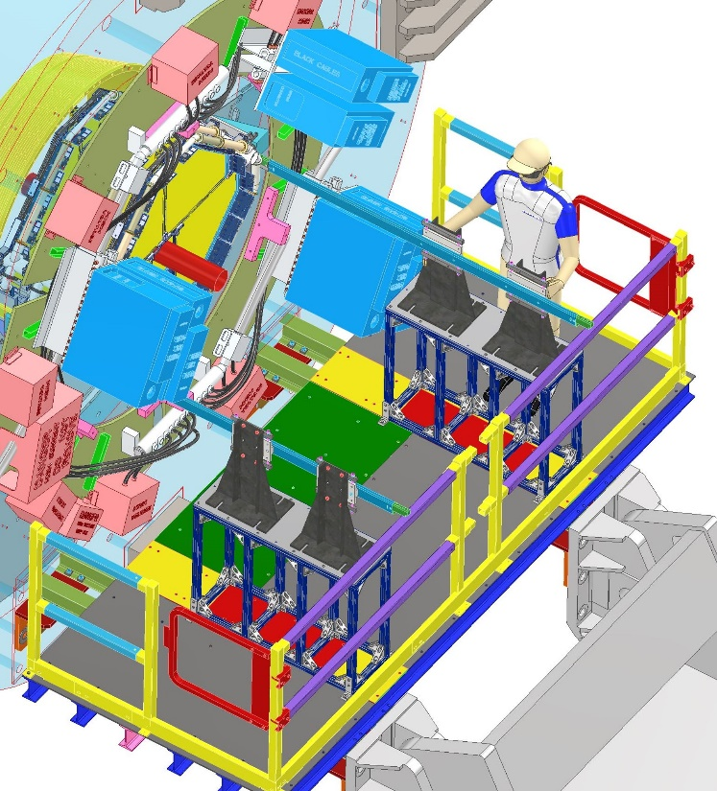
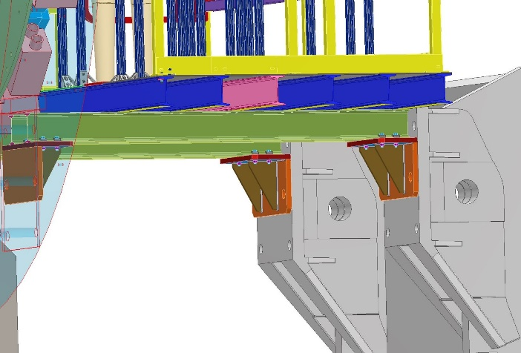
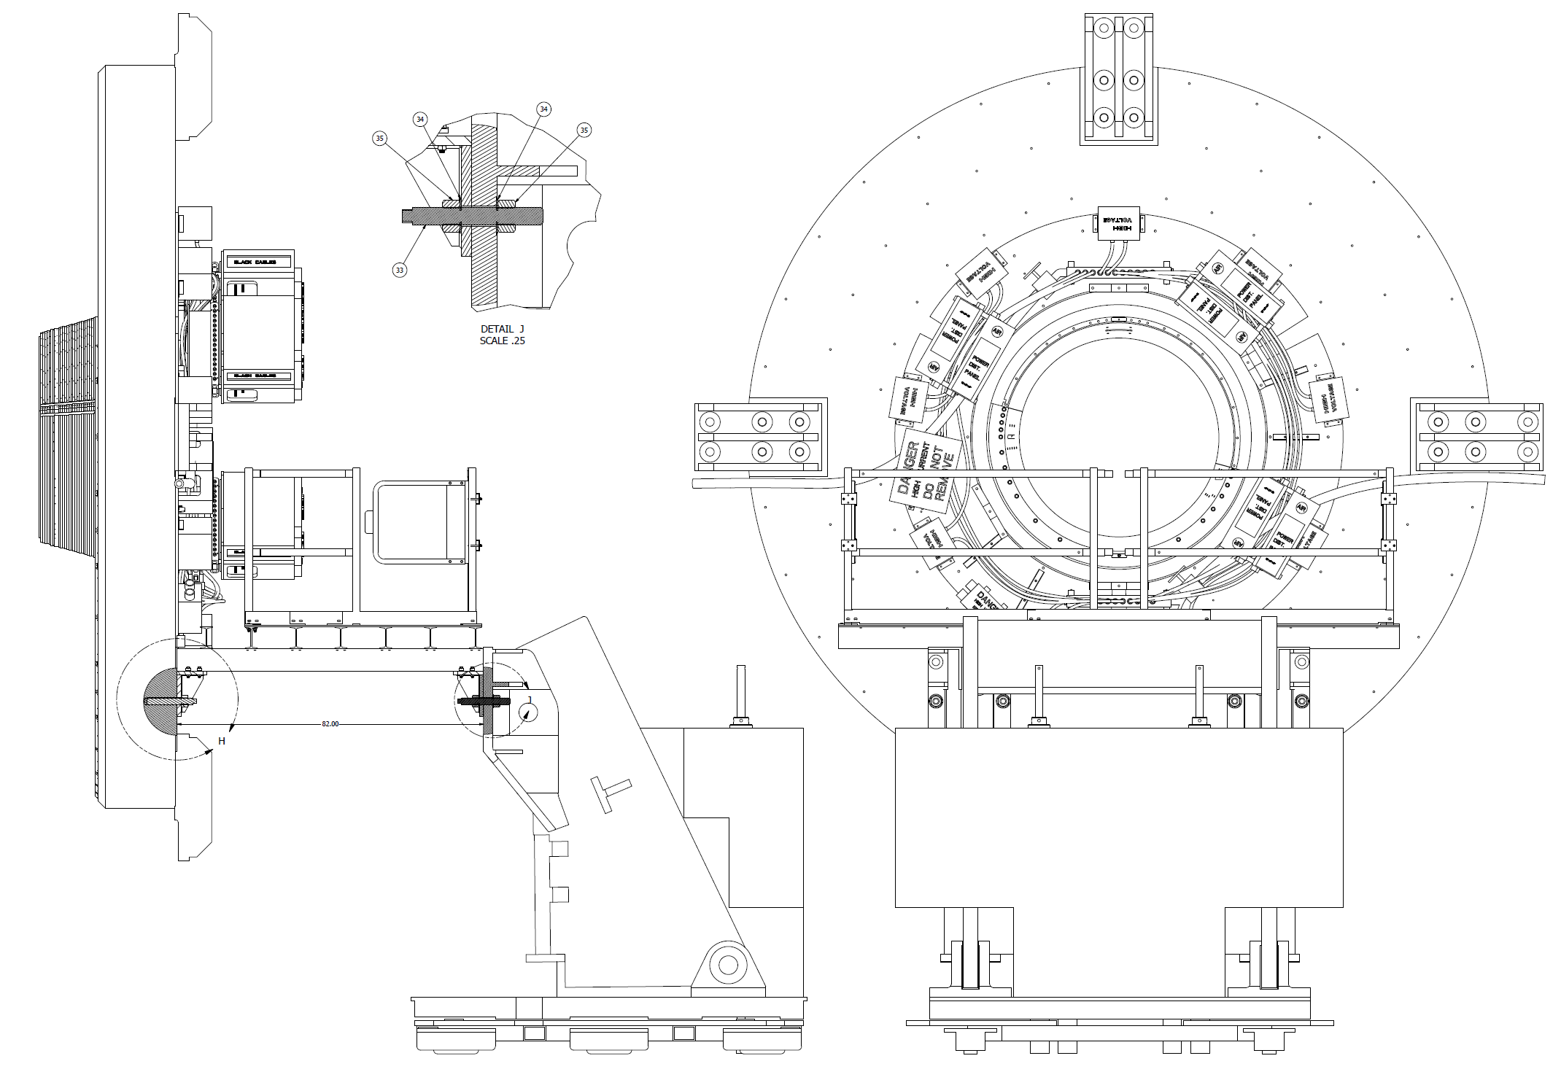
Platform Design

Slide 16
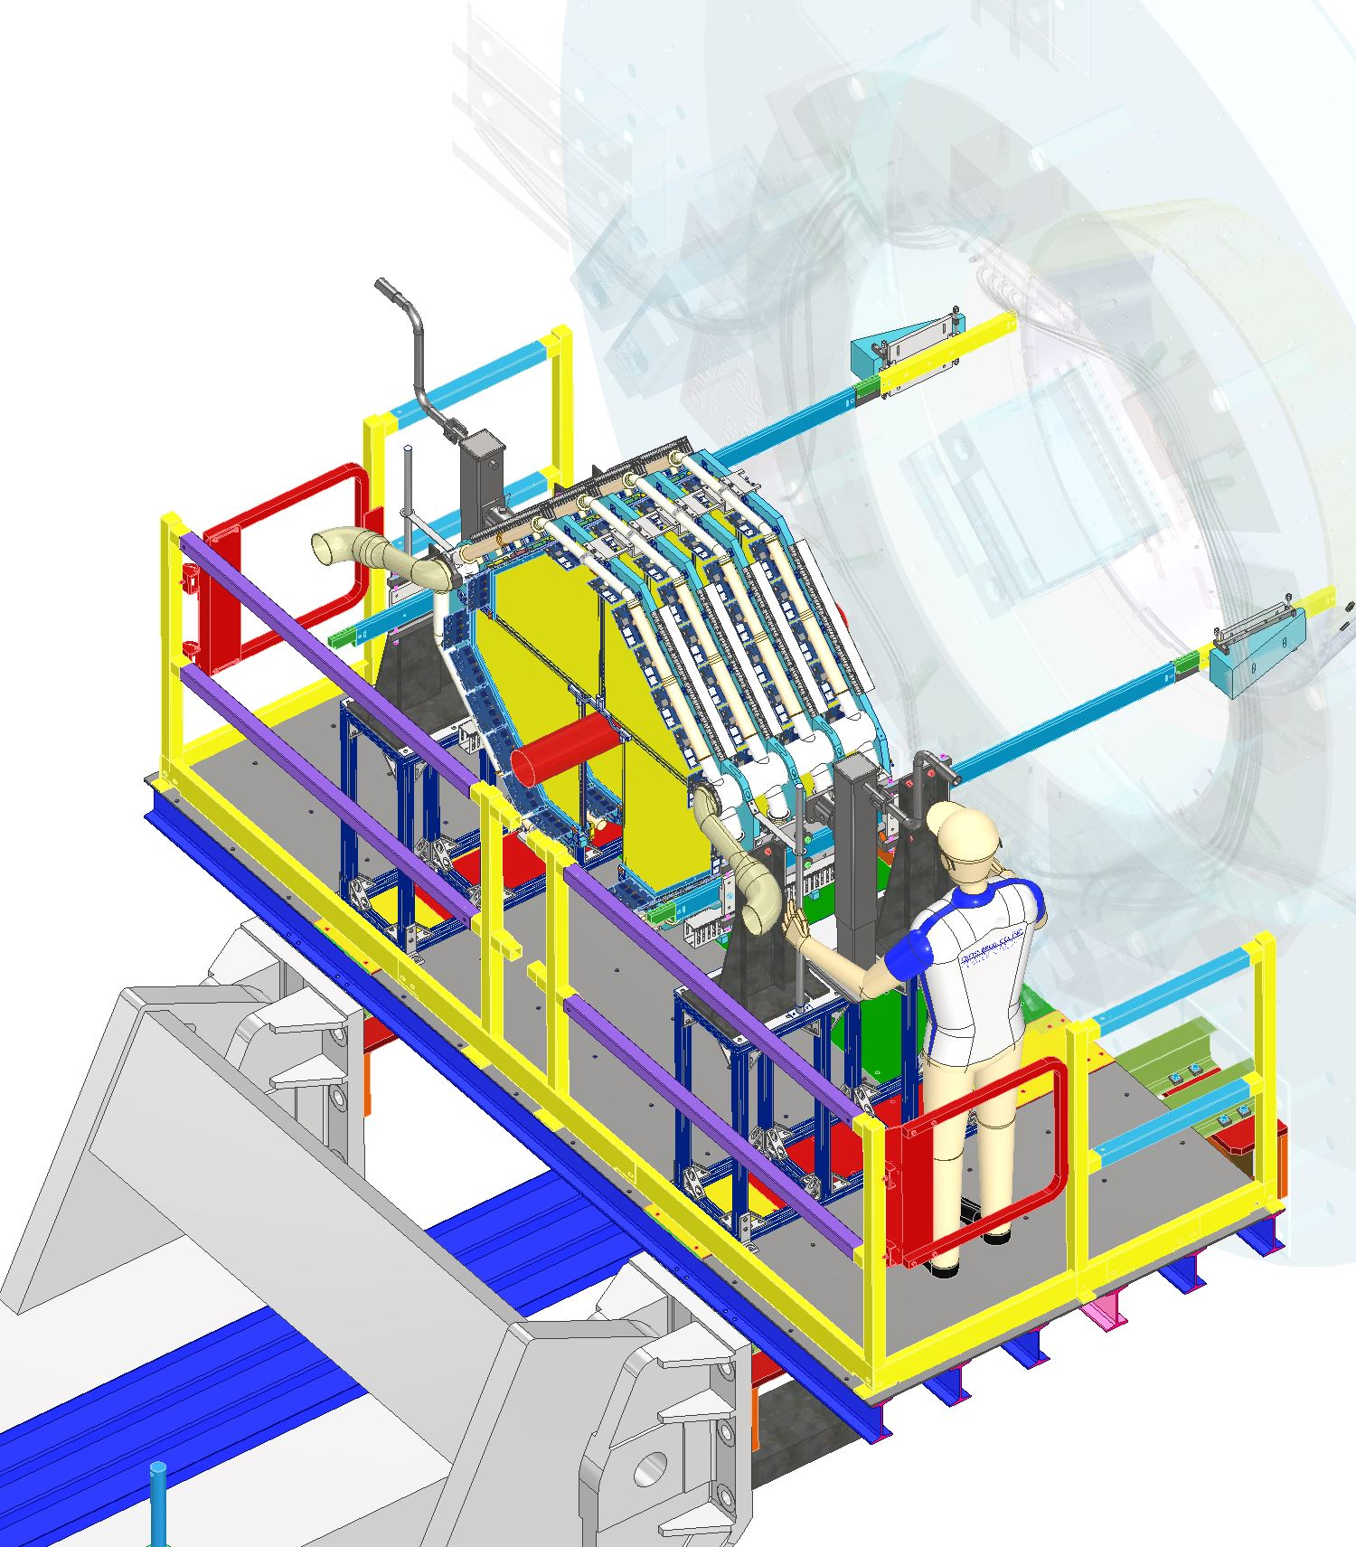
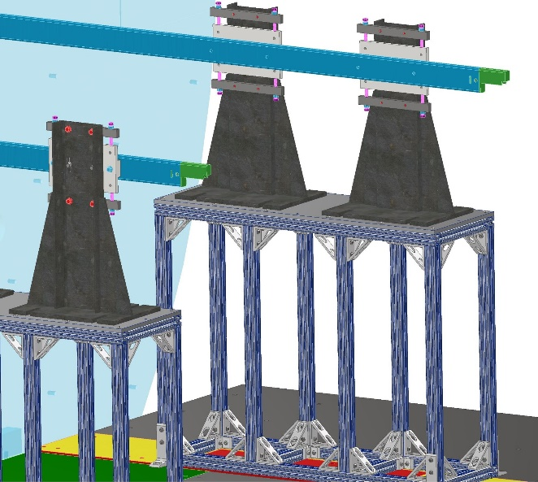
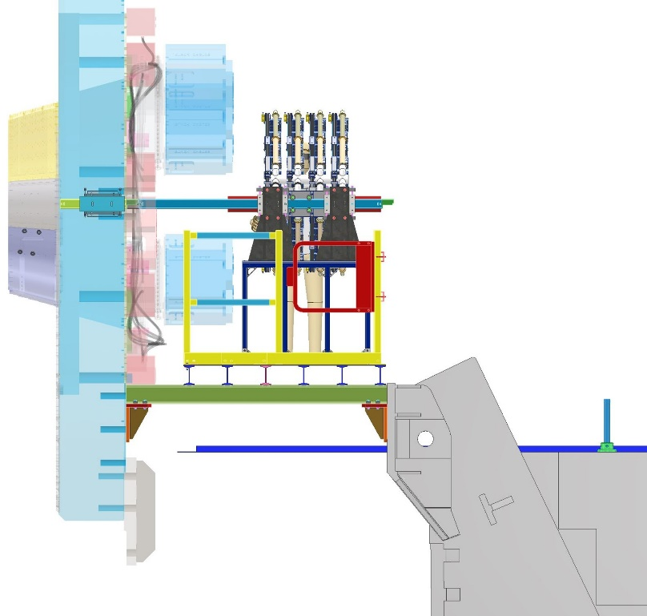
Installation of STGC in STAR
Stanchions, Stands and Rails

Slide 17
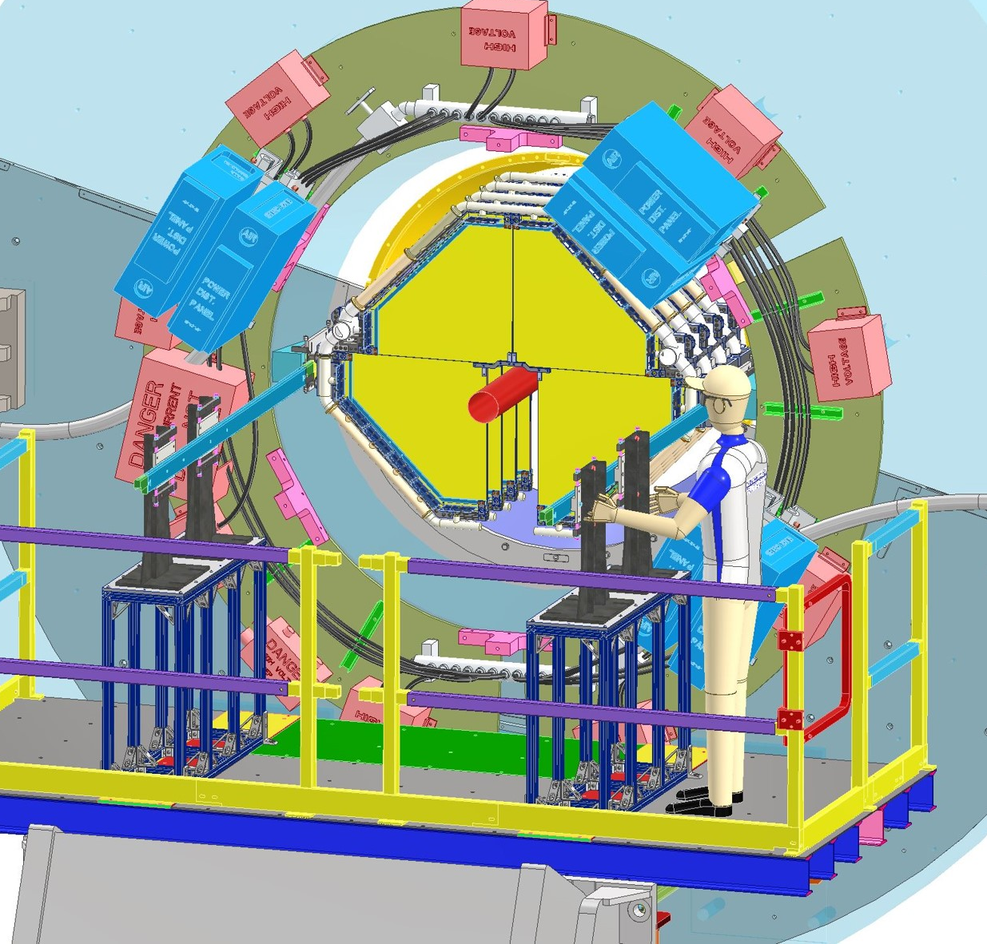
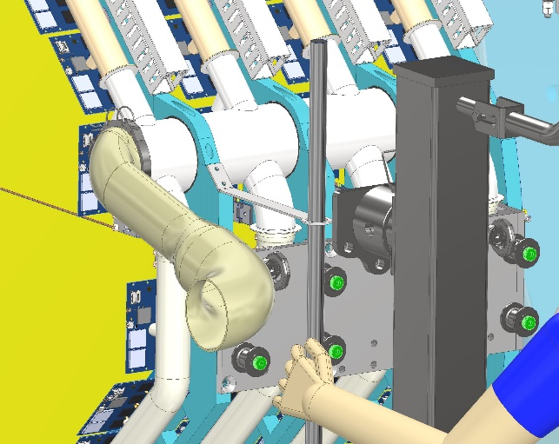
Installation of STGC in STAR

Slide 18
sTGC Schedule
sTGC Support Structure and Installation Design Status:
CFD Simulations - Done
3D Design – Done
Initial Meeting with Mike Gaffney for ESRC approvals was conducted in December.
Detail Drawings to be finished by end of Feb 2021
Parts Sent out for Manufacturing by March 15th 2021
Remaining Tasks:
Structural Analysis – First phase to be completed by Feb 2021, With Second phase to be completed by End of March 2021.
Engineered Lift Documentation and Procedures – Submitted for approval by ESRC- End of March 2021
Engineered Lift Approval- May 2021
Schedule:
4 plane Assembly in assembly hall: Jul- August 2021
Installation in STAR: Sept 2021

Slide 19
ES&H
sTGC Detector:
  sTGC Detector has to be lowered around the beam pipe with 1” clearance all around. Any potential failure in lifting fixtures or the frame will damage the beampipe. This makes the lift operation an Engineered lift. Elaborate analysis and calculations will be done to satisfy the requirements of such a lift. Additional testing will also be done as required by BNL safety.

Slide 20
Current and Future Covid-19 Impact
Current COVID Impact:
  It delayed bringing our new designer on board by a month and then it was more challenging for him to get upto speed with the projects as everyone was working from home.
  Manufacturing delays
Future Impact:
  Because of second wave of COVID, manufacturing of components can be delayed and will cause a problem.
  Design/Analysis work can continue from home.
  Testing work crucial for sTGC Engineered lift can be delayed as well.

Slide 21
Conclusion
STGC
  Detail Drawings in progress– Expected to be finished by End of Feb 2021.
  All approvals including Engineering Lift Approvals : May 2021
  All parts in hand: End of May 2021
  4 plane Assembly in assembly hall: Jul- August 2021
  Installation in STAR: Sept 2021

