Slide 1



FST Integration
Rahul Sharma
Chief Mechanical Engineer (STAR)

Slide 2
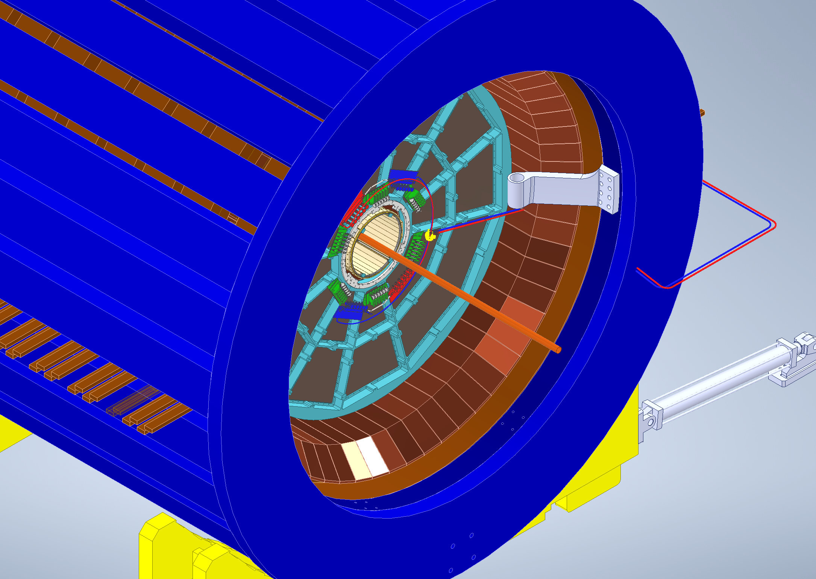
FST in STAR Magnet

Slide 3
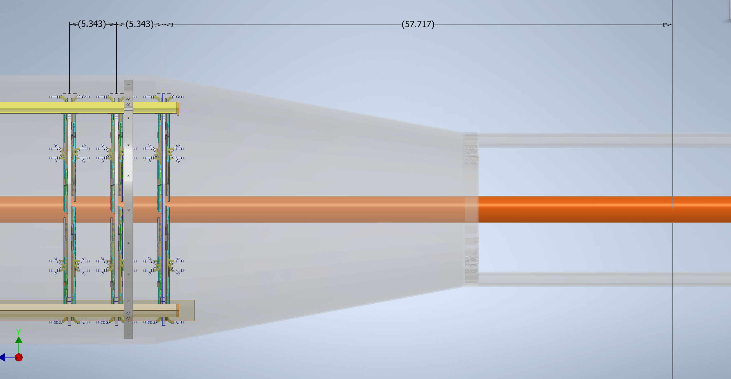
Distances From Interaction Point (IP)
Carbon Fiber IDS/Cone
Beam Pipe
FST Disks

Slide 4
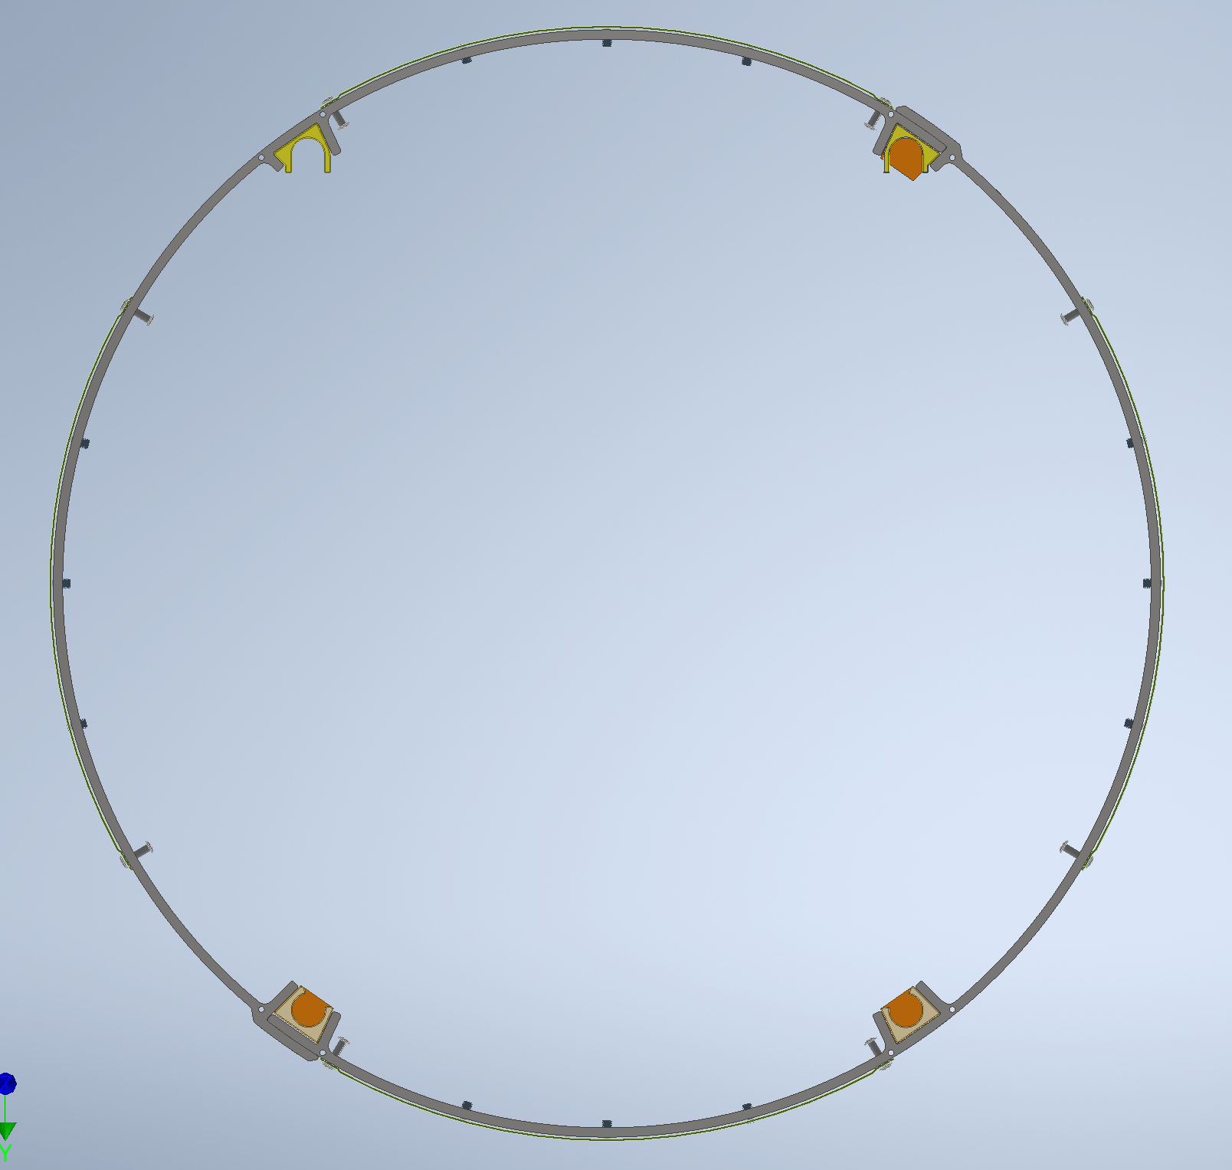
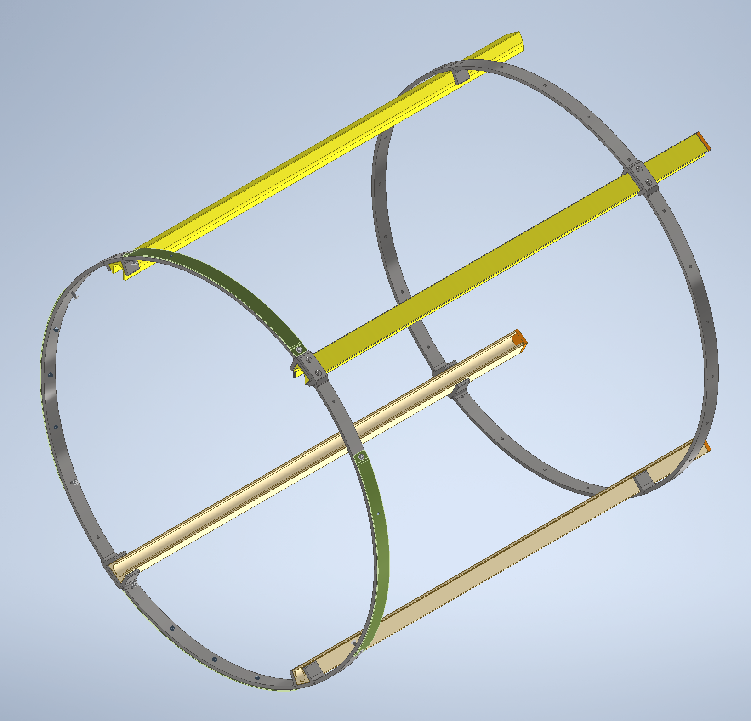
Inner Support Structure
Assembly Weight ~ 21lbs
Size: 24”W x 32”H x 19”L
Ring Diameter = 29.5”
Distance between rings= 30”
Material : Aluminum
(Both for rails and rings)

Slide 5
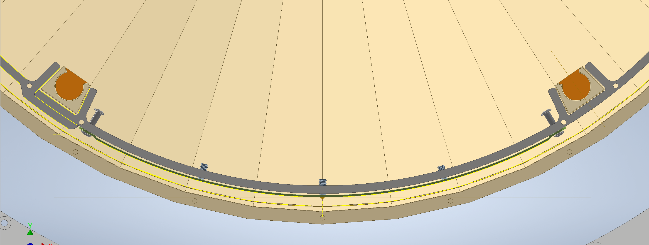
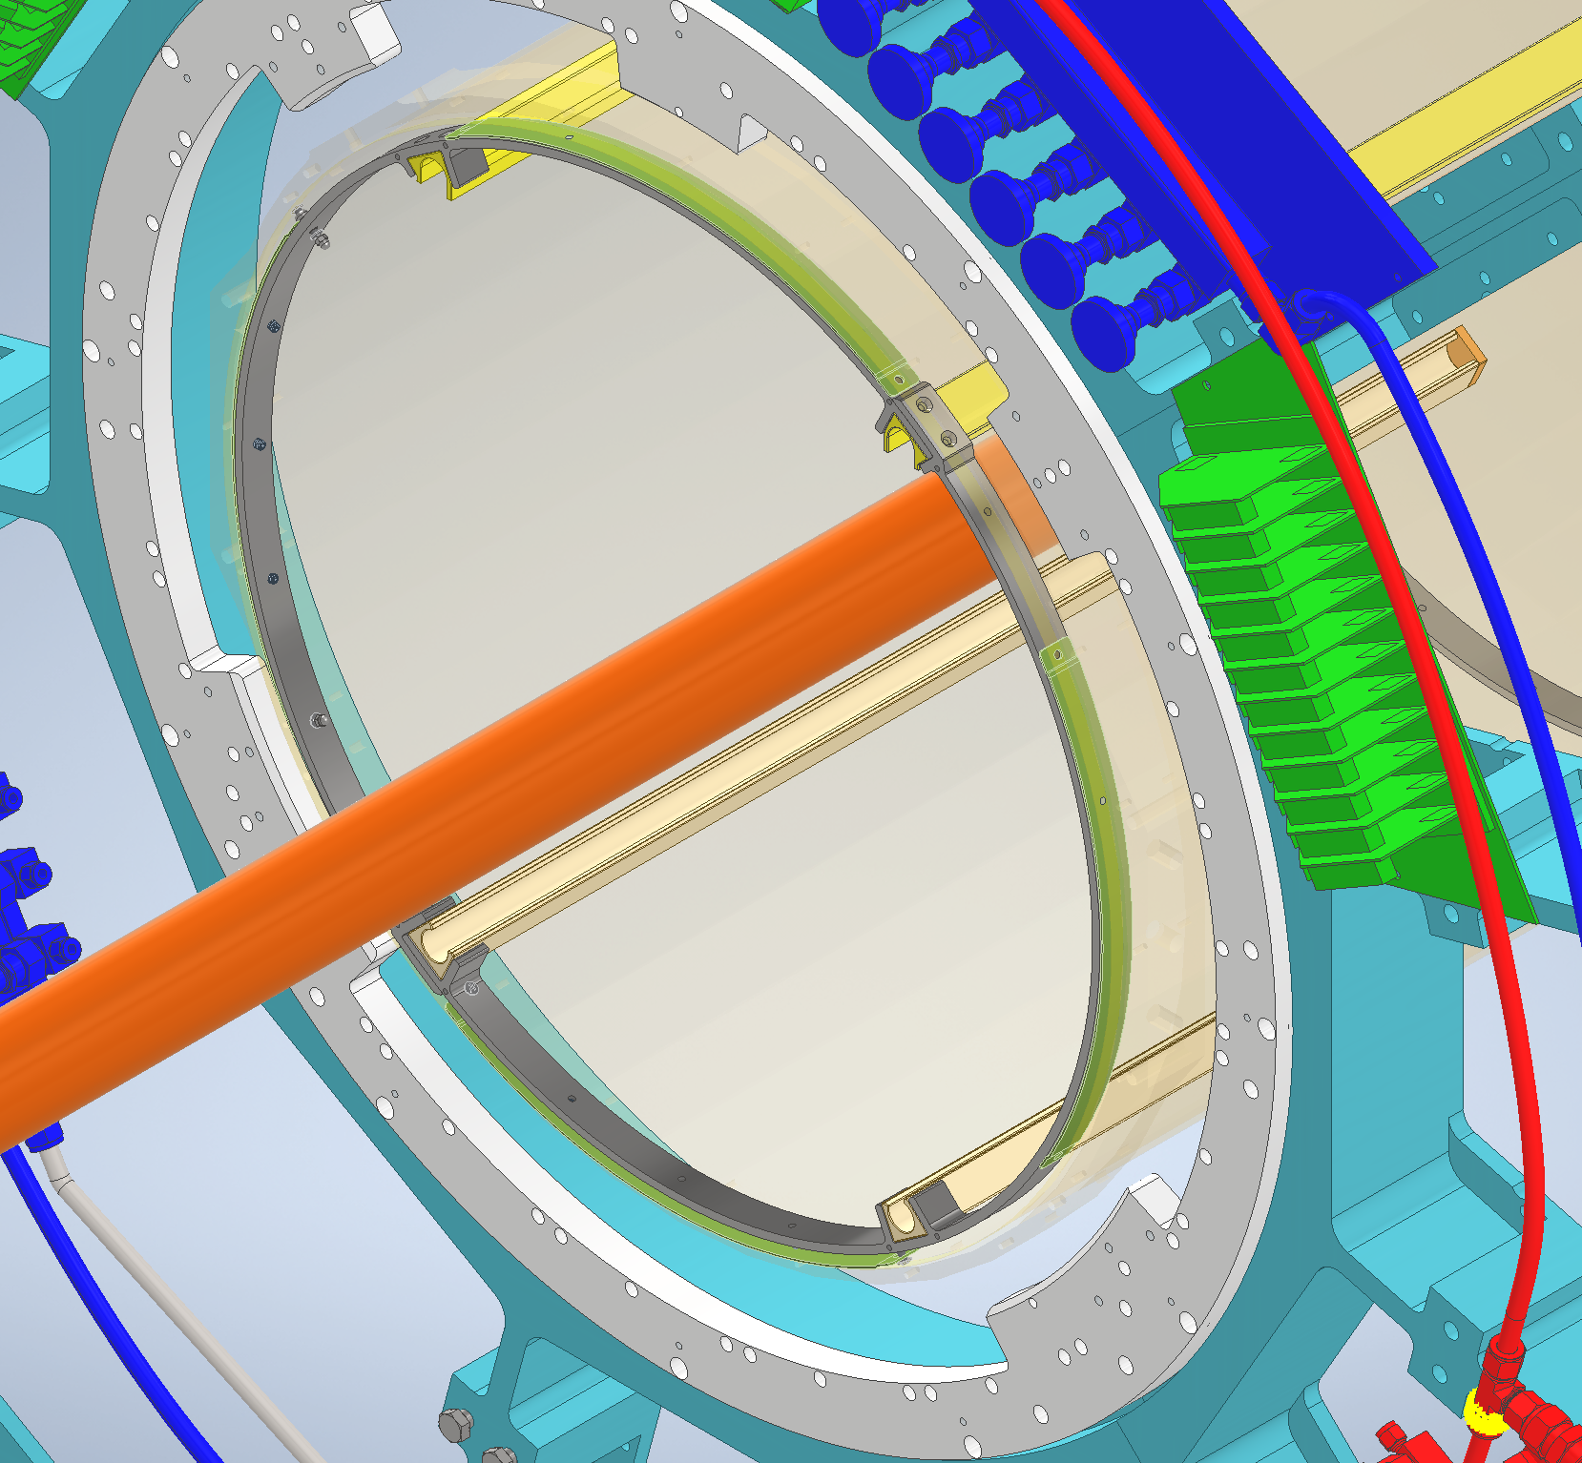
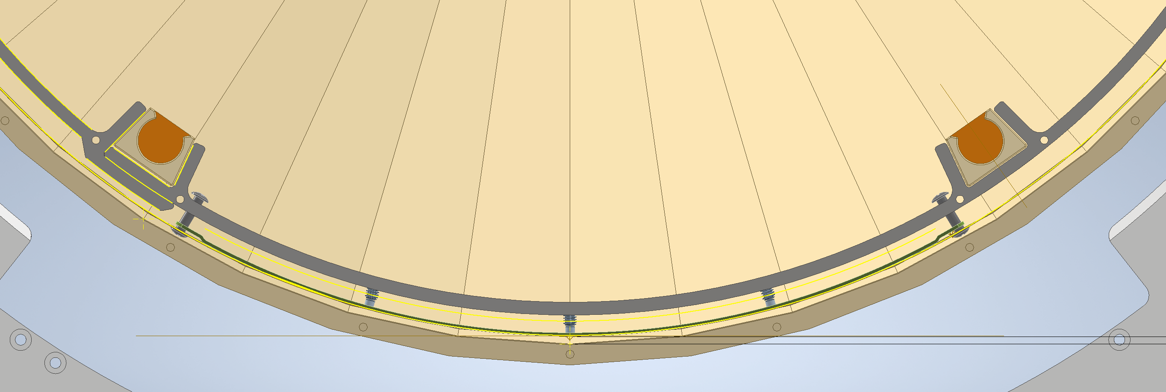
Installation in Carbon Fiber Cone
Capturing Pins
Adjustment Screws
Ring Collar

Slide 6
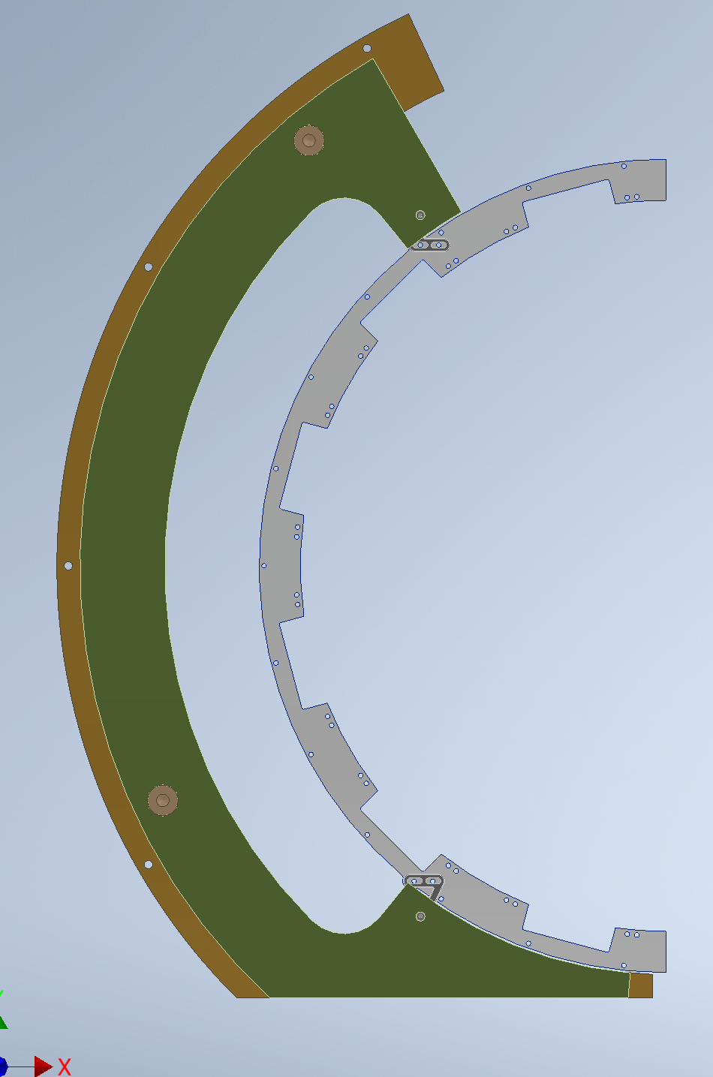
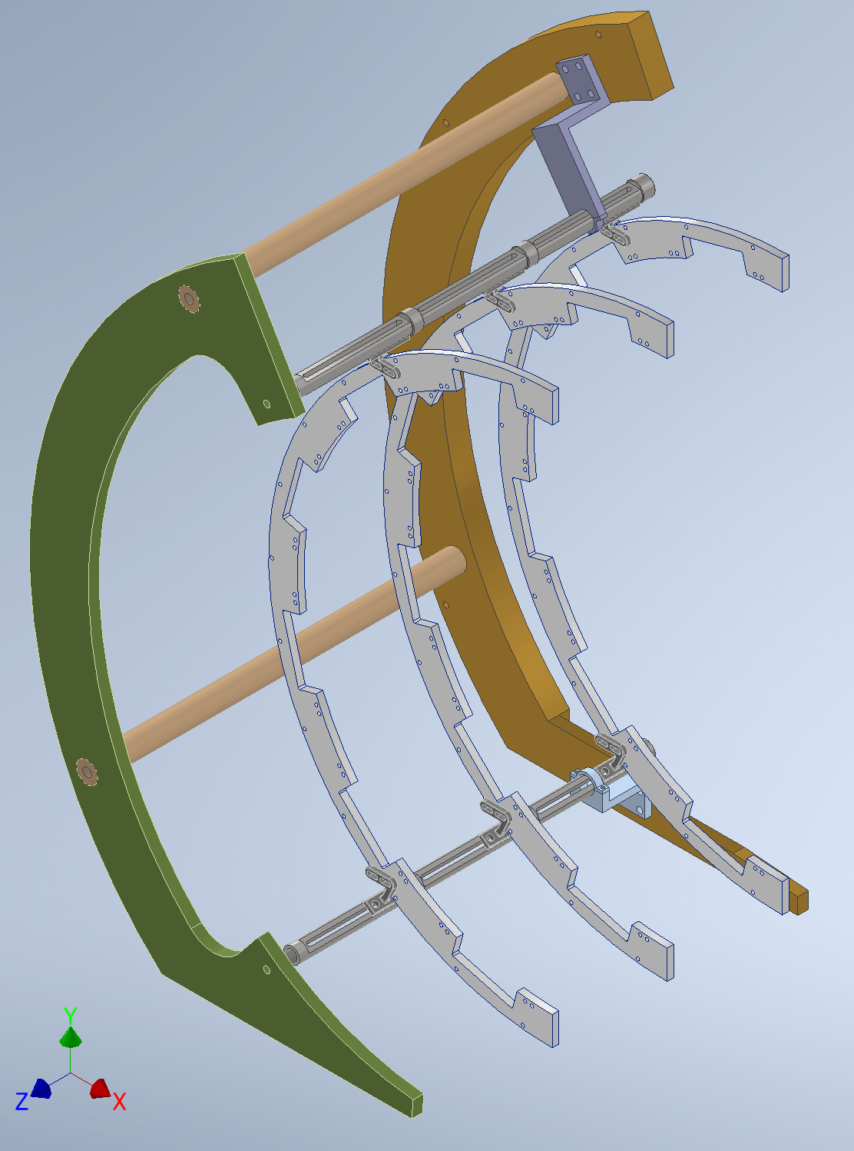
Clean room Assembly of Structure without Sectors, Electronics and Cooling lines
Mechanical Assembly will done in the clean room on a granite table to ensure that all the components fit as intended.
This will be used for the survey and adjustment of positions of the inner support structure inside the IDS/Cone.

Slide 7
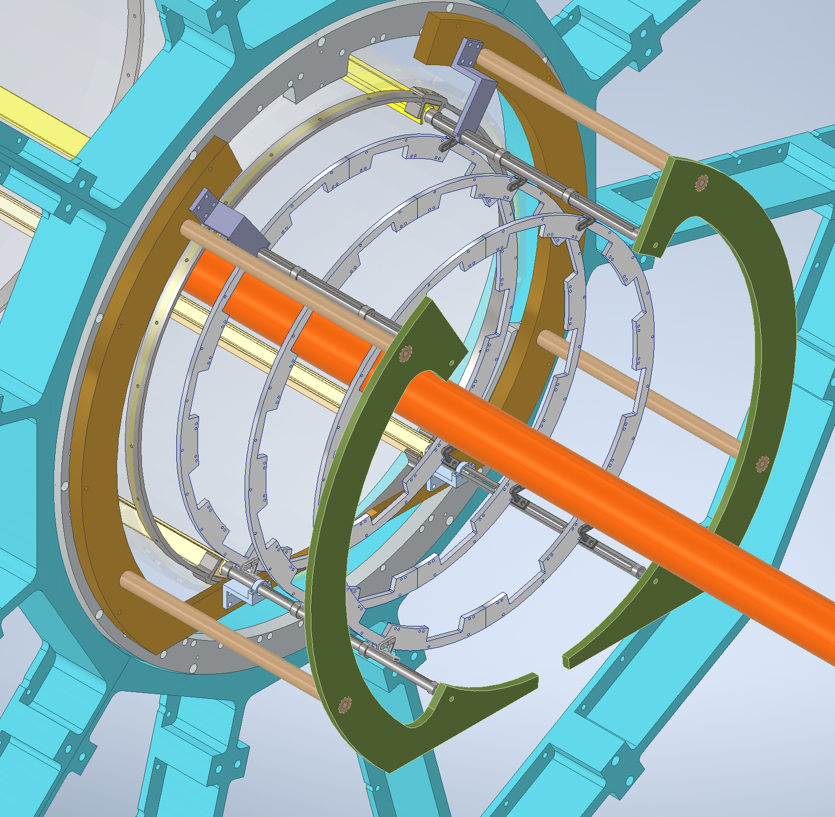
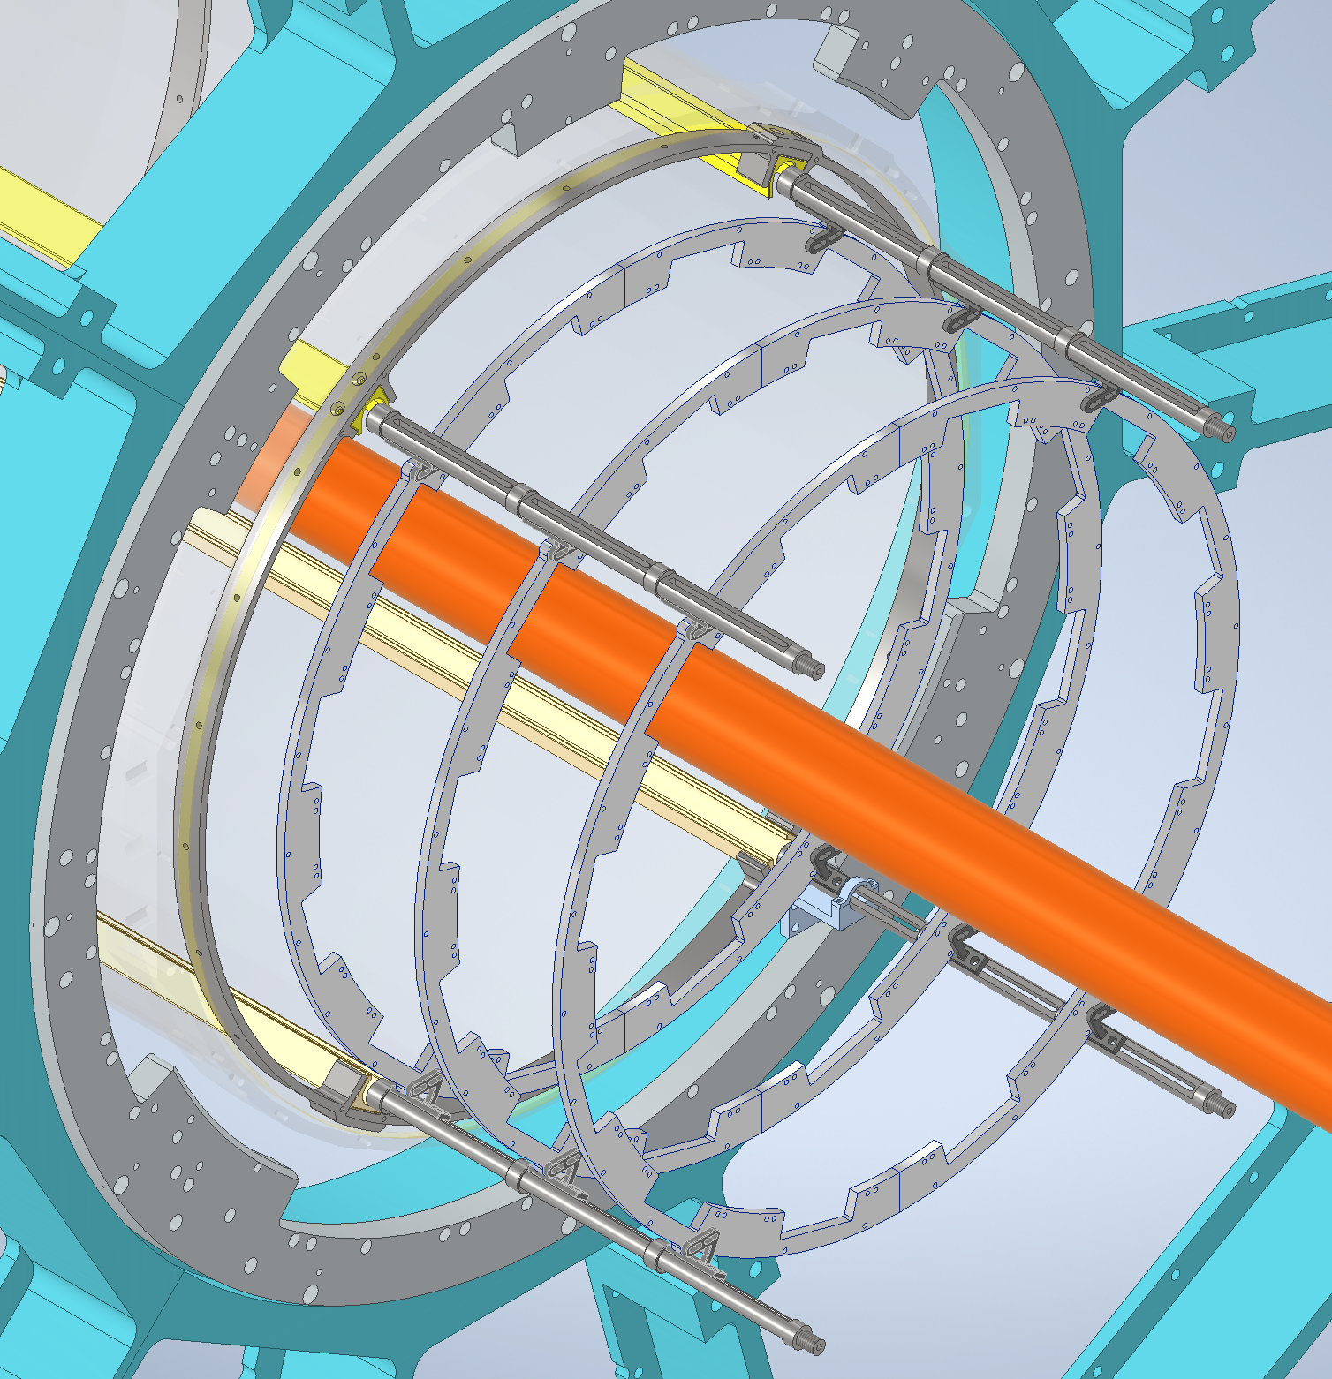
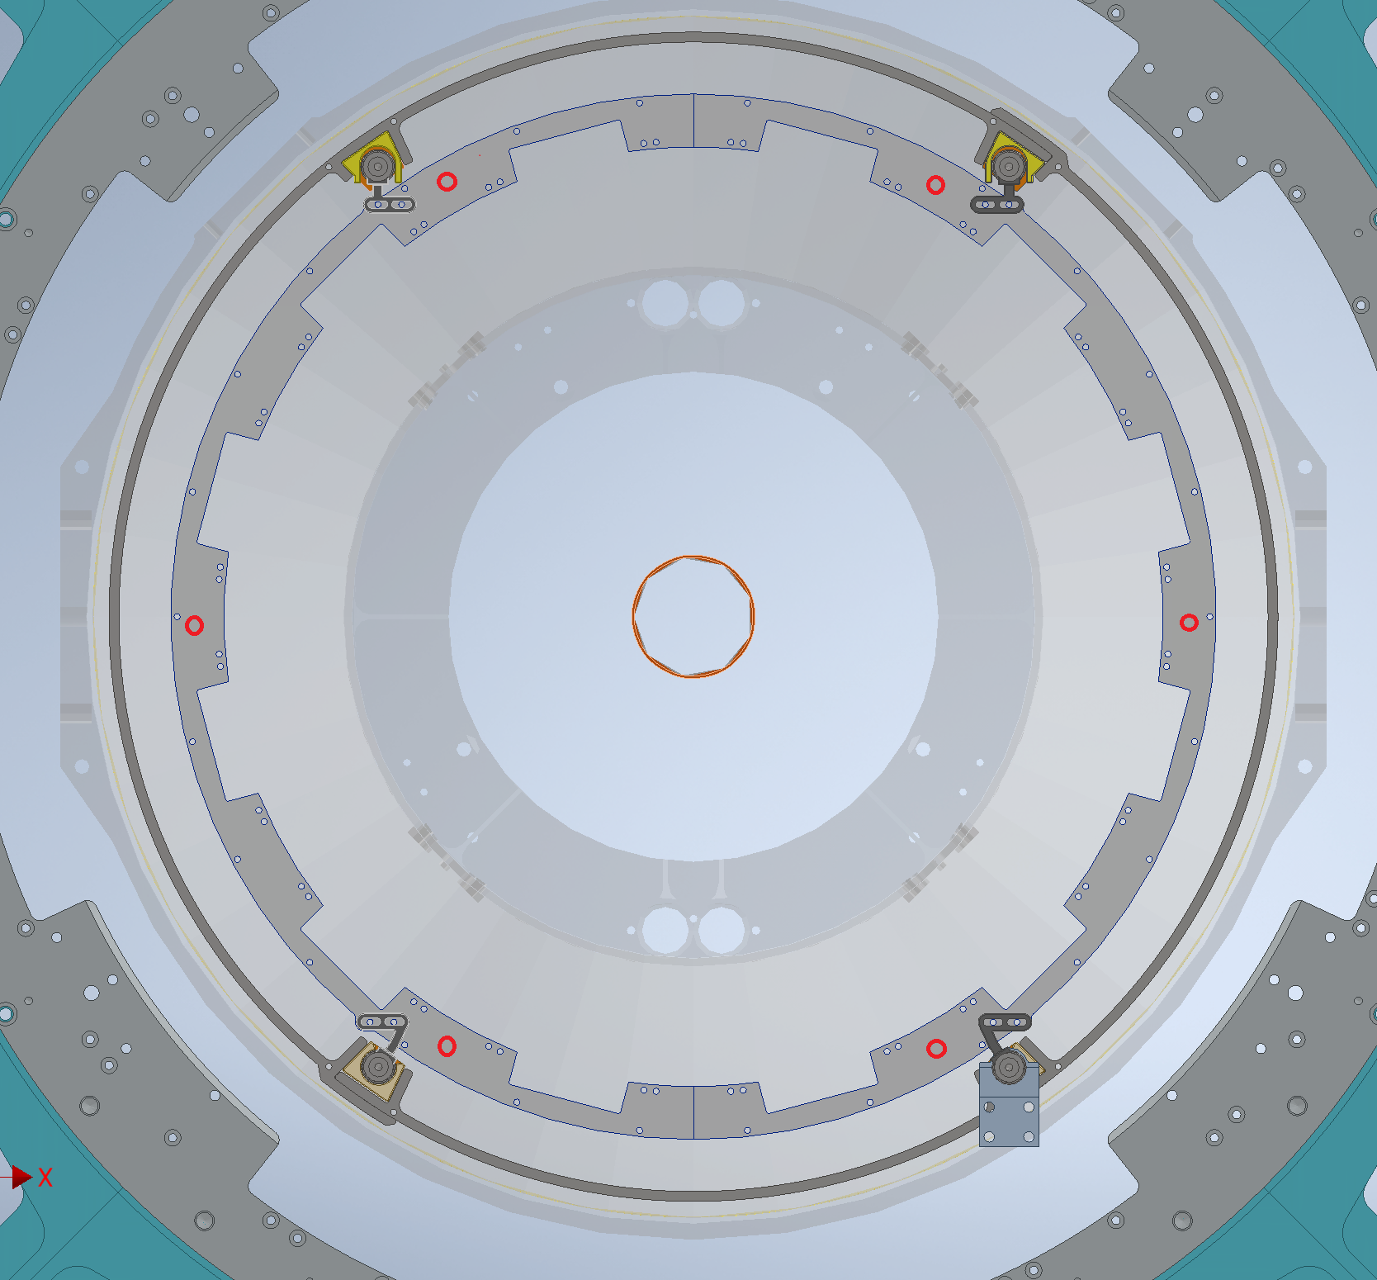
Survey During Installation of Inner Support Structure
Survey Targets
Overall Accuracy of +/- 1/16” can be achieved for location of Inner Support Structure (Engineering Estimate)- This is due to flexing nature of existing Cone.
Survey Technique : Discussed with Survey Group

Slide 8
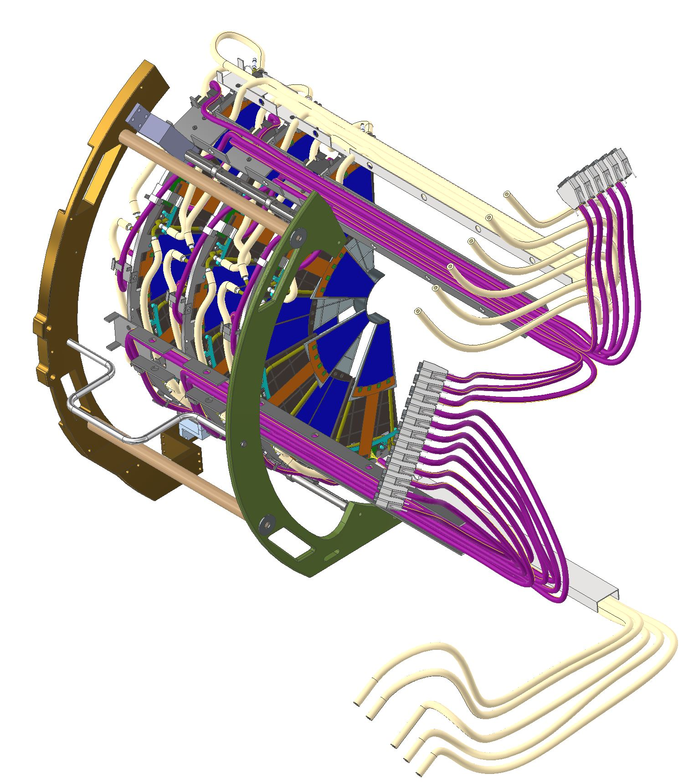
Cleanroom Assembly
BackSupport Plate
Weight ~ 40lbs
Size: 24”W x 32”H x 19”L
Survey/Accurate Measurements can be done inside clean room of disks with respect to one another.
Cleanroom Assembly will rake place on granite table.
The detector halves will be transported on a cart from cleanroom in assembly building to Experimental hall through the plug door in shield wall
It’s a pretty smooth ride with no bumps. Still a thin foam can be used on the cart to minimize vibrations.
Techs will use scissor lifts to take the halves to the first level of scaffolding
Front Support Plate

Slide 9
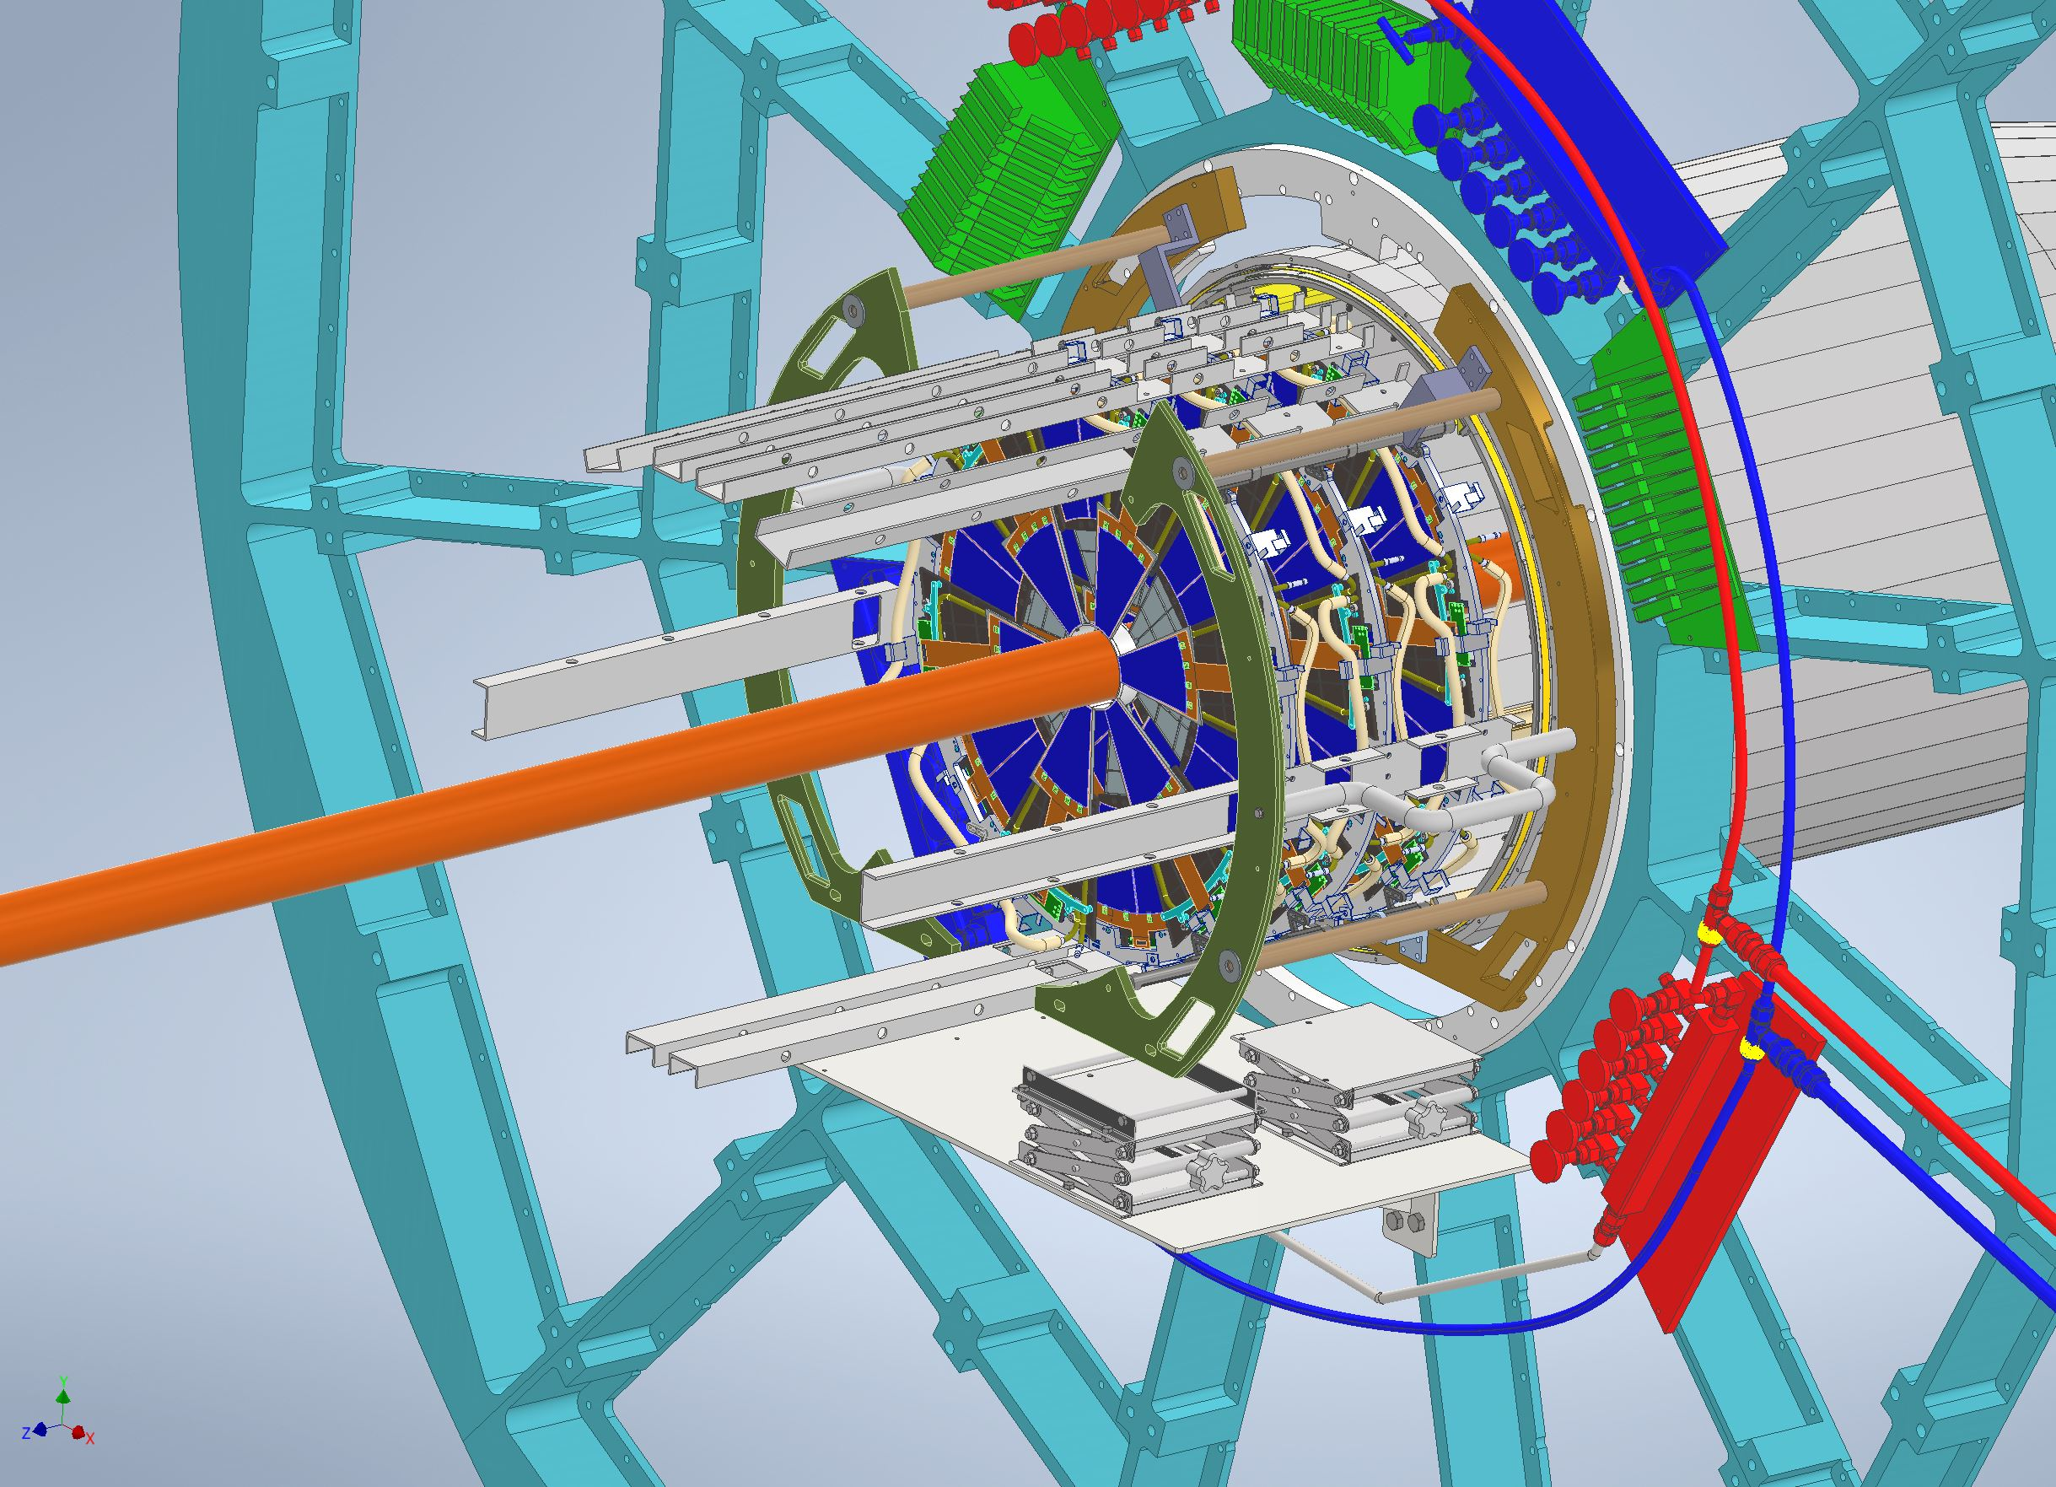
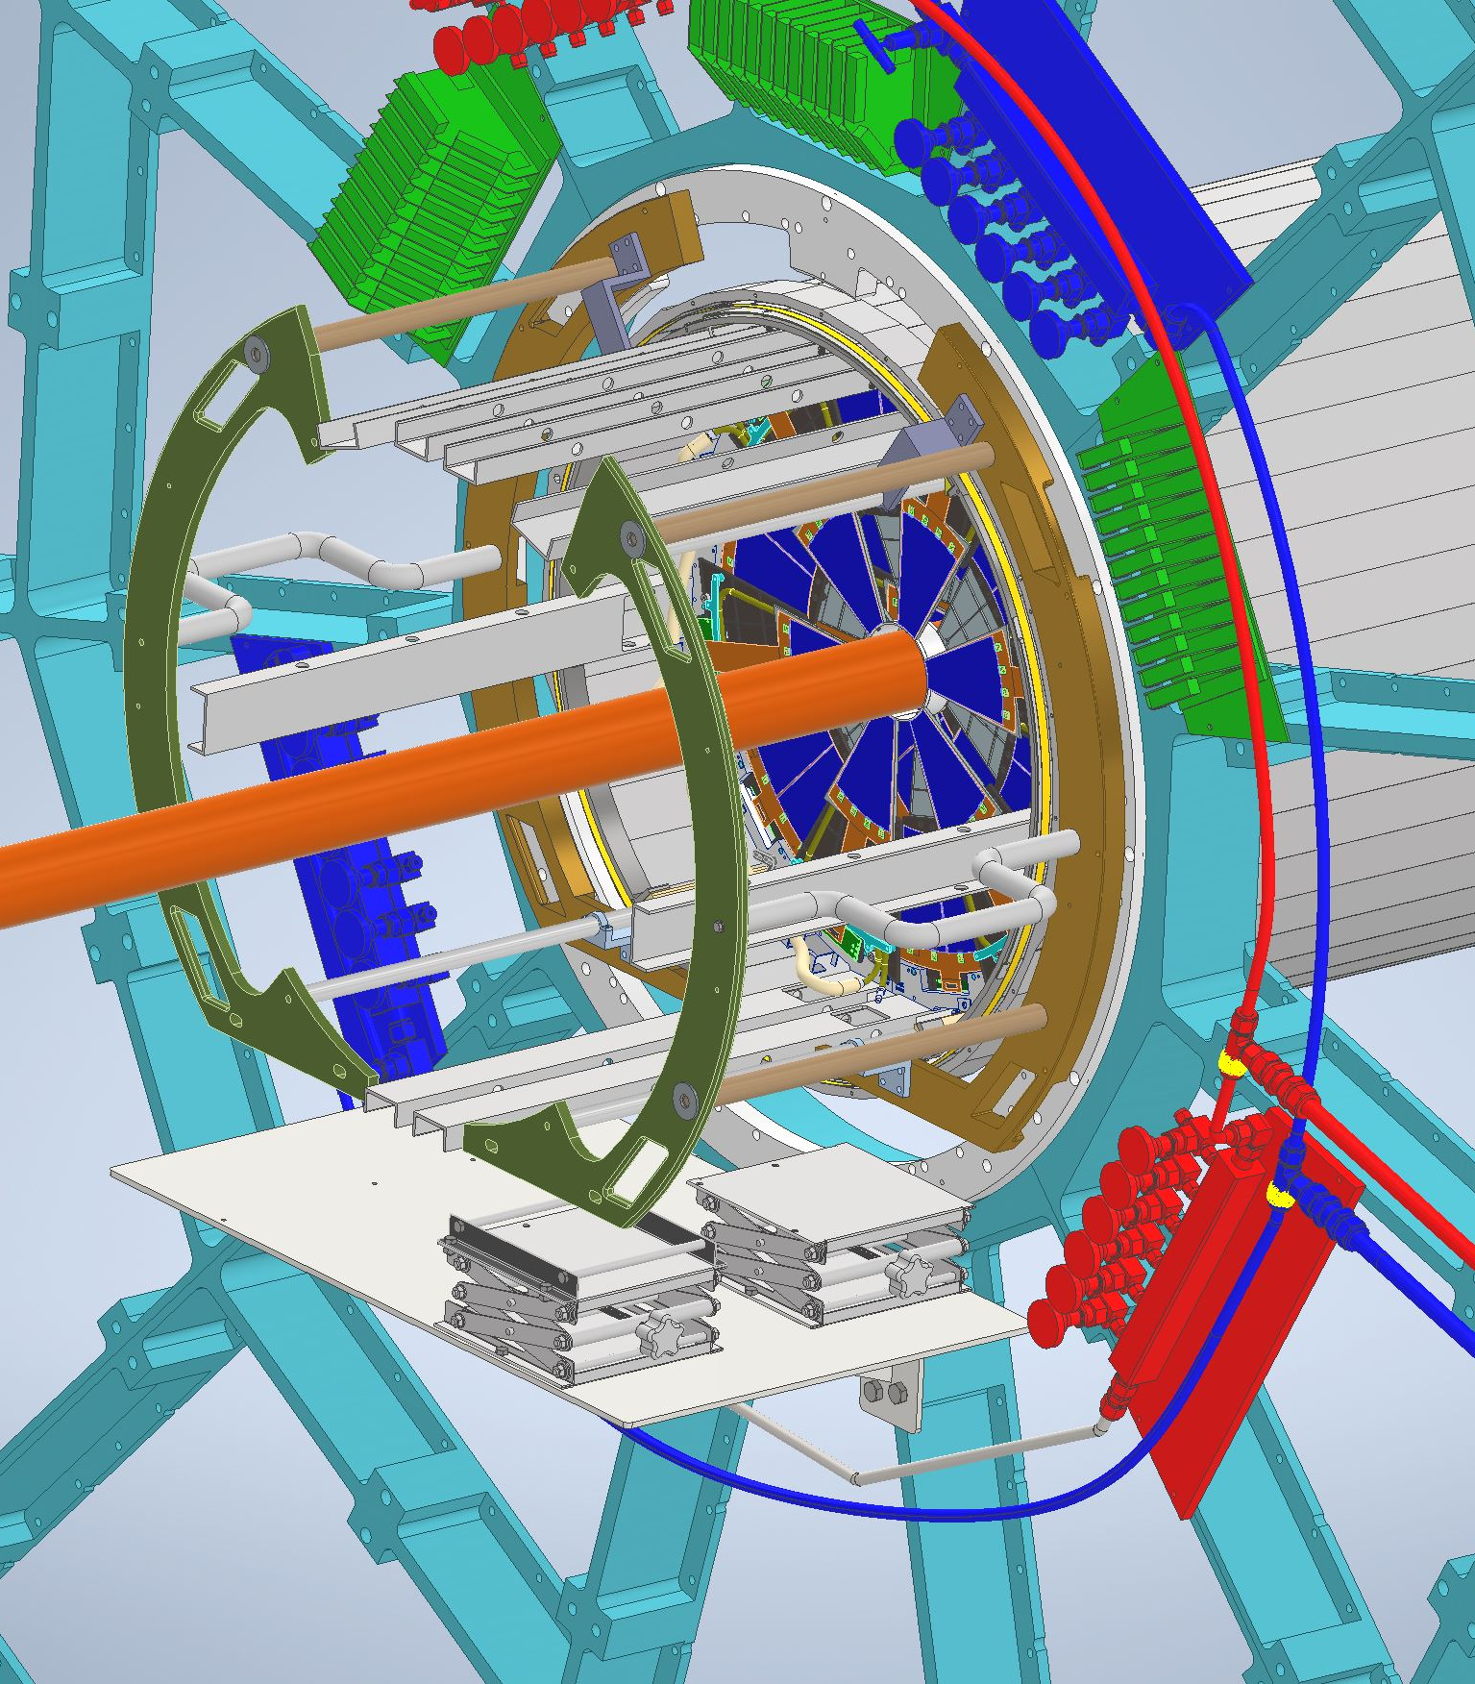
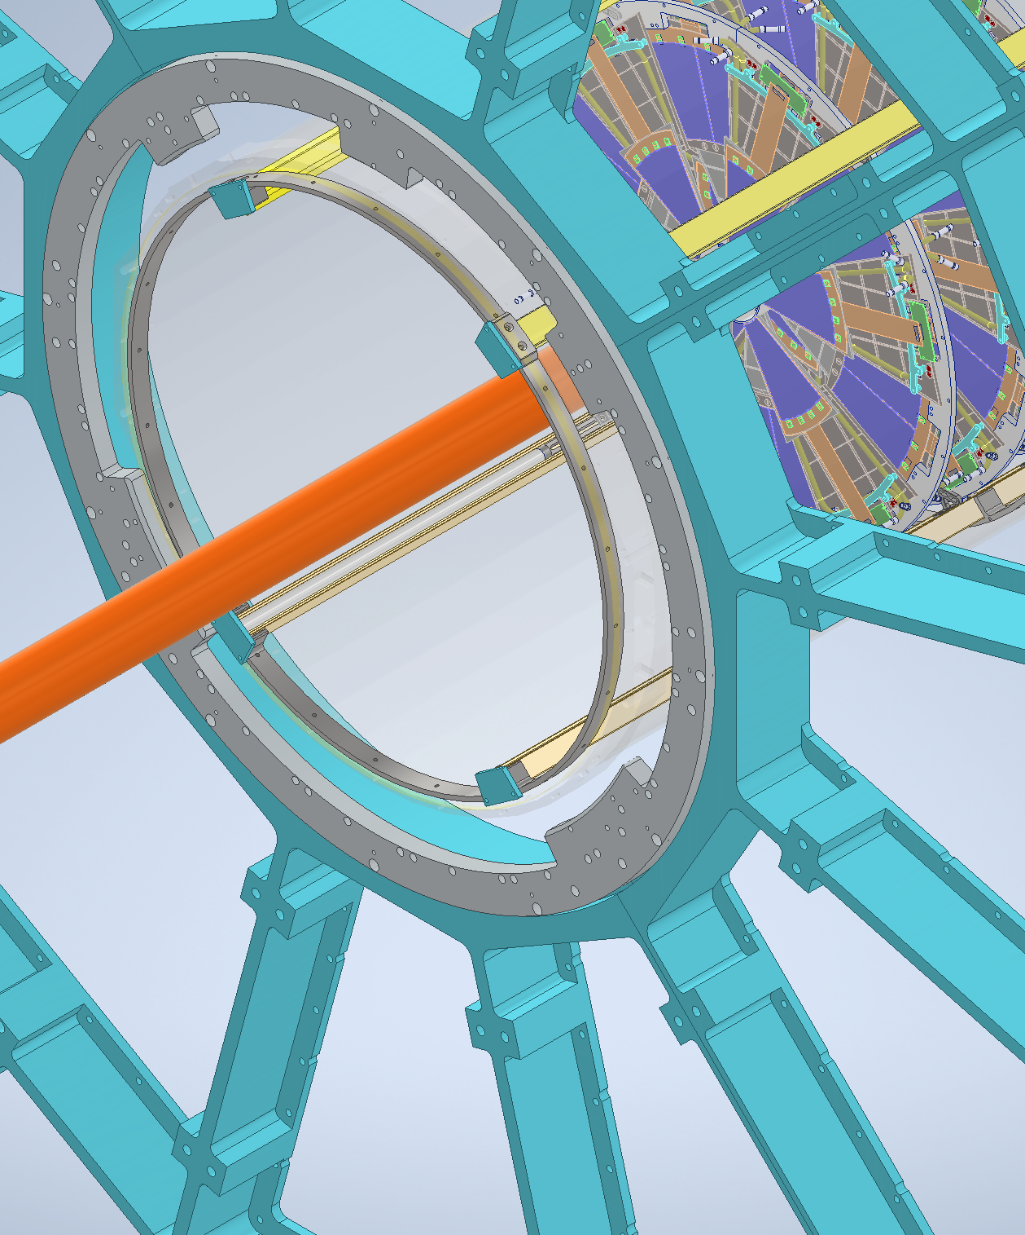
Installation

Slide 10
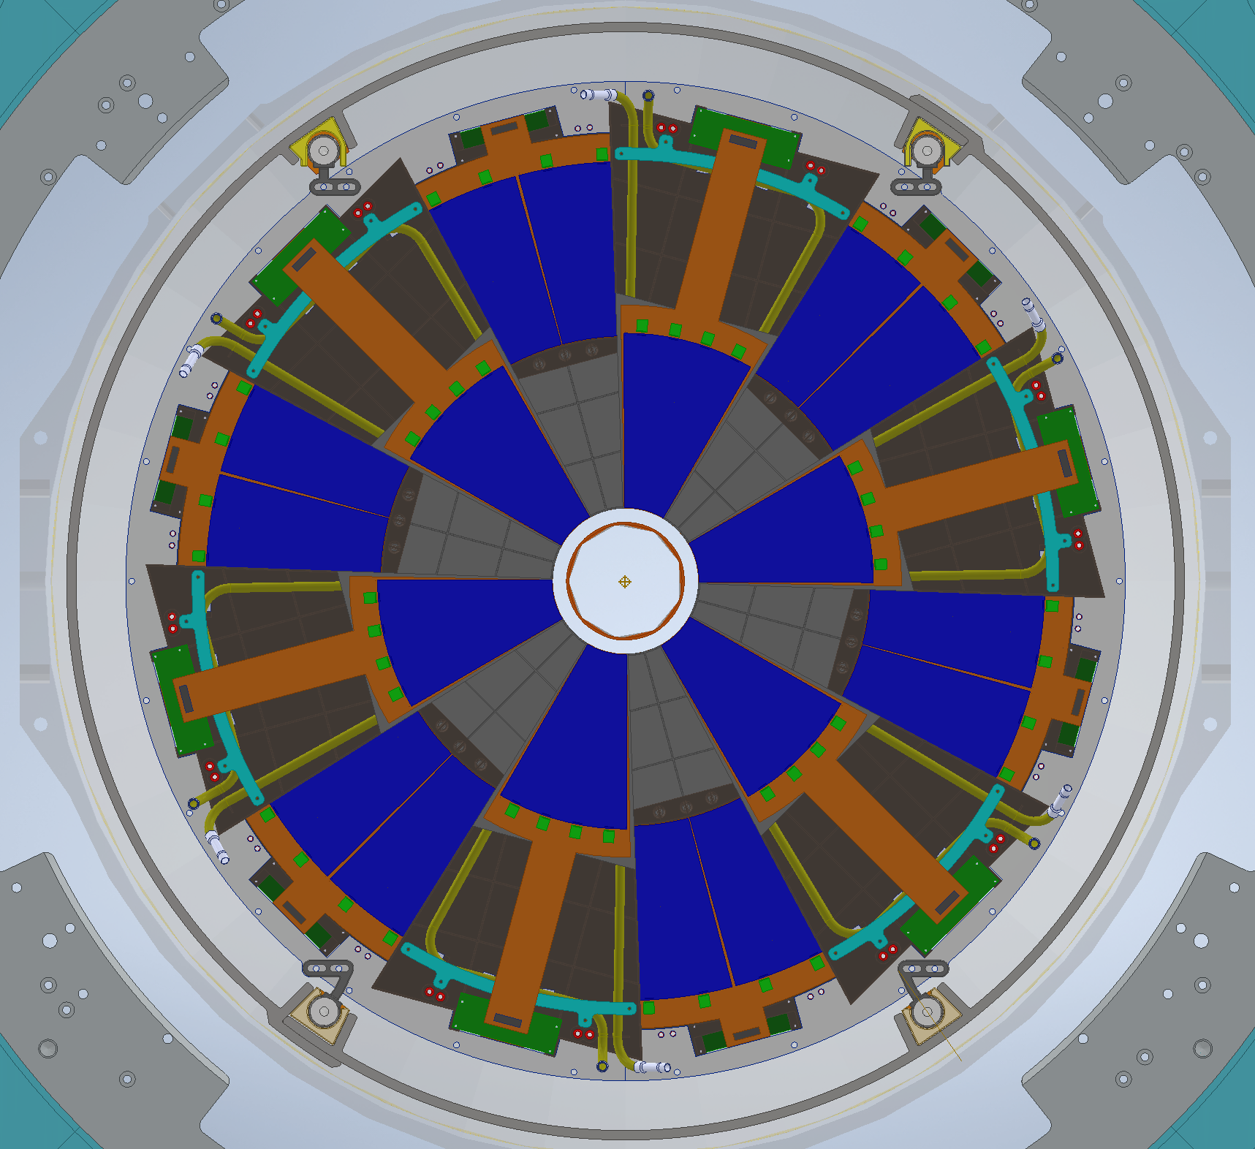
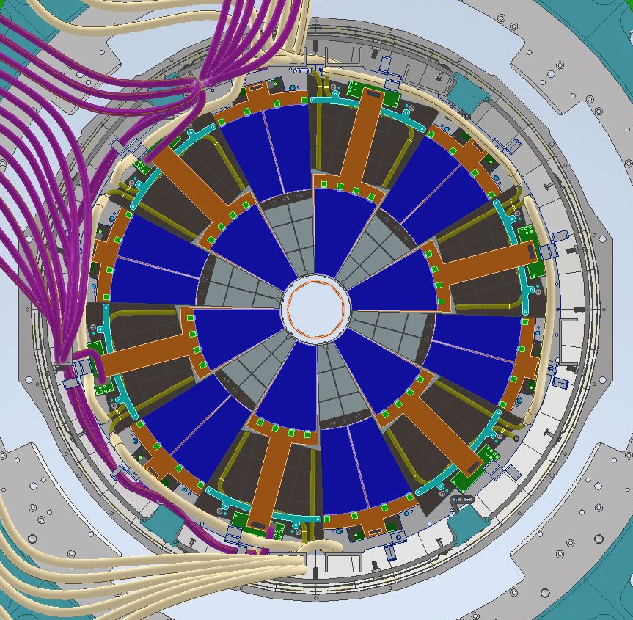
Front View (Final Survey)
Final Survey Targets
Final Survey will be performed (On front Disk) after assembly is fully installed in the IDS/Cone.

Slide 11
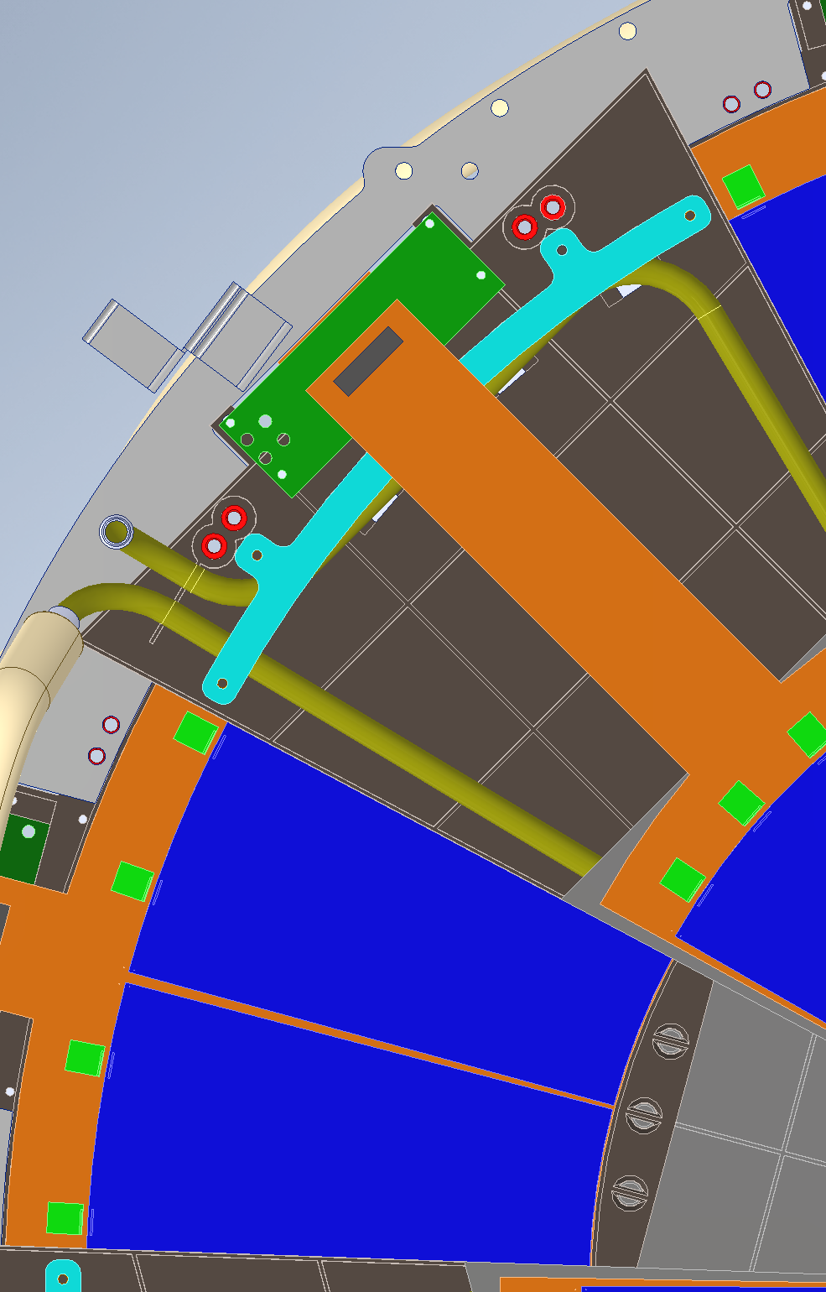
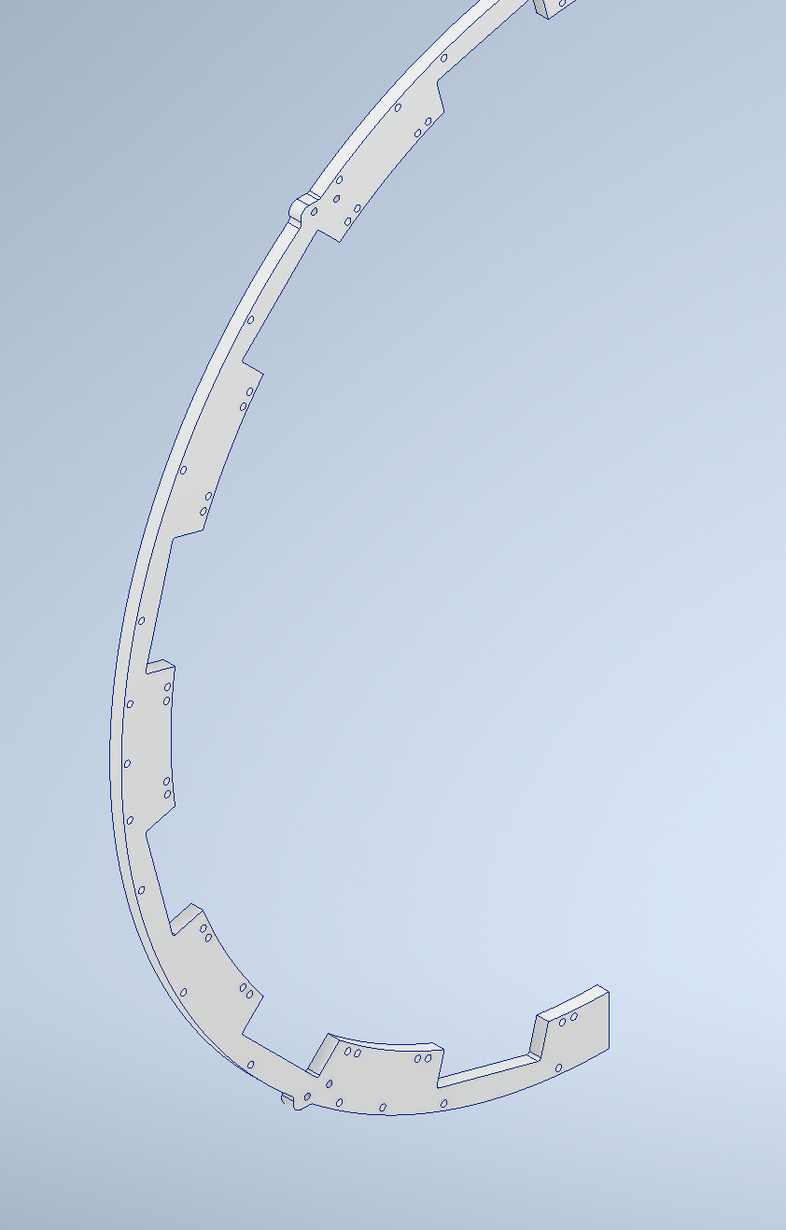
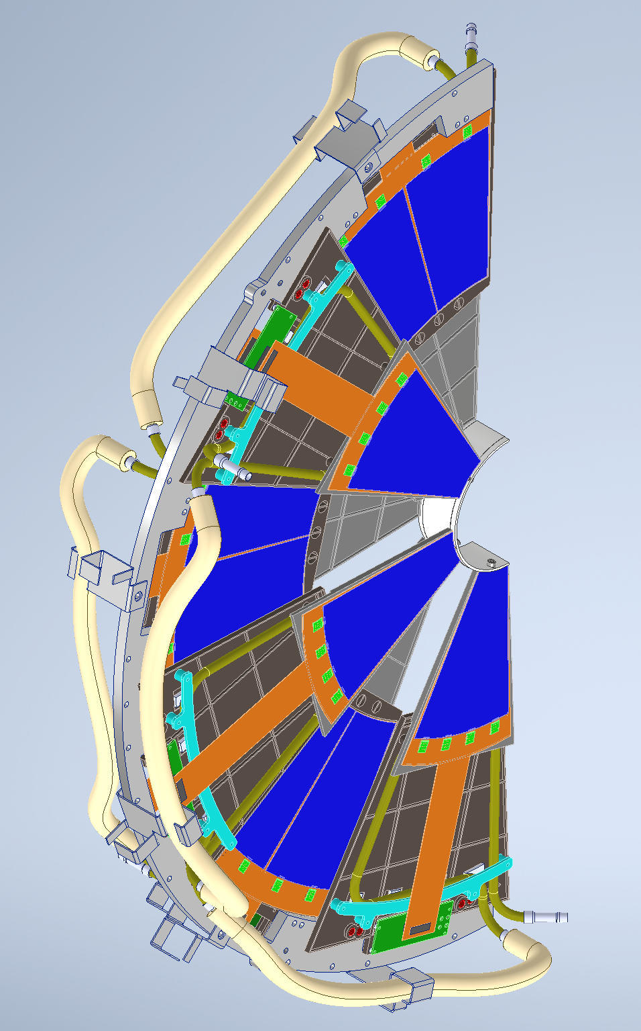
Integration Interface (Mounting Modules)
Pin and slot arrangement for location
Two mounting holes for screws
Details are being worked out

Slide 12
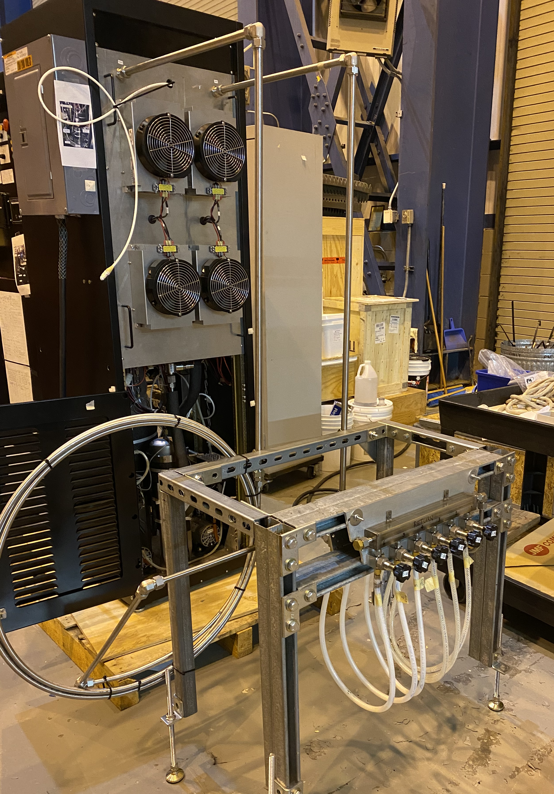
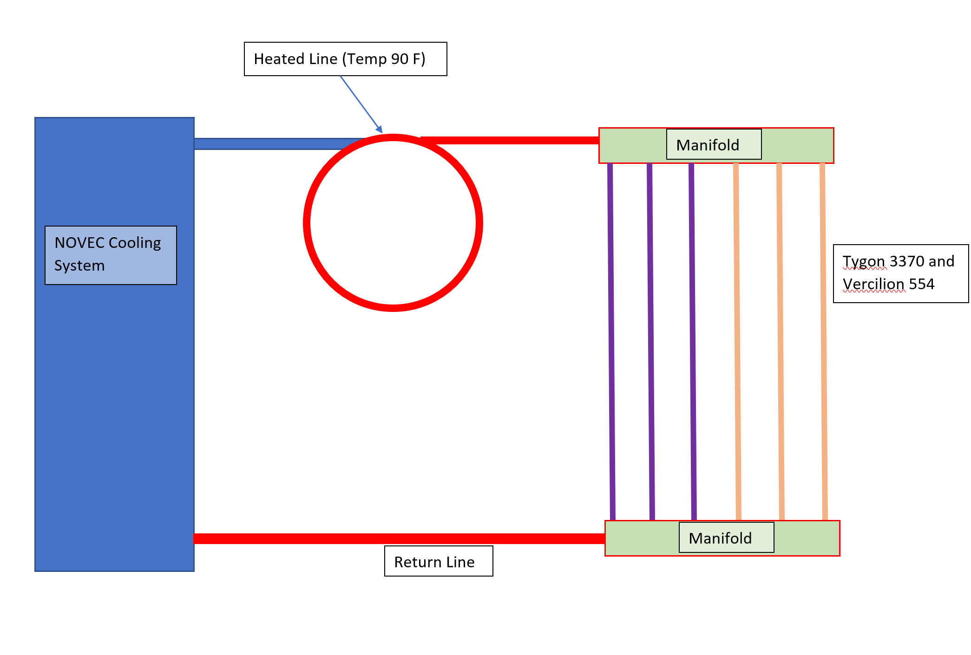
Integration Interface (IST/FST Cooling System)
IST Novec cooling system refurbished to use for cooling FST Detector.
Leak Occurred on : 01/04/2020
Replacement O-rings and spare pumps ordered.
Testing Objectives:
  Testing performance of the flex tube candidate materials (Tygon 3370 and Vercillion 554). So far both candidates performing good.
Test Plan:
  We will run the tests till end of the run 2021 to make sure the hoses don’t leak.

Slide 13
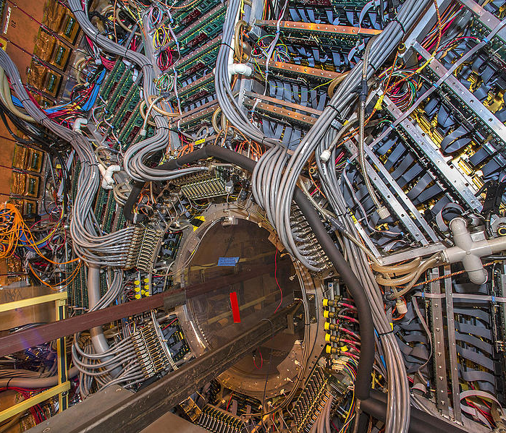
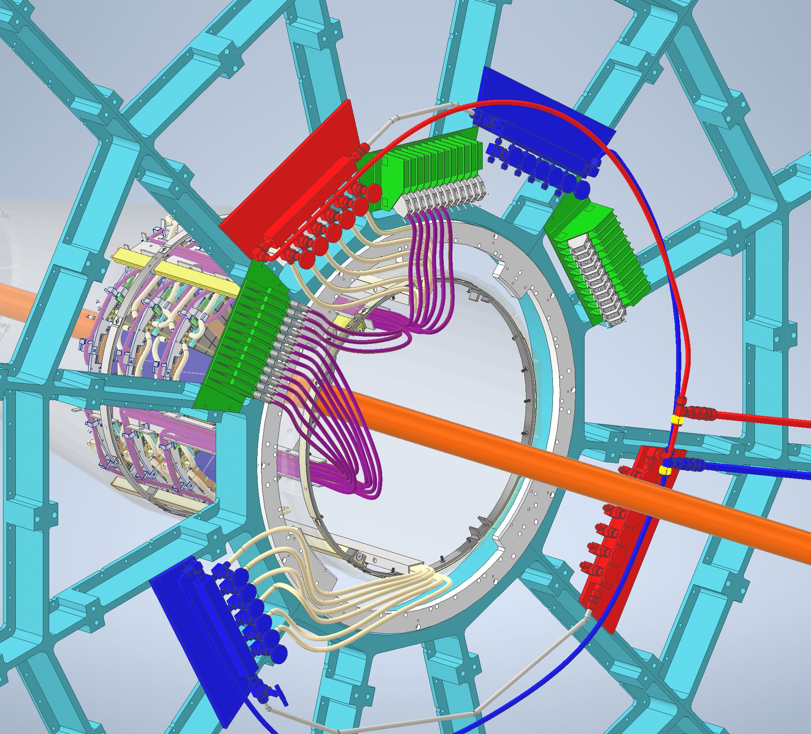
FST

Slide 14
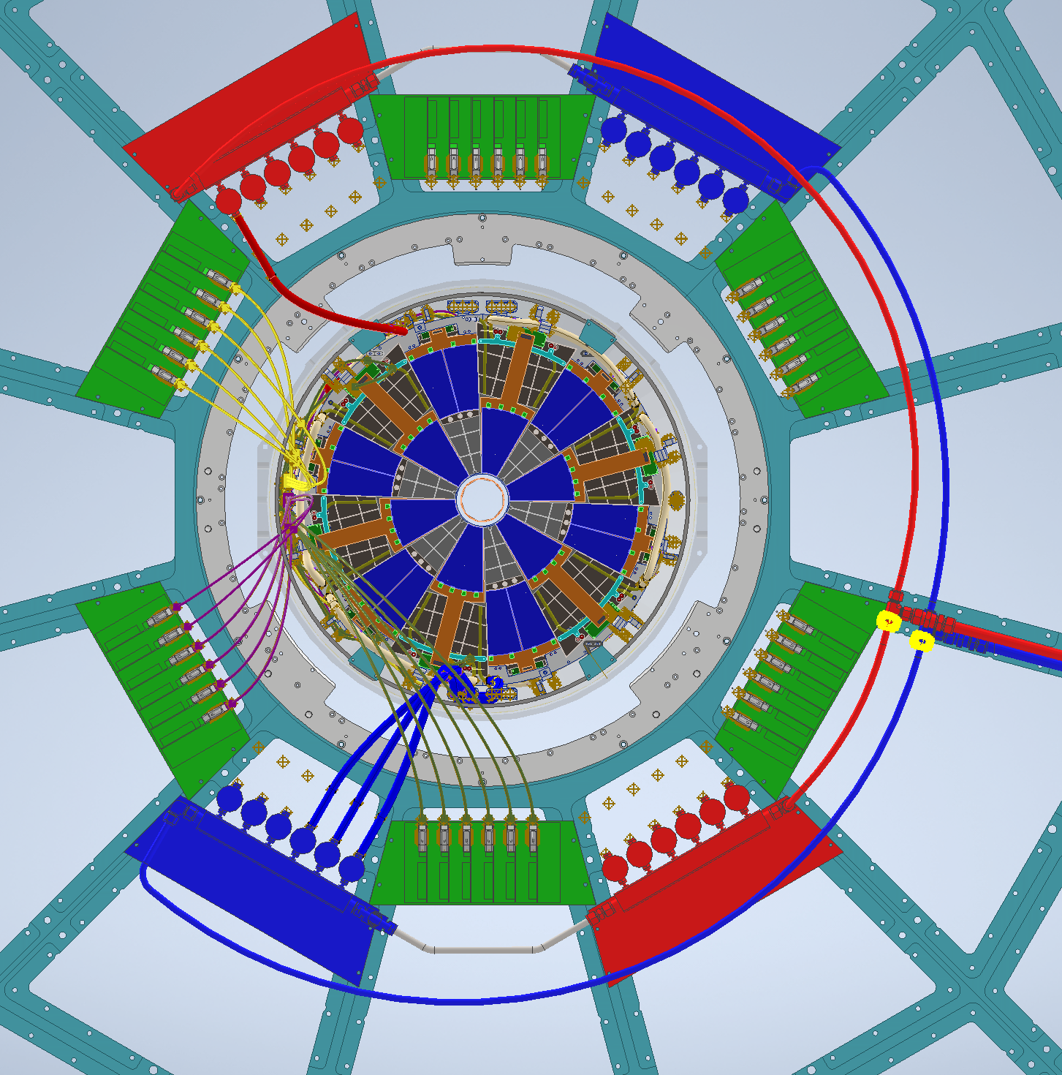
FST Schedule
Detail Design Done
All Parts in Hand : End of Feb 2021
Mockup testing inside cone: Done
Detector installation: 7/28/2021 to 8/10/2021

Slide 15
ES&H Issues
Beam Pipe has to be protected at all times.
  All parts are designed to have enough clearance around beampipe so that no scraping occurs during installation.
Flex cooling lines start leaking due to radiation hardening or due to chemical interaction with NOVEC
  Testing flex lines as showin in the test plans

