Slide 1
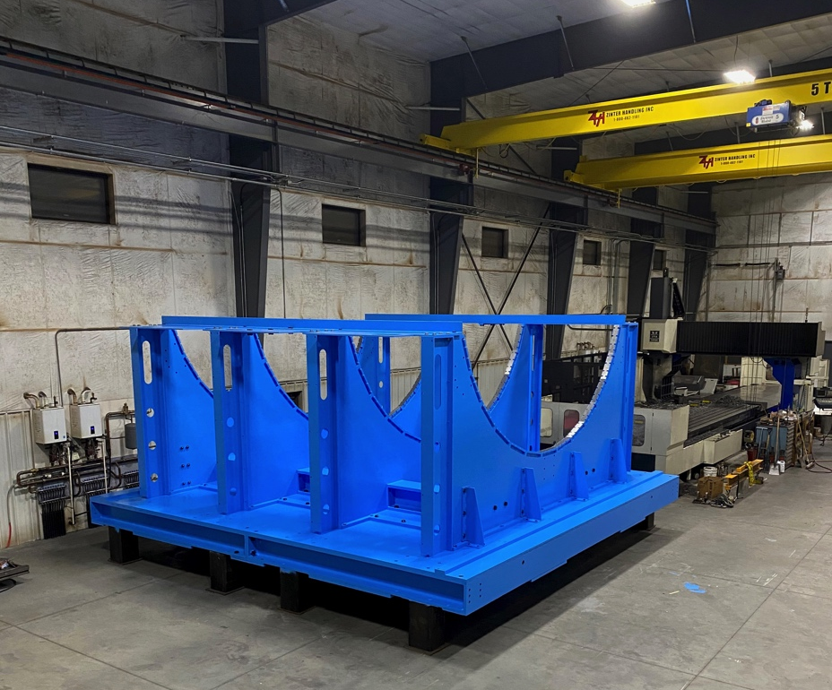
sPHENIX PMG Meeting
Assembled Carriage/Cradle @ Strecks 12/16/20

Slide 2
PMG Agenda
Installation Plan - Russ
MIE component float to installation dates - Glenn
Labor for 2.X activities - EO’B
Issues
EV plots in back up

Slide 3
OuterHCal and EMCal Installation
 | Fabrication Complete | Installation Date | Delta
OHCal Sector 1 & Splice Plates | Week 52, 2020 | Week 22, 2021 | 22
OHCal Sector 13 | Week 5, 2021 | Week 34, 2021 | 29
SC Magnet Coil | 2018 (testing at BNL) | Week 36, 2021 | >100
OHCal Sector 14 | Week 5, 2021 | Week 41, 2021 | 36
OHCal Sector 32 | Week 13, 2021 | Week 45, 2021 | 32
EMCal Sector 1 | Week 14, 2020 | Week 49, 2021 | 87
EMCal Sector 32 | Week 28, 2021 | Week 5, 2022 | 29
EMCal Sector 61 | Week 52, 2021 | Week 10, 2022 | 10
EMCal Sector 64 | Week 3, 2022 | Week 11, 2022 | 8

Slide 4
TPC and Electronics Installation
 | Fabrication Complete | Installation Date | Delta
TPC | Week 50, 2021 | Week 23, 2022 | 25
OHCal Cabling | Week 30, 2021 | Week 47, 2021 | 17
EMCal Cabling | Week 30, 2021 | Week 1, 2022 | 23
Digitizers | Week 32, 2021 | Week 14, 2022 | 34
Trigger & Timing Systems | Week 1, 2022 | Week 14, 2022 | 13
Beampipe | Week 32, 2021 | Week 32, 2022 | 52
TPC, EMCal and OHCal on-detector electronics are installed as part of detector fabrication

Slide 5
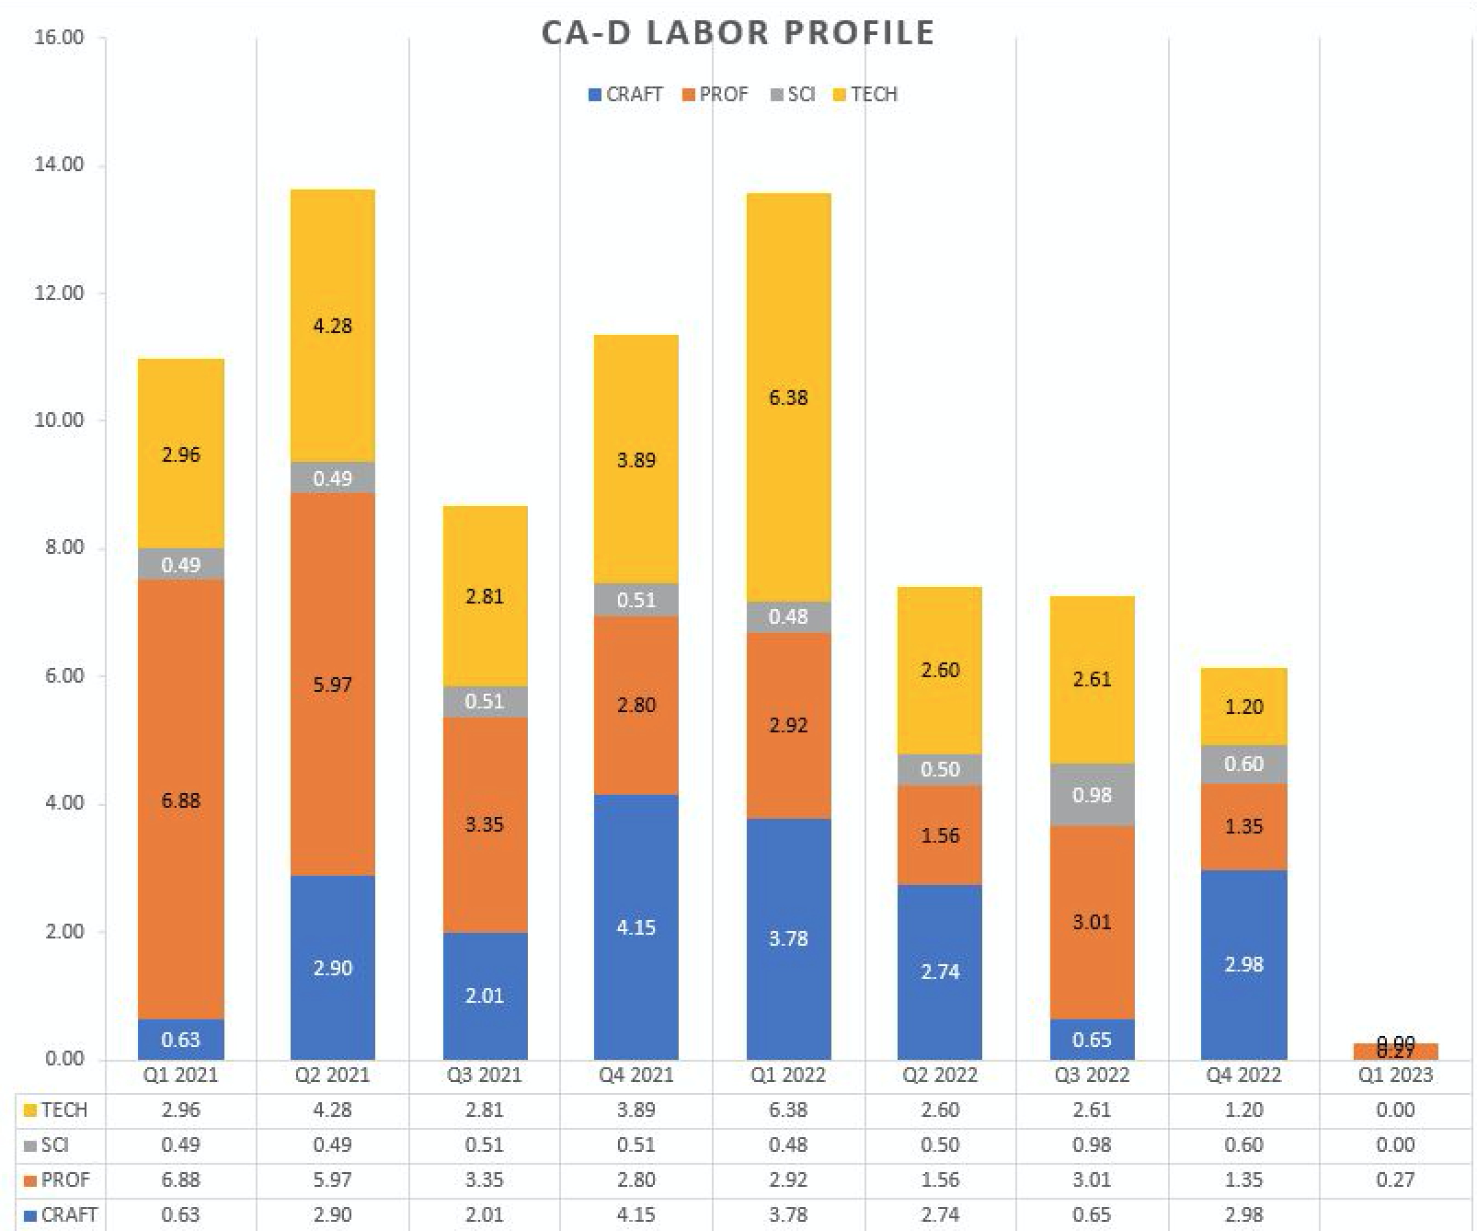
2.X Labor Profile - CAD
Includes labor for Magnet (Cryo, controls, power), 1008 infrastructure, sPHENIX installation and trades

Slide 6
sPHENIX Challenges
We have ~$11M in procurements to make over the next 12 months including $2M in the BNL procurement system right now. PPM released >$1M in orders within the last month.
Concern that additional COVID delays will result in a delay to the RHIC 2021 and 2022 Run schedule and/or the sPHENIX construction schedule. I am particularly concerned about a 2nd BNL shutdown and its schedule impact. Any additional RHIC Run delays will delay sPHENIX installation and impact the start of RHIC Run 2023.
POB

Slide 7
Summary
100% OHCal tiles from Russian vendor Uniplast delivered. Yield 98.7%
Carriage/cradle complete at Streck’s. Final inspection this week.
MIE and I&F early completion dates unchanged for November 11.5 months of float for MIE, 3.5 months of float for I&F.
  RHIC Run-2022 schedule is not linked with I&F schedule in P6
We have 80% of sPHENIX technical staff on site and working. sPHENIX Visitors also approved via ROOP process to be on site (SBU, Baruch, Rutgers, Lehigh, UColorado, ISU)
We have a large team of engineers, designers and managers working remotely on sPHENIX activities.

Slide 8
Back Up – EV and Variance Reports

Slide 9
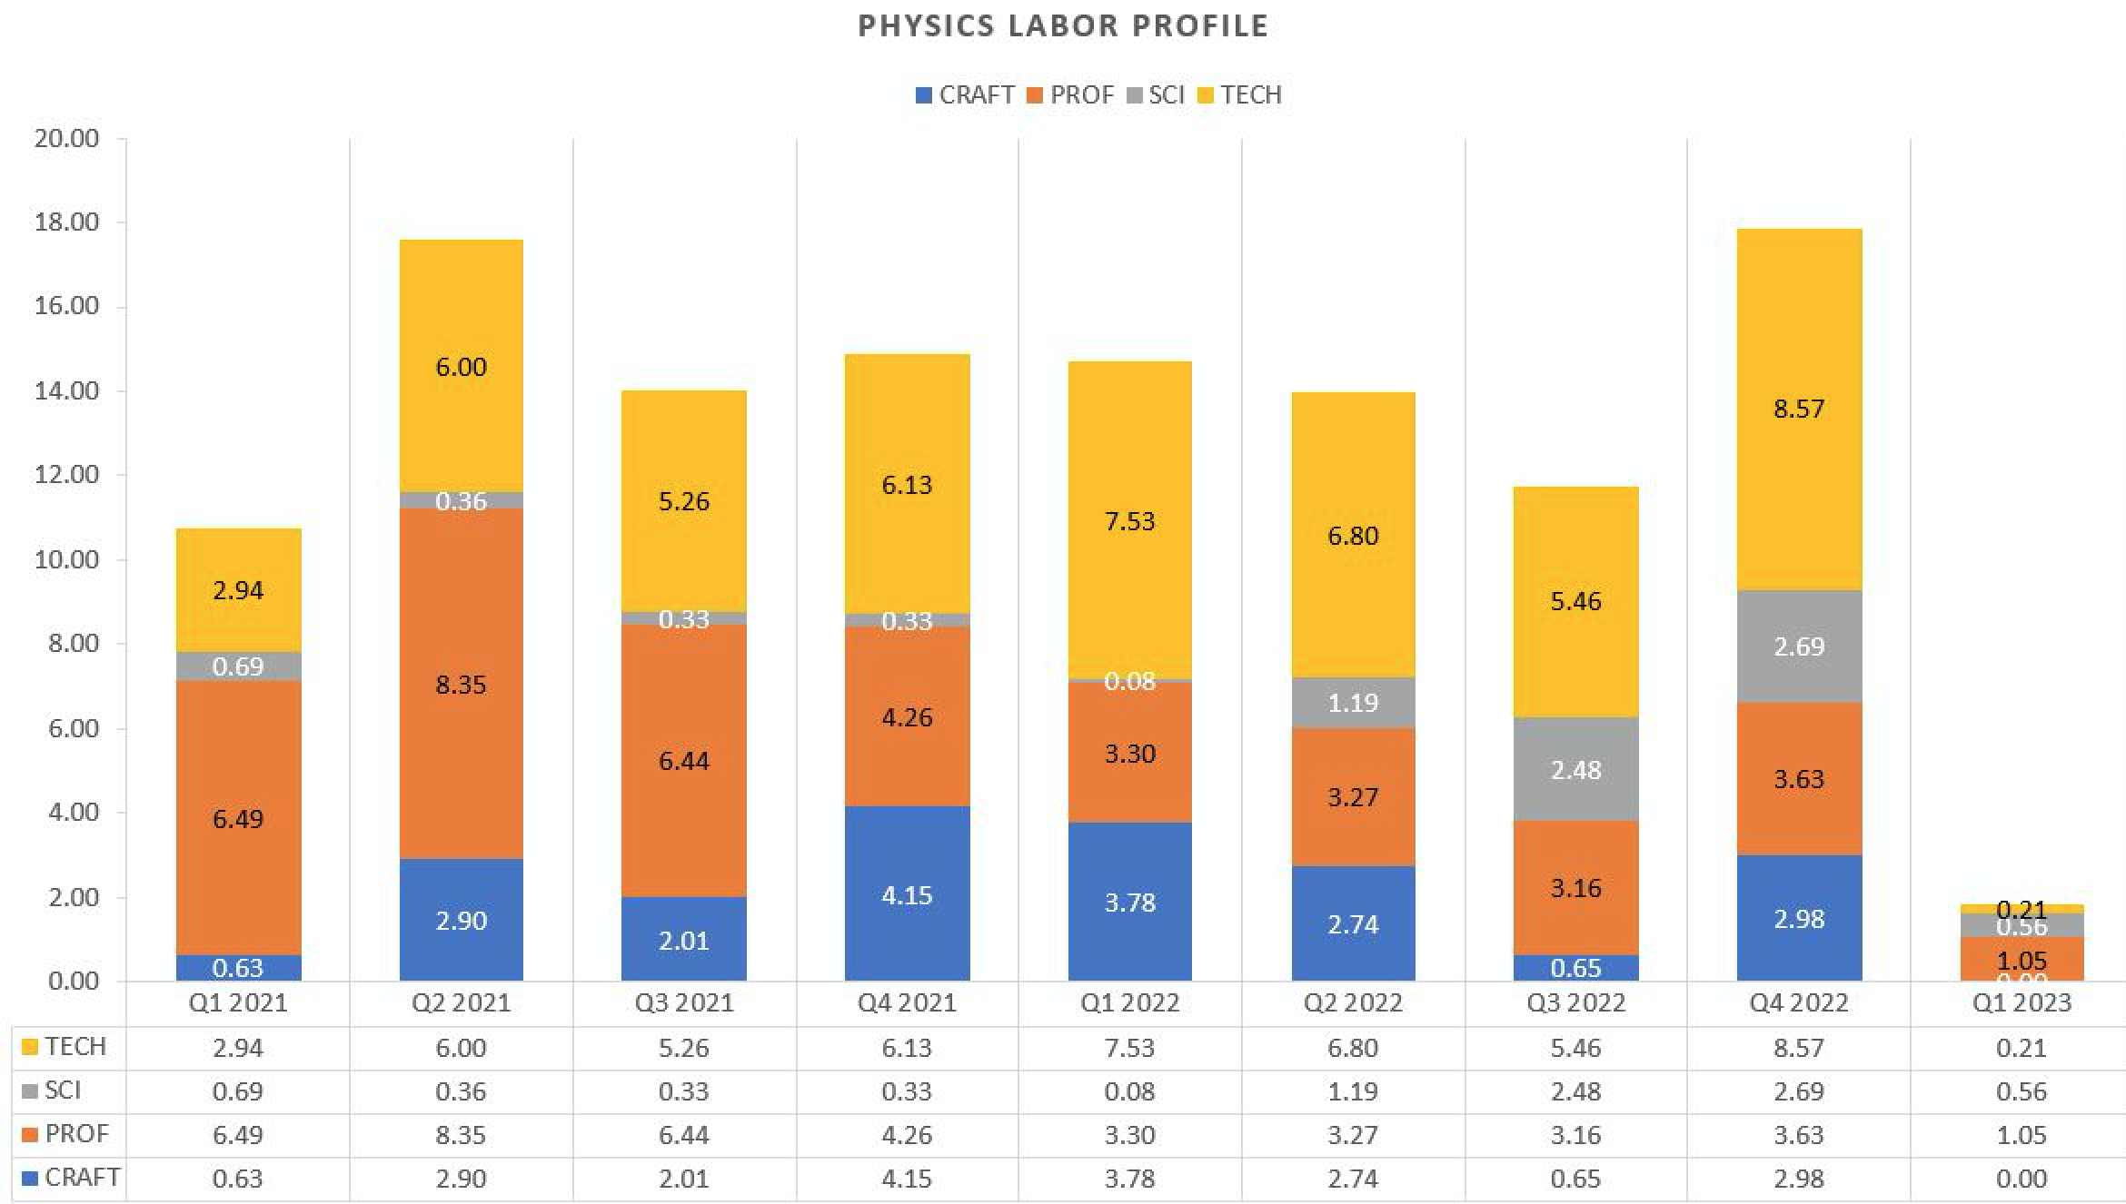
2.X Labor Profile - Physics

Slide 10
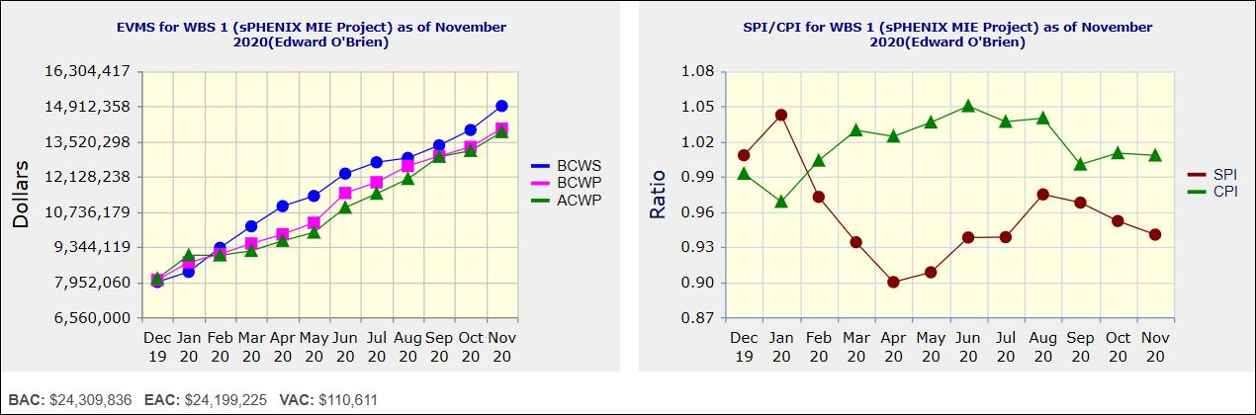
Performance Indices – sPHENIX MIE
Cumulative SPI | Cumulative CPI
0.94 | 1.01
Cumulative BCWS (Scheduled) | $14,915,485
Cumulative BCWP (Performed) | $14,019,300
Cumulative ACWP (Actual) | $13,885,041
DOE SPI or CPI Value Thresholds
0.90 to 1.15
0.85 to 0.89 or 1.16 to 1.25
<0.85 or >1.25

Slide 11
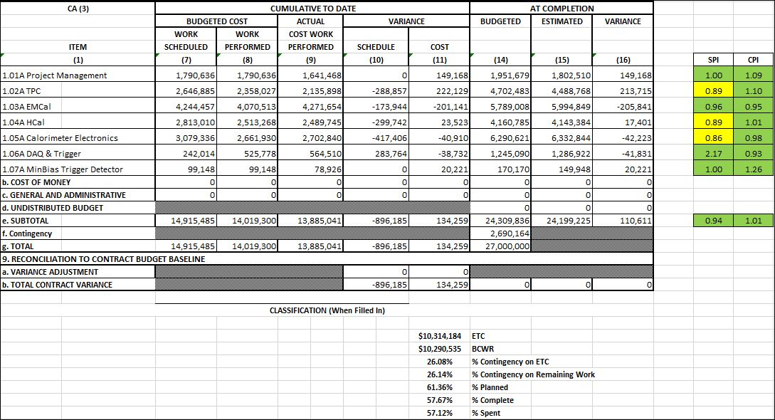
Cost Performance Report (CPR) – sPHENIX MIE
DOE SPI or CPI Value Thresholds
0.90 to 1.15
0.85 to 0.89 or 1.16 to 1.25
<0.85 or >1.25
*Highlights in table above takes variance $ into consideration, not just Indices

Slide 12
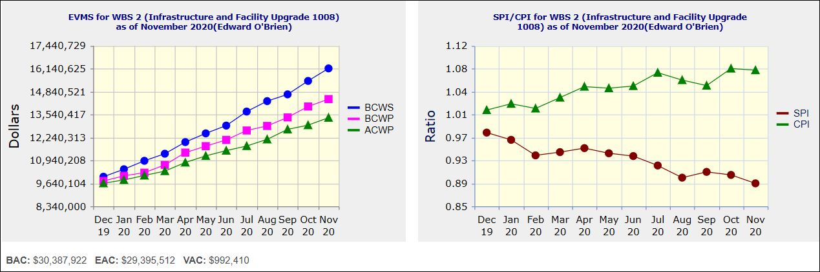
Performance Indices – 1008 Infra and Facility Upgrade
Cumulative SPI | Cumulative CPI
0.89 | 1.08
Cumulative BCWS (Scheduled) | $16,147,984
Cumulative BCWP (Performed) | $14,408,982
Cumulative ACWP (Actual) | $13,355,686
DOE SPI or CPI Value Thresholds
0.90 to 1.15
0.85 to 0.89 or 1.16 to 1.25
<0.85 or >1.25

Slide 13
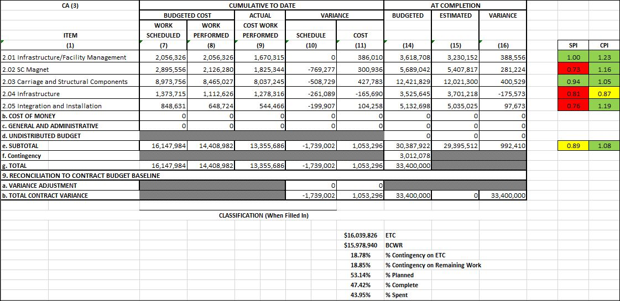
Cost Performance Report (CPR) – 1008 Infra and Facility Upgrade
DOE SPI or CPI Value Thresholds
0.90 to 1.15
0.85 to 0.89 or 1.16 to 1.25
<0.85 or >1.25
*Highlights in table above takes variance $ into consideration, not just Indices

Slide 14
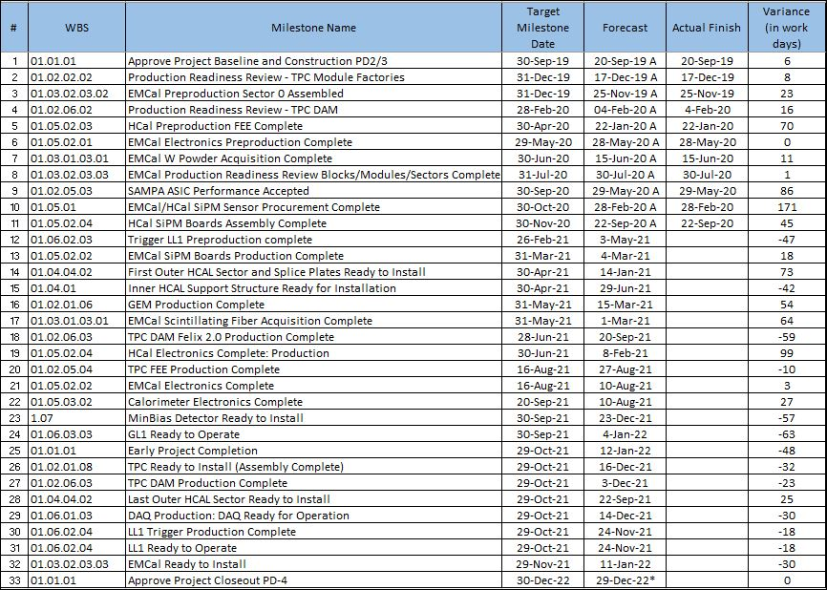
Milestones Status – sPHENIX MIE

Slide 15
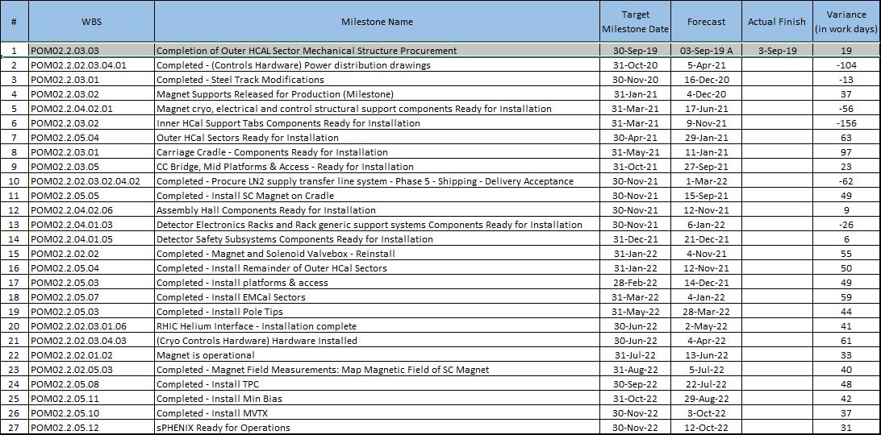
Milestones Status – 1008 Infra and Facility Upgrade

Slide 16
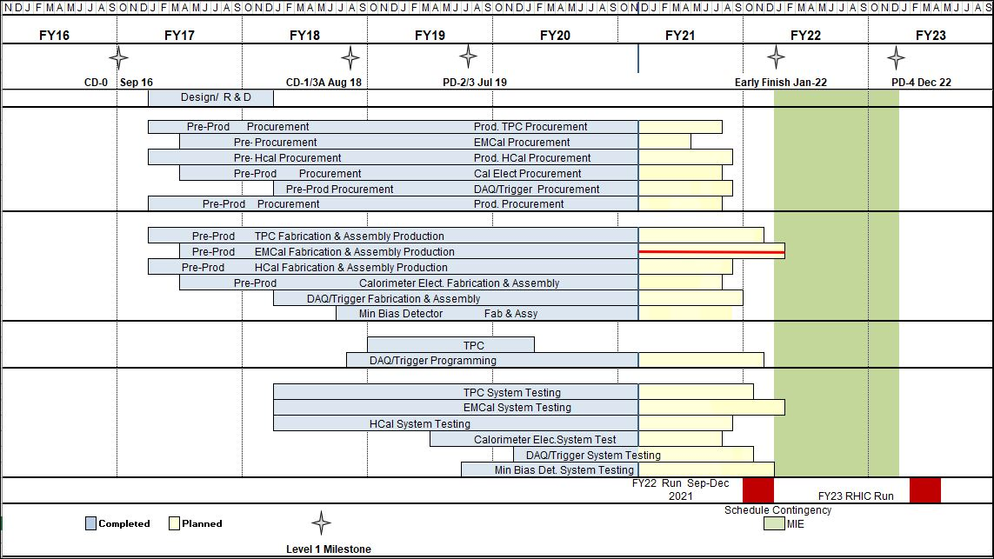
Summary Schedule – sPHENIX MIE

Slide 17
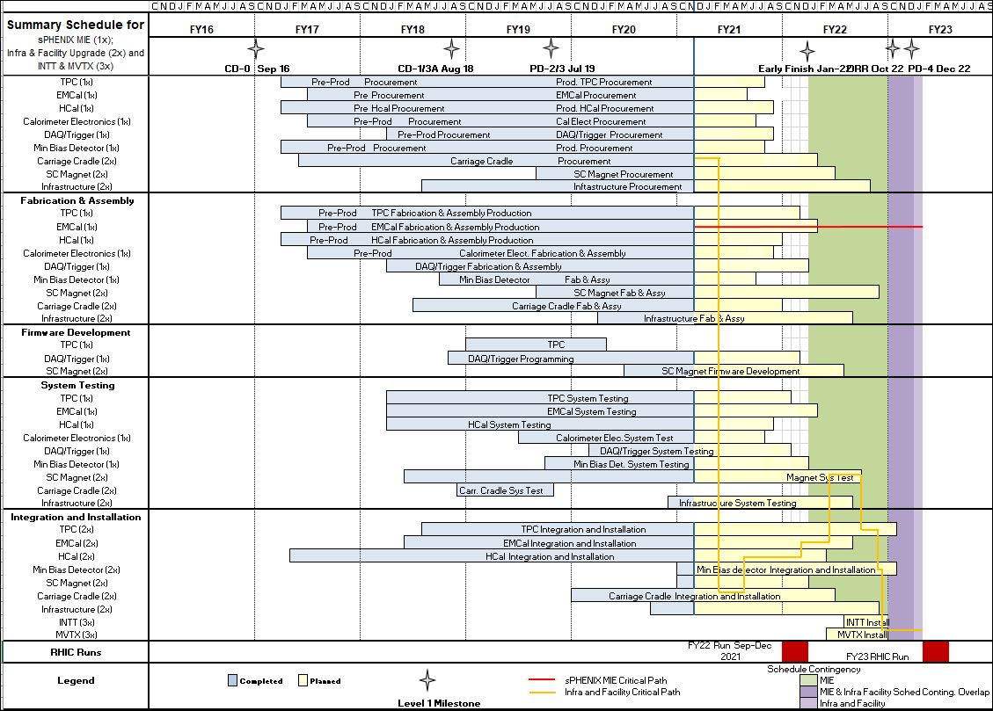
Summary Schedule – sPHENIX MIE and 1008 Infra and Facility Upgrade

Slide 18
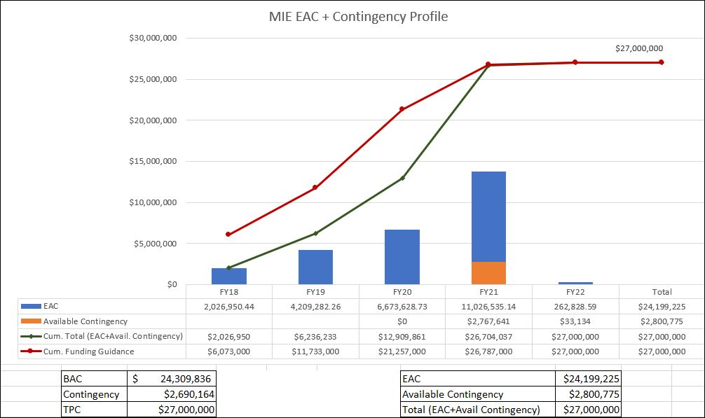
EAC and Contingency Profile – sPHENIX MIE

Slide 19
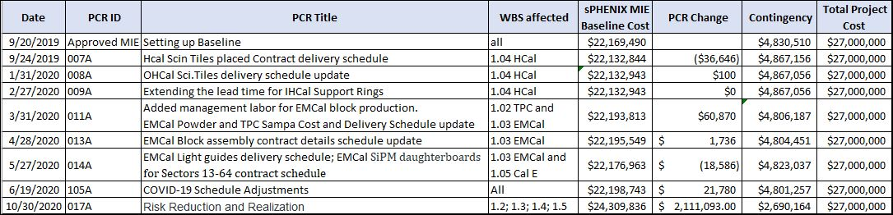
Baseline/Contingency Log - MIE

Slide 20
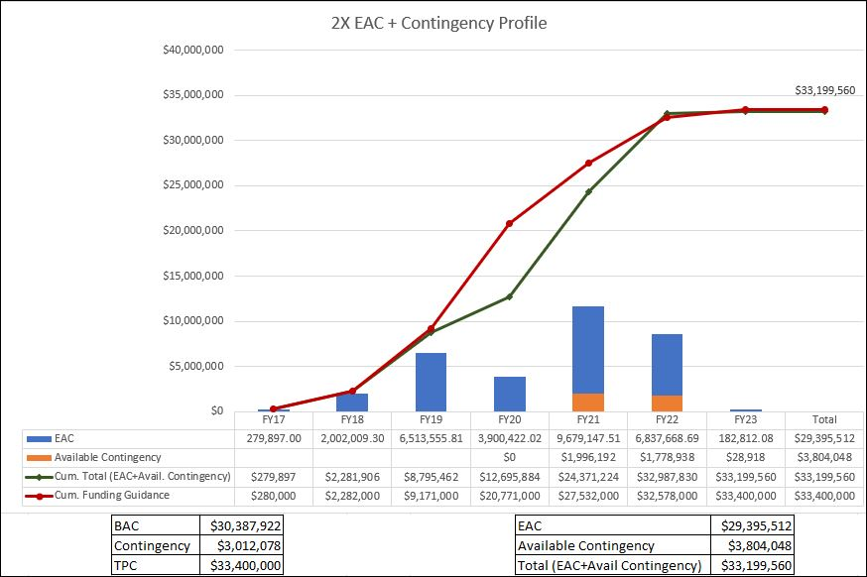
EAC and Contingency Profile – 1008 Infra and Facility Upgrade

Slide 21
Baseline/Contingency Log - 1008 Infra and Facility Upgrade

Slide 22
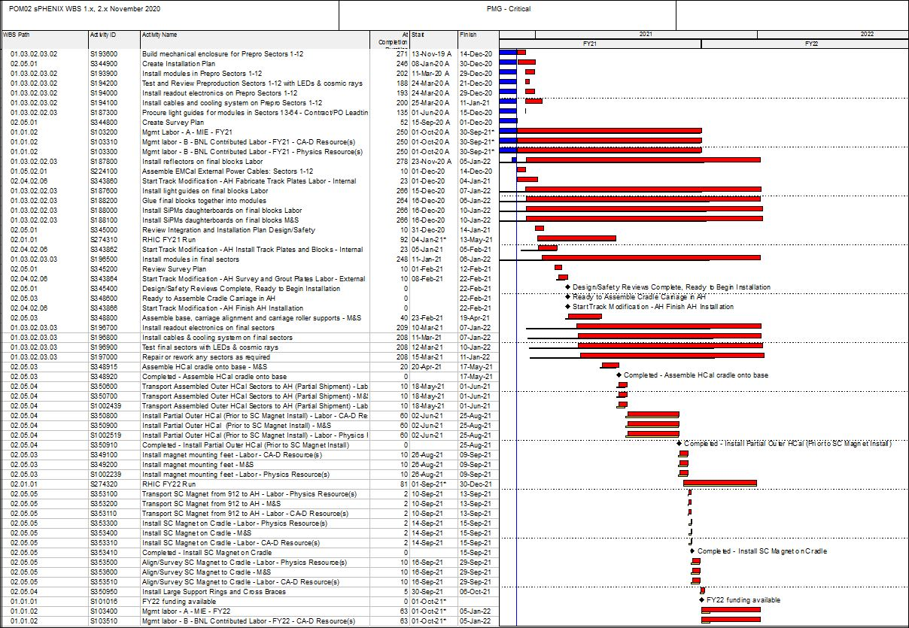
Critical Path (1x, 2x and 3x Combined)

Slide 23
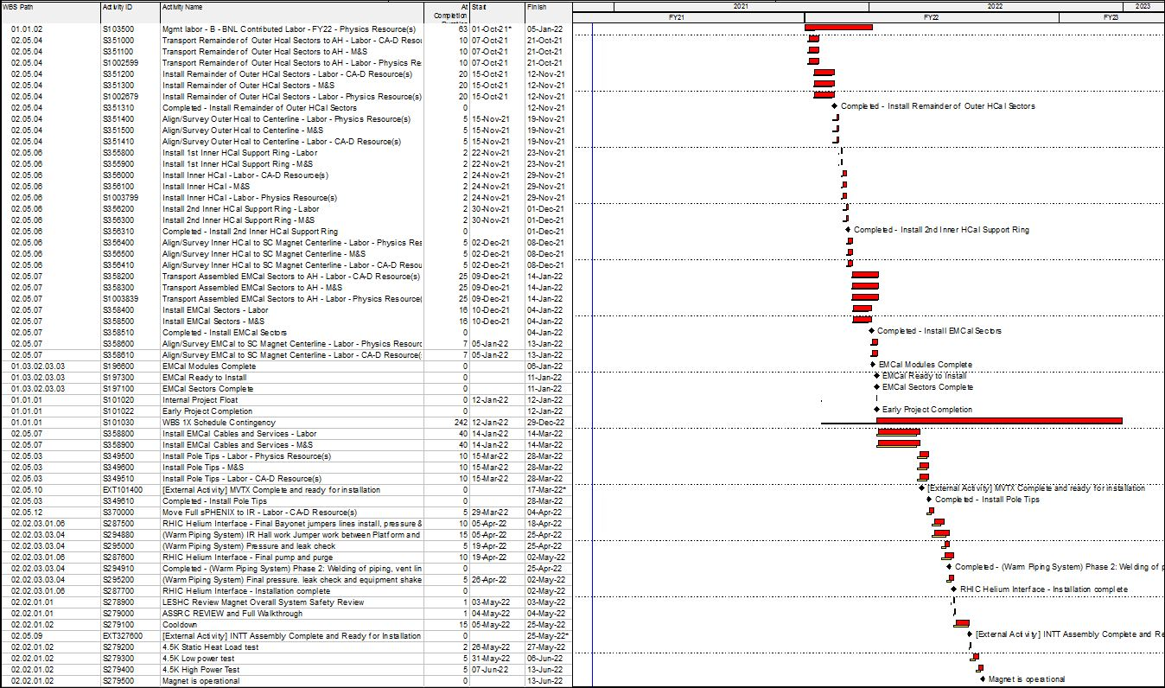
Critical Path (1x, 2x and 3x Combined)

Slide 24
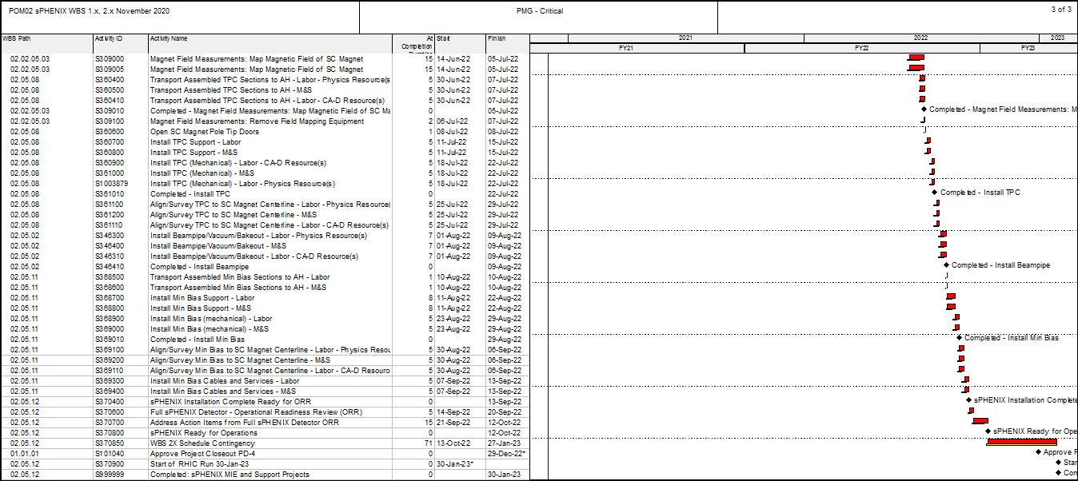
Critical Path (1x, 2x and 3x Combined)

Slide 25
Variance Report – TPC
TPC
Explanation of Variance/Description of Problem:
WBS 1.2.1.6 – GEM acquisition – The GEM start of production was delayed by CERN COVID shutdown leading to a -$47k SV. WBS 1.2.2.3 – TPC GEM Modules R1, R2, R3 – Procure TPC Module Parts – The R1 Pad Planes had to be changed to avoid amplifier saturation in the inner 10 cm. The R2 & R3 pad planes are fully delivered. This leads to a -$50K of SV. WBS 1.2.5.4 – FEE Components Acquisition. The FEE cards had to be rebid due to a failed first bid. This leads to a SV of -$188k. WBS 1.2.7.1 TPC Support System - Laser – manufacture delays experienced in the first magnetic-field-tolerant laser for sPHENIX leads to -$223K of SV. WBS 1.2.7.2 TPC Support System – Gas System – Gas system components order delayed with -$40k of SV. WBS 1.2.7.3 TPC Support System – Cooling System – Bench test required for validation delayed due to COVID. This leads to -$63k of SV.
Impact:
WBS 1.2.1.6 – GEM acquisition – impact none. GEMs have 92 days float. WBS 1.2.2.3 – TPC GEM Modules R1,R2,R3 – Procure TPC Module Parts – impact none. Pad plane has 47 days float. WBS 1.2.5.4 – FEE Components Acquisition. Impact none, 30 days of float. WBS 1.2.7.1 TPC Support System - Laser impact none. Optics has 103 days float. WBS 1.2.7 TPC Support System – Gas System – Impact none. The system has 80 days float; impact none. WBS 1.2.7 TPC Support System – Cooling System – Impact none. The system has 31 days float; impact none.
Corrective Action:
WBS 1.2.1.6 – GEM acquisition – none. WBS 1.2.2-4.3 – TPC GEM Modules R1,R2,R3 –R1 design in engineering review. WBS 1.2.5.4 – FEE Components Acquisition – Improve testing plan for increased parallelization to recoup time after first article deliveries. WBS 1.2.7.1 TPC Support System - Laser – none. First article laser expected for test in December. WBS 1.2.7 TPC Support System – Gas System – none. WBS 1.2.7 TPC Support System – Cooling System – Final design review scheduled in December. Parts orders readied.

Slide 26
VarianceReport - HCal
HCal
Explanation of Variance/Description of Problem:
WBS 1.4.2 – OHCal Sector Mechanics (S205100) – the splice plates delivery from the manufacturer is behind schedule, with negative SV =-$303K. This dominates the HCAL schedule variance.
Impact:
WBS 1.4.2 OHCal Sector Mechanics (S205100) – impact none, the splice plates are needed in June 2021 and thus have 120 days float.
Corrective Action:
WBS 1.4.2 OHCal Sector Mechanics (S205100) – the splice plates are under fabrication at a vendor. The vendor has updated the delivery schedule to the end of December 2020. This is still well in advance of when they are required for outer HCAL assembly and no corrective action is required.

Slide 27
Variance Report – Calorimeter Electronics
CalEl
Explanation of Variance/Description of Problem:
WBS 1.5.2 Calorimeter Electronics – EMCal low voltage system has not been delivered due to long lead time on parts. This leads to -$36.5K of SV. WBS 1.5.2 Calorimeter Electronics – EMCal bias power system has not been delivered due to long lead time on parts. This leads to -$35K of SV. WBS 1.5.2 Calorimeter Electronics – EMCal SiPM boards order has not been completed. This leads to -24K of SV. WBS 1.5.2 Calorimeter Electronics –EMCal Interface boards have not been delivered from the vendor. This leads to -$196K of SV. WBS 1.5.2 Calorimeter Electronics – Calorimeter Controller boards were purchased in advance and tested in advance schedule. This leans to +$94K of SV. WBS 1.5.2 Calorimeter Electronics – EMCal interior signal, and power cables order has not been completed delivered by vendors. This leads to -$288K of SV. WBS 1.5.2 Calorimeter Electronics – Calorimeter test pulse boards have not been ordered. This leads to -$8K of SV. WBS 1.5.2 Calorimeter Electronics – EMCal Crates for controllers have not been ordered. This leads to -$5K of SV. WBS 1.5.2 Calorimeter Electronics – HCal SiPM daughter boards were assembled with the preproduction order ahead of schedule. This leads to +$111K of SV. WBS 1.5.2 Calorimeter Electronics - HCal interior power and signal cables were purchased ahead of schedule. This leads to +$94K of SV. WBS 1.5.2 Calorimeter Electronics – HCal external power and signal cables, low voltage system and bias systems have not been delivered. This leads to -$102K of SV.

Slide 28
Variance Report –Calorimeter Electronics
Impact:
WBS 1.5.2 Calorimeter Electronics – EMCal low voltage system- None. The power supplies have been ordered with a delivery date of April 2021. The low voltae crates have already been received and can be used to start rack assembly. WBS 1.5.2 Calorimeter Electronics – EMCal bias power system- None. The bias system has been ordered and the crates delivered. The bias modules are scheduled for an Feb 2021 delivery time and are not needed until the detector is installed into the IR. WBS 1.5.2 Calorimeter Electronics – EMCal SiPM boards- None. The order for the second half of the boards will be placed in December, with an estimated completion date of February 2021. There are sufficient daughter boards to maintain sector assembly. WBS 1.5.2 Calorimeter Electronics –EMCal Interface boards- None. A partial delivery is scheduled for December of 2020, with the completion of the order scheduled for January 2021. Sufficient interface boards are available to keep up the the EMCal sector assembly. WBS 1.5.2 Calorimeter Electronics – EMCal controller boards- None. This task is complete ahead of schedule. WBS 1.5.2 Calorimeter Electronics – EMCal interior signal, and power cables- None. All power cables have been delivered and partial deliveries of signal cables have been received to allow assembly of EMCal ½-sectors to continue on schedule. WBS 1.5.2 Calorimeter Electronics – Calorimeter test pulse boards- None. There are sufficient boards to perform initial EMCal and HCal testing. The balance of the boards are not required until the detector is installed into the IR. WBS 1.5.2 Calorimeter Electronics – EMCal Crates for controllers have not been ordered- None. Crate order will be placed in early 2021 and delivered In time for installation into the racks. WBS 1.5.2 Calorimeter Electronics – HCal SiPM daughter boards- None. This task is complete ahead of schedule. WBS 1.5.2 Calorimeter Electronics – HCal interior power and signal cables, low voltage system- None. The cables have been delivered and are available for installation. The low voltage and bias systems are ordered with an early 2021 delivery date. Rack assembly can start before the scheduled arrival.

Slide 29
Variance Report –Calorimeter Electronics
Corrective Action:
WBS 1.5.2 Calorimeter Electronics – EMCal low voltage system: The order has been placed and the vendor has a strong track record of delivering on time. Will continue to follow up with vendor on delivery schedule to monitor any changes in schedule. WBS 1.5.2 Calorimeter Electronics – EMCal bias power system: The order has been placed and the vendor has a strong track record of delivering on time. Will continue to follow up with vendor on delivery schedule to monitor any changes in schedule. WBS 1.5.2 Calorimeter Electronics – EMCal SiPM boards: Work BNL procurement to see that the order is placed in a timely manner using the vendor that produced the first half of the boards. Vendor delivered the first half of the number of boards required ahead of schedule. Sufficient boards have been received to maintain EMCal ½-Sector assembly. WBS 1.5.2 Calorimeter Electronics –EMCal Interface boards: A partial delivery is scheduled for December of 2020, with the completion of the order scheduled for January 2021. Sufficient interface boards are available to keep up the EMCal ½-sector assembly. WBS 1.5.2 Calorimeter Electronics – EMCal controller boards: This task is complete ahead of schedule. WBS 1.5.2 Calorimeter Electronics – EMCal interior signal, and power cables: All interior power cables have been delivered. Signal cables are being delivered on a regular schedule by the vendor with fully delivery scheduled in February. Sufficient cables have been delivered to meet the EMCal ½-Sector assembly schedule. WBS 1.5.2 Calorimeter Electronics – Calorimeter test pulse boards: These boards will be ordered in early 2021 and are not needed until the digitizer racks are assembled. WBS 1.5.2 Calorimeter Electronics – EMCal Crates for controllers: These crates are stock items and will be ordered in early 2021 with delivery scheduled before rack assembly starts in mid-2021. WBS 1.5.2 Calorimeter Electronics – HCal SiPM daughter boards: This task is complete ahead of schedule. WBS 1.5.2 Calorimeter Electronics – HCal interior power and signal cables, low voltage system: The power cables and signal cables have been delivered and are available for installation into HCal sectors. The low voltage and bias systems are ordered with an early 2021 delivery date. The crates for them have been received allowing for assembly of the HCal power racks.

Slide 30
Variance Report –DAQ/Trigger
Corrective Action:
WBS 1.5.2 Calorimeter Electronics – EMCal low voltage system: The order has been placed and the vendor has a strong track record of delivering on time. Will continue to follow up with vendor on delivery schedule to monitor any changes in schedule. WBS 1.5.2 Calorimeter Electronics – EMCal bias power system: The order has been placed and the vendor has a strong track record of delivering on time. Will continue to follow up with vendor on delivery schedule to monitor any changes in schedule. WBS 1.5.2 Calorimeter Electronics – EMCal SiPM boards: Work BNL procurement to see that the order is placed in a timely manner using the vendor that produced the first half of the boards. Vendor delivered the first half of the number of boards required ahead of schedule. Sufficient boards have been received to maintain EMCal ½-Sector assembly. WBS 1.5.2 Calorimeter Electronics –EMCal Interface boards: A partial delivery is scheduled for December of 2020, with the completion of the order scheduled for January 2021. Sufficient interface boards are available to keep up the EMCal ½-sector assembly. WBS 1.5.2 Calorimeter Electronics – EMCal controller boards: This task is complete ahead of schedule. WBS 1.5.2 Calorimeter Electronics – EMCal interior signal, and power cables: All interior power cables have been delivered. Signal cables are being delivered on a regular schedule by the vendor with fully delivery scheduled in February. Sufficient cables have been delivered to meet the EMCal ½-Sector assembly schedule. WBS 1.5.2 Calorimeter Electronics – Calorimeter test pulse boards: These boards will be ordered in early 2021 and are not needed until the digitizer racks are assembled. WBS 1.5.2 Calorimeter Electronics – EMCal Crates for controllers: These crates are stock items and will be ordered in early 2021 with delivery scheduled before rack assembly starts in mid-2021. WBS 1.5.2 Calorimeter Electronics – HCal SiPM daughter boards: This task is complete ahead of schedule. WBS 1.5.2 Calorimeter Electronics – HCal interior power and signal cables, low voltage system: The power cables and signal cables have been delivered and are available for installation into HCal sectors. The low voltage and bias systems are ordered with an early 2021 delivery date. The crates for them have been received allowing for assembly of the HCal power racks.

