Slide 1
Progress on Raw Signal Processing
Review of Signal Processing
Deconvolution
Improvement in ROI algorithm
New Challenge of induced change
A new scheme
About Filter
Thoughts on Tracking
Xin Qian
Thanks Craig, Jyoti, Bo, Leon (SLAC), Bruce (FNAL), Herb (FNAL), Tingjun (FNAL) for helpful discussions

Slide 2
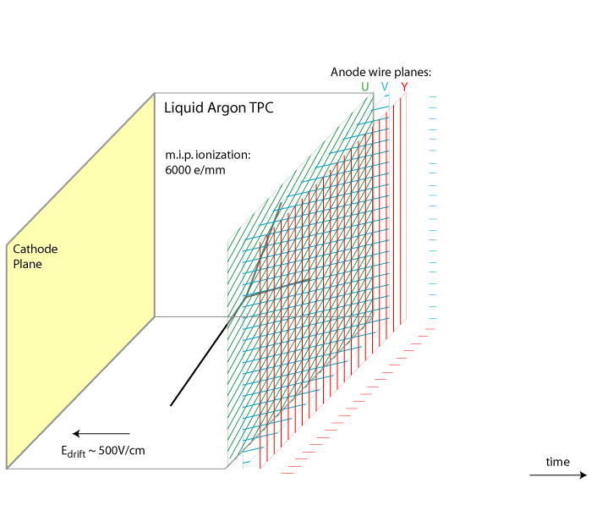
Review of Signal Processing
Number of ionized electrons
Field Response
Signal on Wire Plane
Electronics
Response
Signal to be digitized by ADC
Deconvolution
High-level tracking …
V. Radeka
time

Slide 3
Deconvolution (I)
Goal is to obtain “S”
Inversion of Matrix: > O(n³)
Deconvolution through Fast Fourier Transformation
O(n log(n))
Matrix Format:

Slide 4
Deconvolution (II)
Time domain
Fourier transformation
Frequency domain
Anti-Fourier transformation
Back to time domain

Slide 5
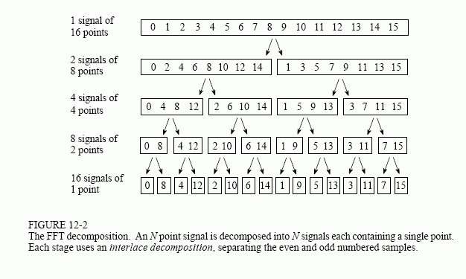
Fast Fourier Transformation
1965, discovered by James Cooley (IBM) and John Tukey (Princeton and AT&T Bell)
One of the top-10 algorithm in 20th century

Slide 6
Improvement in ROI algorithm
TPC time window is long
  9600 bins in MicroBooNE covering 4.8 ms
  Signal is usually short, thus region of interest (ROI)
  No need to do deconvolution on the entire window
Improvement in ROI algorithm
  Simulation
  Deconvolution kernel
  Selection/merge of ROI
  Git + LArSoft (Thanks Brett)
  5-days work at IIT workshop

Slide 7
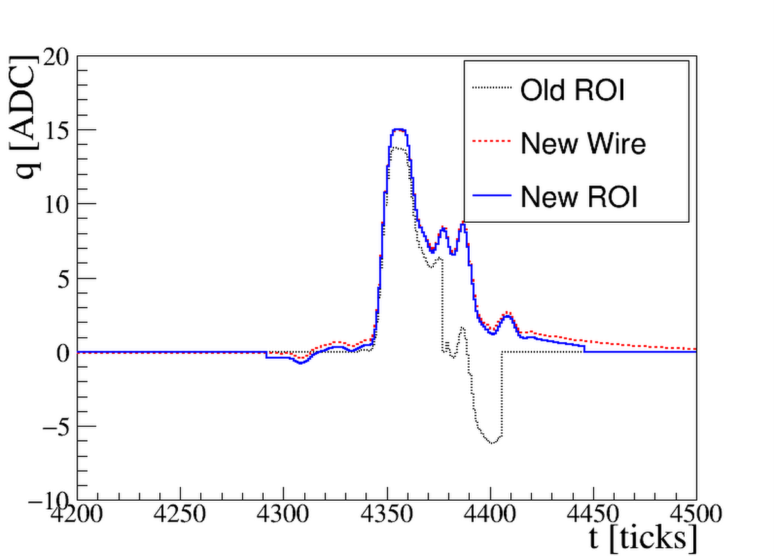
Results of Improvement

Slide 8
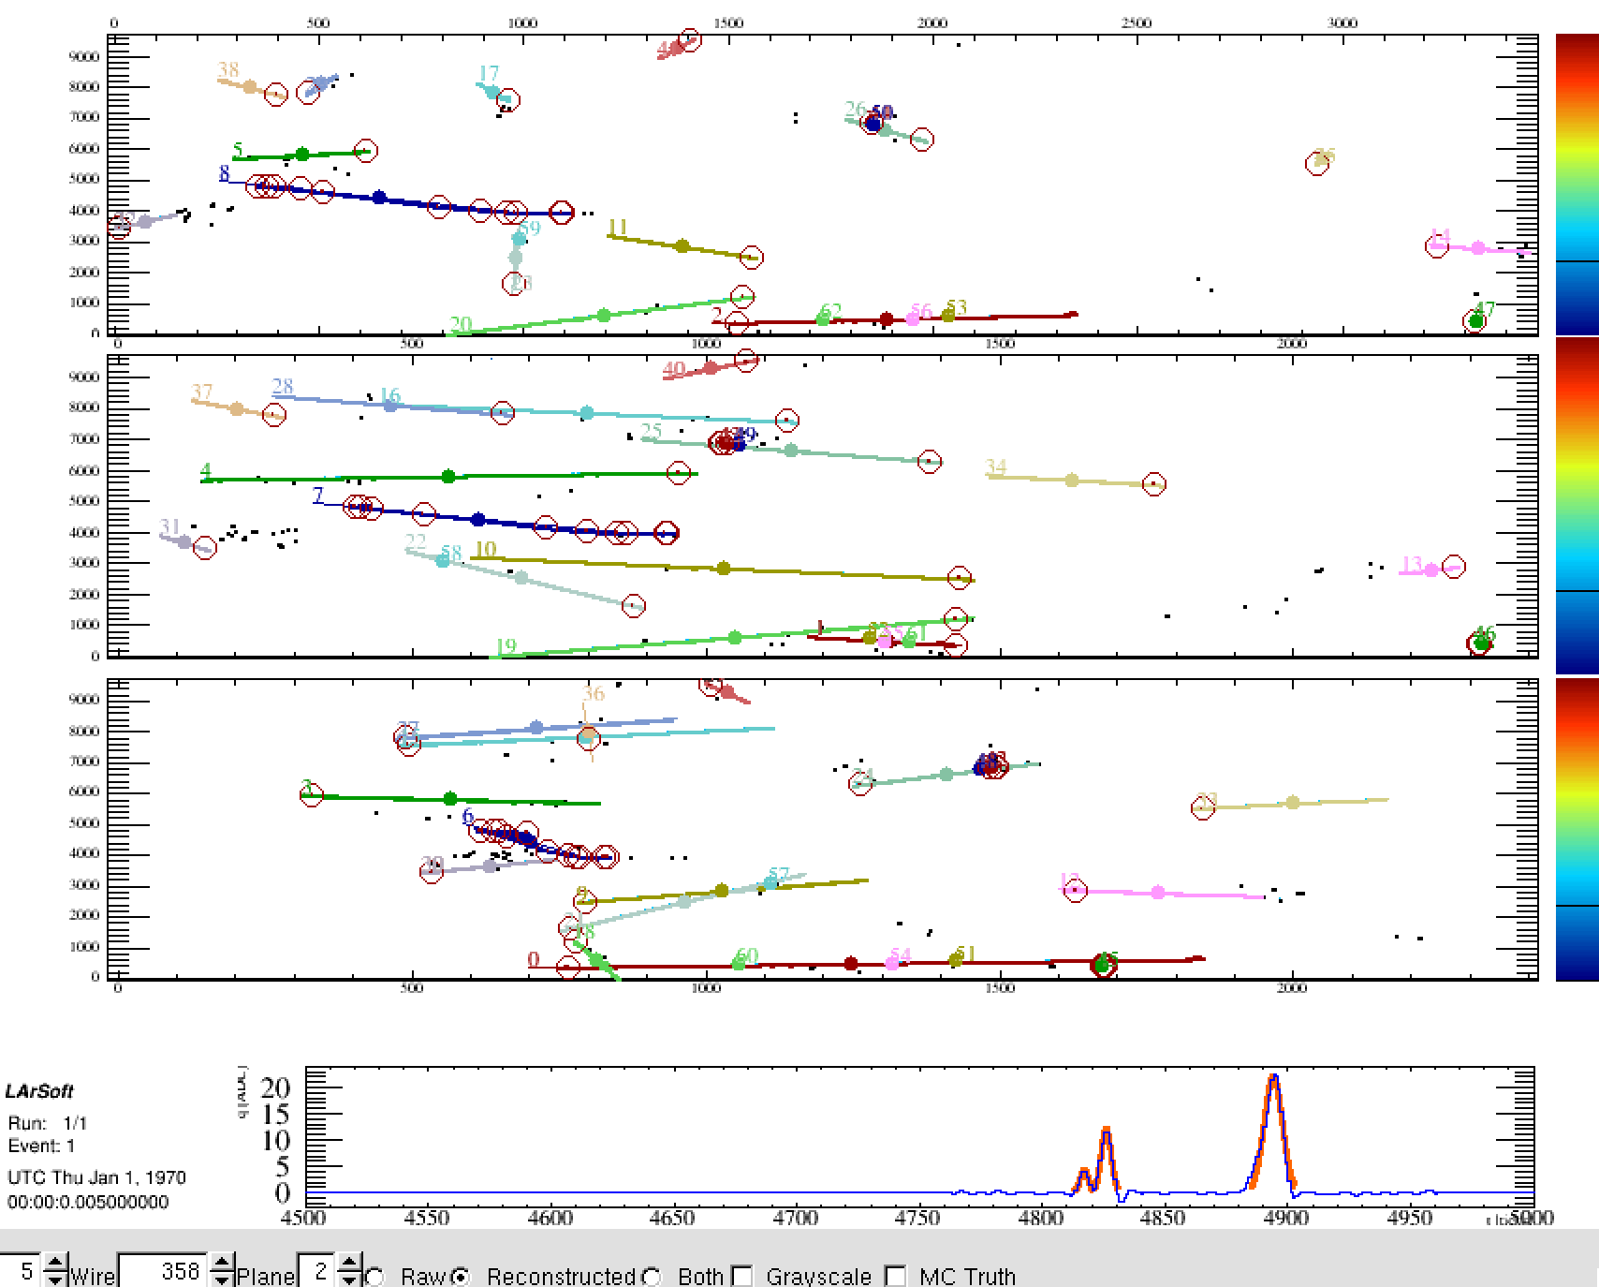
Results of Improvement
From Tracy

Slide 9

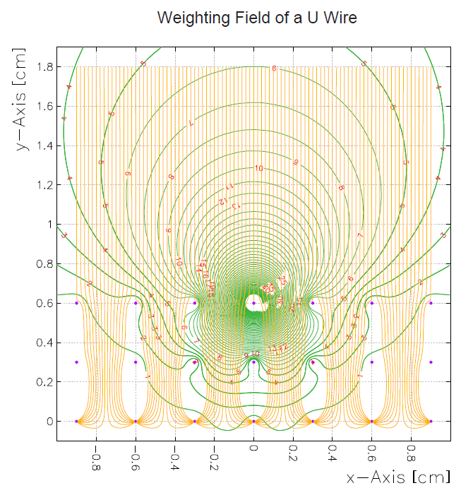
A new Challenge: Induced Charge in Adjacent Wires
V. Radeka Ann. Rev. Nucl. Part. Sci. 38, 217, 1988
v: velocity
E_{w}: weighting field
q_{m}: charge
Bo Yu

Slide 10
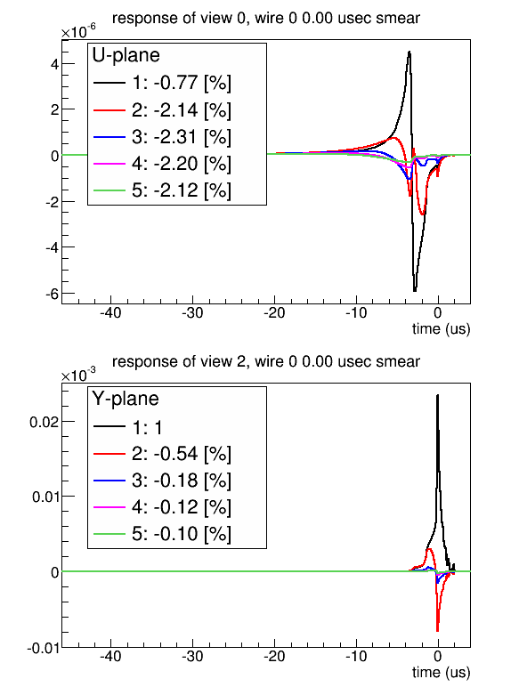
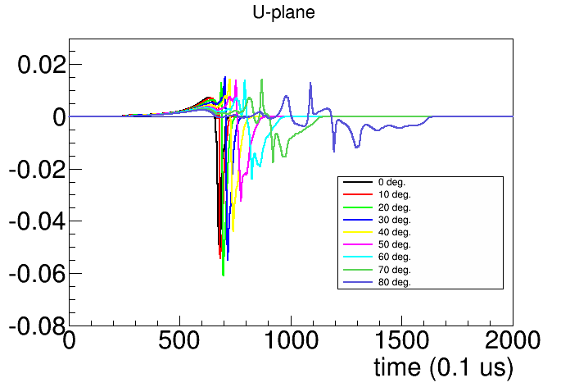
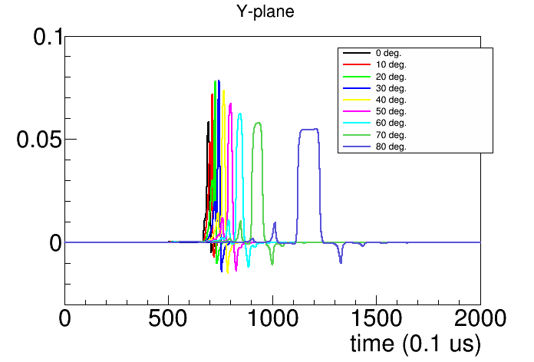
Induced Charge in Adjacent Wires

Slide 11
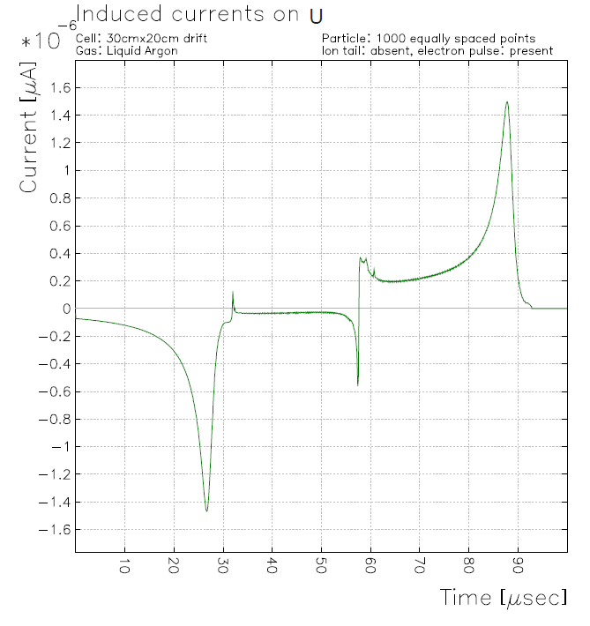
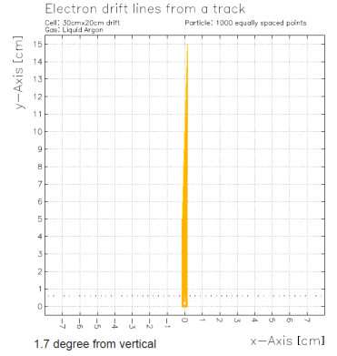
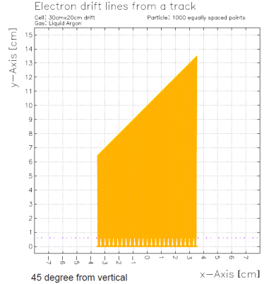
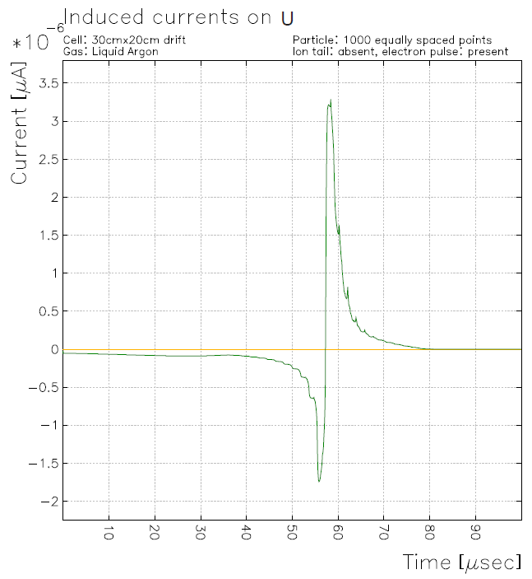
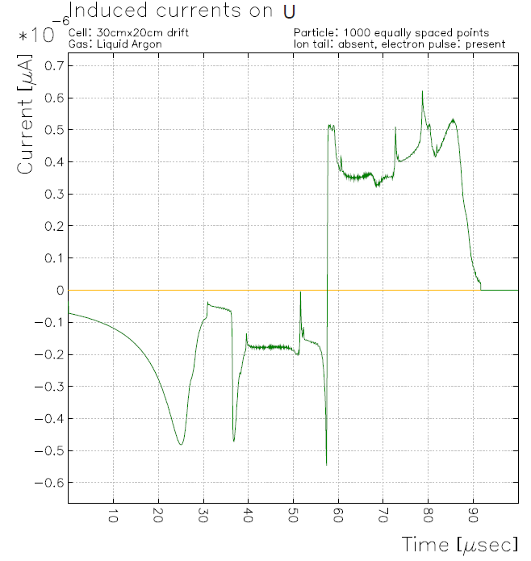
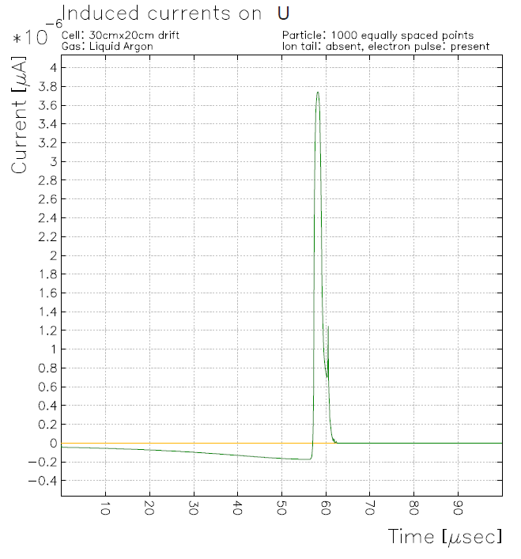
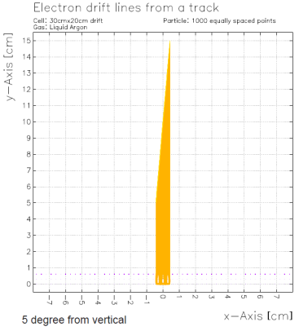
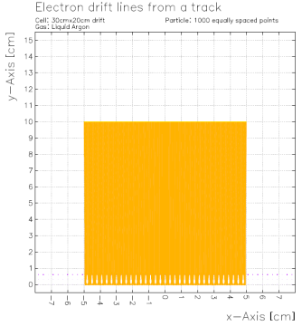
Bo’s Garfield Simulation
1.7 deg 45 deg
5 deg 90 deg

Slide 12
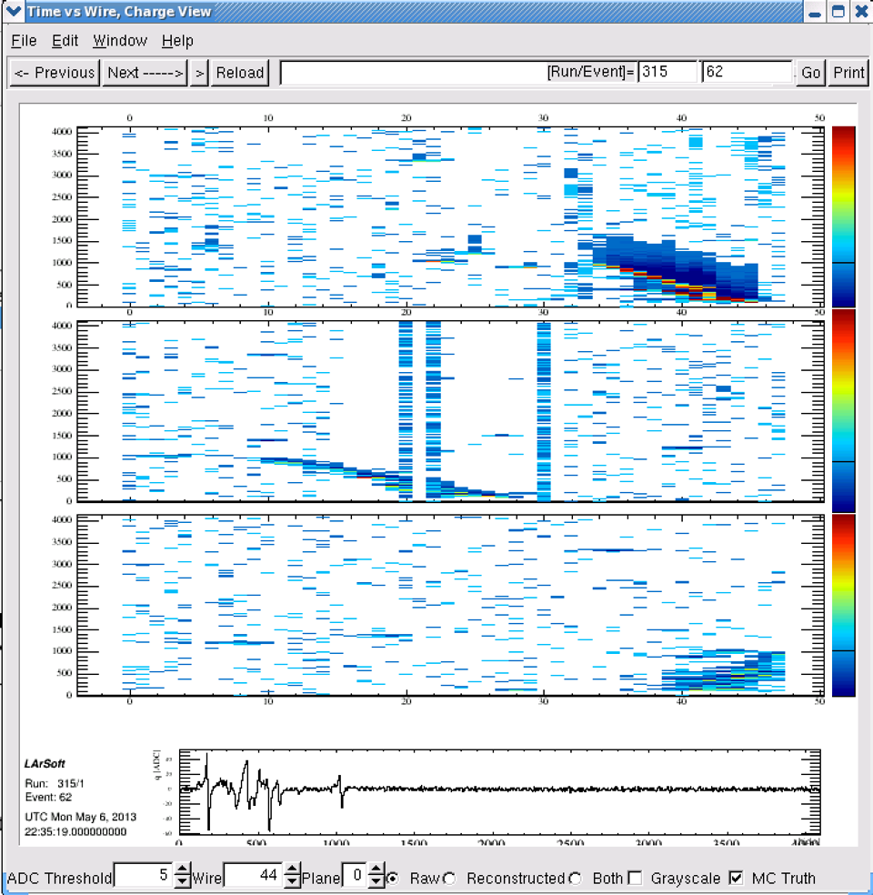
LongBo Data (internal)
Cosmic Muon Data
5 wires firing for 500 ticks
Looks like induced signal on adjacent wires

Slide 13
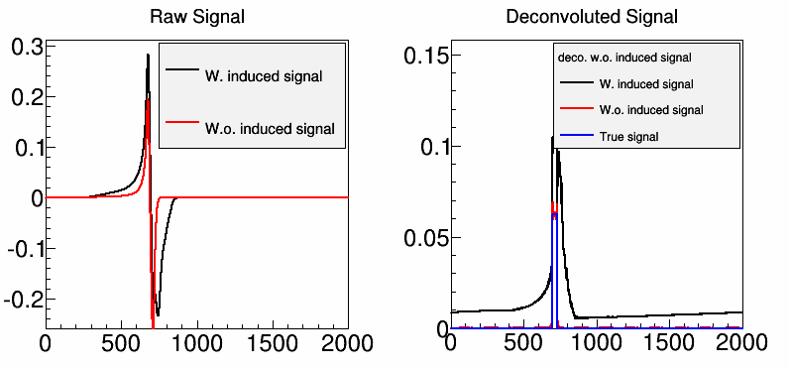
Impact on Deconvolution
Mismatched kernel between convolution and deconvolution

Slide 14
A New Scheme
With induced signals, the signal is still linear sum of direct signal and induced signal
  R₁ represents the induced signal from i+1th wire signal to ith wire
  S_{i} and S_{i+1} are not directly related

Slide 15
If we ignored the Rn when n is large
The inversion of matrix R can again be done with deconvolution through FFT

Slide 16
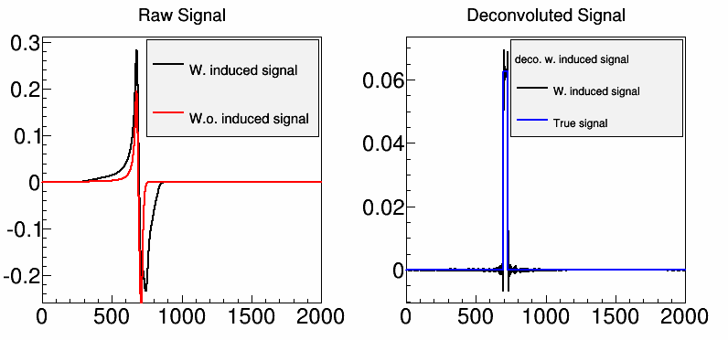
After Implement the Matrix Form

Slide 17
What about neutrino interactions
The implementation of this scheme would need to consider resources: memory, speed etc
Also need to calibrate the response: strong motivation of point-like radioactive sources
New ROI Scheme
Replace unreliable edges
Details to be worked out

Slide 18
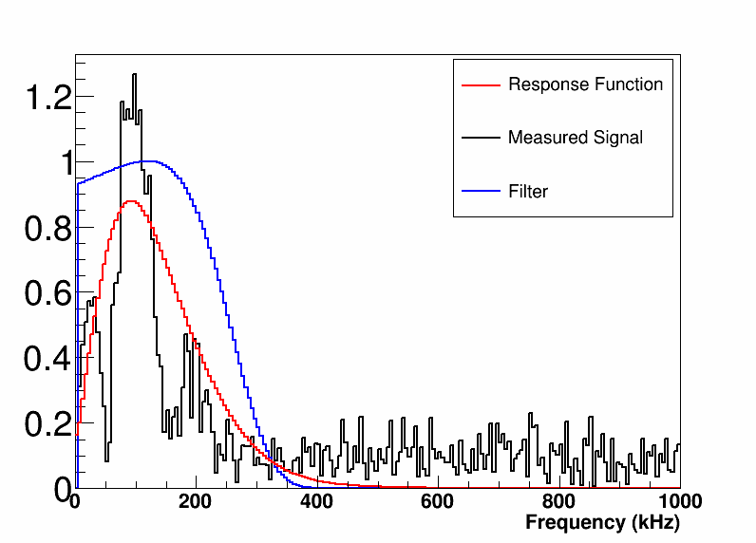
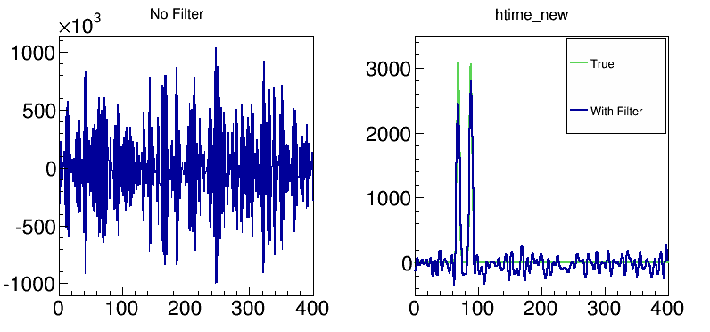
Deconvolution
Time domain
Fourier transformation
Frequency domain
Anti-Fourier
transformation
Back to time domain
Notes:
Explain
1. What is filter like in the frequency domain?
2.Why filter is necessary (e.g. plot results w and w.o. filter )
3. Why we need a zero at zero frequency?

Slide 19
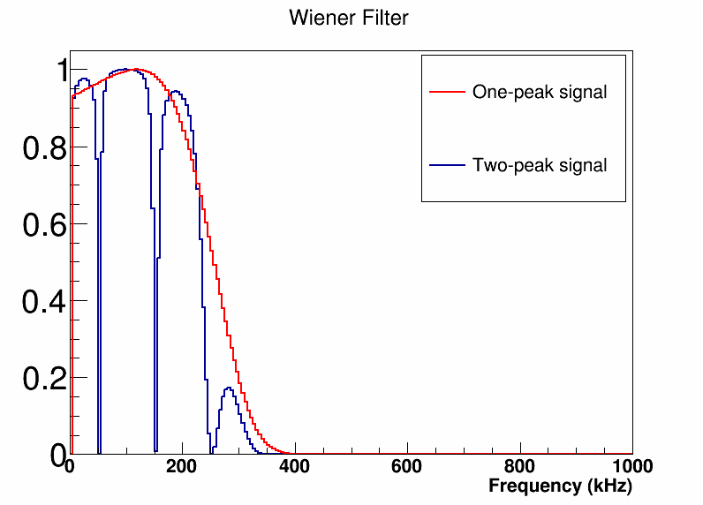
Weiner Filter
The Filter (in LArSoft) are pre-calculated according to “some kind of signal”, will not be optimized for every signal

Slide 20
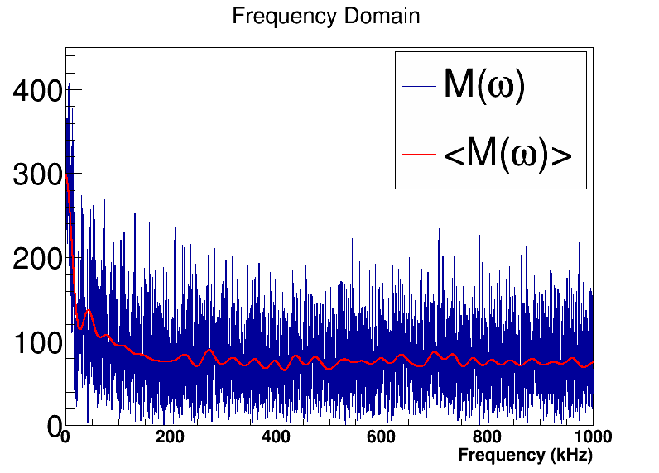
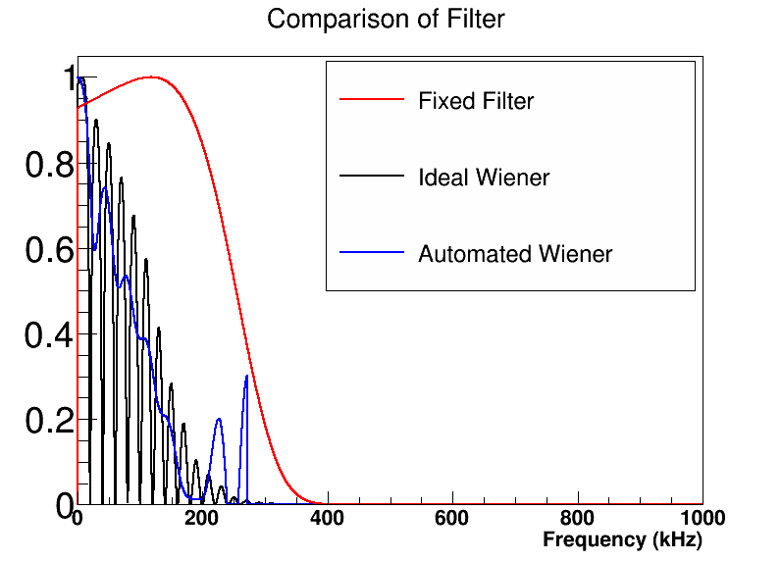
Can we make an automated Weiner filter?
Do another FFT and cutoff the high frequency region

Slide 21
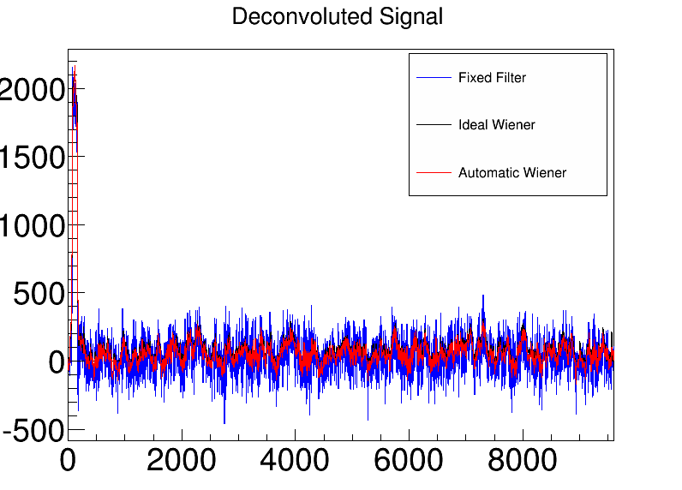
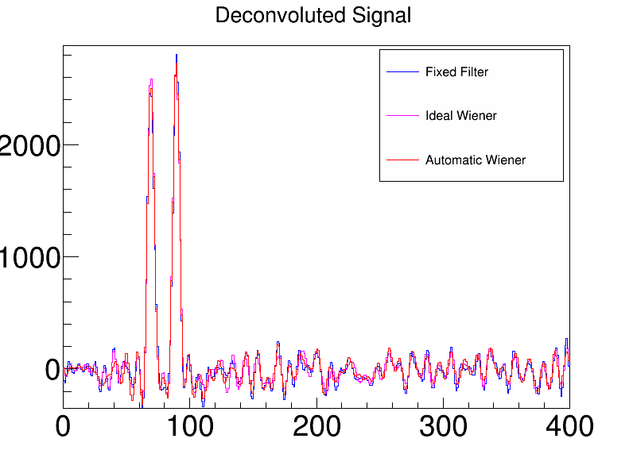
Performance of Automatic Filter
Automated filter has a similar performance as ideal one
At long window (more noise to filter), automated/ideal filter lead to smaller noise
At short window (less noise to filter), not much difference
  Good for ROI, smaller window, but not too small due to the need of baseline restoration

Slide 22
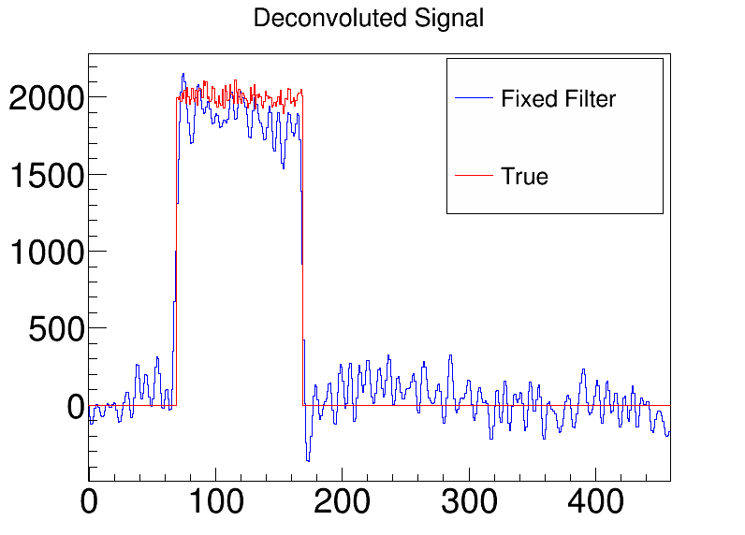
Impact of Filter with Signal
Difference between the deconvoluted signal and true signal
  Impact of noise
  Impact of Filter:
  Filter reduces
  noise a lot at
  the cost of
  reducing some
  signals
  But our signal has meaning → number of electrons reached the wire plane
    It is desired to get the correct charge from induction planes

Slide 23
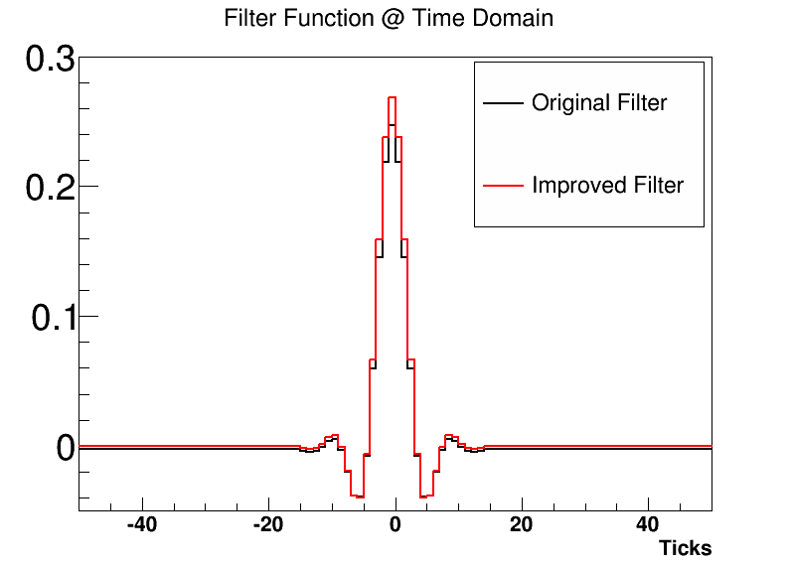
Getting a Better Filter
We recommend fixed filter
  Given noise level in the raw signal, we can easily predict the noise level after the filter
  Given smaller time window, automated filter does not have much advantages
  We can also make a fixed filter which conserve area!
In the time domain, this is basically the convolution of Signal with Filter function
1. Fix baseline at zero
2. Scale the filter, so that the integral is equal to one

Slide 24
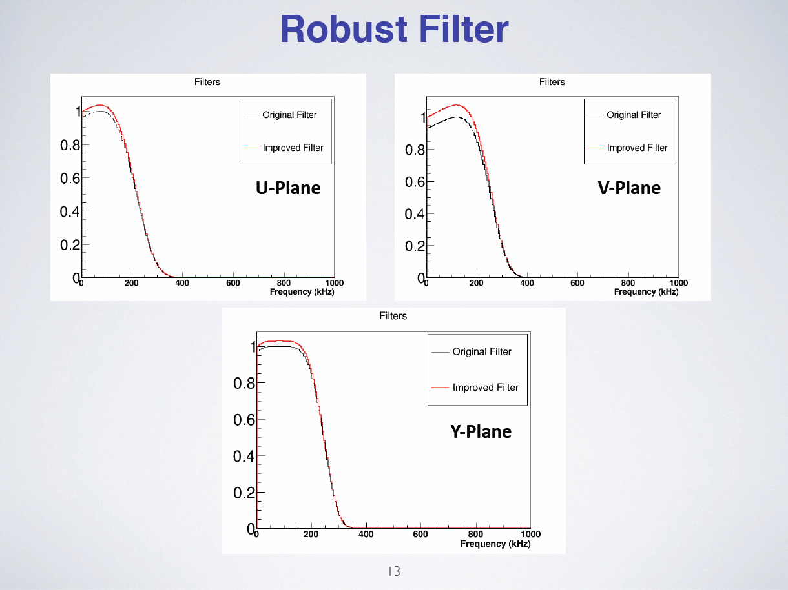
Better Filter
From Jyoti
Now, we should have good charge information from all three planes

Slide 25
How to use charge information in Tracking?
One of the main challenges of tracking is due to the wire readout in TPC
  At fixed time t, the ultimate degrees of freedom in a plane should be “N²”, given a particular wire pitch
  While the wire readout give a constraint of “3N”
  Ambiguity is difficult to be totally removed
    Faked hits when there are many hits at fixed time “t”
u2
v3
True Hits
v2
Use two-plane as an example
Red points are true hits
Blue ones are fake hits
Using only time, one can not differentiate the true and faked hits
At u1, there are two hits, so u1 will see the total change of both hits
u1
v1
At fixed time
Fake Hits

Slide 26
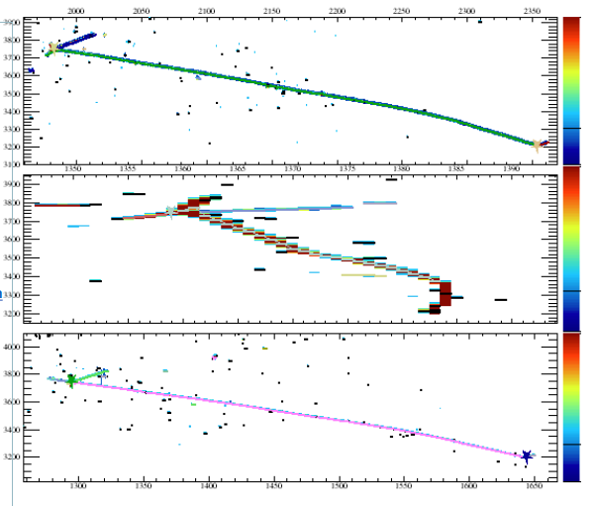
Current solution:
Use the time information first
  Track should be continuous in time
Do tracking in 2-D (time vs. wire number)
Combine three planes into a 3-D tracking
Difficult for Shower, when there are many tracks
Time
Wire Number

Slide 27
New input from Charge
We can in principle remove faked hit by looking at the charge information
  Preliminary algorithm
    Find out all potential hits including faked hits (H_{i})
    We can then form a matrix
This matrix is known
It represents the knowledge
  When there is a hit in 3D, we can predict definitely how much electrons are seen by each wire
  Same charge should be seen by three wires
…….

Slide 28
One Example
u2
v3
True Hits
v2
u1
H1
v1
At fixed time
H2
H4
Fake Hits
H5
H3
H6
There will be less faked hits with 3-plane readout

Slide 29
Discussion
Now, the problem becomes inversion of a matrix
  Difficult to do by human brains
  Easy to do by computer
Fake hit will naturally give close-to-zero charge
  Assuming matrix is invertible, if not more tricks are needed
    There is a potential fundamental degeneracy
Need to/Can take into account time → unfolding (coarse binning in time needed)
How to deal the case when the matrix is not invertible???
Details to be worked out

Slide 31
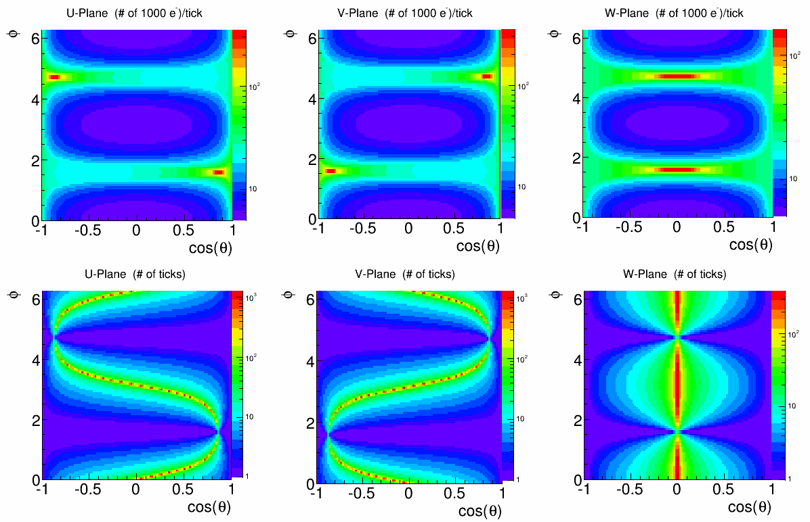
E-field = 500 V/cm, Tele = 3 ms
Suppression factor (0.58,1), 2.2 MeV, 1 meter

Slide 32
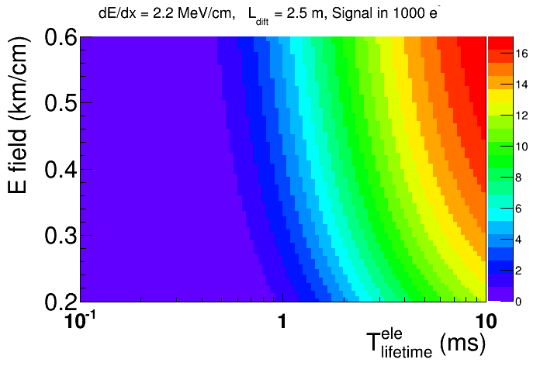
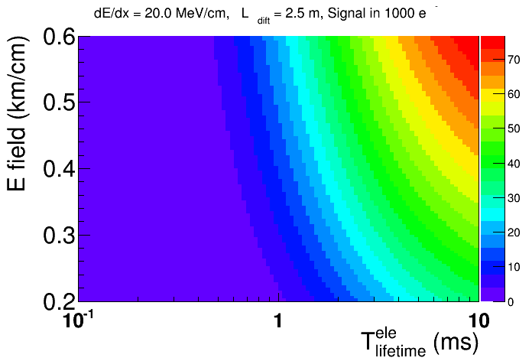
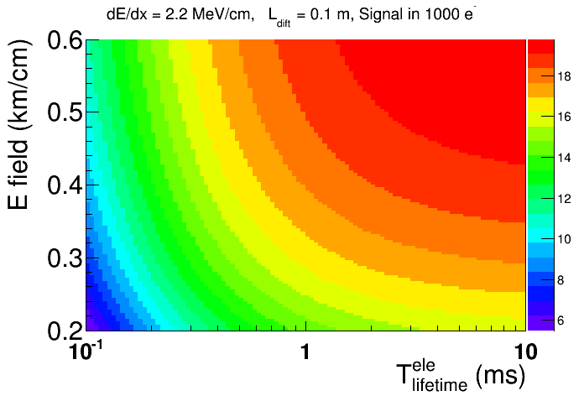
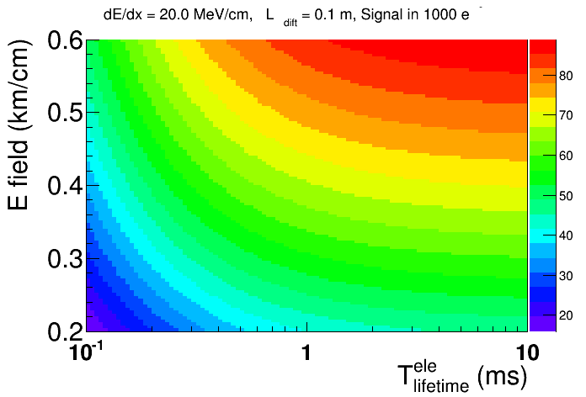
Assume the angle is parallel to the wire plane, but perpendicular to wire

Slide 33
