Slide 1
Unified MFA with PrivacyIDEA
FreeIPA + Keycloak + PrivacyIDEA

Slide 2
PrivacyIDEA
Enterprise ready opensource modular authentication system.
Comes with a variety of MFA tokens and features built-in.
Easy to integrate to other systems with the use of plug-ins.
Ex. PAM, OTRS, Apache2, FreeRADIUS, ownCloud, simpleSAMLphp and Keycloak.
Customizable by utilizing the built-in REST API and event handlers.
Policies to allow modification of system.
Ex.auth, webui, max tokens etc.
Ability to map single realm to multiple external realms in Keycloak. (1 token for IPA & Keycloak)

Slide 3
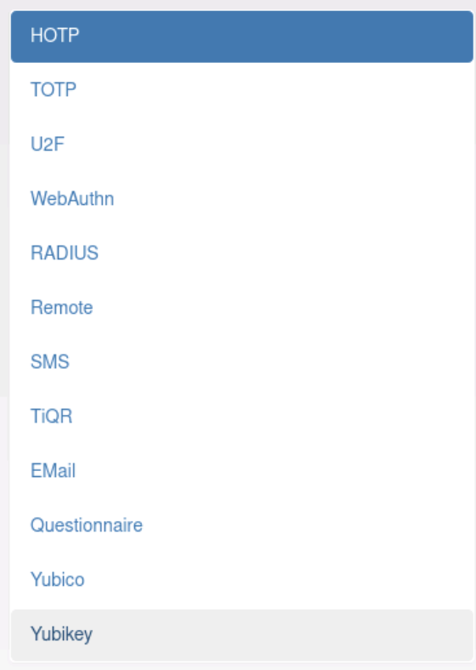
PrivacyIDEA current MFA offerings

Slide 4
Overview
Web services
OTP
Keycloak
PrivacyIDEA
NX
FreeIPA

Slide 5
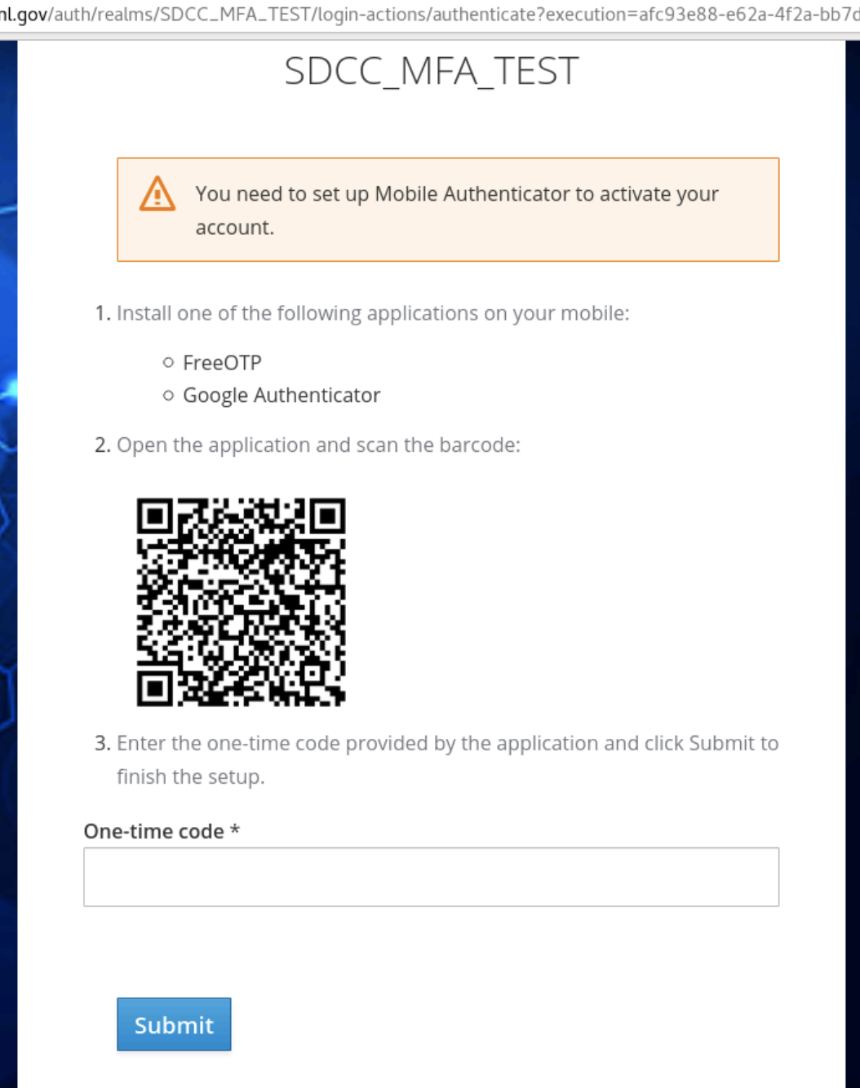
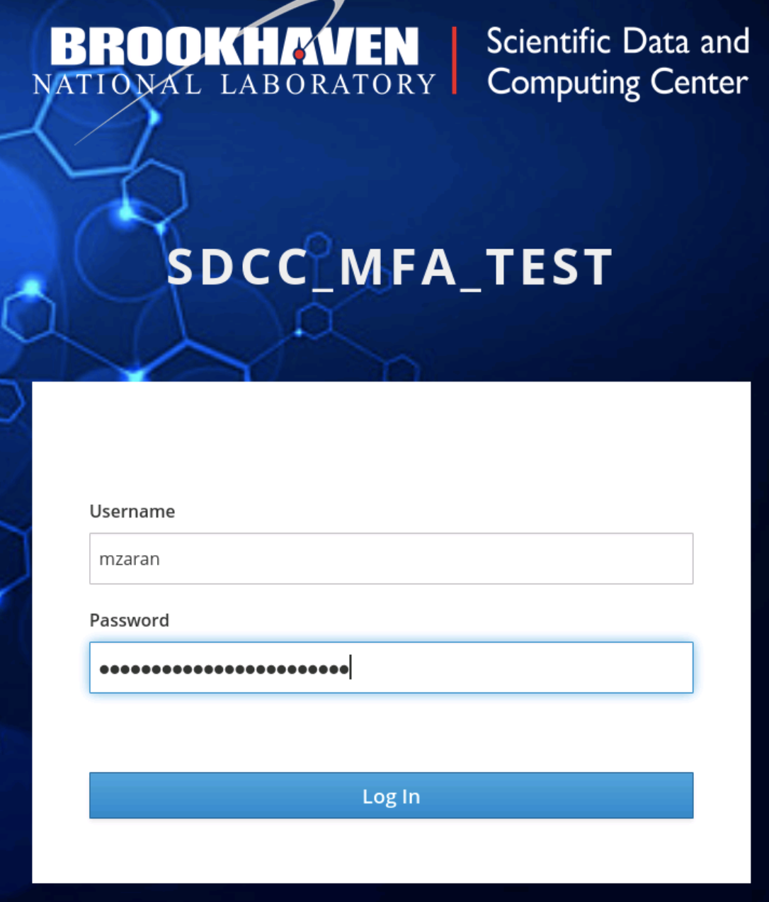
Keycloak enrollment using PrivacyIDEA

Slide 6
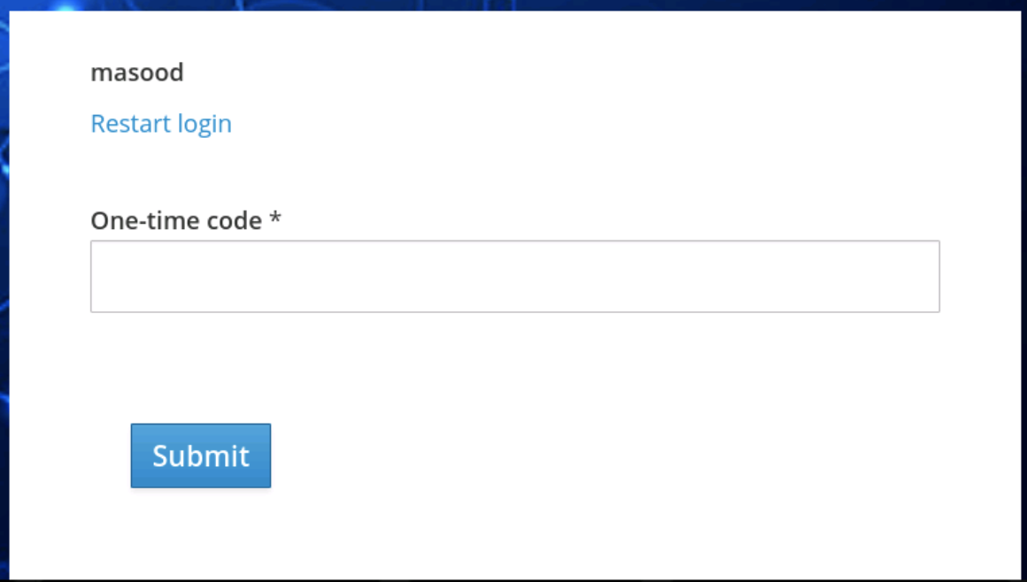
Keycloak login using PrivacyIDEA

Slide 7
PrivacyIDEA testing URL’s
To test out TOTP token creation
https://accounts-test.sdcc.bnl.gov/otpenroll
All tokens created in this test “REALM” will be deleted when put into production.
These tokens will sync to IPA thus allowing NoMachine / NX login using MFA.

Slide 8
Questions?

