Slide 1
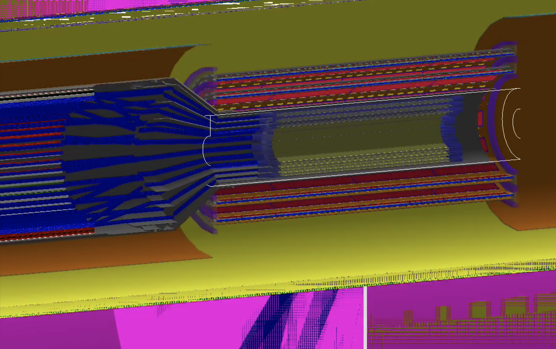
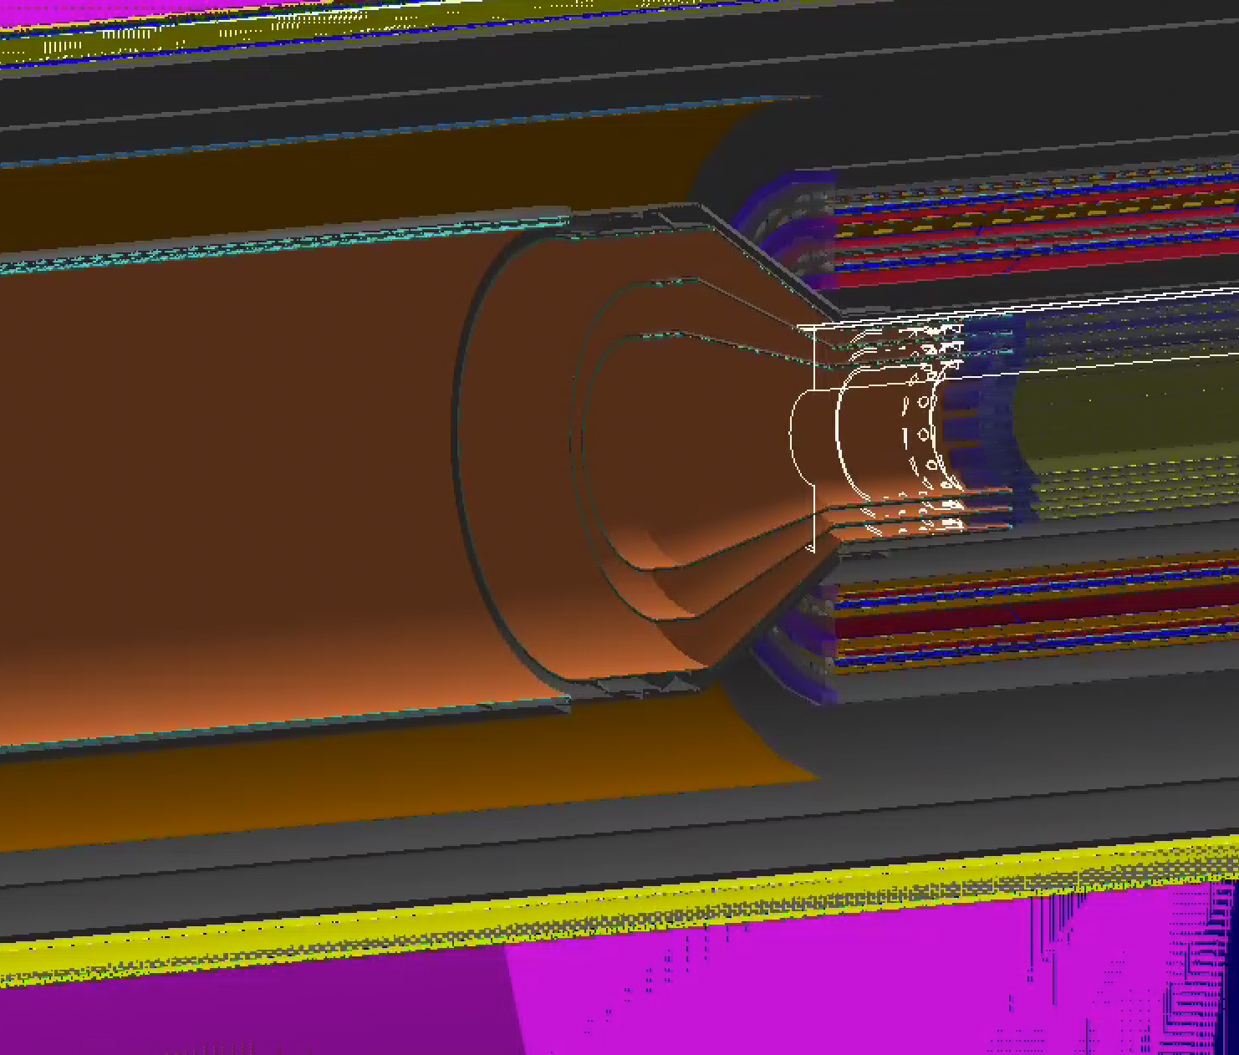
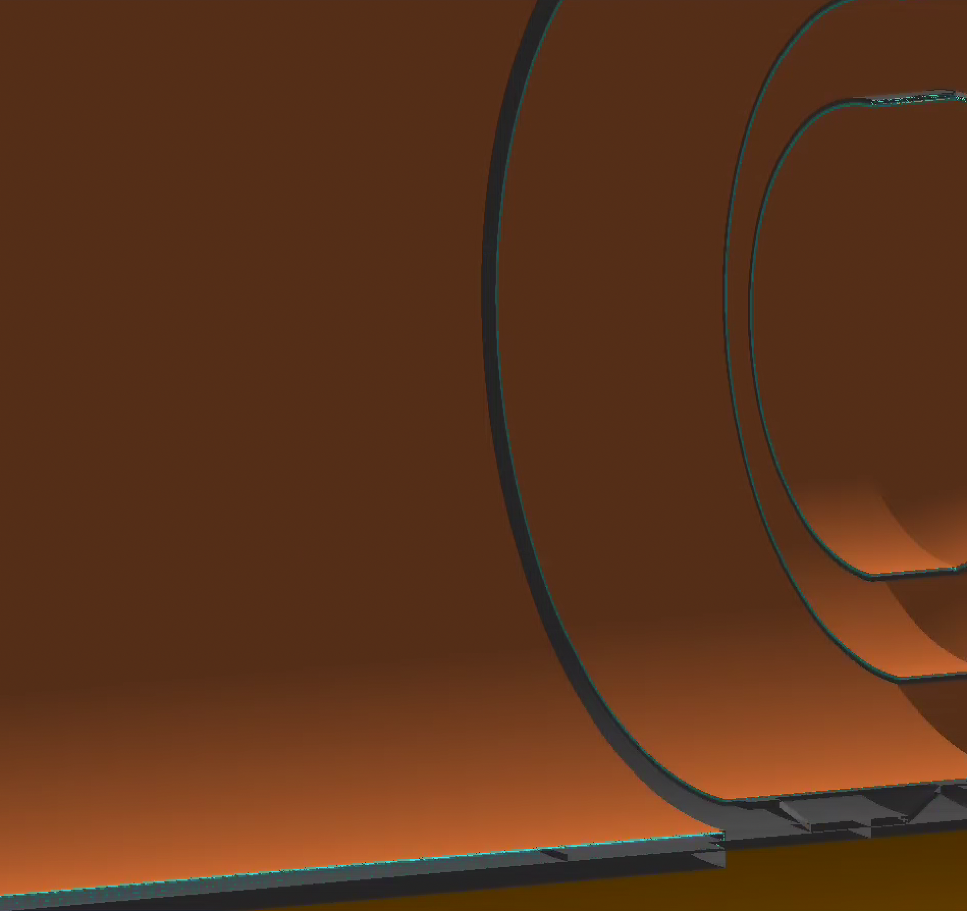
MVTX Status – C. Dean
Updated stave geometry is complete
We had overlaps before
Averaged material budget for service barrel is complete with Sept. 2021 drawing
Realistic material budget with discrete cables is ongoing
Complicated transition from barrel to staves
Must fit 12, 16 and 20 sector circles in a 48 sector circle
Need different 3D rotations for each stave (not just layers: 0, 1, 2, 0, 1, 2)

