Slide 1
sPHENIX Calendar
PRR IHCal tile PRR Jan 12
FDR/PRR EMCal/HCal signal cables Jan 13
Construction Planning meeting Jan 15
sPHENIX Collaboration Meeting Jan 21-22
PRR Large Support Rings and Magnet Supports Jan 25
DOE Monthly Jan 27

Slide 2
High Priority Issues
We need to keep the EMCal and OHCal on schedule
Prep for installation of the HCal sectors on the carriage in the late spring 2021.
Includes completion of 1008 Track reinforcement for both Assembly Hall and IR.
Tied to BNL PEMP notable.
Award of Track reinforcement contract expected to happen by end of January. (with BNL Legal for approval)
Complete remaining engineering design tasks and order components
We must finish the designs and move our attention to assembly, installation and testing.
Can’t allow the final design tasks to get delayed.
Schedule and hold remaining reviews
Place Remaining procurements

Slide 3
2020 Shutdown Tasks
RHIC 2020 shutdown nearly complete
Tasks to complete during the 2020 shutdown include:
Clean services off west wall (Done)
Installing the cryo deck (Done)
Installing and welding cryo spools in the 1008 IR and 1008 B (Done)
Adding track gussets in IR (Done)
Remove excess tracks (Done)
1008 Beam Pipe (Aluminum) installed in preparation for RHIC Run 2021 (Done)
1008 Shield wall being assembled this week.
Reinforcing the tracks in 1008 (Work starts in Assembly Hall in Feb)
Includes reinforcement in both IR and Assembly Hall
Shield wall closes Jan 27. Run ends mid-July.
Thanks to CAD and PO personnel for completing all of the 1008 shutdown work

Slide 4
sPHENIX Status
sPHENIX MIE early completion dates slipped 2 weeks this month. I&F early completion date unchanged but does not include Run-22. 11 months of float for MIE, 3.5 months of float for the I&F.
COVID has some impact on the schedule though EC slippage has been small since (3 weeks) August 2020.
Long lead procurements received: 100% of SiPMs, 100% of tungsten powder, 100% of scintillator tiles, 91% of scintillating fibers
4 TPC Fee preproduction boards at BNL for testing expect 29 additional Fee boards at BNL next week in preparation for slice test.
All Calorimeter Digitizer preproduction boards (20%) at Columbia U/Nevis for testing.
EMCal blocks for 1st 20/64 sectors complete, blocks for sector 21 & 22 underway. EMCal Sectors 1-10 assembled, assembly of sectors 11-13 underway. High eta blocks from Fudan continue to arrive at BNL.
100% OHCal tile testing at GSU complete. Yield = 98.6%
11/32 OHCal sectors complete and tested. Assembly ongoing on OHCal Sectors 12-21.
All MVTX Readout Units tested at ORNL. Minor RU debugging underway. 49/84 of staves completed with additional 11 undergoing testing at CERN (48 working staves needed). (MVTX)
All Cryo spools installed/welded/leak checked in 1008. (1008 I&F)
Carriage/cradle inspected by BNL at vendor. Meets design specifications. (1008 I&F)
sPHENIX Beam Pipe at vendor for modification. (1008 I&F)
LN2 piping, XY Carriage tables, Carriage Hydraulics, Track reinforcement, Pole Tips, Platform ordered or in BNL Procurement system (1008 I&F)

Slide 5
Reviews to Go
FDR/PRR MBD D/S electronics
FDR/PRR TPC Fee boards
FDR LL1 trigger boards
FDR/PRR TPC Laser/Gas system
FDR/PRR for Magnet Mapping
FDR for INTT
PRR for magnet supports, Large Rings, EMCal installation fixture.
FDR/PRR for IHCal and TPC installation tooling
FDR/PRR for beam pipe support
FDR for sPHENIX water and gas distribution
CAD Safety Review and ORR Magnet Cool Down & Magnet Power-up
CAD Safety Review for carriage/cradle, pole tip, platform assembly
CAD Safety Review for each sPHENIX subsystem installation procedure
Safety reviews for each subsystem with the CAD ESRC.
Many reviews to schedule in the next 12-18 months

Slide 6
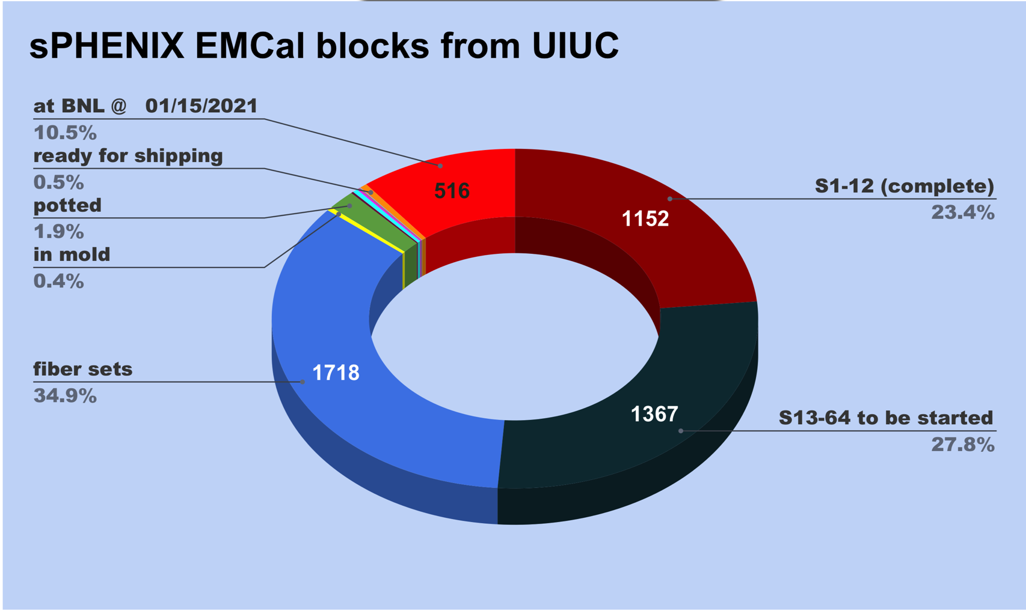
EMCal Block Production Status at UIUC
34% Blocks complete
38% Started
28% Unstarted

Slide 7
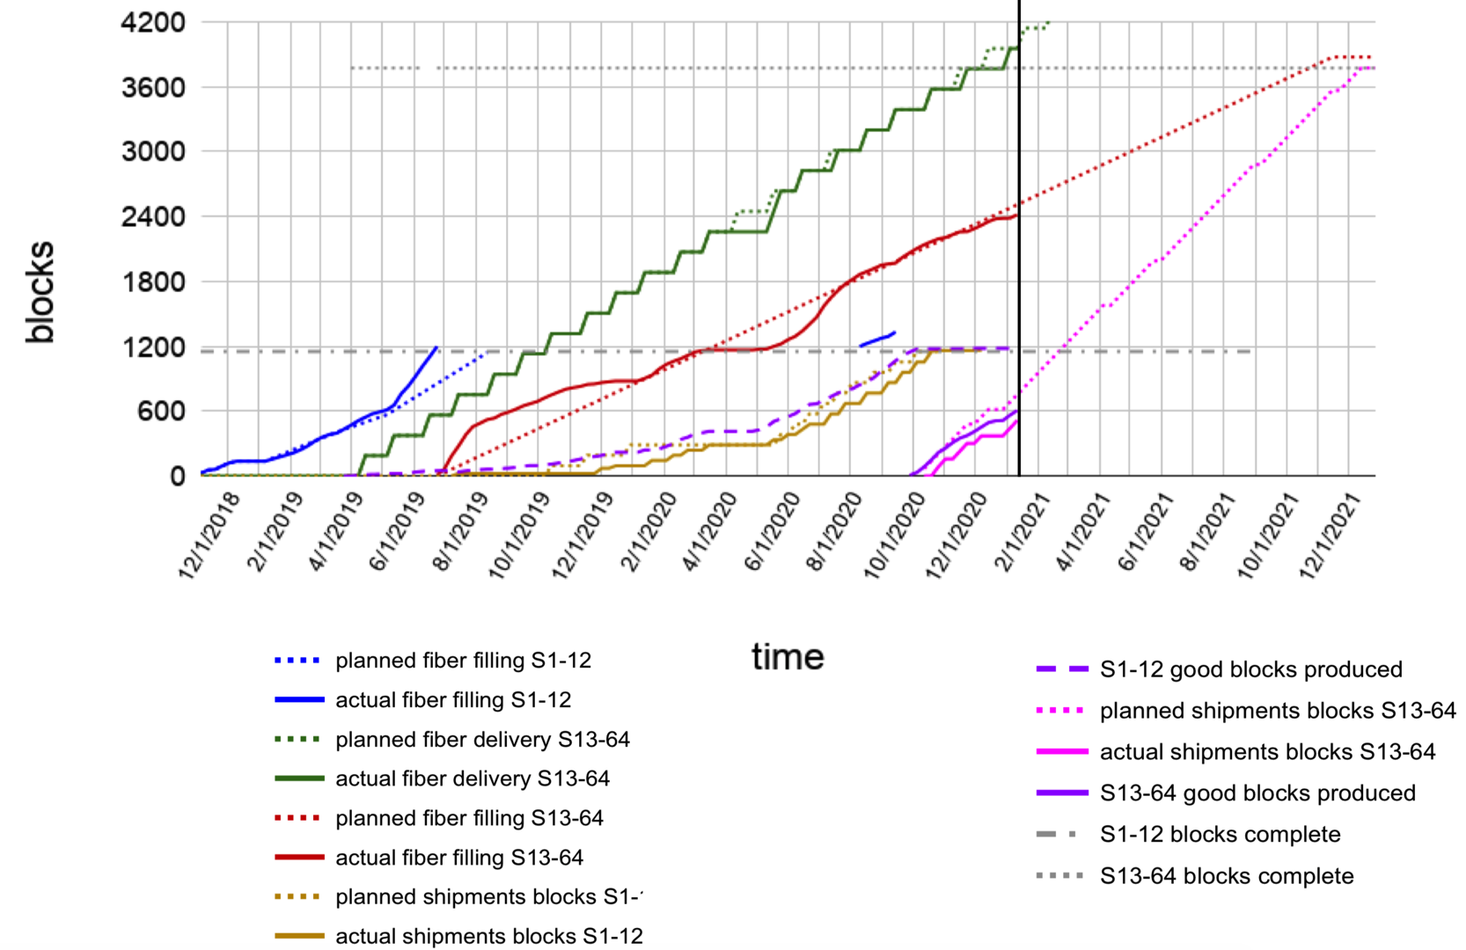
EMCal Block Production Rate at UIUC
Rate of block production good. Needs small increase in slope to meet early completion date

Slide 8
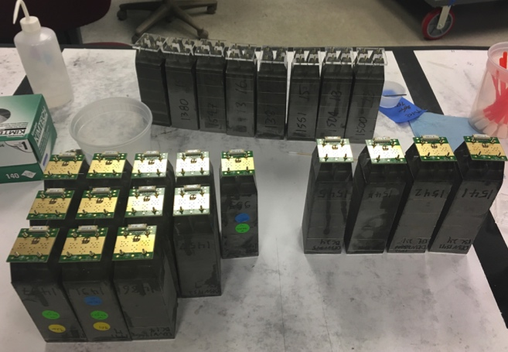
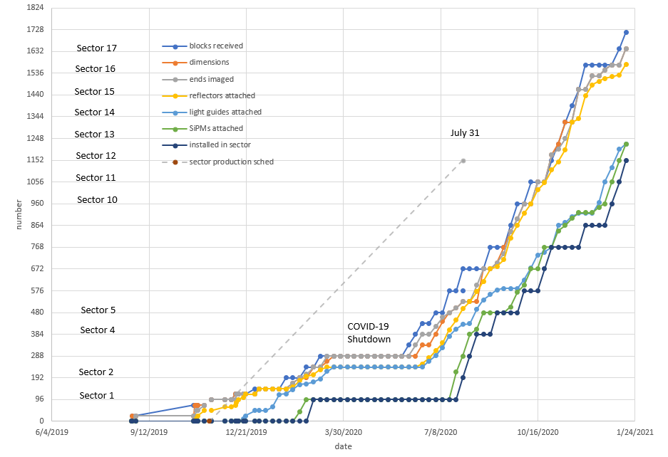
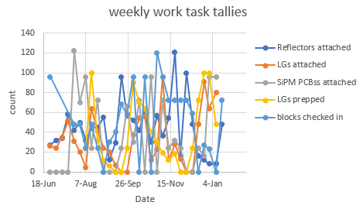
Progress Tracking – Module Production
Red line represents the module assembly slope needed to meet P6 early completion date. Have recently added 3-4 FTEs to EMC Factory to increase rate.

Slide 9
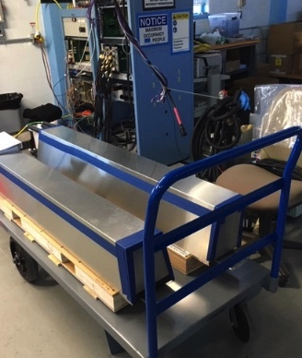
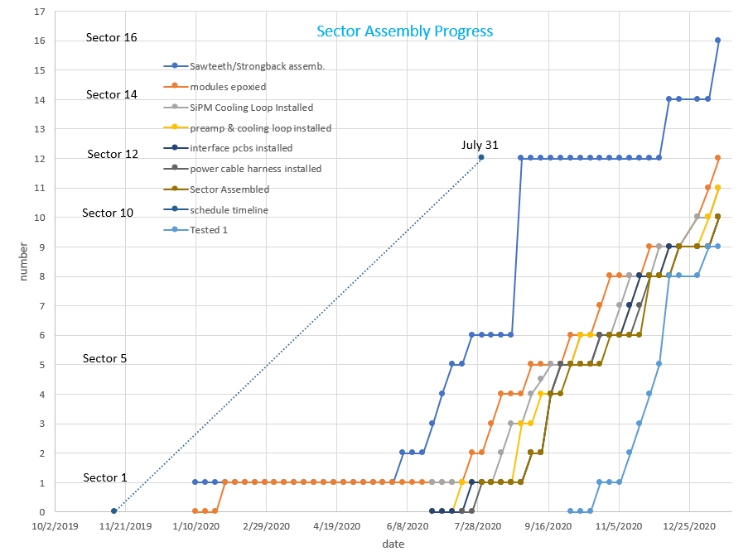
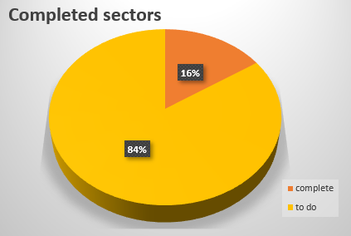
Progress Tracking – Sector Assembly
Red line represents the sector assembly slope needed to meet P6 early completion date. Have recently added 3-4 FTEs to EMC Factory to increase rate.

Slide 10
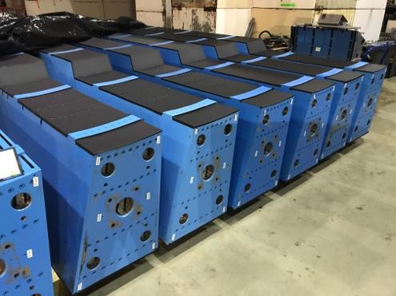
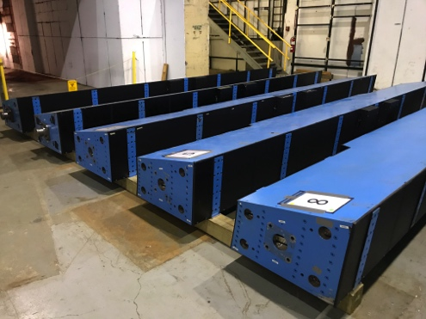
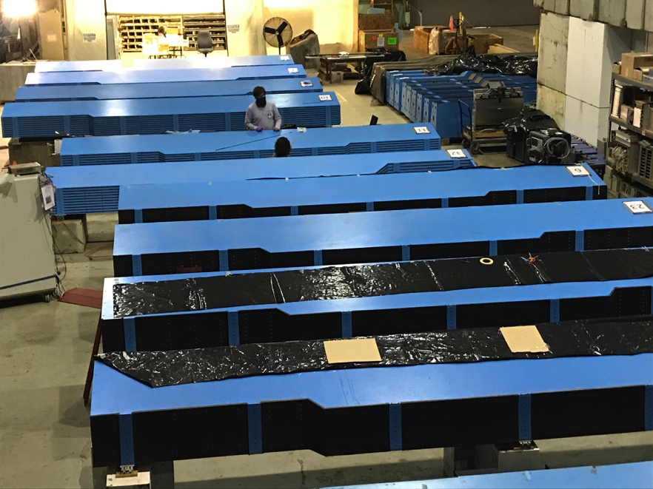
OHCal Status (33% complete)
11/32 sectors complete and in storage.
10/32 sectors on tables
4 fully assembled, undergoing testing
6 undergoing tile installation
#3 needs tiles
#1 tile install begun
#6 testing
#2 needs tiles
#10 needs tiles
#23 testing
#11 tile install begun
#25 testing
#32 (chimney) needs tiles
#26 testing

Slide 11
sPHENIX Challenges
Schedule slippage due to many factors, especially COVID, have resulted In a low SPI for Dec 2020. Overall the MIE early completion date has only slipped 3 weeks since Aug 2020. However the schedule for items off the critical path are being delayed.
sPHENIX FTE threshold of 30 people at BNL will be challenged by additional sPHENIX visitors arriving to work on testing of EMCal, HCal and electronics components and labor added to work in the EMCal and HCal factories. We will request an increase in the FTE threshold to 35.
We have ~$9 M in procurements to make over the next 12 months including $2M in the BNL procurement system right now. PPM released >$1M in orders within the last month.
Concern that additional COVID delays will result in a delay to the RHIC 2021 and 2022 Run schedule and/or the sPHENIX construction schedule. I am particularly concerned about a 2nd BNL shutdown and its schedule impact. Any additional RHIC Run delays will delay sPHENIX installation and impact the start of RHIC Run 2023.

Slide 12
Summary
All 2020 RHIC shutdown tasks completed in 1008 w/ exception of Track reinforcement which will begin in Assembly Hall in February.
Continued great progress in sPHENIX factories. 33% OHCal sectors and EMCal blocks complete. EMCal Sectors, TPC, electronics all making good progress.
MIE early complete date has slipped 2 weeks in December but remains unchanged for the 1008 I&F. COVID mitigation is working at BNL to date. Vendors are seeing COVID impact on their delivery schedules.
We have 80% of sPHENIX technical staff on site and working. sPHENIX Visitors also approved via ROOP process to be on site (SBU, Baruch, Rutgers, Lehigh, UColorado, ISU). Will ask BNL to increase the FTE threshold to accommodate visitors and new hires.
We have a large team of engineers, designers and managers working remotely on sPHENIX activities.

Slide 13
Back Up – EV and Variance Reports

Slide 14
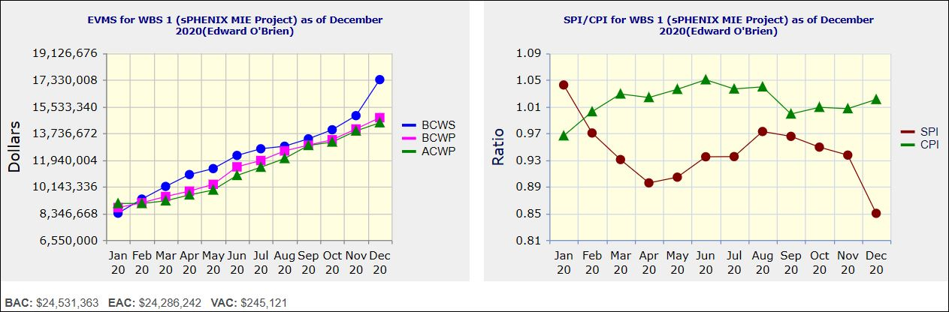
Performance Indices – sPHENIX MIE
Cumulative SPI | Cumulative CPI
0.85 | 1.02
Cumulative BCWS (Scheduled) | $17,338,141
Cumulative BCWP (Performed) | $14,779,328
Cumulative ACWP (Actual) | $14,439,729
DOE SPI or CPI Value Thresholds
0.90 to 1.15
0.85 to 0.89 or 1.16 to 1.25
<0.85 or >1.25

Slide 15
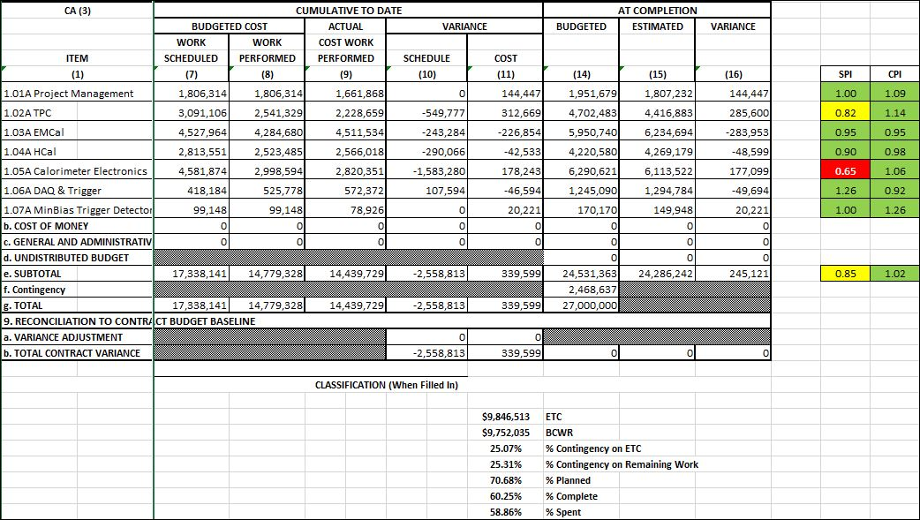
Cost Performance Report (CPR) – sPHENIX MIE
DOE SPI or CPI Value Thresholds
0.90 to 1.15
0.85 to 0.89 or 1.16 to 1.25
<0.85 or >1.25
*Highlights in table above takes variance $ into consideration, not just Indices

Slide 16
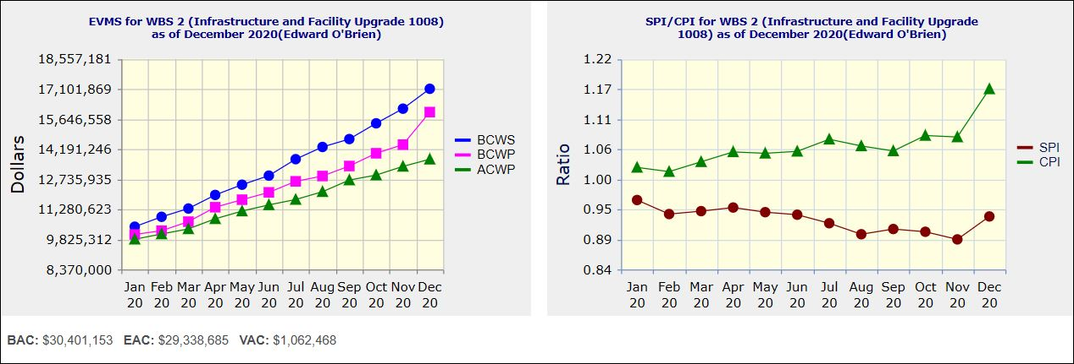
Performance Indices – 1008 Infra and Facility Upgrade
Cumulative SPI | Cumulative CPI
0.93 | 1.17
Cumulative BCWS (Scheduled) | $17,109,493
Cumulative BCWP (Performed) | $15,982,465
Cumulative ACWP (Actual) | $13,702,269
DOE SPI or CPI Value Thresholds
0.90 to 1.15
0.85 to 0.89 or 1.16 to 1.25
<0.85 or >1.25

Slide 17
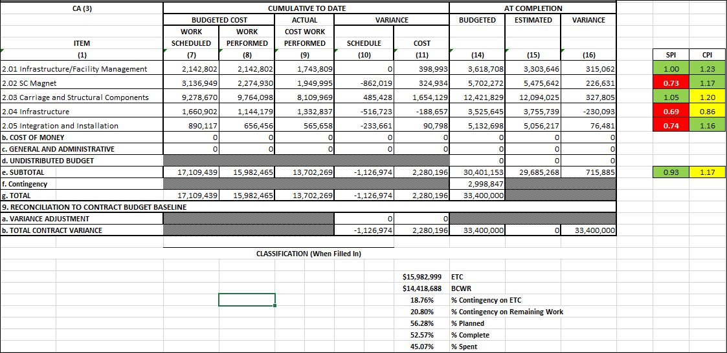
Cost Performance Report (CPR) – 1008 Infra and Facility Upgrade
DOE SPI or CPI Value Thresholds
0.90 to 1.15
0.85 to 0.89 or 1.16 to 1.25
<0.85 or >1.25
*Highlights in table above takes variance $ into consideration, not just Indices

Slide 18
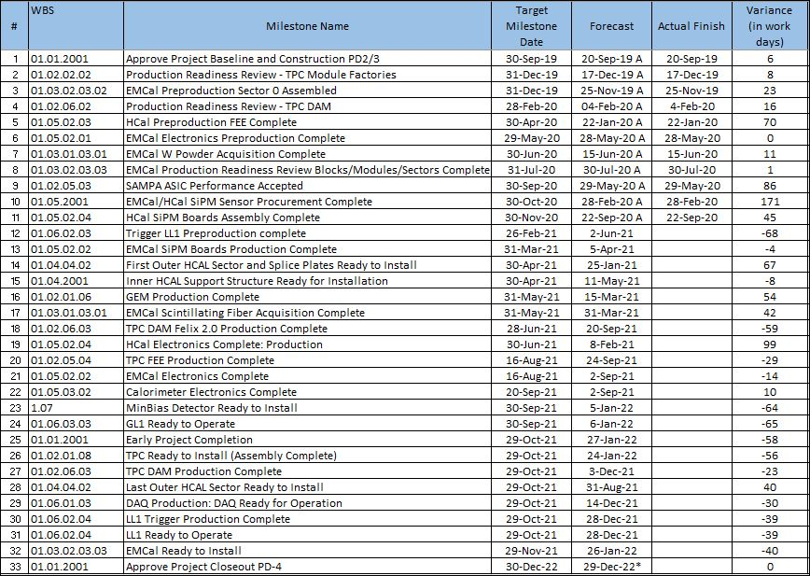
Milestones Status – sPHENIX MIE

Slide 19
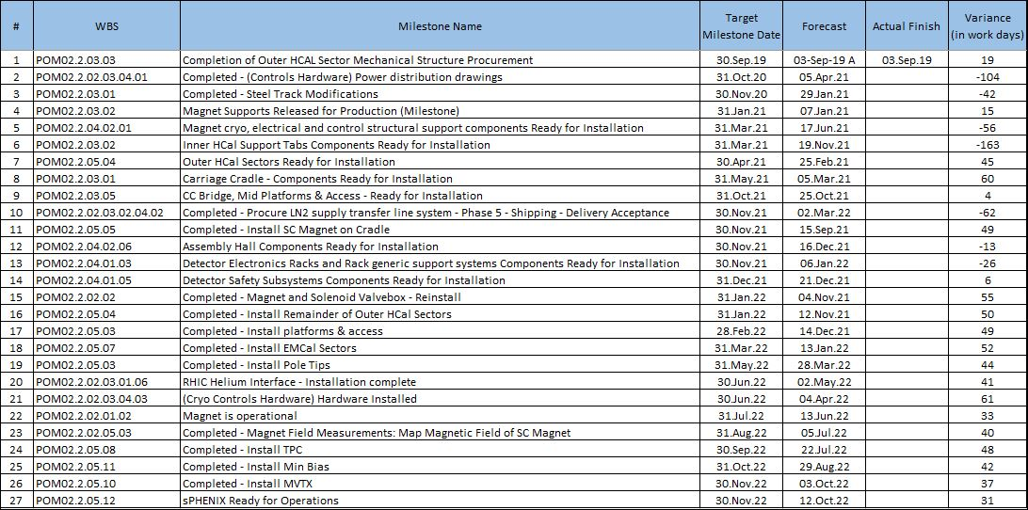
Milestones Status – 1008 Infra and Facility Upgrade

Slide 20
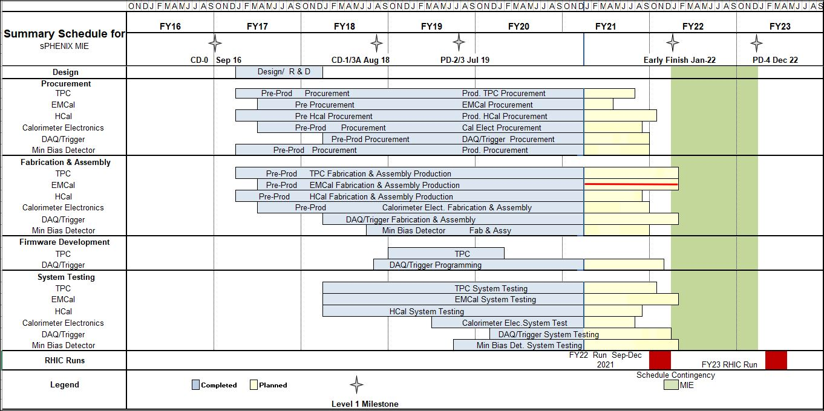
Summary Schedule – sPHENIX MIE

Slide 21
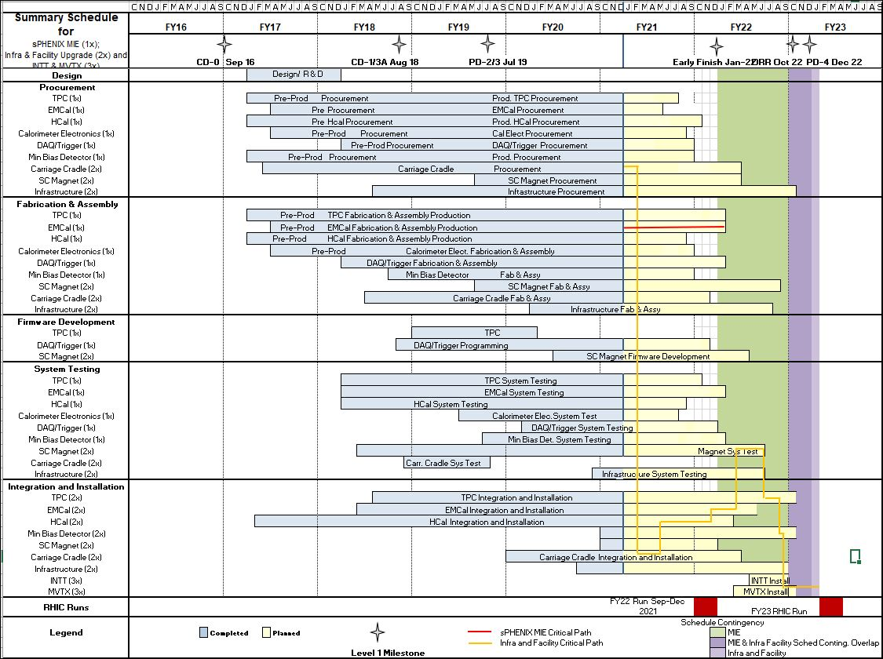
Summary Schedule – sPHENIX MIE and 1008 Infra and Facility Upgrade

Slide 22
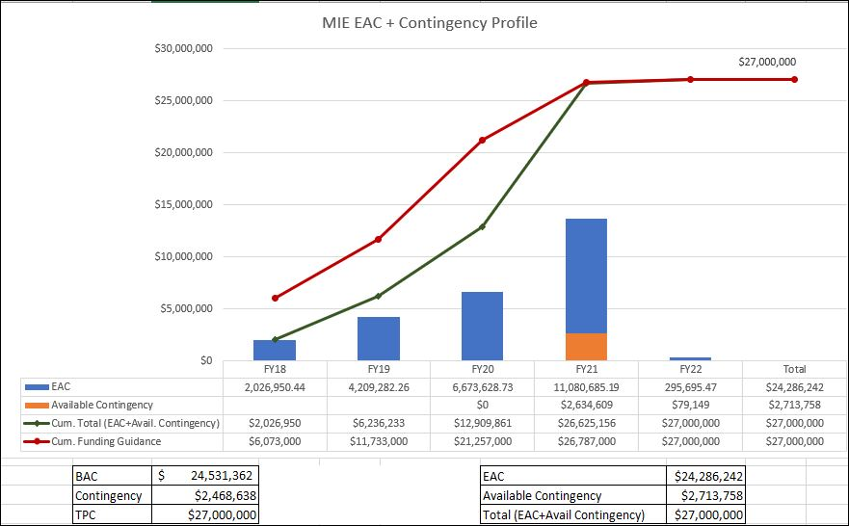
EAC and Contingency Profile – sPHENIX MIE

Slide 23
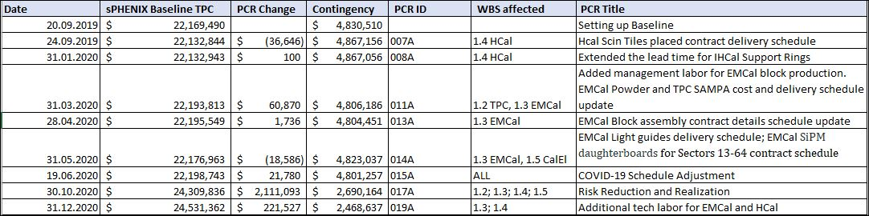
Baseline/Contingency Log - MIE

Slide 24
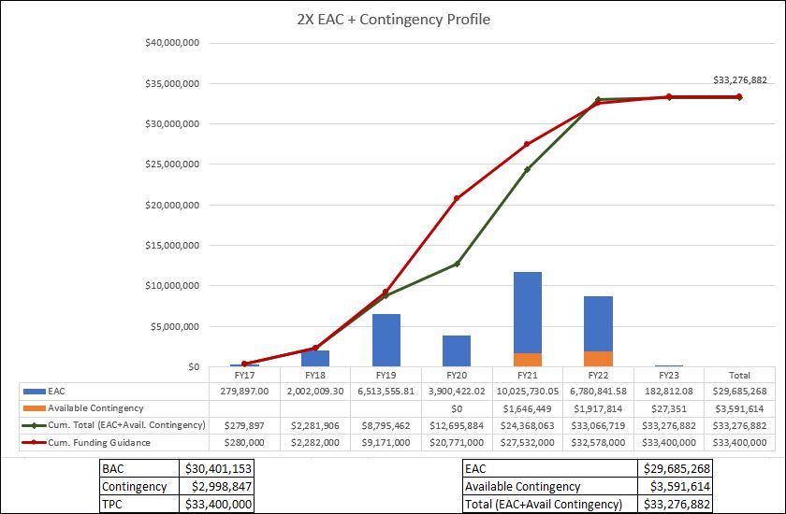
EAC and Contingency Profile – 1008 Infra and Facility Upgrade

Slide 25
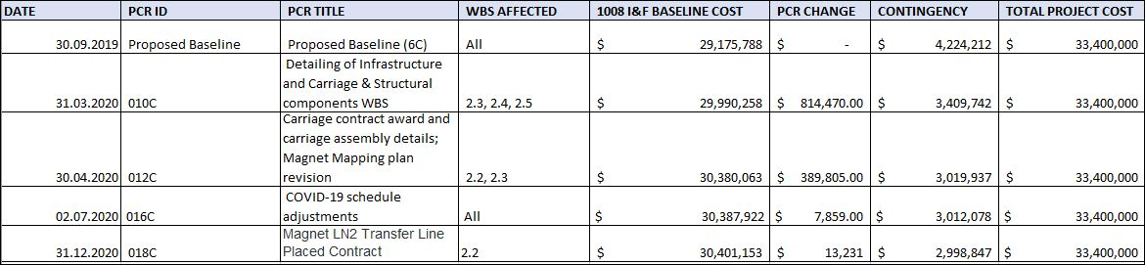
Baseline/Contingency Log - 1008 Infra and Facility Upgrade

Slide 26
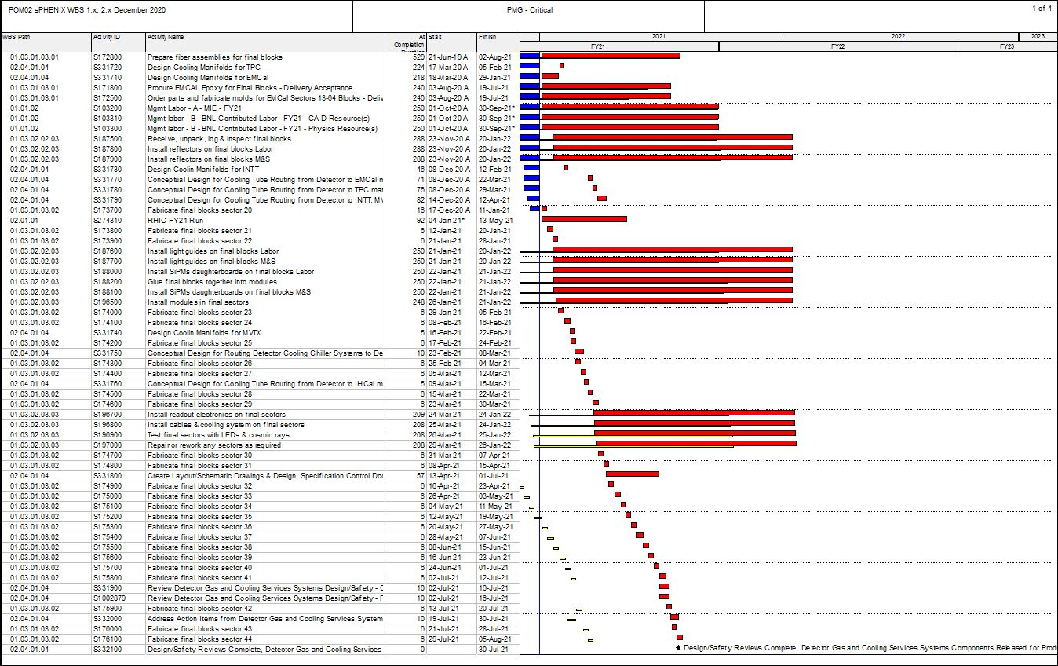
Critical Path (1x, 2x and 3x Combined)

Slide 27
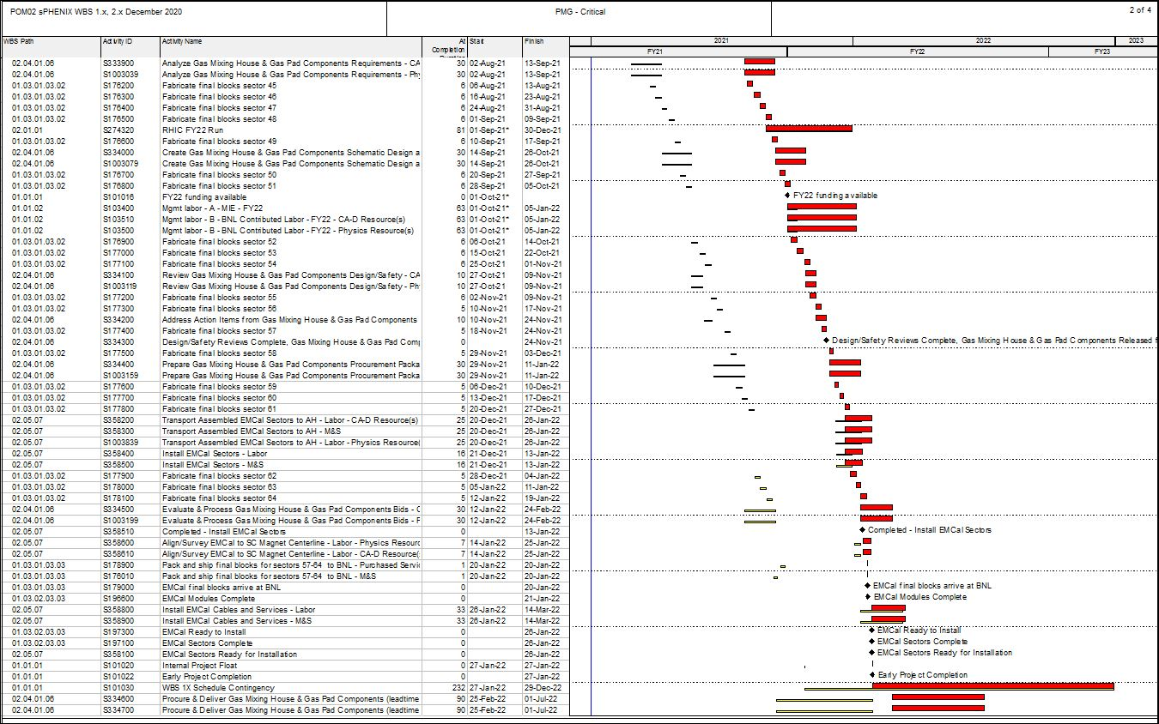
Critical Path (1x, 2x and 3x Combined)

Slide 28
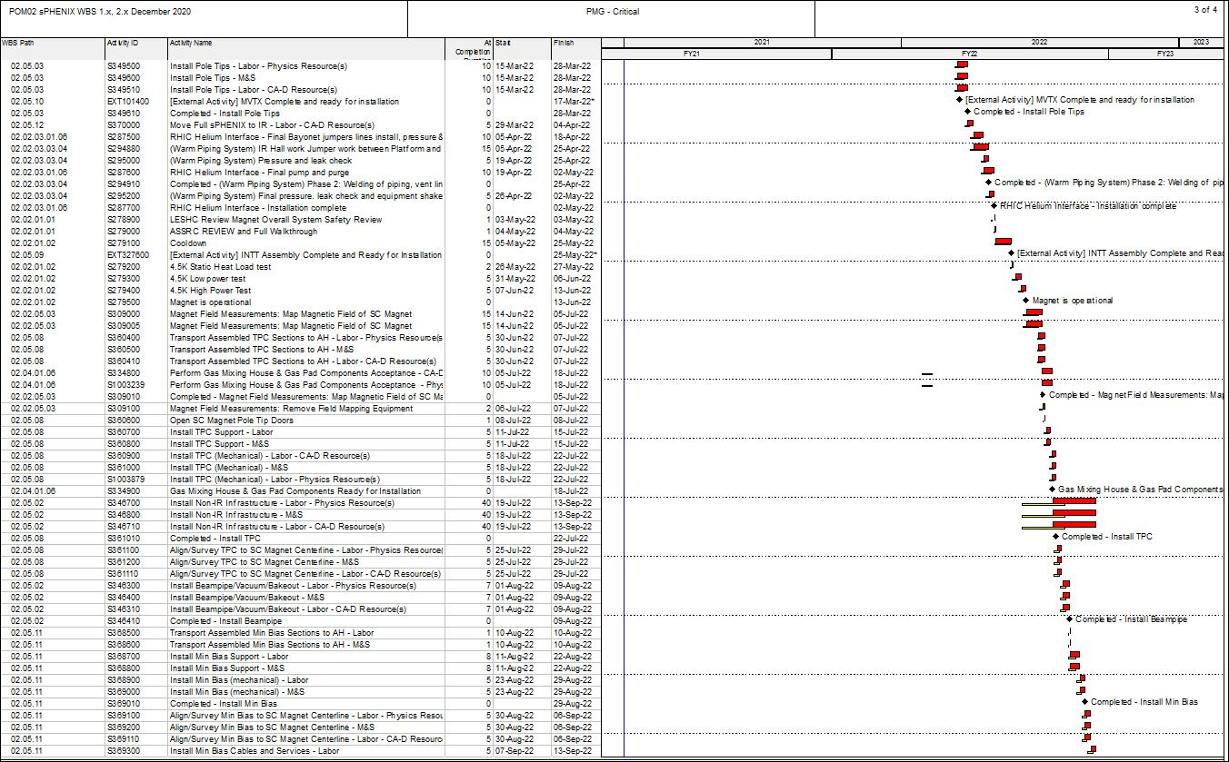
Critical Path (1x, 2x and 3x Combined)

Slide 29
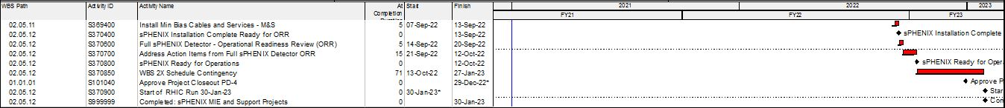
Critical Path (1x, 2x and 3x Combined)

Slide 30
Variance Report
SV Report for WBS 1.0 sPHENIX MIE Project
December 2020
Cumulative BCWS $17,338,141
Cumulative BCWP $14,779,328
Cumulative ACWP $14,439,729
SV = -$2,558,813
CV = +$267,637 SPI = 0.8524
CPI = 1.0185
The following report discusses the major sources of schedule variance, including all items comprising 2% of the total schedule variance, plus a few select other items, and discusses the impact as well as the corrective actions taken. The analysis is done at level 3 of the Work Breakdown Structure. An accompanying Excel file shows BCWS, BCWP, SV and status for the various item noted in the following text.

Slide 31
Variance Report – TPC
WBS 1.2.1 TPC Mechanics
Description – One activity, S120100 Production of GEM foils, has an SV of -$74,602, due to late delivery of GEM foils manufactured at CERN. The delay is due to a COVID-related shutdown of the CERN factory and a subsequent four-month delay in GEM foil manufacture.
Impact – None as yet. All delivered GEM foils, some 20% to date, have been mounted on frames and prepared for assembly into readout modules for the TPC.
Corrective – The order remains in progress. We are supporting a full-time technician at CERN to speed manufacture of remaining foils. The revised delivery schedule provided by CERN will meet our assembly schedule for the TPC readout modules.
WBS 1.2.2 TPC GEM Modules R1
Description – One activity S125100 TPC R1 padplanes is not complete, with an SV of -$50,113. This in turn delays two successor activities, S125500 TPC R1 modules build, with SV = -$32,044 and S125600 TPC R1 Modules test, with SV = -$27,074. The total SV resulting is -$109,232. The layout of the R1 padplane, the smallest of the three types, was hampered by signal trace routing issues which did not conform to design rules required by the printed-circuit board manufacturer.
Impact – None as yet. The rest of R1 module construction is proceeding. Pad planes are to be attached to the modules as a late step in the module assembly sequence. Positive float remains. Corrective – the signal trace routing issue has been resolved and the routing of the board is nearly complete, lacking only final check of ground plane coverage. Manufacture of the pad-plane circuit cards will then happen at the same vendor who successfully built all the pad-plane circuit cards for R2 and R3 modules.

Slide 32
Variance Report - TPC
WBS 1.2.5 TPC Front End Electronics. Description – There are four activities with significant SV, one of which is positive. They are activity S136500 TPC FEE Cooling System, SV = -$69,821,
activity S141800 TPC FEE Production Components, SV = $247,638,
activity S142500 TPC FEE Low Voltage Power system, SV = -$220,595, and
activity S143250, TPC FEE protective elements/diodes, SV = -$36,479.
The net SV is -$79,257.
Impact – None as yet. The key activity is the FEE Production, which is ahead of schedule.
Corrective – All the items covered by these activities are being ordered; required design and procurement reviews are complete. The cooling system requires a series of machined parts, for which the procurement is started. The TPC FEE production components are ahead of schedule. The TPC FEE Low Voltage power supplies are under contract with the vendor scheduling all deliveries over the next three months. The TPC FEE Protection elements/diodes are on order and scheduled to be delivered in February.
WBS 1.2.6 TPC Data Aggregator Modules
Description – Activity S147300 FELIX 2.0 production board is ahead of schedule, SV = $105,916.
Impact – None
Corrective – None needed, the activity is ahead of schedule.

Slide 33
Variance Report – TPC
WBS 1.2.7 TPC Support Systems
Description – There are three areas of effort. The TPC Lasers delivery has started but only the first article has been delivered, SV =-$260,337. The TPC Gas System has procured and received 30% of the components but still needs to place requisitions for the balance, SV =-$61,204. The TPC Cooling system has not procured the high value elements including the chiller, SV =-$76,175.
The total SV for these key items is -$397,716.
Impact – These are all items being procured well ahead of their needed installation in order to allow for more time to test them on the bench and adjust settings.
Corrective – The Preliminary Design reviews are complete and all three of these subsystems have moved to acquiring first articles. Proper operation is to be demonstrated prior to holding the Final Design reviews and the Procurement Readiness reviews, which are expected by March.

Slide 34
Variance Report – EMCal
WBS 1.3.1 EMCal Blocks
Description – There are three main items causing the SV. The S171021 Scintillating Fiber Batch #21, the 21st of the 23 scheduled deliveries of fibers, was not delivered due to year-end shipping delays, causing SV =-$40,858. These fibers are needed for summer 2021 Block production. The S171800 Epoxy is only 60% complete, SV =-$23,990. The S173700-S175200 Blocks for Sectors 20-35 are not complete, SV =-$79,838.
The total SV for these items is -$144,686.
Impact – None
Corrective – The Batch 21 of Scintillating Fibers was delivered January 4, removing this variance. The Epoxy must be bought within a few weeks of use, due to shelf-life issues. It is a commodity item and is purchased on an as-needed basis. The delayed Blocks were caused by personnel absences due to the COVID-19 pandemic. Block production resumed over the summer of 2020 and returned to planned production rates in the Fall. This particular SV will persist until about 2 weeks before the Project is complete, at which time Block production will be complete.
WBS 1.3.2 EMCal Modules and Sectors
Description – The S187400 Production Light Guide contract is not complete, SV = -$235,327. The S195400 Mechanical parts for Final Sectors are being delivered ahead of schedule, SV = $189,635. Total SV in this area is -$45,692.
Impact – None
Corrective – The light guide production was suspended at the vendor until QA and tooling-fixture issues were examined and resolved. These issues were addressed over October-December and production deliveries have resumed at the planned rate and ahead of when they are needed to produce sectors. The light guide vendor has qualified more machine shops supplying him to further improve his delivery rate in the future. The mechanical parts are being delivered somewhat ahead of schedule.

Slide 35
Variance Report – HCal
Outer HCal Structure
Description – The S205100 Splice Plates are not yet delivered, SV = -$303,325.
Impact – None, the current delivery schedule is still 4 months ahead of need.
Corrective – Continued contact with the vendor. The vendor had to reject some of the initial parts due to an issue of cracks developing in the steel after heat treating and subsequent machining. The technique for heat treating was changed, a different method of machining the precision holes was selected and employed, and the problem has not recurred. Delivery of first parts is planned for February and delivery of the balance of the contract is planned for March.

Slide 36
Variance Report – Calorimeter Electronics
WBS 1.5.2 Calorimeter Front End Electronics
Description – Seven separate activities contribute substantially to this SV. They are:
activity S229300 EMCal preamplifiers are not delivered, SV = -$549,642,
activity S231000 EMCal controller boards completed early, SV = $92,155,
activity S231800 EMCal internal cables are only 30% complete, SV = -$187,326,
activity S233250 EMCal trunk signal cables are not complete, SV = -$101,861,
activity S239100 HCal SiPM daughtercards completed early, SV = $110,822,
activity S243700 HCal Internal cables completed early, SV = $94,395, and
activity S244400 HCal External cables are only 20% complete, SV = -$81,552. The total SV for these activities is -$623,009.
Impact – none except for the EMCal preamps, which will be needed by the EMCal sector production line starting in early March.
Correctives – The contract is placed for the EMCal preamplifiers. We have negotiated with the vendor to deliver a first batch, adequate to instrument more than 3 sectors, as soon as possible to help with completion of EMCal sectors. The vendor anticipates being able to meet the March schedule for these first preamplifier units using parts in hand. The vendor is also currently obtaining all the long-lead-time parts for the main EMCal preamplifier production. The vendor for the EMCal internal cables has been delivering them regularly on a schedule well in advance of the need for them during EMCal sector construction. The Procurement readiness review was held in January for the two external cable orders, EMCal and HCal, and procurement documents are being prepared. Potential vendors indicate they can meet the requested delivery schedule for these cables.

Slide 37
Variance Report – Calorimeter Electronics
WBS 1.5.3 Calorimeter Digitizers
Description – There are two activities contributing to this SV. One is S252700 Digitizer Parts, SV = -$678,538 and the other is S252800 Digitizer Boards, SV = - $149,785.
Impact – None presently. The EMCal and OHCal sector production lines have an adequate number of digitizers to perform all needed QA during remaining detector construction. Thus the remaining digitizers are only needed by the completion of the MIE project.
Corrective – The contract for the production digitizers is placed. The vendor indicates they are placing orders for production quantities of all parts but that world-wide supply chains have led to more lead time than foreseen pre-COVID. We continue to monitor the progress by this vendor.

Slide 38
Variance Report – DAQ/Trigger
WBS 1.6.1 Data Acquisition
Description – Three activities have been completed ahead of schedule, resulting in a positive SV = $203,950. These activities are S257600 Sub-Event-Buffer board production, SV = $47,634, S258400 Assembly and Trigger Processor board production, SV = $113,823, and finally S259500 Buffer Box procurement, SV = $41,513.
Impact – None
Corrective – None, activities were completed early.
WBS 1.6.2 Local Level-1 Trigger
Description – Activity, S263600 Preproduction Local Level-1 trigger, is not complete, resulting in SV = -$69,641.
Impact – None
Corrective – The prototype Local Level-1 trigger board has been under full-speed testing for several months. Results to date indicate it will meet all requirements, completing the above activity. It is anticipated the tests will continue until late February, at which point a review will be conducted. It is expected based on results to date that this review will determine that the production Local Level-1 trigger boards can be manufactured during 2021 based on the present design using the existing board assembly house and Bill of Materials. That production will complete this level-3 WBS.

