Slide 1
sPHENIX Construction Plan
Russell Feder for the sPHENIX Team
Jan 21, 2021
sPHENIX PMG

Slide 2
sPHENIX Construction
sPHENIX has all the key detector components to start construction when the AH track reinforcement work is completed → current plan start is 4/28
  The Cradle-Base is complete at Streck’s → Ship to BNL in February for 4/28 installation start
  ~70% of the oHCAL sectors will be ready by June for the start oHCAL installation
  The Babar magnet and cryostat are ready for assembly
The team is managing procurements and completing designs that are critical for the early phase of sPHENIX construction
  The 1008 Assembly Hall track upgrade is the key predecessor to start construction
  The Large Support Rings (LSRs) and Cryostat mounts PRR is Monday 1/25 with procurement soon to follow
The first sPHENIX ESRC and construction planning and safety review is in planning for February
  Complete work planning packages for Cradle-Base, Outer HCAL, Magnet and LSR installations
  Critical lift strategy

Slide 3
sPHENIX Installation Schedule
Sequential Build Steps | Locate | Start | End | CY 2021 |  |  |  | CY 2022
RHIC Run FY21 |  | 1/30/21 | 7/15/21
Cradle-Base | AH | 4/28/21 | 6/2/21
Outer HCAL | AH | 6/4/21 | 11/12/21
Secure Magnet in oHCAL | AH | 8/26/21 | 9/29/21
Large Support Rings | AH | 9/30/21 | 10/6/21
Inner HCAL | AH | 11/22/21 | 12/8/21
EMCAL | AH | 12/10/21 | 3/14/22
Upper Platform, Pole Tips | AH | 11/15/21 | 3/28/22
RHIC Run FY22 |  | 11/15/21 | 4/3/22
Open Wall and Move to IR | IR | 4/5/22 | 4/20/22
Magnet Connect | IR | 4/5/22 | 6/13/22
Magnetic field mapping | IR | 6/14/22 | 7/6/22
TPC | IR | 7/11/22 | 7/22/22
Beam Pipe | IR | 8/1/22 | 8/9/22
INTT | IR | 8/16/22 | 8/18/22
MVTX | IR | 8/12/22 | 10/3/22
MBD | IR | 8/11/22 | 8/29/22
ORR | IR | 10/4/22 | 10/31/22
J
F
M
A
M
J
J
A
S
O
N
D
J
F
M
A
M
J
J
A
S
O
N
D
`

Slide 4
sPHENIX Installation Plan
1008 Assembly Hall Work
(6A) iHCAL barrel fab
(6C) iHCAL insert
(7) EMCAL
(1) Cradle-Base
(2) oHCAL 1-13
(6B) iHCAL install structures
(10) Shield Wall Shuffle
(3) Magnet Part #1
(4) Large Rings
(5) oHCAL 14-32
(8) Upper Pltfrm #1
(9) Pole Tip Doors
Ongoing Sub-System Infrastructure and Commissioning
Ongoing AH, IR and other bldg. 1008 infrastructure upgrades and installations
1008 IR Hall Work
Move to IR
(11) Move to IR
Magnet Cryo, Power
(12) Magnet Connect
Magnet Map
(13) Magnet Mapping
TPC
(14) TPC
Platforms, INTT, Beam Pipe Supports
(15) INTT Support Structure
(16) Beam Pipe Install/Vacuum
Beam Pipe #1
(17) INTT
(18) MVTX
(19) Beam Pipe survey/supports
(20) MBD
(21) System Integration
Ongoing Sub-System Infrastructure and Commissioning
Ongoing AH, IR and other bldg. 1008 infrastructure upgrades and installations

Slide 5
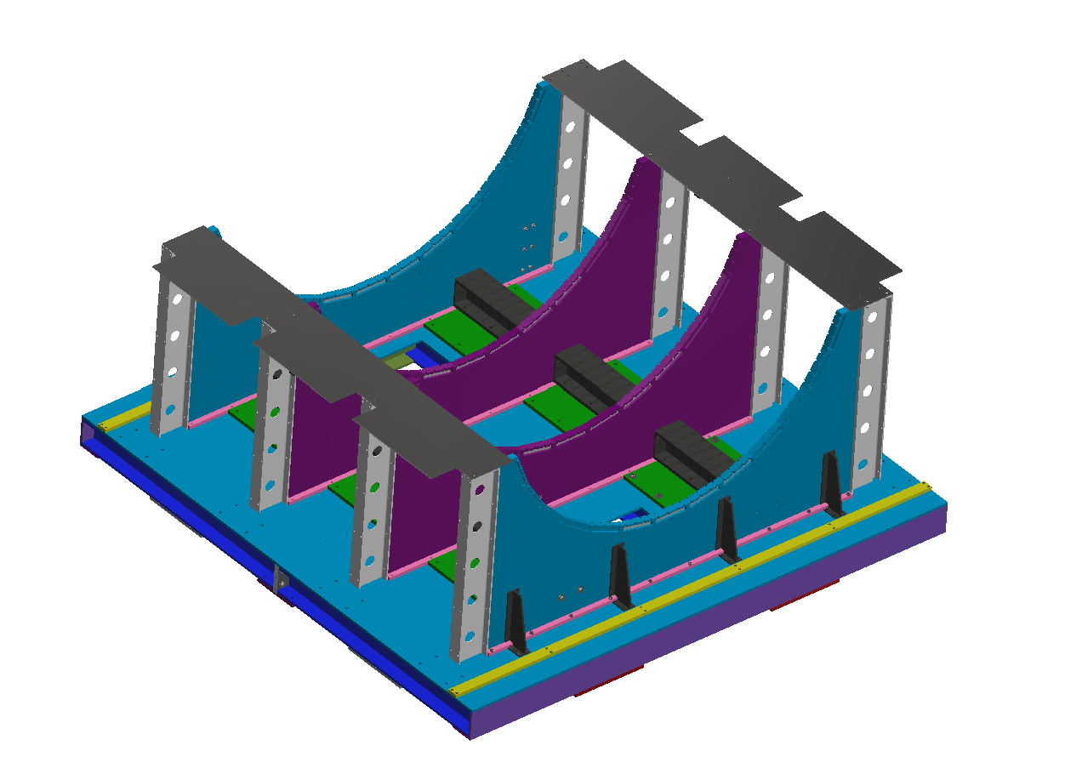
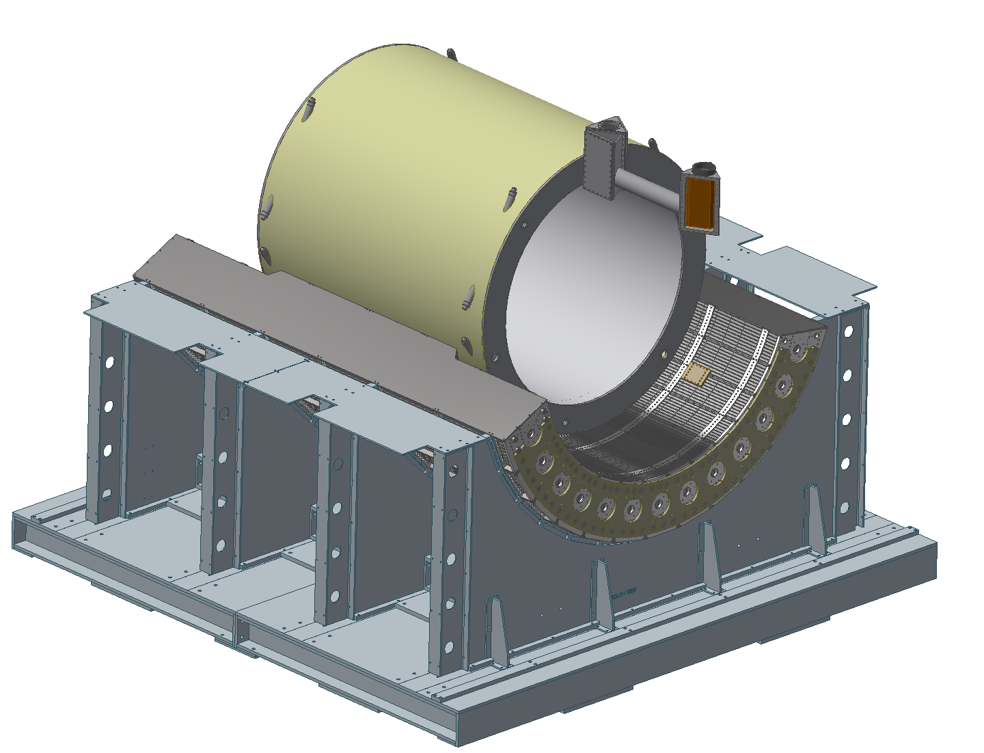
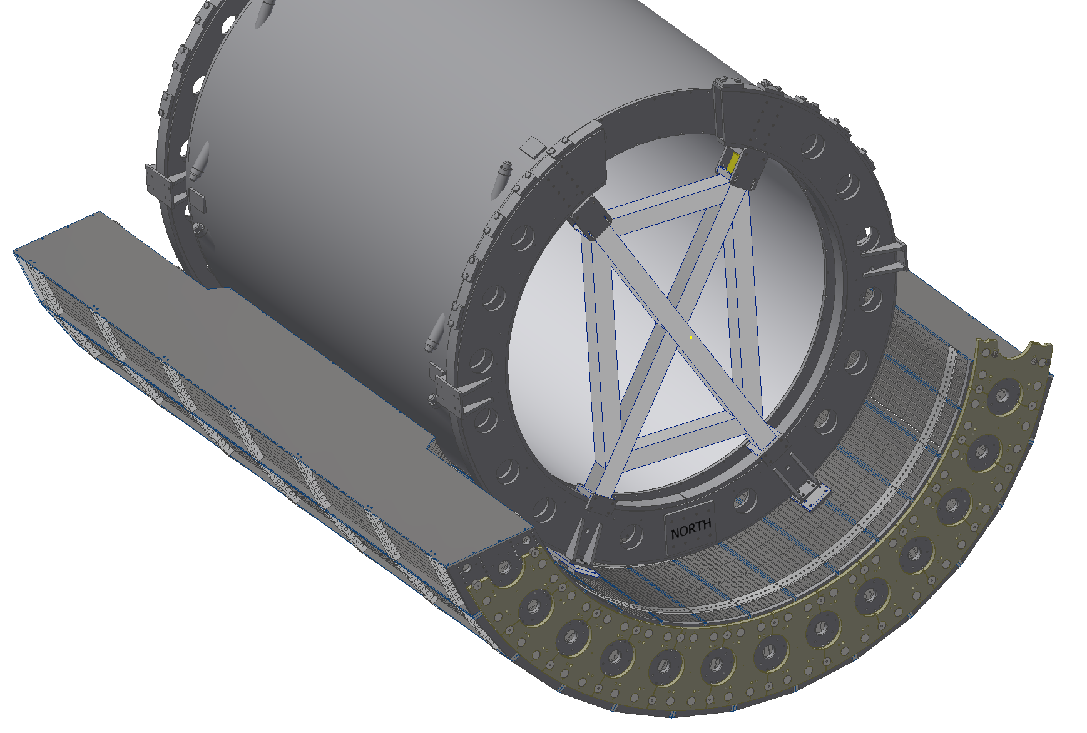
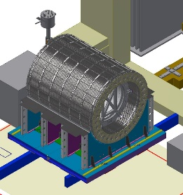
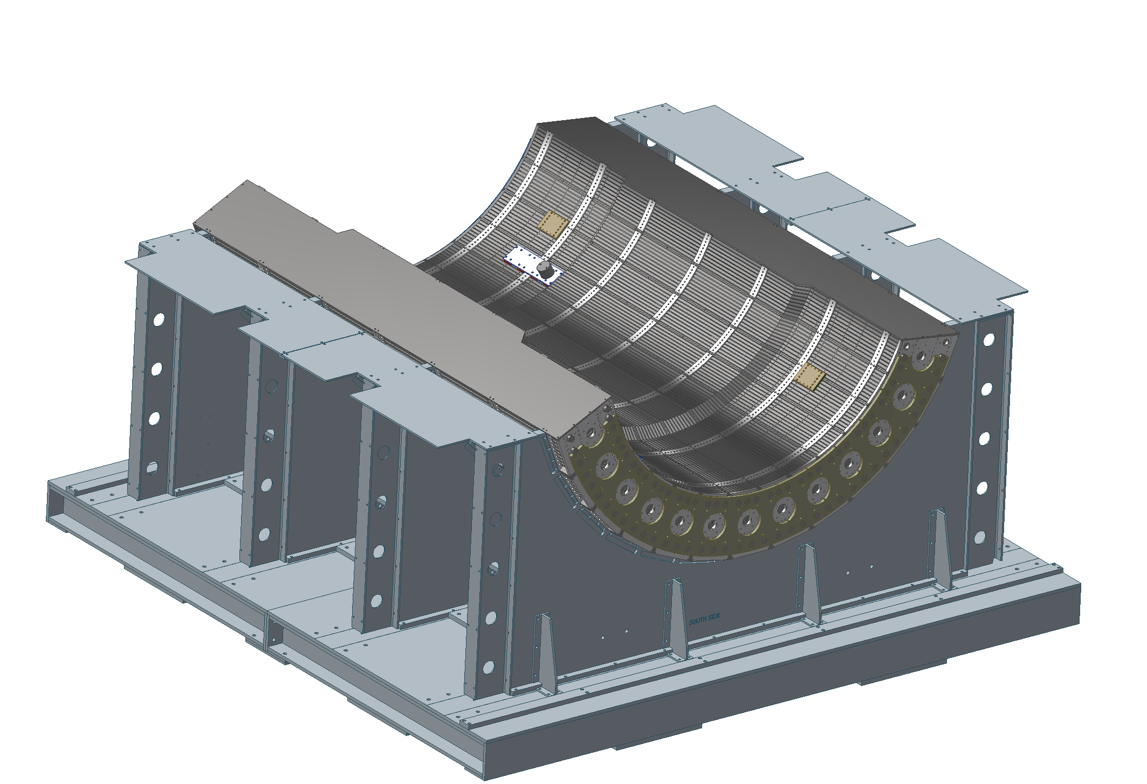
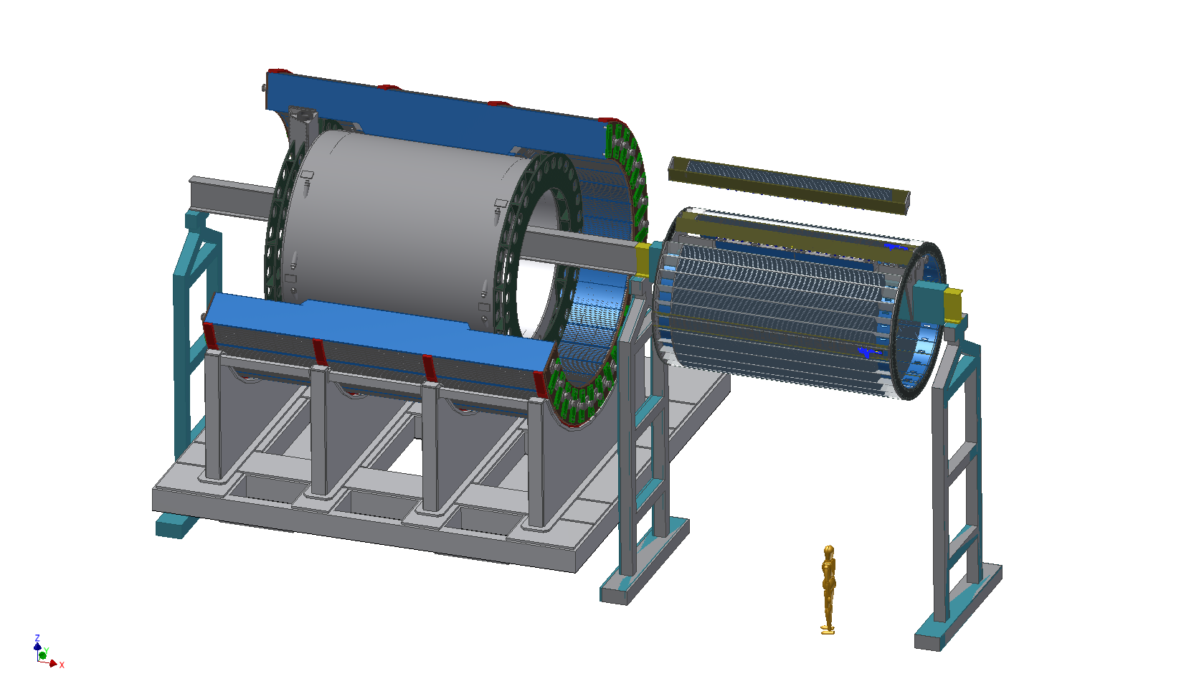
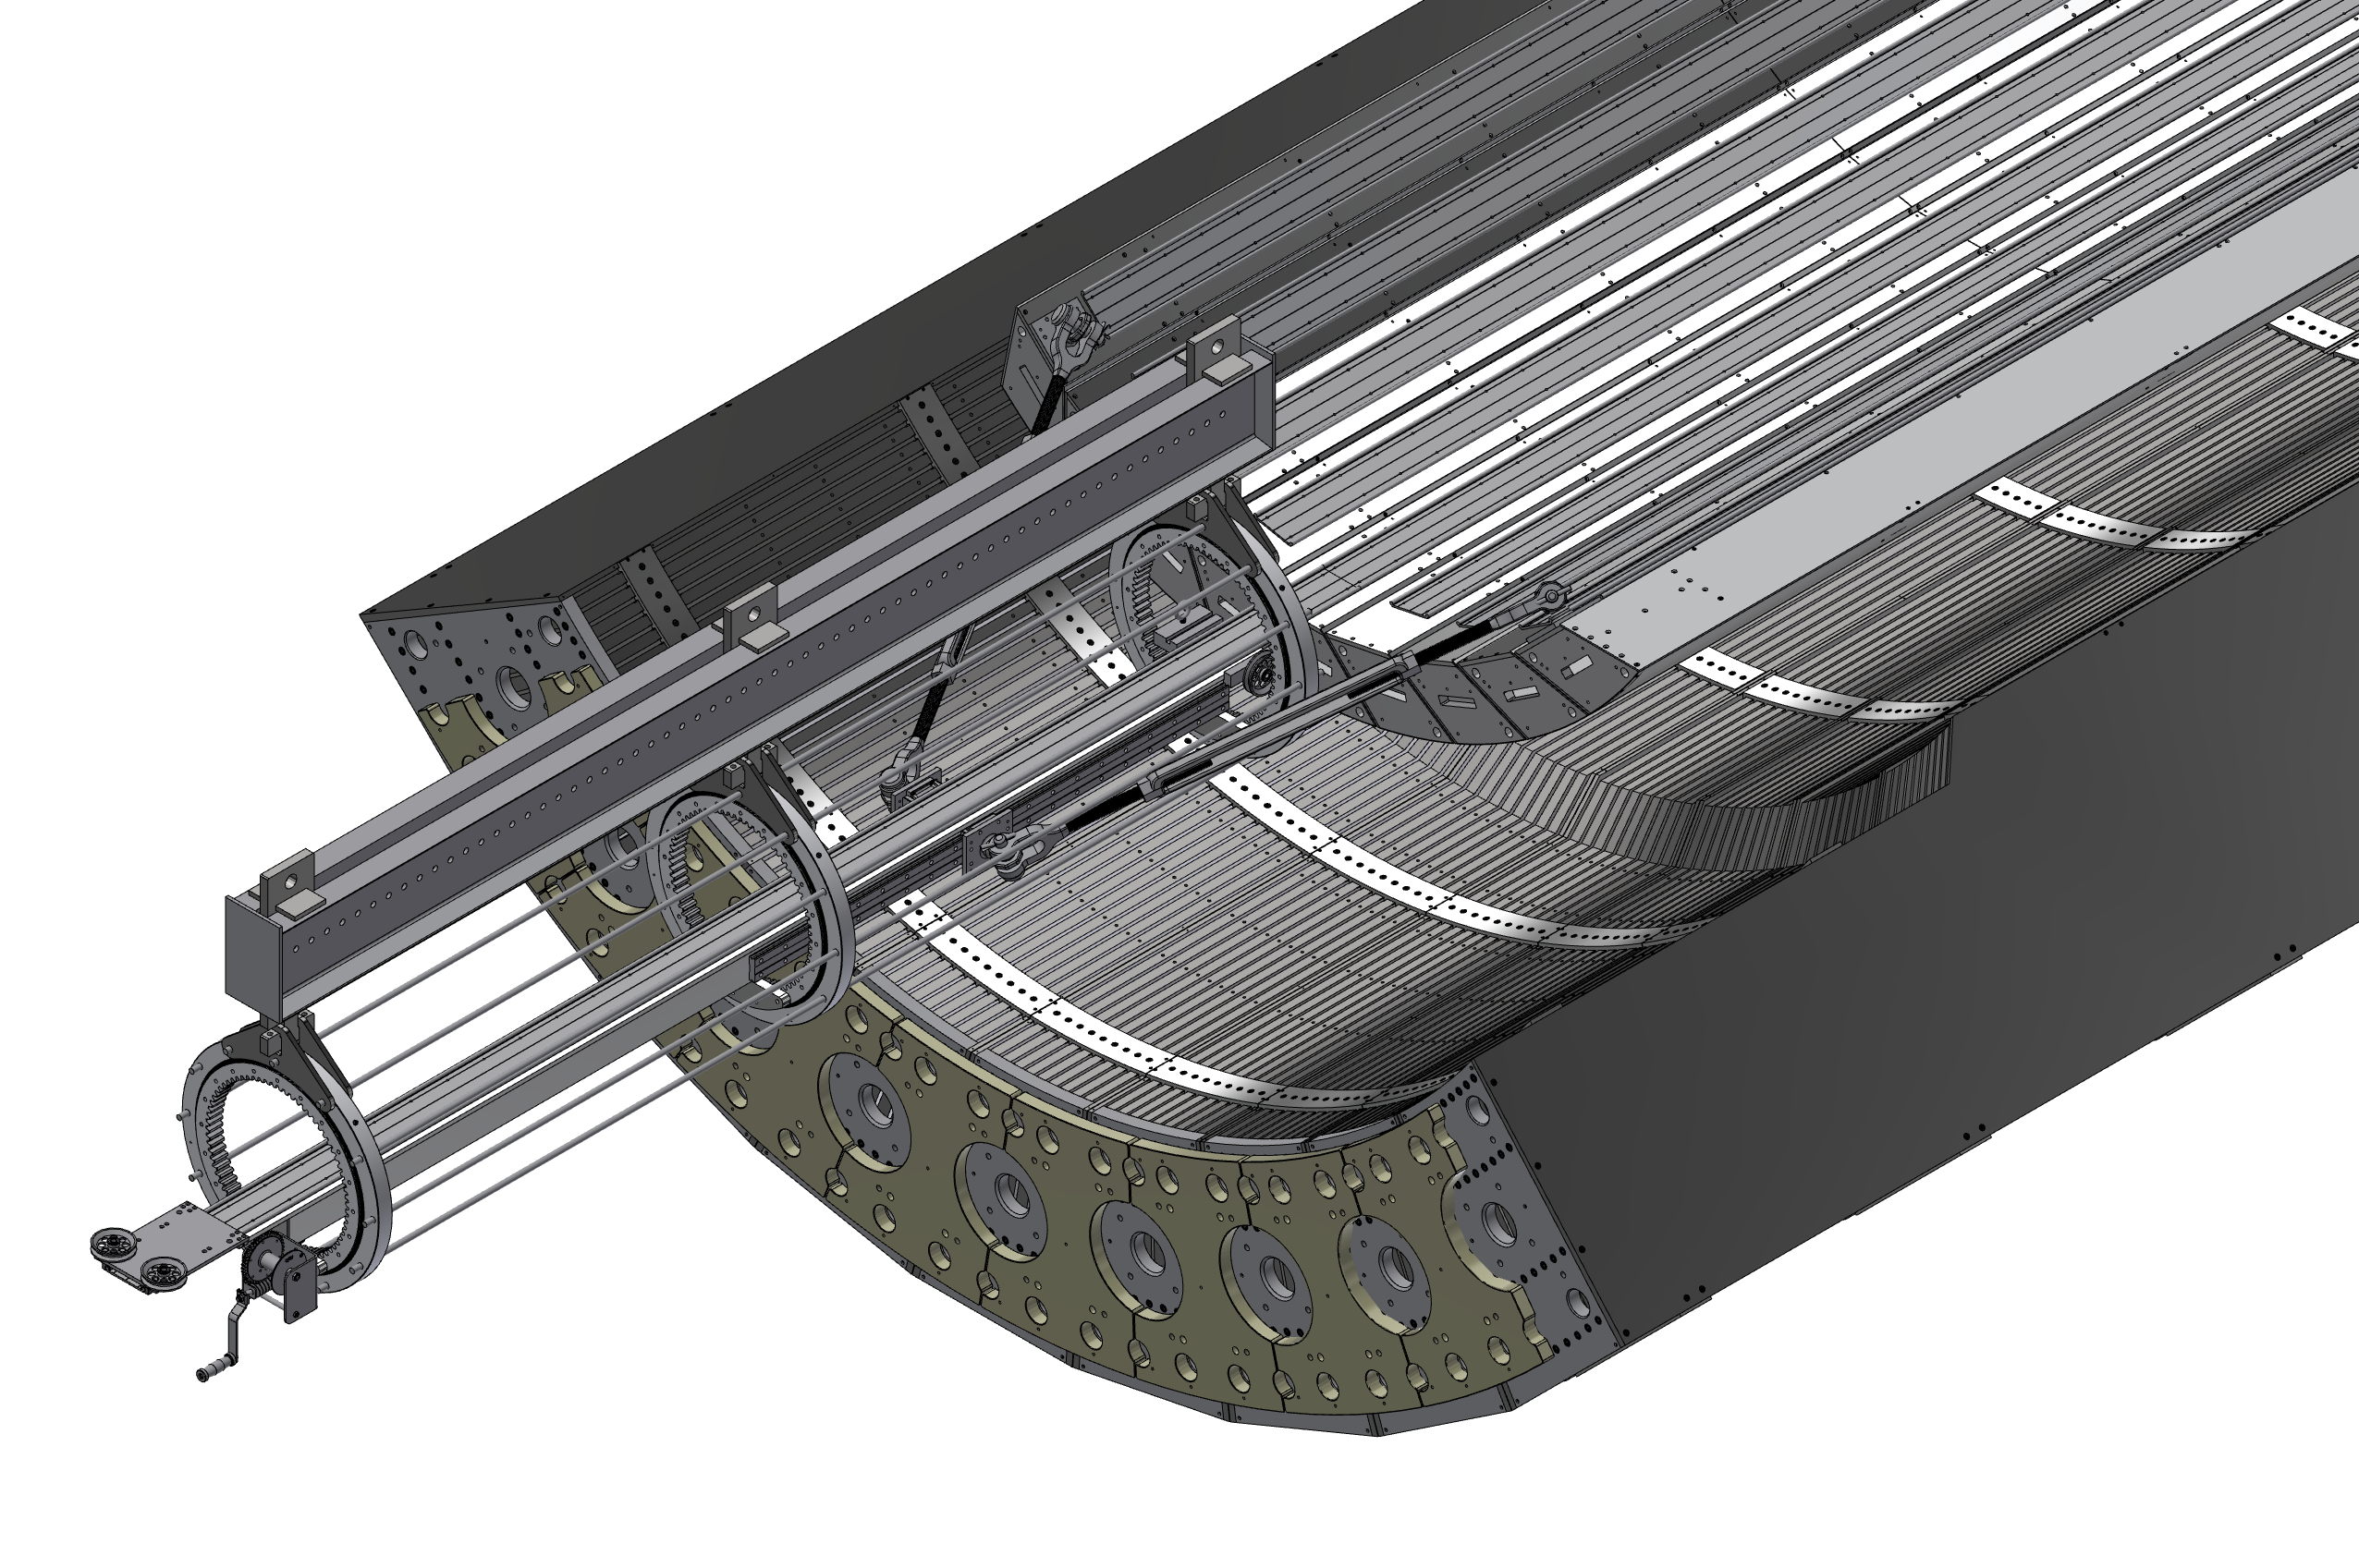
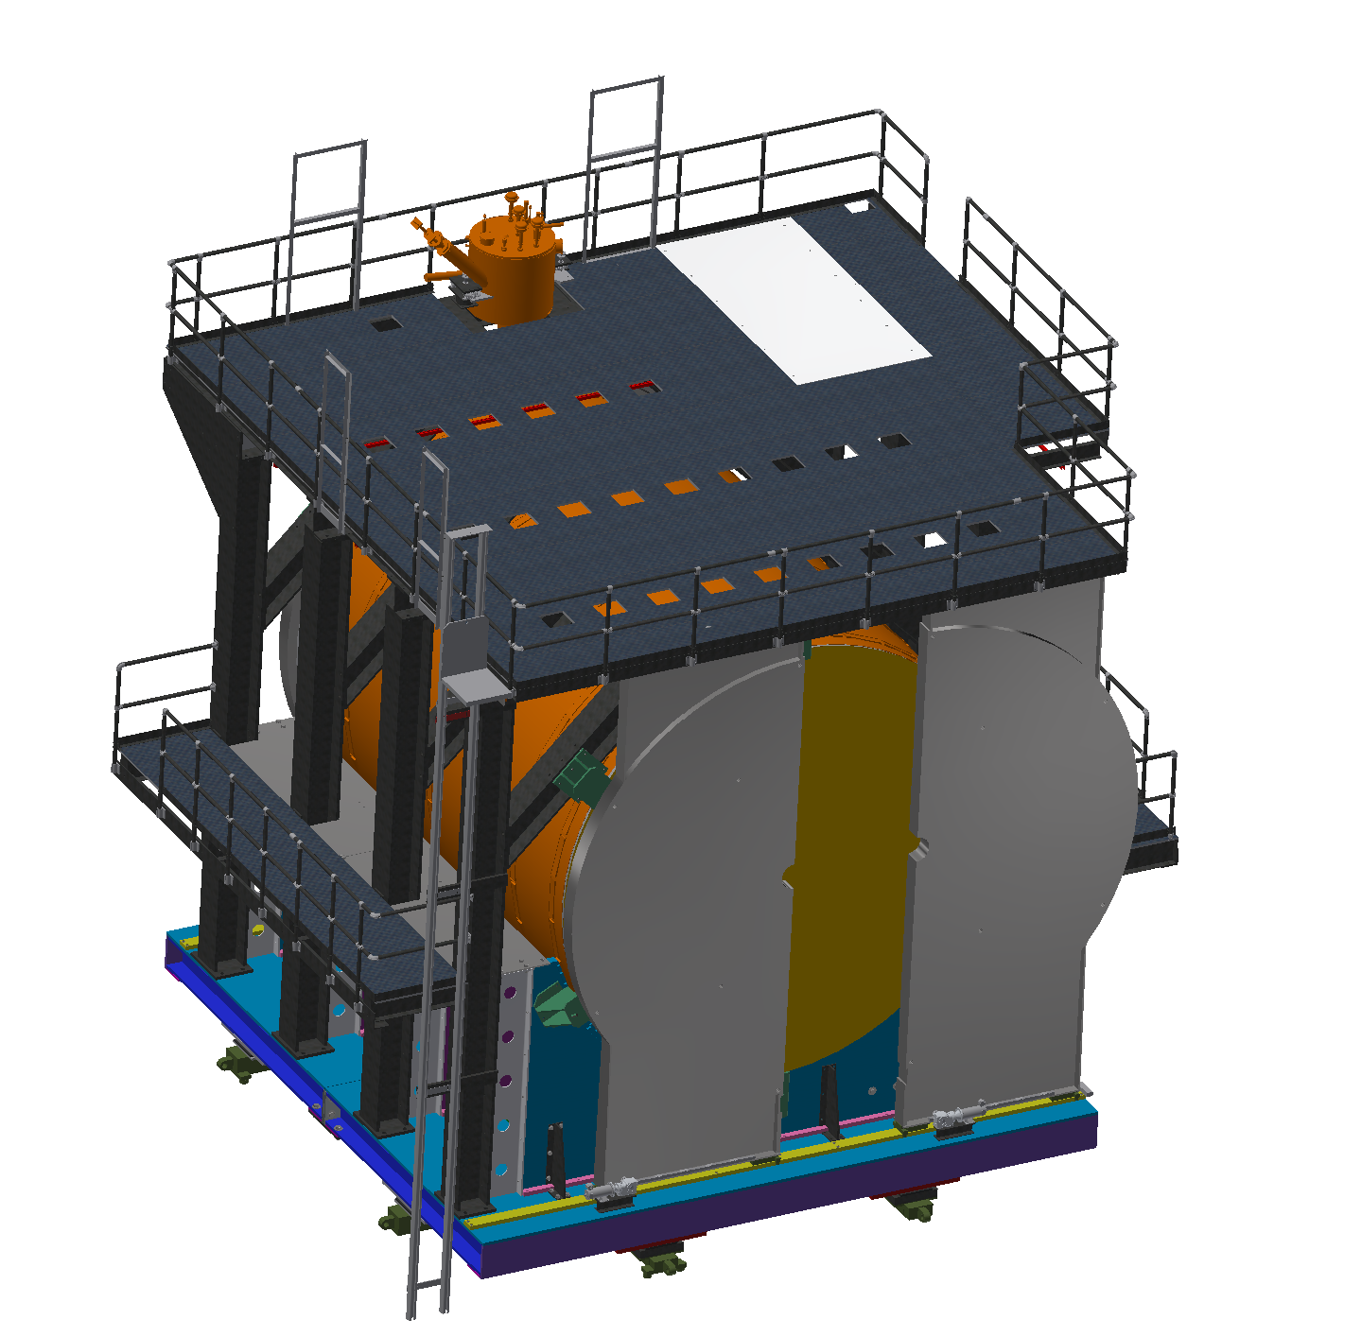
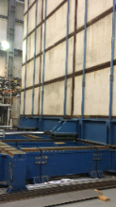
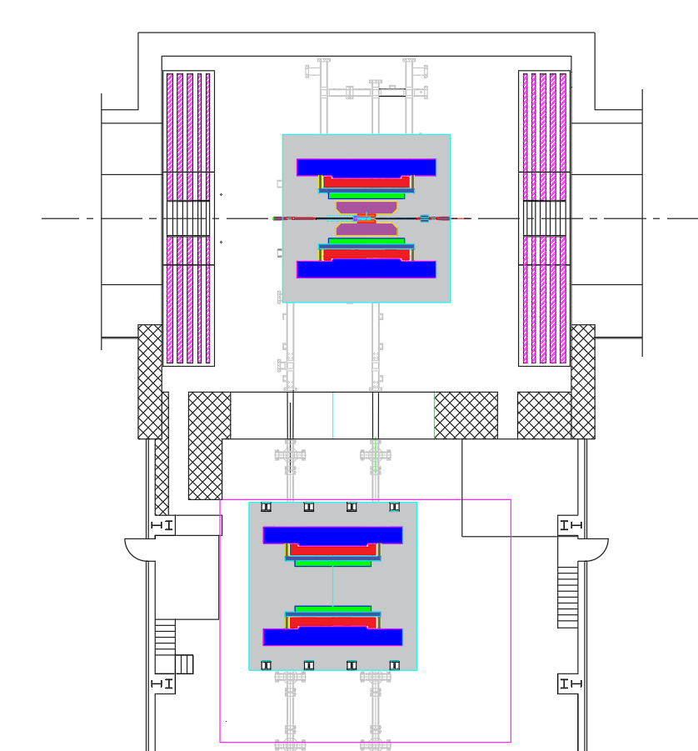
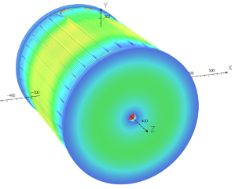
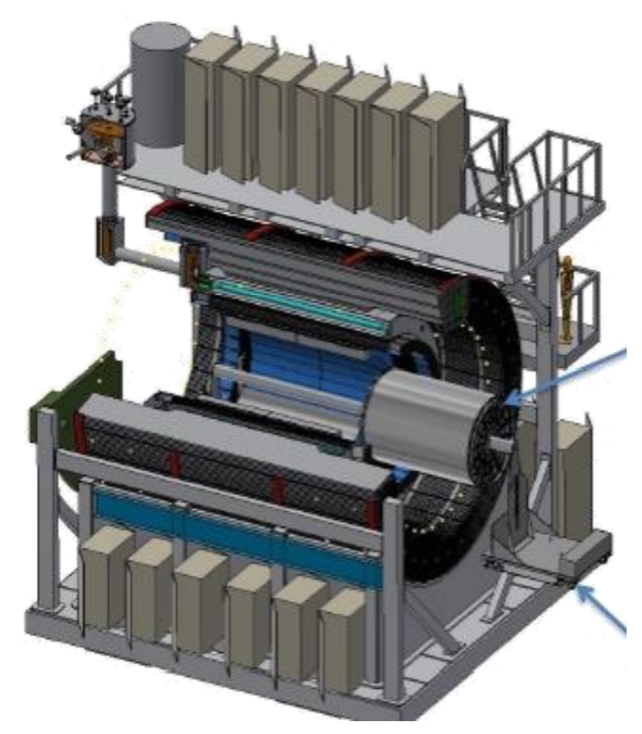
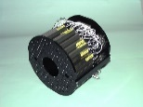
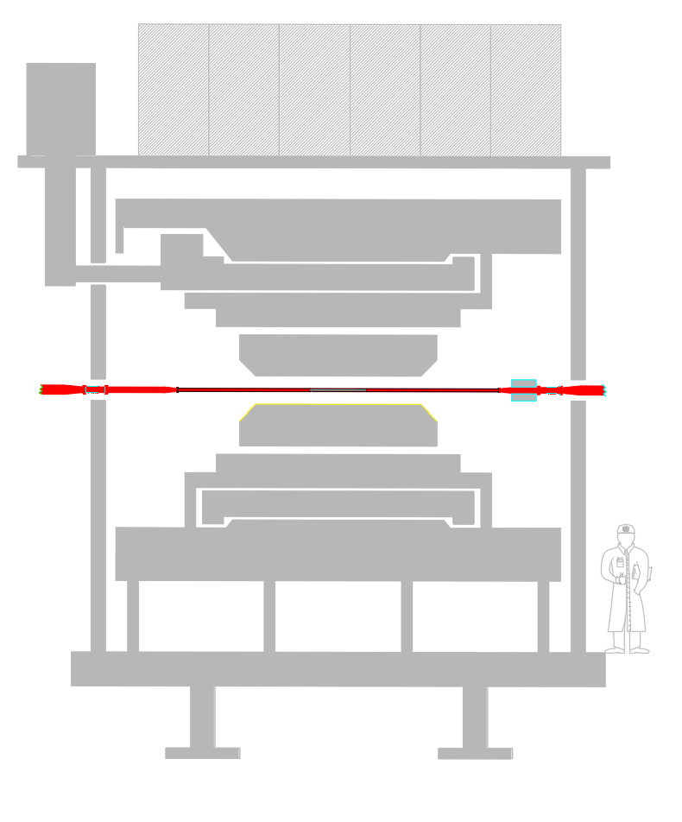
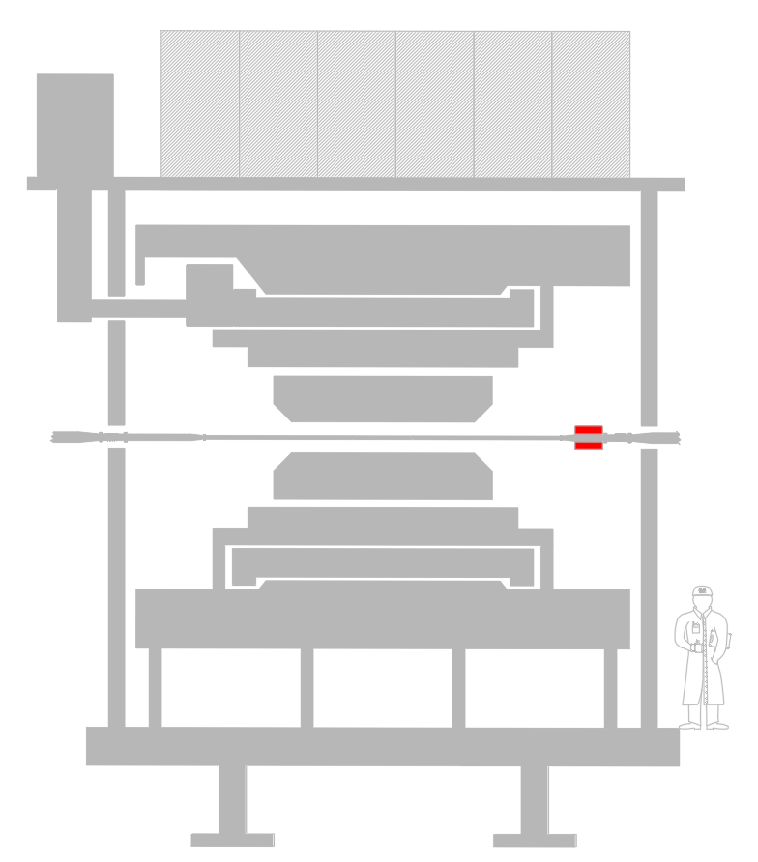
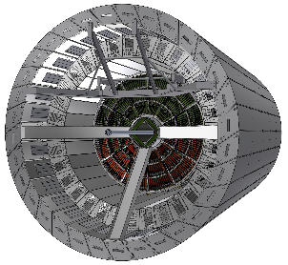
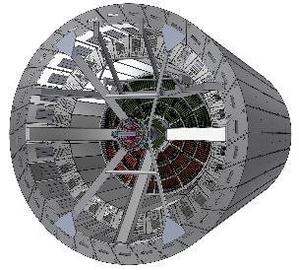
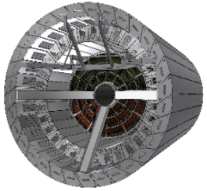
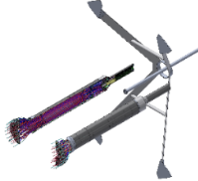
sPHENIX Construction Sequence
(1) Cradle Base | (2) oHCAL Sector 1-13 | (3) Magnet Initial Install | (4) Large Support Rings | (5) oHCAL Sector 14-32 | (6) Inner HCAL
(7) EMCAL | (8) Upper Platform | (10) Open Shield Wall | (11) Move sPHENIX to IR | (12) Magnet Connect | (14) TPC Installation
(15) INTT Supports | (16) Beam Pipe Install | (17) INTT Installation | (18) MVTX Supports and MVTX | (19) Secure Beam pipe | (20) MBD
iHCAL Barrel fabrication ,AH
The base will be built on top of the AH rails
Magnet mount hardware is also attached
The magnet is lowered in to the oHCAL bore
The rings also work to stabilize the magnet
The full oHCAL barrel weighs ~480 tons
The iHCAL barrel slides in from the North
(9) Pole Tips
(13) Magnetic Field Mapping
TPC
There are 64 EMCAL sectors each installed one at a time with a special tool
Work on sPHENIX will stop for the time needed to remove the shield wall
There is a 5-foot move North in the IR
Results from an sPHENIX OPERA EM FEA
TPC slides in the EMCAL bore from North
Beam pipe is supported temporarily
MVTX has a 2mm clearance to the beam pipe
+MBD supports
(21) Full System Integration, ORR

