Slide 1
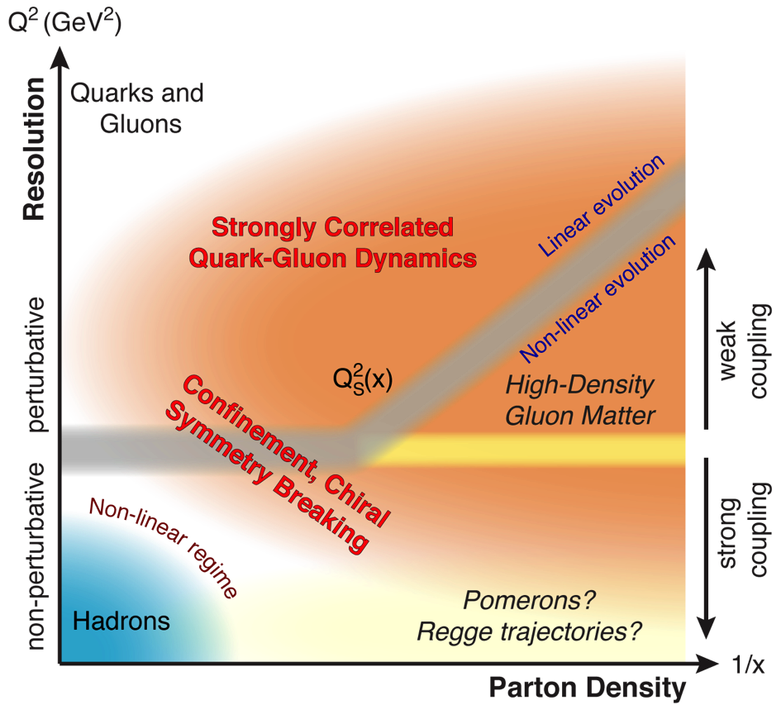


Jets and small-x physics
focus on
e+A collisions
at the EIC
Barbara Jacak
UC Berkeley & LBNL
Sept. 27, 2021

Slide 2
The Questions for small x
Does the gluon density saturate?
How does a parton shower evolve?
  Use precision of EIC e+p to study QCD
How do partons interact inside dense QCD matter?
  Energy loss & transport in dense QCD matter
  Medium modification of jet substructure
  Heavy flavor jets for exquisite control
How do hadrons emerge from a bunch of partons?
  Use nuclei as a variable size filter

Slide 3
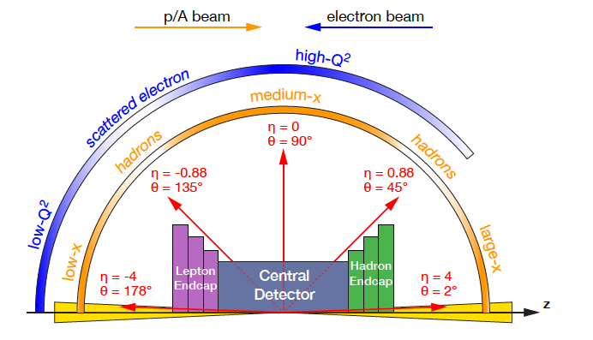
What goes where

Slide 4
To probe the small x region at EIC, excite a small x parton and see how its fate depends on A
(➔ vary the path length, density) as a function of x and Q²
(➔ vary medium density & the probe)

Slide 5
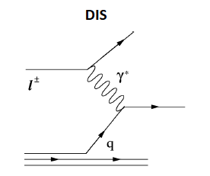
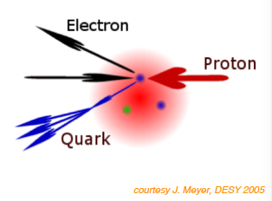
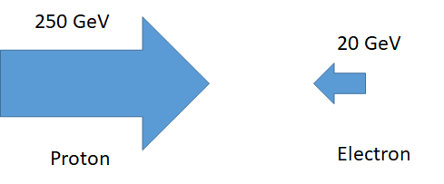
SIDIS off low-x partons -> jets
e
Probe parton at x=10⁻² (almost a fixed target)
-> 5-15 GeV jets
jet
M. Arratia, et al.
100

Slide 6
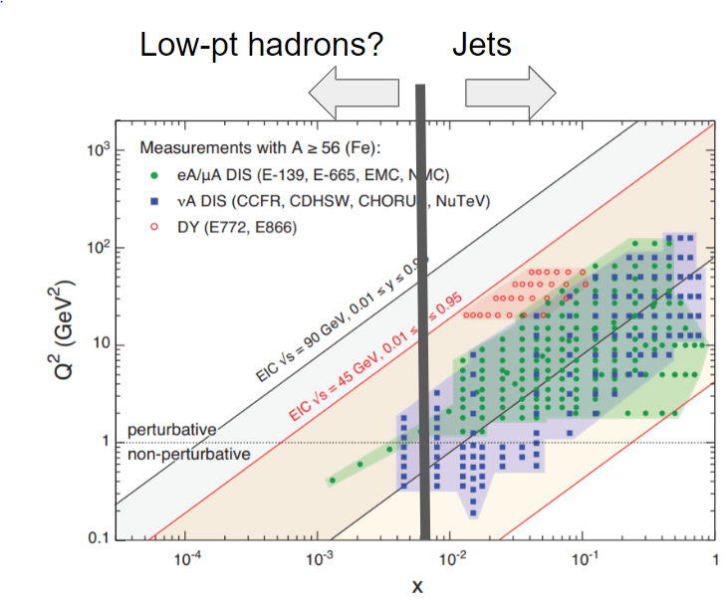
To reach very lowest x
use single hadrons
But jets are better!

Slide 7
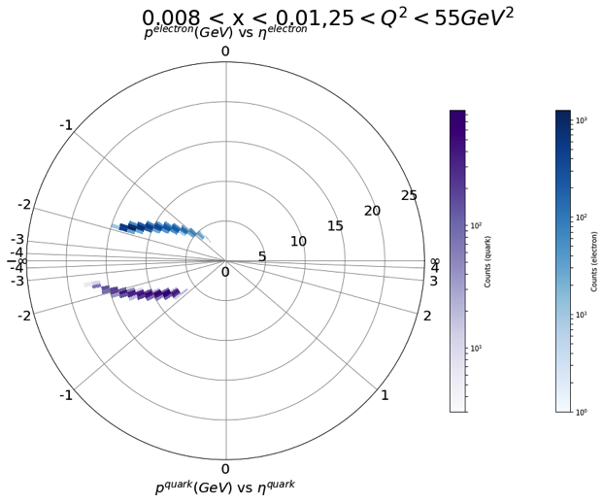
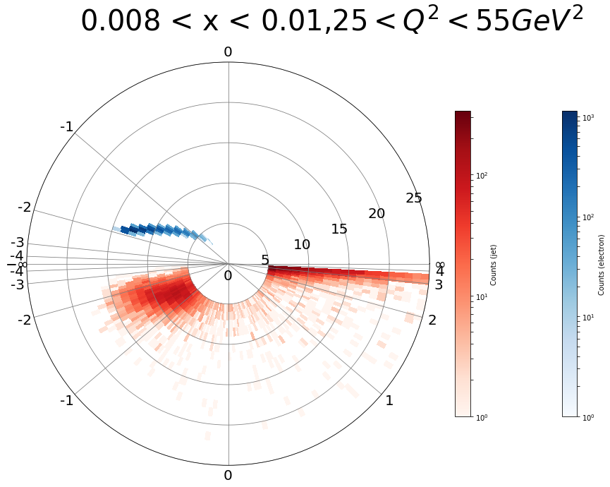
Electron tags original jet energy, angle
e+p, DIS; Pythia 8. Require W² > 4 GeV², jet R=1.0
electron
momentum
struck parton
reconstructed jet
Youqi Song, M. Arratia
⬅ electron direction
proton/ion ➔ direction
Can use R=1 so hadronization uncertainties are small
jet approximates the parton well; calculable with pQCD
Directly measure energy lost to dense matter at small x
NB: Q² >25 GeV ²

Slide 8
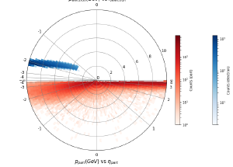
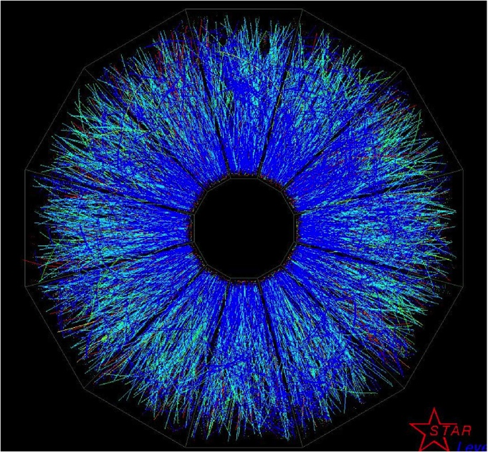
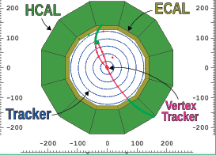
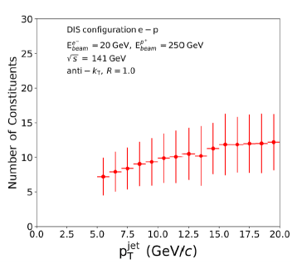
Measuring these jets
Pythia 8
Is easy!
  Underlying event is small
  MPI effects smaller than pp and pA
Is hard!
  The jets are very soft
  Small number of constituents
  But we have practice at RHIC
  - under tougher conditions!
  Look at charged & full jets
hadrons

Slide 9
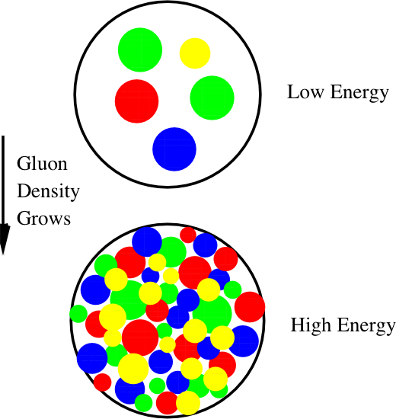
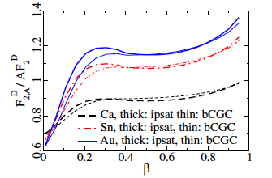


    Does gluon density saturate?
Di-jets are a tool of choice
SIDIS γ + di-jet production
(see talk by Farid Salazar)
Measure SIDIS jet cross sections vs. Q², x, A
    At high density
    gluon # saturates?
other measurements:
Suppression of dihadron/dijet angular correlations in
  e + A -> e’ + h₁ + h₂ + X
Coherent diffraction
  σ ~ g(x, Q²)²
  β = Q²/(Q² + M_{X}²)
(separate from incoherent
by requiring nucleus remnant)
1/Q_{S}²
+
?
First look with DIS

Slide 10
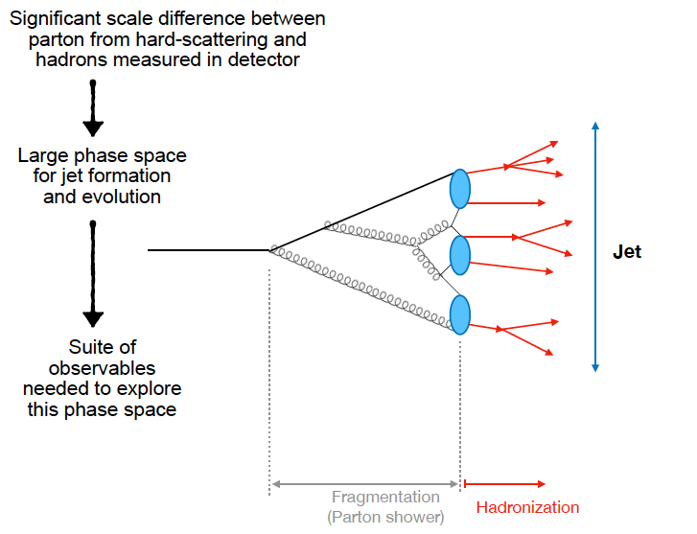
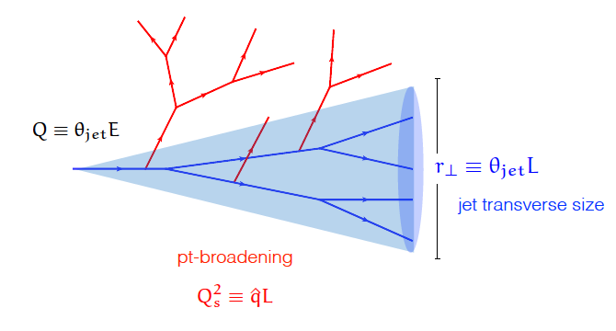
Parton shower evolution
Modified by medium interactions in AA, pA, e+A
(some parts calculable)
Calculable in pQCD
Not calculable in pQCD
Rey Cruz Torres

Slide 11
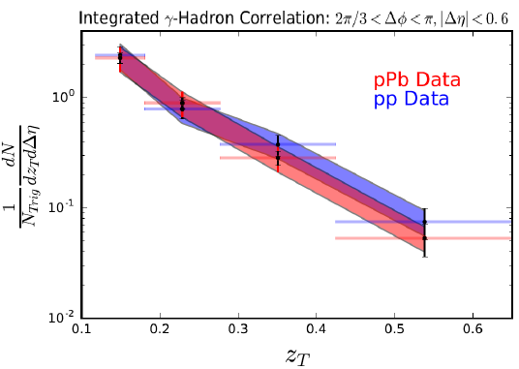

Evolution observables
Fragmentation function
z = p_{T,hadron}/p_{T,jet}
or p_{γ}/p_{T,jet} in pp γ-hadron
Needs better precision!
Do via hadron-in-jet at EIC
-> hadronization corrections
other jet evolution observables:
(see talk by Rey Cruz Torres)
Angularity
(groomed) Jet substructure e.g. jet mass, z_{g}
Jet axis differences

Slide 12
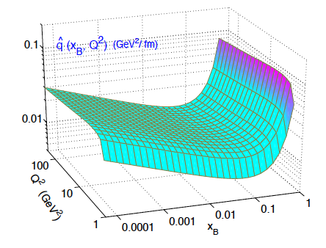
Parton energy loss
Quantify using q-hat
For a 10 GeV parton
  q = 1.9 +/- 0.7 GeV²/fm @ T=470 MeV
  1.2 +/-0.3 GeV²/fm @ T=370 MeV
    JET Collaboration PRC90, 014909 (2014)
  0.38 GeV²/fm @ 150 MeV (hot hadron gas)
  arXiv:1910.07027: Dorau, Rose, Pablos & Elfner
In cold nuclear matter
  q ~ 0.02 GeV²/fm
  arXiv:1907.11808:
  Ru, Kang, Wang,
  Xing & Zhang
<
  q= √μ²/λ λ=mean free path; μ=typical p_{T} transfer per scatter
  ~ k_{T}²/l
⌃
⌃

Slide 13
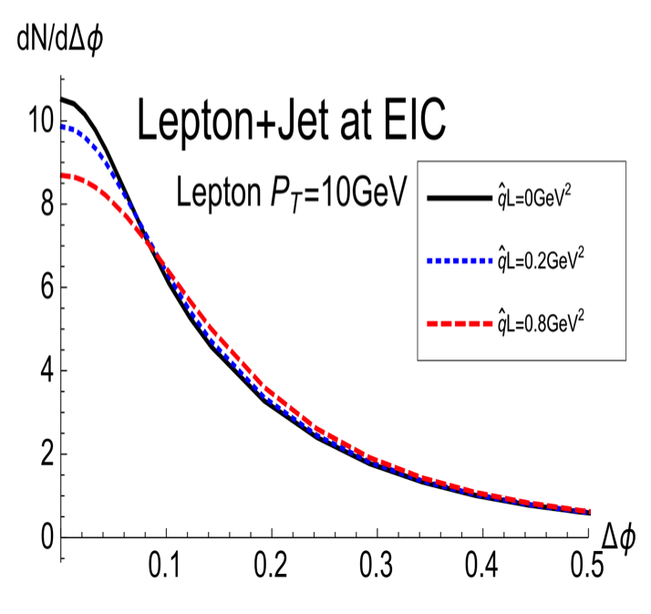
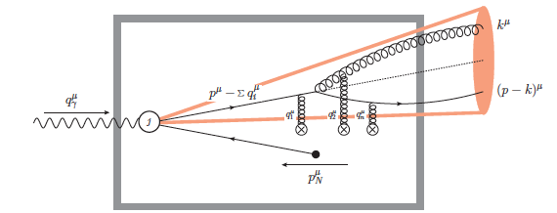
EIC energy loss & medium modification
Energy balance
  via lepton-jet correlations
medium effects -> jet p_{T} broadening
  multiple scatter/induced radiation
  fragmentation function modified
Jet substructure
  Jet angularities
  Energy flow/shower development
  Hadron formation in jets
  …
Di-jet correlations
PRL 122 192003
Breit frame

Slide 14
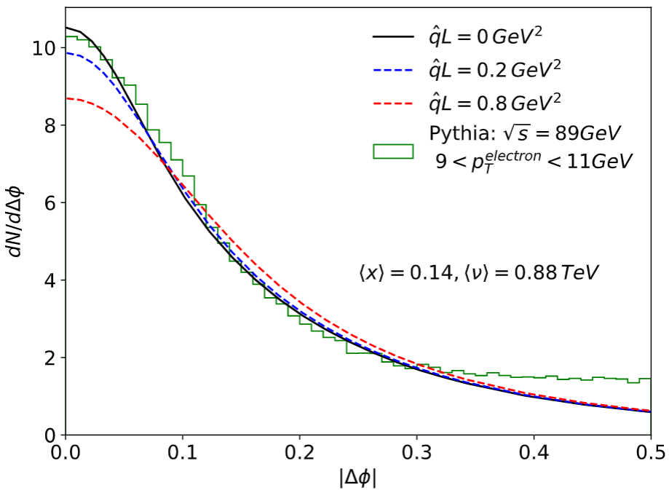
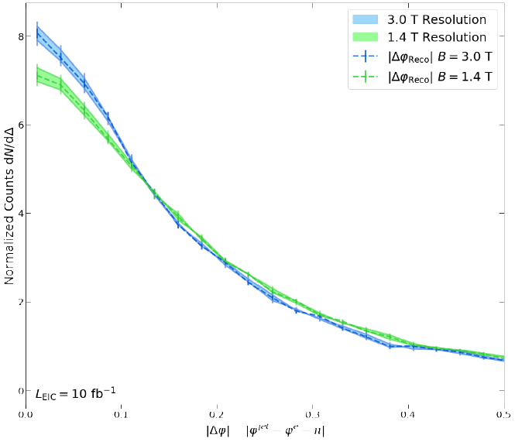
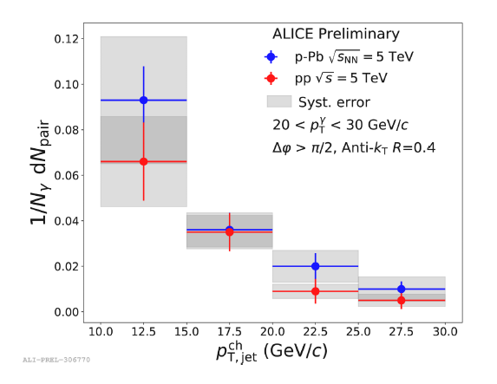
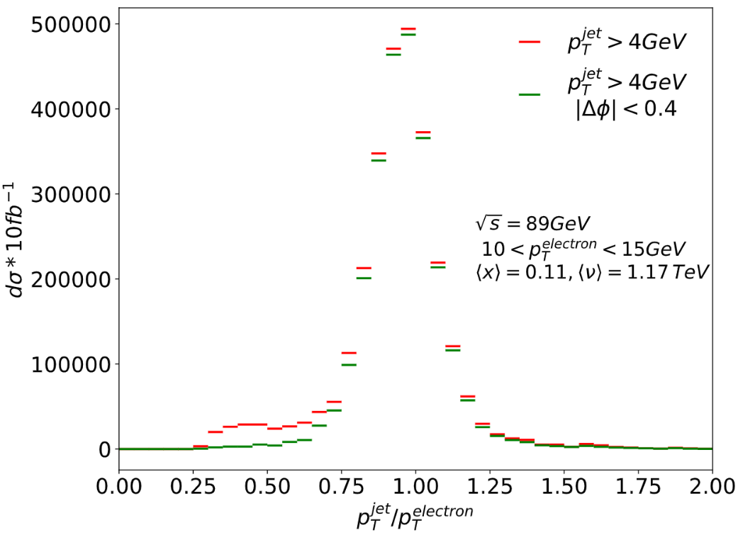
Lepton-jet correlations
Imbalance due to intrinsic quark k_{T} and soft radiation.
8
Fernando Torales Acosta
6
Charged jets with EIC detector response
4
|Δφ| = |φ^{jet} – φ^{e} - π|
Soft γ-jet at LHC
Precision at EIC
(statistics)
Sensitivity ~ 20%

Slide 15
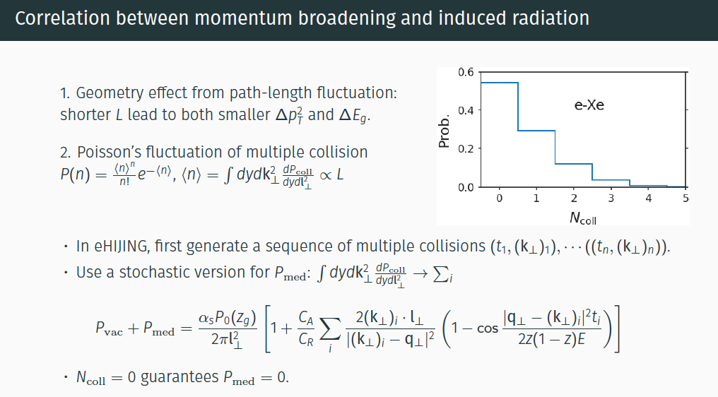
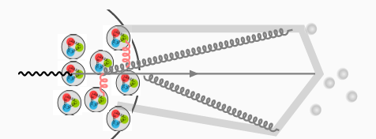

Weiyao Ke, UC Berkeley/LBNL
+ Y. He, H. Xing, X-N Wang
NB: jet broadening observed in AA collisions

Slide 16
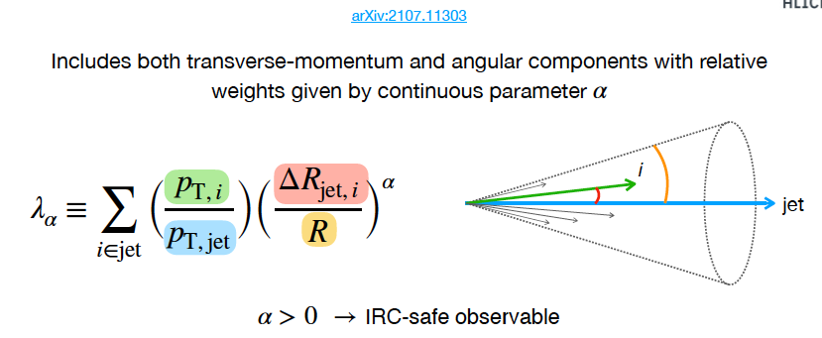
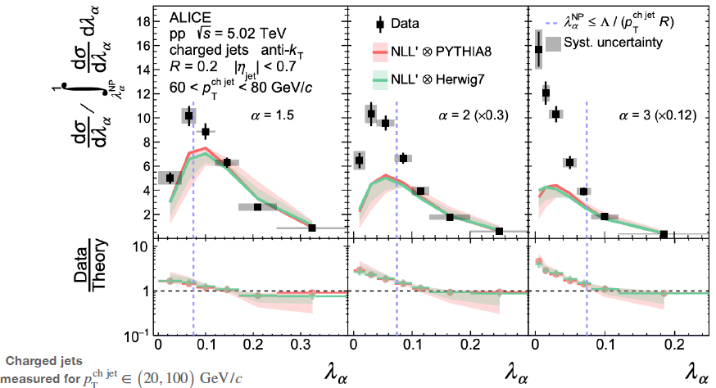
Jet angularity:
Ezra Lesser, Rey Cruz Torres
(shape) Calculable in pQCD
Grooming improves agreement with NLL

Slide 17
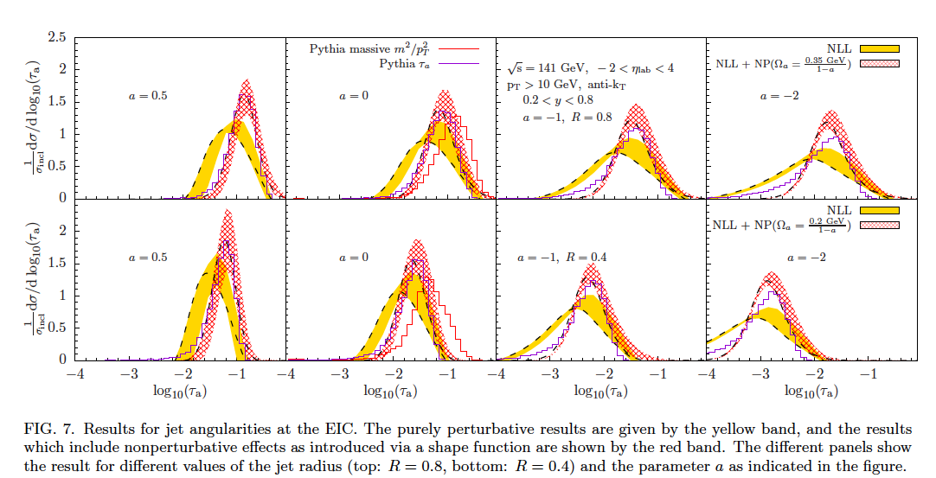
Angularity at the EIC
Higher precision - study QCD & tune models using e+p
Grooming much smaller effect (underlying event)
  Pin down non-perturbative effects (ISR, hadronization)
Sensitivity for small medium modifications
arXiv:1910.11460
NP effects

Slide 18
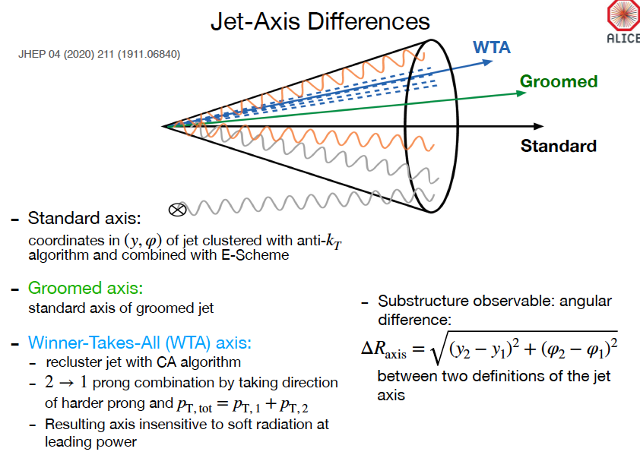
Rey Cruz Torres

Slide 19
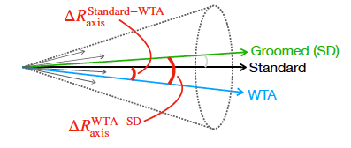
Insights*
Axes have different sensitivity
to non-perturbative physics
Standard & groomed (Soft Drop) axes very similar
  Hadronization correction is important!
  Axis difference sensitive to hadronization model
  Stronger grooming larger difference
  tune on precision EIC data in ep collisions!
WTA axis is less aligned with standard axis
  Difference insensitive to grooming
  WTA – standard can probe medium-induced jet structure modification in soft region
  * See talk by Rey Cruz Torres

Slide 20
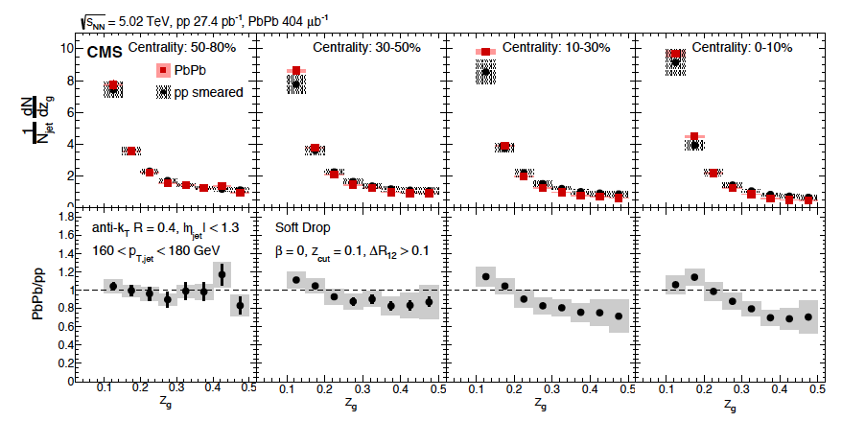
  Probe early gluon splitting
Recluster & groom jet
Use 2 leading clusters
Data can help quantify energy, p_{T} transport.
Confusing dependence on jet E, grooming.
Sort out @ EIC.

Slide 21
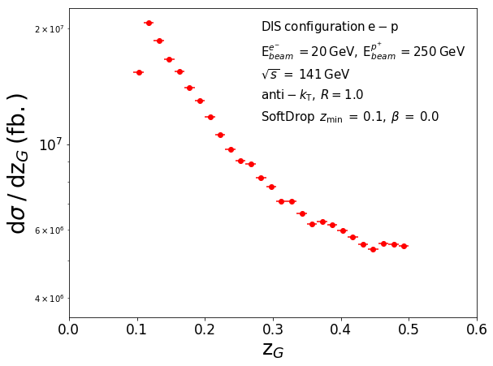
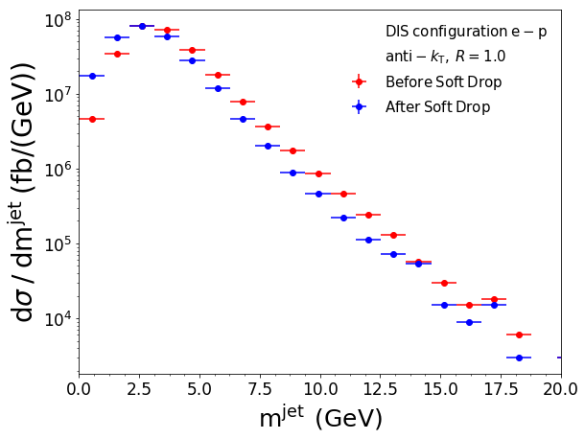

In e + p events @ EIC
Miguel Arratia
High statistical precision, small grooming effect
NB: no detector response in these plots

Slide 22


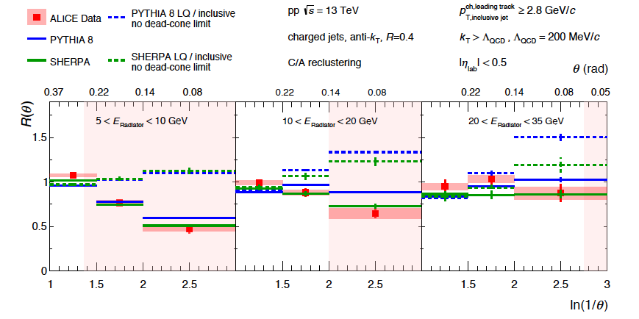
heavy quark energy loss
Soft gluon radiation spectrum
Large M suppresses small angle radiation (phase space effect)
Known as “dead cone effect”
Dokshitzer, et al. J.Phys.G17,1602 (1991)
Dokshitzer & Kharzeev, PL B519, 199 (2001)
ALICE D-tagged vs. inclusive jets in p+p
θ_{g}
HF/ inclusive
arXiv:2106.05713

Slide 23
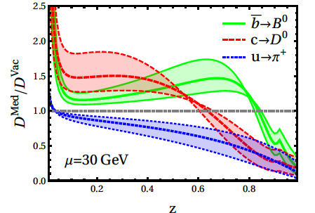
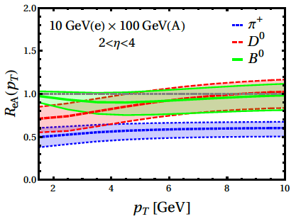
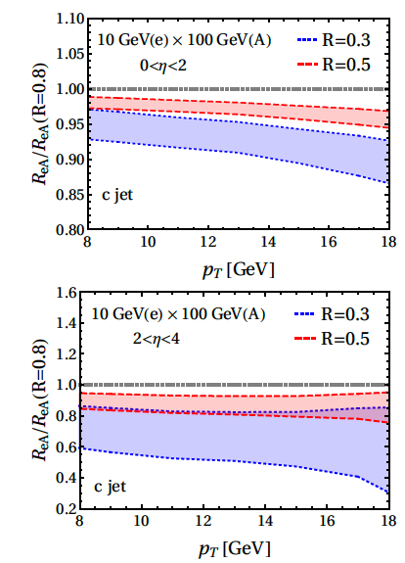
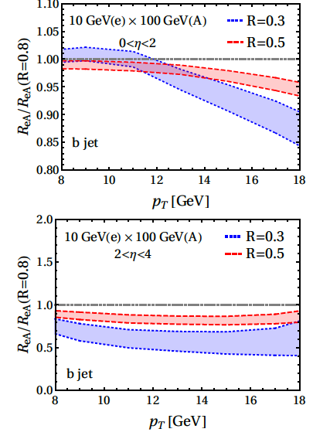
Heavy Flavor at EIC
Open HF
Vitev, et al.
arXiv:2007.10994
Frag. Function modification measurable in forward eta
Clever ratio of jet sizes reduces systematics for heavy flavor jets
HF jets
Vitev, et al.
arXiv:2108.07809
Not such small x, but very sensitive to the medium!

Slide 24
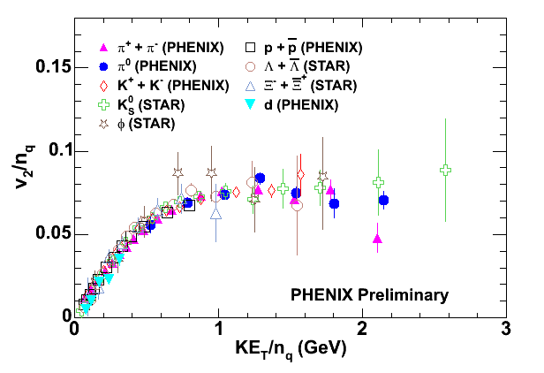
Hadronization of quark gluon plasma
valence quarks, not hadrons, are present when collective flow develops
Recombination from thermal distribution:
Fries, Mueller, Nonaka & Bass, PRC68, 044902 (2003)
Fries, J. Phys. G32, S151 (2006)
transverse KE
dressed quarks are born of flowing field
hadronize by (simple) coalescence of co-moving quarks
quarks somehow (miraculously?) dressed by gluons
Is phase space coalescence how hadrons form?

Slide 25
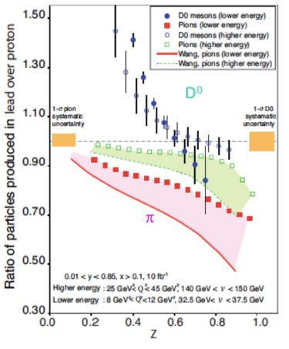
Figure it out at EIC
Hadron yields
And correlations

Slide 26
Backup

Slide 27
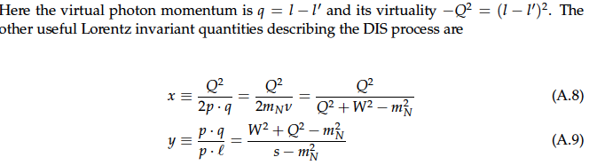
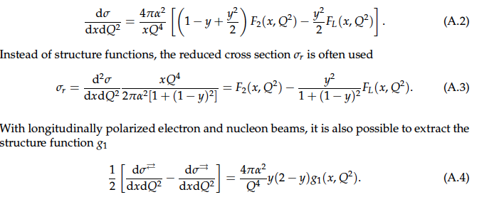
Some basics on kinematics
(cm energy for γN system, p = N momentum)
inelasticity
= 1 – E_{l}’/E_{l} (in N rest frame)
In lab frame all of these can be calculated from N & e in/outgoing info (DIS works!)
Structure functions:

Slide 28
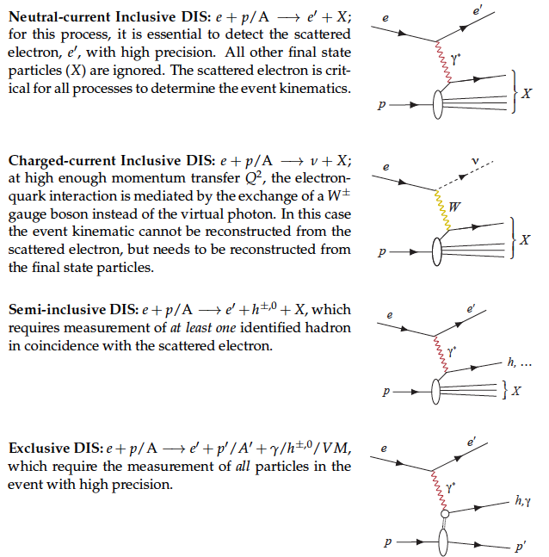
Processes in e + p/A scattering
What is measured

Slide 29
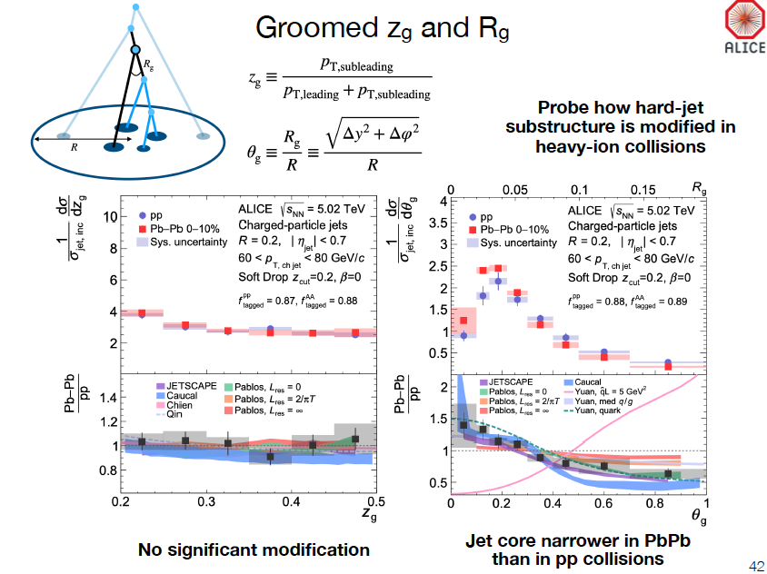

Slide 30
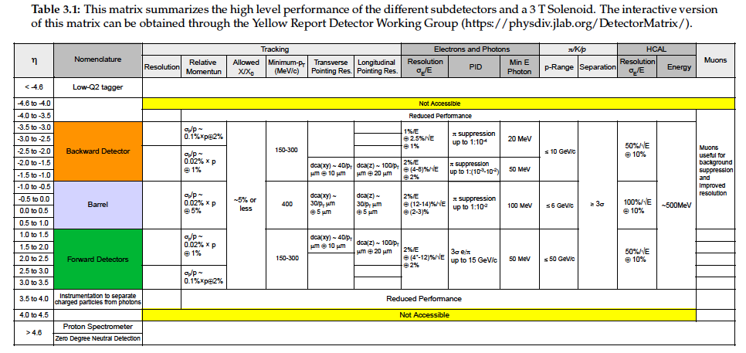
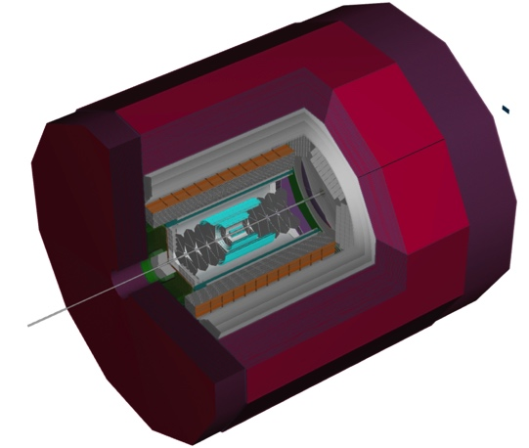
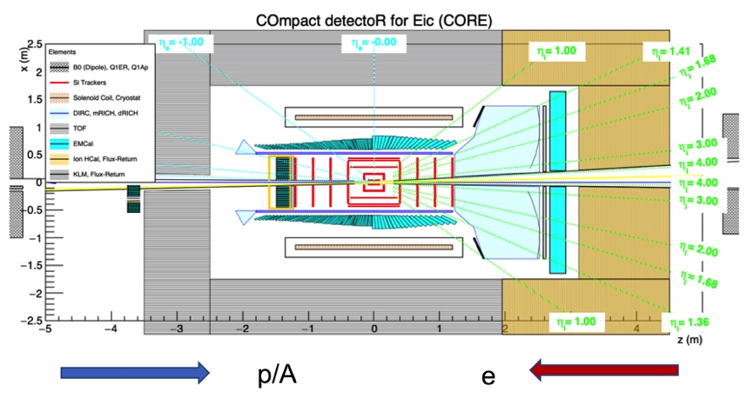
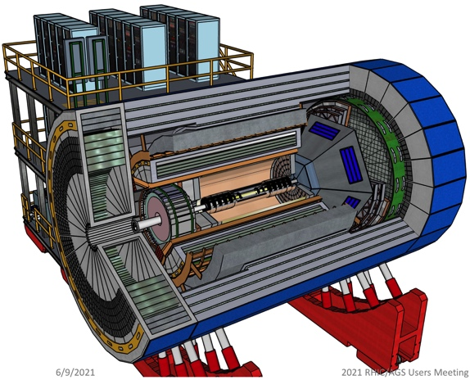
Experiment requirements

Slide 31
outline
Overarching science goals
Kinematic considerations to probe low-x
Reconstructing jets at the EIC
What we know/want to measure

Slide 32
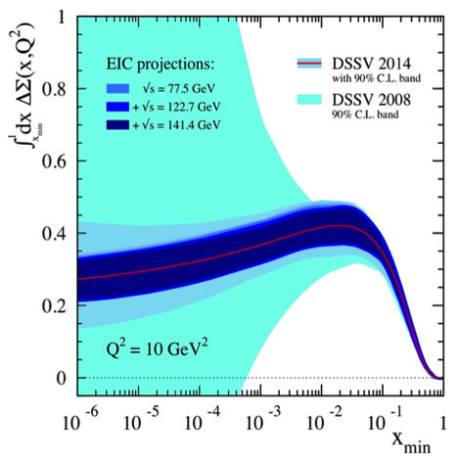


What we will know
E. Aschenauer, R. Sassot and M. Stratmann, Phys. Rev. D92 (2015) 094030.
Quark Spin
Gluon Spin
Orbital Angular Momentum
At EIC, inclusive DIS double spin asymmetry (with both beams polarized) gives the virtual photon asymmetry A₁. Moments of spin structure function g₁(x) allow us to disentangle ΔΣ and ΔG
EIC impact on helicity distributions of anti-u, anti-d and s quarks as well as gluons will be very large!
Will get at neutron spin via polarized d beam

Slide 33



Closing in on orbital angular momenta

Slide 34







Parton distributions: longitudinal
Inclusive DIS: Parton structure Unpolarized
H1 and ZEUS Collaborations (H. Abramowicz et al.), Eur.Phys.J. C75 (2015) no.12, 580.
Measure of probability to find parton f with longitudinal momentum fraction x
1-dimension
R. D. Ball et al., arXiv:1207.1303.

Slide 35


To measure the TMD’s
SIDIS with combinations of e & p polarization
  To get at the transverse quark polarizations
Identify produced hadron to tag quark flavor
  Di-hadrons, di-jets, charm for gluon TMD’s
  Neutron (d beam) as well as proton measurements
Large range of Q² and x to map out the functions
  Also map in hadron z to separate PDF, FF and evolution
Pion production
Sivers Function improvement

Slide 36



Nuclear PDF’s
Inside nucleus: densities modified
  q, g from different nucleons interact
arXiv:1708.01527
Inclusive DIS off nuclear beams

Slide 37






Spinning Glue: QCD and Spin
EIC kinematic reach
Luminosity / / Kinematic coverage
eA
10² - 10³ increase in luminosity:
ep
HERA to EIC
Hard Probes 2020 International Conference
Online / Philadelphia, PA, May 31, 2020
Bernd Surrow

Slide 38

Nucleon mass
Heavy quarkonia production (near threshold) to probe gluon exchange with hadrons @twist 4
Chiral symmetry via meson structure functions and pion EM form factor

Slide 39









Nucleon spin
(~30 %)
(~20-30 %)
(R.L. Jaffe and A. Manohar, Nucl. Phys. B337, 509 (1990))
Measure of probability to find parton f with spin aligned to anti-aligned to proton spin at momentum fraction x
g1 stat. uncertainty projections for 10fb⁻¹ for range of CME in comparison to DSSV+ predictions incl. uncertainties
EIC impact on helicity distributions of anti-u, anti-d and s quarks together with gluons
Get at neutron spin via polarized d beam

Slide 40

Looking differentially inside jets
arXiv: 1908.05264
See also: CMS
arXiv: 1803.00042
Excess soft particles at large jet radius
Narrowing of higher p_{T} particle density
Energy loss vs. medium response?
  quantify: compare theory to the differential data
  CoLBT-hydro, Hybrid, SCET_{G}

