Slide 1




LBNF/DUNE
An Experimental Program in Neutrino Oscillations, Nucleon Decay and Particle Astrophysics
Jim Strait, Fermilab
on behalf of the DUNE Collaboration and LBNF Project Team
Brookhaven Forum 2015
7-9 October 2015

Slide 2
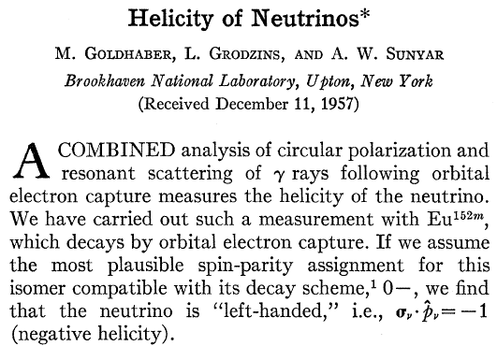
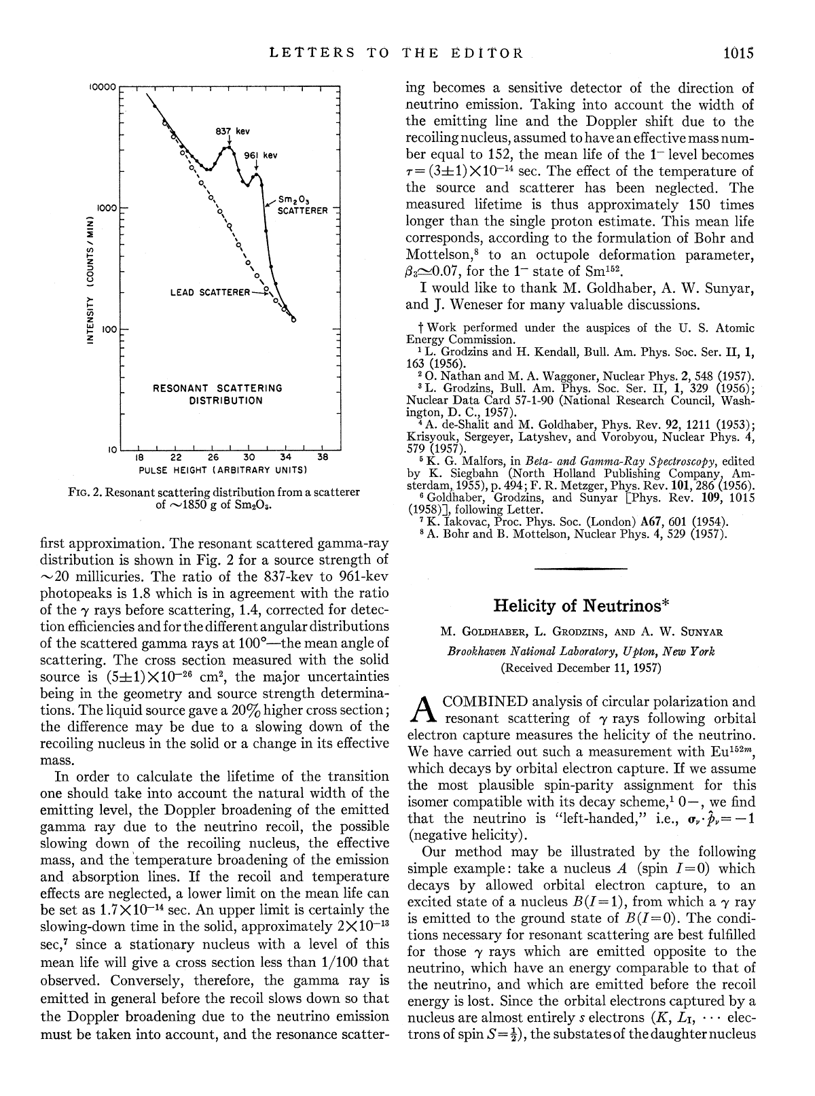
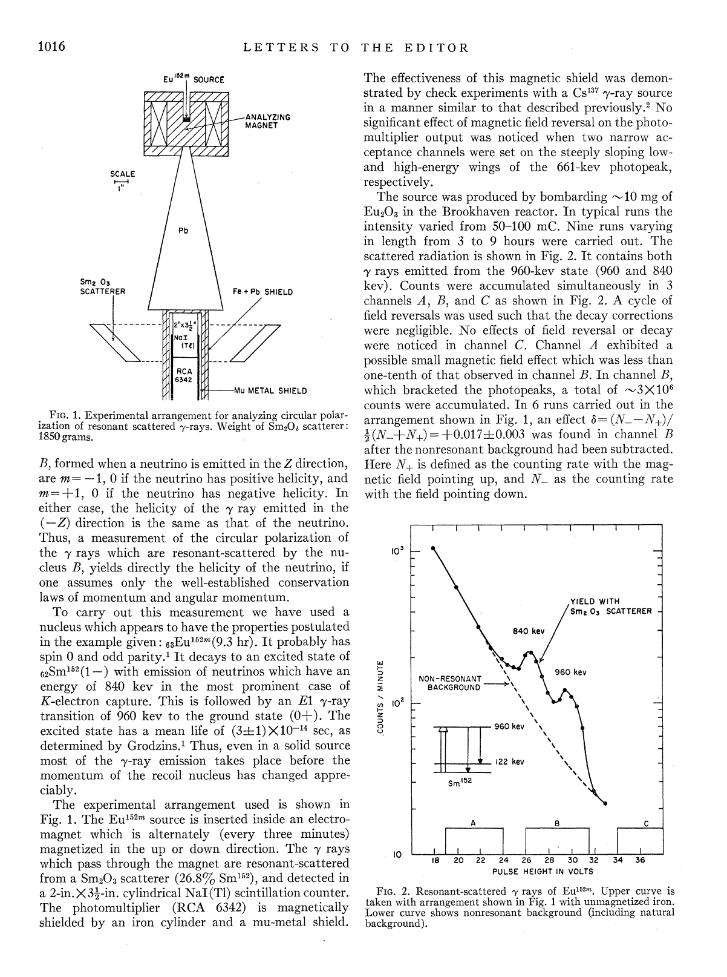
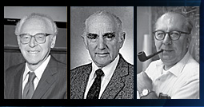
Brookhaven is a special place for neutrinos
1957 Experiment at Brookhaven determines that neutrinos are left-handed

Slide 3
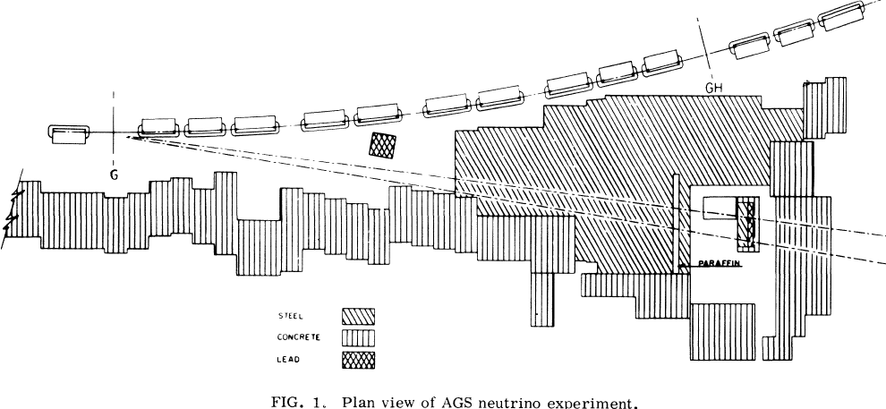
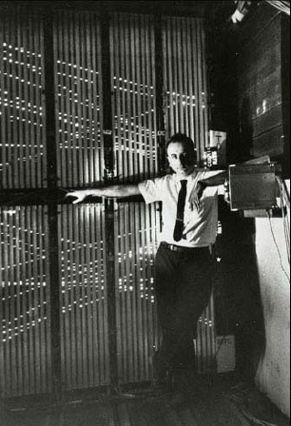
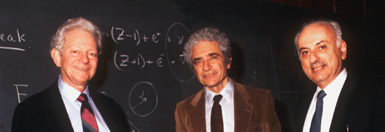
Brookhaven is a special place for neutrinos
1962 Experiment at Brookhaven’s AGS:
There are two types of neutrinos: ν_{e} and ν_{μ}
Nobel Prize 1988

Slide 4
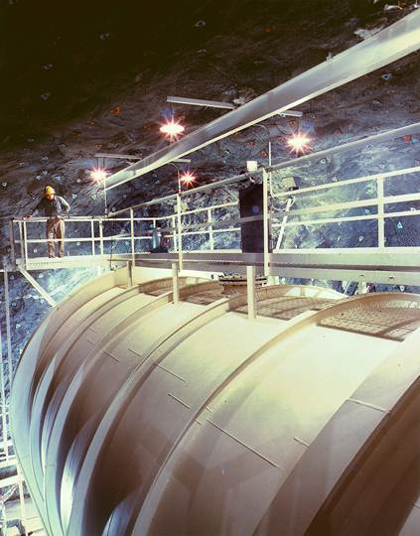
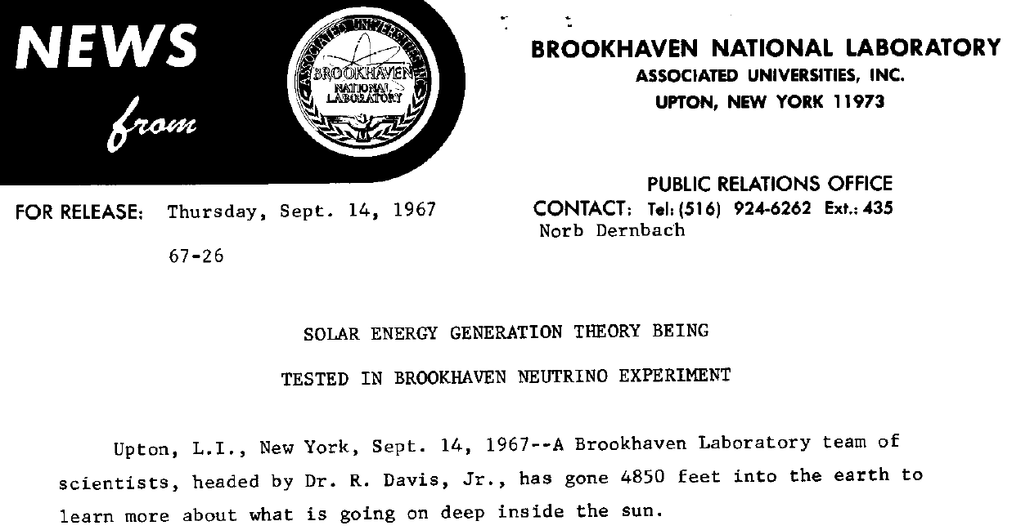
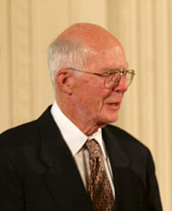
Brookhaven is a special place for neutrinos
Ray Davis’ Solar Neutrino Experiment:
Detect neutrinos via ν_{e} + ³⁷Cl → ³⁷Ar + e⁻ in
600 t of dry cleaning fluid 4850 feet under-
ground in the Homestake Gold Mine
Big surprise ... only ~1/3 the expected rate detected
  Do we not understand how the sun shines?
  Is there something “wrong” with neutrinos?
Nobel Prize 2002

Slide 5
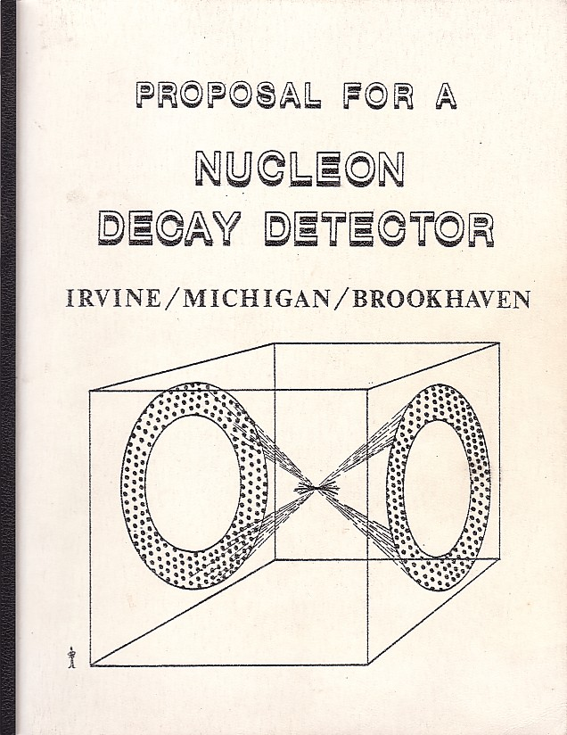
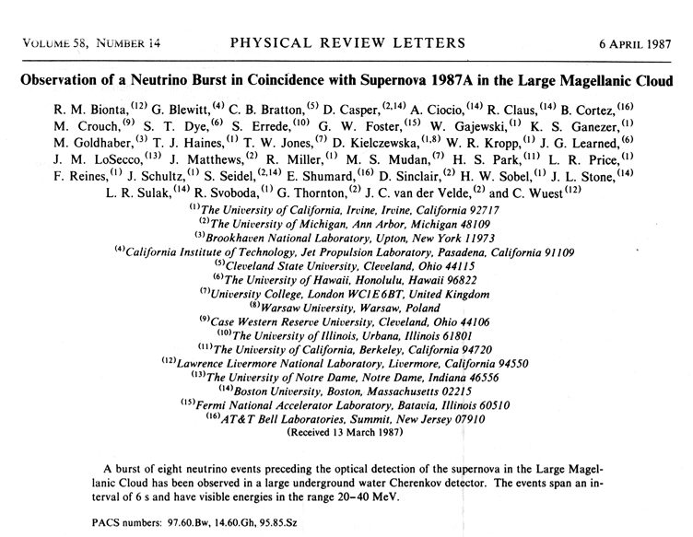
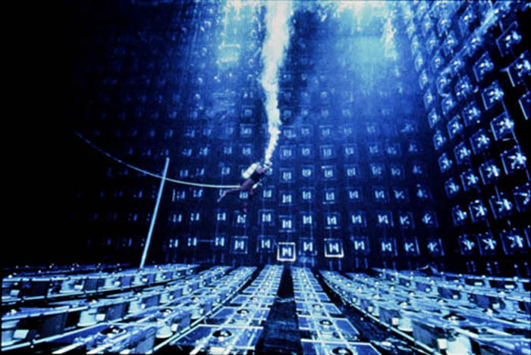
Brookhaven is a special place for neutrinos
IMB:

Slide 6
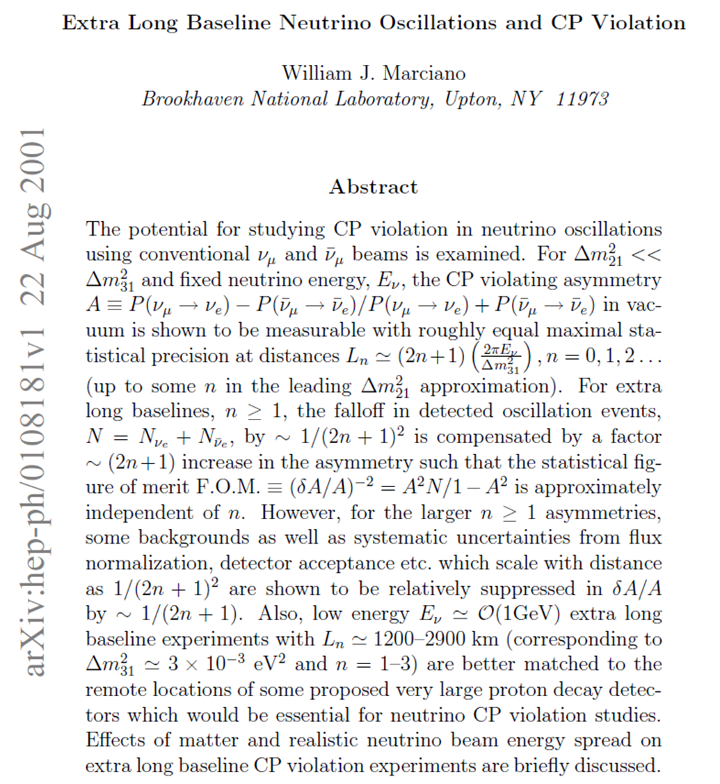
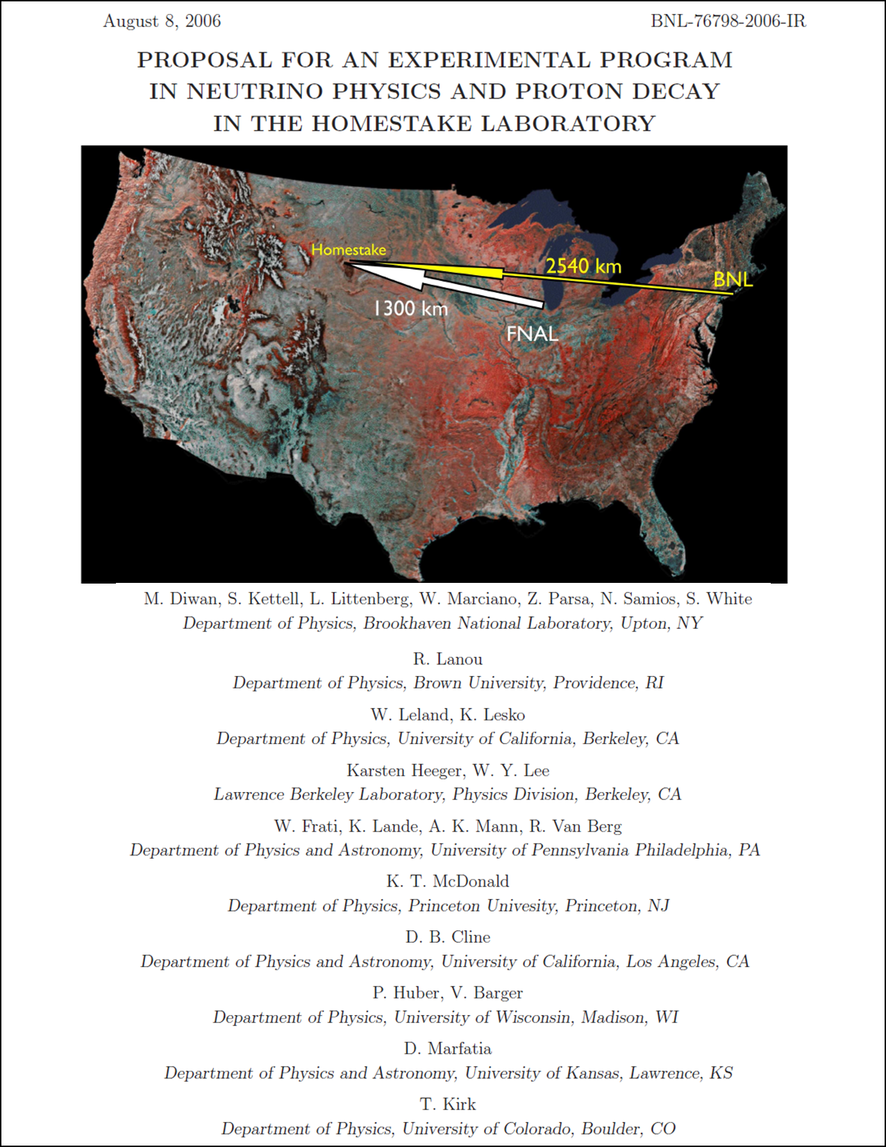
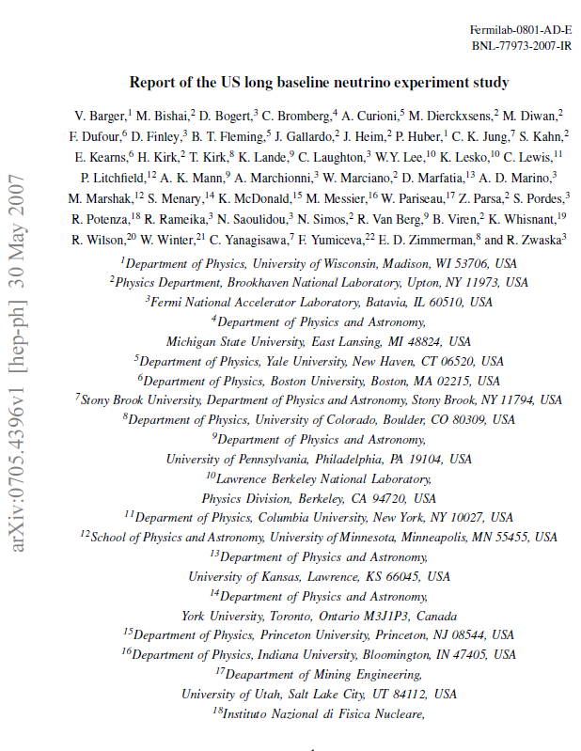
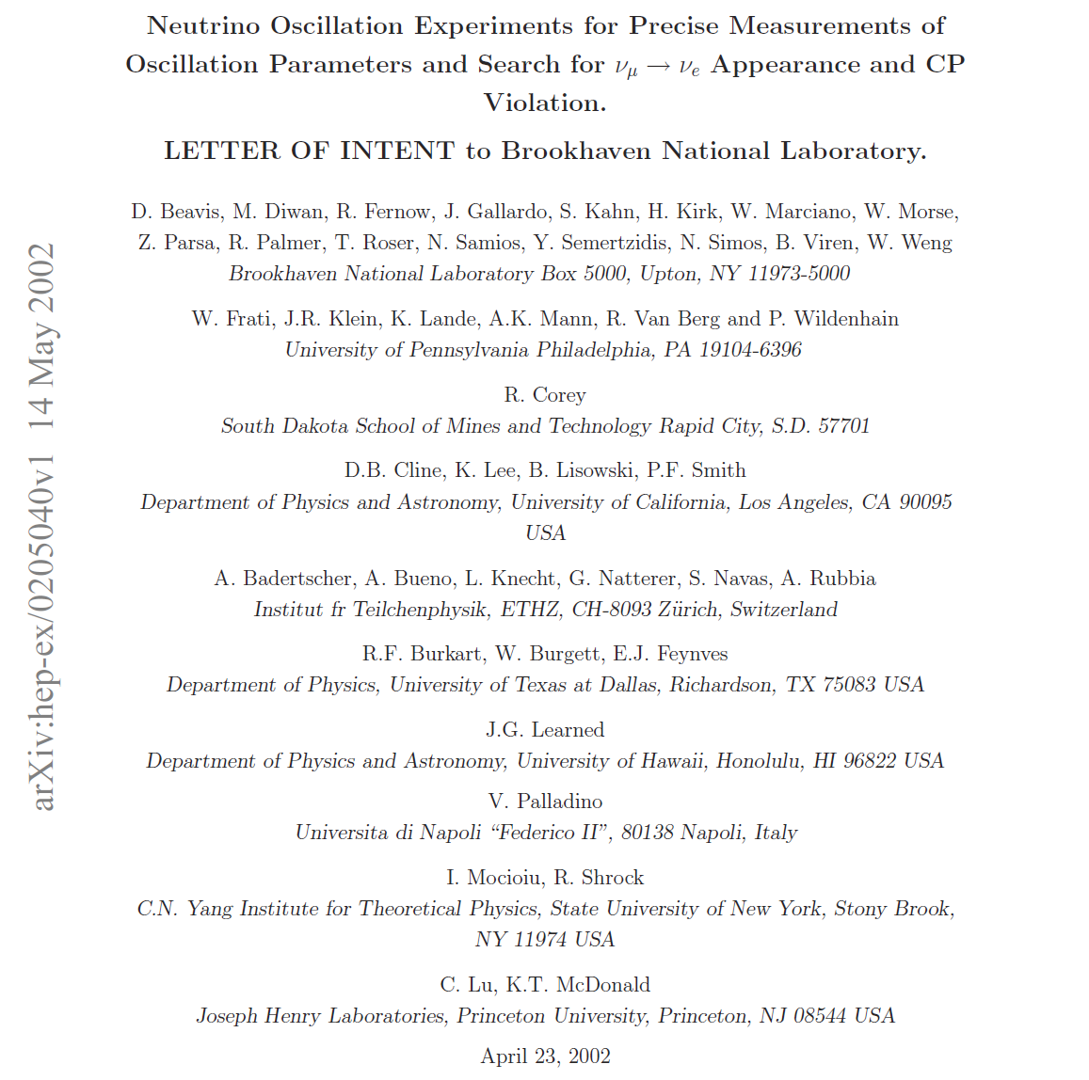
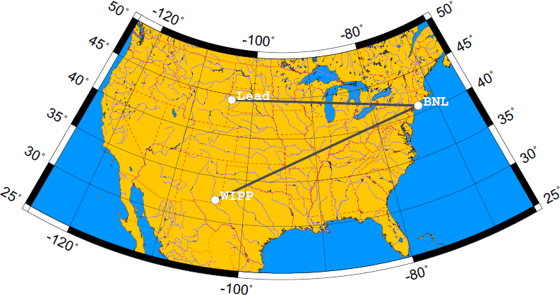
Brookhaven is a special place for neutrinos
Pioneers of what is now LBNF/DUNE
2001
2007
2002
2006

Slide 7
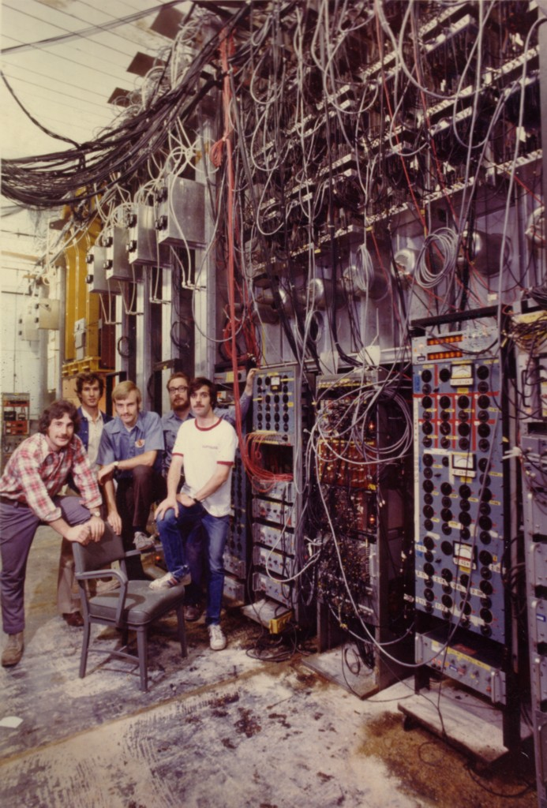
Brookhaven is a special place for neutrinos
… and last and surely least…
The home of my thesis experiment!
BNL E613: 1973 – 1978
First observations and measurements
of ν p → ν p and ν̅ p → ν̅ p

Slide 8
Why are Neutrinos Important?
Neutrinos play an important role in natural processes that are crucial to why we exist.
The reactions in the core of the sun.
The explosions of supernova stars in which the heavy elements are created and expelled into space to form planets and provide the building blocks for life.
Small differences between neutrinos and their anti-particle counterparts could help explain why more matter than anti-matter was produced in the Big Bang.
Because neutrinos hardly interact, they can tell us what happens in places we cannot “see” otherwise:
In the core of the sun
In the center of a supernova at the moment it explodes

Slide 9
Neutrinos are Unusual Particles
Only neutral fundamental matter particles (fermions)
=> perhaps they are their own anti-particle? (Majorana particles)
Dramatically lighter than other fermions
=> Is there a different mechanism for generating their mass?
Neutrino flavors seem to be strongly mixed
=> Why so different from the quarks?
Do neutrinos violate matter – antimatter symmetry (CP violation)?
=> Could they be the key to understanding why the universe is
made of matter and no antimatter (baryon asymmetry of the
universe)?

Slide 10
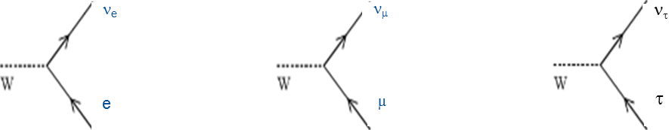
Neutrino Flavor Mixing
Neutrino production and detection determined by flavor eigenstates ν_{e}, ν_{μ}, ν_{τ} of the weak interaction
but propagation through space (and matter) is determined by mass eigenstates ν₁, ν₂, ν₃ of the Hamiltonian (with masses m₁, m₂, m₃ ), these can be related by
Different masses will lead to interference between the propagating waves that affects the flavor probability at detection as a function of distance - “flavor mixing” or “neutrino oscillations”

Slide 11
Neutrino Mixing Matrix
Pontecorvo-Maki-Nakagawa-Sakata
3 x 3 unitary rotation matrix – 3 angles, 1 CP-phase (+2 Majorana phases)
1 0 0
0 c₂₃ s₂₃
0 -s₂₃ c₂₃
c₁₃ 0 s₁₃e^{iδ}
0 1 0
-s₁₃e^{-iδ} 0 c₁₃
c₁₂ s₁₂ 0
-s₁₂ c₁₂ 0
0 0 1
U =
s_{ij} = sinθ_{ij}
c_{ij} = cosθ_{ij}
atmospheric
and accelerator
reactor and
accelerator
solar and
reactor
Phase δ for neutrinos is unknown – related to CP-violation

Slide 12
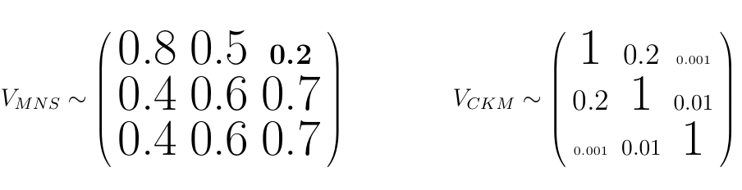
Neutrino vs. Quark Mixing
Neutrinos Quarks
Strikingly different!
Is this telling us something fundamental?
    A different mechanism for mass generation?

Slide 13
Neutrino Oscillations
In a simplified 2-neutrino model, the probability of a neutrino produced as one flavor to be detected with a different flavor is:
θ is the mixing angle
Δm² = m₂² - m₁²
L = distance traveled
E = neutrino energy
( )
Δm²L
4E
P_{α→β,α≠β} = sin²(2θ) sin²

Slide 14
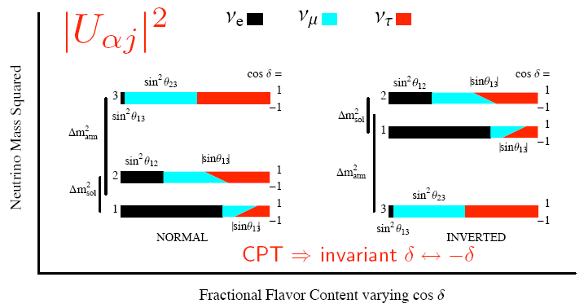
Neutrino Mass Ordering
Δm²₂₁ = +7.6 x 10⁻⁵ eV²
|Δm²₃₂| = 2.4 x 10⁻³ eV²
Δm²₂₁ / |Δm²₃₂| = 0.03
Is third neutrino heavier or lighter than the other two? (MH question)
What is the overall mass scale?

Slide 15

ν_{e} Appearance in a ν_{μ} Beam
Approximation to 3-flavor vacuum mixing with |Δm₂₁²| << |Δm₃₁²|
L – distance from source to detection
E – neutrino energy
  Effectively 2-flavor mixing since Δm₂₁² ≅ 0.03 |Δm₃₁²|
  Wavelength in L/E ~ 1.2 km/GeV
  => maximum probability at 600 km for a 1 GeV neutrino
  Amplitude proportional to sin²2θ₁₃

Slide 16
ν_{e} Appearance in a ν_{μ} Beam
Approximation to 3-flavor vacuum mixing with |Δm₂₁²| << |Δm₃₁²|
L – distance from source to detection
E – neutrino energy
  Effectively 2-flavor mixing since Δm₂₁² ≅ 0.03 |Δm₃₁²|
  Wavelength in L/E ~ 1.2 km/GeV
  => maximum probability at 600 km for a 1 GeV neutrino
  Amplitude proportional to sin²2θ₁₃
Quantum interferometry on a continental scale

Slide 17
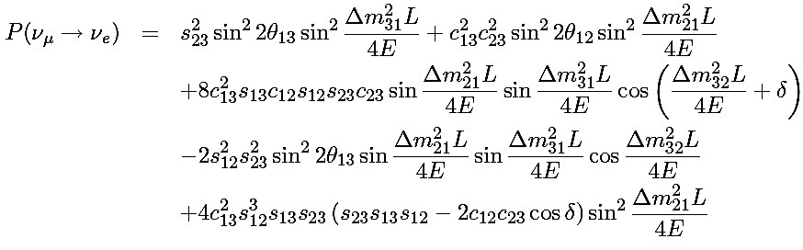
ν_{e} Appearance in a ν_{μ} Beam
Full equation for 3-flavor mixing
J. Boehm, thesis 2009
  Now includes dependence on phase δ manifest in interference terms between the two oscillation scales
  Changing ν → ν̅, δ → −δ
  => matter/antimatter asymmetry if δ ≠ 0 or 180°
  Could this difference help explain why the Big Bang produced more matter than antimatter? ... So that we can exist to ask this question?

Slide 18
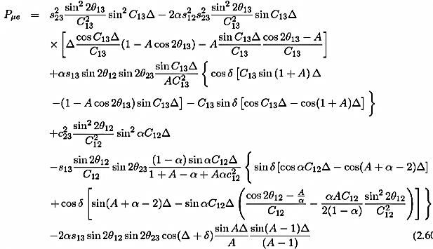
Matter Effect
  Additional ν_{e} interaction → mixing angles and mass differences modified by terms proportional to electron density
  Sign of effect depends on mass ordering => method to determine the Mass Hierarchy
  A complication in determining true matter-antimatter difference

Slide 19
Is the Three-Neutrino Model Complete?
Hints of deviations implying a fourth “sterile” neutrino
  Reactor anomaly => ~7% deficit at short distances
  Short-baseline anomaly, a.k.a. “LSND anomaly”
  => small ν̅_{μ} → ν̅_{e} appearance rate at small L/E
These effects can be tested by
  Direct searches for sterile neutrino signatures
  Over-constraining to PMNS matrix to test it unitarity
Many neutrino experiments are under way or planned to understand the nature of neutrinos.

Slide 20
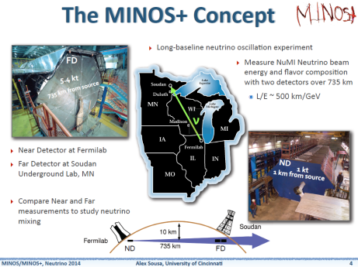
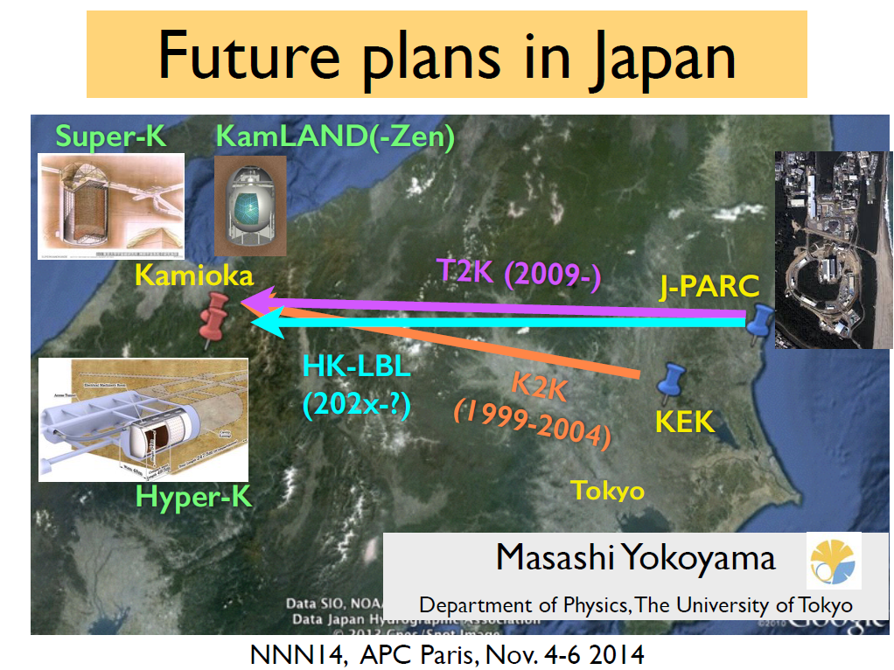
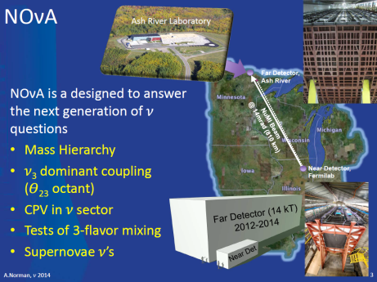
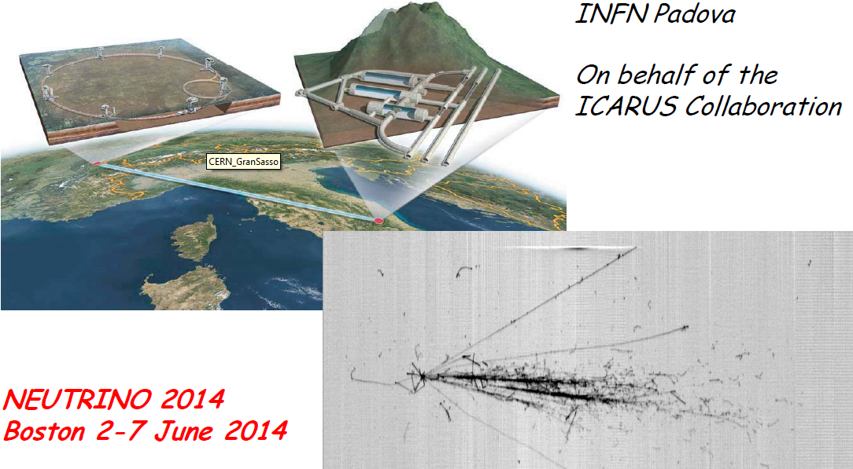
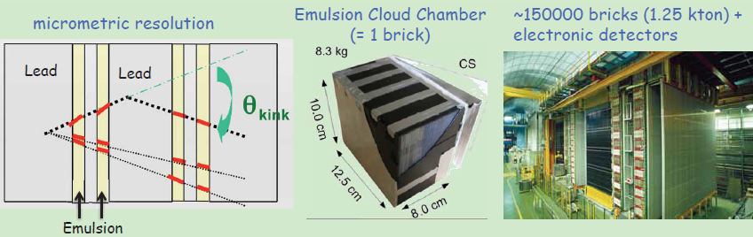
Current Long-Baseline, Accelerator-Based Experiments
CNGS:
ICARUS & OPERA

Slide 21
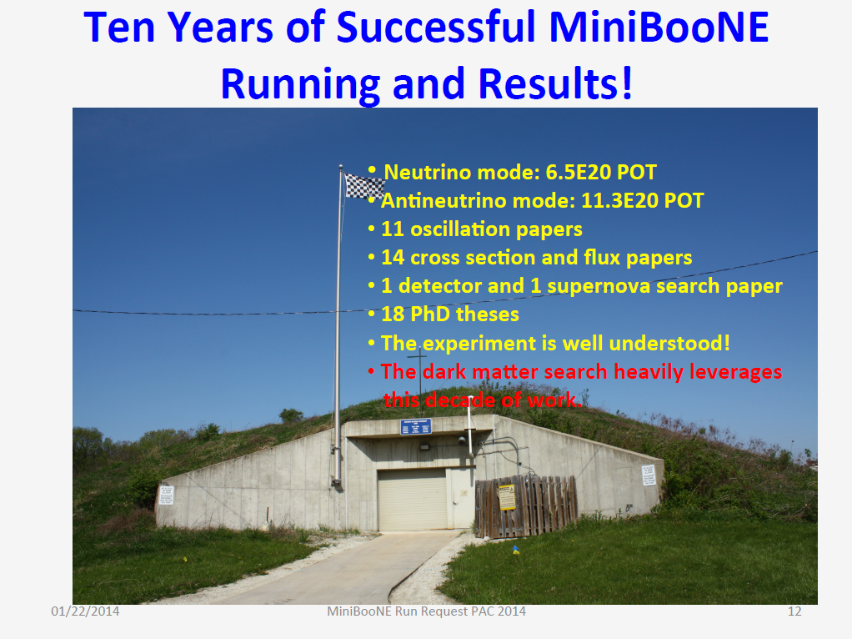
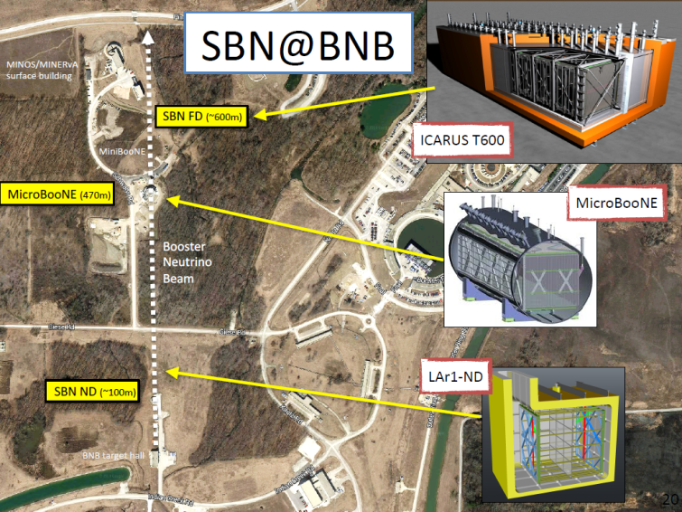
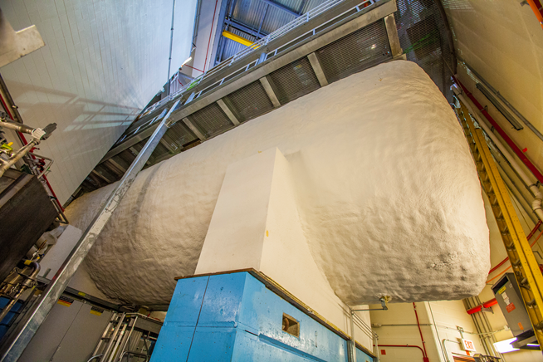
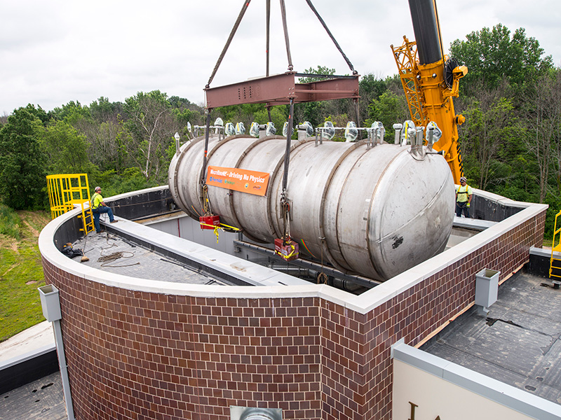
Short-Baseline, Accelerator-Based Experiments
MicroBooNE

Slide 22
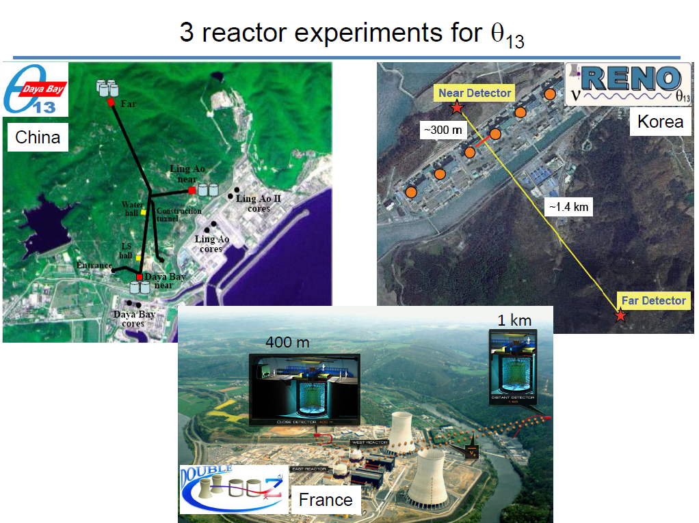
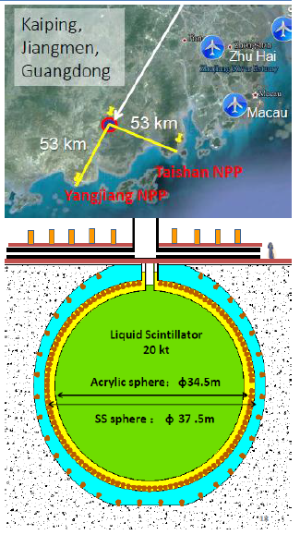
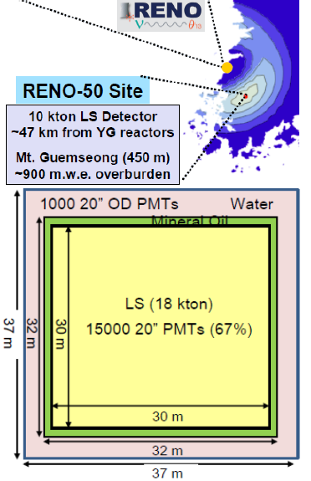
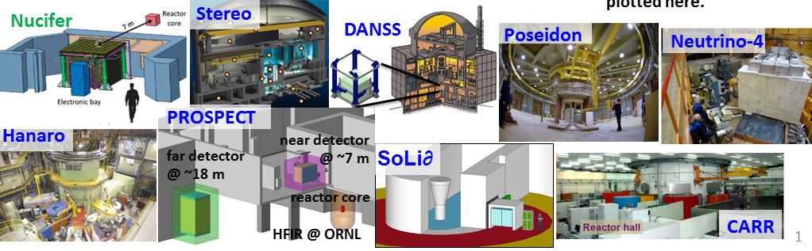
Reactor-Based Experiments
JUNO
Short Baseline (~1 km)
Long Baseline (~50 km)
Mass Hierarchy
Very Short Baseline (~10 m)
Reactor Source Anamolies

Slide 23
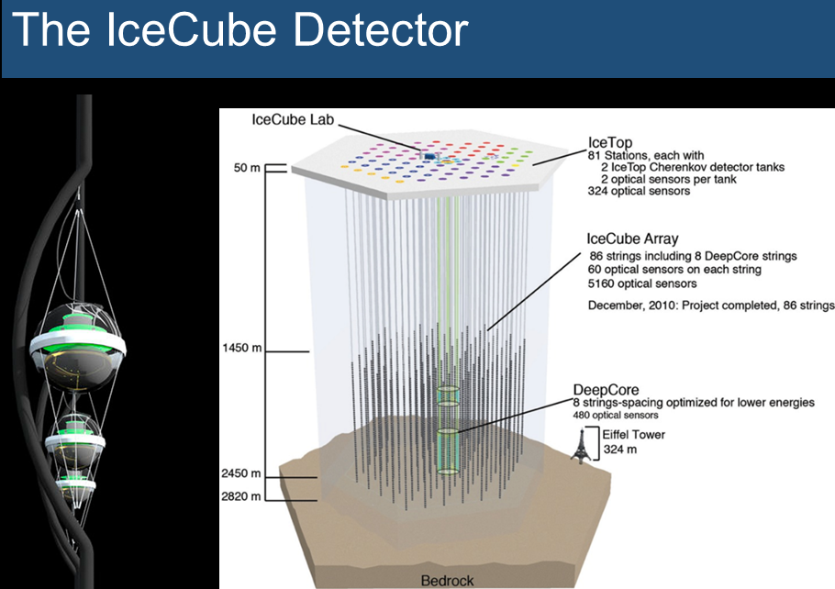
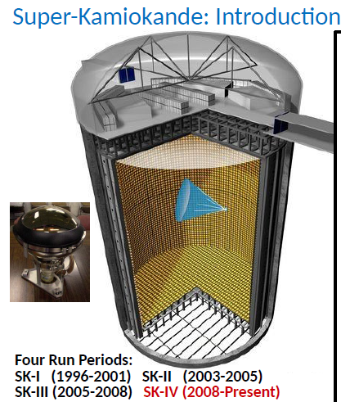
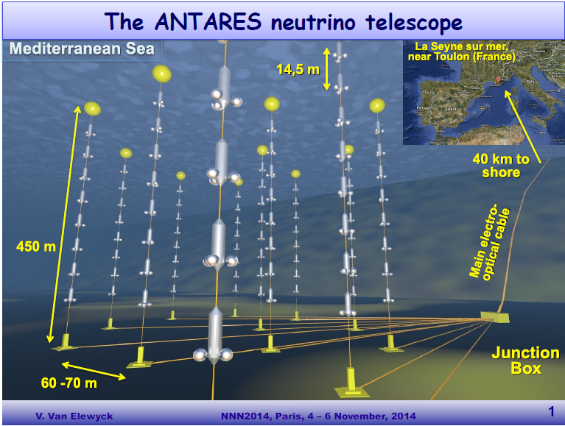

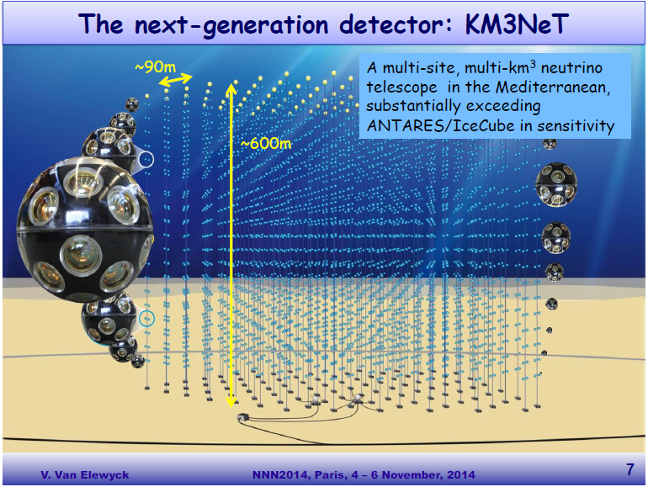
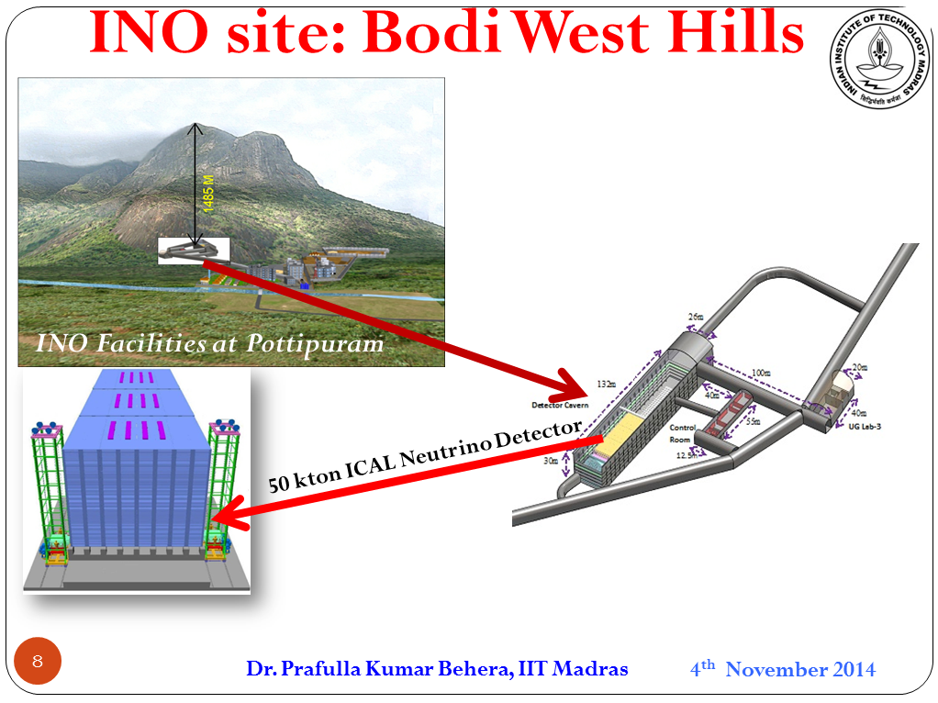
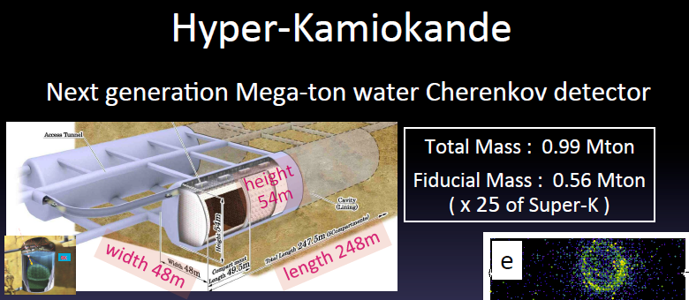
Atmospheric and Ultra-High
Energy Neutrino Experiments
India-based Neutrino Observatory

Slide 24
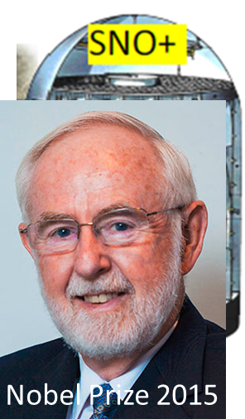
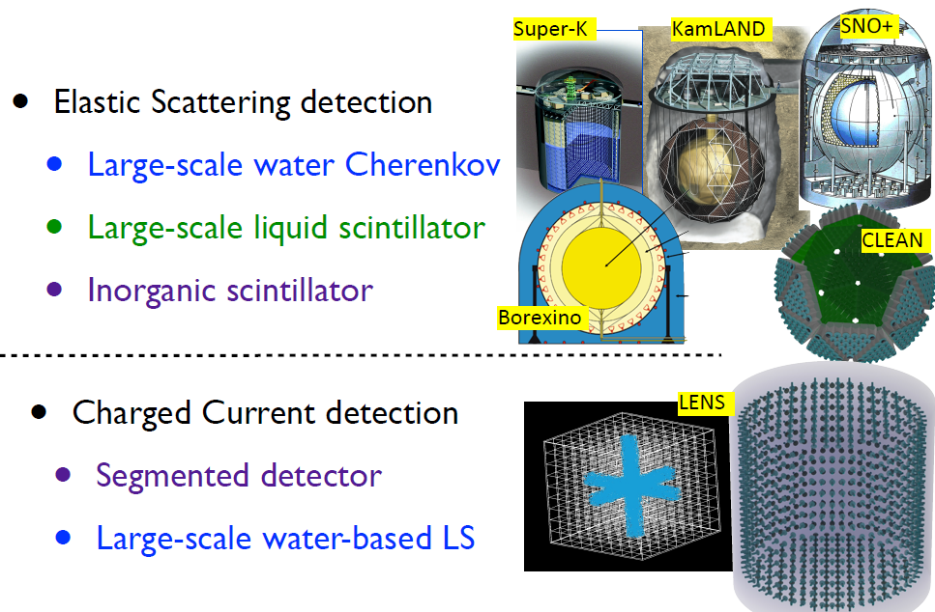
Solar Neutrino Experiments
SNO
SNO

Slide 25
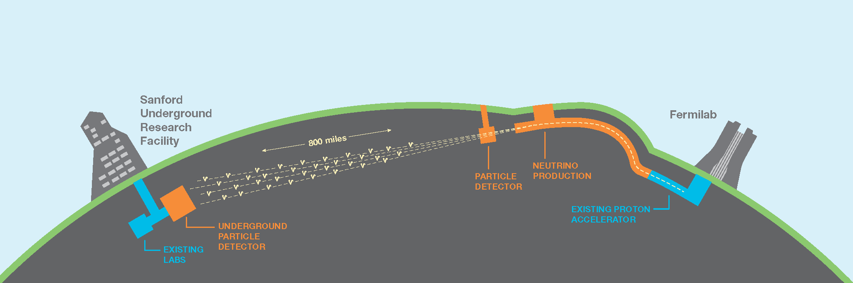
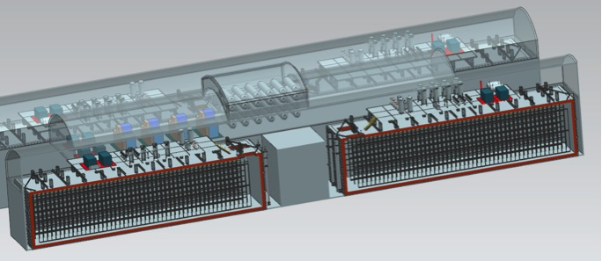
The Next-Generation
Long-Baseline Experiment:
LBNF / DUNE
ν
FD
ND

Slide 26
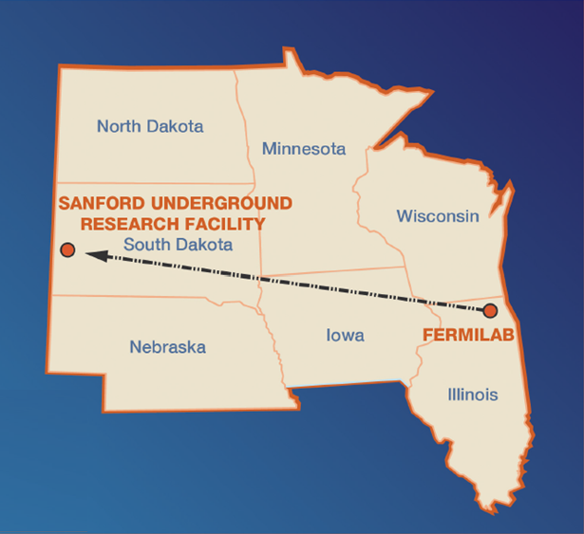
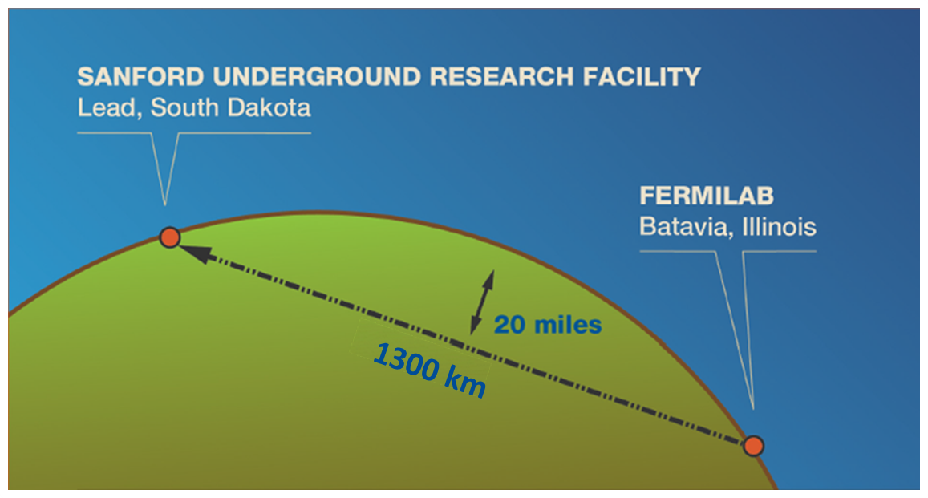
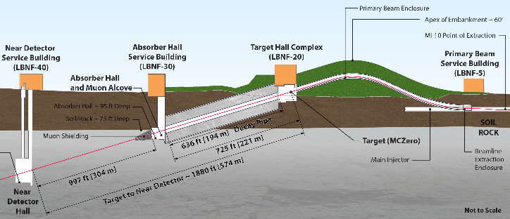

The Next-Generation Long-Baseline
Experiment: LBNF / DUNE
32 km
Comprehensive experimental program to determine CP violation, Mass Hierarchy, and make precision measurements of oscillation parameters
Astrophysical neutrinos and proton decay with a massive underground Liquid Argon TPC Far Detector
Precision neutrino scattering measurements with Near Detector

Slide 27
DUNE Primary Science Program
Focus on fundamental open questions in particle physics and astroparticle physics:
  1) Neutrino Oscillation Physics
    CPV in the leptonic sector
      “Our best bet for explaining why there is matter in the universe”
    Mass Hierarchy
    Precision Oscillation Physics & testing the 3-flavor paradigm
  2) Nucleon Decay
    Predicted in beyond the Standard Model theories [but not yet seen]
      e.g. the SUSY-favored mode,
  3) Supernova burst physics & astrophysics
    Galactic core collapse supernova, sensitivity to ν_{e}
      Time information on neutron star or even black-hole formation

Slide 28
DUNE Primary Science Program
Focus on fundamental open questions in particle physics and astroparticle physics:
  1) Neutrino Oscillation Physics
    CPV in the leptonic sector
      “Our best bet for explaining why there is matter in the universe”
    Mass Hierarchy
    Precision Oscillation Physics & testing the 3-flavor paradigm
  2) Nucleon Decay
    Predicted in beyond the Standard Model theories [but not yet seen]
      e.g. the SUSY-favored mode,
  3) Supernova burst physics & astrophysics
    Galactic core collapse supernova, sensitivity to ν_{e}
      Time information on neutron star or even black-hole formation
Any would be a major discovery

Slide 29
DUNE Ancillary Science Program
  Enabled by the intense LBNF beam and the DUNE near and far detectors
  Other LBL oscillation physics with BSM sensitivity
    Neutrino non-standard interactions (NSIs)
    Sterile Neutrinos at the near and far sites
    Measurements of tau neutrino appearance
  Oscillation physics with atmospheric neutrinos
  Neutrino Physics in the near detector
    Neutrino cross section measurements
    Studies of nuclear effects, FSI etc.
    Measurements of the structure of nucleons
    Neutrino-based measurements of sin²θ_{W}
  Search for signatures of Dark Matter

Slide 30



Neutrino Oscillation Strategy
  Measure neutrino spectra at 1300 km in a wide-band beam
  Determine MH and θ₂₃ octant, probe CPV, test 3-flavor paradigm a and search for ν NSI in a single experiment
    Long baseline:
      Matter effects are large ~ 40%
    Wide-band beam:
      Measure ν_{e} appearance and ν_{μ} disappearance over range of energies
      MH & CPV effects are separable
E ~ few GeV
ν_{μ} / ν̅_{μ} disappearance
ν_{e} / ν̅_{e} appearance

Slide 31

Nucleon Decay & Supernova νs
  Nucleon decay
  Image particles from nucleon decay
    target sensitivity to kaons (from dE/dx)
    from SUSY-inspired GUT p-decay modes
ICARUS cosmic-ray event
E ~ O(200 MeV)
  Supernova burst neutrinos
  Astrophysics and neutrino
  physics
    To date only observed ν̅_{e} from single SN
    In argon, the largest sensitivity is to ν_{e}
      CC interaction:
δt ~ O(10 ms)
E ~ O(10 MeV)

Slide 32

The DUNE Collaboration
Formed this year from the previous LBNE and LBNO collaborations plus many new institutions
  782 Collaborators
  144 institutions
  from 26 Countries
Armenia, Belgium, Brazil,
Bulgaria, Canada, Colombia,
Czech Republic, France,
Germany, India, Iran, Italy,
Japan, Madagascar,, Mexico,
Netherlands, Peru, Poland,
Romania, Russia, Spain,
Switzerland, Turkey, UK,
USA, Ukraine
  on 5 Continents

Slide 33
The DUNE Collaboration
Formed this year from the previous LBNE and LBNO collaborations plus many new institutions
  782 Collaborators
  144 institutions
  from 26 Countries
Armenia, Belgium, Brazil,
Bulgaria, Canada, Colombia,
Czech Republic, France,
Germany, India, Iran, Italy,
Japan, Madagascar,, Mexico,
Netherlands, Peru, Poland,
Romania, Russia, Spain,
Switzerland, Turkey, UK,
USA, Ukraine
  on 5 Continents

Slide 34
LBNF/DUNE Overview
32 km
40 kt fiducial mass LAr TPC far
detector, 1480 m underground
High-power, broad-band ν_{μ}/ν̅_{μ} beam
Precision near detector

Slide 35

Staged Approach to 40 kt
Four-Cavern Layout at the Sanford Underground Research Facility (SURF) at the 4850 foot Level (4300 m.w.e.)
  four caverns hosting four independent 10-kt (fiducial mass) Far Detector modules
    Allows for staged construction of the Far Detector
    Gives flexibility for evolution of LArTPC technology design
      Assume four identical cryostats: 15.1 (W) x 14.0 (H) x 62 (L) m³
      Assume the four 10-kt modules will be similar but not identical
#2
#1
#4
#3

Slide 36




Reference Design:
Single-Phase LAr TPC
Based on the successful design
pioneered by the ICARUS Collaboration
6 m
2.3 m
Anode Plane Assembly (APA)
12 m
3.6 m

Slide 37


Alternative Design:
Dual-phase LAr TPC
  DUNE collaboration recognizes the potential of the dual-phase technology
    Strongly supports the WA105 development program at the CERN neutrino platform
    If demonstrated, could form basis of second or subsequent 10-kt far detector modules

Slide 38


Far Detector Prototypes
Under construction now
35 t single-phase
Prototype at Fermilab
1 x 1 x 3 m³ dual-phase
prototype at CERN

Slide 39



Far Detector Prototypes
Operational by 2018
protoDUNE: single-phase prototype (6 full-scale APAs) at CERN
WA105: 6 x 6 x 6 m³ dual-phase prototype
at CERN
Test Beam (EHN1) at CERN

Slide 40
DUNE Near Detector
  Top-level Requirements
    Ability to constrain systematic uncertainties for the DUNE oscillation analysis
    Drives the design and implies the capability to precisely measure exclusive neutrino interactions
    Naturally results in a self-contained non-oscillation neutrino physics program
        Exploiting the intense LBNF neutrino beam
  International context
    The proposed contribution of Indian institutions to the design and construction of the DUNE near detector is a central part of the DUNE strategy for the construction of the experiment

Slide 41

Near Detector Reference Design
The NOMAD-inspired Fine-Grained Tracker (FGT)
  It consists of:
    Central straw-tube tracking system with
    embedded nuclear targets
    Lead-scintillator sampling ECAL (4π)
    Large-bore warm dipole magnet
    RPC-based muon tracking systems
  It provides:
    Constraints on cross sections and the
    neutrino flux
    A rich self-contained non-oscillation neutrino physics program
  DUNE has set up a ND task force
    End-to-end physics study of FGT measurements and LBL analysis
Quantifying the benefits of augmenting the ref. design with a LArTPC or high-pressure gaseous argon TPC

Slide 42


LBNF Beamline
To SURF
High-Power Horn-Focused Beam
… Still being optimized

Slide 43


LBNF Beamline
BNL Report No. 71228- 2003-IR
To SURF
High-Power Horn-Focused Beam
… Still being optimized
BNL beam design 2003

Slide 44

Neutrino Beam Configuration

Slide 45
Optimizing the Neutrino Beam
Proton energy choice in the range 60-120 GeV (some programmatic consequences).
Horns
  Shape/size
  current (power supply up to 300 kA, just completed new conceptual design)
Target (currently two interaction lengths)
  Size/shape/position with respect to Horn 1
  Material(s) (higher longevity can increase up time - ongoing R&D)
Studied Decay Pipe length and diameter. Current length 194 m (studied 170 m - 250 m). Current diameter 4 m (studied 2-6 m).
Recently fixed at 194 m long x 4 m diameter.

Slide 46


Optimizing the focusing system for greater physics reach
Genetic algorithm, inspired by work done by LBNO Collaboration
to optimize for CP Violation sensitivity
Genetic algorithm and new shape of Horn 1
Horn 2 is NuMI shape in this case but rescaled radially and longitudinally
Target length varied – longer target preferred: 2 → 5 λ_{I}

Slide 47

Neutrino Flux of best configurations compared with Reference Design
80 GeV protons
Substantial flux increase, especially at the 2nd oscillation maximum which is very important for the CP violation and mass ordering measurements.
… Optimization is continuing.
2nd 1st osc max

Slide 48

Evaluating DUNE Sensitivities
Many inputs to calculation (implemented in GLoBeS):
  Reference Beam Flux
    80 GeV protons
    1.07 MW
    NuMI-style two horn system
  Optimized Beam Flux
    Horn system optimized for lower
    energies
  Expected Detector
  Performance
    Based on previous experience
    (ICARUS, ArgoNEUT, …)
    Fast MC smears response at generated final-state particle level
      “Reconstructed” neutrino energy
      kNN-based MV technique used for ν_{e} “event selection”: parameterized efficiencies
ν_{e} appearance

Slide 49
DUNE Sensitivity to CP Violation
Propagate to Oscillation Sensitivities
  using assumptions for systematics (from the ND)
50 % CP Violation Sensitivity
50 % CP Violation Sensitivity
5 % ⊕ 1 %
5 % ⊕ 2 %
  following current
  staging scenario
5 % ⊕ 3 %
<3 % ν_{e} systematics important after ∼200 kt.MW.yr

Slide 50



MH, δ_{CP} and sin²θ₂₃ Sensitivities
Mass Hierarchy Determination
MH Significance

Slide 51

Proton Decay Sensitivity
p → K⁺ ν̅
  DUNE for various staging assumptions

Slide 52


Physics Milestones
Rapidly reach scientifically interesting sensitivities:
    e.g. in best-case scenario for CPV (δ_{CP} = +π/2) :
      with 60 – 70 kt.MW.year reach 3σ CPV sensitivity
    e.g. in best-case scenario for MH :
      with 20 – 30 kt.MW.year reach 5σ MH sensitivity
Global Fit
E.Lisi et al.
Moriond 2015
Genuine potential for early physics discovery

Slide 53
LBNF/DUNE Schedule Summary Overview

Slide 54
Summary
LBNF/DUNE has
an advanced design for a world-leading experiment focused on fundamental open questions in particle physics and astroparticle physics
a clear scientific strategy and a project plan to implement it
the capability of making major discoveries in
  Long-baseline oscillation physics
  Nucleon decay
  Neutrino astrophysics
  Neutrino scattering physics
  . . .

