Slide 1



SIDIS and Jets at a 2nd IR
Anselm Vossen and Zhongbo Kang
Research supported by the

Slide 2
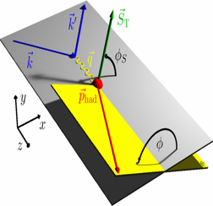
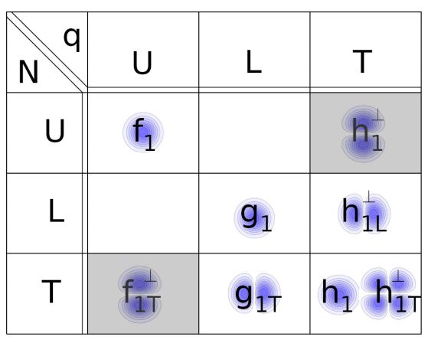
TMD PDFs from SIDIS
Boer-Mulders
Unpolarized
Worm Gear
Transversity
Polarized target
Sivers
Pretzelosity
Polarzied beam and target
Worm Gear
S_{L} and S_{T}: Target Polarizations; λe: Beam Polarization
x: momentum fraction carried by struck quark, z: fractional energy of hadron
Notes:
Identifiy with

Slide 3
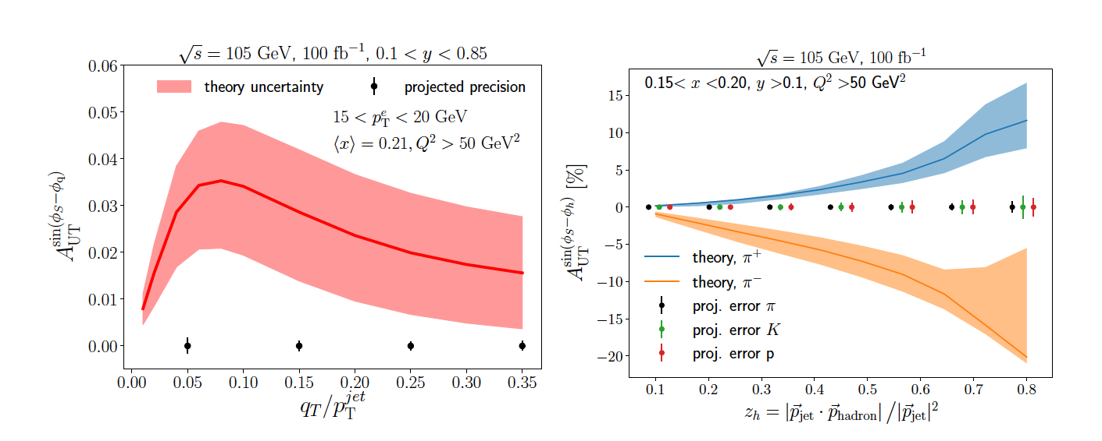
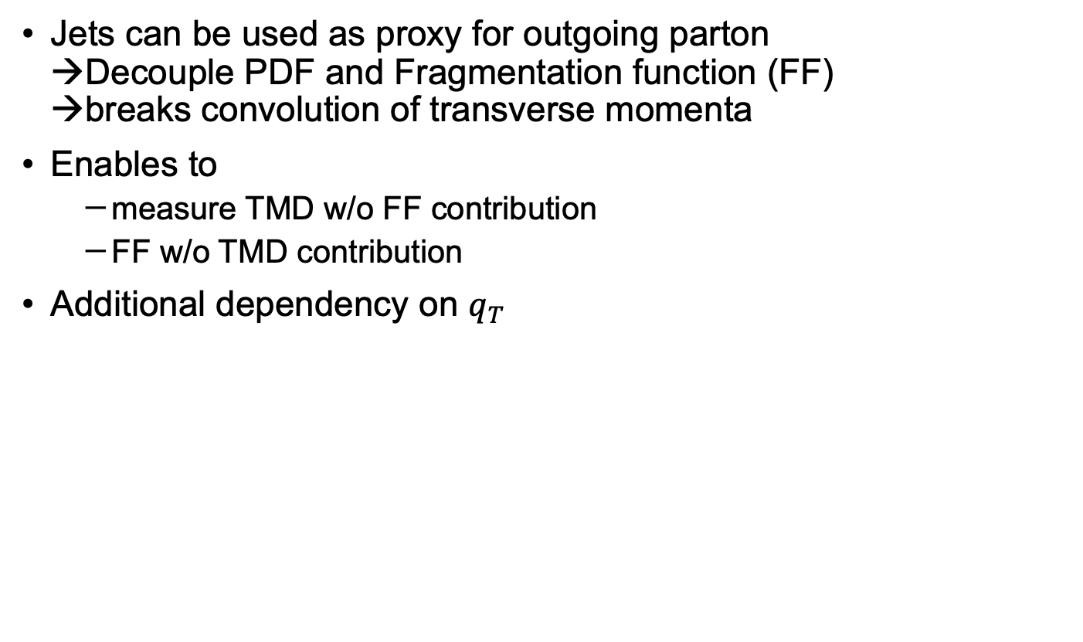
Accessing TMD PDFs and FFs with Jets
Jets can be used as proxy for outgoing parton
→Decouple PDF and Fragmentation function (FF)
→breaks convolution of transverse momenta
Enables to
  measure TMD w/o FF contribution
  FF w/o TMD contribution
Additional dependency on $q_{T}$
Phys.Rev.D 102 (2020) 7, 074015
Sivers asymmetry
Collins asymmetry

Slide 4
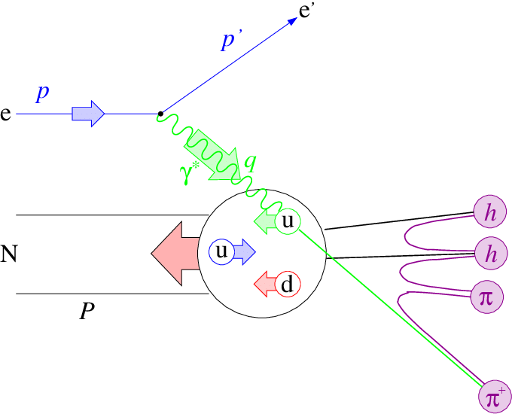
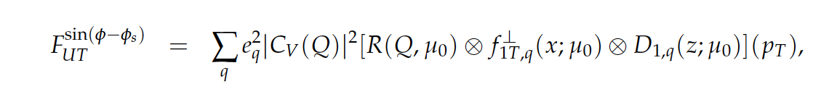
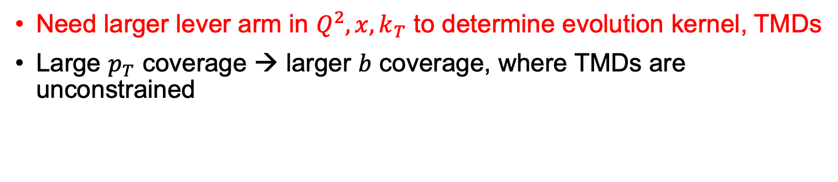
Evolution of TMDs
Evolution Kernel
TMD PDF
TMD FF
Need larger lever arm in $Q^{2}, x, k_{T}$ to determine evolution kernel, TMDs
Large $p_{T}$ coverage → larger $b$ coverage, where TMDs are unconstrained

Slide 5
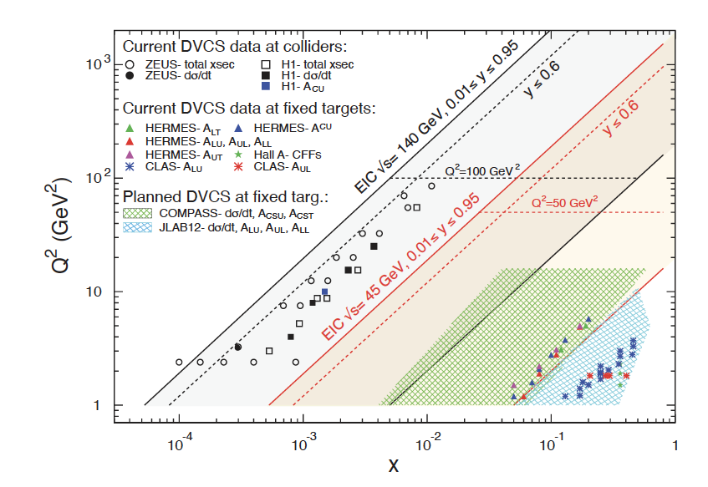
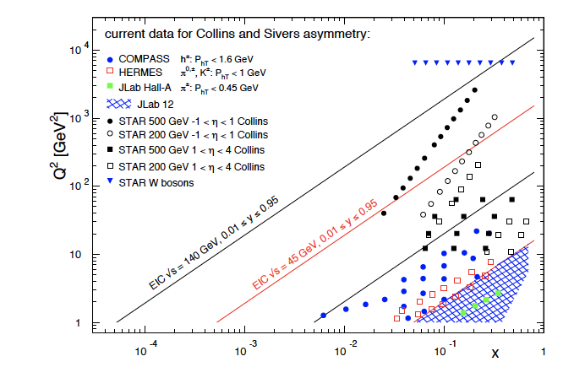
SIDIS physics at an EIC: Coverage
Slide from AV YR Imaging
summary talk
Common theme on EIC impact
  Extended kinematic coverage and precision, along with polarization
  and possible beam charge degrees of freedom allow multi-pronged approach →needed to extract multidimensional objects
  TMD factorization is valid
Large $Q^{2}$ lever arm: probe evolution, disentangle contributions to $σ$
Coverage to low $x:$ access sea and gluon distributions
Need 2nd IR to cover full phase
space and maximize physics impact!

Slide 6
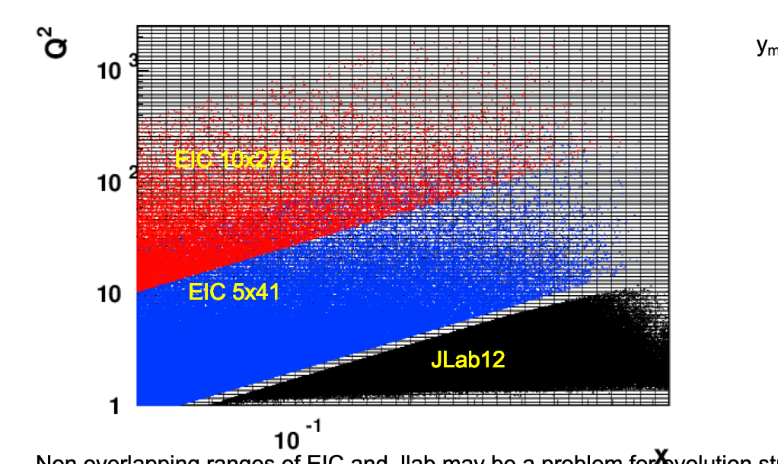
Big picture: Kinematics low/high sqrtS
y>0.025
From H. Avakian

Slide 7
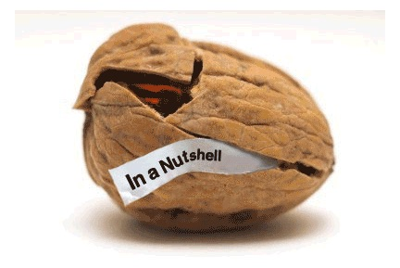
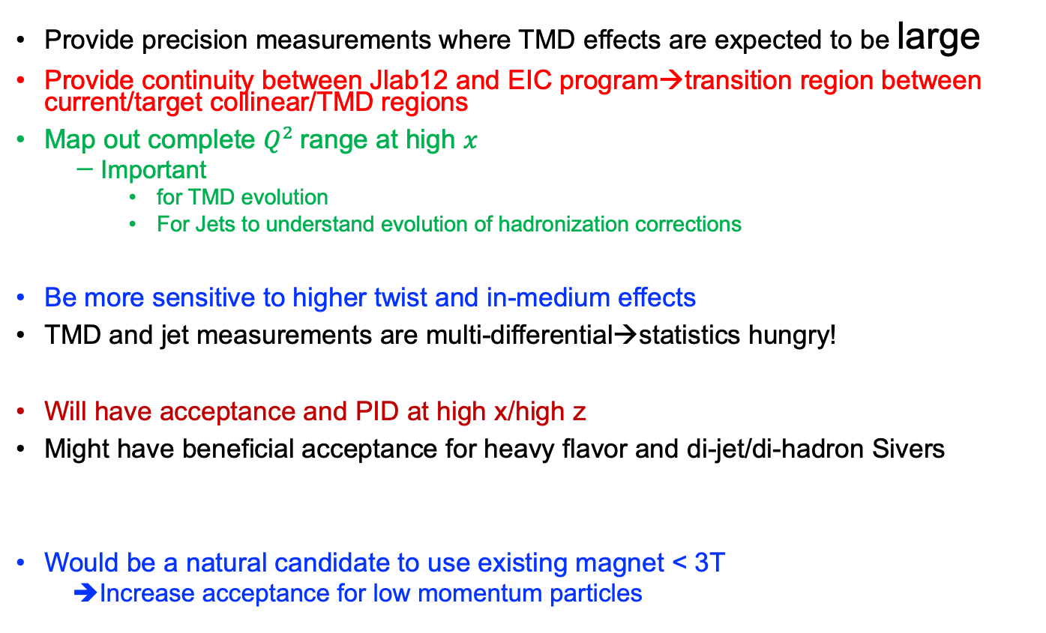
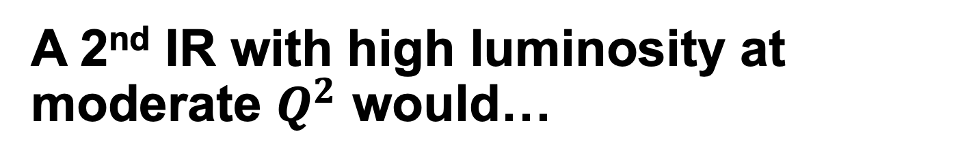
A 2nd IR with high luminosity at moderate $Q^{2}$ would…
Provide precision measurements where TMD effects are expected to be large
Provide continuity between Jlab12 and EIC program→transition region between current/target collinear/TMD regions
Map out complete $Q^{2}$range at high $x$
  Important
    for TMD evolution
    For Jets to understand evolution of hadronization corrections
Be more sensitive to higher twist and in-medium effects
TMD and jet measurements are multi-differential→statistics hungry!
Will have acceptance and PID at high x/high z
Might have beneficial acceptance for heavy flavor and di-jet/di-hadron Sivers
Would be a natural candidate to use existing magnet < 3T
  ➔Increase acceptance for low momentum particles

Slide 8
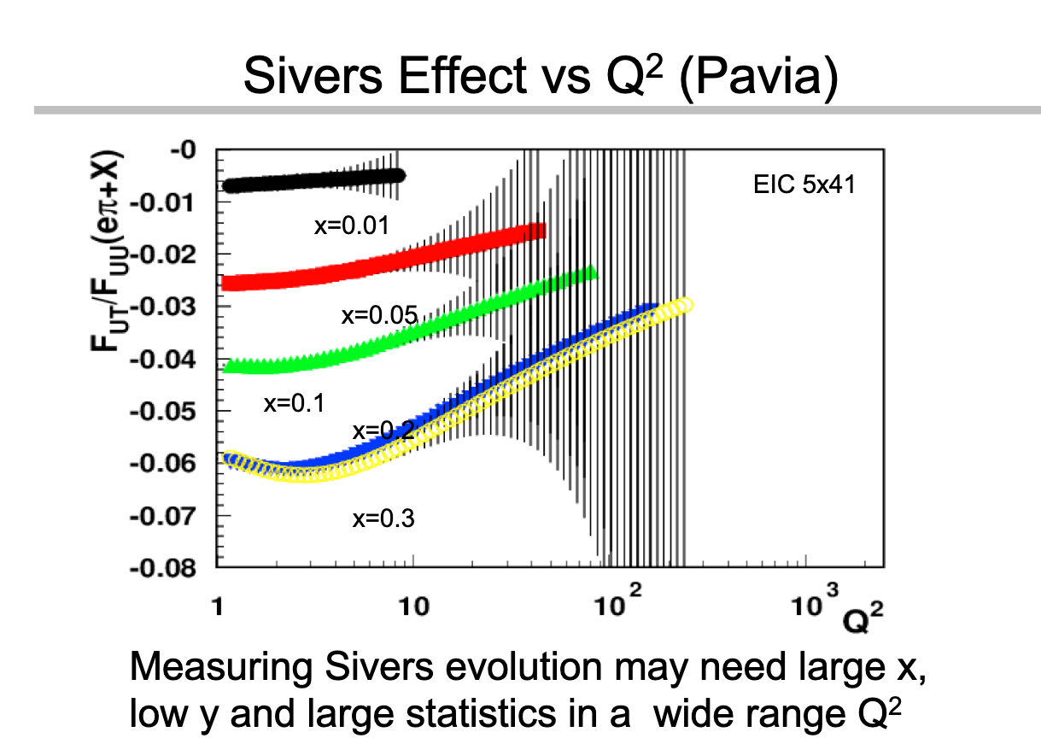
Example Expected TMD signal
Evolution doesn’t quite cancel.
STAR W results should shed more light
From A Signori by way of Harut

Slide 9
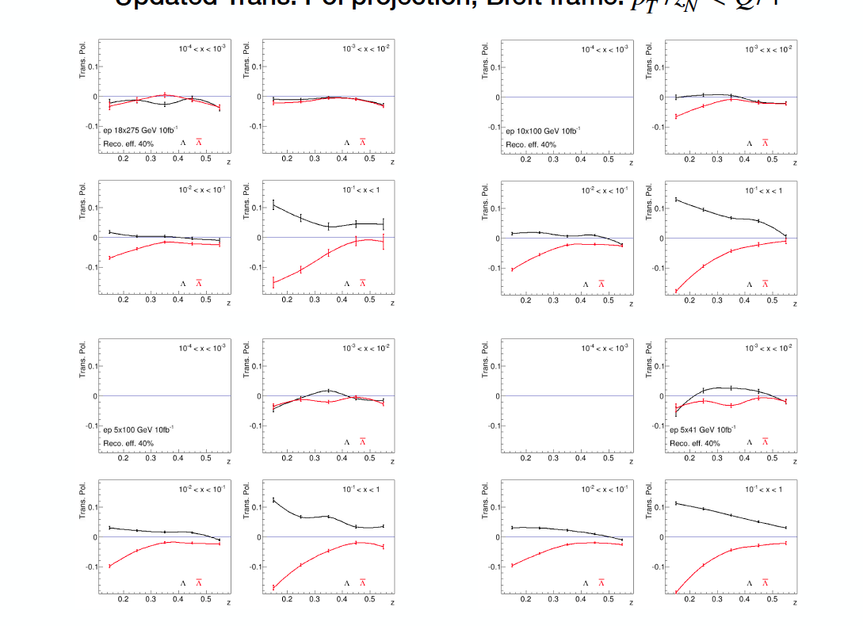

Also shown in $Λ^{↑}$ projections
Plots provided by Jinlong Zhang

Slide 10
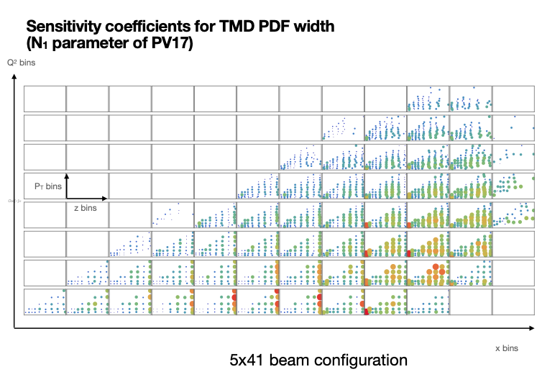
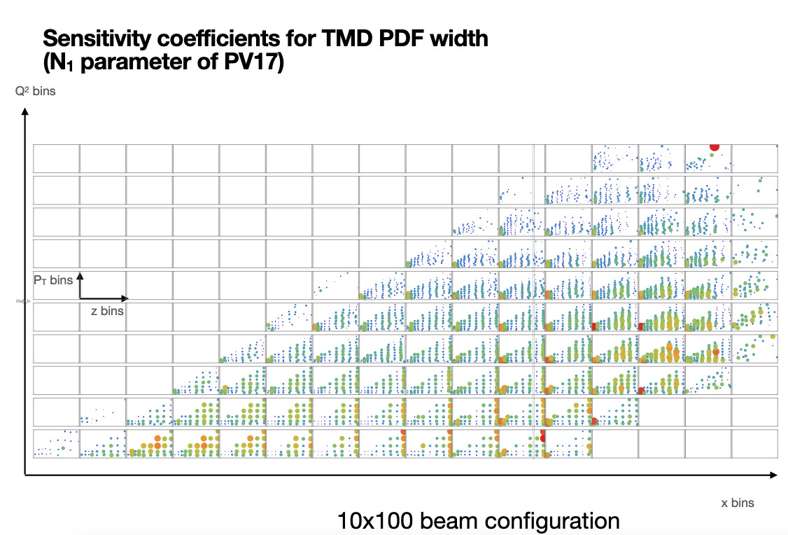
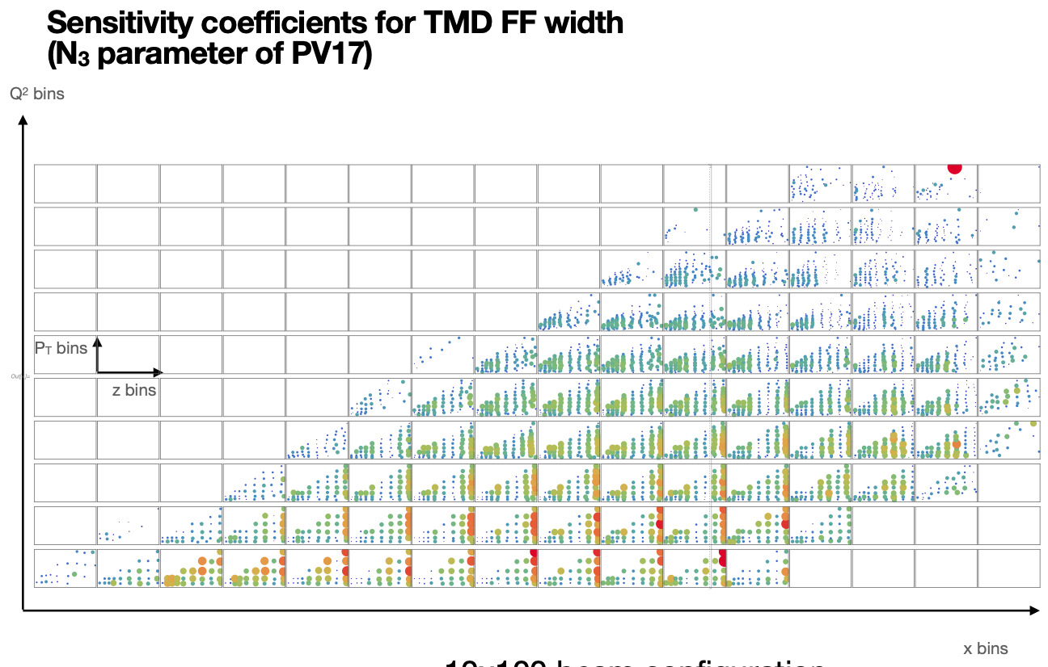
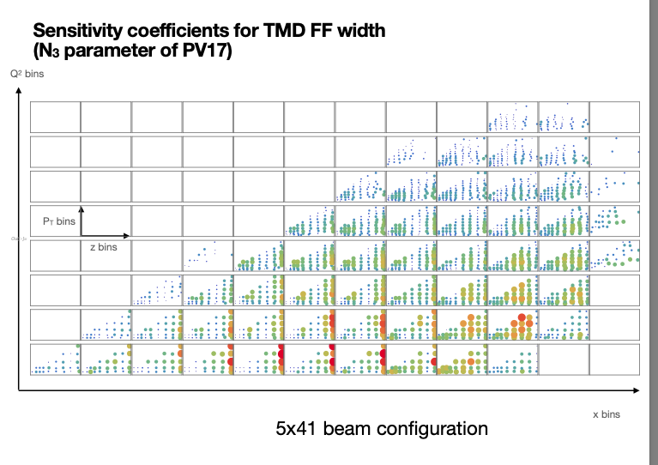

Sensitivity coefficients for PV17
5x41
10x100
Impact at high $x, low k_{t}/Q$ (see backup)
From A. Bacchetta at YR meeting

Slide 11
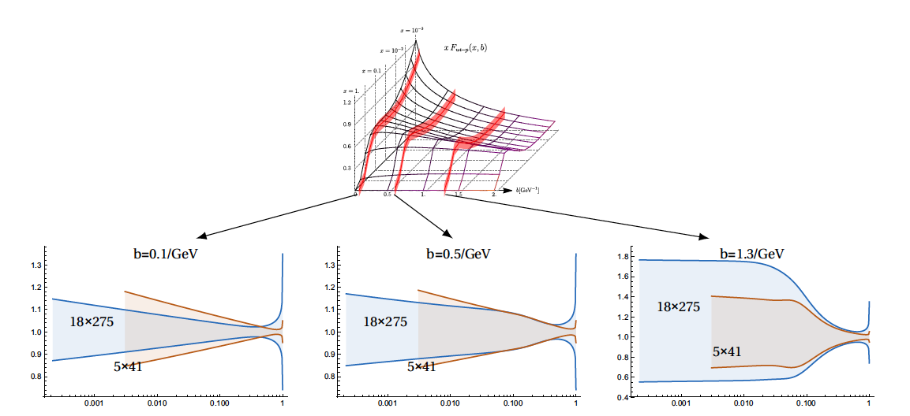
From Alexey Vladimirov
→see parallel session

Slide 12
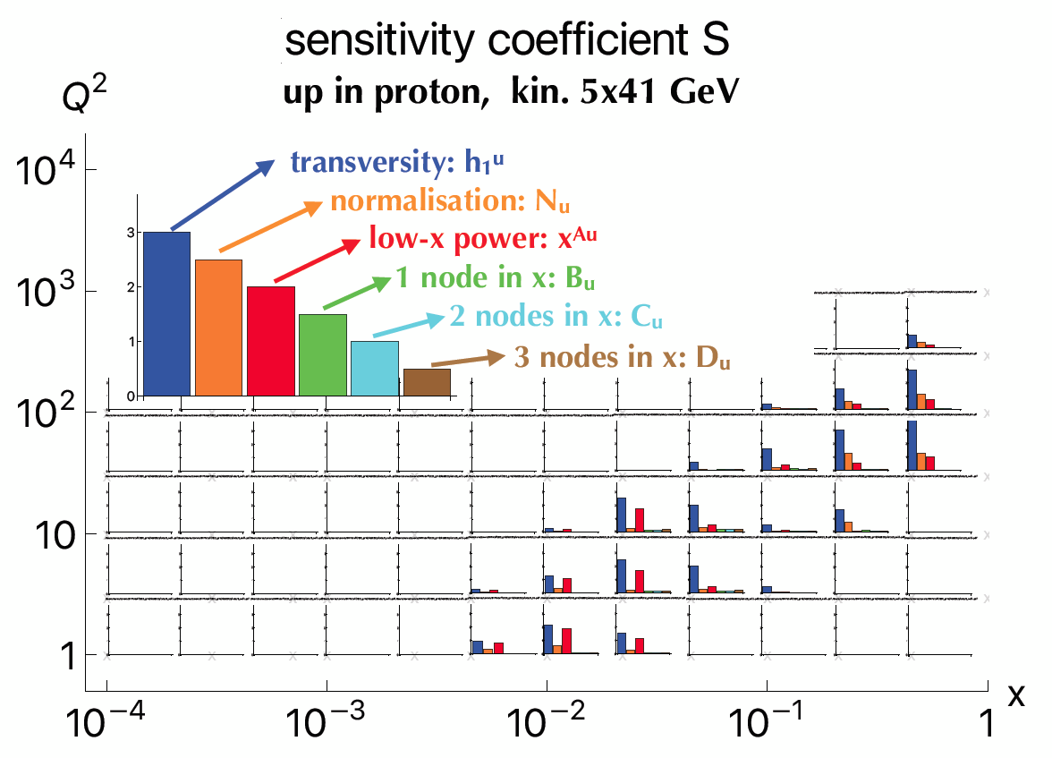
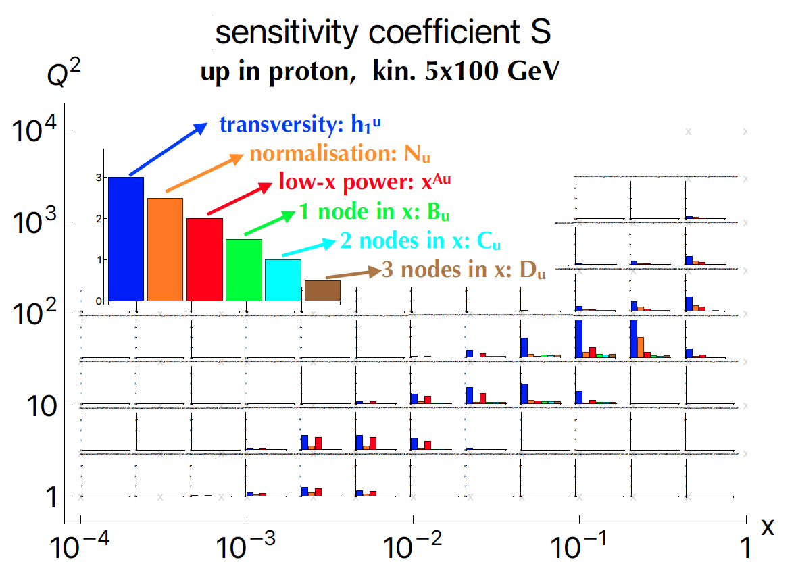
Sensitivity of transversity extraction via di-hadrons
From Marco Radici

Slide 13
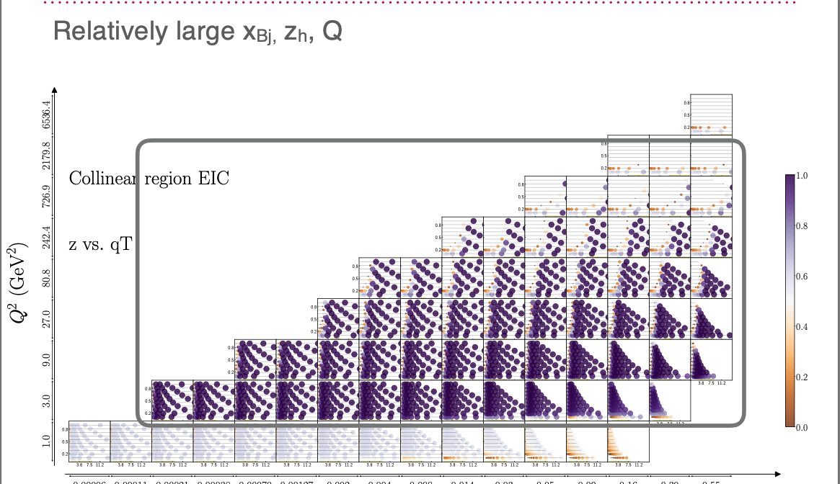
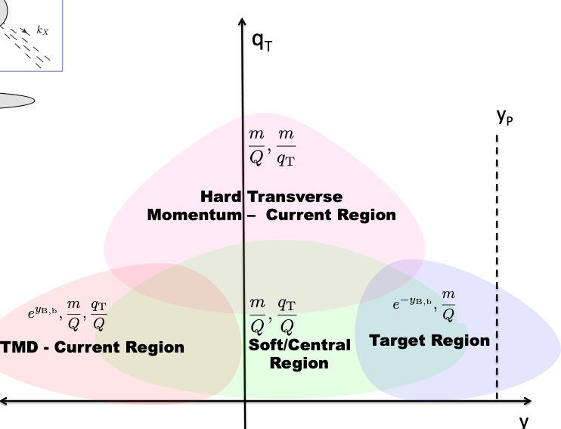
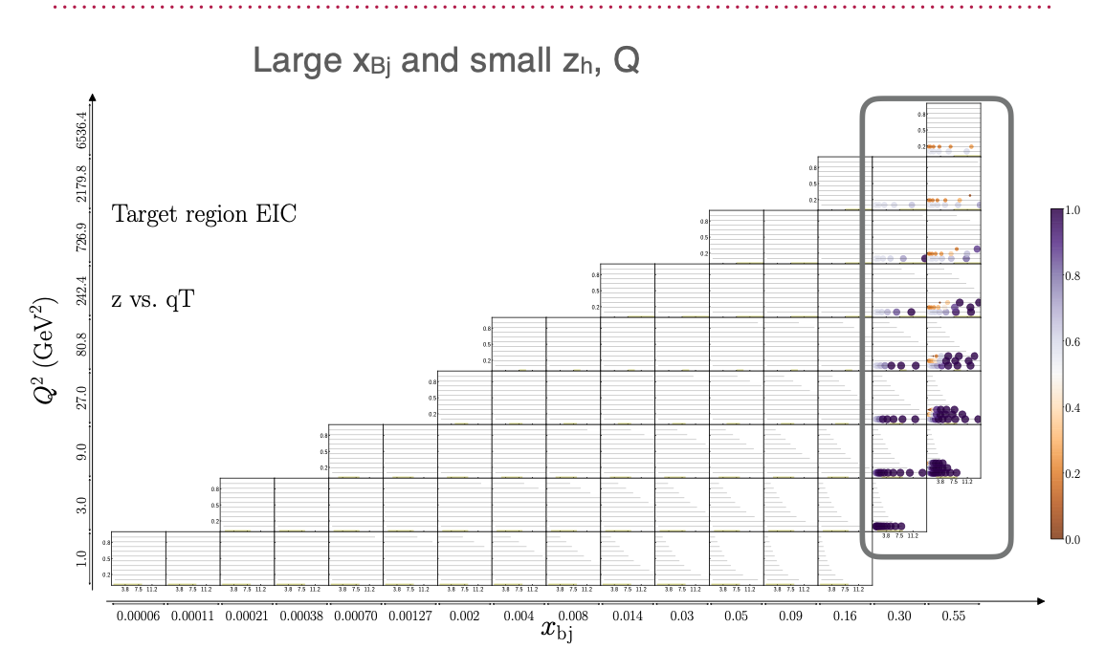
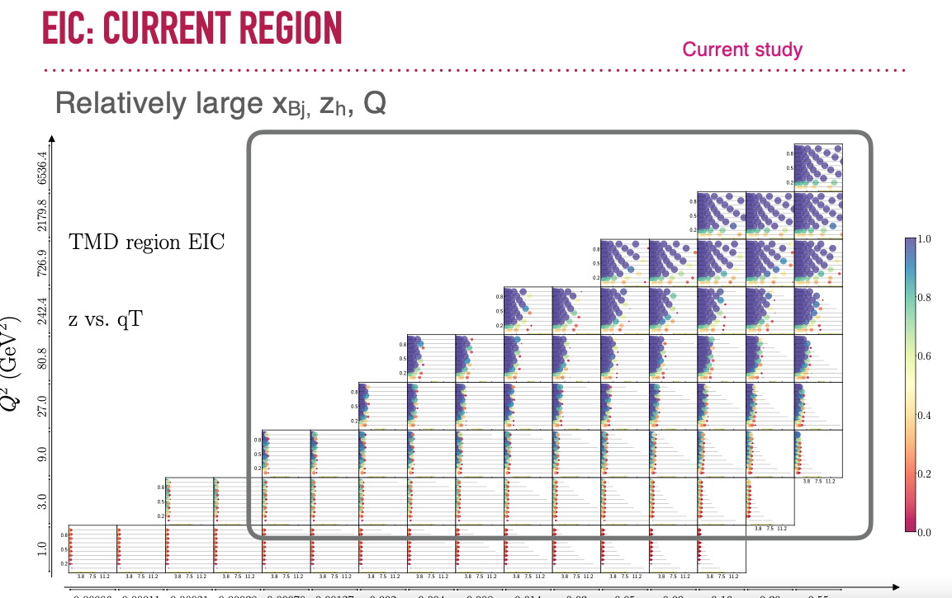
2nd IR data will be in transition
region collinear/TMD, target/current
Prokudin et al. (YR SIDIS meeting)
See also JHEP 10 (2019) 122, JHEP10(2019)122

Slide 14
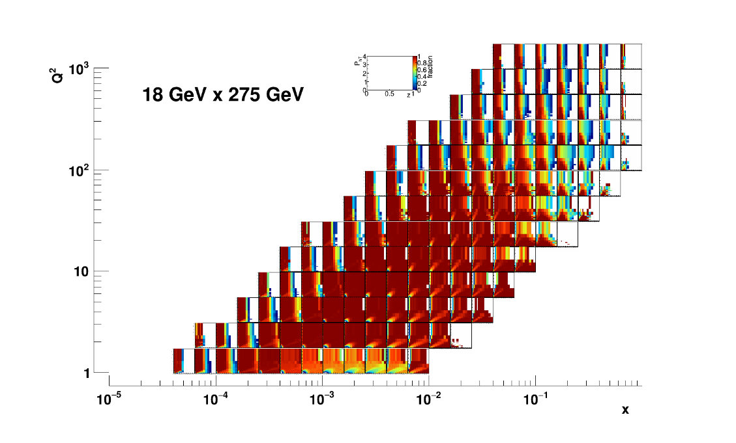
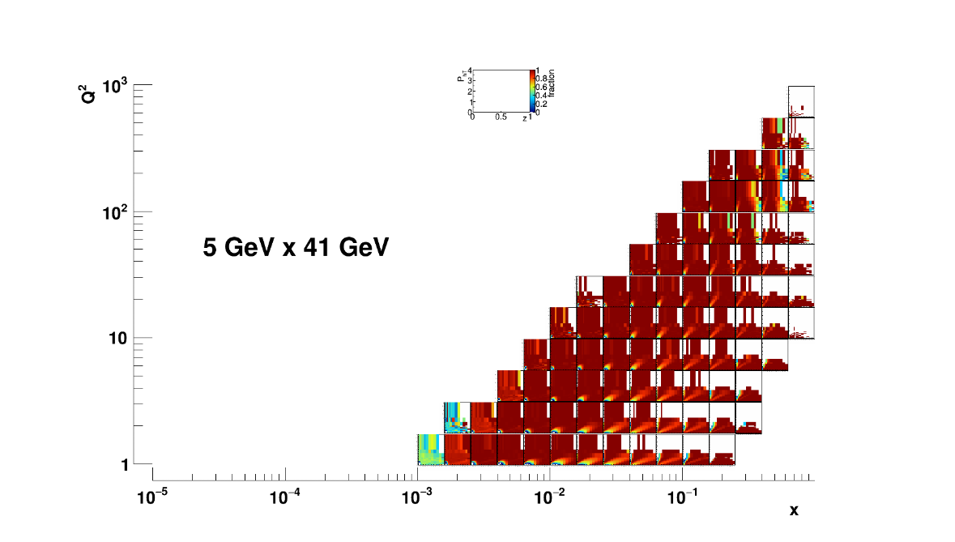
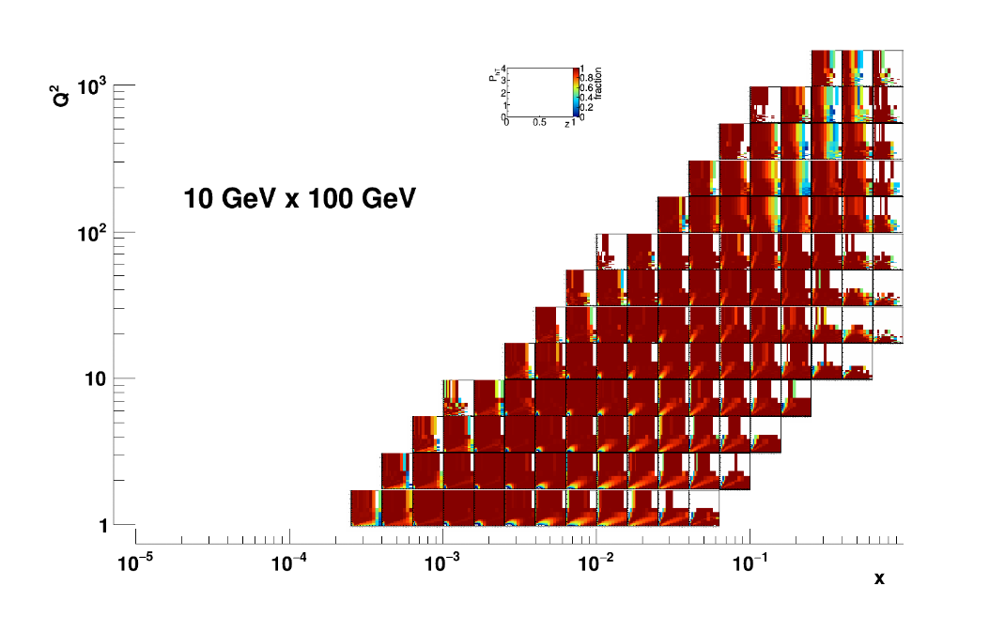
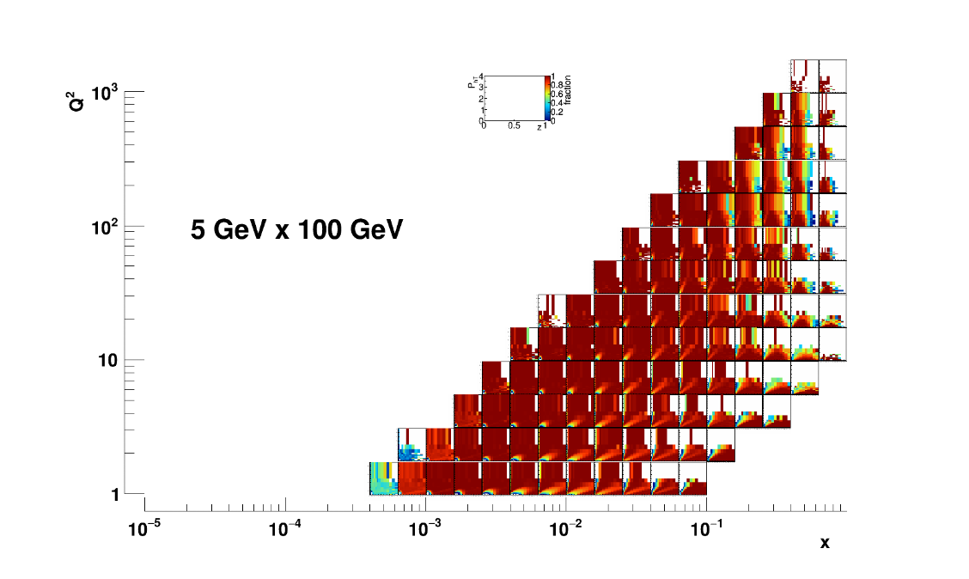

Acceptance I ($y>0.01)$
At full energy Acceptance at high $x, Q^{2}$ might also be impacted by PID capabilities

Slide 15
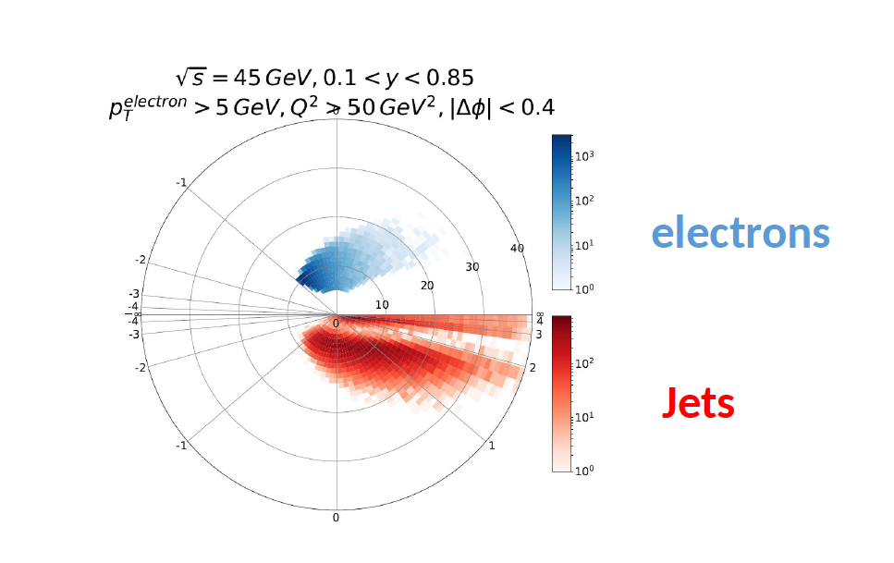
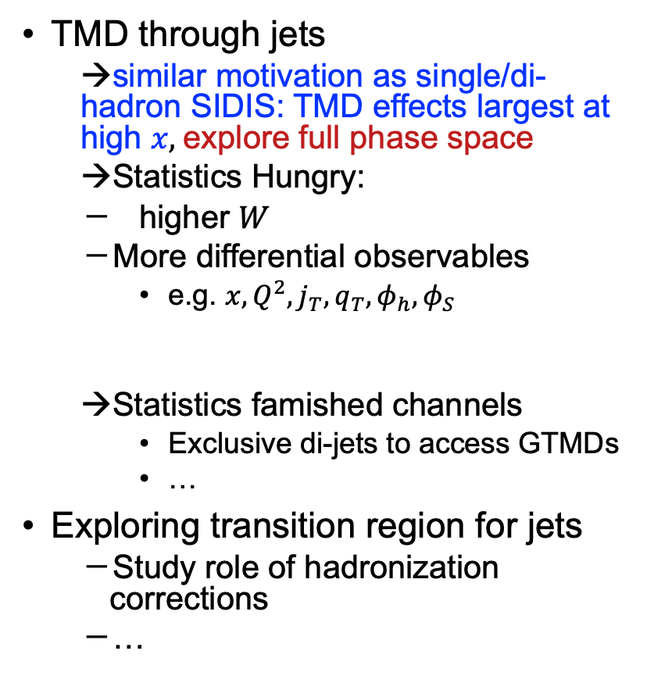
Jets
TMD through jets
  →similar motivation as single/di-hadron SIDIS: TMD effects largest at high $x,$explore full phase space
  →Statistics Hungry:
  higher $W$
  More differential observables
    e.g. ${x,Q^{2},j}_{T}, q_{T},φ_{h},φ_{S}$
  →Statistics famished channels
    Exclusive di-jets to access GTMDs
    …
Exploring transition region for jets
  Study role of hadronization corrections
  …
M. Arratia

Slide 16
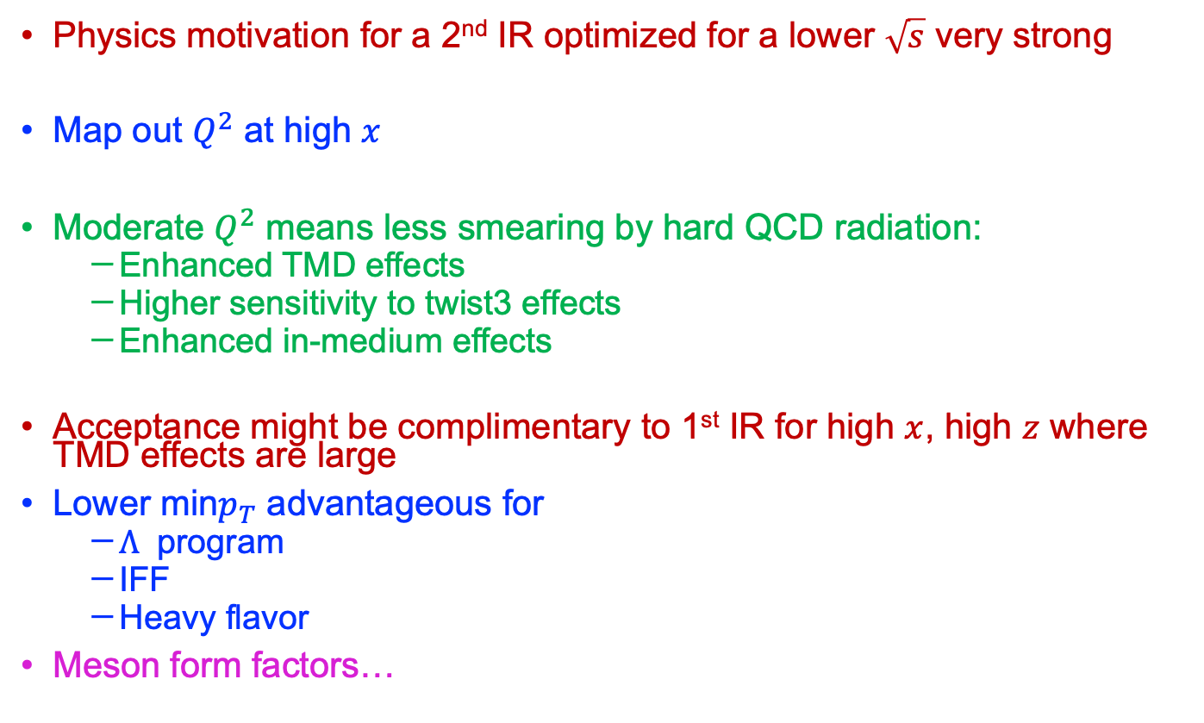
Summary and Conclusion
Physics motivation for a 2nd IR optimized for a lower $\sqrt{s}$ very strong
Map out $Q^{2}$ at high $x$
Moderate $Q^{2}$ means less smearing by hard QCD radiation:
  Enhanced TMD effects
  Higher sensitivity to twist3 effects
  Enhanced in-medium effects
Acceptance might be complimentary to 1st IR for high $x$, high $z$ where TMD effects are large
Lower min$p_{T}$ advantageous for
  $Λ$ program
  IFF
  Heavy flavor
Meson form factors…

Slide 17
Backup

Slide 18
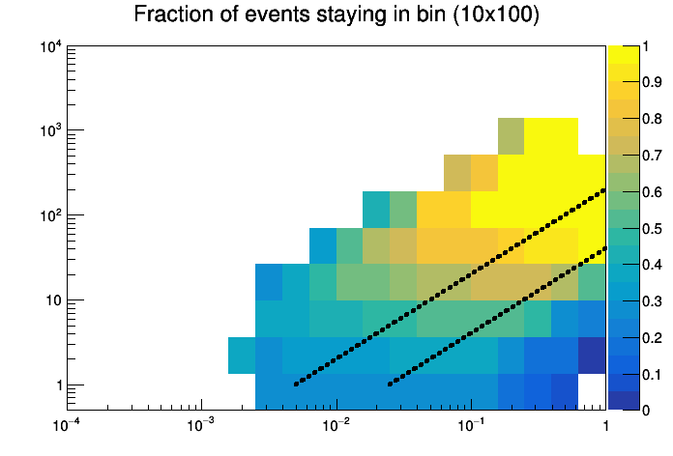
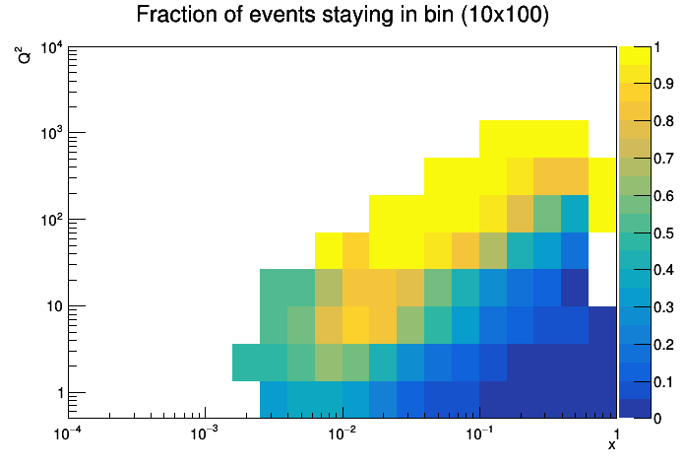
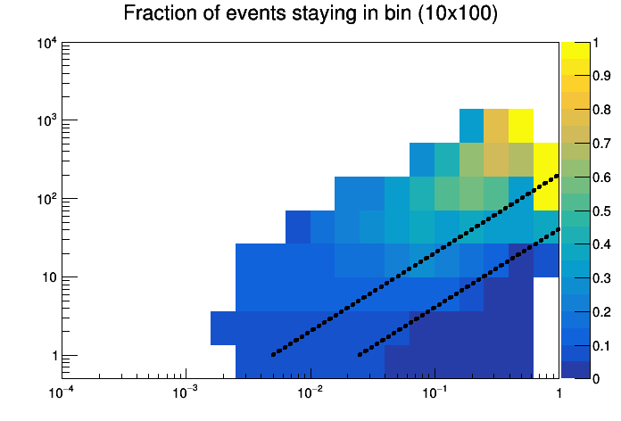
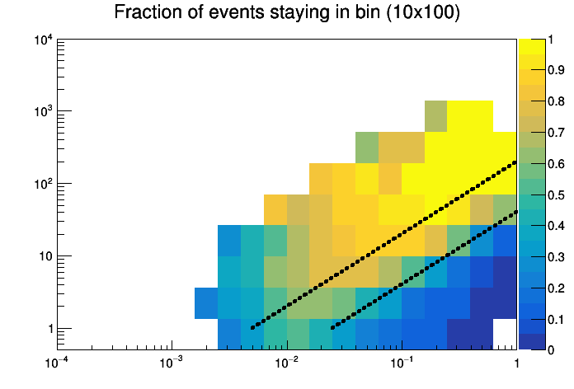






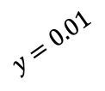
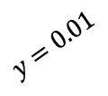

Results with EIC smear (100k events)
$$Q^{2}$$
Double angle
Just electron
$$y=0.05$$
$$y=0.01$$
x
$$Q^{2}$$
$$Q^{2}$$
JB method
Mixed method
$$y=0.05$$
$$y=0.05$$
$$y=0.01$$
$$y=0.01$$
x
x

Slide 19
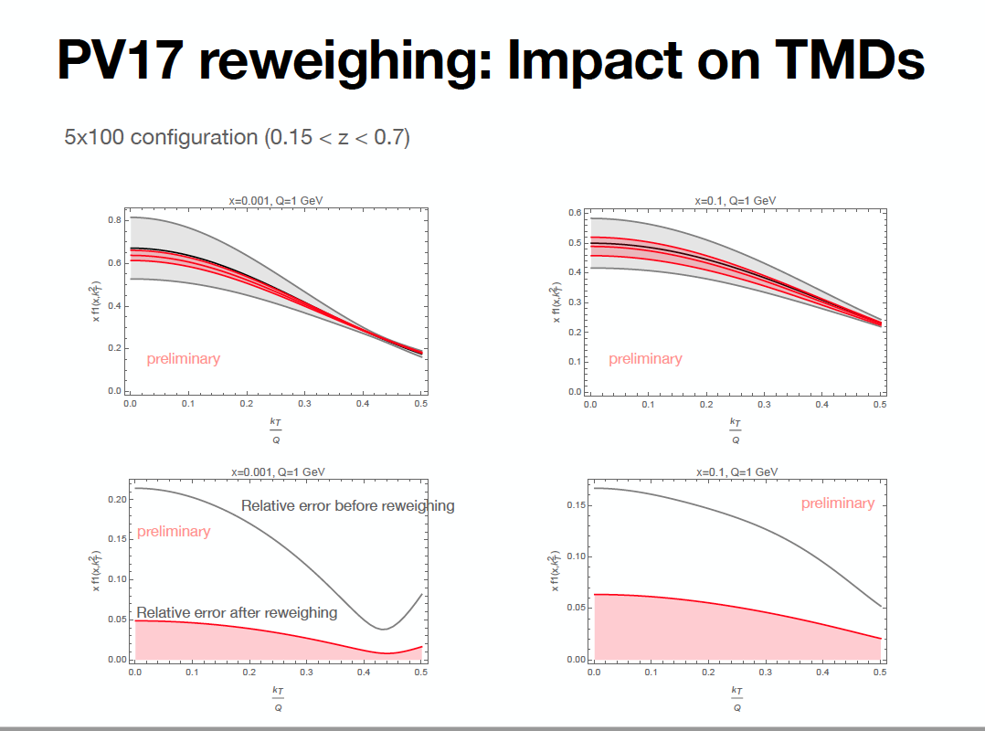

Slide 20
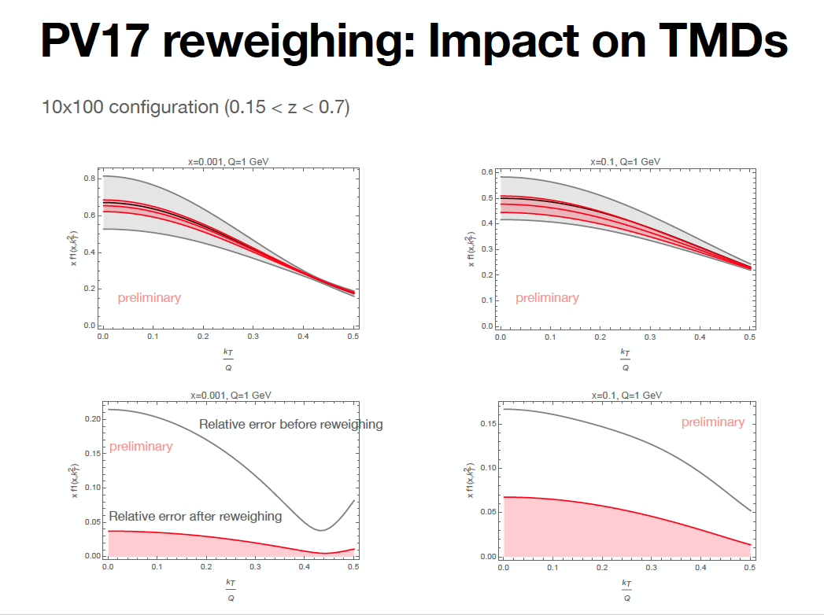

Slide 21
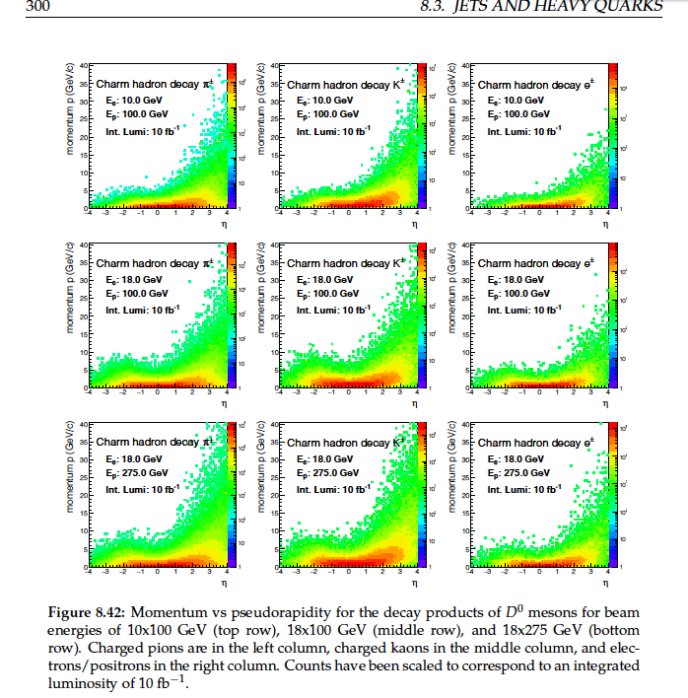
Less boost (might be interesting
For some channels, similar to
Spectroscopy program)
PID might be better at high z

Slide 22
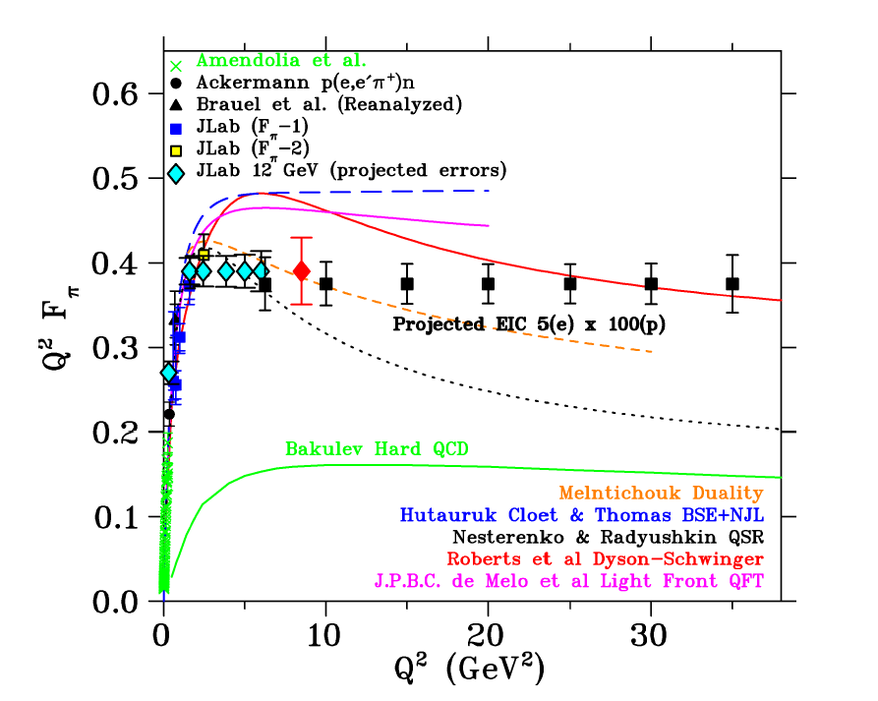
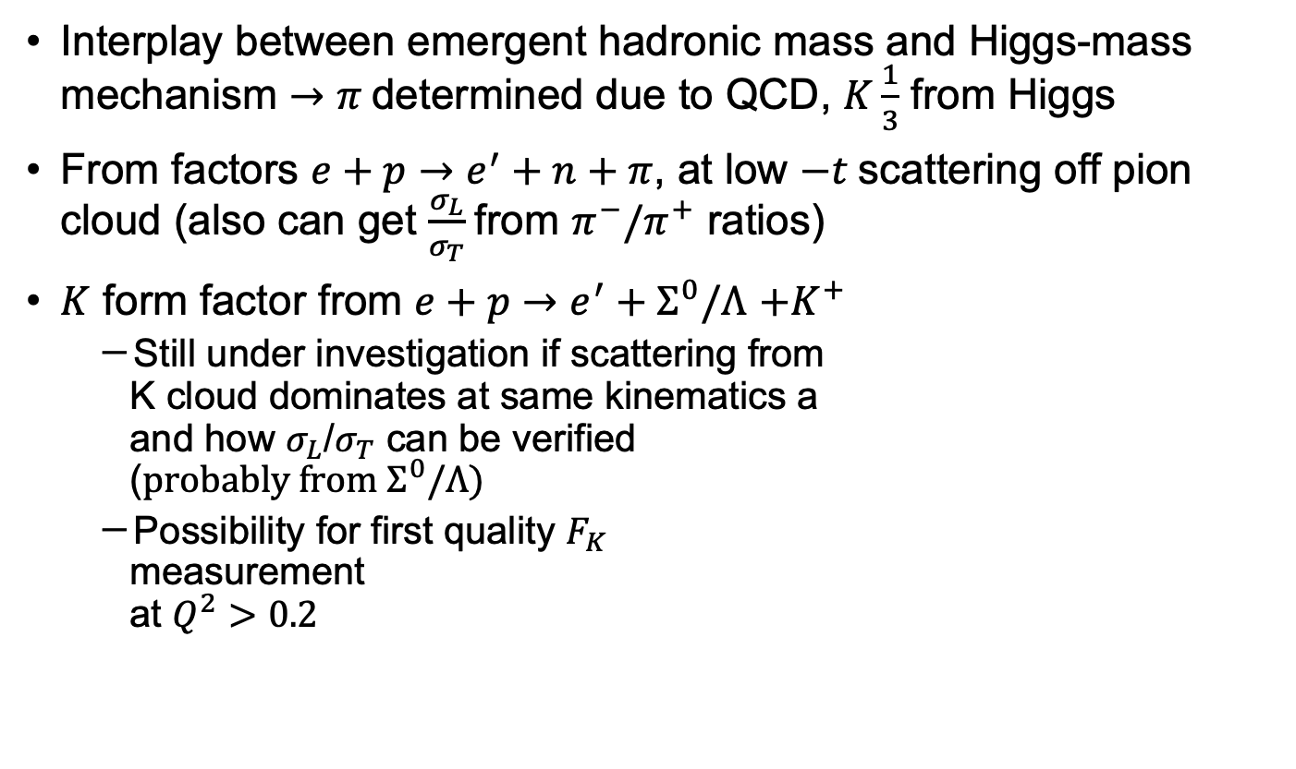

Meson Form Factors
Interplay between emergent hadronic mass and Higgs-mass mechanism $→π$determined due to QCD, $K\frac{1}{3}$ from Higgs
From factors $e+p→e^{′}+n+π$, at low $−t$scattering off pion cloud (also can get $\frac{σ_{L}}{σ_{T}}$from $π^{−}/π^{+}$ ratios)
$K$ form factor from $e+p→e^{′}+Σ^{0}/Λ$ $+K^{+}$
  Still under investigation if scattering from
  K cloud dominates at same kinematics a
  and how $σ_{L}$/$σ_{T}$ can be verified
  ($probably from Σ^{0}/Λ)$
  Possibility for first quality $F_{K}$
  measurement
  at $Q^{2}>0.2$
Using $20fb^{−1}$, $5×100$

Slide 23
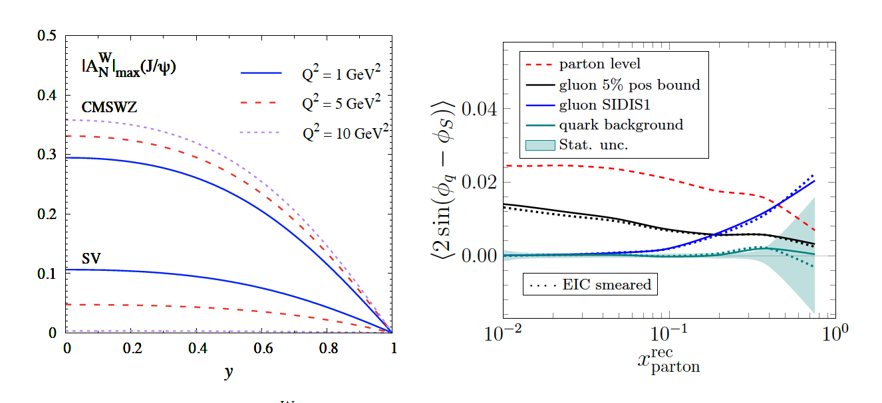



Access to Gluon TMDs with dijets
$J/Ψ$ $A_{N}$
Gluon TMDs structure more involved than quark sector
  8 TMDs, two types: Weizsacker-Williams (WW) and dipole
  SIDIS unique for WW type
  Very little known about unpolarized and polarized gluon TMDs
  Heavy quarkonium ideal channel, but relation of asymmetries to gluon TMDs model dependent
  Open heavy quark (e.g. D meson pairs) also good, but large uncertainties
  →dijet/dihedron most promising
Example: Gluon Sivers via dijet asymmetries
Dijet $A_{N}$
$$10 fb^{−1}, 18×275$$

Slide 24
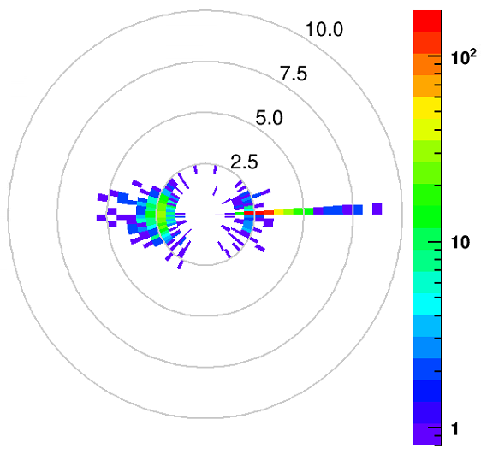
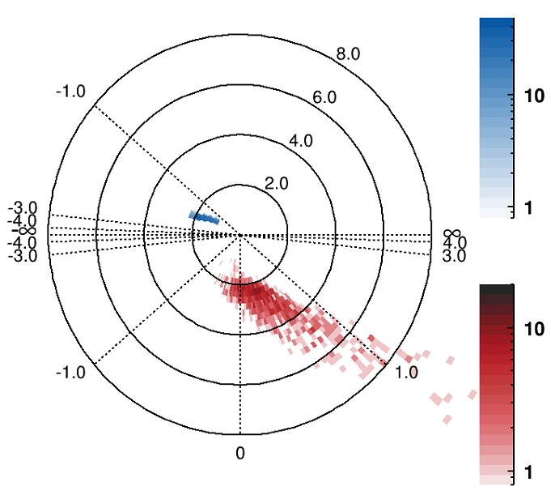
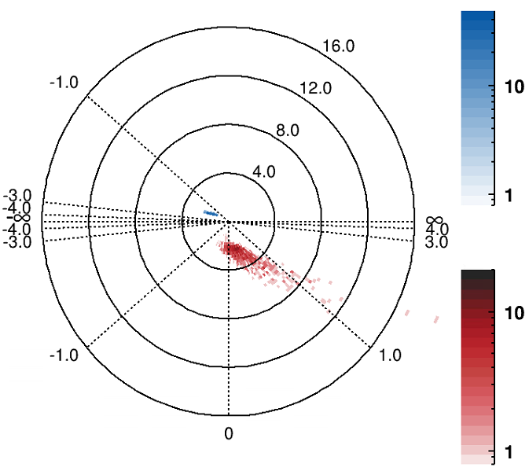
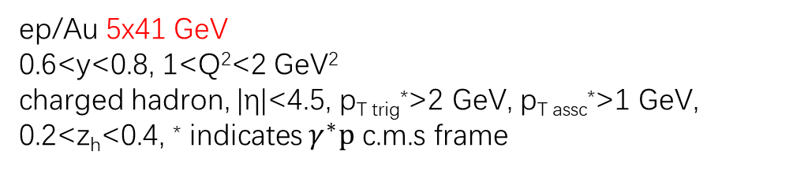


Kinematic map for dihadron measurements on gluon saturation
p_{T} vs $Δφ$ for associate hadron relative to leading hadron
ep/Au 5x41 GeV
0.6<y<0.8, 1<Q²<2 GeV²
charged hadron, |η|<4.5, p_{T trig}*>2 GeV, p_{T assc}*>1 GeV, 0.2<z_{h}<0.4, * indicates $γ^{∗}p$ c.m.s frame
Scattered e⁻ p range: 1~2 GeV, η range: -2~-1 (tight Q², y cuts)
Hadron p range: 3~6 GeV, η range: forward rapidity
Leading hadron
$p$ vs $η$ for scattered electron and charged hadron pairs (blue for e-, red for hadron)
e

Slide 25
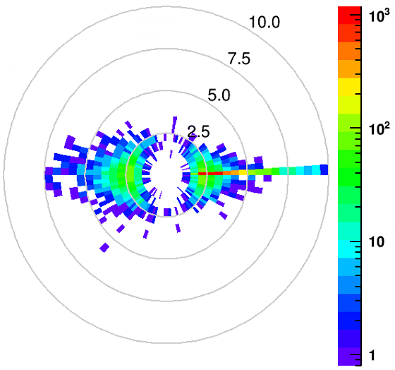



Kinematic map for dihadron measurements on gluon saturation
p_{T} vs $Δφ$ for associate hadron relative to leading hadron
ep/Au 18x110 GeV 0.6<y<0.8, 1<Q²<2 GeV² charged hadron, |η|<4.5, p_{T lab}>0.25 GeV, p_{T trig}*>2 GeV, p_{T assc}*>1 GeV,
* indicates $γ^{∗}p$ c.m.s frame
Scattered e⁻ p range: 4~7 GeV, η range: -3~-2 (tight Q², y cuts)
Hadron p range: 3~8 GeV, η range: backward rapidity
Leading hadron
$p$ vs $η$ for scattered electron and charged hadron pairs (blue for e-, red for hadron)
e

Slide 26





Medium Modification of Azimuthal Asymmetries
In gaussian approximation
$f_{1}^{A}\left(x,k_{⊥}\right)≈{\frac{A}{πα}f}_{1}^{N}\left(x\right)e^{\frac{−{\vec{k}}_{⊥}^{2}}{α}}$, with $α=\left\langle k_{⊥}^{2}\right\rangle +Δ_{2F}$
$\text{Quark} \text{transport} \text{parameter} Δ_{2F} \text{related} \text{to} \text{gluon} \text{density} \text{(}\text{due} \text{to} \text{interaction} \text{with} \text{gluons}\text{)}$
Jets are sensitive to TMD PDF $k_{T}$ only
$$\frac{Δ_{2F}}{⟨k_{⊥}^{2}〉}$$
$$\frac{Δ_{2F}}{⟨k_{⊥}^{2}〉}$$

Slide 27

Backup

Slide 28

Meson form factors
Elucidating in vis a vis mass generation (see also discussion about mass generation in 7.1) (kaon 1/3 higgs, pion almost 100% QCD)
(how is F extracted again?)
Kaon cloud unclear, to be verified by Jlab →sigma0/lambda ratio to get \sigma_L/sigma_T

Slide 29
TMD

