Slide 1
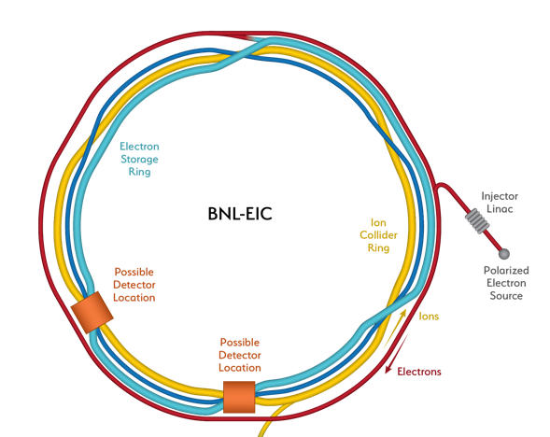
EIC4(AI4EIC): EIC (and other) Accelerator Design for AI4EIC
EIC accelerator overview
Primary tuning parameters and impacts
  Instantaneous luminosity
  Integrated luminosity
(Some) Traditional optimization methods
Bonus round: opportunites for AI/ML
  Integrated luminosity analogue models
  Commissioning and operability
  ”Challenges and Opportunities”
Rapid Cycling
Synchrotron (RCS)
Electron Storage
Ring (ESR)
Hadron Storage
Ring (HSR)
T. Satogata, Jefferson Lab
Caveat: Project is between CD-1/CD-2
Do NOT take any parameters shown here as gospel!

Slide 2
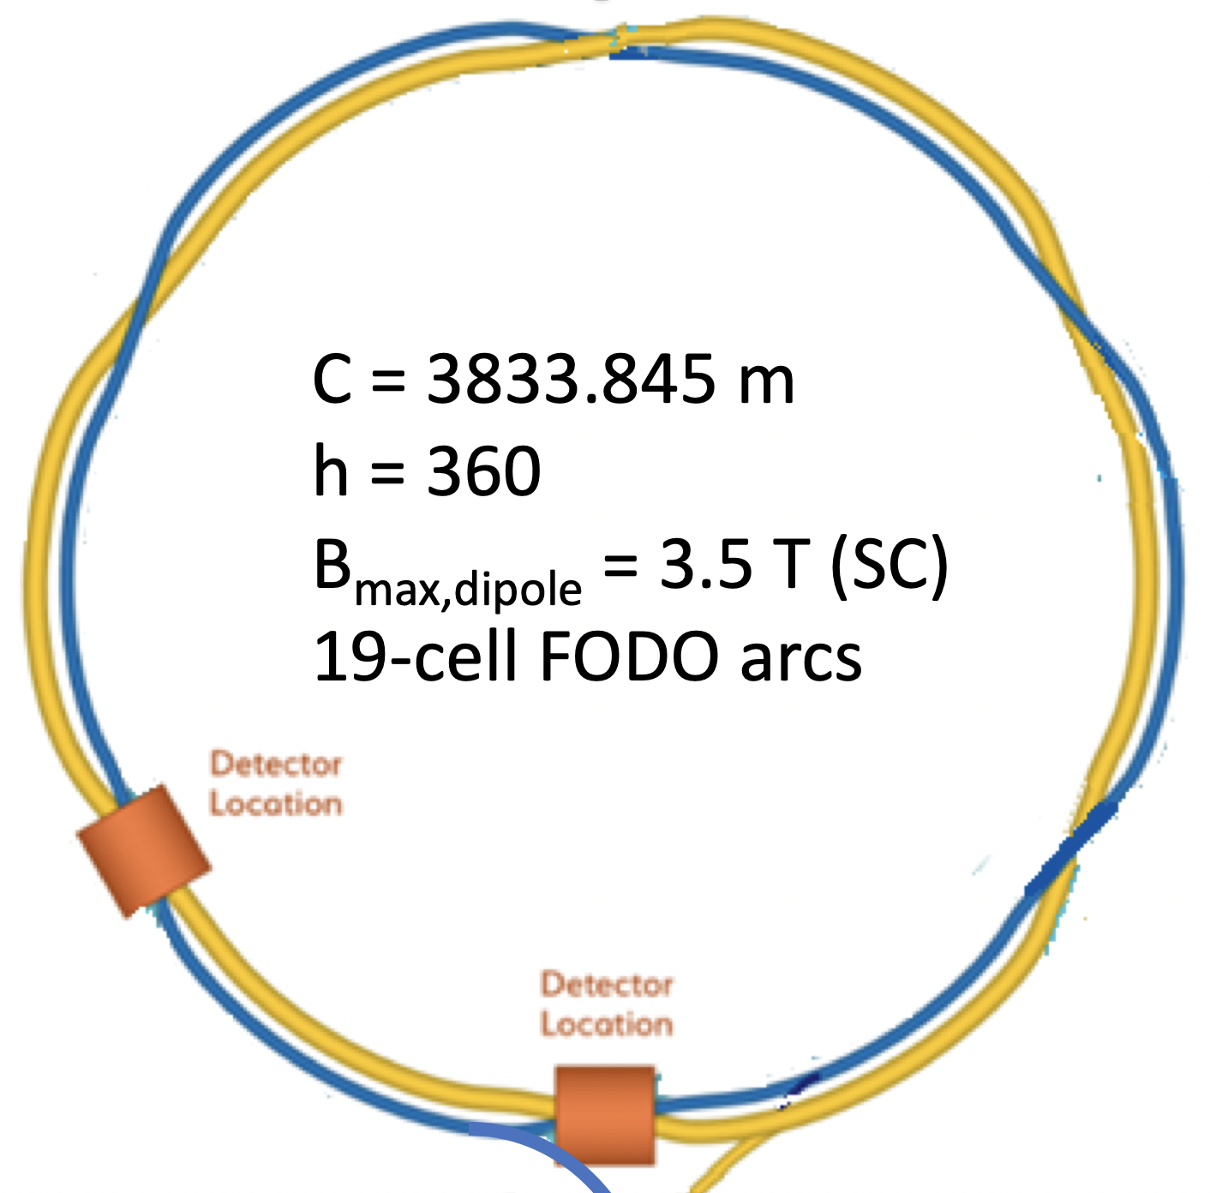
From RHIC to the EIC
RHIC: Relativistic Heavy Ion Collider
  Hadron (ion) collider
  6-100 GeV/u ions
  100-250 GeV polarized protons
  Two independent rings
    Asymmetric operations
    include e.g. d-Au collisions
Constructed 1990-2000
RHIC complex is operating at its peak
  Well-maintained
Will operate to ~2025
  EIC project accommodates this schedule

Slide 3
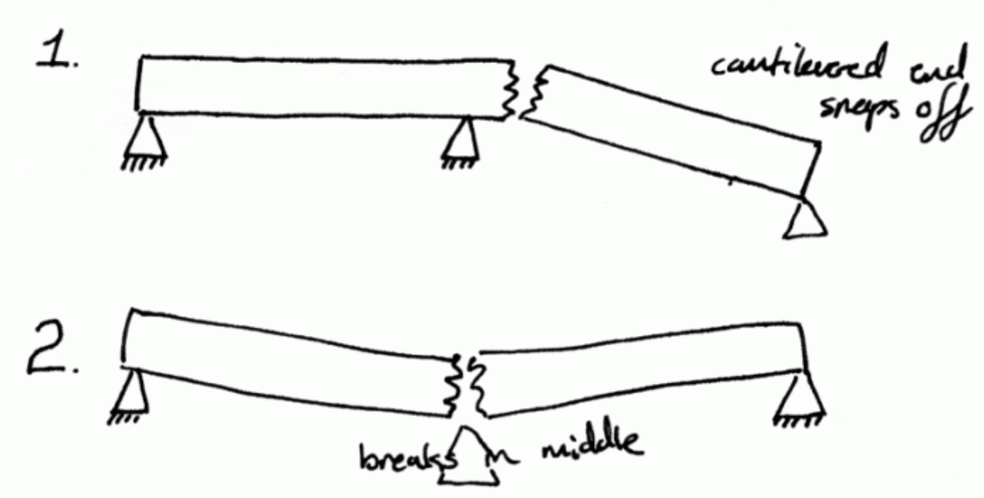
Large Accelerator Design and Risk: “Harrison’s Law”
Todd learned from Mike Harrison in the RHIC Project, c. 1993
Every major technical (accelerator) project should have at least one and at most two major technical risks
  Zero technical risks: make the parameters more ambitious
  More than two technical risks: parameters are too ambitious for existing technology
  One or two technical risks: address with focused R&D within project scope/cost/schedule
This is an overarching design principle
  Multiple risks and/or their mitigations can interact in complex ways
  Significant design complexity may be considered its own risk
  Suggests narrow-scope technical design optimization is most
  acceptable for new methods of optimization (e.g. AI/ML)
https://tinyurl.com/ujypvnvb

Slide 4
From RHIC to the EIC in the Same Tunnel
HSR is modified RHIC Yellow Ring
  40-275 GeV (10% higher than RHIC)
  1160 bunches, 1A beam current (3x RHIC)
  Bright vertical emittance: 1.5 nm
  Strong beam cooling (CEC from an ERL)
ESR is new Electron Storage Ring
  2.5-18 GeV (spin rotators)
  2.5 A beam current (5x NSLS-II)
  9 MW synchrotron radiation beam power
  Superconducting RF cavities
RCS is new Rapid Cycling Synchrotron
  0.4-18 GeV, 1-2 Hz
  “Swapout injection” into ESR
New High Luminosity IR(s)
  Crossing angles, crab cavities, spin rotators
Rapid Cycling
Synchrotron (RCS)
Electron Storage
Ring (ESR)
Hadron Storage
Ring (HSR)

Slide 5
Driving Collider Quantity: (Integrated) Luminosity
A general equation for electron-ion collision luminosity is complex and opaque
  Differences are not useful for our purposes of illuminating parameter optimization
An equation for symmetric beam collisions is sufficient for this presentation
Revolution frequency
(Given for EIC in RHIC tunnel)
Beam and lattice parameters:
Geometric factors:
- hourglass effect
- crossing angle/crabbing

Slide 6
(Instantaneous) Luminosity Parameters (Good luck with a multidimensional Pareto front)
Beam and lattice parameters:
Beam
Dynamics
Maximize beam currents
  Self-interactions
    Space charge, Touschek
    Intra-beam scattering
  Environmental beam interactions
    Impedances, instabilities
    Electron cloud
    Beam-gas interactions
  Environmental tech interactions
    Beampipe heating, cryogenics load
    Material tolerances
Minimize beam emittances
  Self-interactions
    Space charge, Touschek
    Intrabeam scattering
  Liouville’s Theorem
  Limitations of beam cooling
    Bandwidth, cooling time
  Source technology
Minimize IP lattice functions
  Optics of strong focusing
    Hyperbolic β(s) behavior
    Small β* -> Large β_{max}
  Technical feasibility
    Magnet technology
    Field quality
  Experiment size, acceptance
    Limits on L*
  Experiment backgrounds
    Synchrotron radiation
    Beam-gas, collimation
  Infrastructure geometry
    Existing RHIC tunnel
Constrained by beam dynamics
  Beam-beam forces, crabbing
  Higher-order optics (e.g. chromaticity)
  Other nonlinear dynamics

Slide 7
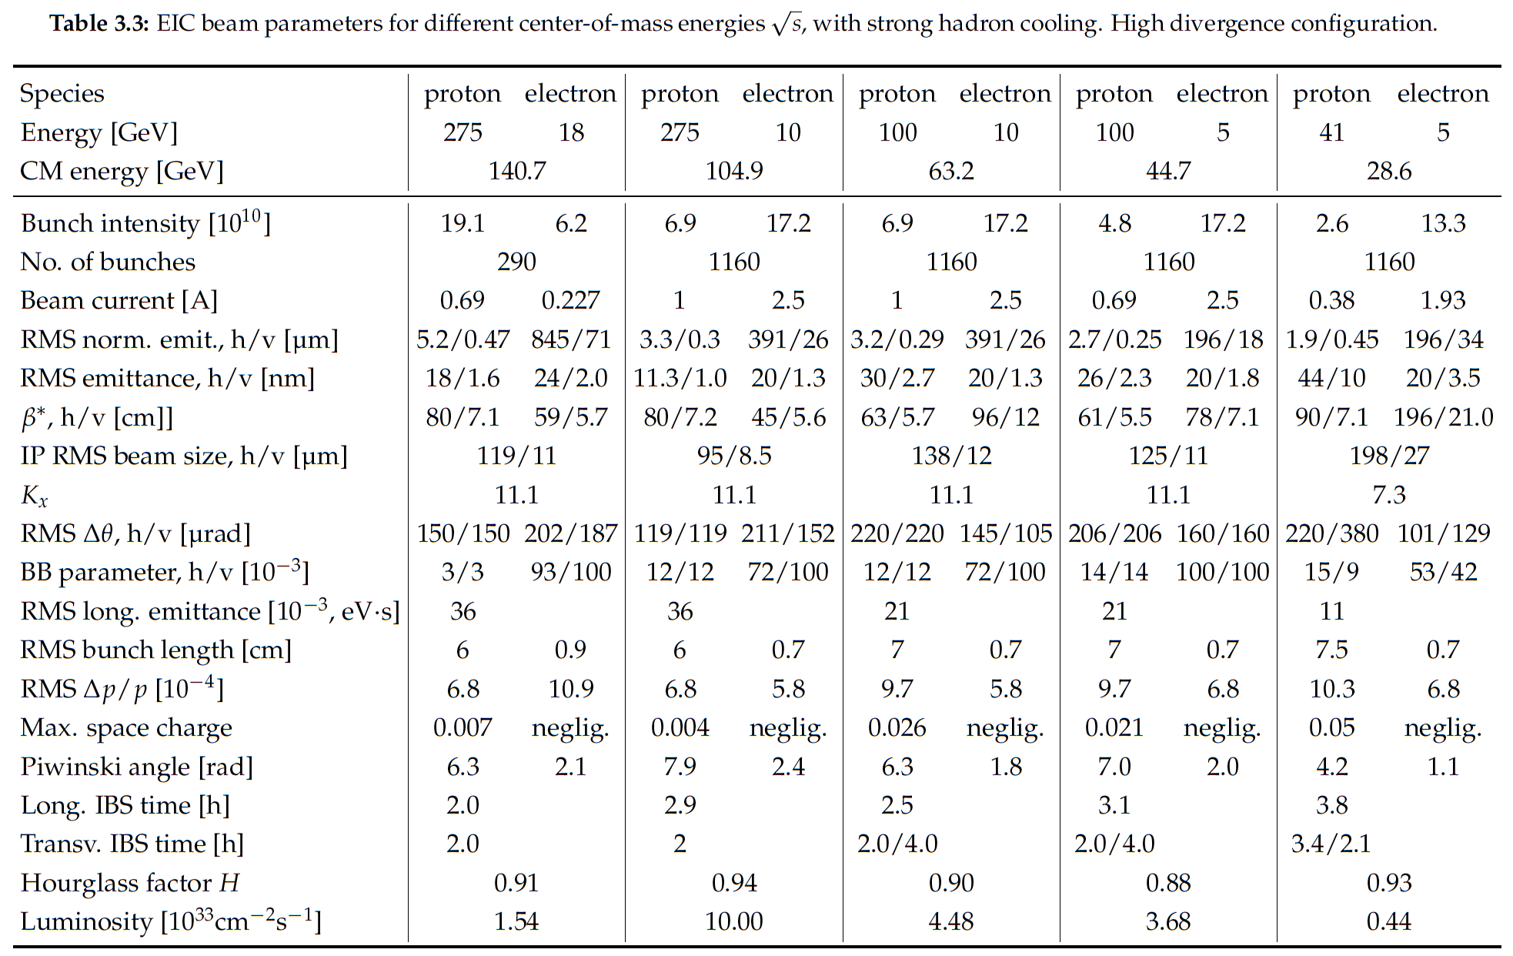
Parameter Table from EIC CDR (CD-1)

Slide 8
Parameter Table from EIC CDR (CD-1)
Caveat: Project is between CD-1/CD-2
Do NOT take any parameters shown here as gospel!

Slide 9
(Instantaneous) Luminosity Parameters (Good luck with a multidimensional Pareto front)
Beam and lattice parameters:
Beam
Dynamics
Maximize beam currents
  Self-interactions
    Space charge, Touschek
    Intra-beam scattering
  Environmental beam interactions
    Impedances, instabilities
    Electron cloud
    Beam-gas interactions
  Environmental tech interactions
    Beampipe heating, cryogenics load
    Material tolerances
Minimize beam emittances
  Self-interactions
    Space charge, Touschek
    Intrabeam scattering
  Liouville’s Theorem
  Limitations of beam cooling
    Bandwidth, cooling time
  Source technology
Minimize IP lattice functions
  Optics of strong focusing
    Hyperbolic β(s) behavior
    Small β* -> Large β_{max}
  Technical feasibility
    Magnet technology
    Field quality
  Experiment size, acceptance
    Limits on L*
  Experiment backgrounds
    Synchrotron radiation
    Beam-gas, collimation
  Infrastructure geometry
    Existing RHIC tunnel
Constrained by beam dynamics
  Beam-beam forces, crabbing
  Higher-order optics (e.g. chromaticity)
  Other nonlinear dynamics

Slide 10
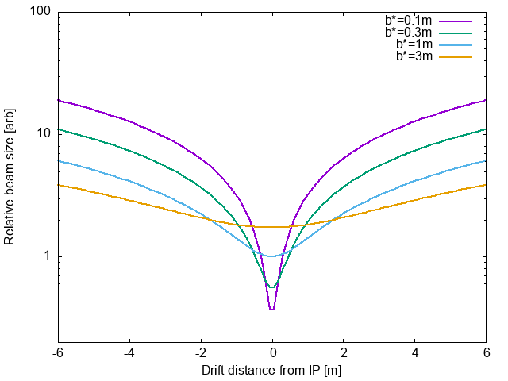
Example: Limitations on β*
Hyperbolic dependency of beam size on distance from IP
  Assumes a drift space
  Beam size scales as
Pushing final focus quadrupoles closer to IP permits more aggressive focusing
  for same magnet apertures, gradients
Complexity:
  Magnetic fields near magnet apertures become highly nonlinear (iteration)
  Constraints are technical, geometrical (e.g pathlength, tunnel walls)
electrons
ions
IR8 draft layout
R. Gamage, EIC UG
Aug 2021, L*~5.5m
https://tinyurl.com/y6je34cp

Slide 11
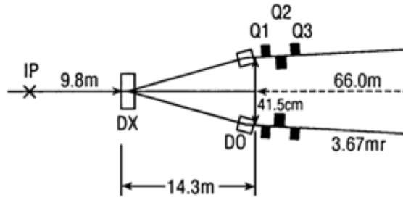
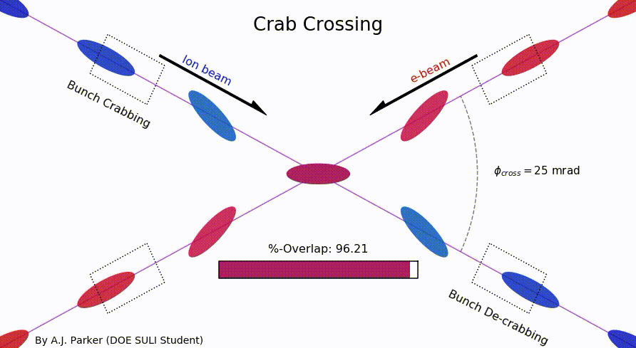
Example: Luminosity, Crossing Angle, and Crabbing
A crossing angle at the IP is a top-level design decision for the EIC
  Colliding asymmetric beams must be combined before/separated after collision
    Very different beam rigidities for magnetic optics
    Need separate final focus quadrupoles/optics for ions/electrons
    Minimize L* (distance from IP to first quad) to minimize β_{max} for minimum β* for same magnets
    Assumes magnets are already as technically challenging as acceptable (Harrison’s Law)
  Bending multi-GeV electrons -> dipoles -> undesired synchrotron radiation fans
    Counter-rotating electrons and ions bend the same direction in the same dipole
    Cannot use “dipole-first” separation configuration (as in RHIC)
  Conclusion: beams must have a crossing angle
    Implication: must include crab cavities in design
  Crab cavities require analysis, R&D
    Technically challenging RF devices: targeted project R&D
    5D/6D coupled beam dynamics: target evaluation
    Leverage US/LHC program, crabbing for HL-LHC
https://tinyurl.com/3ksj2rbb
A. Parker (Duquesne U.),
D. Higinbotham (JLab),
SULI

Slide 12
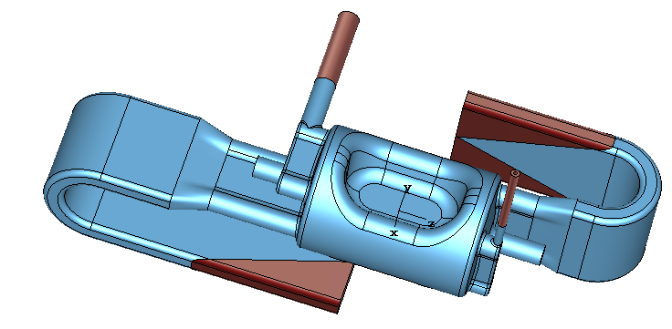
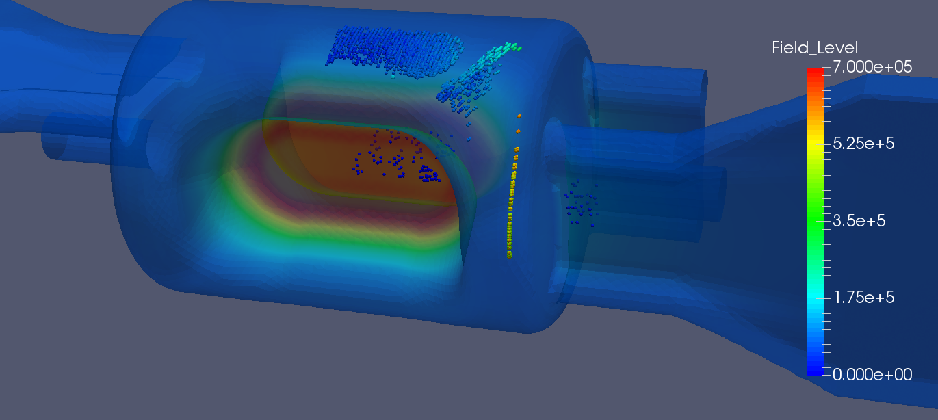
Example: EIC Crab Cavities
Crab cavities are one example of SRF design optimization
Accessible optimizable constraints include
  Correct fundamental mode frequency
  Maximize fundamental mode crabbing voltage
  Minimize R/Q (shunt impedance)
  Minimize dangerous higher order modes (HOMs)
  Minimize multipacting (local E fields)
  MOGA techniques helpful, computationally intensive
Less accessible optimizable constraints include
  Provide locations for efficient power coupling
  Mechanically tunable/detunable
  Constructable (complicated 3D EB welds)
  Cryostattable (transverse/longitudinal space)
  MOGA/AI techniques less helpful; ML training techniques? (Edelen et al.)
S. De Silva (ODU)
Private Communication
FPC
HHOM
VHOM
Field Probe

Slide 13
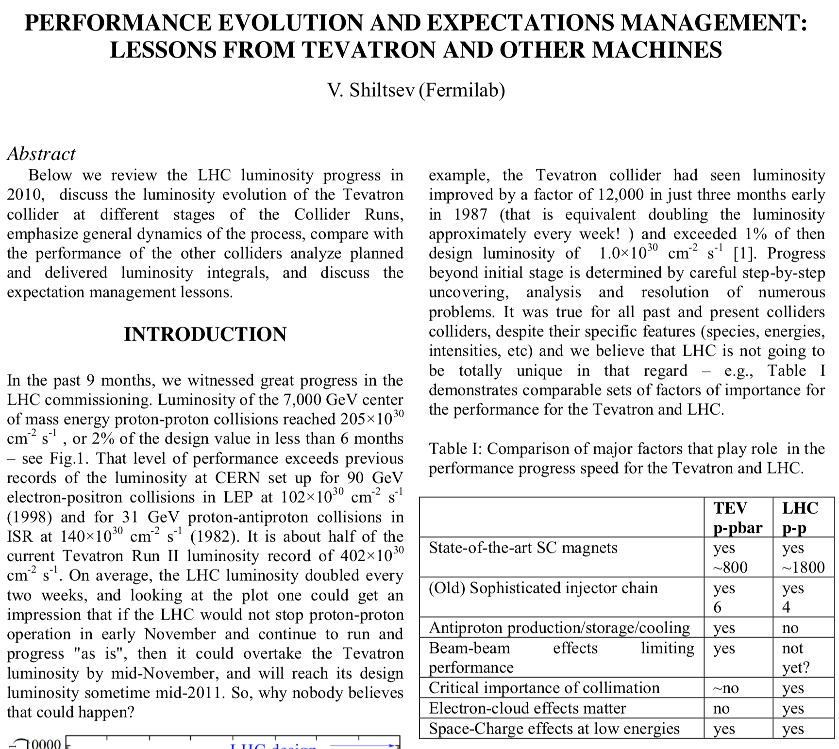
The “Undiscovered” Country: Integrated Luminosity
The real deliverable for any collider is integrated luminosity: Maximize beam lifetime in collisions
Sensitive to all effects:
  Positive (tuning, correction) and negative (failure, beam lifetime, backgrounds)
Some training data exists at facilities! (e.g. RHIC)
Beam lifetime and dependence on machine parameters
  Extremely bad conditions (e.g. resonances, bad vacuum, instability thresholds) have ~predictable beam lifetimes
  Difference between tolerable and great conditions is much harder (e.g. dynamic aperture; computational complexity)
  Many sensitivities, even environmental (e.g. service building temperatures, tides, TGV schedules)
  Intrinsic to the nature of pushing machine parameters?
Can one develop an analogue model or AI approach to predictive beam lifetime and integrated luminosity?
  The EIC primary technical risk: electron cooling
V. Shiltsev, https://arxiv.org/abs/1202.3950, 2012
From 2011 LHC Chamonix Performance Workshop
Parameterizes lumi evolution by collider complexity

Slide 14
EIC and General Accelerator Physics Challenges
Computer optimization methods have been used in accelerator physics “forever”
  Modifications of iterative linear methods
    Orbit correction, MICADO; Optics parameter iterative design matching
  Late 80’s, early 90’s: neural networks for control
    Orbit correction (Bozoki, Parseh, et al.)
AI/ML in accelerator physics has been developing over last 6-8 years
  Complex adaptive control (Edelen talk), large data set fault classification (Tennant et al)
  EIC dynamic aperture analogue modeling (Hao et al)
  MOGA techniques started earlier for device design optimization (e.g. SRF electron guns, injector design optimization)
Some challenges to AI/ML adoption in accelerator design space
  Simulations are computationally complex: o(10⁸⁻¹¹) particles for o(10⁶⁻¹⁰) turns, fidelity/stability
    Scale may be improved o(x10) with symplectified maps (e.g. SLAC PEP-II in 1990s)
  High intensity Coulomb interactions with everything: self-, colliding beam, environment
  Most beam dynamics problems are nonlinear where they are interesting
  Many cost/schedule/performance/technical tradeoffs: “art of design” and risk management
  Many unknowns (field quality, construction tolerances/errors not all known economically)
  Environmental dynamical factors (ground motion/microphonics, temperatures)
All of these challenges are applicable to EIC machine design

Slide 15
AI/ML EIC Accelerator Opportunity: Commissioning
EIC commissioning in 5-10y may benefit from AI/ML techniques being developed now
  Benefits may include
    Development/convergence of high-fidelity commissioning models
    More efficient commissioning via improved signal/noise rejection in large datasets
    Faster identification of failures/faults
  Model-informed online optimization
    A. Hanuka et al., PRAB 24 072802 (2021); https://doi.org/10.1103/PhysRevAccelBeams.24.072802
    Gaussian process optimization for traditional accelerator models informed by data
  Machine learning for beam dynamics studies at the CERN Large Hadron Collider
    P. Arpaia et al., NIM 985 164652; https://doi.org/10.1016/j.nima.2020.164652
    Classifiers to isolate signal (collimation), identify failures (BPMs)
  Virtual diagnostics
    C. Emma, A. Edelen et al., Information 2021, 12(2), 61; https://doi.org/10.3390/info12020061
    Used for beam quality preservation/monitoring in FACET-II (with very different beam parameters)
  May inform and even guide commissioning plans and machine studies

Slide 16
Closing Comments
The EIC is being built at BNL by the EIC project
  Several new machines, leveraging existing infrastructure including RHIC tunnel
  We are between CD-1 (June 2021) and CD-2/CD-3A (baselining, ~January 2023)
  Projects at this stage are by nature broadly risk-averse
Instantaneous Luminosity is the driving physics quantity for the EIC
  An interplay of parameters: beam current/emittances, bunch intensities, IP focusing
  All contributing parameters are driven to rational limits within acceptable risk
Integrated Luminosity ultimately drives facility productivity
  Predictive analogue models related to facility complexity may be useful
Opportunties for AI/ML to contribute to EIC accelerator challenges exist
  Component design optimization and evaluation of tradeoffs (e.g. MOGA Pareto fronts)
  Analogue models for complicated problems (e.g. nonlinear systems, integrated lumi)
  Machine commissioning and facility operations
Broader-scope AI/ML adoption in accelerator design is challenging
  Interaction of many computationally complex parameters in complex design space
  Many design drivers are not (easily?) parameterizable

