Slide 1

EIC Overview and Schedule
R. Ent (JLab)
E.C. Aschenauer (BNL)
Co-Associate Directors for the Experimental Program
AI4EIC-Exp - Experimental Applications of Artificial Intelligence for the Electron Ion Collider
September 7-10, 2021
Electron Ion Collider

Slide 2
Outline
EIC introduction
EIC recent progress and schedule
Detector progress
User activities
Experimental program preparations
Summary
Interspersed links between EIC-related efforts and AI in talk

Slide 3
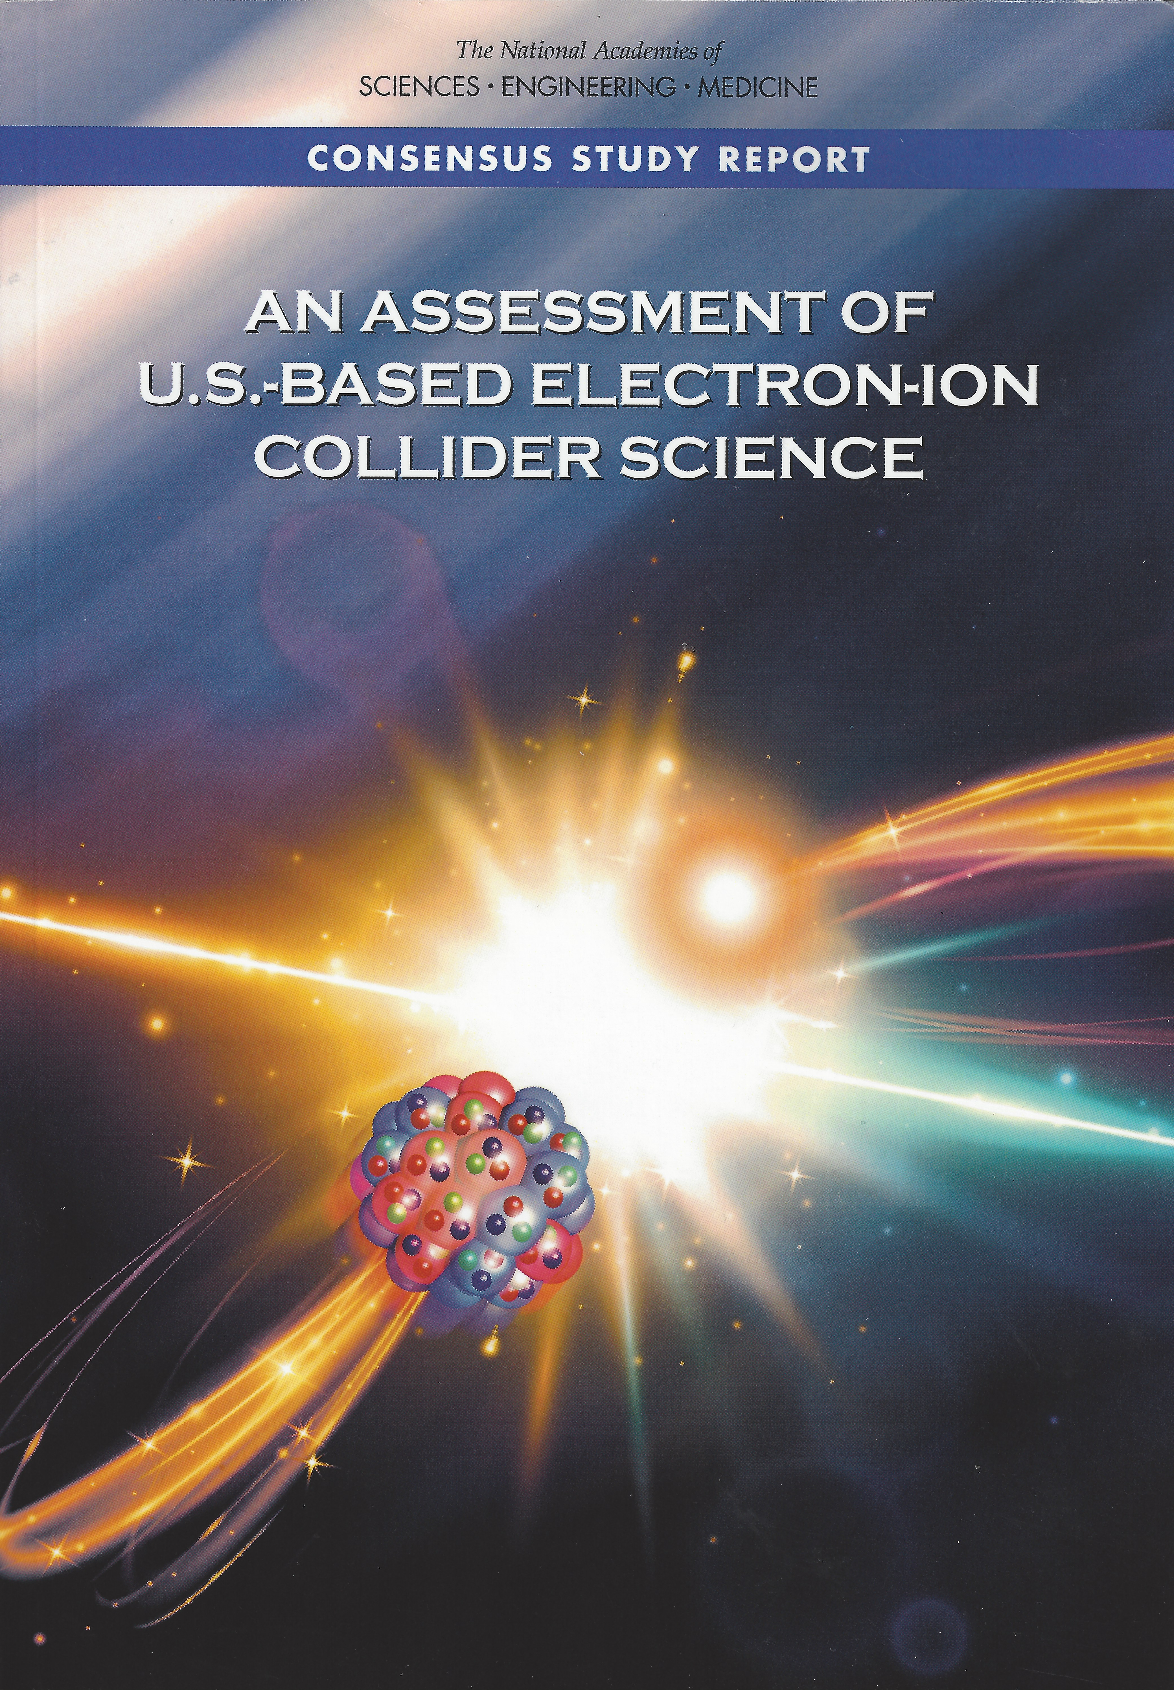
EIC Science – Findings of the NAS Committee
Finding 1: An EIC can uniquely address three profound questions about nucleons — neutrons and protons — and how they are assembled to form the nuclei of atoms:
  How does the mass of the nucleon arise?
  How does the spin of the nucleon arise?
  What are the emergent properties of dense systems of gluons?
Finding 2: These three high-priority science questions can be answered by an EIC with highly polarized beams of electrons and ions, with sufficiently high luminosity and sufficient, and variable, center-of-mass energy.
EIC science is compelling,
timely and fundamental
Developed by NAS committee with broad science perspective

Slide 4
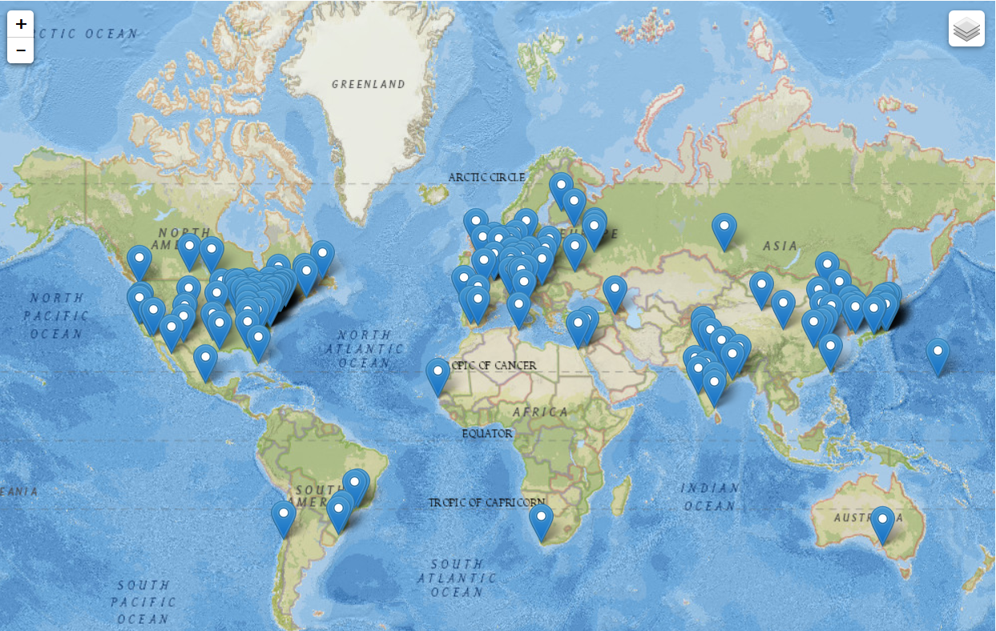
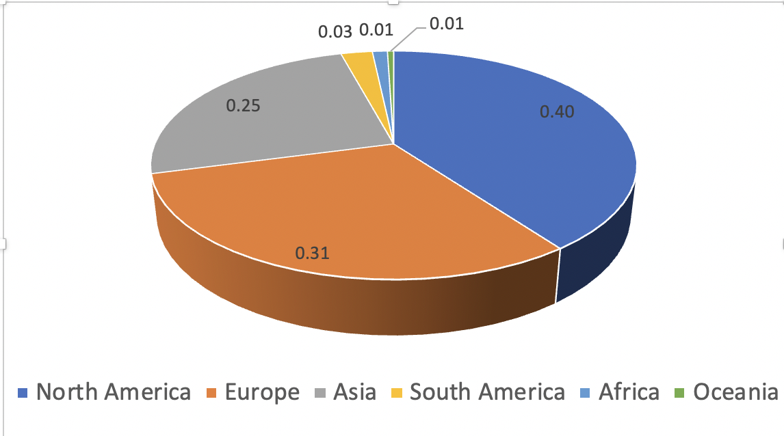
Worldwide Interest in EIC Physics
The EIC Users Group: EICUG.ORG
Map of institution’s locations
Formed 2016 –
1298 collaborators,
35 countries,
263 institutions
as of September 6, 2021.
Strong and Growing International Participation.
Annual EICUG meeting
2016 UC Berkeley, CA
2016 Argonne, IL
2017 Trieste, Italy
2018 Washington, DC
2019 Paris, France
2020 Miami, FL
2021 VUU, VA & UCR, CA
2022 Warsaw, Poland

Slide 5
EIC Design per NSAC and NAS Requirements
Note: this is per definition, as these were the parameters given to the labs for the independent cost review and independent EIC site assessment.
Center of Mass Energies 20 GeV – 140 GeV
Maximum Luminosity 10³⁴ cm⁻²s⁻¹
Hadron Beam Polarization 80%
Electron Beam Polarization 80%
Ion Species Range p to Uranium
Number of interaction regions up to two
p/A beam
e beam
p: 41 GeV, 100 to 275 GeV
e: 5 GeV to 18 GeV

Slide 6
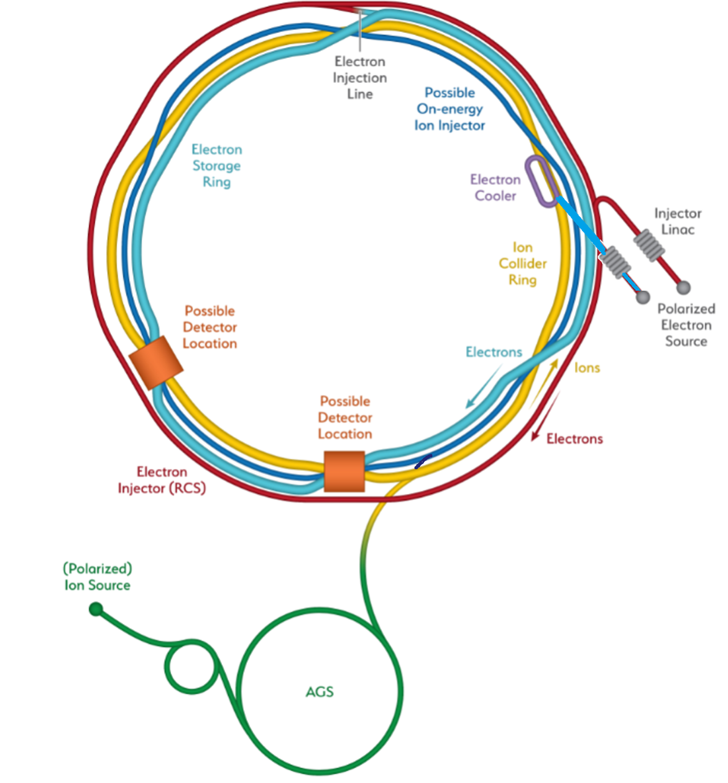
Detector – Location
Two possible locations – IP6 and IP8 – for detectors and Interaction Regions.
IP6 - planned EIC project detector location
hadrons “going from inner to outer arc”
IP8 - viable location for complementary detector/IR
hadrons “going from outer to inner arc”
→ IR designs are NOT interchangeable with each other
IP8
IP6
Hadron Storage Ring
Electron Storage Ring
Electron Injector Synchrotron
Possible on-energy Hadron
injector ring
Hadron injector complex

Slide 7
EIC Recent History
Event | Date
DOE Mission Need Statement Approved | January 22, 2019
DOE Independent Cost Review | July 2019
DOE Electron Ion Collider Site Assessment | October 2019
Critical Decision – 0 (CD-0) Approved | December 19, 2019
DOE Site Selection Announced | January 9, 2020
BNL TJNAF Partnership Agreement | May 7, 2020
DOE Office of Science Status Review | September 9-11, 2020
Independent EIC Conceptual Design Review | November 16-18, 2020
DOE Office of Science CD-1 Review | January 26-29, 2021
DOE Independent Cost Review | January - February 2021
CD-1 Approval* | June 29, 2021
* DOE Project Management Risk Committee (PMRC) blessed CD-1 – June 1, 2021
DOE CD-1 Energy Systems Acquisition Advisory Board (ESAAB) meeting – June 28
7

Slide 8
Schedule – what do the CD milestones mean?
CD-0 – Approve mission need: this documents that a scientific goal or a new capability, requiring material investment exists.
CD-1 – Approve Alternative Selection and Cost Range: serves as a determination that the selected alternative and approach is optimized to meet the mission need defined at CD-0. What is perhaps most relevant is that CD-1 allows for release of Project Engineering and Design (PED) funds, which means the next phases of design of accelerator and detector can begin.
CD-2 – Approve Performance Baseline: CD-2 is an approval of the preliminary design of the project and the baseline scope, cost, and schedule. What is most relevant is that CD-2 means there is now a definitive plan that the project will be measured against in cost, schedule and technical performance.
CD-3 – Approve Start of Construction: CD-3 is an approval of the project’s final design and authorizes release of funds for construction. What is most relevant is that projects can now proceed with construction related procurements and activities. CD-3 is sometimes split in CD-3A in a tailored approach to approve start construction for long-lead procurements.
CD-4 – Approve Start of Operations or Project Completion: CD-4 provides recognition that the project’s objectives have been met. CD-4 is sometimes split in CD-4A that allows, after agreed-upon criteria for technical success have been met, for transition into operations, and CD-4B that provides the formal closeout of the project.

Slide 9
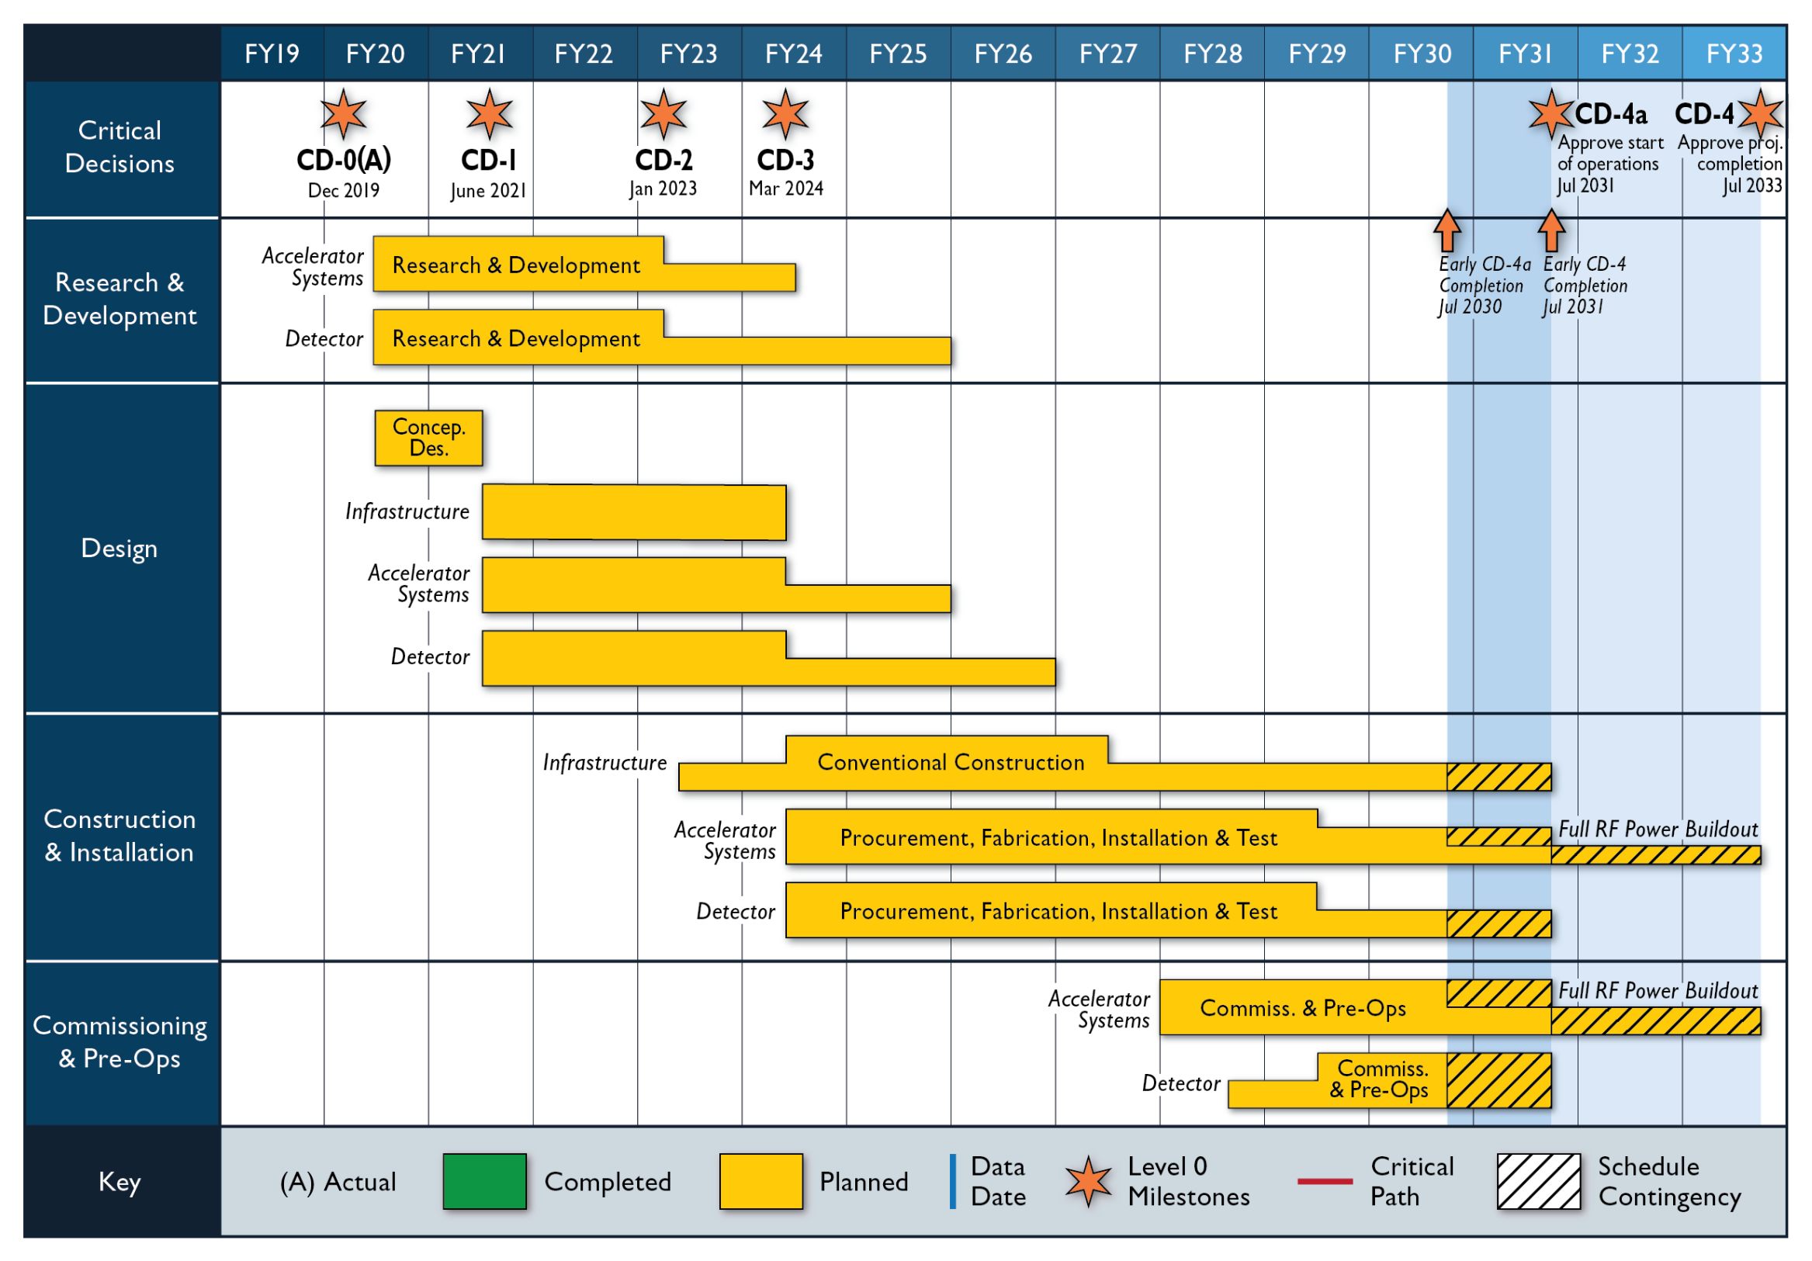
Schedule
Goal for CD-2: early 2023
EIC operations are a decade away

Slide 10
CD-2/3A Approval Timeline – January → April 2023
Assumptions
Funding ($70 million in FY2022,…)
Resources (people, purchases, contracts)
Tailored CD-2/3A approach
Schedule
DOE Mini Review (confirm CD-2/3A goal) October 19-21, 2021
DOE Status Review (confirm plans for OPA/ICR reviews) April TBD 2022
First Draft Baseline/Start EVMS (practice w/ August data) September 2022
Preliminary Design Complete November 2022
Final Design/Maturity Readiness for CD-3A Items November 2022
Freeze Data for CD-2 Reviews November 2022
Preliminary Design Review November 2022
Director’s Review Early December 2022
Director’s Review Feedback/Corrections December2022
DOE OPA Review and ICR Late January 2023

Slide 11
Path to CD-2 – Detector Focus
Focus for CY21 is to prepare everything as much as possible so we can move full speed ahead once the EIC collaboration proposal detector is defined.
Challenge: to make enough progress to reach CD-2 without having the detector well defined by the collaboration before Q2FY22 – This required creative thinking to have an expedient “plug and play” transition from the reference detector to the user-defined EIC detector, following the call for detector proposals.
High-level work goals:
develop design for one detector in support of the CD-1 project package and further advance its design towards CD-2.
understand the interfaces and service needs for the various detector technologies, and the overall assembly and Hall areas.
detail the detector and Interaction Region installation activities to ensure they can be done in phase.
advance design and develop requirements for experimental equipment that must stay in phase with accelerator design and infrastructure due to the highly integrated detector and IR region.
initiate the EIC project detector R&D activities.
guide the EIC detector collaboration proposal activities and support discussions on international engagement.

Slide 12
Specific Work Activities for CY2021
Magnet
  Advanced conceptual design of a new 3T experimental solenoid (with CEA Saclay).
  Conceptual design of field shaping to establish projectivity in the existing BaBAR magnet.
Detector
  Advancing hadron and electromagnetic calorimeter Detector Conceptual Designs
  Advancing Particle Identification Detector Conceptual Designs
  Advancing Tracking Detector Conceptual Designs
Advancing Electronics, Data Acquisition and Computing Concepts
  Remain in phase of potential ASICs, PCBs and FPGA needs, document ASIC requirements.
  Fully worked-out plans (grounding, cabling, computing, etc.) late 2021
  Develop and document a plan to ensure compatibility with streaming readout and future AI operations.
Integration
  Engineering concept for full reference detector in IP6, including frames, cradles, services, ...
  Interface control, system, functional requirements documents for reference detector in IP6.
  Assembly procedures of the central detector as a whole.
  Integration of detector in IP6, installation sequencing and facilitating maintenance modes.
  Engineering concept for a full detector integration in IP8, including installation and maintenance tasks.
Polarimetry
  Verification the current RHIC hadron polarimetry can be made to work for EIC

Slide 13
Cartoon/Model of the Extended Detector and IR
EIC physics covers the entire region (backward, central, forward)
The detector requirements differ in these regions due to the EIC asymmetry
Many EIC science processes rely on excellent scattered electron detection and excellent and fully integrated forward detection scheme
Adapted from 2nd Yellow Report Meeting, Detector Working Group
p/ion beam
e beam
far-backward
e-detection
e final-focus quads
“Central detector”, includes e-endcap, central, and p/ion endcap detectors
forward dipole
incl. h detection
Ion final-focus quads
forward dipole
far-forward h-detection
far-forward
h-detection
Low-Q²
spectroscopy
Inclusive Structure Functions, TMDs, heavy flavors and jets, electrons for GPDs
GPDs/DVCS, tagging, diffraction, high-medium t
Baryon decay
π/K structure
evaporated n
GPDs, tagging, diffraction, lowest-t
GEMs
Diamond detectors?
Vertex and Tracking detectors, particle identification detectors, calorimetry detectors, muon detectors, etc.
Si/GEMs
Roman pots,
e/γ calorim.
GEMs
Roman pots
e/γ calorim.
Roman pots
ZDCs
physics examples
detector examples

Slide 14
Highly integrated detector system
Highly Integrated detector system: ~75m
1.Central detector: ~10m
2.Backward electron detection: ~35m
3.Forward hadron spectrometer: ~40m
Lesson learned from HERA – ensure low-Q² coverage
Various stage detector to capture forward-going protons and neutrons, and also decay products (Δ, Λ).
Polarimetry not shown here
p: 41 GeV, 100 to 275 GeV
e: 5 GeV to 18 GeV
p/A beam
e beam
far-forward detectors
far-backward detectors
14

Slide 15
WBS 6.10 Detector Scope
This WBS covers the cost for R&D, PED and construction of a general-purpose detector capable of the physics program detailed in the NAS review at full center-of-mass energy range (20 GeV and 140 GeV) and luminosity (10^{33 – 34} cm⁻²s⁻¹).
The detector consist of
  a solenoidal magnet,
  the central detector with 5 subsystems and
  a lepton and hadron endcap with each 5 subsystems.
Further data-acquisition and trigger, infrastructure and integration as well as online and offline software efforts are included in the scope.
In addition, the auxiliary detectors needed to tag particles with very small scattering angles both in the outgoing lepton and hadron beam direction (Roman Pots, Zero-degree Calorimeter and low Q²-tagger).
Since the CD-1 review we moved the scope of “polarimetry and luminosity (detector)” from 6.06 (Interaction Region) to 6.10.14.
15

Slide 16
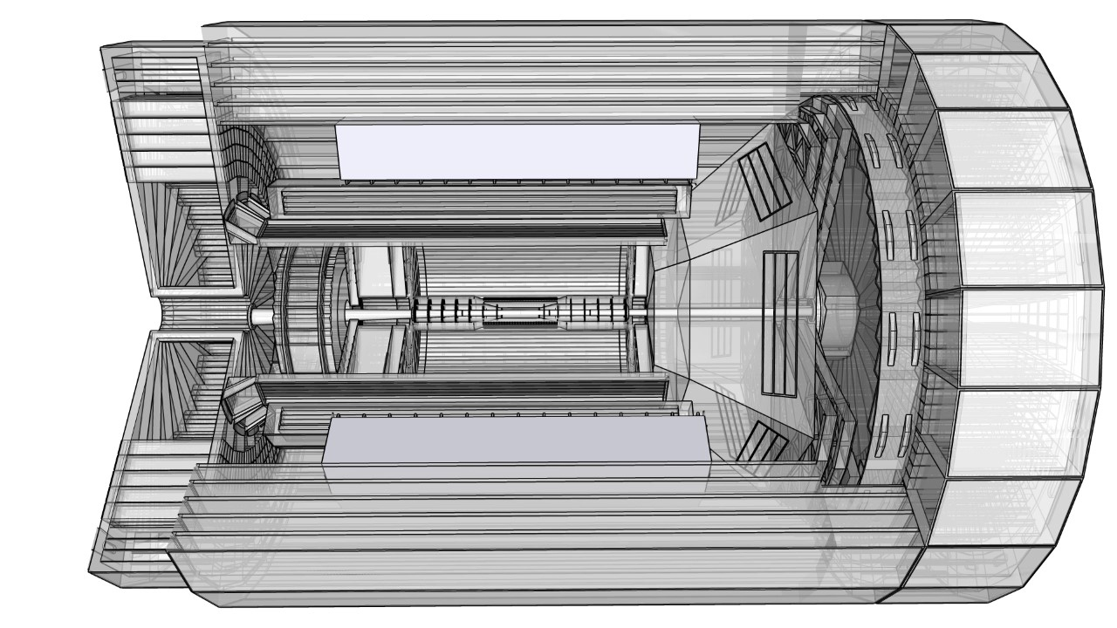
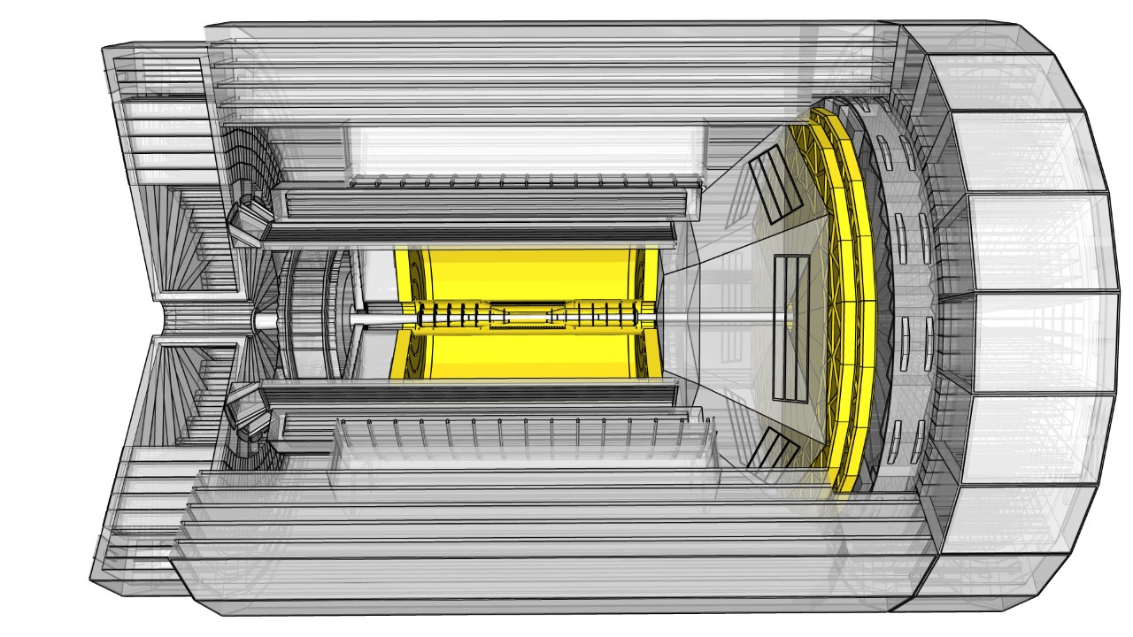
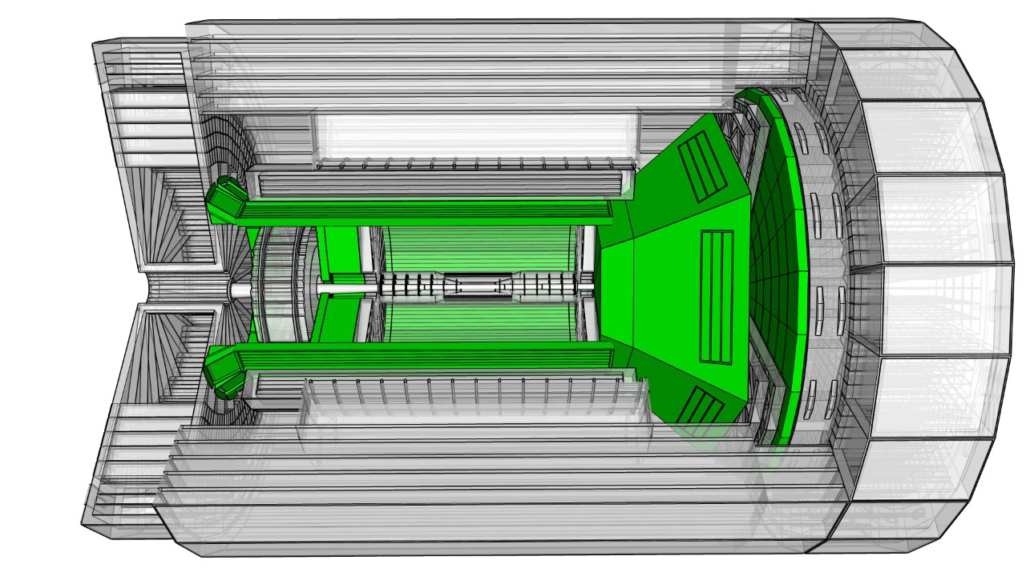
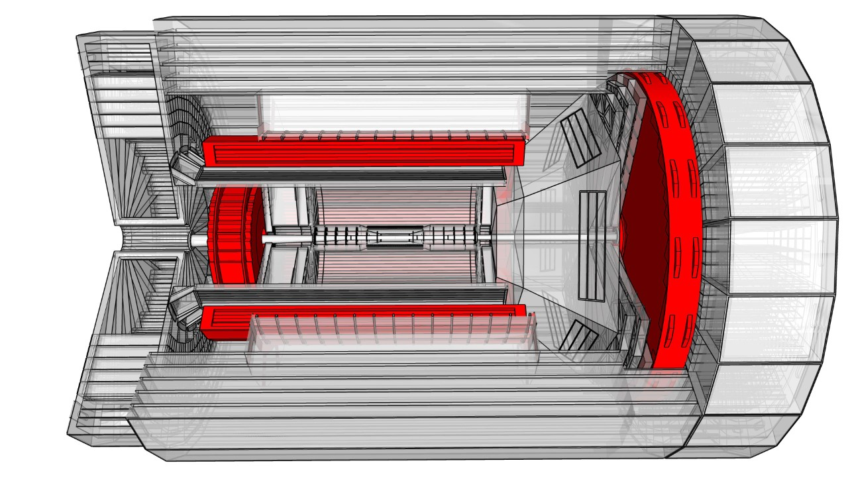
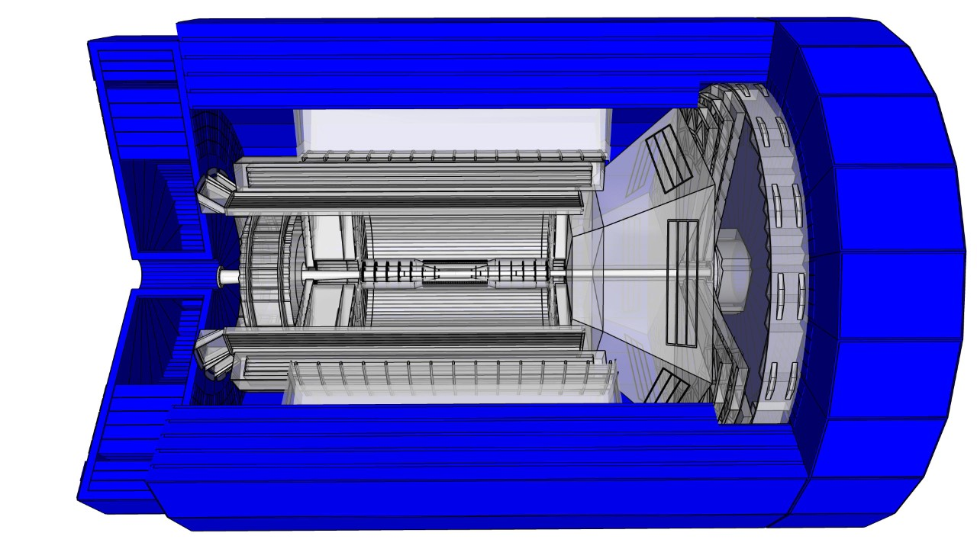
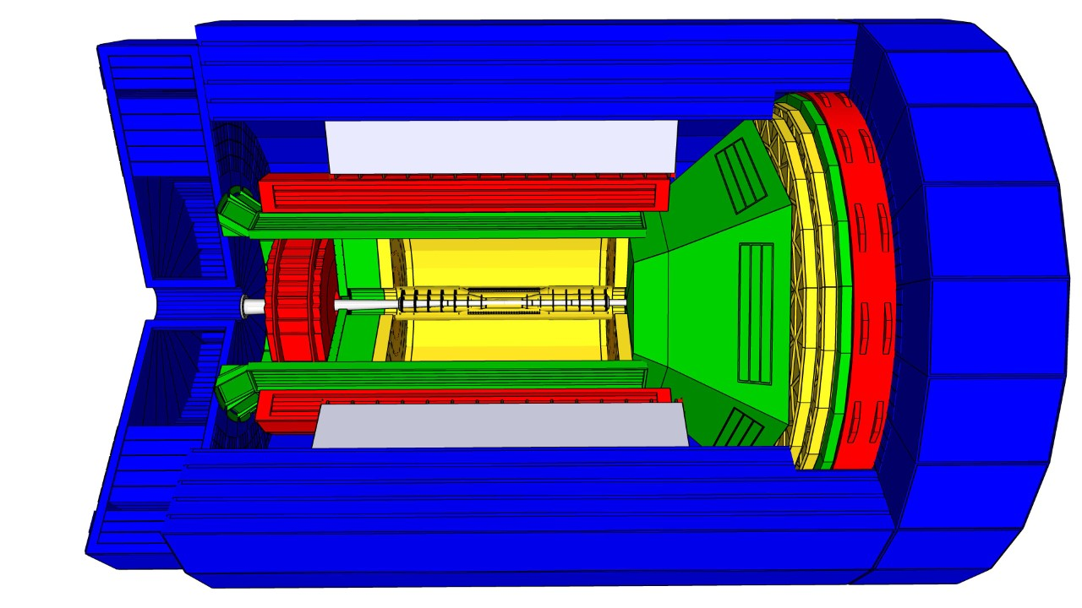
Overview of an example EIC Central Detector
This example based on new 3T Magnet (as assumed by ATHENA)
Magnet coil
Tracking Particle Id EM calorimetry Hadron calorimetry
16

Slide 17
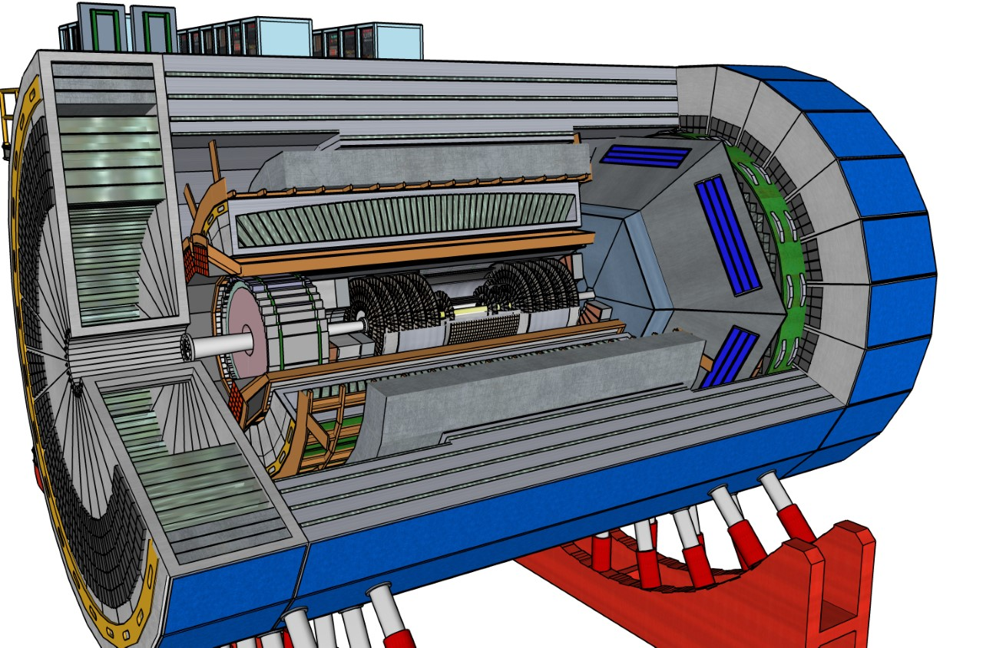
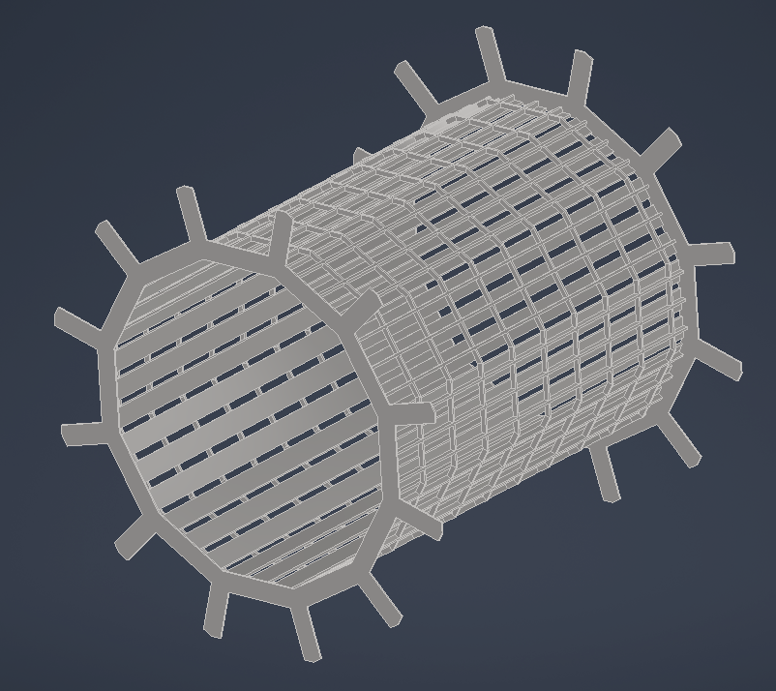
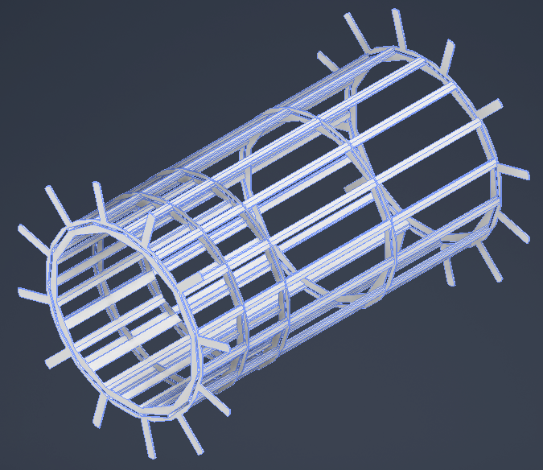
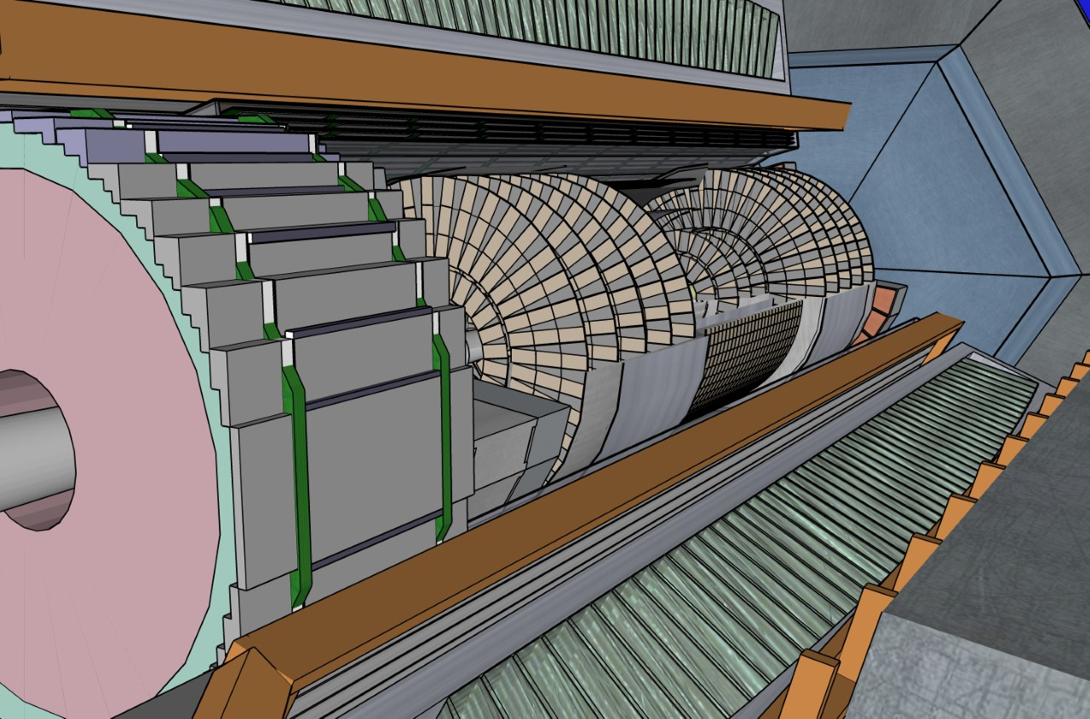
Progress – detector integration
Example with SketchUp (for ECCE)
Good engineering concepts for everything left of orange line:
  Frame to hold barrel EM calorimeter
  Universal frame to hold DIRC and detectors inside, including backward EM calorimeter
  Frame and cooling for backward EM calorimeter
  Backward hadronic calorimeter and way to split it for maintenance → can be transferred to hECaL & hHCal
  Can reuse STAR cradle, may need sleeve or jackets to adjust for EIC detector diameter
Only conceptual as of yet for everything right of orange line
  Tracking, forward RICH, forward EM calorimeter and hadron calorimeter → recent progress in tracking
17

Slide 18
Progress – Interaction Region
2nd focus
(0,0) is here defined as IP. It is also shifted ring inwards.
IR-6: change request submitted to change distance of IP to B0 magnet from 4.5 to 5 meters
Impact on beam optics, beam dynamics, magnets and acceptance checked and okay.
Coordinate system defined, same for IP-6 and IP-8.
Beam effects impacting science such as crossing angle, crabbing, and divergence have been integrated in the software library for simulations.
IR-8: pre-conceptual design with 35 mr crossing angle and secondary focus passed on to proto-collaborations for science complementary checks.
2nd focus enables:
enhanced low P_{T} acceptance, DVCS (imaging) on nuclei, Light ion tagging, Diffraction, improved Gluon imaging by detection of (A-1) nuclei
18

Slide 19
EIC User Group Driven Yellow Report Activity
Detector requirements and design as driven by EIC Physics program defined by Community
EICUG Yellow Report activity http://www.eicug.org/web/content/yellow-report-initiative
Provides critical input for detector proposals – handoff between Physics & Detector Working Groups in “interactive detector matrix”: Collects physics requirements “real time”, lists all technologies for a given region, and links to studies that established the numbers
Different Physics (5) and Detector (8) Working Groups
Timeline:
  December 2019 Kick-off meeting at MIT
  March 2020 1st meeting at Temple
  May 2020 2nd meeting at Pavia/Italy
  July 15-17, 2020 remote EIC-UG Meeting (at Miami)
  September 2020 3rd meeting at CUA
  November 2020 4th meeting at UCB/LBL
  January 12, 2021 completion Yellow Report
  → sent to external reviewers
  February 2021 Yellow Report volumes on arXiv:2103.05419
117 citations already!

Slide 20
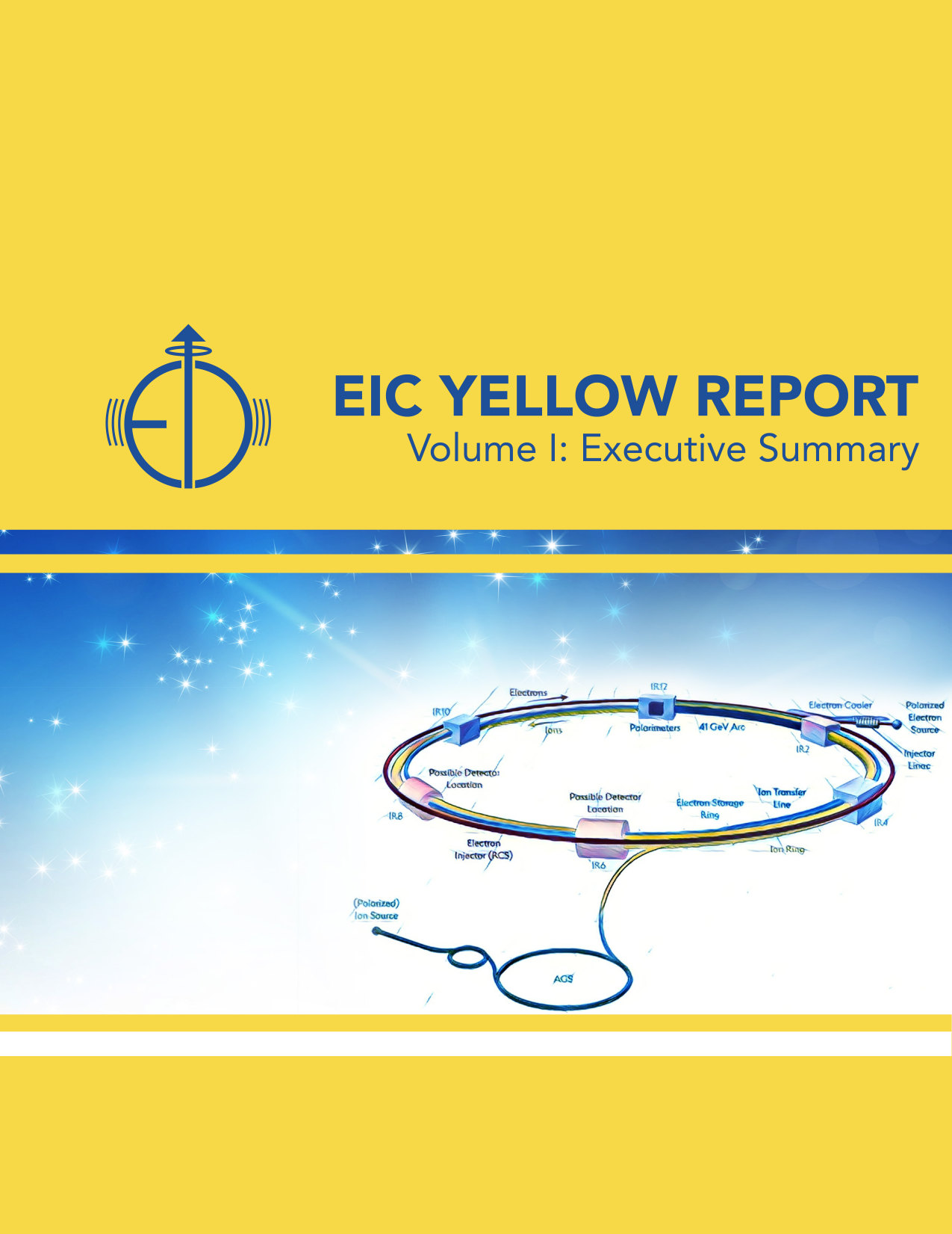
Relevance of AI for EIC highlighted in Yellow Report

Slide 21
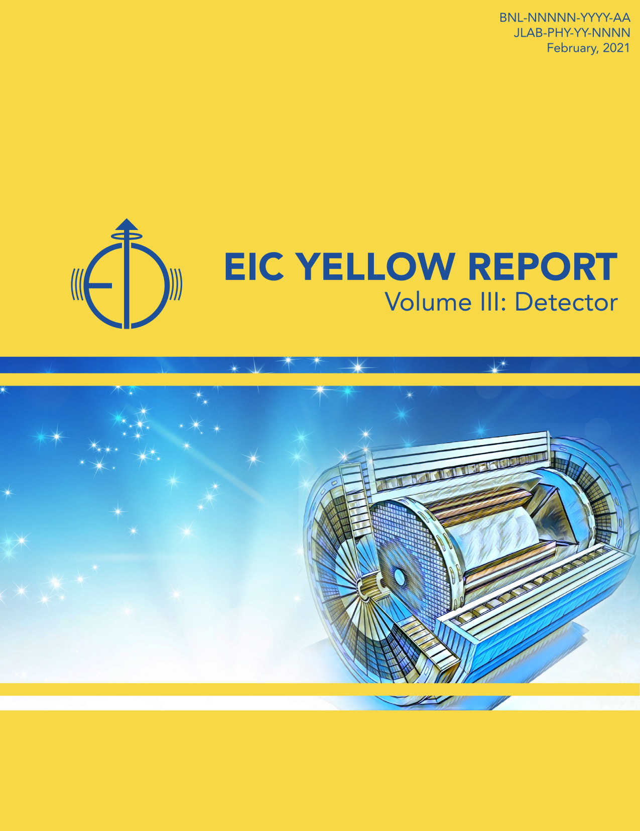
Relevance of AI for EIC highlighted in Yellow Report

Slide 22
Beyond the Yellow Report – Project eAST
From recent presentation on Project eAST at annual EICUGM:
https://indico.bnl.gov/event/11463/contributions/52574/attachments/36398/59805/2021-08-05%20Project%20eAST.pdf

Slide 23
Beyond the Yellow Report - continued
Why is this relevant for this AI4EIC workshop?
We definitely plan to continue this work to be able to fully include AI/ML in simulations and both raw and high-level data analysis

Slide 24
Experimental Program Preparation
Call for Collaboration Proposals for Detectors launched after extensively soliciting input from DOE and EIC User community
Jointly developed between EIC Project, JLab and BNL
BNL and TJNAF Jointly Leading Process to Select Project Detector | BNL and TJNAF Jointly Leading Process to Select Project Detector
2020 | Call for Expressions of Interest (EOI) https://www.bnl.gov/eic/EOI.php | May 2020
 | EOI Responses Submitted | November 2020
 | Assessment of EOI Responses | Finalized
2021 | Call for Collaboration Proposals for Detectors https://www.bnl.gov/eic/CFC.php | March 2021
 | BNL/TJNAF Proposal Evaluation Committee | Spring 2021
 | Collaboration Proposals for Detectors Submitted | December 2021
✔️ | Decision on Project Detector | March 2022

Slide 25
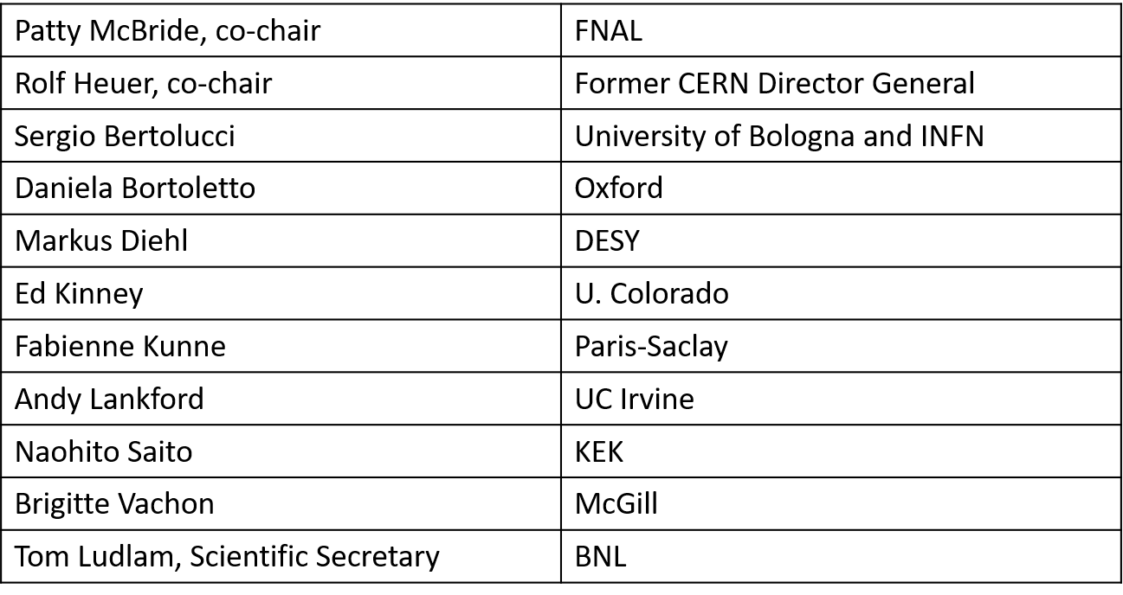
Proposal Advisory Panel established
(Note: protocollaborations should not engage in unsolicited communication with the Panel)
Working with Advisory Panel Chairs, with project Detector Advisory Committee chair for DAC input/evaluation, with BNL, JLab and EIC Project through review process

Slide 26
EIC Proto-Collaborations at a Snapshot
ECCE (https://www.ecce-eic.org)
  A detector based on an existing 1.5T solenoid in either EIC interaction region
  Contacts: Or Hen (MIT), Tanja Horn (CUA), John Lajoie (Iowa State)
  ~80 collaborating institutions
  Includes institutions from Armenia, Canada, Chile, China, Croatia, Czech, France, Germany, Israel, Japan, Korea, Russia, Senegal, Slovenia, Taiwan, UK
ATHENA (https://sites.temple.edu/eicatip6/)
  An EIC experiment at IP6 based on a new 3 T magnet and the YR Reference Detector
  Coordinating Committee: Abhay Deshpande (BNL/SBU), Silvia Dalla Torre (INFN Trieste), Olga Evdokimov (UIC), Yulia Furletova (JLab), Barbara Jacak (LBL/UCB), Alexander Kiselev (BNL), Franck Sabatie (Saclay), Bernd Surrow (Temple)
  ~100 collaborating institutions
  Includes institutions from Armenia, Canada, China, Czech, France, Italy, India, Poland, Rumania, UK
CORE (https://eic.jlab.org/core/)
  An EIC Detector proposal based on a new 2-2.5 T compact magnet at IP8
  Contacts: Charles Hyde (ODU) and Pawel Nadel-Turonski (SBU)
  Smaller-scale effort, ~20-30 active collaborators

Slide 27
Summary
The EIC is making excellent progress
  BNL/JLab partnership project
  CD-1 approved!
  Path to CD-2/3A defined
  Increasing engagement of potential in-kind partners
The EIC User Community is strongly engaged in all parts of the EIC experimental program
  The Yellow Report was finalized: https://arxiv.org/abs/2103.05419
  Generic detector R&D program; and Project detector R&D phase started
  Next step: Detector Proposals, see https://www.bnl.gov/eic/CFC.php
Critical to have excellent detector proposals with science and technology complementarity integrated.
  Time to engage is now.
AI is becoming ubiquitous in Nuclear and Particle Physics
  Logical development if one folds in complexities of relativistic, quantum-mechanical, strongly interacting many-body system where data will always be sparse and limited.
  Time to engage in AI for EIC is now, from material and detector design and optimization, to large-scale simulations, to embedding AI in streaming readout and software, to including AI in high-level physics data analysis and visualizations.

Slide 28
Backup

Slide 29
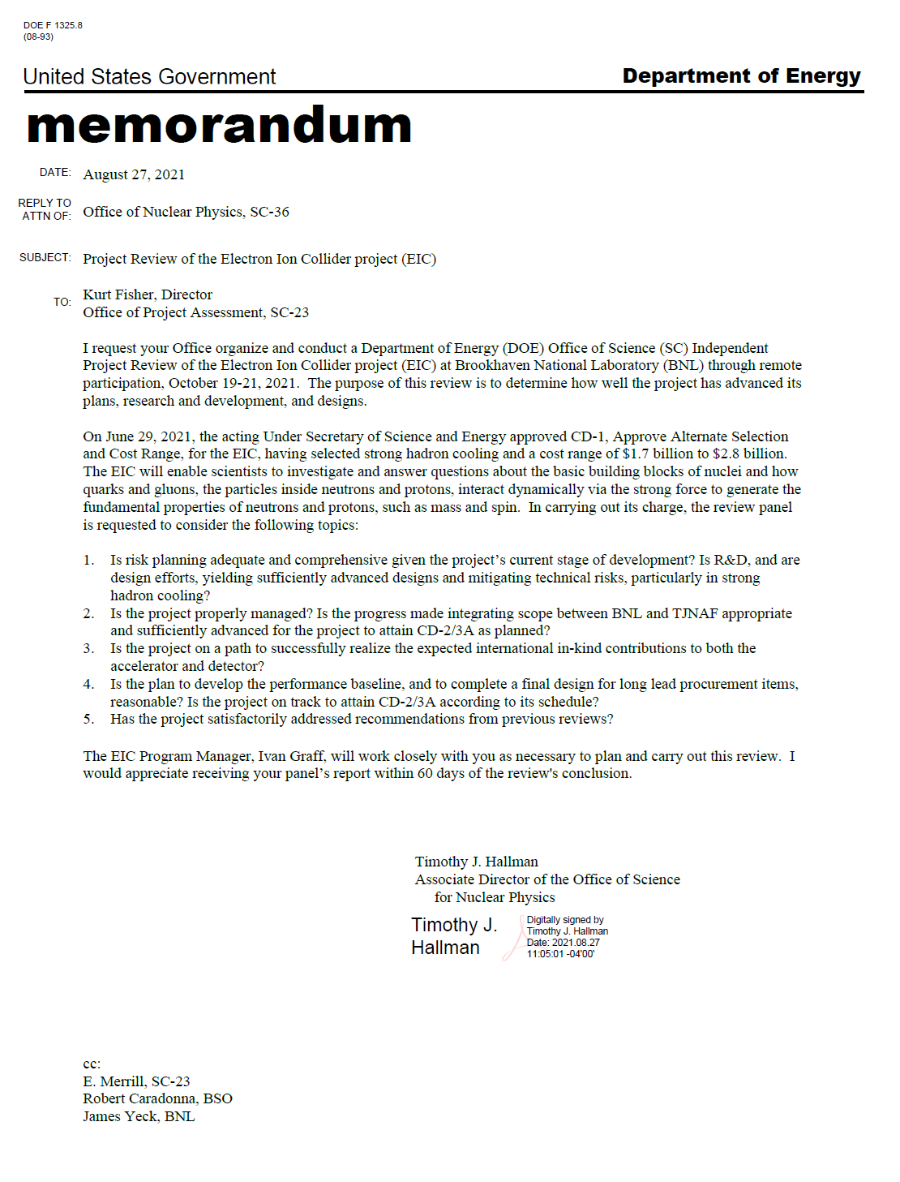
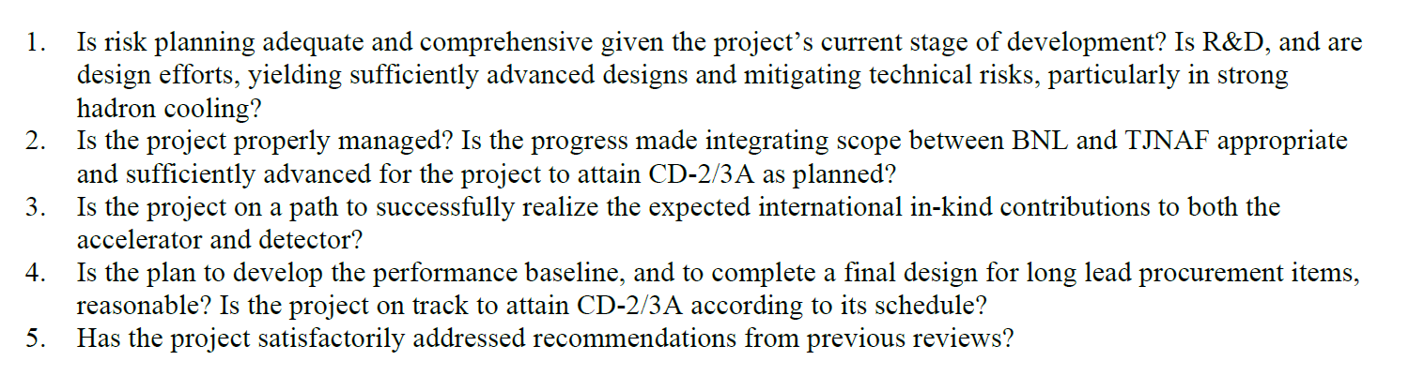
October 2021 DOE Review Charge

Slide 30
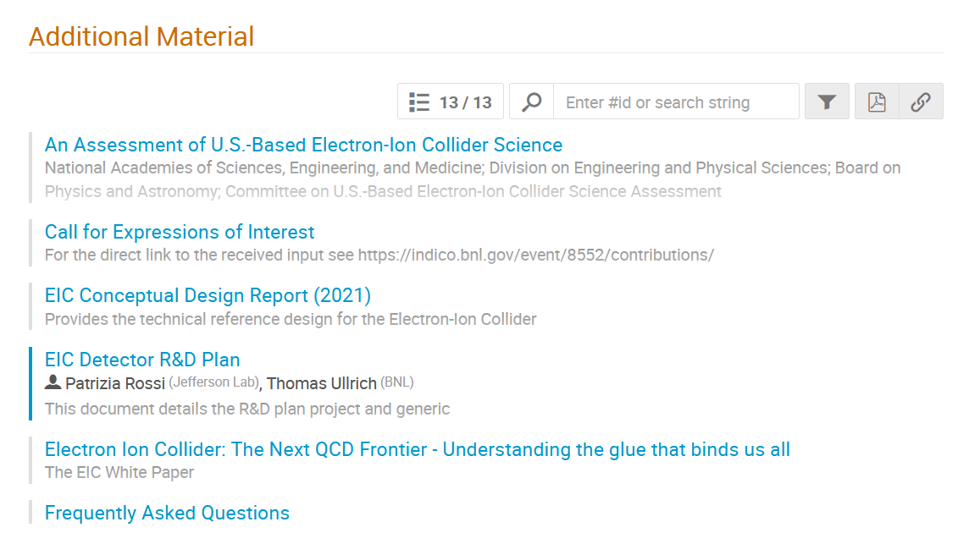
Experimental Program Preparation
Pay attention to the huge amount of useful information to help all in the Collaboration Proposal for Detectors submission: https://indico.bnl.gov/event/10974/contributions/

Slide 31
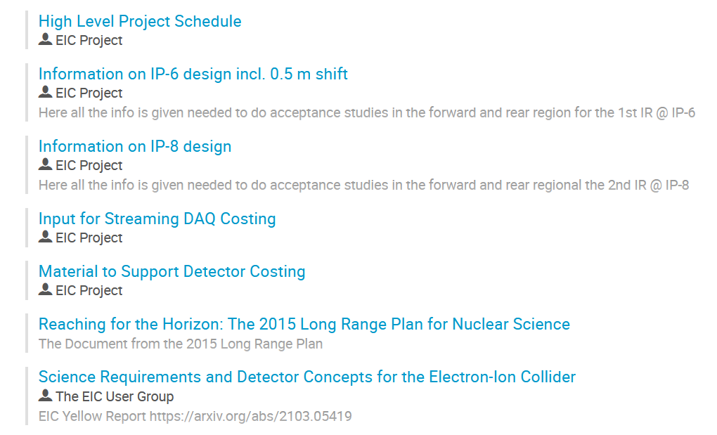
Experimental Program Preparation

Slide 32
Excellent Progress
CD-1 Approved!
TJ/BNL Scope Integration Completed
  L2 WBS Managers and their teams working through the details
Successfully navigated within FY2021 financial constraints
New York Empire State Development Corporation Approved $100M Investment
  Working through details
Accelerator Technical Reviews Underway
Call for Collaboration Proposals for EIC Detectors issued in March 2021 and responses due December 1
Increasing Engagement of Potential In-kind Partners
  Accelerator Workshop in October Hosted by TRIUMF
  International Detector Collaborations Forming

