Slide 1

EIC Detector Overview
Douglas Higinbotham (Jefferson Lab)

Slide 2
Science Drives Both the Accelerator and Detector Requirements
Key science questions that the EIC will address are:
• How do the nucleonic properties such as mass and spin emerge from partons and their underlying interactions?
• How are partons inside the nucleon distributed in both momentum and position space?
• How do color-charged quarks and gluons, and jets, interact with a nuclear medium? How do the confined hadronic states emerge from these quarks and gluons? How do the quark-gluon interactions create nuclear binding?
• How does a dense nuclear environment affect the dynamics of quarks and gluons, their correlations, and their interactions? What happens to the gluon density in nuclei? Does it saturate at high energy, giving rise to gluonic matter or a gluonic phase with universal properties in all nuclei and even in nucleons?

Slide 3
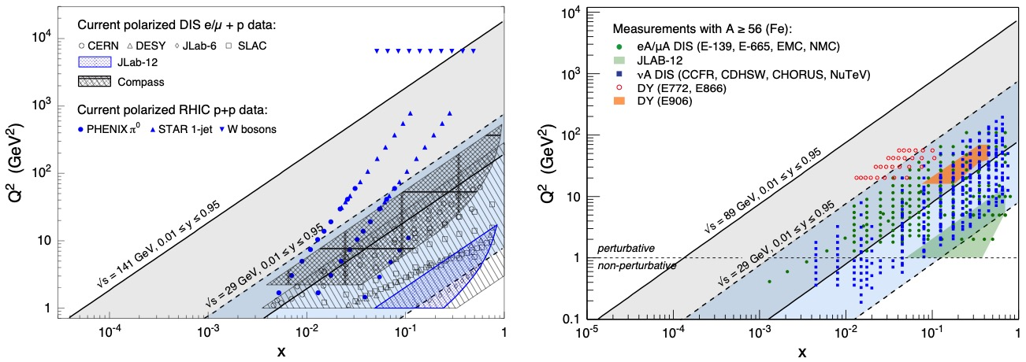
Kinematic Coverage Of The Electron Ion Collider
Q² is the Lorentz invariant four-momentum transfer and x = Q²/(2m(E-E’))
NOTE: The fixed target Jefferson Lab facility can achieve very high luminosity >10³⁸ cm⁻²s⁻¹ while the proposed EIC will be ~10³³ to 10³⁴ cm⁻²s⁻¹ so kinematic coverage alone isn’t the whole story especially at high x_{B} and high Q².

Slide 4
Deep Inelastic Electron Scattering
Inclusive DIS
Semi-Inclusive DIS
Exclusive DIS
Shown neutral current events, but can also measure charge current without the scattered
Electron on must use the other final-state particles to determine the reaction.
Requires Tracking, Particle Identification and Calorimetry (plus electronics & read-out).

Slide 5
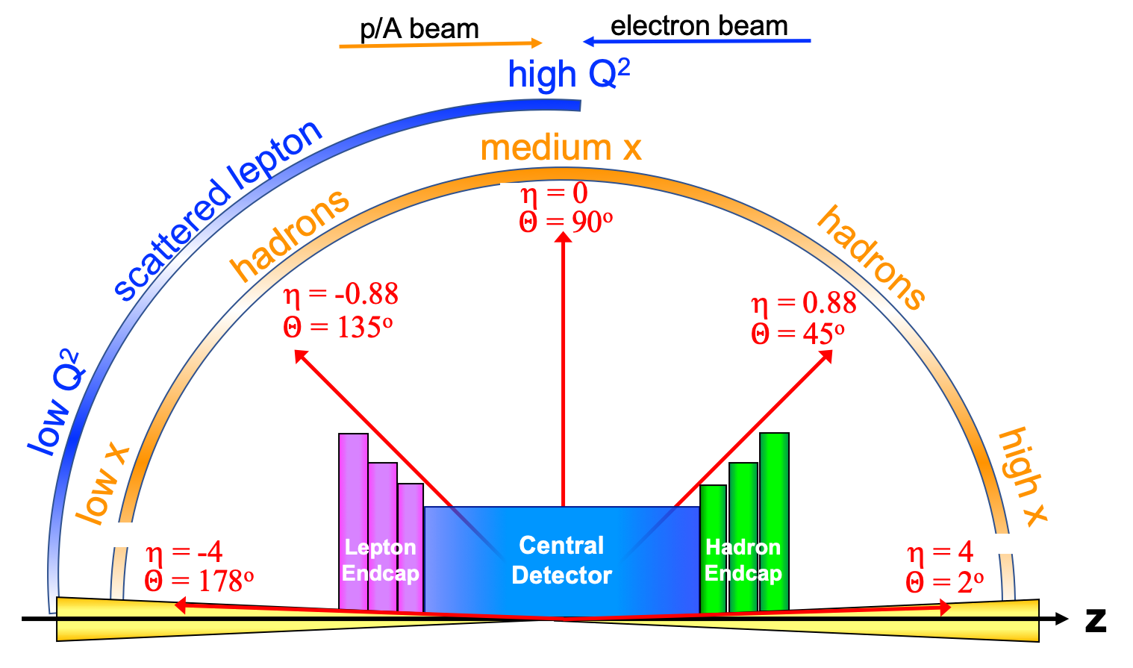
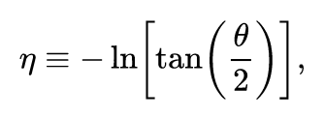
Detector polar angle / pseudo-rapidity coverage

Slide 6
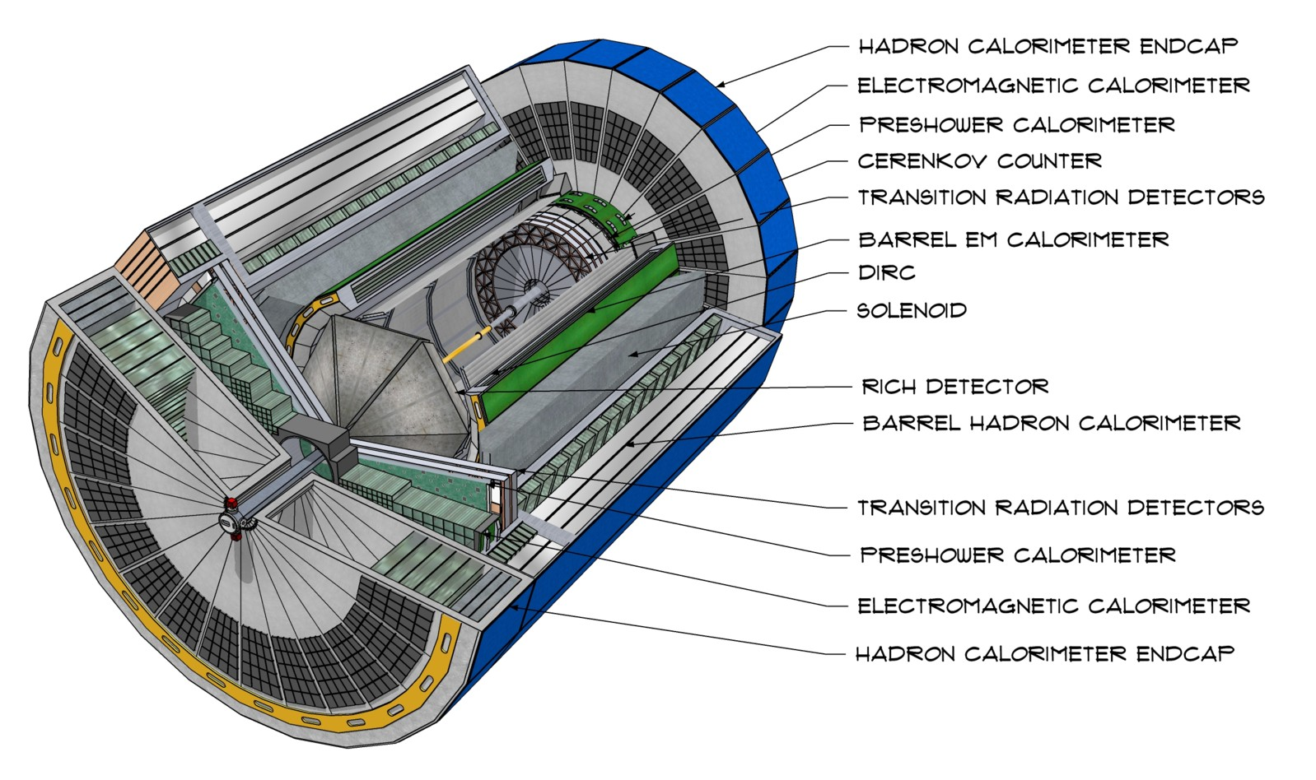
CAD Model of Generic EIC Detector
https://arxiv.org/abs/2103.05419

Slide 7
Call for Detector Collaboration Proposals
Due 1 December 2021
Detector 1 Collaboration Proposals: Experiments must address the EIC White Paper and NAS Report science case. The collaboration should propose a system that meets the performance requirements described in the EIC CDR and EICUG YR. The design should be compatible with that of the accelerator and interaction region layout of the CDR. Completion of detector construction must be achieved by Critical Decision (CD)-4A, the start of EIC accelerator operations.
Detector 2 Collaboration Proposals: Experiments should address science goals described in the EIC White Paper and possibly science beyond that and enable some complementarity to Detector 1. The Detector 2 interaction region design should be consistent with the accelerator design as detailed in the CDR, with perhaps some interaction region optimization. The detector design should allow for an estimated construction schedule compatible with achieving detector completion by CD-4 (which follows CD-4A). Note: Currently, the EIC project scope does not include the construction of Detector 2 or the accelerator components needed for the second interaction region.

Slide 8
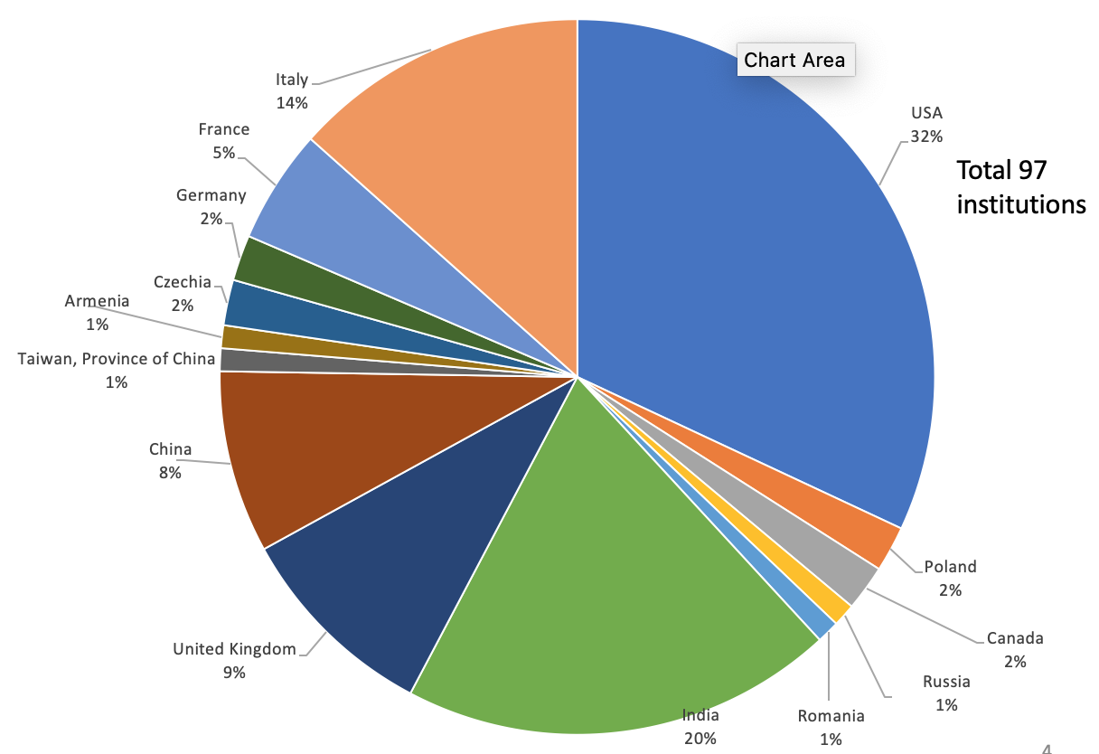
http://athena-eic.org
Kick-off meeting : 12-13 March
IP6 – Detector 1
New 3 T magnet
New state-of-art detectors
New future-oriented simulation and reconstruction software framework ( similar to one used for HL-LHC )
Bi-weekly meeting 11am EDT on Thursday
Monthly 8pm EDT on Thr mainly for Asia colleagues.
Regular meetings with EIC project team
Charter and Membership policy - done
Currently steered by org group:
Detector and Physics WGs,
Proposal Committee ( Integration, Draft, Cost)
Election committee (SP election – September)
IB chair: Ernst Sichtermann

Slide 9
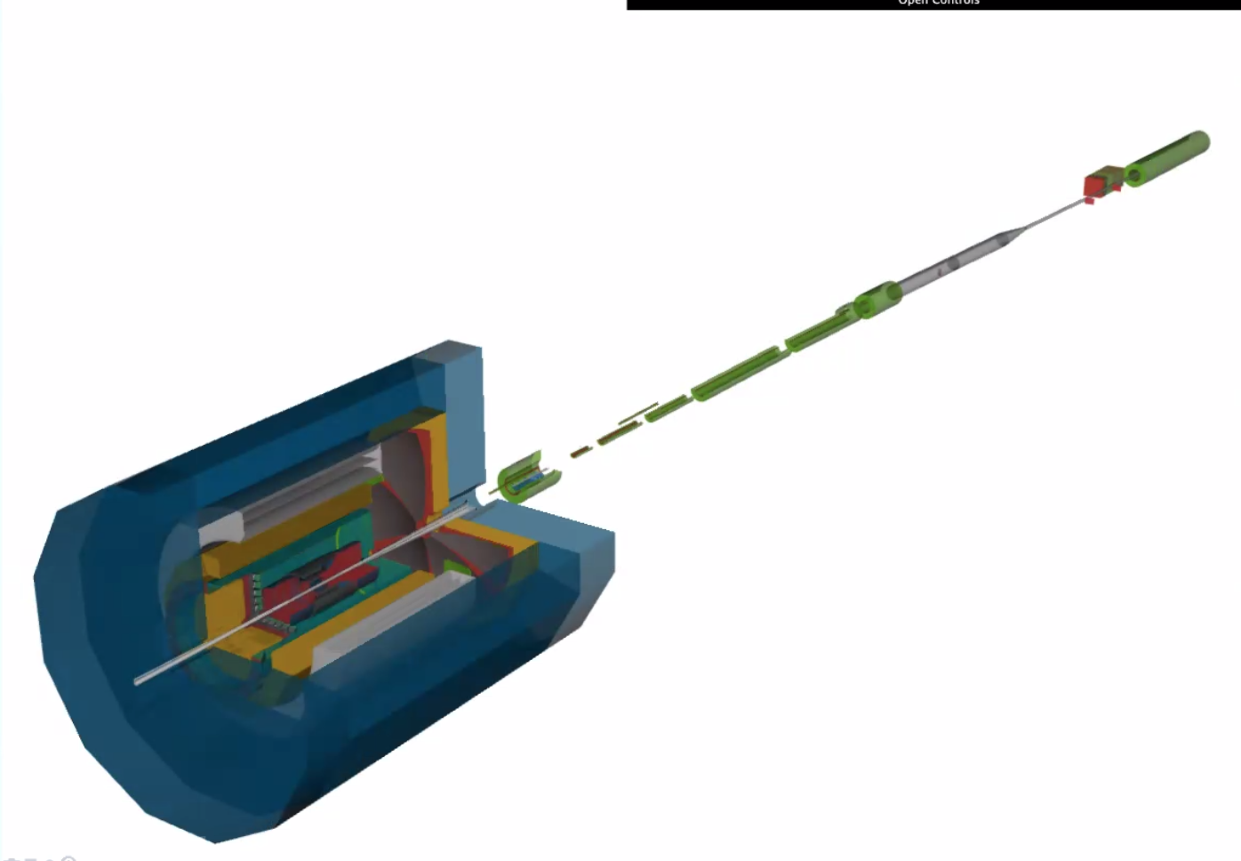
ATHENA configuration
Full detector assembly ( default configuration) including services and beampipe - completed (including support structures and overlaps)
MC production started yesterday: files are on S3.
https://dtn01.sdcc.bnl.gov:9000/minio/eictest/ATHENA/
Cost and Schedule : in the progress - of collecting info and quotes.
Baseline configuration:
Barrel :
Solenoid, All-Silicon Tracker (no MPGD) + HP-DIRC, EMCAL + HCAL (Fe/Sc)
Hadron -going direction :
Si-Disks + GEM Layer + dRICH + EMCAL(Wpowder/ScFi) + HCAL (Fe/Sc) + B0(MAPS) + Off-Momentum + Roman Pots(AC-LGAD) + ZDC
Electron going direction:
Si-Disks + GEM Layer + mRICH + iEMCAL(PbWO4) + oEMCAL + HCAL (Fe/Sc) + Low-Q2 Tagger

Slide 10
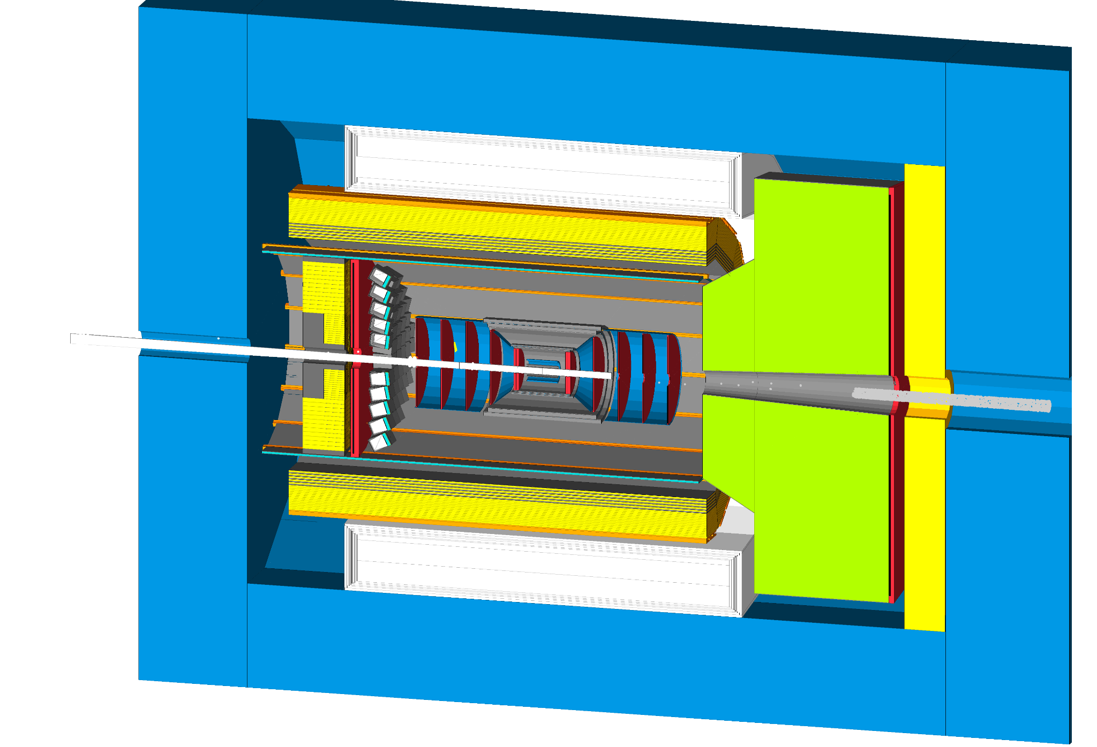
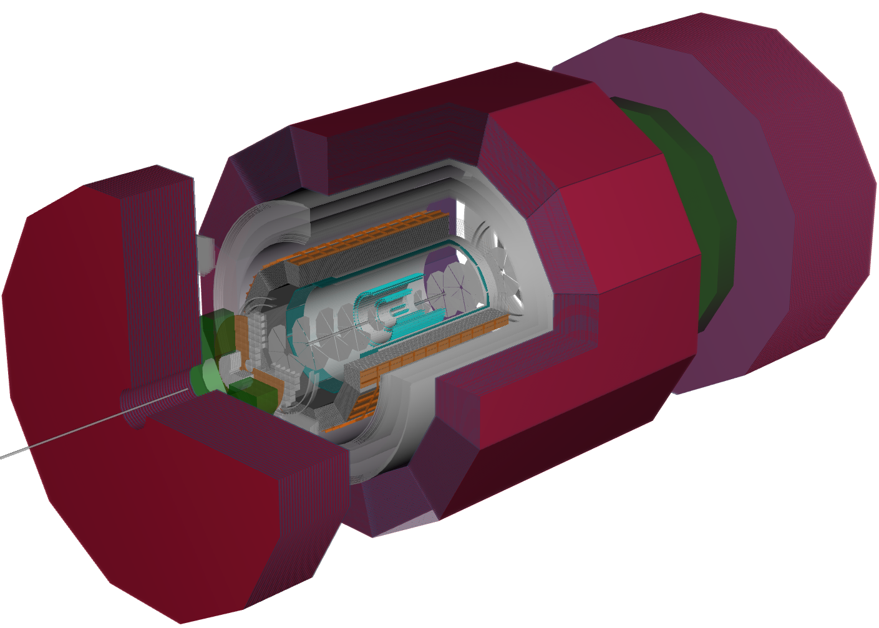
Software Philosophy:
Let’s prepare for our future at the EIC
Build forward-looking team of software developers to ensure the long-term (decades) success of the EIC scientific program.
Focus on modern scientific computing practices
  Strong emphasis on modular, orthogonal tools
  Integrate with high performance computer, continuous integration workflows, and enable use of data-science toolkits
Software on top of mature, well-supported, and actively developed software stack.
Actively work with the EICUG software group to help develop and integrate new community tools.
Slide from Dmitry Romanov

Slide 11





Oversimplified software stack
MCEG: Monte Carlo Event Generators
DD4hep: Geant4, geometry, detector
Juggler: Digitization + reconstruction (Gaudi, Podio, ACTS for tracking)
Gaudi: Processing framework
ACTS: Experiment-independent tracking toolkit (ACTS’ geometry constructed from DD4hep via plugin)
Podio: Robust data model definition
MCEG
Automated
Tests,
Benchmarks
Validation
DD4Hep,
Geometry,
Geant4 (DDSim)
Juggler,
Gaudi - processing
ACTS - tracking,
Tensorflow - ML
Custom reco algorithms
Analysis/Benchmarks
Slide from Dmitry Romanov

Slide 12
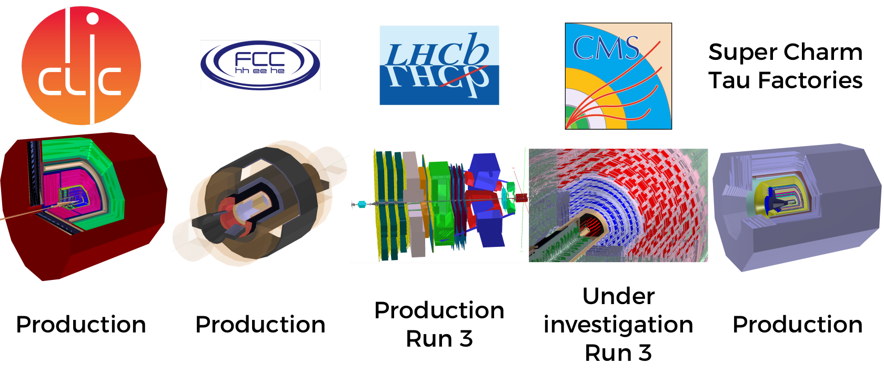
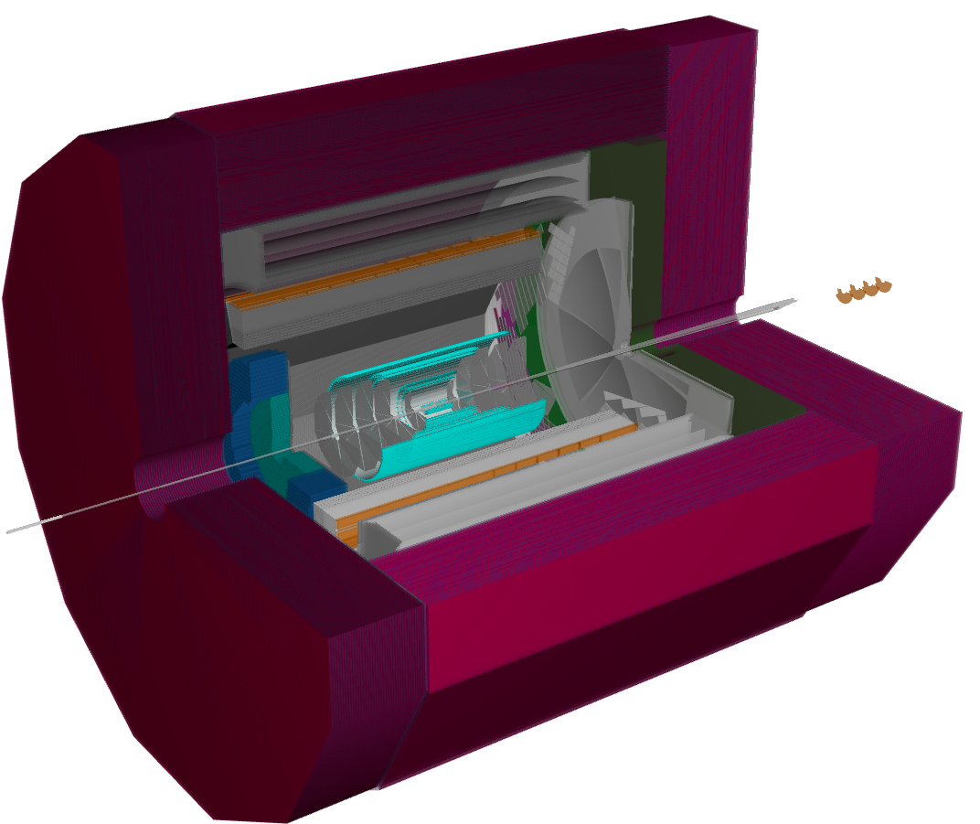






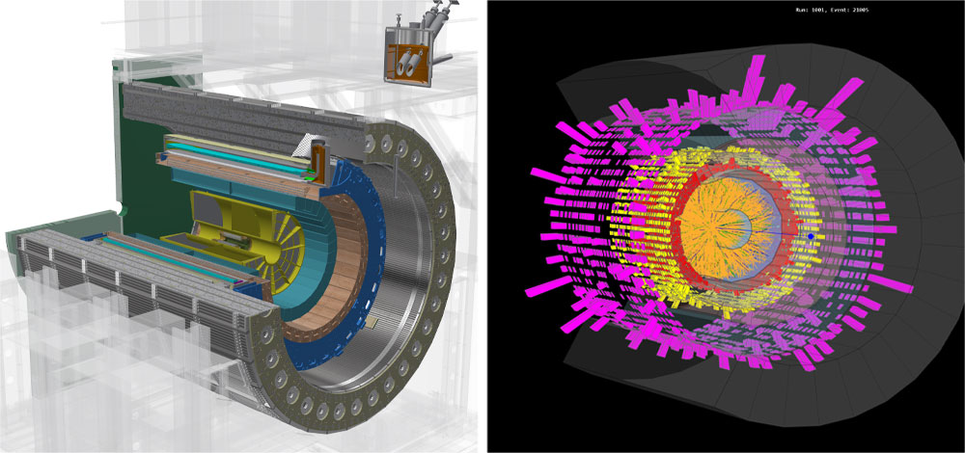
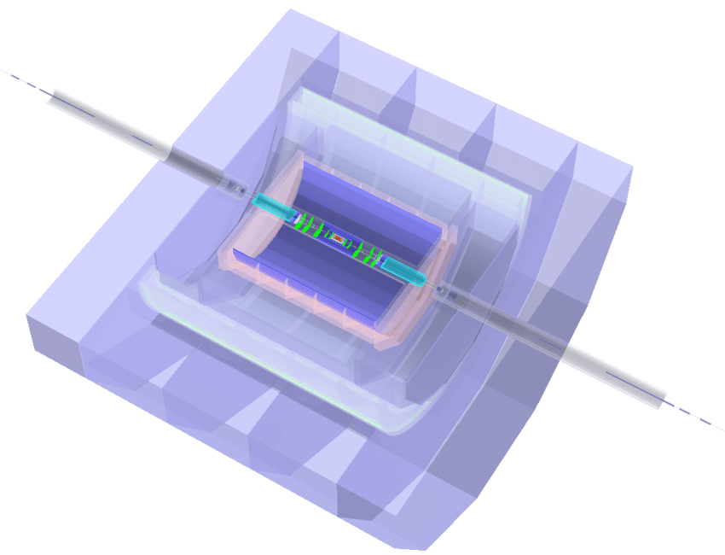
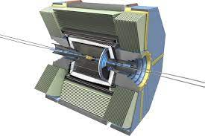
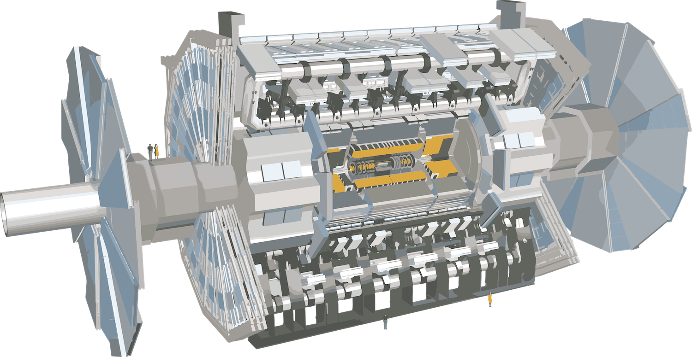
Software component community
Gaudi
Slide from Dmitry Romanov

Slide 13
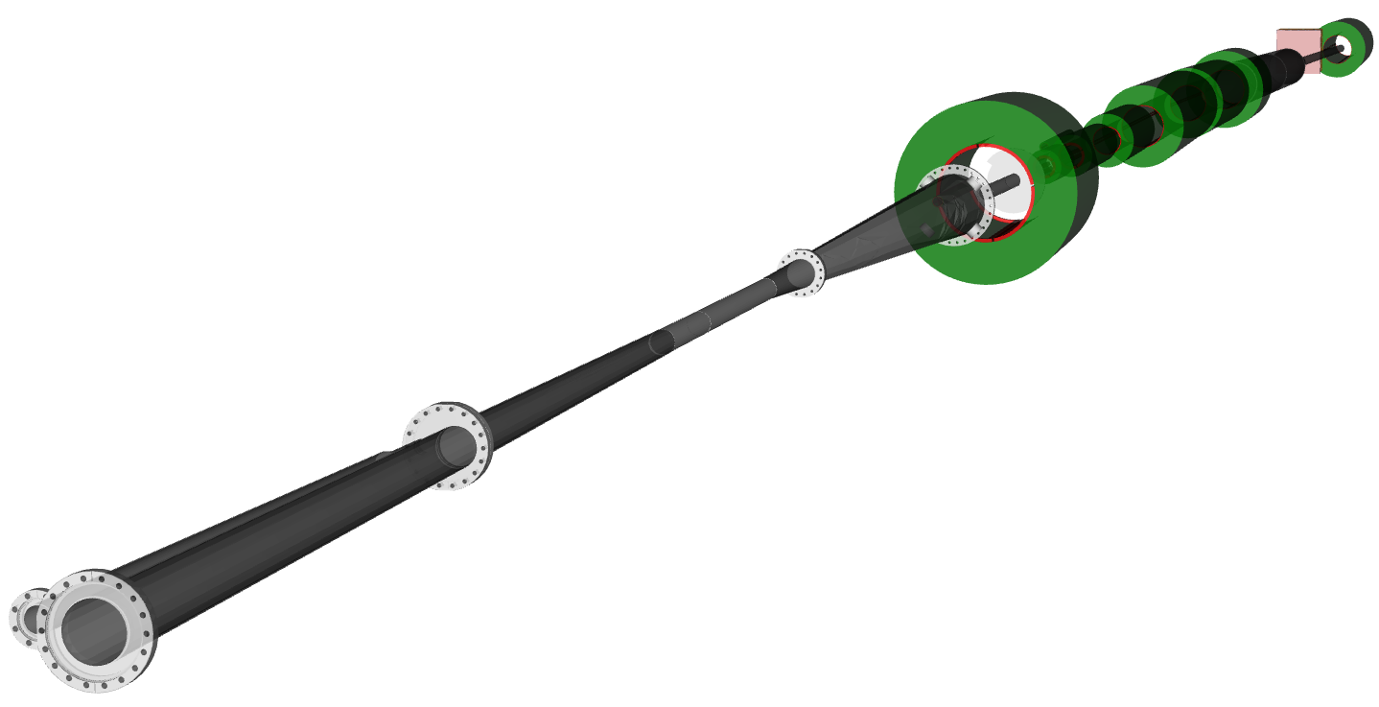
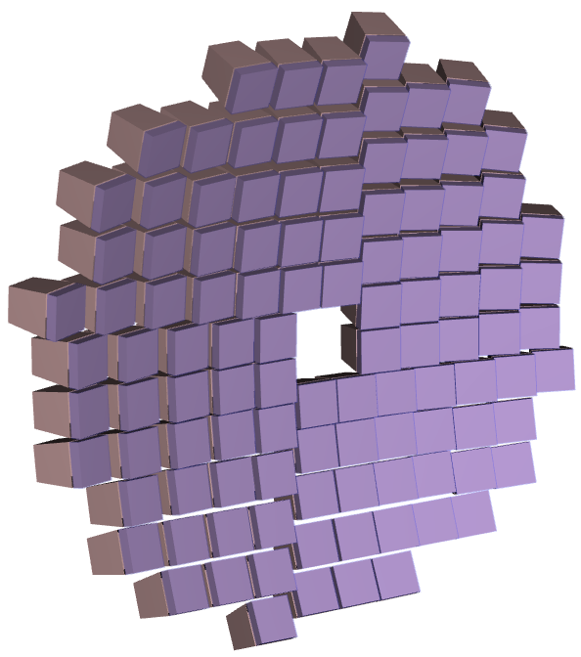
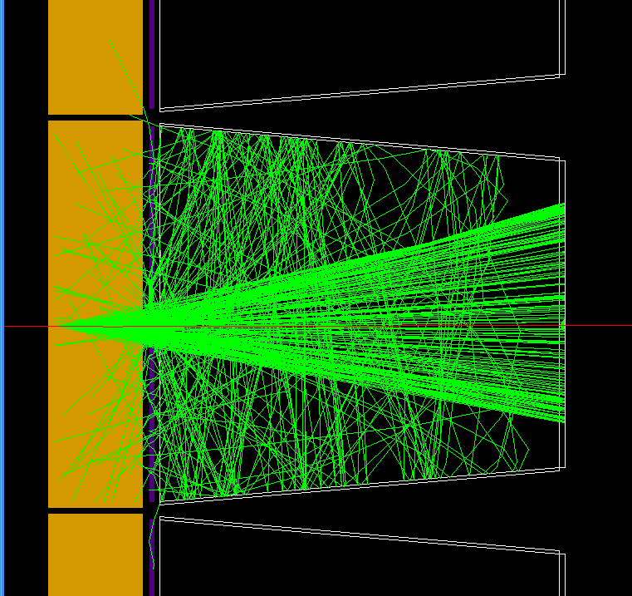
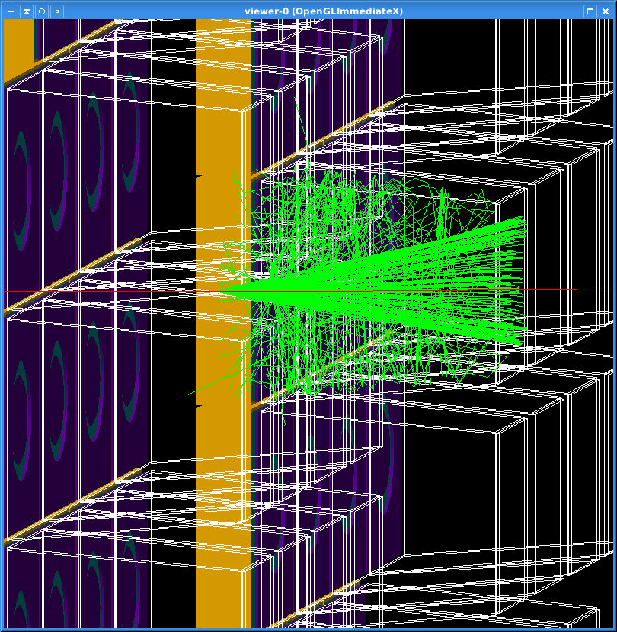
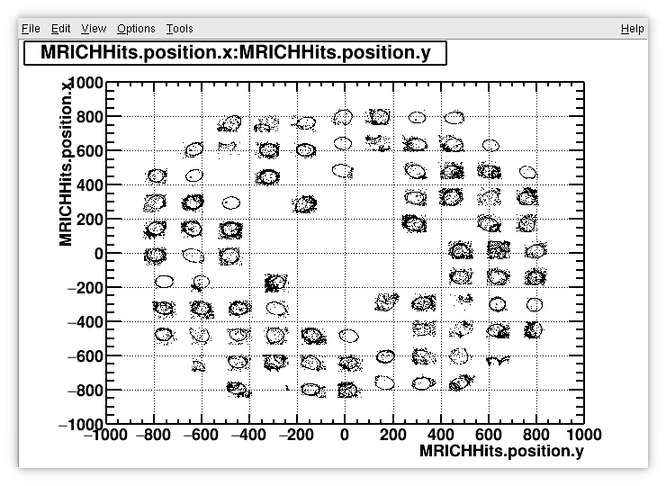
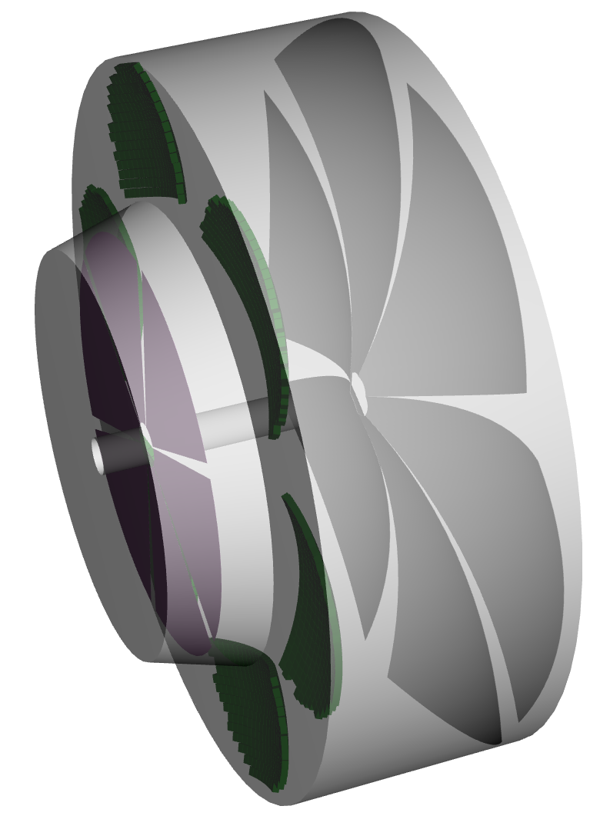
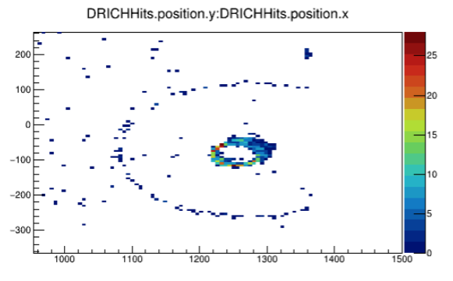
Detailed geometry implementation
FF region including B0 tracker, OMD, RPs, ZDC and realistic beampipe
Modular RICH
Central beampipe from CAD
Dual RICH + rings reco
Documentation portal: doc.athena-eic.org
Slide from Dmitry Romanov
Full simulation tutorials

Slide 14
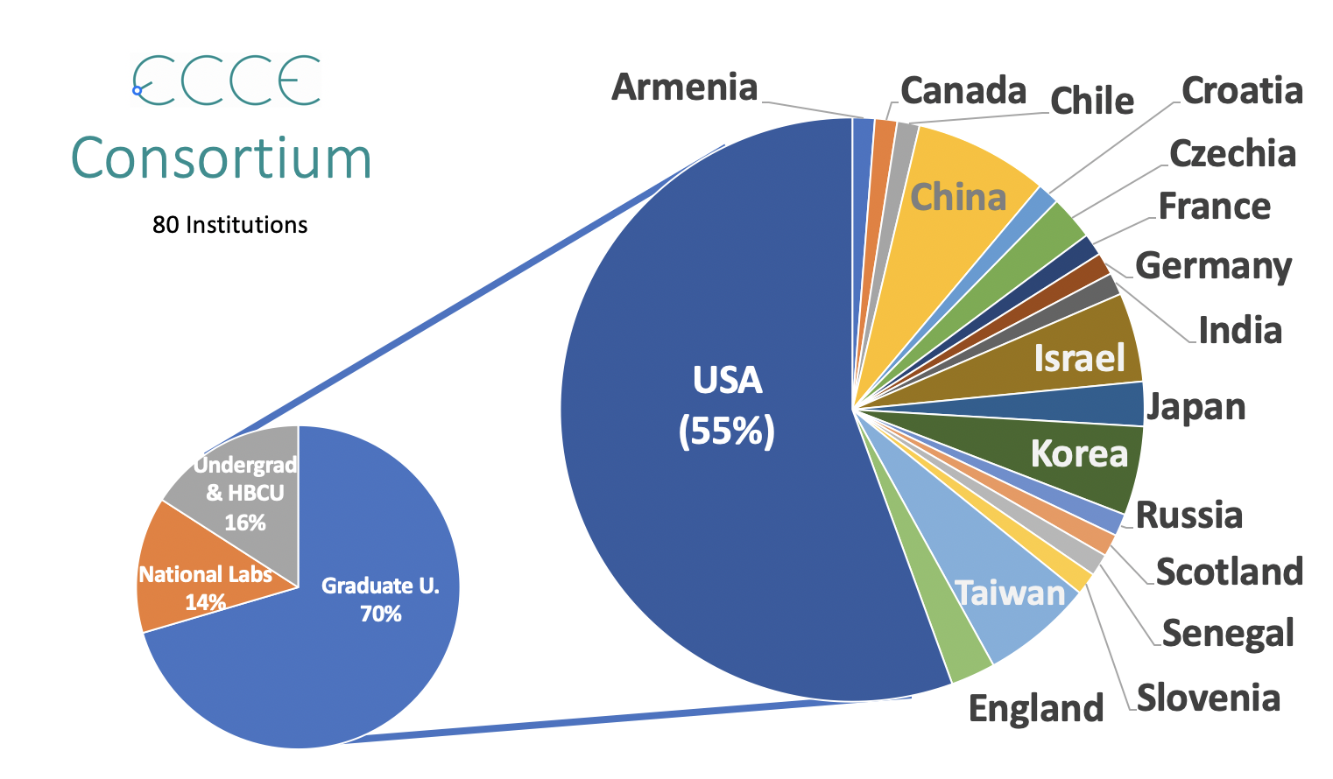
There are some overlaps with Athena, but also many different groups and different
groups willing to make in-kind contributions (note Italy not part of ECCE)

Slide 15
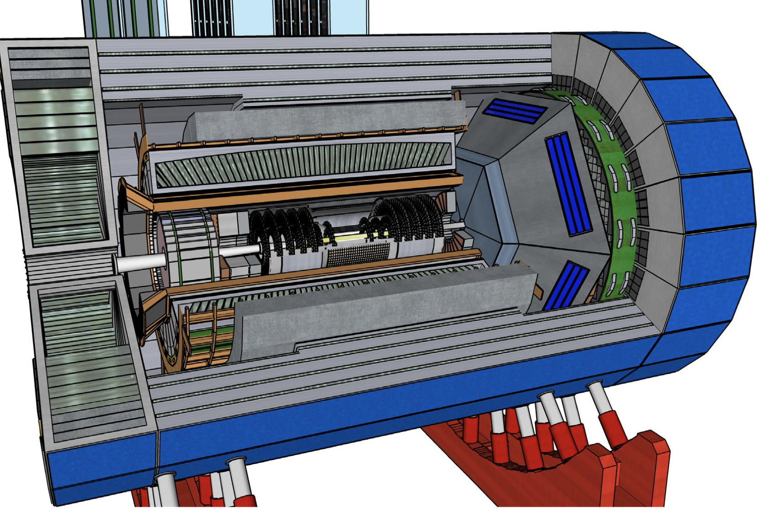
ECCE Detector with 1.4 T BaBar magnet
Upcoming High current tests and Performance will be Monitored for sPHENIX
ELECTRON ENDCAP
Tracking: Large area μRWELL
Electron Detection:
  Inner: PbWO4 crystals (reuse some)
  Outer: SciGlass
h-PID: mRICH & AC-LGAD
HCAL: Fe/Sc (STAR re-use)
CENTRAL BARREL
Tracking: Silicon (design being AI optimized)
Electron PID: SciGlass
h-PID: hpDIRC & AC-LGAD
HCAL: Fe/Sc (sPHENIX re-use)
HADRON ENDCAP
Tracking: Large area μRWELL
PID: dual-RICH & AC-LGAD
Calorimetry: standard Pb/ScFi shashlik (PHENIX re-use)
(other options under study)
Using Fun4All (well known to sPHENIX team) and has completed 1st simulation campaign with a 2nd starting this week.
Extensive work with AI optimization especially of the tracking detectors.

Slide 16
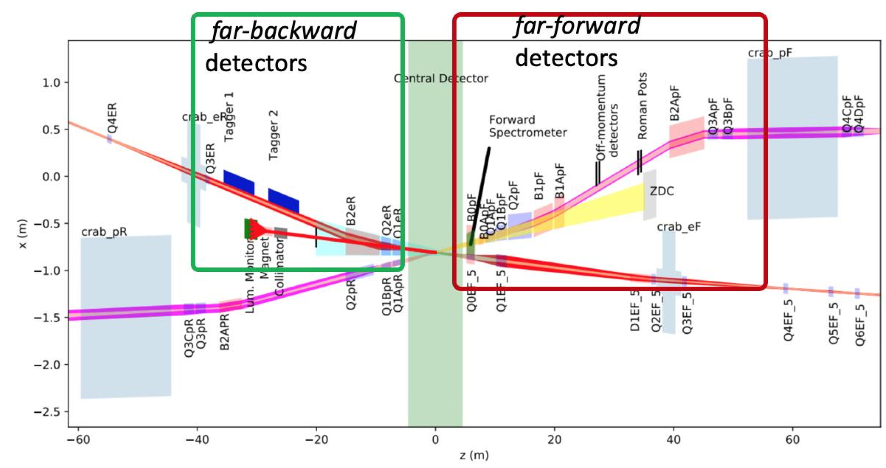
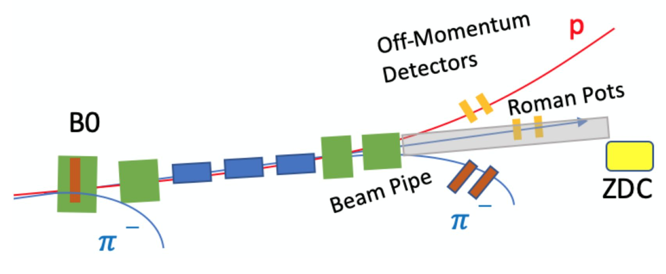
ECCE Far Forward/Backward
Detector | Proposed Technology | Interested groups
Zero-Degree Calorimeter (ZDC) | Combined function EMCal+HCAL based on ALICE FoCal* | EIC-Japan, Kansas U.
Roman Pots | AC-LGADs | IJC-Orsay, Rice U., LGAD consortium, …
Off-Momentum Detectors | AC-LGAD | LGAD consortium, …
B0 Spectrometer | Fine granularity silicon for tracking (MAPS or similar); silicon preshower, compact EMCal | LANL on the silicon sensors, …., PWO crystals may be available
Low Q2 Tagger | EMCal, Timepix telescope | U. Glasgow
IP6 Beamline implemented in Geant4 with proper coordinate system and the 0.5m shift (detector space from -4.5 to 5.0m)
ECCE and Athena have similar designs in these regions.

Slide 17
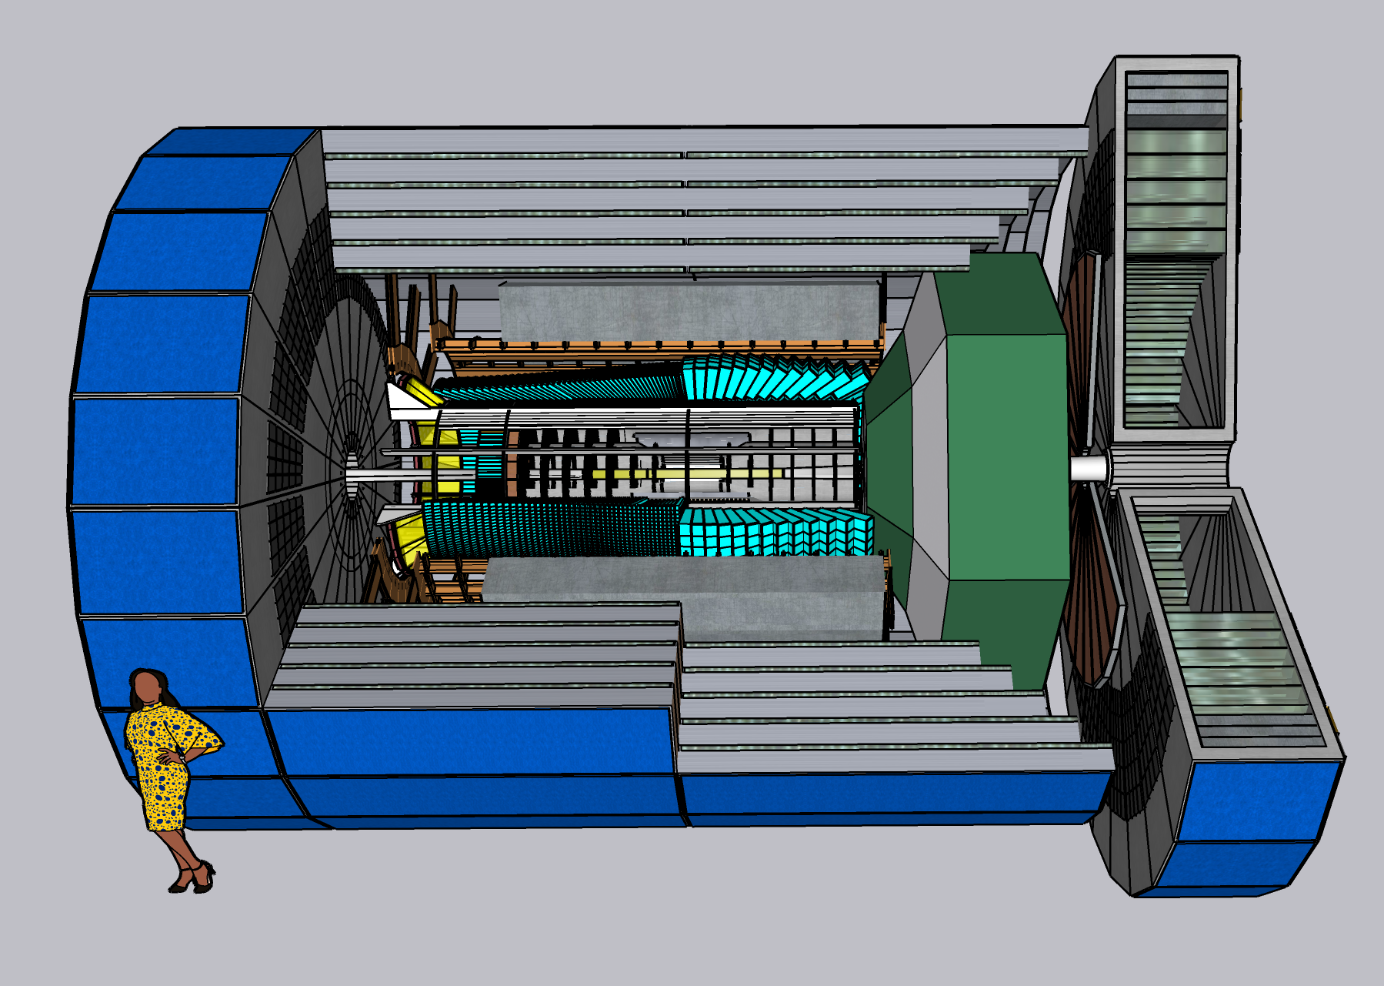
CORE: a COmpact detectoR for the EIC
proposed as a detector 2 for IP8
https://eic.jlab.org/core
Catholic University of America (CUA)
Duke University (Duke)
GSI Helmholtz Centre for Heavy Ion Research, Germany
Erlangen-Nuremberg University, Germany (GAU)
Hampton University (HU)
Indiana University (IU)
Jefferson Lab (JLab)
Kansas University (KU)
Oak Ridge National Lab (ORNL)
Old Dominion University (ODU)
Penn State University (PSU)
Stony Brook University (SBU)
University of the Basque Country (UPV/EHU), Spain
University of Connecticut (UConn)
University of Hawaii (UH)
University of South Carolina (USC)
University of York, U.K.

Slide 18
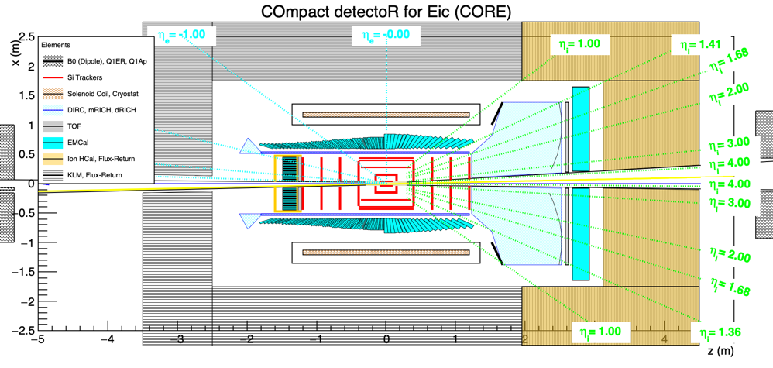
CORE systems
New 3 T solenoid (2.5 m long, 1 m inner radius)
Tracking: central all-Si tracker (eRD25) and h-endcap GEM tracker (eRD6)
EMcal (eRD1): PWO for η < 0 and W-Shashlyk for η > 0
Cherenkov PID (eRD14): DIRC (50 cm radius) in barrel and dual-radiator RICH in h-endcap
TOF: LGADs in e-endcap (eRD29) and a simple TOF behind the dRICH
Hcal / K_{L}-μ (KLM) detector integrated with the magnetic flux return

Slide 19
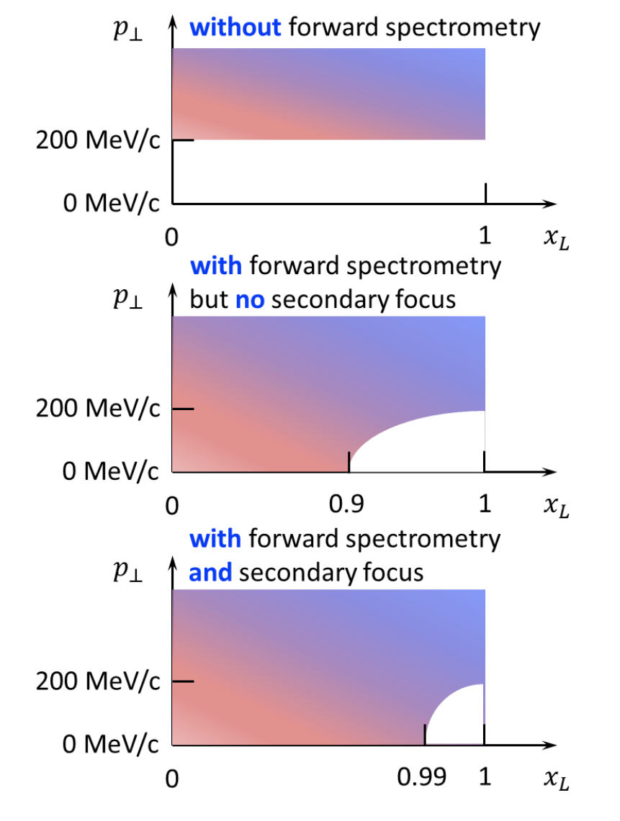
IP8 Planned Secondary Focus
https://arxiv.org/abs/2105.13564
Protons with a small longitudinal momentum loss (large 𝑥_{𝐿}) where 𝑥_{𝐿} = 𝑝′_{𝐿}/𝑝_{beam}
𝑝_{𝑇} is the hadron transverse momentum
Critically important for Nuclear Diffractive Processes
Also allows reactions like DVCS to be done with one tune instead of two
Shown for 275 GeV protons

Slide 20
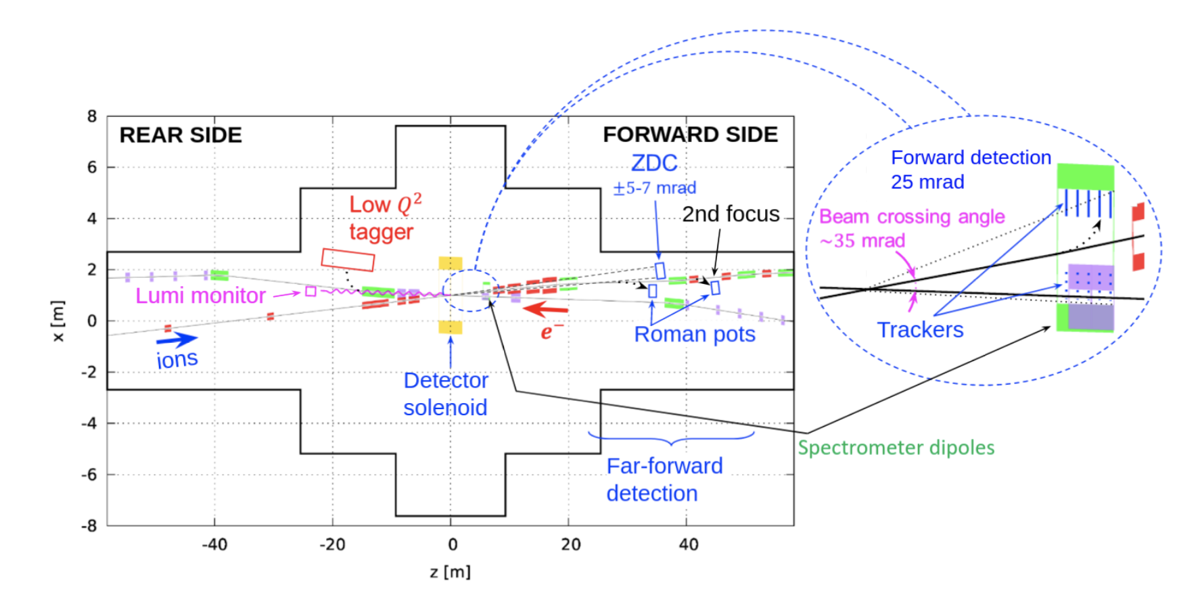
IP8 Planned Secondary Focus
https://arxiv.org/abs/2105.13564

Slide 21
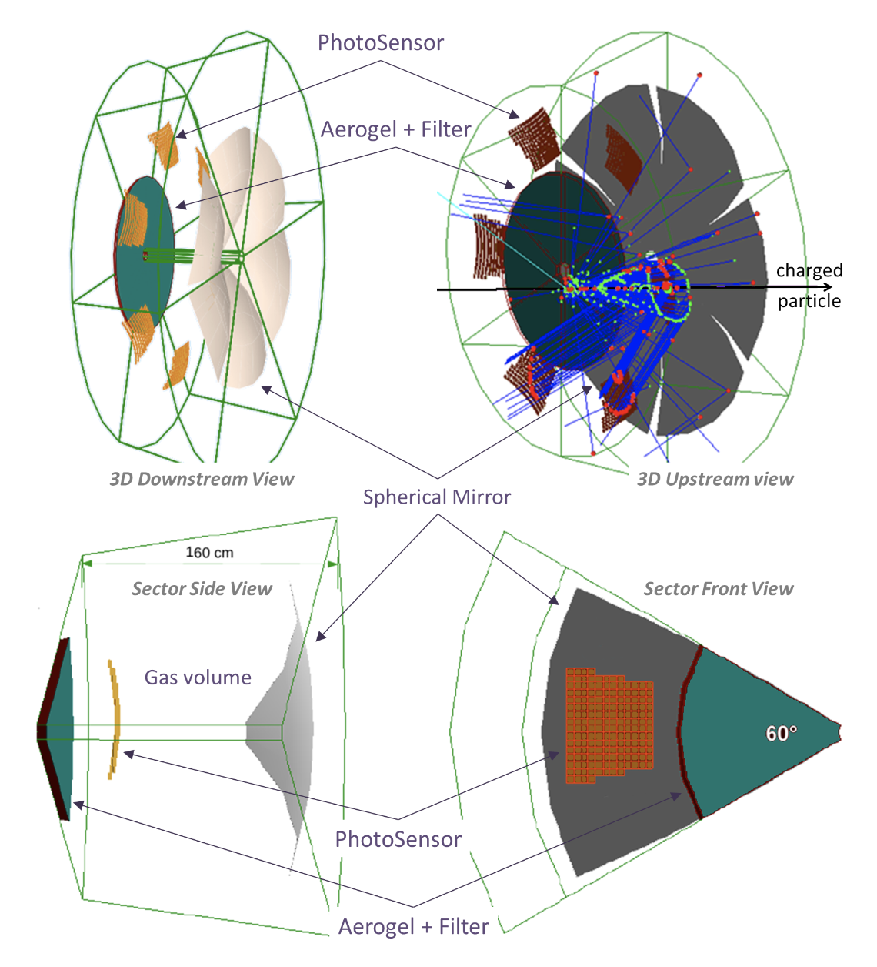
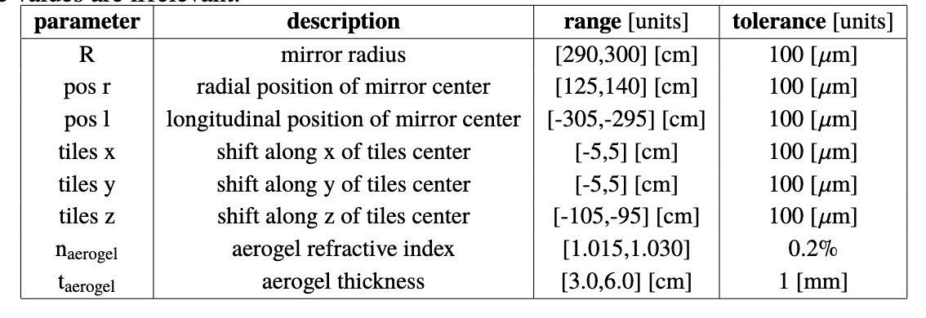
Bayesian Optimization of EIC Dual Rich
https://doi.org/10.1088/1748-0221/15/05/P05009
Eight parameters that were optimized along
With the very important tolerance parameters
to prevent irrelevant over determination of
values.
These ideas are being used by the
proto-collaborations with tracking being especially exciting though perhaps most exciting the holistic AI detector optimizations.

Slide 22
Project Research & Development
• Project supported research (nothing to do with generic R&D program) and are not collaboration specific:
  -eRD101 mRICH
  -eRD102 dRICH
  -eRD103 hpDIRC
  -eRD104 Silicon Service reduction
  -eRD105 SciGlass
  -eRD106 Forward EMCAL
  -eRD107 Forward HCAL
  -eRD108 Cylindrical MPGD
  -eRD110 Photosensors
  -eRD111 Si-Vertex (excl. sensors)
  -eRD112 AC-LGAD
•These projects have been endorsed by the Detector Advisory Committee and are well aligned with the R&D priorities presented at the CD-1 review.
•eRD109 ASICs/Electronics: this effort will start on a later time

Slide 23
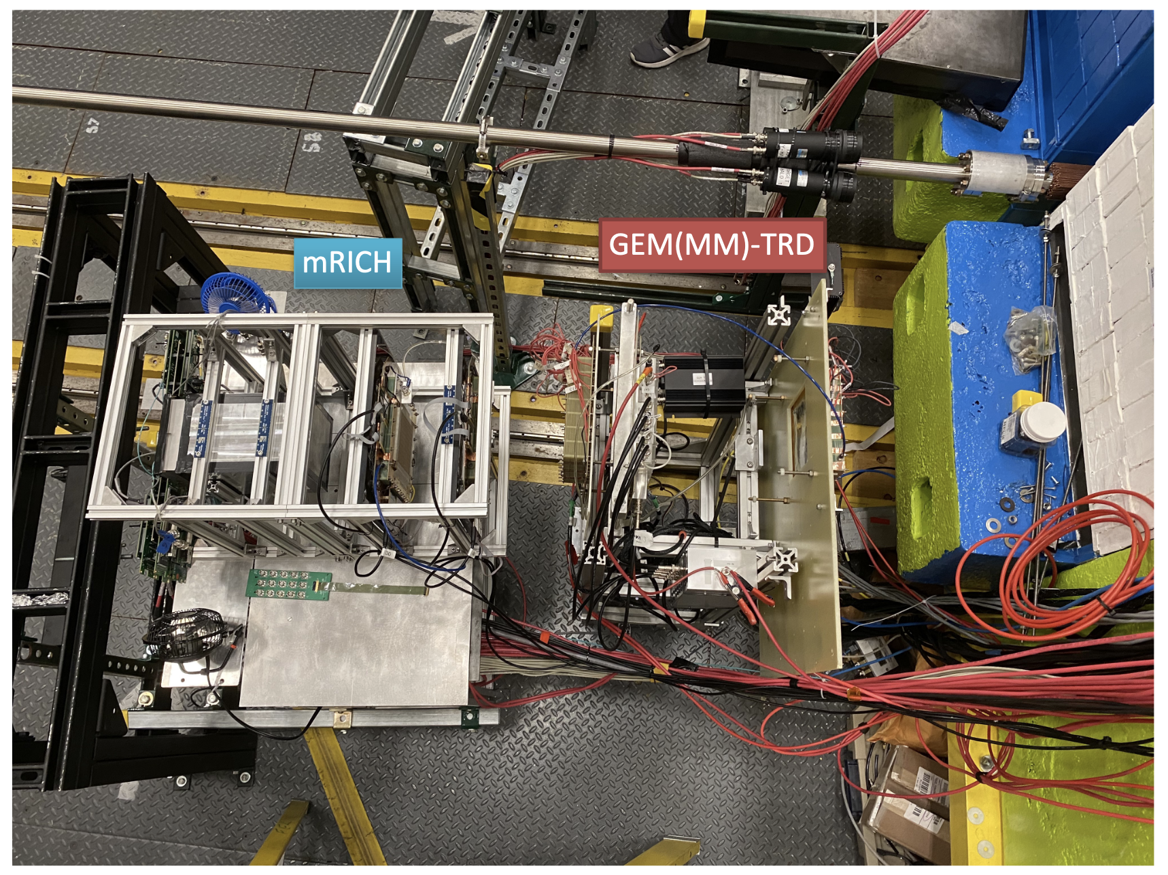
Ongoing EIC Detector Tests
AI optimizations require realistic detector performance parameters

Slide 24
Summary
The physics case for the EIC was clearly laid out in the EIC White Paper and the National
Academy of Science Report.
The Yellow Report took those physics requirements and turned them into detector
requirements to do the science.
Photo-collaborations are presently working on collaboration proposals for the project and
2nd EIC detectors: Athena, CORE and ECCE
AI is already planning a major role in the optimization of these detectors and I believe this
conference will make clear, these AI driven optimizations and refinements will continue as
we all strive to make the best possible EIC detectors within the given space, schedule and
funding parameters.
Detector development and testing key to best possible AI results!

