Slide 1
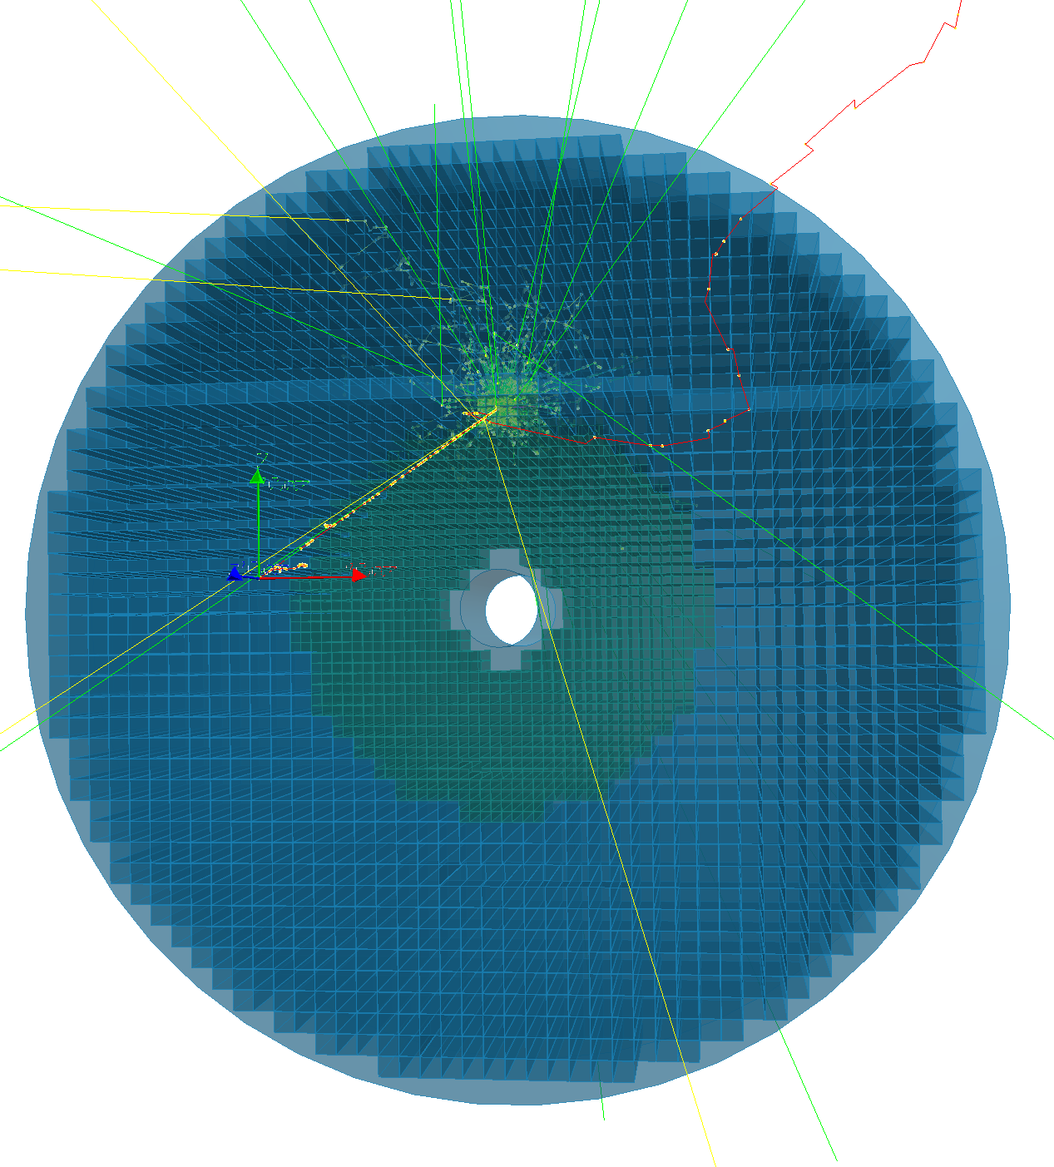
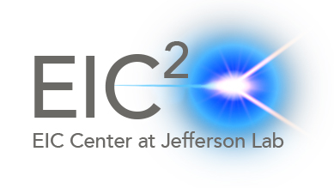
EIC Calorimetry
Dmitry Romanov (Jefferson Lab)
Hybrid Calorimeter Case
AI4EIC
September 8 2021

Slide 2
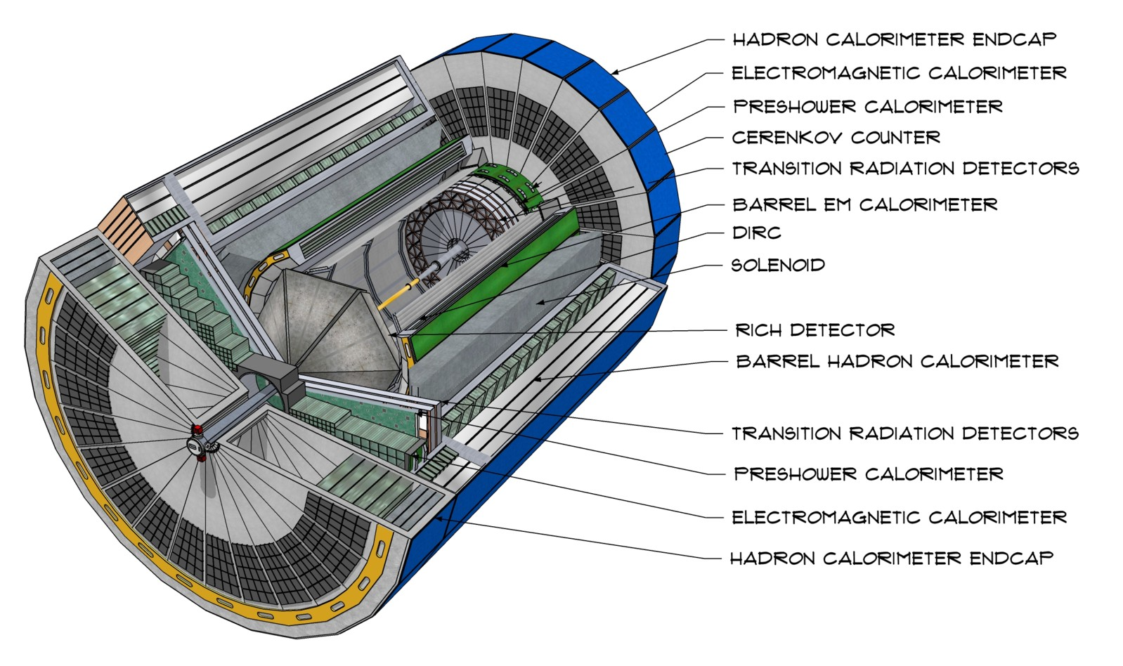
CAD Model of Generic EIC Detector
https://arxiv.org/abs/2103.05419

Slide 3
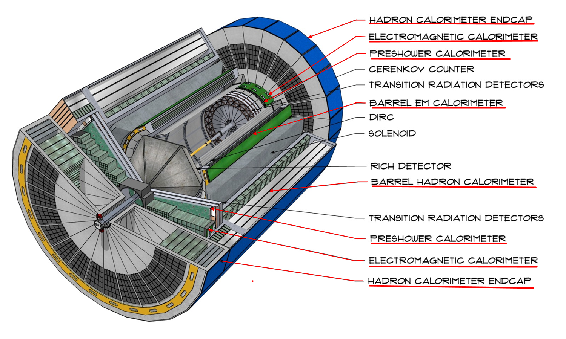
CAD Model of Generic EIC Detector
https://arxiv.org/abs/2103.05419
+ FAR FORWARD ZERO DEGREE CALORIMETER (ZDC)

Slide 4
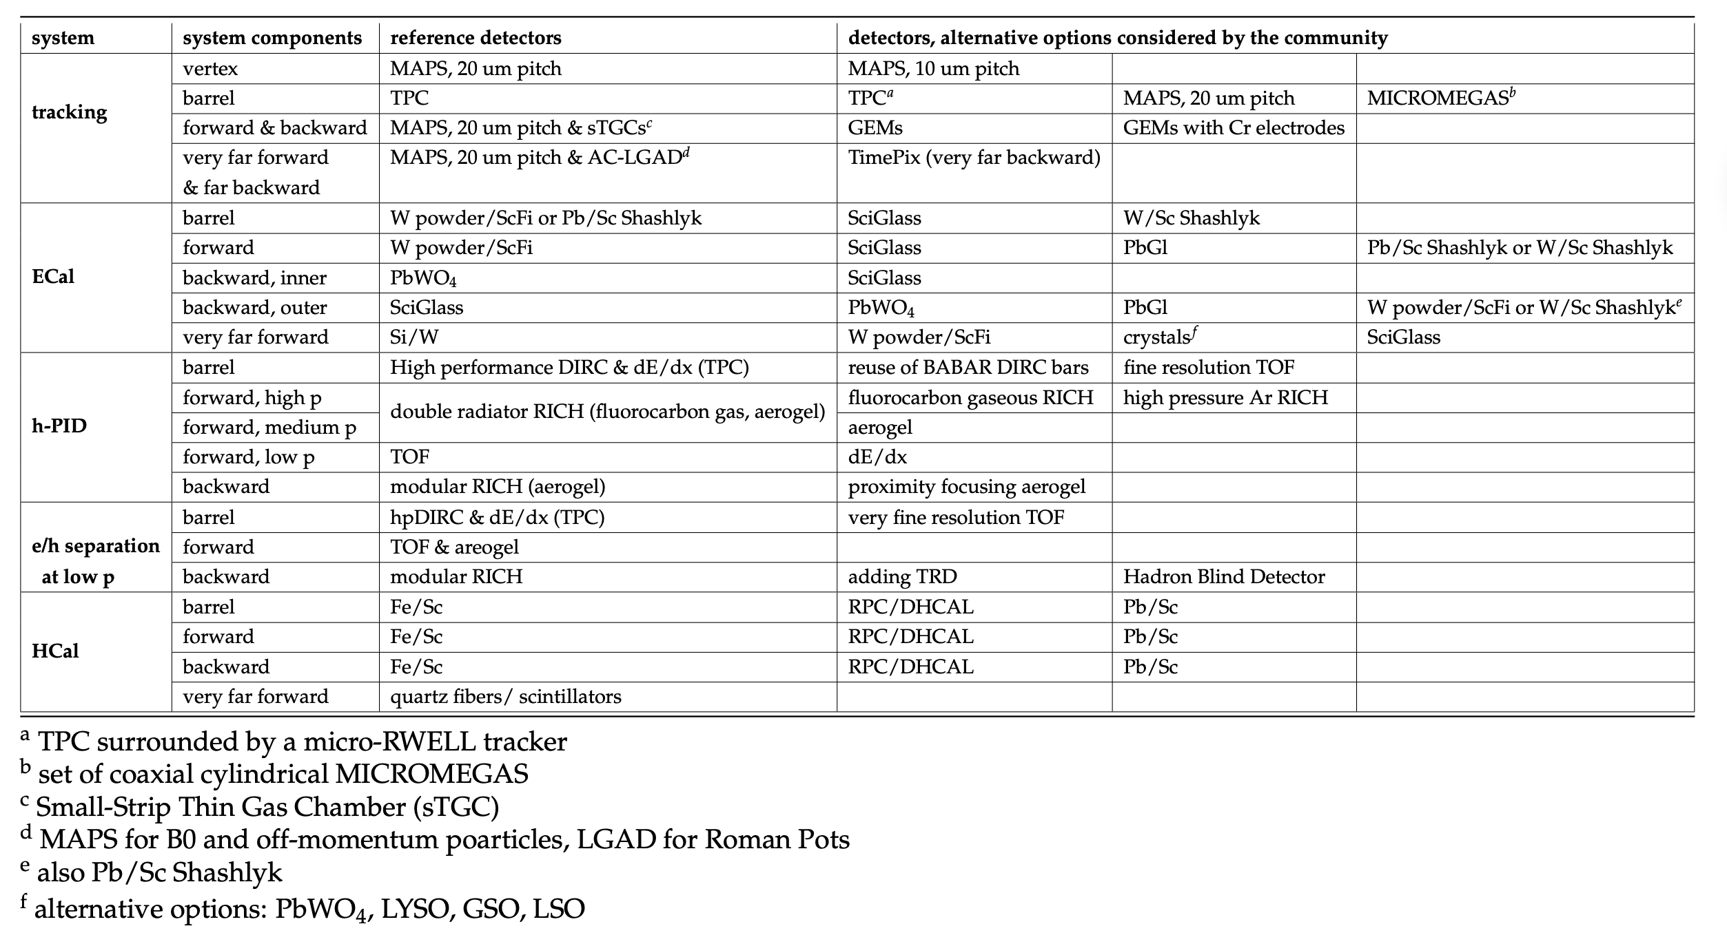
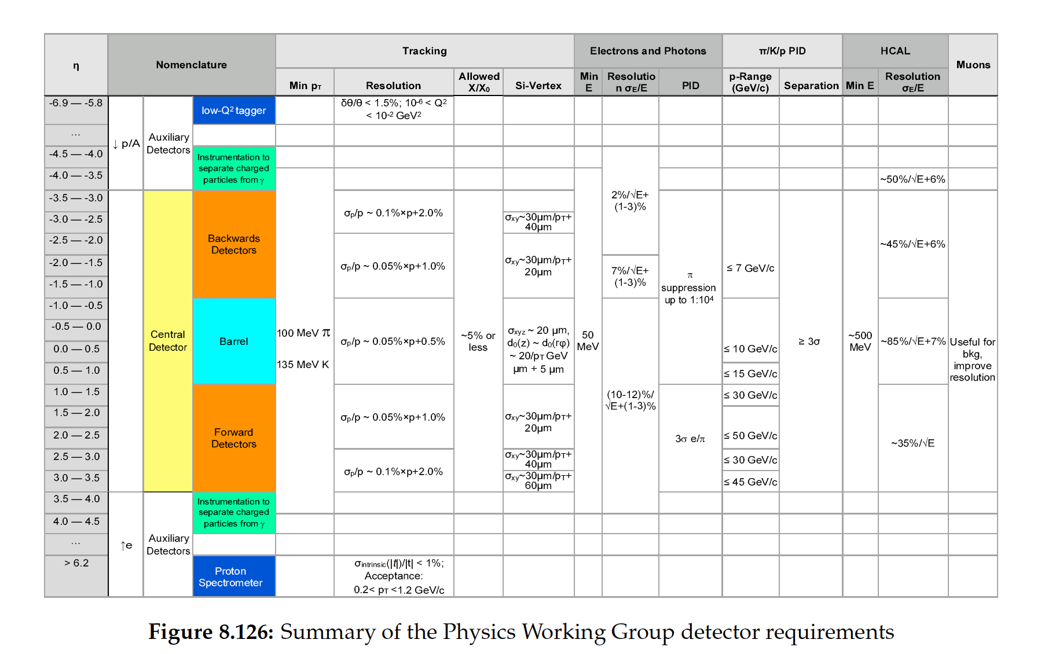
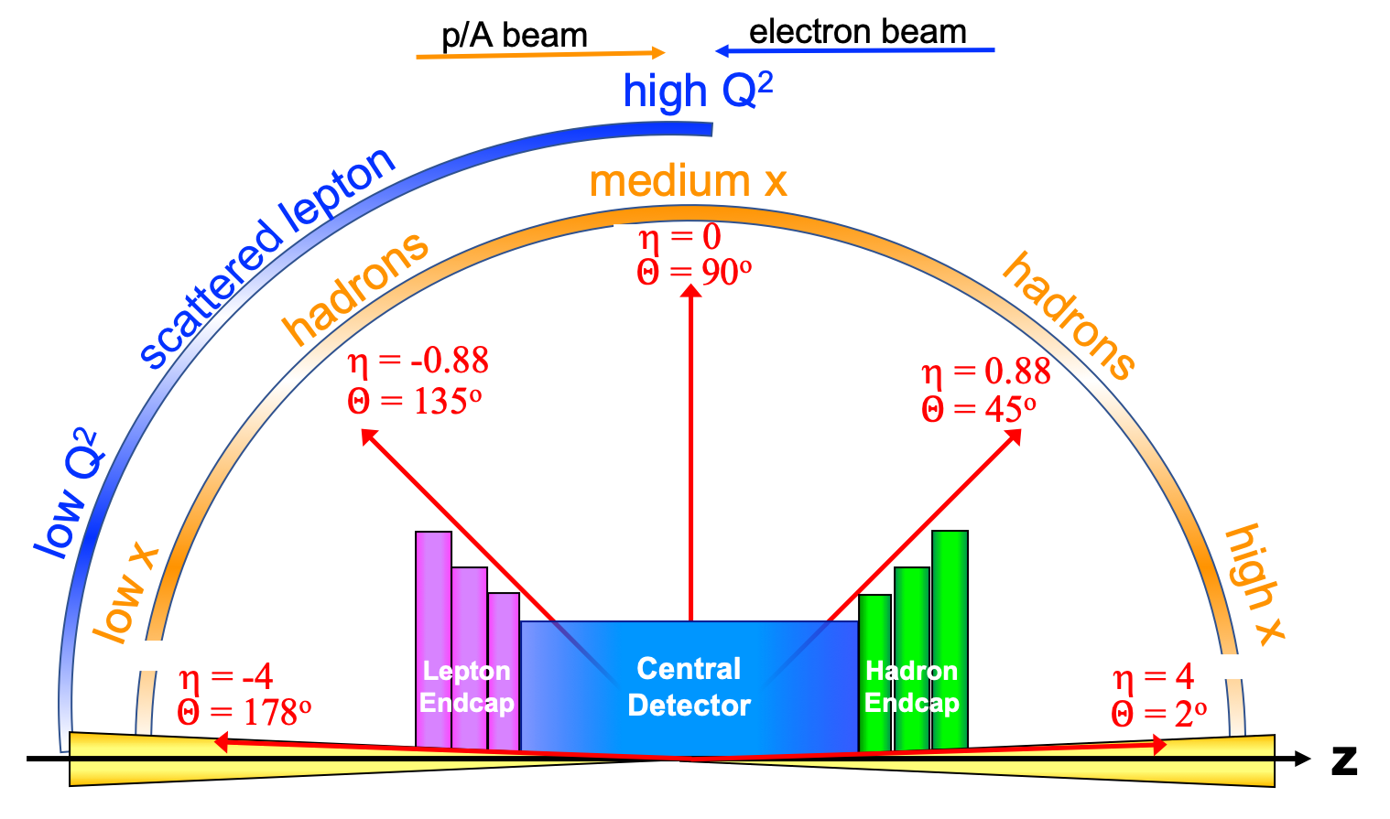
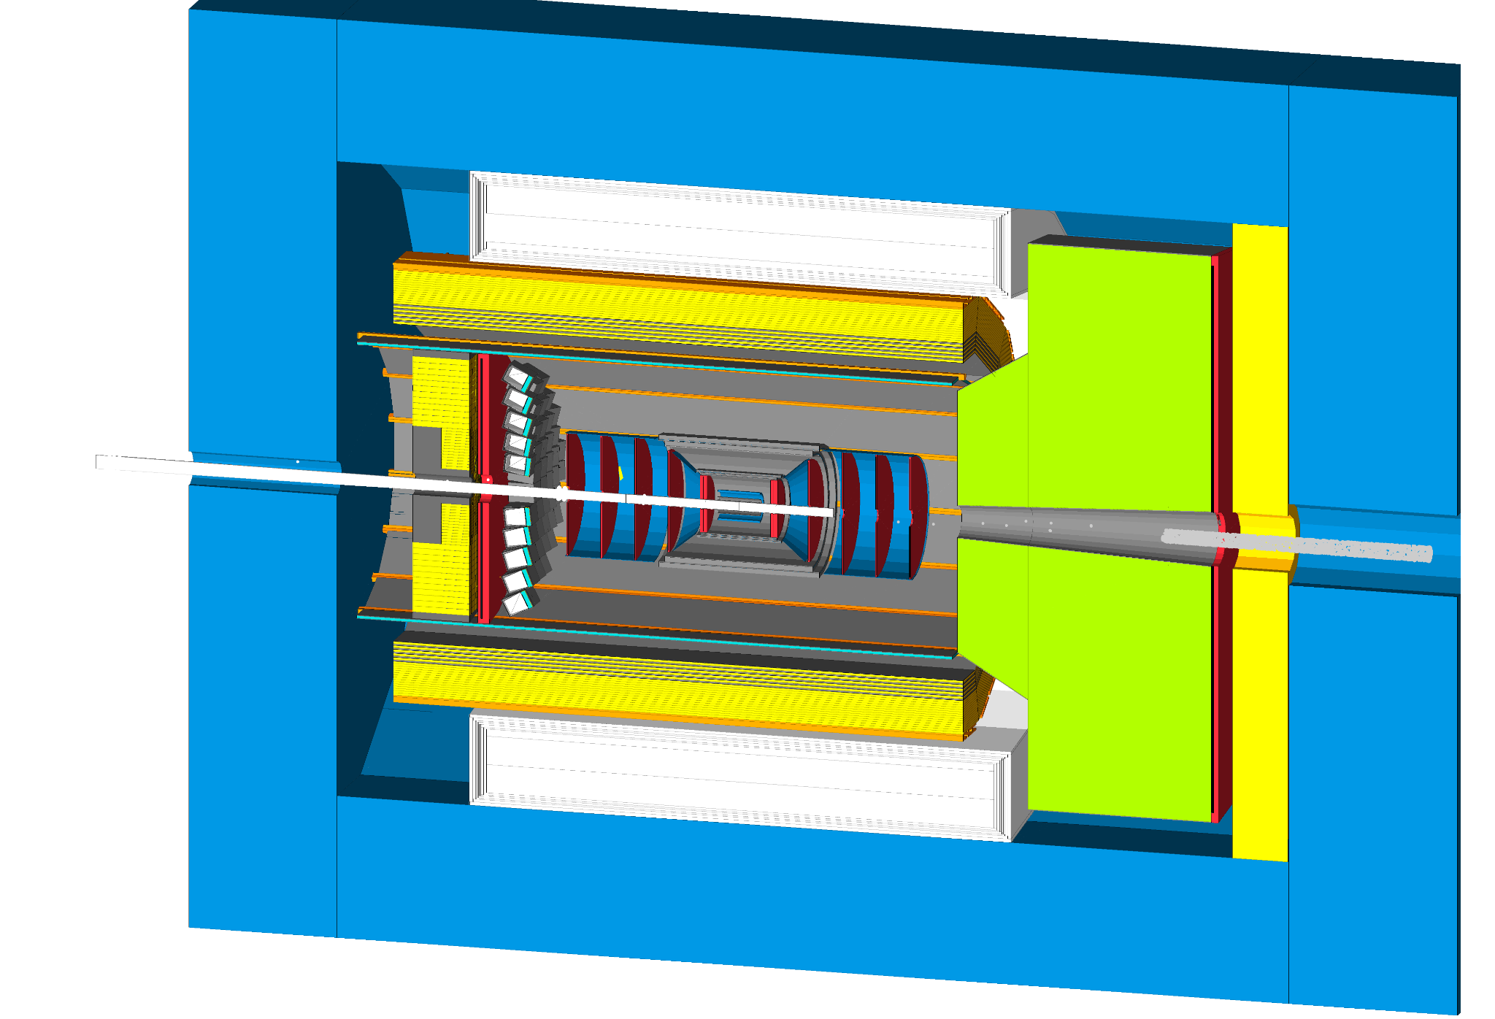
Calorimetry requirements and table

Slide 5
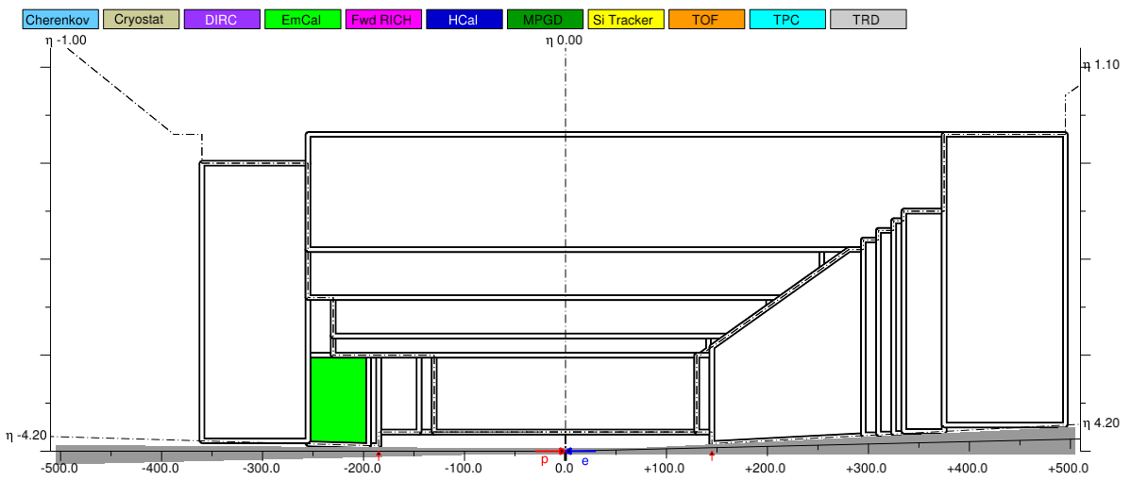
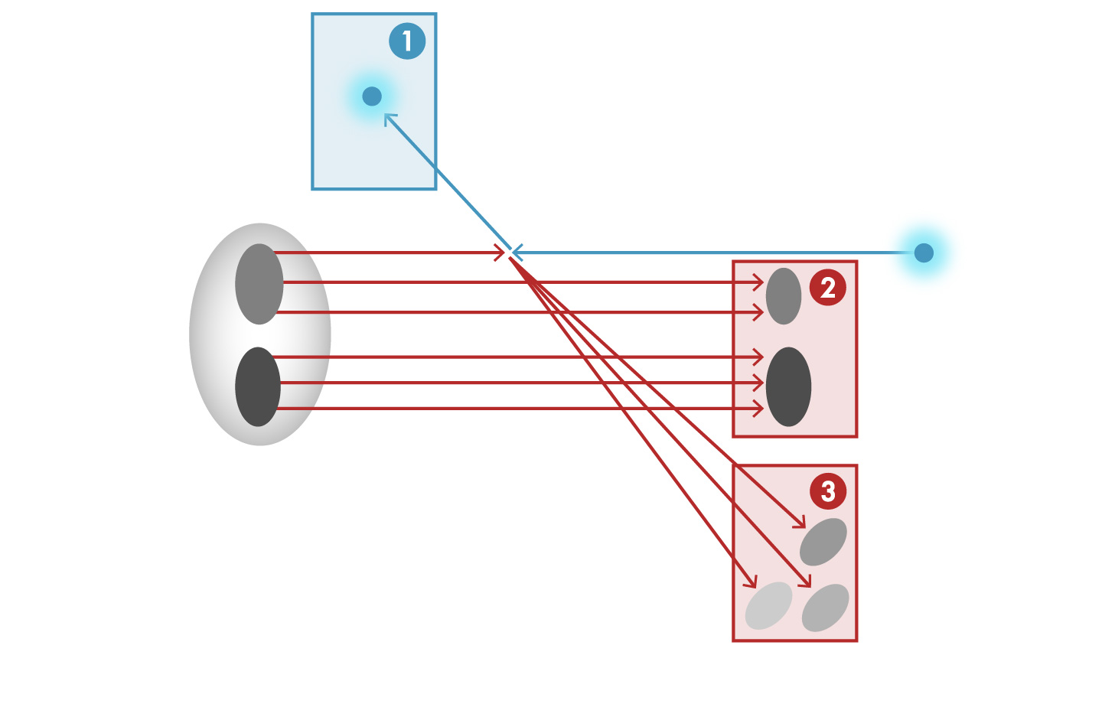
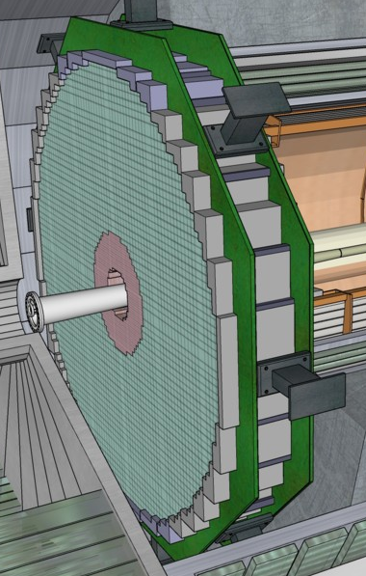
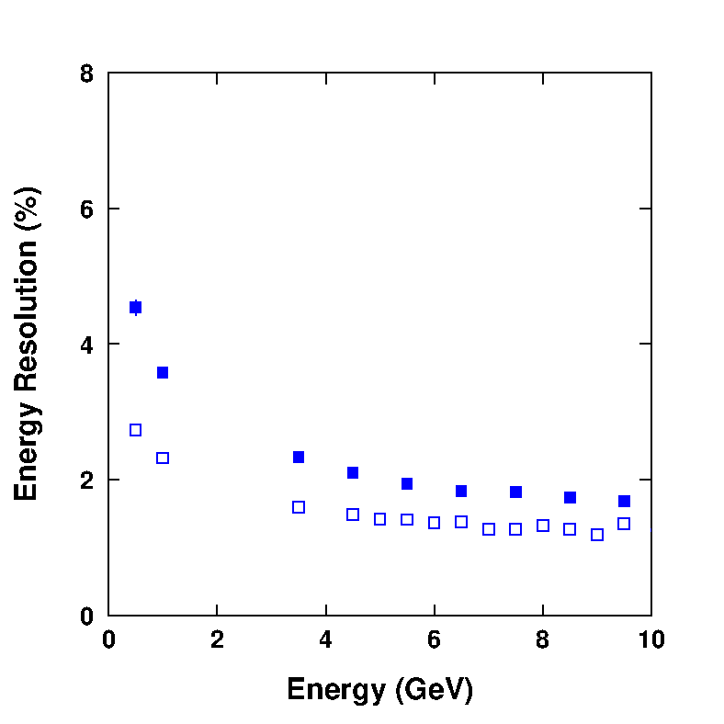
Lepton Endcap EM Calorimeter
Electron Detection - Goal
Scattered electron detection in the Lepton Endcap covering pseudorapidity -3.5 to -1 with
e’
e
p/A
REFERENCE
PbWO₄ crystals (inner)
compact, radiation hard, luminescence yield to achieve high energy resolution, including the lowest photon energies
Sensor: SiPMs (TBC)
SciGlass (outer)
EIC eRD1
radiation hard, luminescence yield similar or better than crystals depending on longitudinal length
Sensor: SiPMs (TBC)
Scattered electron
Particle associated with initial Ion
Particle associated with struck quark
PbWO₄
SciGlass projected energy resolution
SciGlass

Slide 6
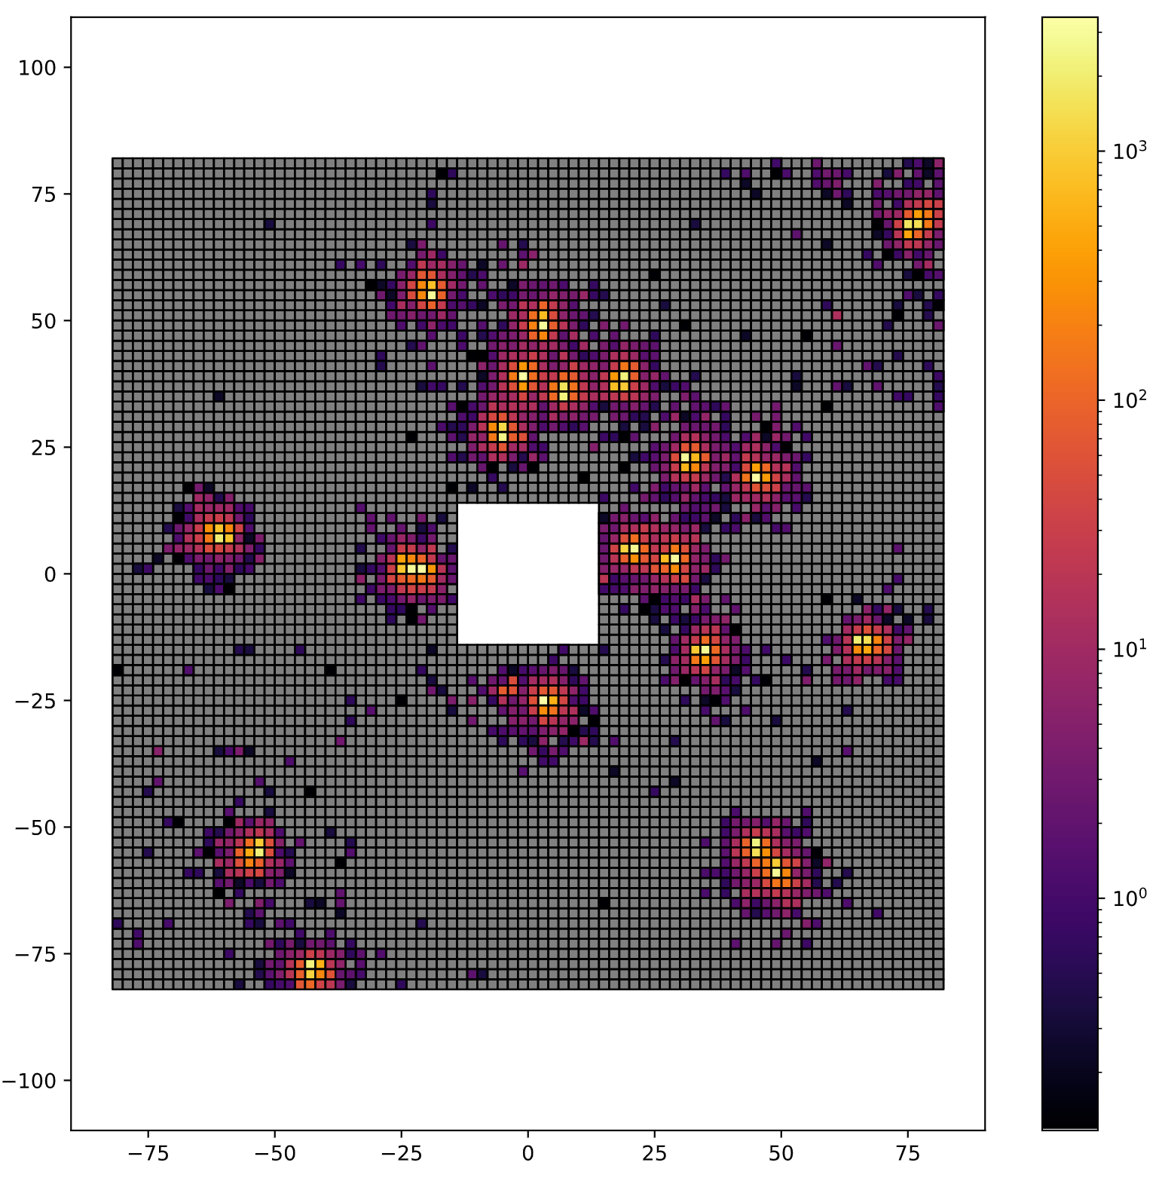
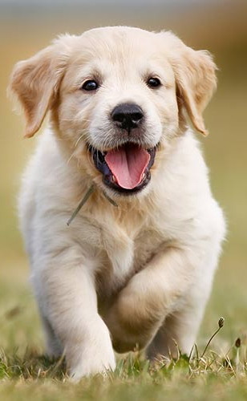
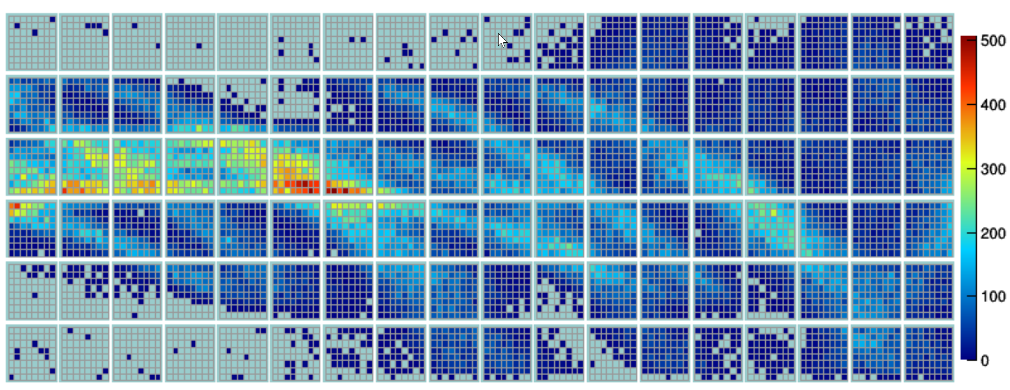
AI for Hybrid EMCal
The Same
AI DRIVEN CALORIMETER?
AI driven optimization
Reconstruction (special cases)
Denoising
Clustering
Realtime FPGA processing
Calibration
Etc.
Hybrid EMCal:
Pixelated detector
With pure 2d data representation
Well studied parameters
Existing robust reconstruction
Yet still having many places of AI application
The project/s are in progress, the results are preliminary or in process

Slide 7
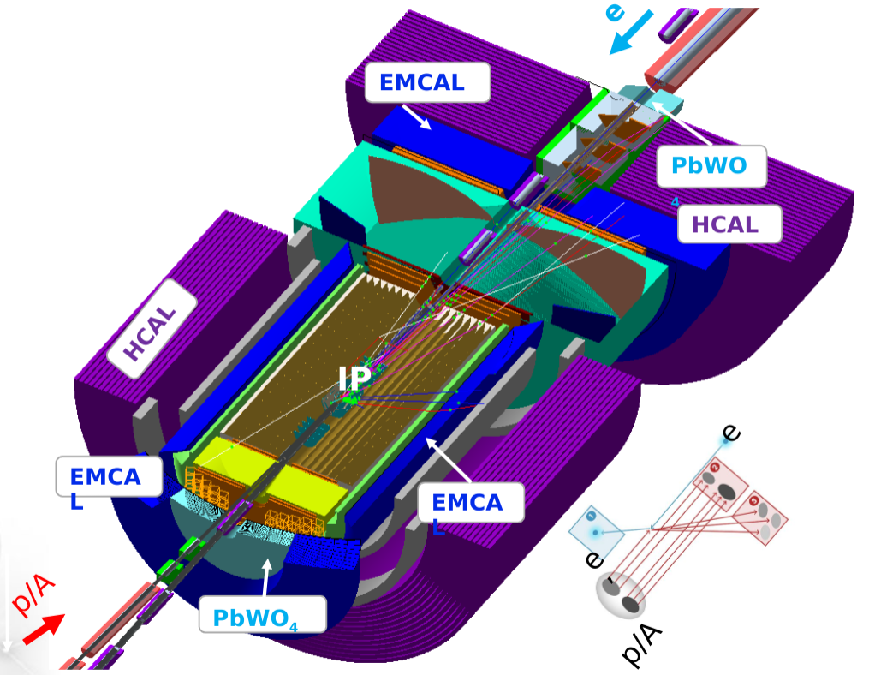
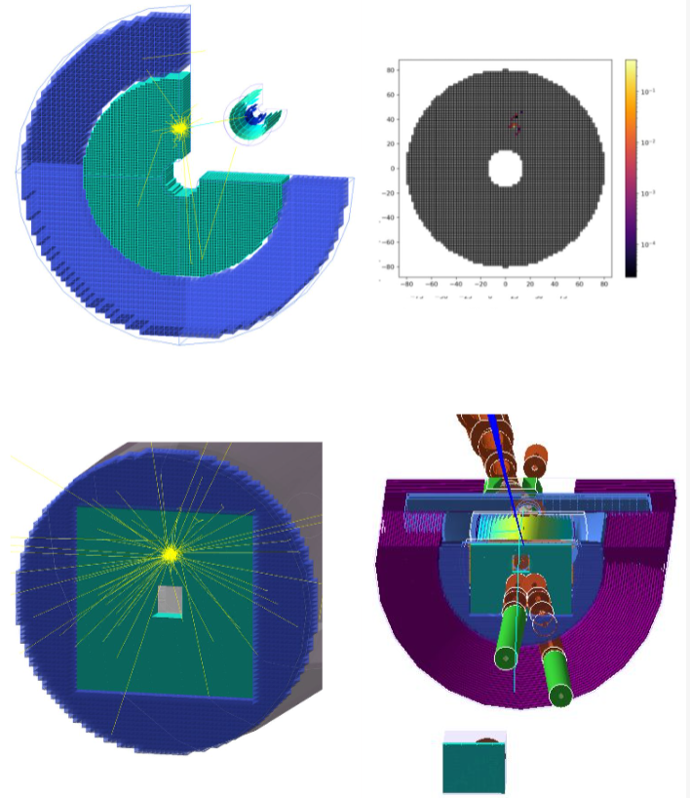
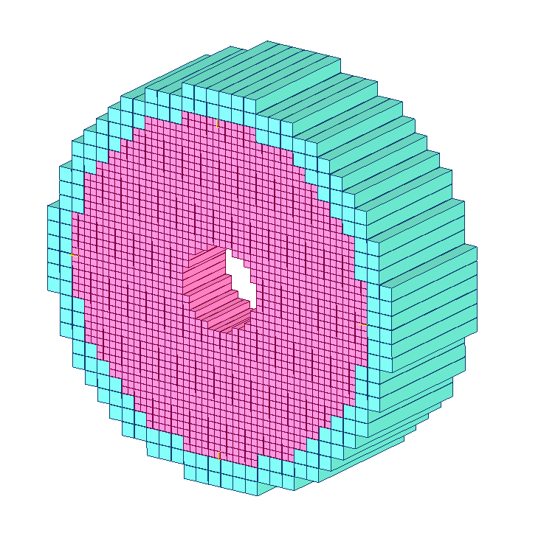
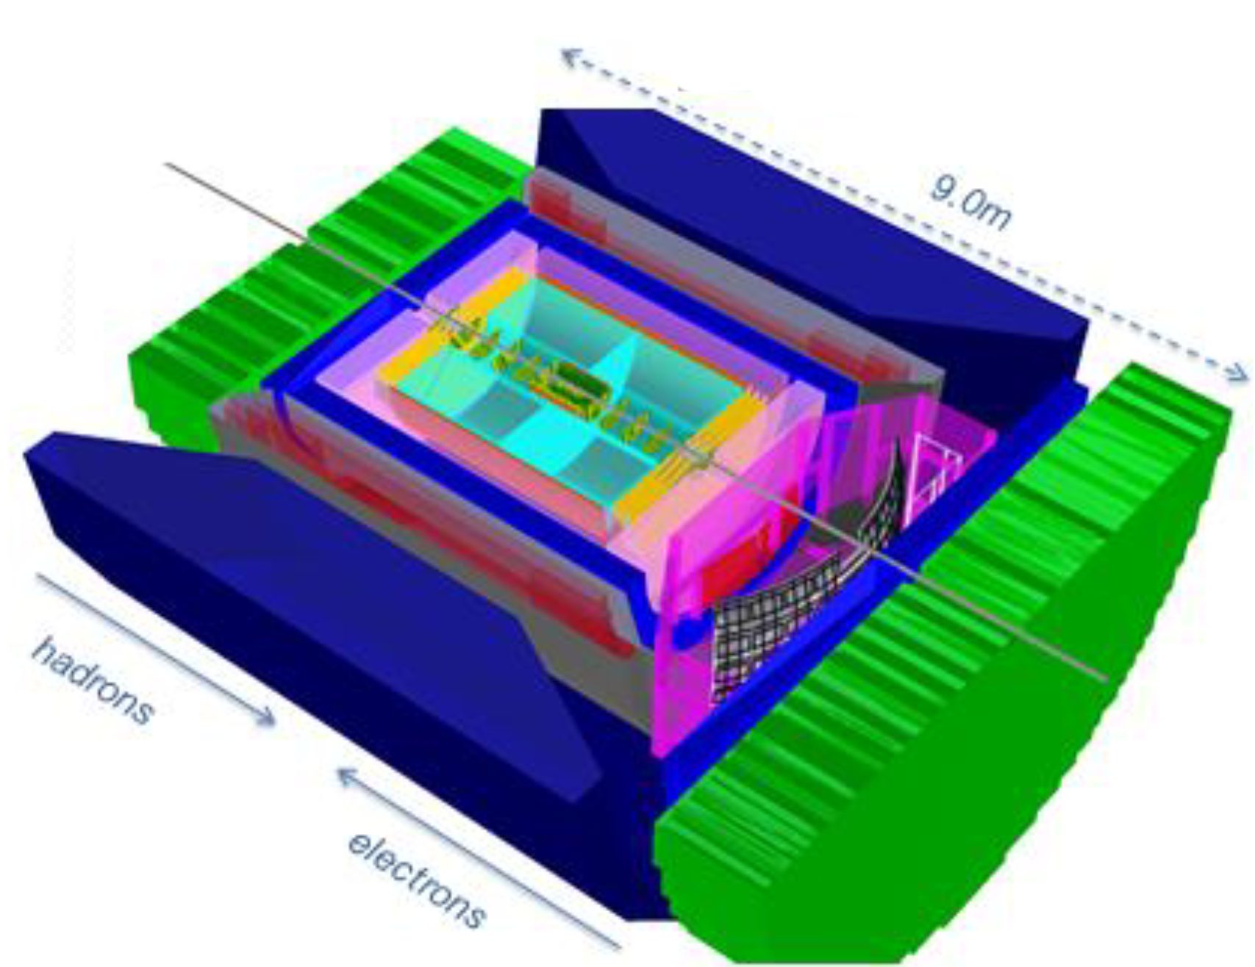
HyCal hybrid calorimeter
YP G4E 2019-2020
JLEIC 2017
Generic model 2020
BEAST 2019
ECCHE 2021
ATHENA 2021

Slide 8
AI Driven optimization
Approach based on Cristiano Fanelli - Artificial Intelligence for the EIC Calorimeter Design​
  AI-optimized detector design for the future Electron-Ion Collider: the dual-radiator RICH case
Points for Optimization:
  Position
  Geometries (Internal/External)
  Crystal to Glass ratio
  Materials
  Cost (tricky)
What is needed:
  Resolution plots
  Validation plots
    X and Q² graphs
Will use an unsupervised clustering algorithms
  From Cristiano Fanelli (used in Hall B)
  From Ilya Larin (used for HyCal, and FERMI Lab)
Will use AI for transition region analysis

Slide 9

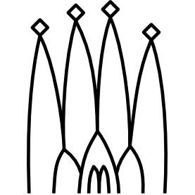

Optimization pipeline and software
Detector performance
(energy, x, y resolutions, e/pi separation etc.)
Global physics performance
x, Q2, work in terms of whole detector
Particle gun
MCEG
Software side
Detector simulation
Reconstruction
Analysis
Gaudi Juggler
Resolution
results
Physics results
x, Q²
Optimizer

Slide 10
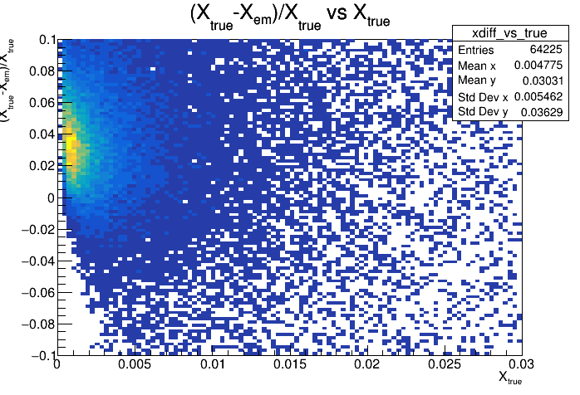
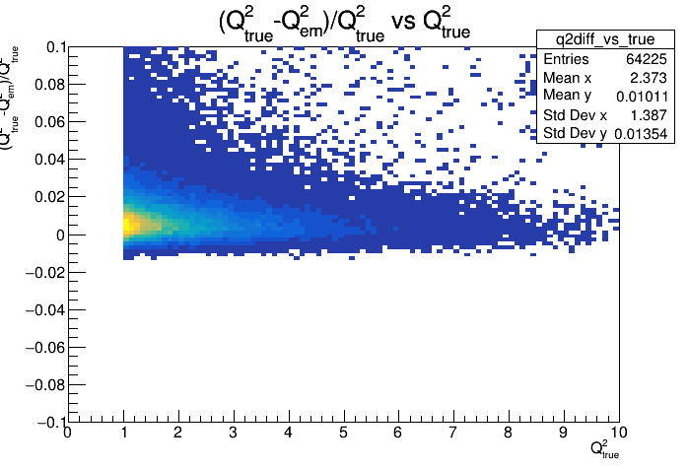
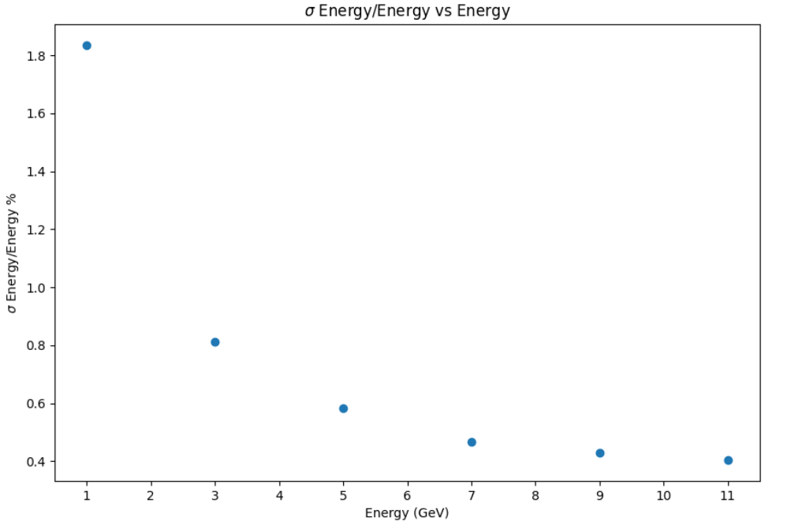
Optimization pipeline details
Events generation:
  Particle gun
  Event generators: Pythia8, BeAGLE
Detector simulation – G4E / DD4Hep:
Reconstruction – eJana (JANA2)/ Gaudi +Juggler
Analysis + plots – python + jupyter
Established reconstruction pipeline Cristiano
σ Energy/Energy vs Energy
Can optimization benefit from ML reconstruction?
A. Boldyrev et al 2021 J. Phys.: Conf. Ser. 1740 012047

Slide 11
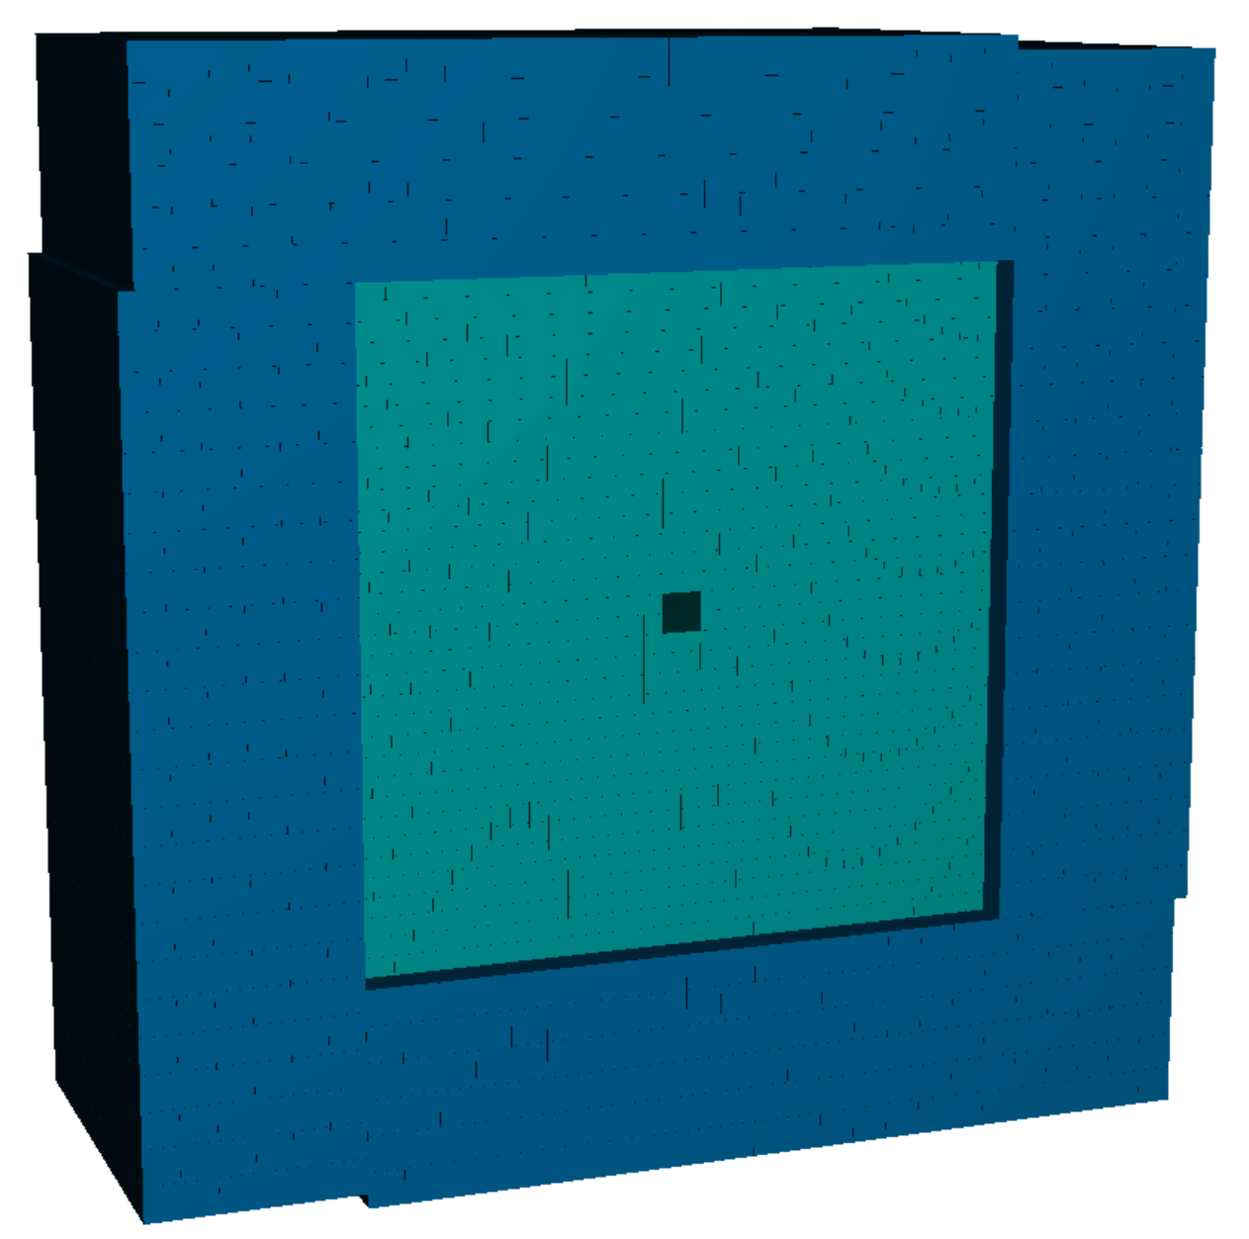
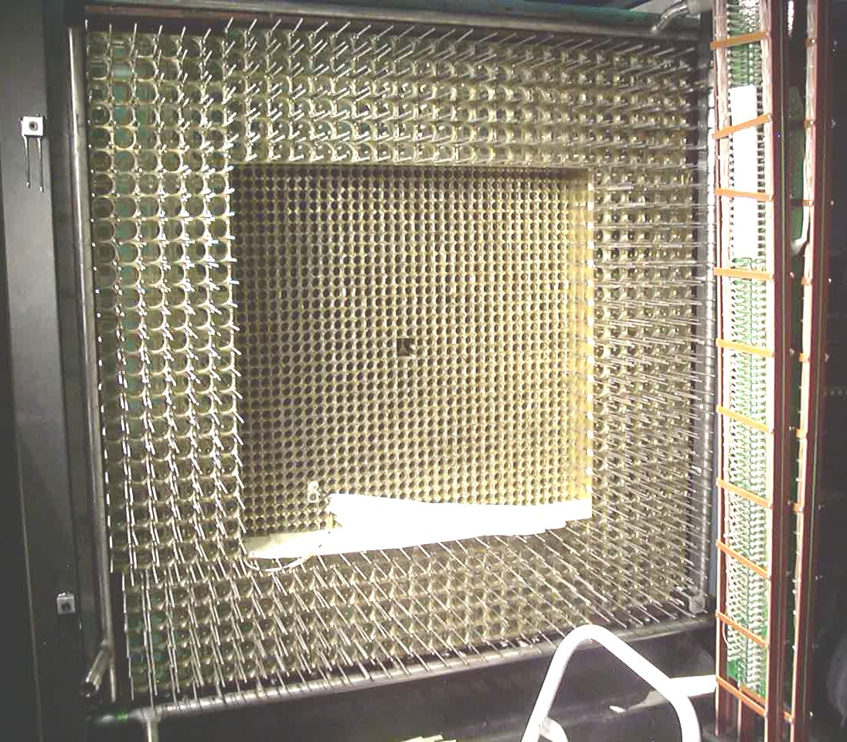
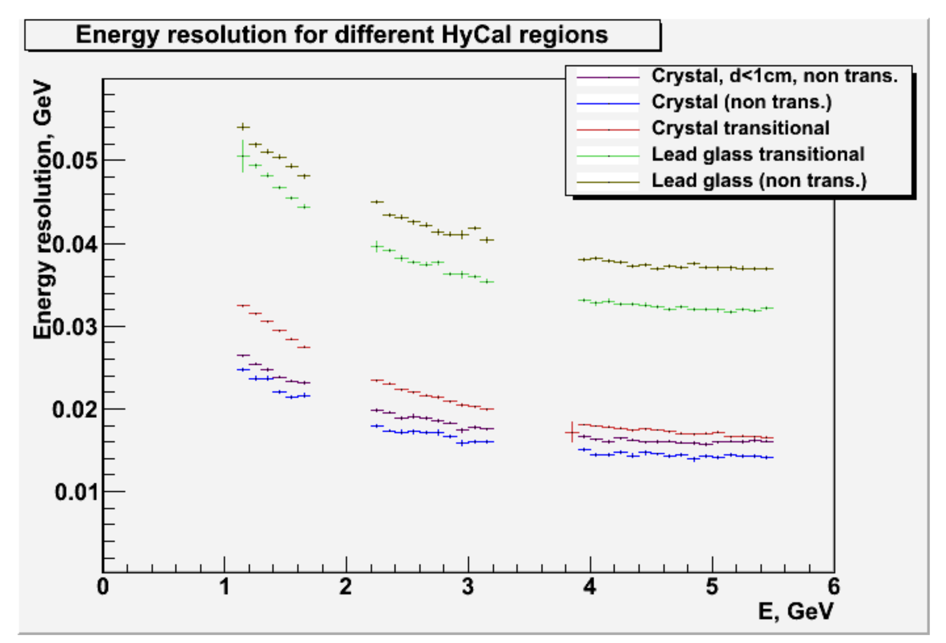
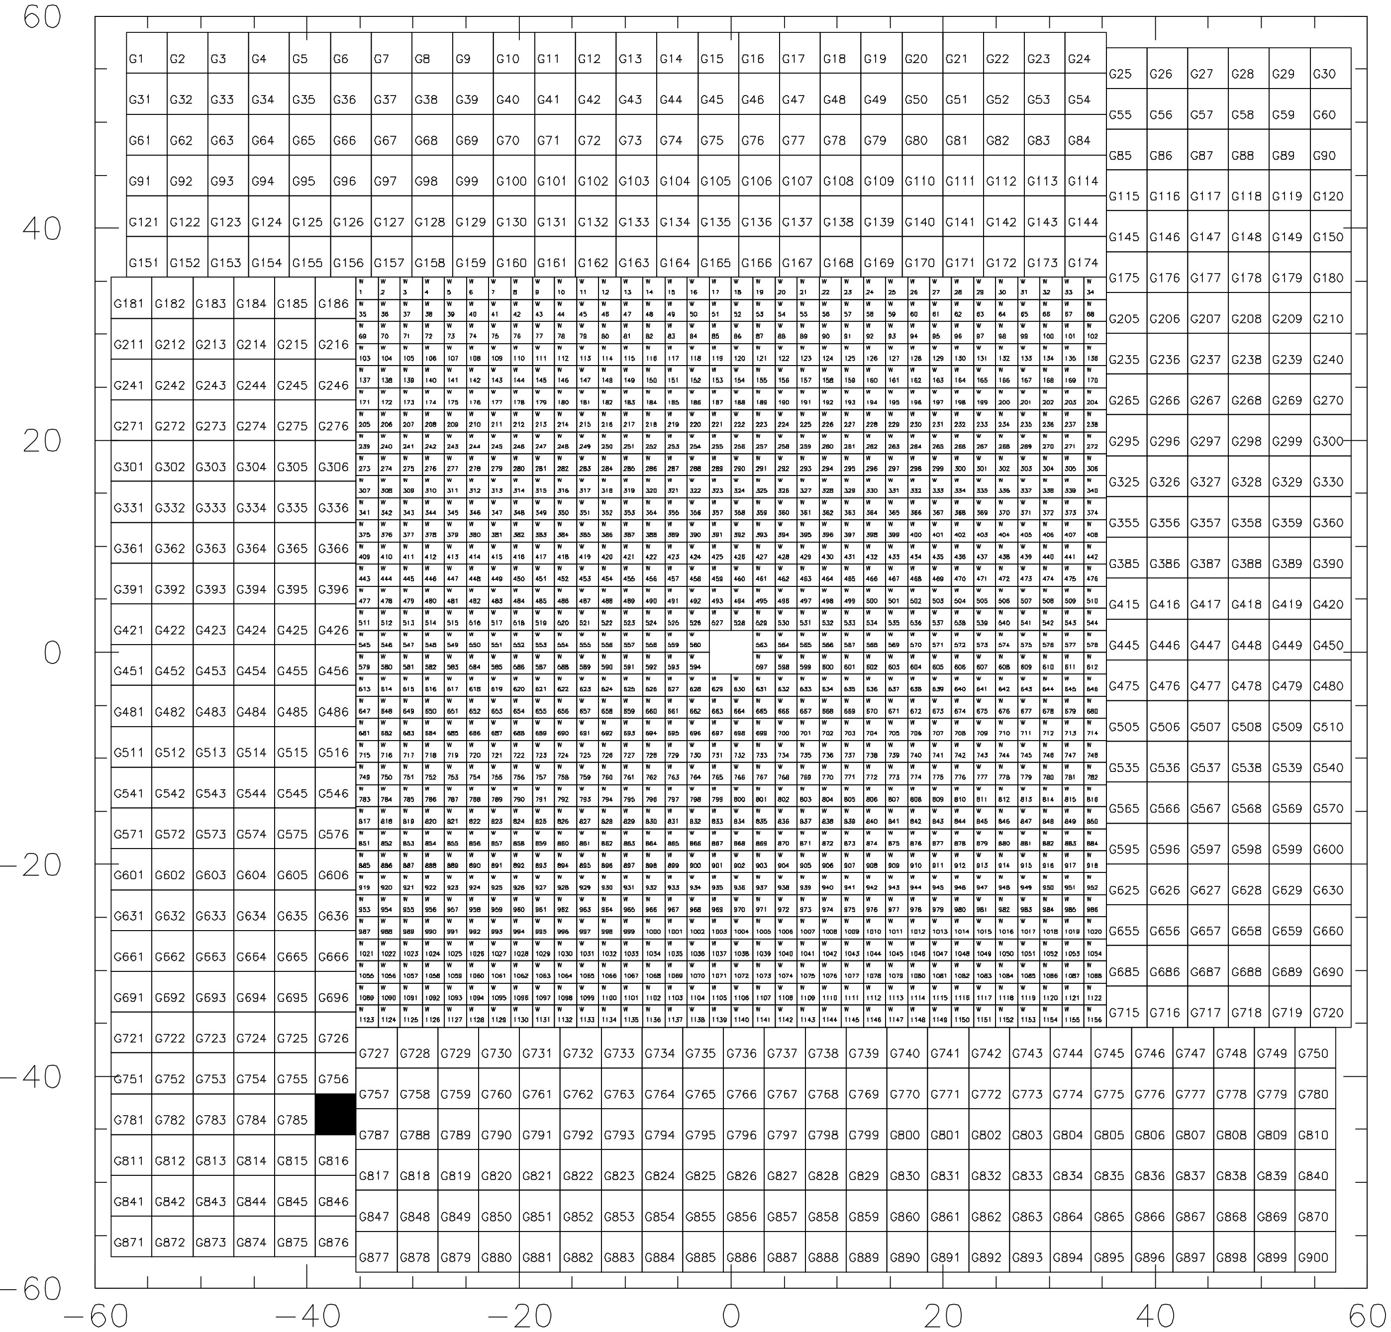
Event reconstruction. Primex HyCal
Hybrid calorimeter:
PbWO4 crystals inner
Lead glass outer
Relevant in terms of EIC as:
The same kind of crystals
Well known problems of the transition area
Real data

Slide 12
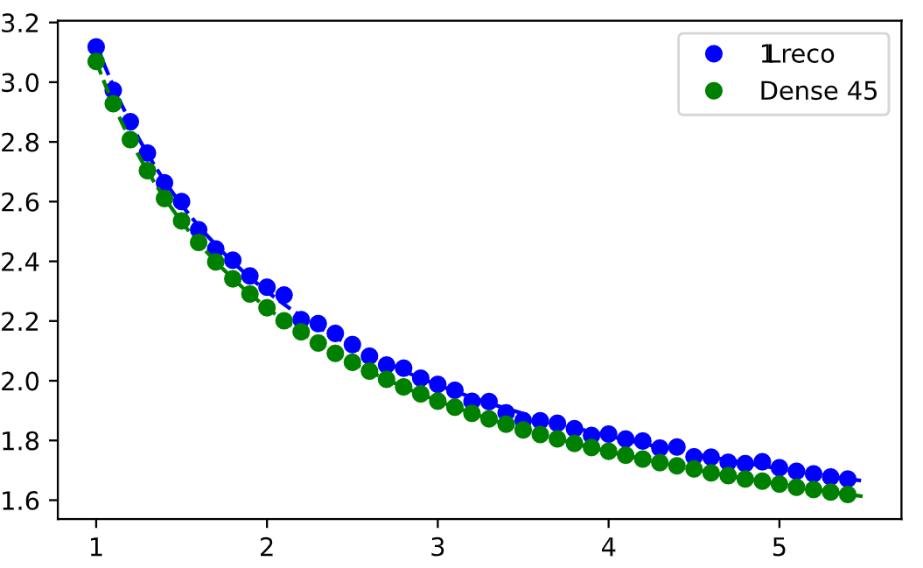
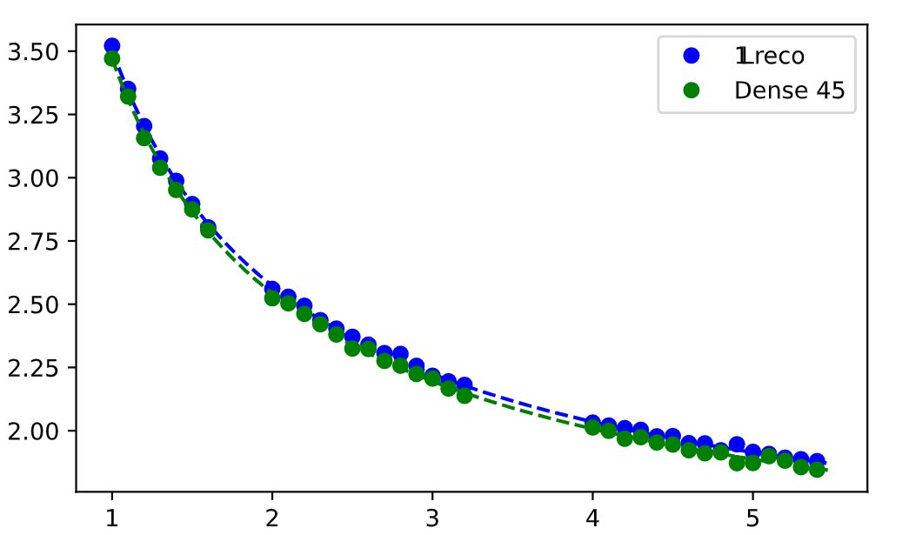
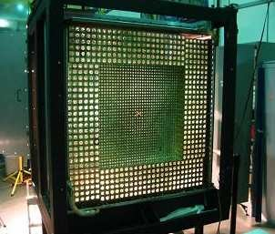
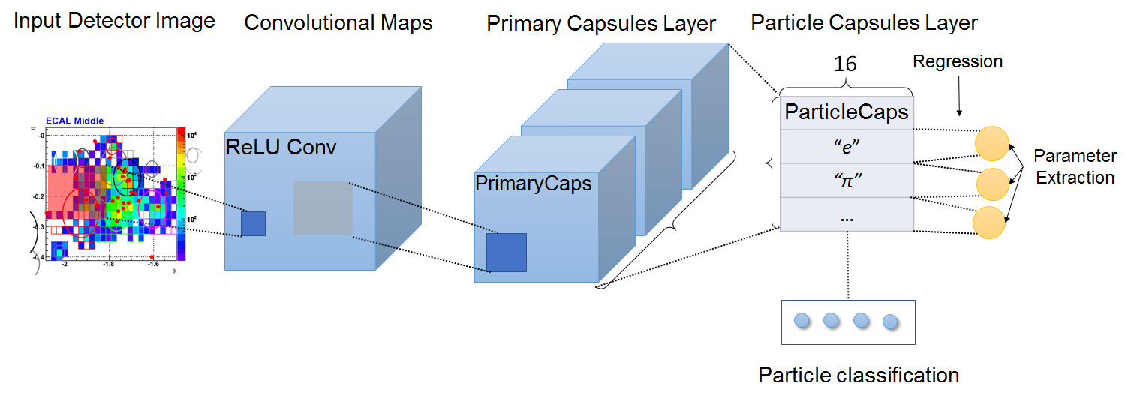
Applying different DNN to E, x, y parameters extraction
Fast sim, geant3 (yes), real data sets
Clean events (no pileup, no edge hits, etc)
reco Island clustering + profile matching
Applied different DNN architectures:
  Dense (worked the best),
  Conv (including VGG16, etc.)
  ResNet,
  …,
  Capsules!(didn’t work)
Tested transfer to real data (works!)
Simulation
Calib. runs
Example of application of Capsule networks

Slide 13
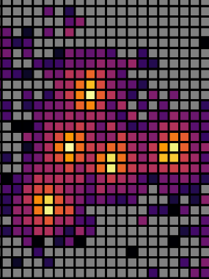
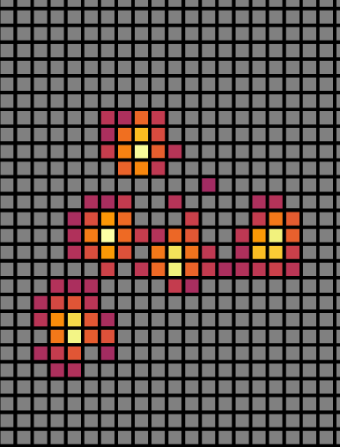
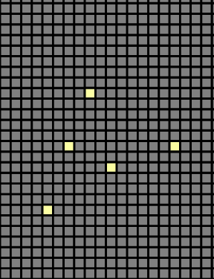
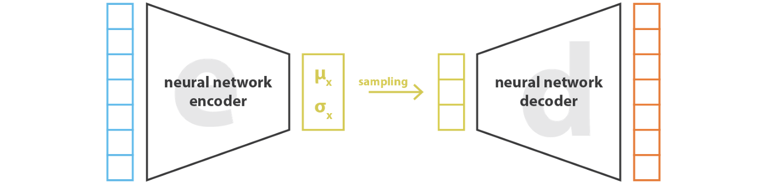
Noise reduction -> Better clustering
Can we apply noise reduction to drastically improve reconstruction performance?
- Apply VA to improve merged cluster reco
- Works amazing in some cases
- Worsen things in others
- Require future work and tuning
Data
Aug.
Post calib
Reco

Slide 14
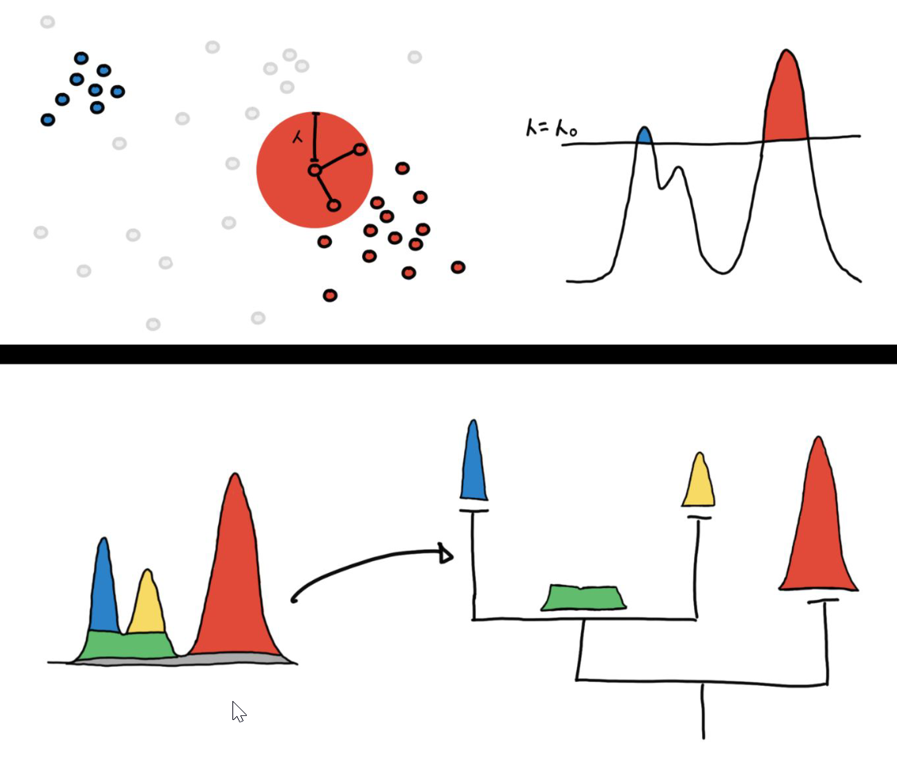
Unsupervised clustering
Density-based methods:
DBSCAN , HDBSCAN, Clustering by Fast Search and Find Density Peak (CFSFDP), CLUE (parallelizable CFSFDP inspired), EWSCAN (DBSCAN inspired with Edge Weights)
Hierarchical clustering is an unsupervised ML technique to provide a hierarchy of clusters.
It is based on estimate of density of points in a multi-dimensional space encoding detector information at the hit level (e.g., position, time, energy...).
Hierarchy is defined through measurements of persistence and mutual eachability of points.

Slide 15
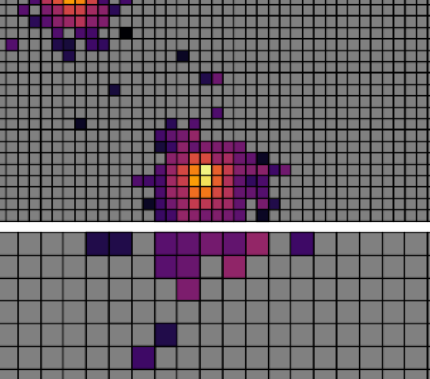
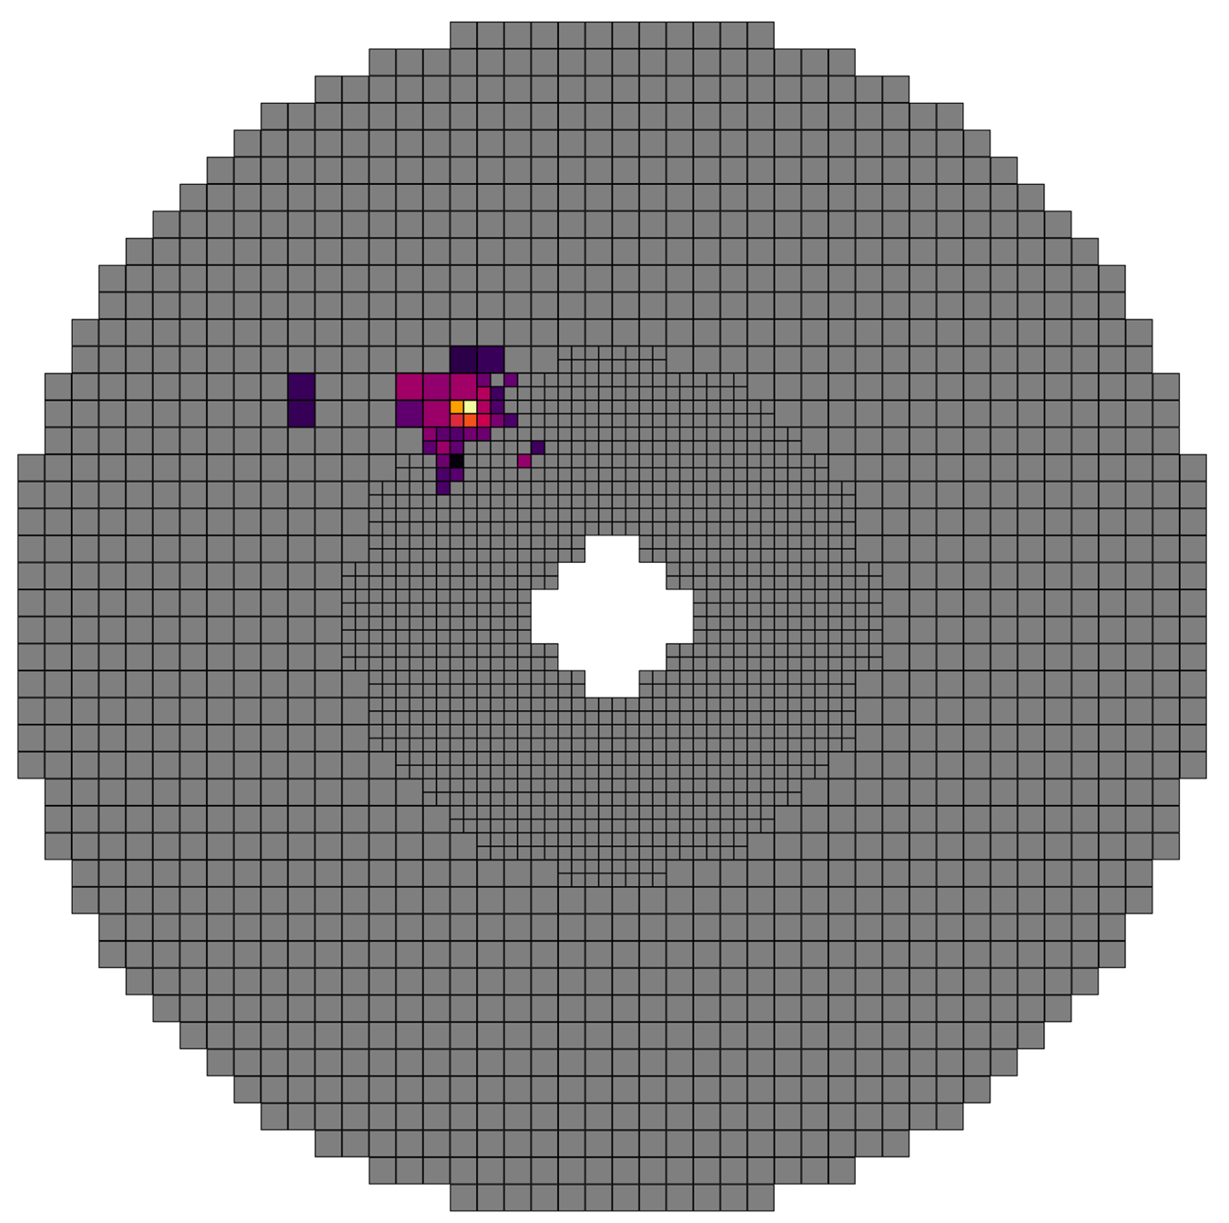
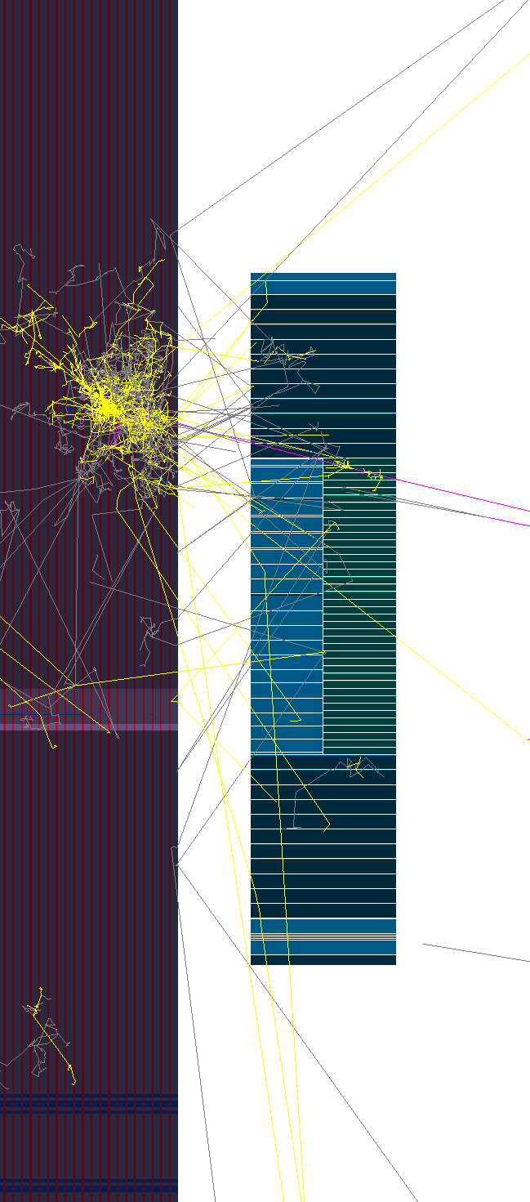
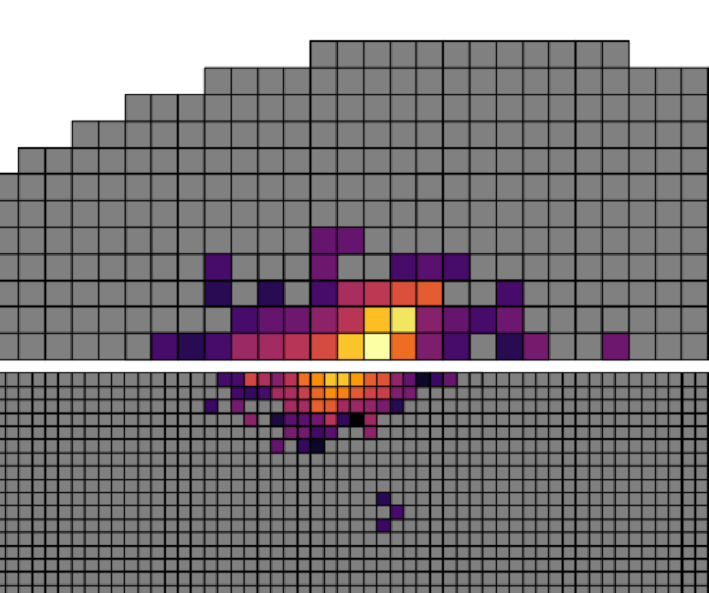
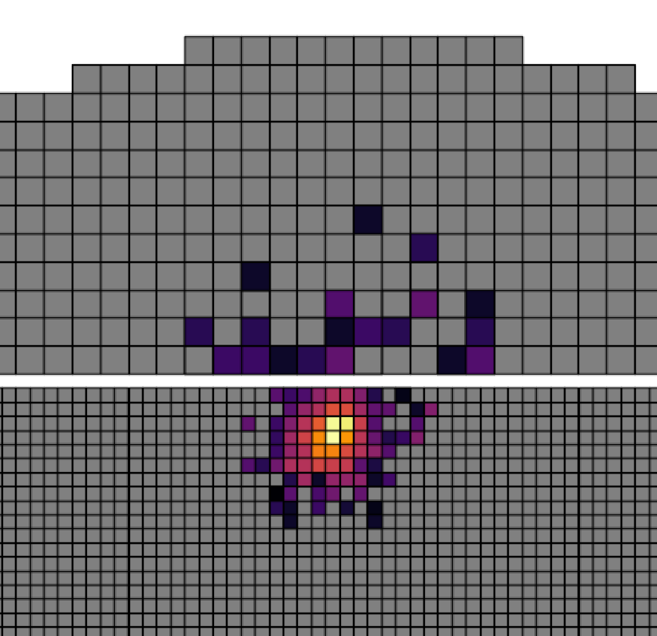
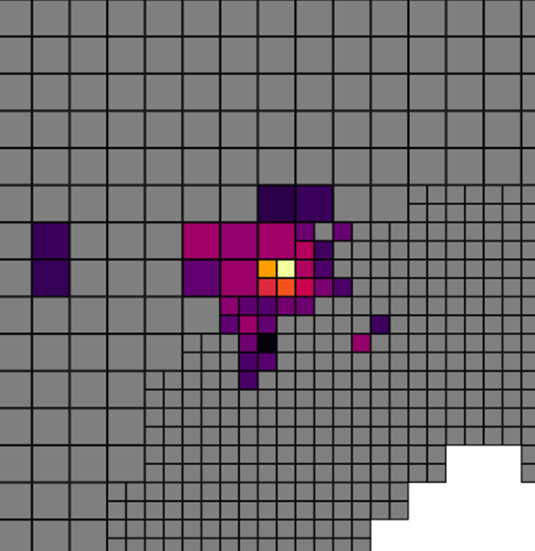
Transition region reconstruction
Crystal
Glass

Slide 16
Transition area reconstruction (classic method)
Reconstruct glass area alone
Reconstruct crystal part alone
Find matching clusters close together on glass/crystal
Go over hypothesis applying synthetic χ2 test to:
Answer if those are from one, two, three… particles
Try to apply cluster separation/reconstruction
Different modules alignment on TR

Slide 17
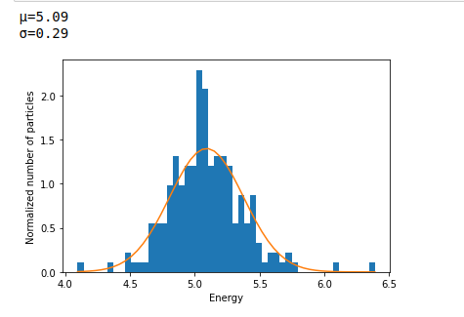
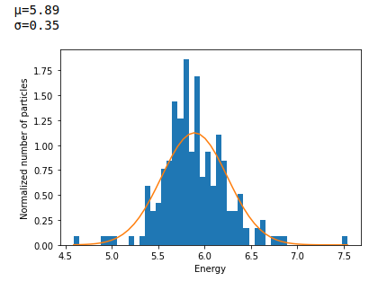
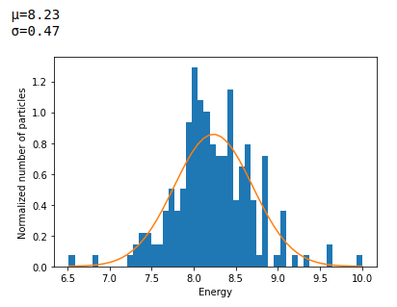
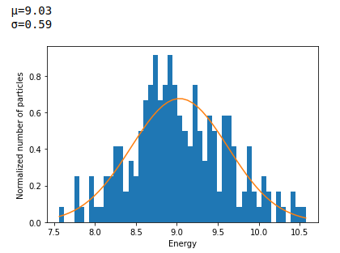
Application of ML to transition area reco
Use DNN to classify hypothesis
Do space transformation of glass region
Apply convolutional DNN
Conv
Conv
Dense Relu
Dense Relu
Dense Relu
Dense Relu
Dense Line
DNN Architecture
Very (very) preliminary results

Slide 18
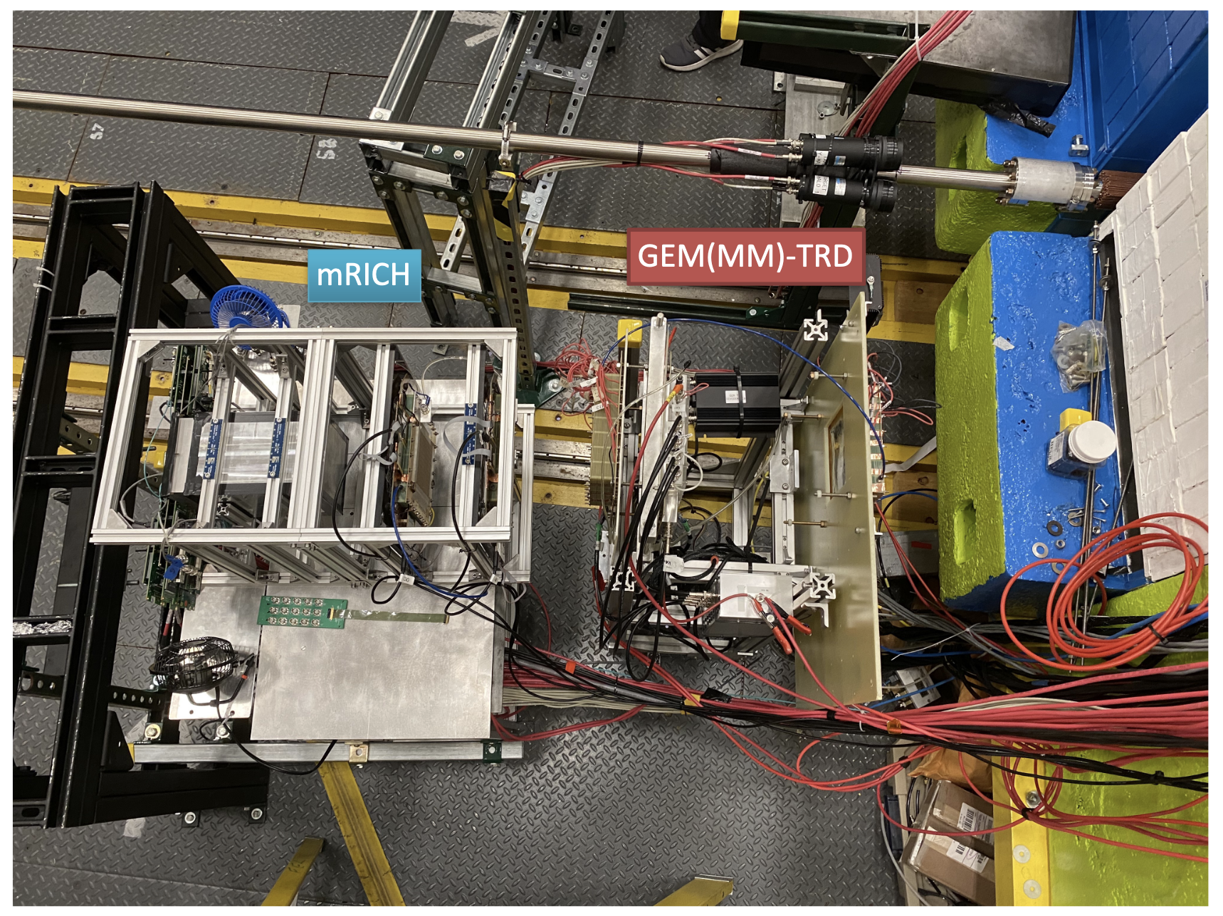
ML for Calorimeter e/pi separation test stand
“Event tagging and triggering on FPGA” Dr Sergey Furletov (JLab) Thursday, 9 September (2021)
3x3 SciGlass modules are planned to be put into the real beam tests this Fall. We prepared for mRICH + GEM + Cal PID in FPGA tests

Slide 19
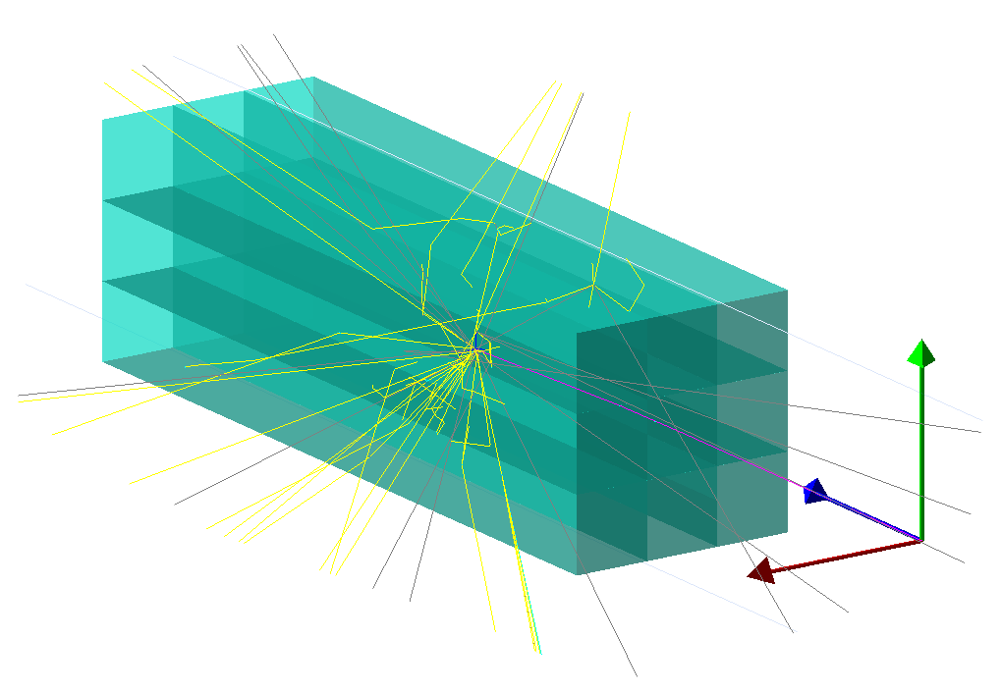
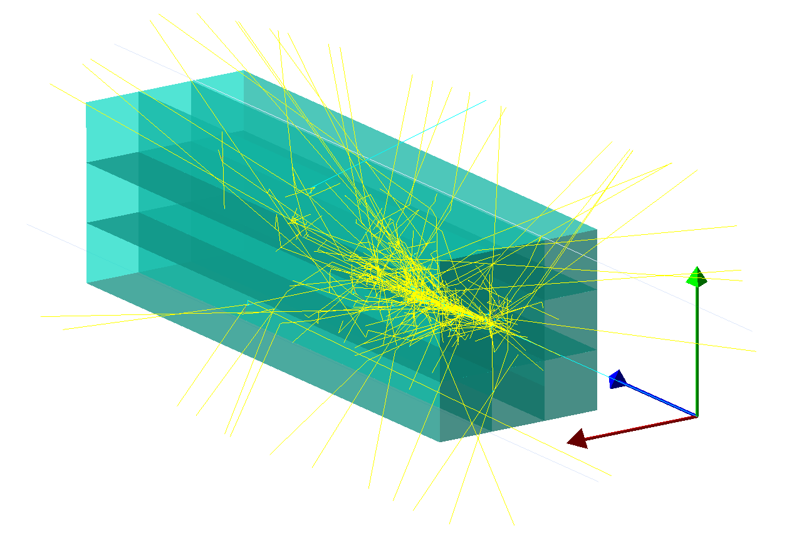
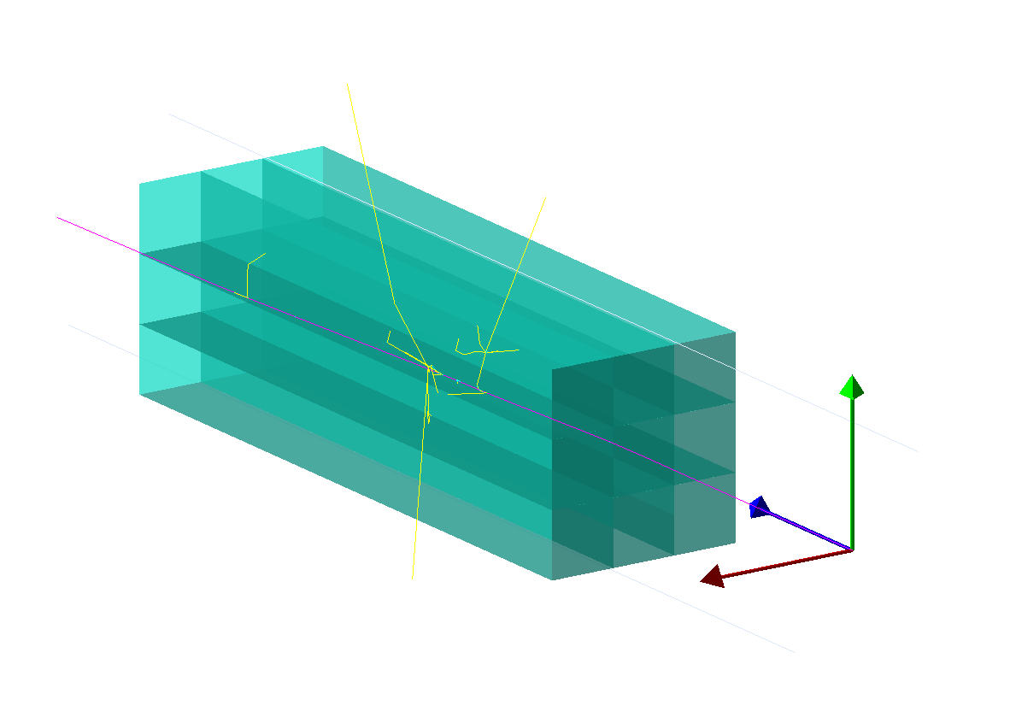

e/pi separation ML methods
Simulated data and trained with different:
  energy
  angles
  Incident cells
Geant 4 simulation
π⁻
e
Classification | Last-layer activation | Loss function
single-label | softmax | categorical_crossentropy
multi-label (scores for candidates) | sigmoid | binary_crossentropy
Calorimeter
modules
deposits
μ⁻
RELU dense layers
% accuracy
training
validation
PbWO₄ 20 cm
Categorical output
Training epoch
Examples of events with e and π⁻
showers and μ⁻ passing through.

Slide 20




e/pi separation ML study
A study of stability and misidentification was performed
Application of different normalizations and tranforms are tested:
PCA + Log transform are the best in terms of accuracy + mismatches
Log transform visualized
Accuracy by energy

Slide 21



AI software stack
How to run ML projects in production?
Modern software stack is being develop for EIC
Special design for ML
MCEG
DD4Hep,
Geometry,
Geant4 (DDSim)
Juggler,
Gaudi - processing
ACTS - tracking,
Tensorflow - ML
Custom reco algorithms
Analysis/Benchmarks
Gaudi offloading service
Slide from Dmitry Romanov

Slide 22
People involved
Tanja Horn
Vladimir Berdnikov
Ilya Larin
Mariangela Bondi
Cristiano Fanelli
Dmitry Romanov
Sergey Furletov
Alexander Zaitsev
Nathan Branson
Hasan Mustafa
Vinet Tripathi
and others!
AI FOR CALORIMTERY
LETS COLLABORATE !

Slide 23
Summary
Several projects of application of various AI methods towards EIC lepton endcap calorimeter is being actively developed
AI driven optimization is at a stage of ready pipelines and optimizer and is being in progress
A research work on application of various ML methods for reconstruction has been performed using simulation and real data for HyCal hybrid calorimeter (similar to EIC) and EIC
Project on PID ML in FPGA with use of calorimeter modules is preparing for real beam test (presentation by S. Furletov)
The study of reconstruction of the transition area with ML is started and got the first very preliminary results
Application of unsupervised learning clustering methods is set for the near future project

Slide 24
Thank you!
Questions?

Slide 25

Software Philosophy:
Let’s prepare for our future at the EIC
Build forward-looking team of software developers to ensure the long-term (decades) success of the EIC scientific program.
Focus on modern scientific computing practices
  Strong emphasis on modular, orthogonal tools
  Integrate with high performance computer, continuous integration workflows, and enable use of data-science toolkits
Software on top of mature, well-supported, and actively developed software stack.
Actively work with the EICUG software group to help develop and integrate new community tools.
Slide from Dmitry Romanov

Slide 26












Software component community
Gaudi
Slide from Dmitry Romanov

Slide 27
Summary
The physics case for the EIC was clearly laid out in the EIC White Paper and the National
Academy of Science Report.
The Yellow Report took those physics requirements and turned them into detector
requirements to do the science.
Photo-collaborations are presently working on collaboration proposals for the project and
2nd EIC detectors: Athena, CORE and ECCE
AI is already planning a major role in the optimization of these detectors and I believe this
conference will make clear, these AI driven optimizations and refinements will continue as
we all strive to make the best possible EIC detectors within the given space, schedule and
funding parameters.
Detector development and testing key to best possible AI results!

Slide 28
Lepton Endcap EM Calorimeter
Electron Detection - Goal
We aim to design and construct the scattered electron detection in the Lepton Endcap covering pseudorapidity -3.5 to -1 with an electromagnetic calorimeter (EEEMCal).
REFERENCE
PbWO₄ crystals (inner)
compact, radiation hard, luminescence yield to achieve high energy resolution, including the lowest photon energies
Sensor: SiPMs (TBC)
SciGlass (outer)
EIC eRD1
radiation hard, luminescence yield similar or better than crystals depending on longitudinal length
Sensor: SiPMs (TBC)
Energy Resolution
PbWO₄
Particle Energy (GeV)
SciGlass projected energy resolution
SciGlass

