Slide 1
LGAD Consortium
for EIC
Alessandro Tricoli (BNL)
Wei Li (Rice)
LGAD Consortium Meeting, February 3rd , 2021

Slide 2
Landscape
There have been tremendous interests in ultra fast silicon detector and/or LGADs in recent years
LGADs are being used at the HL-LHC for pileup mitigation, TOF-PID
Several ideas and proposals have been put forward for detectors that use LGAD-based technologies at EIC and other future projects
Being the next major collider, the EIC is a stepping stone for establishing a generic consortium to foster the technology for future applications (TOF, 4-D tracking, Roman Pots etc.)
Comments from EIC Detector Advisory Committee on eRD24,29:
“It would appear natural, and beneficial overall, to see EIC LGAD-based efforts to form a consortium (like silicon tracking with MAPS) sooner rather than later. The Committee would look with approval on such convergences.”
LGADs are relatively new and need a collaborative effort to make them ready for use at EIC in a short time scale
There is a broad spectrum of expertise in HEP, high-and medium energy NP!

Slide 3
The LGAD Consortium Goals
Create a collaborative effort to develop EIC detector technologies based on the LGAD sensors
Bring together people with common interest in LGAD-based detectors in HEP and NP communities
Share expertise on the common aspects of the underlying technology that transcend any specific detector realisation
NB: the consortium does not intend to replace the collaborative effort of a detector project, but supplement it, in order to study common challenges and possibly develop common solutions across different detector projects
On a longer term this consortium will be a stepping stone for other, longer-term applications of LGADs

Slide 4
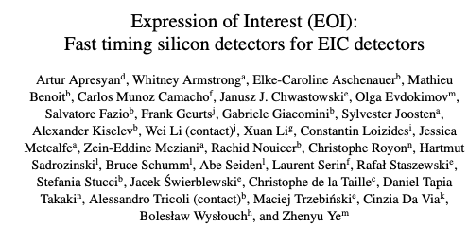
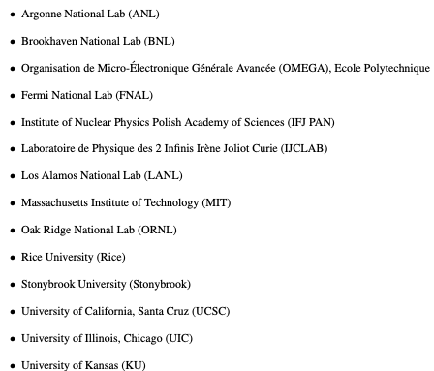
Participating Institutes and People
Submission of EOI for EIC detectors based on LGADs on Oc. 30th, 2020
LINK
14 Institutes, 33 people
Interests in different detector concepts
TOPSiDE
4pi Hybrid LGAD/SOI Tracker
Generic 4D Tracker
TOF
Roman Pots
Preshower
Interests and expertise in several different areas
Sensors
Electronics
System Design, Engineering and Construction

Slide 5
EIC Timeline Overview
The EIC is capable of supporting a science program that includes two detectors and two interaction regions, but Project has only funding for one full IR and one Detector
$200M on detector project and an assumed $100M (US accounting) in-kind contributions
A second IR and detector within the same timeline is desirable, and will depend on the EoI outcome
General-purpose detector must deliver on the promised EIC science
Design must be able to do the EIC science
Detector must be buildable in the EIC Project timeline
Detector technologies must have reasonable risk
Timeline (driven by CD schedule - have one detector constructed by CD-4)
March 2021: Start call for Detector Proposals
September 2021: Deadline for Detector Proposals
December 2021:Selection of Detector(s)
Reference: https://indico.bnl.gov/event/9080/contributions/41435/attachments/30459/47756/Detector.Plans.final.pdf

Slide 6
This Meeting
Goals of this meeting:
Present detector proposals that plan on using LGADs as main sensor technology
Outlines of detector concepts
Status of activities
Inform about interests and expertise from participating institutes
EIC project interests
Relevant areas of interest (sensor R&D, testing, electronics, assembly/integration, mechanical design,others)
Equipment available
Clarify timeline and upcoming deadlines/milestones for EIC
Prepare future activities, based on specific interests by participating institutes

Slide 7
Next Steps
Based on input and feedback from today’s meeting we should plan for closer and stronger collaborations to facilitate activities across the various detector proposals
Arrange discussions focus on specific common aspects
Sensor R&D (ultimate timing performance, space+timing sensors - TI/AC-LGADs, testing)
Electronics (test-boards, ASICs, data transmission, clock distribution, offline electronics)
System Design and Mechanical Engineering (e.g. mechanical designs, cooling etc.)
Intention is not to proliferate meetings, but to create fora for targeted technical discussions bringing together experts and discuss common challenges and possible solutions

Slide 8
Backup

Slide 9
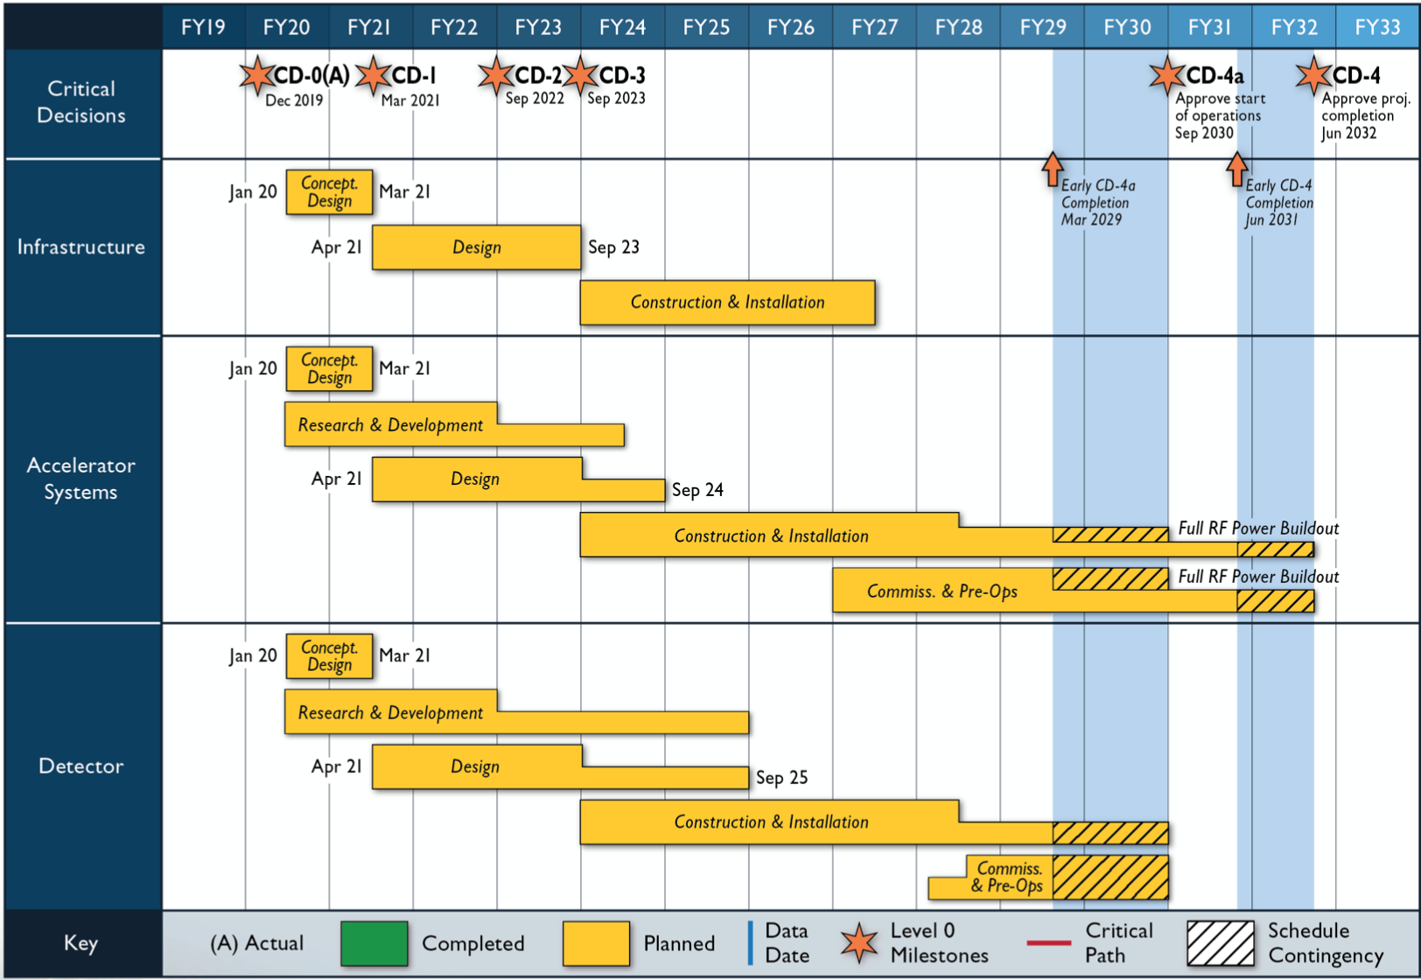
Timeline
Reference: https://indico.bnl.gov/event/9080/contributions/41435/attachments/30459/47756/Detector.Plans.final.pdf

