Slide 1
Simulation Statistics
BY SAGAR AND SIDDHANT

Slide 2
Simulation Parameters
e⁻, kaon⁻, pi⁻ (180k, 100k, 50k)
pt: 4 GeV/c
cut: e>0.2 GeV
Eta: [-4,4]
phi: [-pi,pi]
default units

Slide 3
Color Coding
Electron
Kaon
Pion

Slide 4
CEMC

Slide 5
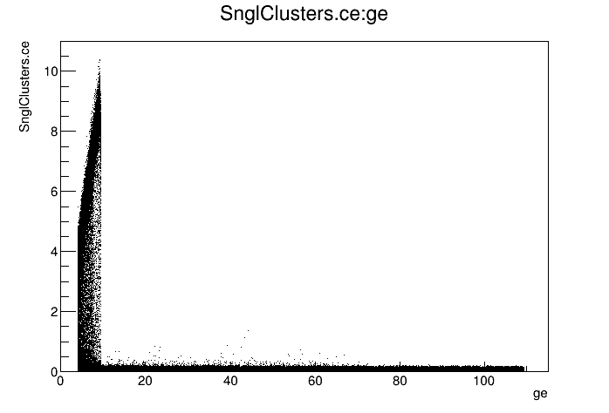
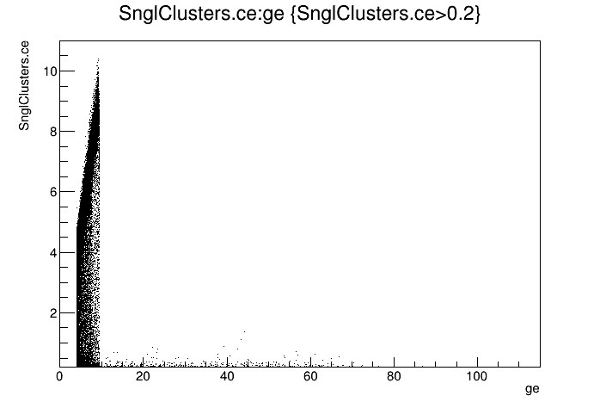
CEMC
e vs ge

Slide 6
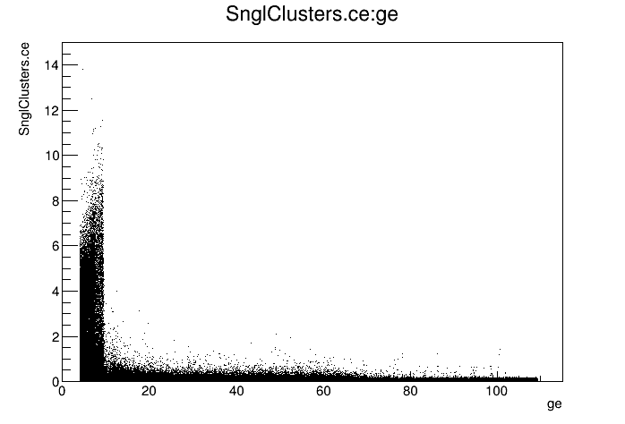
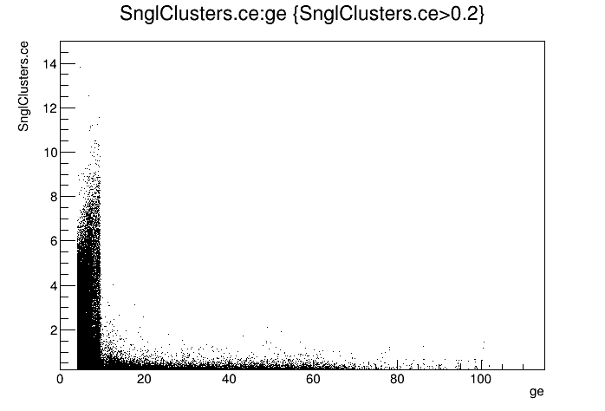
CEMC
e vs ge

Slide 7
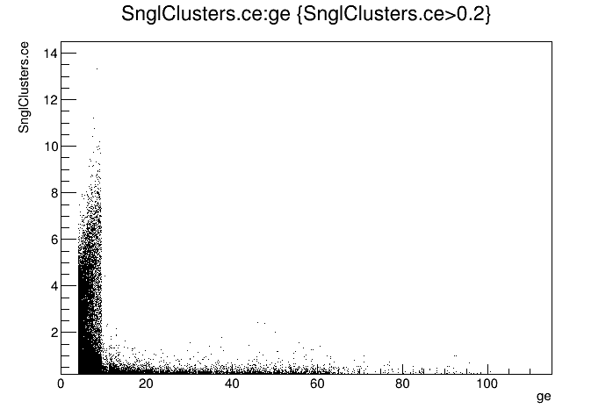
CEMC
e vs ge

Slide 8
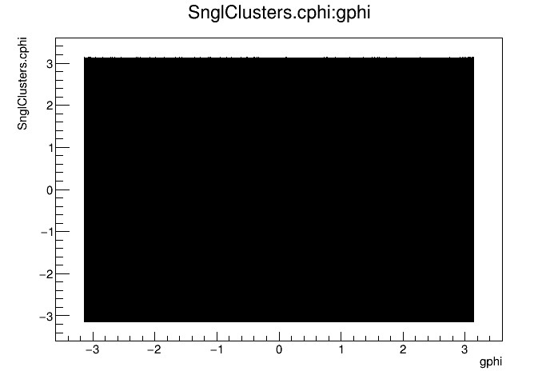
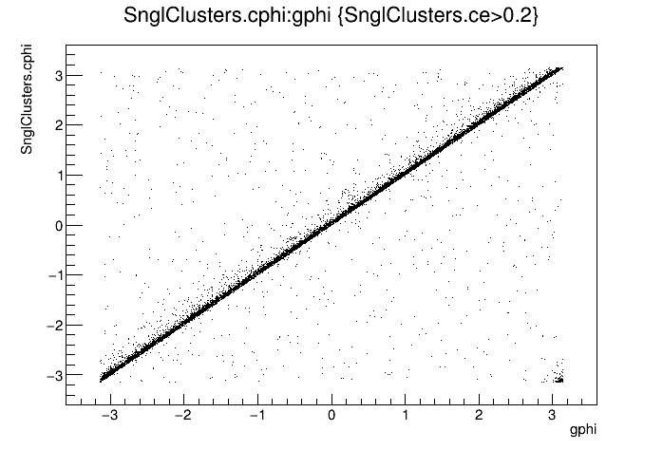
CEMC
phi vs gphi

Slide 9
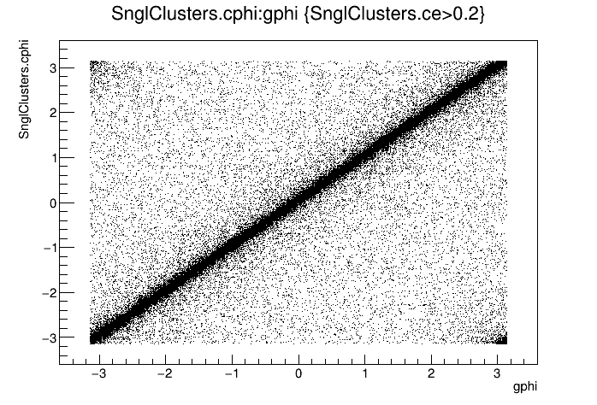
CEMC
phi vs gphi

Slide 10
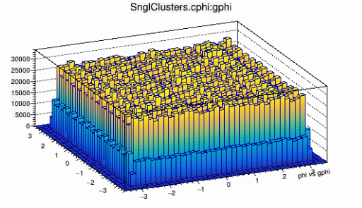
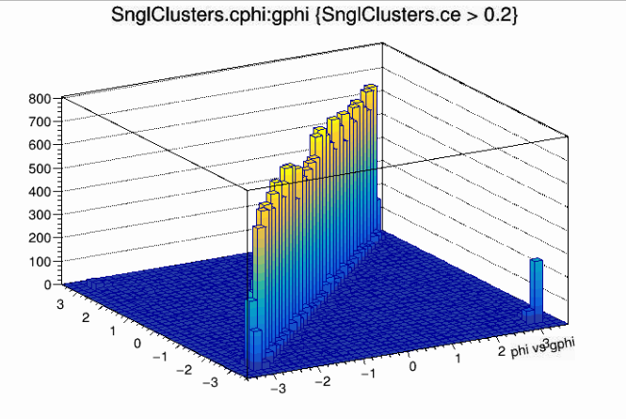
CEMC
phi vs gphi

Slide 11
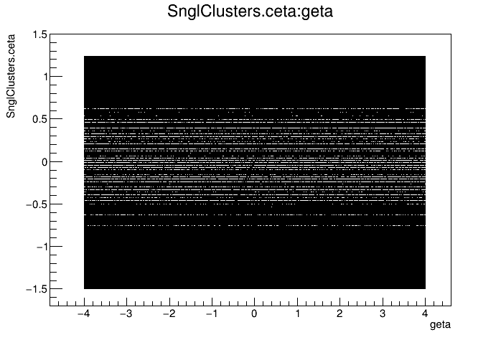
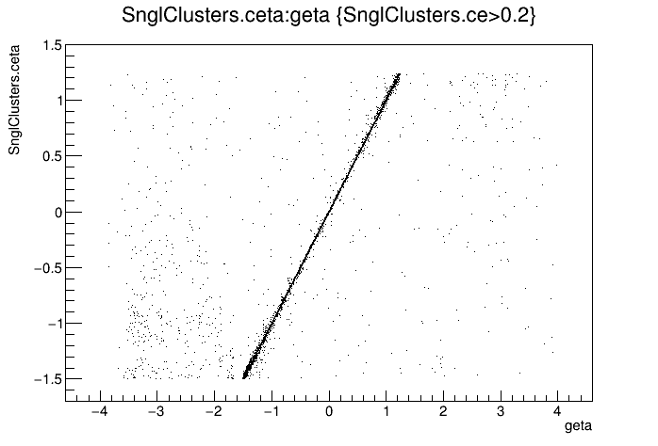
CEMC
eta vs geta

Slide 12
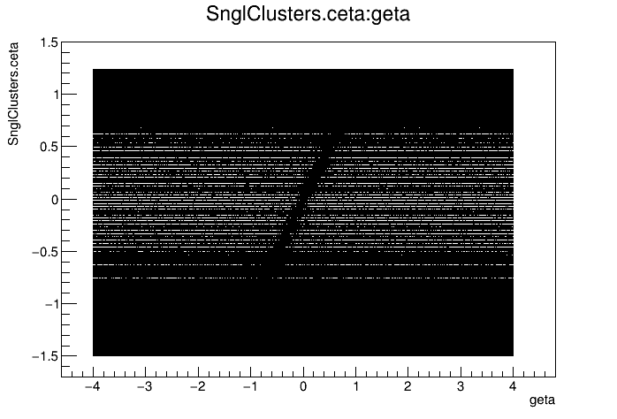
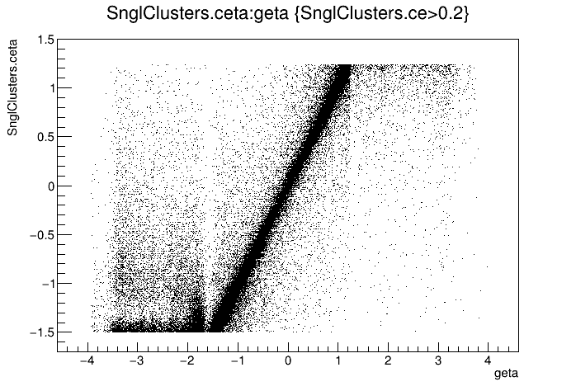
CEMC
eta vs geta

Slide 13
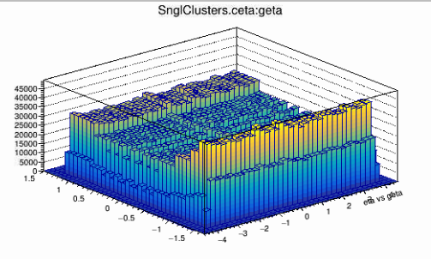
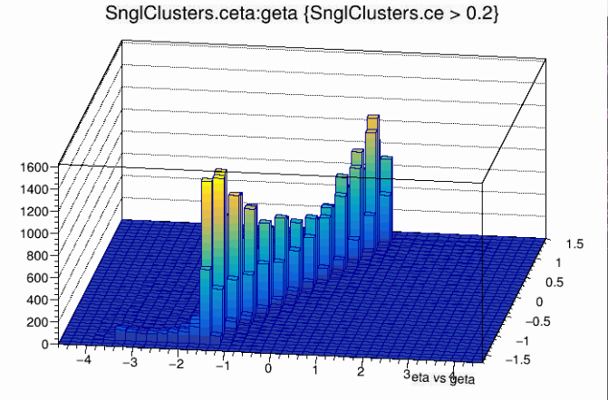
CEMC
eta vs geta

Slide 14
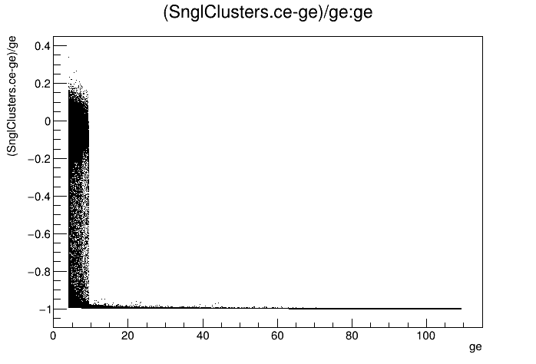
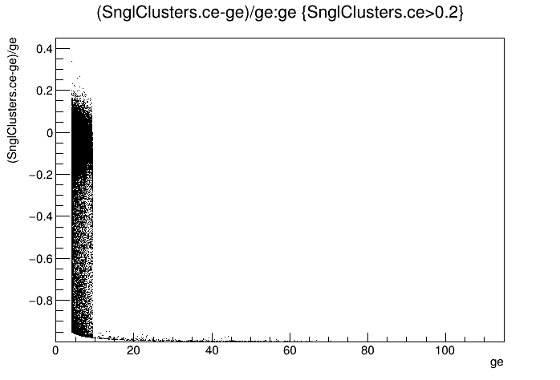
CEMC
Δe/ge vs ge

Slide 15
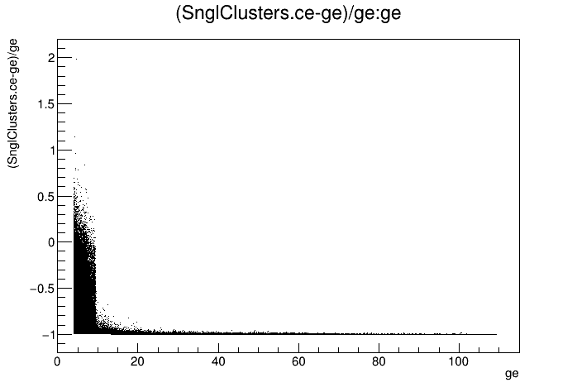
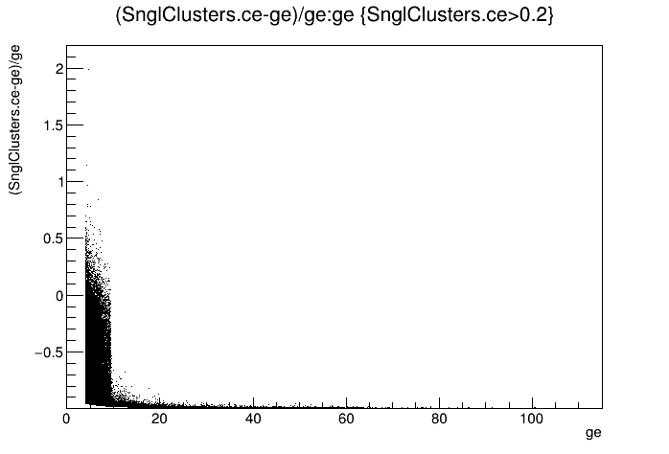
CEMC
Δe/ge vs ge

Slide 16
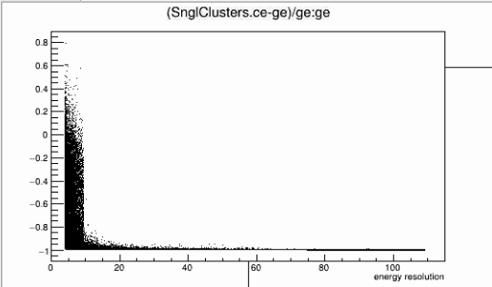
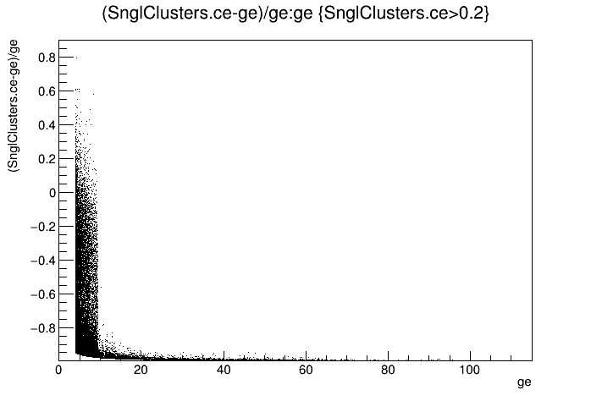
CEMC
Δe/ge vs ge

Slide 17
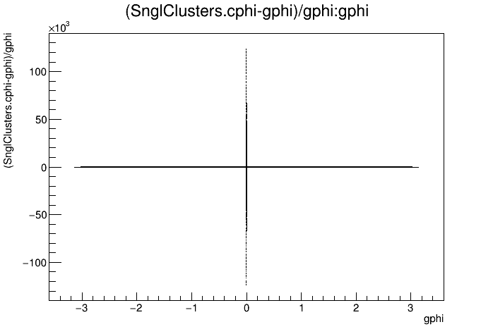
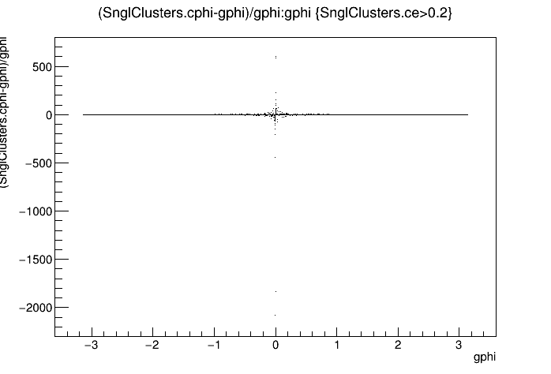
CEMC
Δphi/gphi vs gphi

Slide 18
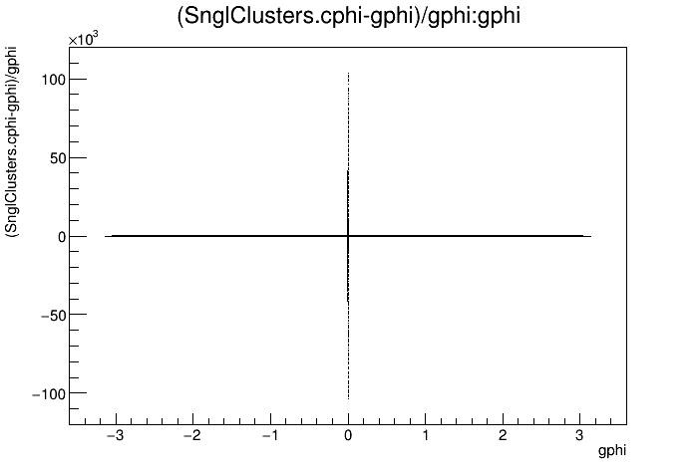
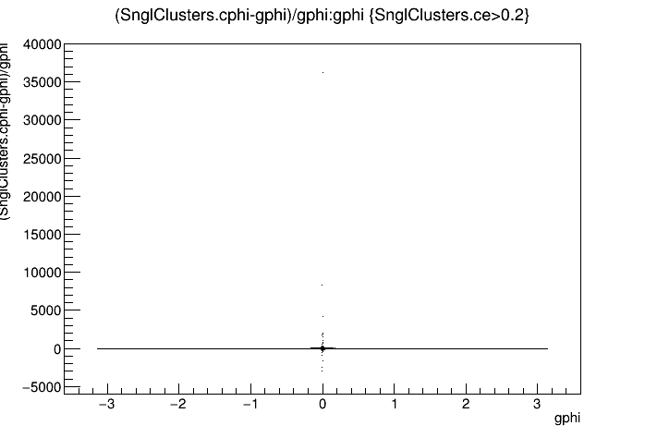
CEMC
Δphi/gphi vs gphi

Slide 19
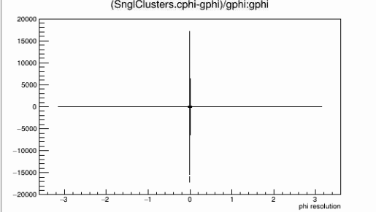
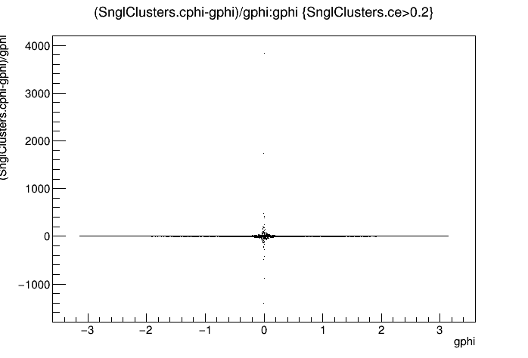
CEMC
Δphi/gphi vs gphi

Slide 20
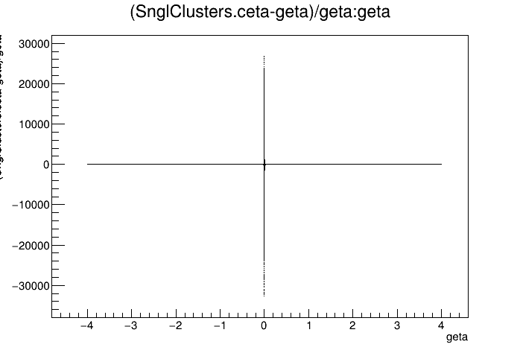
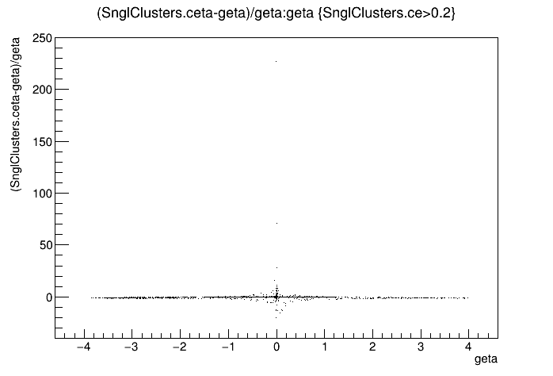
CEMC
Δeta/geta vs geta

Slide 21
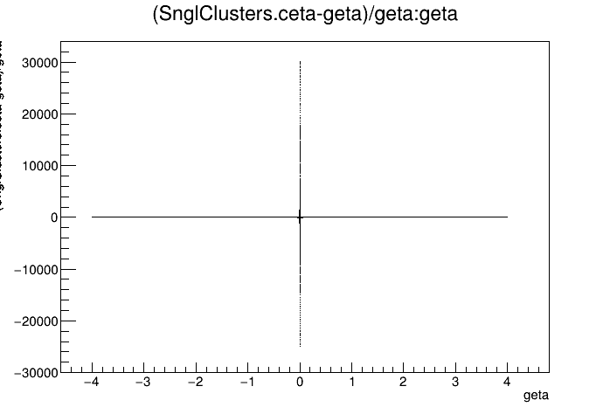
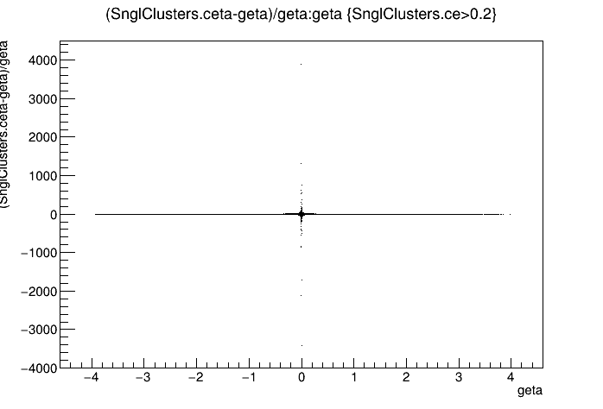
CEMC
Δeta/geta vs geta

Slide 22
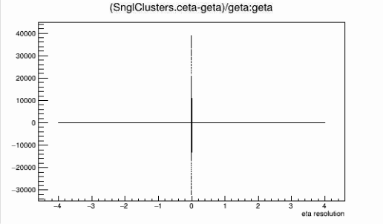
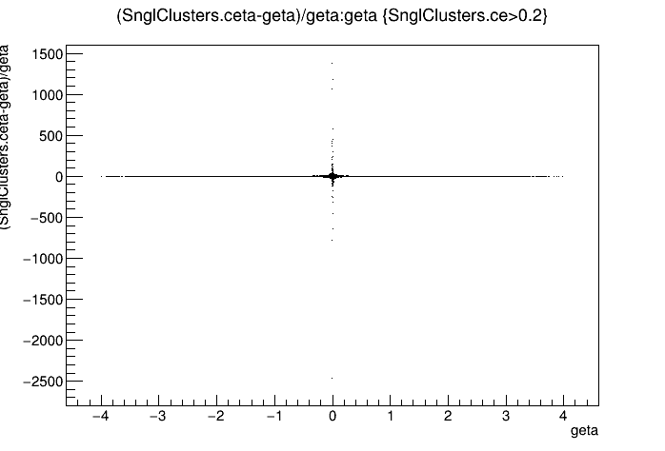
CEMC
Δeta/geta vs geta

Slide 23
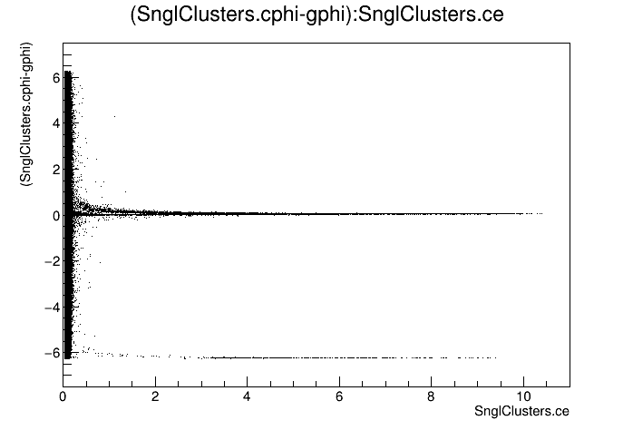
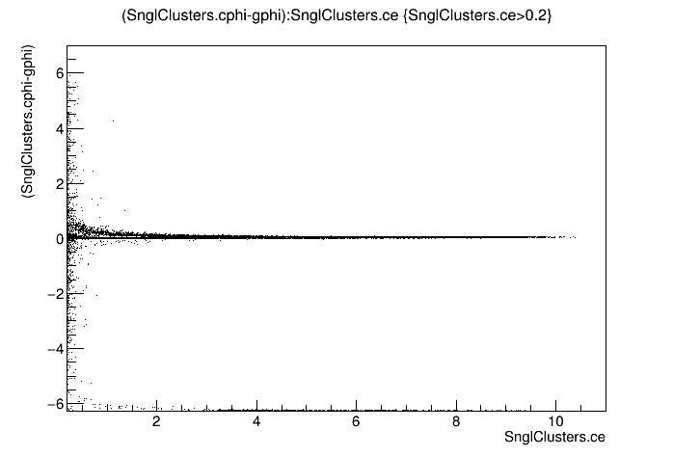
CEMC
Δphi vs e

Slide 24
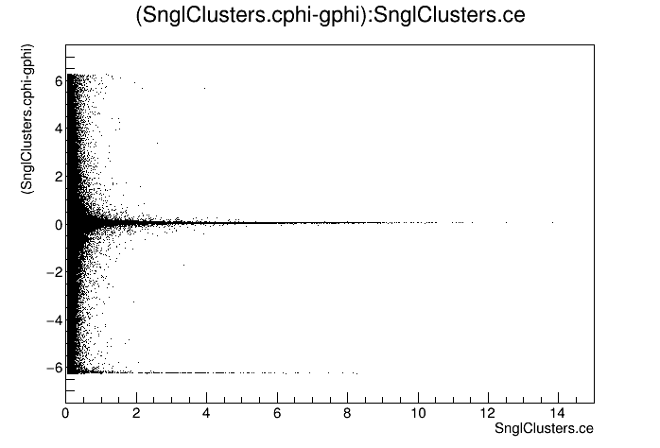
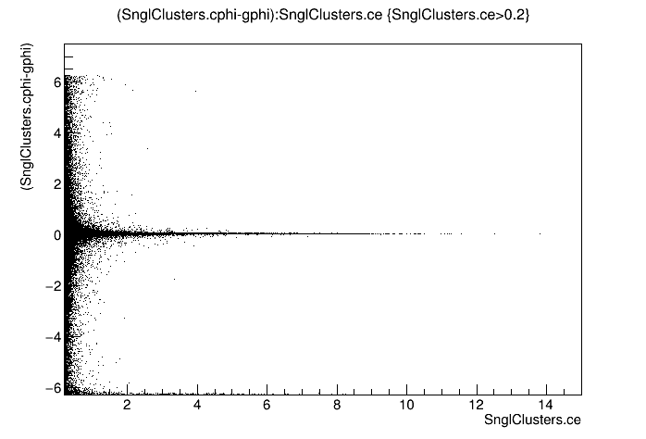
CEMC
Δphi vs e

Slide 25
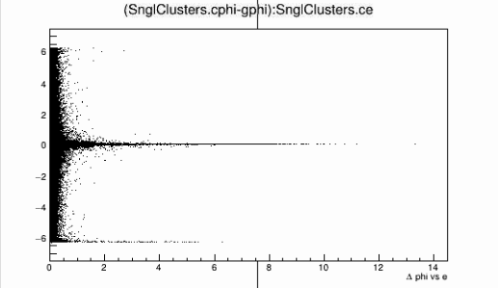
CEMC
Δphi vs e

Slide 26
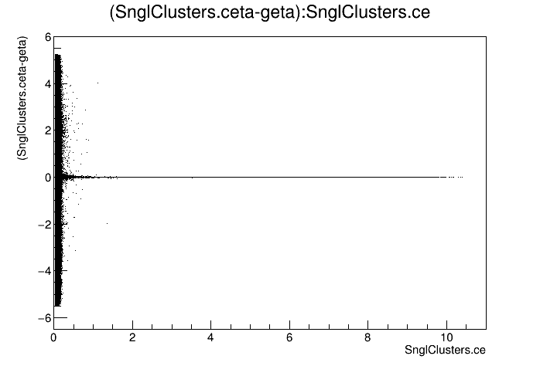
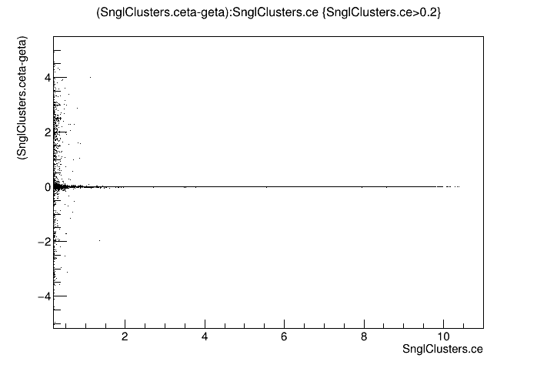
CEMC
Δeta vs e

Slide 27
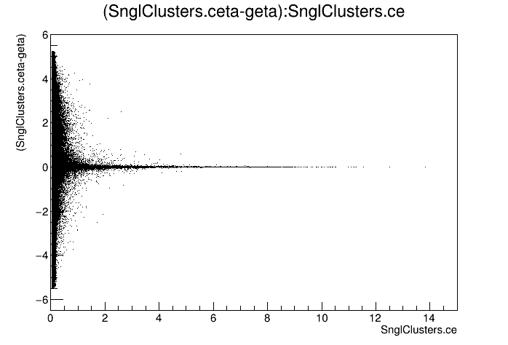
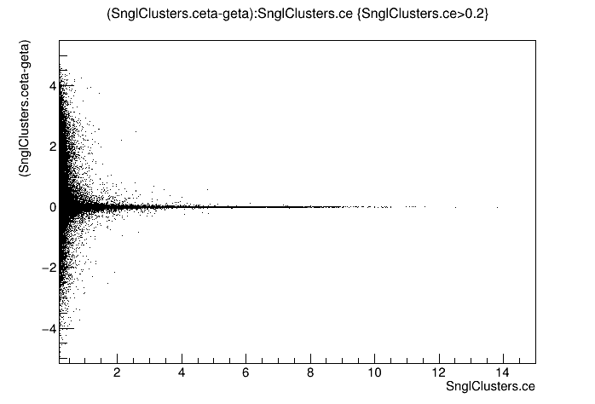
CEMC
Δeta vs e

Slide 28
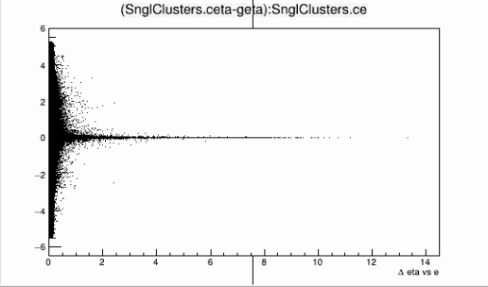
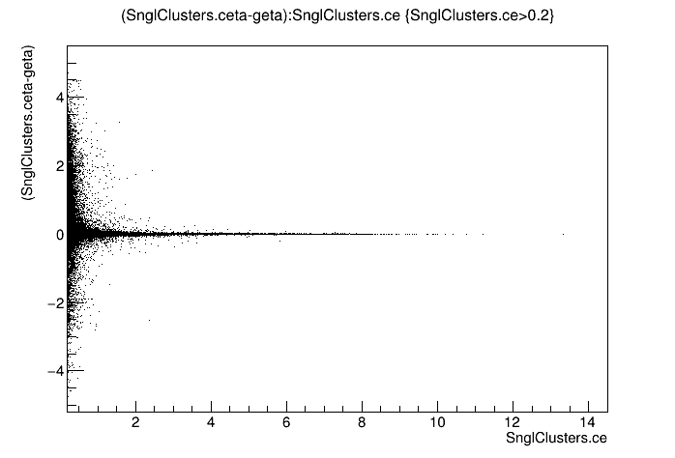
CEMC
Δeta vs e

Slide 29
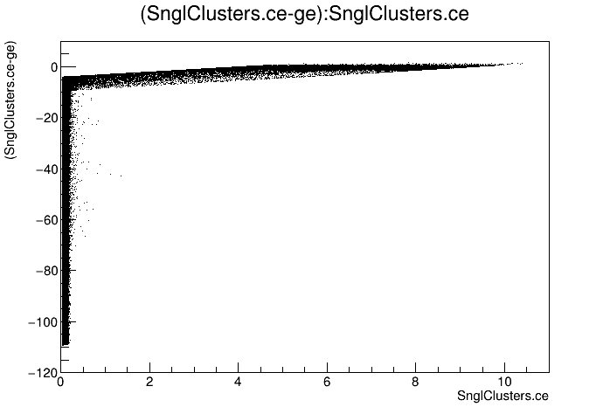
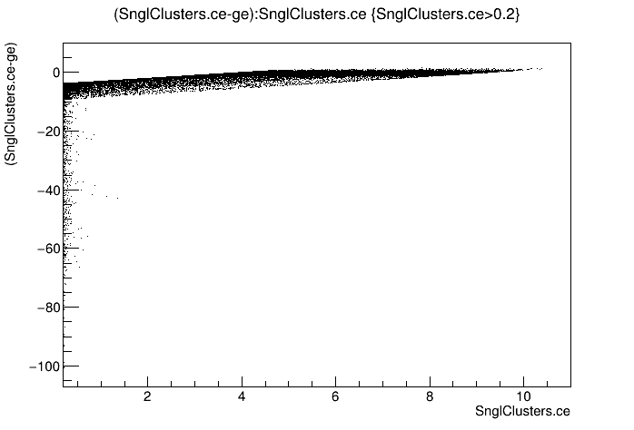
CEMC
Δe vs e

Slide 30
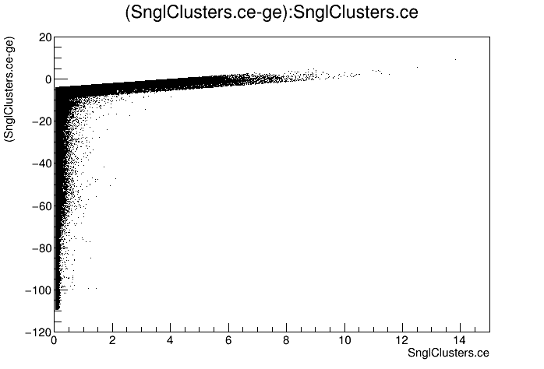
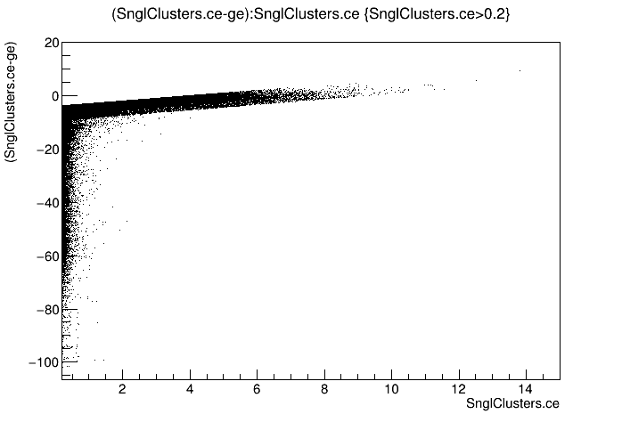
CEMC
Δe vs e

Slide 31
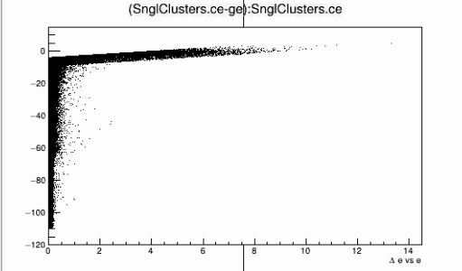
CEMC
Δe vs e

Slide 32
CEMC
Distribution

Slide 33
CEMC
Distribution

Slide 34
CEMC
Distribution

Slide 35
EEMC

Slide 36
EEMC
e vs ge

Slide 37
EEMC
e vs ge

Slide 38
EEMC
e vs ge

Slide 39
EEMC
phi vs gphi

Slide 40
EEMC
phi vs gphi

Slide 41
EEMC
phi vs gphi

Slide 42
EEMC
eta vs geta

Slide 43
EEMC
eta vs geta

Slide 44
EEMC
eta vs geta

Slide 45
EEMC
Δe/ge vs ge

Slide 46
EEMC
Δe/ge vs ge

Slide 47
EEMC
Δe/ge vs ge

Slide 48
EEMC
Δphi/gphi vs gphi

Slide 49
EEMC
Δphi/gphi vs gphi

Slide 50
EEMC
Δphi/gphi vs gphi

Slide 51
EEMC
Δeta/geta vs geta

Slide 52
EEMC
Δeta/geta vs geta

Slide 53
EEMC
Δeta/geta vs geta

Slide 54
EEMC
Δphi vs e

Slide 55
EEMC
Δphi vs e

Slide 56
EEMC
Δphi vs e

Slide 57
EEMC
Δeta vs e

Slide 58
EEMC
Δeta vs e

Slide 59
EEMC
Δeta vs e

Slide 60
EEMC
Δe vs e

Slide 61
EEMC
Δe vs e

Slide 62
EEMC
Δe vs e

Slide 63
EEMC
Distribution

Slide 64
EEMC
Distribution

Slide 65
EEMC
Distribution

Slide 66
FEMC

Slide 67
FEMC
e vs ge

Slide 68
FEMC
e vs ge

Slide 69
FEMC
e vs ge

Slide 70
FEMC
phi vs gphi

Slide 71
FEMC
phi vs gphi

Slide 72
FEMC
phi vs gphi

Slide 73
FEMC
eta vs geta

Slide 74
FEMC
eta vs geta

Slide 75
FEMC
eta vs geta

Slide 76
FEMC
Δe/ge vs ge

Slide 77
FEMC
Δe/ge vs ge

Slide 78
FEMC
Δe/ge vs ge

Slide 79
FEMC
Δphi/gphi vs gphi

Slide 80
FEMC
Δphi/gphi vs gphi

Slide 81
FEMC
Δphi/gphi vs gphi

Slide 82
FEMC
Δeta/geta vs geta

Slide 83
FEMC
Δeta/geta vs geta

Slide 84
FEMC
Δeta/geta vs geta

Slide 85
FEMC
Δphi vs e

Slide 86
FEMC
Δphi vs e

Slide 87
FEMC
Δphi vs e

Slide 88
FEMC
Δeta vs e

Slide 89
FEMC
Δeta vs e

Slide 90
FEMC
Δeta vs e

Slide 91
FEMC
Δe vs e

Slide 92
FEMC
Δe vs e

Slide 93
FEMC
Δe vs e

Slide 94
FEMC
Distribution

Slide 95
FEMC
Distribution

Slide 96
FEMC
Distribution

Slide 97
FHCAL

Slide 98
FHCAL
e vs ge

Slide 99
FHCAL
e vs ge

Slide 100
FHCAL
e vs ge

Slide 101
FHCAL
phi vs gphi

Slide 102
FHCAL
phi vs gphi

Slide 103
FHCAL
phi vs gphi

Slide 104
FHCAL
eta vs geta

Slide 105
FHCAL
eta vs geta

Slide 106
FHCAL
eta vs geta

Slide 107
FHCAL
Δe/ge vs ge

Slide 108
FHCAL
Δe/ge vs ge

Slide 109
FHCAL
Δe/ge vs ge

Slide 110
FHCAL
Δphi/gphi vs gphi

Slide 111
FHCAL
Δphi/gphi vs gphi

Slide 112
FHCAL
Δphi/gphi vs gphi

Slide 113
FHCAL
Δeta/geta vs geta

Slide 114
FHCAL
Δeta/geta vs geta

Slide 115
FHCAL
Δeta/geta vs geta

Slide 116
FHCAL
Δphi vs e

Slide 117
FHCAL
Δphi vs e

Slide 118
FHCAL
Δphi vs e

Slide 119
FHCAL
Δeta vs e

Slide 120
FHCAL
Δeta vs e

Slide 121
FHCAL
Δeta vs e

Slide 122
FHCAL
Δe vs e

Slide 123
FHCAL
Δe vs e

Slide 124
FHCAL
Δe vs e

Slide 125
FHCAL
Distribution

Slide 126
FHCAL
Distribution

Slide 127
FHCAL
Distribution

Slide 128
HCALIN

Slide 129
HCALIN
e vs ge

Slide 130
HCALIN
e vs ge

Slide 131
HCALIN
e vs ge

Slide 132
HCALIN
phi vs gphi

Slide 133
HCALIN
phi vs gphi

Slide 134
HCALIN
phi vs gphi

Slide 135
HCALIN
eta vs geta

Slide 136
HCALIN
eta vs geta

Slide 137
HCALIN
eta vs geta

Slide 138
HCALIN
Δe/ge vs ge

Slide 139
HCALIN
Δe/ge vs ge

Slide 140
HCALIN
Δe/ge vs ge

Slide 141
HCALIN
Δphi/gphi vs gphi

Slide 142
HCALIN
Δphi/gphi vs gphi

Slide 143
HCALIN
Δphi/gphi vs gphi

Slide 144
HCALIN
Δeta/geta vs geta

Slide 145
HCALIN
Δeta/geta vs geta

Slide 146
HCALIN
Δeta/geta vs geta

Slide 147
HCALIN
Δphi vs e

Slide 148
HCALIN
Δphi vs e

Slide 149
HCALIN
Δphi vs e

Slide 150
HCALIN
Δeta vs e

Slide 151
HCALIN
Δeta vs e

Slide 152
HCALIN
Δeta vs e

Slide 153
HCALIN
Δe vs e

Slide 154
HCALIN
Δe vs e

Slide 155
HCALIN
Δe vs e

Slide 156
HCALIN
Distribution

Slide 157
HCALIN
Distribution

Slide 158
HCALIN
Distribution

Slide 159
HCALOUT

Slide 160
HCALOUT
e vs ge

Slide 161
HCALOUT
e vs ge

Slide 162
HCALOUT
e vs ge

Slide 163
HCALOUT
phi vs gphi

Slide 164
HCALOUT
phi vs gphi

Slide 165
HCALOUT
phi vs gphi

Slide 166
HCALOUT
eta vs geta

Slide 167
HCALOUT
eta vs geta

Slide 168
HCALOUT
eta vs geta

Slide 169
HCALOUT
Δe/ge vs ge

Slide 170
HCALOUT
Δe/ge vs ge

Slide 171
HCALOUT
Δe/ge vs ge

Slide 172
HCALOUT
Δphi/gphi vs gphi

Slide 173
HCALOUT
Δphi/gphi vs gphi

Slide 174
HCALOUT
Δphi/gphi vs gphi

Slide 175
HCALOUT
Δeta/geta vs geta

Slide 176
HCALOUT
Δeta/geta vs geta

Slide 177
HCALOUT
Δeta/geta vs geta

Slide 178
HCALOUT
Δphi vs e

Slide 179
HCALOUT
Δphi vs e

Slide 180
HCALOUT
Δphi vs e

Slide 181
HCALOUT
Δeta vs e

Slide 182
HCALOUT
Δeta vs e

Slide 183
HCALOUT
Δeta vs e

Slide 184
HCALOUT
Δe vs e

Slide 185
HCALOUT
Δe vs e

Slide 186
HCALOUT
Δe vs e

Slide 187
HCALOUT
Distribution

Slide 188
HCALOUT
Distribution

Slide 189
HCALOUT
distribution

