Slide 1
Simulation Statistics
BY SAGAR AND SIDDHANT

Slide 2
Simulation Parameters
Electrons
(10k)
pt: 4-4
cut: e>0.225
Eta: 1.5 - 4
phi: -pi to pi
default units

Slide 3
CEMC

Slide 4
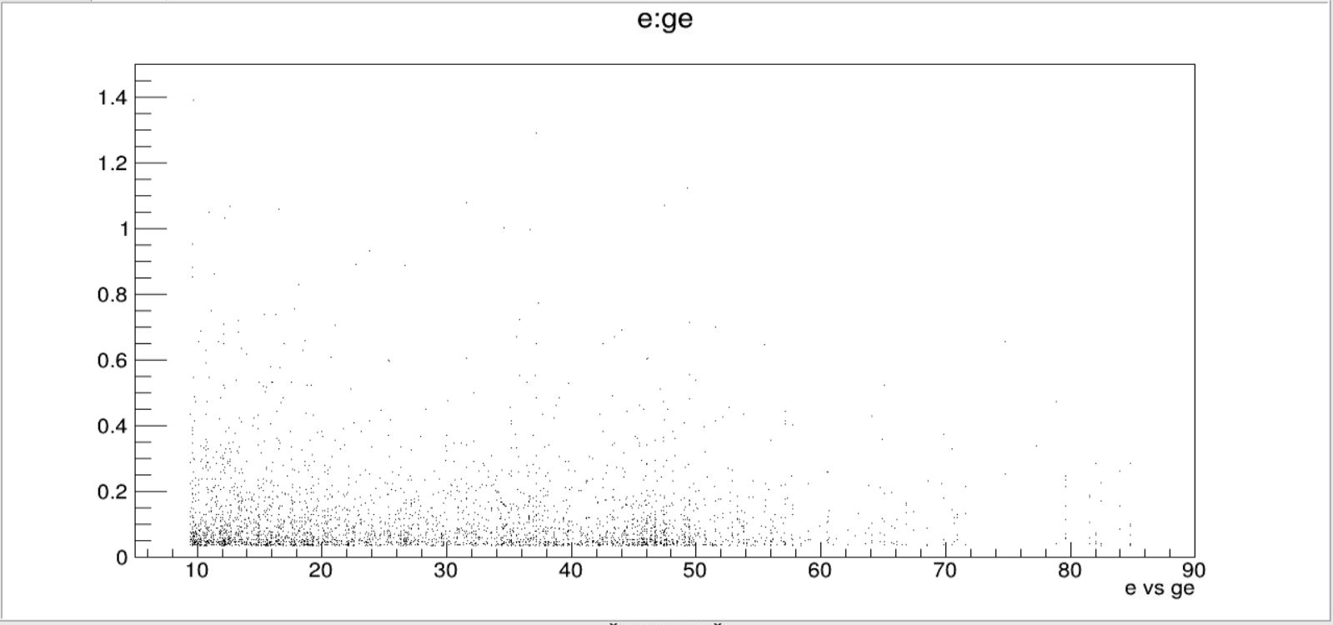
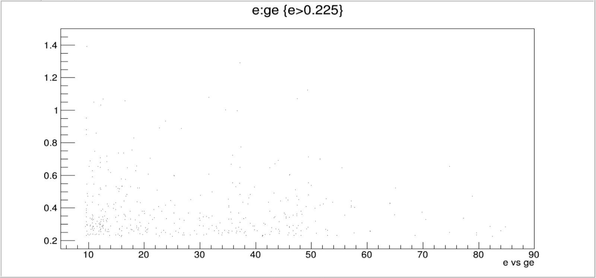
CEMC
e vs ge

Slide 5
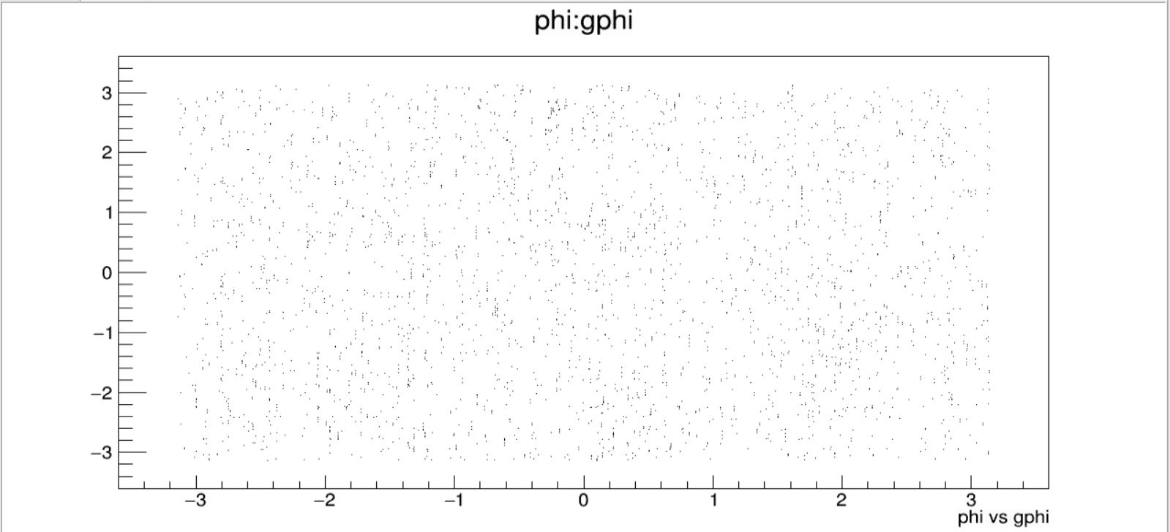
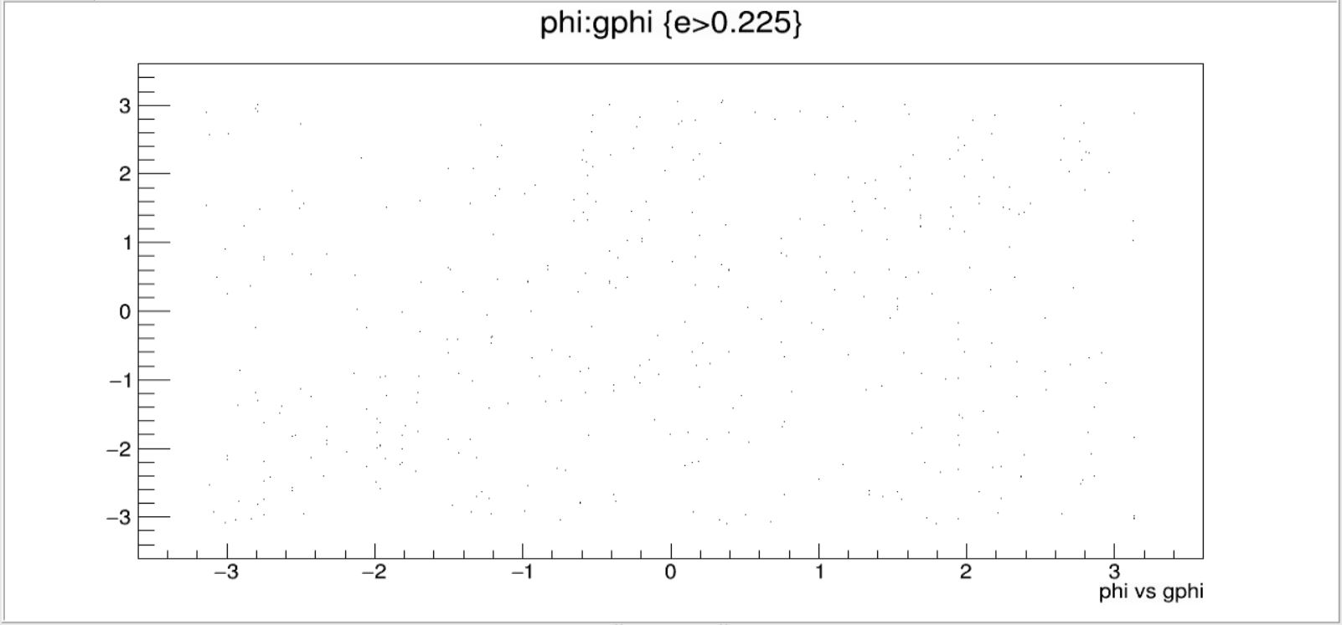
CEMC
phi vs gphi

Slide 6
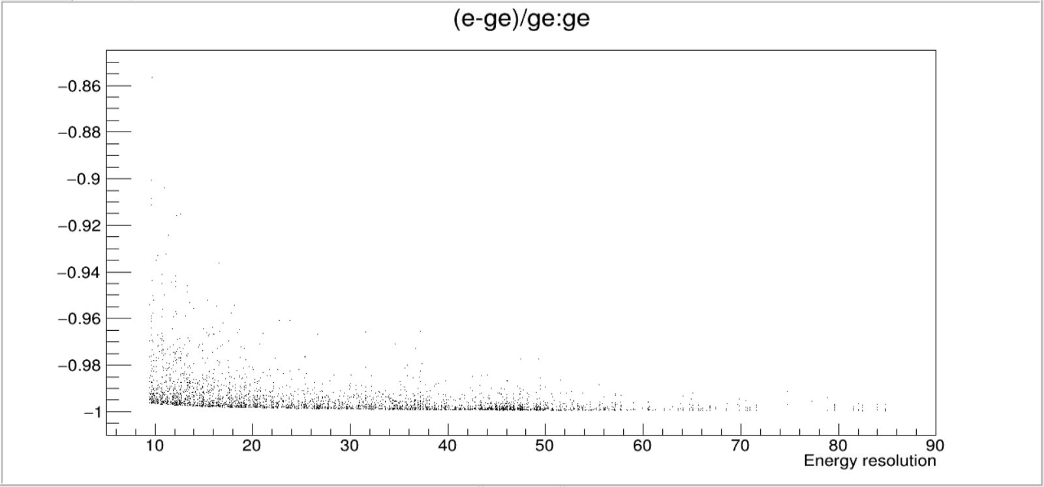
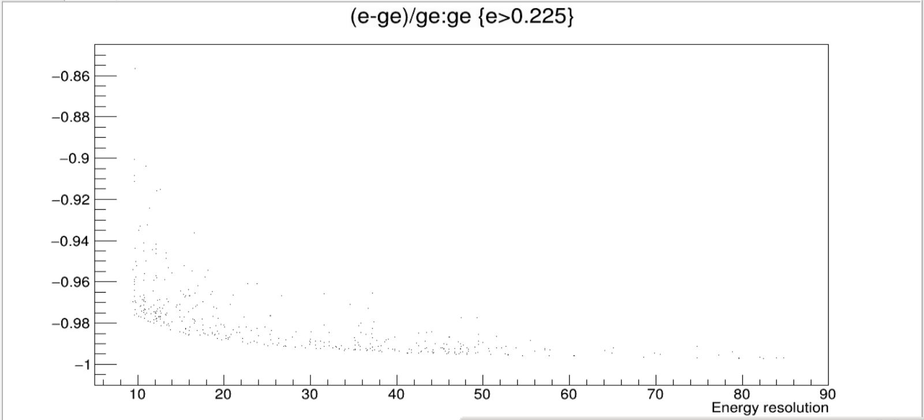
CEMC
Δe/ge vs ge

Slide 7
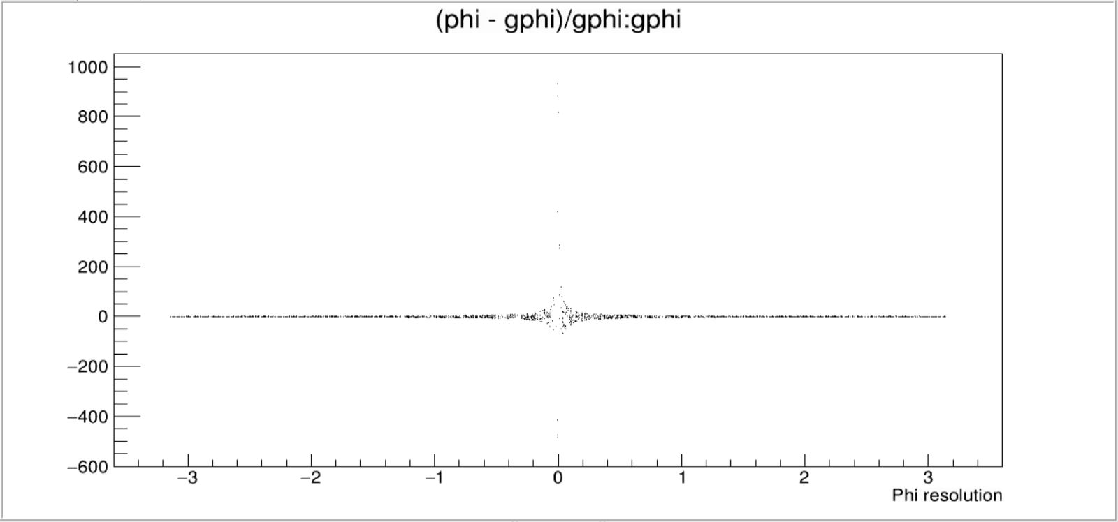
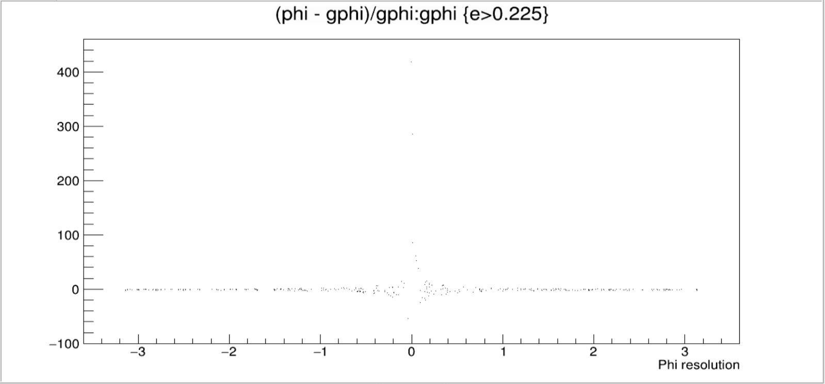
CEMC
Δphi/gphi vs gphi

Slide 8
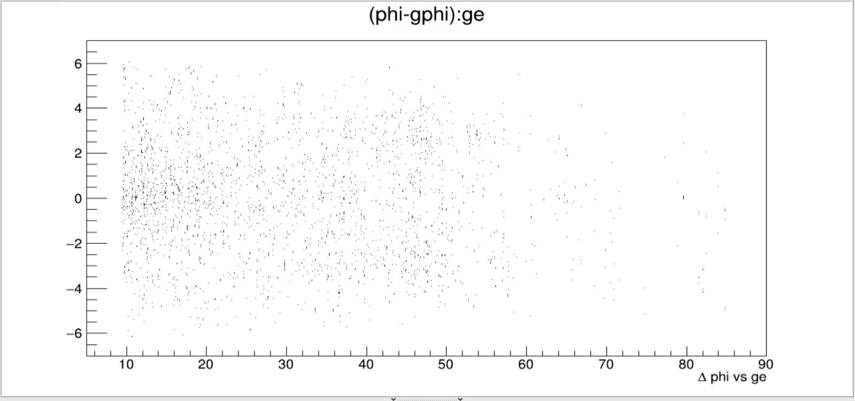
CEMC
Δphi vs ge

Slide 9
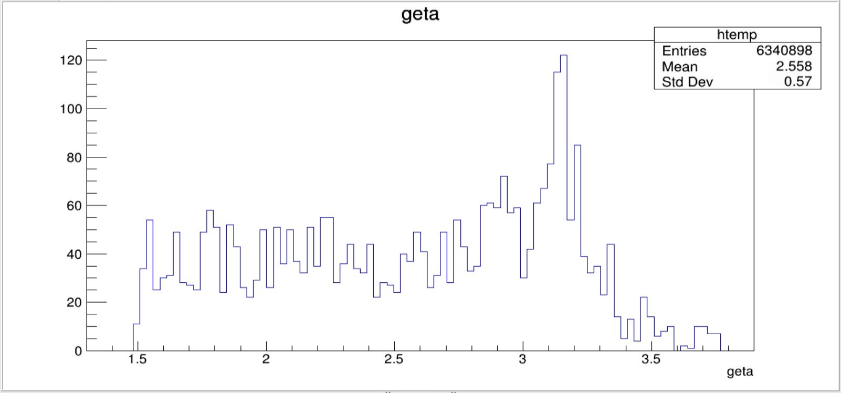
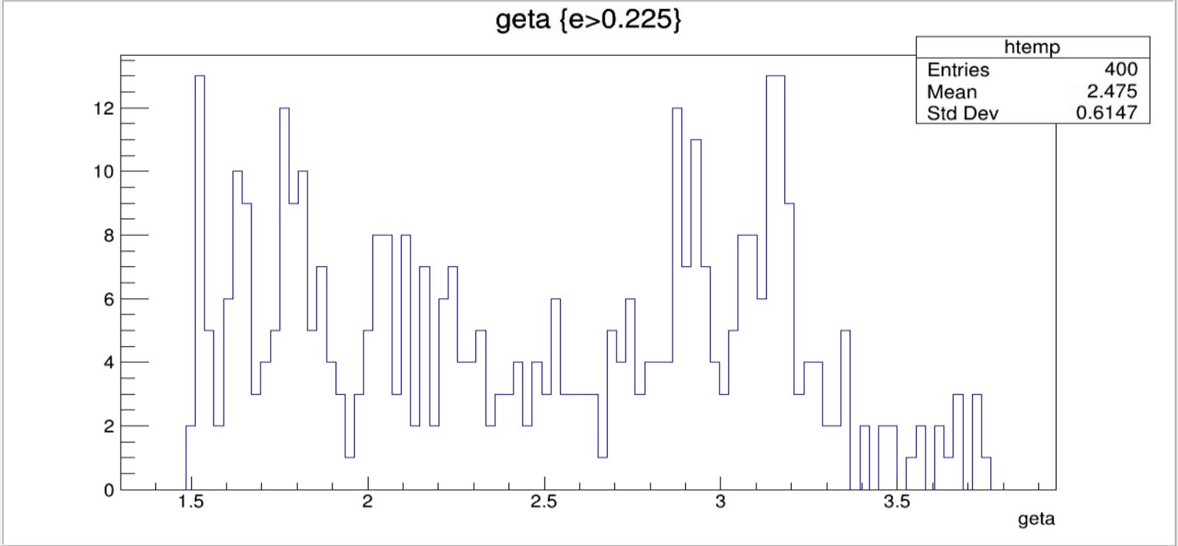
CEMC
geta vs count

Slide 10
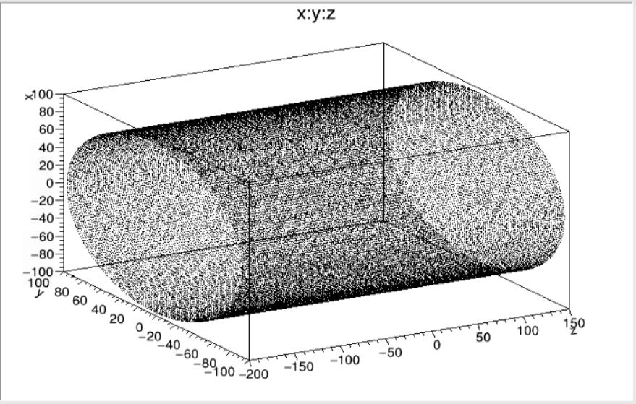
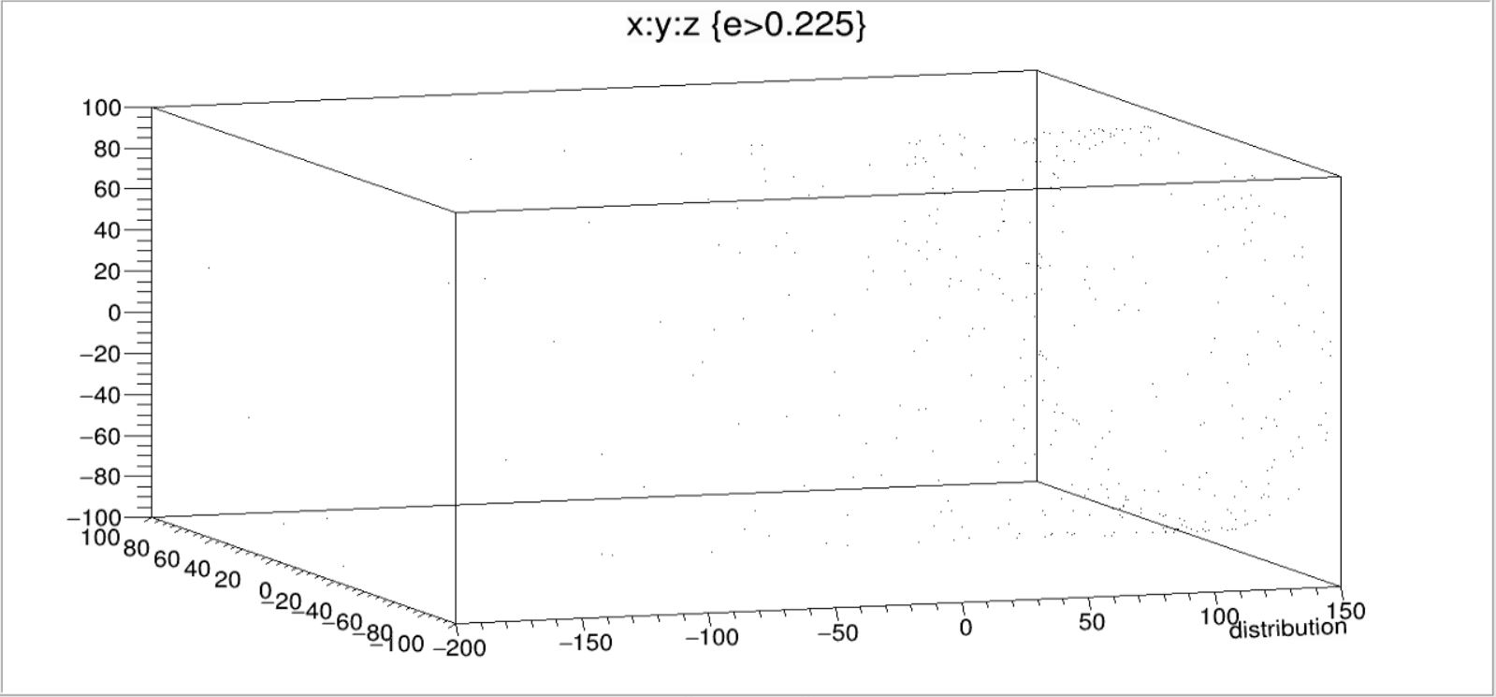
CEMC
Distribution

Slide 11
EEMC

Slide 12
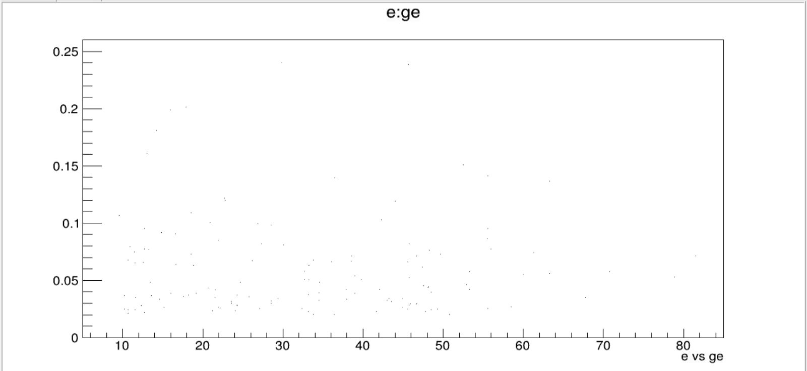
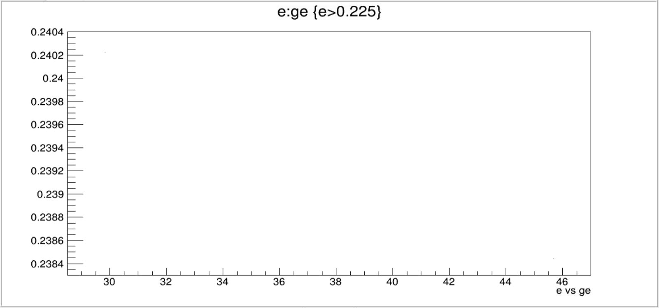
EEMC
e vs ge

Slide 13
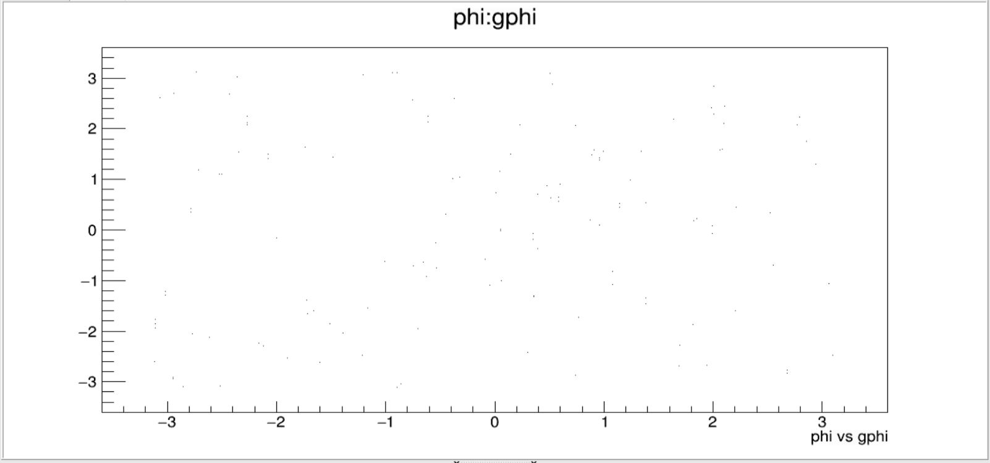
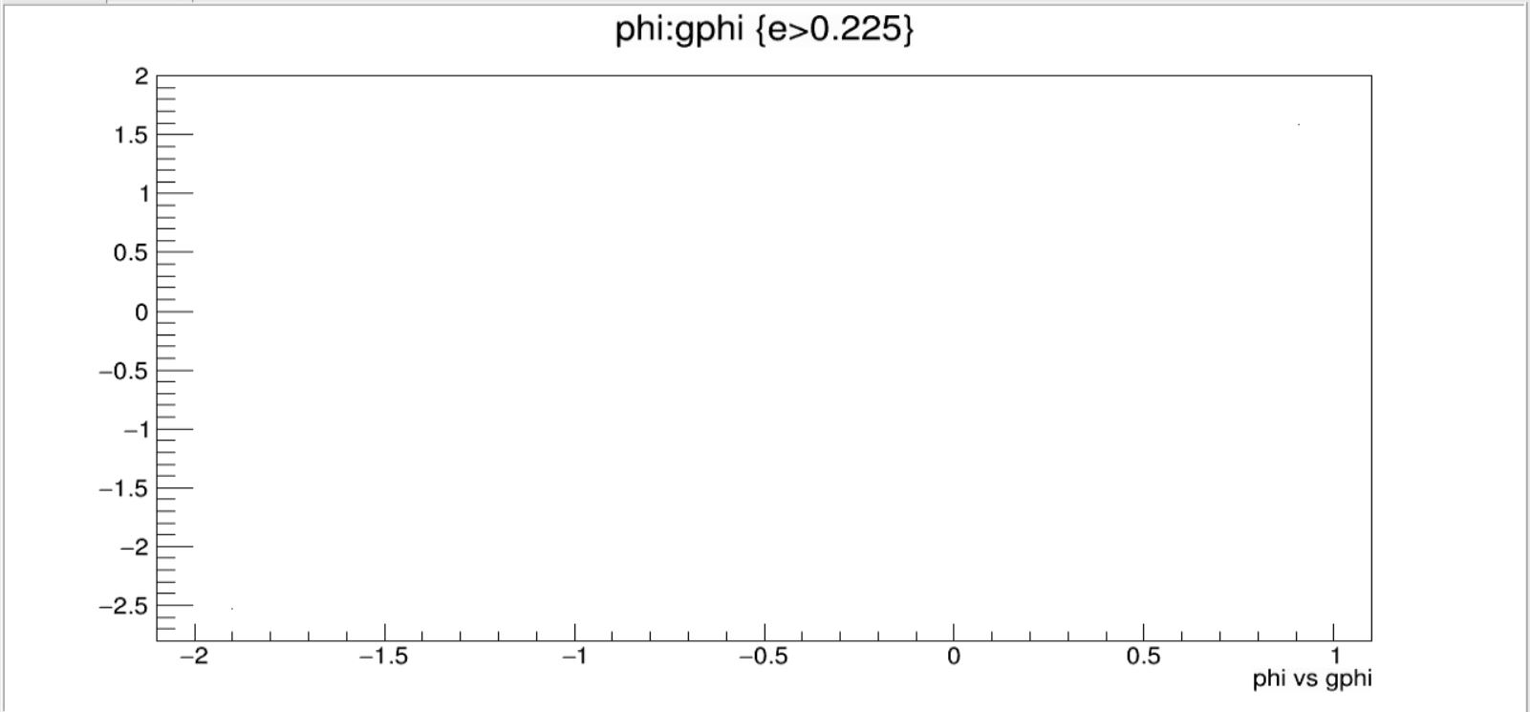
EEMC
phi vs gphi

Slide 14
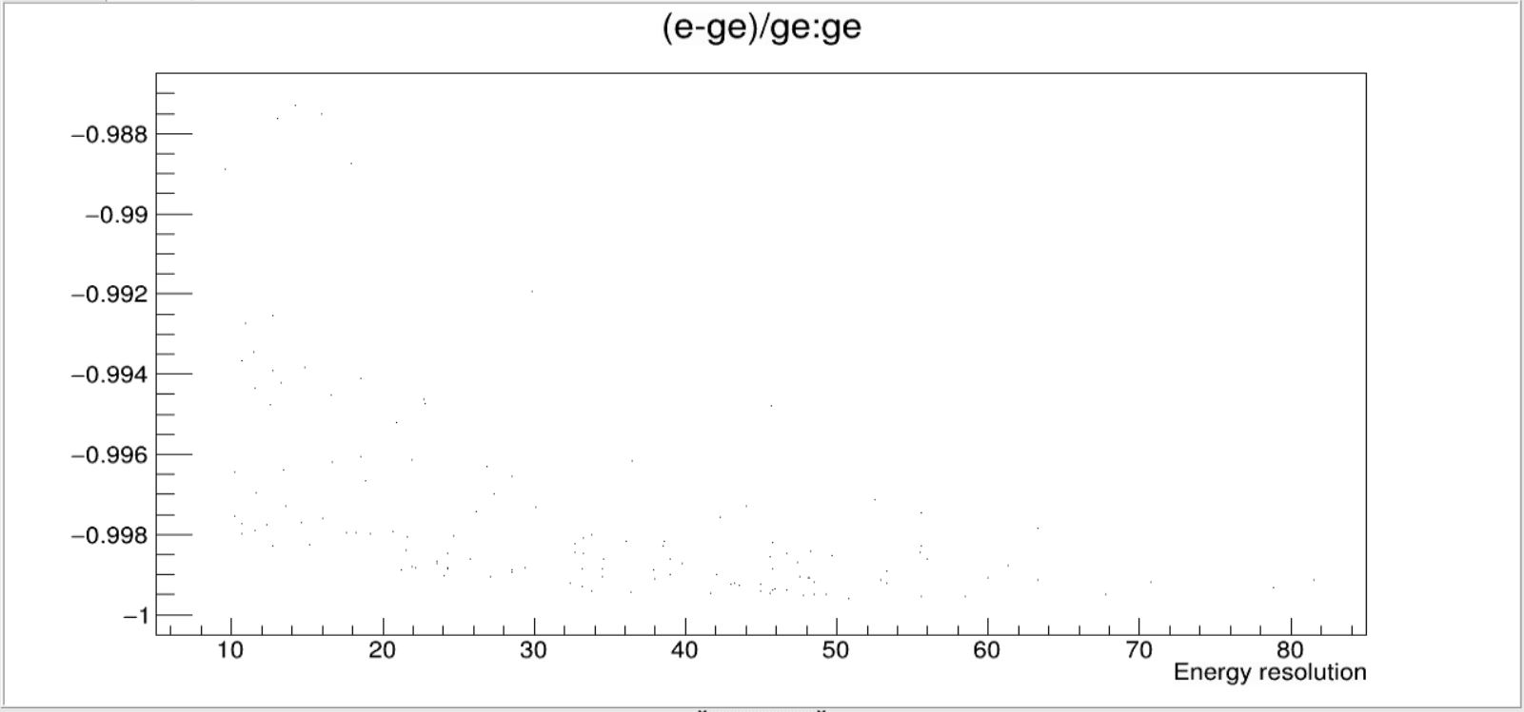
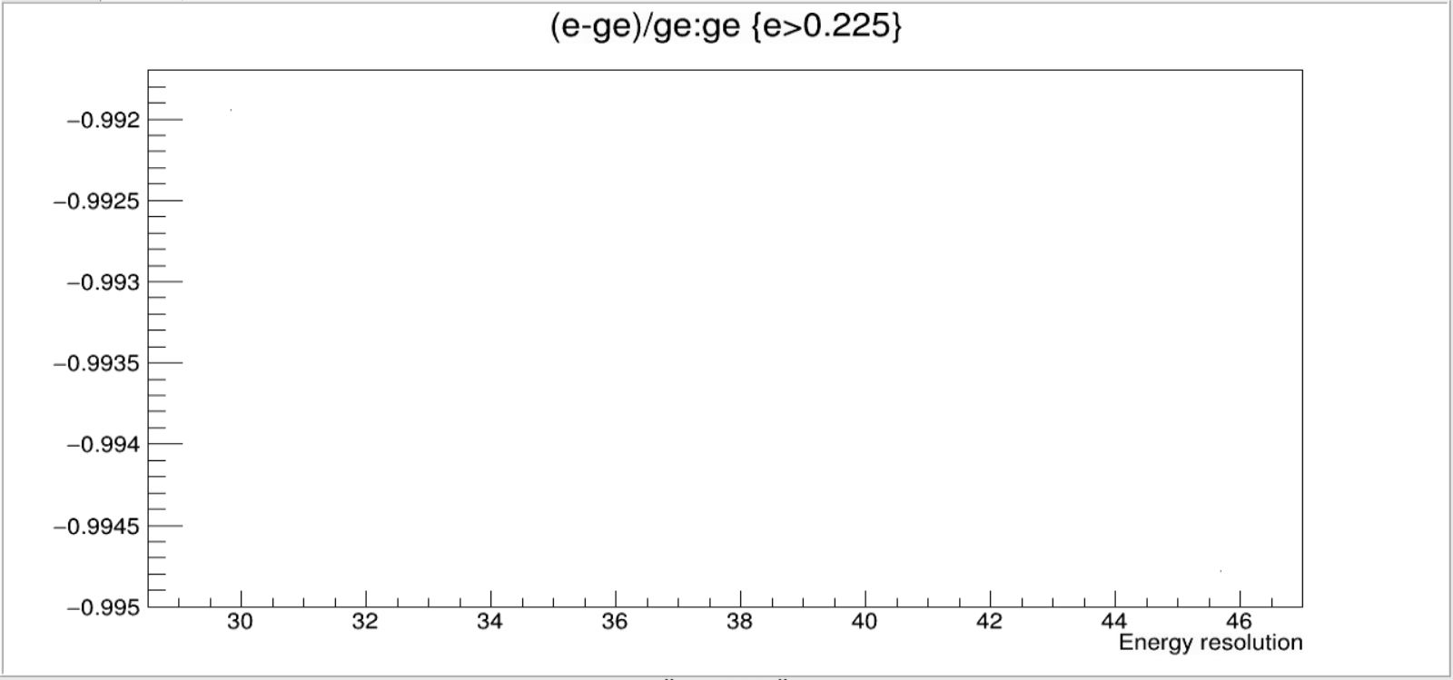
EEMC
Δe/ge vs ge

Slide 15
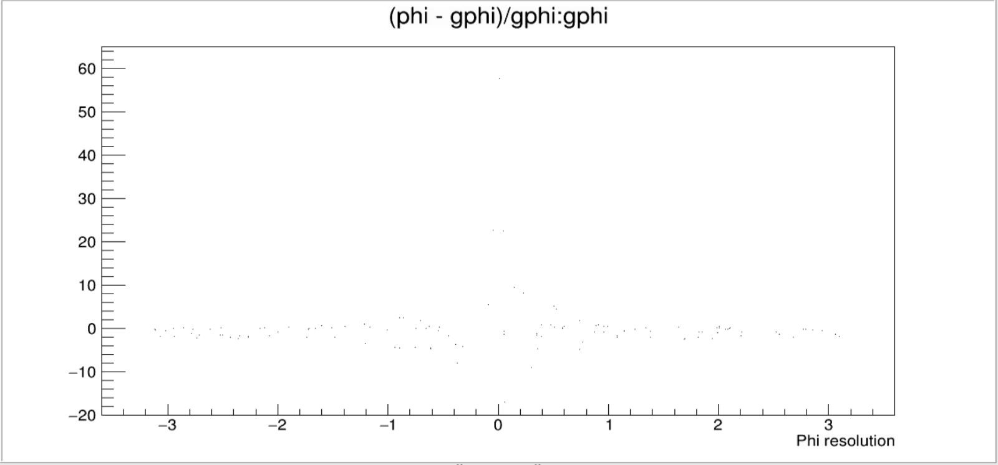
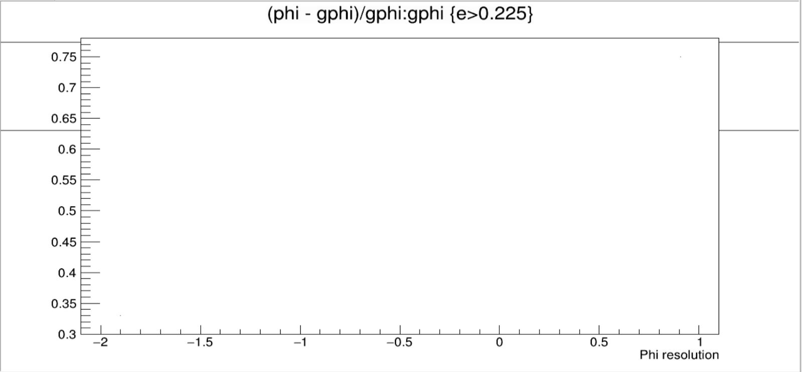
EEMC
Δphi/gphi vs gphi

Slide 16
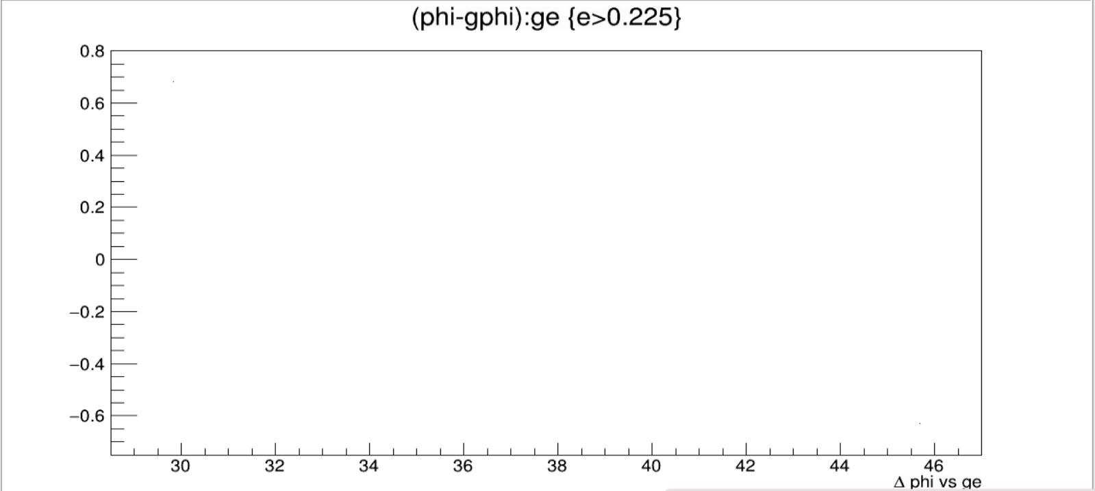
EEMC
Δphi vs ge

Slide 17
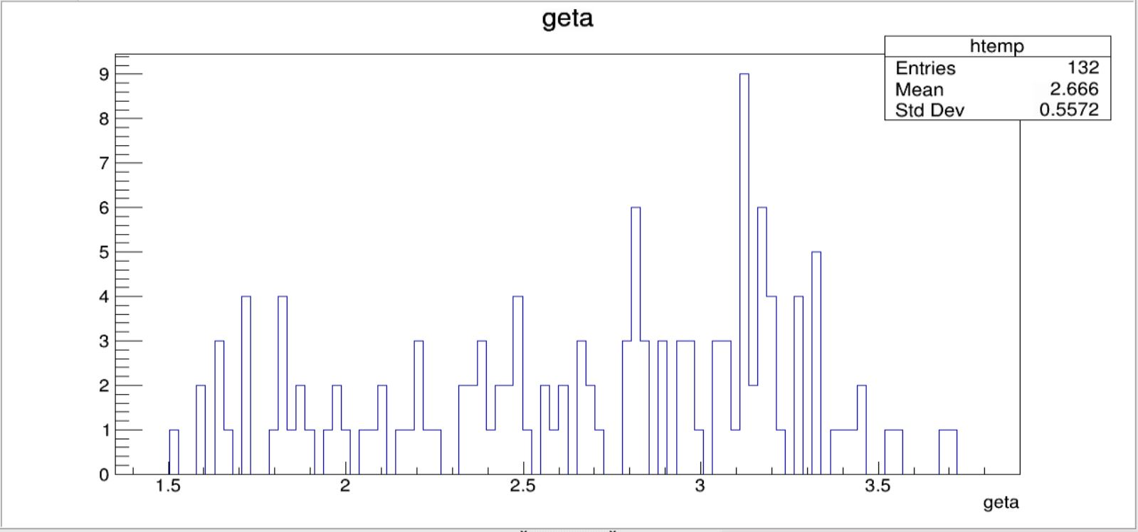
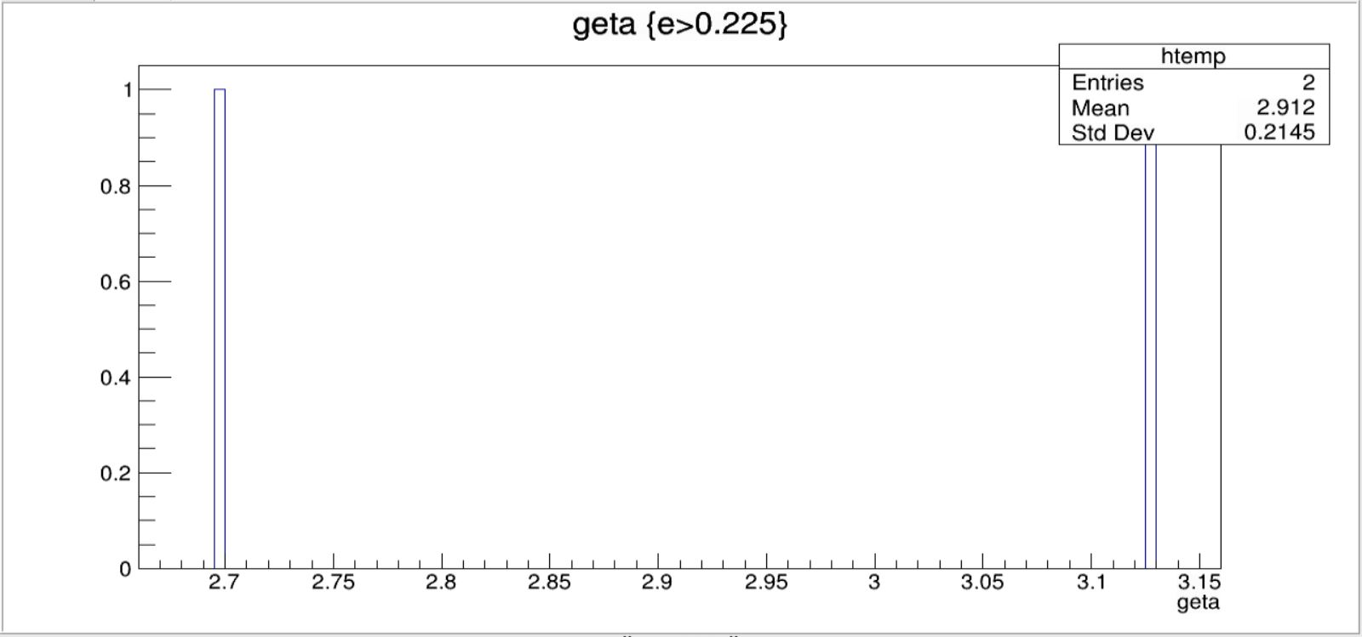
EEMC
geta vs count

Slide 18
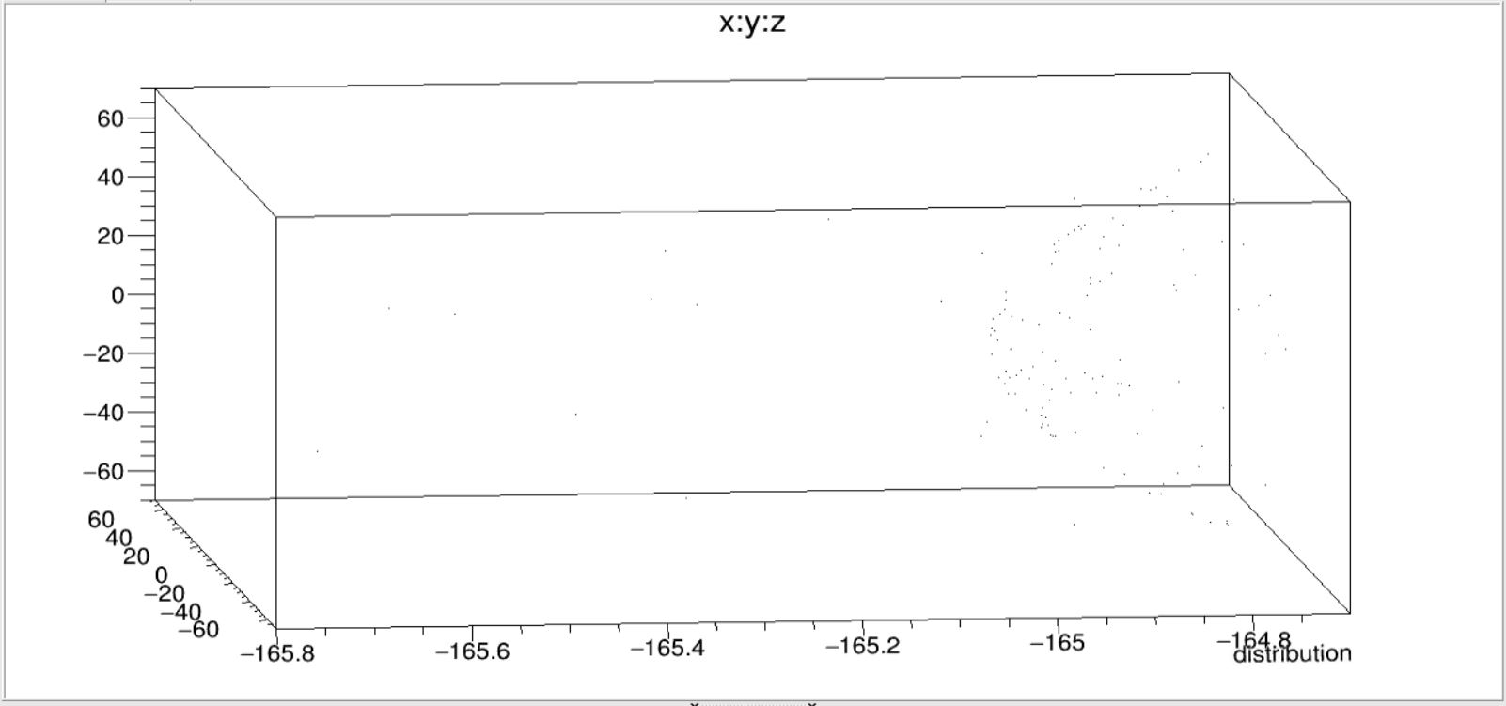
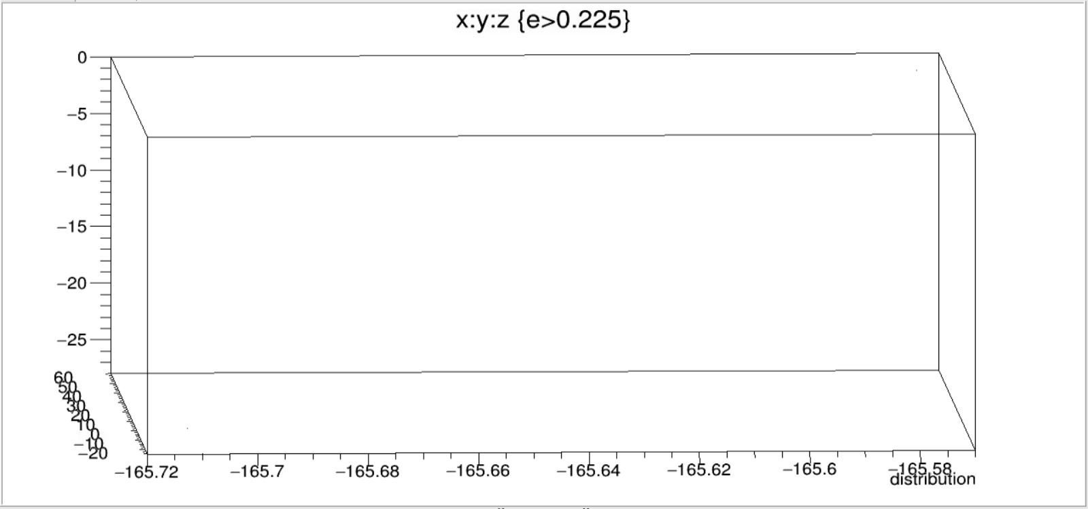
EEMC
Distribution

Slide 19
FEMC

Slide 20
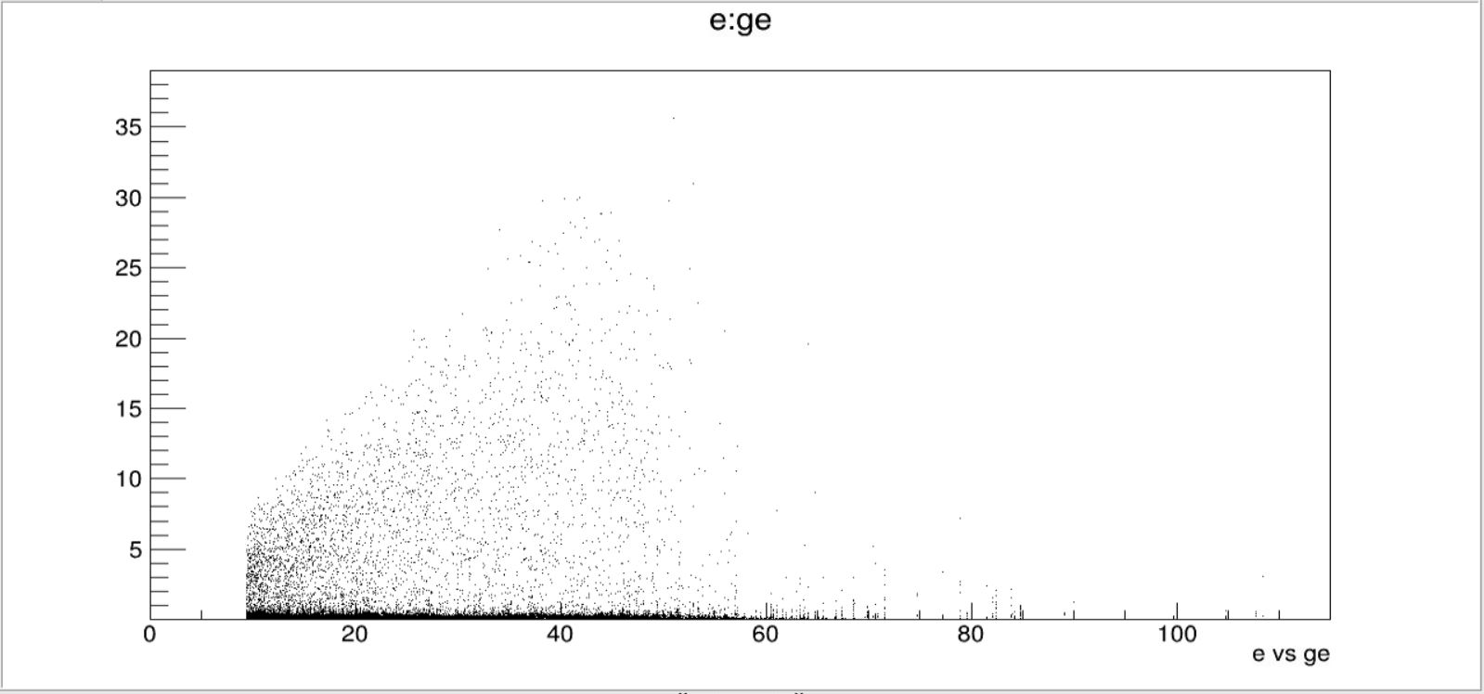
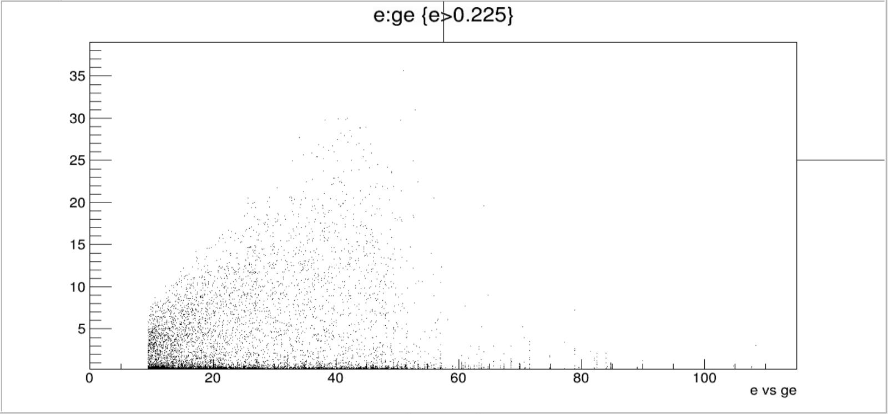
FEMC
e vs ge

Slide 21
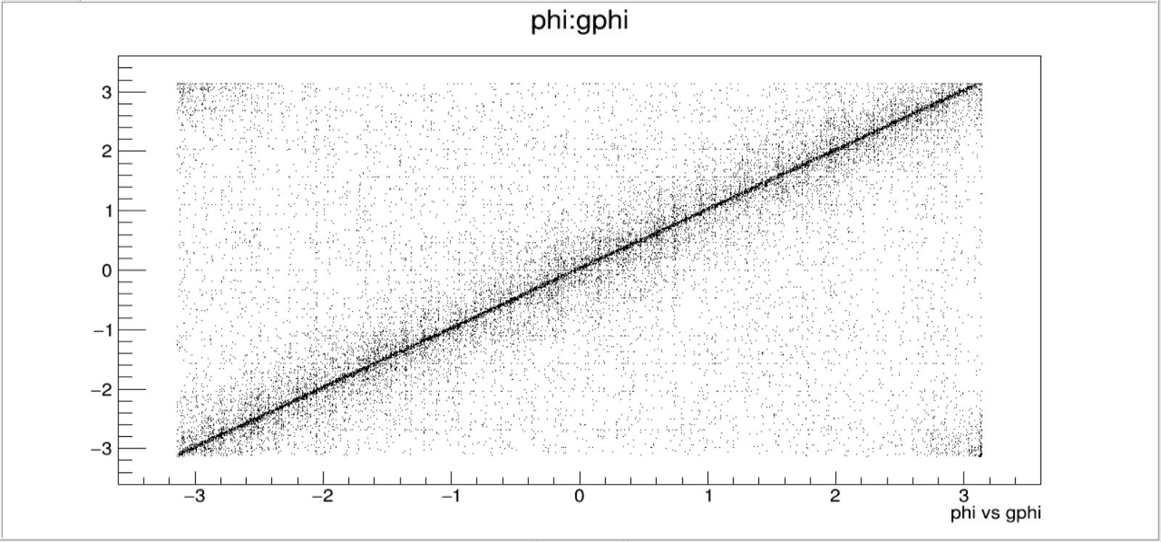
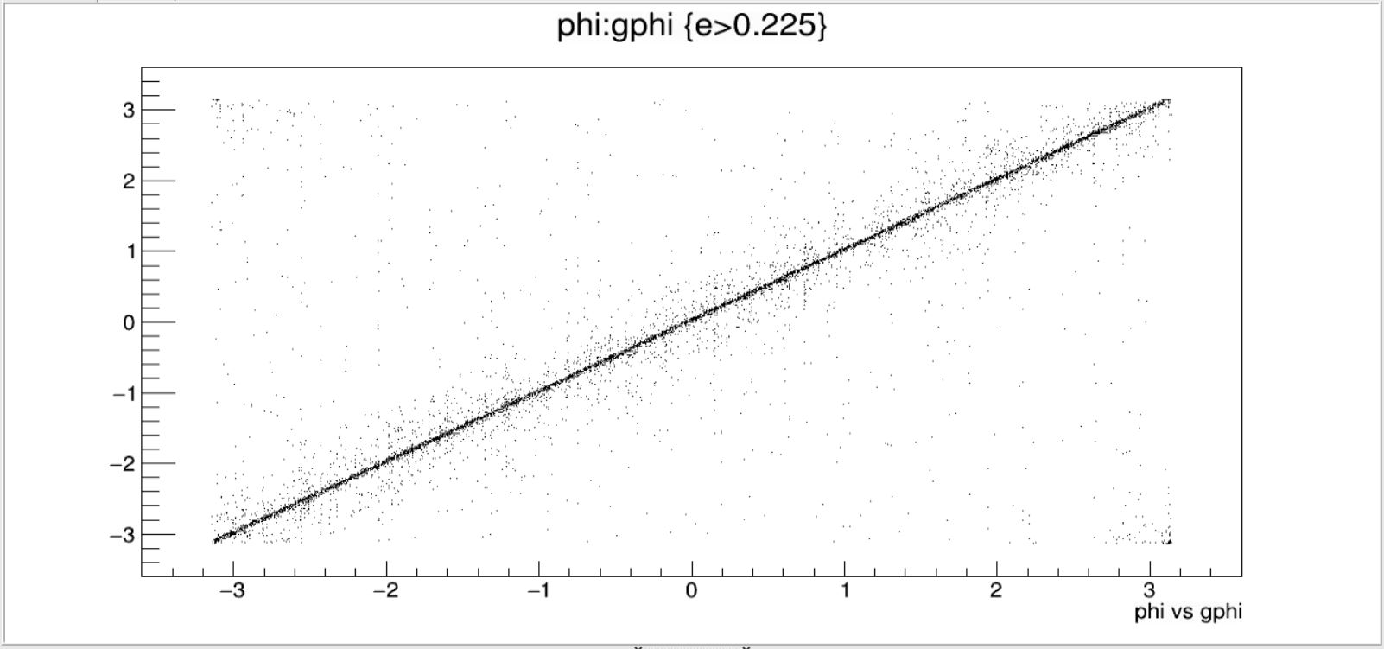
FEMC
phi vs gphi

Slide 22
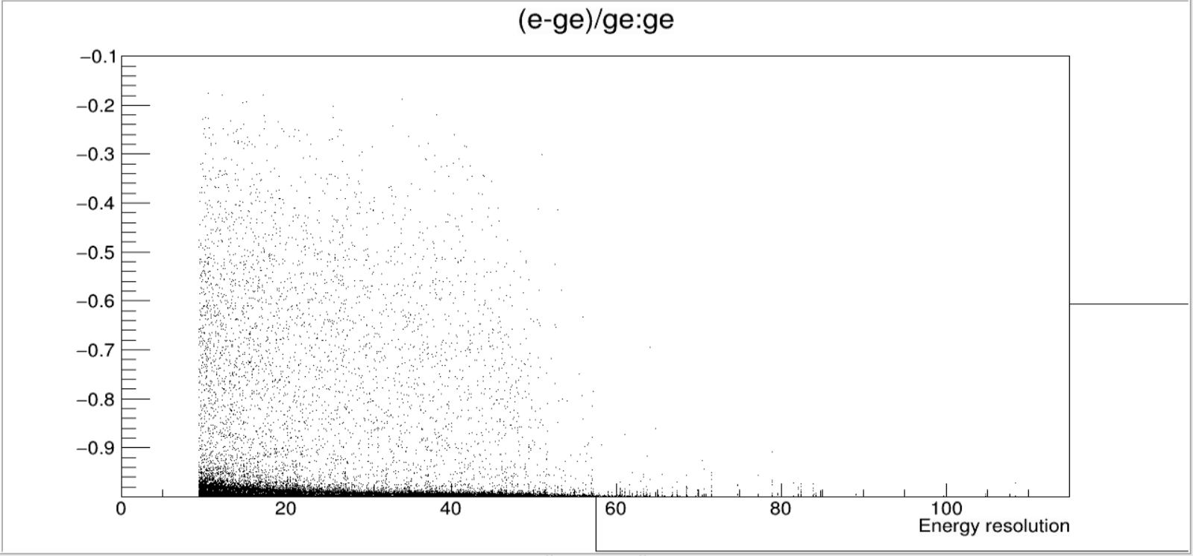
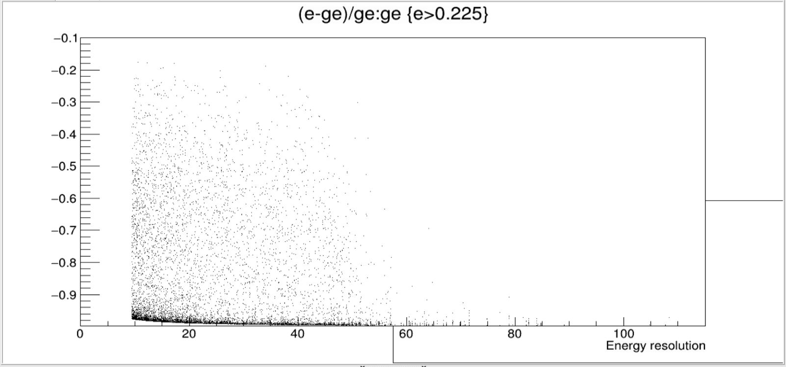
FEMC
Δe/ge vs ge

Slide 23
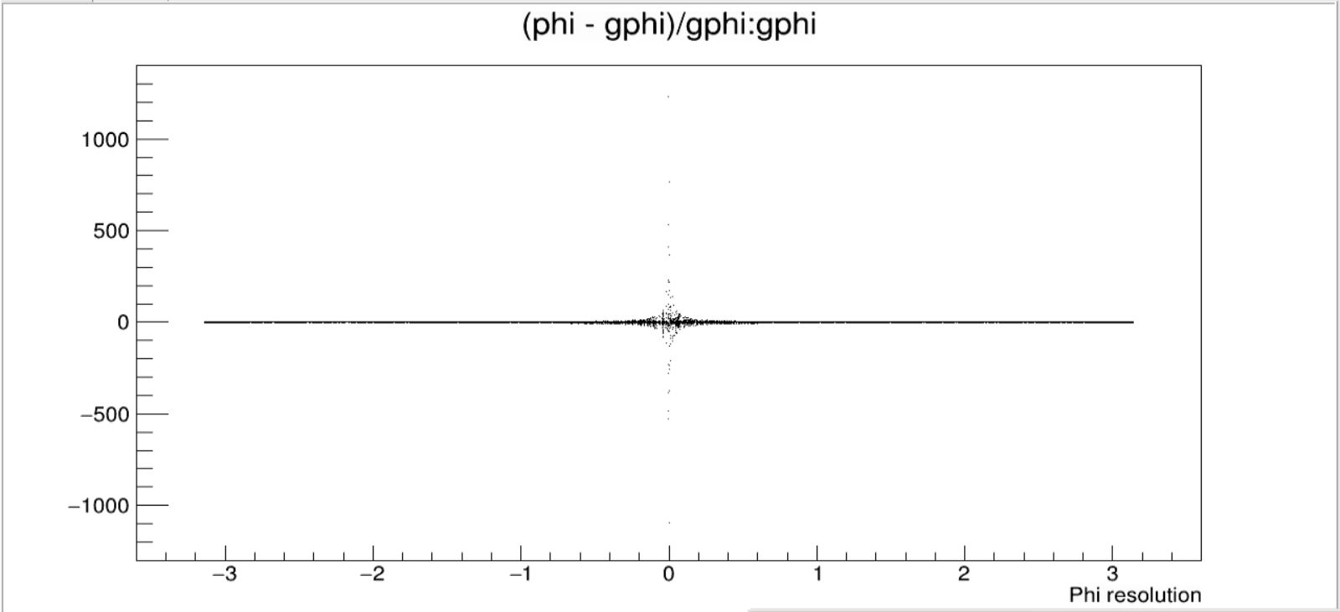
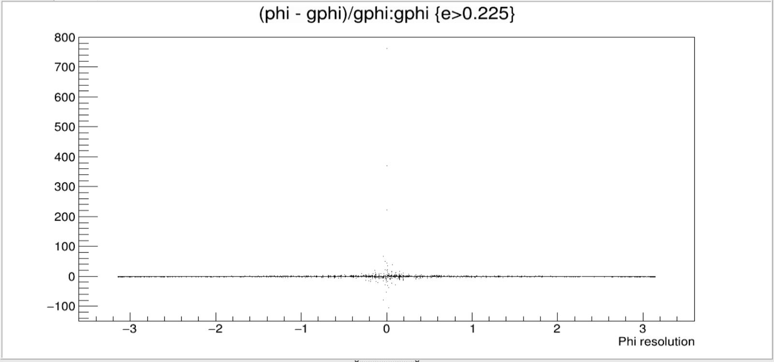
FEMC
Δphi/gphi vs gphi

Slide 24
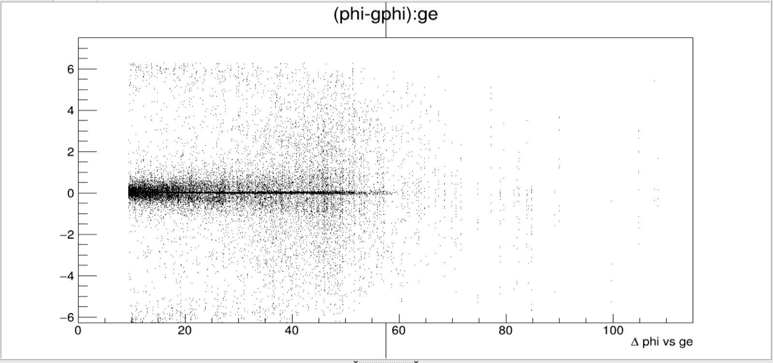
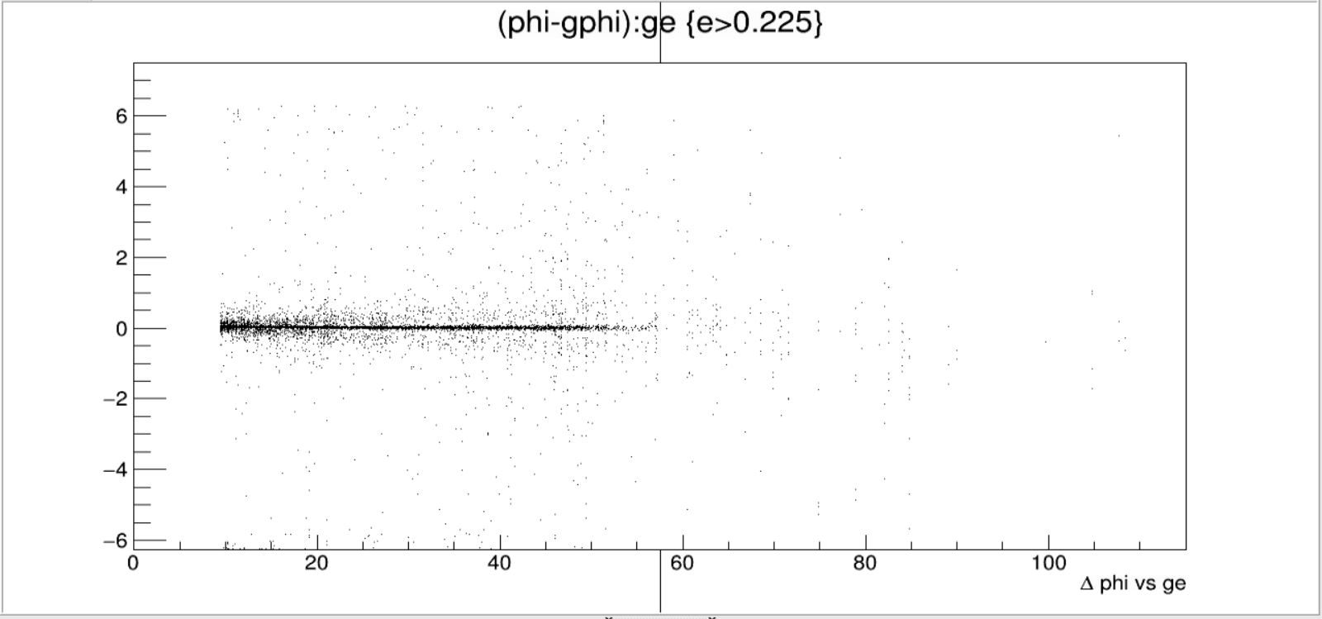
FEMC
Δphi vs ge

Slide 25
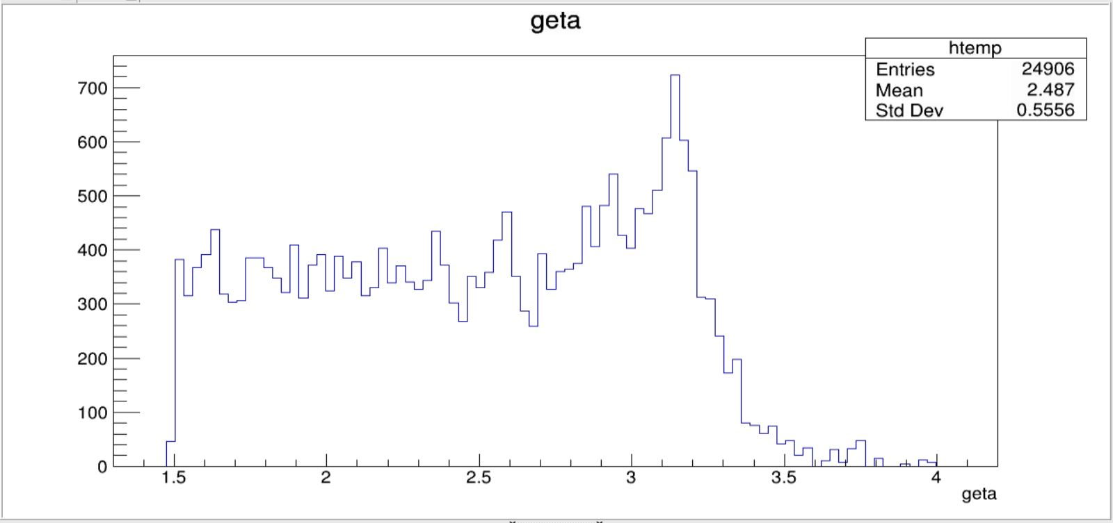
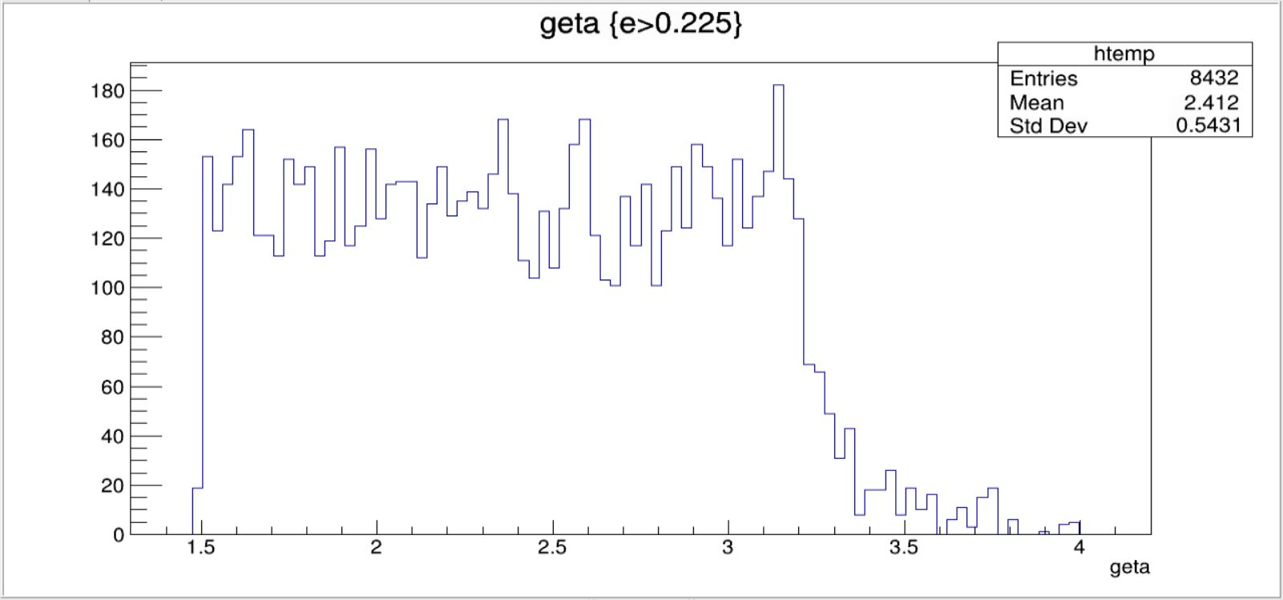
FEMC
geta vs count

Slide 26
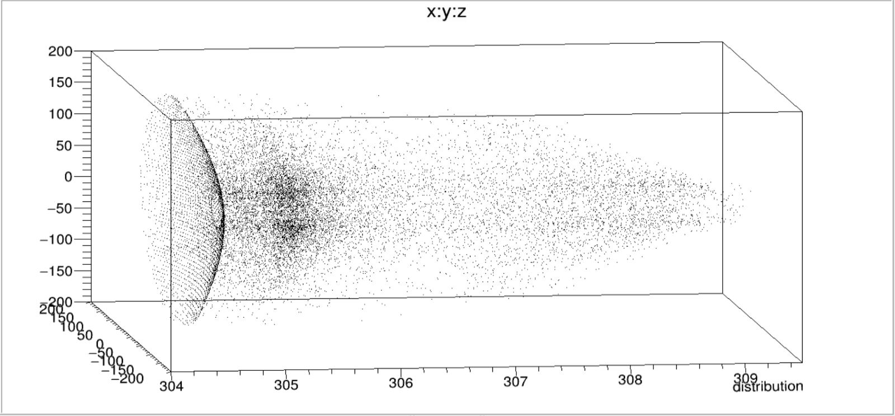
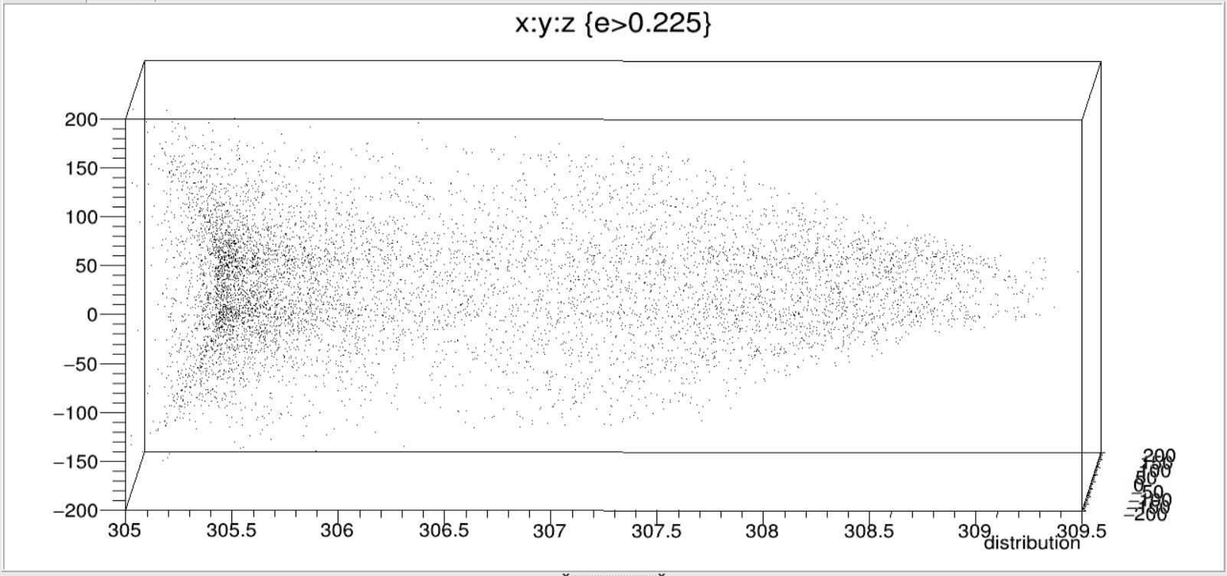
FEMC
Distribution

Slide 27
FHCAL

Slide 28
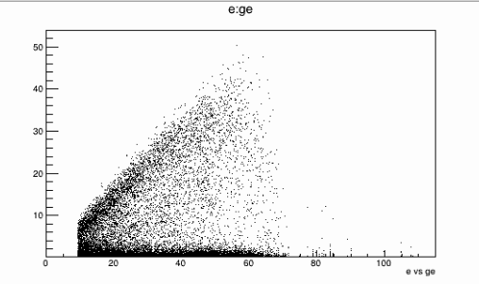
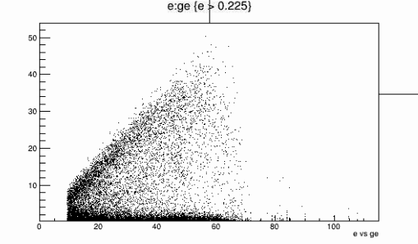
FHCAL
e vs ge

Slide 29
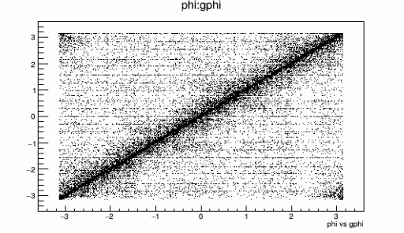
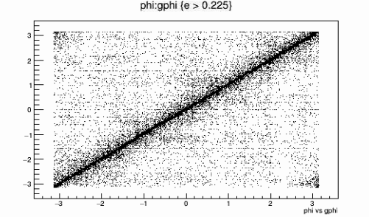
FHCAL
phi vs gphi

Slide 30
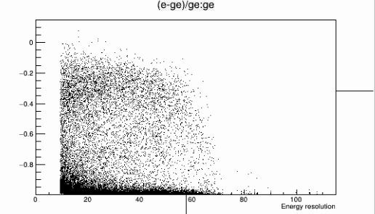
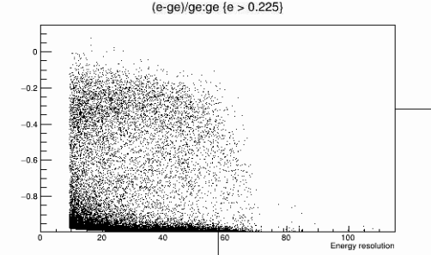
FHCAL
Δe/ge vs ge

Slide 31
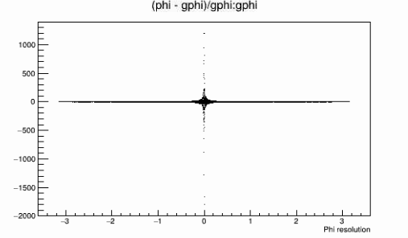
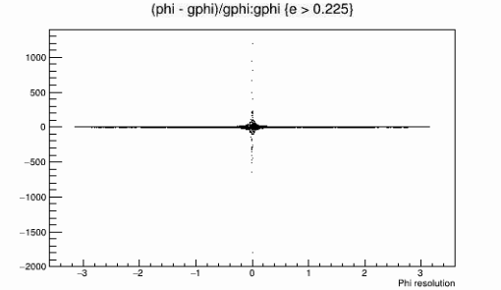
FHCAL
Δphi/gphi vs gphi

Slide 32
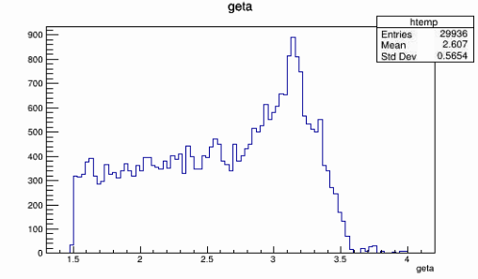
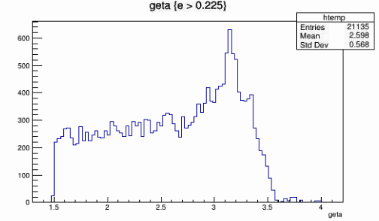
FHCAL
geta vs count

Slide 33
FHCAL
Distribution

Slide 34
HCALIN

Slide 35
HCALIN
e vs ge

Slide 36
HCALIN
phi vs gphi

Slide 37
HCALIN
Δe/ge vs ge

Slide 38
HCALIN
Δphi/gphi vs gphi

Slide 39
HCALIN
geta vs count

Slide 40
HCALIN
Distribution

Slide 41
HCALOUT

Slide 42
HCALOUT
e vs ge

Slide 43
HCALOUT
phi vs gphi

Slide 44
HCALOUT
Δe/ge vs ge

Slide 45
HCALOUT
Δphi/gphi vs gphi

Slide 46
HCALOUT
geta vs count

Slide 47
HCALOUT
distribution

Slide 48
CONCLUSION
Eta values for all detectors have come out to be 0. Hence, Eta resolution plots have not been plotted.
The energy cuts have been applied to optimise the phi vs gphi plots. Though, because of the relatively lower statistics, the number of entries in graphs of some detectors are approaching zero
In the distribution graph of FEMC, we can see that most of the particles in the second ‘knot’ of particles are removed after employing the energy cut
Presentation template designed by Slidesmash

