Slide 1
Simulation Statistics
BY SAGAR AND SIDDHANT

Slide 2
Simulation Parameters
e⁻ (100k)
p: [0,30] GeV/c
cut: e>0.2 GeV
Eta: [-4,4]
phi: [-pi,pi]
default units

Slide 3
CEMC

Slide 4
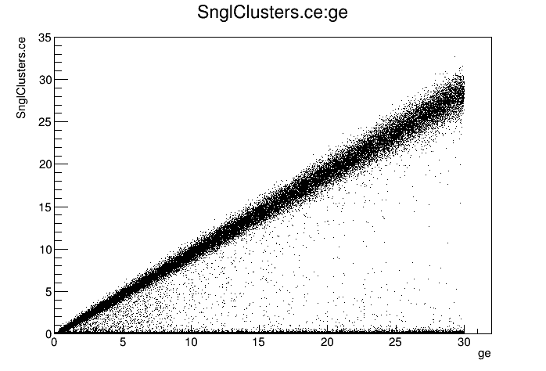
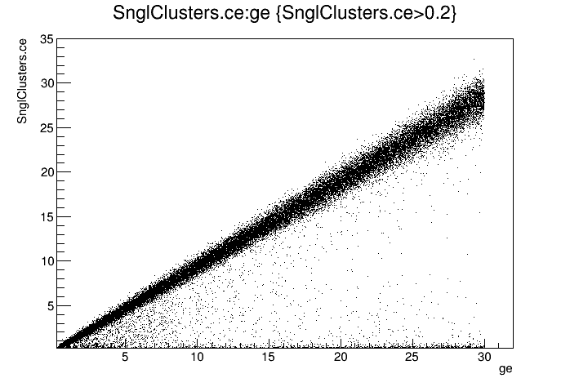
CEMC
e vs ge

Slide 5
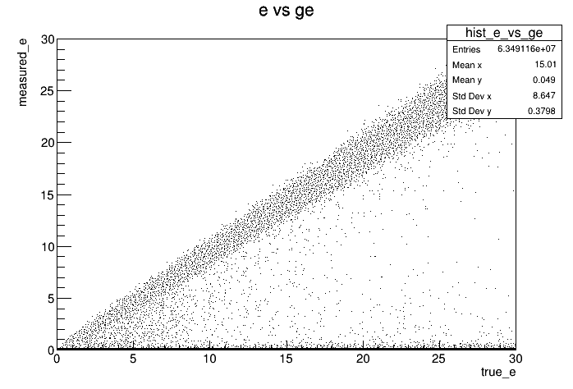
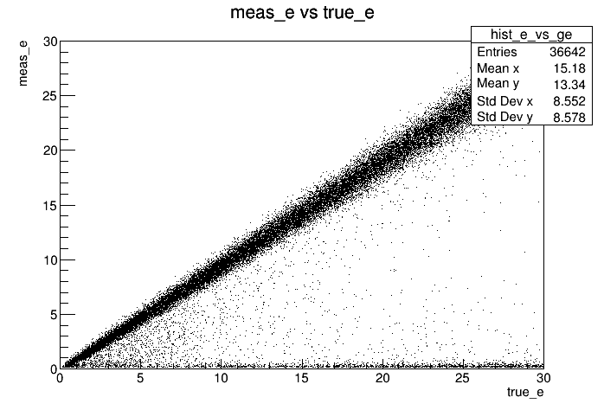
CEMC
e vs ge (Histogram)

Slide 6
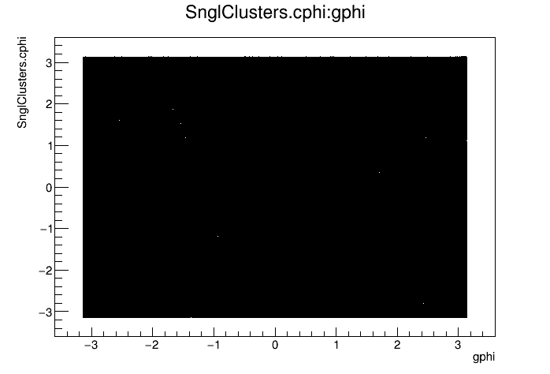
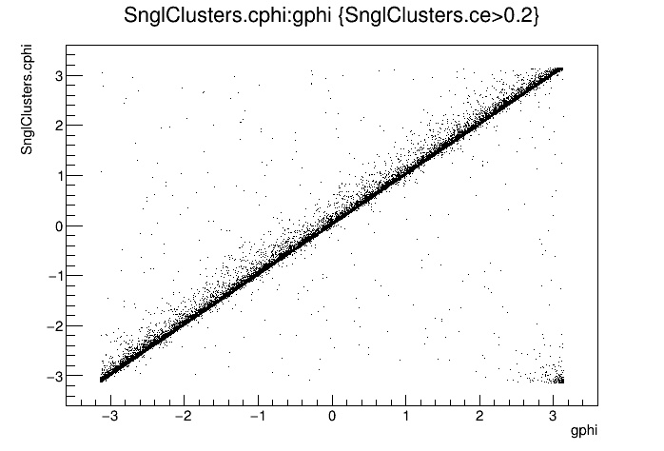
CEMC
phi vs gphi

Slide 7
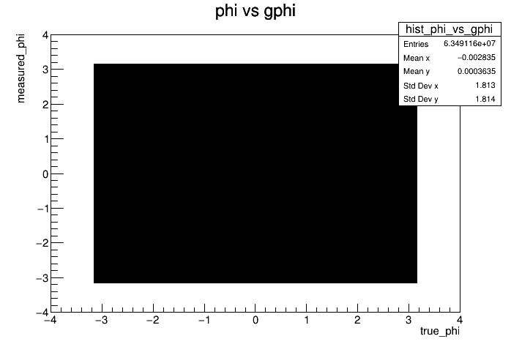
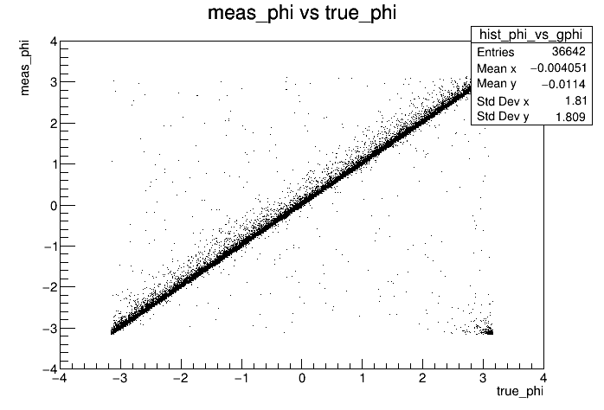
CEMC
phi vs gphi
(Histogram)

Slide 8
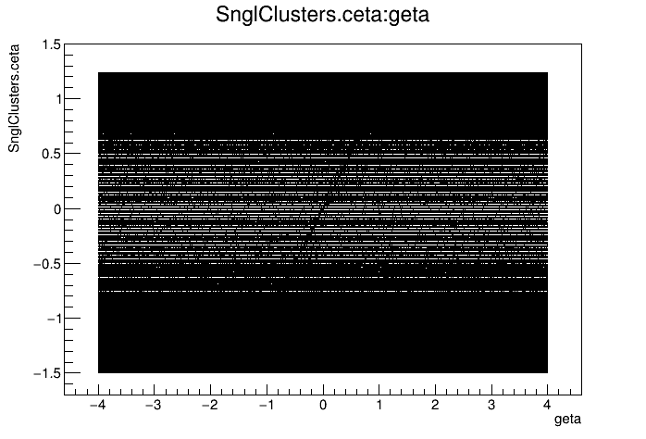
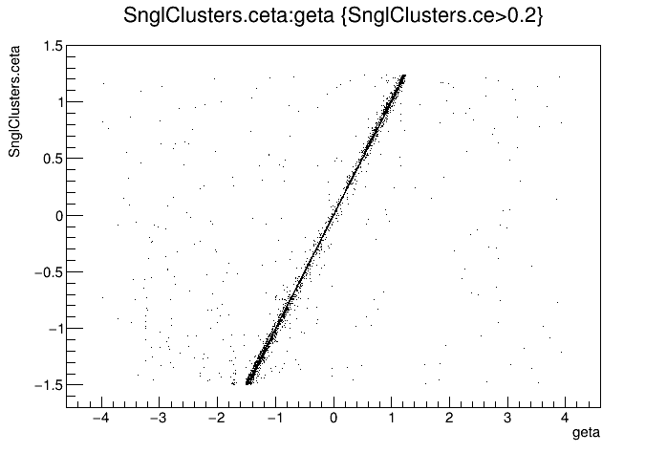
CEMC
eta vs geta

Slide 9
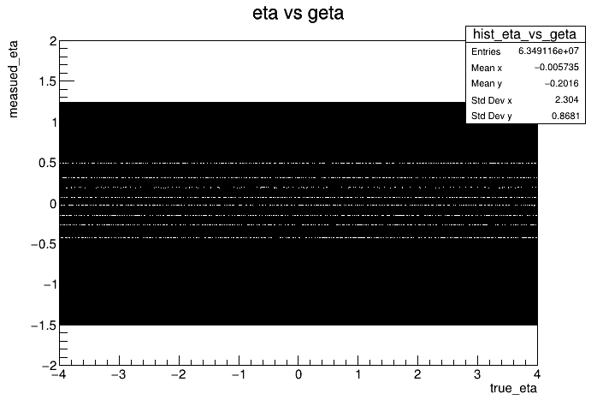
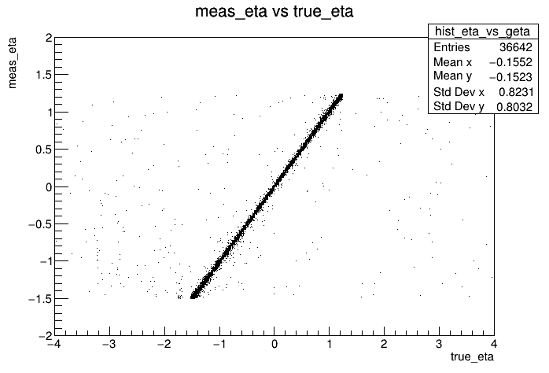
CEMC
eta vs geta
(Histogram)

Slide 10
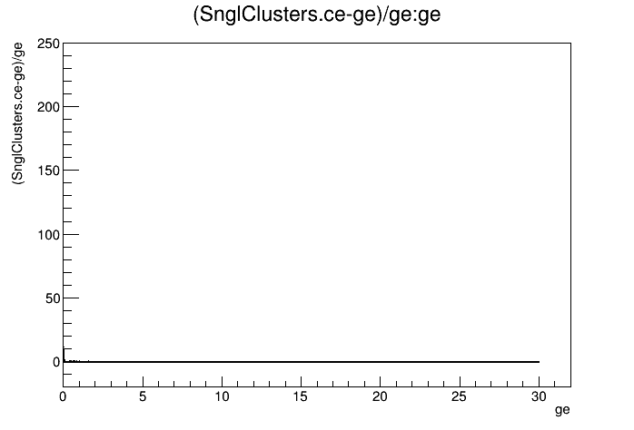
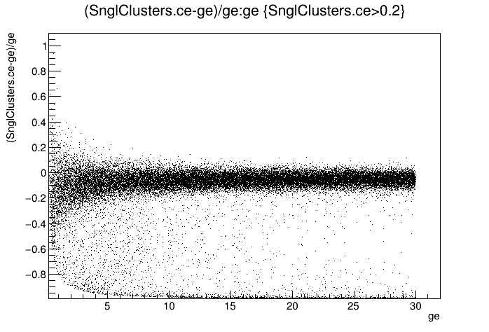
CEMC
Δe/ge vs ge

Slide 11
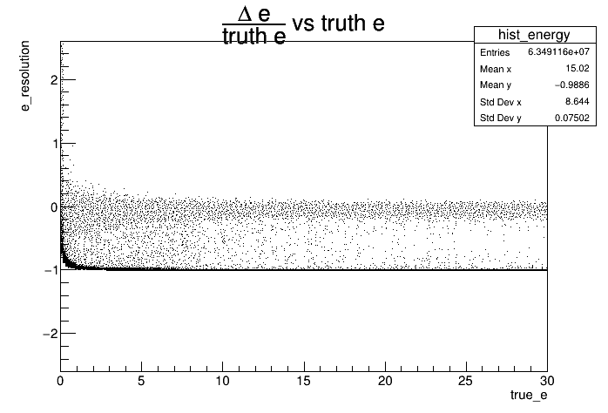
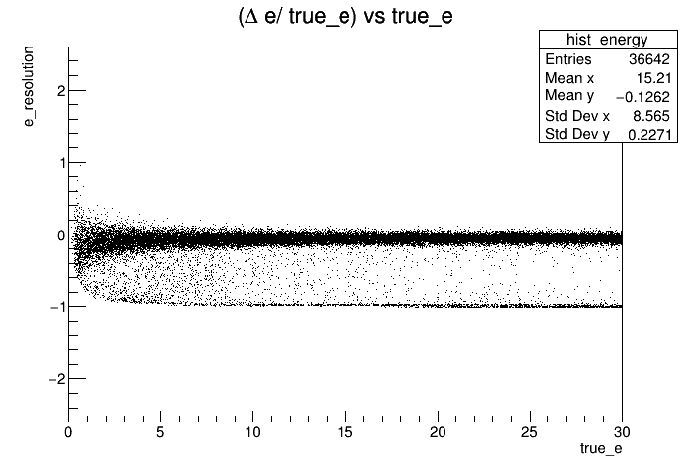
CEMC
Δe/ge vs ge
(Histogram)

Slide 12
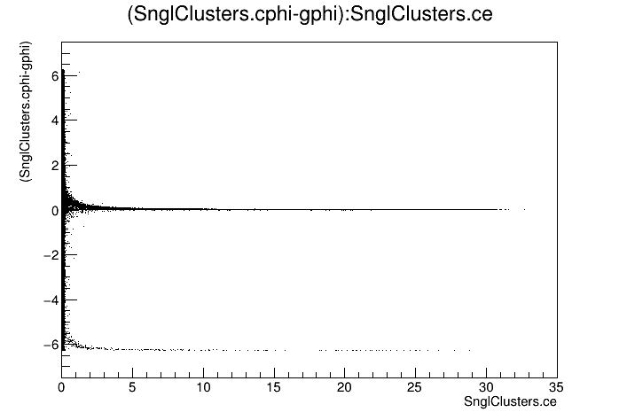
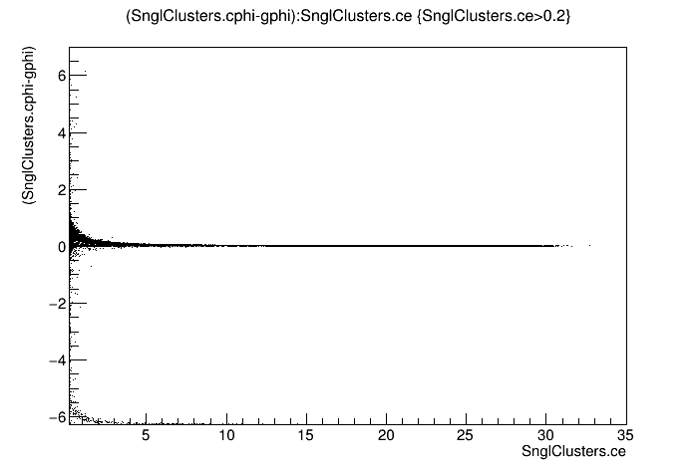
CEMC
Δphi vs ge

Slide 13
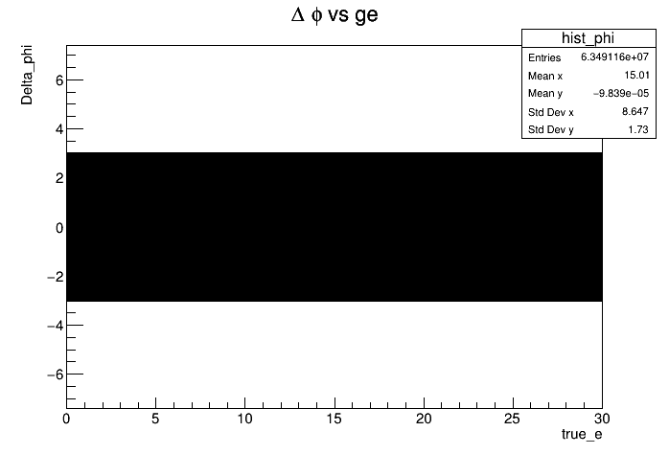
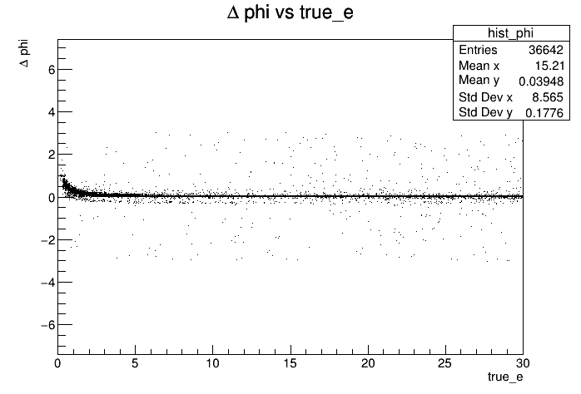
CEMC
Δphi vs ge
(Histogram)

Slide 14
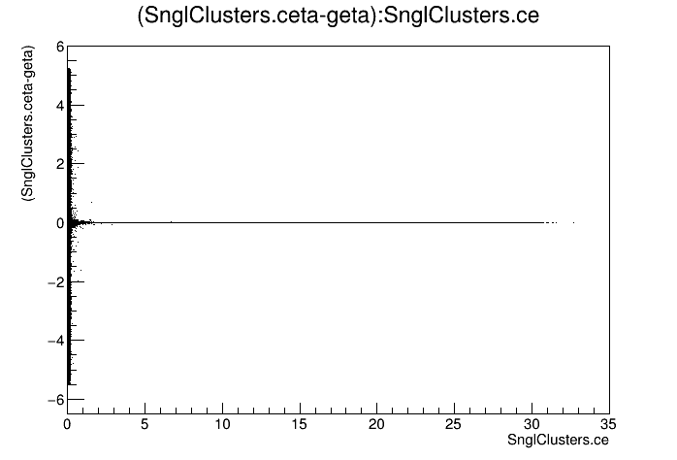
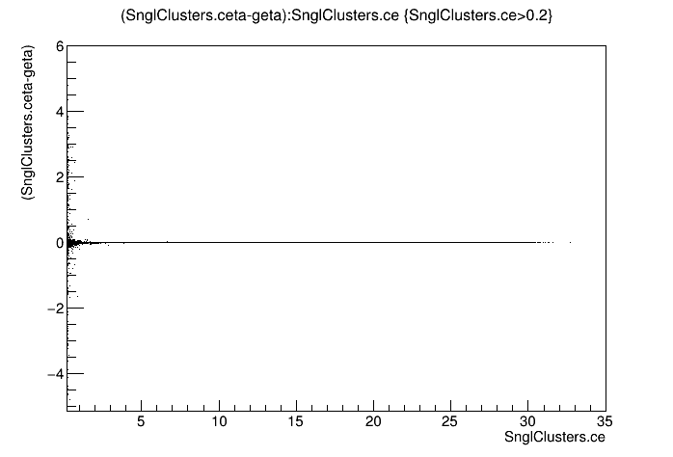
CEMC
Δeta vs ge

Slide 15
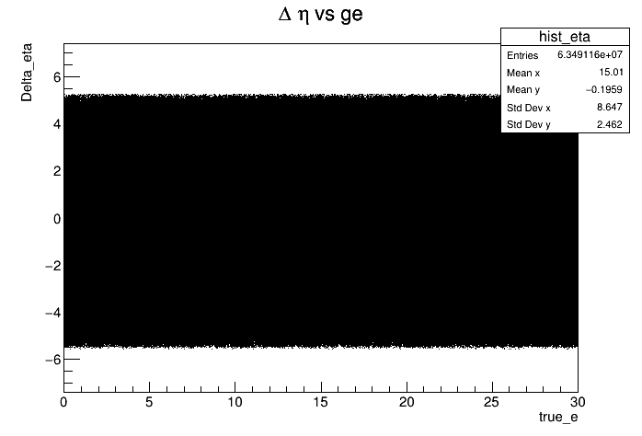
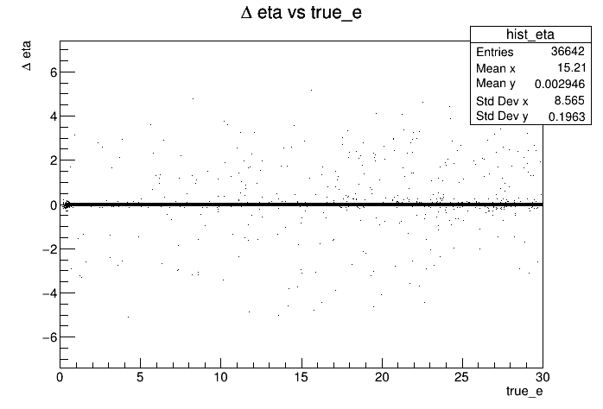
CEMC
Δeta vs ge
(Histogram)

Slide 16
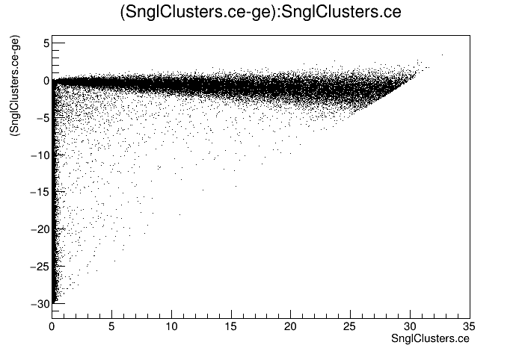
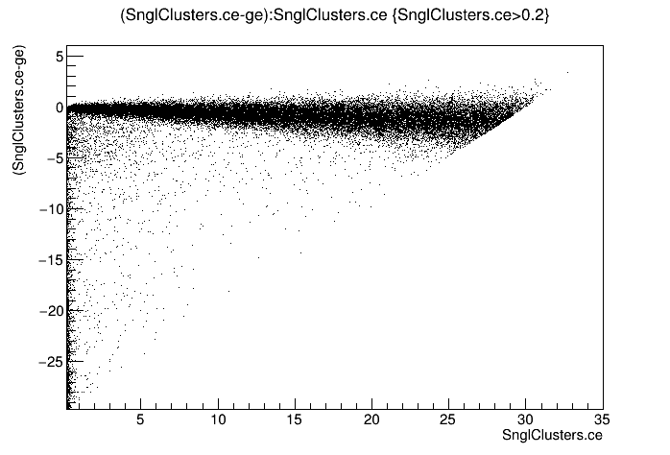
CEMC
Δe vs ge

Slide 17
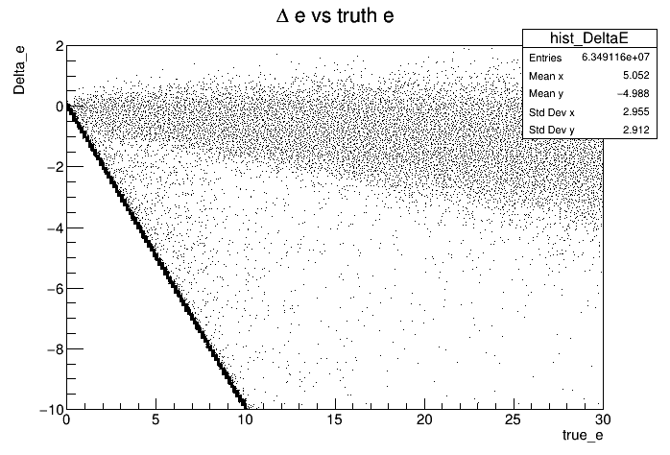
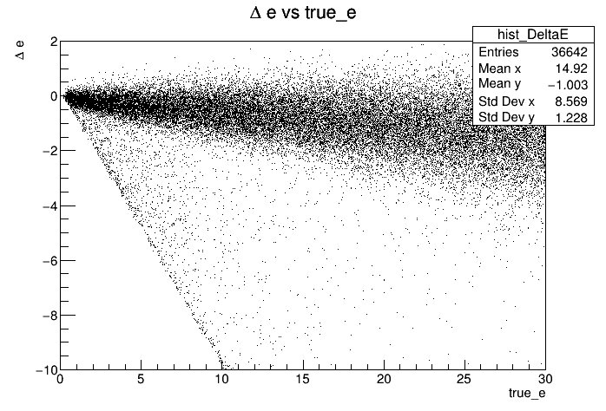
CEMC
Δe vs ge
(Histogram)

Slide 18
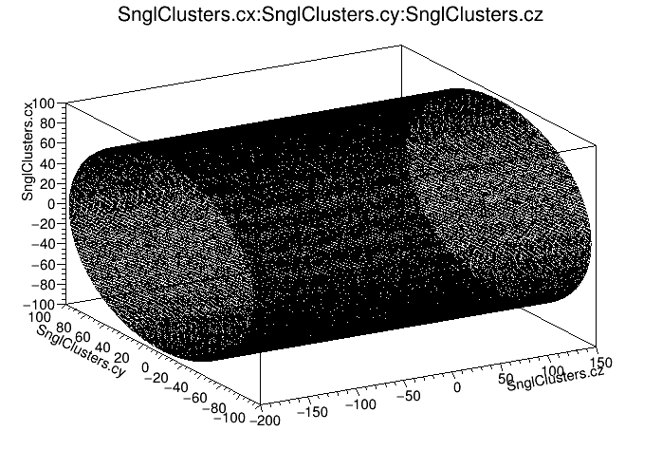
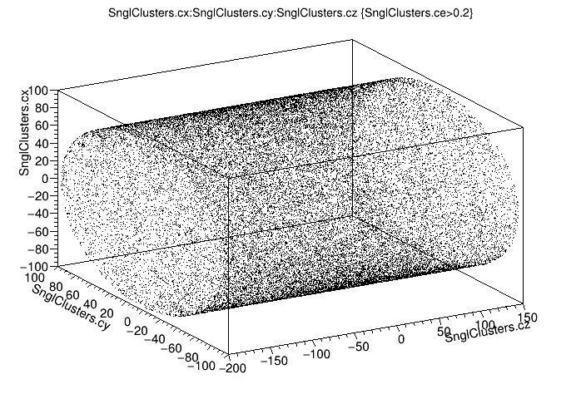
CEMC
Distribution

Slide 19
EEMC

Slide 20
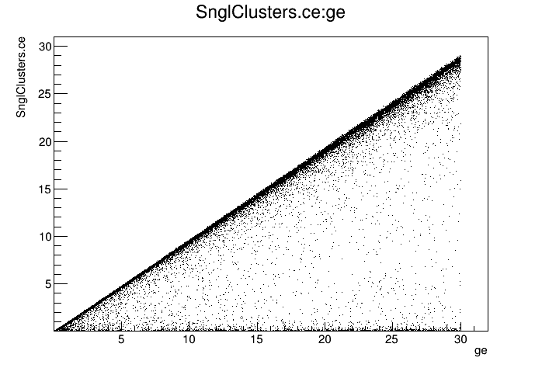
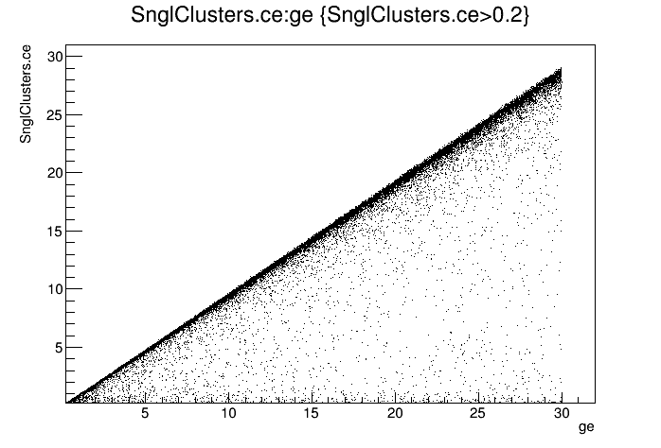
EEMC
e vs ge

Slide 21

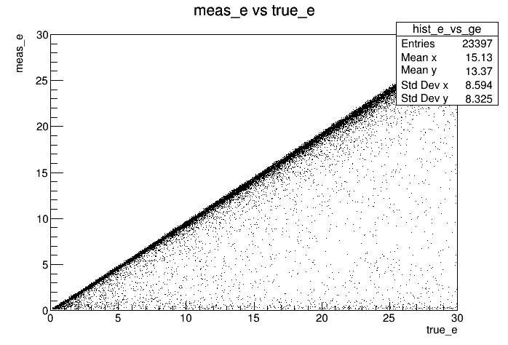
EEMC
e vs ge
(Histogram)

Slide 22
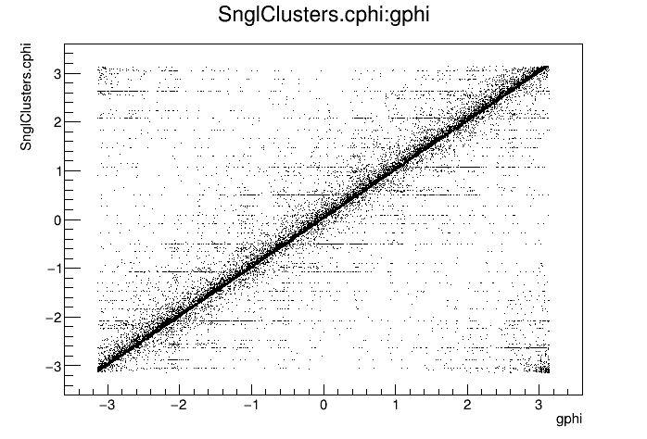
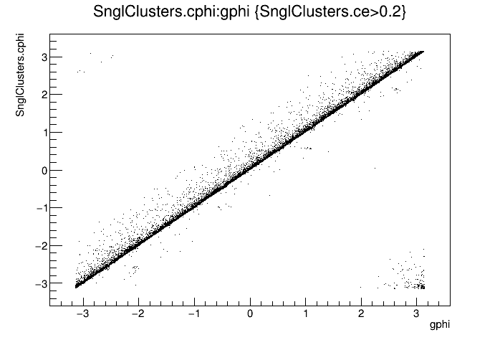
EEMC
phi vs gphi

Slide 23
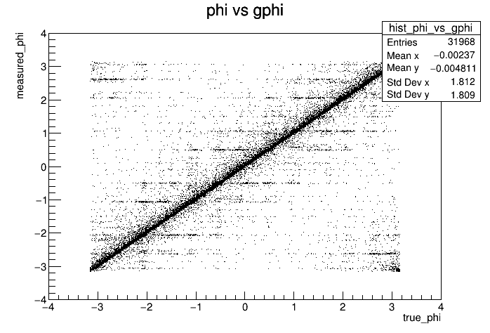
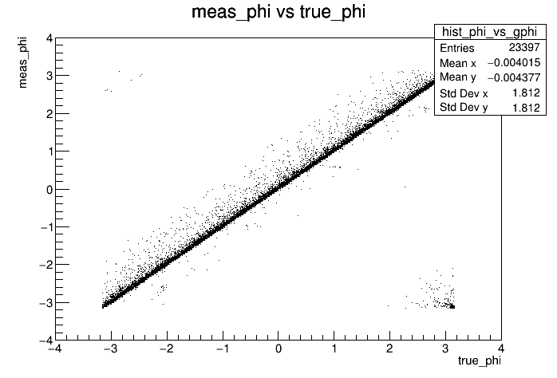
EEMC
phi vs gphi
(Histogram)

Slide 24
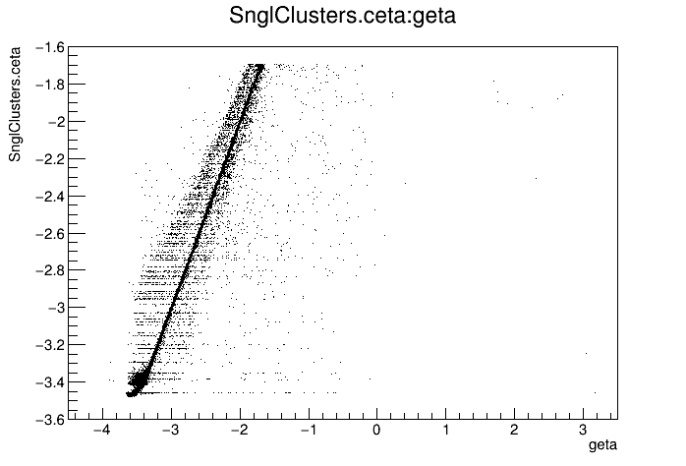
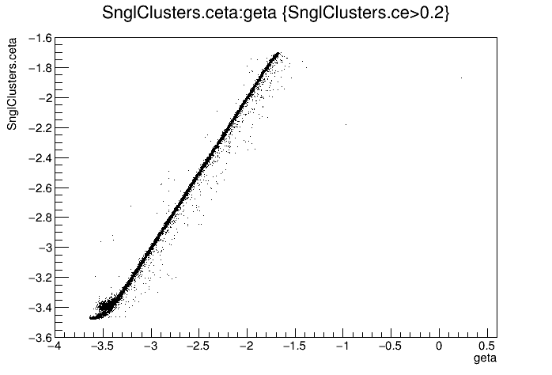
EEMC
eta vs geta

Slide 25
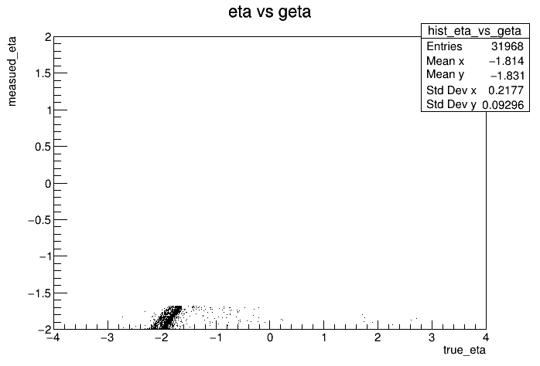
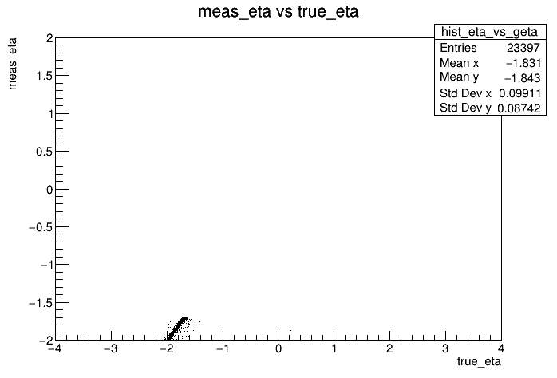
EEMC
eta vs geta
(Histogram)

Slide 26
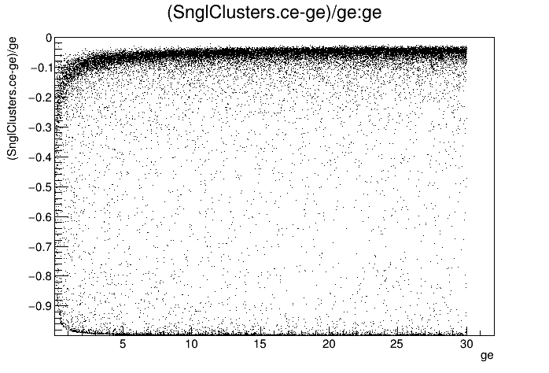
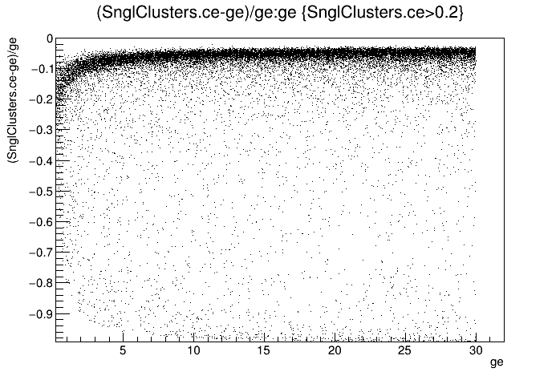
EEMC
Δe/ge vs ge

Slide 27
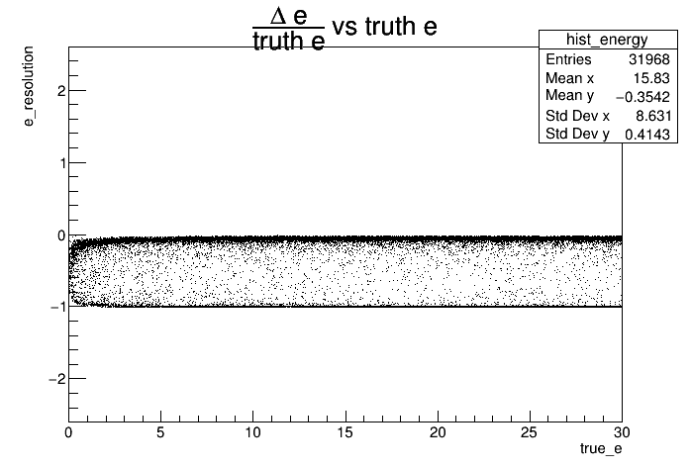
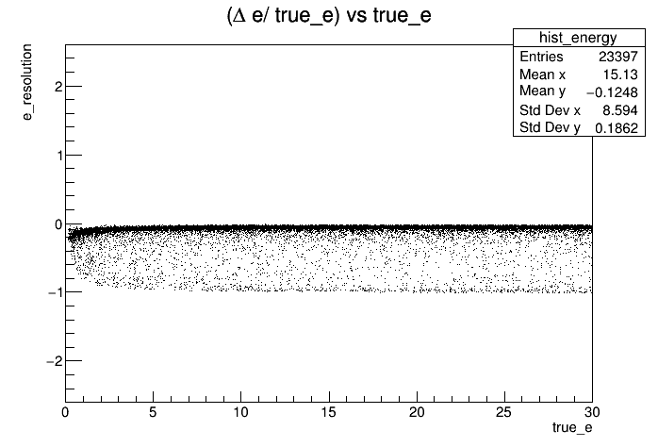
EEMC
Δe/ge vs ge
(Histogram)

Slide 28
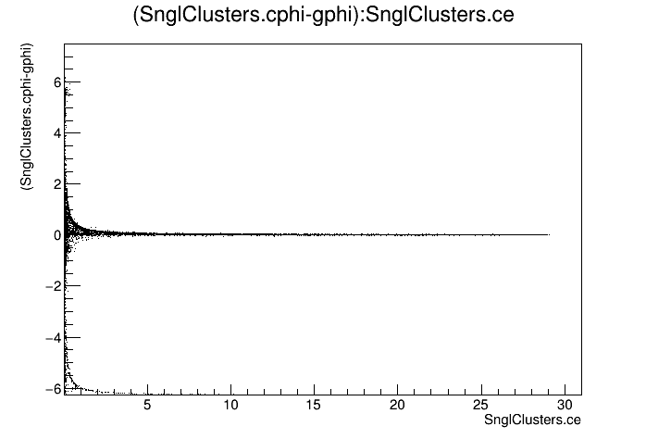
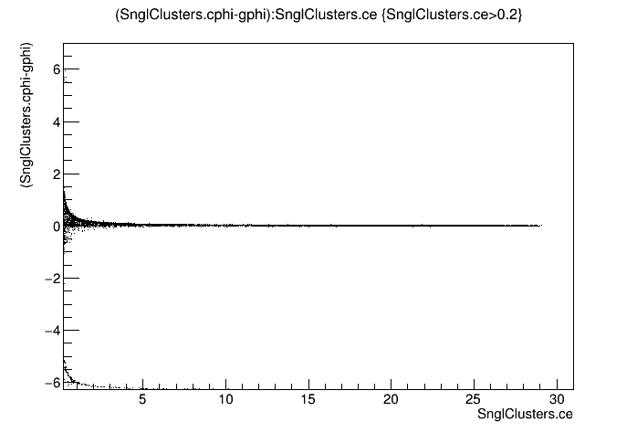
EEMC
Δphi vs ge

Slide 29
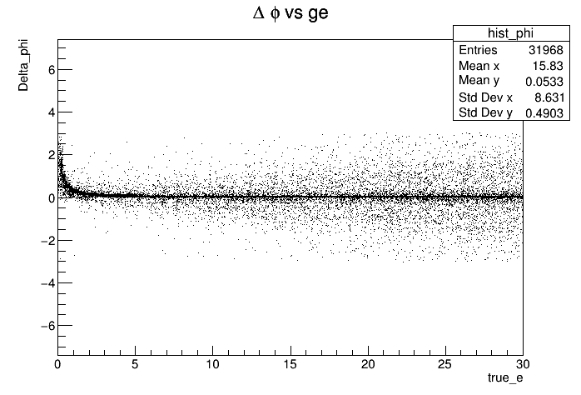
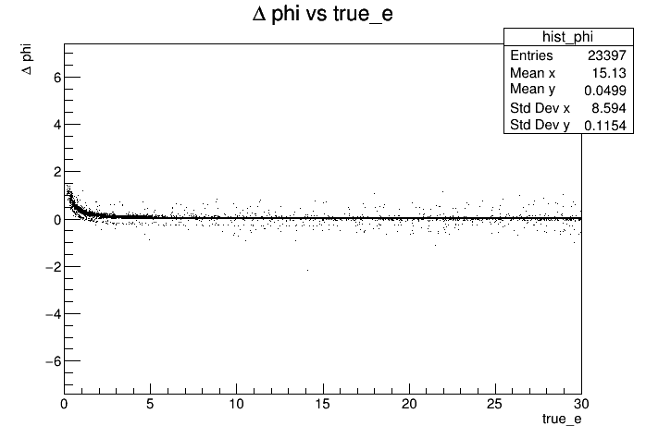
EEMC
Δphi vs ge
(Histogram)

Slide 30
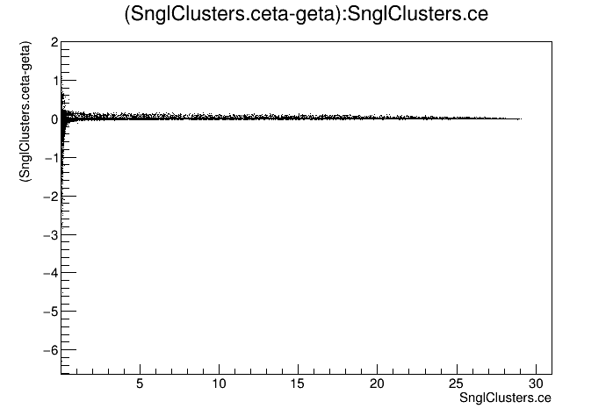

EEMC
Δeta vs ge

Slide 31


EEMC
Δeta vs ge
(Histogram)

Slide 32


EEMC
Δe vs ge

Slide 33


EEMC
Δe vs ge
(Histogram)

Slide 34


EEMC
Distribution

Slide 35
FEMC

Slide 36


FEMC
e vs ge

Slide 37


FEMC
e vs ge (Histogram)

Slide 38


FEMC
phi vs gphi

Slide 39


FEMC
phi vs gphi
(Histogram)

Slide 40


FEMC
eta vs geta

Slide 41


FEMC
eta vs geta
(Histogram)

Slide 42


FEMC
Δe/ge vs ge

Slide 43


FEMC
Δe/ge vs ge
(Histogram)

Slide 44


FEMC
Δphi vs ge

Slide 45


FEMC
Δphi vs ge
(Histogram)

Slide 46


FEMC
Δeta vs ge

Slide 47


FEMC
Δeta vs ge
(Histogram)

Slide 48


FEMC
Δe vs ge

Slide 49


FEMC
Δe vs ge
(Histogram)

Slide 50


FEMC
Distribution

Slide 52


