Slide 1
Eta ranges
Extracted by geantinos

Slide 2
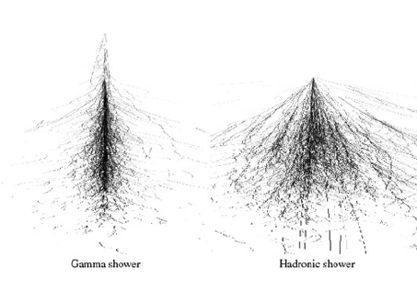
EM showers vs Hadronic Showers

Slide 3
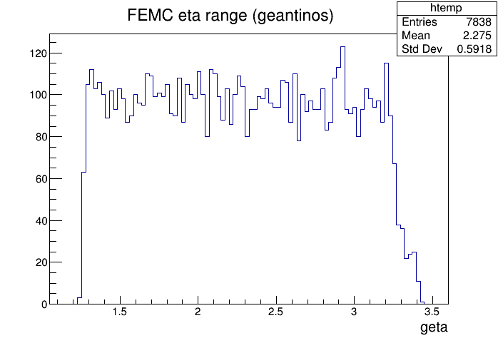
FEMC
Suggested range 1.3 to 3.3

Slide 4
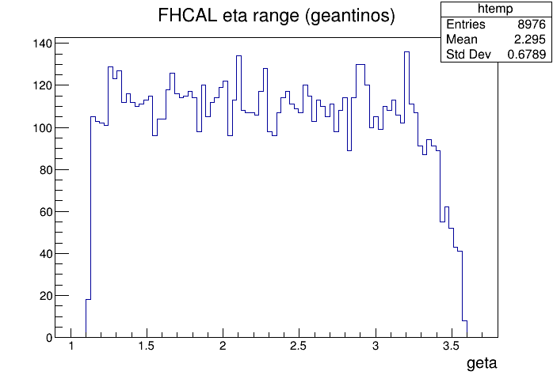
FHCAL
Suggested range 1.2 to 3.5

Slide 5
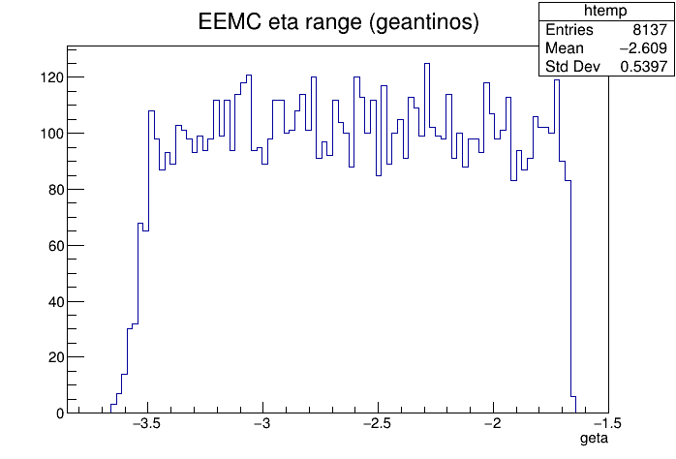
EEMC
Suggested range -3.5 to -1.7

Slide 6
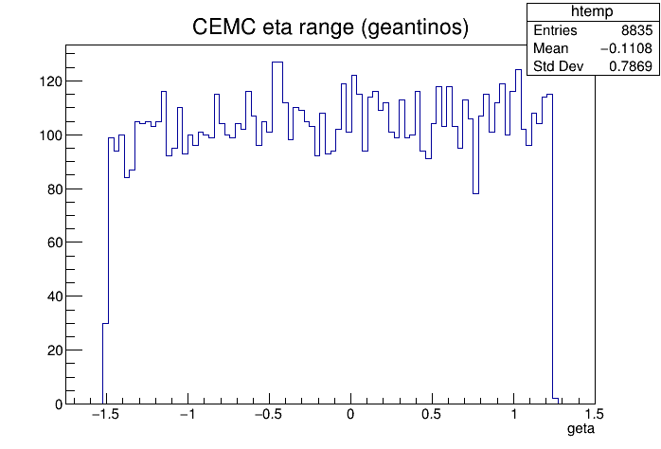
CEMC
Suggested range -1.5 to 1.2

Slide 7
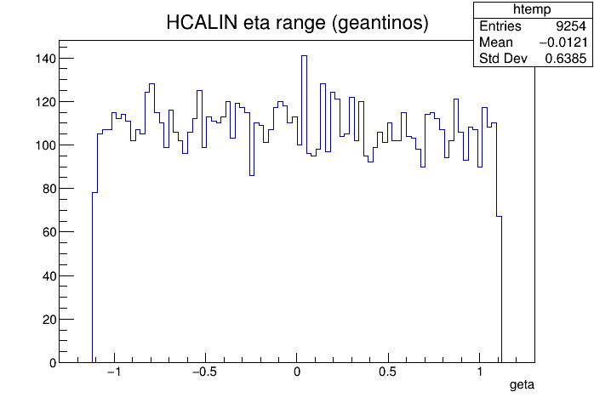
HCALIN
Suggested range -1.1 to 1.1

Slide 8
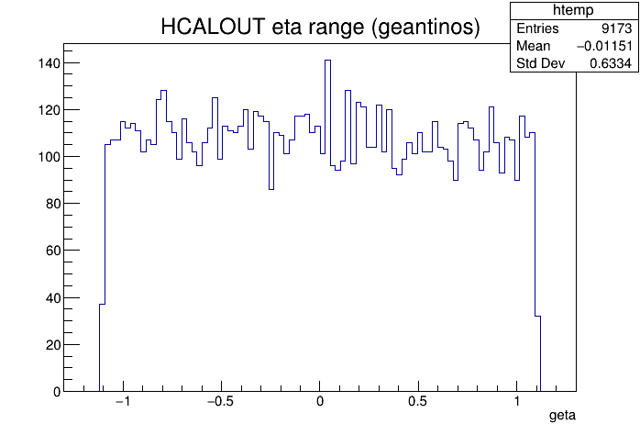
HCALOUT
Suggested range -1.1 to 1.1

