Slide 1
Digitization Noise

Slide 2
Digitization Choices
None (kNo_digitization)
Simulation energy is copied into tower
kSimple_photon_digitization (default)
Energy is translated into photons
Photons get translated into adc
Pedestal is subtracted
kSiPM_photon_digitization
Adds efficiency of SiPM
Scales with the number of channels Affected Calorimeters:
CEMC (~26GeV)
EEMC (0.2GeV)
HCALIN (0.7GeV)
HCALOUT (1.7GeV)

Slide 3
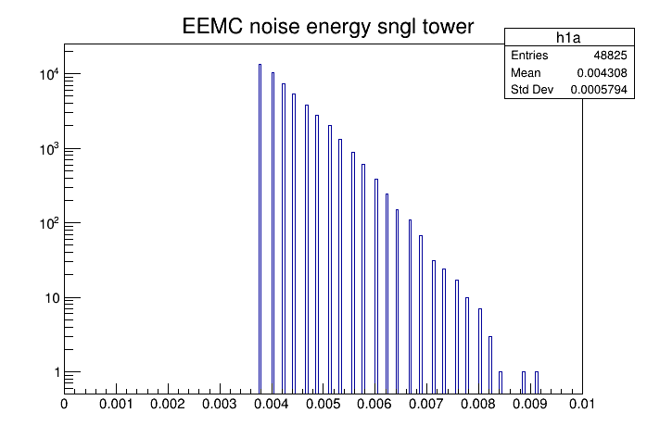
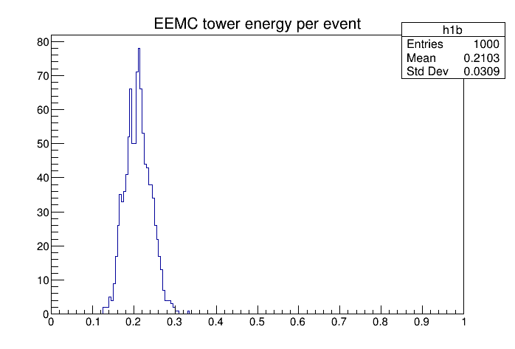
EEMC
Noisy towers are removed by energy cut – no clusters

Slide 4
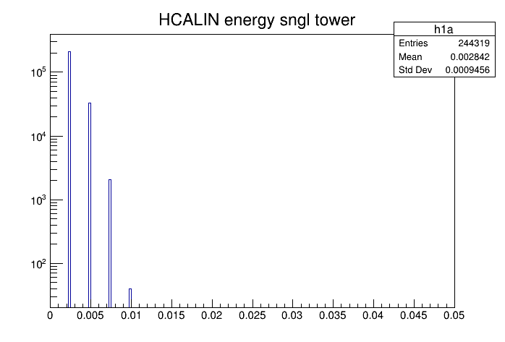
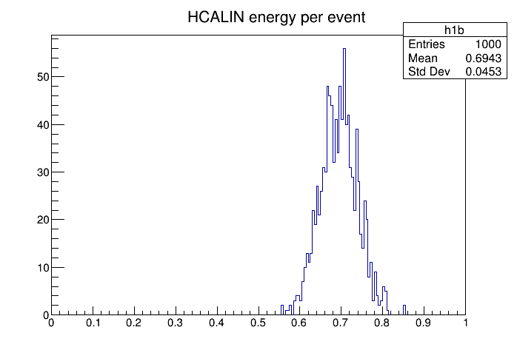
HCALIN
Noisy towers are removed by energy cut – no clusters

Slide 5
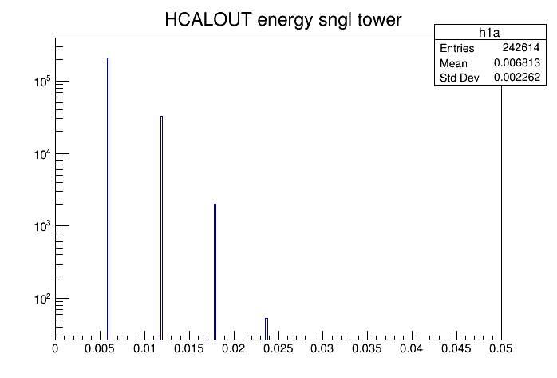
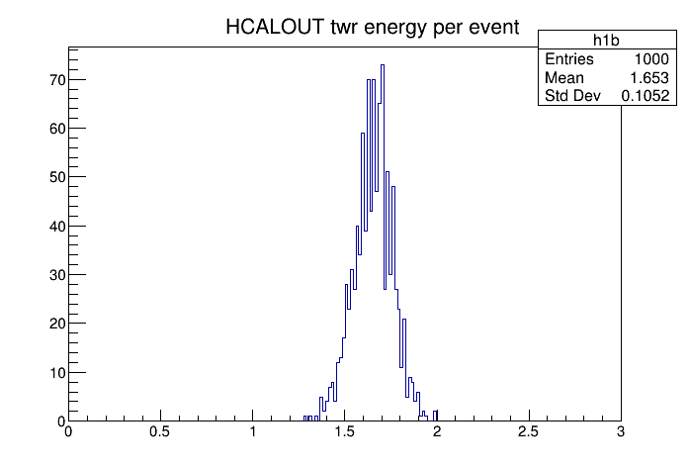
HCALOUT
Noisy towers are removed by energy cut – no clusters

Slide 6
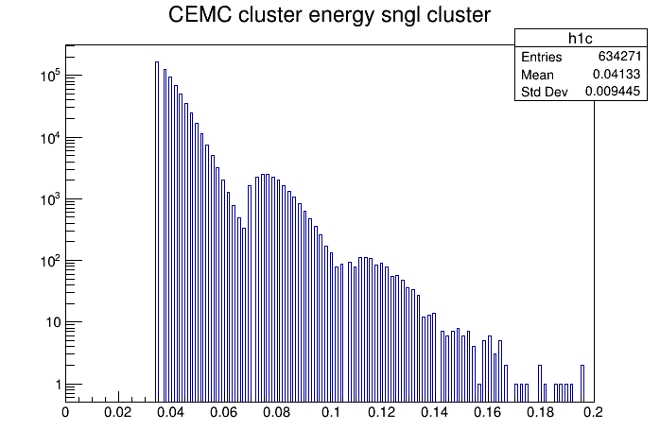
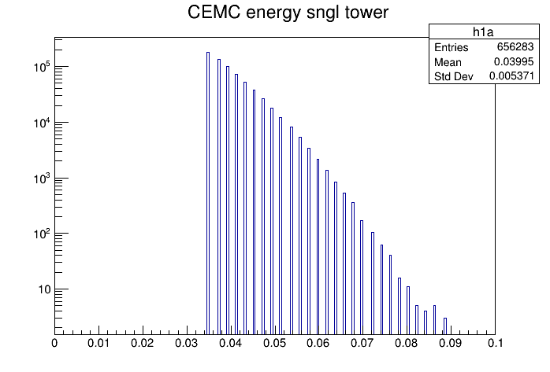
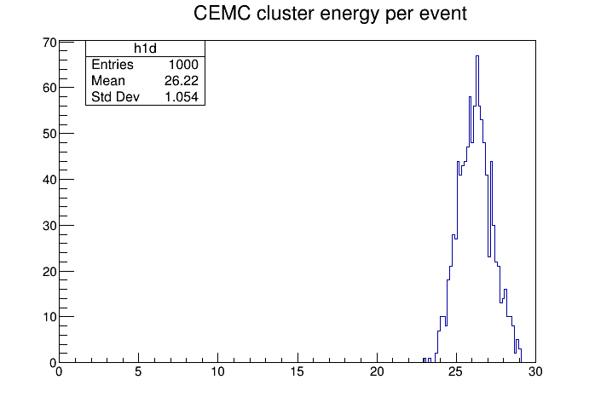
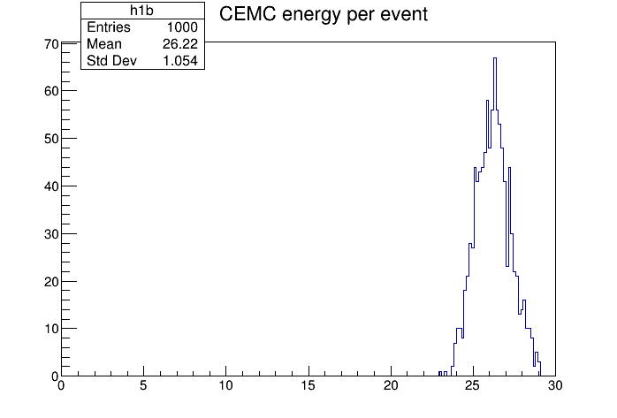
CEMC
Noise survives tower energy cut, Noise energy adds to cluster energy

Slide 7
Summary
The main effects are on the CEMC data
Digitization was made configurable
To turn off, e.g. G4CEMC::TowerDigi = RawTowerDigitizer::kNo_digitization;
It is set to no-digitization in our Fun4All_G4_EICDetector.C macro from now on (please do a git pull to update)
The EvalRootTTreeReco code was updated to handle events without truth information (no event generator, noise only)
Support for x8664_sl7 has been discontinued – please use
source /cvmfs/eic.opensciencegrid.org/default/opt/fun4all/core/bin/eic_setup.csh -n
Which will give you a c++17 environment. No changes for macros but you need to recompile your code

